Slide 1

Women in STEM
Unpacking the opportunities and capabilities
With Andrea Soanes, Liz Cleary,
Melinda Stevenson and Victoria Metcalf
2 June 2016
@NZScienceLearn
www.sciencelearn.org.nz
© 2015 The University of Waikato | www.sciencelearn.org.nz
Notes:
During this webinar, we will meet some amazing women working hard to encourage young women to seek careers in STEM.
They are leaders in their work and contribute hugely to their fields of expertise.
I am excited to get started!

Slide 2
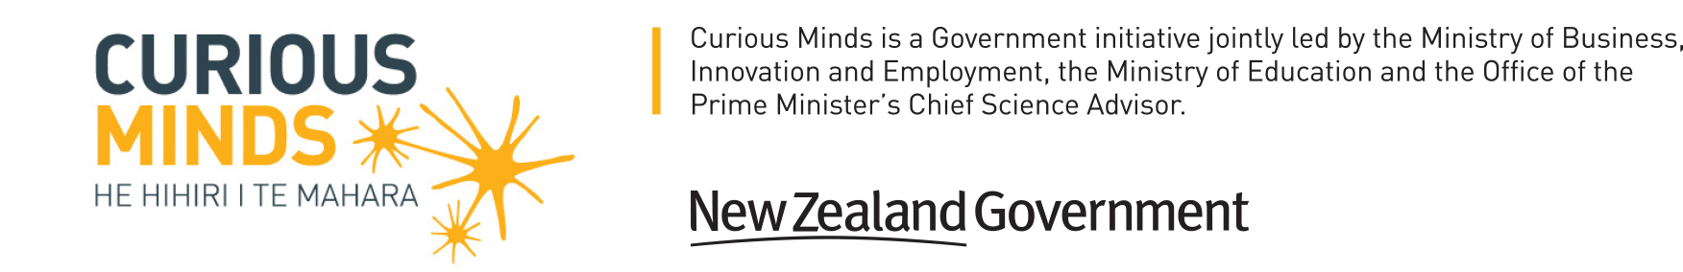

What is the Science Learning Hub?
A trustworthy online resource – produced by educators and scientists
Based on world-class New Zealand science research
Supported by learning activities, information about the key science ideas and concepts, multimedia tools and other resources
Written for New Zealand teachers and students
Notes:
So for those you you not familiar with the Science Learning Hub site, it is a site with thousands of pages of articles, resources, activities, worksheets, videos, images and animations to support teachers and communities with understanding science.
It is about making current scientific research in New Zealand accessible for all, increasing the scientific literacy of New Zealanders of all ages form all walks of life.
It is based on the New Zealand curriculum and is funded by the New Zealand Government through the Ministry of Business, Innovation and Employment (MBIE).

Slide 3
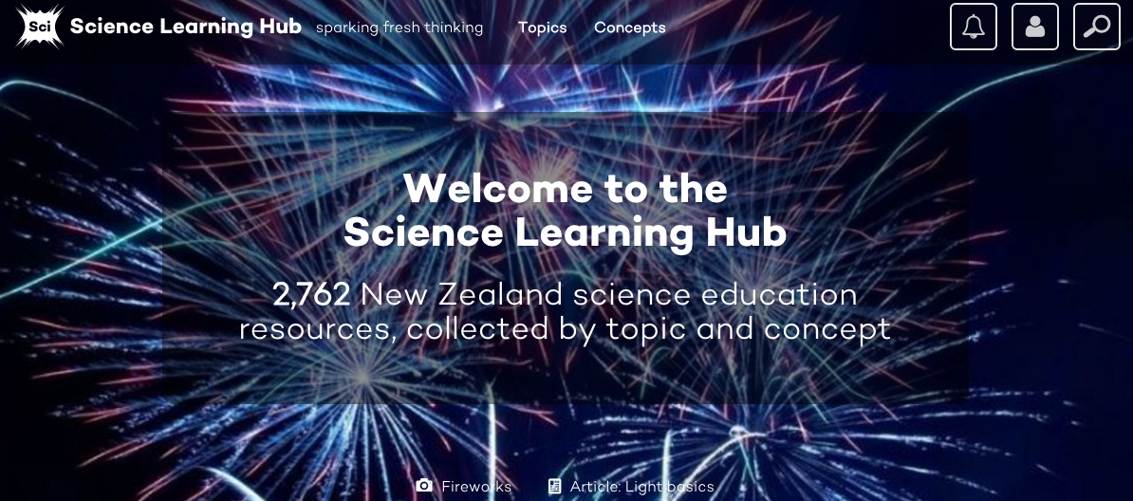
The Hub’s new website design

Slide 4
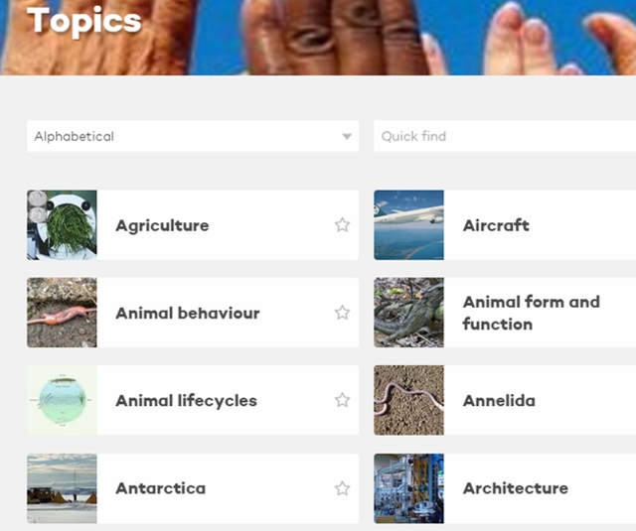
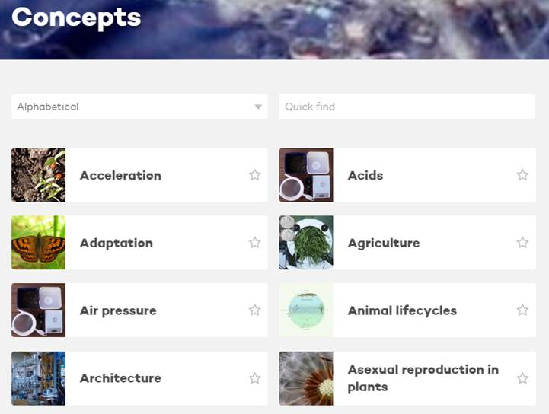
Search by topic or concept
We will host webinars about the new Science Learning Hub on 16 and 30 June

Slide 5
What is STEM?
Science
Technology
Engineering
Mathematics

Slide 6
What is a STEM curriculum?
STEM is an interdisciplinary and applied approach
STEM integrates subjects in a cohesive way based on real-world applications
STEM transferable skills
Notes:
Curriculum based on the idea of integrating learning for students under four specific disciplines – science, technology, engineering and mathematics.
Rather than teach the four disciplines as separate and discrete subjects, it’s about teaching in a cohesive way, being responsive to the individuals within your classroom.

Slide 7
Your turn
Type in any skills you think that are required for embarking on a career in STEM
Skills:
Type in some careers that involve STEM?
Careers:
Notes:
Let’s take a look forward to opportunities for students when they leave school and start their careers – industry, university or trades.
Such a wide range of future options when working in STEM (interested in knowing the audience – unpacking skills rather than content knowledge – what is their understanding – have they thought about this before?)

Slide 8
Skills and overlaps – the real world of STEM
Science – Technology – Engineering – Mathematics
Problem solving
Process data in a meaningful way
Will it withstand an earthquake?
How do I make it safer – improve it?
How do I know my results are reliable?
How do I critique the information I come across?
Do scientists interpret data the same way?
Making predictions and building models – testing theories
Collaboration – what are others doing?
Engaging with the world around us – building curiosity
Notes:
So in the world outside school, what do different people within STEM think about? What skills do they have? What might some thinking or misconceptions of STEM be?

Slide 9
Science capabilities
Gather and interpret data
Use evidence
Critique evidence
Interpret representations
Engage with science
http://scienceonline.tki.org.nz/Introducing-five-science-capabilities
Notes:
We know there are many other capabilities, but the Ministry of Education has decided that these five capabilities are the ones we need to focus on in our classrooms, strengthening these within our students, ensuring the skills are practised and also seen to be transferable from one subject to another. How do we use STEM education to build these skills?
In the context of the webinar today, we are exploring the synergies between science capabilities and STEM. What does this mean for teaching in the classroom? What does this mean if we are preparing our students as contributing citizens – interesting concept that New Zealand, being a small country, we need innovators, we need curiosity builders, we need that number 8 wire mentality to move our economy forward. How do we do this? How do we prepare our students?

Slide 10
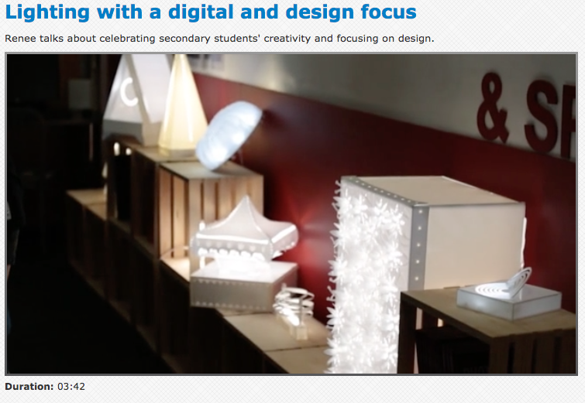
TKI – inspirational teaching and learning
http://technology.tki.org.nz/Videos/Contexts/Lighting-with-a-digital-and-design-focus
Notes:
Play the video (4 min)

Slide 11
Your turn
A thinking question – to ponder
What do you do right now to support your students to strengthen those skills?
Do your students know about the huge opportunities and different career choices in the STEM fields?
How would your classroom change if your students could see themselves in STEM careers?
Notes:
Can see them working in those fields – can picture themselves discovering new things, building structures etc. That’s the key message. How do your students see scientists or engineers or mathematicians? Good example – Emma’s blog.

Slide 12
Why?
Gender imbalance in STEM fields within New Zealand and globally
Notes:
We have talked about STEM and skills and careers – this webinar is called Women in STEM. Why? Initiatives to shift this imbalance. Introducing Liz Cleary form the Ministry of Education.

Slide 13
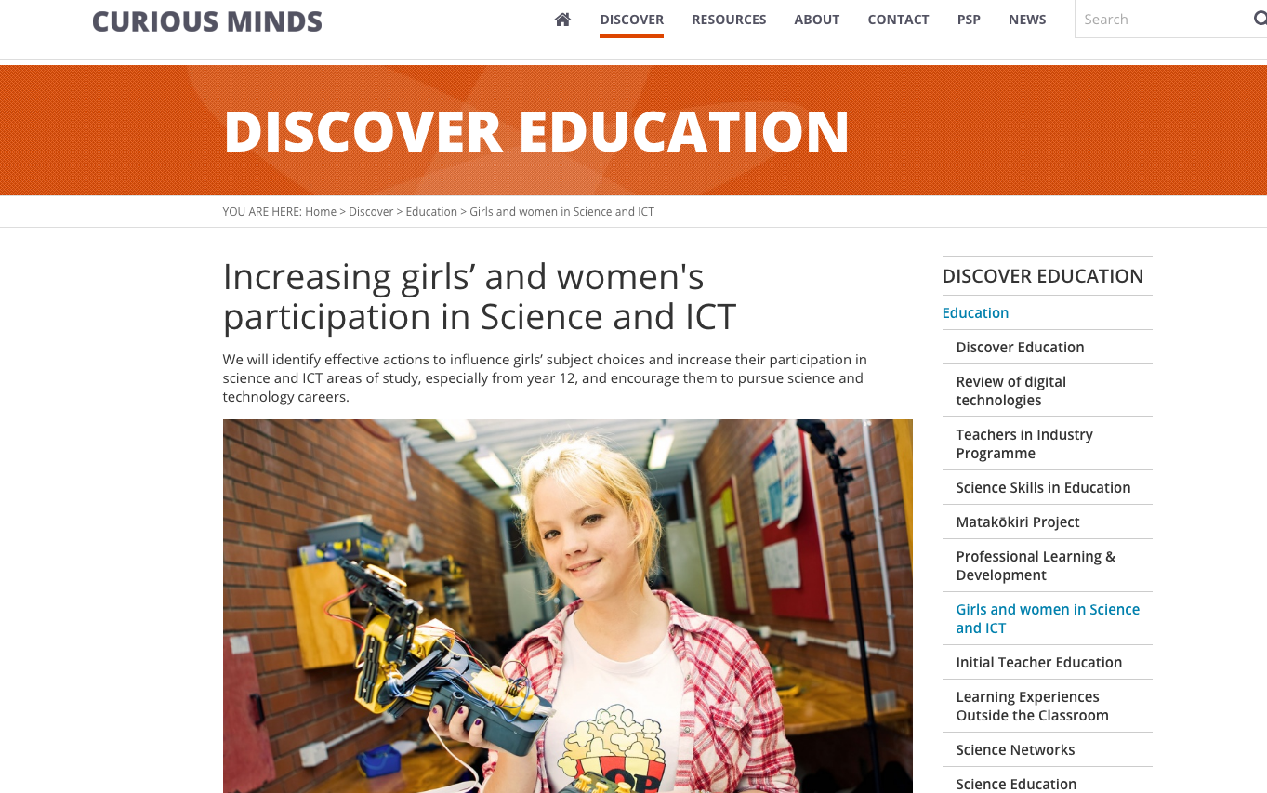
Liz Cleary – Women in STEM profiles
Image: http://www.curiousminds.nz/discover/article/6/10/girls-and-women-in-science-and-ict
Notes:
The Science in Society Plan A Nation of Curious Minds – He Whenua Hihiri i te Mahara sets the strategic direction for science and technology for the next 10 years. Curious Minds was launched in 2014 and is run jointly by MoE, MBIE and the Office of the Prime Minister’s Chief Science Advisor.
The Curious Minds objective is to “encourage and enable better engagement with science and technology across all sectors of New Zealand society” to deliver:
more science and technology-competent learners and more choosing STEM-related career pathways
a more scientifically engaged public and a more publicly engaged science sector
a more skilled workforce and more responsive science and technology.
.
Girls and Women in STEM
One of the key Curious Minds actions for MoE is to “identify effective actions to influence girls’ subject choices and increase their participation in STEM areas of study, especially from year 12, and encourage them to pursue science and technology careers”.
Part of our work on this is to create a series of Women in STEM profiles. These are here: http://www.curiousminds.nz/discover/article/6/10/girls-and-women-in-science-and-ict.

Slide 14
What do we ask?
What do you do on an average work day?
What did you study at school? And after high school?
Was your study directly related to what you do now?
What would you like to share with young women thinking about their career choices right now?
What are some of your career highlights so far?
Why do you believe engaging in STEM – working in the field, studying it or just educating oneself around the issues – is important to New Zealand?
Why is it important to have more women working in STEM?
Notes:
Women in STEM profiles
The profiles are based around women working or studying in STEM, answering seven questions.

Slide 15
What have we found?
The same themes keep coming through in the profiles:
STEM subjects are dynamic and evolving – there is always more to be understood about the world around us
STEM can help us understand current local and global issues
If you have a passion for or an interest in something, pursue it
Diversity in any field provides alternative perspectives that ultimately lead to greater ideas and outcomes
Don’t be afraid to try something new or different or to ask other people questions

Slide 16
Some other sites
Te Puni Kōkiri and the Ministry for Pacific Peoples also has similar STEM profiles aimed at students, whānau and teachers
http://www.maorifuturemakers.com/
http://www.mpp.govt.nz/our-stories/pacific-stars-2/successfulpacififcpeoples/

Slide 17
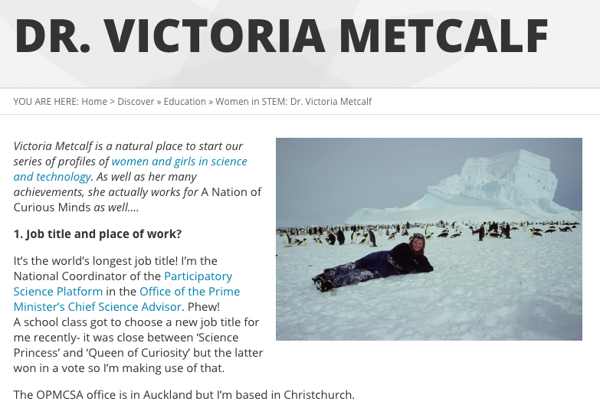
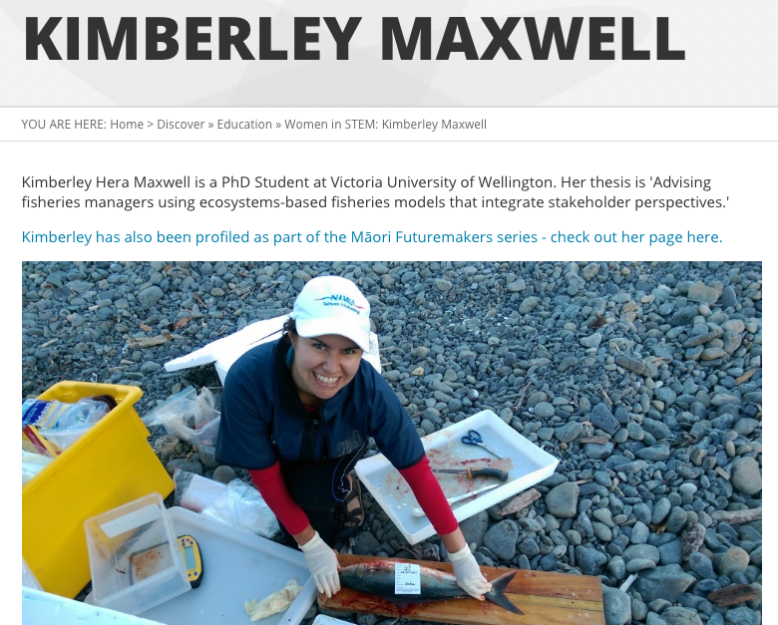
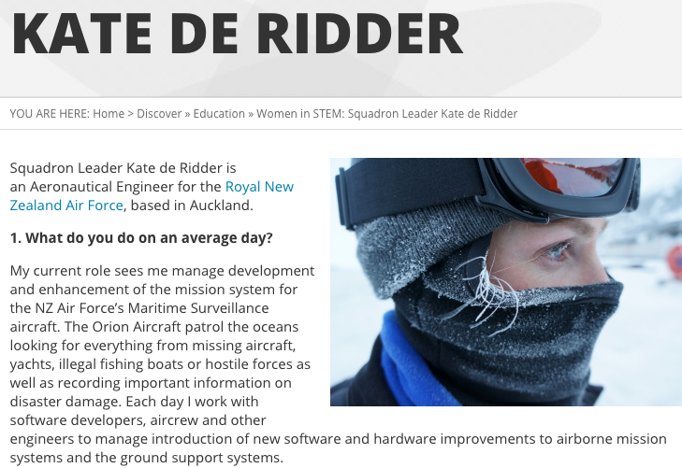
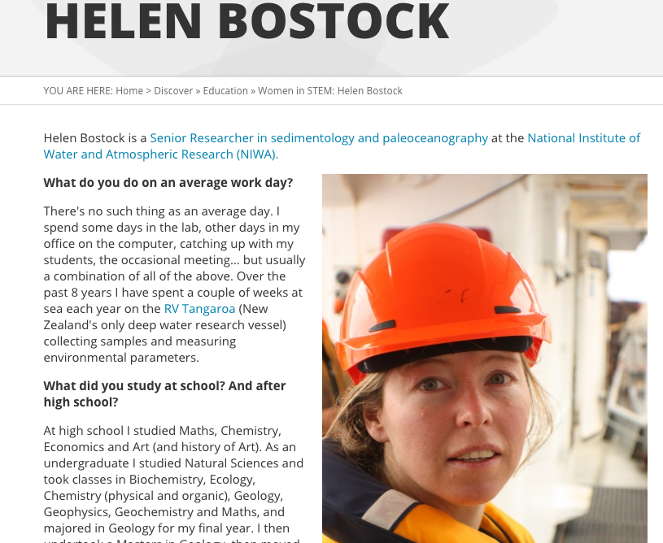
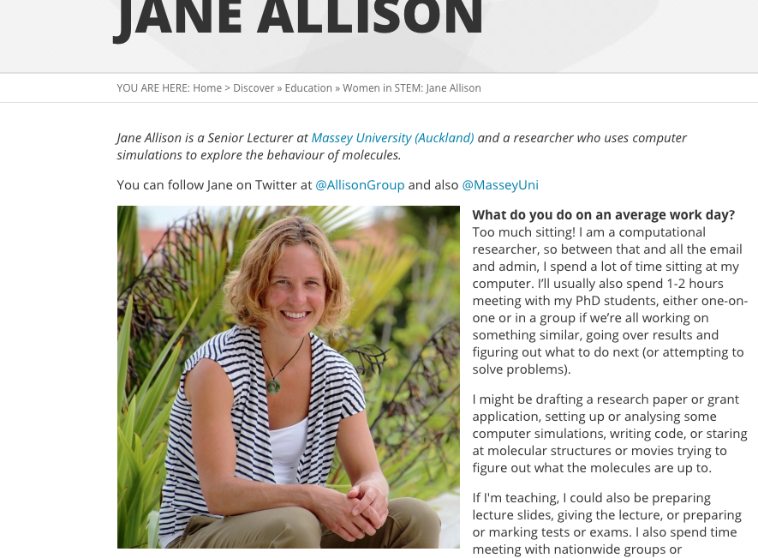
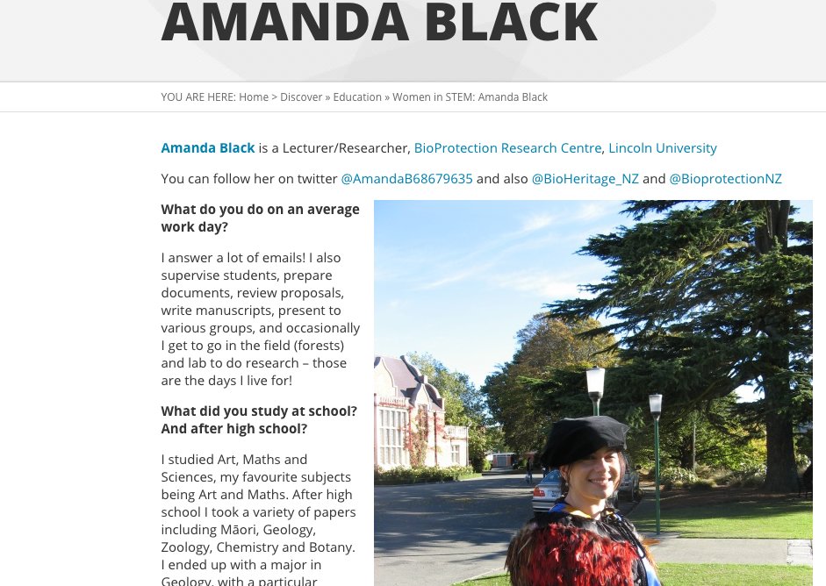
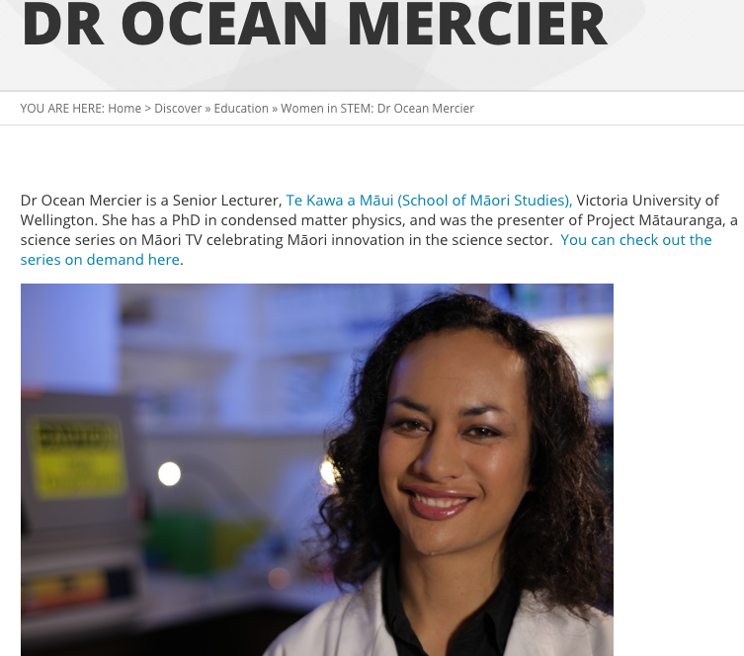
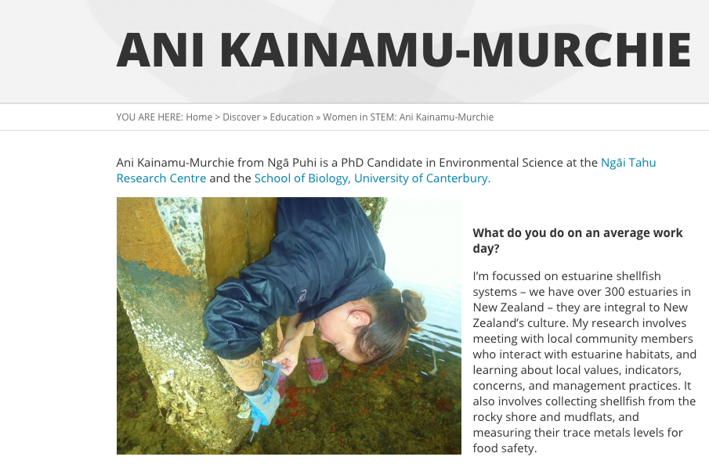
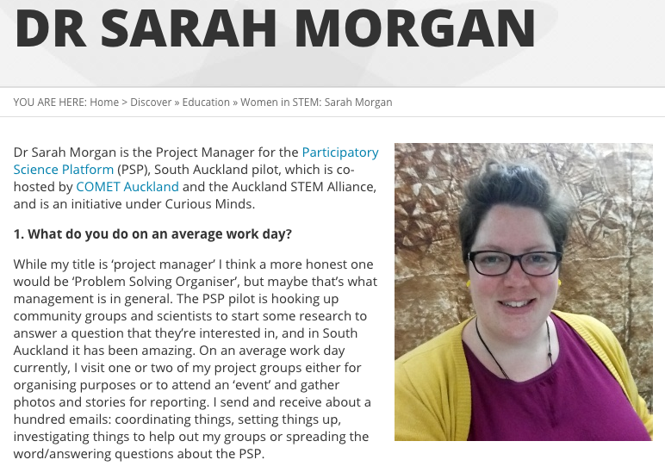
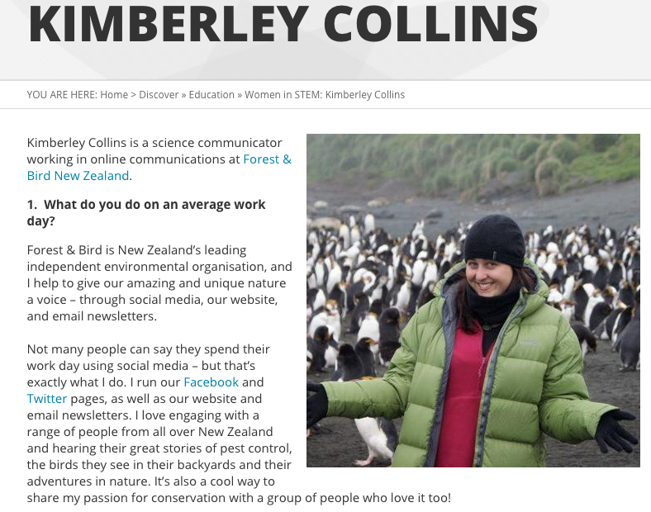
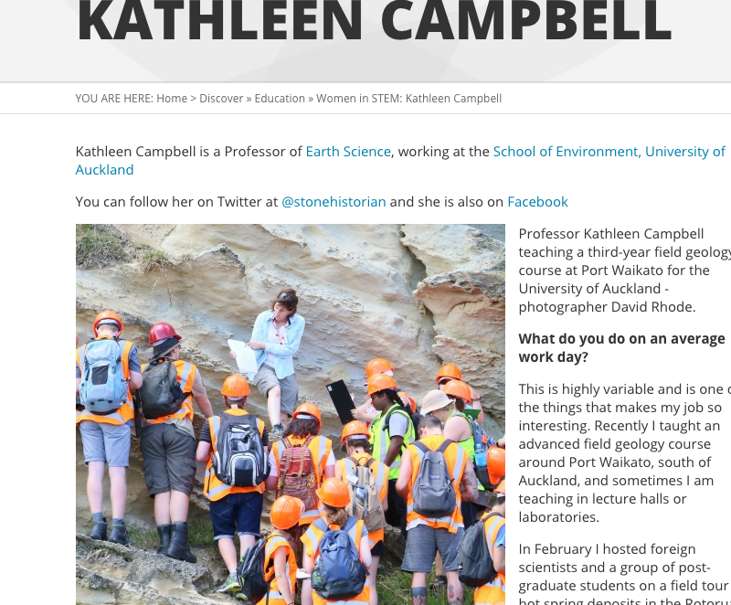
http://www.curiousminds.nz/discover/article/6/10/girls-and-women-in-science-and-ict

Slide 18
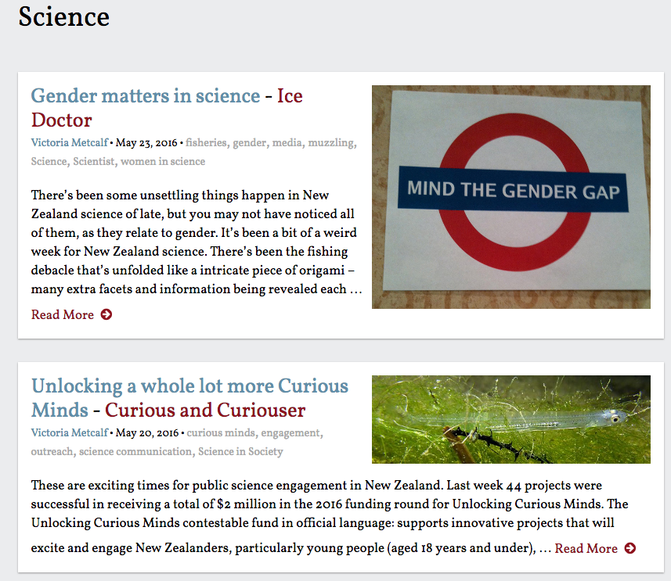
Victoria Metcalf – Queen of Curiosity
Image: http://sciblogs.co.nz/category/science/

Slide 19
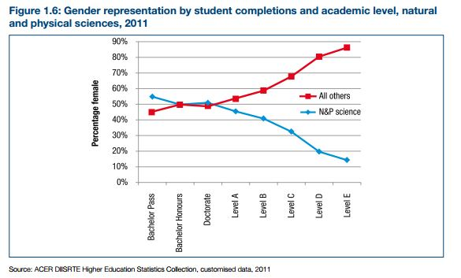
Source: Women in the Science Research Workforce , Identifying and Sustaining the Diversity Advantage, Bell & Yates, University of Melbourne, 2014.

Slide 20
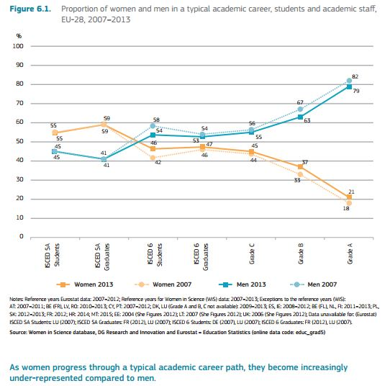
Source: SHE Figures 2015, European Commission

Slide 21
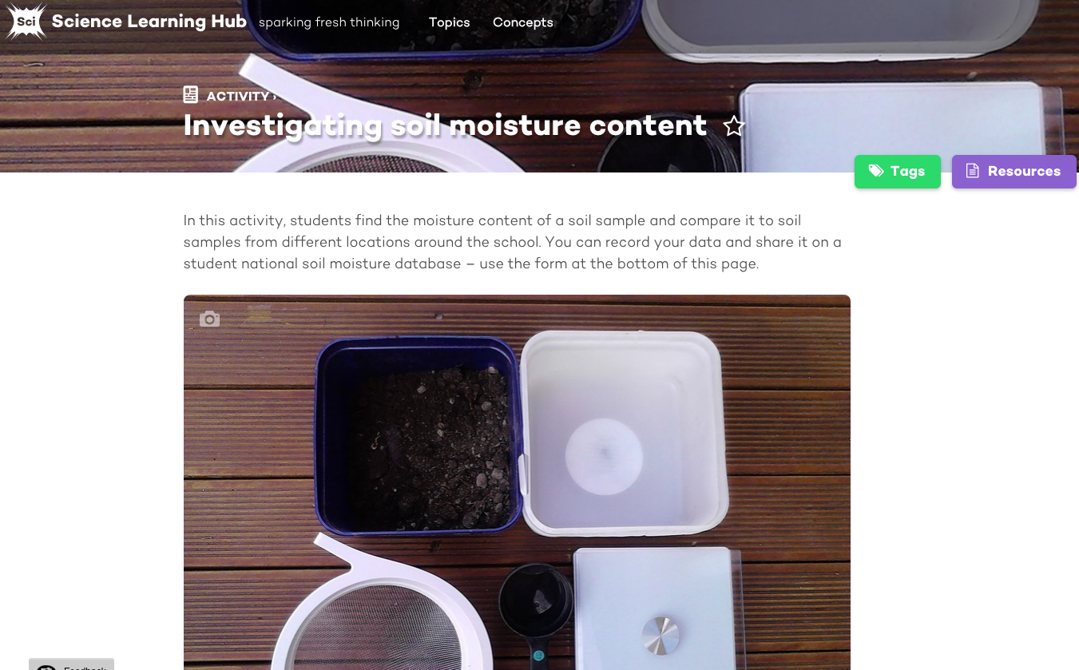
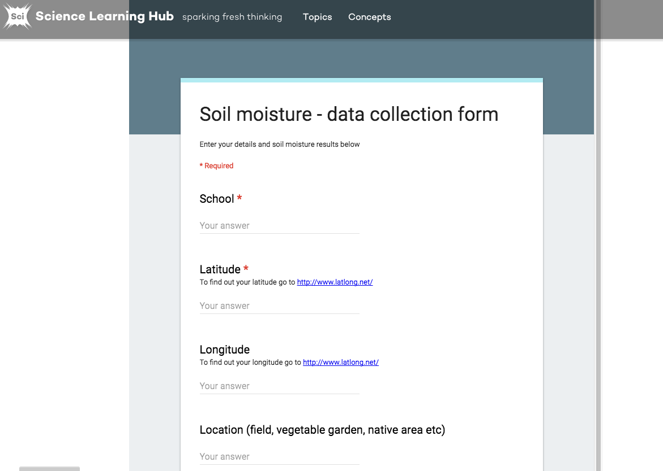
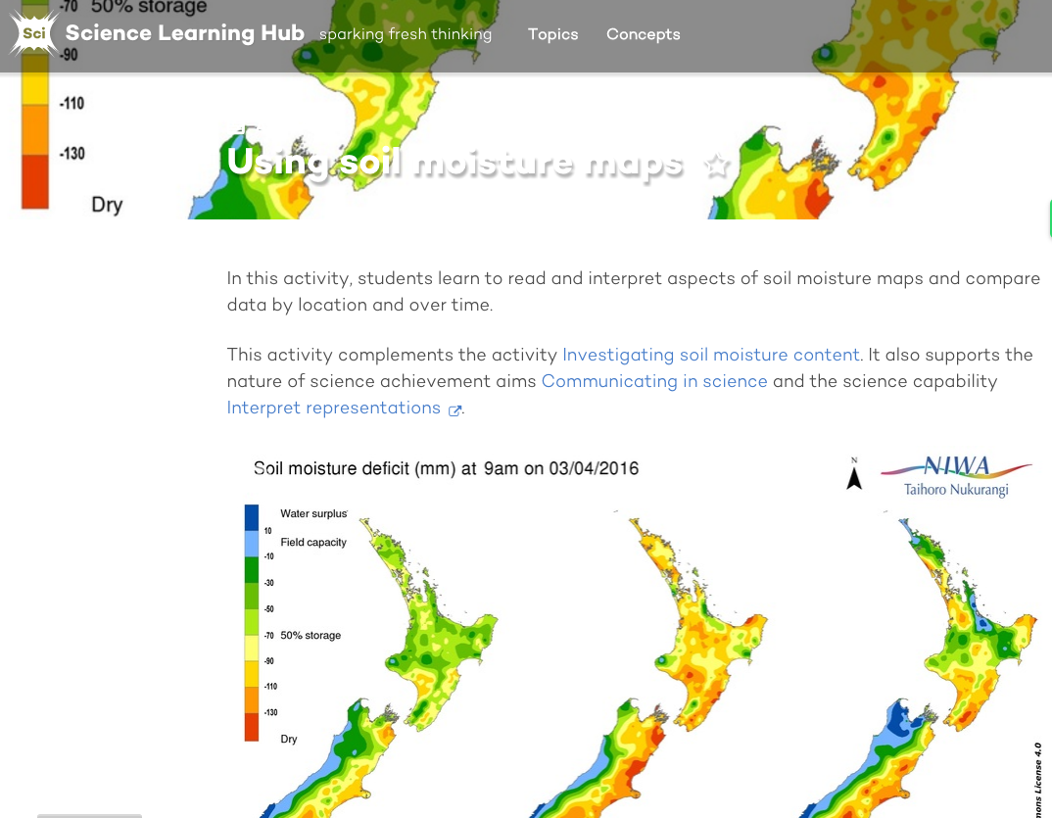
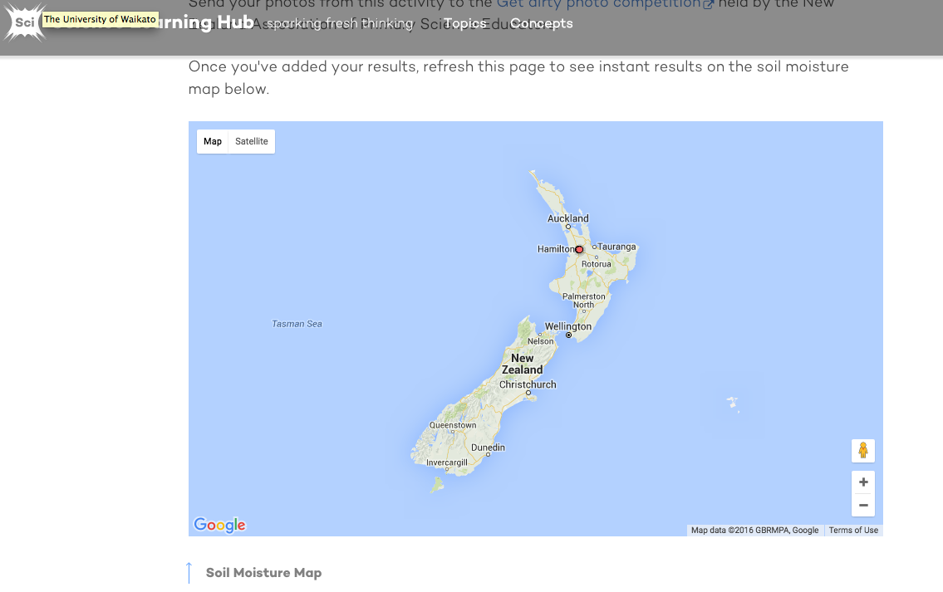
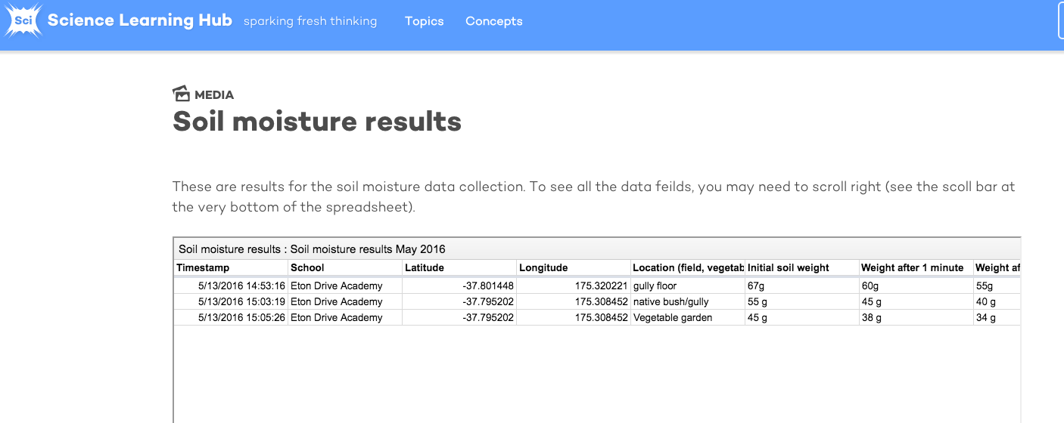
As teachers – how do we go about engaging our kids in STEM?
Notes:
The Science Learning Hub has thousands of pages of articles about research, teaching and learning resources and ideas. Here is one recent example of how the Hub is supporting teachers to build that skill base in their students – with practical relevant scientific collaboration across multiple subject areas.

Slide 22
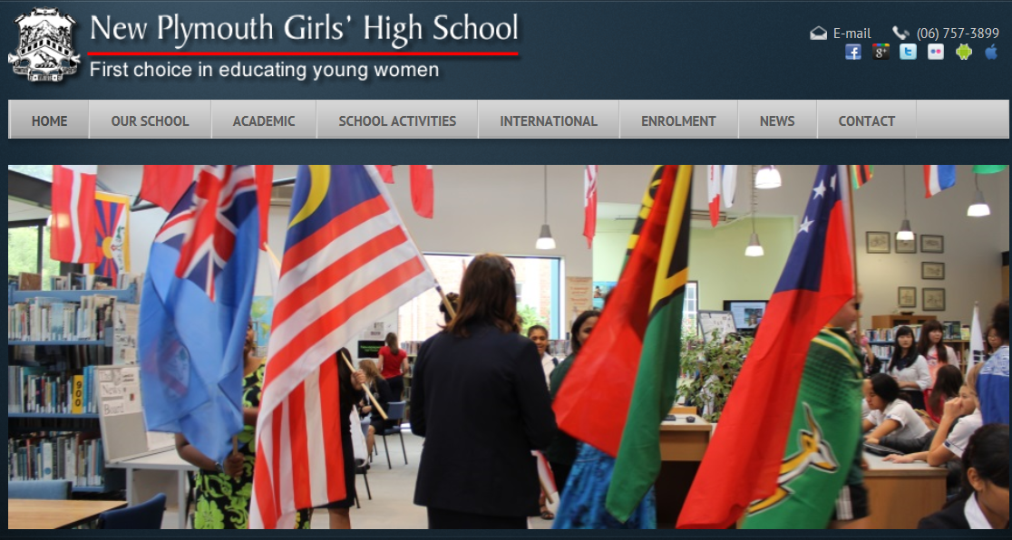
Melinda Stevenson – Digital Technologies teacher at New Plymouth Girls’ High School
New Plymouth Girls' High School has shaped and influenced the lives of young women since 1885
Image: New Plymouth Girls’ High School website
Notes:
Introducing Melinda Stevenson who has been a Lead Advisor working with the Ministry of Education and is now a Digital Technologies teacher at New Plymouth Girls’ High – Melinda is sharing her wealth of knowledge 5-10 minutes

Slide 23
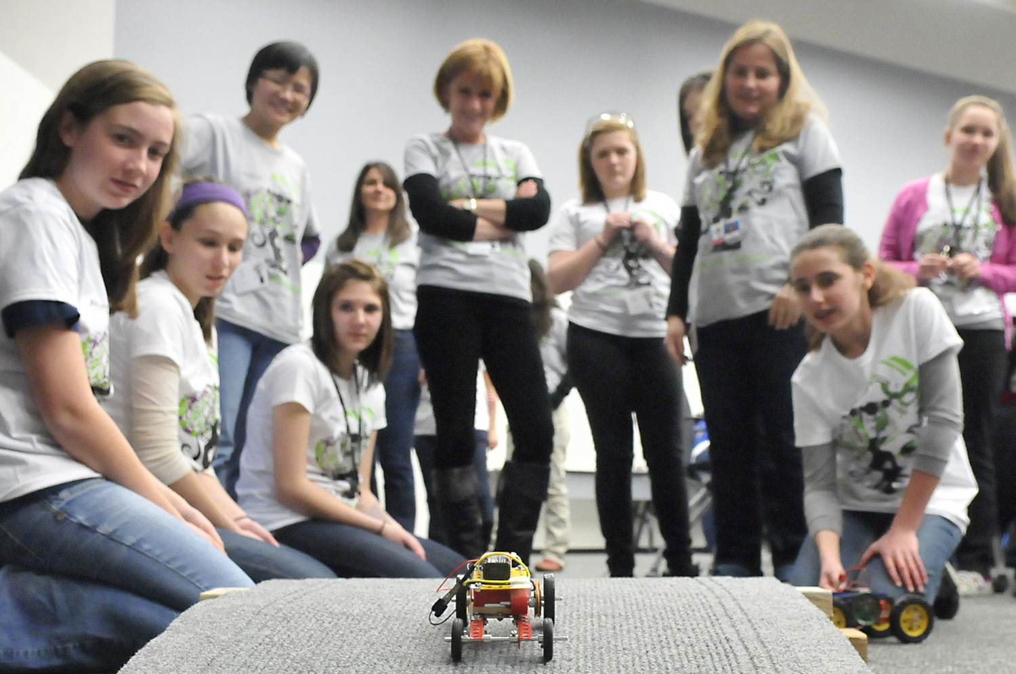
Sparking the interest
Image from http://sustainable-nano.com/2014/06/18/girls-in-stem-programs-my-single-sex-education-experience/
Licensed under a Creative Commons Attribution-NonCommercial-ShareAlike 3.0 Unported Licence.
Notes:
As teachers, what do we do right now to support our students to strengthen their understanding of the huge opportunities and different career choices in the STEM fields?
How do we spark the interest in STEM?
How do we help our students to develop digital era skills and knowledge?

Slide 24

Science @ NPGHS
All students must take English, science and mathematics up to the end of year 11
One-on-one career counselling programme from the Science Department
Broad range of courses to meet the diverse needs of students both academically and career and personal goals
High retention rate from year 11 onwards
Flexibility to move between courses
Notes:
Retain a large number of students from year 11 onwards.
Offer the traditional sciences – chemistry, physics and biology and animal/plant science.
Created a mid-range course that is totally internally assessed. This helps students to follow a career path (e.g. nursing courses are all internally assessed).
Broad range of courses that meet the diverse needs of the students both academically and career wise.
Flexibility of course selection and flexibility of movement between ‘banding’ of courses.

Slide 25
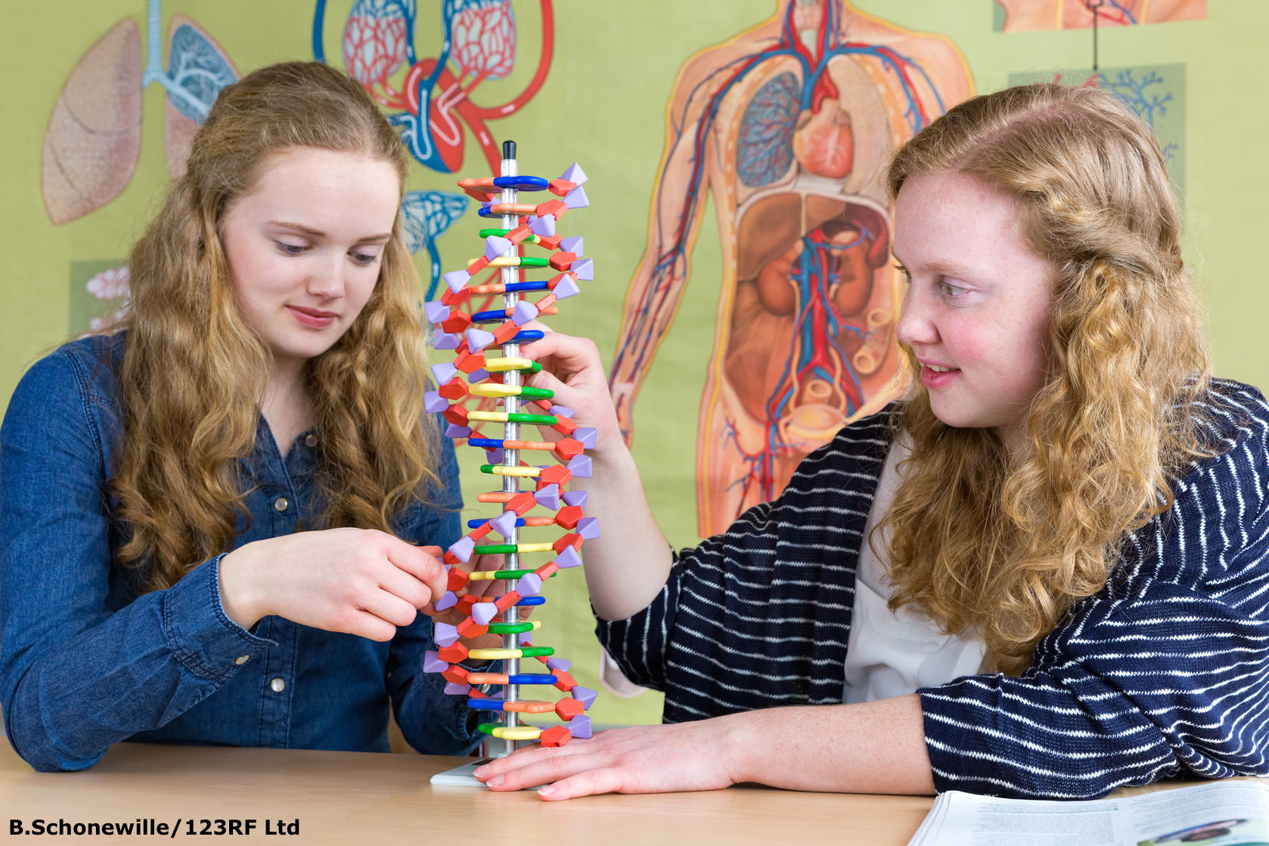
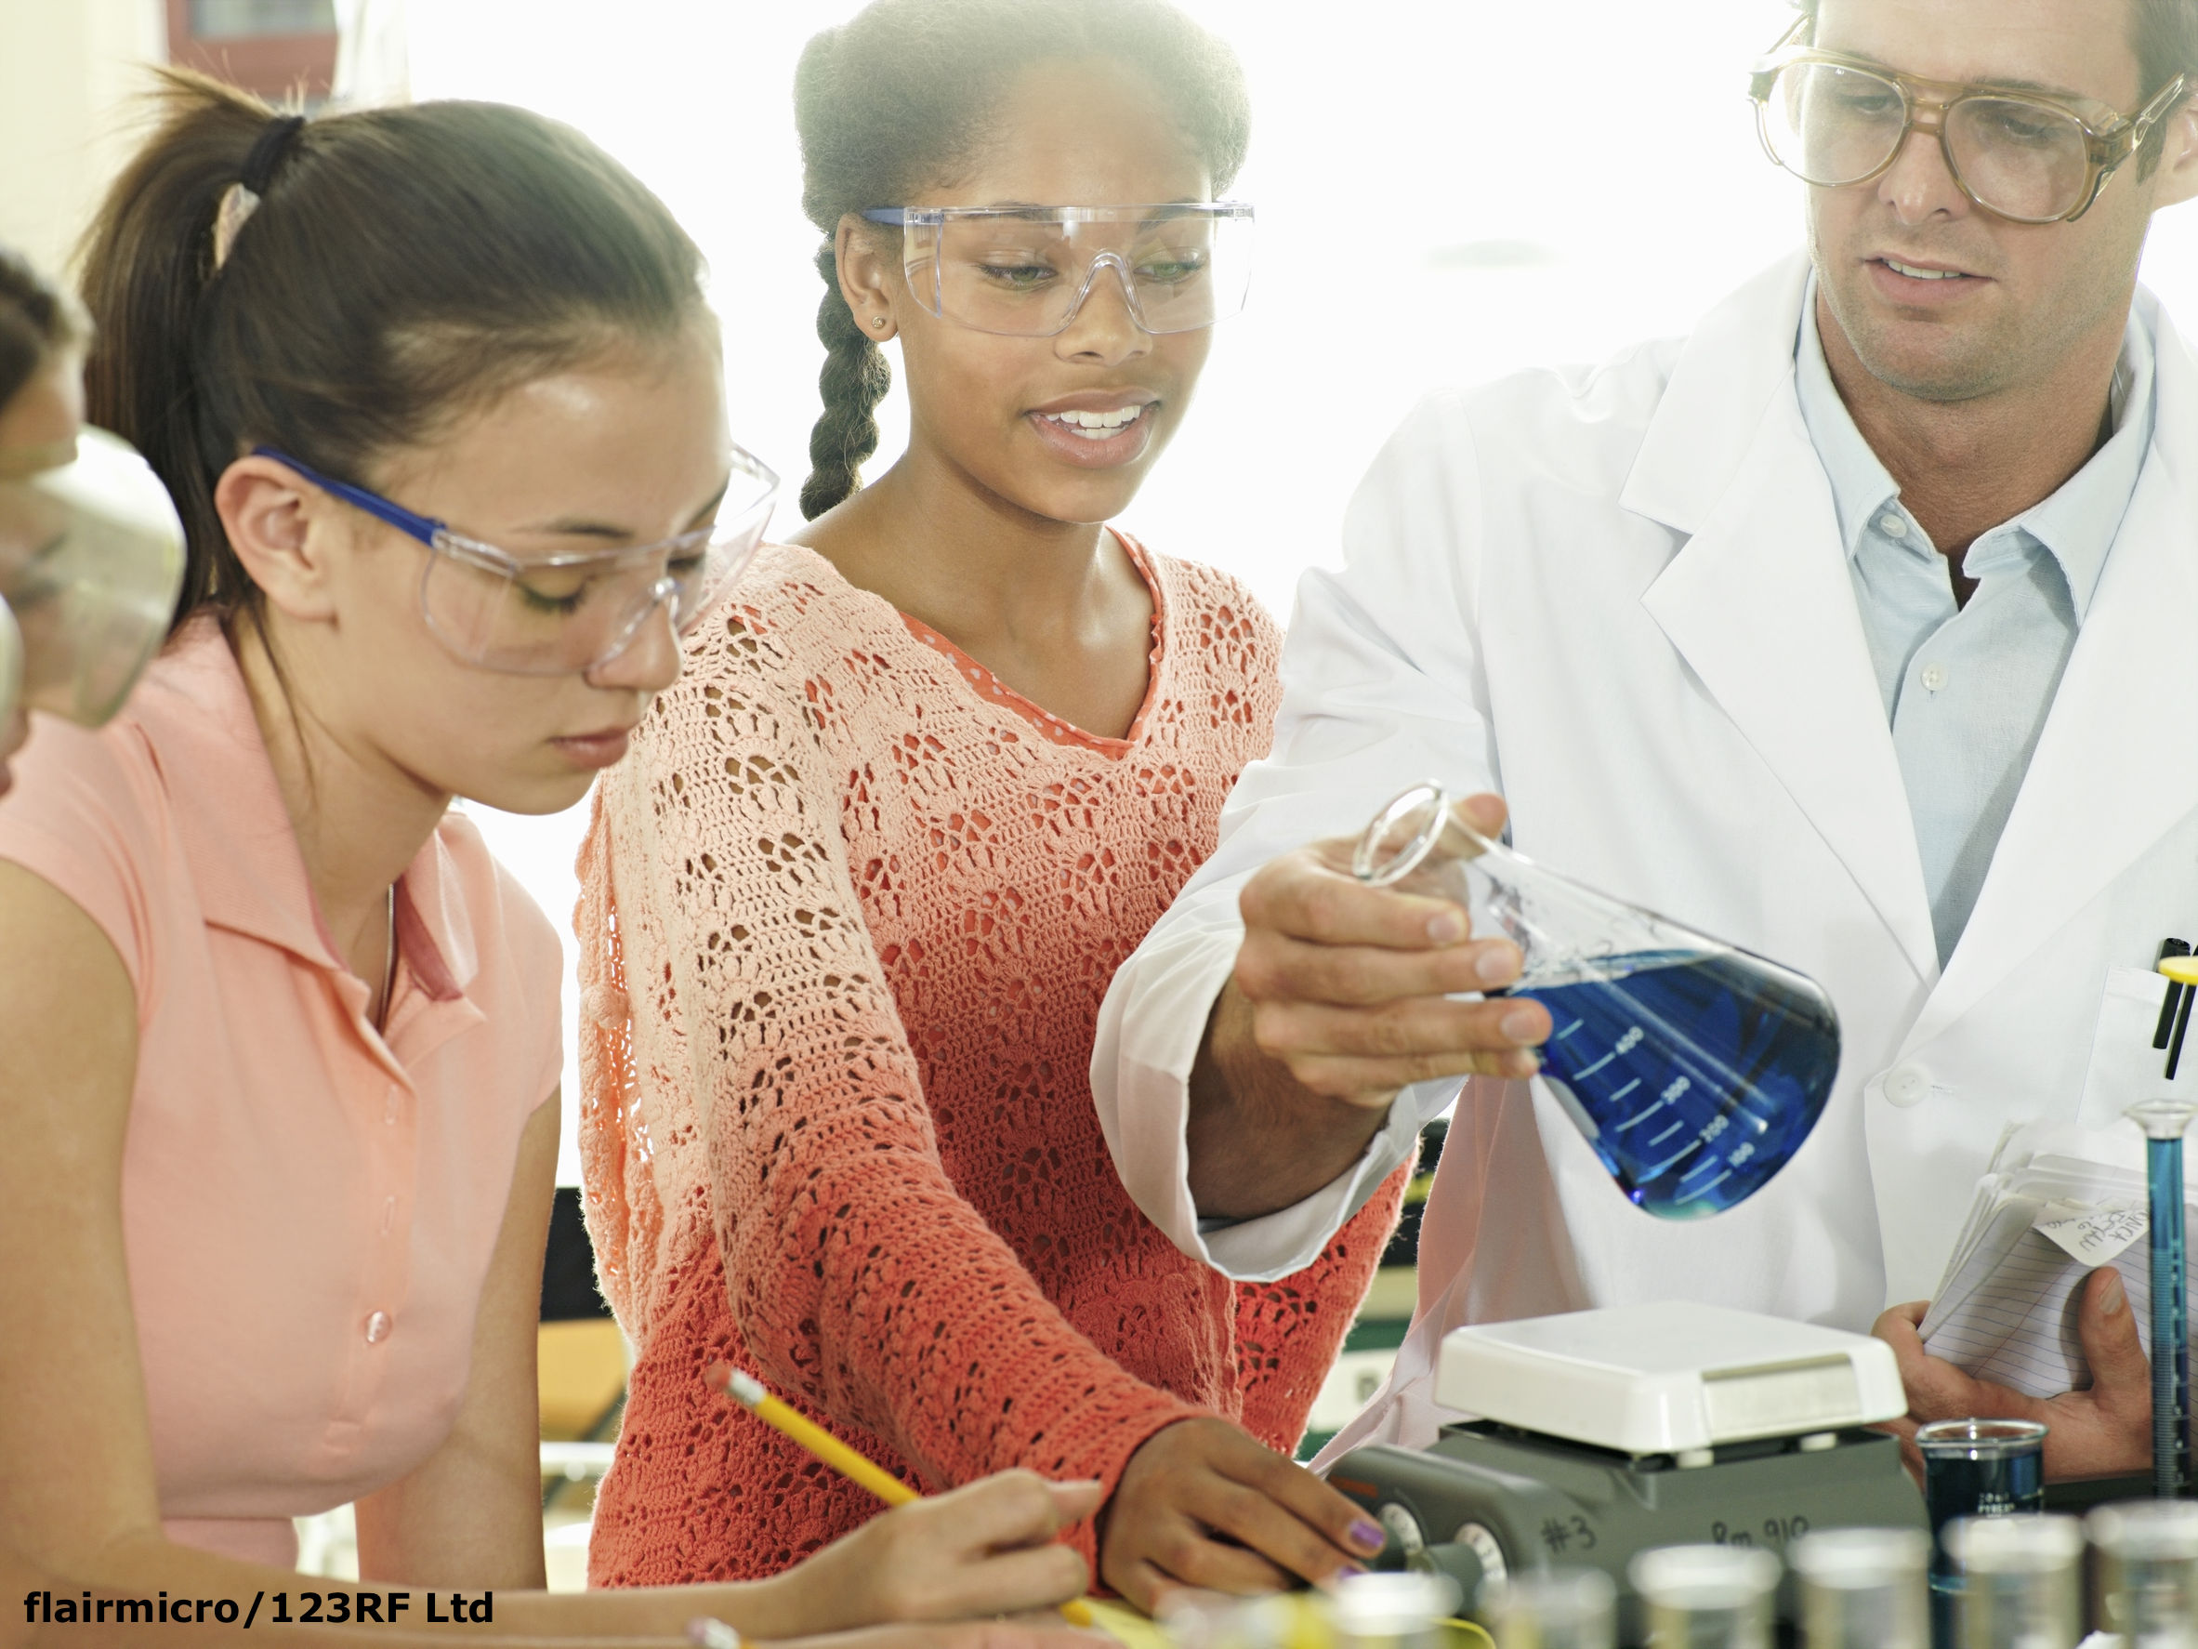
Making it real
Putting science into a context that is relevant and authentic for teenage girls
Help students to understand how the world works
Spark the curiosity
Notes:
Putting science into a context that is relevant to teenage girls and helping them to understand how the world works.
Making it real for the student and authentic for the student.

Slide 26
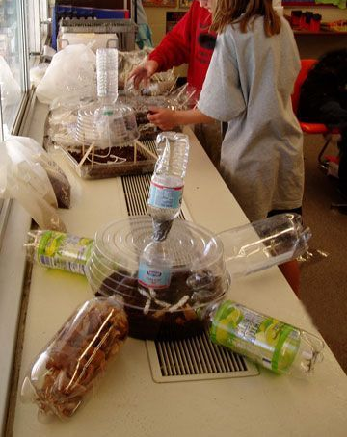
Getting it right
The context
The career guidance
The career focus
Revisit, revisit and re-evaluate
Keep up to date and informed

Slide 27

Get students interested at an early age
Establish an after-school or lunchtime Code Club
Encourage students to work in pairs or teams
Give them real-world, authentic problems to solve
Get the parents/family/whānau involved and educate the community
Highlight STEM careers
Notes:
Get students interested at an early age.
Establish an after-school or lunchtime Code Club.
Encourage students to work in pairs or teams so that they build collaborative expertise.
Educate the community – talk about STEM careers.

Slide 28

Keep informed
Women In Tech
http://www.nztech.org.nz/promote/technology-career-training/
http://www.nztech.org.nz/category/nztech-women/

Slide 29

Spark the interest and start the discussion
https://www.madewithcode.com/
Google Made with Code is an initiative to champion creativity, girls and code, all at once

Slide 30
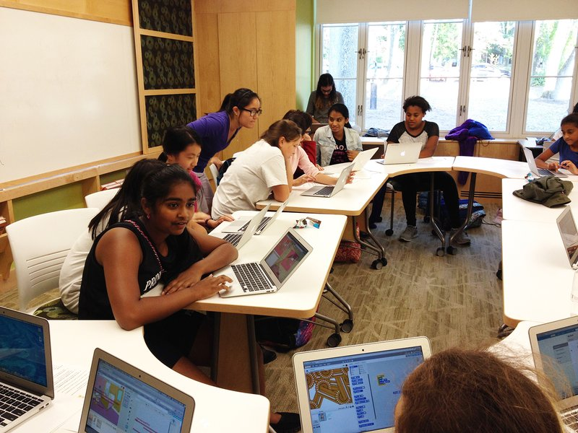
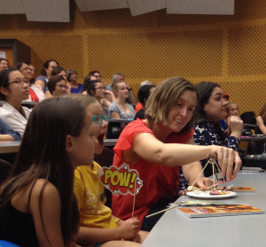
Coding clubs for girls
Programming Challenge 4 Girls http://www.pc4g.org.nz/about.php
Girl Code
http://girlcode.co.nz/
Code Club Aotearoa
http://www.codeclub.nz/
STEAM Ahead
http://www.steam-ahead.org/
Images courtesy of http://www.steam-ahead.org
Notes:
A vast number of options exist for secondary school students to gain exposure and experience with STEM subjects and technology career opportunities.
Programming Challenge 4 Girls
A programming competition for year 10 girls designed to introduce them to computer programming.
Girl Code
An 8-week software adventure for young women aged 15 to 25.
This year, Microsoft and OMGTech! have provided funding to run Girl Code for free in low-decile schools.
Code Club Aotearoa
A nationwide network of volunteer-led after-school coding clubs for Kiwi kids.
210 clubs in New Zealand.
STEAM Ahead
A series of events that help mums and their teenage daughters meet women who work in science, engineering, technology and related fields.
Hon Jo Goodhew, Minister of Women’s Affairs, revealed a shocking statistic that came from surveying New Zealand schoolgirls about their future career plans. The top two most-desired careers are air hostess and hairdresser. The lack of ambition is disheartening, and it comes most likely from the fact that these girls have not been exposed to other possible career choices and have not been encouraged by their mothers to achieve more.
She decided to do something about this. Together with The Mind Lab and Futureintech, an organisation that promotes careers in food technology, biomedical engineering, software development and forensic science, we have come up with a concept for an educational career event called “STEAM Ahead”

Slide 31

Of interest
CODE: Debugging the gender gap, a new film by American director Robin Hauser Reynolds, tackles why there is such a shortage of women in coding and programming.

Slide 32
The future
The science capabilities and a STEM approach help students practise the types of thinking, questioning and actions needed to become active citizens
Women seeking careers in these areas is an important aspect of gender balance within our communities
Community members need to be critical consumers of STEM – curious, questioning, action taking, solution seeking, story telling, interested, creative, contributing, active …
Participatory citizens
Notes:
How do we model this?

Slide 33
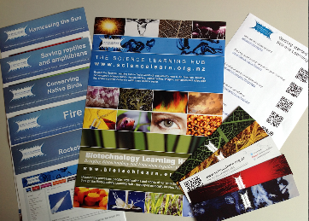


Would you like a promo pack?
Packs of bookmarks and flyers available – email us enquiries@sciencelearn.org.nz
Follow us on Twitter: https://twitter.com/NZScienceLearn
Like us on Facebook: www.facebook.com/nzsciencelearn
Explore our Pinterest Boards: www.pinterest.com/nzsciencelearn
© 2016 The University of Waikato | www.sciencelearn.org.nz

Slide 34

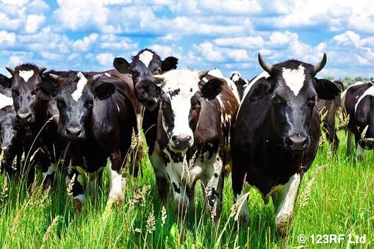
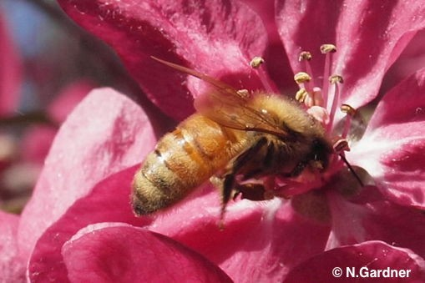
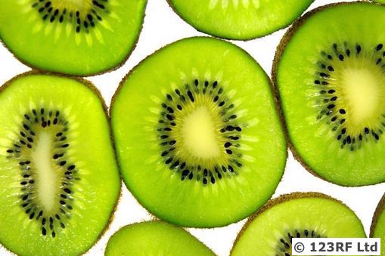
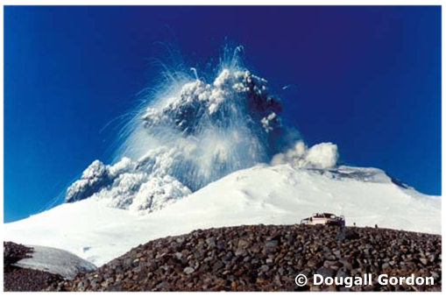
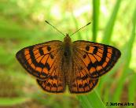
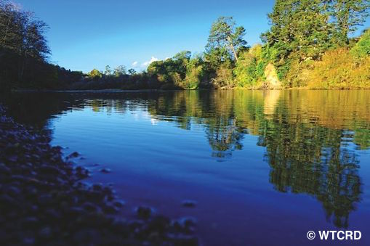
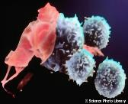
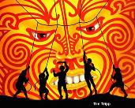
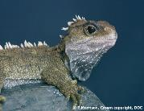
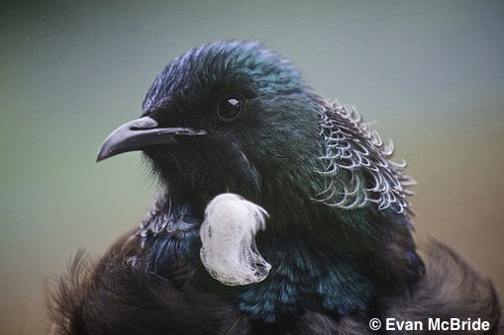
Thanks!
Questions and comments?
The images contained within this PowerPoint presentation are copyrighted to the University of Waikato and other third-party individuals and organisations. Any reuse beyond the classroom as per the intended use of these resources should be cleared with the copyright owner/s.

