Slide 1
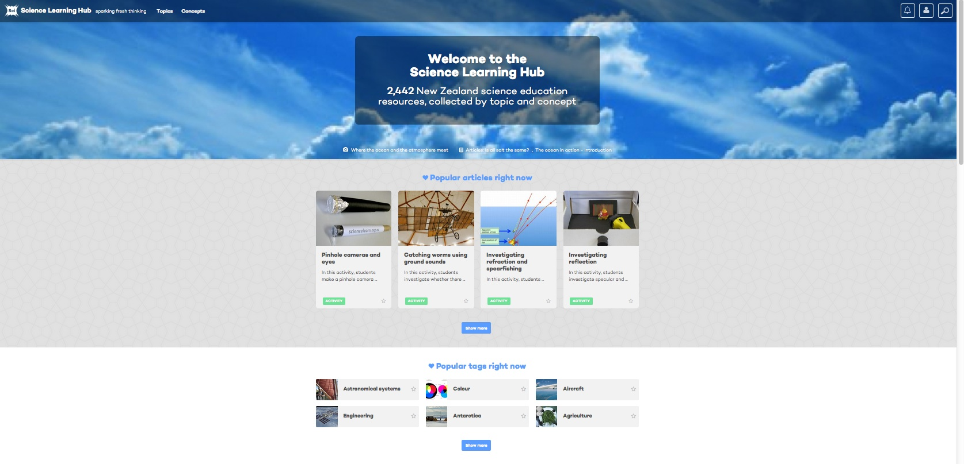
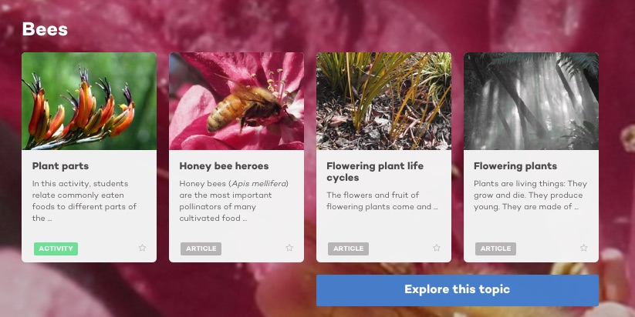
Science Learning Hub new-look website – a secondary focus
@NZScienceLearn
www.sciencelearn.org.nz
June 2016
© 2015 The University of Waikato | www.sciencelearn.org.nz

Slide 2



What is the Science Learning Hub?
A trustworthy online resource – produced by educators and scientists
Based on world-class New Zealand science research
Supported by learning activities, information about the key science ideas and concepts, multimedia tools and other resources
Written for New Zealand teachers and students
Notes:
My name is Andrea Soanes – I am the PM here at the Hubs – I am a trained secondary school teacher – science biology and EFS - I am very excited to showcase or new look site
The SLH and BTLH have been around for over 10 years – and with that history many expert educators and scientists have contributed to building the enormous content housed on the Hubs sites.
The processes put in place many years ago have created a trustworthy site – content goes through vigorous checks and editing before it is loaded. Writing developers work with scientists to bring their research alive in the classroom – accessible to all levels including community – All material is accessorized with learning activities and some unit plans to support teachers in the classroom – building confidence in science concepts and creating accessible contextual content specifically for New Zealand – it is funded by the NZ govt- MBIE and sites under the Curious minds umbrella.

Slide 3
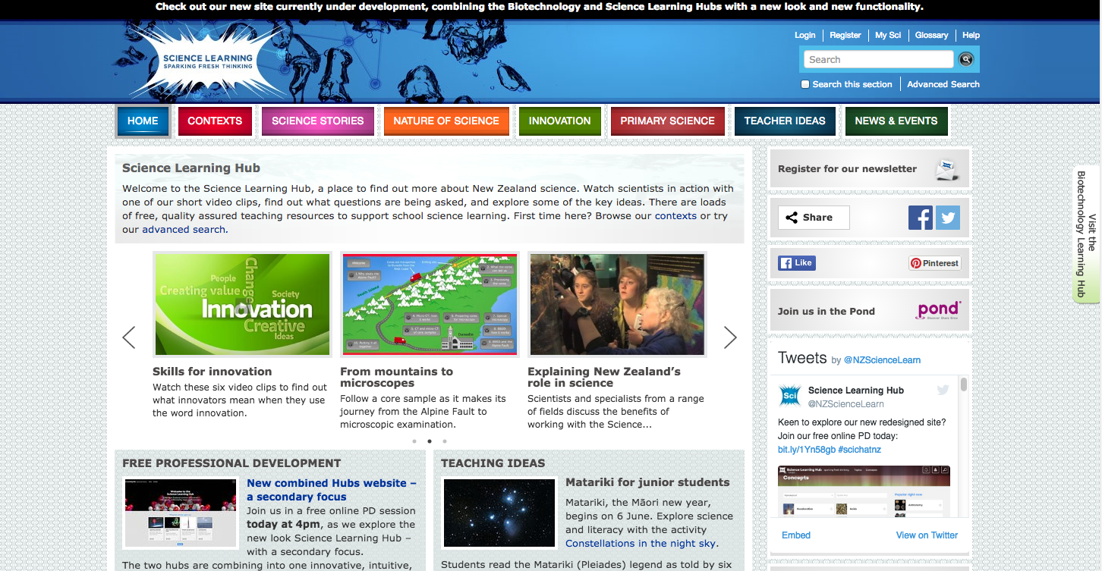
All images are copyrighted. For further information, please refer to enquiries@sciencelearn.org.nz
Copyright University of Waikato. All rights reserved.
Notes:
All the 100’s of content mages in the SLH can be found in the top bar – contexts science stories – the content was placed under specific contexts which meant that they were also at times hidden behind multiple click throughs – and in its time was the most innovative format at the time – in fact winning multiple awards for its IT innovation.

Slide 4
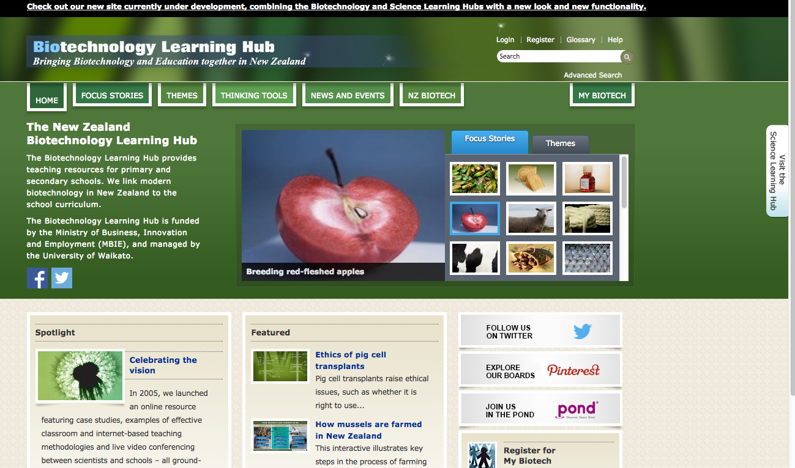
All images are copyrighted. For further information, please refer to enquiries@sciencelearn.org.nz
Copyright University of Waikato. All rights reserved.
Notes:
The BLH – also had its content placed under focus stories and themes.
To access our new look site – called a beta site as it sits along side the other sites and will do for some time yet click on the top bar to take you to the beta site – go back a page and show the SLH click link.

Slide 5



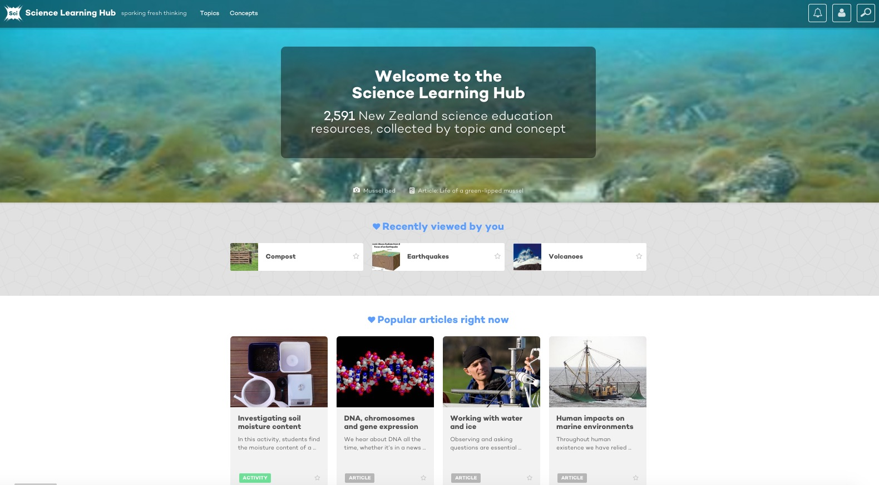
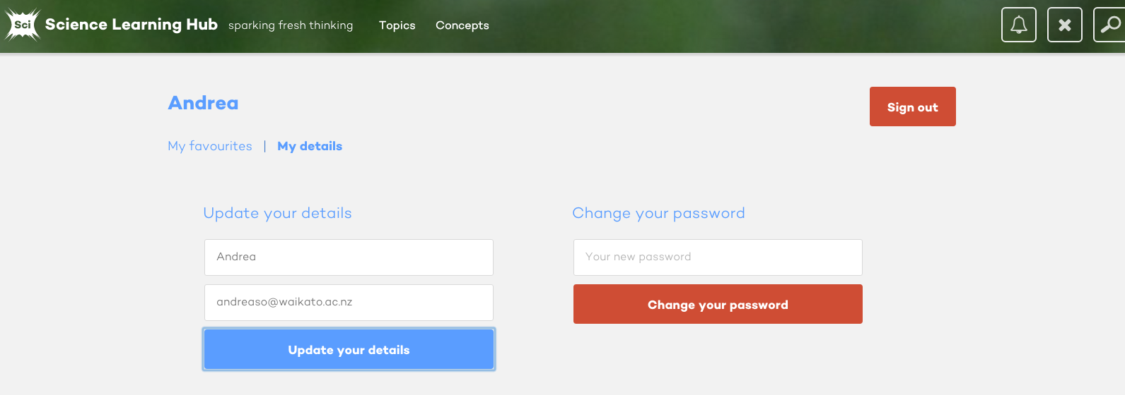
New look for the Science Learning Hub
All images are copyrighted. For further information, please refer to enquiries@sciencelearn.org.nz
Copyright University of Waikato. All rights reserved.
Notes:
Expand on the detail as it appears (top line) – notifications signing in and search – talk about the notifications aspect

Slide 6
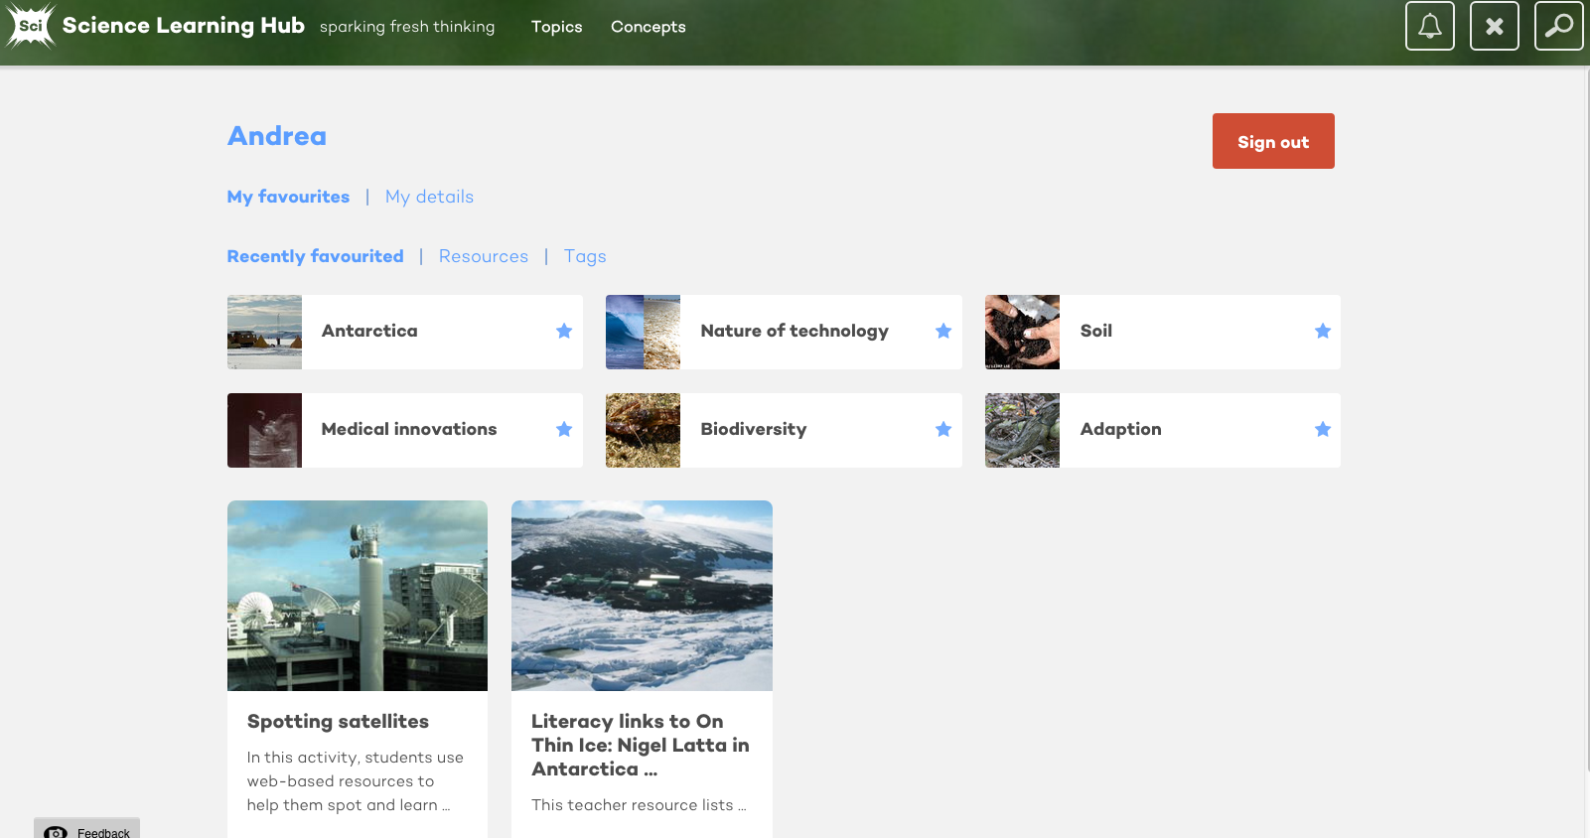
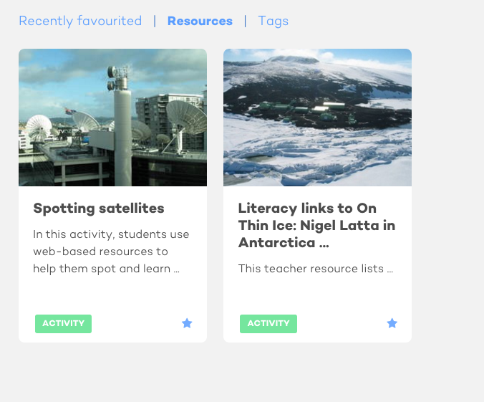
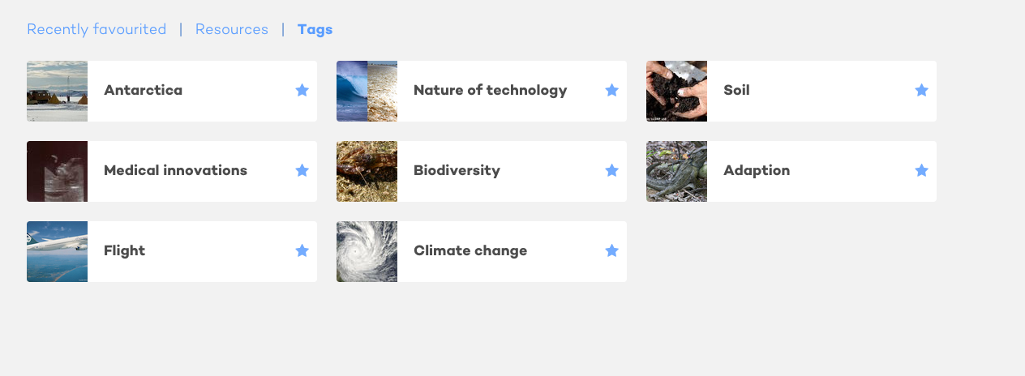
New look for the Science Learning Hub
All images are copyrighted. For further information, please refer to enquiries@sciencelearn.org.nz
Copyright University of Waikato. All rights reserved.
Notes:
Talk about the benefits of favouriting

Slide 7
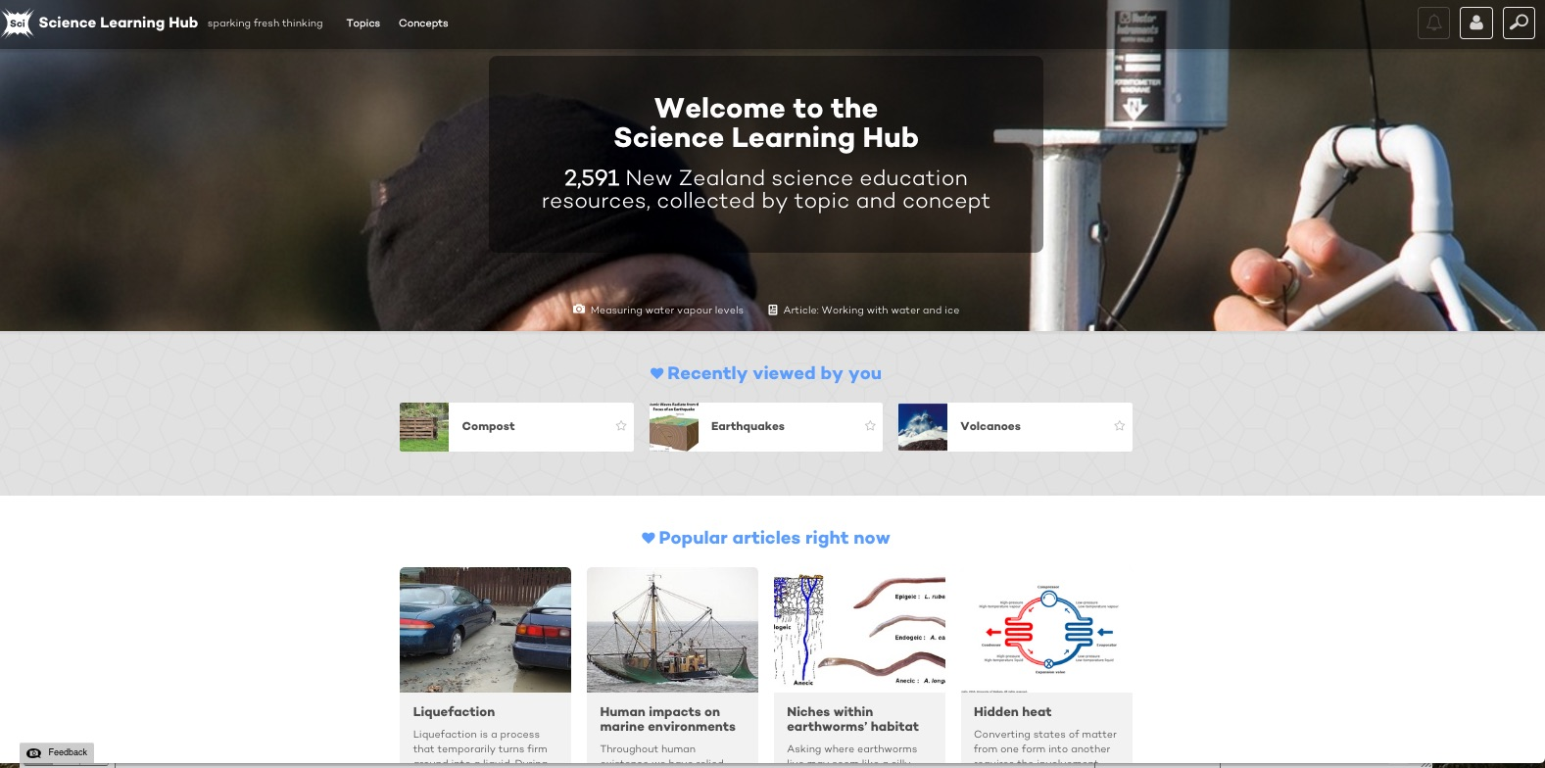
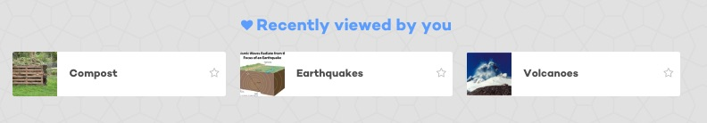
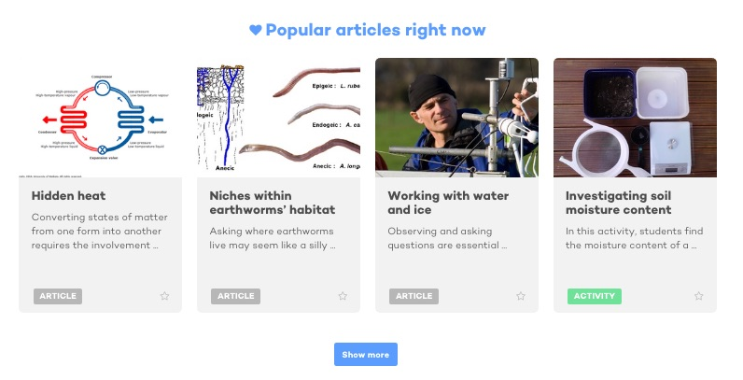
All images are copyrighted. For further information, please refer to enquiries@sciencelearn.org.nz
Copyright University of Waikato. All rights reserved.
Notes:
Other parts seen on the home page

Slide 8
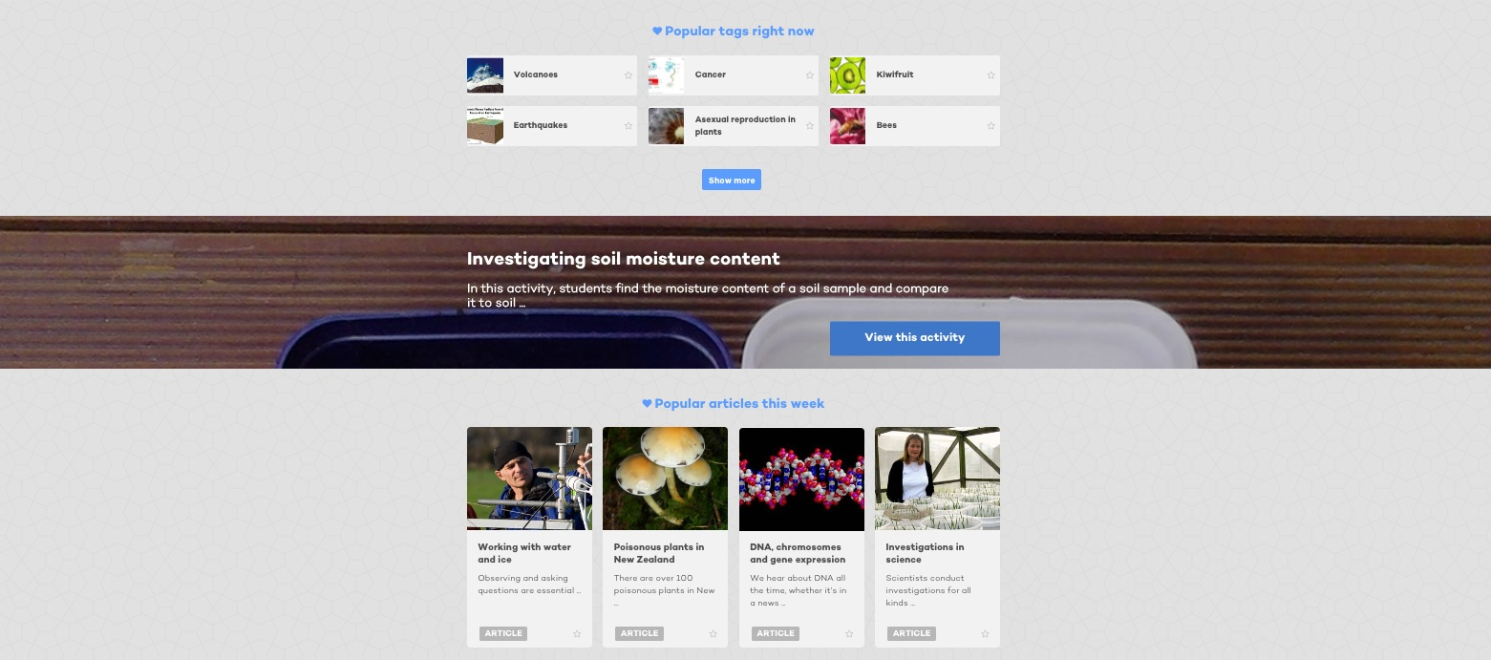
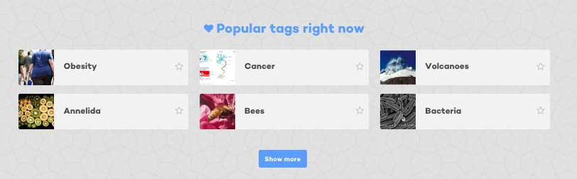
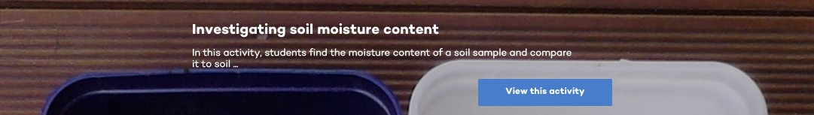
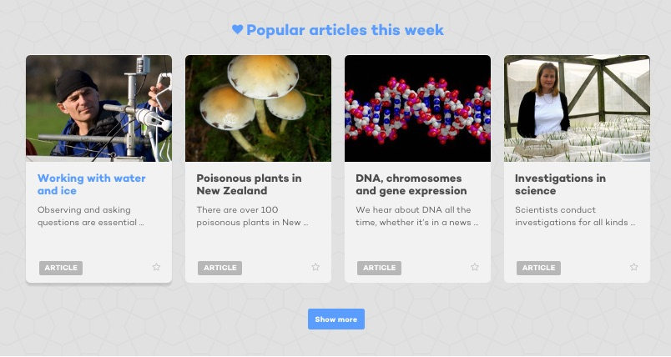
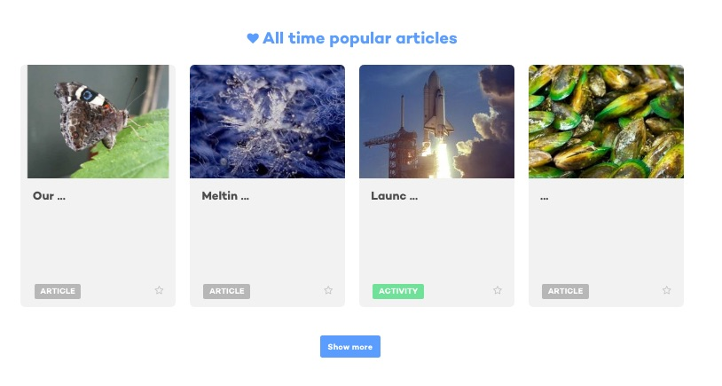
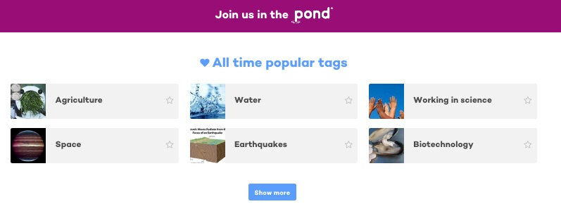
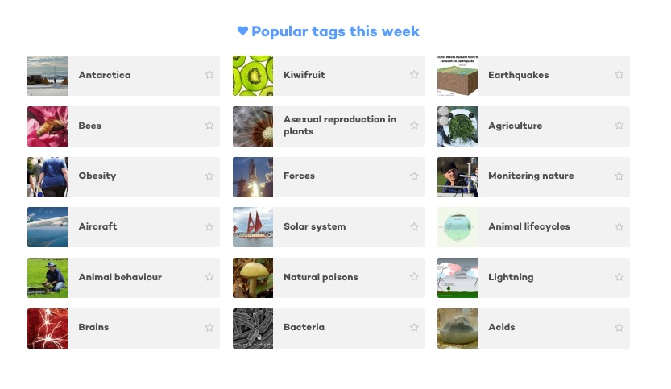
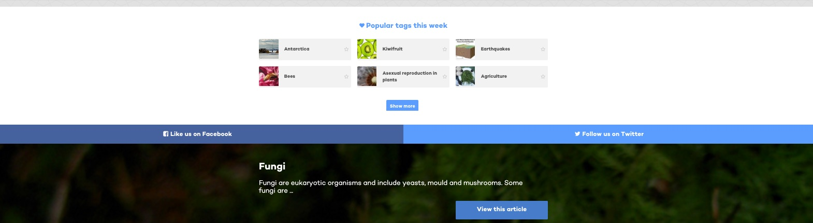
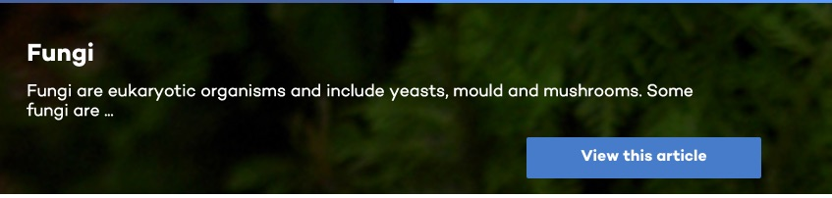
All images are copyrighted. For further information, please refer to enquiries@sciencelearn.org.nz
Copyright University of Waikato. All rights reserved.
Notes:
Further down the page you might see…

Slide 9
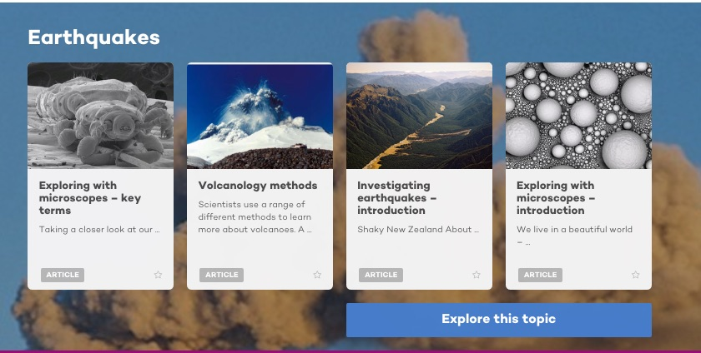
All images are copyrighted. For further information, please refer to enquiries@sciencelearn.org.nz
Copyright University of Waikato. All rights reserved.
Notes:
…and some ideas to explore

Slide 10
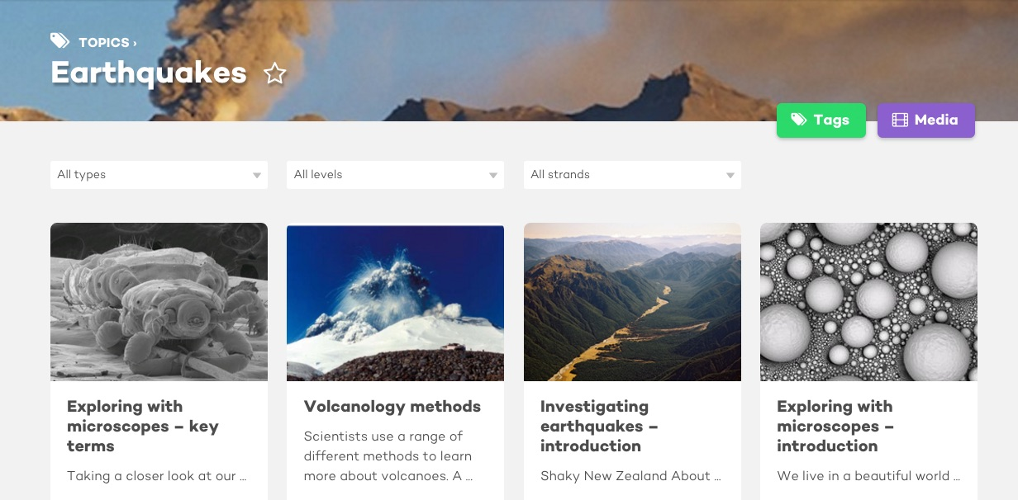
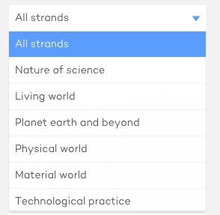
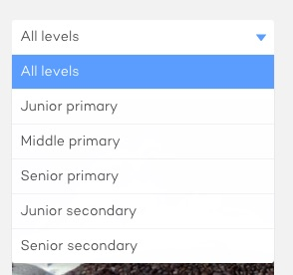
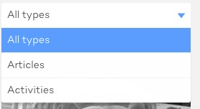
Copyright University of Waikato. All rights reserved.
Notes:
Explaining types/levels/strands – although some of the primary work is still able to be adapted for junior secondary, so don’t dismiss it

Slide 11
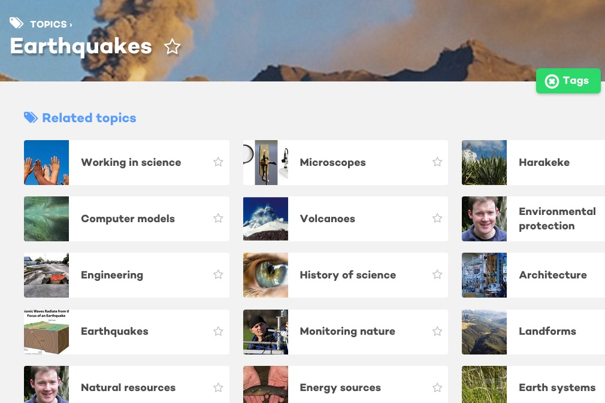
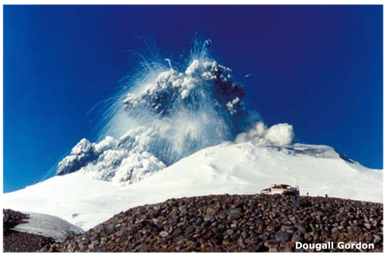
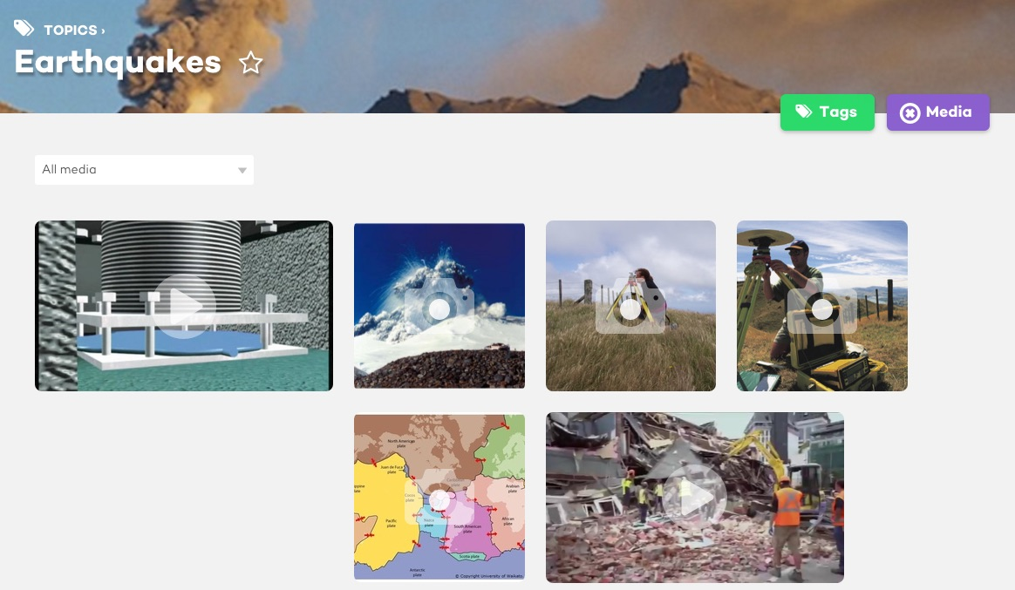
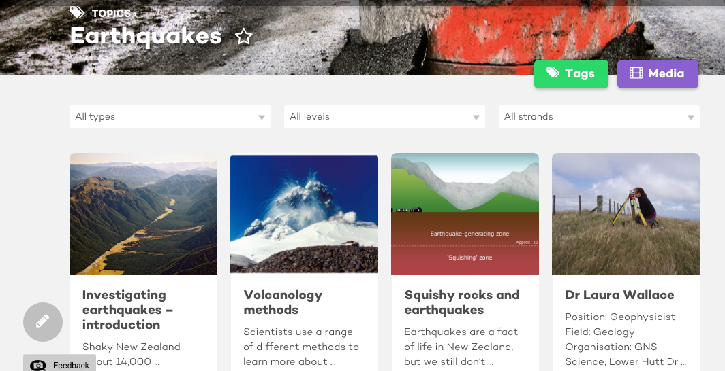
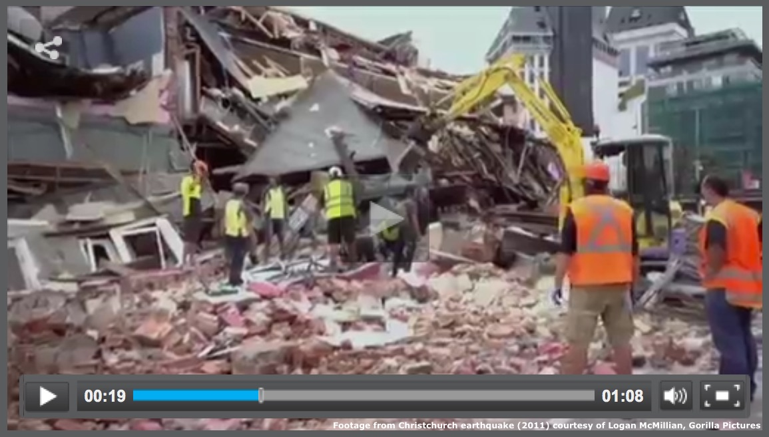

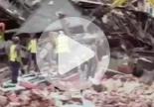
Copyright University of Waikato. All rights reserved.
Notes:
Explaining tags and media

Slide 12
Junior secondary – years 9 and 10
Themes?
Big idea?
Inquiry?
Traditional?
Concept based?
Copyright University of Waikato. All rights reserved.
Notes:
How do you plan your junior science programmes?

Slide 13
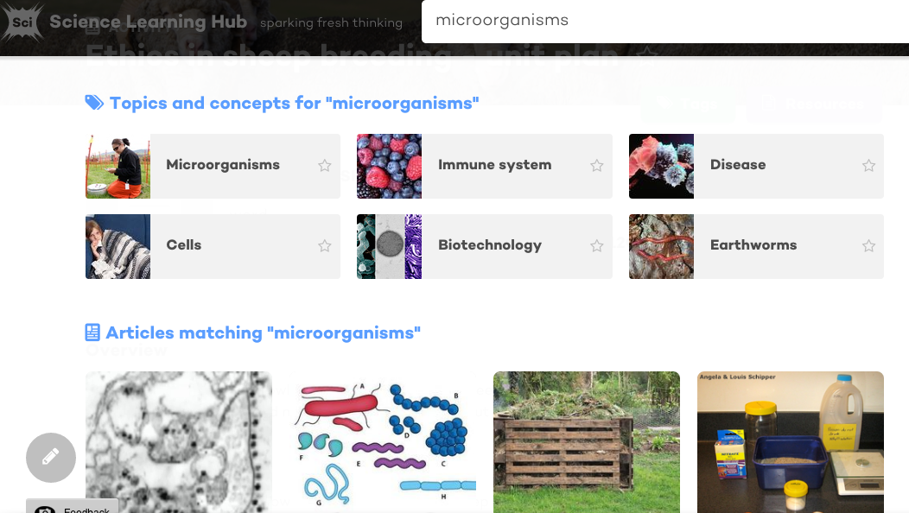
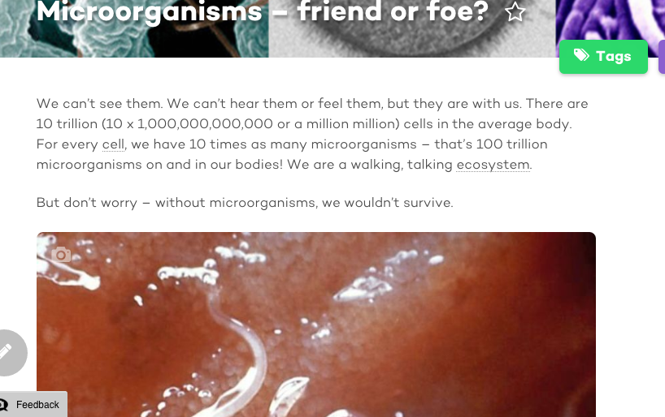
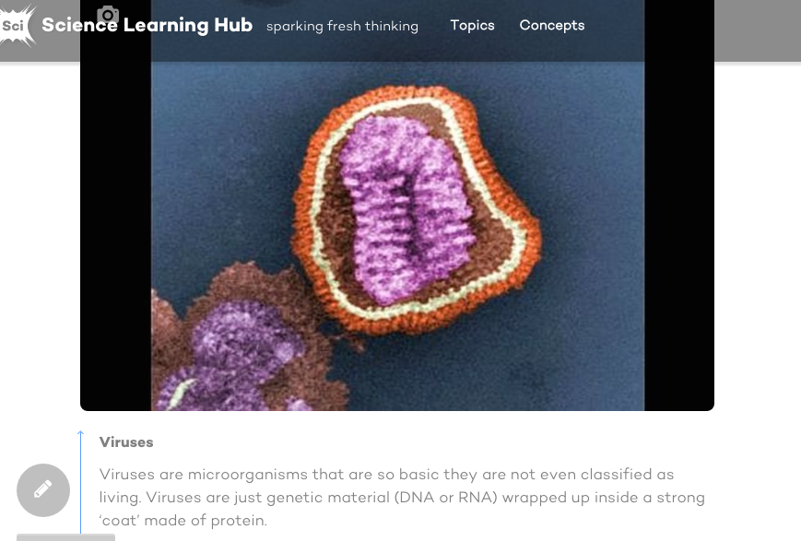
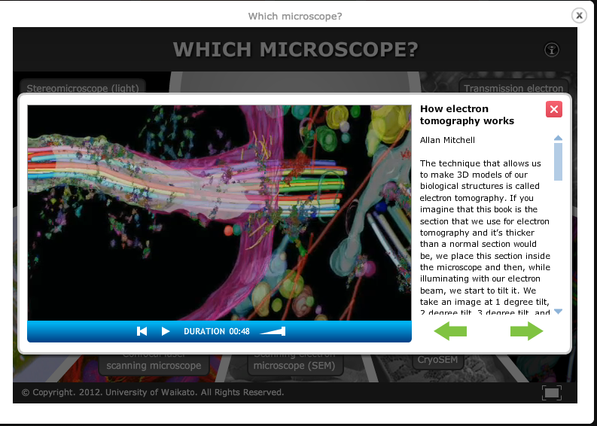
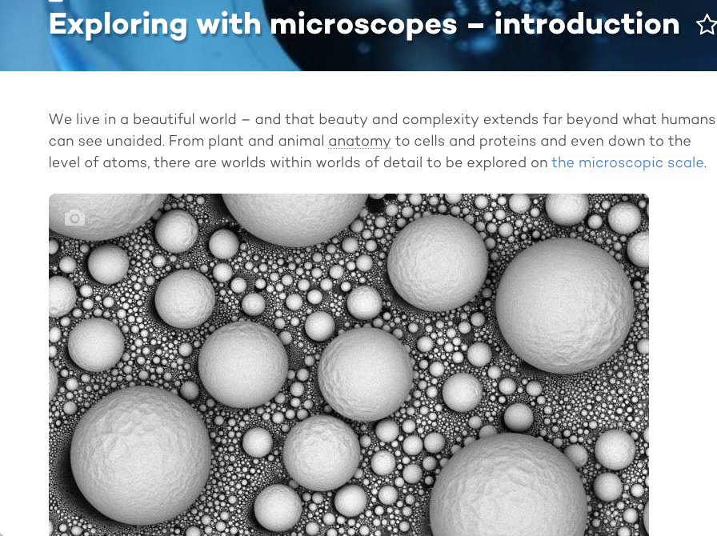
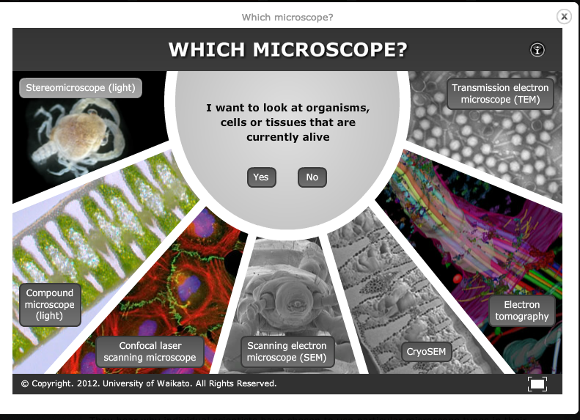
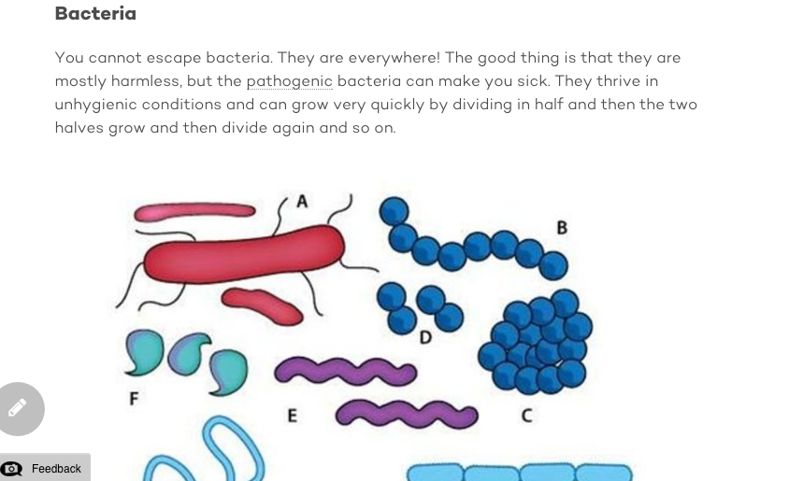
All images are copyrighted. For further information, please refer to enquiries@sciencelearn.org.nz
Copyright University of Waikato. All rights reserved.
Notes:
The search function – microorganisms – contextualising microscope work and microorganisms, microscopes, bacteria and viruses

Slide 14
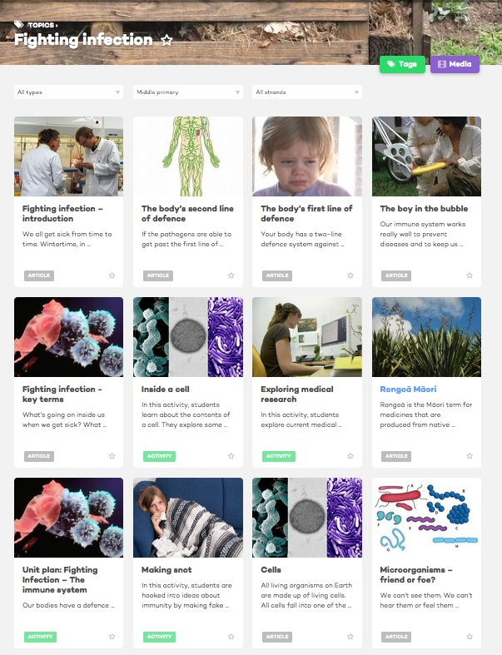
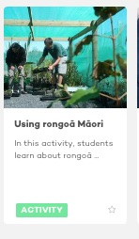
All images are copyrighted. For further information, please refer to enquiries@sciencelearn.org.nz
Copyright University of Waikato. All rights reserved.
Notes:
The search function – microorganisms –‘Using rongoa Maori’ contextualising through a range of contexts to suit your students’ interests – talk about articles in research – span such a wide range of concepts and topics

Slide 15
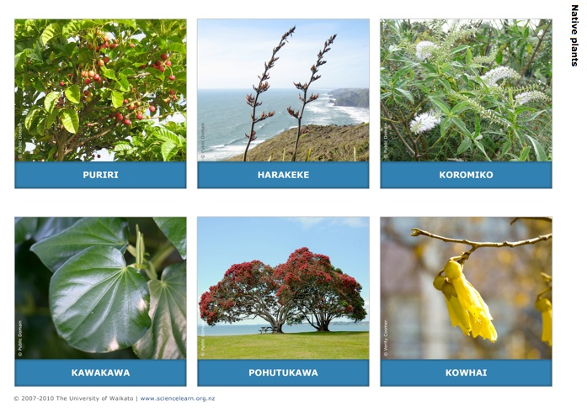
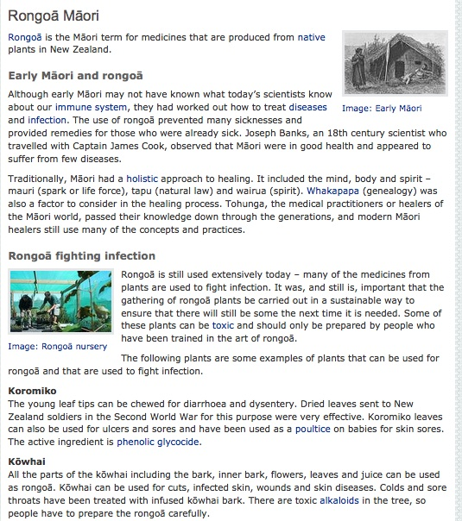
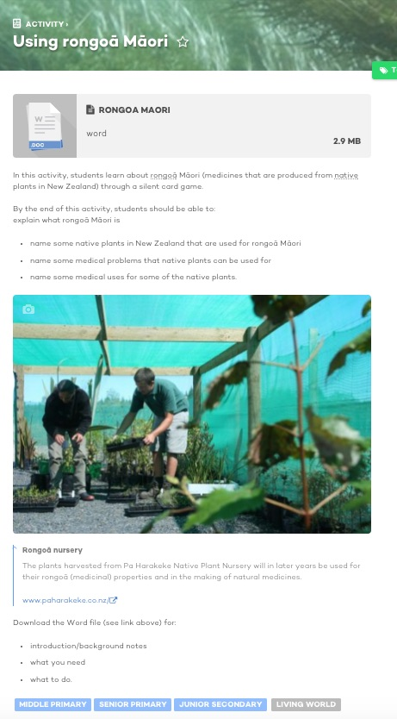
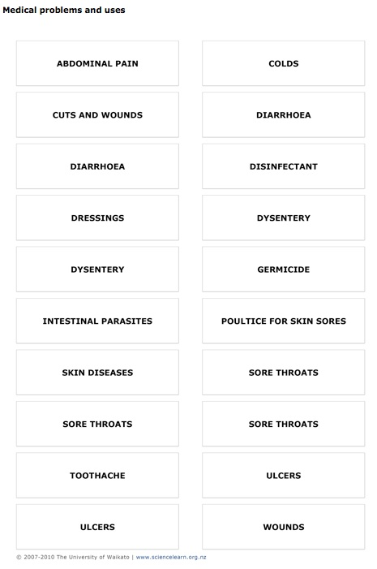
All images are copyrighted. For further information, please refer to enquiries@sciencelearn.org.nz
Copyright University of Waikato. All rights reserved.
Notes:
Showing an activity and article that goes with it.

Slide 16
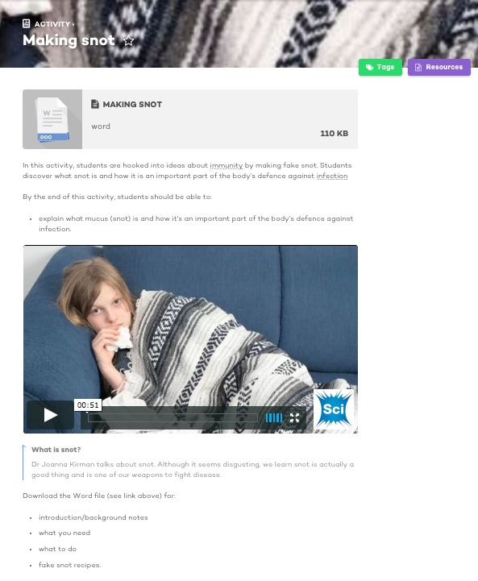
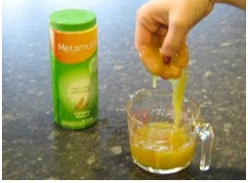
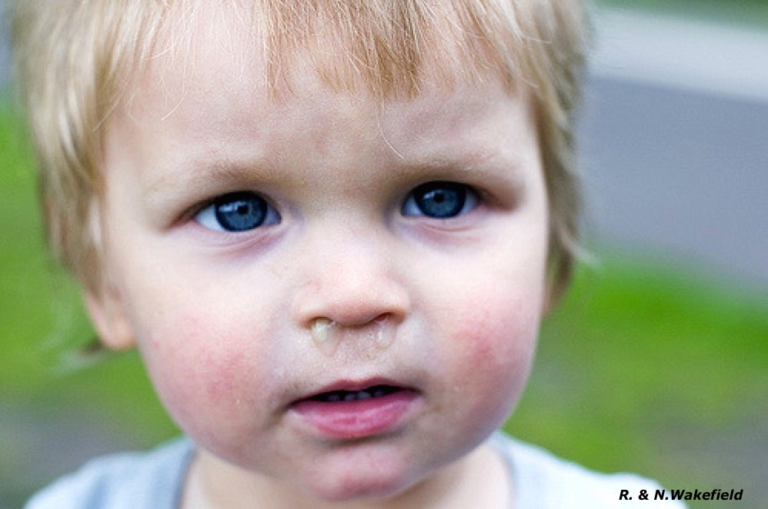
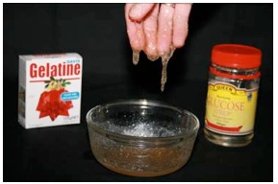
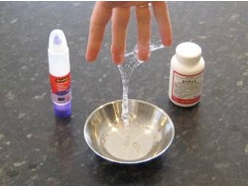

Making snot – student activity
Copyright University of Waikato. All rights reserved.
Notes:
Another activity - show video after talking about activity - fun -

Slide 17
Water, water everywhere
Water conservation
Water in ecosystems
Water as a molecule
Copyright University of Waikato. All rights reserved.
Notes:
Example 2: Water – so many different aspects to water as a topic covering many concepts – atoms and molecules – solids, liquids and gases – ecological systems – water cycle etc

Slide 18




All images are copyrighted. For further information, please refer to enquiries@sciencelearn.org.nz
Copyright University of Waikato. All rights reserved.
Notes:
The search – included alternative conceptions – found further down the page

Slide 19

All images are copyrighted. For further information, please refer to enquiries@sciencelearn.org.nz
Copyright University of Waikato. All rights reserved.
Notes:
Alternatively you can find the same things by searching for ‘states of matter’ junior primary

Slide 20




Copyright University of Waikato. All rights reserved.
Notes:
Selected activity – talk about briefly

Slide 21







Biotechnology
Copyright University of Waikato. All rights reserved.
Notes:
Do you want this slide? Interactive is not accessible on the new site – it would be good to let teachers know they can still get it on the old site currently. If you use it – might pay to link to interactive and show it (share screens or get them to play themselves).

Slide 22



Copyright University of Waikato. All rights reserved.
Notes:
Search for video

Slide 23
Senior subjects
Show me how the SLH can help
Copyright University of Waikato. All rights reserved.

Slide 24





All images are copyrighted. For further information, please refer to enquiries@sciencelearn.org.nz
Copyright University of Waikato. All rights reserved.

Slide 25





Senior subjects
Show me how the SLH can help
Copyright University of Waikato. All rights reserved.

Slide 26



All images are copyrighted. For further information, please refer to enquiries@sciencelearn.org.nz
Copyright University of Waikato. All rights reserved.
Notes:
There are four items. The activity River connections may well be what you’re looking for.

Slide 27




Copyright University of Waikato. All rights reserved.
Notes:
A quick look at River connections – explain activity – you have it on desktop Andrea

Slide 28




Copyright University of Waikato. All rights reserved.
Notes:
Another interactive – showing the excitement of scientists talking about their work.

Slide 29










All images are copyrighted. For further information, please refer to enquiries@sciencelearn.org.nz
Copyright University of Waikato. All rights reserved.
Notes:
Two activities and two articles – I might choose to investigate further

Slide 30

For articles and activities on the nature of science
All images are copyrighted. For further information, please refer to enquiries@sciencelearn.org.nz
Copyright University of Waikato. All rights reserved.
Notes:
If teachers want information on NoS, they can search for Nature of Science. Briefly talk about some of the articles/activities

Slide 31



Copyright University of Waikato. All rights reserved.
Notes:
Teachers should learn about observation (NoS) before children observe the water (then include ideas during the activities).

Slide 32


How can SLH help ? enquiries@sciencelearn.org.nz
All images are copyrighted. For further information, please refer to enquiries@sciencelearn.org.nz
Copyright University of Waikato. All rights reserved.

Slide 33



We are here to support you.
email us enquiries@sciencelearn.org.nz
Follow us on Twitter: https://twitter.com/NZScienceLearn
Like us on Facebook: www.facebook.com/nzsciencelearn
Explore our Pinterest Boards: https://nz.pinterest.com/nzsciencelearn/
Join us in the pond: www.pond.co.nz/community/214015/science-learning-hub
All images are copyrighted. For further information, please refer to enquiries@sciencelearn.org.nz
Copyright University of Waikato. All rights reserved.

Slide 34










Thanks!
Questions and comments?
The images contained within this PowerPoint presentation are copyrighted to the University of Waikato and other third-party individuals and organisations. Any reuse beyond the classroom as per the intended use of these resources, should be cleared with the copyright owner/s.

