Slide 1
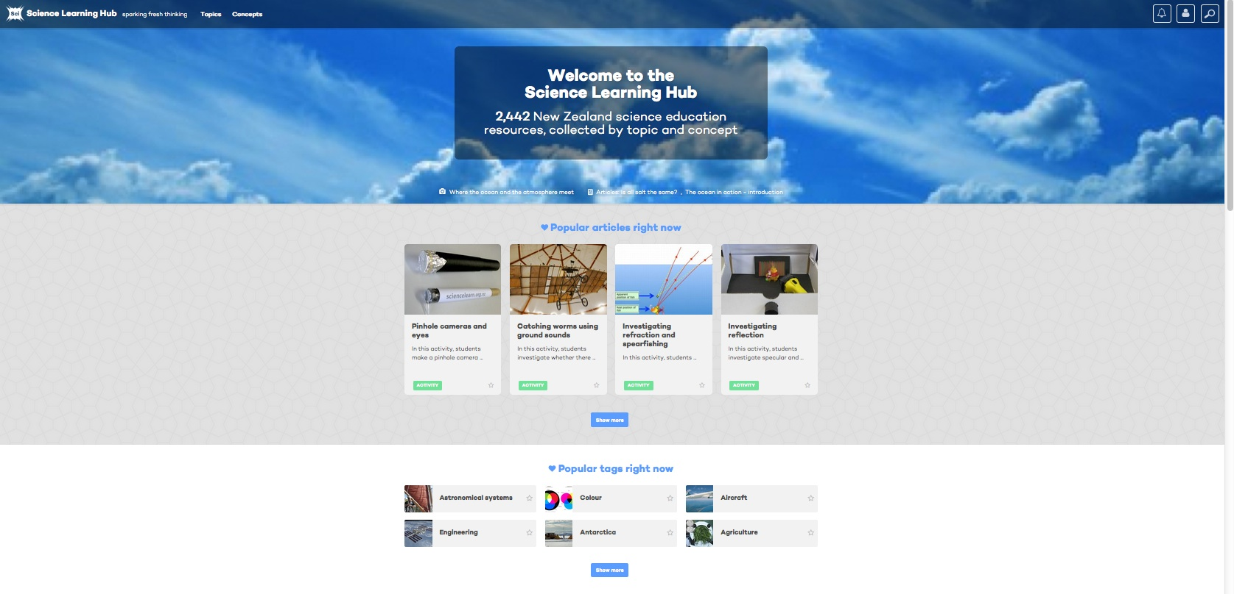
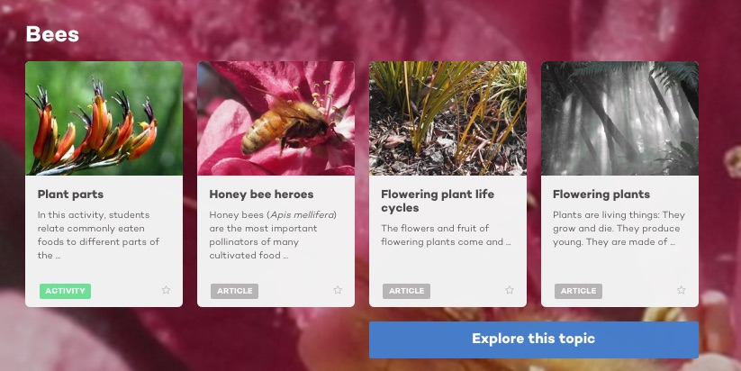
Science Learning Hub new-look website – a primary focus
@NZScienceLearn
www.sciencelearn.org.nz
June 2016
© 2015 The University of Waikato | www.sciencelearn.org.nz

Slide 2


What is the Science Learning Hub?
A trustworthy online resource – produced by educators and scientists
Based on world-class New Zealand science research
Supported by learning activities, information about the key science ideas and concepts, multimedia tools and other resources
Written for New Zealand teachers and students

Slide 3
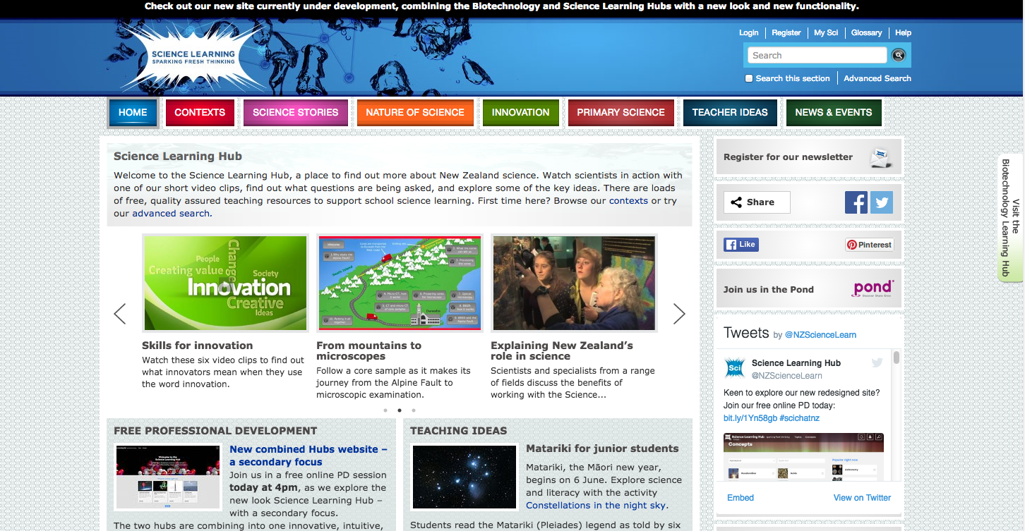
Copyright University of Waikato. All rights reserved.
All images are copyrighted. For further information, please refer to enquiries@sciencelearn.org.nz
Notes:
All the 100s of content images in the SLH can be found in the top bar – contexts, science stories – the content was placed under specific contexts which meant that they were also at times hidden behind multiple click-throughs – and in its time was the most innovative format at the time – in fact winning multiple awards for its IT innovation.

Slide 4
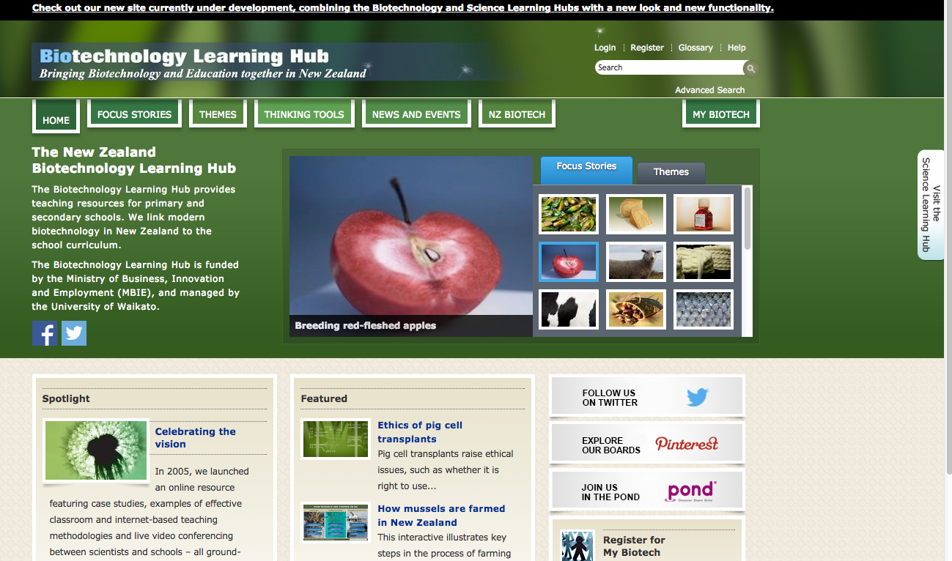
Copyright University of Waikato. All rights reserved.
All images are copyrighted. For further information, please refer to enquiries@sciencelearn.org.nz
Notes:
The BLH – also had its content placed under focus stories and themes.
To access our new-look site – called a beta site as it sits alongside the other sites and will do for some time yet – click on the top bar to take you to the beta site – go back a page and show the SLH click link.

Slide 5



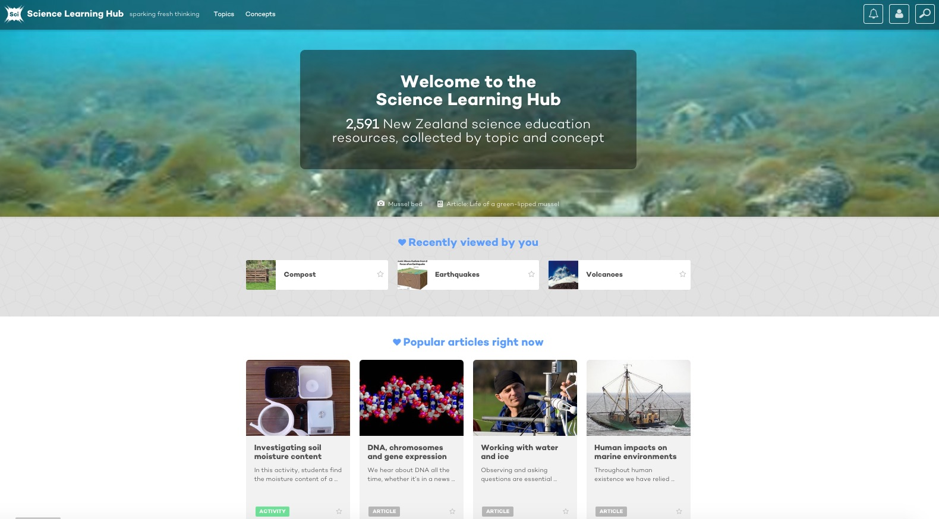
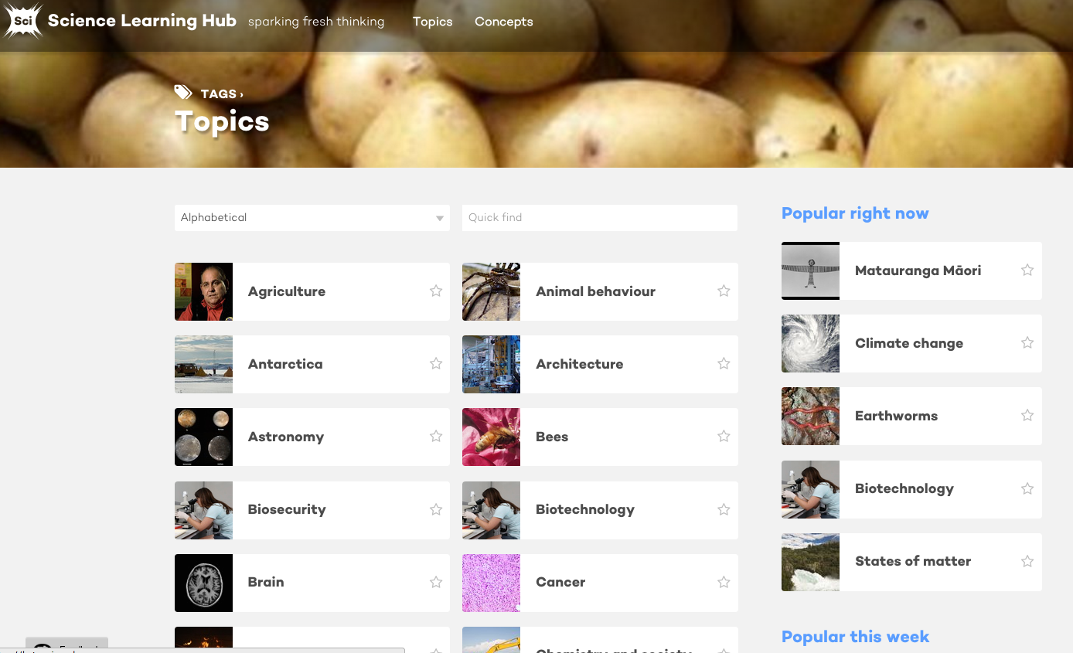
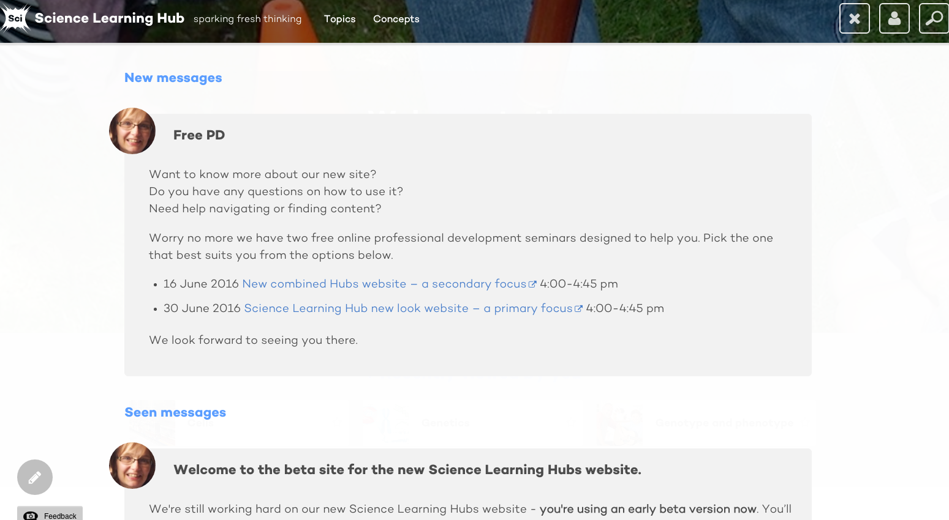
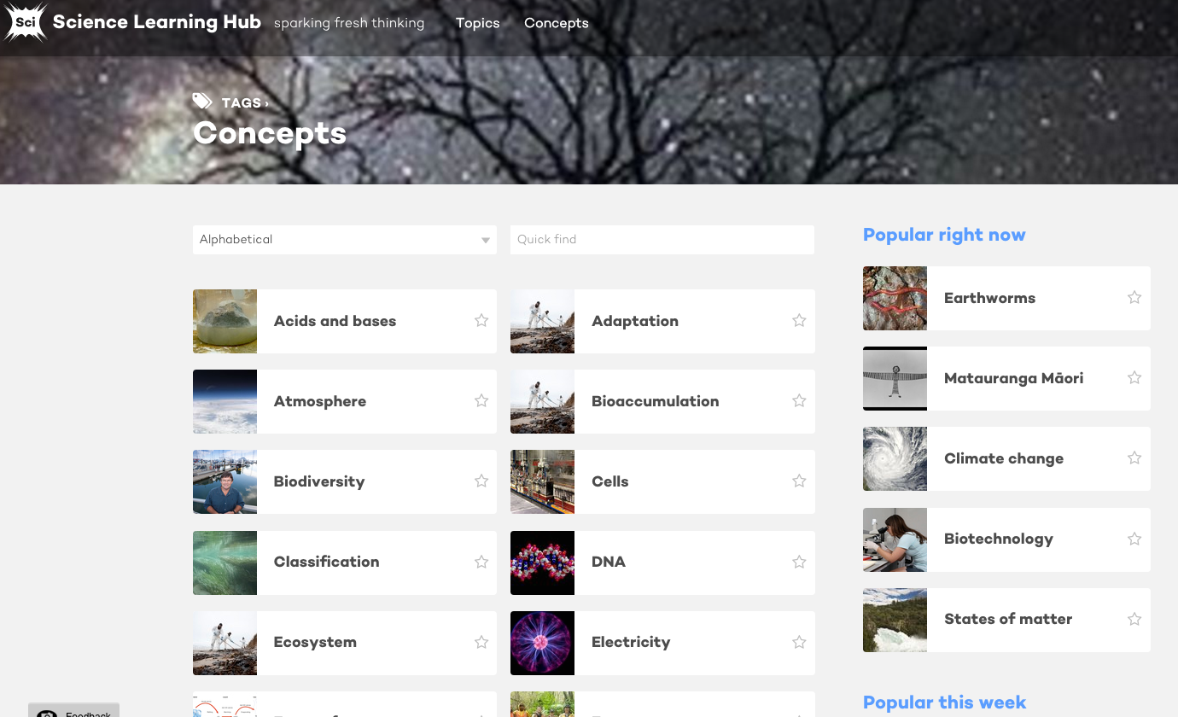
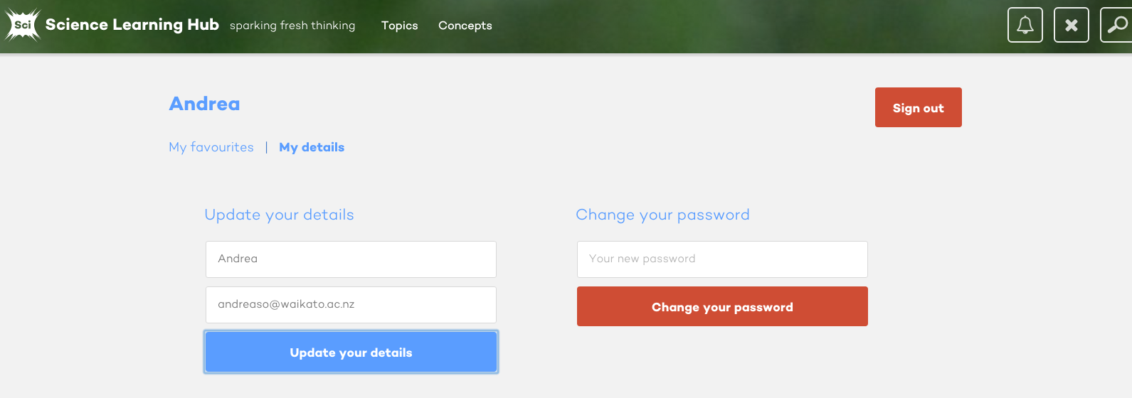
New look for the Science Learning Hub
Copyright University of Waikato. All rights reserved.
All images are copyrighted. For further information, please refer to enquiries@sciencelearn.org.nz
Notes:
Expand on the detail as it appears (top line)

Slide 6
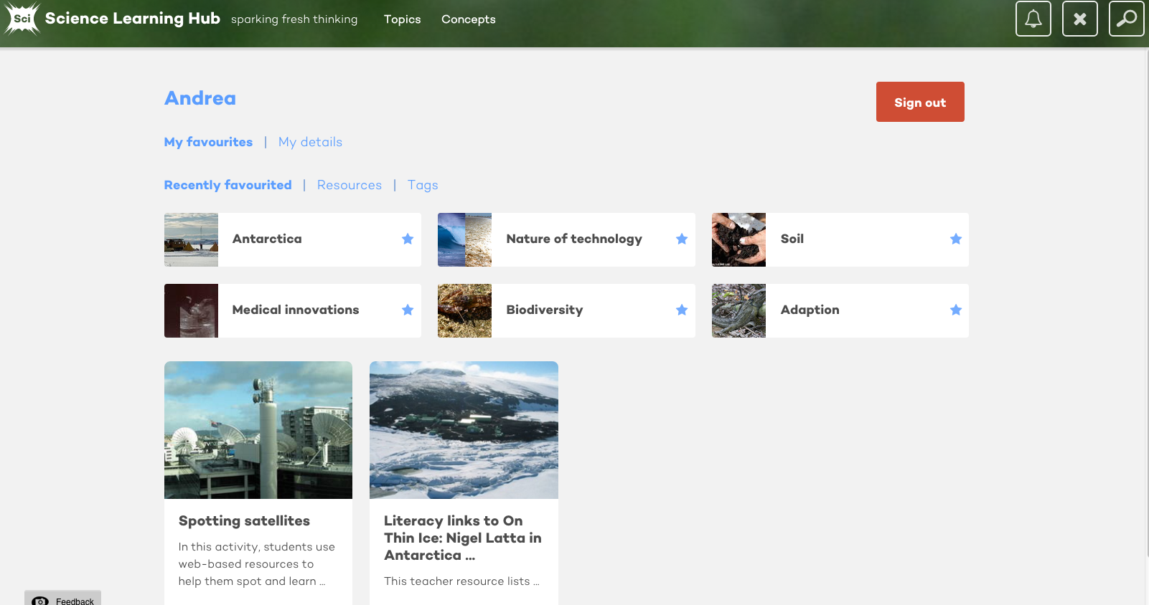
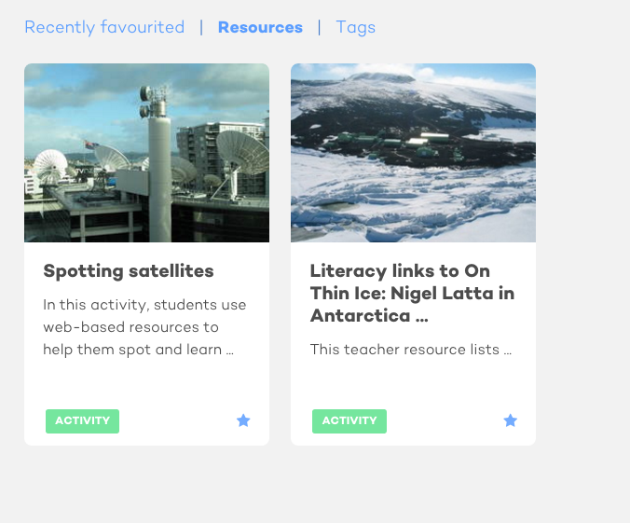
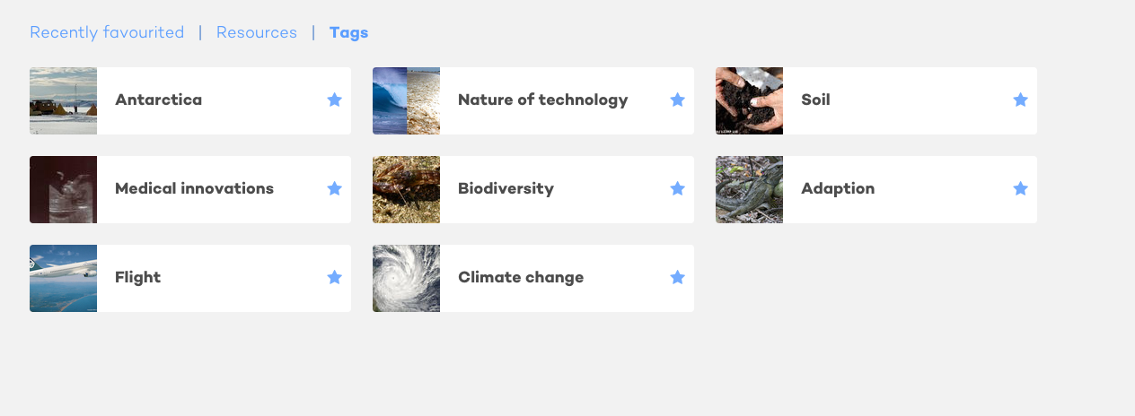
New look for the Science Learning Hub
Copyright University of Waikato. All rights reserved.
All images are copyrighted. For further information, please refer to enquiries@sciencelearn.org.nz
Notes:
Talk about the benefits of favouriting

Slide 7
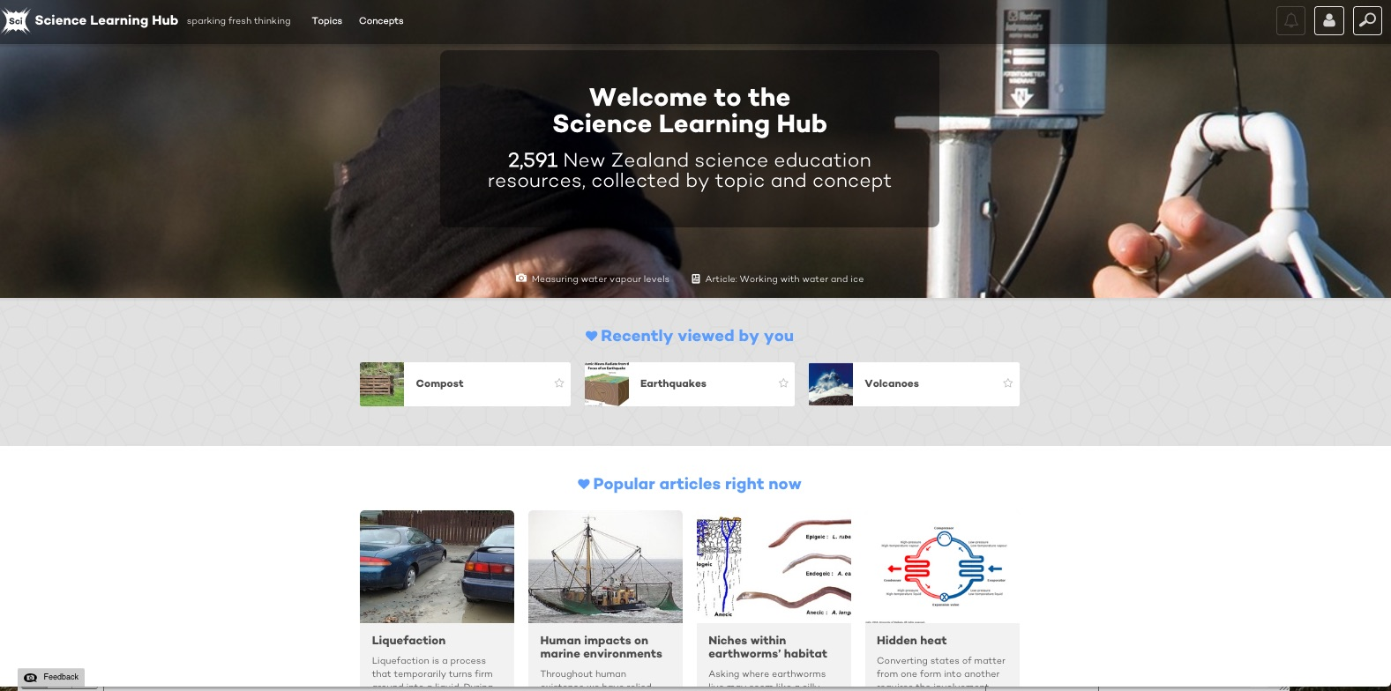
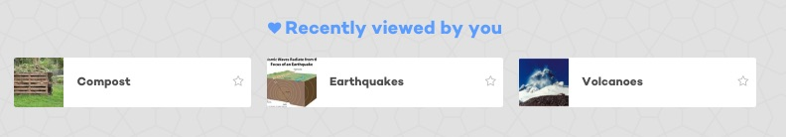
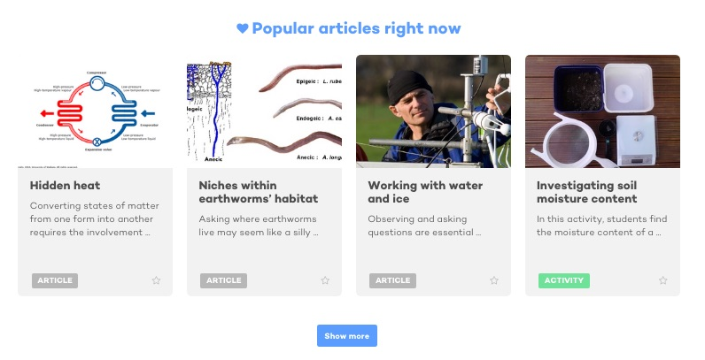
Copyright University of Waikato. All rights reserved.
All images are copyrighted. For further information, please refer to enquiries@sciencelearn.org.nz
Notes:
Other parts seen on the home page

Slide 8
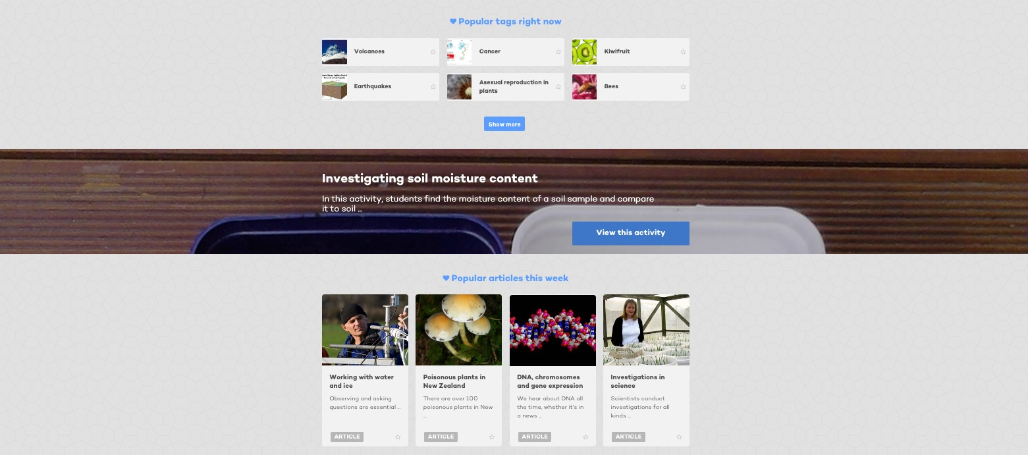
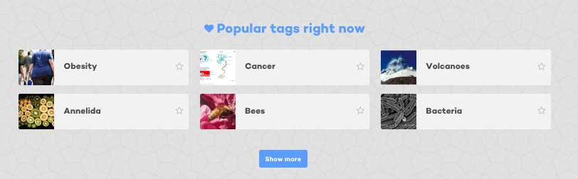
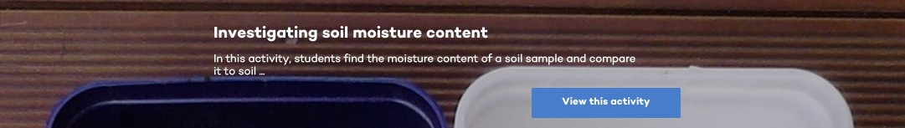
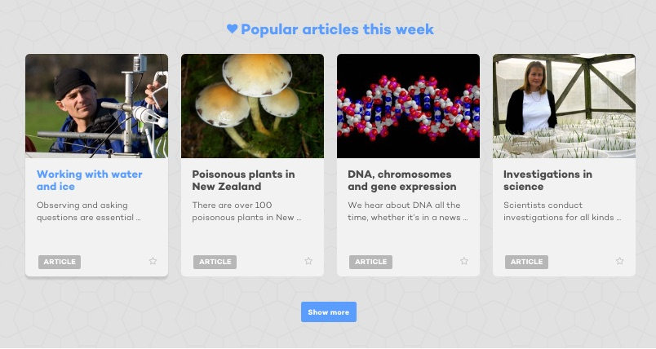
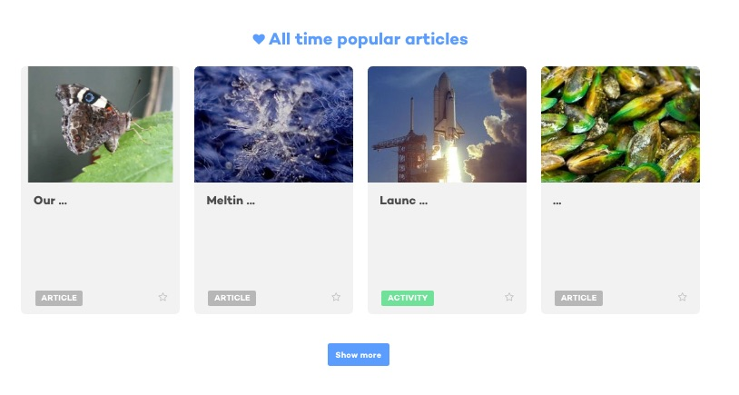
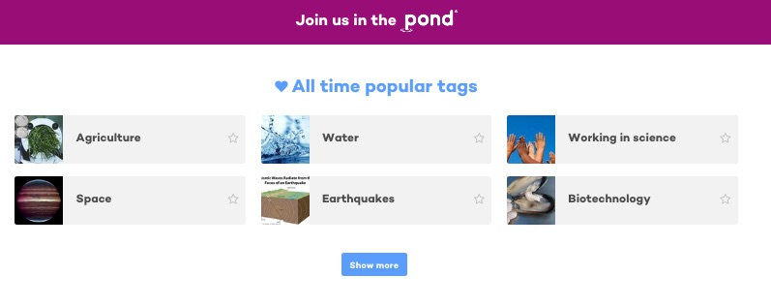
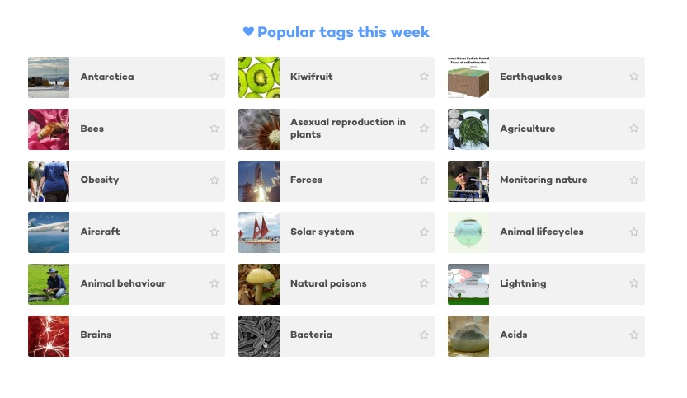
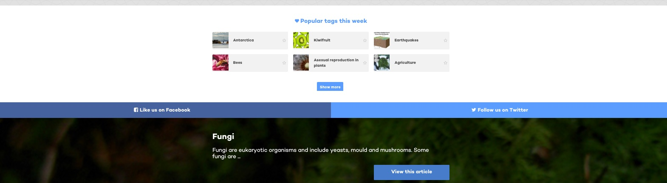
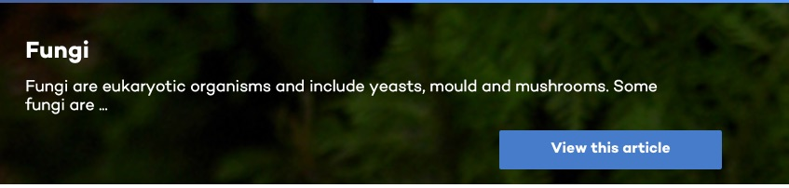
Copyright University of Waikato. All rights reserved.
All images are copyrighted. For further information, please refer to enquiries@sciencelearn.org.nz
Notes:
Further down the page you might see…as you scroll down the landing page

Slide 9
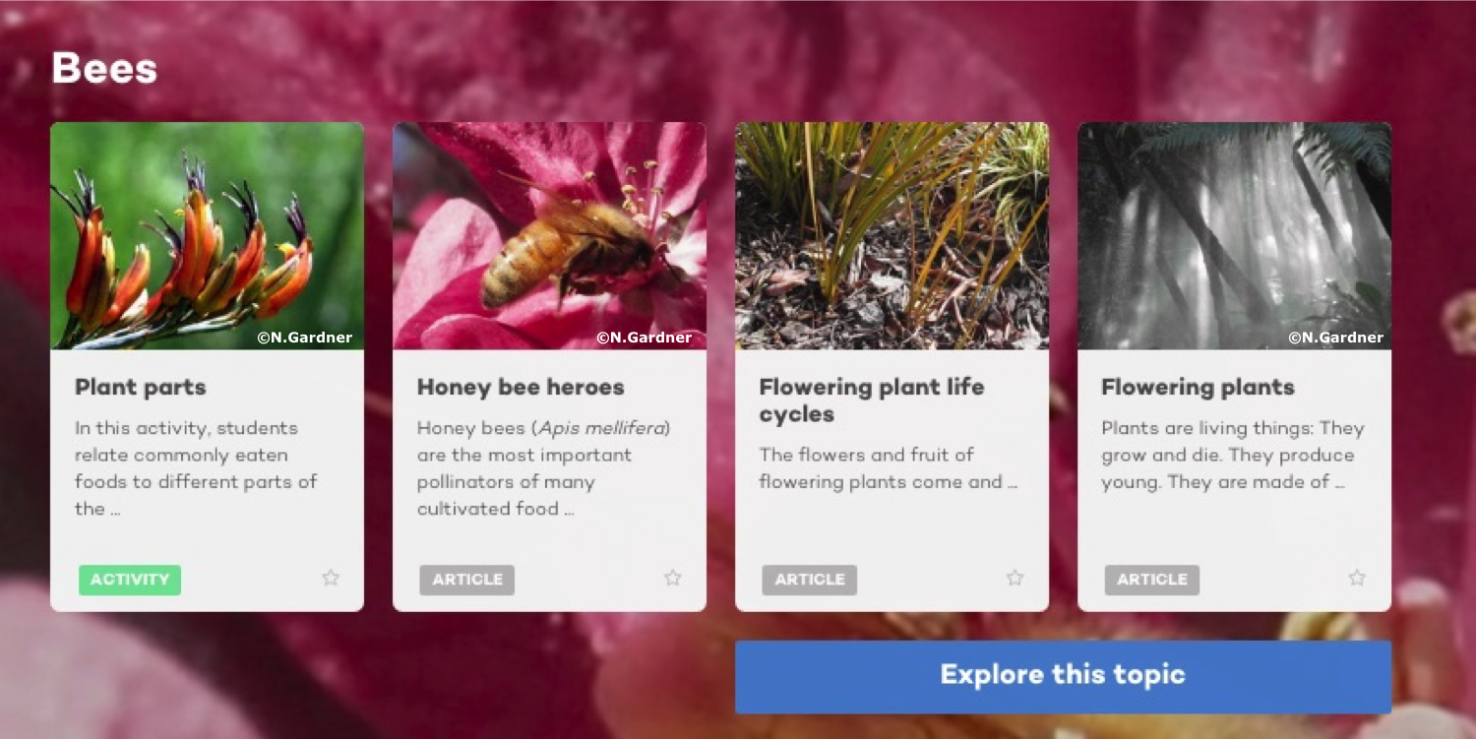
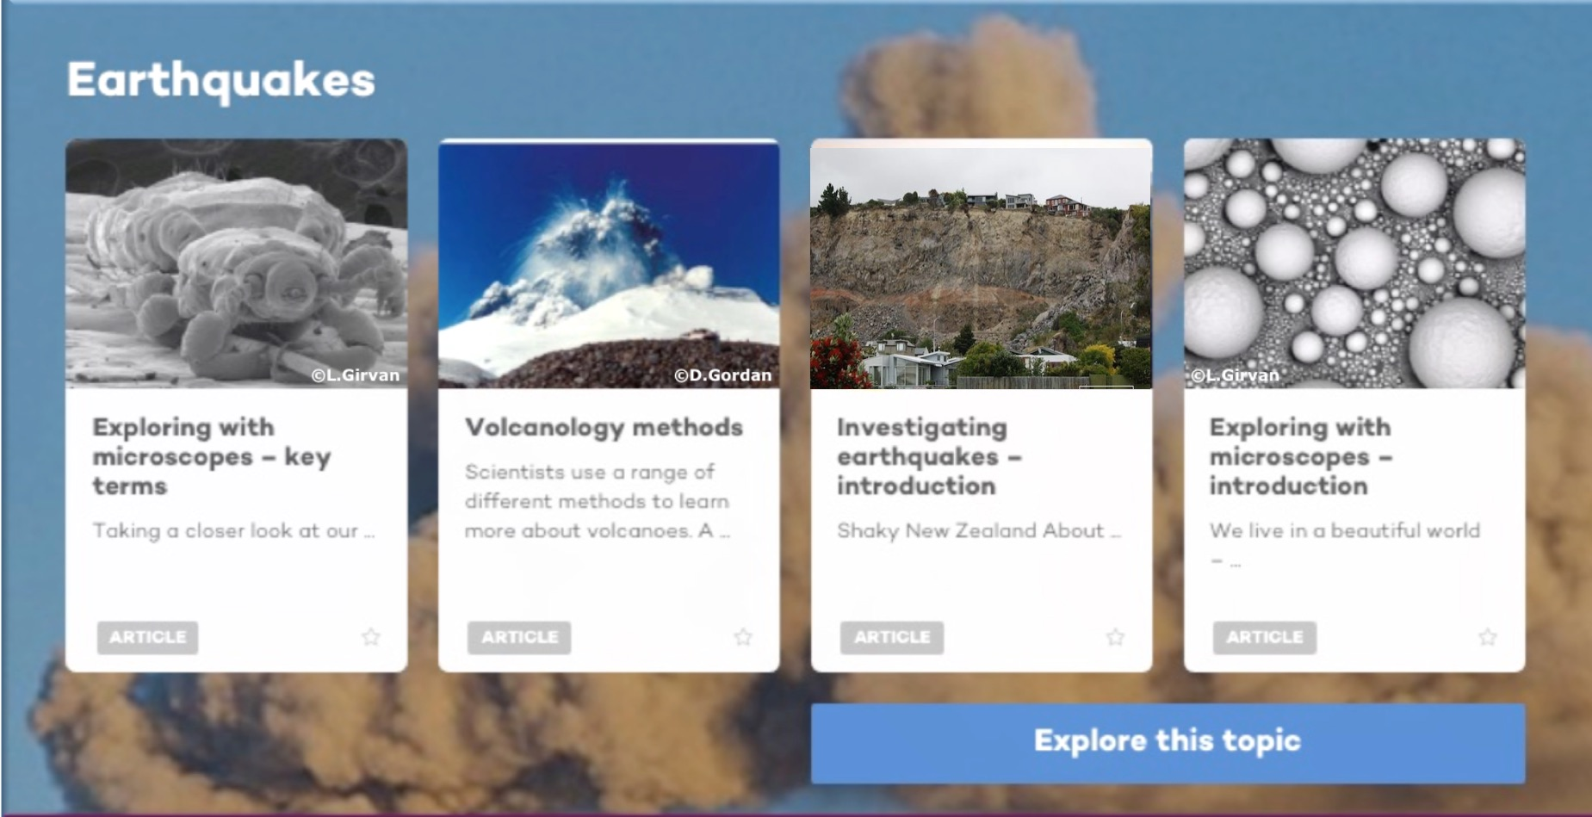
Copyright University of Waikato. All rights reserved.
All images are copyrighted. For further information, please refer to enquiries@sciencelearn.org.nz
Notes:
… and some ideas to explore

Slide 10
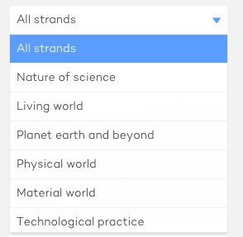
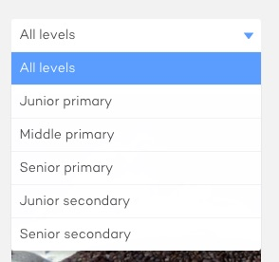
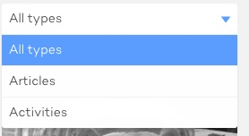
Copyright University of Waikato. All rights reserved.
All images are copyrighted. For further information, please refer to enquiries@sciencelearn.org.nz
Notes:
Explaining types/levels/strands – although some of the primary work is still able to be adapted for junior secondary, so don’t dismiss it

Slide 11
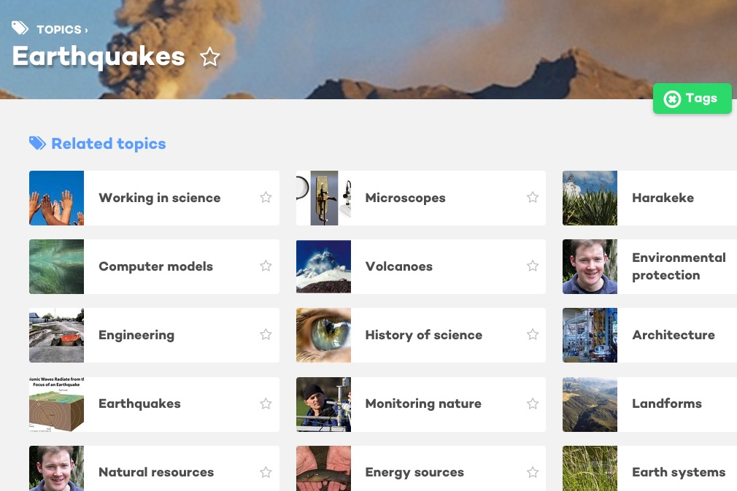
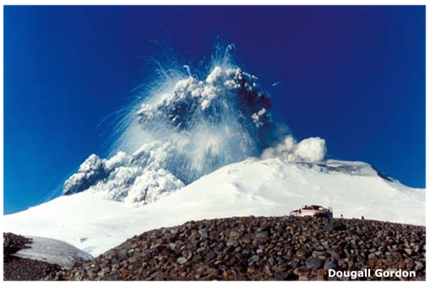
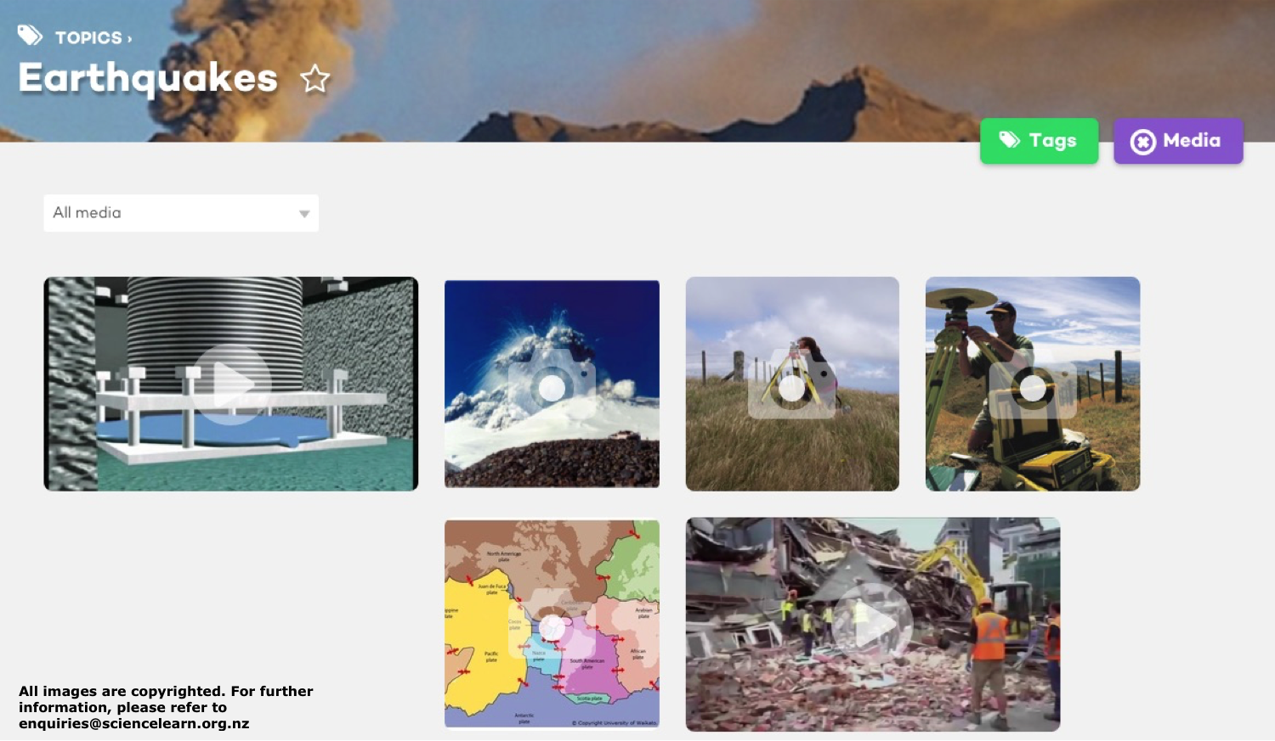
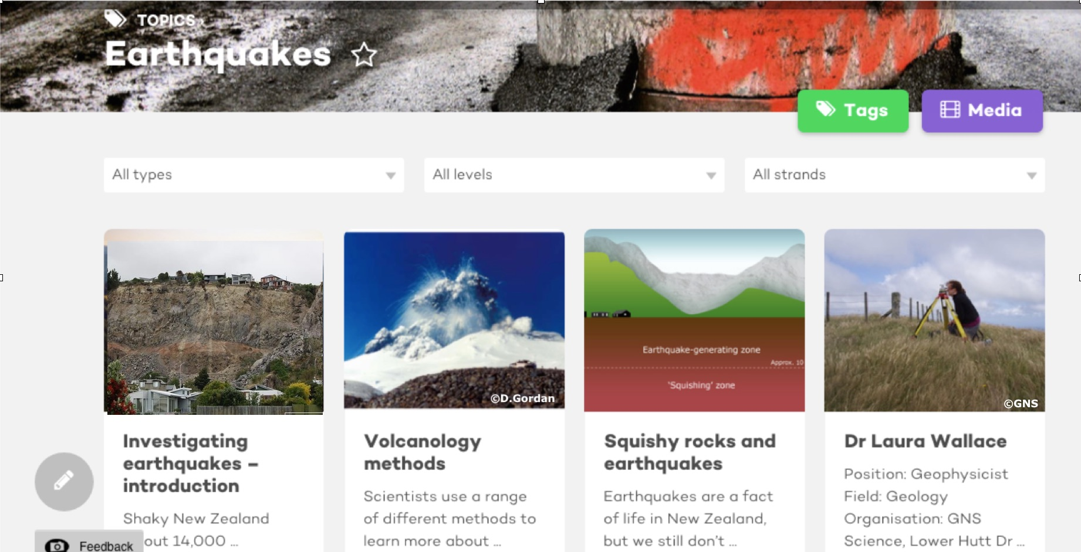
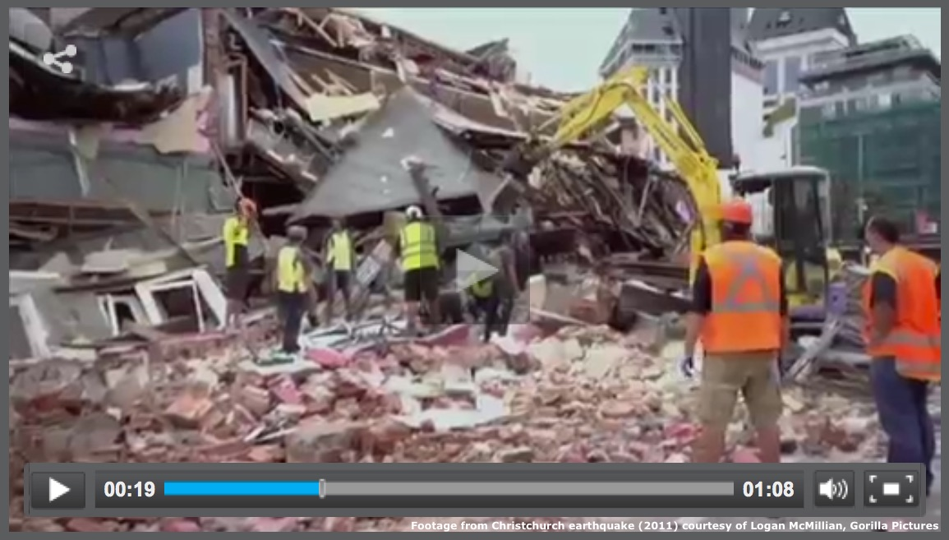

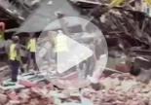
Copyright University of Waikato. All rights reserved.
All images are copyrighted. For further information, please refer to enquiries@sciencelearn.org.nz
Notes:
Explaining tags and media

Slide 12
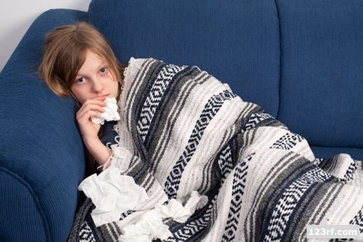
It’s winter and I want to teach a unit on coughs and colds so the students have some understanding about what happens and how they can avoid lurgies!
Copyright University of Waikato. All rights reserved.
All images are copyrighted. For further information, please refer to enquiries@sciencelearn.org.nz
Notes:
An example: a teacher wanting something on coughs and colds

Slide 13
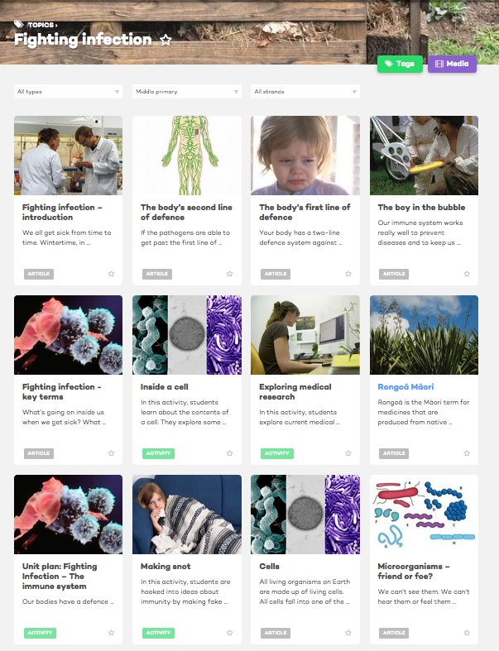
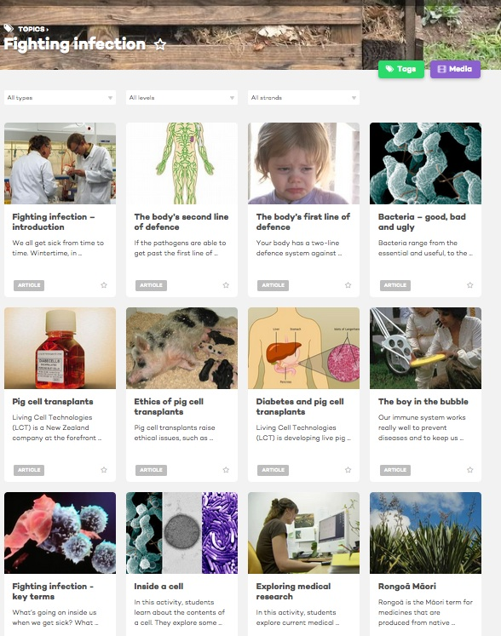
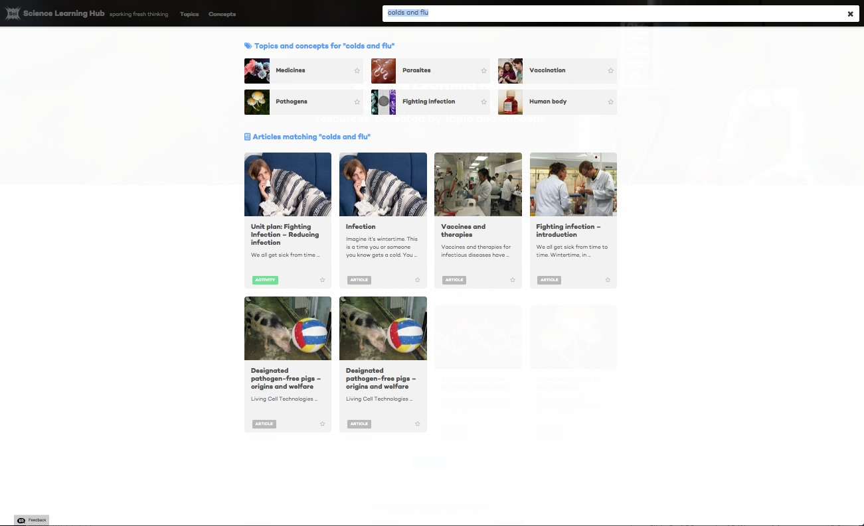
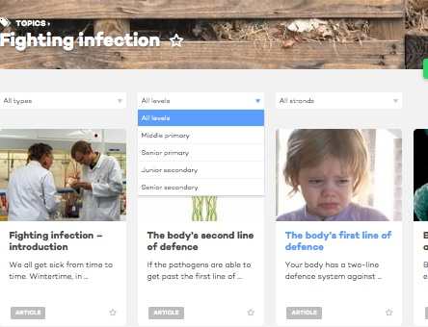
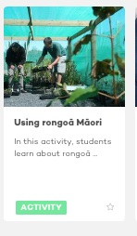
Copyright University of Waikato. All rights reserved.
All images are copyrighted. For further information, please refer to enquiries@sciencelearn.org.nz
Notes:
The search – mention ‘Using rongoā Maori’ pops in because it was found further down the page

Slide 14
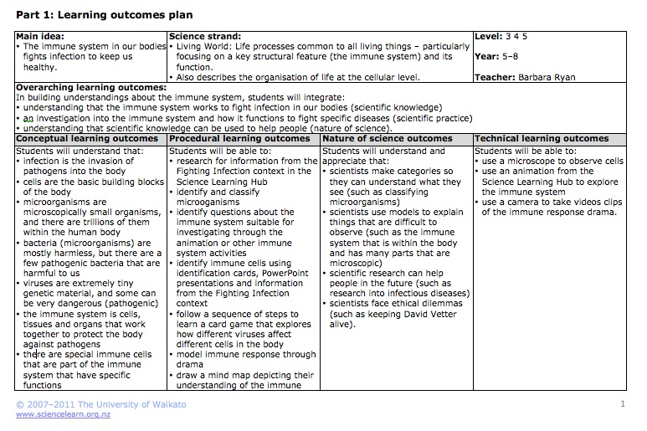
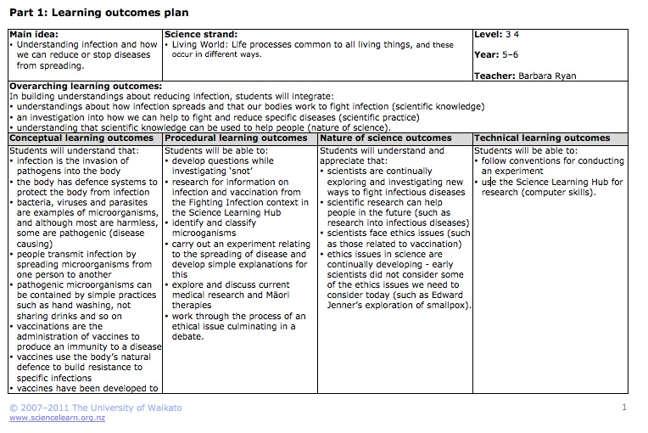
Ready-made units
Copyright University of Waikato. All rights reserved.
All images are copyrighted. For further information, please refer to enquiries@sciencelearn.org.nz
Notes:
Showing ready-made units

Slide 15
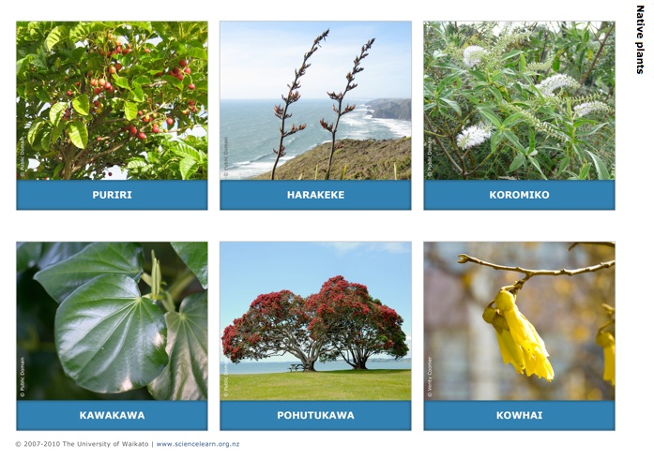
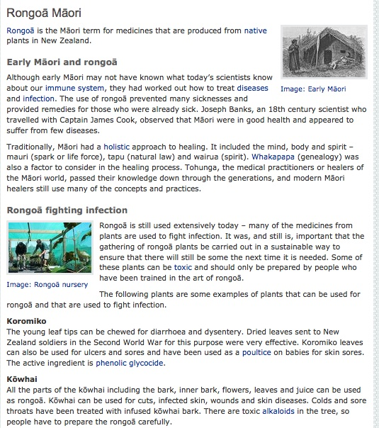
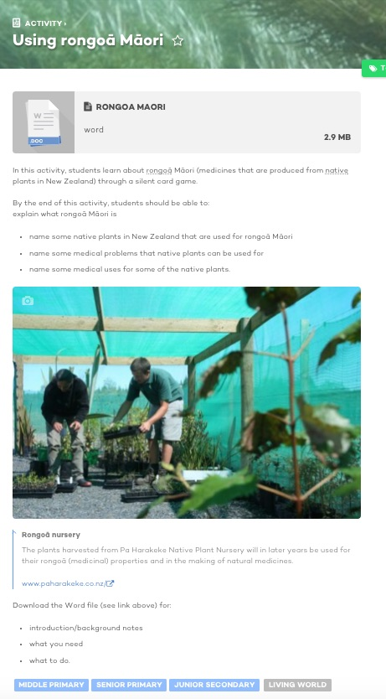
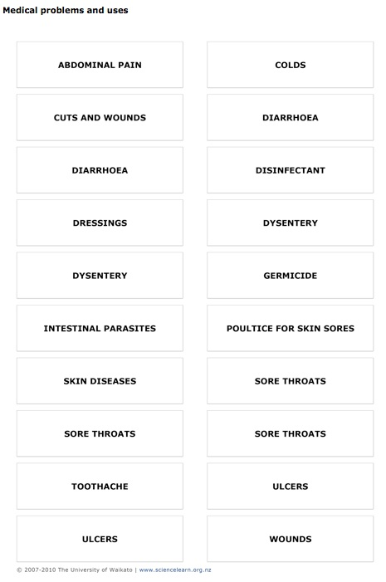
Copyright University of Waikato. All rights reserved.
All images are copyrighted. For further information, please refer to enquiries@sciencelearn.org.nz
Notes:
Showing an activity and article that goes with it.

Slide 16
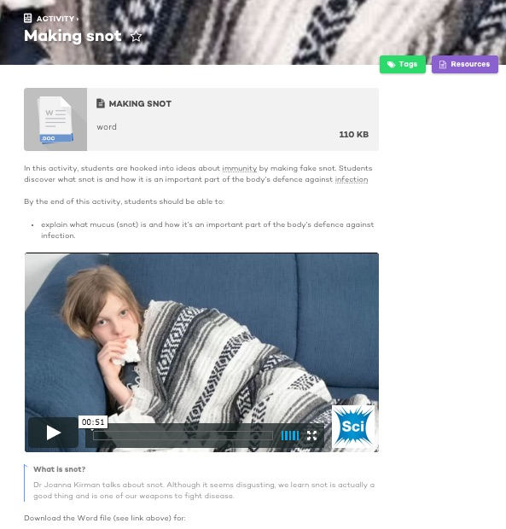
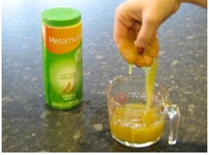
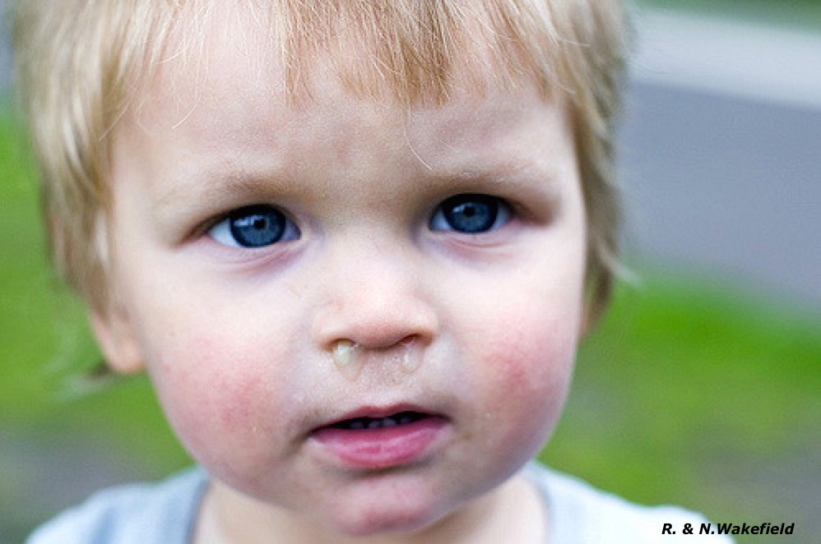



Making snot – student activity
Copyright University of Waikato. All rights reserved.
All images are copyrighted. For further information, please refer to enquiries@sciencelearn.org.nz
Notes:
Another activity - show video after talking about activity

Slide 17
Our school theme this term is ‘change’, and I would like to look at water for our science unit.
I have year 3 and 4 children.
How can the new site help me?
Copyright University of Waikato. All rights reserved.
All images are copyrighted. For further information, please refer to enquiries@sciencelearn.org.nz
Notes:
Example 2: Water and change

Slide 18




Copyright University of Waikato. All rights reserved.
All images are copyrighted. For further information, please refer to enquiries@sciencelearn.org.nz
Notes:
The search – included alternative conceptions – found further down the page

Slide 19

Copyright University of Waikato. All rights reserved.
All images are copyrighted. For further information, please refer to enquiries@sciencelearn.org.nz
Notes:
Alternatively you can find the same things by searching for States of matter – junior primary

Slide 20



Observing water unit plan
Copyright University of Waikato. All rights reserved.
All images are copyrighted. For further information, please refer to enquiries@sciencelearn.org.nz
Notes:
Example of unit plan for some ideas

Slide 21


Copyright University of Waikato. All rights reserved.
All images are copyrighted. For further information, please refer to enquiries@sciencelearn.org.nz
Notes:
Alternative conceptions

Slide 22


Copyright University of Waikato. All rights reserved.
All images are copyrighted. For further information, please refer to enquiries@sciencelearn.org.nz
Notes:
Teachers should learn about observation (NoS) before children observe the water (then include ideas during the activities).

Slide 23



Copyright University of Waikato. All rights reserved.
All images are copyrighted. For further information, please refer to enquiries@sciencelearn.org.nz
Notes:
Selected activity – talk about briefly

Slide 24




Copyright University of Waikato. All rights reserved.
All images are copyrighted. For further information, please refer to enquiries@sciencelearn.org.nz
Notes:
Another selected activity – talk about

Slide 25


Copyright University of Waikato. All rights reserved.
All images are copyrighted. For further information, please refer to enquiries@sciencelearn.org.nz
Notes:
Search for video

Slide 26

Copyright University of Waikato. All rights reserved.
All images are copyrighted. For further information, please refer to enquiries@sciencelearn.org.nz
Notes:
Show Water is everywhere (junior primary)

Slide 27

Copyright University of Waikato. All rights reserved.
All images are copyrighted. For further information, please refer to enquiries@sciencelearn.org.nz
Notes:
Do you want this slide? Interactive is not accessible on the new site – it would be good to let teachers know they can still get it on the old site currently. If you use it – might pay to link to interactive and show it (share screens or get them to play themselves).

Slide 28
I want to teach my year 5 and 6 children about gravity.
Show me how the SLH can help.
Copyright University of Waikato. All rights reserved.
All images are copyrighted. For further information, please refer to enquiries@sciencelearn.org.nz

Slide 29




Copyright University of Waikato. All rights reserved.
All images are copyrighted. For further information, please refer to enquiries@sciencelearn.org.nz
Notes:
Using ‘concepts’ to find something

Slide 30






Copyright University of Waikato. All rights reserved.
All images are copyrighted. For further information, please refer to enquiries@sciencelearn.org.nz
Notes:
Two activities and two articles I might choose to investigate further

Slide 31
I just want one activity to show the interdependence of living things
– for year 5.
Copyright University of Waikato. All rights reserved.
All images are copyrighted. For further information, please refer to enquiries@sciencelearn.org.nz

Slide 32



Copyright University of Waikato. All rights reserved.
All images are copyrighted. For further information, please refer to enquiries@sciencelearn.org.nz
Notes:
There are four items. The activity River connections may well be what you’re looking for.

Slide 33




Copyright University of Waikato. All rights reserved.
All images are copyrighted. For further information, please refer to enquiries@sciencelearn.org.nz
Notes:
A quick look at River Connections – explain activity

Slide 34

For articles and activities on the nature of science
Copyright University of Waikato. All rights reserved.
All images are copyrighted. For further information, please refer to enquiries@sciencelearn.org.nz
Notes:
If teachers want information on NoS they can search for Nature of Science. Briefly talk about some of the articles/activities

Slide 35


How can SLH help ? enquiries@sciencelearn.org.nz
All images are copyrighted. For further information, please refer to enquiries@sciencelearn.org.nz
Copyright University of Waikato. All rights reserved.

Slide 36




Would you like a promo pack?
Packs of bookmarks and flyers available – email us enquiries@sciencelearn.org.nz
Follow us on Twitter: https://twitter.com/NZScienceLearn
Like us on Facebook: www.facebook.com/nzsciencelearn
Explore our Pinterest Boards: https://nz.pinterest.com/nzsciencelearn/
Join us in the pond: www.pond.co.nz/community/214015/science-learning-hub
Copyright University of Waikato. All rights reserved.
All images are copyrighted. For further information, please refer to enquiries@sciencelearn.org.nz

Slide 37










Thanks!
Questions and comments?
The images contained within this PowerPoint presentation are copyrighted to the University of Waikato and other third-party individuals and organisations. Any reuse beyond the classroom as per the intended use of these resources, should be cleared with the copyright owner/s.

