Slide 1
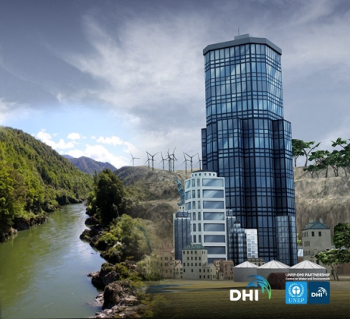

Aqua Republica
Unpacking the opportunities and capabilities
With Andrea Soanes, Deli Connell and Rose Jowsey
4 August 2016 – 4pm
www.sciencelearn.org.nz
© 2015 The University of Waikato | www.sciencelearn.org.nz
Notes:
Hello everyone and welcome to the first in our series of three webinars to introduce you to, and support you to play, the serious online game…Aqua Republica.
I am excited to get started!

Slide 2


What is the Science Learning Hub?
A trustworthy online resource – produced by educators and scientists
Based on world-class New Zealand science research
Supported by learning activities, information about the key science ideas and concepts, multimedia tools and other resources
Written for New Zealand teachers and students

Slide 3
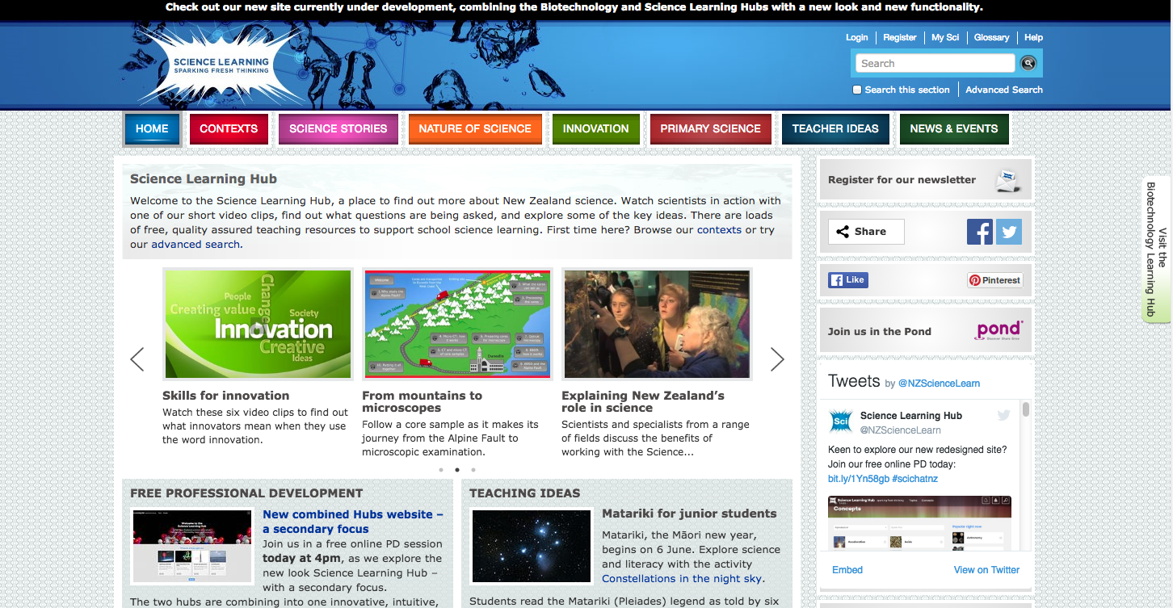
Copyright University of Waikato. All rights reserved.
All images are copyrighted. For further information, please refer to enquiries@sciencelearn.org.nz
Notes:
All the 100s of content mages in the SLH can be found in the top bar – contexts, science stories – the content was placed under specific contexts, which meant that they were also at times hidden behind multiple click-throughs – and in its time was the most innovative format at the time – in fact winning multiple awards for its IT innovation.

Slide 4
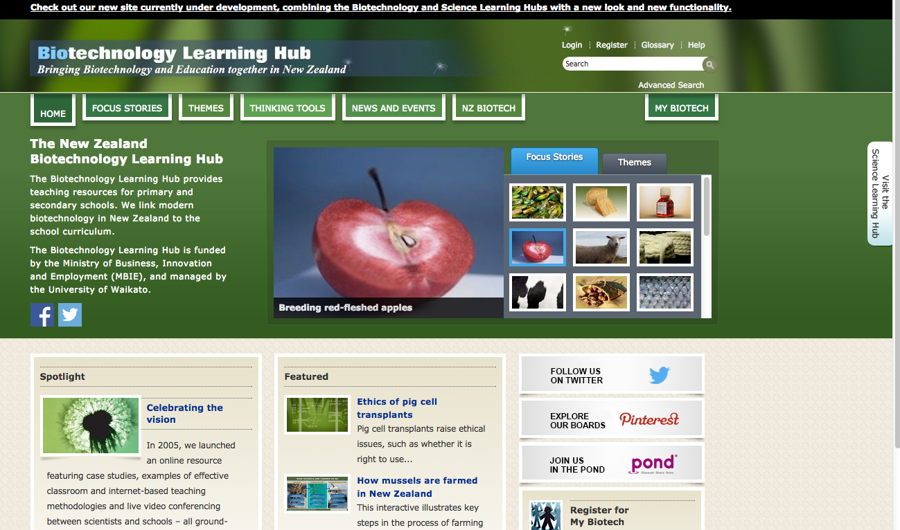
Copyright University of Waikato. All rights reserved.
All images are copyrighted. For further information, please refer to enquiries@sciencelearn.org.nz
Notes:
The BLH also had its content placed under focus stories and themes.
To access our new-look site – called a beta site as it sits along side the other sites and will do for some time yet - click on the top bar to take you to the beta site – go back a page and show the SLH click link.

Slide 5



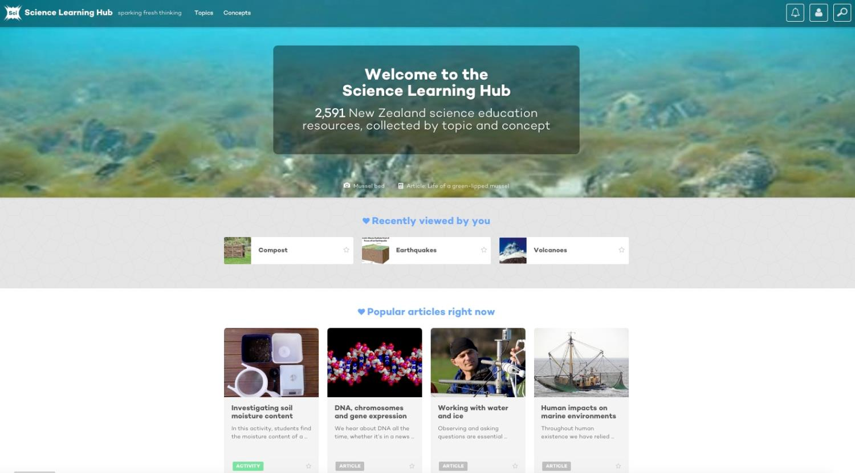
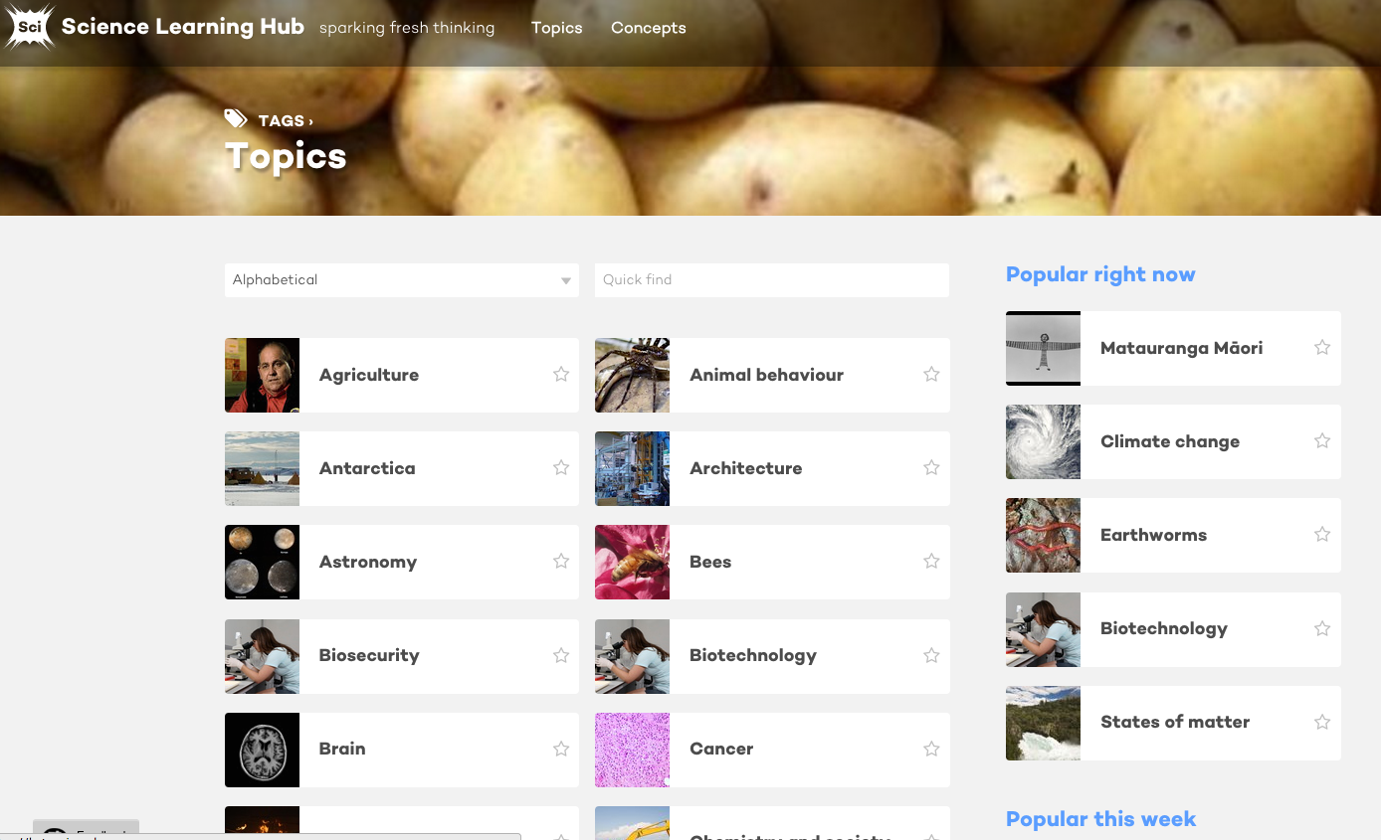
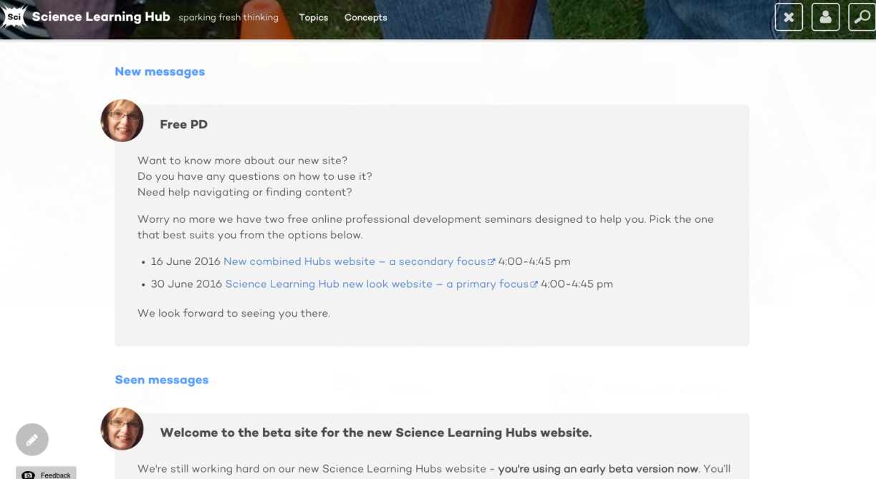
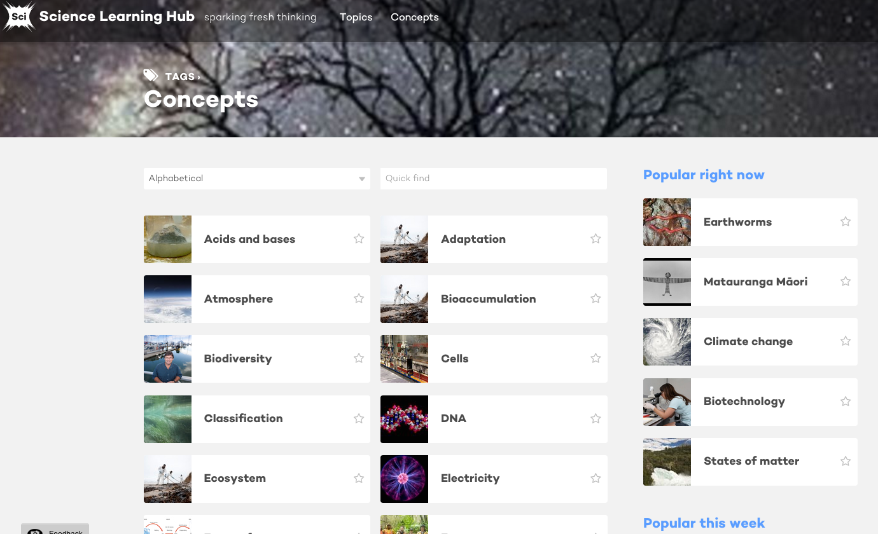
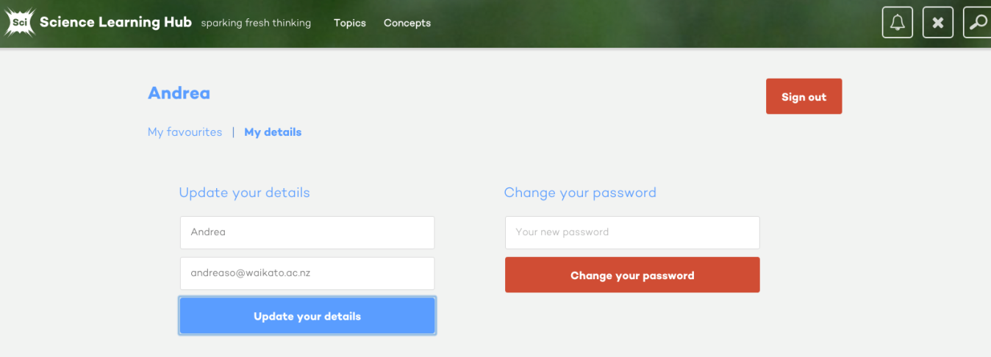
New look for the Science Learning Hub
Copyright University of Waikato. All rights reserved.
All images are copyrighted. For further information, please refer to enquiries@sciencelearn.org.nz
Notes:
Expand on the detail as it appears (top line)

Slide 6
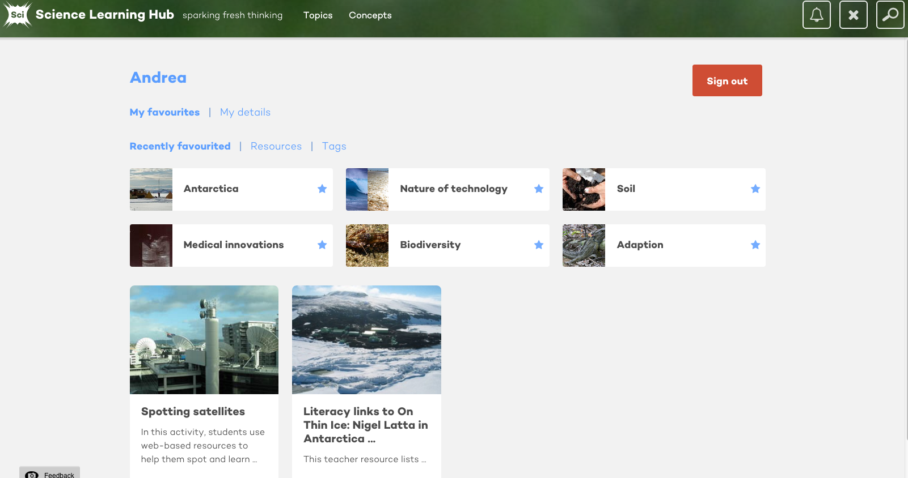
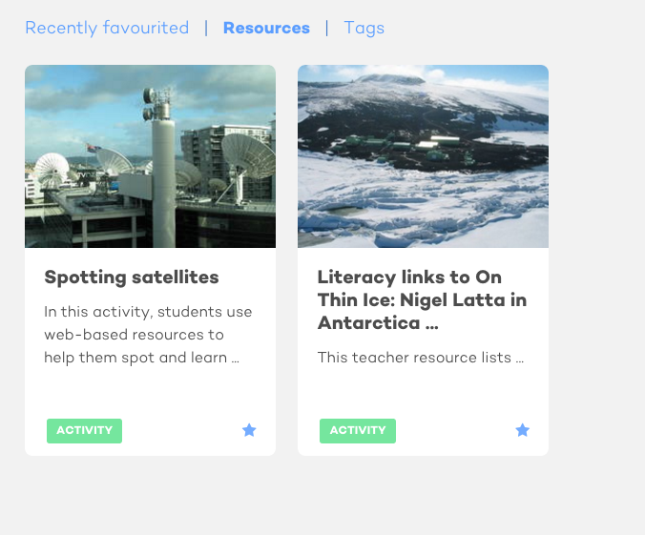
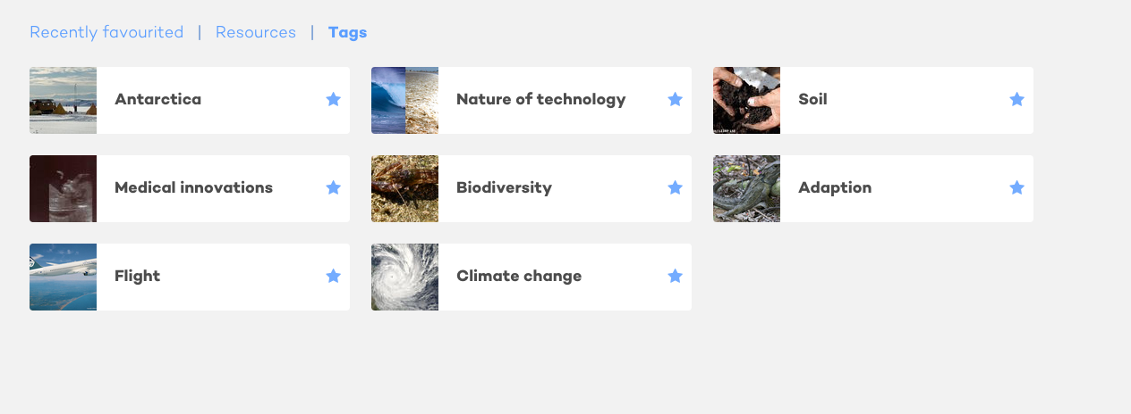
New look for the Science Learning Hub
Copyright University of Waikato. All rights reserved.
All images are copyrighted. For further information, please refer to enquiries@sciencelearn.org.nz
Notes:
Talk about the benefits of favouriting

Slide 7
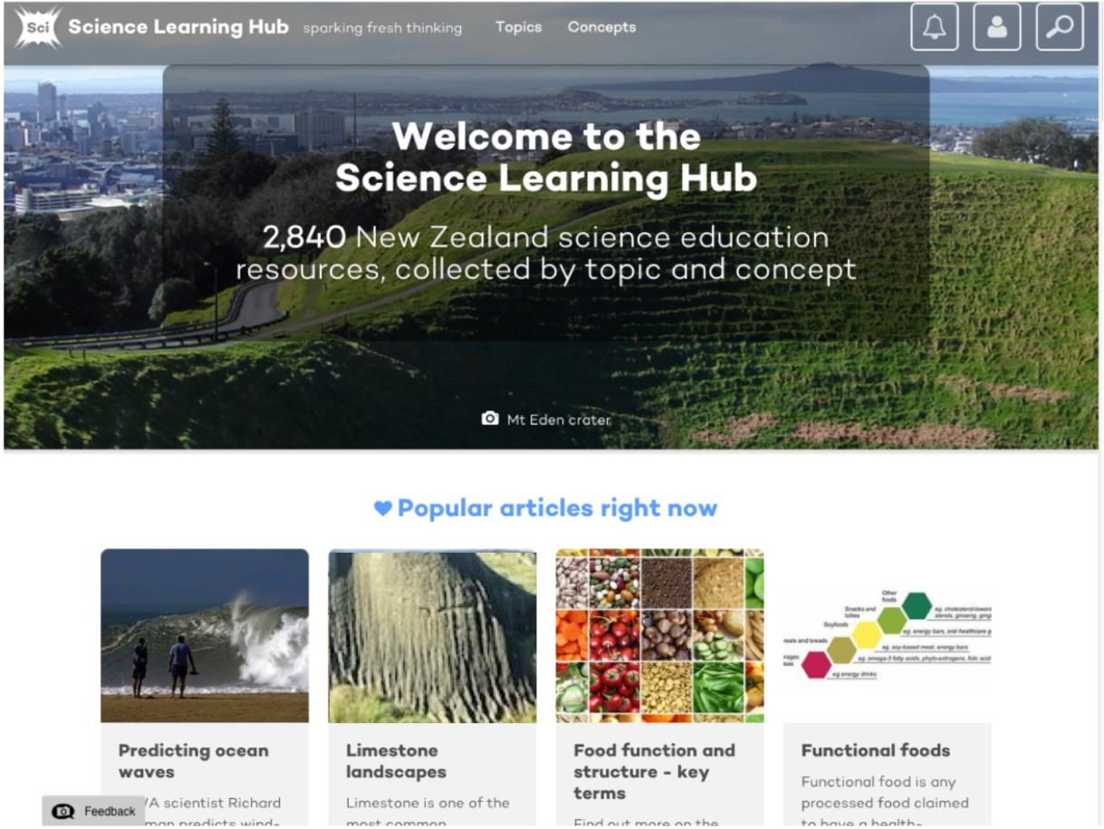
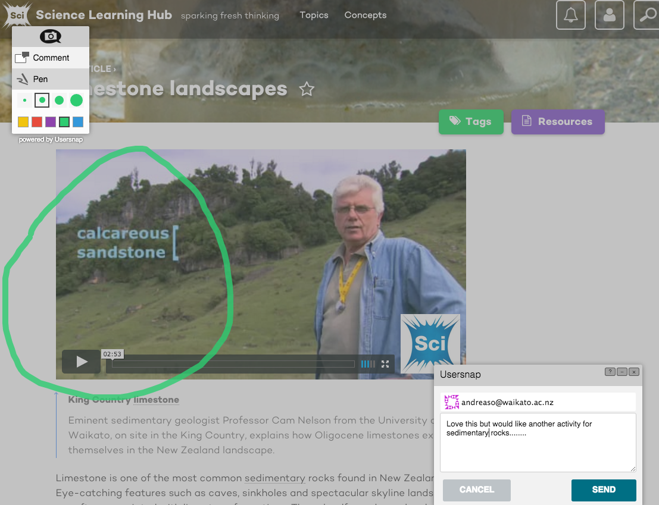
Copyright University of Waikato. All rights reserved.
All images are copyrighted. For further information, please refer to enquiries@sciencelearn.org.nz

Slide 8
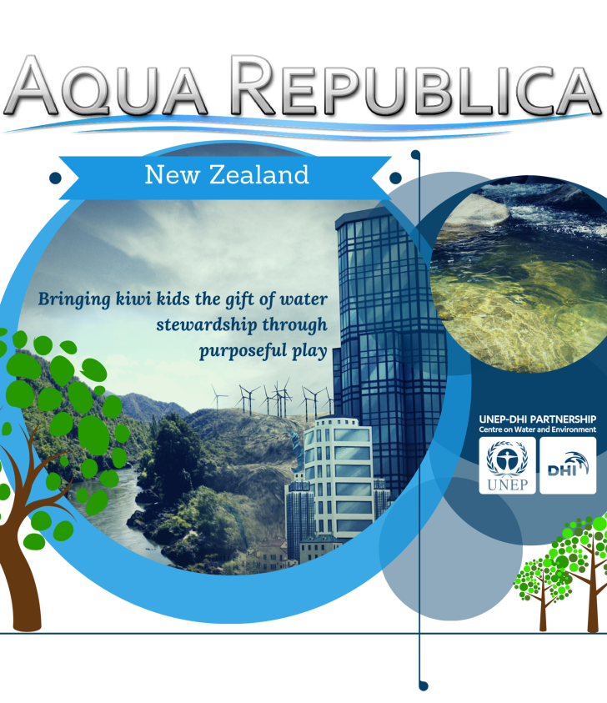

Purpose of the webinar
To introduce the serious game Aqua Republica
To support teachers and students to play the game
To identify curriculum links
To highlight supporting resources on the Hub
Copyright University of Waikato. All rights reserved.
All images are copyrighted. For further information, please refer to enquiries@sciencelearn.org.nz

Slide 9
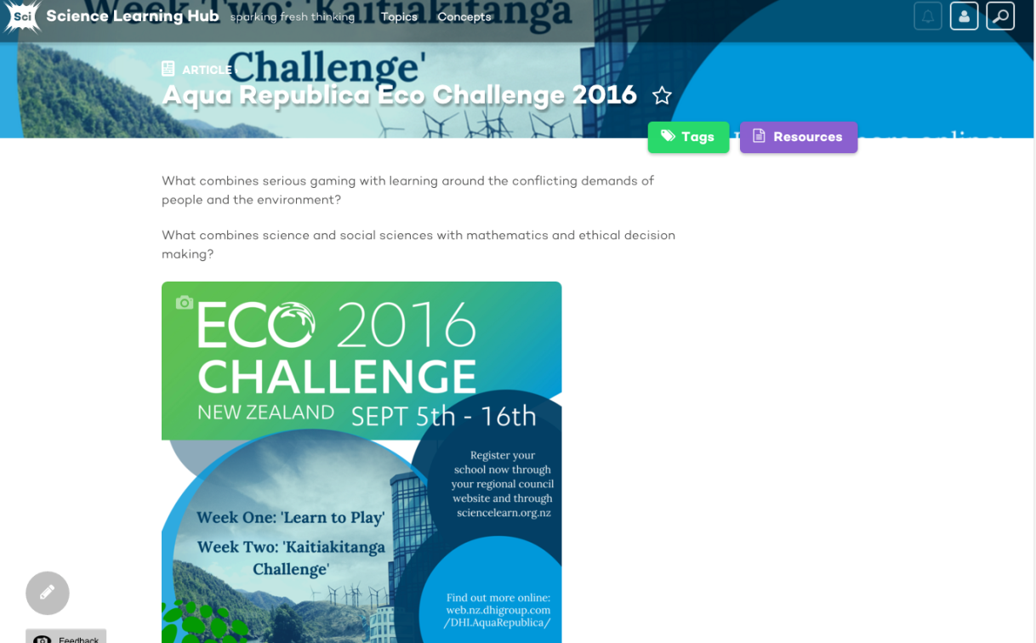
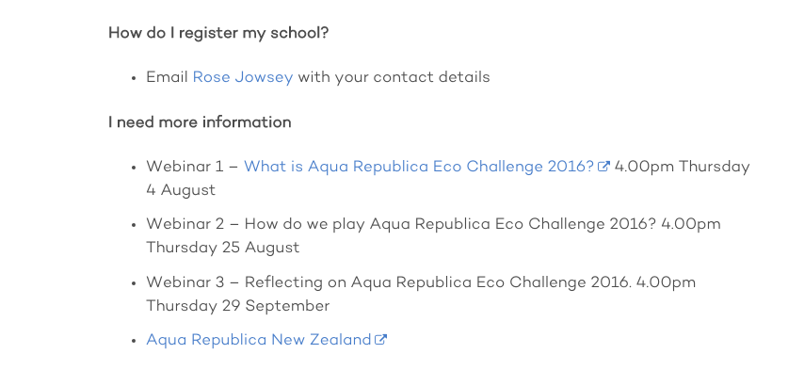
Information page
Copyright University of Waikato. All rights reserved.
All images are copyrighted. For further information, please refer to enquiries@sciencelearn.org.nz
Notes:
Some questions: Where do I find it on the Hubs – will be updated with the portal link – is this emailed out to participants that have registered? Do they have to register to play? Etc.

Slide 10


Introducing Rose Jowsey from
DHI Water
Aqua Republica
What?
Who?
Why?
Collaboration with SLH
Copyright University of Waikato. All rights reserved.
All images are copyrighted. For further information, please refer to enquiries@sciencelearn.org.nz
Notes:
The Science Learning Hub is delighted to be collaborating with DHI Water New Zealand to support the 2016 trial of the Aqua Republica online serious game.
We’re very pleased to have Rose Jowsey to talk us through how the game came about and what the learning outcomes will be for your students.

Slide 11


It’s a challenge, but is it also a competition?
Copyright University of Waikato. All rights reserved.
All images are copyrighted. For further information, please refer to enquiries@sciencelearn.org.nz

Slide 12


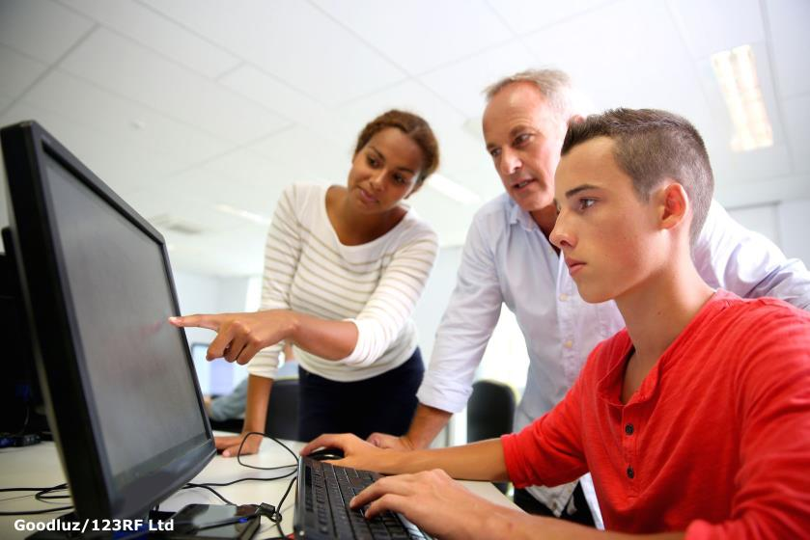


Who can play this game?
Copyright University of Waikato. All rights reserved.
All images are copyrighted. For further information, please refer to enquiries@sciencelearn.org.nz

Slide 13
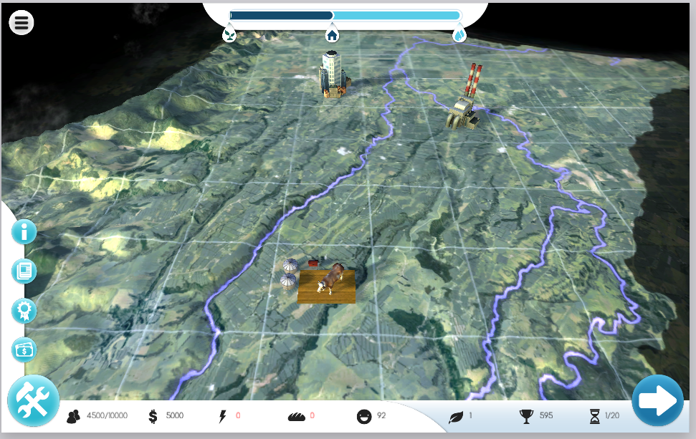
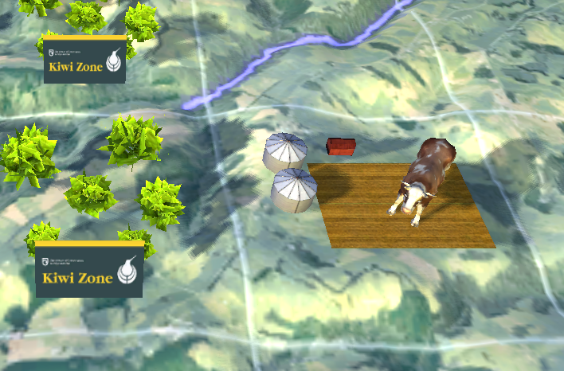
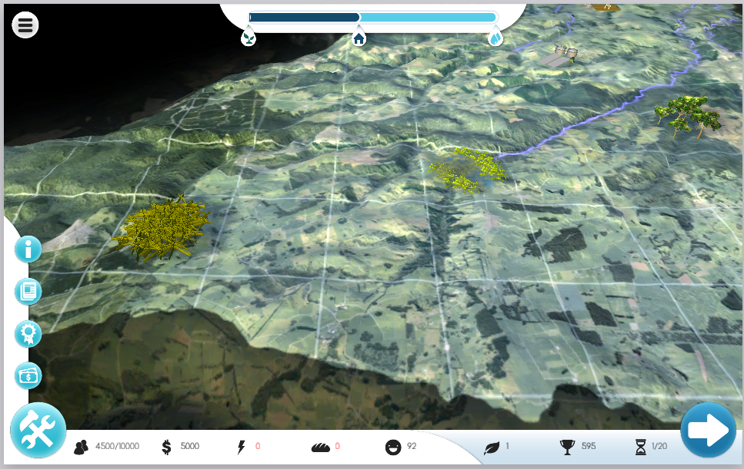
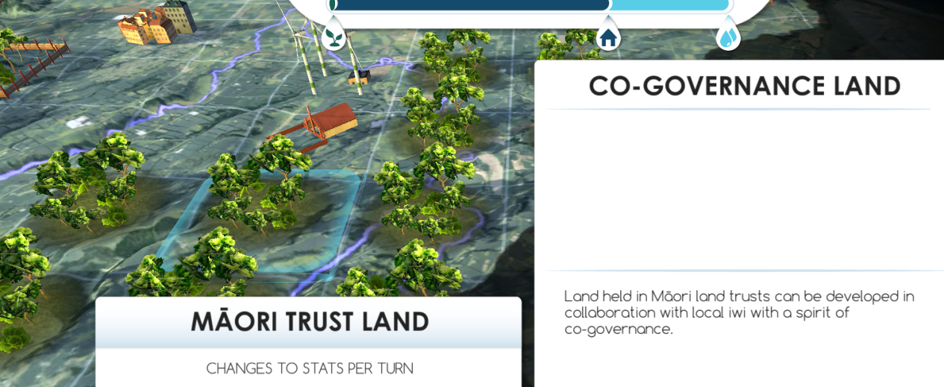
What does the game look like?
Copyright University of Waikato. All rights reserved.
All images are copyrighted. For further information, please refer to enquiries@sciencelearn.org.nz
Notes:
Rose covered the look of the game - comparisons with things like the Sims.

Slide 14
How do we play?
Practice Week
Kaitiakitanga Challenge
Webinar 2 – 25 August 4pm
Copyright University of Waikato. All rights reserved.
All images are copyrighted. For further information, please refer to enquiries@sciencelearn.org.nz
Notes:
There are two stages to the game - highlight how important Webinar 2 How to play Aqua Republica, on 25 August.

Slide 15

Important aspects of the game
Collaboration and negotiation
People and communities
Ecosystems
Kaitiakitanga
Balancing the demands of humans vs environment
Conservation
Energy
Water
Copyright University of Waikato. All rights reserved.
All images are copyrighted. For further information, please refer to enquiries@sciencelearn.org.nz

Slide 16
Question time
How are we doing so far?
Type in your questions for the team to answer
Copyright University of Waikato. All rights reserved.
All images are copyrighted. For further information, please refer to enquiries@sciencelearn.org.nz

Slide 17
Science Learning Hub
How can I find resources to support our work around Aqua Republica?
What contexts or learning areas does the challenge align with?
Junior curriculum?
Senior curriculum?
Copyright University of Waikato. All rights reserved.
All images are copyrighted. For further information, please refer to enquiries@sciencelearn.org.nz

Slide 18


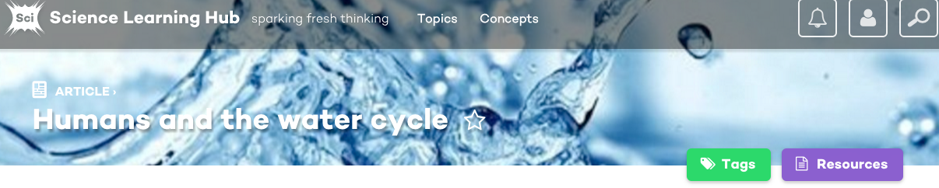
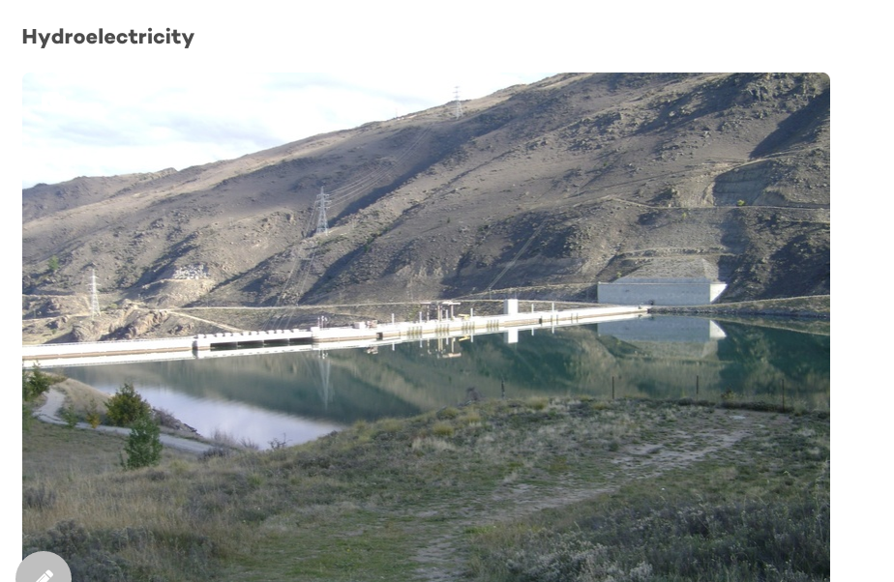
People and communities – human impacts
Copyright University of Waikato. All rights reserved.
All images are copyrighted. For further information, please refer to enquiries@sciencelearn.org.nz
Notes:
Excellent example for Andrea to speak to - which Hub site/what topic/what context?

Slide 19

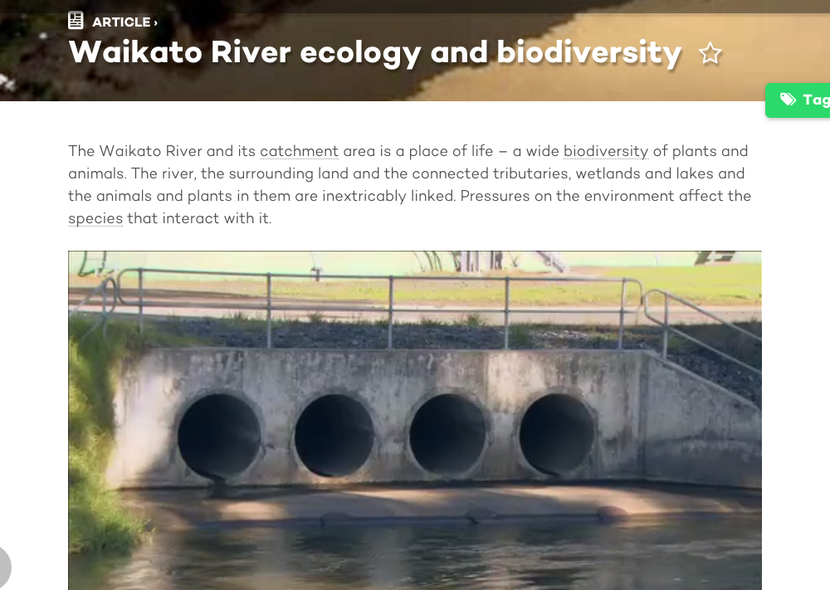
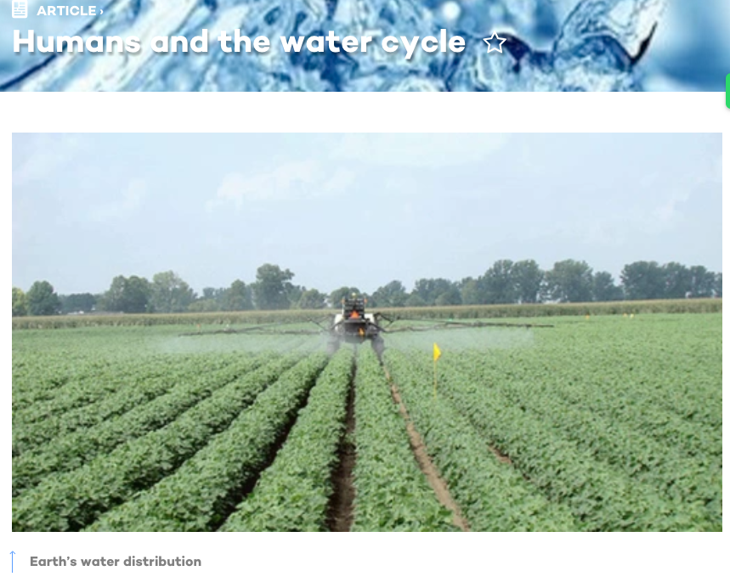
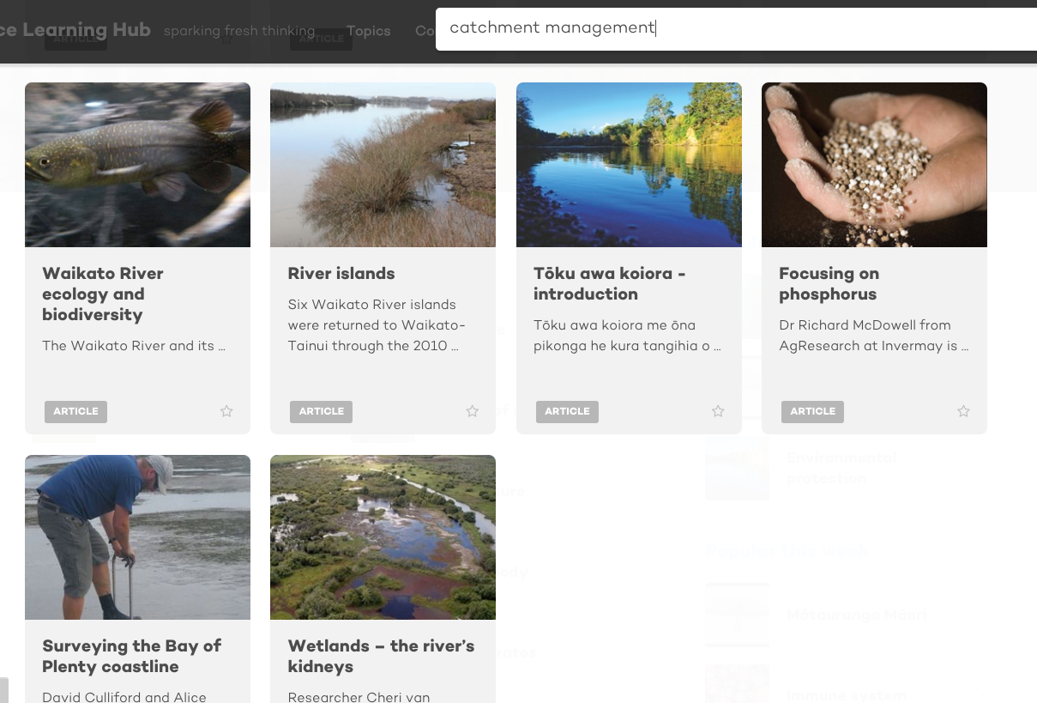
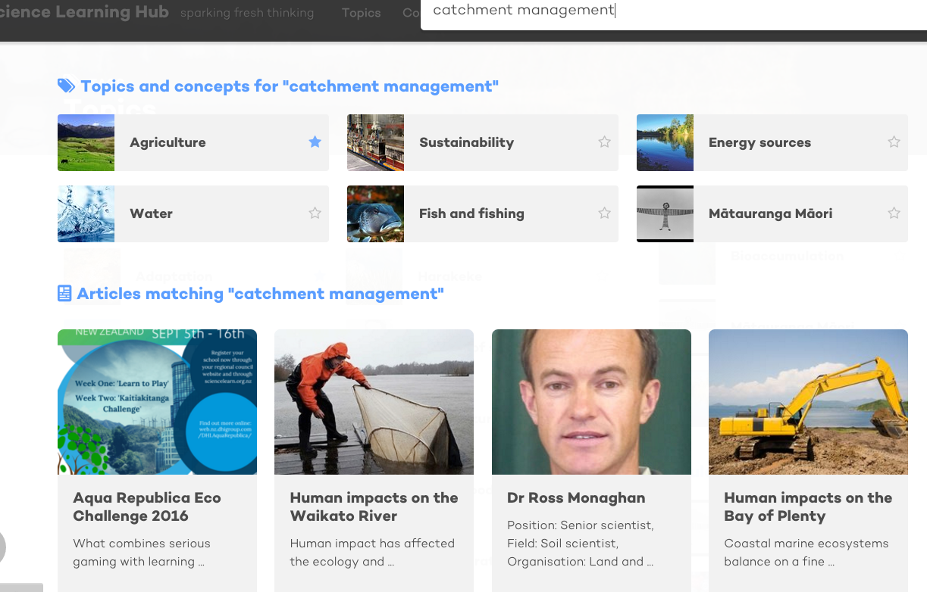
Searching for catchment resources
Copyright University of Waikato. All rights reserved.
All images are copyrighted. For further information, please refer to enquiries@sciencelearn.org.nz
Notes:
Second example Andrea to speak to

Slide 20
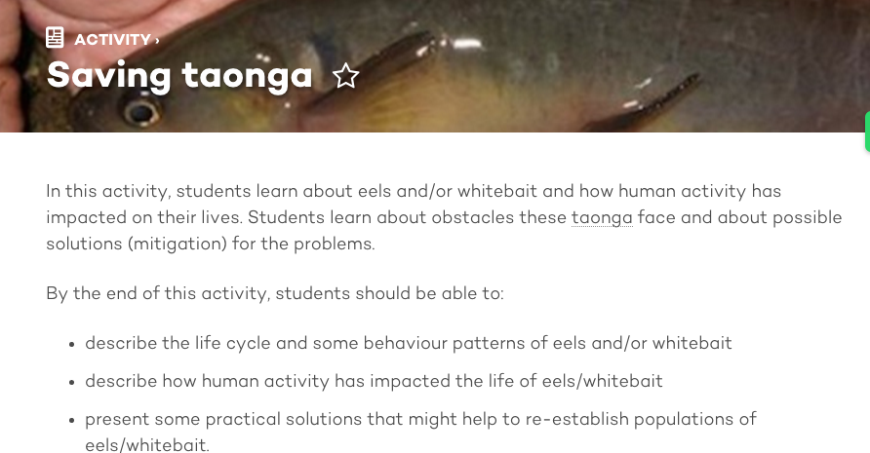
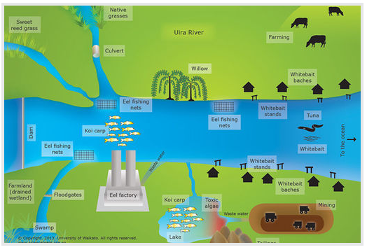
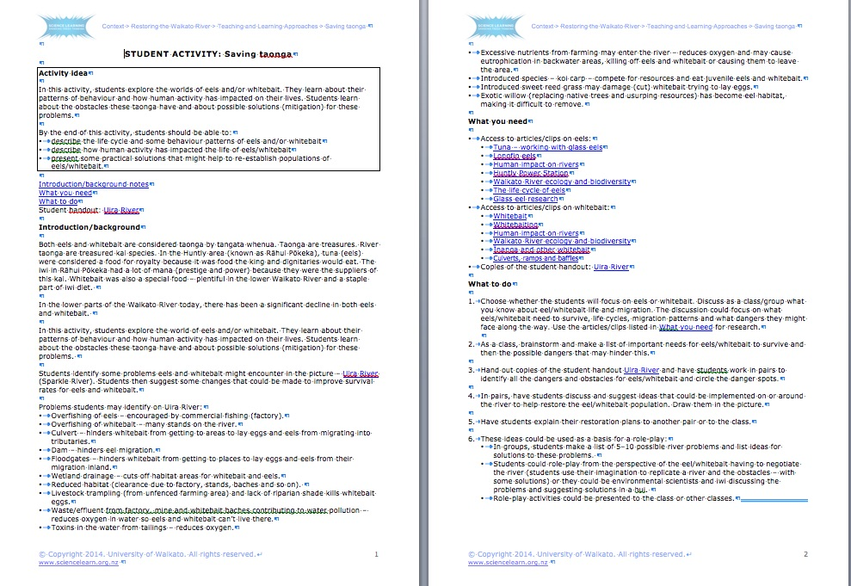
Copyright University of Waikato. All rights reserved.
All images are copyrighted. For further information, please refer to enquiries@sciencelearn.org.nz

Slide 21
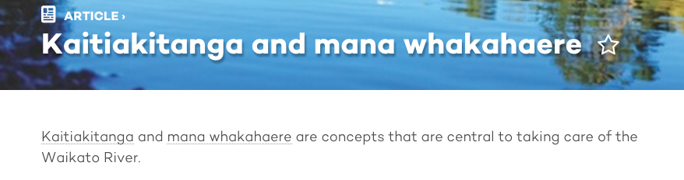
Mātauranga Māori
An important aspect of managing a water catchment area is kaitiakitanga
Resources within the kaupapa and spirit of kaitiakitanga
Copyright University of Waikato. All rights reserved.
All images are copyrighted. For further information, please refer to enquiries@sciencelearn.org.nz
Notes:
Where to find/how does it support?

Slide 22
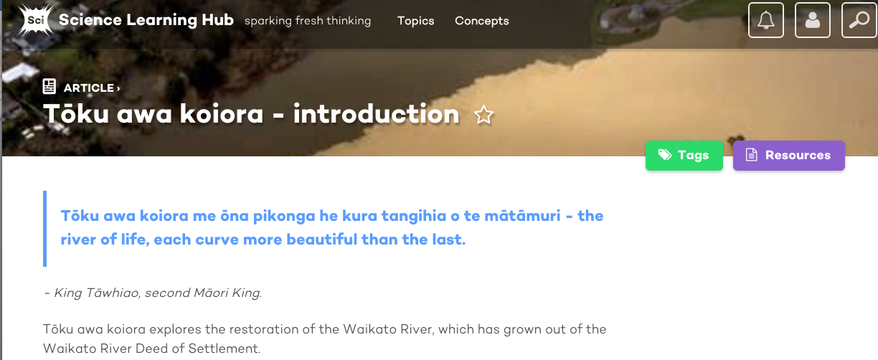
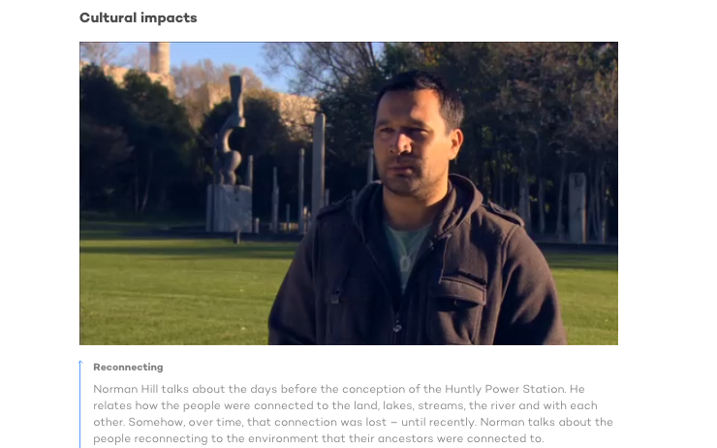
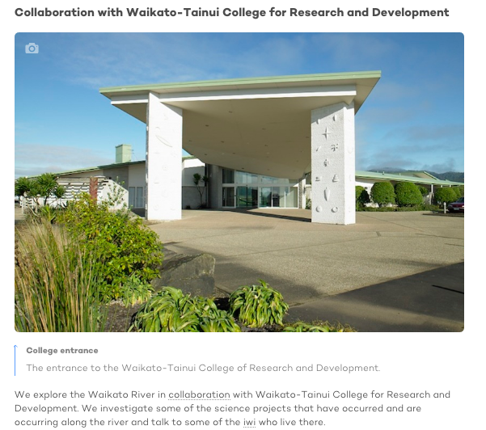
Collaboration and negotiation
Copyright University of Waikato. All rights reserved.
All images are copyrighted. For further information, please refer to enquiries@sciencelearn.org.nz

Slide 23

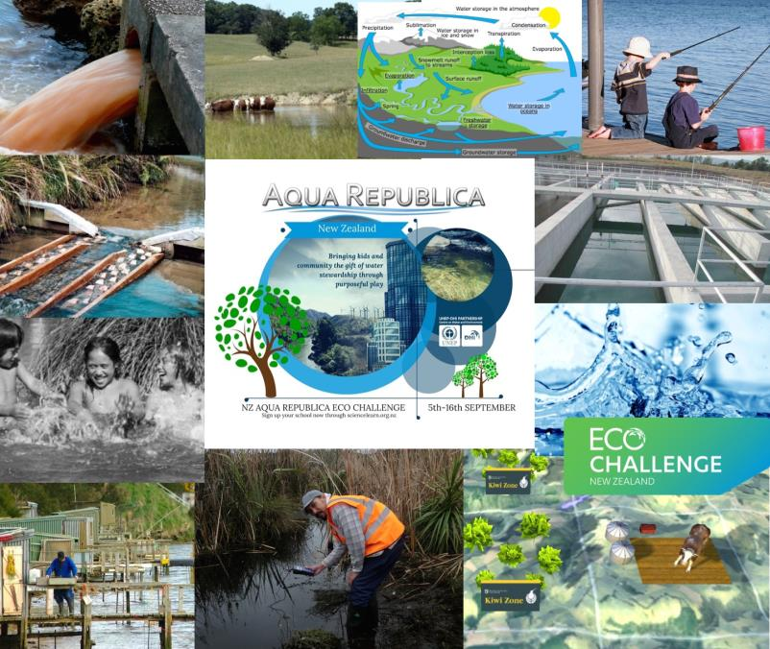
Pond
Copyright University of Waikato. All rights reserved.
All images are copyrighted. For further information, please refer to enquiries@sciencelearn.org.nz

Slide 24
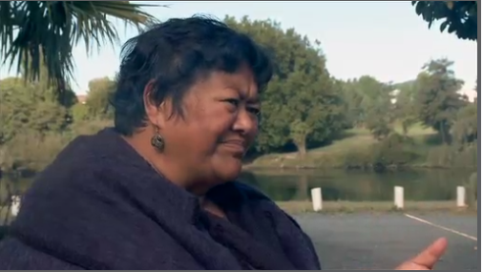
Mamae Takerei – This is important
Video courtesy of Waikato-Tainui College for Research and Development and Mamae Takerei
Copyright University of Waikato. All rights reserved.
All images are copyrighted. For further information, please refer to enquiries@sciencelearn.org.nz
Notes:
The last word – play video (Mamae Takerei) – Why is this important?

Slide 25
Maximising the benefits of
Aqua Republica
How do you see this fitting with your classroom learning?
How will your students engage with the game?
What are some of the challenges you think may arise?
Questions?
Copyright University of Waikato. All rights reserved.
All images are copyrighted. For further information, please refer to enquiries@sciencelearn.org.nz
Notes:
Interactive conversation with teachers

Slide 26

Don’t miss Webinar 2
Thursday 24 August at 4pm
Carl Johnson explains the ‘techy’ stuff
Tips and pointers on how to play
Video of the game in action
Copyright University of Waikato. All rights reserved.
All images are copyrighted. For further information, please refer to enquiries@sciencelearn.org.nz

Slide 27
Don’t miss Webinar 3
Thursday 29 September 29 at 4pm
Reflecting on the challenge
Teachers’ thoughts
Students’ thoughts
Looking forward to Eco Challenge 2017!
Copyright University of Waikato. All rights reserved.
All images are copyrighted. For further information, please refer to enquiries@sciencelearn.org.nz
Notes:
Showing ready-made units

Slide 28

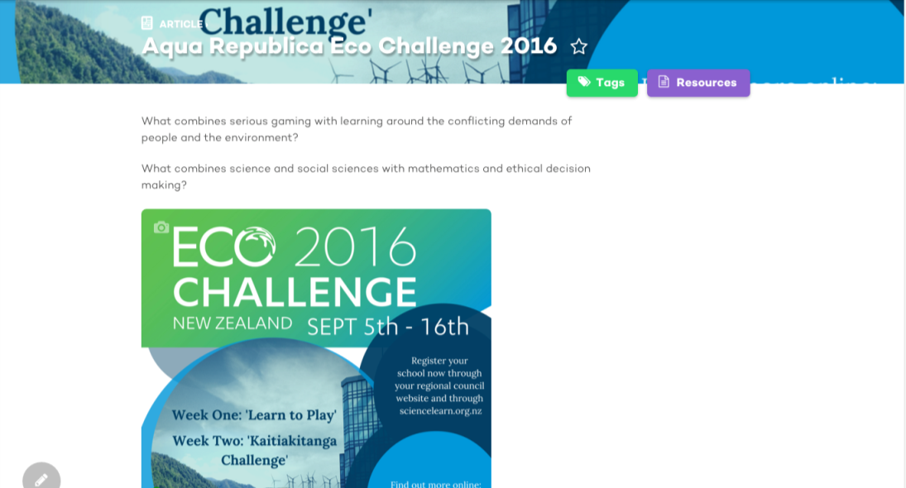
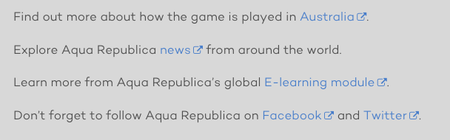

Contacts/links for further support
Copyright University of Waikato. All rights reserved.
All images are copyrighted. For further information, please refer to enquiries@sciencelearn.org.nz

Slide 29
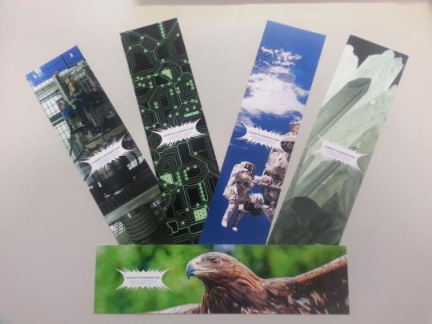



Would you like some bookmarks?
Bookmarks are available – email us enquiries@sciencelearn.org.nz
Follow us on Twitter: https://twitter.com/NZScienceLearn
Like us on Facebook: www.facebook.com/nzsciencelearn
Explore our Pinterest Boards: https://nz.pinterest.com/nzsciencelearn/
Join us in the pond: www.pond.co.nz/community/214015/science-learning-hub
Copyright University of Waikato. All rights reserved.
All images are copyrighted. For further information, please refer to enquiries@sciencelearn.org.nz

Slide 30
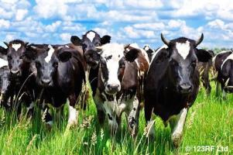
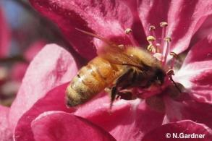
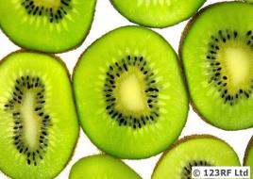
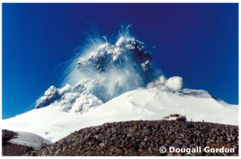
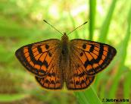
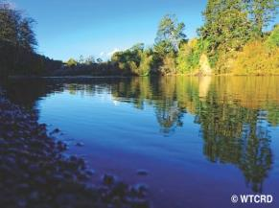
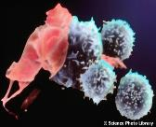
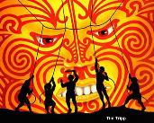
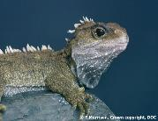
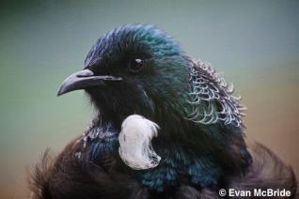
Thanks!
Questions and comments?
The images contained within this PowerPoint presentation are copyrighted to the University of Waikato and other third party individuals and organisations. Any reuse beyond the classroom as per the intended use of these resources, should be cleared with the copyright owner/s.

