Slide 1
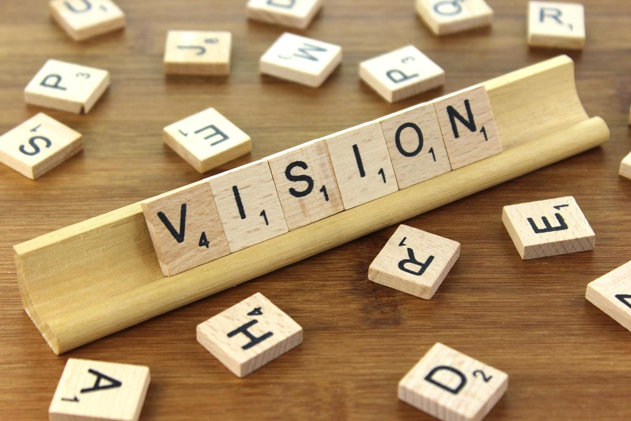
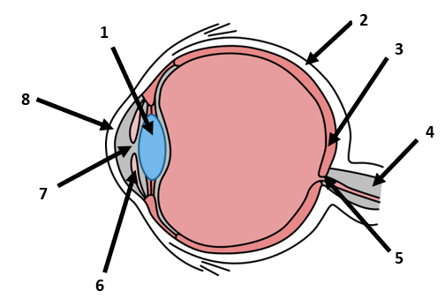
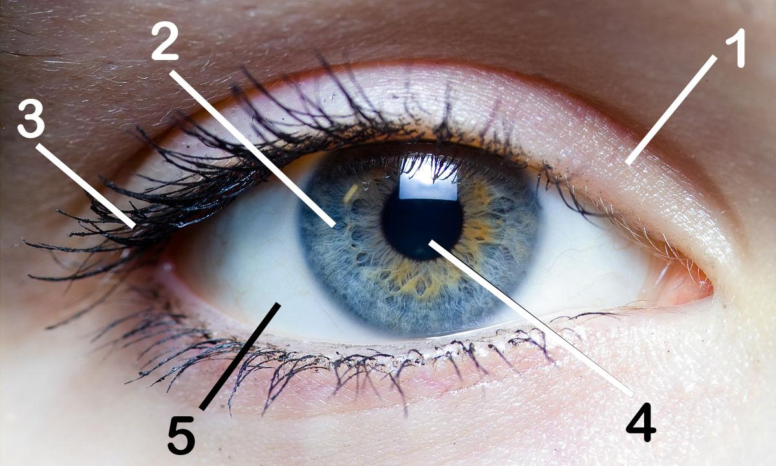
Vision Health Module

Slide 2
What is Vision?
Notes:
Brainstorm with the class what they already know about vision and the eye, to determine their prior level of learning.

Slide 3
Parts of the Eye - Front view
Pupil
Eyelashes
Iris
Sclera
Eyelid
Notes:
See which parts of the eye the children can already name (answers on next slide).

Slide 4
Parts of the Eye
Eyelid - Protects the eye from things like dust, dirt or sand.
Iris - The coloured part of the eye. Has muscles attached to it which change the size of the pupil.
Eyelashes - Protects the front of the eye. Responsible for blinking which keeps the eye clean and moist.
Pupil - The black “hole” in the middle of the iris through which light enters the eye. Gets bigger or smaller to let more or less light in.
Sclera - The white part of the eyeball. Helps to protect the eye and maintain the shape of the eyeball.
Notes:
Discuss what each part does.
Eyelid: protects the front of the eye. Responsible for blinking which keeps the eye clean and moist.
Eyelashes: protect the eye from things like dust, dirt or sand.
Sclera: the white part of the eyeball. Covers most of the eyeball, tough. Helps protect eye and maintain shape of eyeball
Pupil: black circle in the middle of the iris through which light enters the eye. Like a hole, or an opening in the iris. Can get bigger or smaller to let more or less light in.
Iris: the colourful part of the eye - determines what colour our eyes are. Has muscles attached to it which change the size of the pupil to let more or less light in.
Workbook activity: complete “Activity 1: Drawing and Labelling an Eye” in the student workbook.

Slide 5
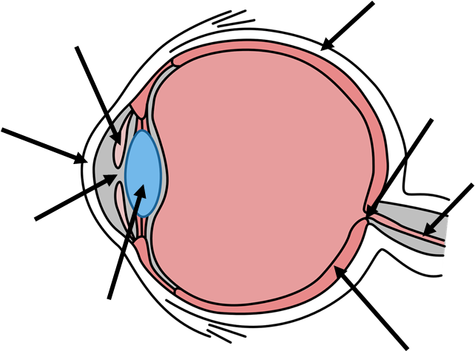
Parts of the Eye - Side view
1
2
Pupil
Iris
Sclera
Cornea
Lens
Optic nerve
Optic disk
Retina
3
8
7
4
5
6
Notes:
See which parts of the eye the children can already name (answers on next slide).

Slide 6
Parts of The Eye
Sclera
Iris
Cornea - the transparent front part of the sclera, sits in front of the iris. Helps the eye focus as light comes through it.
Pupil
Lens - sits behind the pupil and iris, and is clear and colourless. Focuses light rays on the back of the eyeball - the retina. The lens changes shape to view things up close or far away.
1
2
3
8
7
4
5
6
Notes:
Discuss what each part does.
Cornea: the transparent front part of the sclera, sits in front of the iris. Helps the eye focus as light comes through it.
Lens: behind the pupil and iris, clear and colourless. Focuses light rays on the back of the eyeball - the retina. The lens changes shape to view things up close or far away.
Ask the kids - who remembers what the iris, pupil and sclera do? (Answers on slide 4).

Slide 7
Parts of The Eye
6. Retina - at the back of the eye, contains millions of light cells called rods and cones. Turns the light into nerve signals and sends them to the brain through the optic nerve, so the brain can understand what we are seeing.
7. Optic Nerve - sends information from the eye to the brain.
8. Optic Disk - where the optic nerve “plugs in” to the retina
1
2
3
8
7
4
5
6
Notes:
Discuss what each part does.
Retina: at the back of the eye, contains millions of light cells called rods and cones. Turns the light into nerve signals and sends them to the brain through the optic nerve, so the brain can understand what we are seeing.
Optic Nerve: sends information from the eye to the brain.
Optic Disk: where the optic nerve “plugs in” to the retina (in other words, the optic disk is the front surface of the optic nerve).
Workbook activity: complete “Activity 2: Labelling the parts of the eye” in the student workbook.

Slide 8
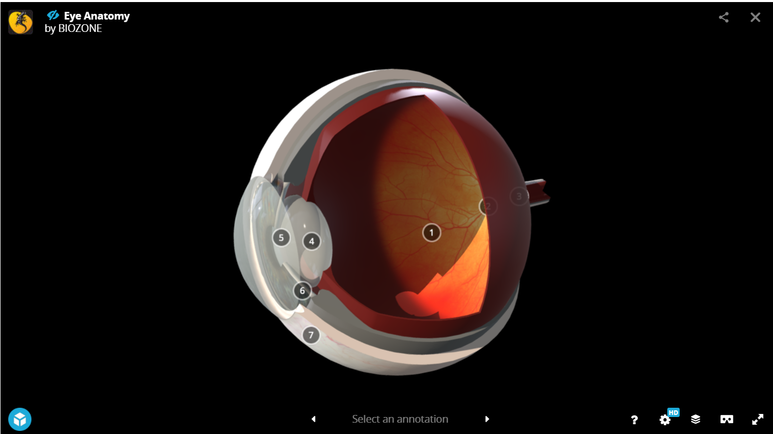
Parts of the Eye - Recap
Test your knowledge of parts of the eye using this 3d-viewer: 3dViewer - Biozone
Notes:
Use the interactive model to move the eye around and look at parts of the eye from different angles. Label each part of the eye, and review functions.
Workbook activity: complete “Activity 3: Mix and Match” in the student workbook.

Slide 9
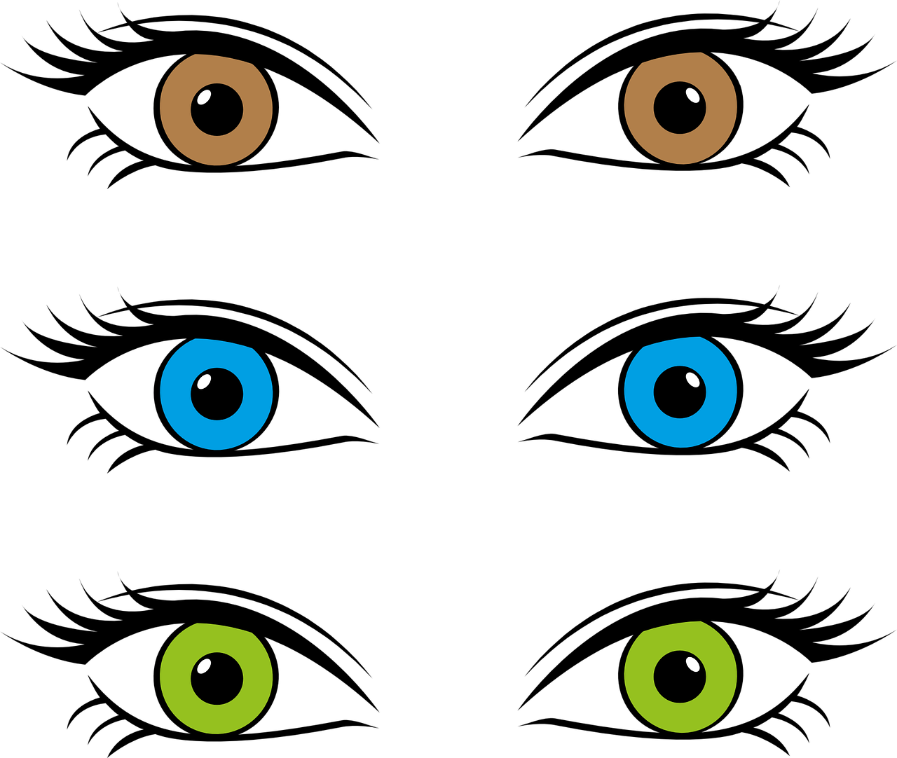
Iris Colour Survey
What is the most common iris colour in your classroom?
These are the results from across the world. Is your classroom similar?
Brown 55-79%
Blue 8-10%
Hazel 5%
Amber (golden yellow) 5%
Green 2%
Grey < 1%
Red <1%
Hererochromia (when each iris is a different colour) < 1%
Notes:
The iris can be many different colours. Eye colours vary depending on what country you live in, but eye colour statistics from around the world are as follows:
· Brown:
o 55-79% of the world’s population.
o One of the reasons that brown is the most common eye colour is that eye colour is partially genetic, and the colour brown is dominant. This means that if one of your parents has brown eyes, you will likely also have brown eyes, even if your other parent has different coloured eyes.
· Blue:
o 8-10% of the world’s population.
o All people who have blue eyes have a very distant common ancestor!
· Hazel:
o 5% of the world’s population.
o Hazel eyes look like a mixture of brown, green, orange and gold.
o This eye colour is common in North Africa, the Middle East, Brazil and Spain.
· Amber:
o 5% of the world’s population.
o These eyes look like a very light brown or golden yellow.
o This colour is common in people who are Asian, Spanish, South American or South African.
· Green:
o 2% of the world’s population.
o This colour is very common in people who are Irish or Scottish, or who live in Northern Europe.
· Grey:
o <1% of the world’s population.
· Red:
o <1% of the world’s population.
o This is usually when someone is albino and they lack pigment (colour) in their skin. This means they also lack pigment in their eyes, so the light reflects off the blood vessels in their eyes and make them look red.
· Heterochromia:
o <1% of the world’s population.
o This is where each iris is a different colour. It is common dogs but very rare in people.
Iris colour survey
This activity is best completed teacher-led, as a whole class.
First ask students to discuss in pairs or small groups what their eye colours are.
Call out each colour and ask children to put their hands up if their eyes are that colour.
Have a child count the hands and tally the numbers on the board.
Calculate the percentage of each eye colour in your classroom.
Compare to the statistics of eye colour from around the world.
Discussion Discuss what eye colours children have in their family – are they mostly similar or different? What colours are most common? Are their eyes the same colour as their parents and siblings?
Statistics from: https://www.worldatlas.com/articles/which-eye-color-is-the-most-common-in-the-world.html

Slide 10
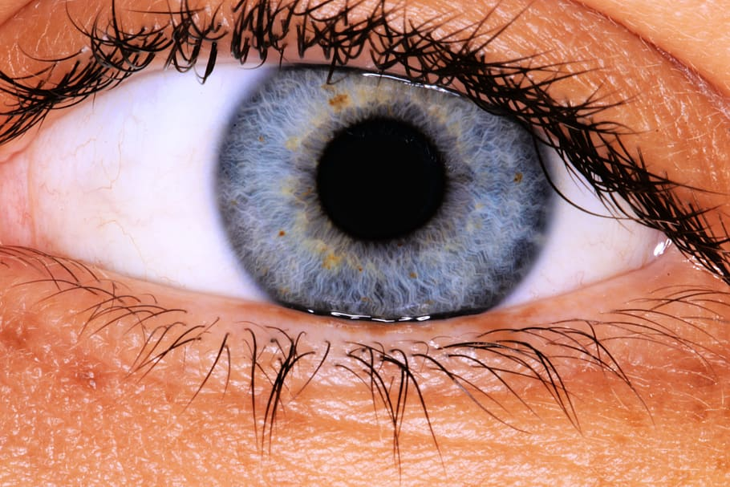
Pupil Size
In pairs or threes, you are going to observe how your pupil changes size in response to light.
Look towards the window or an area of bright light for 10 seconds. Observe the size of each other’s pupils - are they large or small?
Now cup your fingers around your eyes and look somewhere dark for 10 seconds. Observe each other’s pupils again. Have they changed size?
Notes:
Recap:
The pupil is actually a “hole” in the middle of the iris, through which light enters the back of the eye. It can get bigger or smaller to let more or less light in.
The pupil only takes in as much light as it needs to see things.
When the environment is bright, the pupil becomes smaller to let less light into the eye.
When the environment is dark, the pupil becomes larger to let as much light as possible into the eye.
Ask students to complete this activity in pairs or threes. Then come back together and discuss the results as a class.
Activity instructions:
In pairs or threes, you are going to observe how your pupil changes size in response to light.
1. Look towards the window or an area of bright light for 10 seconds. Observe the size of each other’s pupils – are they large or small?
2. Now cup your fingers around your eyes and look somewhere dark for 10 seconds. Observe the size of each other’s pupils again. Have they changed size?

