Slide 1

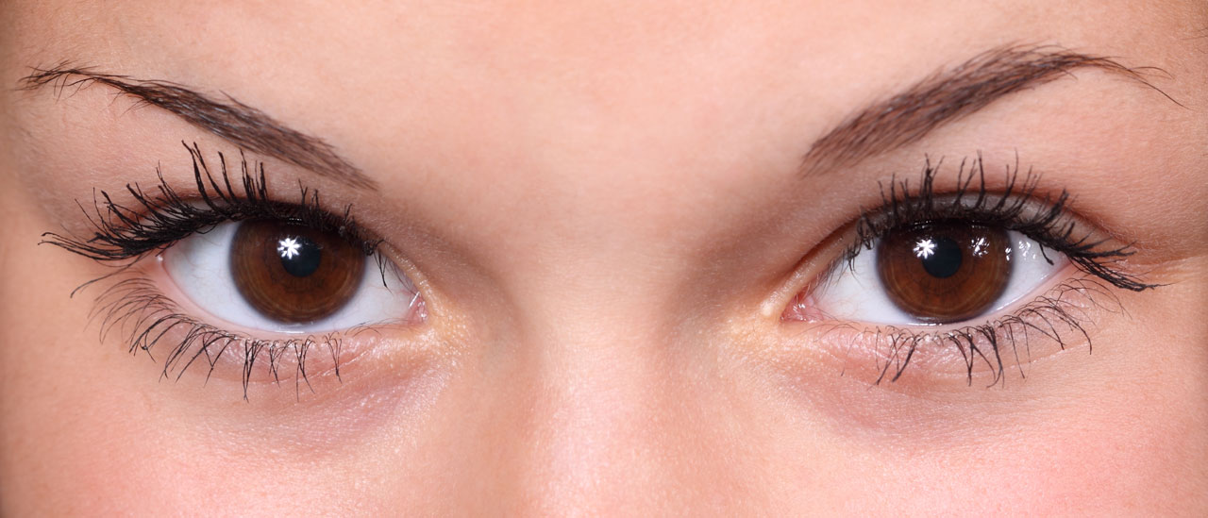
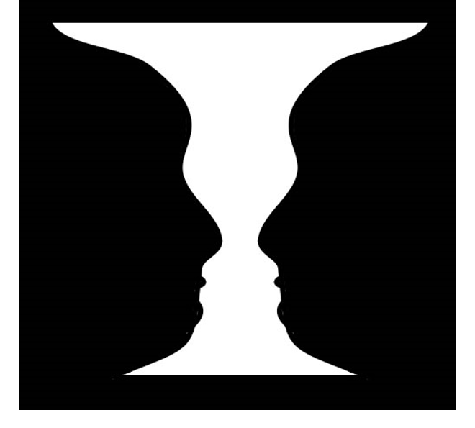
Vision Health Module
How do our eyes work - Part 2

Slide 2
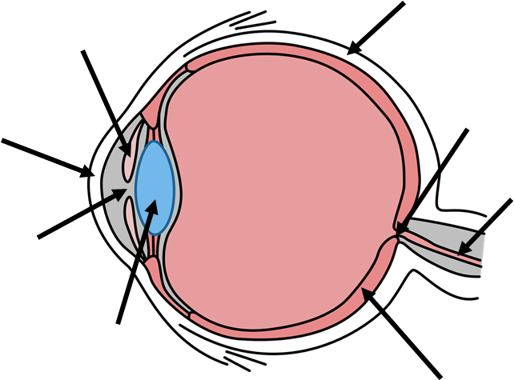
Parts of the Eye - Side view
1
2
Sclera
Iris
Cornea
Pupil
Lens
Retina
Optic Nerve
Optic Disk
3
8
7
4
5
6
Notes:
Review each part of the eye, including function. Focus discussing the function of the retina, optic nerve, and optic disk.
Sclera: the white part of the eyeball. Covers most of the eyeball, tough. Helps protect eye and maintain shape of eyeball
Iris: the colourful part of the eye - determines what colour our eyes are. Has muscles attached to it which change the size of the pupil to let more or less light in.
Cornea: the transparent front part of the sclera, sits in front of the iris. Helps the eye focus as light comes through it.
Pupil: black circle in the middle of the iris through which light enters the eye. Like a hole, or an opening in the iris. Can get bigger or smaller to let more or less light in.
Lens: behind the pupil and iris, clear and colourless. Focuses light rays on the back of the eyeball - the retina. The lens changes shape to view things up close or far away.
Retina: at the back of the eye, contains millions of light cells called rods and cones. Turns the light into nerve signals and sends them to the brain through the optic nerve, so the brain can understand what we are seeing.
Optic Nerve: sends information from the eye to the brain.
Optic Disk: where the optic nerve “plugs in” to the retina (in other words, the optic disk is the front surface of the optic nerve).

Slide 3
What is a Blind Spot?
Optic disk = where the optic nerve “plugs in” to the retina
The rod and cone cells send light signals to the brain. There are no rod and cone cells at the optic disk.
This means that no light signals go to the brain from the optic disk.
When we look at something, and the light from it falls directly on our optic disk, there are no signals going to our brain, so we can’t see it!
How come we don’t usually notice this!? Because our clever brain “fills in the gaps”!
Notes:
Who remembers the optic disk?
Optic disk = where the optic nerve “plugs in” to the retina
The rod and cone cells in the retina convert the light to electrical signals to go to our brain. However, there are no rod and cone cells at the optic disk.
What does this mean?
This means that the area of your optic disk doesn’t give your brain any visual information; no light signals go to the brain from the optic disk.
When we look at something, and the light from it falls directly on our optic disk, no signals go to the brain so we can’t see it.
How come you don’t usually notice this!? Because our clever brain “fills in the gaps”! Let’s see an example of this (next exercise).
The concept of the blind spot may be difficult to grasp for some children.

Slide 4

Finding your Blind Spot
Equipment:
Piece of A4 paper
Ruler
Black pen
X
PART ONE
Fold the piece of A4 paper in half (so it’s A5 size), then fold in half again the same way, so you have a long, narrow piece of paper, as in the picture above.
Draw a 1cm circle on the left side of the paper.
Measure 7cm to the right, then draw a 1cm cross.
Hold the paper so the cross is on the RIGHT side, an arm’s length away from your nose.
Close your RIGHT eye and look at the cross with your LEFT eye.
Move the paper very slowly towards your nose. Make sure you keep looking at the cross.
You will find that the dot disappears then reappears as you move the paper towards you!
Repeat for the other eye: turn the paper so the cross is on the left, and cover your left eye.
7CM
Notes:
Explain to the children that they are going to do an activity to find their blind spot.
· Students can complete this activity individually or in pairs.
· It may be easier to complete steps 1-3 as a class.
· Once the activity is completed, discuss the results as a class.
Equipment needed per student
1 piece of A4 paper
Black pen
Ruler
Instructions Part 1:
Fold the piece of A4 paper in half (so it’s A5 size), then fold in half again the same way, so you have a long, narrow piece of paper, as in the picture above.
Draw a 1cm circle on the left side of the paper.
Measure 7cm to the right, then draw a 1cm cross.
Hold the paper so the cross is on the RIGHT side, an arm’s length away from your nose.
Close your RIGHT eye and look at the cross with your LEFT eye.
Move the paper very slowly towards your nose. Make sure you keep looking at the cross.
You will find that the dot disappears then reappears as you move the paper towards you!
Repeat for the other eye: turn the paper so the cross is on the left, and cover your left eye.
Explanation: the dot disappears for a brief moment - this is when the light is falling on their optic disk. No signals are going to their brain so the brain thinks there is nothing there. When the light stops falling on their optic disk, they can see the dot again.

Slide 5
Finding your Blind Spot
X
PART TWO
Draw a line straight through the circle and cross as shown.
Repeat Part One. You will find that even when you can’t see the circle, the line appears to have no gaps.
What’s going on?
Notes:
PART TWO
Draw a line straight through the circle and cross as shown.
Repeat Part One. You will find that even when you can’t see the circle, the line appears to have no gaps.
What’s going on?
This is an example of your brain “filling in the gaps”. When the light hits your blind spot and the dot disappears, your brain assumes that the line is unbroken and fills in the piece of the line where the dot would be, so even though you can’t see the dot, the line seems to continue. The brain is very good at filling in gaps from your blind spot and usually this is helpful, as it would be very annoying to notice your blind spot all the time.
Discuss results as a class.

Slide 6
What is a Dominant Eye?
Because our eyes are in slightly different positions, they actually see two slightly different images..
However, when looking at something with both eyes, most people see the image from one eye more than the other = your dominant eye.
This is the eye that we prefer to use, and which sends slightly more information to the brain about what we are seeing.
People can be right-eye dominant, left-eye dominant, or neither.
Notes:
Because our eyes are in slightly different positions, they actually see two slightly different images. Our brain is really good at combining these two images into one 3-D image.
However, when looking at something with both eyes, most people see the image from one eye more than the other. This is your dominant eye; the eye that we prefer to use, and which sends slightly more information to the brain about what we are seeing.
Having a dominant eye is like being left or right-handed. People can be right-eye dominant, left-eye dominant, or neither. 80% people are right-eye dominant, 10% left, 10% neither. Your dominant eye is not necessarily the same as your dominant hand.

Slide 7

Finding your Dominant Eye
Make a triangle ith your index fingers and thumbs.
Hold your arms straight out in front of you, as far away as possible.
With both eyes open, look through the triangle at an object in the distance (at least 3m away). Make sure the object is in the centre of the triangle.
Keep your hand still, but close your right eye. Does the
object stay in the centre of the triangle or appear to move?
Still keeping your hands still, now open your right eye
but close your left. Does the object stay in the centre of
the triangle or appear to move?
The eye that was open when the object move the least,
is your dominant eye.
Notes:
Students can complete this activity individually or in pairs.
Demonstrate first.
Student instructions
Make a triangle with your index fingers and thumbs as in the photo - make sure the triangle is small.
Hold your arms out straight in front of you, as far away as possible
With both eyes open, look through the triangle at an object in the distance (at least 3m away). Make sure the object is in the centre of the triangle.
Keep your hands still but close your right eye. Does the object stay in the centre of the triangle or appear to move?
Still keeping your hands still, now open your right eye but close your left. Does the object stay in the centre of the triangle or appear to move?
The eye that was open when the object moved the least, is your dominant eye.
Discussion
The eye that was open when the object moved the least, is your dominant eye. For example, you were looking through the triangle with your left eye (your right eye was closed), and the object hardly seemed to move. You then looked through the triangle with your right eye open (left eye closed), and the object was no longer in the centre of the triangle and appeared to move to one side. In this case, your left eye is your dominant eye, and the one you use the most.
How many children have a right dominant eye? How many a left? How many neither?

Slide 8
What is an Optical Illusion?
Recap: the eyes send signals to the brain about the colour, light and patterns of we are seeing. The brain then interprets these signals to work out what we are looking at.
The problem is that these signals between our eyes and brain are very basic. Sometimes the brain must “fill in the blanks” from the signals it gets from the eyes, or it gets these signals mixed up.
Optical illusion = when the brain gets confused about what it is seeing. For example, the brain might think things are moving when they’re not or see colours that aren’t really there.
Notes:
Recap: the eyes send signals to the brain about the colour, light and patterns of we are seeing. The brain then interprets these signals to work out what we are looking at.
The problem is that these signals between our eyes and brain are very basic. Sometimes the brain must “fill in the blanks” from the signals it gets from the eyes, or it gets these signals mixed up.
Optical illusion = when the brain gets confused about what it is seeing. For example, the brain might think things are moving when they’re not or see colours that aren’t really there.
Workbook activity: complete “Activity 4: Optical Illusions” in the student workbook.

Slide 9
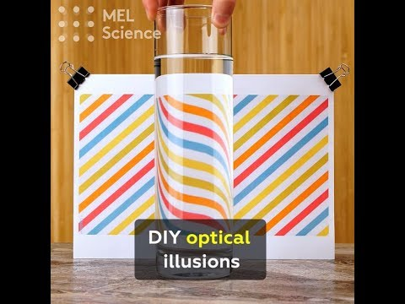
Notes:
Watch the video about creating your own optical illusions at home.

