Slide 1
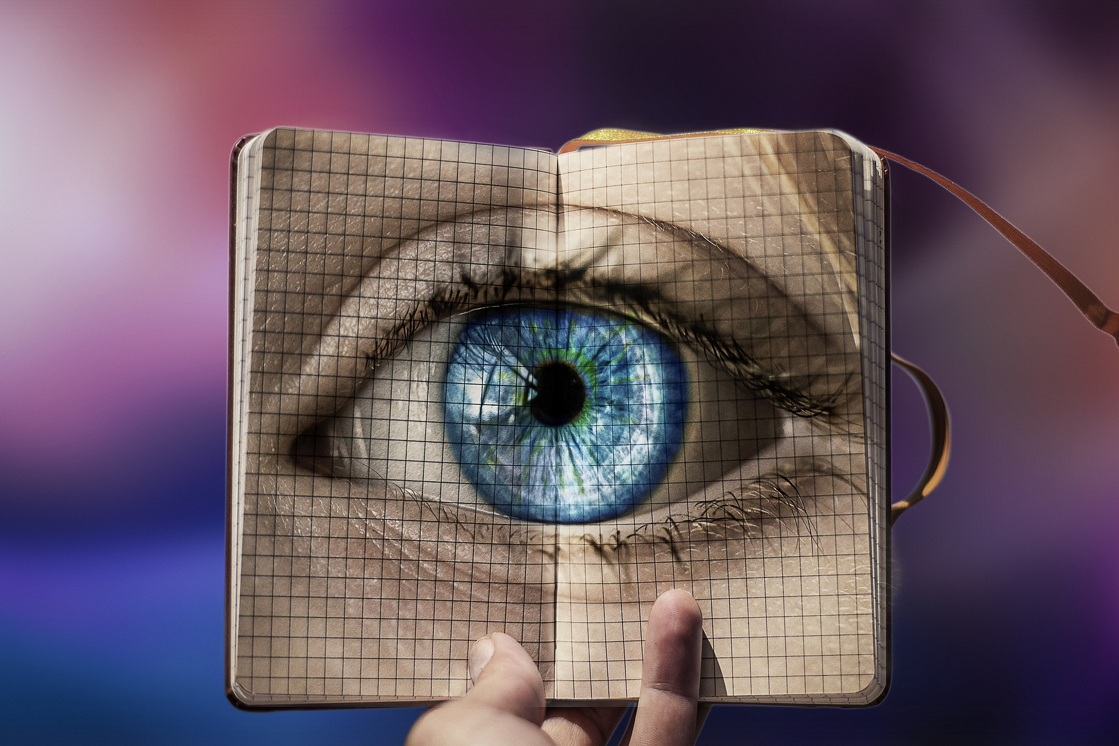
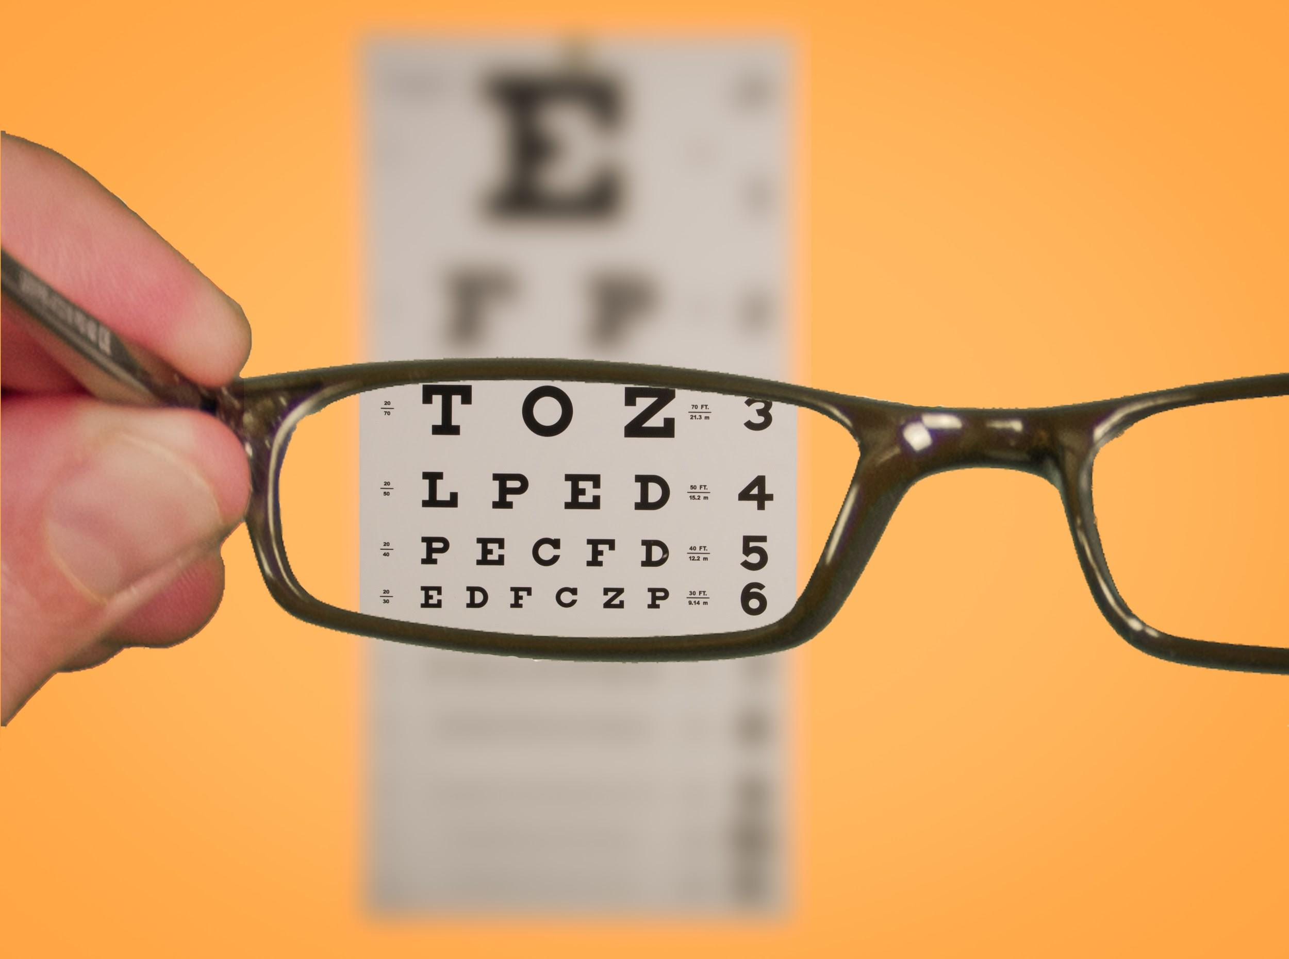
Vision Health Module
Looking after our eyes

Slide 2
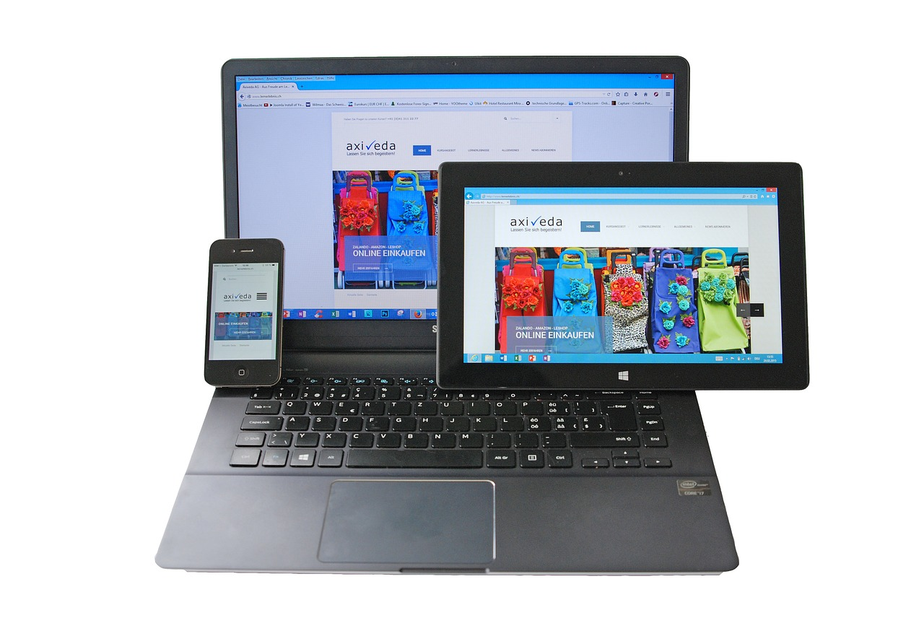
Eye Health: Digital Eye Strain
Symptoms
Sore eyes
Headaches
Sensitivity to light
Difficulty refocusing
Treatment
Tilt screen
Wear glasses
Blink!
20-20-20 rule
Notes:
What is digital eye strain?
Also called computer vision syndrome.
Caused by spending too long looking at screens (computer, iPad/tablet, phone)
Results in eye discomfort and vision problems, from prolonged computer, tablet or phone use.
Symptoms:
Sore eyes
Sensitivity to light
Headaches
Difficulty refocusing between distance and near
Treatment:
Test your vision - use glasses if necessary
Blink regularly
Have screen tilted away from you not upright, have top of screen bit lower than eye level so looking down at it
20-20-20 rule - on next page.

Slide 3
Eye Health: The 20-20-20 Rule
20
Every MINUTES
Take a SECOND break
Look FEET away (6m)
Notes:
20-20-20 rule: every 20 minutes take a 20 second break and look at an object that’s 20 feet away
How far is 20 feet? About 6 metres.
Why do you think this helps?
You are refocusing your eyes and looking at something in the distance.

Slide 4
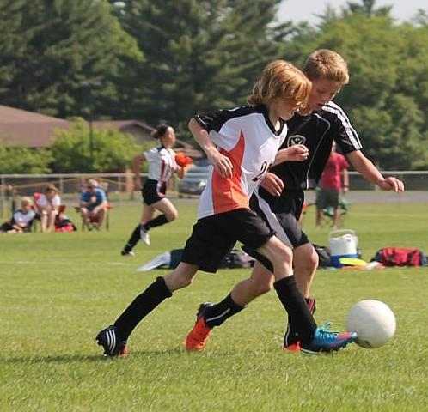
Eye Health
How else can we look after our eyes?
Notes:
Other ways to look after your eyes:
How can you look after your eyes when you’re outside?
Wearing sunglasses
UV light rays are not visible to our eyes. They cause our skin to darken (getting a suntan), but also cause wrinkles, skin discolouration, sunburn and skin cancer. If you don’t protect your eyes UV light can cause eye disease.
Wearing UV blocking sunglasses is important to prevent this.
Increased likelihood of UV exposure:
Time of day - when sun highest in sky, usually 10am to 2pm.
Highly reflective surfaces like sand or snow.
Australia and New Zealand because of the thin ozone layer.
How many of you have sunglasses?
Spending 2 hours outdoors every day can help to prevent myopia/short-sightedness.
Needs to be playing, with focus on distance/far-away.
Not reading books/near work.
Sunbathing ok.
Workbook activity: complete “Activity 5: Crossword: Eye Health” in the student workbook.

Slide 5
Vision and Learning
Vision is vital for learning
To learn, the eyes must be able to:
Focus on things far away e.g. the whiteboard
Focus on things close up e.g. a book
Change focus from things far away to close up
Move focus quickly and accurately from line to line e.g. when reading
Focus quickly on moving objects e.g. when playing sports
Notes:
Vision is vital for learning.
To learn, the eyes must be able to:
Focus on things far away e.g. the whiteboard
Focus on things close up e.g. a book
Change focus from things far away to close up
Move focus quickly and accurately from line to line e.g. when reading
Focus quickly on moving objects e.g. when playing sports
Ask children to brainstorm things someone might notice if they had problems with their vision (answers on next slide).

Slide 6
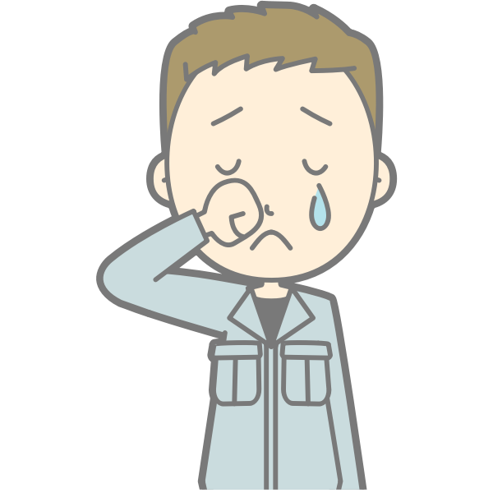
Things to look out for
Possible symptoms of vision problems:
Complaining of not seeing clearly
Headaches
Rubbing eyes
Burning or itchy eyes
Shutting one eye when reading
Tilting the head at an angle to the book
Holding a book very close or sitting close to the TV
Using finger to keep place when reading
Poor concentration
Copying incorrectly from the blackboard
Losing place when copying or reading
Blinking excessively when doing near vision work
Reversing letters or numbers
Writing up or down hill, with irregular letter or word spacing
Feeling dizzy or sick when trying to focus
Seeing double
Squinting
Difficulty with hand-eye coordination when playing sports
Notes:
Ask children to read through the list. Did they guess many symptoms?
Complaining of not seeing clearly
Headaches
Rubbing eyes
Burning or itchy eyes
Shutting one eye when reading
Tilting the head at an angle to the book
Holding a book very close or sitting close to the TV
Using finger to keep place when reading
Poor concentration
Copying incorrectly from the blackboard
Losing place when copying or reading
Blinking excessively when doing near vision work
Reversing letters or numbers
Writing up or down hill, with irregular letter or word spacing
Feeling dizzy or sick when trying to focus
Seeing double
Squinting
Difficulty with hand-eye coordination when playing sports

Slide 7
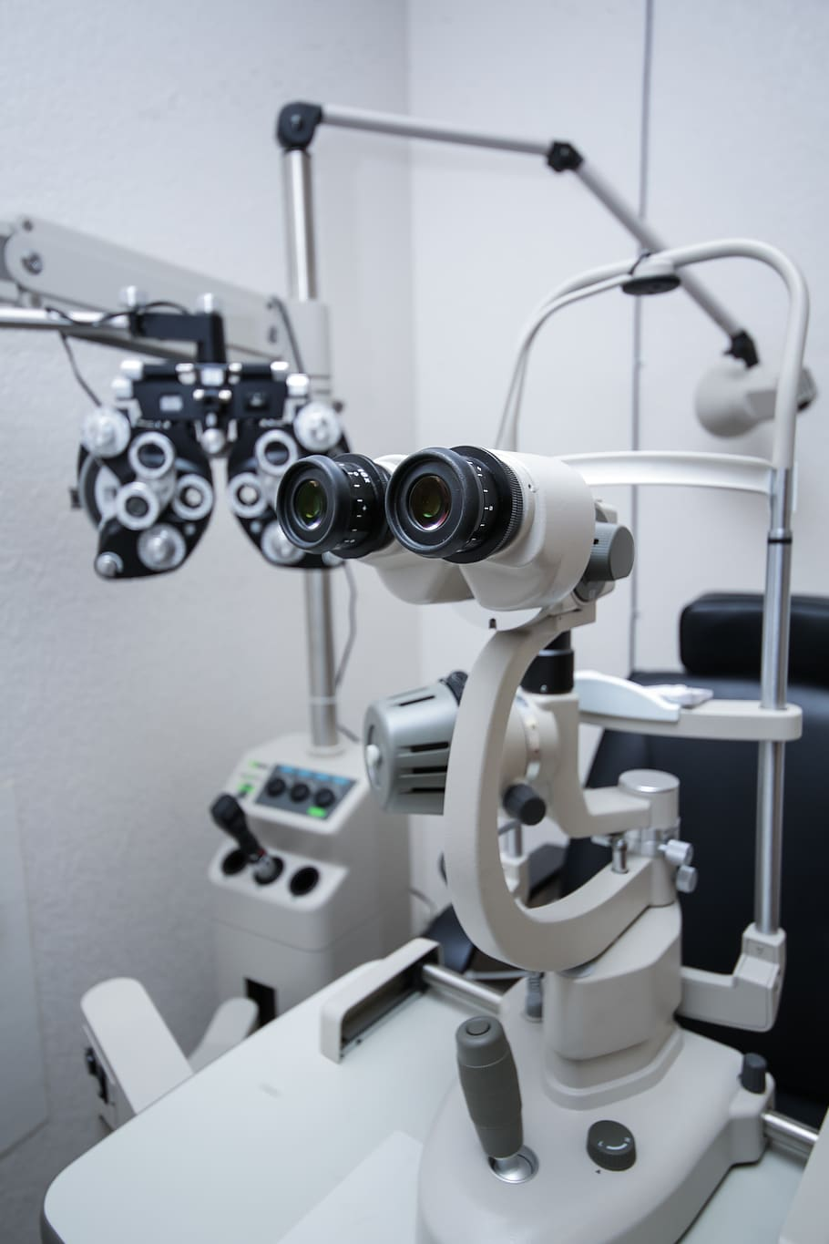
Eye Testing
INSERT VIDEO OF GLASSES STORIES (From Alex)
Regular eye testing is very important
Going to the optometrist
Wearing glasses
Notes:
Regular eye testing is important – if conditions are picked up early, they are easier to manage and treat.
Going to the optometrist:
Who has been to an optometrist? What was it like?
There is a machine called an automatic refractor that you will look at images through.
You will read some letters on a chart.
The optometrist may put some drops in your eye to make your pupils bigger. This enables them to test your eyes more accurately.
If the optometrist thinks you need glasses, they will try different strength lenses in front of your eyes to make your vision better.
Watch the video about visiting the optometrist.
Wearing glasses:
If you need glasses but don’t wear them, your vision can get worse. It’s really important to bring your glasses to school and wear them when you need to.
Ask children their thoughts about wearing glasses.
Do they like them? Why/why not? If why not, what would make them like wearing them more?
What do their friends think?
What do their parents think?
What can glasses help with?

Slide 8
True or False?
60-80% of all learning is through your eyes.
Your eyes can get sunburnt.
About ¼ of the human brain is dedicated to vision and seeing.
Symptoms of vision problems can include headaches, blinking lots, seeing double or finding it difficult to concentrate when reading..
The eye is the most complex organ in the body.
Notes:
Discuss with the children whether they think each fact is true or false.
True or false?
60-80% of all learning is through your eyes
TRUE, most of what we learn is through what we see in our environment.
Your eyes can get sunburnt
TRUE - it is called photo-ophthalmia and means that UV rays from the sun have burnt and damaged your cornea. You can also get photoretinitis, which is when infrared light burns the retina. Symptoms of these can be feeling like you have shards of glass in your eye, redness, blurry vision and sensitivity to bright light.
About ¼ of the human brain is dedicated to vision and seeing
FALSE - it’s actually over half of our brain! This is why it is so important that we can see properly .
Symptoms of vision problems can include headaches, blinking lots, seeing double or finding it difficult to concentrate when reading.
TRUE
The eye is the most complex organ in the body
FALSE - the brain is the most complex organ, the eye is the 2nd most complex.

