Slide 1

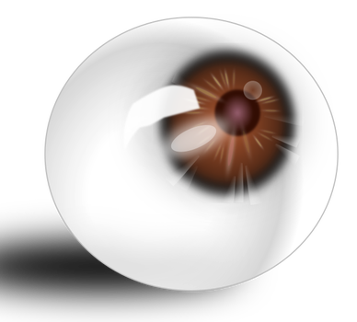
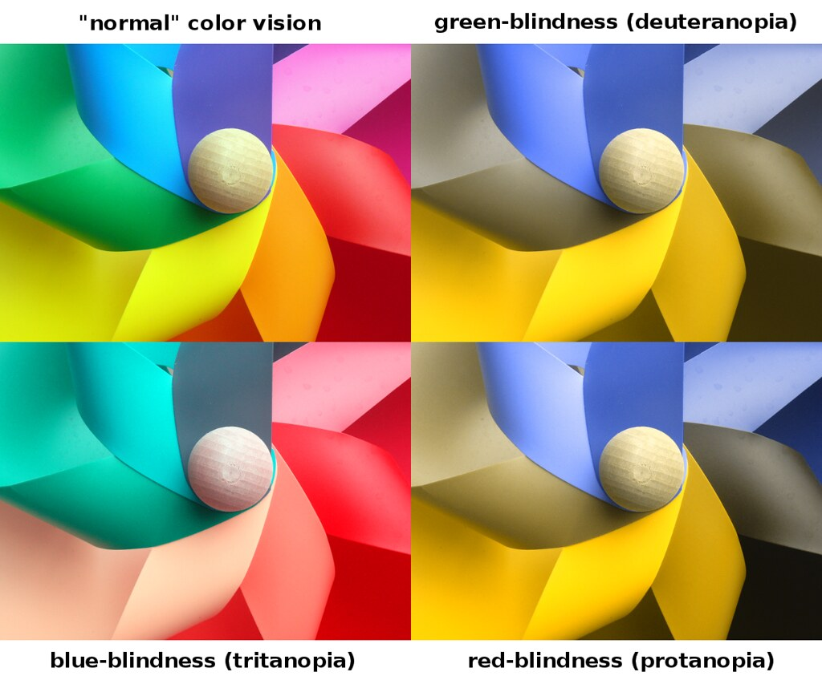
Vision Health Module
We all see differently

Slide 2
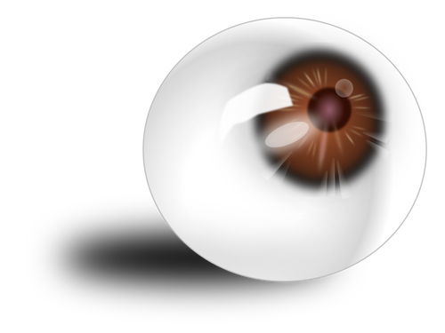
Eye Conditions
What is an eye condition?
Myopia (near-sightedness)
Hyperopia (far-sightedness)
Astigmatism
Colour blindness
Notes:
Eye Conditions - also called visual impairment.
What is an eye condition?
A problem that occurs in the eye that affects someone’s vision, and changes the way they see the world. Some eye conditions are able to be fixed and others aren’t.
Who has heard of any of the things on this list?
Do you know anyone with an eye condition?
Do you know people with glasses?
Do you know why they have them?

Slide 3
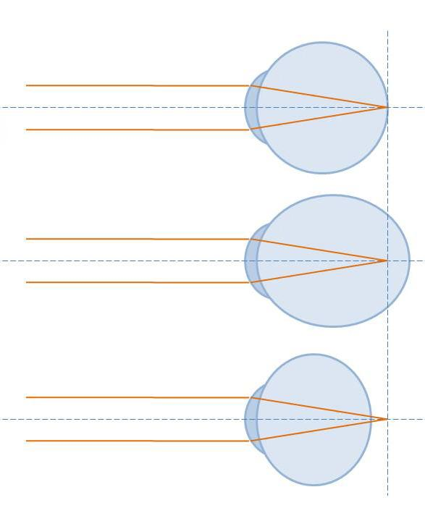
Myopia and Hyperopia
Normal vision
Myopia
Hyperopia
Myopia = near-sightedness
  Eyeball too long
  Easier to see things close-up
Hyperopia = far-sightedness
  Eyeball too short
  Easier to see things further-away
Notes:
Myopia:
Near-sightedness or short-sightedness
Eyeball too long, so light gets focused in front of the retina
This means that objects that are far away look blurry, and objects that are close look clear.
Most common.
Hyperopia:
Far-sightedness or long-sightedness
Eyeball too short, so light gets focused behind the retina
This means that objects that are far away look clear, but objects that are close look blurry.
Tip to remember: “Hyperopia” = longer word = long-sightedness. Easier to see objects a LONG way away.

Slide 4
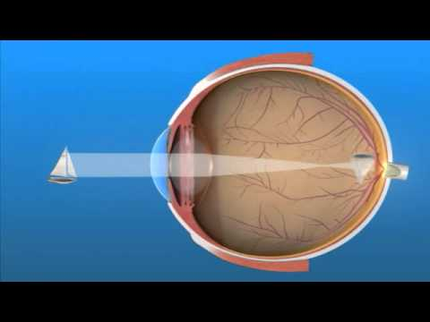
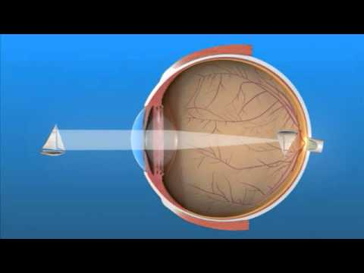
Myopia and Hyperopia
Notes:
Watch these two short videos explaining myopia (15 seconds) and hyperopia (17 seconds).

Slide 5

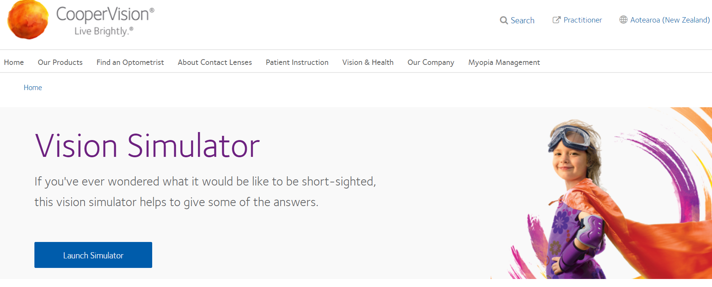
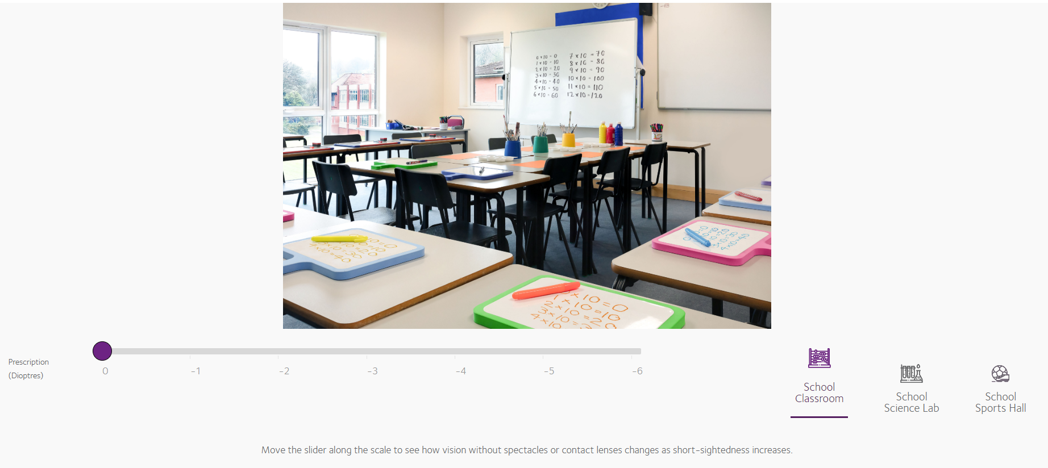
Myopia Simulation
On your iPad, search for “coopervision simulator” and open the website below
https://coopervision.co.nz/practitioner/clinical-resources/myopia-in-children/myopia-simulator
Choose “Launch Simulator”
Below the picture is a slider with different numbers. These represent the degree of myopia - numbers towards the right are more severe myopia.
Click on the different numbers. What happens to the picture?
On the bottom right of the page are options for “school science lab” and “school sports hall”. Click on these options to see what having myopia is like in these situations.
Notes:
Myopia can make it difficult to see things that are far away. In school, this may mean it is hard to see the whiteboard or things on the wall, and that is also hard to see the ball when playing sports. Some people may have mild myopia, whereas others may have severe myopia.
Teacher instructions
First discuss background information on what myopia is.
Emphasize that the simulator simulates what it is like to have untreated myopia – this is what it would look like for someone with myopia if they weren’t wearing their glasses or contact lenses.
This activity can be completed as a whole class, individually or in small groups.
The myopia simulation is at https://coopervision.co.nz/practitioner/clinical-resources/myopia-in-children/myopia-simulator
Either pre-open this simulation on devices or ask students to search “cooper vision simulator” to find the app themselves.
Once the activity is completed, discuss the results as a class.
Student instructions
Once the “myopia simulation” page is open, you will see a box at the top of the page with “Vision Simulator” written in it. Click on “Launch Simulator”.
You will see a picture of a classroom. Below this picture is a slider with different numbers. These numbers represent the degree of myopia – numbers on the left are milder myopia, and numbers towards the right are severe myopia.
Click on the different numbers, then wait for the picture to load. What happens to the picture?
On the bottom right of the page, there are options for “school science lab” and “school sports hall”. Click on these options to see what having myopia is like in these situations.
Discussion
What else could be difficult to do if you had myopia?
If children in the class have myopia and are willing, discuss the following:
What is it like?
What do you find difficult?
How do your glasses help?
Do you know what your glasses prescription is? Which number on the simulator is like what you can see without your glasses?
Who has family members or friends with myopia?

Slide 6
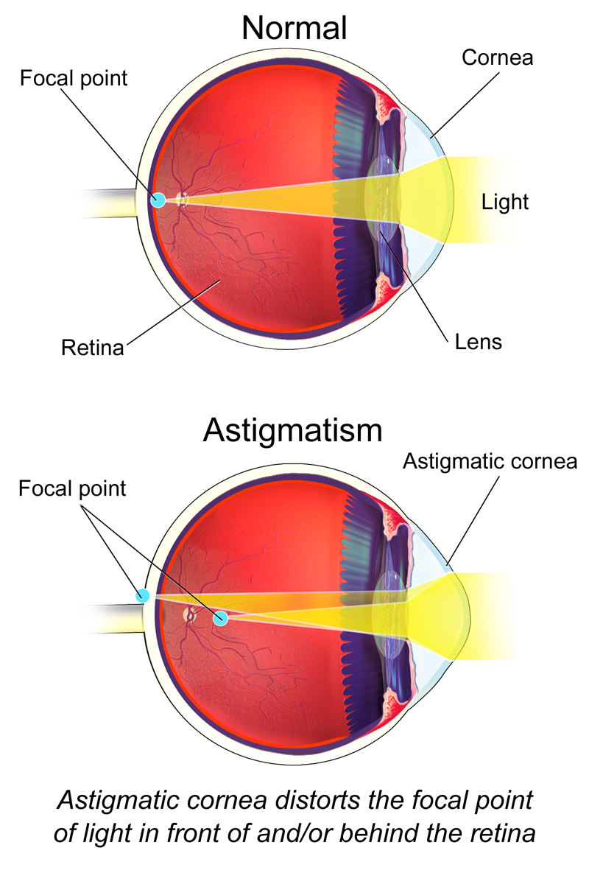

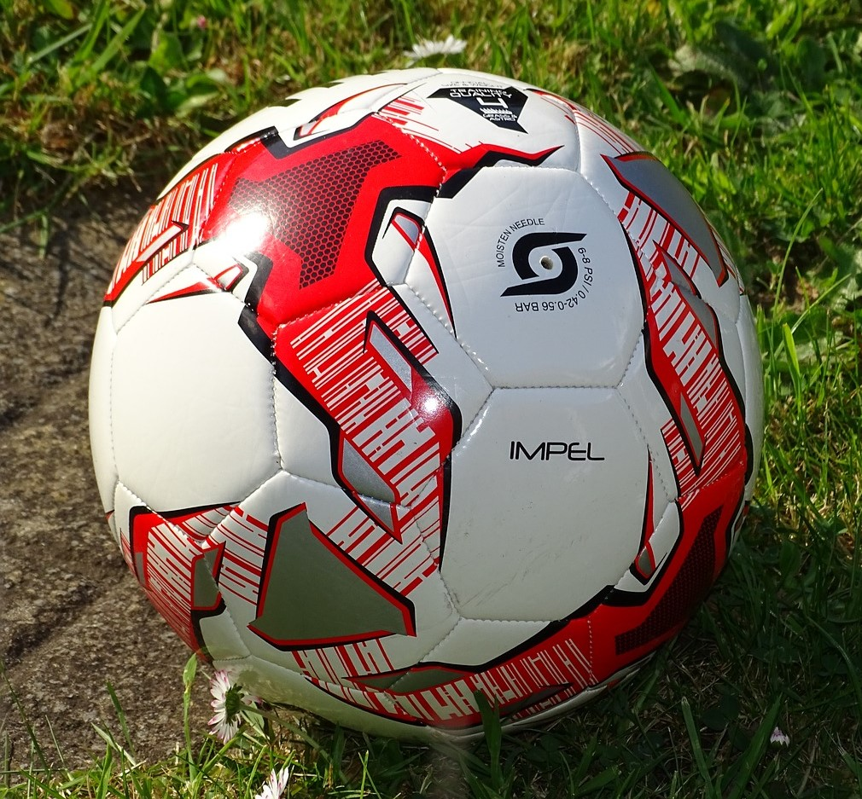
Astigmatism
Cornea uneven shape, like rugby ball
Light focused in two different places
Objects blurry both close up and far away
Notes:
Discuss with the class what astigmatism is.
Astigmatism affects the shape of our cornea. Usually our cornea is round and shaped more like a basketball or soccer ball, but with astigmatism the cornea is an uneven shape and is shaped more like a rugby ball.
This means that light is focused in two different places. Often one is in front of the retina and one is behind.
These two places are often at right angles to each other.
This means that things often appear blurry both close up and far away as it is hard for the eye to focus.

Slide 7
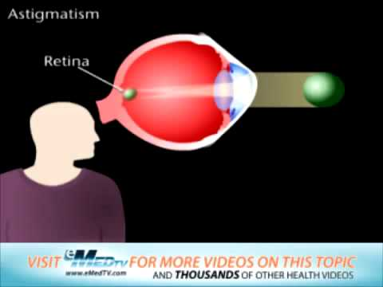
Astigmatism
Notes:
Watch this short video explaining astigmatism (31 seconds). Discuss with the class to ensure the children’s understanding.

Slide 8
Colour Blindness
People who are colour blind see colours in a different way from other people.
Caused by a problem with the cone cells in the retina, which help you see colour.
Lots of different types - the most common is red-green colour blindness.
Can be mild, moderate or severe.
Affects 8% of males and 1% of females.
Occurs from birth.
Notes:
Discuss with the class what colour blindness is.
Colour blindness:
Problem with the cone cells in the retina
There are 3 types of cone cells - blue, green and red.
In colour-blindness, you have a problem with one type of cone cells, so you see colours in a different way. For example, a problem with your green cone cells means you are less sensitive to green light, but it affects how you see all colours.
There are lots of different types of colour-blindness, and it can be mild, moderate or severe.
Affects about 8% of males and 1% of females.
It is inherited from your parents - you are born with it. Boys often inherit it from their grandfathers.
Can be mild, moderate or severe.
99% of colour-blindness is red-green colour-blindness (actually includes 4 types).
This means that people have a problem with either their red or green cone cells, so are less sensitive to red or green light. Some people don’t have red or green cone cells at all!
They have difficulty distinguishing between reds, greens, browns and oranges, and also commonly confuse blue and purple.
Which colours look similar in the picture?

Slide 9
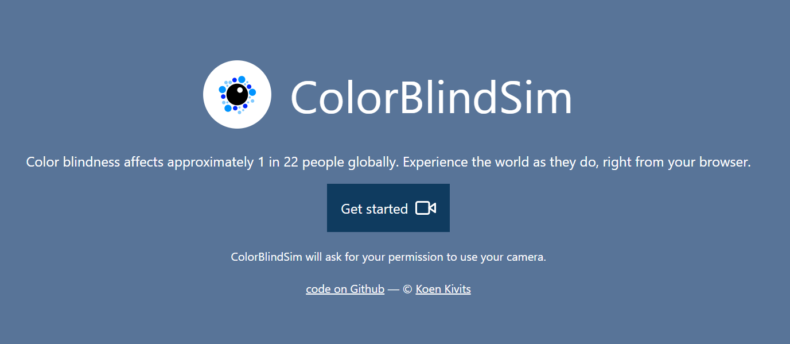
Colour Blindness Simulation
https://www.colorblindsim.com/#app
Search for “color blind sim” on your iPad.
Open the app and click “Get Started”.
On the left side of the page is a list of all the different types of colour blindness.
Click on the first type of colour blindness and hold the iPad over your coloured pencils. What happens to the colours?
You can click on the “eye” symbol on the screen to change back to normal vision as a comparison.
Try this with the different types of colour blindness.
Notes:
What you need
· iPad, tablet or computer, with internet access.
· Items of different colours e.g. coloured pencils, felts, paper.
Teacher instructions
This activity can be completed as a whole class, individually or in small groups.
The colour blindness simulation is at https://www.colorblindsim.com/
Either pre-open this simulation on devices or ask students to search “color blind sim” to find the app themselves.
Once the activity is completed, discuss the results as a class.
Student instructions
1. Once the “color blind sim” page is open, click on “Get Started”.
2. On the left side of the page is a list of the different types of colour blindness.
3. Click on the first type of colour blindness and hold the device over the different coloured items. What happens to the colours? Are they all different or only some of them?
4. You can click on the “eye” symbol on the screen to change back to normal vision as a comparison.
5. Try this with all the types of colour blindness.
Discussion
Which types of colour blindness were similar?
Do you know anyone who is colour blind?
How could being colour blind affect someone in their daily life?

