Slide 1


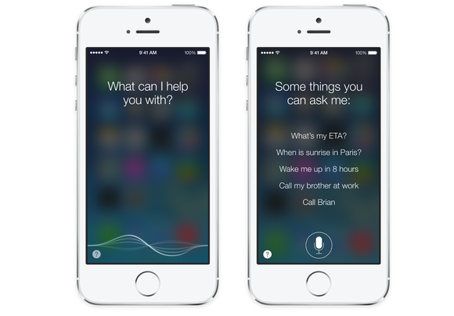
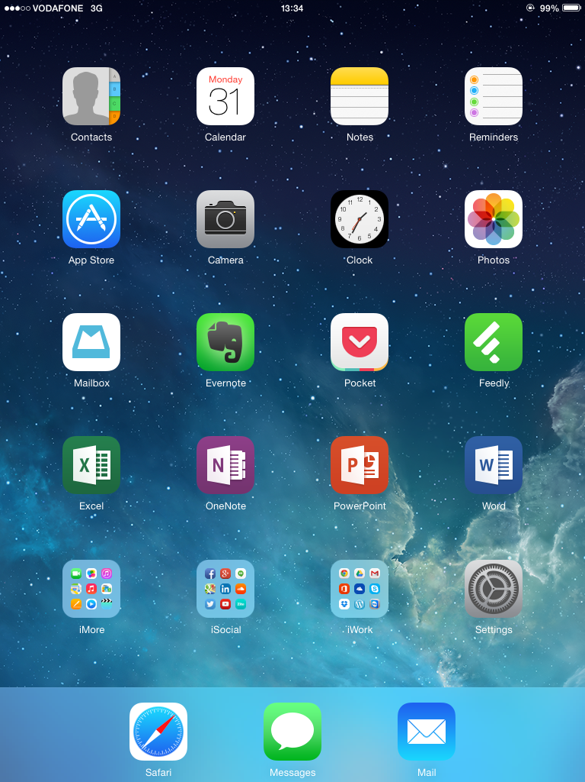
Vision Health Module
Technology and Vision

Slide 2
Technology for Visual Impairment
iPAD / iPHONE | ANDROID
Siri | Google Now
Voiceover | Talkback
Magnifier | Magnifier
SeeingAI | TapTapSee
Notes:
There is a lot of technology around that can help people who have eye conditions or visual impairment. This table is an example of some technologies that are available on iPads/iPhones, and their equivalent Android phones and or tablets. We’re going to explore some of the iPad technology a bit later.
Brainstorm with the class on the board:
What are some things that might be hard to do with your phone or iPad, if you couldn’t see very well?
What are some general daily things that might be hard to do?
Make sure the following are included in the list:
Knowing what time it is, or what day / date it is
Seeing which Apps are which to open them
Sending texts or emails
Reading emails or texts
Knowing what colour things are e.g. pens or your clothes.
Reading food labels eg on cans

Slide 3

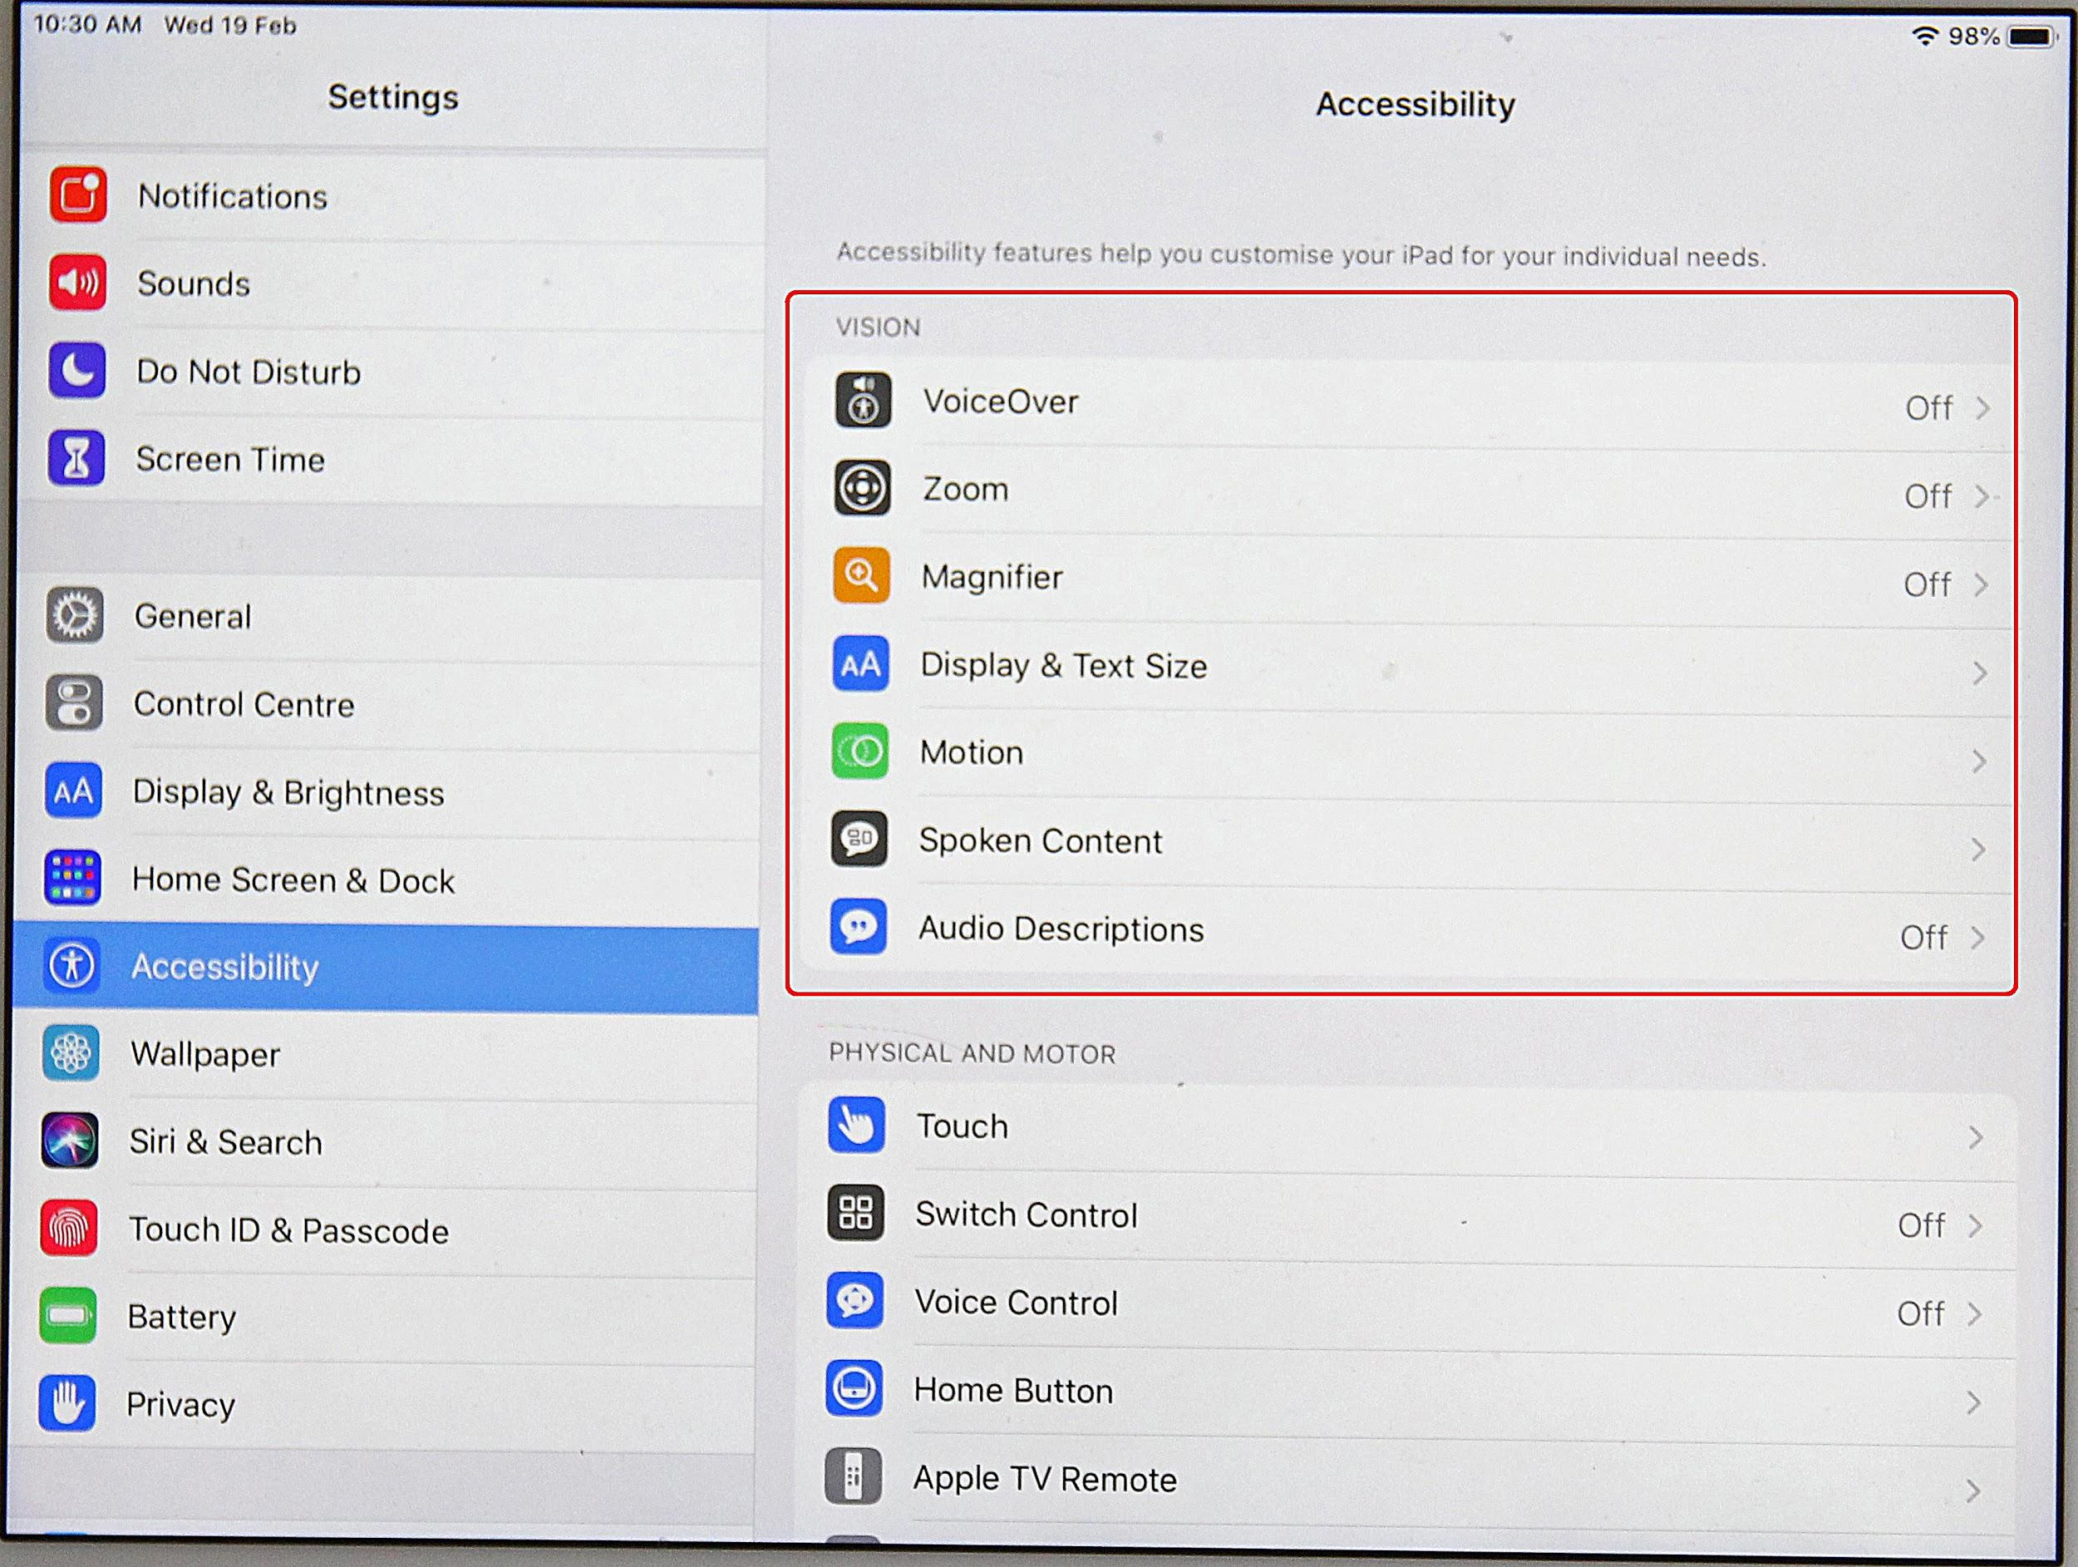
iPad Accessibility
Open your iPad “Settings” “General” “Accessibility” “Vision”.
Explore each feature, except for VoiceOver.
Think about the following:
  How do they work?
  What kind of things could they help with?
  Are they easy to use?
  Would they be easy to use for someone who had a visual impairment?
Notes:
There is a lot of technology around that can help people who have eye conditions or visual impairment. The vision accessibility features available on an iPad or iPhone are one example of technology that has been developed to assist those with visual impairments. Students will explore these features and reflect on their usefulness to someone who has difficulty seeing.
Vision accessibility features include:
VoiceOver
Zoom
Magnifier
Display and Text Size
Motion
Spoken Content
Audio Descriptions
Teacher instructions
These activities can be completed individually, or in pairs or groups. It may work best to divide up the accessibility features between groups and get the groups to report back to the class.
Before starting the activity, brainstorm with the class on the board:
What are some things that might be hard to do with your phone or iPad, if you couldn’t see very well?
What are some general daily things that might be hard to do?
For example: knowing what time it is, seeing apps to open them, sending texts or emails, reading texts or emails, knowing what colours things are e.g. pens or your clothes, reading food labels.
· Note: exploring VoiceOver is completed in a separate activity.
Student instructions
Open your iPad settings
Go into “General”, then “Accessibility”, then “Vision”. It should look similar to the list below, depending on which version iPad/iPhone you have.
Explore the features available. Think about the following:
How do they work?
What kind of things would they help with?
Are they easy to use?
Would they be easy to use for someone who had a visual impairment?
Discussion
Questions to reflect on:
Which features would be most useful if someone had visual impairment?
Were there any problems with them?
What did you find the easiest to use?
For which activities on the list you made, could the accessibility features help with?

Slide 4
What is Siri?
Siri is Apple’s voice-controlled personal assistant.
Siri can:
Answer specific questions
e.g. what time is it?
Perform actions
e.g. open camera
Make recommendations
e.g. how do I get to ….?
Notes:
Ask the children who knows what Siri is?
How many people have used Siri before?
Siri is Apple’s voice-controlled personal assistant. Siri can:
Answer specific questions
Tell you how much battery is left on your phone
Tell you the time or date
Tell you the weather forecast
Perform actions
Open apps eg “open camera”
Set an alarm, reminder or calendar appointment
Phone or text people
Read out and reply to emails
Make recommendations
Give you directions to get somewhere
Where is the best place to eat

Slide 5
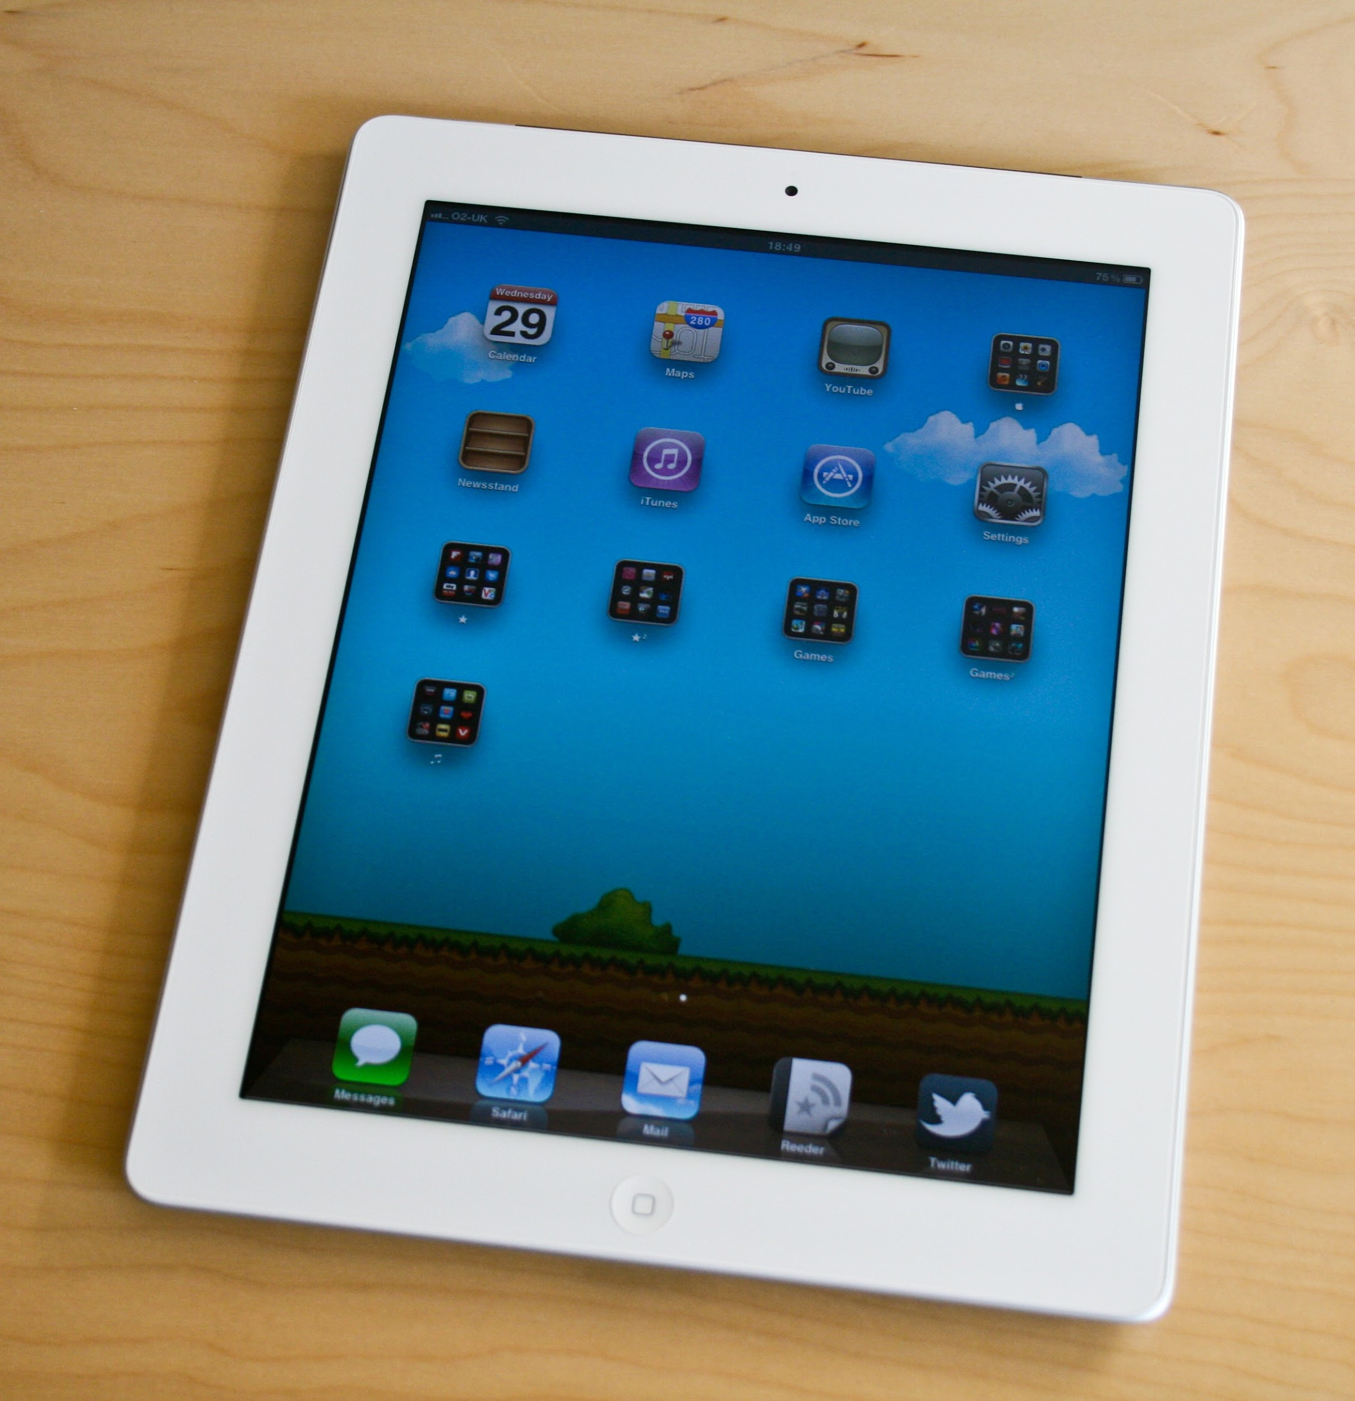
Using Siri
Make sure Siri is activated
Go to Settings General Siri on.
How to use Siri
Hold down Home button for approximately 1-2 seconds.
Take finger off home button, then speak/ask your question.
Siri will reply.
Test out the following, using Siri as though you have a visual impairment:
How much battery is left on the iPad?
What date / time is it?
Opening apps
Reading a text or email
What is the weather like today?
Where is the nearest park?
Notes:
Teacher instructions
These activities can be completed individually, or in pairs or groups. Activities could be allocated to groups of students, with groups reporting on their findings to the class.
The aim is for the children to explore ways that Siri could help someone with visual impairment.
To simulate visual impairment, children can either wear sunglasses smeared with Vaseline, or close their eyes.
How to use Siri:
Before using Siri, you need to make sure she is activated. Go to “Settings”, then “General”, then “Siri”, then “ON”.
Hold down the Home button, for approximately 1-2 seconds. Take your finger off the home button, then speak/ask your question. Siri will reply.
Test out the following, using Siri as though you have a visual impairment:
How much battery is left on the iPad?
What date is it?
What time is it?
Opening apps
Reading a text or email
Sending a text or email
What is the weather like today?
Where is the nearest park?
Discussion
Questions to reflect on:
Which tasks would be most useful if someone had visual impairment?
Were there any problems with them?
What did you find the easiest to use?
For which activities on the list you made, could Siri help with?
Tell the children that they are going to imagine that they have a visual impairment and test out Siri to see what she could help them with.
To simulate visual impairment, children can either
Smear vaseline on either lab glasses or sunglasses and wear them
Close their eyes
Using Siri:
Before using Siri, you need to make sure she is activated. Go to Settings, General, Siri, ON.
How to use Siri:
- Hold down the Home button, for approximately 1-2 seconds. If VoiceOver is on, it makes a beep sound. Take finger off home button, then speak/ask your question. Siri will reply.
From the list you made of things that might be hard to do with a visual impairment:
Get kids to test out on iPads if Siri can help with them, and make notes on which ones Siri helps with and which ones she can’t.
Make sure the following are tested:
Sending a text and/or email
Reading a text and/or email
Asking the time and/or date
Opening apps
Battery charge
Report back to class.

Slide 6
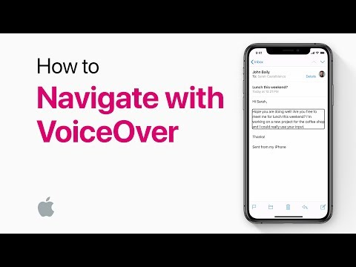
What is VoiceOver?
Notes:
VoiceOver is Apple’s screen reader, which will describe aloud what is on your screen. It has been designed especially for people who have visual impairment or dyslexia.
Watch the following video introducing Voiceover (3 mins 57 seconds).

Slide 7
VoiceOver Summary
Turning on VoiceOver
Make sure VoiceOver is enabled under accessibility settings.
Either:
  Ask Siri to turn on VoiceOver “Siri, turn on VoiceOver”
  OR Press the “Home” button three times quickly
Using VoiceOver
Tap/touch an app and VoiceOver will read it out.
Move your finger around the screen for VoiceOver to read other apps.
Tap an app twice and VoiceOver will open it.
Use three fingers to swipe to another page/screen.
Notes:
Demonstrate to the class how to turn Voiceover on/off, and how to use it on the screen.
Make sure all children turn Voiceover on, and have a brief go using it.
Instructions:
Turning on VoiceOver
Make sure VoiceOver is enabled under accessibility settings.
Either:
Ask Siri to turn on VoiceOver “Siri, turn on VoiceOver”
OR Press the “Home” button three times quickly (if this feature is enabled).
Using VoiceOver
Tap/touch an app and VoiceOver will read it out.
Move your finger around the screen for VoiceOver to read other apps.
Tap an app twice and VoiceOver will open it.
Use three fingers to swipe to another page/screen.

Slide 8
Using VoiceOver
INSTRUCTIONS:
Turn on VoiceOver on your iPad.
Get your partner to choose an app for you to find.
With your eyes closed, use VoiceOver to navigate around the iPad and find the correct app.
Swap roles and try various apps.
Notes:
Teacher instructions
This activity is designed to be completed in pairs or threes.
The aim is for the children to explore ways that VoiceOver could help someone with visual impairment. To simulate visual impairment, children can either wear sunglasses smeared with Vaseline, or close their eyes.
Demonstrate to the class how to turn Voiceover on/off, and how to use it.
Student instructions:
Turn on VoiceOver on your iPad.
Get your partner to choose an app for you to find.
With your eyes closed, use VoiceOver to navigate around the iPad and find the correct app.
Swap roles and try various apps.
Discussion
Questions to reflect on:
How easy was it to use VoiceOver to find and open apps?
What else do you think VoiceOver could help with?

Slide 9
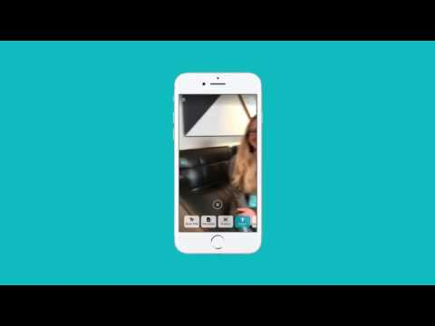
What is Seeing AI”?
Notes:
Seeing AI is a free iPhone app that narrates the world around you. It has been designed especially for people with visual impairment, and it has different channels that do different things. It works with iPhone 6 or later.
Channels include:
Short text: reads out text that you hold your phone over e.g. an envelope or sign. Also works for some food packets.
Document: takes a photo of a larger volume of text and reads it out e.g. a document, book.
Product: scans a barcode on a product and tells you what it is e.g. can of tomato soup
Currency: tells you what type of bank note you have (note: doesn’t work for NZ currency)
Colour: tells you what colour an item is. Not very accurate.
Person: describes a person and roughly how far away they are from you. You can teach the app to recognise your friends.
Scene: describes a scene e.g. “person sitting at a table in front of a laptop”
Handwriting: takes a photo of handwriting and reads out the text
Light: emits a tone – higher tone when there is lots of light, lower town when it is dark. Useful to identify windows, doors etc.
Watch the following video about Seeing AI (1 min 32 seconds).
Which of the activities in your original list, does Seeing AI claim to help with?

Slide 10
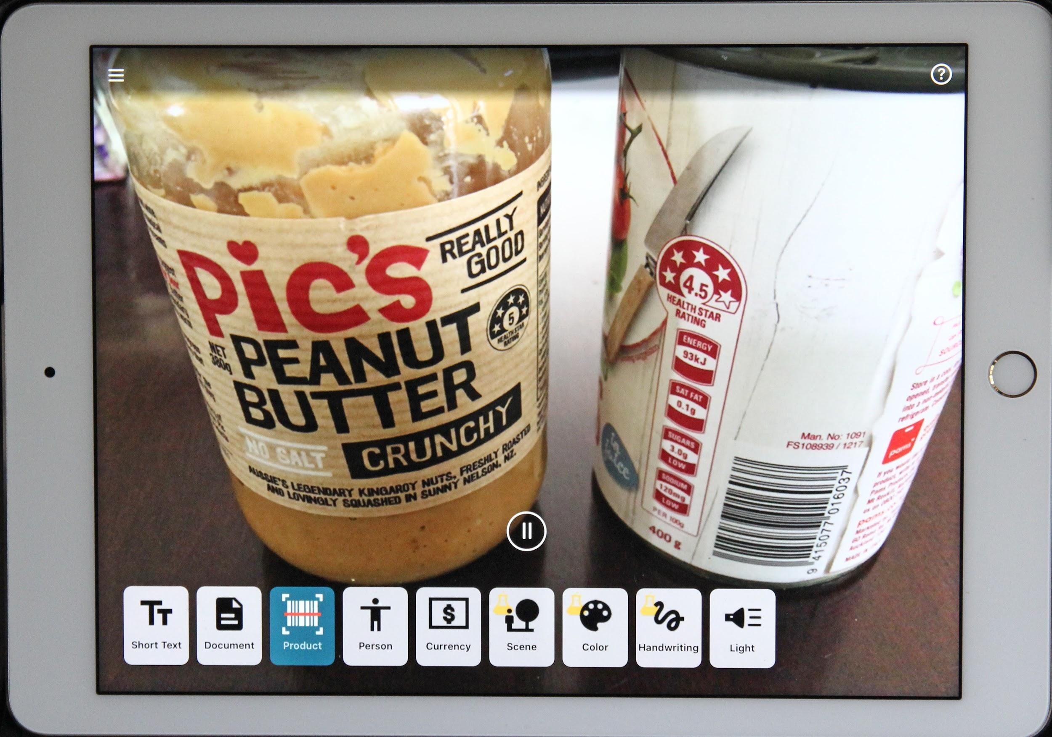
Seeing AI Summary
Seeing AI is a free iPhone/iPad app that uses the device’s camera to do things like read out written text, describe people, identify colours and scan food barcodes.
How to use Seeing AI
Make sure VoiceOver is on
To open Seeing AI:
  Use Siri: “open seeing ai”
  OR use VoiceOver to double tap app to open it.
Tap bottom of screen to activate channels.
Swipe up from bottom of screen to move to a channel on the right.
Swipe down towards bottom of screen to move to a channel on the left.
To go back to the main screen from a channel: at the top left corner of the screen is the back button – tap this once, then tap twice.
Channels
- Short text - Document
- Product - Person
- Currency - Scene
- Color - Handwriting
- Light
Notes:
Briefly demonstrate to the class how to use Seeing AI. Make sure each child has turned Voiceover on and has opened Seeing AI.
Seeing AI Summary:
How to use Seeing AI
Make sure VoiceOver is on
To open Seeing AI:
Use Siri: “open seeing ai”
OR use VoiceOver to double tap app to open it.
Tap bottom of screen to activate channels.
Swipe up from bottom of screen to move to channel on the right.
Swipe down towards bottom of screen to move to channel on the left.
To go back to the main screen from a channel: at the top left corner of the screen is the back button – tap this once, then tap twice.

Slide 11
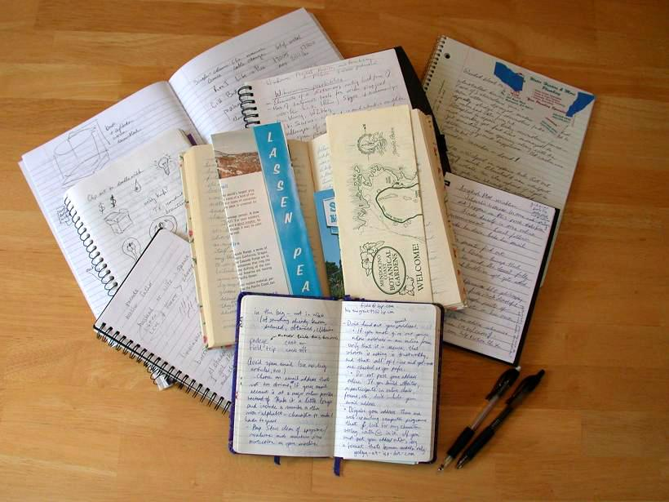

Using Seeing AI
Use Seeing AI to complete the following tasks:
Short text channel: Read out the title of a book, or a sign in the classroom
Product channel: Scan the barcode on your food packet / can
Handwriting channel: Read your handwriting in a school book
Person channel: Describe a classmate
Scene channel: Describe the scene in the room
Color channel: Identify the colour of something (e.g. a pen, your jersey)
Document channel: Scan a page of text and read it out (e.g. from a book)
Light channel: Find the windows in the classroom
Which tasks worked well? Which didn’t work so well?
Notes:
What you need
iPad/iPhone
Lab glasses/sunglasses (optional)
Vaseline (optional)
Food packets
Food cans
School books – with handwriting
Newspaper or magazine article
Exploring Seeing AI:
Using Seeing AI, complete the tasks below either wearing the Vaseline-smeared glasses, or with your eyes closed.
Read out a sign in the classroom and/or the title of a book
Use the “Short text” channel
Hold the phone over the text and it will automatically read it out.
Scan the barcode on your food packet or can
Use the “Product” channel
Hold the phone over the barcode, it will beep when it sees the barcode and then read it out.
Read your handwriting in a schoolbook
Use the “Handwriting” channel
Tap button once, then twice to take a picture. The phone will then read out the text.
Describe a classmate
Use the “Person” channel
Hold up the phone towards a person, the phone will tell you roughly how far away the person is.
Tap screen once, then tap twice to take a picture. The phone will then describe the person with their rough age and facial expression.
Describe a scene
Use the “Scene” channel
Hold phone towards a scene (e.g. classroom, group of people doing something)
Tap screen once, then tap twice to take a picture. The phone will then describe the scene.
Identify the colour of something (e.g. a pen, your jersey)
Use the “Colour” channel
Scan a page of text and read it out (e.g. from a book)
Use the “Document” channel
Hold phone over the text, the phone will direct you to make sure it can see the edges.
Press button once to activate the camera, then twice to take a photo. The phone will then read out the text.
Find the windows in the classroom
Use the “Light” channel
Move around the room (guided by a friend to avoid collisions). The phone will emit a tone (noise), which will sound higher when there is lots of light. Listen to this tone and find you way towards the windows.
Discussion
Questions to reflect on:
How easy was it to use the different channels?
Which tasks worked well?
Which channels do you think would be the most useful if you had a visual impairment?
What other tasks can you think of that Seeing AI could help with?

