Slide 1

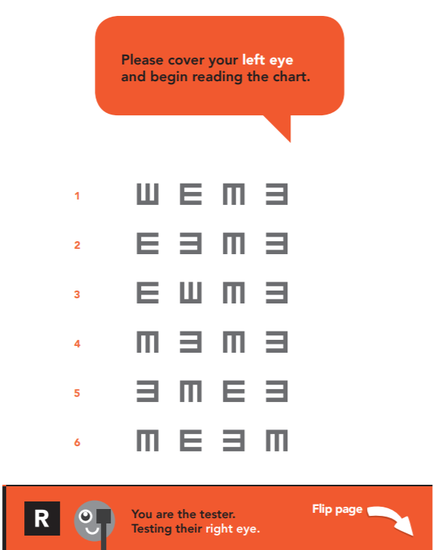
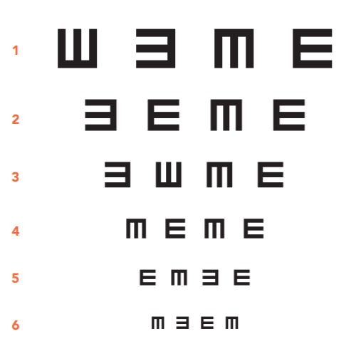
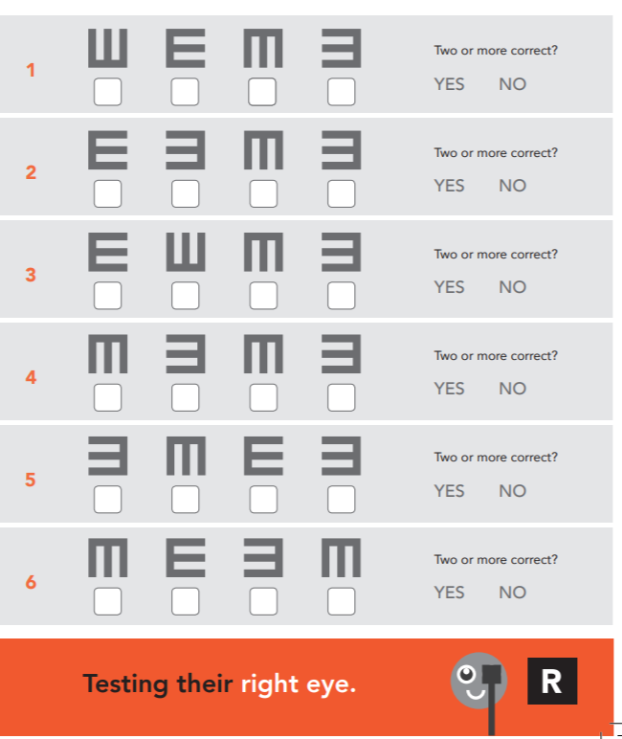
Vision Health Module
Child-to-Child Vision Screening

Slide 2
Vision screening overview
You are going to test each other’s vision,
working in groups of 3
  1 person has their vision tested
  (points the direction of the E’s)
  1 person tests someone’s vision
  (holds the flipchart)
  1 person records the results
There are two tests - each eye is tested
separately (cover your other eye so you can’t see)
Then swap roles, so each person gets their vision tested
Notes:
Work in groups of three
1 person has their vision tested (points the direction of the E’s)
1 person tests someone’s vision (holds the flipchart)
1 person records the results
There are 2 tests in total - each eye is tested separately (cover your other eye so you can’t see)
Each test is colour-coded
Swap roles, so each person gets their vision tested
Note: it is recommended not to have more than 5 groups of children (15 children) testing each other’s vision at once. This allows the teacher to effectively monitor each group of children to ensure they are completing the testing accurately.

Slide 3
Vision screening roles
ROLE 1: Having your vision tested
(pointing the directions of the E’s)
If you usually wear glasses for seeing things in the distance,
make sure you wear them for this test.
Stand on the line of tape, 4m away from the person holding the flipchart.
Make sure you cover your eye with your hand so you can’t see out of it.
Read the chart from left to right, starting at Row A.
Use your arm to point in the direction that the branches of the “E” are facing.
Make sure you point SLOWLY.
If you make a mistake, you can repeat that row once.
Notes:
Person having their vision tested (pointing the direction of the E’s)
If they usually wear glasses, it is essential that children wear them for this exercise. This excludes reading glasses as they are to improve near vision and won’t be needed for this far vision testing.
Stand on the line of tape, 4m away from the person holding the flipchart. These lines will be measured and marked out with tape.
This vision test uses the letter E. Children will be asked to point with their arm the direction that the branches of the E are facing. It is important that they do this very SLOWLY so the person screening them, and the results keeper can clearly see what direction they are pointing.
We are testing both left and right eyes in turn. When testing children’s left eye for example they will need to cover their right eye with their hand enough to block their vision from that eye. It’s important that they can’t see anything out of the eye they are covering.
It is important to read the chart from left to right (start on the side with the red numbers).
Even if children can’t see a letter very well, they can have a guess as to which way the E’s are facing.
Get the children to point the direction of the top line of E’s on the screen, to ensure their understanding.
Note: you may notice that the E’s that are pointing left and right, are facing opposite ways on the charts for the person being screened and the person testing/recording the results. For example, an E which is facing to the right for the tester and person recording the results, will face to the left for the person being tested. This is because if a child points to his/her left, it will look like they are pointing right for the tester and person recording the results.

Slide 4
Vision screening roles
ROLE 2: Testing someone’s vision
(holding the flipchart)
Stand on the line of tape, 4m away from the person having
their vision tested.
Hold the chart up straight, at the top and bottom.
Read out the instructions exactly as they are written on the page.
Make sure the person having their vision testing is covering the correct eye.
Read out the letter of the row before the person being tested starts pointing, e.g. “ row 1”.
Turn each page AWAY from you.
If the person being tested gets a direction wrong, you can ask them to repeat that line.
Notes:
Person testing someone’s vision (holding the flipchart)
Make sure they hold the chart up straight, at the top and bottom so they are not covering any of the letters.
Make sure the person having their vision tested is covering the correct eye.
Read out the number of each row before the person being tested starts pointing, e.g. “row 1”.
They need to turn each page AWAY from them.
Make sure the person being tested reads the row from LEFT to RIGHT.
If the person being tested gets a direction wrong, they can ask them to repeat that line.
Hold up a flipchart to demonstrate the correct way to hold it. Demonstrate turning the pages over the correct way.

Slide 5
Vision screening roles
ROLE 3: Recording the results
Stand beside the person holding the flipchart.
Carefully watch the person who is getting their vision tested,
and which way they are pointing for the limbs of the E’s.
If they point in the correct direction, draw a TICK in the box.
If they point in the wrong direction, draw a CROSS in the box.
Start at Row 1 and go through each line of the chart.
Make sure you are recording the results for the correct test.
Make sure you complete tests for both eyes.
If the person being tested gets a direction wrong, you can ask them to repeat that line.
Notes:
Person recording the results
Their job is to carefully watch the person who is getting their vision tested, and which way they are pointing, for the limbs of the “E’s”.
If they point in the correct direction, draw a “tick symbol” in the box.
If they point in the wrong direction, draw an “X” in the box.
When they have finished the row, circle “yes” or “no” for whether they have gotten two or more ticks for that row.
Start at row 1 and go through each line of the chart.
Make sure you are recording the results for the correct test.
Make sure you complete both tests.
If the person being tested gets a direction wrong, you can ask them to repeat that line.
Hold up a results sheet to show the children.

Slide 6

Fair testing
What is fair testing?
A way to investigate a scientific question
Important to follow the instructions exactly
  e.g. stand on the 4m line
  If someone points too fast and you didn’t see which way
  they pointed you need to ask them to repeat that line
Must be honest with your results and not help each other to see the E’s.
Why is fair testing important?
Otherwise the results might not be accurate
Someone might not get glasses when they need them and their eyes might get worse
This test is not about having “good” or “bad” vision but about understanding that everyone sees differently.
Notes:
Ask children if they know what fair testing is?
A way to investigate a scientific question
Variables must be kept the same, except for the variable you are investigating (children’s vision in this case)
Means they need to follow the instructions exactly
e.g. stand on the 4m line
If someone pointed too fast and you didn’t see which way they pointed you need to ask them to repeat that line
Fair testing also means that they need to be honest with their results and not help each other to see the E’s.
Why is fair testing important?
Otherwise it might make it easier or harder for someone to see the E’s.
It might mean our results aren’t accurate
Someone might not get glasses when they need them - eyesight could get worse
Emphasize that it’s not about having “good” or “bad” vision but about understanding that everyone sees differently.
Ask the children if they have any questions and clarify any confusion regarding the vision screening process.
Use the masking tape and metre ruler to measure and mark the 4m lines. When children are doing the screening, the person being tested will stand behind the tape on one side and the tester and results recorder will stand opposite them behind the second masking tape line.

Slide 7
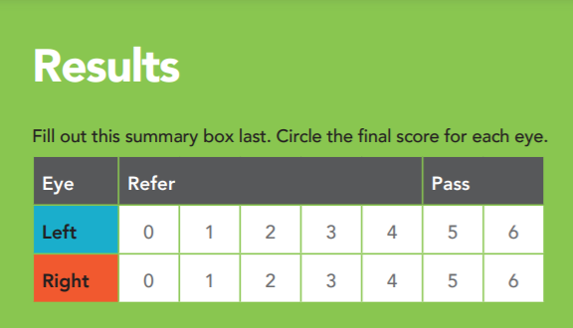
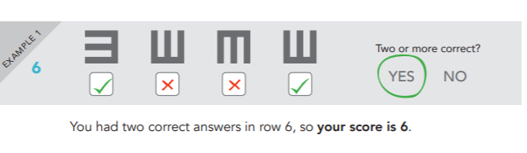
Summarizing your results
You need to fill in the “Results Summary” table
on your results sheet.
First, you must calculate your score for
each test.
Your final score is the number of the most
difficult line that you got two or more correct
(two or more ticks).
The most difficult line is Row 6.
Start by looking at Row 6.
Notes:
This can be completed by children in their groups of threes (utilising peer-to-peer teaching), or can be led by the teacher (the whole class summarizes their results together).
The children need to calculate their final score for each test, so they can fill in the results summary table on their results sheet.
Their final score for each test/page, is the number of the most difficult line that they got two or more correct (two or more ticks).
The most difficult line is row 6; the easiest line is row 1.
Look at the scores for row 6 first.
E.g. If they got 2 or more ticks for row 6, then their score is 6.
E.g. If they got 0 or 1 tick for row 6, look at how many ticks they got for row 5. If they got 2 or more ticks for row 5, their score is 5. If they got 0 or 1 or tick, look at row 4 etc. Continue as far up the chart as necessary.
The majority of children will score 6’s and not need referring for visual impairment.
When they have worked out their score for a test, circle the score number in the results summary chart.
Complete this process for both charts.
Explanation of the scores:
A score of 0-4 = refer. This means that the child may have some problems with their vision, so it is recommended that they go to the optometrist for a more detailed eye examination.
A score of 5-6 = pass. This means that the child’s vision is within normal range.
For further information on interpreting “refer” scores, see “Child-to-child vision screening toolkit - further information”.

Slide 8
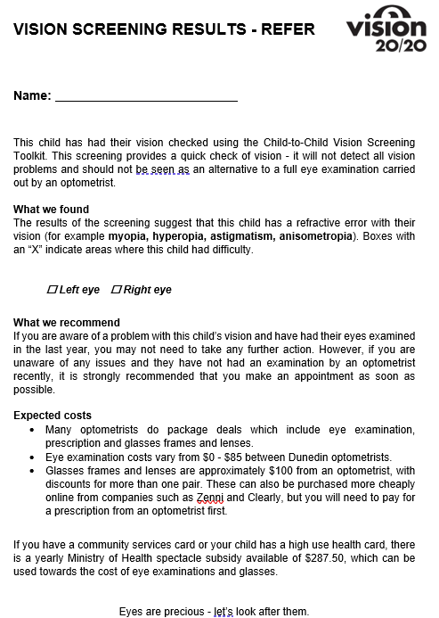
Recording your results
You need to record your results in two places:
Class vision screening spreadsheet
Vision screening results letter
  You will take this home to your parents
  If your overall result is “Pass” - write your name at the top of the “Vision Screening Results - Pass” letter.
  If your overall result is “Refer” - write your name at the top of the “Vision Screening Results - Refer” letter. Then tick the boxes on the letter for which tests you had a “refer” score (0-4).
Notes:
Once children have had their vision screened and have summarized their results, they need to record these results in two places:
1. Excel spreadsheet
· There is an excel spreadsheet template available for teachers to download from the Science Learning Hub, for the children to input their results into. Teachers will then have a record of children’s overall results.
2. Vision Screening Results letter
· This letter will go home with the child to their parents. The “Pass” and “Refer” letters are intentionally printed in the same colour so that children’s results are less obvious to their peers.
· Overall result “Pass”
o Children simply need to write their name at the top of the “Vision Screening Results – Pass” letter.
· Overall result “Refer”
o Children need to write their name at the top of the “Vision Screening Results – Refer” letter.
o They then need to tick the boxes on the letter for which tests they had a “refer” score (0-4).

