Slide 1
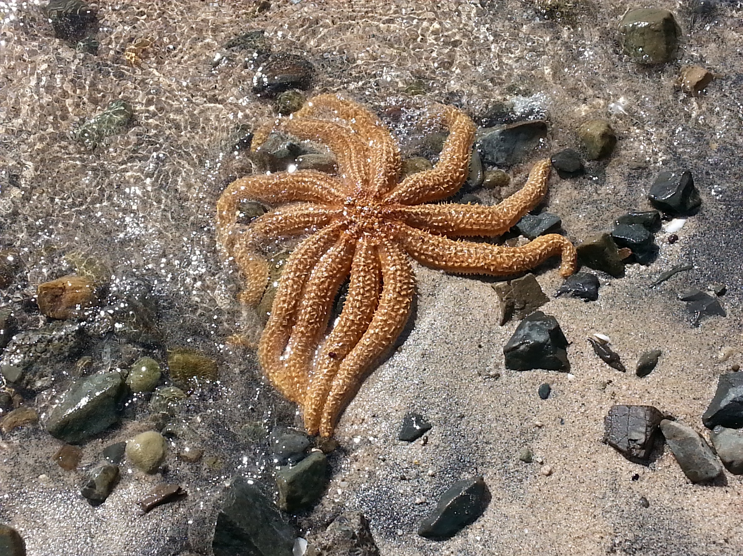
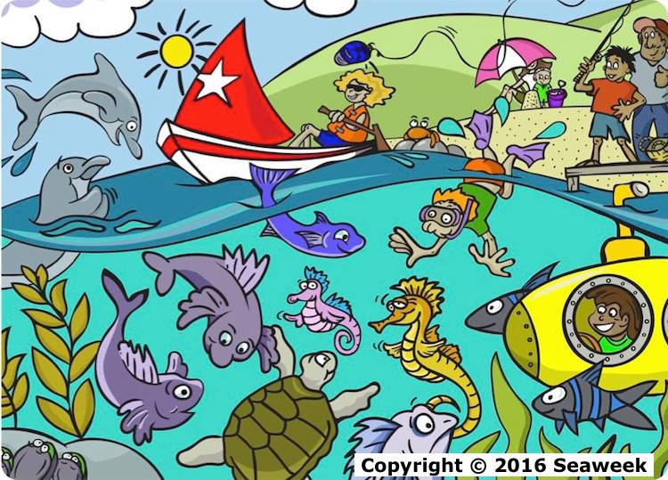
Seaweek
Toiora te Moana – Toiora te Tangata
Healthy Seas, Healthy People
Barb Ryan
February 2016
@NZScienceLearn
www.sciencelearn.org.nz
© 2015 The University of Waikato | www.sciencelearn.org.nz

Slide 2


What is the Science Learning Hub?
A trustworthy online resource – produced by educators and scientists
Based on world-class New Zealand science research
Supported by learning activities, information about the key science ideas and concepts, multimedia tools and other resources
Written for New Zealand teachers and students

Slide 3
What is Seaweek?
Seaweek is New Zealand’s annual national week about the sea – events are held all over New Zealand
Saturday 27 February to Sunday 6 March 2016
It is hosted by
the New Zealand Association for Environmental Education (NZAEE)
Theme: Toiora te Moana – Toiora te Tangata – Healthy Seas, Healthy People.
National Coordinator: mels@subliminal.co.nz
For further information, go to: http://seaweek.org.nz
© 2016 The University of Waikato | www.sciencelearn.org.nz

Slide 4
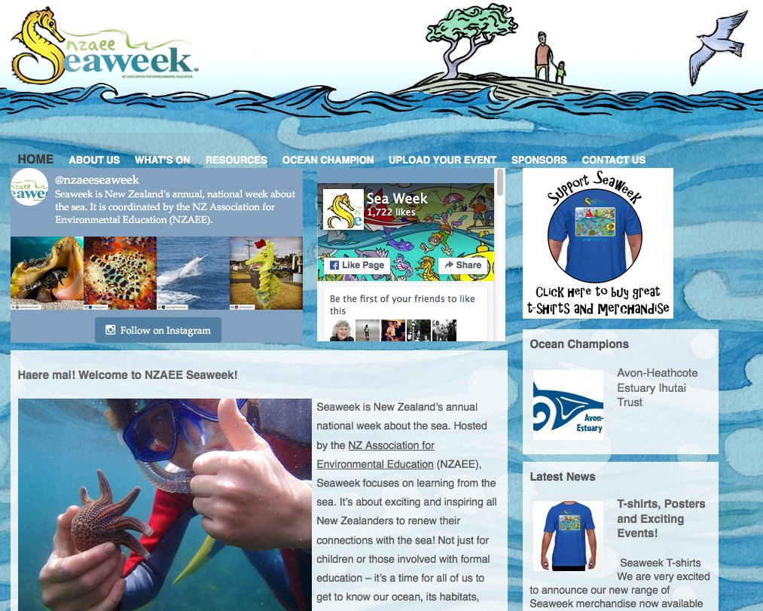
© 2016 The University of Waikato | www.sciencelearn.org.nz

Slide 5
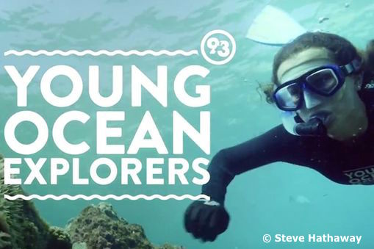
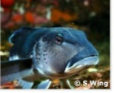
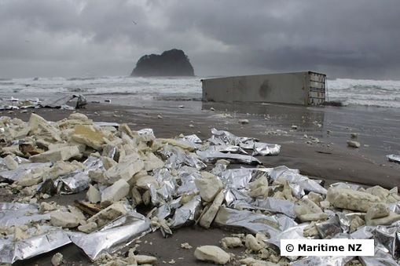
Try some of these resources from the Science Learning Hub
Young Ocean Explorers: Teenager Riley Hathaway and her dad Steve Hathaway
explore New Zealand’s marine ecosystems
Life in the Sea: Exploring New Zealand’s
marine environment
Where Land Meets Sea: Land and sea are intricately linked – one impacts on the other
© 2016 The University of Waikato | www.sciencelearn.org.nz

Slide 6
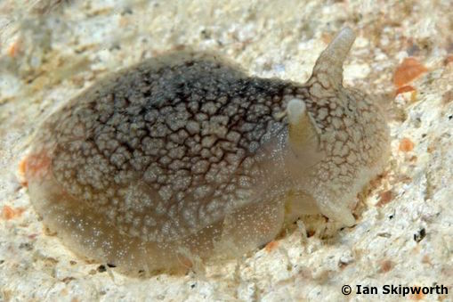
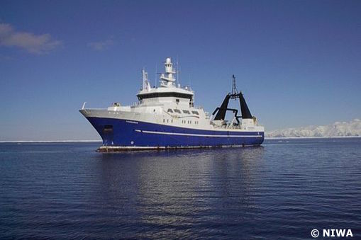
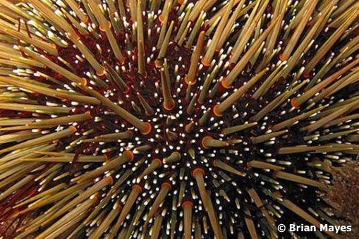
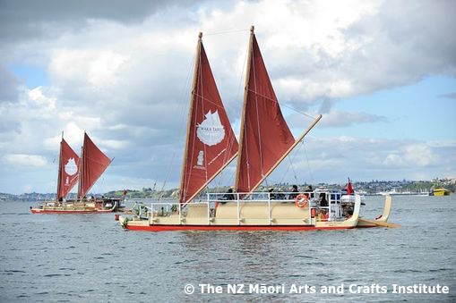
More resources from the Science Learning Hub
Toxins: Links between toxins and the marine food web
Research Voyage to Antarctica: Scientists make an 8-week voyage to the Ross Sea
The Noisy Reef: Relates mostly to concepts about sound but has an article describing a healthy reef
Navigating Without Instruments: Navigating using the ocean and the sky
© 2016 The University of Waikato | www.sciencelearn.org.nz

Slide 7
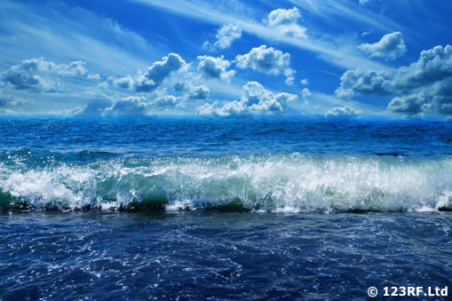

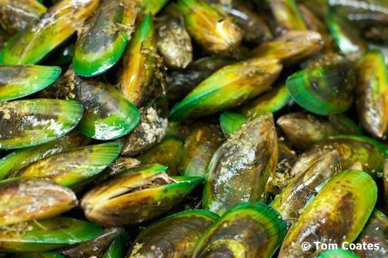
More resources from the Science Learning Hub
The Ocean in Action: Looks at the chemical and physical processes – the ocean’s role in caring for the planet
Tsunamis and Surf: Articles on protecting the coast
Farming green-lipped mussels: Using biocontrol to get rid of the pea crab parasite (Biotechnology Learning Hub)
© 2016 The University of Waikato | www.sciencelearn.org.nz

Slide 8
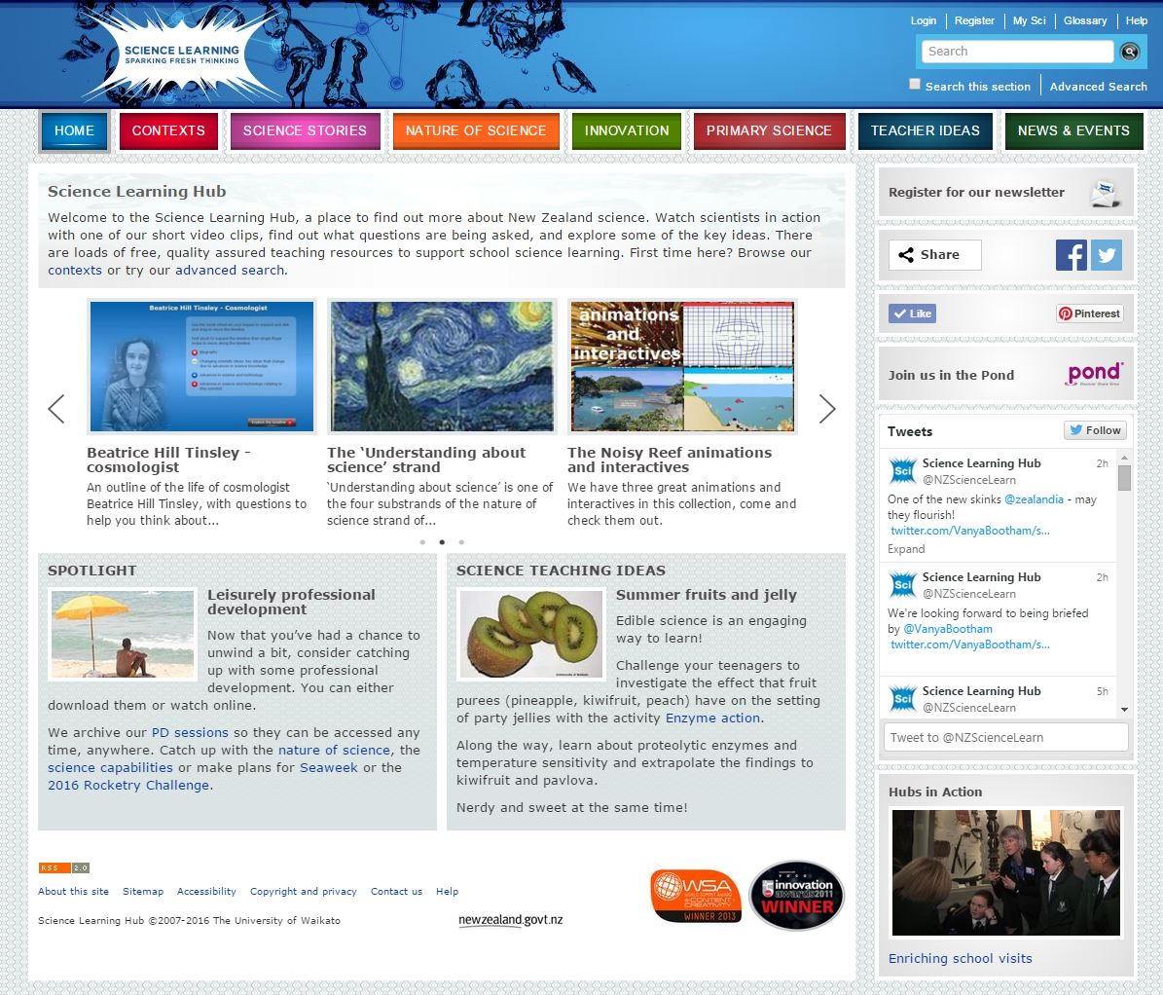
© 2016 The University of Waikato | www.sciencelearn.org.nz

Slide 9
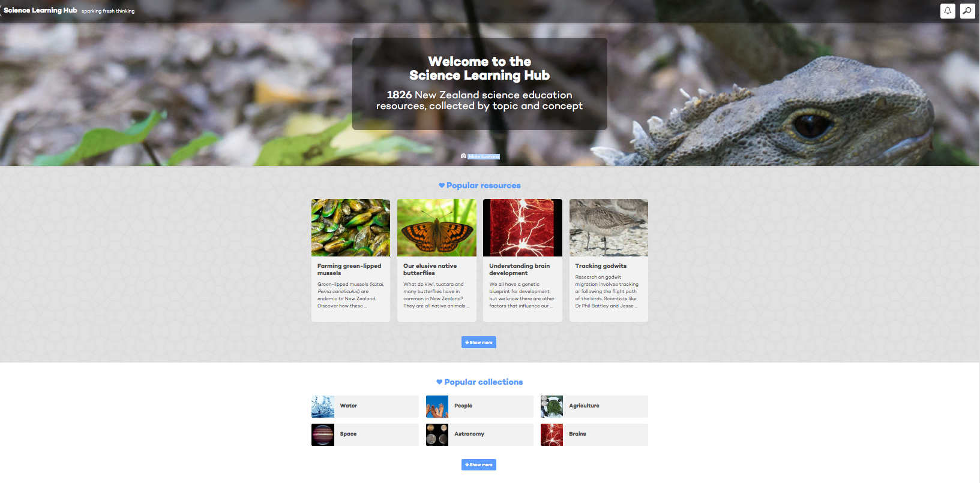
New look for the Science Learning Hub
All images are copyrighted. For further information, please refer to enquiries@sciencelearn.org.nz
© 2016 The University of Waikato | www.sciencelearn.org.nz

Slide 10
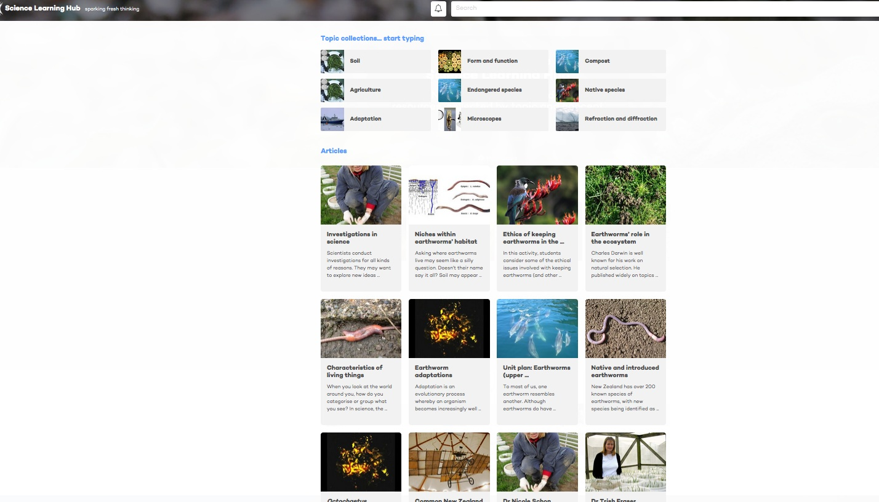
All images are copyrighted. For further information, please refer to enquiries@sciencelearn.org.nz
© 2016 The University of Waikato | www.sciencelearn.org.nz

Slide 12
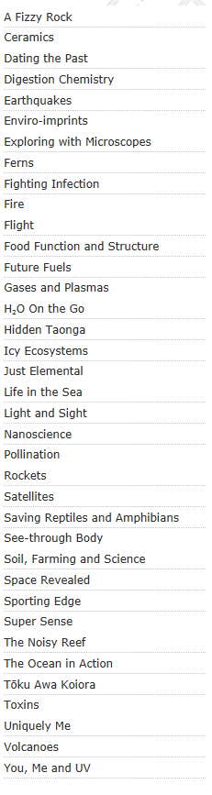
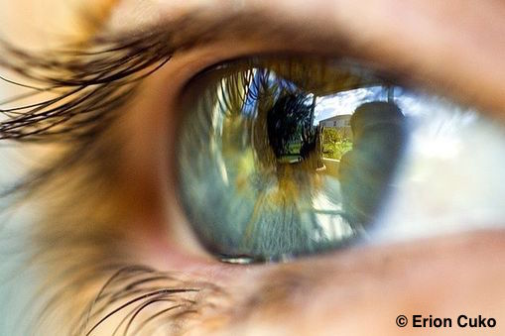
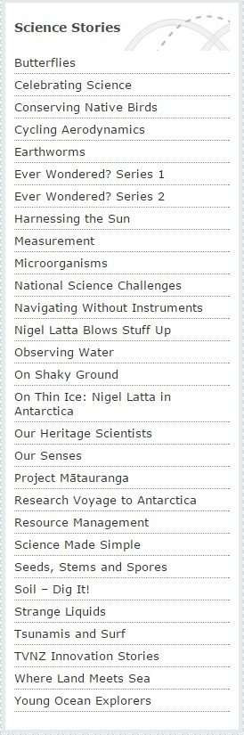
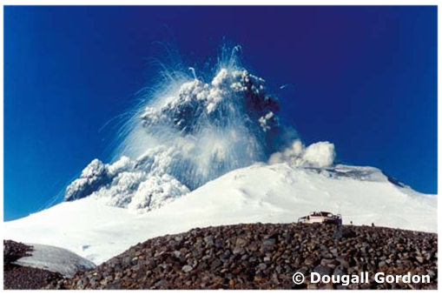
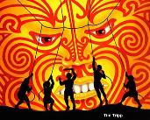

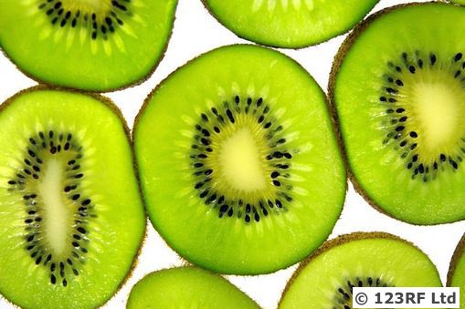
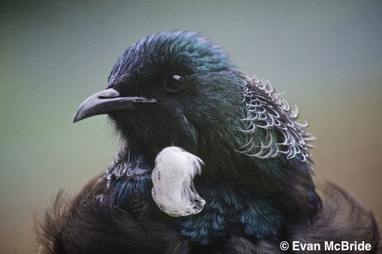
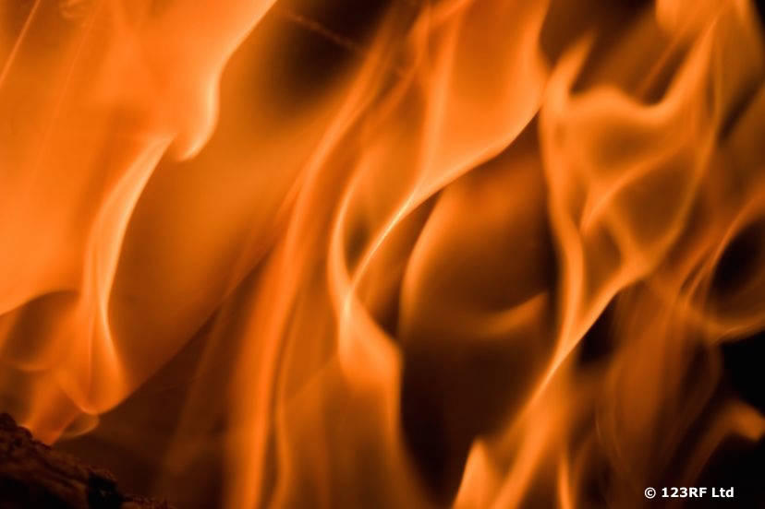
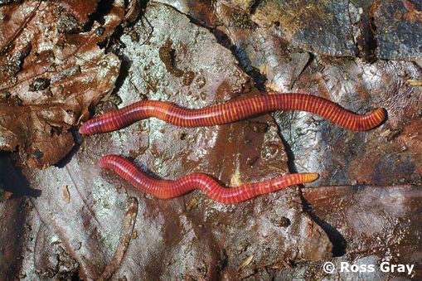
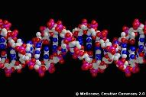
Contexts
Science stories
Images © P.Battley & J.Conklin
Notes:
Contexts and science stories – the main content of the Hub.

Slide 13
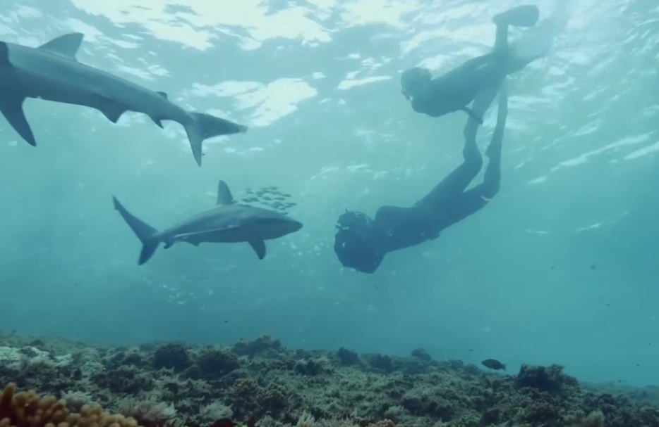
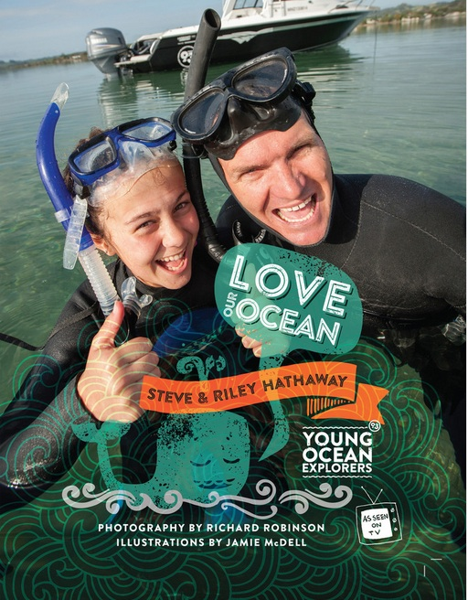
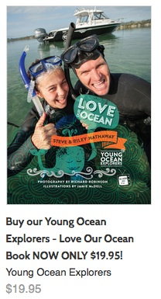
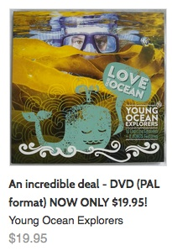
Young Ocean Explorers
www.youngoceanexplorers.co.nz
Copyright © 2016 Young Ocean Explorers

Slide 14
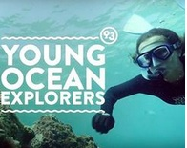
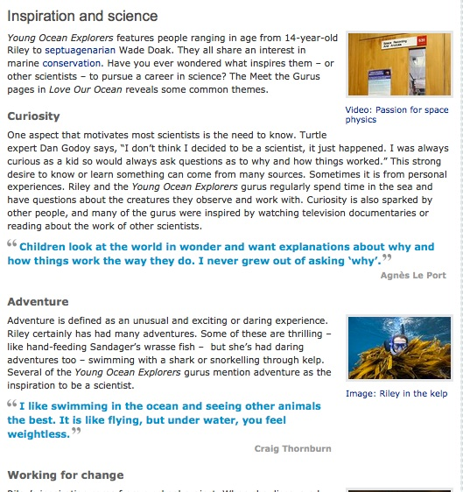
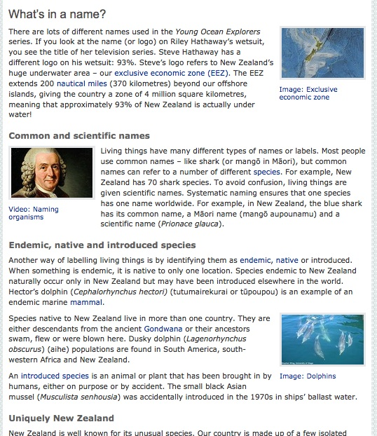
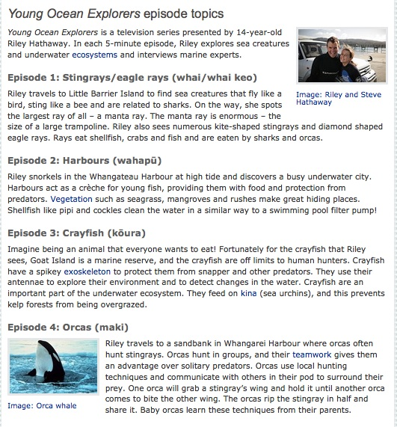
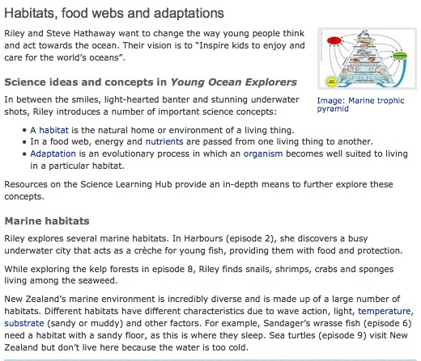
Young Ocean Explorers
© 2016 The University of Waikato | www.sciencelearn.org.nz

Slide 15
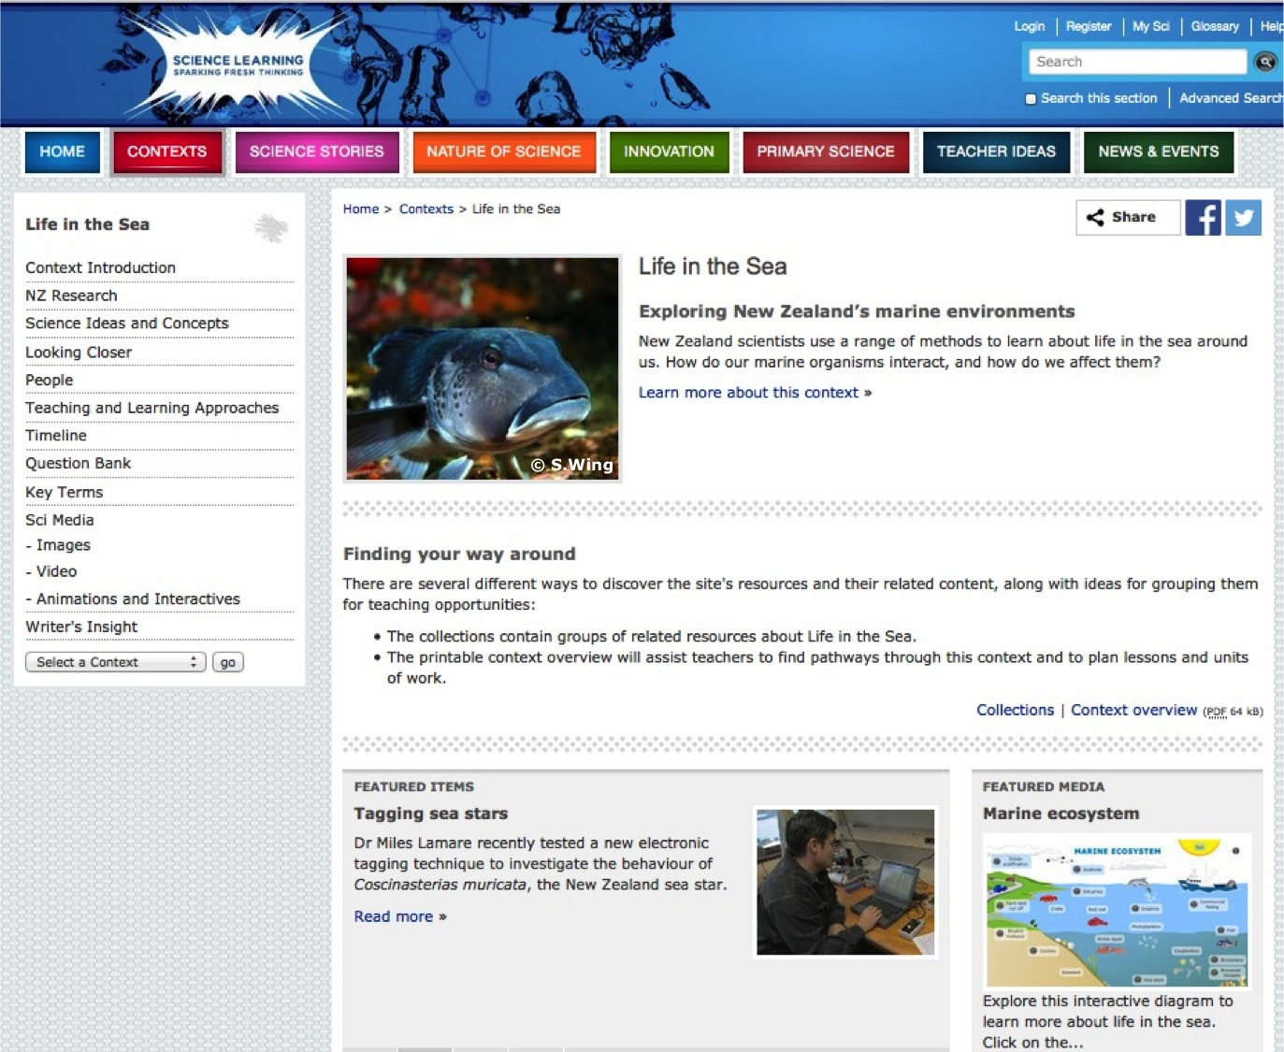
© 2016 The University of Waikato | www.sciencelearn.org.nz

Slide 16
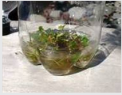
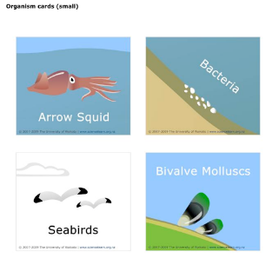
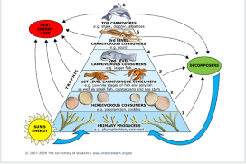
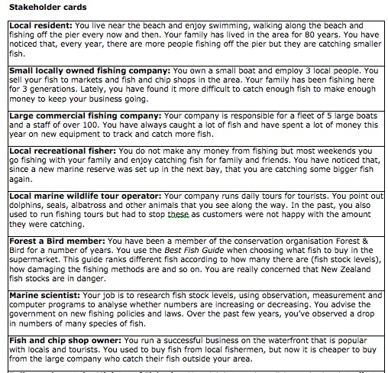
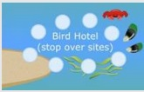
Life in the Sea – student activities
Nutrient impact experiment
Students investigate some of the potential impacts increased nutrient use on land can have on the marine environment
Build a marine food web
Bird hotel
Students take on the role of migrating birds
Fisheries role-play
Students learn to debate as they take on the role of a stakeholder in New Zealand fisheries
© 2016 The University of Waikato | www.sciencelearn.org.nz
Notes:
Talk about the student activity – learning about food webs using a marine environment.

Slide 17
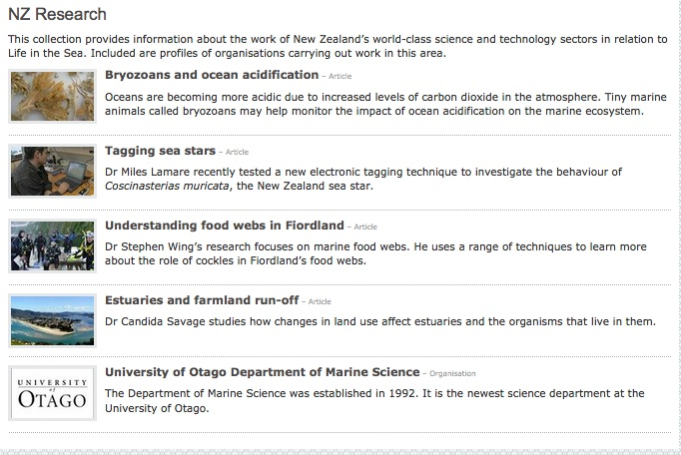
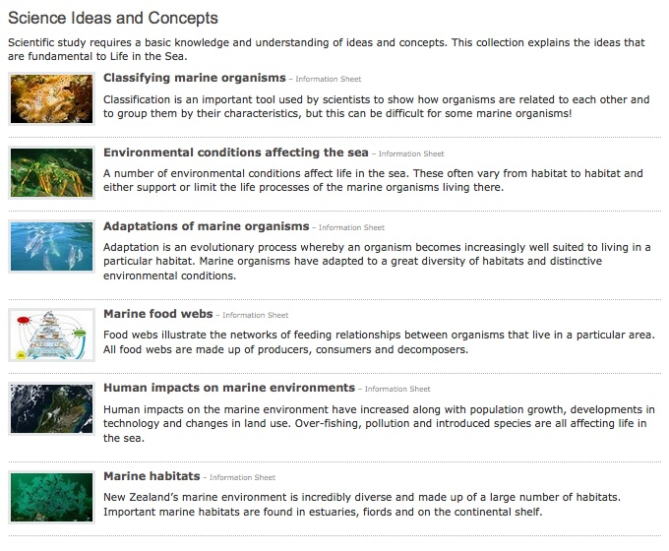
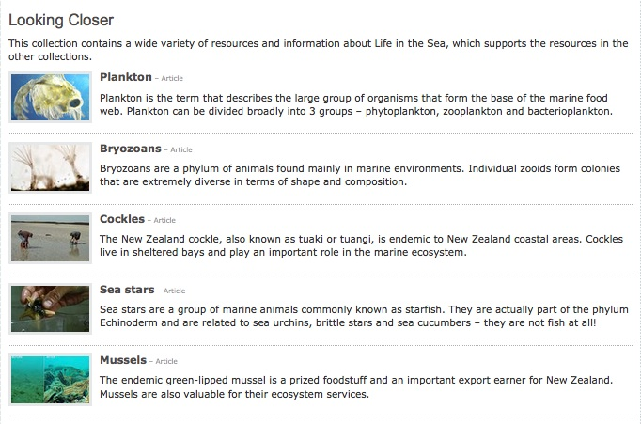
Supporting content
All images are copyrighted. For further information, please refer to enquiries@sciencelearn.org.nz
© 2016 The University of Waikato | www.sciencelearn.org.nz

Slide 18
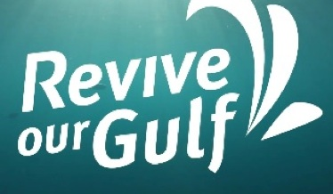
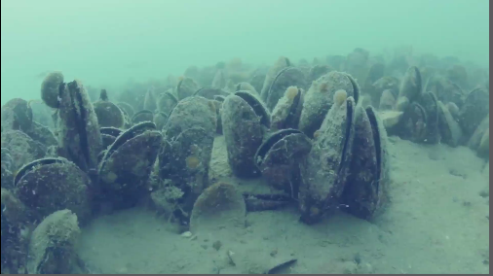
Videos
Mussels filtering water
Images courtesy of Revive Our Gulf/
Mussel Reef Restoration Trust
© 2016 The University of Waikato | www.sciencelearn.org.nz

Slide 19
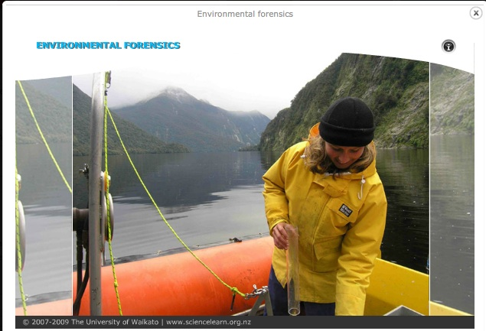
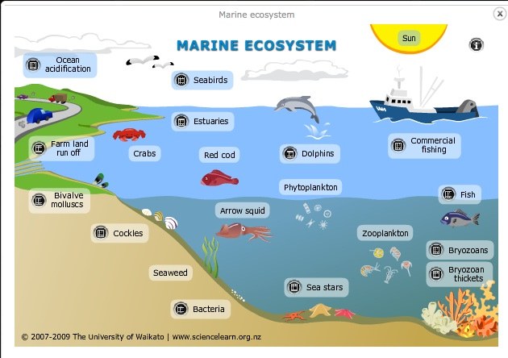
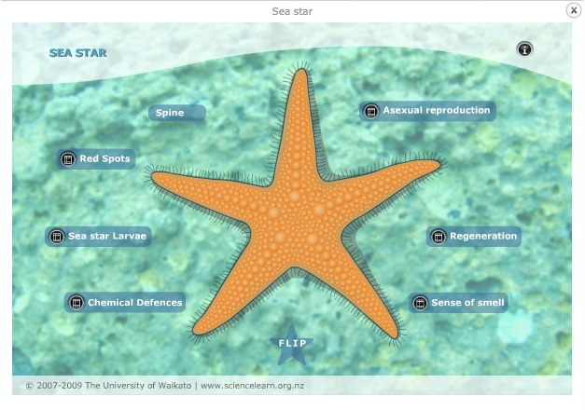
Interactives and animations
© 2016 The University of Waikato | www.sciencelearn.org.nz

Slide 20
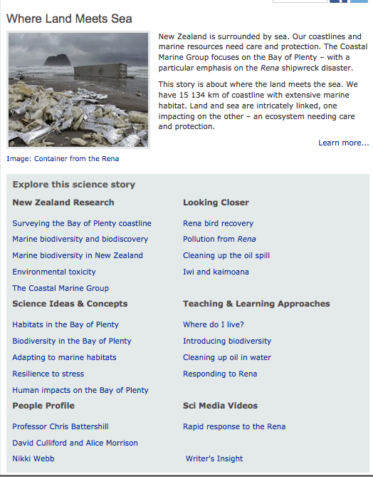
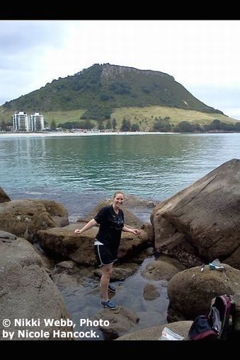



Slide 21




Where Land Meets Sea – student activities
Responding to Rena
Students consider short-term and long-term responses to an environmental disaster such as the Rena
Nutrient impact experiment
Students investigate some of the potential impacts increased nutrient use on land can have on the marine environment
Cleaning up oil in water
Students experiment with oil in water
Where do I live?
Students learn about habitats and why and how animals and plants are best suited to particular habitats
Introducing biodiversity
Students are introduced to biodiversity – they make models of a marine ecosystem and use their models to explore human impact on ecosystems and biodiversity
© 2016 The University of Waikato | www.sciencelearn.org.nz

Slide 22









Supporting content
© 2016 The University of Waikato | www.sciencelearn.org.nz

Slide 23




Toxins – student activities
Tracking toxins
Students model bioaccumulation of toxins in marine animals – they participate in a food web game where feeding decisions determine their survival
Interactive: What killed the dogs?
Students learn about how scientists worked out what killed some dogs on Auckland beaches
© 2016 The University of Waikato | www.sciencelearn.org.nz

Slide 24











Tracking toxins through food webs
© 2016 The University of Waikato | www.sciencelearn.org.nz
© 2015 The University of Waikato | www.sciencelearn.org.nz

Slide 25



Supporting content
All images are copyrighted. For further information, please refer to enquiries@sciencelearn.org.nz
© 2016 The University of Waikato | www.sciencelearn.org.nz

Slide 26
http://sciencelearn.org.nz/Contexts/Toxins/Sci-Media/Interactives/Bioaccumulation-in-the-sea
© 2016 The University of Waikato | www.sciencelearn.org.nz

Slide 27






Research Voyage to Antarctica
Making a food web – student activity
The benthic zone –
PowerPoint
How much life in a litre of sea water?
Blog snippets over 8 weeks – sea life in Antarctica
Hiding in plain sight – student activity
© 2016 The University of Waikato | www.sciencelearn.org.nz
All images courtesy of NIWA

Slide 28



The Noisy Reef – Life on a reef
© 2016 The University of Waikato | www.sciencelearn.org.nz

Slide 29







The Noisy Reef
New Zealand reef noise – NZ Research
Science Ideas and Concepts
An animation
Sound in water – video
Make and use a hydrophone
Sounds in the school pool
Sound detectives – student activity
© 2016 The University of Waikato | www.sciencelearn.org.nz
Notes:
An alternative way to explore sound. What sound is, how it travels, what changes under water and how animals use it.
Evening chorus – how creatures like snapping shrimp, kina and crabs use sound to navigate.

Slide 30





Navigating Without Instruments
The Waka Tapu voyage
Navigation includes using ocean swells
Kupe and modern voyaging –
student activity
© 2016 The University of Waikato | www.sciencelearn.org.nz

Slide 31




The Ocean in Action – student activities
Using Argo data
Students use real-time data from Argo scientific floats to study ocean currents
Buoyancy in water
Students make a Cartesian diver to demonstrate the relationship between volume, mass and density
Using radiocarbon carbon dioxide data
Students interpret graphs from a long- term study of carbon dioxide in the atmosphere
© 2016 The University of Waikato | www.sciencelearn.org.nz

Slide 32



Supporting content
All images are copyrighted. For further information, please refer to enquiries@sciencelearn.org.nz
© 2016 The University of Waikato | www.sciencelearn.org.nz

Slide 33

The Ocean in Action
Carbon cycle – interactive
© 2016 The University of Waikato | www.sciencelearn.org.nz
Notes:
Explores the chemical and physical properties of the ocean. Features the Argo project – worldwide ocean monitoring using floating buoys.
Salinity, temperature, density, dissolved gases, carbon cycling.

Slide 34




Tsunamis and Surf
© 2016 The University of Waikato | www.sciencelearn.org.nz

Slide 35







Green-lipped mussels – student activities (BLH)
Interactive
Similarities and differences: wild and farmed green-lipped mussels
Finding a female
Students play a card game that models the journey of a male pea crab from his mussel host and back again
© 2016 The University of Waikato | www.sciencelearn.org.nz

Slide 36


Supporting content
© 2016 The University of Waikato | www.sciencelearn.org.nz

Slide 37

Mussel life cycle
© 2016 The University of Waikato | www.sciencelearn.org.nz

Slide 38







Slide 39



National Science Challenge – Sustainable Seas
http://sustainableseaschallenge.co.nz/
© 2016 The University of Waikato | www.sciencelearn.org.nz

Slide 40

List of Seaweek resources on the Hub: http://sciencelearn.org.nz/Primary-Science/Seaweek-resources

Slide 41

Pond bucket https://www.pond.co.nz/detail/704362/marine-science
All images are copyrighted. For further information, please refer to enquiries@sciencelearn.org.nz
© 2016 The University of Waikato | www.sciencelearn.org.nz

Slide 42




Would you like a promo pack?
Packs of bookmarks and flyers available – email us enquiries@sciencelearn.org.nz
Follow us on Twitter: https://twitter.com/NZScienceLearn
Like us on Facebook: www.facebook.com/nzsciencelearn
Explore our Pinterest Boards: www.pinterest.com/nzsciencelearn
Join us in the pond: www.pond.co.nz/community/214015/science-learning-hub
© 2016 The University of Waikato | www.sciencelearn.org.nz

Slide 43






Thanks!
Questions and comments?
The images contained within this PowerPoint presentation are copyrighted to the University of Waikato and other 3rd party individuals and organisations. Any reuse beyond the classroom as per the intended use of these resources, should be cleared with the copyright owner/s.

