Slide 1
The Science
Learning Hub
Resources supporting the teaching and learning of
agricultural and horticultural science
Kate Rice
3 June 2015
4.00–4:45pm
@NZScienceLearn
www.sciencelearn.org.nz
Notes:
Welcome to the Science Leaning Hub, where you will find a wide variety of science resources designed especially for primary and secondary teachers and students. It is funded by the Ministry of Business, Innovation and Employment.

Slide 2
Outcomes for session
Search both Science Learning Hub and Biotechnology Learning Hub for resources useful in teaching agriculture and horticulture
Explore ways to incorporate the identified resources into teaching programmes under key concepts
Share ways to adapt and use the resources to develop student capability to use the conventions commonly used to communicate ideas in agriculture and horticulture
© 2015 The University of Waikato | www.sciencelearn.org.nz

Slide 3


What is the Science Learning Hub?
Based on world-class New Zealand science research
A trustworthy online resource – produced by educators and scientists
Supported by learning activities, information about the key science ideas and concepts, multimedia tools and other resources
Written for New Zealand teachers and aimed at students
in years 2–10

Slide 4
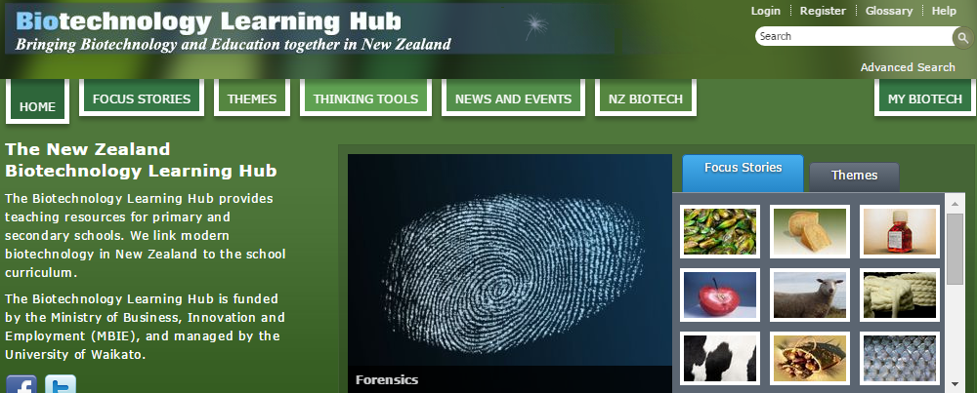
What is the Biotechnology Learning Hub?
Provides teaching resources for primary and secondary schools
Links modern biotechnology in New Zealand to the school curriculum.
Funded by the Ministry of Business, Innovation and Employment (MBIE)
Managed by the University of Waikato
© 2015 The University of Waikato | www.sciencelearn.org.nz
Notes:
http://biotechlearn.org.nz

Slide 5

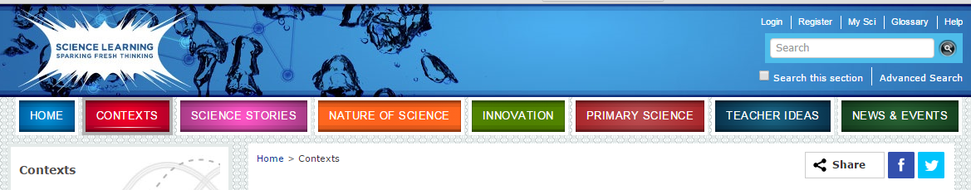
Let's explore what's there …
Type “agriculture” or “horticulture” into the search box
© 2015 The University of Waikato | www.sciencelearn.org.nz
Notes:
Suggest you type in quotes “plant reproduction” so it searches for the phrase or plant +reproduction so it searches for the two words – otherwise it searches for any content with either plant or reproduction in it.

Slide 6
Let's explore what's there …
Type “agriculture” or “horticulture” into the search box
© 2015 The University of Waikato | www.sciencelearn.org.nz
Notes:
Suggest you type in quotes “plant reproduction” so it searches for the phrase or plant +reproduction so it searches for the two words – otherwise it searches for any content with either plant or reproduction in it.

Slide 7
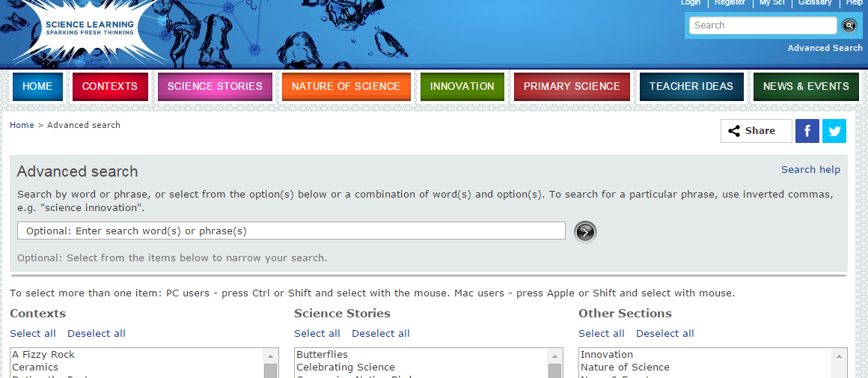
… or use the advanced search option
Fill in details here about the aspects of agriculture or horticulture and select the sections to consider
© 2015 The University of Waikato | www.sciencelearn.org.nz

Slide 8
From the huge list you get, I have selected some to follow up
I sorted these into three key aspects of agriculture and horticulture to follow up:
Soil, Farming and Science
Plant reproduction – particularly using avocado, maize and kiwifruit
Management practices – using Focus Stories (BLH)
Next, I explored a range of resources to identify ways to use them in teaching.
© 2015 The University of Waikato | www.sciencelearn.org.nz
Notes:
http://sciencelearn.org.nz/Science-Stories/Seeds-Stems-and-Spores

Slide 9
Resources identified from the Soil, Farming and Science context
Science Ideas and Concepts include:
Soil formation
Soil properties
Biogeochemistry
The nitrogen cycle
The phosphorus cycle
Farming and environmental pollution
Check out Timeline – Farming and Environment and the expand function
Teaching and Learning Approaches include:
Growing soil microbes (yr 9–10)
Clover and nitrogen fixation (yr 9–11)
Testing water for nitrate (yr 11)
Visual soil assessment (yr 11)
Water and nutrient leaching (yr 9–10)
Farming and environmental issues (yr 11–13)
© 2015 The University of Waikato | www.sciencelearn.org.nz
Notes:
http://sciencelearn.org.nz/Contexts/Soil-Farming-and-Science
http://sciencelearn.org.nz/Contexts/Soil-Farming-and-Science/Timeline
http://sciencelearn.org.nz/Contexts/Soil-Farming-and-Science/Teaching-and-Learning-Approaches

Slide 10
Looking deeper at Soil, Farming and Science
NZ Research contains several useful articles:
Managing nutrients
Inhibiting nitrification
Inhibiting nitrous oxide emissions
Focusing on phosphorus
Denitrification beds – a creative approach
Looking Closer resources:
Farming development and changing landscapes
Farm management practices
Good for junior classes:
Fertiliser
The role of clover
Soil names
© 2015 The University of Waikato | www.sciencelearn.org.nz

Slide 11
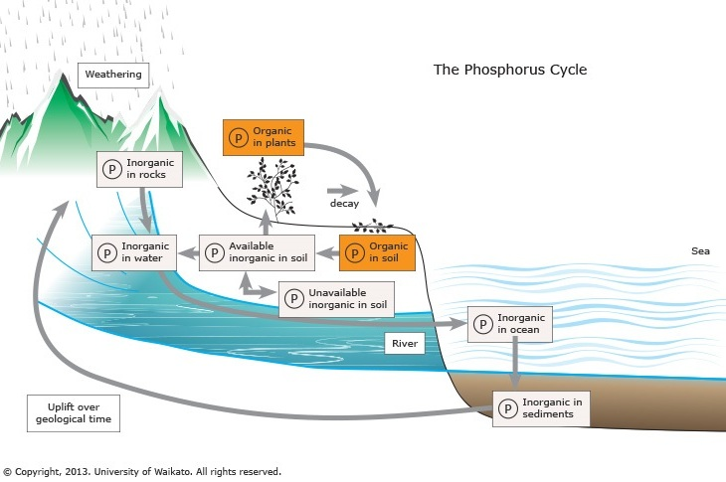
Looking deeper at Soil, Farming and Science
Video resources
The importance of clover
Managing the nutrient problem
PFR – Land Use Change and Intensification (in the Innovation section)
Images include
New Zealand soils map
Phosphorus availability to plants
Topic planners (could be used with yr 9–10)
Soil theme – Nutrients
Soil theme – Is all soil the same?
© 2015 The University of Waikato | www.sciencelearn.org.nz
Notes:
http://sciencelearn.org.nz/Contexts/Soil-Farming-and-Science/Sci-Media/Images/The-phosphorus-cycle

Slide 12
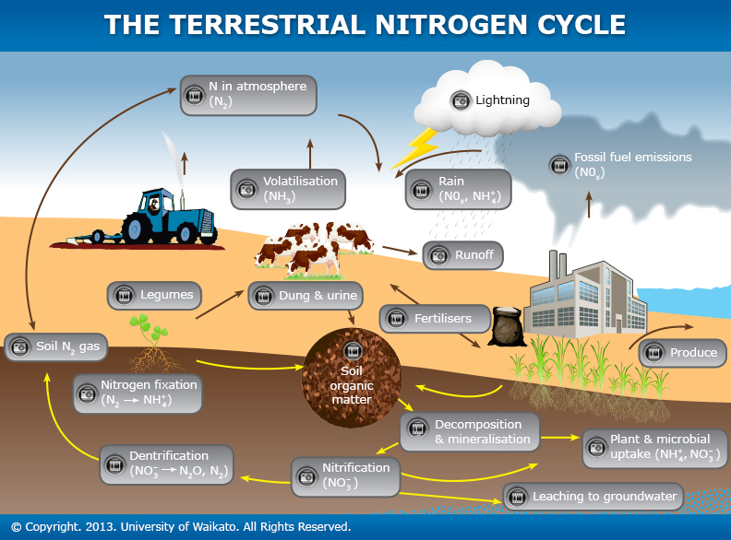
Using the nitrogen cycle interactive
http://sciencelearn.org.nz/Contexts/Soil-Farming-and-Science/Sci-Media/Interactive/The-terrestrial-nitrogen-cycle
© 2015 The University of Waikato | www.sciencelearn.org.nz
Notes:
http://sciencelearn.org.nz/Contexts/Soil-Farming-and-Science/Sci-Media/Interactive/The-terrestrial-nitrogen-cycle

Slide 13
The terrestrial nitrogen cycle treasure hunt
What percentage of the world’s population is fed by food grown using nitrogen in fertilisers or nitrogen-fixing plants?
Why are fertilisers described as a farmer’s tool?
What is mineralisation?
What is the main way nitrogen leaves a farm?
What native plant can also carry out nitrogen fixation?
What is N₂ gas converted to in clover plants?
40%
Can be used to boost production when needed
Decomposition of litter into forms that plants can take up
Through leaching where water moves through the soil profile into ground water
Kōwhai
N₂ gas to NH₄⁺
© 2015 The University of Waikato | www.sciencelearn.org.nz

Slide 14
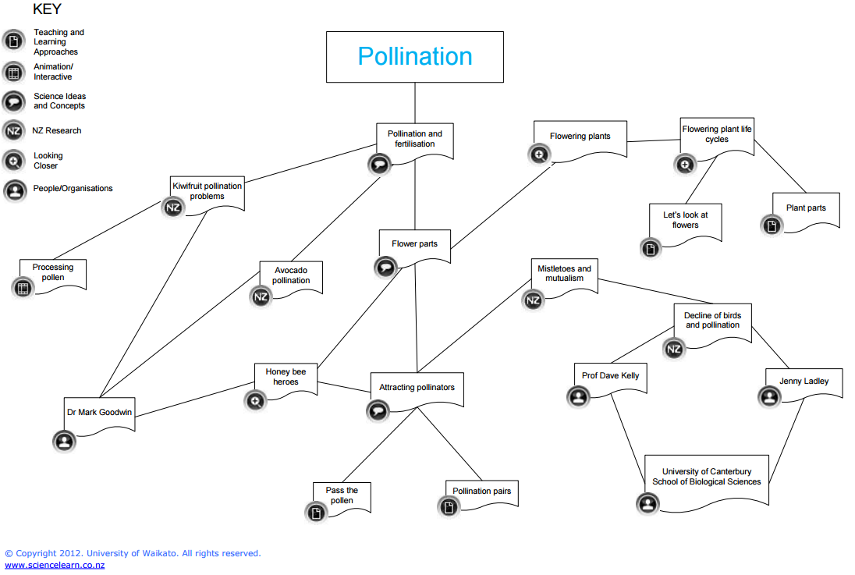
Exploring a horticulture context – Pollination
Using the context overview
Open the context overview pdf
Identify aspects that could be appropriate for your students
Are there possible activities and articles and research stories? For example: Kiwifruit pollination problems; Avocado pollination; Processing pollen; Honey bee heroes; Pollination and fertilisation; Attracting pollinators
© 2015 The University of Waikato | www.sciencelearn.org.nz

Slide 15
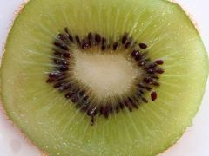
Exploring a horticulture context – Pollination
The context introduction can introduce the topic using a three-level guided reading activity
Consider using the interactive Processing pollen to link ideas on why scientists might need to find ways to assist in plant reproduction to ensure successful crop production
  Explore the horticultural ideas in the following:
  Kiwifruit pollination problems
  Avocado pollination
  Processing pollen
  Honey bee heroes
  Pollination and fertilisation
  Attracting pollinators
© 2015 The University of Waikato | www.sciencelearn.org.nz
Notes:
http://sciencelearn.org.nz/Contexts/Pollination/NZ-Research-Collection/Kiwifruit-pollination-problems
http://sciencelearn.org.nz/Contexts/Pollination/Sci-Media/Video/RoboBee
http://sciencelearn.org.nz/Contexts/Pollination/Sci-Media/Interactive/Processing-pollen

Slide 16
Further places to explore on SLH
Other contexts to follow up
A Fizzy Rock
Enviro-imprints
Future Fuels
H₂O on the Go
Tōku Awa Koiora
Innovation stories to explore
Bloodmeal to bioplastic
Biospife
Zealong Tea
Aerial scanning for pasture analysis
PFR – Land Use Change and Intensification
Other science stories to follow up
Celebrating Science
Earthworms
Observing Water
Resource Management
Also explore the News Archive for topics such as Belching cows and a tiny bacterium
© 2015 The University of Waikato | www.sciencelearn.org.nz

Slide 17
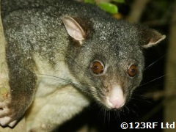
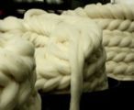
Using Biotechnology Learning Hub resources
Focus Stories
Biological control of possums
Breeding red-fleshed apples
Cheesemaking
Easy care sheep
Evolved enzymes
Farming green-lipped mussels
Fish oil in functional food
Future foods
Honey to heal
Mining milk
Nutrigenomics
Pig cell transplants
Potato plates
Robotic milking
Taewa (Māori potatoes)
Transgenic cows
Wool innovations
Themes to follow up
Biocontrol
Future farming
Marvellous milk
Animations to consider
How mussels are farmed in New Zealand
Hyper-immune milk – What’s the story?
Making a transgenic animal
Making a transgenic plant
Possum fertility control
Processing pig cells for transplants
To moove or not to moove
Worksheets
Consumer research on future apples
Instrumental firmness test
Investigating apple attributes
© 2015 The University of Waikato | www.sciencelearn.org.nz
Notes:
http://biotechlearn.org.nz/themes/biocontrol
http://biotechlearn.org.nz/themes/future_farming
http://biotechlearn.org.nz/themes/marvellous_milk
http://biotechlearn.org.nz/focus_stories/breeding_red_fleshed_apples/making_a_transgenic_plant
http://biotechlearn.org.nz/focus_stories/farming_green_lipped_mussels/how_mussels_are_farmed_in_new_zealand

Slide 18
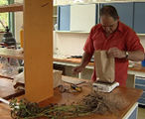
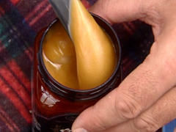
BLH Unit Plans
Biocontrol in action: links to management practices or use as yr 9–10 unit
Develop a novel taewa product: links to yr 13 attributes or use as yr 9–10 unit
Developing a biocontrol game: links to environment issues, management practices or use as yr 9–10 unit
Developing future apple varieties: links to yr 13, product attributes and management practices
Effects of silage on a rural stream: links to environment issues or use as yr 9–10 unit
Ethics of transgenic cows: links to yr 13, product attributes and management practices
Planning for cow movement through an automated milking system: links to animal behaviour/management practices or use as yr 9–10 unit
The properties of honey: links to attributes of products for yr 13 or yr 9–10 unit
© 2015 The University of Waikato | www.sciencelearn.org.nz
Notes:
http://biotechlearn.org.nz/themes/biocontrol/biocontrol_in_action
http://biotechlearn.org.nz/focus_stories/taewa_maori_potatoes/develop_a_novel_taewa_product
http://biotechlearn.org.nz/focus_stories/biological_control_of_possums/developing_a_biocontrol_game
http://biotechlearn.org.nz/focus_stories/breeding_red_fleshed_apples/developing_future_apple_varieties
http://biotechlearn.org.nz/themes/future_farming/effects_of_silage_on_a_rural_stream2
http://biotechlearn.org.nz/focus_stories/transgenic_cows/ethics_of_transgenic_cows
http://biotechlearn.org.nz/focus_stories/robotic_milking/planning_for_cow_movement_through_an_automatic_milking_system
http://biotechlearn.org.nz/focus_stories/honey_to_heal/the_properties_of_honey

Slide 19
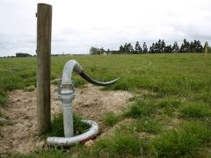
Achievement Standard 90160
2 Demonstrate knowledge of the impact on the environment of primary production management practices involves describing the impact on the environment of primary production management practices
Demonstrate detailed knowledge involves explaining the positive and/or negative impact on the environment of primary production management practices.
Demonstrate comprehensive understanding involves applying knowledge of the positive and/or negative impact on the environment of primary production management practices. This may involve comparing and contrasting the impact on the environment of these practices.
To build student knowledge for this learning, resources include some of the innovation stories/videos:
  Plant & Food Research and Etec Crop Solutions – Pheromone-based Insecticide
  Ian Yule – Aerial Scanning for Pasture Analysis
  PFR – Land Use Change and Intensification
Other resources include:
  Farming and environmental pollution
  Farm management practices
  Environment
  Biocontrol
© 2015 The University of Waikato | www.sciencelearn.org.nz
Notes:
sciencelearn.org.nz/Innovation/Innovation-Stories/Celebrating-Success/Videos/Plant-Food-Research-and-Etec-Crop-Solutions-Pheromone-based-Insecticide
http://sciencelearn.org.nz/Innovation/Innovation-Stories/Celebrating-Success/Videos/Ian-Yule-Aerial-Scanning-for-Pasture-Analysis
http://sciencelearn.org.nz/Innovation/Innovation-Stories/Celebrating-Success/Videos/PFR-Land-Use-Change-and-Intensification
http://sciencelearn.org.nz/Contexts/Soil-Farming-and-Science/Science-Ideas-and-Concepts/Farming-and-environmental-pollution
http://sciencelearn.org.nz/Contexts/Soil-Farming-and-Science/Looking-Closer/Farm-management-practices
http://biotechlearn.org.nz/nz_biotech/sectors/environment

Slide 20
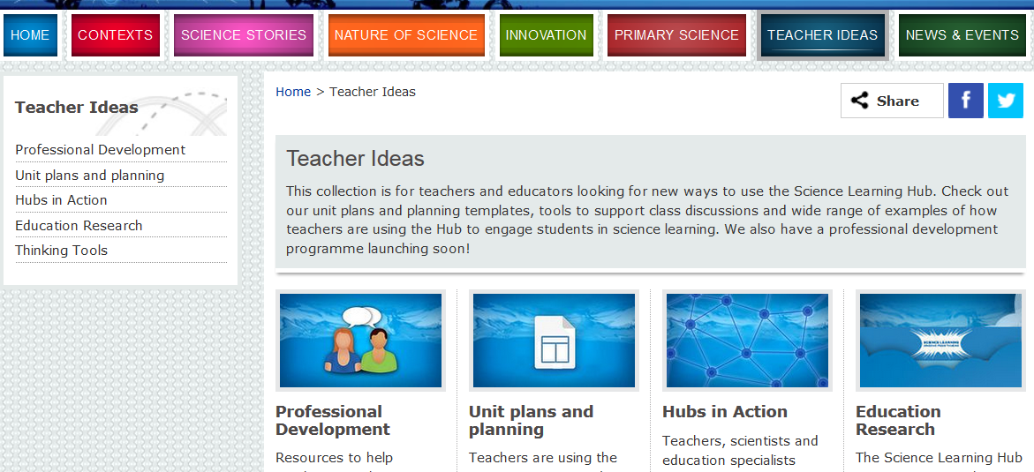
Other useful places for teacher ideas on SLH
© 2015 The University of Waikato | www.sciencelearn.org.nz

Slide 21
Accessing today’s resources
COMING SOON
The resources shared in this session to develop scientific literacy and aspects of Communicating in Science will be added to the contexts they support
This PowerPoint will be added to the Teacher Ideas section under Professional Development
Other useful resources can be found in the Unit Plans and Planning section
© 2015 The University of Waikato | www.sciencelearn.org.nz

Slide 22
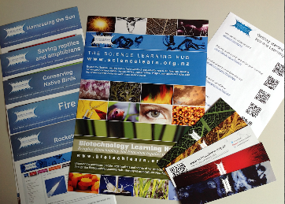


Would you like a promo pack?
Packs of bookmarks and flyers available – email us enquiries@sciencelearn.org.nz
Follow us on Twitter: https://twitter.com/NZScienceLearn
Like us on Facebook: www.facebook.com/nzsciencelearn
Explore our Pinterest boards: www.pinterest.com/nzsciencelearn
Carbon cycle Pinterest board: www.pinterest.com/nzsciencelearn/slh-agriculturehorticulture
© 2015 The University of Waikato | www.sciencelearn.org.nz

Slide 23

Thank you
Questions and comments?
The images contained within this PowerPoint presentation are copyrighted to the University of Waikato and other 3rd party individuals and organisations. Any reuse beyond the classroom as per the intended use of these resources, should be cleared with the copyright owner/s.
© 2015 The University of Waikato | www.sciencelearn.org.nz

