Slide 1
Get kids excited about science
Barb Ryan – with Andy Peart
3 December 2015
@NZScienceLearn
www.sciencelearn.org.nz
© 2015 The University of Waikato | www.sciencelearn.org.nz

Slide 2


What is the Science Learning Hub?
A trustworthy online resource – produced by educators and scientists
Based on world-class New Zealand science research
Supported by learning activities, information about the key science ideas and concepts, multimedia tools and other resources
Written for New Zealand teachers and students

Slide 3
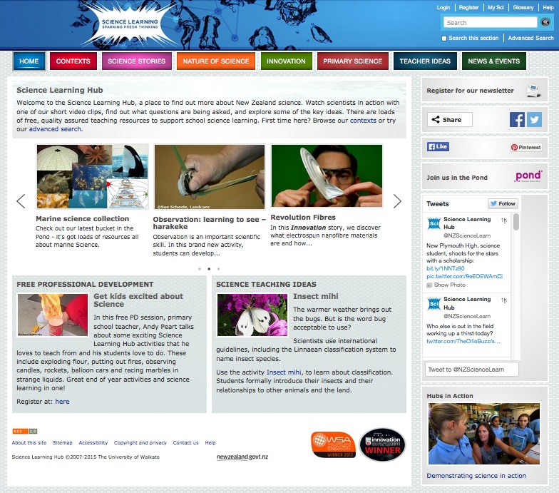
© 2015 The University of Waikato | www.sciencelearn.org.nz

Slide 4
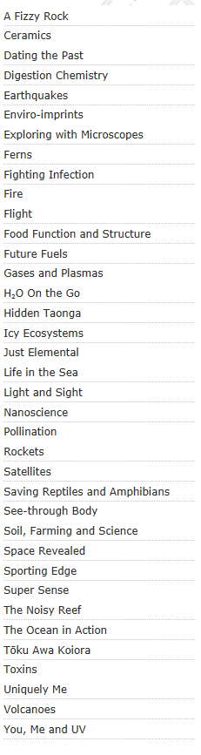
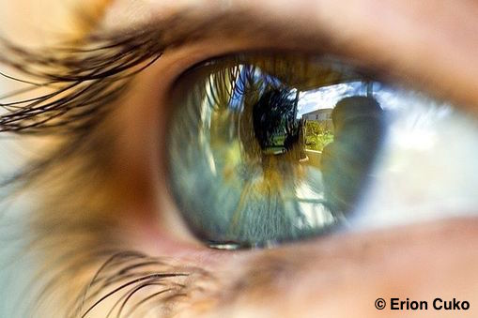
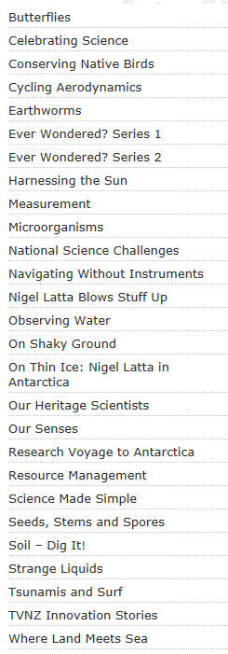
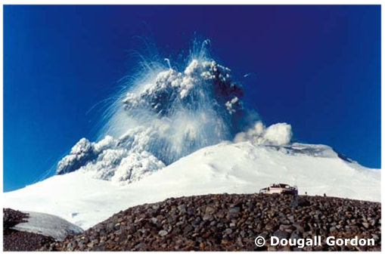
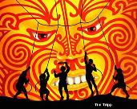

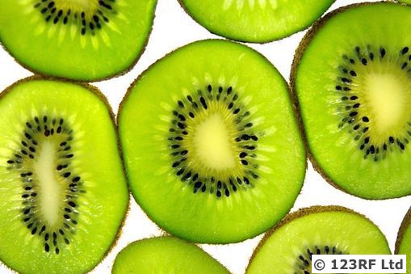
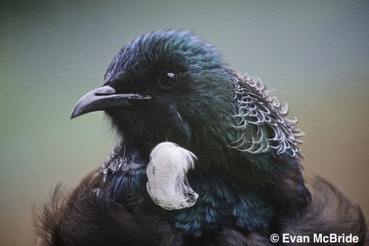
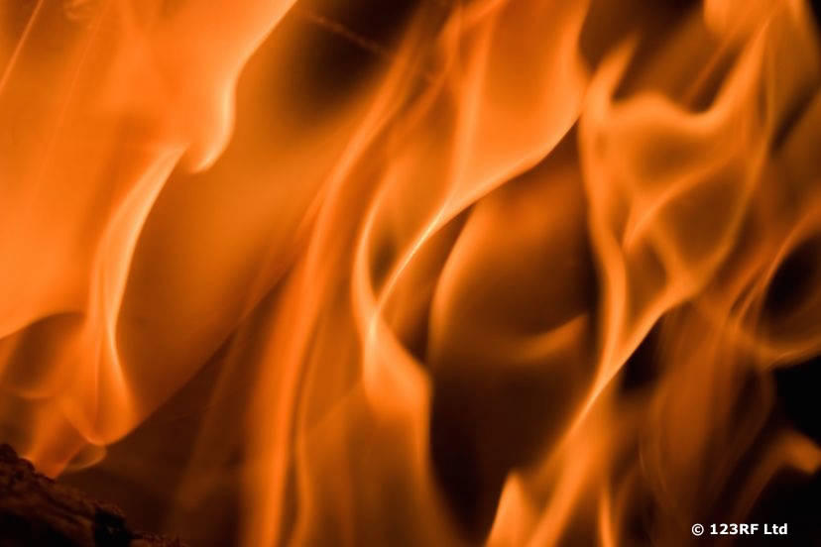
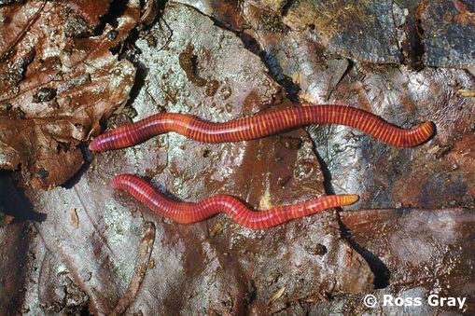
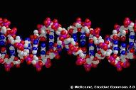
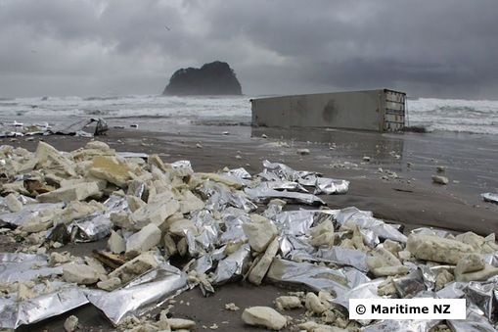
Contexts
Science stories
Images © P.Battley & J.Conklin
Notes:
Contexts and science stories – the main content of the Hub.

Slide 5
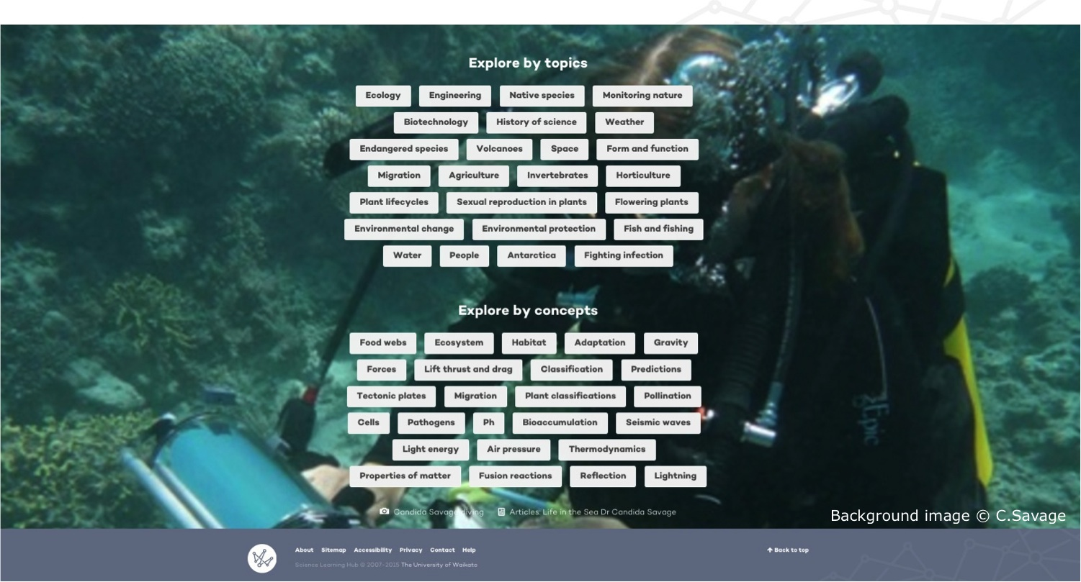
Explore by topics or concepts
© 2015 The University of Waikato | www.sciencelearn.org.nz

Slide 6
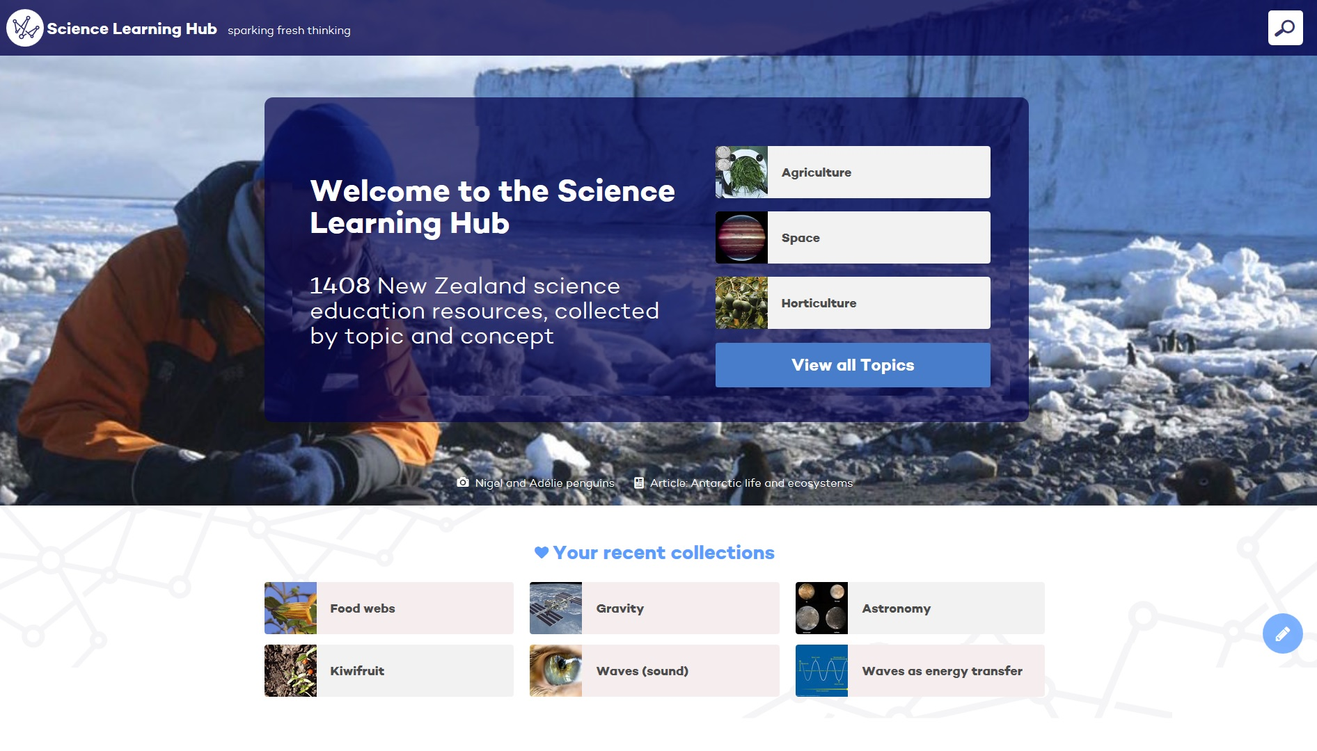
New look for the Science Learning Hub
© 2015 The University of Waikato | www.sciencelearn.org.nz

Slide 7
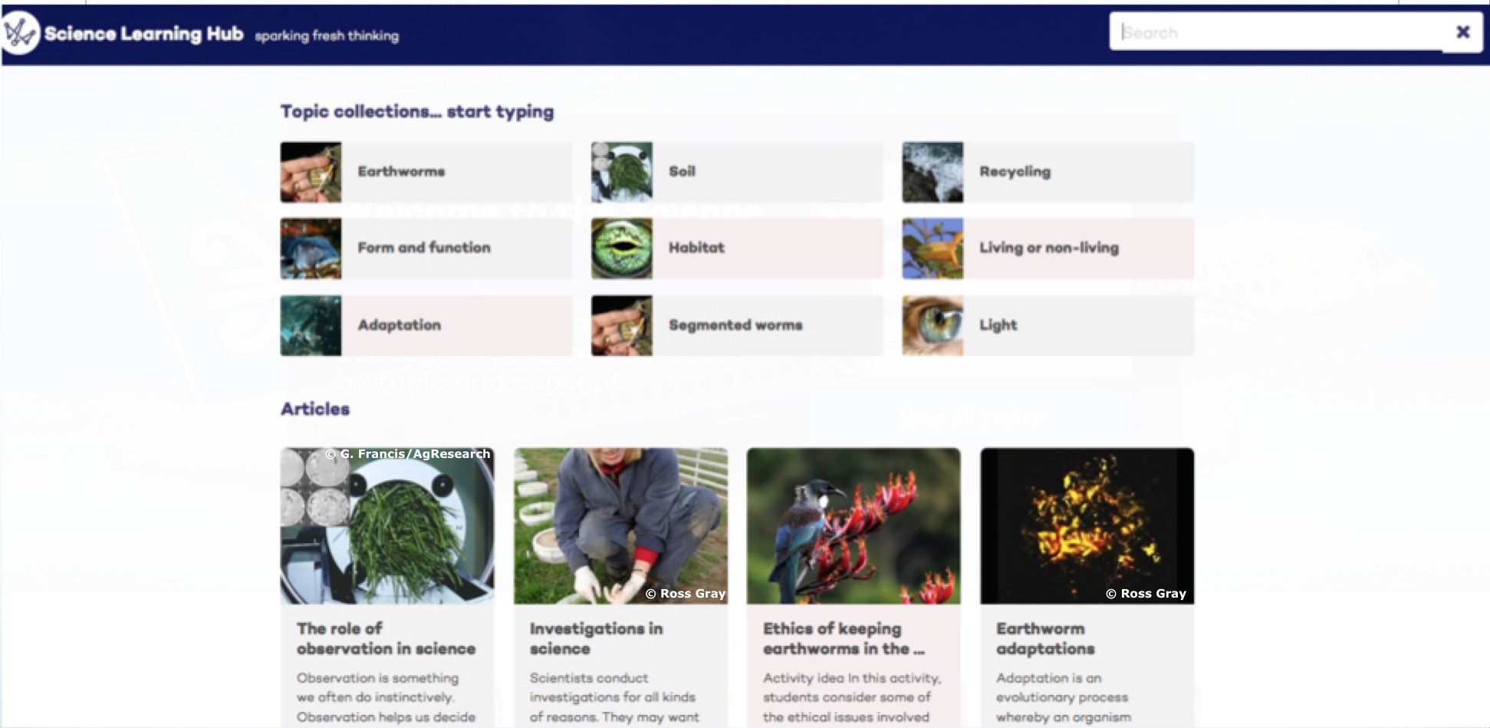
© 2015 The University of Waikato | www.sciencelearn.org.nz

Slide 8
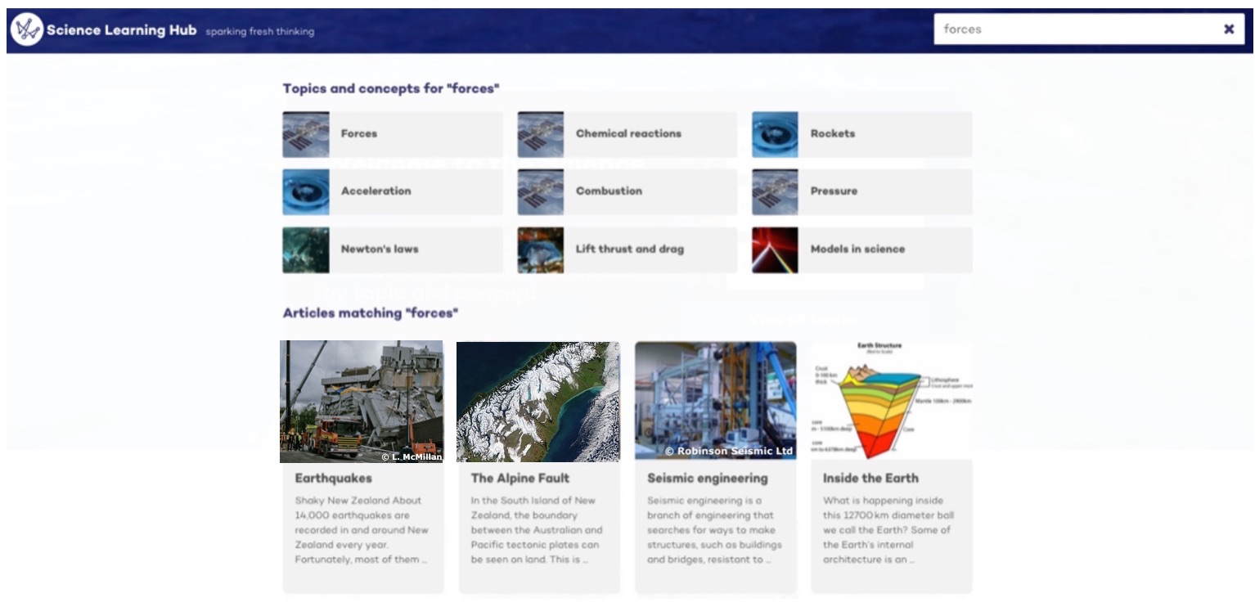
Results for ‘forces’
© 2015 The University of Waikato | www.sciencelearn.org.nz

Slide 9
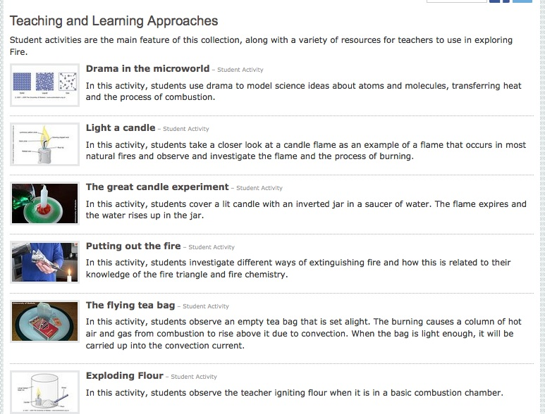
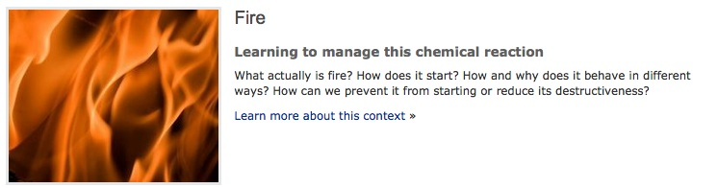
Student activities: FIRE
© 2015 The University of Waikato | www.sciencelearn.org.nz

Slide 10
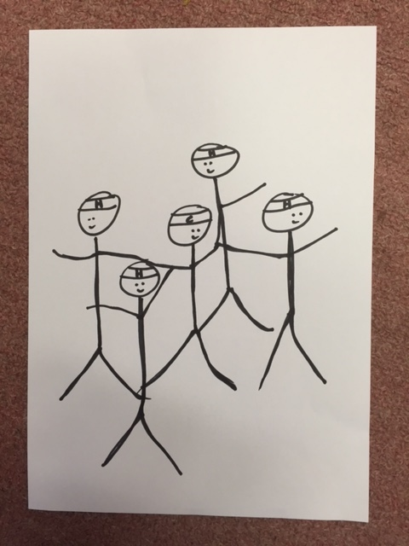
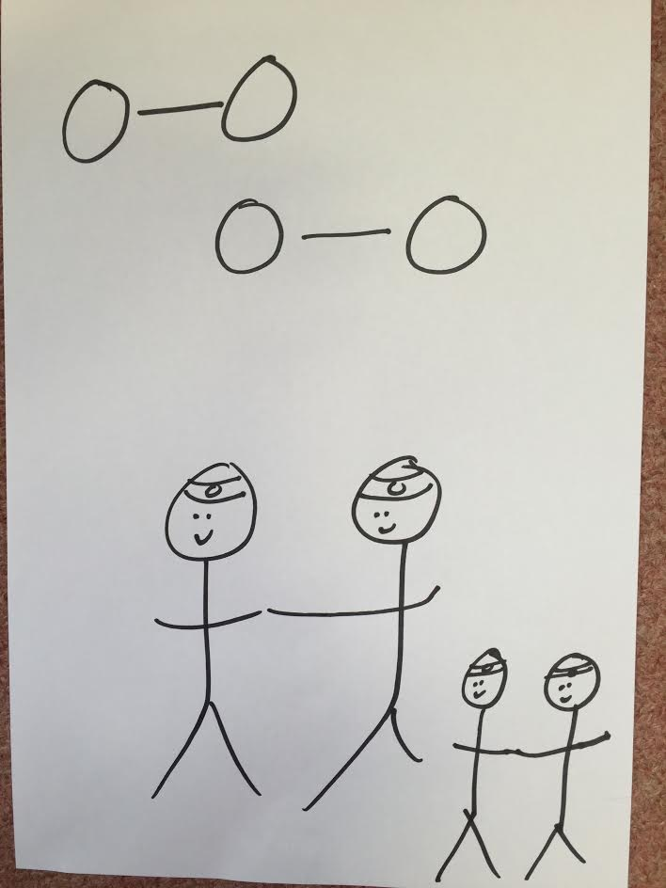
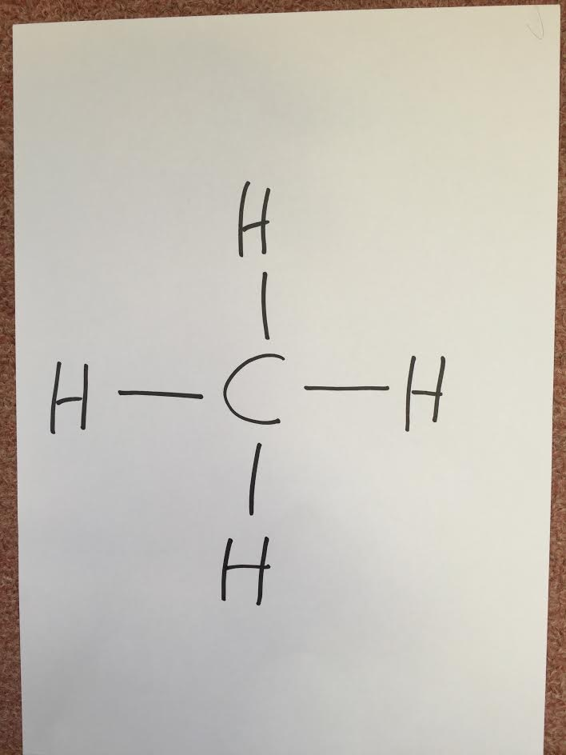
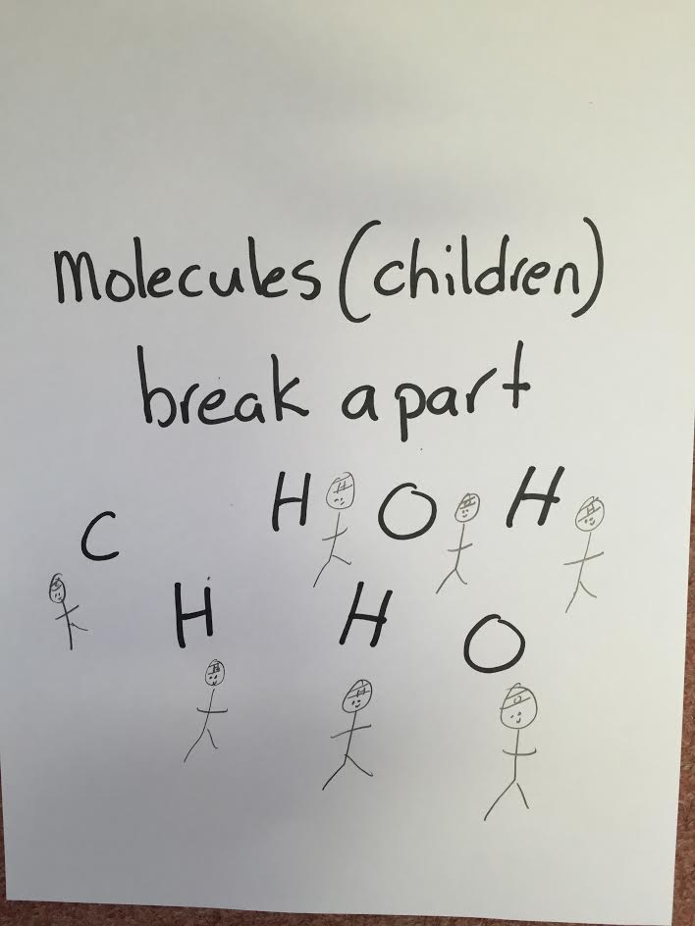
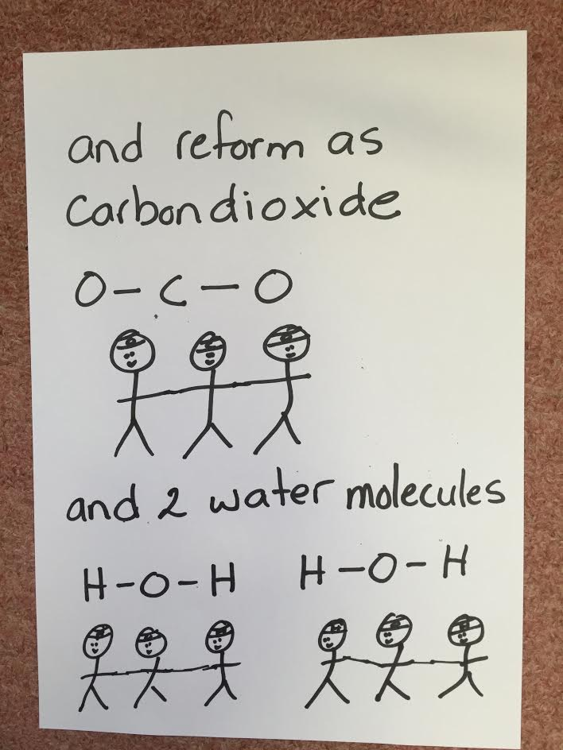
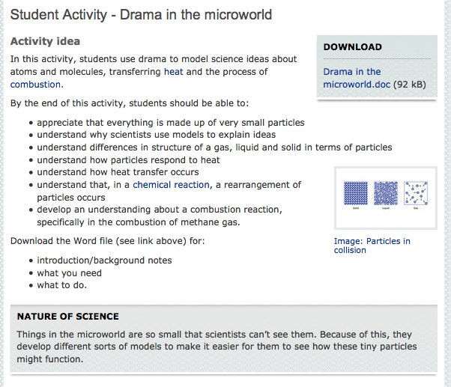
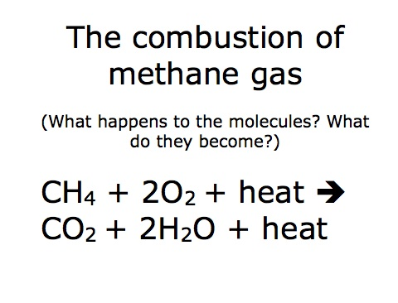
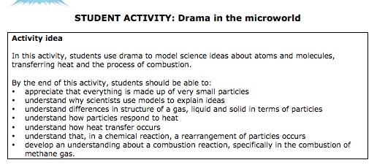
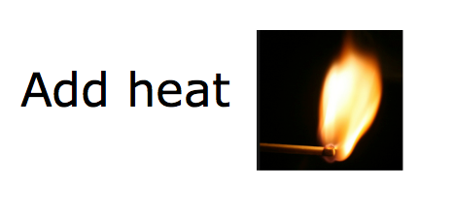
© 2015 The University of Waikato | www.sciencelearn.org.nz

Slide 11
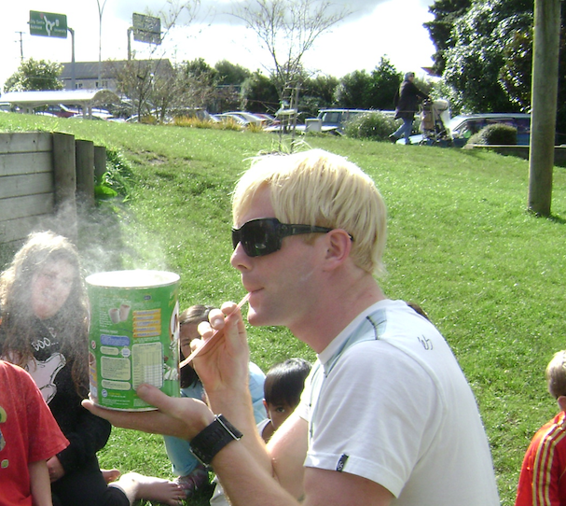
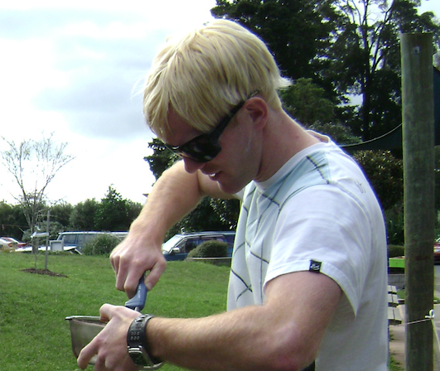
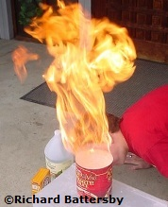
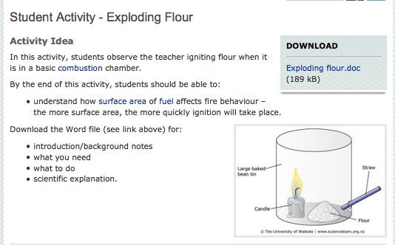
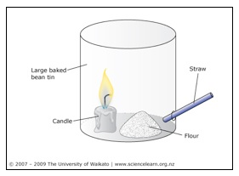
© 2015 The University of Waikato | www.sciencelearn.org.nz

Slide 12
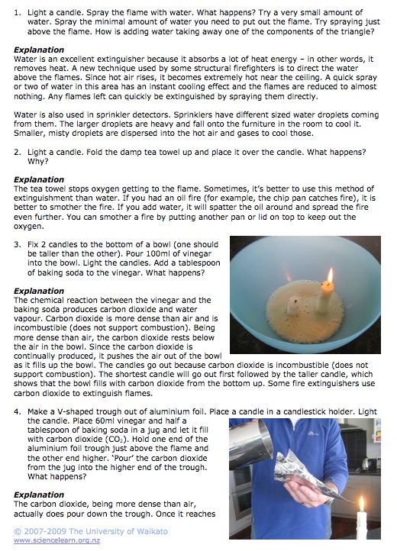
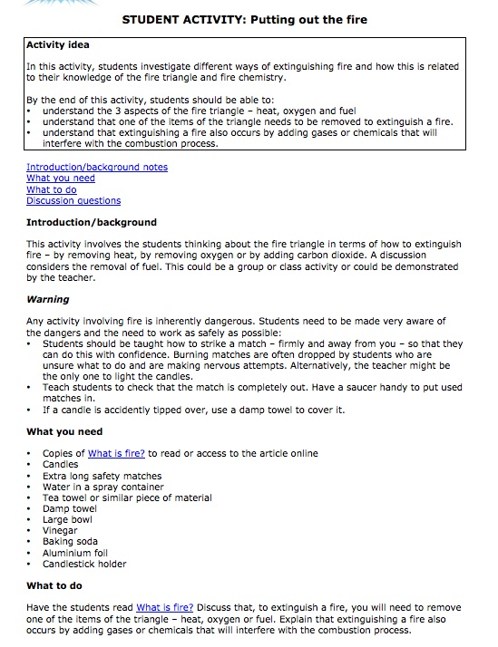
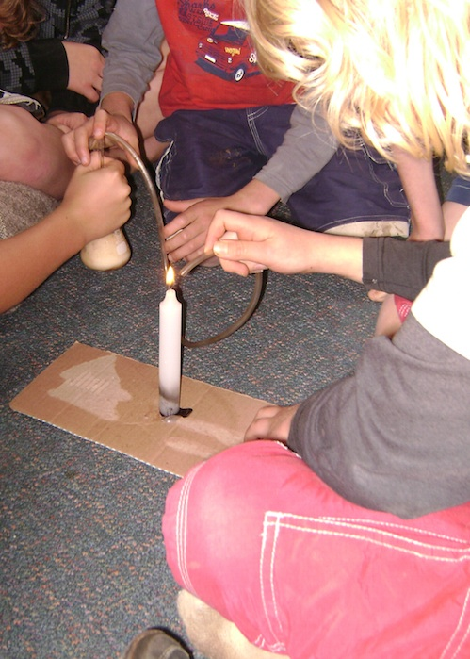
© 2015 The University of Waikato | www.sciencelearn.org.nz

Slide 13
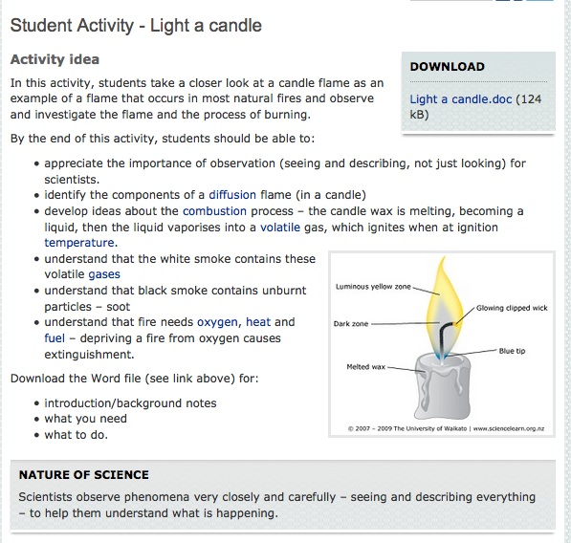
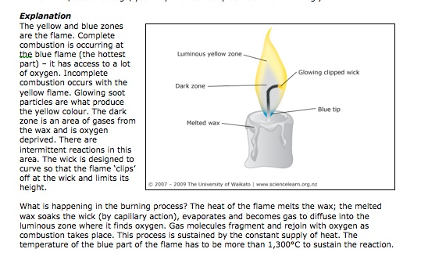
© 2015 The University of Waikato | www.sciencelearn.org.nz

Slide 14
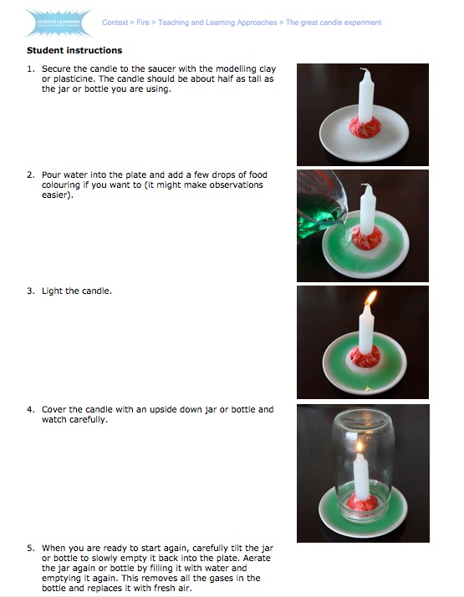
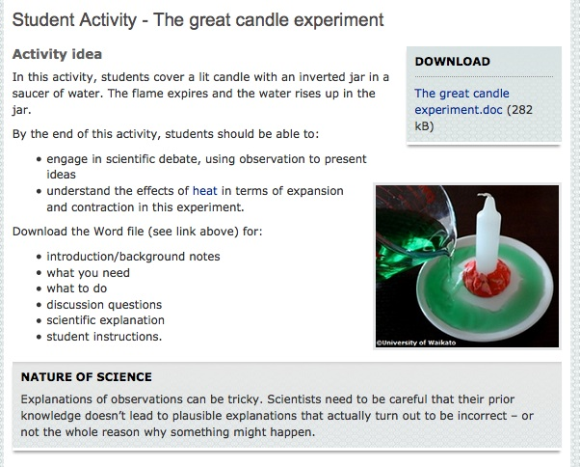
© 2015 The University of Waikato | www.sciencelearn.org.nz

Slide 15
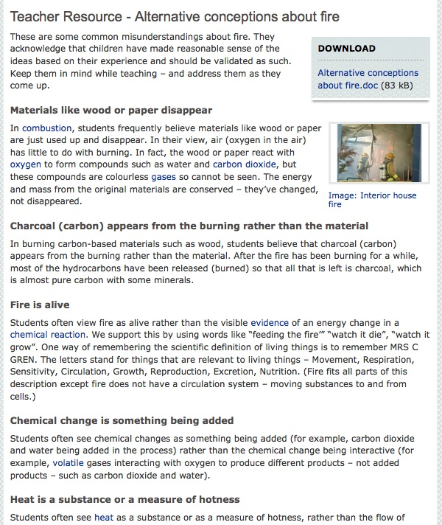
© 2015 The University of Waikato | www.sciencelearn.org.nz

Slide 16
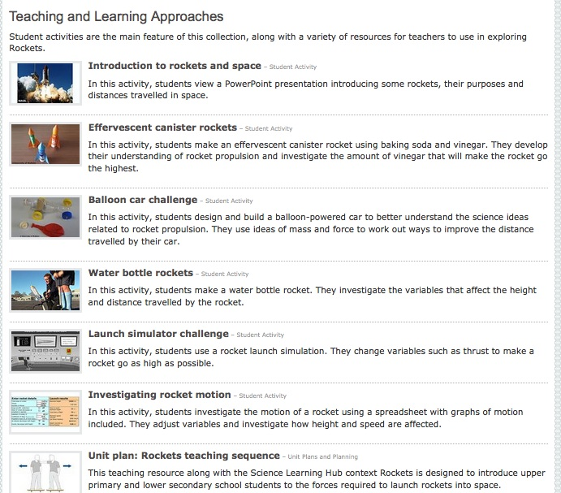
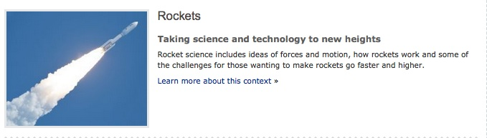
© 2015 The University of Waikato | www.sciencelearn.org.nz

Slide 17
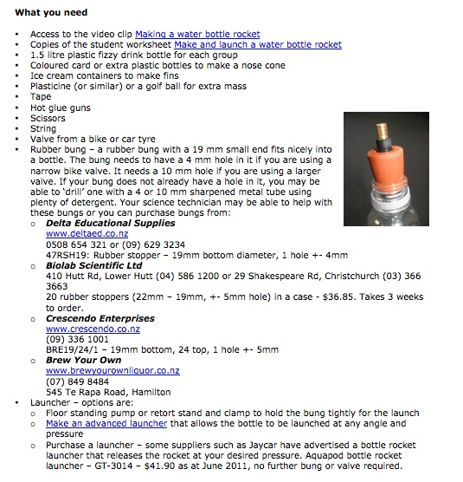
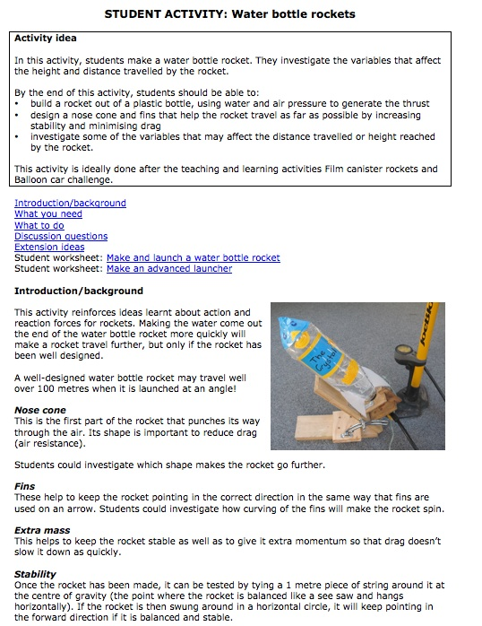
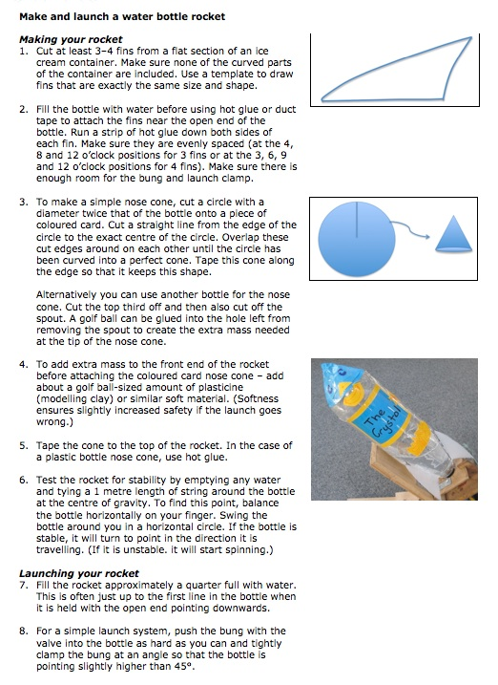
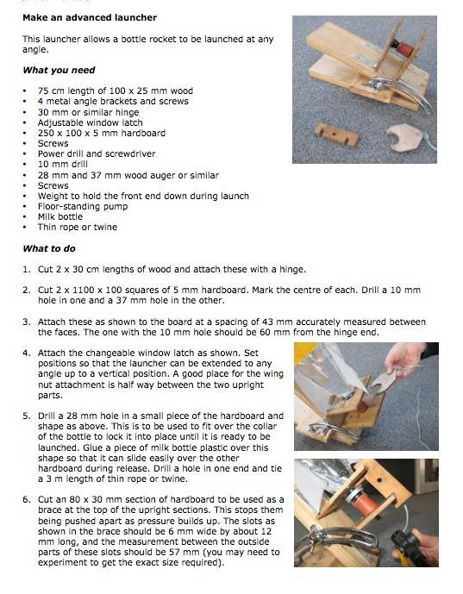
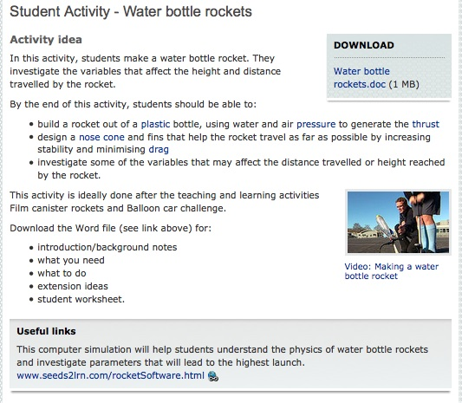
© 2015 The University of Waikato | www.sciencelearn.org.nz

Slide 18
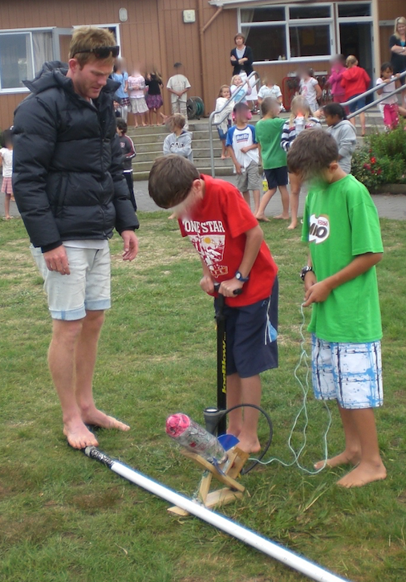
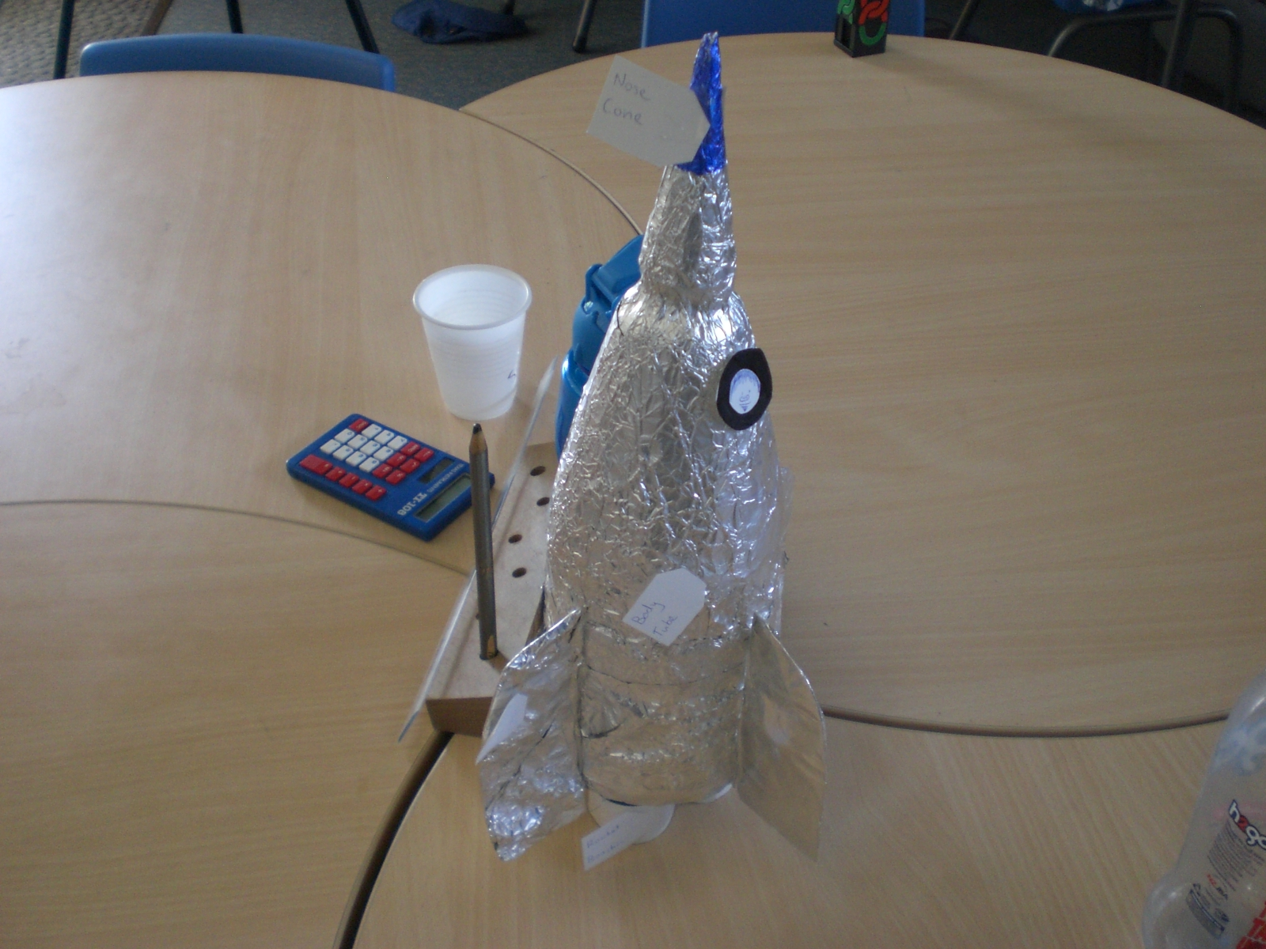
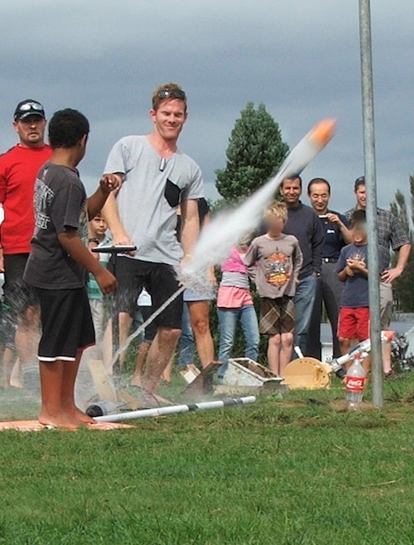

© 2015 The University of Waikato | www.sciencelearn.org.nz

Slide 19

© 2015 The University of Waikato | www.sciencelearn.org.nz

Slide 20

Video: Making a water bottle rocket
http://sciencelearn.org.nz/Contexts/Rockets/Sci-Media/Video/Making-a-water-bottle-rocket
© 2015 The University of Waikato | www.sciencelearn.org.nz

Slide 21

Jaycar Electronics
www.jaycar.co.nz/PRODUCTS/General-Consumer/Toys-%26-Games/15%2Byrs/Aquapod-Bottle-Rocket-Launcher/p/GT3014
© 2015 The University of Waikato | www.sciencelearn.org.nz

Slide 22




© 2015 The University of Waikato | www.sciencelearn.org.nz

Slide 23


Canister rockets
© 2015 The University of Waikato | www.sciencelearn.org.nz
Notes:
Find pics from Star programme

Slide 24


Effervescent canisters
© 2015 The University of Waikato | www.sciencelearn.org.nz
Images with permission of Barb Ryan

Slide 25






© 2015 The University of Waikato | www.sciencelearn.org.nz

Slide 26





© 2015 The University of Waikato | www.sciencelearn.org.nz

Slide 27


© 2015 The University of Waikato | www.sciencelearn.org.nz

Slide 28



Introducing inquiry with an image or news article
© Barb Ryan
© Barb Ryan
© 2015 The University of Waikato | www.sciencelearn.org.nz
Notes:
branding

Slide 29




UV beads
© 2015 The University of Waikato | www.sciencelearn.org.nz
Images with permission of Barb Ryan
Notes:
The beads made into something to wear. Note the coloured ones have been exposed to UV rays.

Slide 30



Checking out the sunscreen
© 2015 The University of Waikato | www.sciencelearn.org.nz
Images with permission of Barb Ryan
Notes:
Sunscreen testing. Sunscreens brought from home. Also used the school one.

Slide 31

10-year-old’s pamphlet on UV
© Barb Ryan
© 2015 The University of Waikato | www.sciencelearn.org.nz

Slide 32
Some comments from teachers who used
You, Me and UV with their classes
The children are loving it. They really love the hands-on experiments with the beads.
I liked the positive and negative presentation of UV. It gave good grounding for some great debates.
It was great for my GATE kids. They went off and investigated how the colour change took place in the UV beads and then presented it to the class.
My children were using the Hub for themselves – both at school and at home.
They’ve discovered that the school sunscreen is not that effective. They’re going to write letters to the BOT and to the principal.
This is awesome. We’re so enjoying doing this science. Exciting stuff, isn’t it?
© 2015 The University of Waikato | www.sciencelearn.org.nz
Notes:
Some of the things they said. Teachers all really enjoyed the experience. Some who had not taught science very much and felt uncomfortable doing so felt it gave them confidence to plan another unit using the Science Learning Hub.

Slide 33






Strange Liquids
© 2015 The University of Waikato | www.sciencelearn.org.nz

Slide 34




Oobleck
From YouTube: BRAINIAC Science Abuse - John Tickle Walks On Custard
© 2015 The University of Waikato | www.sciencelearn.org.nz

Slide 35


Forces – looking for some science to back up your technology ideas?
© 2015 The University of Waikato | www.sciencelearn.org.nz

Slide 36



© 2015 The University of Waikato | www.sciencelearn.org.nz

Slide 37

© 2015 The University of Waikato | www.sciencelearn.org.nz

Slide 38




© 2015 The University of Waikato | www.sciencelearn.org.nz

Slide 39

Solar cars
© 2015 The University of Waikato | www.sciencelearn.org.nz

Slide 40






© 2015 The University of Waikato | www.sciencelearn.org.nz

Slide 41




© 2015 The University of Waikato | www.sciencelearn.org.nz

Slide 42




Would you like a promo pack?
Packs of bookmarks and flyers available – email us enquiries@sciencelearn.org.nz
Follow us on Twitter: https://twitter.com/NZScienceLearn
Like us on Facebook: www.facebook.com/nzsciencelearn
Explore our Pinterest Boards: www.pinterest.com/nzsciencelearn
Join us in the pond: www.pond.co.nz/community/214015/science-learning-hub
© 2015 The University of Waikato | www.sciencelearn.org.nz

Slide 43






Thanks!
Questions and comments?
The images contained within this PowerPoint presentation are copyrighted to the University of Waikato and other 3rd party individuals and organisations. Any reuse beyond the classroom as per the intended use of these resources, should be cleared with the copyright owner/s.

