Slide 1
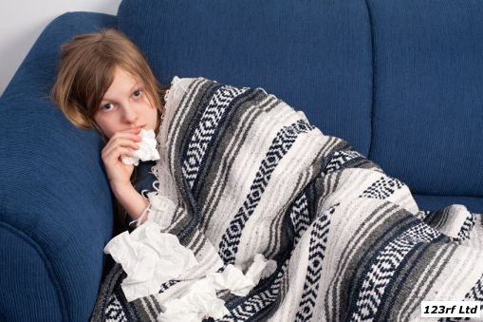
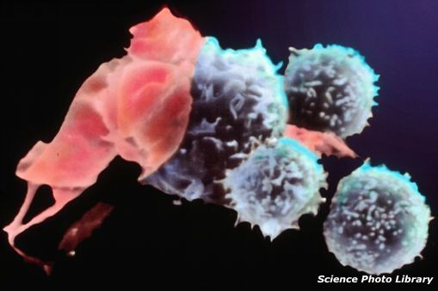
Fighting Infection
Barb Ryan
with Dr Kara Filbey
April 2016
@NZScienceLearn
www.sciencelearn.org.nz
© 2015 The University of Waikato | www.sciencelearn.org.nz

Slide 2


What is the Science Learning Hub?
A trustworthy online resource – produced by educators and scientists
Based on world-class New Zealand science research
Supported by learning activities, information about the key science ideas and concepts, multimedia tools and other resources
Written for New Zealand teachers and students

Slide 3
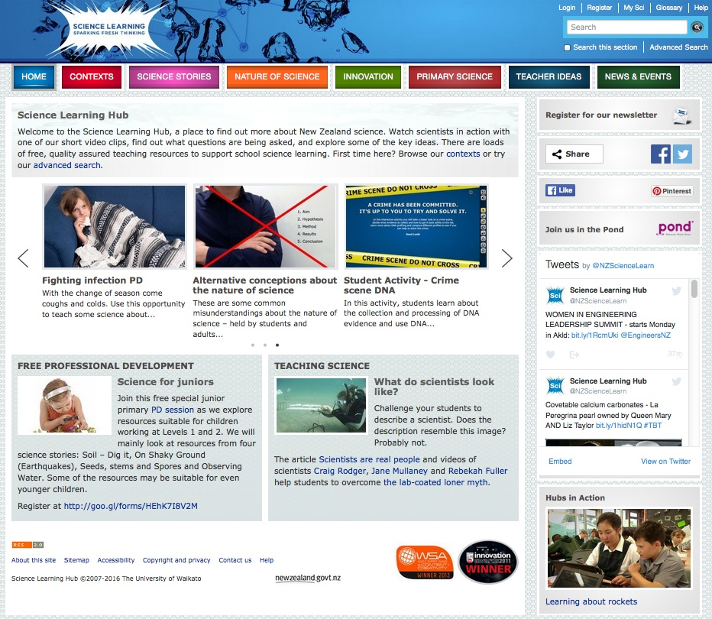
All images are copyrighted. For further information, please refer to enquiries@sciencelearn.org.nz

Slide 4
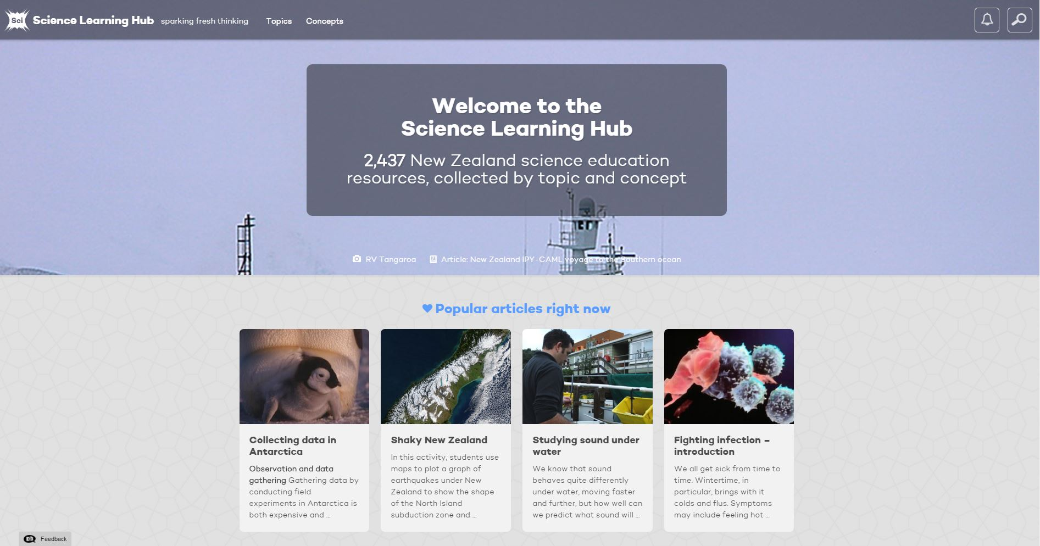
New look for the Science Learning Hub
All images are copyrighted. For further information, please refer to enquiries@sciencelearn.org.nz
Copyright University of Waikato. All rights reserved.

Slide 5
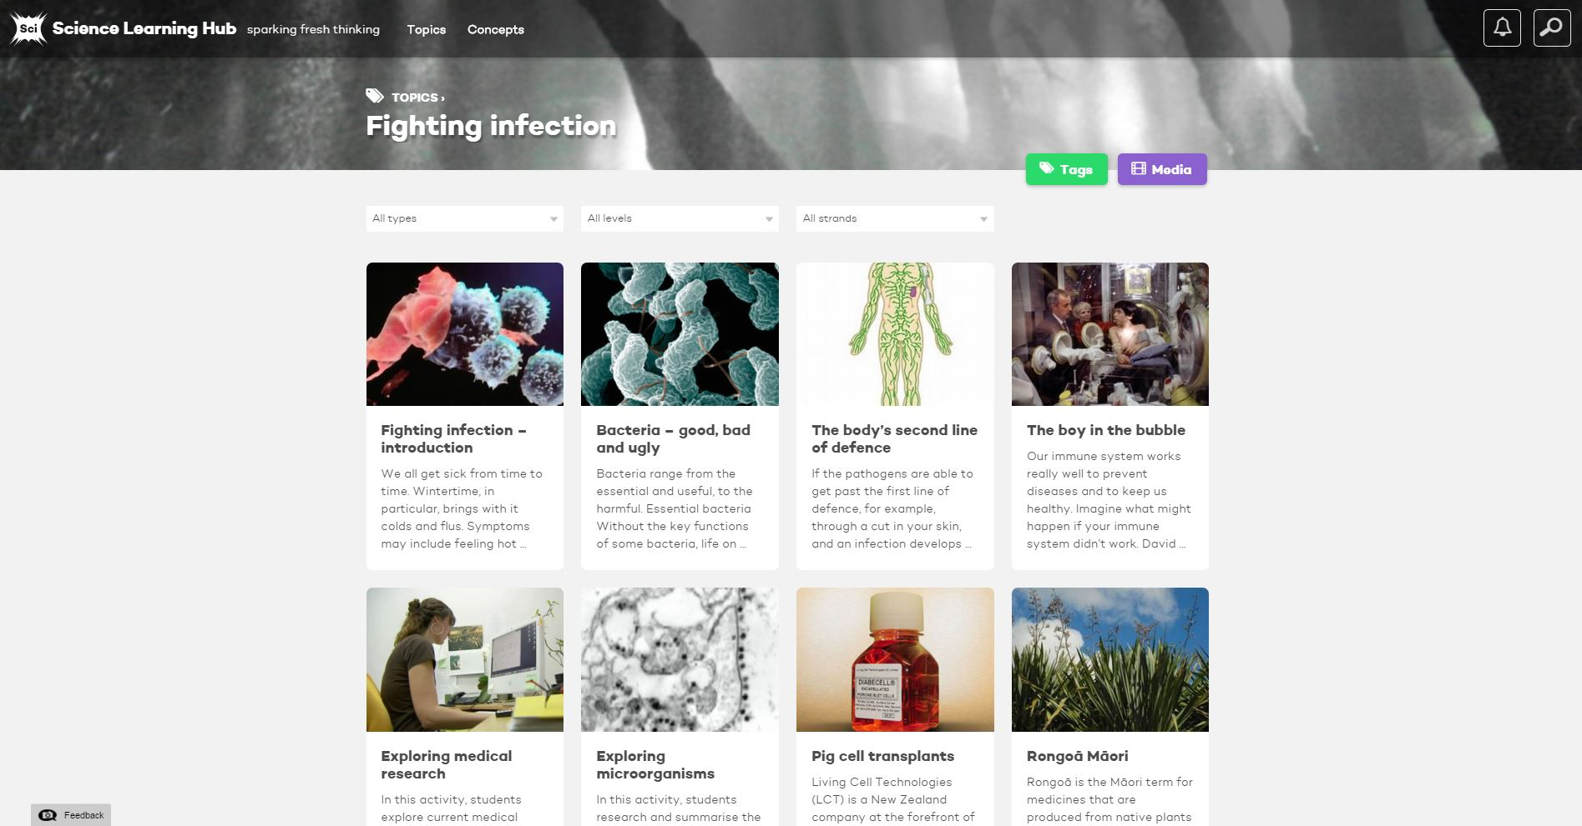
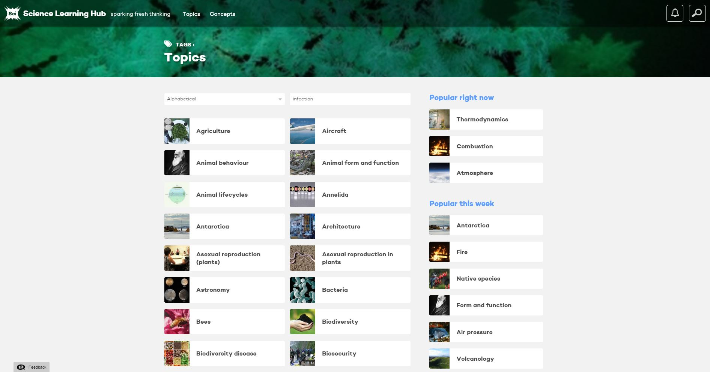
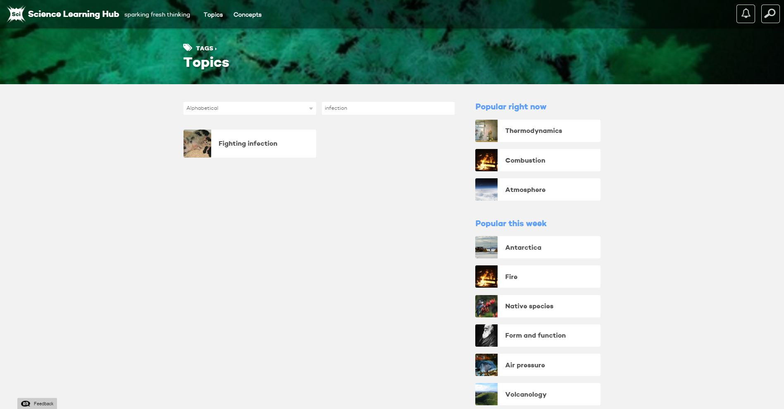
All images are copyrighted. For further information, please refer to enquiries@sciencelearn.org.nz
Copyright University of Waikato. All rights reserved.

Slide 6
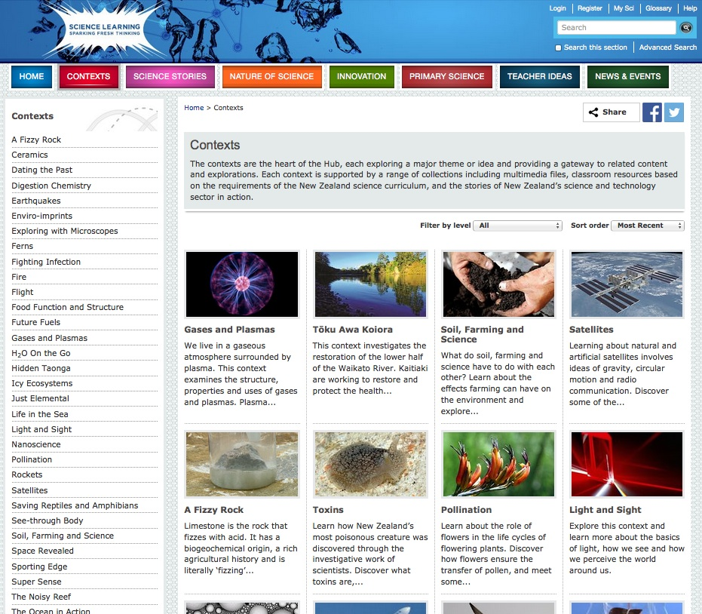
Copyright University of Waikato. All rights reserved.

Slide 7
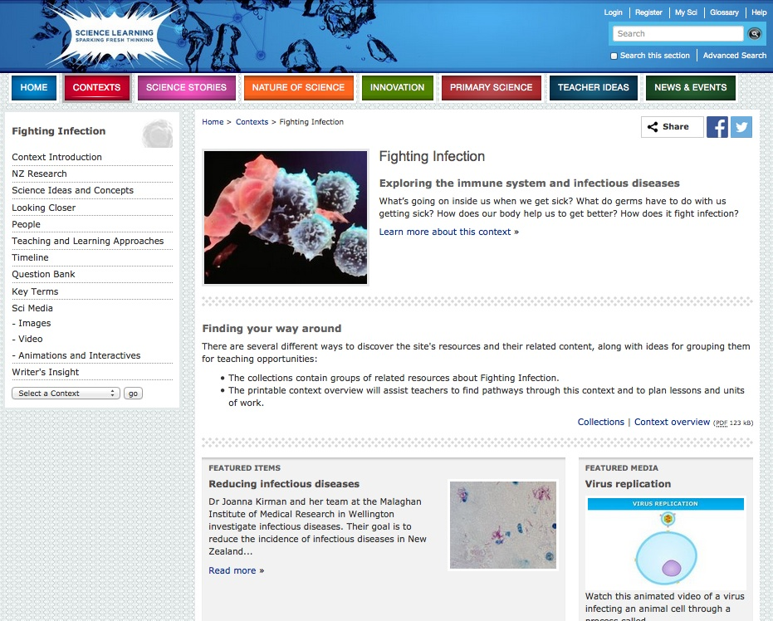
Copyright University of Waikato. All rights reserved.

Slide 8
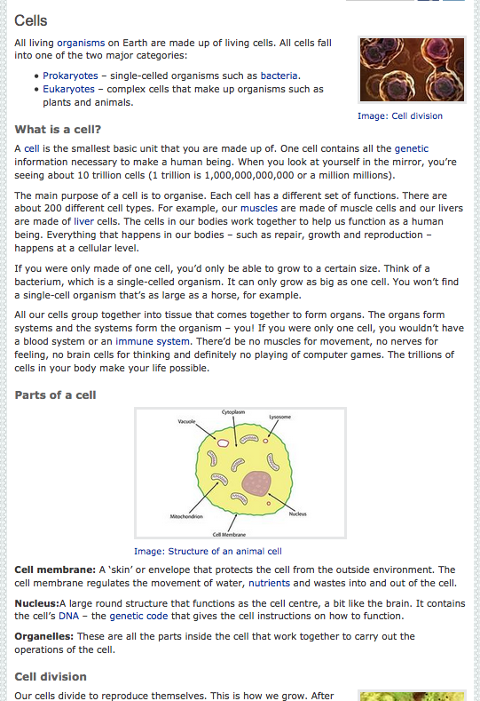

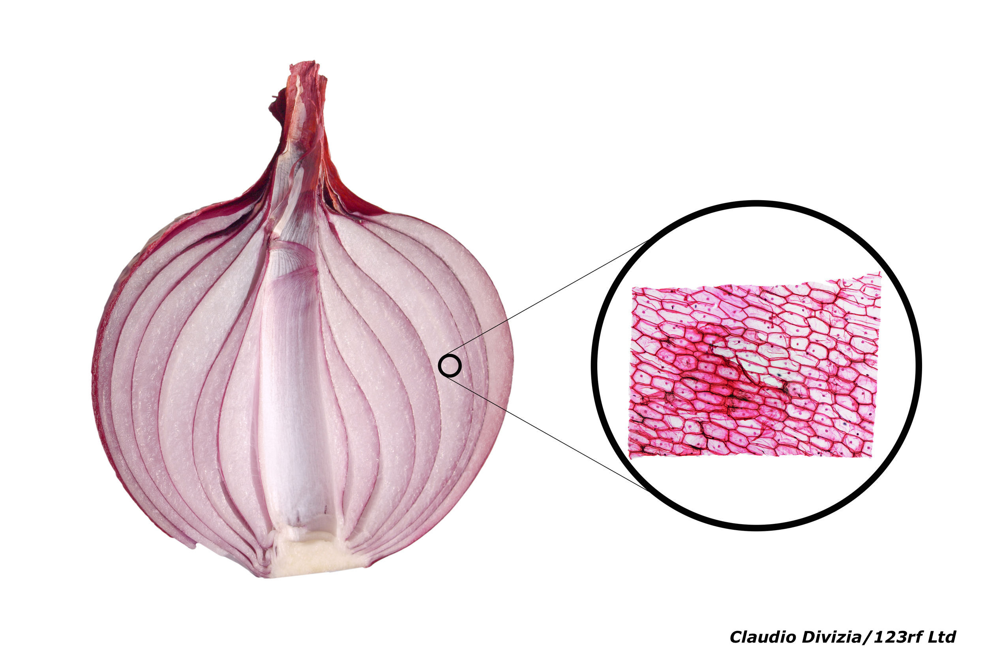
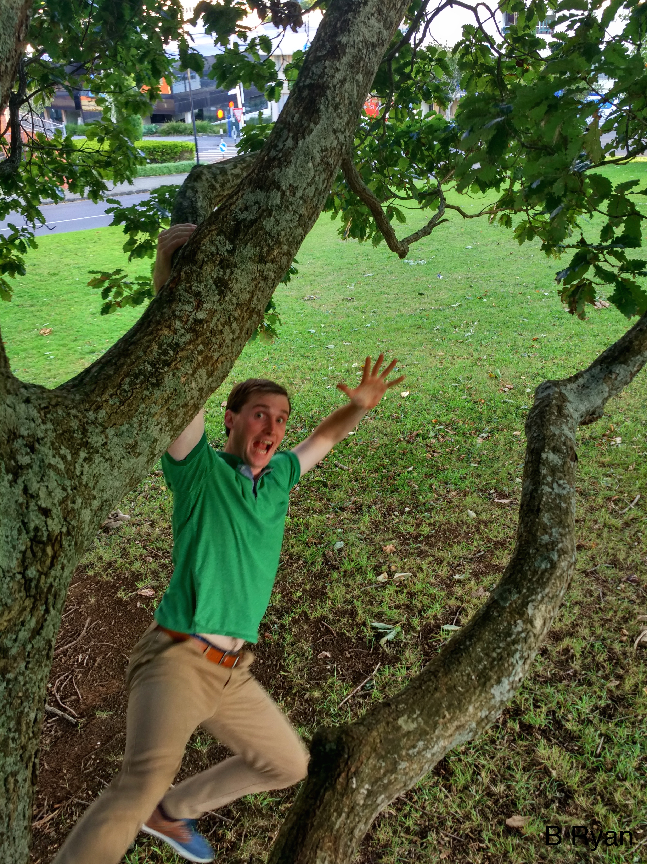
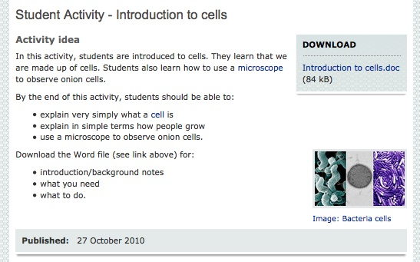
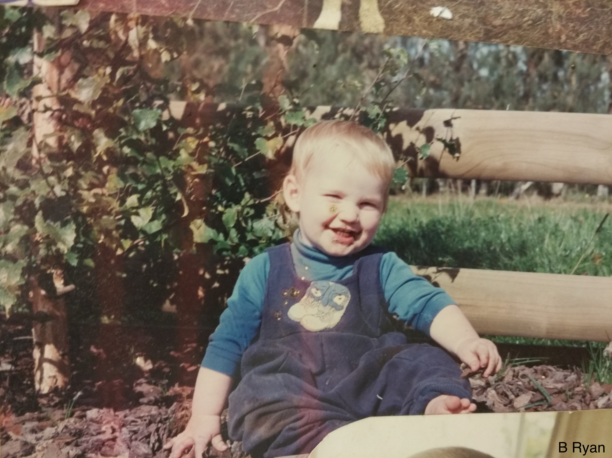
Student activities
Copyright University of Waikato. All rights reserved.

Slide 9
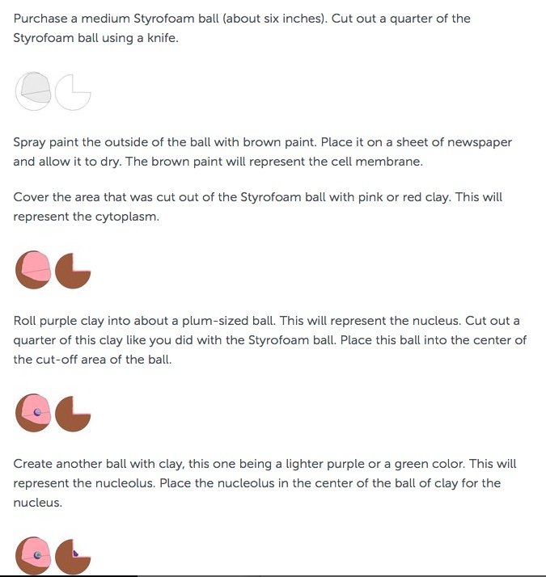
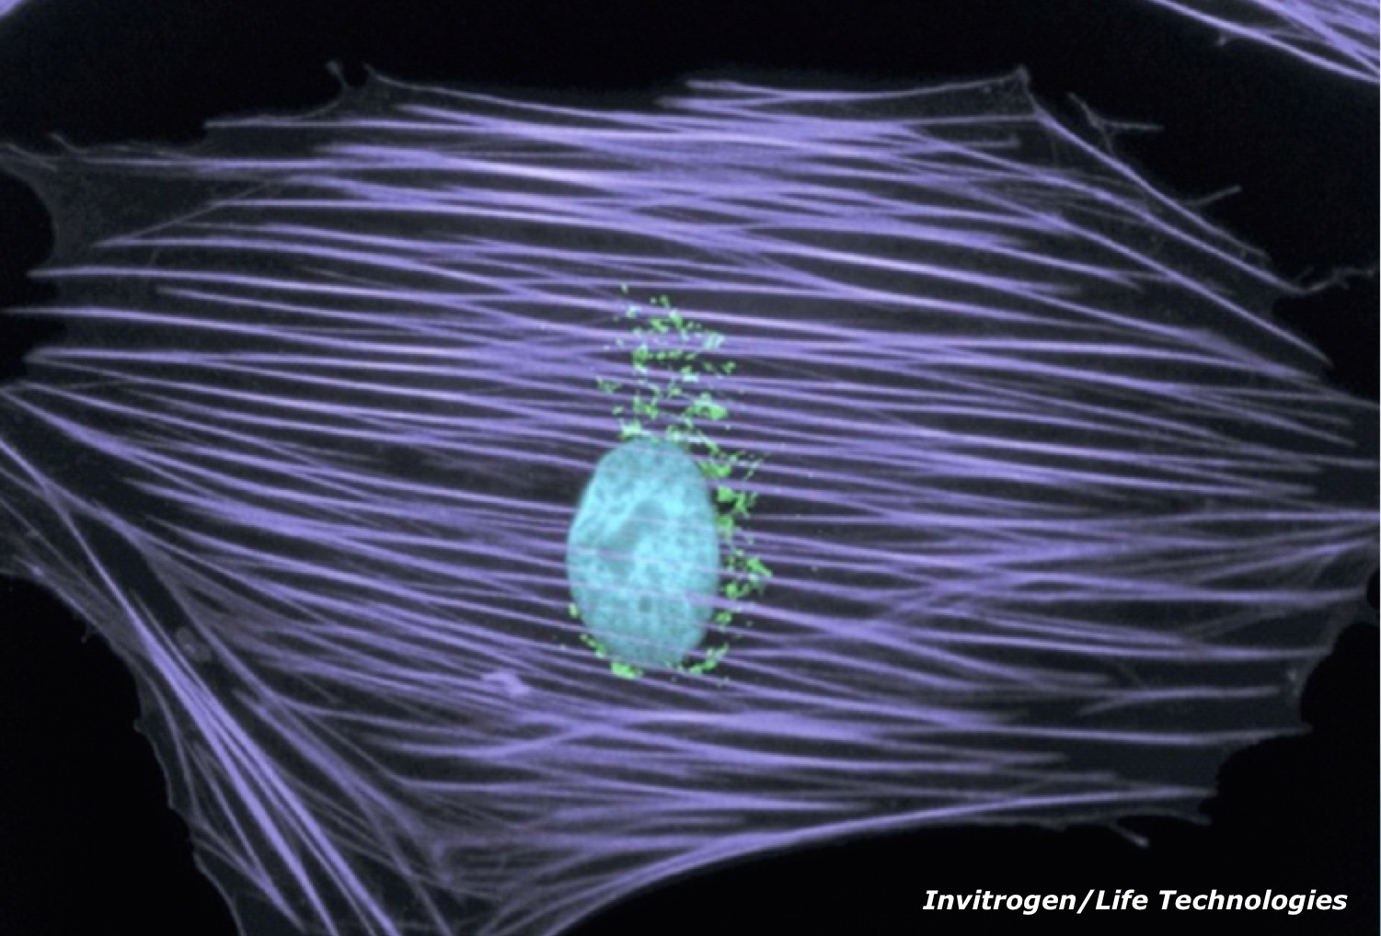
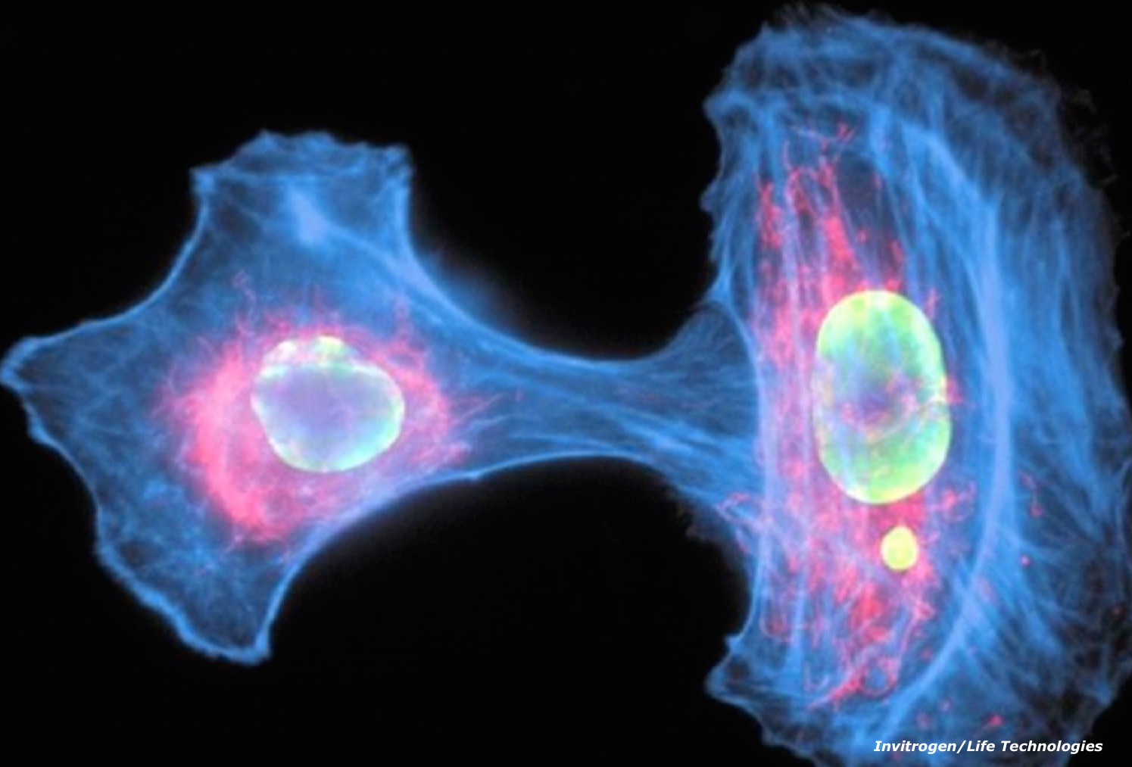
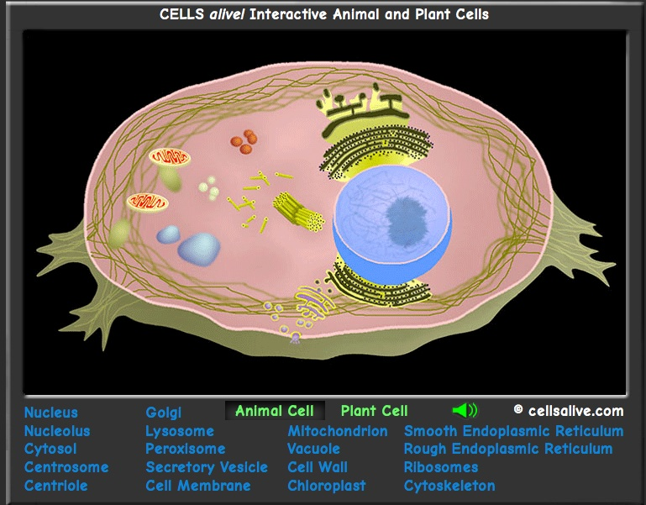
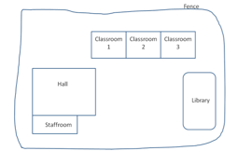
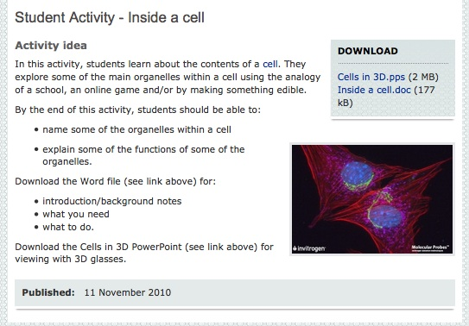
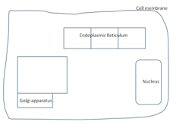
Copyright University of Waikato. All rights reserved.

Slide 10
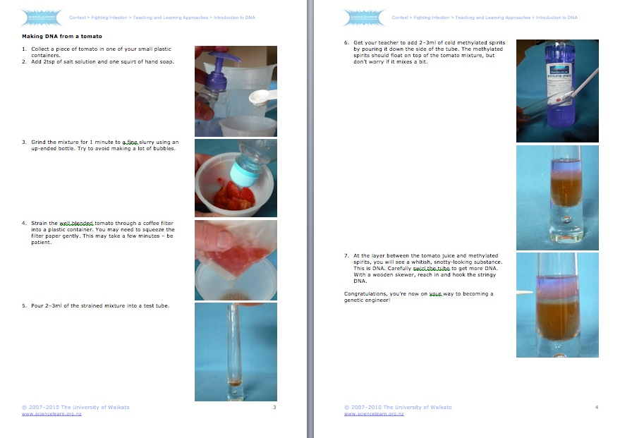
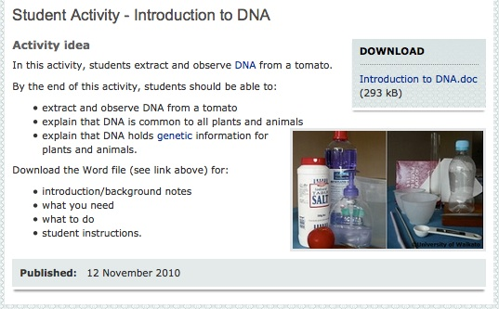
Copyright University of Waikato. All rights reserved.

Slide 11
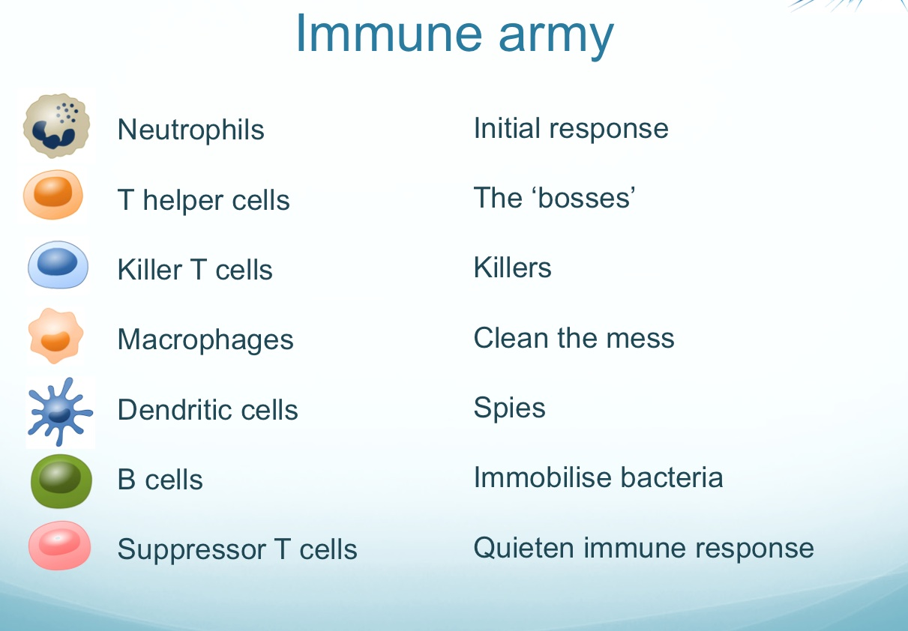
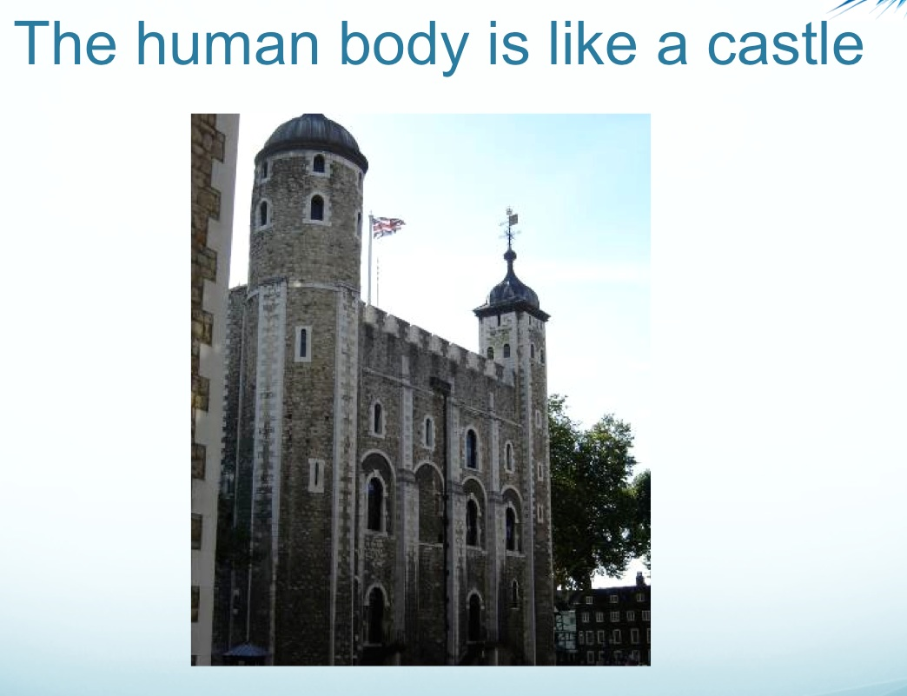
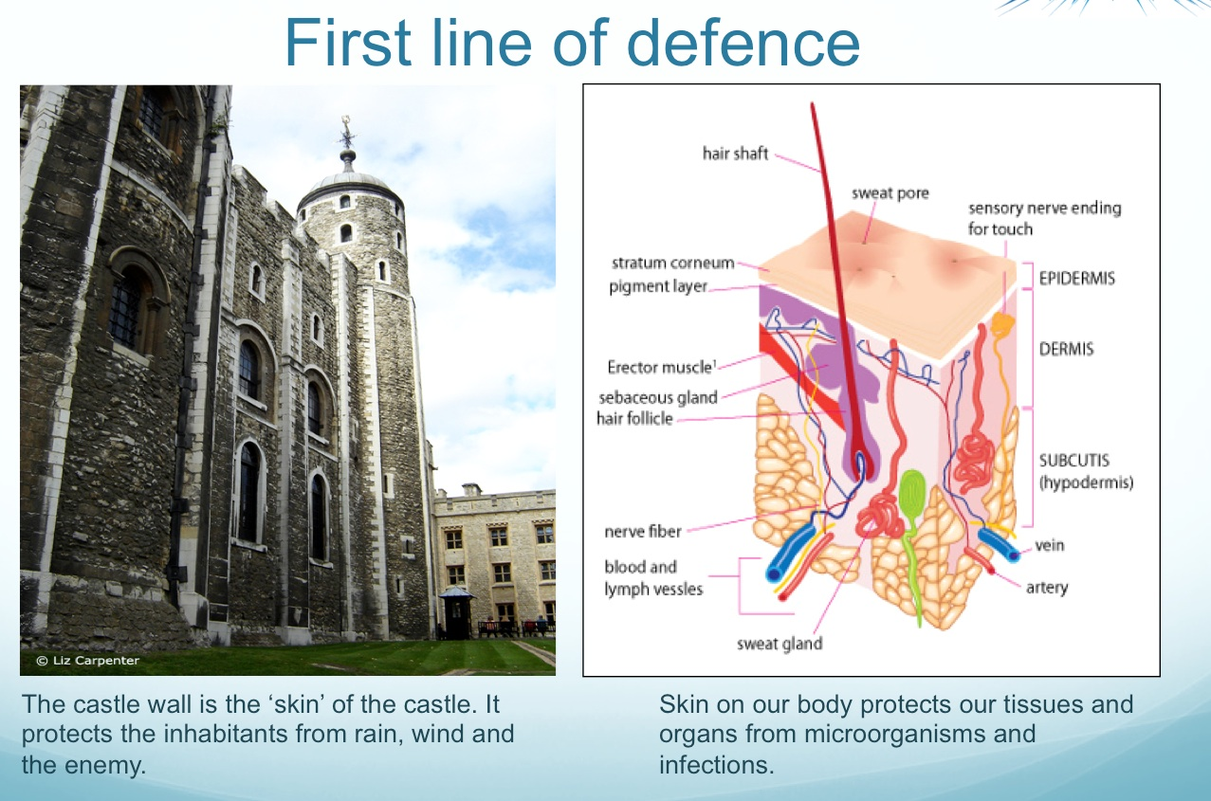
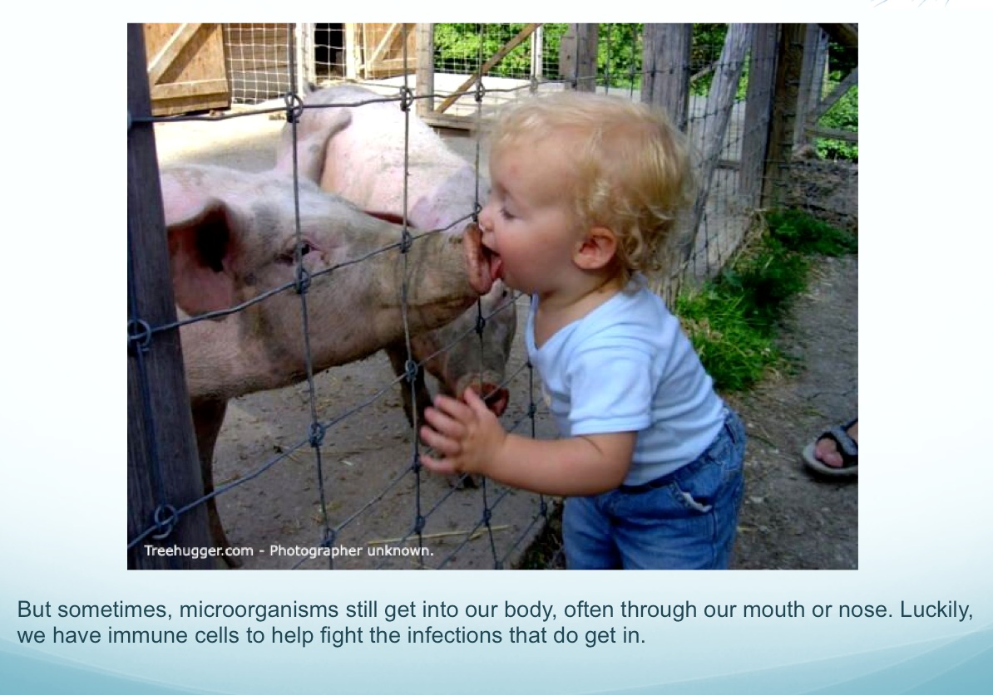
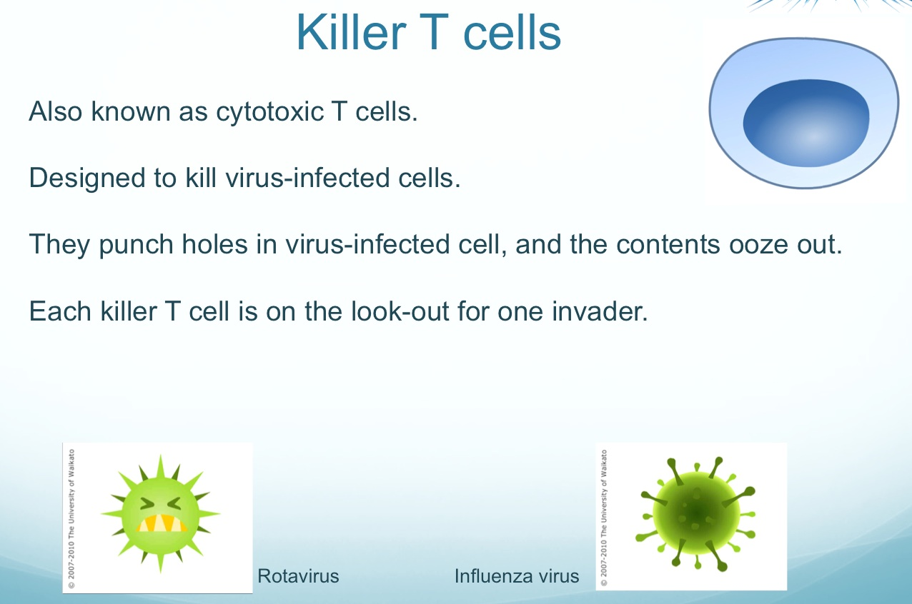
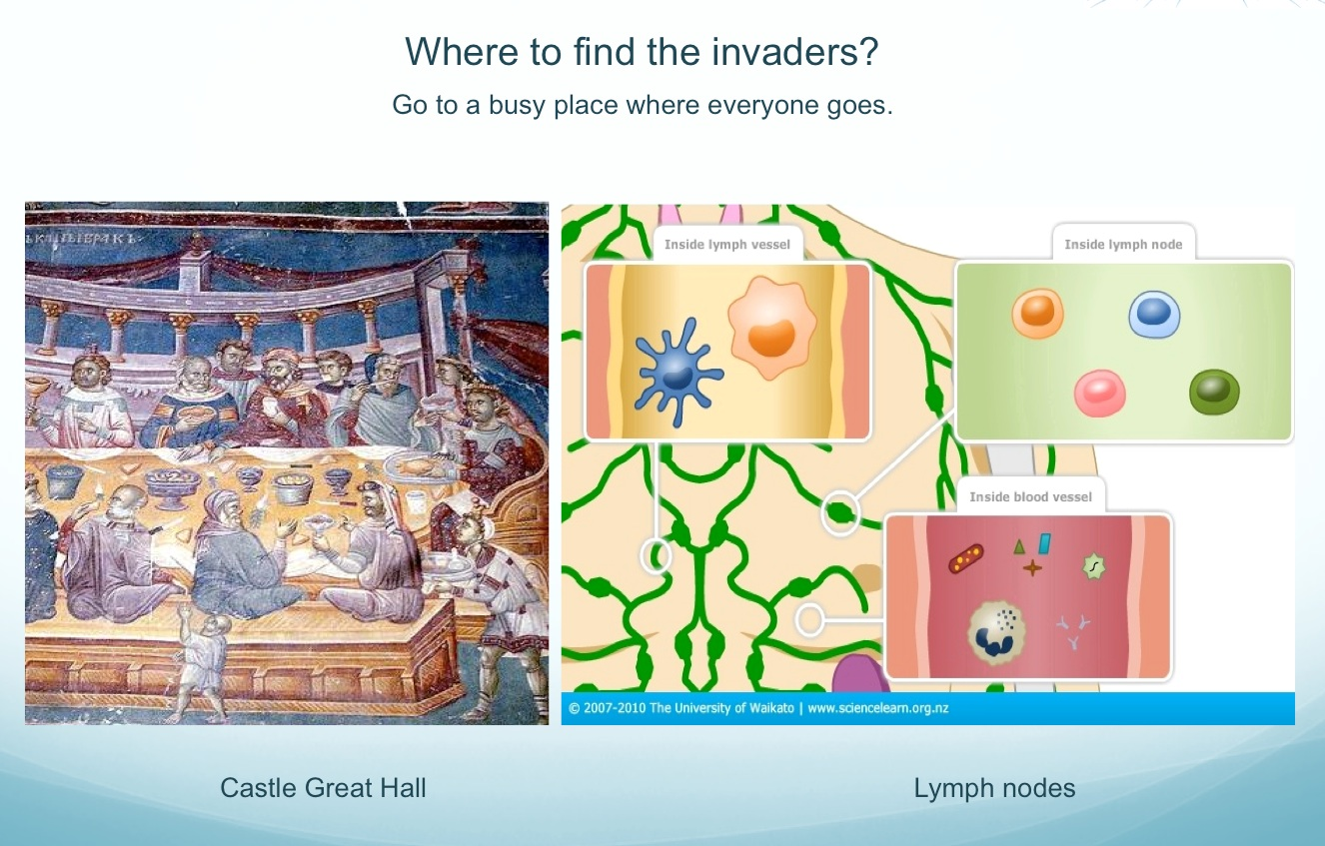
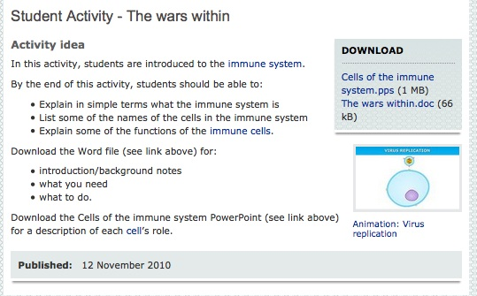
Copyright University of Waikato. All rights reserved.

Slide 12
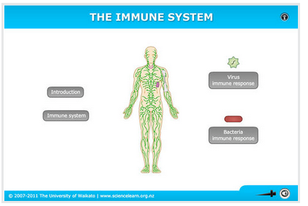
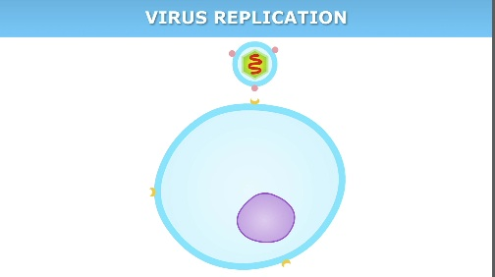
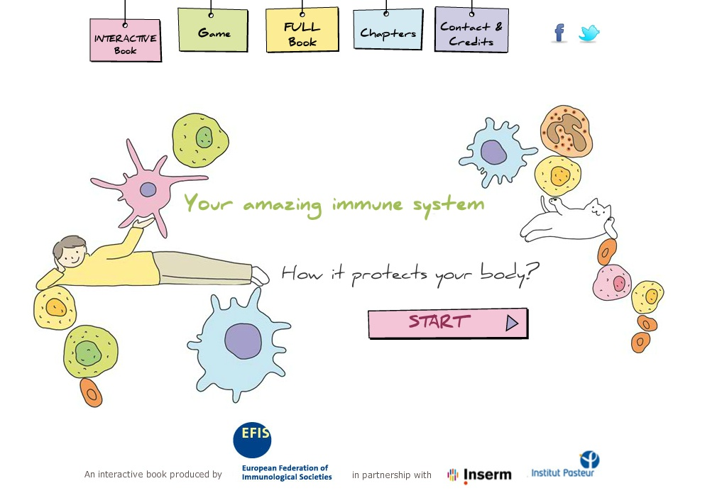

Animations
http://www.interactive-immunity.net/
Copyright University of Waikato. All rights reserved.

Slide 13
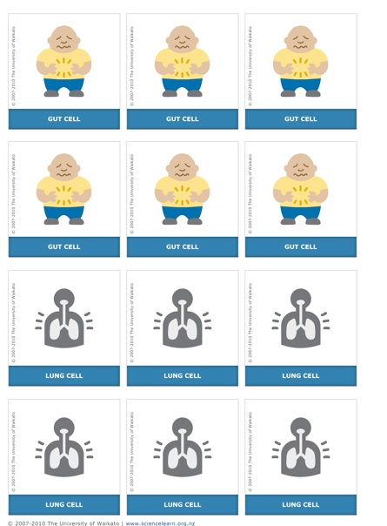
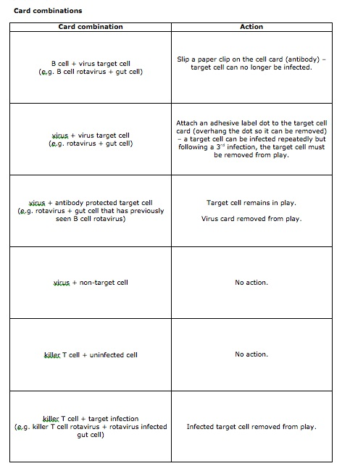
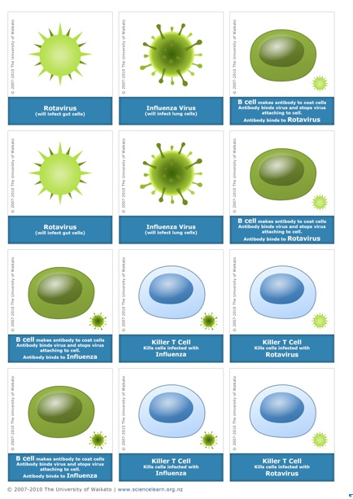
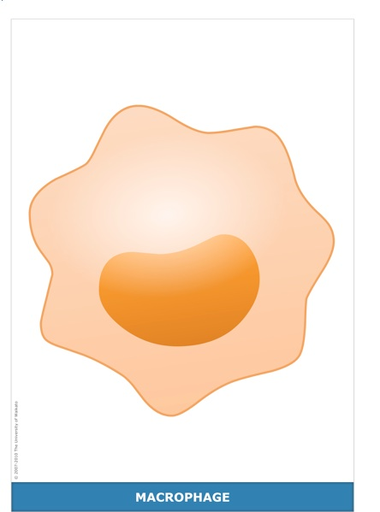
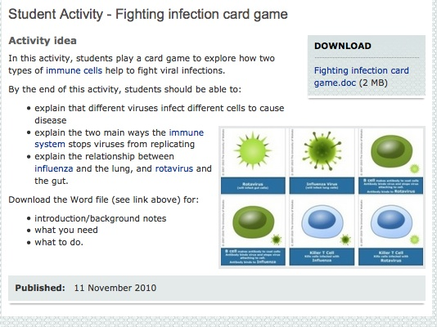
Copyright University of Waikato. All rights reserved.

Slide 14
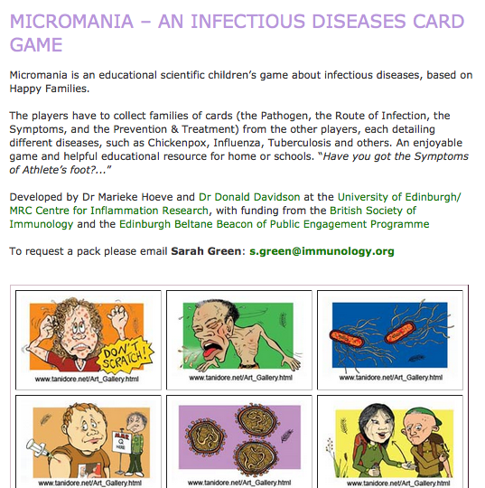
‘Micromania’ developed by Dr Marieke Hoeve and Dr Donald Davidson at the University of Edinburgh/ MRC Centre for Inflammation Research, with funding from the British Society of Immunology and the Edinburgh Beltane Beacon of Public Engagement Programme
https://www.immunology.org/page.aspx?pid=1844
Copyright University of Waikato. All rights reserved.

Slide 15
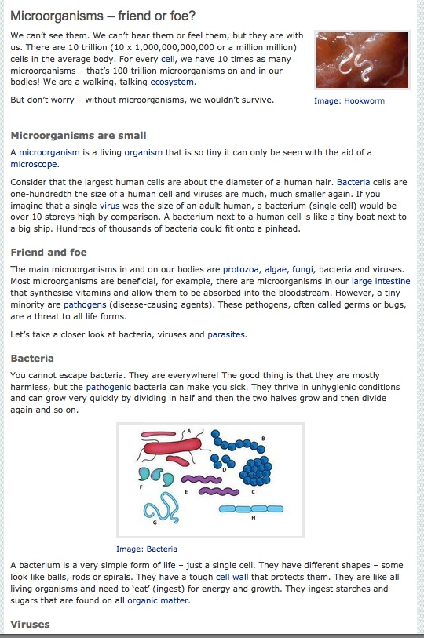
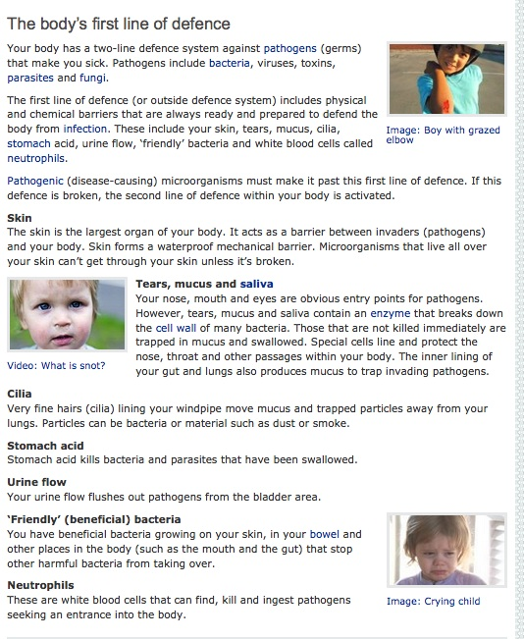
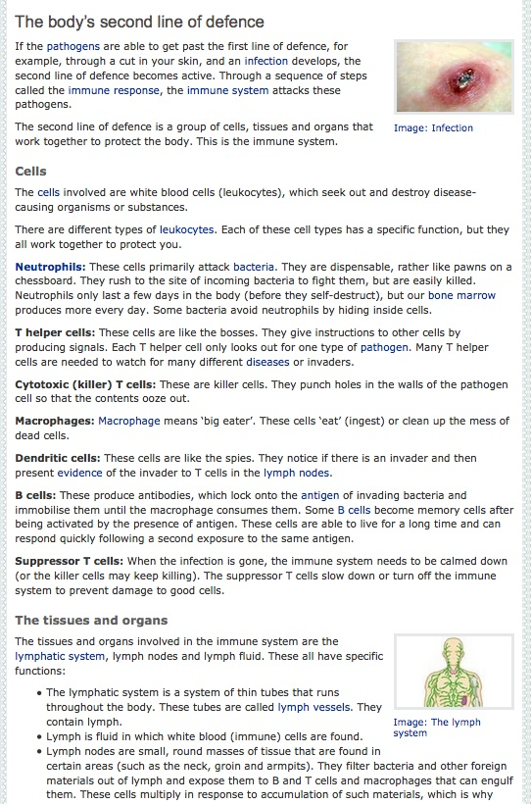
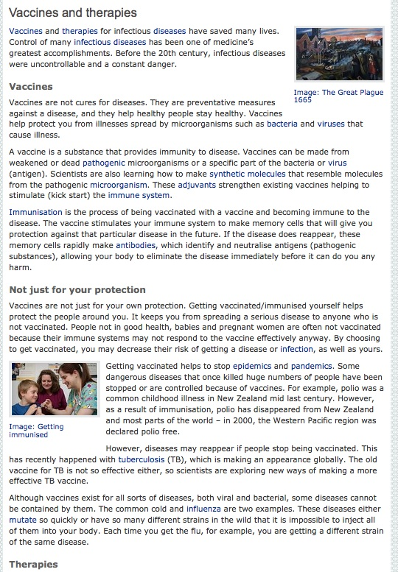
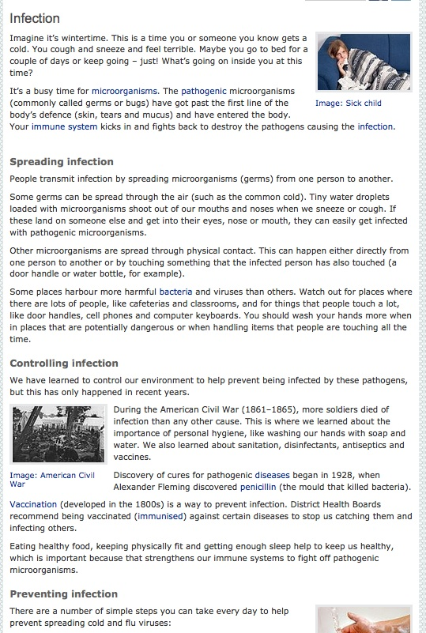
Science ideas and concepts
All images are copyrighted. For further information, please refer to enquiries@sciencelearn.org.nz
Copyright University of Waikato. All rights reserved.

Slide 16
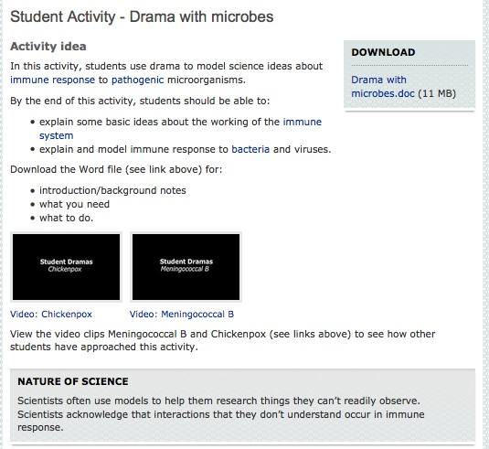
Copyright University of Waikato. All rights reserved.

Slide 17
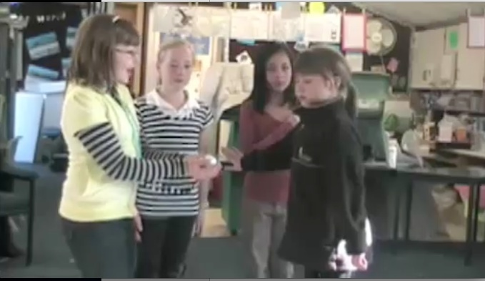
Student video: Meningococcal B
Copyright University of Waikato. All rights reserved.

Slide 18
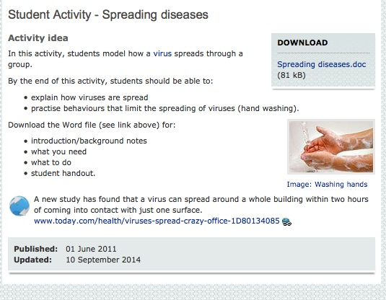
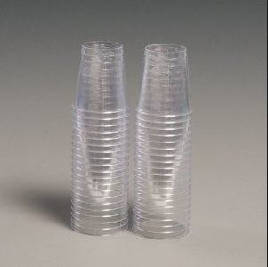
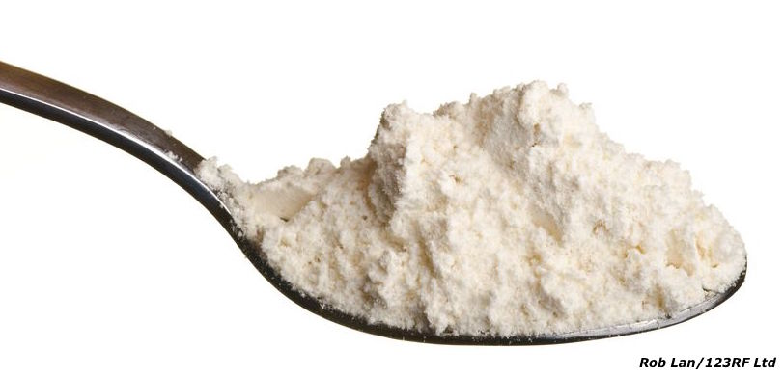
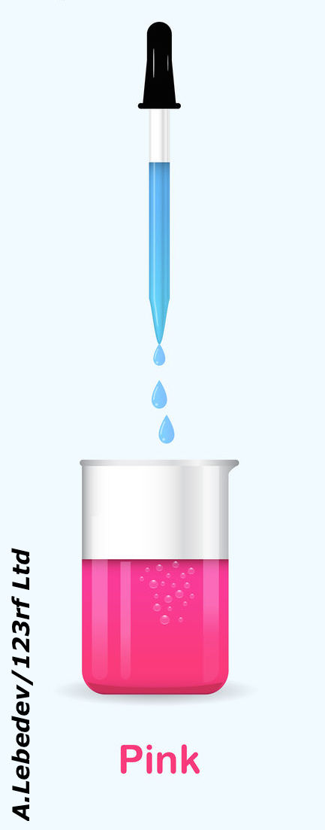
Copyright University of Waikato. All rights reserved.

Slide 19





Copyright University of Waikato. All rights reserved.

Slide 20







Copyright University of Waikato. All rights reserved.

Slide 21
Talking ethics
Who is affected by this issue?
What are the consequences? (harms and benefits)
Are some consequences greater or lesser than others? Who decides?
Who has rights?
Who has responsibilities?
Do I have the right to choose for myself? What effects might my choice have on others?
Copyright University of Waikato. All rights reserved.

Slide 22


Teaching ethics using…
Noisy Round Robin
Debate
Continuums – initial and final
Role-play
Transactional writing
Copyright University of Waikato. All rights reserved.

Slide 23

Copyright University of Waikato. All rights reserved.

Slide 24






Making snot – student activity
Copyright University of Waikato. All rights reserved.

Slide 25




All images are copyrighted. For further information, please refer to enquiries@sciencelearn.org.nz
Copyright University of Waikato. All rights reserved.

Slide 26


Ready-made units
Copyright University of Waikato. All rights reserved.

Slide 27





All images are copyrighted. For further information, please refer to enquiries@sciencelearn.org.nz
Copyright University of Waikato. All rights reserved.

Slide 28

Dr Kara Filbey
Copyright University of Waikato. All rights reserved.

Slide 29






Investigating our immune response to infection with
parasitic worms
Our immune system has different strategies to fight infection with
different types of pathogens:
Fungi/yeast
Bacteria
clker
West Coast Podiatry Centre, USA
clker
Helminths (worms)
Protozoa
Viruses
clker
Copyright University of Waikato. All rights reserved.

Slide 30



Investigating our immune response to infection with
parasitic worms
Helminths
Natural History Museum, London
Dr Richard Kes and Dr Gene Shih via Getty Images
Sabin Institute

Slide 31




Investigating our immune response to infection with
parasitic worms
How do we get them?
Can Stock Photo
WHO/TDR/Stammers

Slide 32

Investigating our immune response to infection with
parasitic worms
What symptoms do they cause?
Usually caused by migration through or trapping of larvae in tissues or from a damaging immune
response to the parasite.
Include:
Anaemia/blood loss
Skin lesions
Blindness
Bowel/GI problems
Malnutrition
Lethargy
Elephantiasis
Liver pathology
Lung function impairment
Cognitive impairment
Sabin Institute

Slide 33


Investigating our immune response to infection with
parasitic worms
Many helminths can live for months, years or even decades in their host.
How do they survive this long without getting killed by our immune system?
Immune response

Slide 34

Investigating our immune response to infection with
parasitic worms
Some parasitic worms have the ability to
down-regulate responses that our immune system
makes against them.
This allows them to survive and reproduce for
longer inside us. This can lead to long-term
damage to our bodies and complications
from other types of infection.
Immune response

Slide 35



Investigating our immune response to infection with
parasitic worms
But it also means that people who have worms can be less susceptible to certain allergic and autoimmune diseases due to this regulated immune environment the worm creates for its own good.
Inflammatory bowel diseases
Allergies/asthma
Autoimmunity (e.g. MS)
clker
clker
clker
lineartestpilot/shutterstock

Slide 36

Investigating our immune response to infection with
parasitic worms
Projects I’m working on:
Understanding the basic immunology of helminth infections.
Investigating how helminths can improve allergy/inflammatory conditions.
Can we help develop a vaccine to prevent helminth infections in parts of the world where they cause most debilitating disease and economic burden?

Slide 37





Copyright University of Waikato. All rights reserved.

Slide 38

https://www.pond.co.nz/detail/1434656/human-health
POND
Copyright University of Waikato. All rights reserved.

Slide 39




Would you like a promo pack?
Packs of bookmarks and flyers available – email us enquiries@sciencelearn.org.nz
Follow us on Twitter: https://twitter.com/NZScienceLearn
Like us on Facebook: www.facebook.com/nzsciencelearn
Explore our Pinterest Boards: https://nz.pinterest.com/nzsciencelearn/
Join us in the pond: www.pond.co.nz/community/214015/science-learning-hub
Copyright University of Waikato. All rights reserved.

Slide 40










Thanks!
Questions and comments?
The images contained within this PowerPoint presentation are copyrighted to the University of Waikato and other 3rd party individuals and organisations. Any reuse beyond the classroom as per the intended use of these resources, should be cleared with the copyright owner/s.

