Slide 1
The Science
Learning Hub
Resources supporting the teaching and learning of carbon chemistry and carbon cycling
Kate Rice
26 March 2015
4.00–4:45pm
@NZScienceLearn
www.sciencelearn.org.nz
Notes:
Welcome to the Science Leaning Hub, where you will find a wide variety of science resources designed especially for primary and secondary teachers and students. It is funded by the Ministry of Business, Innovation and Employment.

Slide 2

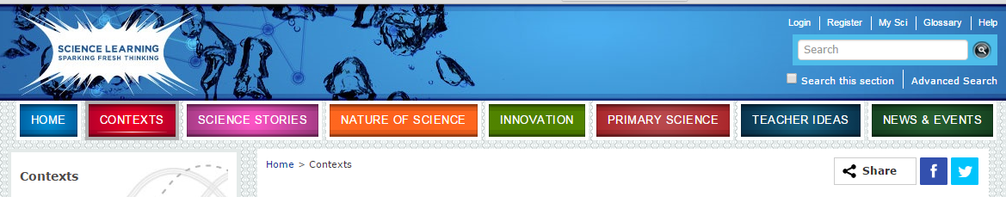
Let's explore what's there …
Type “carbon cycle” into the search box
© 2015 The University of Waikato | www.sciencelearn.org.nz
Notes:
Suggest you type in quotes “carbon cycle” so it searches for the phrase or carbon +cycle so it searches for the two words – otherwise it searches for any content with either carbon or cycle in it.

Slide 3
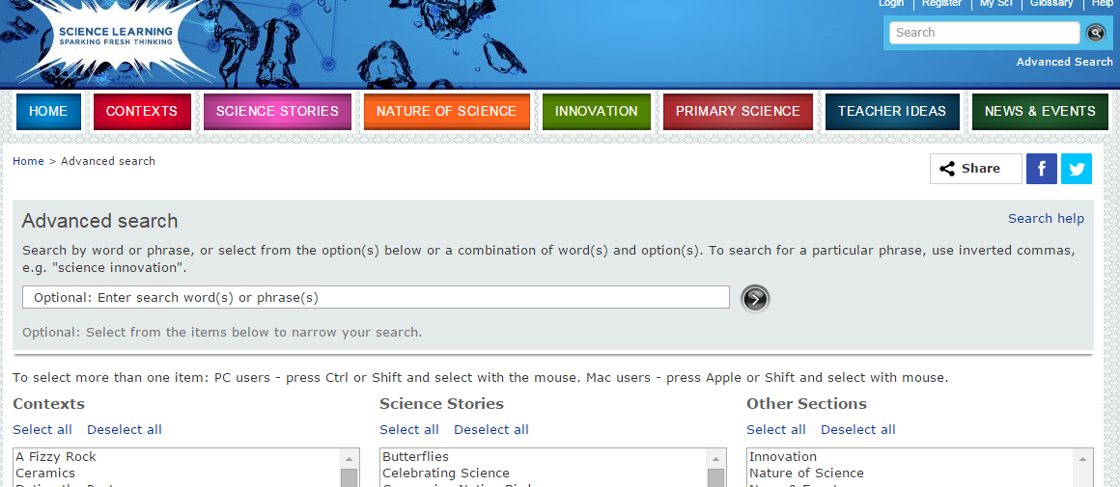
… or use the advanced search option
Fill in details here about the carbon cycle and select the sections to consider
© 2015 The University of Waikato | www.sciencelearn.org.nz

Slide 4
Resources identified from the search
Context: The Ocean in Action
Science Ideas include:
Ocean and the Carbon Cycle
Ocean dissolved gases
Ocean Temperature
Context: A Fizzy Rock
Science Ideas include:
Calcium carbonate biomineralisation
Cold seep carbonates
Limestone origins
NZ origins
Also articles such as
Replicating biomineralisation in laboratory
Context Future Fuels
Science Ideas and Animations included:
Carbon cycle
Ancient environments
CO₂ sequestration
How oil and gas are made
Marine fossils on hilltops
Oil and gas in rocks
Oil formation
© 2015 The University of Waikato | www.sciencelearn.org.nz

Slide 5
From the huge list you get, I have selected some to follow up:
I sorted these into the three processes of the carbon cycle:
Removal
Addition
Storage
Next, I developed these into ways to use them in the teaching sequence that follows.
© 2015 The University of Waikato | www.sciencelearn.org.nz

Slide 6
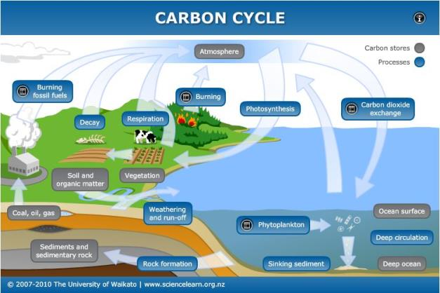
Resources to introduce ideas about the
Carbon cycle
A great starting point is the Carbon cycle interactive, which introduces the aspects of the cycle, covering the ways carbon is:
  added to the atmosphere from different
  activities in the ecosystem
  removed from the atmosphere
  stored in the ecosystem
Find this resource at: http://sciencelearn.org.nz/Contexts/The-Ocean-in-Action/Sci-Media/Interactive/Carbon-cycle
© 2015 The University of Waikato | www.sciencelearn.org.nz

Slide 7
http://sciencelearn.org.nz/Contexts/The-Ocean-in-Action/Sci-Media/Interactive/Carbon-cycle
Quiz on the Carbon cycle interactive
Where is carbon stored?
Which storage process contains the highest level of carbon?
Why is the CO₂ exchange between ocean and atmosphere important?
Why are phytoplankton in the ocean important in the carbon cycle?
Atmosphere, plants, coal, oil and gas, soil, sediments and sedimentary rocks, ocean surface, deep ocean
Sediments and sedimentary rocks –
1 000 000 000 000 billion tonnes
The ocean stores 60 times more carbon than the atmosphere so reduces levels in the atmosphere
They are tiny plants that absorb CO₂, and when they die, they can decompose and return CO₂ to the atmosphere or they can add to the stores in the deep ocean sediments, reducing the amount of CO₂ circulating in the system
© 2015 The University of Waikato | www.sciencelearn.org.nz

Slide 8

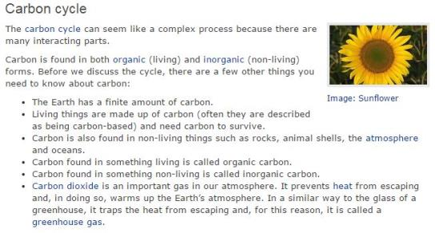
Developing understanding of the components
of the carbon cycle
Use a guided reading process with the Science Ideas and Concepts resource on the carbon cycle
http://sciencelearn.org.nz/Contexts/Future-Fuels/Science-Ideas-and-Concepts/Carbon-cycle
1 Reading on the lines:
List an organic form of carbon
List two inorganic forms of carbon
Why is CO₂ called a greenhouse gas?
2 Reading between the lines:
How is inorganic carbon added to
the atmosphere?
3 Reading beyond the lines:
Why is knowing about the carbon cycle important for our future?
© 2015 The University of Waikato | www.sciencelearn.org.nz

Slide 9
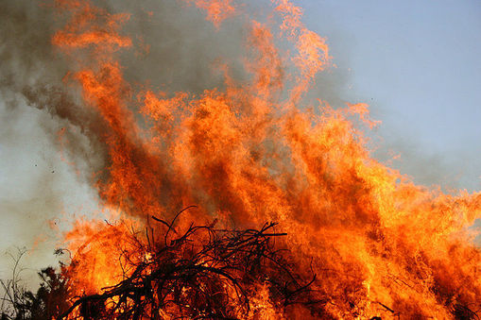
Resources linking to addition of carbon to
the atmosphere
Respiration of plants and animals
http://sciencelearn.org.nz/Contexts/Digestion-Chemistry/Science-Ideas-and-Concepts/Unlocking-the-energy-in-foods
Burning fuels – wood, coal, oil and its products
http://sciencelearn.org.nz/Contexts/Future-Fuels/Science-Ideas-and-Concepts/Non-renewable-energy-sources
Fertiliser manufacture and use
http://sciencelearn.org.nz/Contexts/A-Fizzy-Rock/Science-Ideas-and-Concepts/Limestone-uses
Chemical reactions
http://sciencelearn.org.nz/Contexts/A-Fizzy-Rock/Science-Ideas-and-Concepts/Carbonate-chemistry
© 2015 The University of Waikato | www.sciencelearn.org.nz
Notes:
Image from:
http://sciencelearn.org.nz/contexts/future-fuels/sci-media/video/fuels-and-greenhouse-gases aka: http://sciencelearn.org.nz/Contexts/Future-Fuels/Sci-Media/Images/Wood-bonfire (Public domain – worldwide)

Slide 10
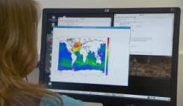
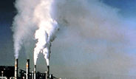
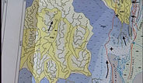
Resources linking to removal of carbon from the atmosphere
Sinking sediment from phytoplankton etc.
http://sciencelearn.org.nz/Contexts/The-Ocean-in-Action/Science-Ideas-and-Concepts/The-ocean-and-the-carbon-cycle
Deep circulation or CO₂ sequestration
http://sciencelearn.org.nz/Contexts/Future-Fuels/Sci-Media/Video/Carbon-dioxide-sequestration
Future fuels
http://sciencelearn.org.nz/Contexts/Future-Fuels/Sci-Media/Video/Ancient-environments
Rock formation
    http://sciencelearn.org.nz/Contexts/A-Fizzy-Rock/Science-Ideas-and-Concepts/Limestone-origins
© 2015 The University of Waikato | www.sciencelearn.org.nz
Notes:
Images from:
http://sciencelearn.org.nz/Contexts/The-Ocean-in-Action/Sci-Media/Video/Southern-Ocean-carbon-sink
http://sciencelearn.org.nz/Contexts/Future-Fuels/Sci-Media/Video/Carbon-dioxide-sequestration
http://sciencelearn.org.nz/Contexts/Future-Fuels/Sci-Media/Video/Ancient-environments

Slide 11
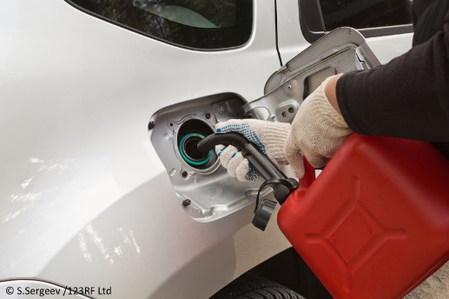
Resources linking to storage of carbon
The ocean
http://sciencelearn.org.nz/Contexts/The-Ocean-in-Action/Science-Ideas-and-Concepts/The-ocean-and-the-carbon-cycle
http://sciencelearn.org.nz/Contexts/The-Ocean-in-Action/Science-Ideas-and-Concepts/Ocean-temperature
Vegetation
http://sciencelearn.org.nz/Contexts/Future-Fuels/Sci-Media/Video/The-Bioenergy-Options-project
Photosynthesis
http://sciencelearn.org.nz/Contexts/Soil-Farming-and-Science/Sci-Media/Images/Essential-needs-for-plants
Fossil fuels
http://sciencelearn.org.nz/Contexts/Future-Fuels/Science-Ideas-and-Concepts/Carbon-cycle
http://sciencelearn.org.nz/Contexts/Future-Fuels/Science-Ideas-and-Concepts/Non-renewable-energy-sources
Rock cycle and rocks containing carbonates
http://sciencelearn.org.nz/Contexts/A-Fizzy-Rock/Science-Ideas-and-Concepts/Limestone-origins
© 2015 The University of Waikato | www.sciencelearn.org.nz
Notes:
Image © S. Sergeev/123RF Ltd

Slide 12
Achievement Standard 90953
2 Demonstrate understanding involves describing the addition, removal and storage of carbon using information, visual representations, and data.
3 Demonstrate in-depth understanding involves explaining the addition, removal and storage of carbon using information, visual representations, and data.
4 Demonstrate comprehensive understanding involves explaining thoroughly links between the addition, removal and storage of carbon using information, visual representations, and data. It may involve elaborating, applying, justifying, relating, evaluating, comparing and contrasting, and analysing.
© 2015 The University of Waikato | www.sciencelearn.org.nz

Slide 13
Developing an Assessment Task for AS 90953
Class discussion should proceed the assessment by identifying local situations relating to the three considerations:
How is Carbon in our area
added to the atmosphere? – such as local industries, coal mining, household fires, cars and trucks
removed from the atmosphere? – such as by plants and in the local lakes or ocean
Stored short term? - such as forests and plantations,
Stored long term? – such as local limestone deposits, nearby ocean sediments etc
Consider using a visual representation of the carbon cycle that students can annotate to reflect the resources used in teaching and learning.
Students will better address the requirements of the assessment if the task relates to the processes of the Carbon Cycle occurring in the local area.
© 2015 The University of Waikato | www.sciencelearn.org.nz

Slide 14
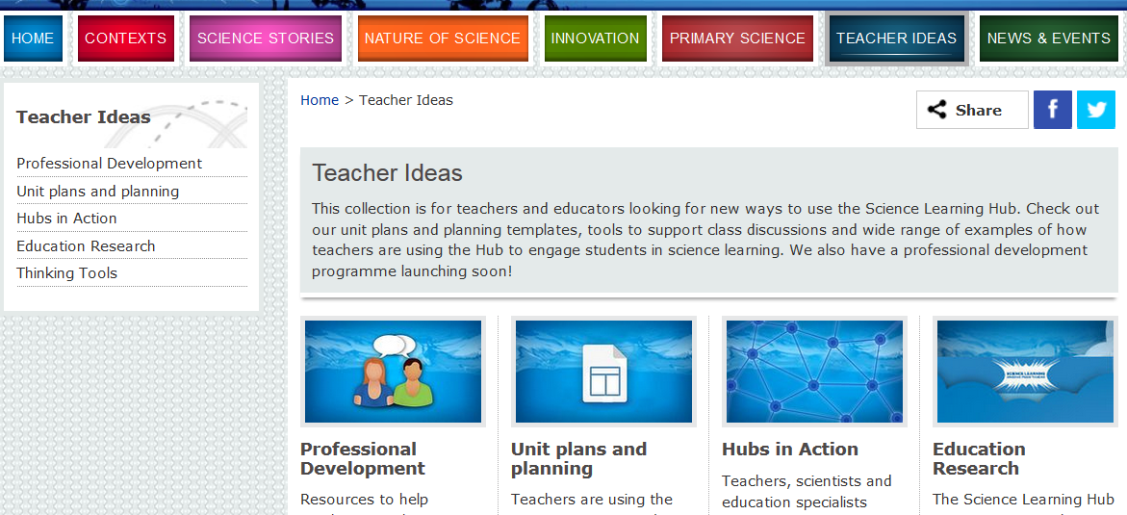
Other useful places for Teacher ideas on SLH
© 2015 The University of Waikato | www.sciencelearn.org.nz

Slide 15
Accessing today’s Carbon Cycle resources
COMING SOON -
A Unit Plan The Carbon Story outlining a teaching and learning programme that can lead to assessment with both Science AS 1.6 and Science 1.14.
This will include resources useful to develop scientific literacy and aspects of Communicating in Science
This power point will be added to the Teacher Ideas section under the Professional Development section
Other useful resources can be found in the Unit Plans and Planning section
© 2015 The University of Waikato | www.sciencelearn.org.nz

Slide 16
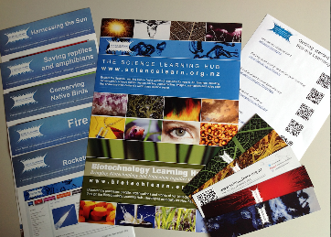


Would you like a promo pack?
Packs of bookmarks and flyers available – email us enquiries@sciencelearn.org.nz
Follow us on Twitter: https://twitter.com/NZScienceLearn
Like us on Facebook: www.facebook.com/nzsciencelearn
Explore our Pinterest boards: www.pinterest.com/nzsciencelearn
Carbon cycle Pinterest board: www.pinterest.com/nzsciencelearn/slh-the-carbon-cycle
© 2015 The University of Waikato | www.sciencelearn.org.nz

Slide 17
Thank you
Questions and comments?
The images contained within this PowerPoint presentation are copyrighted to the University of Waikato and other 3rd party individuals and organisations. Any reuse beyond the classroom as per the intended use of these resources, should be cleared with the copyright owner/s.
© 2015 The University of Waikato | www.sciencelearn.org.nz

