Slide 1
How Cows Spend Their Day

Slide 2
Lincoln University cares about animals and want to ensure their welfare, while working towards positive environmental outcomes.
One way of working towards those goals is observing cows which can now do with modern technology.

Slide 3
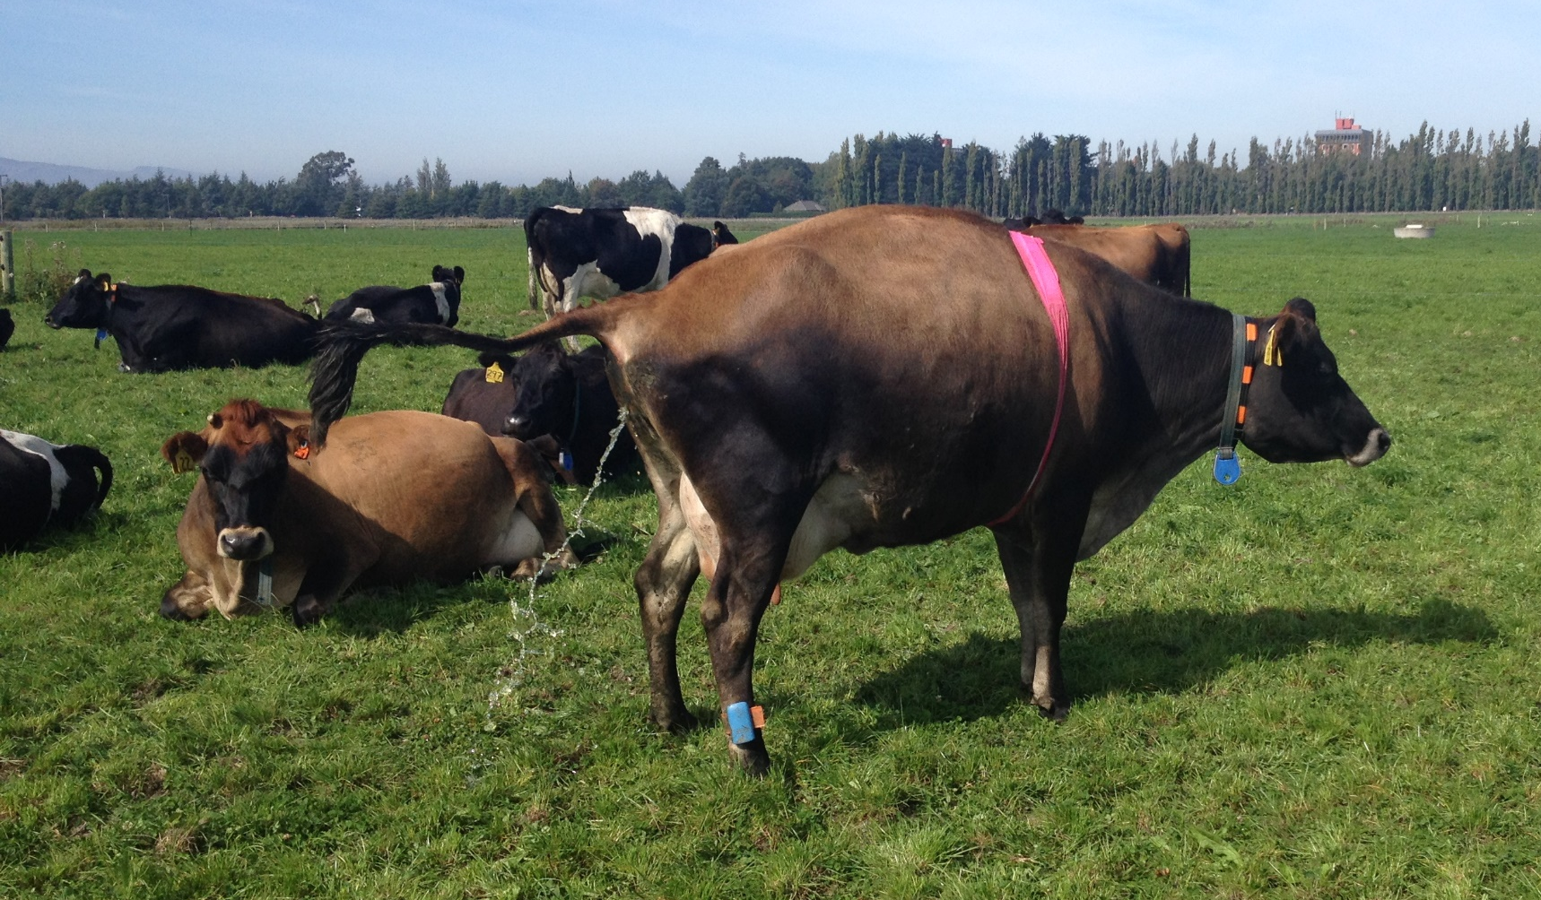
Some of the data collected through animal studies on the Lincoln University Research Dairy Farm
Electronic identifier
700 kg N/ha in urine patch (urea fertiliser only applied at 30 kg N/ha)
.
Fitbit for cows
Measures cow’s heart rate

Slide 4
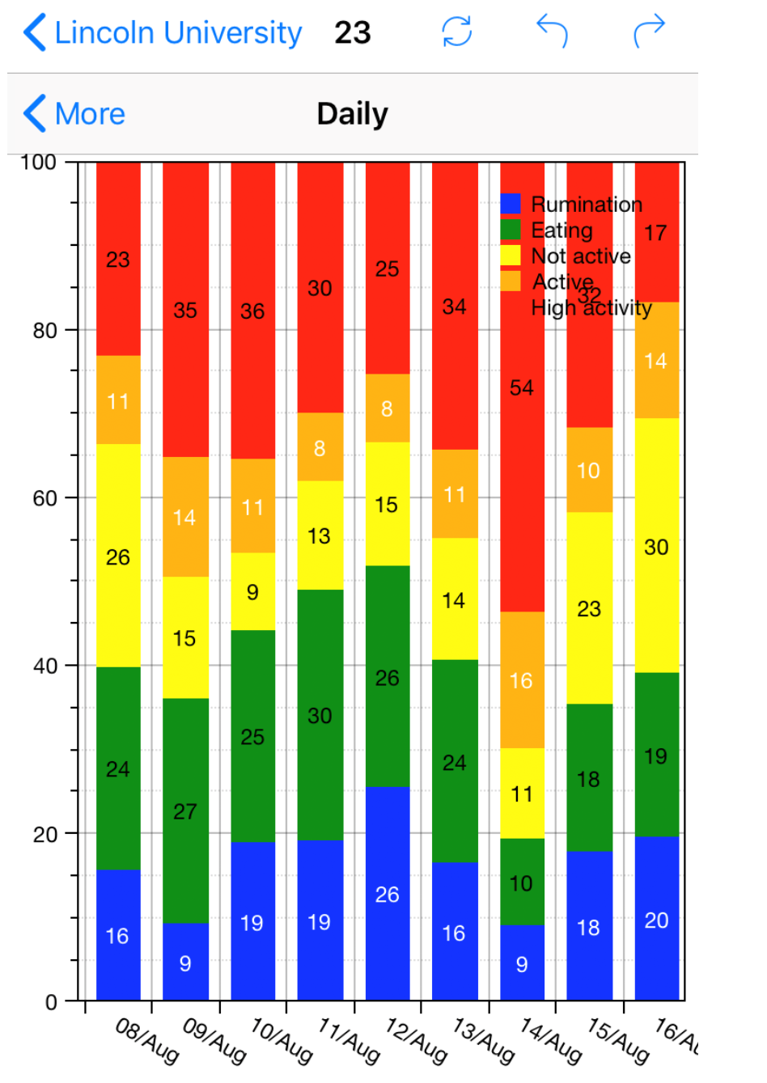
What the cow Fitbit data looks like for cow 23…
Because grass is hard to break down cows have four stomachs and ruminate. Rumination is when a cow vomits grass up from her first (of the four) stomachs and re-chews it. Cows can eat 100kgs of fresh grass a day so they need to do a lot of rumination.
What activities could be covered under “not active”, “active” and “high activity”?
These numbers are in percentages. Calculate the average percentage of time spent in each activity.
Convert the percentage of time to hours per day.

Slide 5
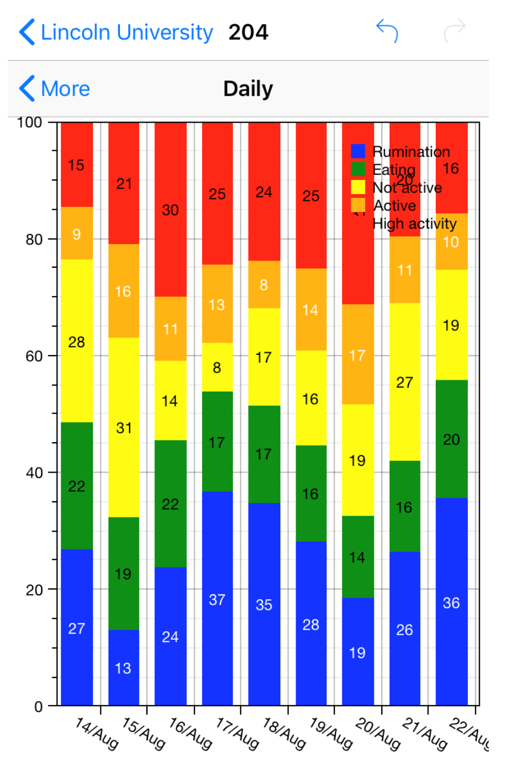
Different cows have slightly different habits.
4) Compare the two cows and write down how 204 is different to 23.
5) Which one do you think is the more social and dominant cow?
32
20
31

