Slide 1
Social Factors
Notes:
AS90831
Resources: Whiteboard & pens, tea/coffee and biscuits, Clear tech bottles, A3 paper, handouts – Dairy Tomorrow, Water Quality, Powerpoint, Pics of Aqua Flex

Slide 2
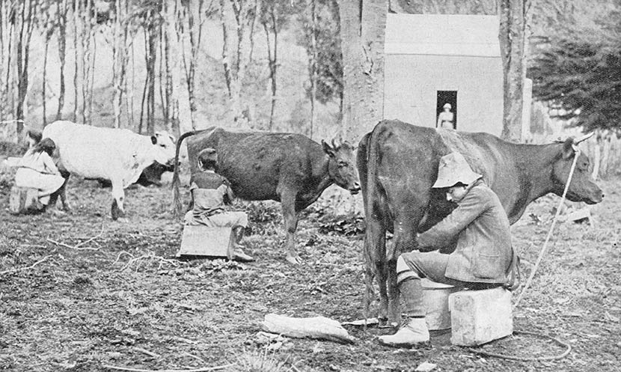

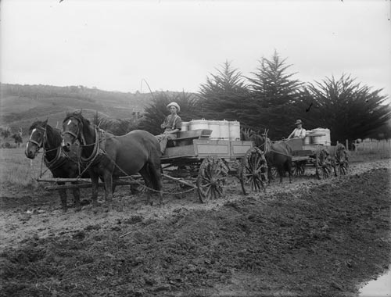
A European Cultural Norm
Milk has traditionally been consumed in European cultures and was brought to New Zealand as part of the process of colonisation. The first dairy cows to arrive in New Zealand were Shorthorns, known at that time as Durhams.
They were introduced in 1814 by missionary Samuel Marsden. Almost all milk was consumed locally as refrigeration only became available around 1882, which enabled New Zealand exports to flourish.
In the early 1800s the dairy industry in New Zealand has gone from farmers keeping a few domestic cows on bush blocks. Each family usually keeping one or two to provide its dairy needs.
Making butter with a butter churn which can take 30 minutes to do. In the early days of New Zealand settlement, butter was the only dairy product with a marketable value – although it was often bartered rather than sold for cash.
There where very few factories. Milk was delivered to skimming stations (to get the cream) and farmers would return with skimmed milk. The cream was turned into butter or cheese. These Northland farmers are making the daily milk run about 1910.

Slide 3
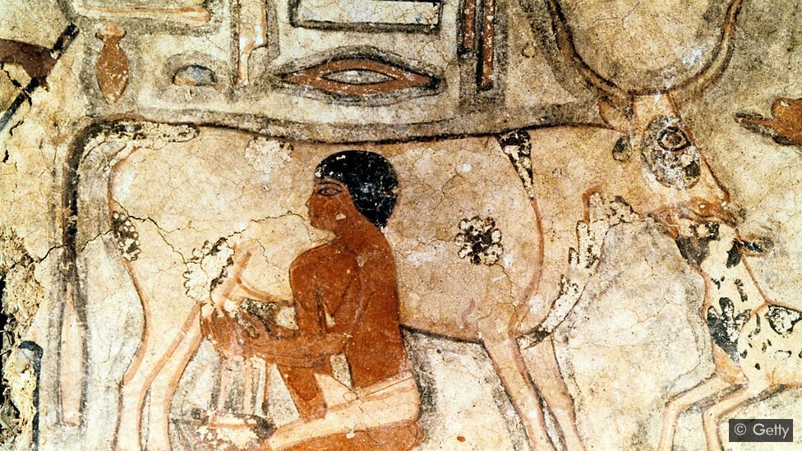
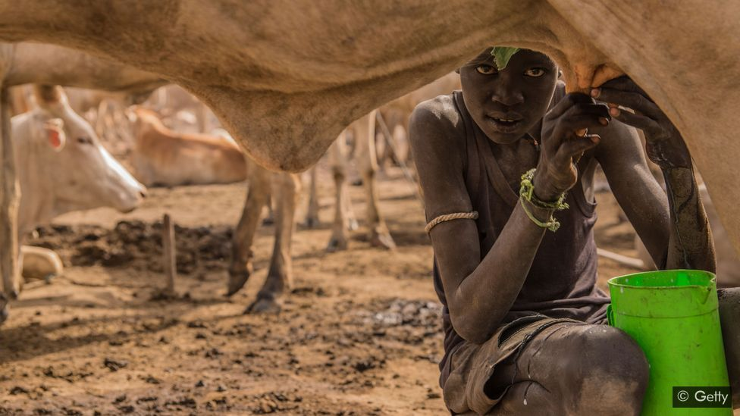
Genetic Legacy
Set against the 300,000-year history of our species, drinking milk is quite a new habit. Before about 10,000 years ago or so, hardly anybody drank milk, and then only on rare occasions.
When we are babies, our bodies make a special enzyme called lactase that allows us to digest the lactose in our mother’s milk. But after we are weaned in early childhood, for many people this stops.
So the first Europeans who drank milk probably farted a lot as a result. But then evolution kicked in: some people began to keep their lactase enzymes active into adulthood. This “lactase persistence” allowed them to drink milk without side effects.
“The first time that we see the lactase persistence allele in Europe arising is around 5,000 years BP [before present] in southern Europe, and then it starts to kick in in central Europe around 3,000 years ago,” says assistant professor Laure Ségurel at the Museum of Humankind in Paris.
The lactase persistence trait was favoured by evolution and today it is extremely common in some populations. In northern Europe, more than 90% of people are lactase persistent. The same is true in a few populations in Africa and the Middle East.
But there are also many populations where lactase persistence is much rarer: many Africans do not have the trait and it is uncommon in Asia and South America.
Artwork from the tomb of Methethi in Egypt, dated to around 2350BC, shows an ancient Egyptian milking a cow (Credit: Getty)
A Sudanese boy milks a cow at a cattle camp; an enduring mystery is why only some pastoralist groups acquired lactase persistence (Credit: Getty)

Slide 4
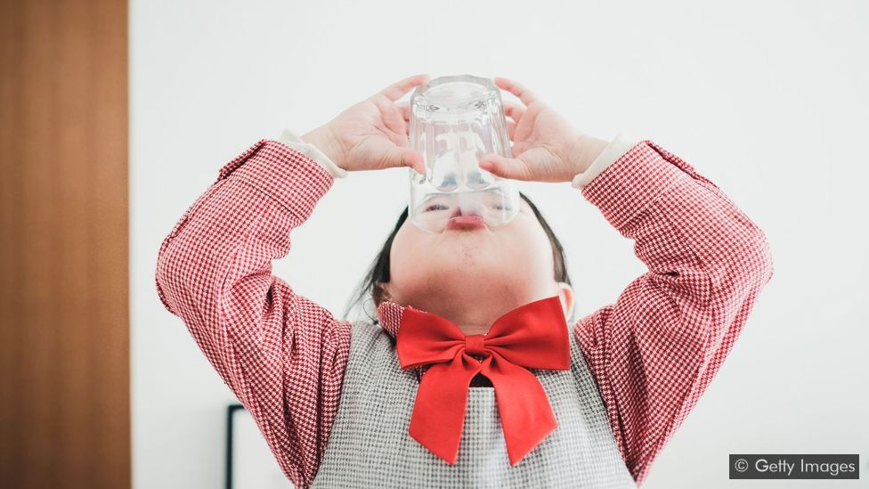
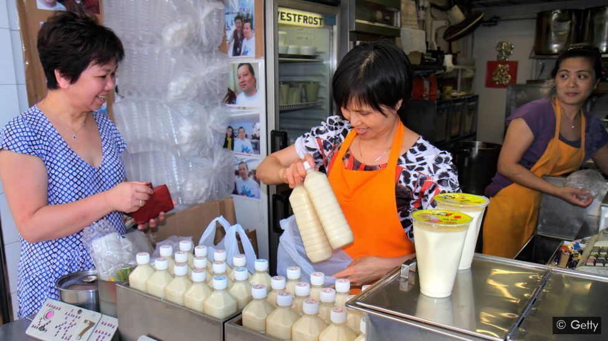
Dairy Decline and the rise of ‘nut milk’?
In November 2018, the Guardian published a story headlined “How we fell out of love with milk”, describing the meteoric rise of the companies selling oat and nut milks, and suggesting that traditional milk is facing a major battle.
But the statistics tell a different story. According to the 2018 report of the IFCN Dairy Research Network, global milk production has increased every year since 1998 in response to growing demand and they forecast milk demand to rise 35% by 2030 to 1,168 million tonnes.
There are some more localised trends. A 2010 study of food consumption found that in the US milk consumption has fallen over the last few decades – although it was replaced with fizzy drinks, not almond milk. This fall was balanced by growing demand in developing countries, especially in Asia.
China’s appetite for milk has exploded in recent years, despite the majority of the population not easily able to process lactose. The nation of nearly 1.4 billion people is now the world’s second largest consumer of dairy products. Traditionally Chinese did not drink milk, By the 1980s in China, powdered milk was a health product, and it was generally used for babies and for older folks. As a more western diet has been adopted the more milk products are being consumed by the Chinese market.
Many Chinese people have regarded milk as a food for children or the elderly (Credit: Getty Images)
A woman purchases soy milk in Hong Kong. Dairy can make many people feel sick in Asia, where the lactase persistence trait is uncommon (Credit: Getty)

Slide 5
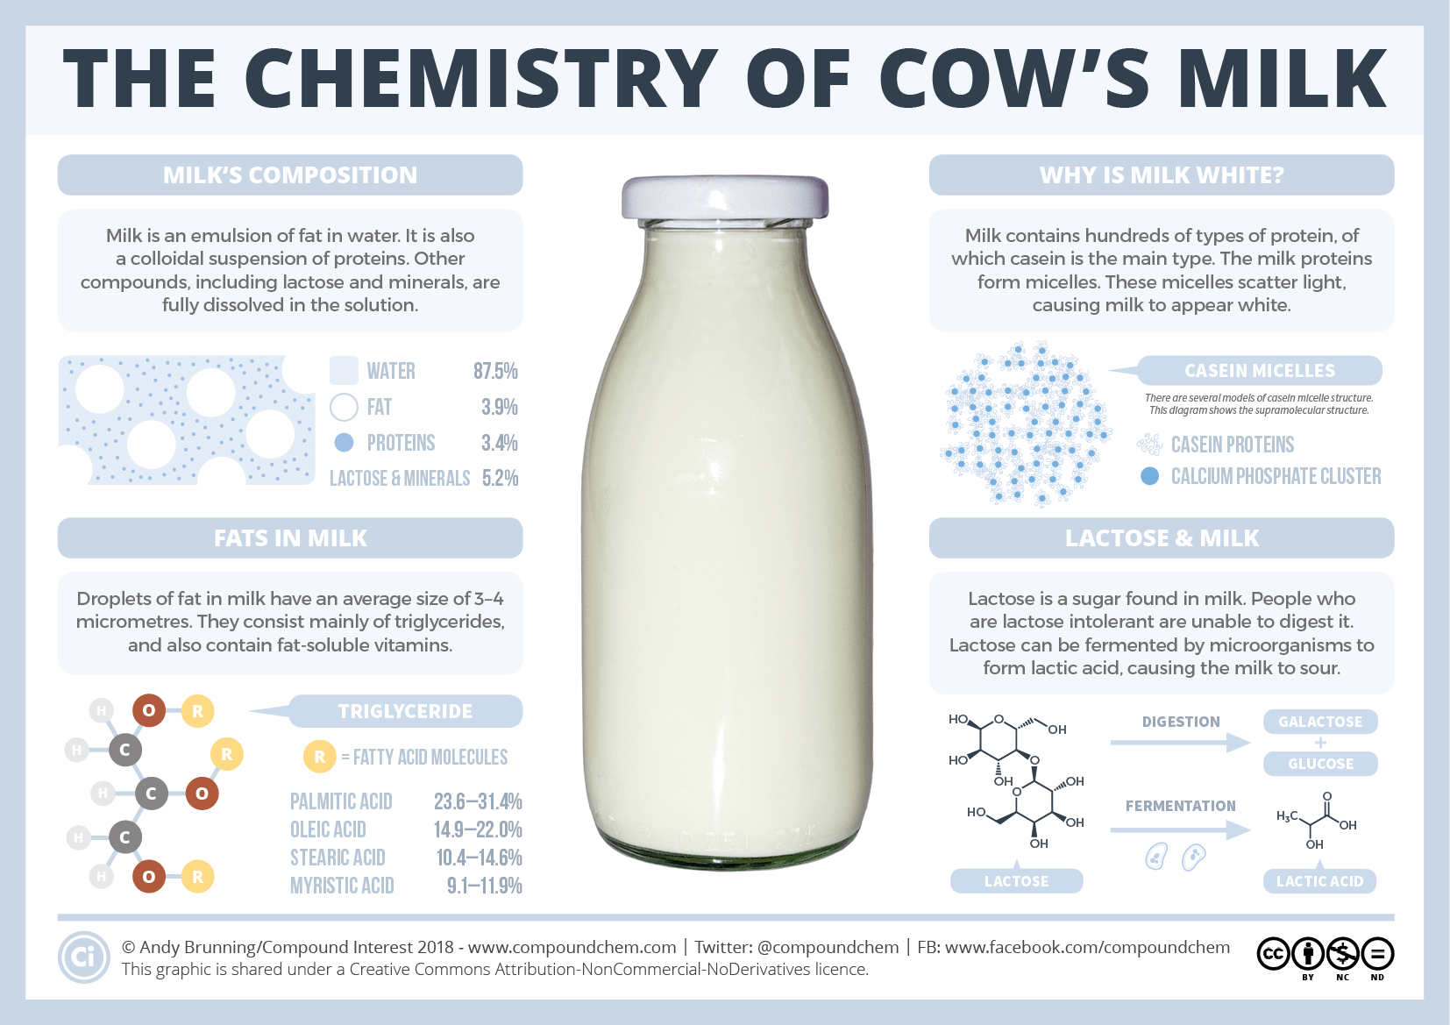
What is milk made of?

Slide 6
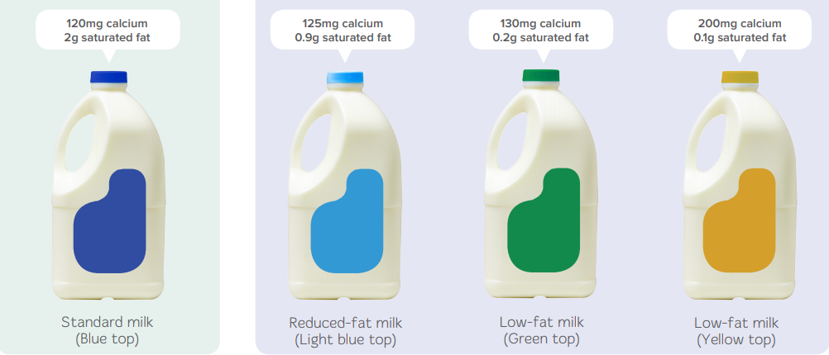
Different types of milk…
These milks have had cream (fat) removed which can then be made into cream, butter, cheese or other products.
The left over milk can then be separated in whey and casin which is used in most protein shakes or products with “added protein”. Or split up into other components for food manufacturing.
Pasteurised milk is heated, usually to 71.7°C, for 15 seconds to kill the bacteria that causes food-poisoning and makes the milk go off. Pasteurising makes milk safer to drink and longer-lasting.
UHT is ultra heat-treated milk, sometimes called long-life milk. It has been heated to at least 135°C for at least one second to destroy all bacteria.
All these milk contain the same amount of naturally occurring sugar.
They are all homogenised, which means that the size of the fat globules (the cream that rises to the top of the glass or bottle) are reduced so they are dispersed evenly throughout the milk.

Slide 7
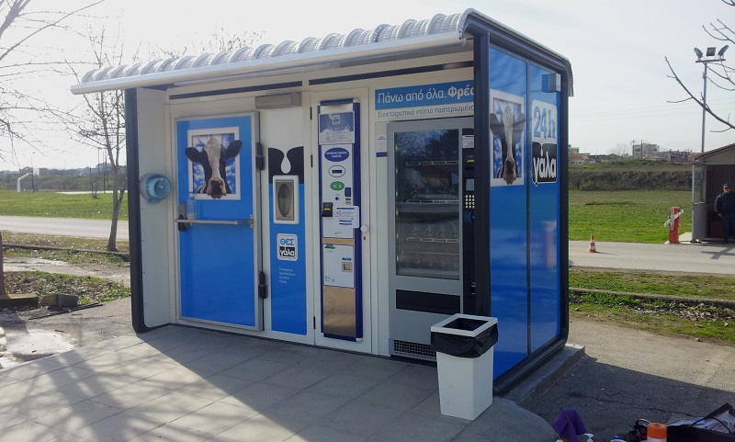

Raw milk vending machines
Some place in New Zealand there are raw milk vending machines where you can refill your glass milk bottle.
The milk come straight from a particular farm and has not been pasteurised or homogenised.
Some people prefer the taste and see it as more ‘natural’. However due to the lack of pasteurisation there is an increased risk of food poisoning due to bacteria.
Farmers are only allowed to sell small amounts at the “farm gate” and there are lots of paperwork and regular testing that needs to be done which can make it difficult to operate this option of milk supply.

Slide 8
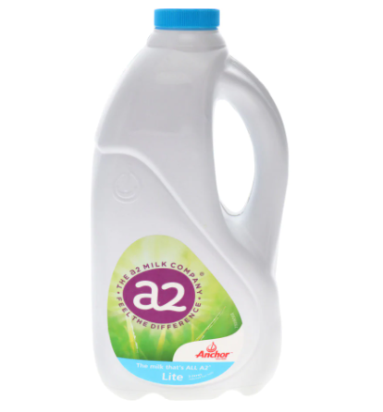
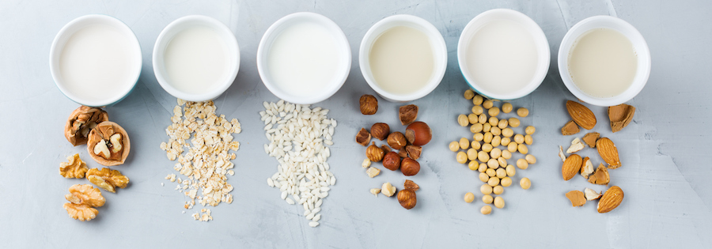
Other milks…
What is A2 milk?
Nutritionally, A2 milk is similar to regular milk in terms of how much protein, fat and calcium it contains. The difference is in their types of beta-casein protein. Beta-casein makes up 30% of the protein in milk and comes in two main forms – A1 and A2. Most cows produce a mix of A1 and A2 beta-casein but some cows produce only A2 beta-casein, which is where A2 milk comes from. It is suggested that A2 milk is easier to digest and cause less gut discomfort for those that are sensitive.
Almond milk.
Is made out of Almonds and there has been much debate around if it is a ‘milk’ or ‘nut juice’. It provides an alternative to dairy milk for vegans and lactose-intolerant people and its use and availability has risen and it is seen as more environmentally sustainable.
There have been a few main issues associated with almond milk production mainly around water use and pesticide use. These may produce long lasting effects on the environment in drought-stricken California, where more than 80% of the world’s almonds are grown.
Can you name all the plant based milks?
A: walnut, oat, rice, hazelnut, soy, almond

Slide 9
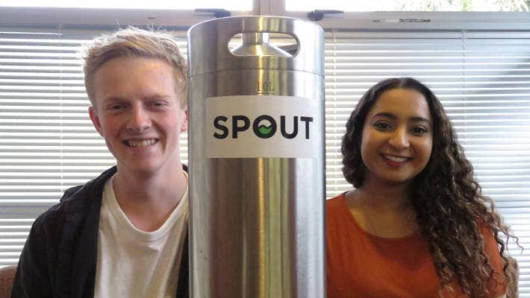
New Zealand Problem Solvers
A keg may help solve the problem of reducing plastic milk containers from the country's cafes.
Enter the team from Spout Alternatives: Jo Mohan, 22, and Luka Licul, 18, from Dunedin, and Nick Jackson, 23, from Christchurch.
The trio met at the youth business accelerator Venture Up in Wellington in February, and started working on the idea of creating a milk dispensing system for cafes.
What they came up with was using 10 litre stainless steel kegs – popular with home brewers – filled with milk sourced from a local dairy farm.
Not only do the kegs keep the milk cool, they also reduce five 2ltr plastic containers from entering the recycling stream.
https://www.stuff.co.nz/business/better-business/114964960/dairy-me-milk-kegs-take-on-plastic-containers

Slide 10
Sources used…
https://teara.govt.nz/en/dairying-and-dairy-products/page-1
https://www.bbc.com/future/article/20190218-when-did-humans-start-drinking-cows-milk
https://www.bbc.com/future/article/20201016-why-china-developed-a-fresh-taste-for-milk
https://www.consumer.org.nz/articles/a2-milk-health-or-hype
https://sustainability.ucsf.edu/1.713#:~:text=The%20main%20issues%20associated%20with,the%20world's%20almonds%20are%20grown.
https://www.stuff.co.nz/business/farming/dairy/106050501/micro-differences-between-milk-brands-so-why-are-some-customers-prepared-to-pay-a-premium

