Slide 1
The economics and markets of the New Zealand Dairy Industry.

Slide 2
Where does the dairy go?
Task 1: Create definitions for the following terms: exports, differentiation, markets
Task 2: Outline the following regions on a map using different colours…
North America
Central and South America
North Asia
South East Asia
Oceania
Middle East
Africa
Europe
Task 3: Label and colour in the following countries in that regions colour …
- India | - Saudi Arabia
- Sri Lanka | - Chile
- Philippines and Malaysia | - England
- Australia | - New Zealand

Slide 3
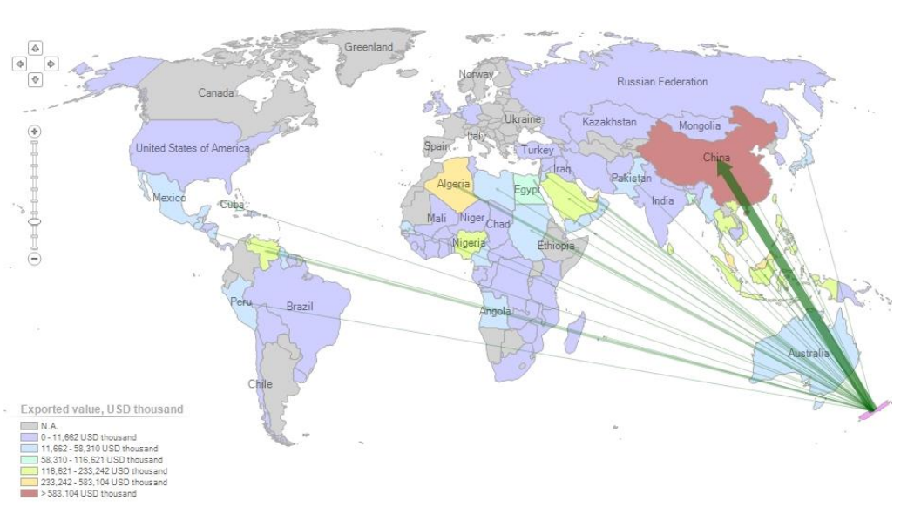
Exports of Whole Milk Powder and Skim Milk Powder from New Zealand in 2015 in USD
https://nzier.org.nz/static/media/filer_public/29/33/29336237-3350-40ce-9933a5a59d25bd31/dairy_economic_contribution_update_final_21_february_2017.pdf
Task: look at the value of milk products sold to each region list the regions from largest volume sold to smallest volume sold.

Slide 4
- Look at the following factors and discuss if they are beneficial/for or a challenge/against New Zealand dairy production. - Some factors can be both beneficial and a challenge.
Economic Factors in Dairy Farming
Lack of Experts/ Labour
Commodities market
Location/ Distance
Environment
Environmental Footprint
Majority of exports to China
Genetics
Co-ops
(co-operation business model)
Shelf life of milk powder

Slide 5
Economic Factors in Dairy Farming
16% of students know a lot or a fair amount
31% of parents know a lot or a fair amount

Slide 6
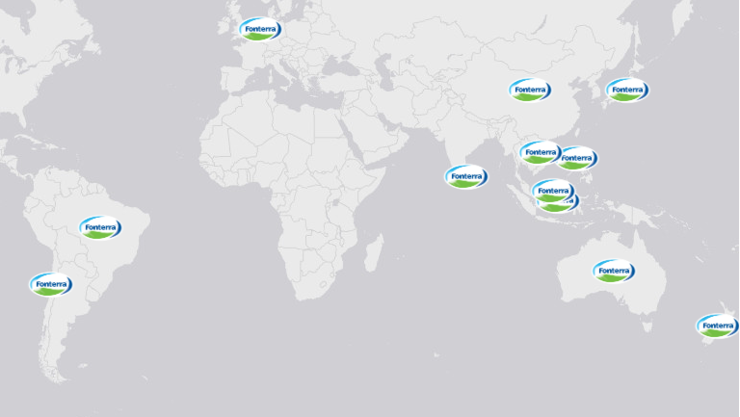
Export Markets Characteristics
Fonterra is our largest dairy producer and a significant exporter. They have a number of brands that they export under. You can get a good idea about the export market by understanding how Fonterra is marketing their product. You will watch a series of advertisements from specific countries/markets and summarize the target market.
Your summaries should include the following…
Target market (young children, older children, teenagers, mums, dads, working age adults, older people).
What idea/ key point is the ad trying to communicate?
How have they done this? (images, statistics, language).
https://www.global-rural.org/story_map/deconstructing-the-new-zealand-dairy-boom/

Slide 7
India
There are significant trade barriers to exporting milk to India.
“The cost means Dreamery doesn't use New Zealand milk, but Fonterra contributes by giving its expertise and know-how to create a range of valued-added products which currently includes flavoured milk, yoghurt, cheese, and UHT cow's milk dubbed "toned" milk in India to indicate it is whole milk.
The partnership enables Dreamery to boast "130 years of dairy" on its packaging and call its products "New Zealand designed.“
The joint venture does use New Zealand milk in products under the Anchor Food Professionals brand. The products launched so far are extra whipping cream, butter sheets, extra stretch mozzarella cheese and cream cheese. These high-end products are able to extract margins which make it possible to be exported into India despite tariffs.
Source Articles
https://www.stuff.co.nz/business/farming/113778177/fonterra-launches-product-line-in-joint-venture-with-indian-consumer-giant-future-group
https://www.nzherald.co.nz/business/fonterras-plan-for-a-1b-indian-business/Z2ONI7VMA5XPX7OV5RXKPB7PQI/

Slide 8
India
Click on video to view in PowerPoint or
the link to view in browser: https://www.youtube.com/watch?v=J5zEBwwESMo

Slide 9
Sri Lanka
https://www.youtube.com/watch?v=HQ9ynKjziEQ and https://www.youtube.com/watch?v=SF9lfLIgYOY

Slide 10
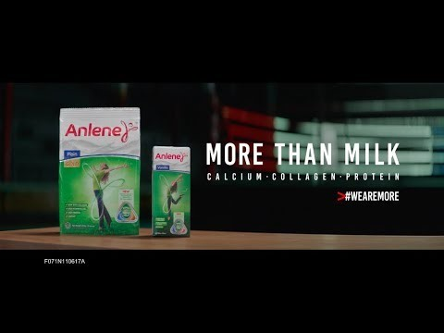
Philippines and Malaysia
Old marketing approach/ old ad
https://www.youtube.com/watch?v=4xCS_FIH7Ow
New marketing approach/ new ad
https://www.youtube.com/watch?v=xRuEEkhXzUk

Slide 11
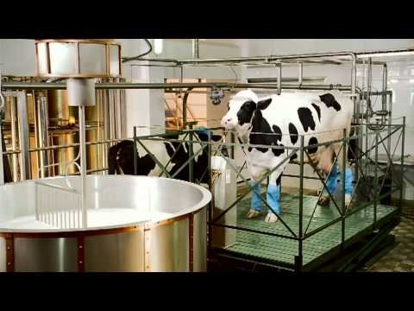
England
https://www.youtube.com/watch?v=Yuf6QVQkNR4
Extra video: advert from 1990: https://www.youtube.com/watch?v=zAwHoprKVcI

Slide 12
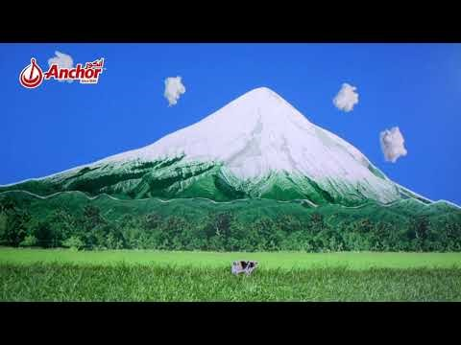
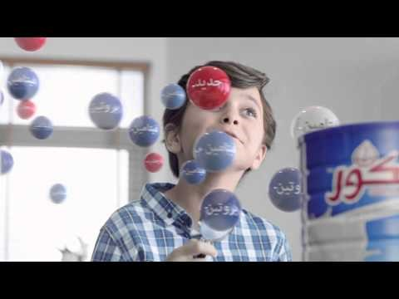
Saudi Arabia
https://www.youtube.com/watch?v=laHz3_InPFY
https://www.youtube.com/watch?v=xyRIFJsBvbs

Slide 13
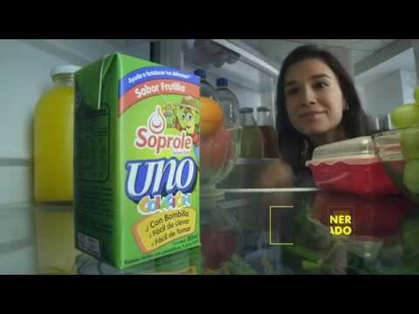
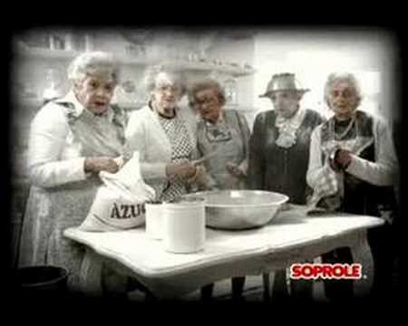
Chile
https://www.youtube.com/watch?v=gNw8sEnk7lY
https://www.youtube.com/watch?v=DZp6VBk6sPE

Slide 14
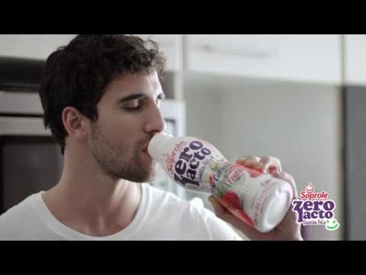
Chile
https://www.youtube.com/watch?v=TD9DhabOol0 Most of these Zero Lacto products are not available in New Zealand, however straight milk is.

Slide 15
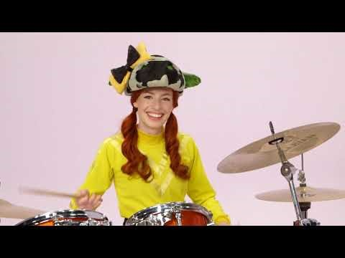
Australia
Brownies Dairy is another Fonterra Brand
https://www.youtube.com/watch?v=jUblGDhepLY

Slide 16
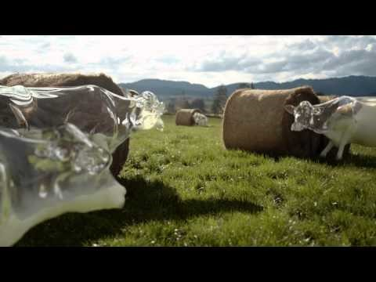
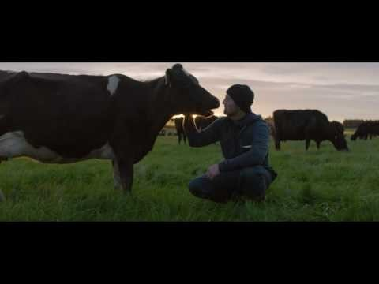
New Zealand
https://www.youtube.com/watch?v=61CaZryYpQ0
https://www.youtube.com/watch?v=hXA9d_-LSLw

Slide 17
Reflection Questions
Q1: What are some of the similarities that most adverts used to make their milk distinctive (stand out)?
Clean green, pasture based systems implies the milk is healthier and of higher quality. Certification, testing and secure production lines ensure a quality product that has the ingredients stated on the label. A lot of ads featured children and are marketed at mothers as they are still seen as the primary carer.
Q2: What were some of the differences between markets?
English based markets had humorous ads and a greater focus on the cows rather than the environment and food quality which was a focus of Asian markets.
Australia marketed directly to children by using the Wiggles. This could indicate that children may have a larger impact on what goes into the shopping trolley or using value added products as a reward rather than the strong focus on nutrition.
Q3: Fonterra either owns or has a financial stake in each of the companies. Why do you think Fonterra uses different brands?
In a small market it can give the illusion of consumer choice. It also allows price differences to maximise profit. Different brands are targeted at different markets so it allows access to all markets.

Slide 18
Which adverts do you remember/ think are best?

