Slide 1
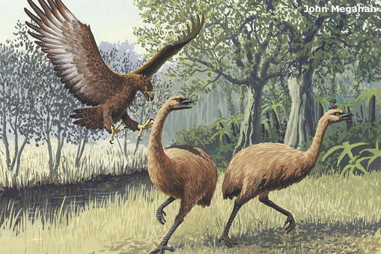
Developing an eagle eye
Fostering observation skills in the classroom
With Andrea Soanes and Lyn Rogers
1 December 2016
4pm
www.sciencelearn.org.nz
© 2015 The University of Waikato | www.sciencelearn.org.nz

Slide 2
Developing an eagle eye - index
Topic PowerPoint slide number(s) Video timecode
Webinar purpose 3 00:31
Observation activity 4–5 02:17
Finding observation resources on the SLH 6–7 05:31
Mystery box activity 7 07:22
What is observation? 8–9 12:12
Why is it important and where does it fit in the 10–14 14:40
New Zealand Curriculum?
What opportunities do we offer our students to 15–16 17:50
observe their world?
Rally table activity 17 19:27
Practical tools and adding value to existing activities 18–20 26:59
Social media links, thanks and comments 21–22 31:51

Slide 3
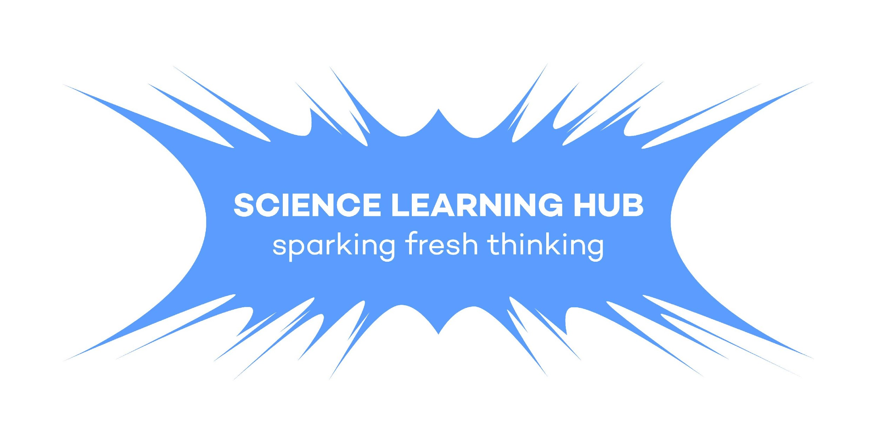
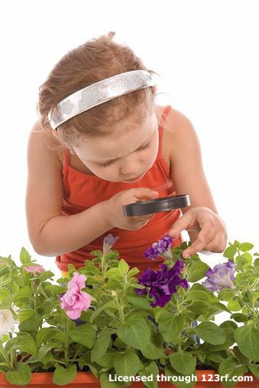
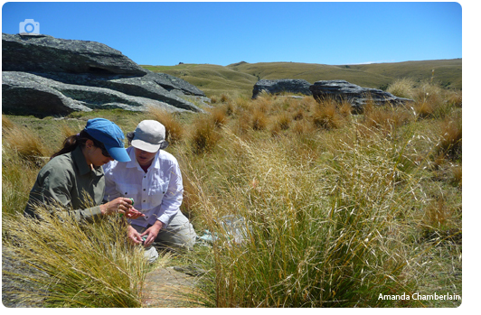
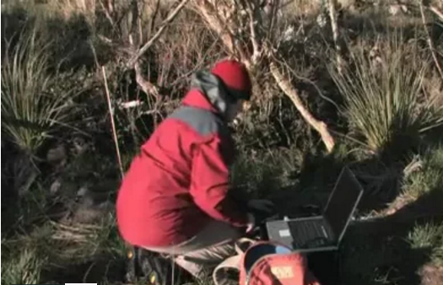
Developing an eagle eye
This webinar session focuses on using observation to engage students in the nature of science.
We will share ideas and resources that will support you to:
actively look for opportunities to build students’ observation skills
explicitly engage students in science
build on students’ understandings of the nature of science
help develop students’ science capabilities
explore relevant activities on the Science Learning Hub.
Copyright University of Waikato. All rights reserved.
All images are copyrighted. For further information, please refer to enquiries@sciencelearn.org.nz
Notes:
The session will model strategies teachers can use with their students, with teachers playing the role of the student, provide access to these activities, resources and articles to enhance both their own and students’ understanding of the role of observation in the nature of science.

Slide 4
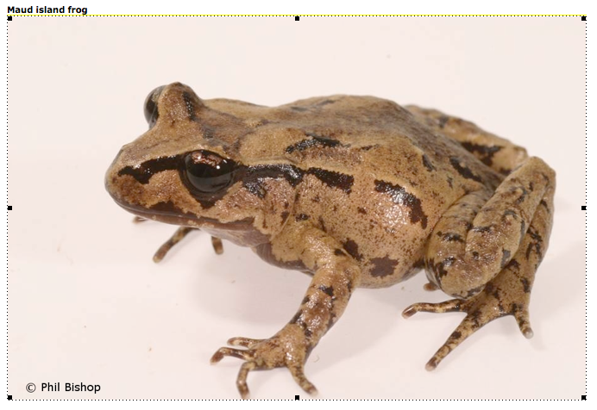
Copyright University of Waikato. All rights reserved.
All images are copyrighted. For further information, please refer to enquiries@sciencelearn.org.nz
Notes:
Follow through instructions in the activity Observation: Learning to see.

Slide 5
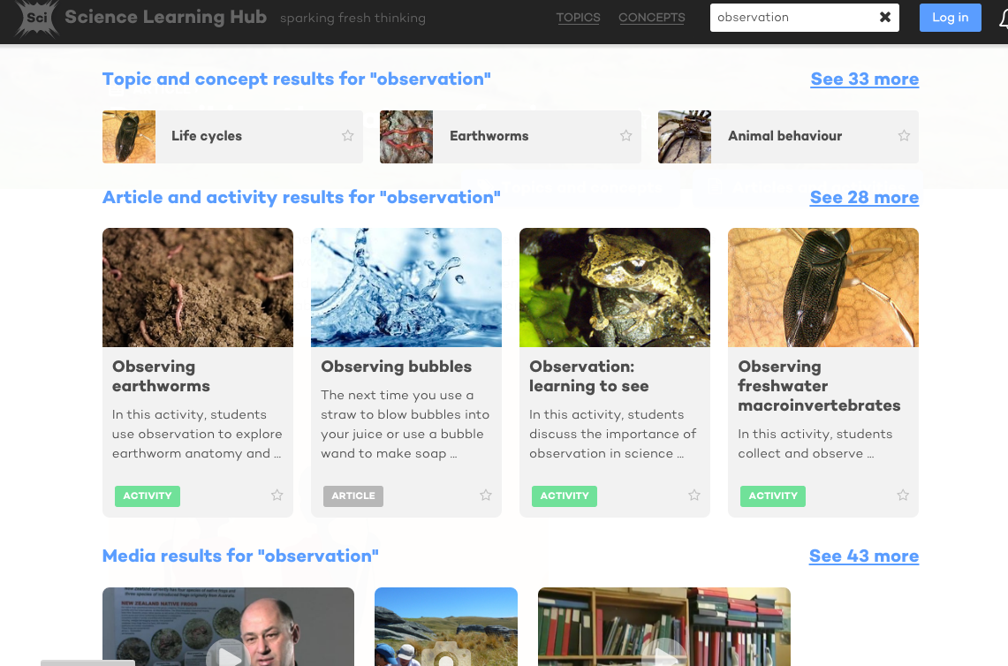
Copyright University of Waikato. All rights reserved.
All images are copyrighted. For further information, please refer to enquiries@sciencelearn.org.nz
Notes:
Looking at a simple search using ‘observation’ as the keyword, this is the page that comes up on the new site. There is a large range of articles and activities. The activity we just did is the frog one on this page.

Slide 6
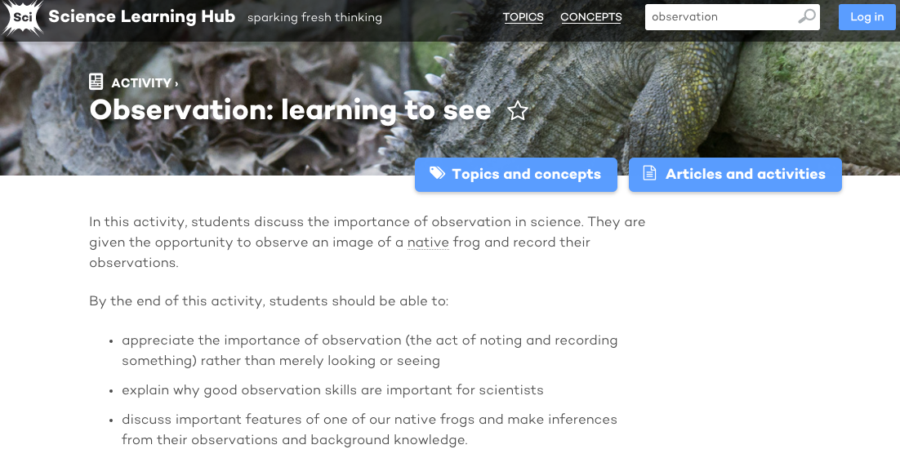
Copyright University of Waikato. All rights reserved.
All images are copyrighted. For further information, please refer to enquiries@sciencelearn.org.nz
Notes:
Each activity opens to reveal the instructions or information on a new page.

Slide 7
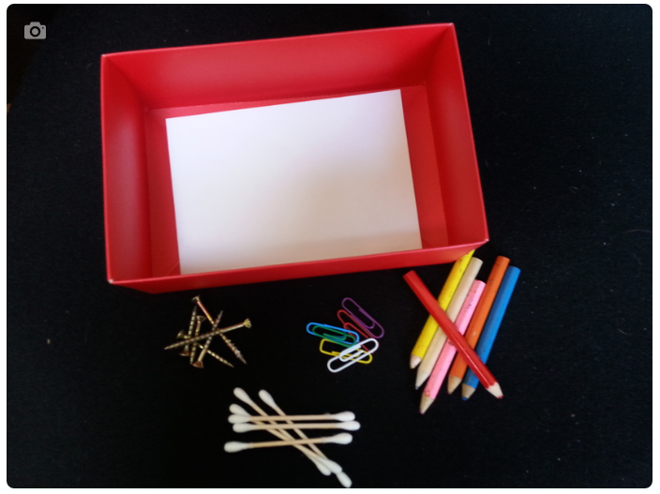
Mystery boxes
Copyright University of Waikato. All rights reserved.
All images are copyrighted. For further information, please refer to enquiries@sciencelearn.org.nz
Notes:
We did this activity in the live webinar, it can be found here: https://www.sciencelearn.org.nz/resources/430-observation-and-the-mystery-box.

Slide 8
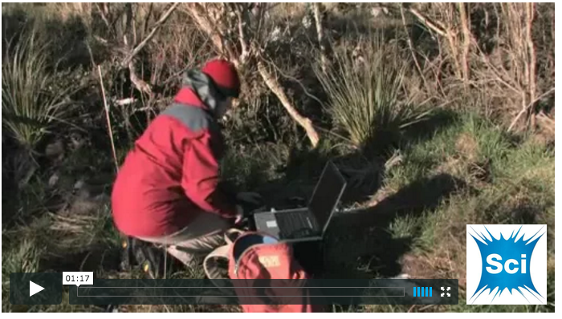
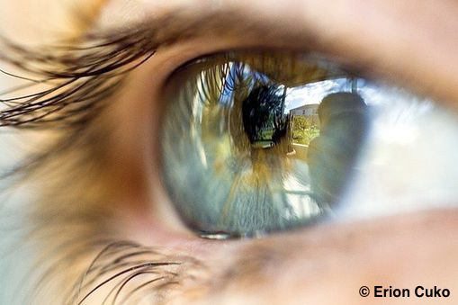
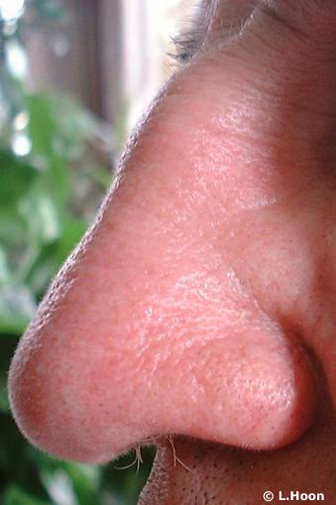
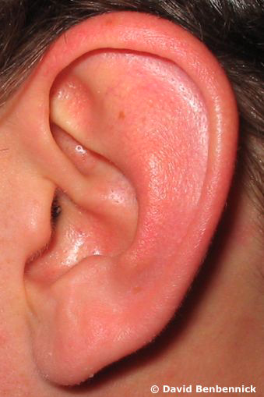
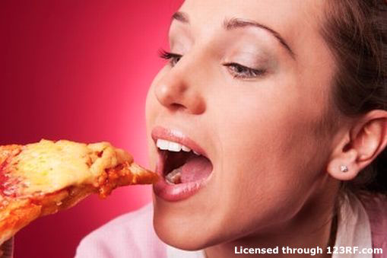
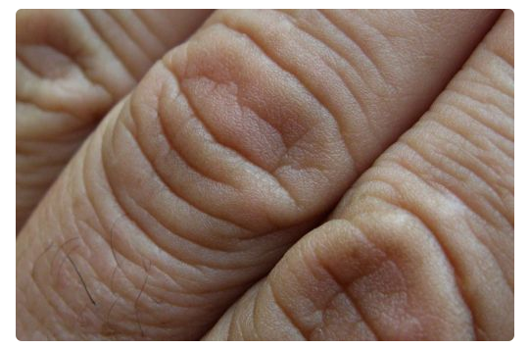
What is observation?
What does it involve?
Copyright University of Waikato. All rights reserved.
All images are copyrighted. For further information, please refer to enquiries@sciencelearn.org.nz
Notes:
We brainstormed answers to the question, taking 1-2 minutes to do so and shared our ideas in the chat box in the live webinar. Some of these are collated on the next slide. We then watched a short video: https://www.sciencelearn.org.nz/videos/703-observation-in-science.

Slide 9
What is observation?
Copyright University of Waikato. All rights reserved.
All images are copyrighted. For further information, please refer to enquiries@sciencelearn.org.nz
Notes:
These are some of the answers the teachers in the live webinar came up with.

Slide 10
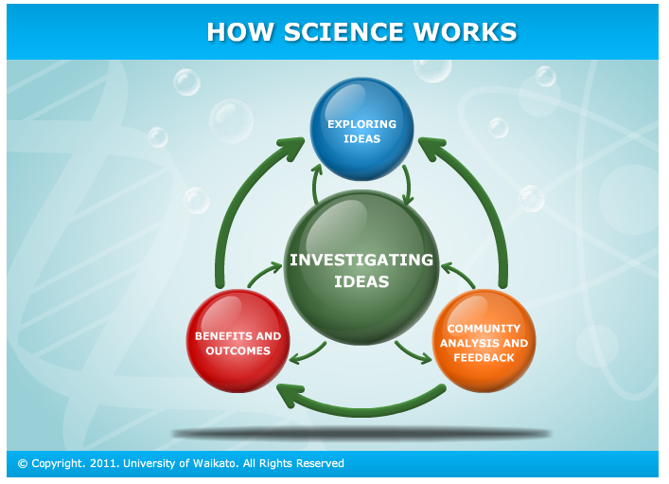
Why is observation important?
Copyright University of Waikato. All rights reserved.
All images are copyrighted. For further information, please refer to enquiries@sciencelearn.org.nz
Notes:
Observation is fundamental for building skills and understandings about science.

Slide 11
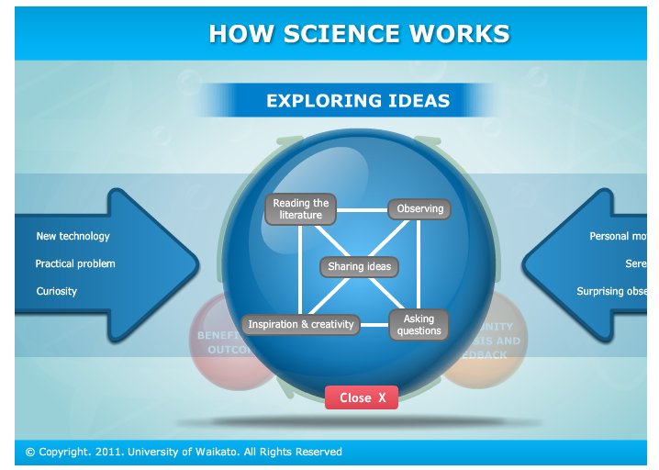
Copyright University of Waikato. All rights reserved.
All images are copyrighted. For further information, please refer to enquiries@sciencelearn.org.nz
Notes:
This is an expansion of the blue bubble in the How science works interactive showing the place of observation in how science works. Note this interactive was Flash and is no longer available.

Slide 12
Copyright University of Waikato. All rights reserved.
All images are copyrighted. For further information, please refer to enquiries@sciencelearn.org.nz
Notes:
This is an expansion of the green bubble in the How science works interactive showing the place of observation in investigation. Note this interactive was Flash and is no longer available, but there is this article https://www.sciencelearn.org.nz/resources/3038-investigating-in-science.

Slide 13
How does it fit?
NZC: Nature of science
Science capability: Gather and interpret data
Observation
Copyright University of Waikato. All rights reserved.
All images are copyrighted. For further information, please refer to enquiries@sciencelearn.org.nz
Notes:
This graphic shows how observation can be seen to sit in the centre of the science curriculum: It is fundamental to the nature of science, especially the ‘Understanding science’, ‘Investigating in science’ and ‘Communicating in science’ strands. NZCER has identified 5 Science capabilities that are essential to help students with those understandings. Observation is crucial to the capability ‘Gather and interpret data’: “Learners make careful observations and differentiate between observation and inference. Science knowledge is based on data derived from direct, or indirect, observations of the natural physical world and often includes measuring something. An inference is a conclusion you draw from observations – the meaning you make from observations. Understanding the difference is an important step towards being scientifically literate.” http://scienceonline.tki.org.nz/Science-capabilities-for-citizenship/Introducing-five-science-capabilities

Slide 14
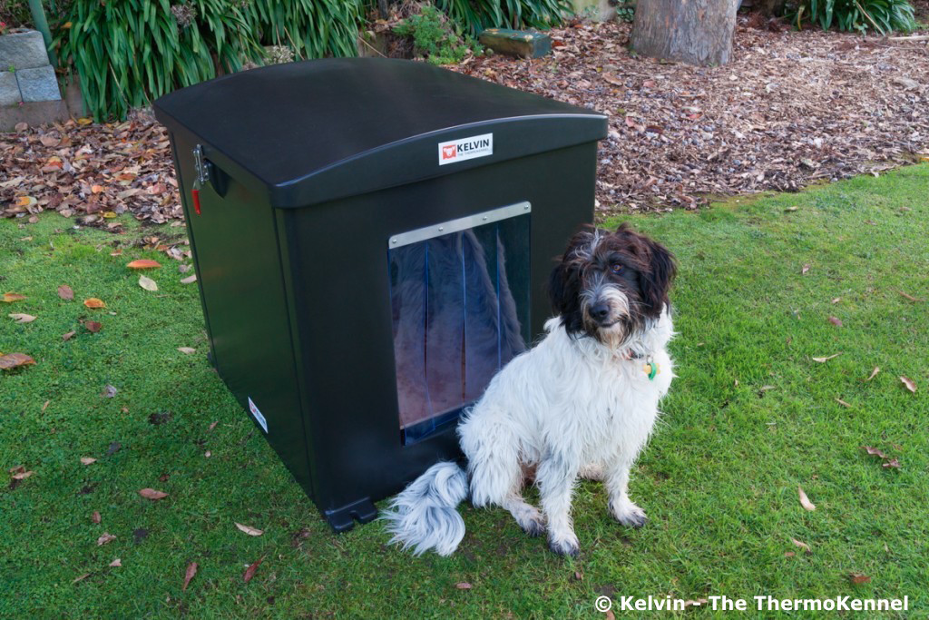
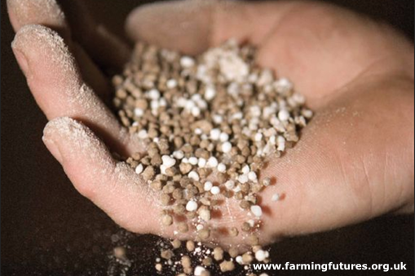
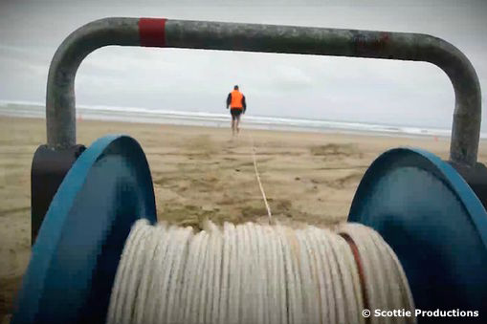
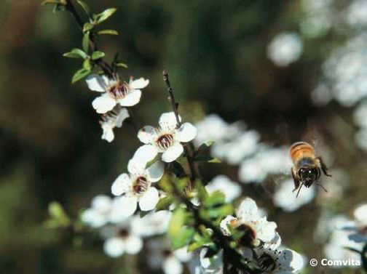
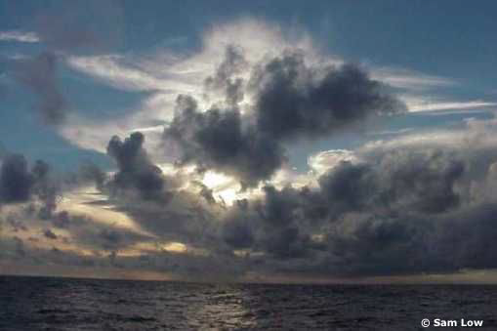
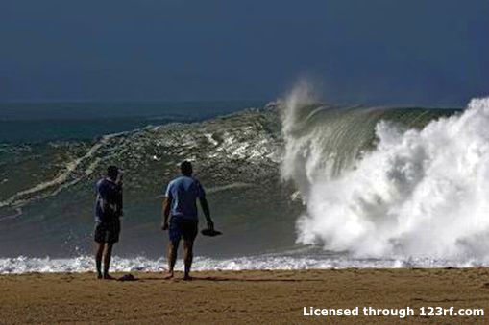
What opportunities do we currently
offer our students to observe their
world? Reflecting on our own current practice
Copyright University of Waikato. All rights reserved.
All images are copyrighted. For further information, please refer to enquiries@sciencelearn.org.nz
Notes:
The webinar participants took 1-2 minutes to brainstorm in the chat box the ideas, contexts and activities they already use with their students to foster observation skills. Some of these ideas are recorded on the next slide.

Slide 15
Notes:
These are some of the suggestions from teachers who attended the webinar.

Slide 16
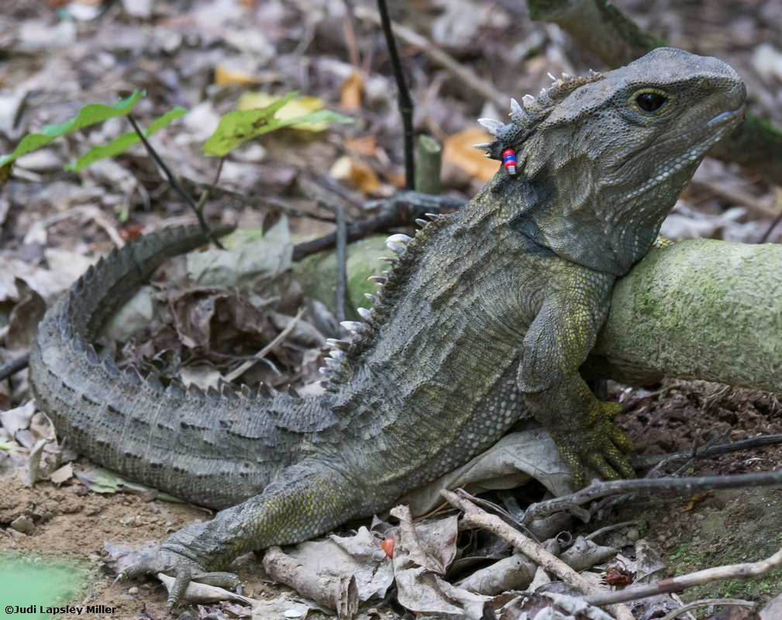
Copyright University of Waikato. All rights reserved.
All images are copyrighted. For further information, please refer to enquiries@sciencelearn.org.nz
Notes:
Follow through instructions in the activity What do we see? This is a rally table literacy activity adapted for this context.

Slide 17
copyright University of Waikato. All rights reserved.
All images are copyrighted. For further information, please refer to enquiries@sciencelearn.org.nz

Slide 18
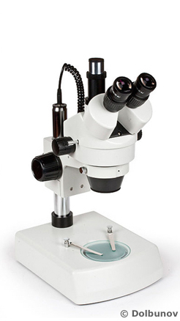
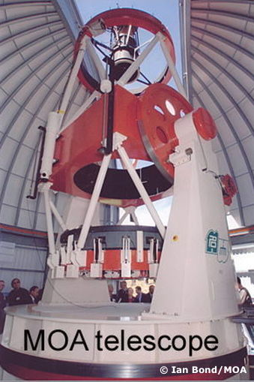
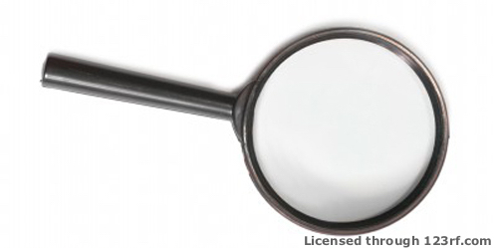
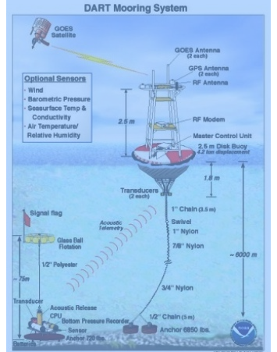
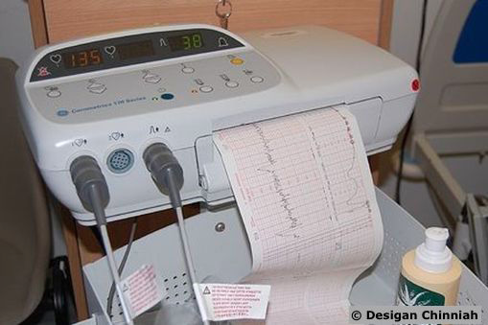
Using tools to enhance our
observations
Copyright University of Waikato. All rights reserved.
All images are copyrighted. For further information, please refer to enquiries@sciencelearn.org.nz
Notes:
Discuss the tools discuss what tools may have added to enhance our observational capabilities.

Slide 19
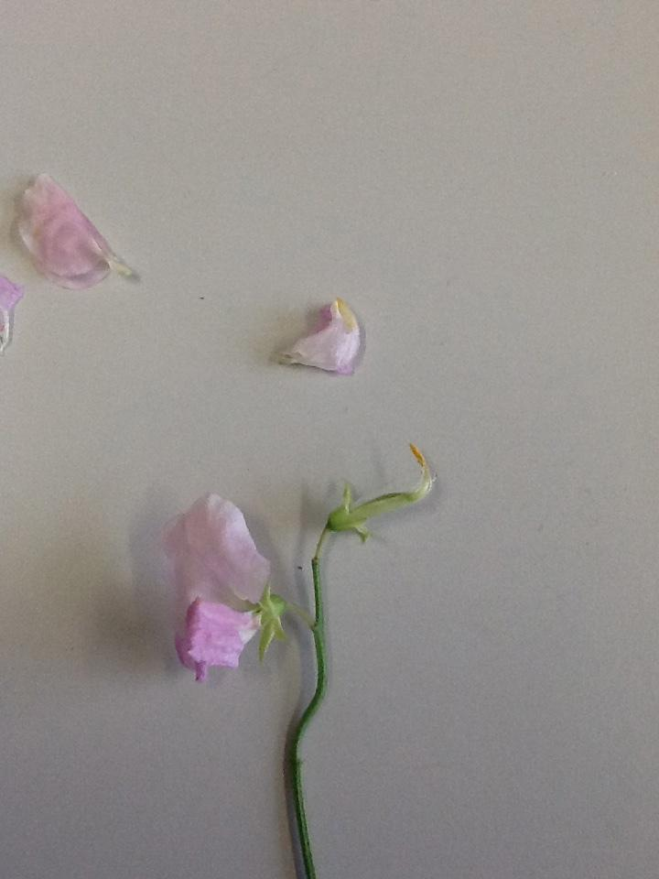
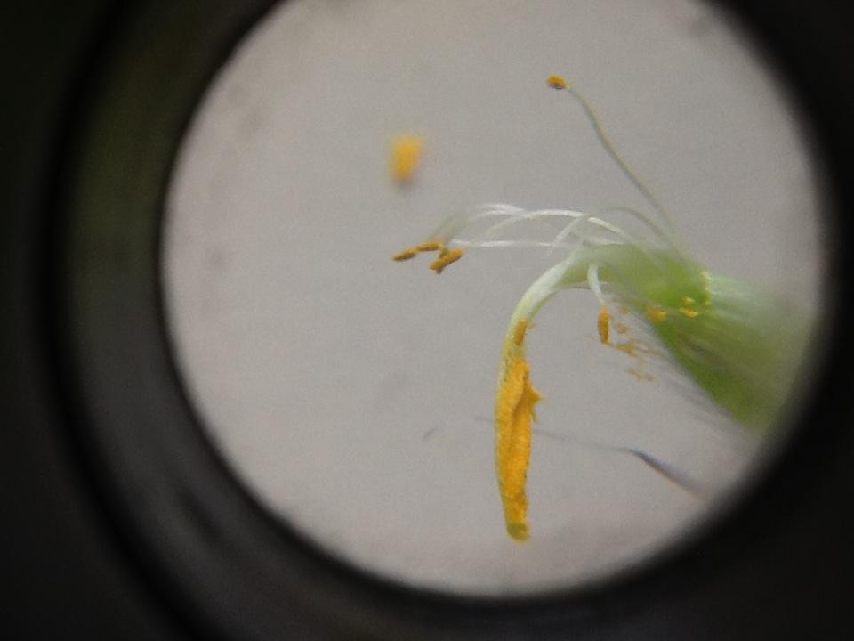
Making our own microscope
Copyright University of Waikato. All rights reserved.
Image © NIWA, Chang et al. (2005)/ Miriam Godfrey
Notes:
This activity was shared in the webinar, using available equipment to make our own microscope. This activity can be found on the Science Learning Hub: Making a simple microscope

Slide 20
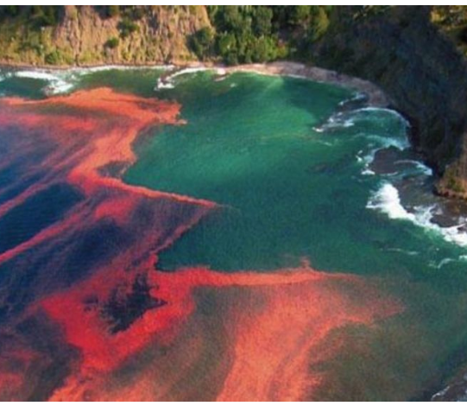
Adding more value
How can we add value to current experiments/activities by maintaining an overt focus on observation?
Stimulating inquiry: fostering students’ questioning about their world
from what they observe
Connecting to other curriculum
areas: discussing the importance
of observation across the
curriculum
Making meaning: eliciting prior knowledge through discussion
and relevant contexts
Copyright University of Waikato. All rights reserved.
Image © NIWA, Chang et al. (2005)/ Miriam Godfrey
Notes:
This is a discussion slide.

Slide 21
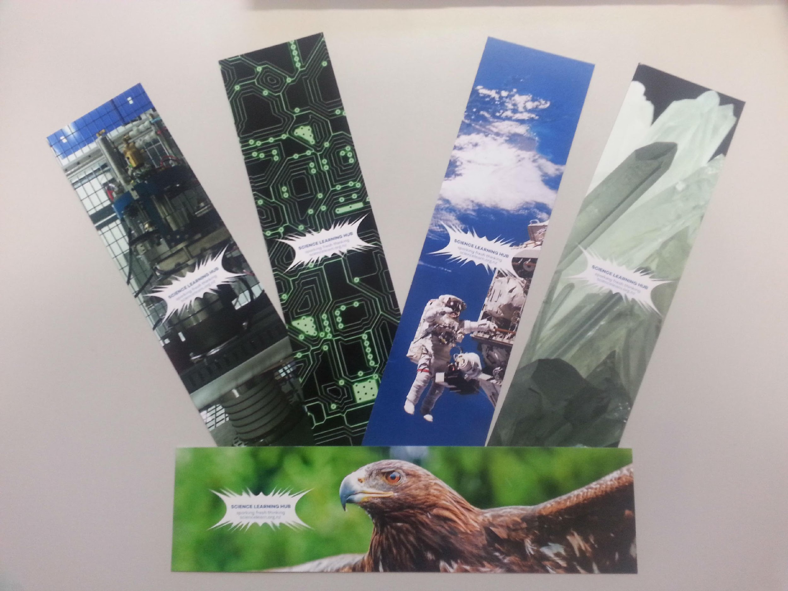
Would you like some bookmarks?
Bookmarks are available – email us enquiries@sciencelearn.org.nz
Follow us on Twitter: https://twitter.com/NZScienceLearn
Like us on Facebook: www.facebook.com/nzsciencelearn
On Pinterest: https://nz.pinterest.com/nzsciencelearn/observation-in-science/
Copyright University of Waikato. All rights reserved.
All images are copyrighted. For further information, please refer to enquiries@sciencelearn.org.nz
Notes:
See our observation resources using our search function, remember you can filter by strand, level etc.

Slide 22
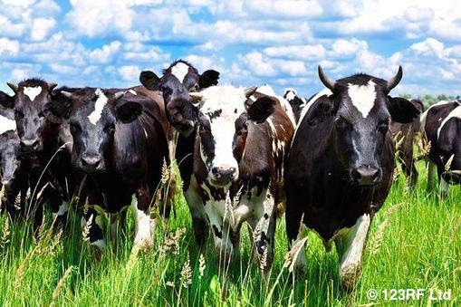
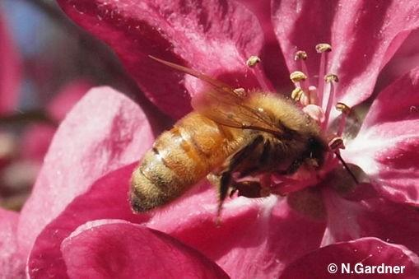
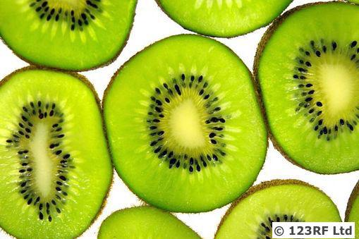
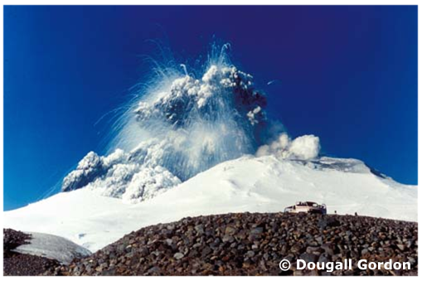
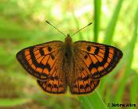
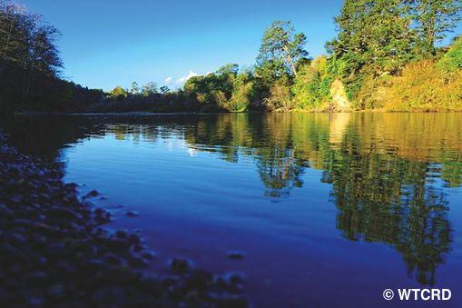
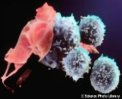
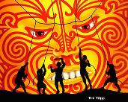
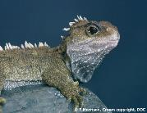
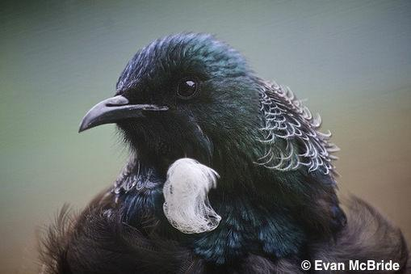
Thanks!
Questions and comments?
The images contained within this PowerPoint presentation are copyrighted to the University of Waikato and other third-party individuals and organisations. Any reuse beyond the classroom as per the intended use of these resources should be cleared with the copyright owner/s.

