Slide 1
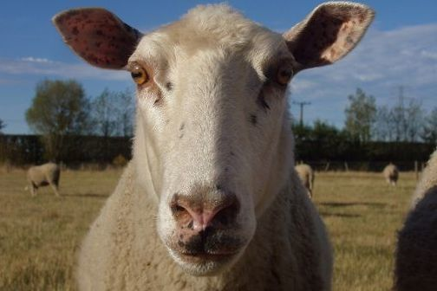
Making sense of what we see
Interpreting observations
With Andrea Soanes and Lyn Rogers
8 December 2016
4pm
www.sciencelearn.org.nz
© 2015 The University of Waikato | www.sciencelearn.org.nz
Notes:
Hello everyone and welcome to our webinar. We are excited to be here and thank you for joining us. With a big push from industry

Slide 2
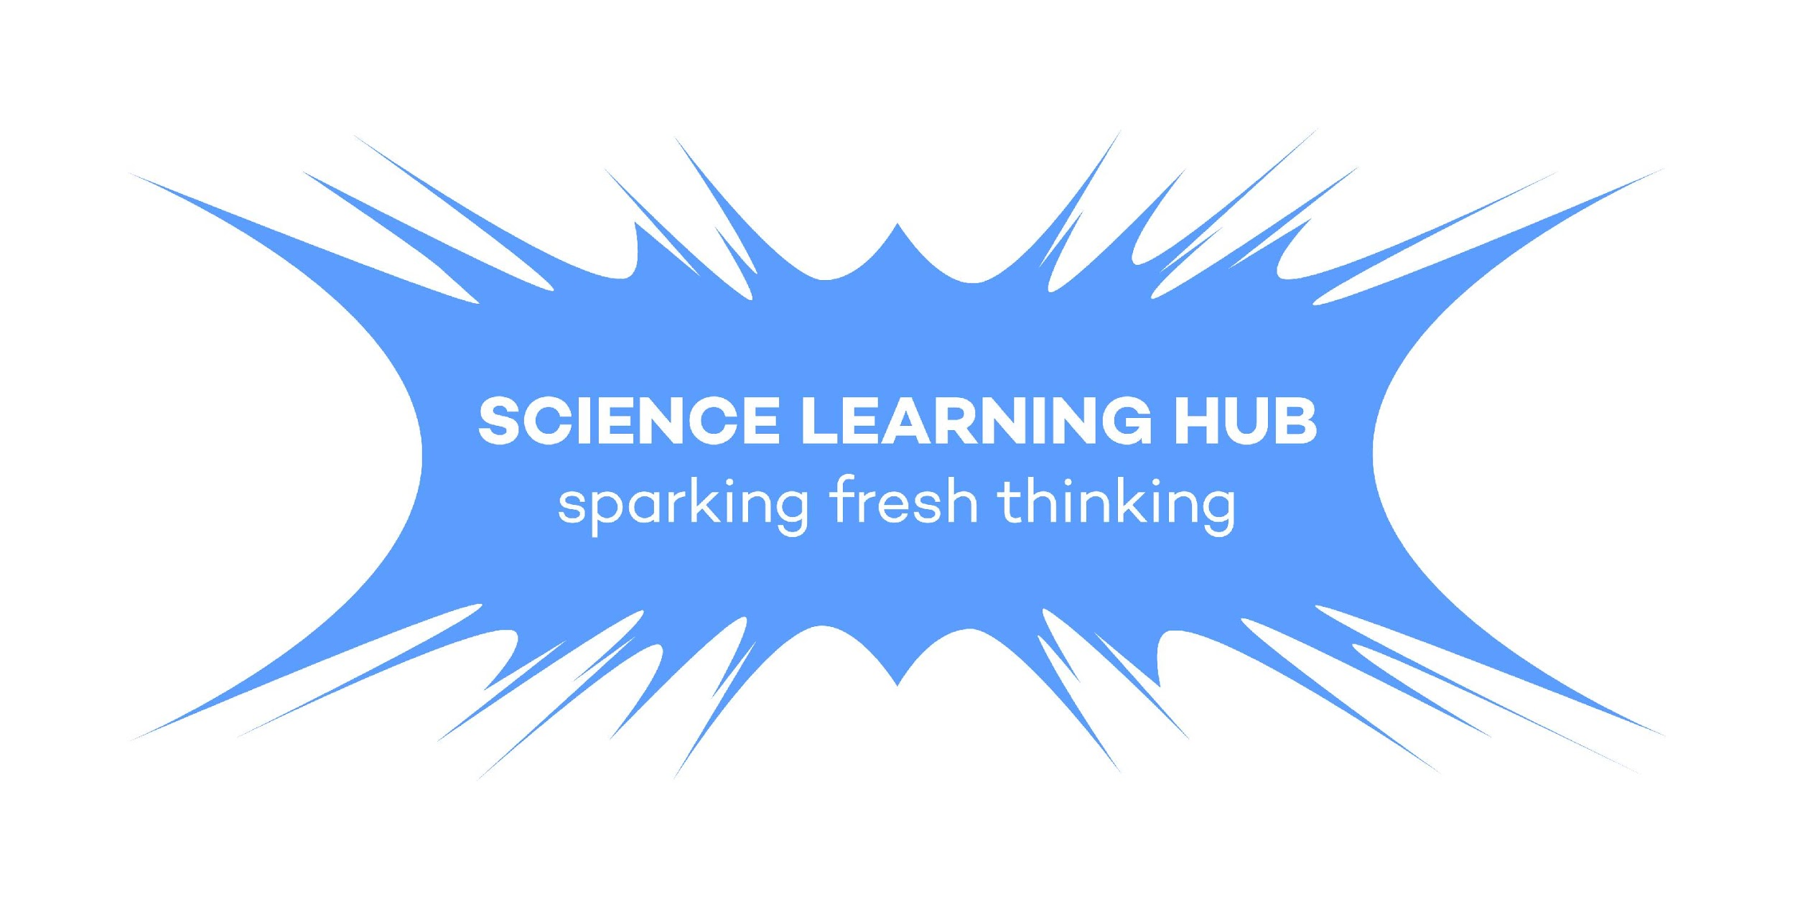
Making sense of what we see
This webinar session focuses on making sense of observational data.
We will share ideas and resources that will support you to:
enhance your students’ understanding of the differences between observation and inference
utilise students’ prior knowledge
build on students’ understandings of the nature of science
help develop students’ science capabilities
explore relevant activities on the Science Learning Hub.
Copyright University of Waikato. All rights reserved.
All images are copyrighted. For further information, please refer to enquiries@sciencelearn.org.nz
Notes:
This session will model strategies teachers can use with their students (with teachers playing the role of the student) and will provide access to these activities, resources and articles to enhance both their own and students’ understanding of the differences between observation and inference. Building on students’ understandings of the nature of science, in particular making meaning from their observational and inferential data. The science capabilities are particularly Gather and Interpret data, but also moving into being able to ask relevant questions and form hypotheses.

Slide 3
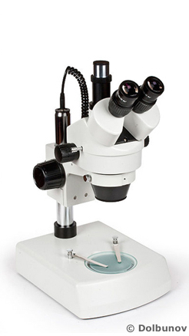
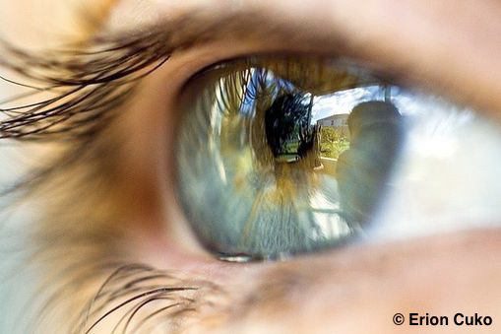
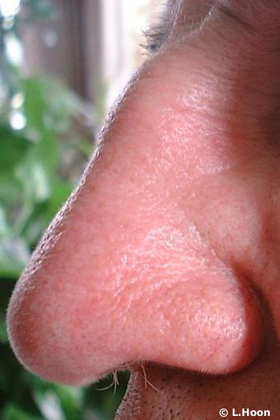
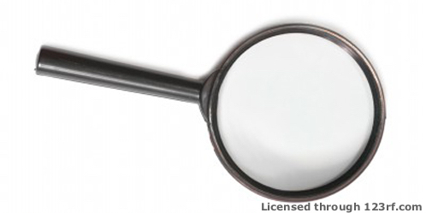
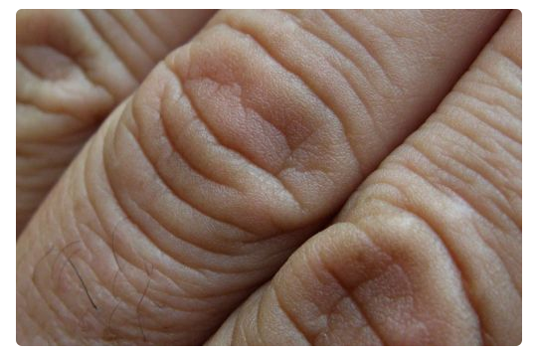
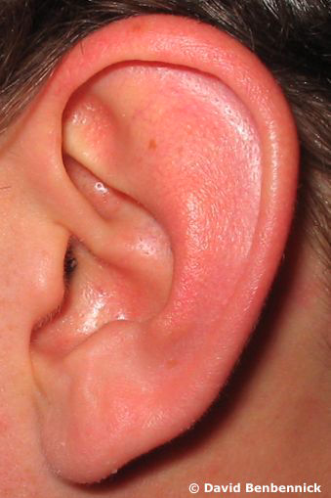
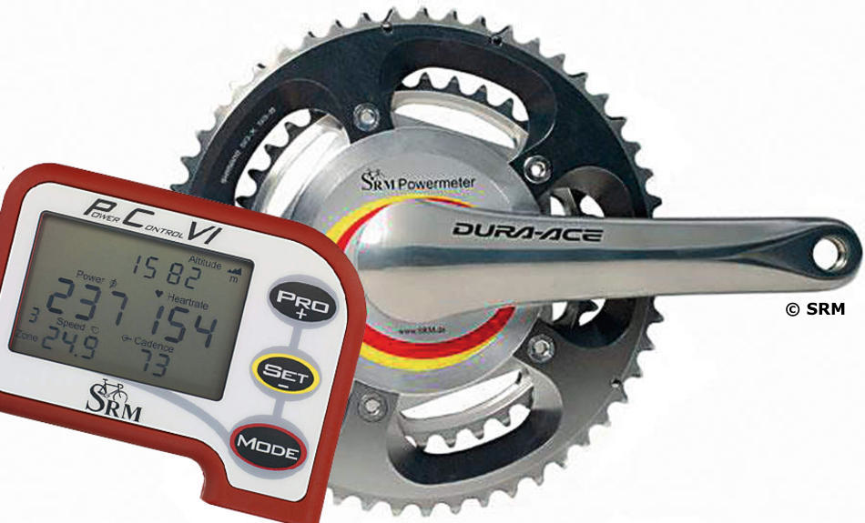
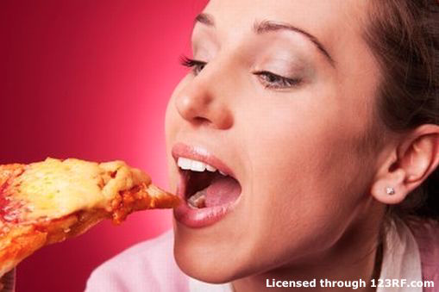
Why is observation important?
“Science knowledge is based on data derived from direct, or indirect, observations of the natural physical world and often includes measuring something.” (Science capabilities – TKI)
Copyright University of Waikato. All rights reserved.
All images are copyrighted. For further information, please refer to enquiries@sciencelearn.org.nz
Notes:
Gathering data. Using our senses, Using tools, very brief recap of last webinar session.

Slide 4
How does it all fit?
NZC: Nature of science
Science capability: Gather and interpret data
Observation
Copyright University of Waikato. All rights reserved.
All images are copyrighted. For further information, please refer to enquiries@sciencelearn.org.nz
Notes:
A quick recap of the place of observation in the NZC. Science capability: Gather and interpret data Links to NoS (NZC) Learners make careful observations and differentiate between observation and inference. Science knowledge is based on data derived from direct, or indirect, observations of the natural physical world and often includes measuring something. An inference is a conclusion you draw from observations – the meaning you make from observations. Understanding the difference is an important step towards being scientifically literate.

Slide 5
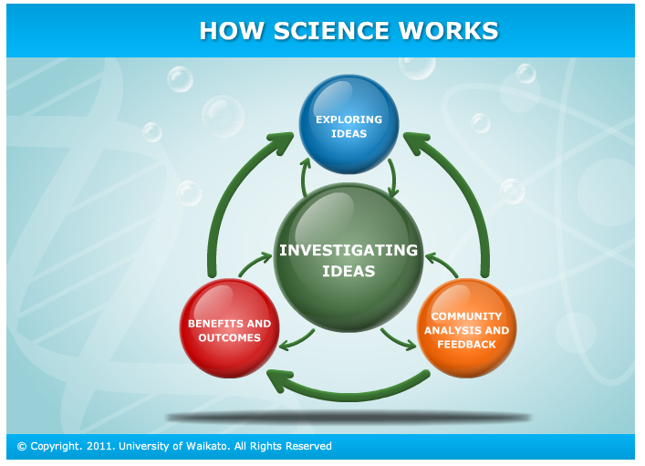
Why is observation important?
Copyright University of Waikato. All rights reserved.
All images are copyrighted. For further information, please refer to enquiries@sciencelearn.org.nz
Notes:
Where do inference and interpretation sit in relation to observation and the science process? Note that the interactive, How does science work, is no longer on the Hubs as it was created in Flash.

Slide 6
Copyright University of Waikato. All rights reserved.
All images are copyrighted. For further information, please refer to enquiries@sciencelearn.org.nz
Notes:
By building skills in observation, fostering inquiry and questions and curiosity, challenging ideas and thinking and allowing for a range of possible answers that can then be investigated. The focus is on the process of inquiring and investigating to find out more about their world.
Importance of knowing your students so you can foster their excitement and interest. Looking at scientists who maintain their enthusiasm for their topic.
Search for a video of a cool excited scientist.

Slide 7
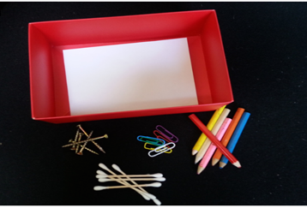
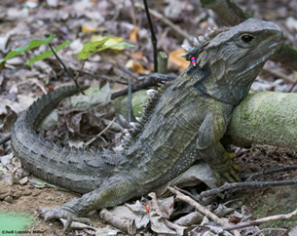
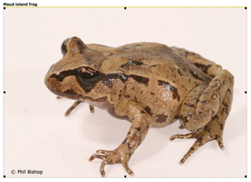
What is inference?
An inference is a conclusion you draw from observations – the meaning you make from observations
Copyright University of Waikato. All rights reserved.
All images are copyrighted. For further information, please refer to enquiries@sciencelearn.org.nz
Notes:
Looking at the three examples we included in last week’s webinar; inference vs observation. In the frog activity, all the responses were observations of surface features. In the mystery boxes activity, there were many simple observations e.g. ‘clanking’ and some also included application of prior knowledge (inference) such as ‘sounds like metal’ ‘a stapler’. In the tuatara one most observations were of surface features but one person mentioned that the tuatara had been tagged. This is specific science knowledge. In order for us/our students to progress in developing their science understandings it is important to understand the difference between these, so we can be objective when necessary. However, it is also important that as we become more proficient in observation, and our science knowledge improves, our observations will become more detailed and more informed. As teachers we can use this type of task to build an understanding of our students interests, prior knowledge and understanding of a context, to aid in planning to meet their needs and interests. These pictures come from observation tasks on the hub Observation: Learning to see Mystery boxes What do we see?

Slide 8
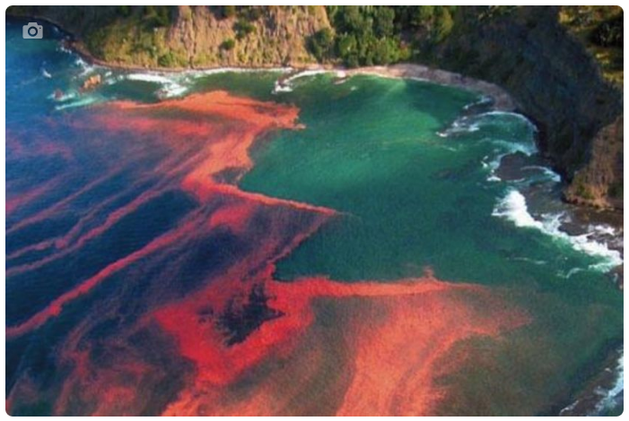
Inference versus observation
Understanding the difference is an important step towards being scientifically literate
Copyright University of Waikato. All rights reserved.
Image © NIWA, Chang et al. (2005)/Miriam Godfrey
Notes:
Again using the whiteboard, brainstorm your observations. Discuss the difference between inference and observation, and discuss how crucial prior knowledge is in making sense of the world.

Slide 9
Copyright University of Waikato. All rights reserved.
Notes:
Again using the whiteboard, brainstorm your observations. Discuss the difference between inference and observation, and discuss how crucial prior knowledge is in making sense of the world.

Slide 10
How does focusing on observation and inference enhance teaching and learning?
Stimulates student inquiry, questioning
Offers opportunities for teachers to become more culturally responsive, connect with their students’ world views, understand their perspectives
Supports students’ critical thinking
Supports collaborative practice (ako, tuakana/teina)
Fosters engagement and curiosity about science and the world
Copyright University of Waikato. All rights reserved.
All images are copyrighted. For further information, please refer to enquiries@sciencelearn.org.nz
Notes:
It is important to know our students so we can foster their excitement and interest.

Slide 11
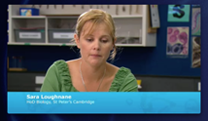
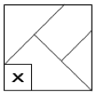
New knowledge and old
Adding new knowledge and fitting it in with what we already know can be a challenge. Prior knowledge, new information, perspectives and world views, among a range of other things, can alter our perception of how the world works.
www.sciencelearn.org.nz/Teacher-Ideas/Hubs-in-Action/Phenomenally-great-information
We (and our students) hold
a view of the world.
New information may shift
that view.
Copyright University of Waikato. All rights reserved.
All images are copyrighted. For further information, please refer to enquiries@sciencelearn.org.nz
Notes:
There is a challenge to identify and connect to what our students understand. We showed the video, Phenomenally Good Information. This is an activity that can be used to identify new knowledge, to explore the tentative nature of science with more senior students. This is an opportunity to encourage students questions, testing theories etc. The activity is here The extra piece.

Slide 12
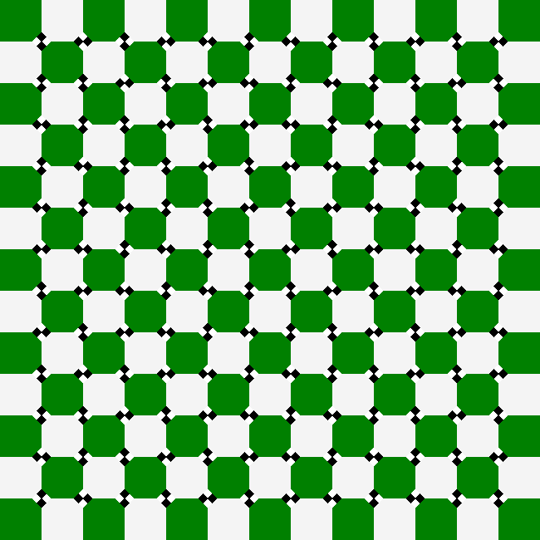
Do you see what I see?
Copyright University of Waikato. All rights reserved.
All images are copyrighted. For further information, please refer to enquiries@sciencelearn.org.nz
Notes:
Using optical illusions to introduce the ideas of science requiring corroborative information and replication before we can necessarily trust our data.
We don’t all see the same things, or the same things in the same way. That’s OK and offers scope for discussion. How far can we trust our senses? Why do we need to test things again and again? Why do we have to check, measure, discuss? This activity can be found here www.sciencelearn.org.nz/resources/2070-do-you-see-what-i-see

Slide 13
Do you see what I see?
Moving
Black dots
Crooked lines
Circles
Looks wavy even though it is static
Organic lines
Squares
Small black squares
4 dots around most squares
The corners are missing from some of the squares
Curvature
Blurry
Curvature
White circles
Green, white and black
Octagons
The circles; black and white are not all the same
Looks like a piece of fabric
Outside lines are straight, inside lines appear wavy
Fabric that has been scrunched up in the middle
Copyright University of Waikato. All rights reserved.
All images are copyrighted. For further information, please refer to enquiries@sciencelearn.org.nz
Notes:
Using optical illusions to introduce the ideas of science requiring corroborative information and replication before we can necessarily trust our data.
We don’t all see the same things, or the same things in the same way. That’s OK and offers scope for discussion. How far can we trust our senses? Why do we need to test things again and again? Why do we have to check, measure, discuss? This activity can be found here www.sciencelearn.org.nz/resources/2070-do-you-see-what-i-see

Slide 14
What next?
Gathering and Interpreting Data (SC) |  | Using and critiquing evidence (SC) | Investigating in Science (NoS)
What did we already know about…..? What did we observe? What other data did we collect? | What could we infer? What did our observations show? What did we learn? | What do we still need to know? What questions do we have? What are our theories? | What do we need to do in order to determine the actual facts? How do we find out which theory is the best one?
Copyright University of Waikato. All rights reserved.
All images are copyrighted. For further information, please refer to enquiries@sciencelearn.org.nz

Slide 15
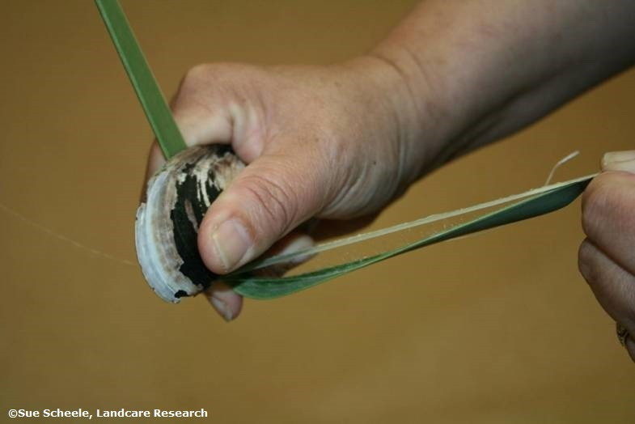
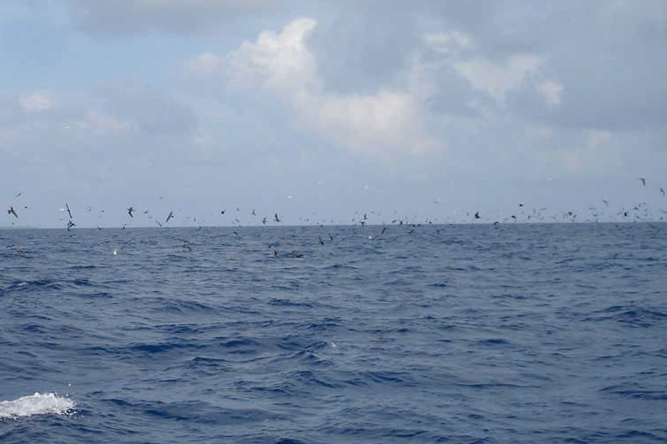
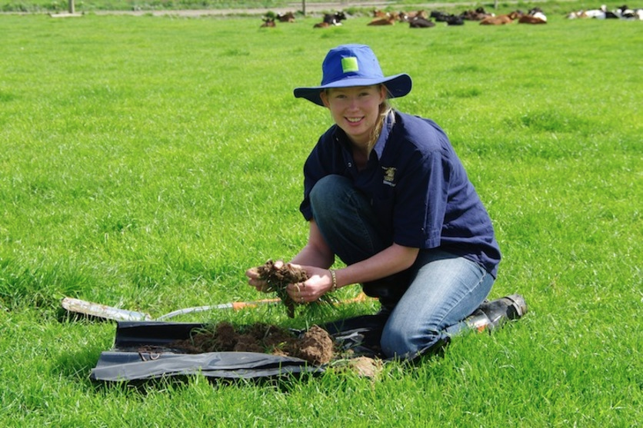
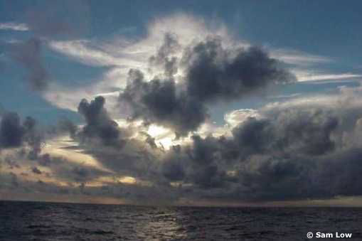
Some useful resources on the hub
Activities e.g.
Key search words
Observation
Nature of science
Science capabilities
Investigating
Articles e.g.
Observation www.sciencelearn.org.nz/resources/519-observation-learning-to-see-harakeke
Locating land
www.sciencelearn.org.nz/resources/629-locating-land
Three-level reading guides www.sciencelearn.org.nz/resources/29-observation-in-science-three-level-reading-guide
Observing clouds and weather
www.sciencelearn.org.nz/resources/628-observing-clouds-and-weather
Copyright University of Waikato. All rights reserved.
All images are copyrighted. For further information, please refer to enquiries@sciencelearn.org.nz
Notes:
Explain the range of activities and articles and how they can be used. Links to literacy, use of student templates etc.

Slide 16
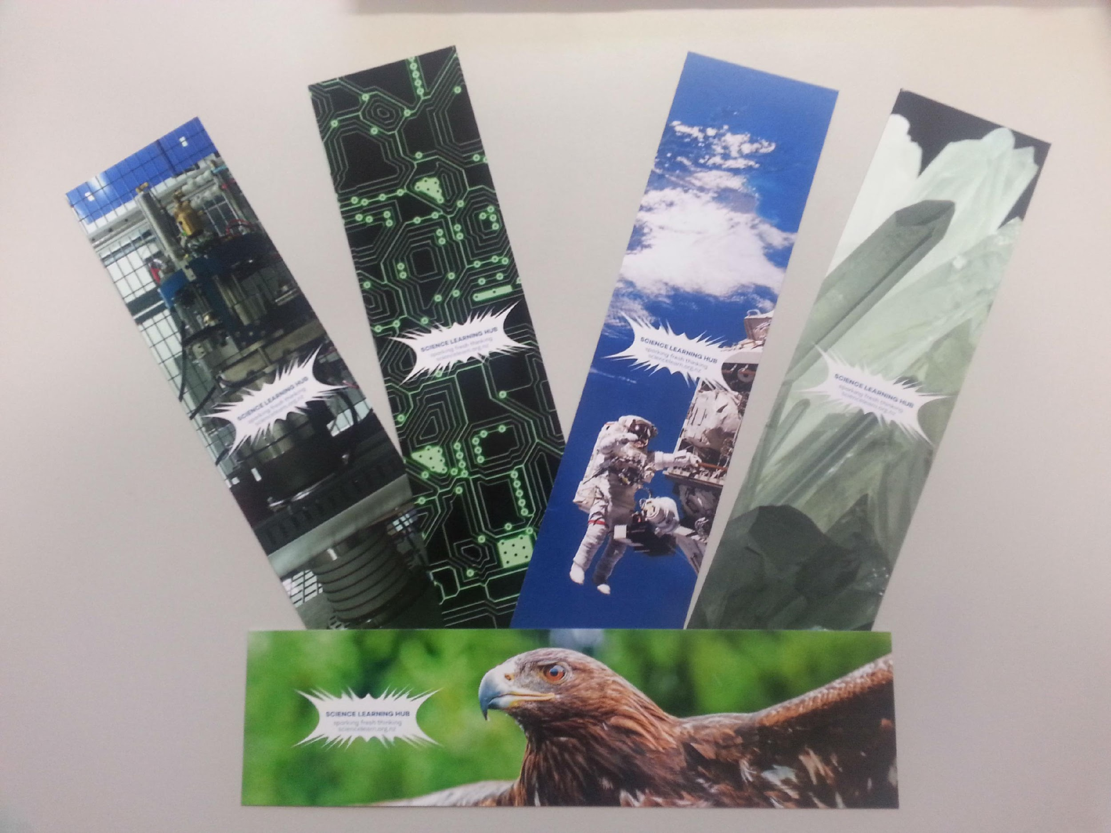
Would you like some bookmarks?
Bookmarks are available – email us enquiries@sciencelearn.org.nz
Follow us on Twitter: https://twitter.com/NZScienceLearn
Like us on Facebook: www.facebook.com/nzsciencelearn
Explore our Pinterest Boards: https://nz.pinterest.com/nzsciencelearn/
Copyright University of Waikato. All rights reserved.
All images are copyrighted. For further information, please refer to enquiries@sciencelearn.org.nz

Slide 17
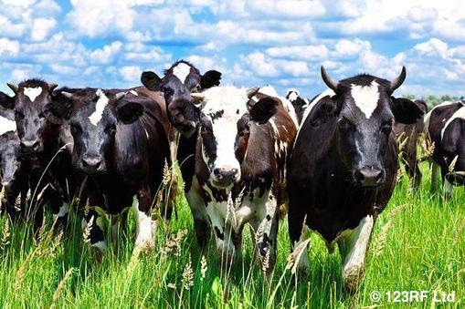
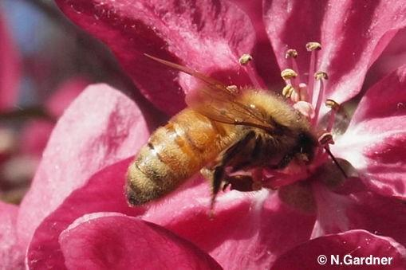
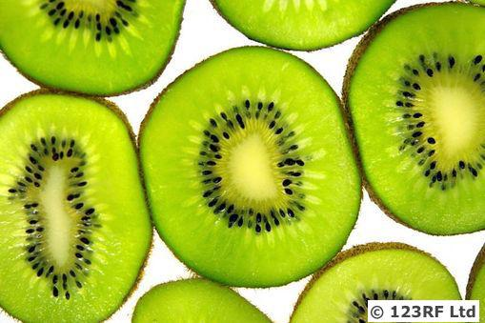
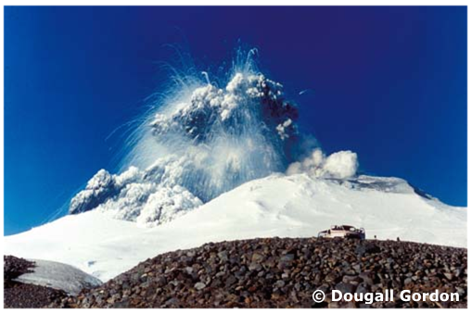
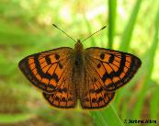
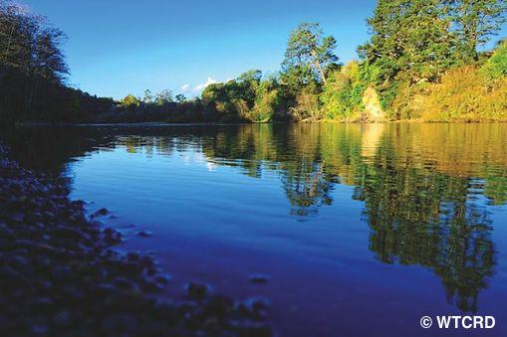
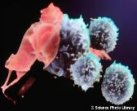
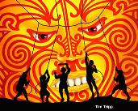
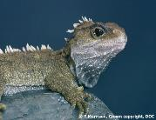
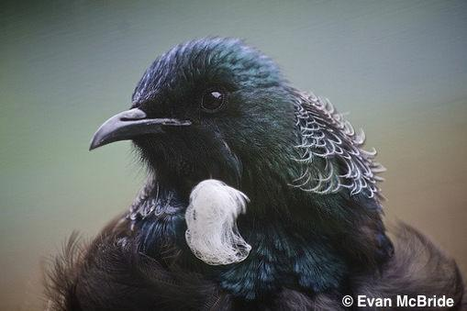
Thanks!
Questions and comments?
The images contained within this PowerPoint presentation are copyrighted to the University of Waikato and other third party individuals and organisations. Any reuse beyond the classroom as per the intended use of these resources, should be cleared with the copyright owner/s.

