Slide 1
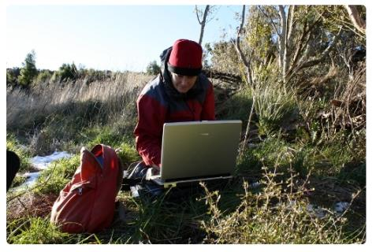
Delving into data
What is data and how can we collect it?
With Andrea Soanes and Lyn Rogers
23 February 2017
4pm
www.sciencelearn.org.nz
© 2015 The University of Waikato | www.sciencelearn.org.nz
Notes:
Hello everyone and welcome to our webinar. We are excited to be here and thank you for joining us.

Slide 2
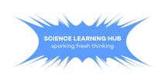
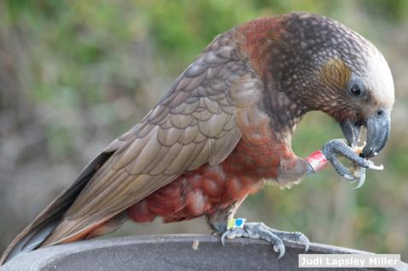
Delving into data
This webinar session explores the following questions:
What is data?
Why is data important?
What is the difference
between:
data and evidence?
qualitative
and quantitative data?
What constitutes ‘good’
data, and how do we collect it?
“Science knowledge is based on data derived from direct, or indirect, observations of the natural physical world and often includes measuring something.” (Science capabilities – TKI)
Copyright University of Waikato. All rights reserved.
All images are copyrighted. For further information, please refer to enquiries@sciencelearn.org.nz
Notes:
The session will model strategies teachers can use with their students and will provide access to activities, resources and articles to enhance both their own and students’ understandings about data. The next webinar session ‘Making sense of data’ will focus upon what it all means and how we might make use of the data we collect. Photo url: https://www.sciencelearn.org.nz/images/1313-a-banded-kaka

Slide 3
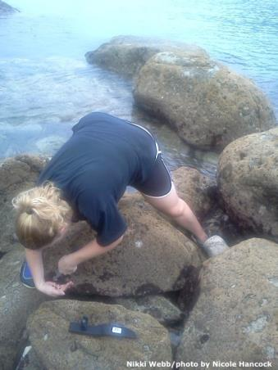
We will share ideas and resources that will support you to:
enhance your students’ understanding about data
utilise students’ prior knowledge
build on students’ understandings
of the nature of science
help develop students’ science capabilities
explore relevant activities on the Science Learning Hub.
Copyright University of Waikato. All rights reserved.
All images are copyrighted. For further information, please refer to enquiries@sciencelearn.org.nz
Notes:
https://www.sciencelearn.org.nz/images/1265-nikki-webb-collects-marine-samples

Slide 4
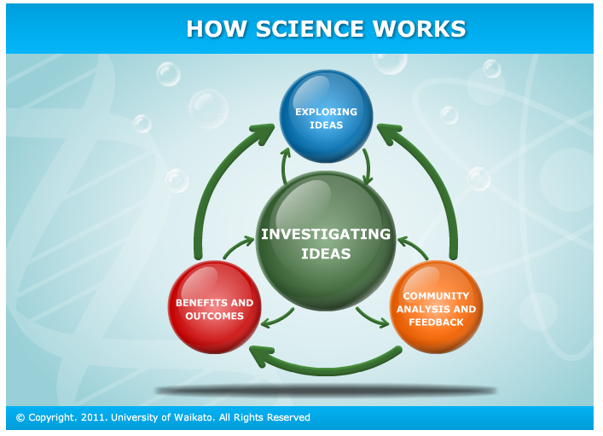
Why is data collection important?
Copyright University of Waikato. All rights reserved.
All images are copyrighted. For further information, please refer to enquiries@sciencelearn.org.nz
Notes:
Where does data collection sit in relation to the science process?
https://www.sciencelearn.org.nz/resources/410-nature-of-science-introduction

Slide 5
Copyright University of Waikato. All rights reserved.
All images are copyrighted. For further information, please refer to enquiries@sciencelearn.org.nz
Notes:
Data collection is integral to the process of inquiry and investigating to find out more about the world. It is important to know your students so you can foster their excitement and interest.
See https://www.sciencelearn.org.nz/resources/3038-investigating-in-science

Slide 6
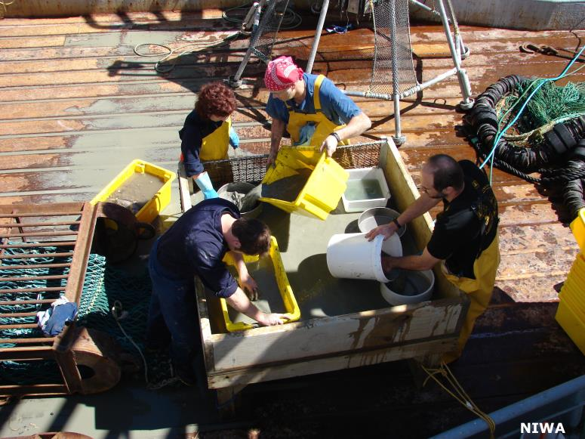
What is data? Teachers initial ideas
A measure of a variable
Recording information
Observations
Accurate measurements
A count of something
Information that has been gathered or collected
Fact
Information
Any kind of observation based information
It often but not necessarily including numbers
Copyright University of Waikato. All rights reserved.
All images are copyrighted. For further information, please refer to enquiries@sciencelearn.org.nz
Notes:
Photo URL https://www.sciencelearn.org.nz/videos/267-sampling-cold-seep-communities

Slide 7
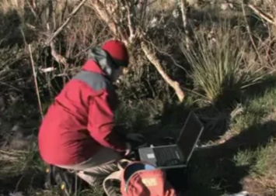
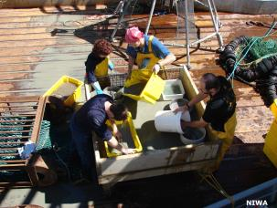
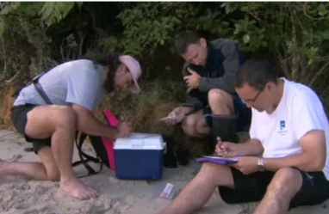
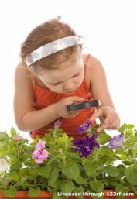
What is data?
Scientific data is defined as information collected using specific methods for a specific purpose of studying or analysing.
www.yourdictionary.com/scientific-data
Copyright University of Waikato. All rights reserved.
All images are copyrighted. For further information, please refer to enquiries@sciencelearn.org.nz
Notes:
www.yourdictionary.com/scientific-data Think about/discuss the key ideas expressed in this definition.
Photo urls https://www.sciencelearn.org.nz/resources/413-tenets-of-the-nature-of-science; https://www.sciencelearn.org.nz/videos/168-scientist-researcher-tangata-whenua; https://www.sciencelearn.org.nz/images/849-tracking-pea-crab-larvae; https://www.sciencelearn.org.nz/videos/703-observation-in-science; https://www.sciencelearn.org.nz/videos/267-sampling-cold-seep-communities

Slide 8
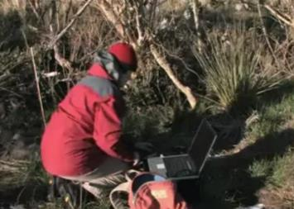
Teachers ideas about the data that is possibly being collected in these situations
The way it's gathered is important...
Observable features
Measuring
Looking for patterns
Could be looking at range and number of species in a particular habitat
Are they doing a quadrat on the beach? What you find in a metre squared?
Recording
volume
Numbers or variety of things (e.g. insects) on a plant...
Measuring conditions: could be temperature or time measures
Magnifying some creature
Copyright University of Waikato. All rights reserved.
All images are copyrighted. For further information, please refer to enquiries@sciencelearn.org.nz
Notes:
Looking at the five examples of collecting data, would all of them have particular protocols or specific methods? What data could they be collecting?
Photo urls https://www.sciencelearn.org.nz/resources/413-tenets-of-the-nature-of-science; https://www.sciencelearn.org.nz/videos/168-scientist-researcher-tangata-whenua; https://www.sciencelearn.org.nz/images/849-tracking-pea-crab-larvae; https://www.sciencelearn.org.nz/videos/703-observation-in-science; https://www.sciencelearn.org.nz/videos/267-sampling-cold-seep-communities

Slide 9
Why is data important and how does it differ from evidence? Some teacher ideas.
Data is evidence
Evidence can be data
Evidence is something that could be used to support a theory and is possibly data
Data is something that stands alone
Data is factual information
Data is important as it forms the basis of your understanding
Data provides the evidence
How we interpret the data then gives us the evidence
Copyright University of Waikato. All rights reserved.
All images are copyrighted. For further information, please refer to enquiries@sciencelearn.org.nz
Notes:
Resource urls https://www.sciencelearn.org.nz/videos/168-scientist-researcher-tangata-whenua

Slide 10
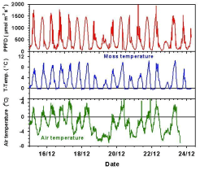
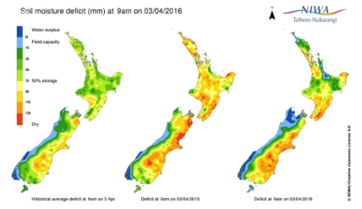
Why is data important? How does it differ from evidence?
Once data is processed and analysed or interpreted in some way, it becomes information that may be used for building our knowledge or understanding.
It may also constitute evidence that can be used to make conclusions, support decisions or lead to further questions or investigation.
Copyright University of Waikato. All rights reserved.
All images are copyrighted. For further information, please refer to enquiries@sciencelearn.org.nz
Notes:
Photo urls https://www.sciencelearn.org.nz/videos/80-data-for-the-model; https://www.sciencelearn.org.nz/resources/915-using-soil-moisture-map

Slide 11
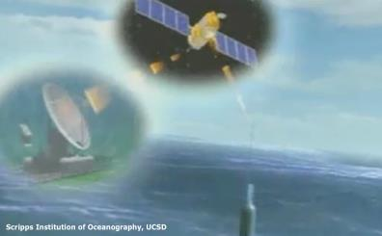
Why is data important?
‘In science, explanations need to be supported by evidence that is based on, or derived from, observations of the natural world.
Students should be encouraged to ask and answer questions such as:
How do you know that? What makes you think so? How could you check that?’
‘What sets scientific explanations apart from other ways of explaining the world is their reliance on evidence and their ability to evolve as new evidence comes to light.’
http://scienceonline.tki.org.nz/Science-capabilities-for-citizenship/Introducing-five-science-capabilities/Use-evidence
Copyright University of Waikato. All rights reserved.
All images are copyrighted. For further information, please refer to enquiries@sciencelearn.org.nz
Notes:
From TKI and the capabilities, focusing on gathering data for a purpose.
Image from video: https://www.sciencelearn.org.nz/videos/350-what-we-are-learning-from-argo

Slide 12
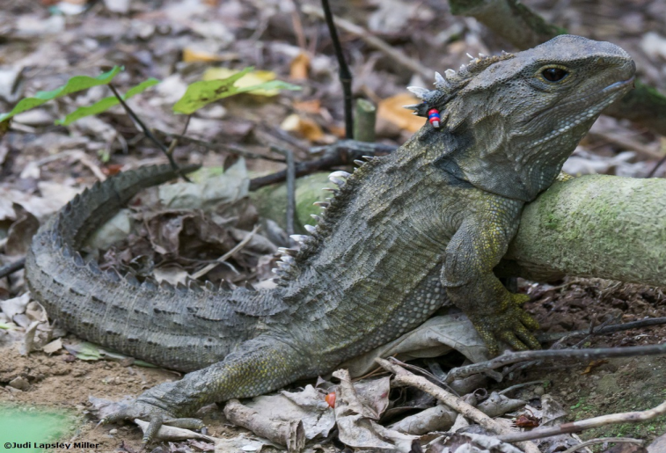
What is the difference between qualitative and quantitative data?
Observations are often qualitative
Describing the environment
Patterns on the skin
Skin colour
Anything with numbers is quantitative
The way it moves
Number of toes on the foot
How much food is consumed over a certain time
Roughness of skin
How many times it moves in a specific time
e.g. number of movements in a 10 minute period
Number of times it feeds
How many spikes on its back?
Measurements e.g. length of body parts such as the tail or claws
Copyright University of Waikato. All rights reserved.
All images are copyrighted. For further information, please refer to enquiries@sciencelearn.org.nz
Notes:
Given that this tuatara has been tagged, what sort of quantitative data may be gathered about it? What sort of qualitative data could be gathered? Qualitative ideas are in green, quantitative ones in pink.
Photo url https://beta.sciencelearn.org.nz/images/713-male-tuatara

Slide 13
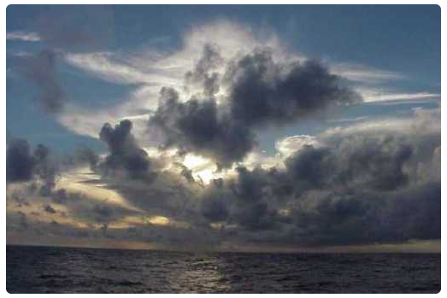
Collecting data about weather: qualitative vs quantitative data
Colour of the clouds
Cloud patterns
Texture of the clouds
Numbers of different types of clouds
Types of clouds visible
Wind direction
Air temperature
Colour of the sky
Rainfall e.g. mm of rainfall in January
Changes in the cloud formations
Height of different clouds
Humidity levels
Number of clouds
Wind speed
Copyright University of Waikato. All rights reserved.
All images are copyrighted. For further information, please refer to enquiries@sciencelearn.org.nz
Notes:
Qualitative data ideas are in green, quantitative ideas are in pink.
Photo url https://www.sciencelearn.org.nz/images/692-towering-cumulus-clouds

Slide 14
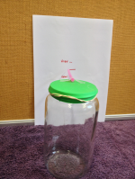
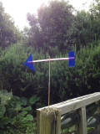
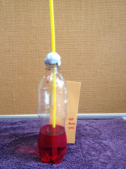
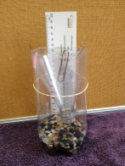
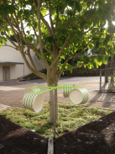
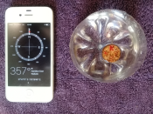
Collecting data about weather: qualitative vs quantitative data
Quantitative data-collecting tools:
collecting ‘good’ data
Simple weather vane
Simple barometer
Simple thermometer
Simple rain gauge
Simple anemometer
Simple compass
Copyright University of Waikato. All rights reserved.
All images are copyrighted. For further information, please refer to enquiries@sciencelearn.org.nz
Notes:
How important is it to have the right tools and protocols for collecting data? These simple activities allow plenty of scope for discussion around data collection protocols and what constitutes ‘good’ data.
Making a barometer, Making an anemometer, Making a weather vane and compass, Making a rain gauge, Making a thermometer.
https://www.sciencelearn.org.nz/images/692-towering-cumulus-clouds

Slide 15
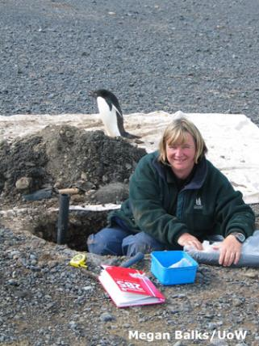
What constitutes ‘good’ data?
The goal for data collection is to provide quality evidence that:
allows convincing and credible answers to inquiry questions
supports any conclusions drawn
supports (or possibly dismisses) theories and hypotheses
corroborates or challenges existing data
may prompt further inquiry.
‘Good’ data is robust data. It is reliable and can be easily validated.
Copyright University of Waikato. All rights reserved.
All images are copyrighted. For further information, please refer to enquiries@sciencelearn.org.nz
Notes:
Photo url https://www.sciencelearn.org.nz/images/1179-dr-megan-balks

Slide 16
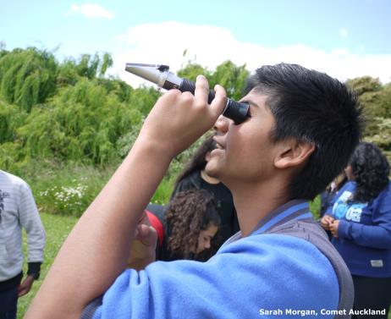
How does focusing on data enhance teaching and learning?
It stimulates student inquiry, questioning, engagement and curiosity.
Teachers can become more culturally responsive – connect with their students’ world views, understand their perspectives and support collaborative practice.
It supports students’ critical thinking and scientific literacy.
Copyright University of Waikato. All rights reserved.
All images are copyrighted. For further information, please refer to enquiries@sciencelearn.org.nz
Notes:
Photo url https://www.sciencelearn.org.nz/images/2719-using-equipment

Slide 17
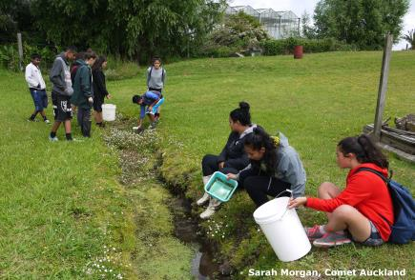
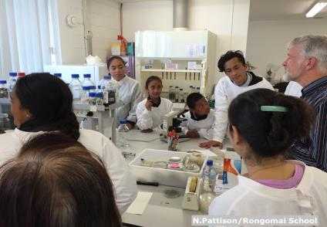
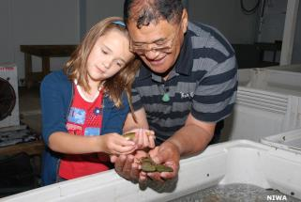
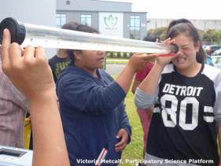
What opportunities do we currently offer our students to collect data?
Copyright University of Waikato. All rights reserved.
All images are copyrighted. For further information, please refer to enquiries@sciencelearn.org.nz
Notes:
Photo urls
https://www.sciencelearn.org.nz/resources/1688-students-help-restore-mauri-to-the-oruarangi-stream https://www.sciencelearn.org.nz/images/2252-students-in-the-classroom;
https://www.sciencelearn.org.nz/images/1414-weno-working-with-a-student;
https://www.sciencelearn.org.nz/images/1300-students-with-dr-peter-buchanan

Slide 18
What opportunities do we currently offer our students to collect data?
We made
solar ovens - used light meters to find out which places gave us the most reliable sunny spots, then used a ‘gun’ thermometer to check and log temperatures to check which designs worked best.
In our gardens we are measuring the moisture,
ph levels, temperature of the soil etc. to help
work out what might be best to grow there.
I'm thinking
I could also begin to add quantitative data to extend some children.
Observational drawing
I have begun gathering observational journals, looking at one particular patch around local environment around school: mainly qualitative.
My NE/Year 1 kids have been collecting (dead) bugs they find in the playground and using a magnifying glass to draw them.
Collecting leaves from our playground, how they are the same/different.
Observations of the natural.
Copyright University of Waikato. All rights reserved.
All images are copyrighted. For further information, please refer to enquiries@sciencelearn.org.nz
Notes:
Brainstorm

Slide 19
What next?
Gathering and interpreting data (SC) |  | Using and critiquing evidence (SC) | Investigating in science (NoS)
What did we already know about …? What did we observe? What other data did we collect? | What could we infer? What did our observations show? How do we know that? Do our sets of data agree? Is our data ‘good’? | What do we still need to know? What questions do we still have? What did we learn? What are our theories? Does our data provide good evidence? Are we sure of our findings? Are we sure of what we have learned? Do we have enough ‘good’ data to support our theories? | Is there more information we still have to find or more data we have to collect before it makes sense? How do we find out which theory is the best one? What evidence do we have to support it? What makes us think that? Is our data valid, reliable, replicable? How can we make sure of that?
Copyright University of Waikato. All rights reserved.
All images are copyrighted. For further information, please refer to enquiries@sciencelearn.org.nz
Notes:
These questions could be used to prompt thinking, depending on levels our students are working at and how curious they are.

Slide 20
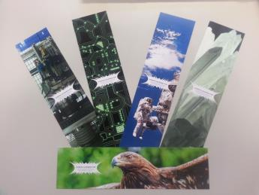
Would you like some bookmarks?
Bookmarks are available – email us enquiries@sciencelearn.org.nz
Follow us on Twitter: https://twitter.com/NZScienceLearn
Like us on Facebook: www.facebook.com/nzsciencelearn
On Pinterest: https://nz.pinterest.com/nzsciencelearn/observation-in-science/
Copyright University of Waikato. All rights reserved.
All images are copyrighted. For further information, please refer to enquiries@sciencelearn.org.nz

Slide 21
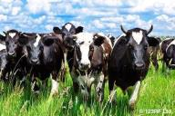
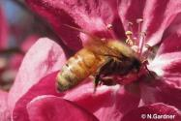
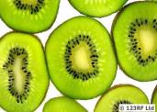
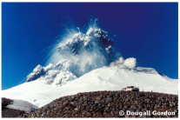
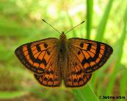
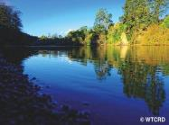
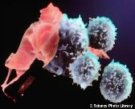
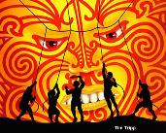
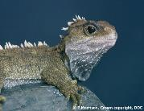
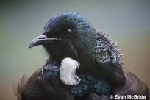
Thanks!
Questions and comments?
The images contained within this PowerPoint presentation are copyrighted to the University of Waikato and other third-party individuals and organisations. Any reuse beyond the classroom as per the intended use of these resources should be cleared with the copyright owner/s.

