Slide 1
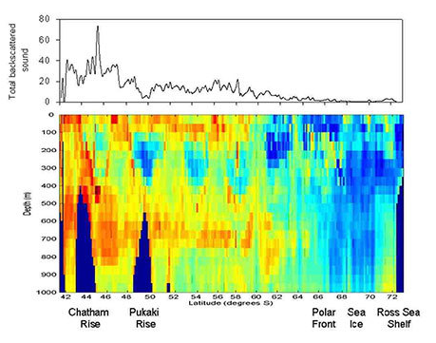
Making sense of data
What does it all mean?
With Andrea Soanes and Lyn Rogers
16 March 2017
4pm
www.sciencelearn.org.nz
© 2015 The University of Waikato | www.sciencelearn.org.nz
Notes:
Hello everyone and welcome to our webinar. We are excited to be here and thank you for joining us. With a big push from industry

Slide 2
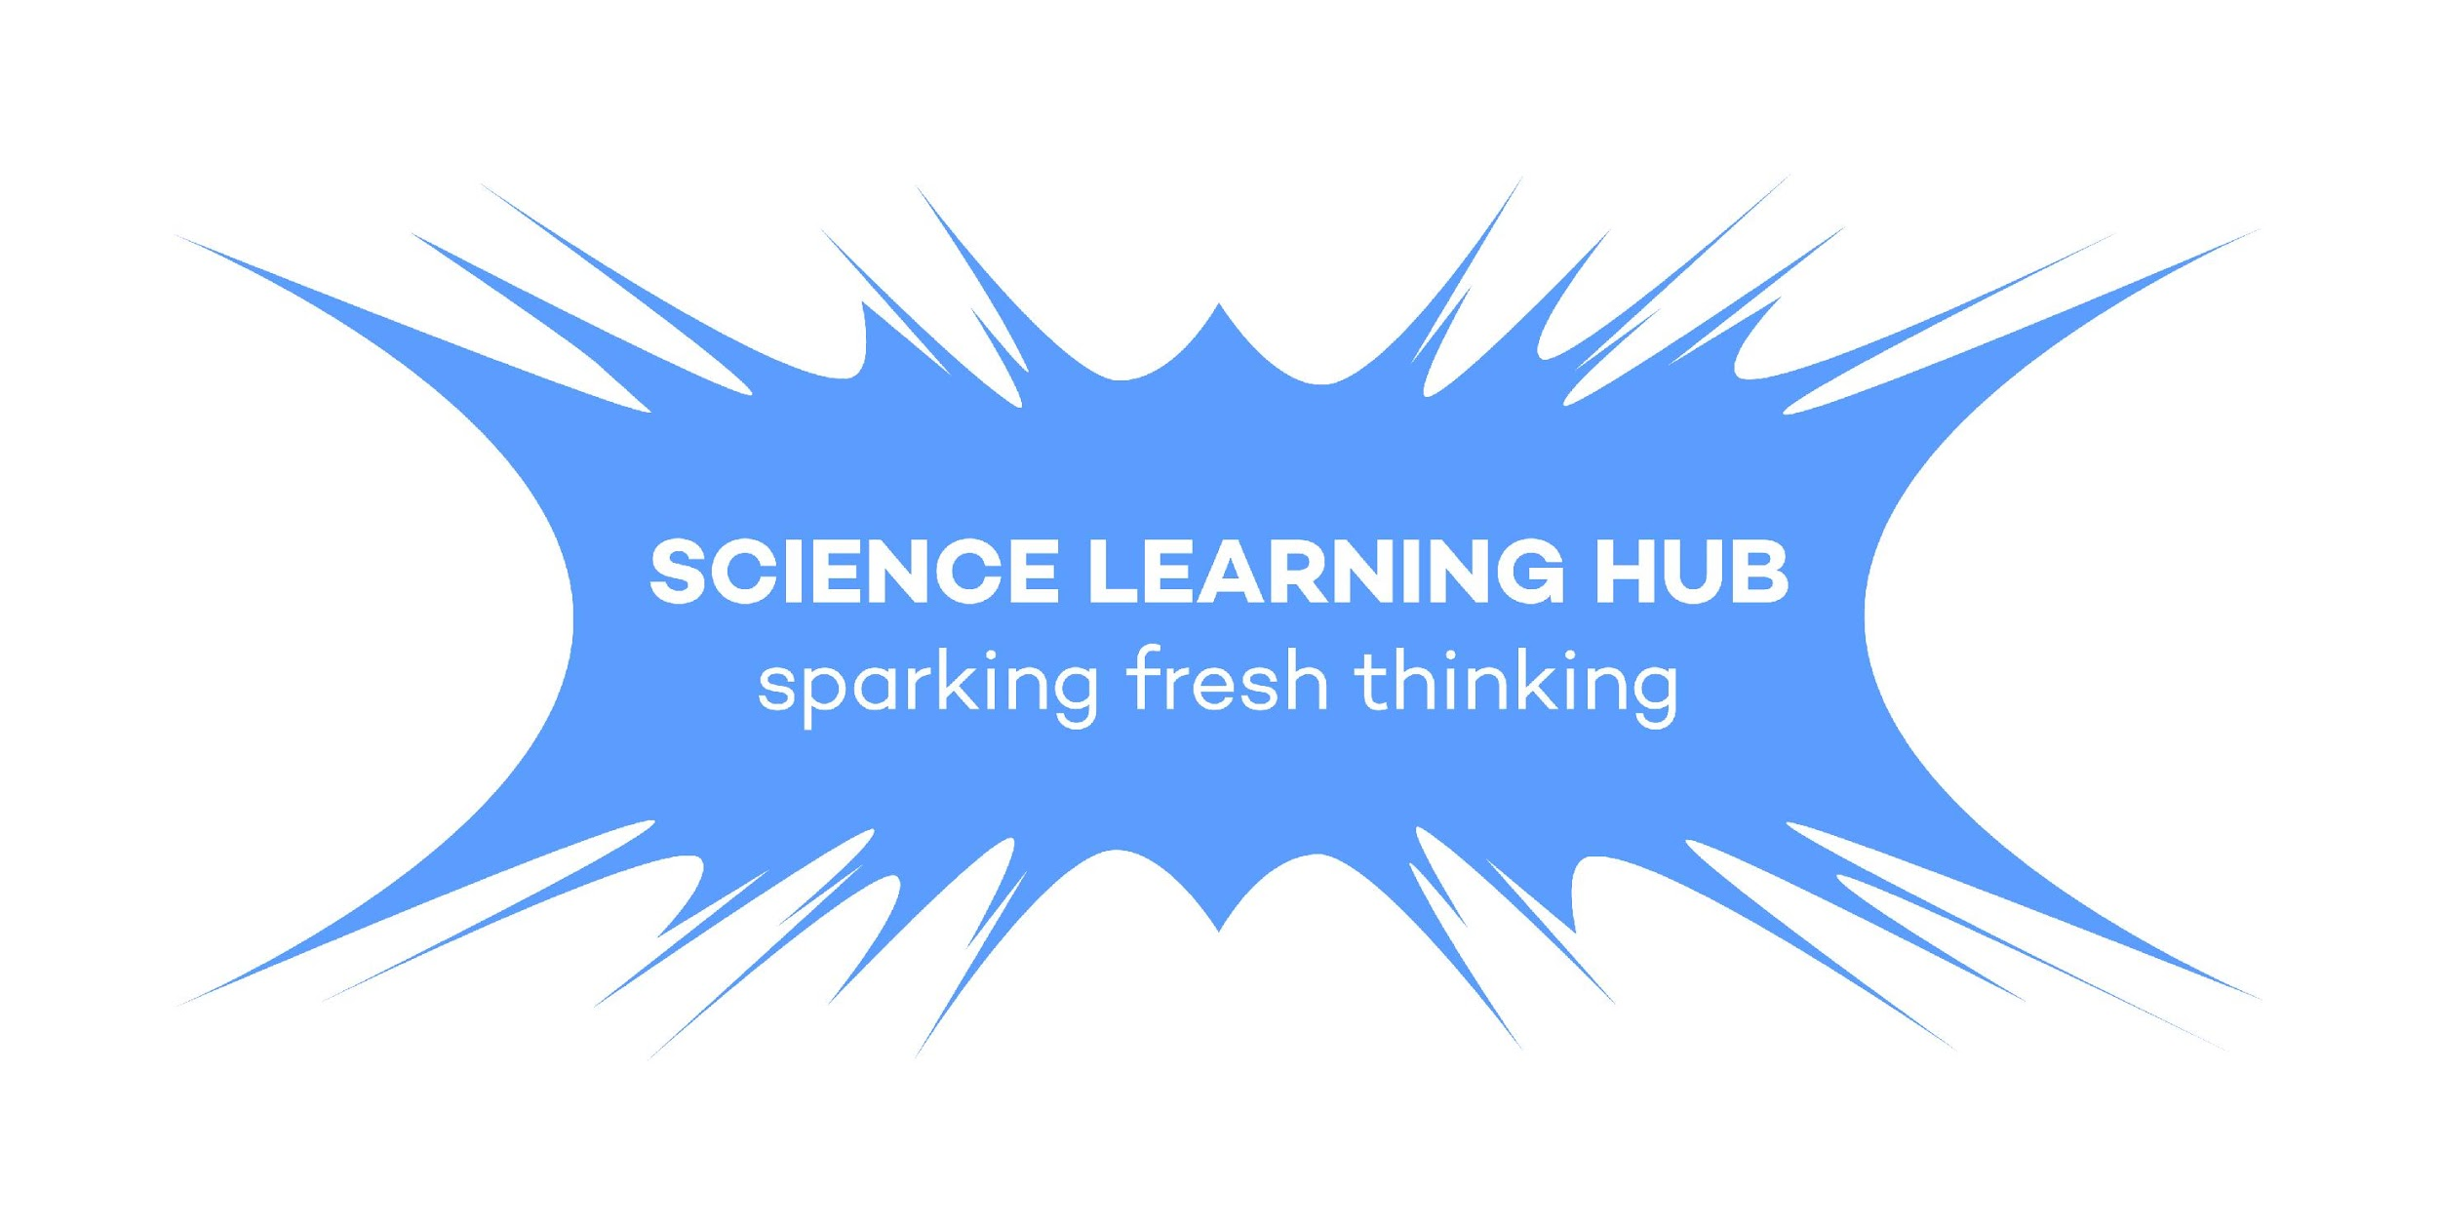
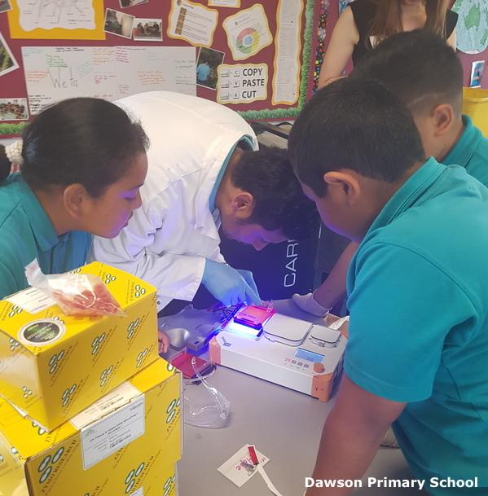
Making sense of data
This webinar session explores the following questions:
What does our data mean?
What is data used for?
Why is data important?
How can we process, analyse and present data to make it meaningful?
When does data become evidence?
Science knowledge is based on data derived from direct, or indirect, observations of the natural physical world and often includes measuring something. (Science capabilities – TKI)
Copyright University of Waikato. All rights reserved.
All images are copyrighted. For further information, please refer to enquiries@sciencelearn.org.nz
Notes:
The session models questioning strategies that teachers can use to enhance both their own and students’ understandings about data, in order to support them in finding out more about their world.
It is worth exploring with your students the meanings of the words ‘data’ and ‘evidence’ in a scientific context, as this is an area where everyday use of the words implies something slightly different.
Photo url www.sciencelearn.org.nz/images/2438-dna-sequencing

Slide 3
We will share ideas to support you to:
enhance your students’ understanding about data and evidence
build on students’ understandings of the nature of science
help develop students’ science capabilities
explore relevant resources on the Science Learning Hub
Science education research suggests that activities are most effective when they are designed to interactively engage students.
Copyright University of Waikato. All rights reserved.
All images are copyrighted. For further information, please refer to enquiries@sciencelearn.org.nz
Notes:
Photo from video taken by the Science Learning Hub
http://serc.carleton.edu/introgeo/models/IntEng.html

Slide 4
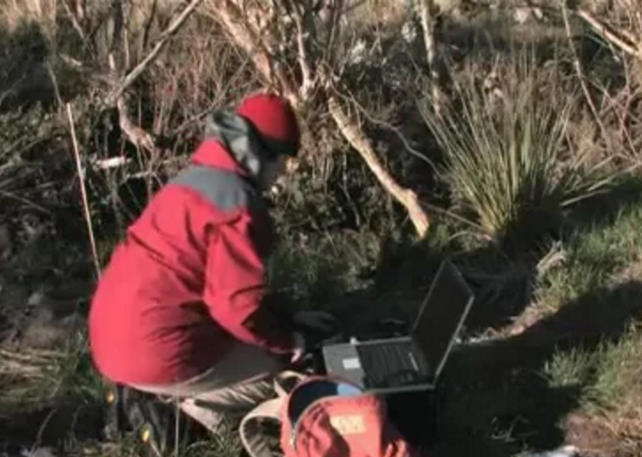
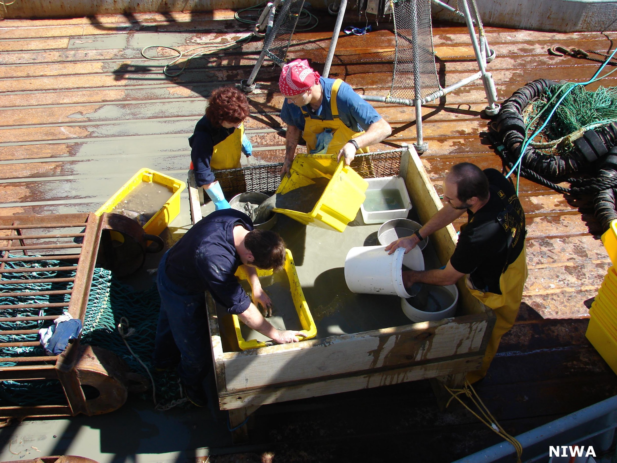
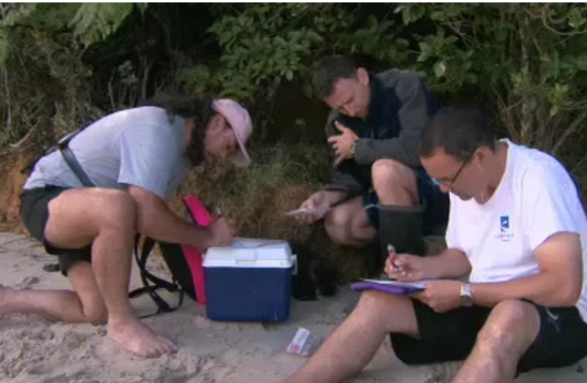
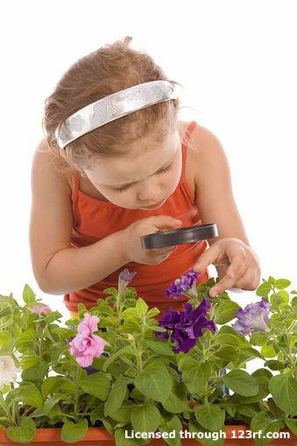
What is data?
Scientific data is defined as information collected using specific methods for a specific purpose of studying or analysing.
Copyright University of Waikato. All rights reserved.
All images are copyrighted. For further information, please refer to enquiries@sciencelearn.org.nz
Notes:
Thinking about What is data? Discuss qualitative vs quantitative.
Definition url www.yourdictionary.com/scientific-data
https://www.sciencelearn.org.nz/resources/413-tenets-of-the-nature-of-science
https://www.sciencelearn.org.nz/videos/168-scientist-researcher-tangata-whenua
https://www.sciencelearn.org.nz/images/849-tracking-pea-crab-larvae
https://www.sciencelearn.org.nz/videos/703-observation-in-science
https://www.sciencelearn.org.nz/videos/267-sampling-cold-seep-communities

Slide 5
Where does data fit in the curriculum?
Gathering and interpreting data (SC) |  | Using and critiquing evidence (SC) | Investigating in science (NoS)
What did we already know about …? What did we observe? What other data did we collect? | What could we infer? What did our observations show? How do we know that? Do our sets of data agree? Is our data robust? | What do we still need to know? What questions do we still have? What did we learn? What are our theories? Does our data provide good evidence? Are we sure of our findings? Are we sure of what we have learned? Do we have enough data to support our theories? | Is there more information we still have to find or more data we have to collect before it makes sense? How do we find out which theory is the best one? What evidence do we have to support it? What makes us think that? Is our data valid, reliable, replicable? How can we make sure of that?
Copyright University of Waikato. All rights reserved.
All images are copyrighted. For further information, please refer to enquiries@sciencelearn.org.nz
Notes:
These questions can be used to prompt thinking, depending on levels our students are working at and how curious they are. With appropriate scaffolding, even kindergarteners can ask questions about data – another skill critical to building a scientific frame of mind. Our challenge as teachers is to provide students with a way to build scientific skills and habits of mind. Scientific investigations are often ongoing, raising new questions even as old ones are answered.

Slide 6
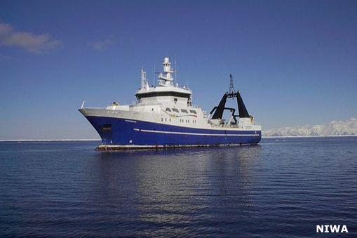
How does data fit into the research process?
Copyright University of Waikato. All rights reserved.
All images are copyrighted. For further information, please refer to enquiries@sciencelearn.org.nz
Notes:
Photo url www.sciencelearn.org.nz/resources/1291-investigating-data-from-the-rv-tangaroa. This is NIWA’s large research vessel, carrying scientists on a variety of missions, in the waters of the Pacific and Southern Ocean. Each scientist will have their own protocols about the data they want to collect, for a particular purpose. This is the point: purposeful data collection. Discuss the place of data in the research process and how the data we choose to collect needs to be relevant to the questions we ask. Once we have collected it, what do we do with it? The importance of analysing it to see what it all means.

Slide 7
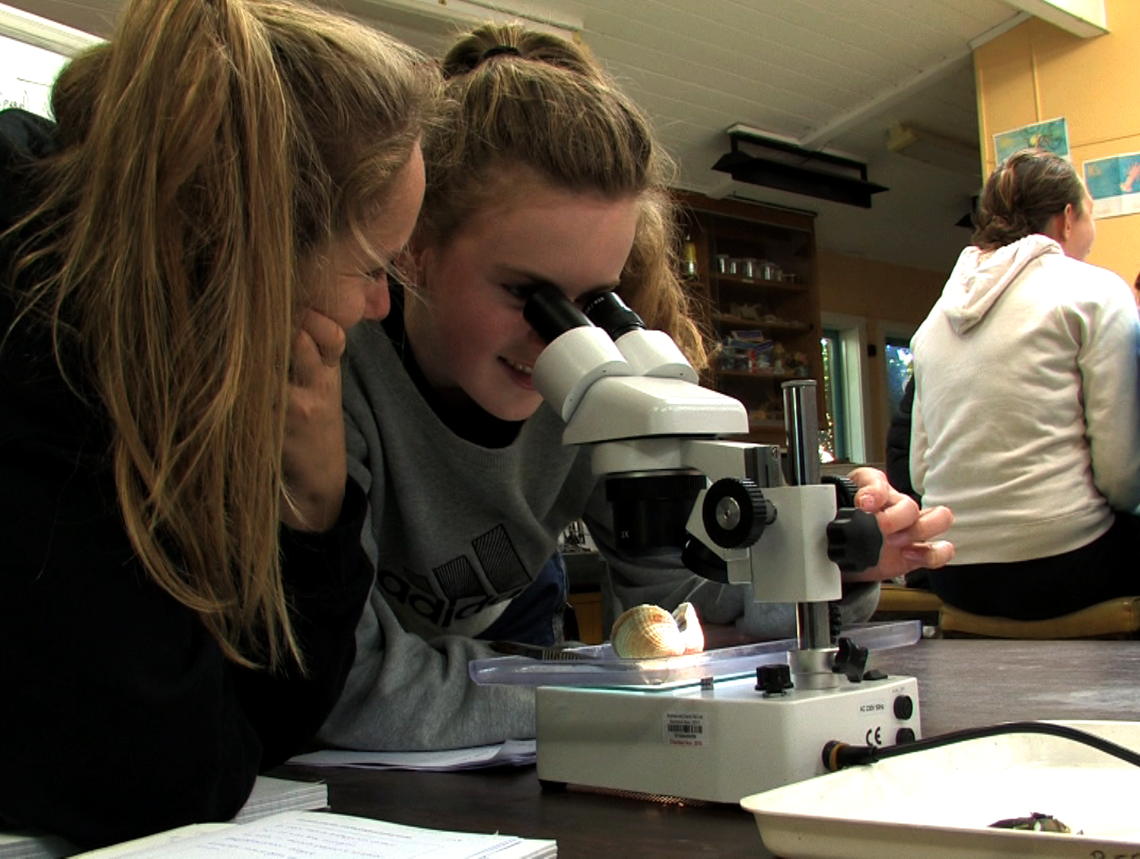
How can data be used?
The goal for data collection is to provide quality evidence that:
allows convincing and credible answers to inquiry questions
supports any conclusions drawn
supports (or possibly dismisses) theories and hypotheses
correlates with, corroborates or challenges existing data
may prompt further inquiry and research.
Robust data is reliable and can be easily validated.
Copyright University of Waikato. All rights reserved.
All images are copyrighted. For further information, please refer to enquiries@sciencelearn.org.nz
Notes:
To try and ensure their explanations are robust, i.e. that their inferences are valid, scientists do a number of different things, for example:
They ask questions like: “Could there be another explanation for this data?”
They might collect more data, perhaps using a different method. They might also test alternative explanations.
They communicate and debate their ideas with other scientists.
Photo from video taken by the Science Learning Hub

Slide 8
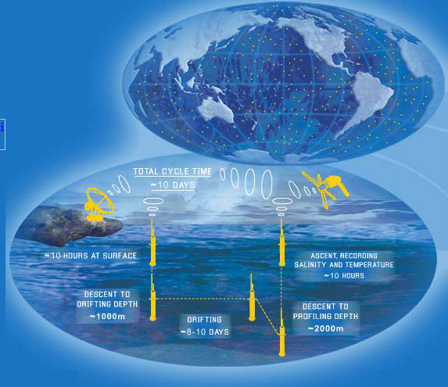
There is so much data collected nowadays, what can we do with it? How can it be processed and analysed so it can be useful?
Notes:
www.argo.net

Slide 9
How is data collected, processed and analysed in our classrooms?
Some teacher ideas
Provided ramps and pulleys for children to investigate forces.
They worked out what sort of table to use.
They used different slopes
Stream survey of living organisms - changes depending on river use
Sensory taste testing (L3) average work out most preferred attributes --> make recommendations for growers using data from other sources to support findings. Written report.
We're going to record the weather remotely. We'll use the data for "real-life" information dissemination about UV levels (for instance).
Experimental - temperature change, stomatal counts, rates of reaction - usually get raw data, tabulate, average, graph, change from non-linear to linear.
We counted and sorted the insects in our garden.
Do experiments with food energy, burning high fat chips etc. Measure energy given off, individual results then pool results. Do analysis, graph etc., look for meaning…
We had to work out what conclusions we might make from the data we collected.
Collecting data about the weather: the apparent mismatch between qualitative weather data (i.e. cloud cover, overcast) and quantitative data (i.e. high UV levels) will provide great teachable moments.
Notes:
www.argo.net

Slide 10
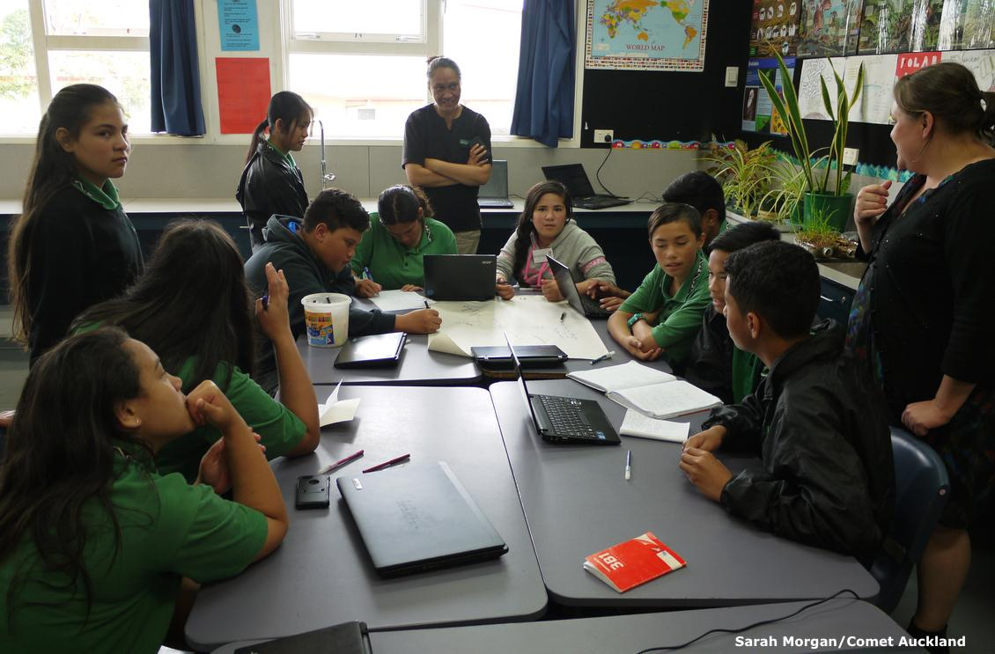
Processing, analysing and presenting data: questions to consider
What are some of the ways in which we can analyse and present data? How do we decide what type of analysis and presentation will be appropriate? What next?
The answers to these questions depend, in turn, on the answers to these questions:
For what purpose was the data collected? What was the original question?
What audience will we share this information with?
What will we do with the knowledge we have gained from the data?
Copyright University of Waikato. All rights reserved.
All images are copyrighted. For further information, please refer to enquiries@sciencelearn.org.nz
Notes:
Photo url www.sciencelearn.org.nz/images/2721-students-work-on-their-presentations

Slide 11
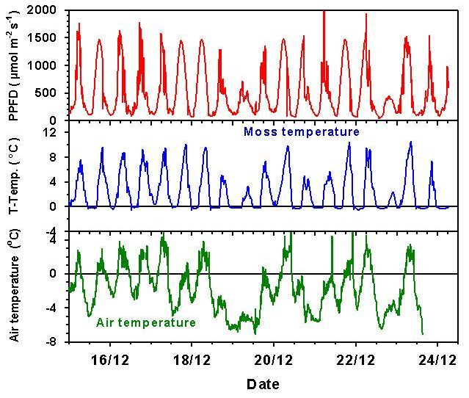
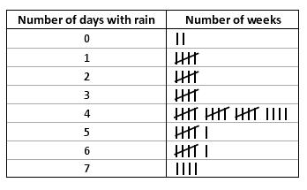
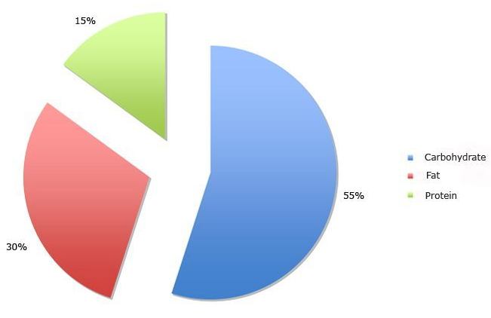
Processing, analysing and presenting data
Copyright University of Waikato. All rights reserved.
All images are copyrighted. For further information, please refer to enquiries@sciencelearn.org.nz
Notes:
Looking at a variety of data presentation. These are presentation methods that many people would immediately recognise as data presentations. What are the reasons why you might choose one method over another?

Slide 12
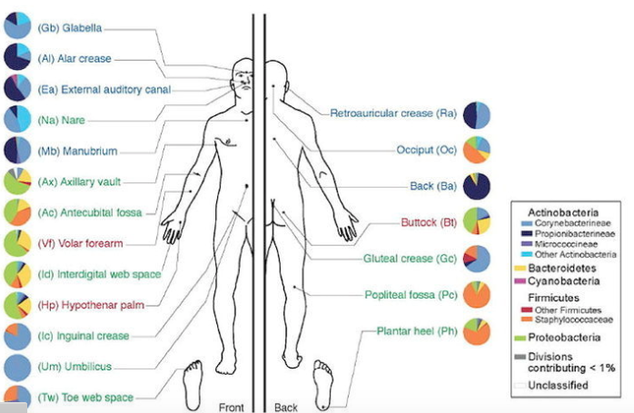
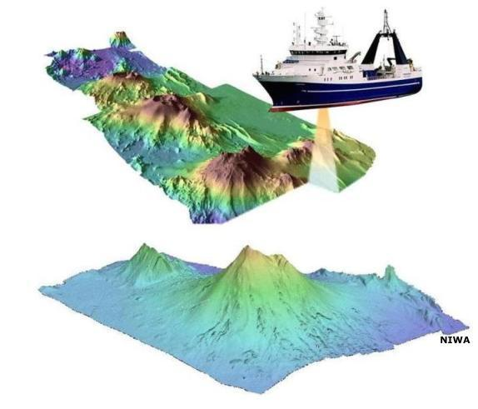
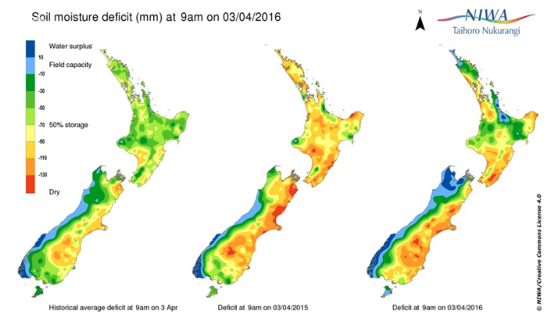
Presenting data
Copyright University of Waikato. All rights reserved.
All images are copyrighted. For further information, please refer to enquiries@sciencelearn.org.nz
Notes:
More pictorial types of data presentation. Focus on finding the methods of analysis and presentation that allow us to identify patterns or trends, and to communicate the ideas/information/data/findings clearly for the desired audience.
www.sciencelearn.org.nz/images/2326-bacterial-populations-on-the-skin
www.sciencelearn.org.nz/resources/915-using-soil-moisture-map
www.sciencelearn.org.nz/resources/1822-multibeam-seafloor-survey

Slide 13
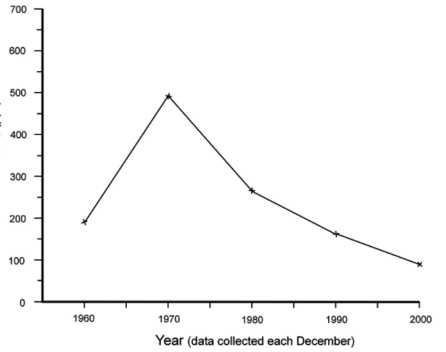
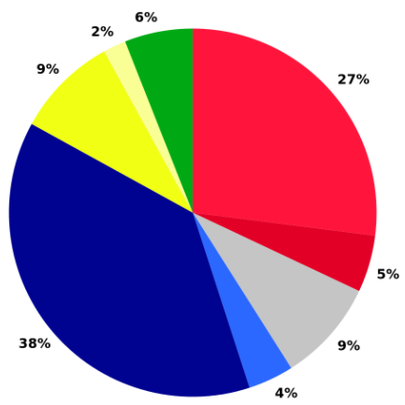
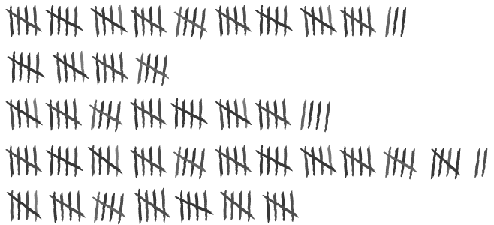
Copyright University of Waikato. All rights reserved.
All images are copyrighted. For further information, please refer to enquiries@sciencelearn.org.nz
Notes:
What type of data may have been collected in this example?
What might have been the inquiry/research question?
What processing/analysis has or could still be done? What could be done with this data?

Slide 14
What type of data may have been collected in each case?
It can show a trend e.g. height of students
Could be change in temperature over time
What processing/analysis has or could still be done?
Some teachers ideas
It tells a story
Continuous data can be processed like this
It could show improvement in the number of missing library books at the end of year
This is another way of processing discrete data
Tally can be used to count something
Turn it around on the board - it looks like a bar graph
You can turn numbers into percentages
Anything you can tally, you can use a pie graph for
Discrete data e.g. number of students with different features
Turn into a bar chart
Use a pie chart instead of a bar chart
E.g. the number of cars passing the school gate
Copyright University of Waikato. All rights reserved.
All images are copyrighted. For further information, please refer to enquiries@sciencelearn.org.nz
Notes:
One of the websites shared by the teachers was www.informationisbeautiful.net

Slide 15
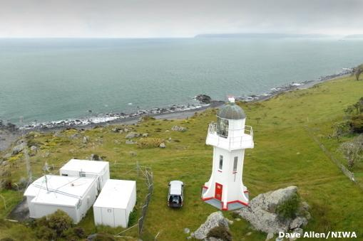
How does data differ from evidence?
Once data is measured and collected, it can be processed and analysed. It can be visualised using graphs, images or other analysis tools, then it can be interpreted and reported as useful information.
Scientifically literate citizens understand the importance of a sceptical disposition towards all empirical evidence and the role of argument (in science) and critique in the construction of knowledge in science.
Copyright University of Waikato. All rights reserved.
All images are copyrighted. For further information, please refer to enquiries@sciencelearn.org.nz
Notes:
Scepticism and questioning – critiquing, checking, corroborating
www.sciencelearn.org.nz/resources/684-carbon-dioxide-in-the-atmosphere
http://nzcurriculum.tki.org.nz/The-New-Zealand-Curriculum/Science

Slide 16
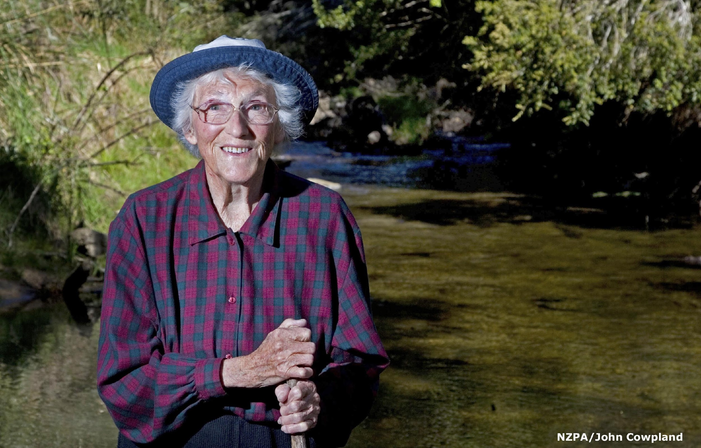
How can data be verified? Data becoming evidence
Copyright University of Waikato. All rights reserved.
All images are copyrighted. For further information, please refer to enquiries@sciencelearn.org.nz
Notes:
The first slide (jigsaw) was a screenshot of the complete photo put into an online jigsaw creating programme www.jigsawplanet.com/?rc=play&pid=39c04c387768
The complete photo url www.sciencelearn.org.nz/resources/512-citizen-scientists
First video: “Joan Wiffen and her fossils” www.sciencelearn.org.nz/videos/784-joan-wiffen-and-her-fossils
Second video: “How old is that dinosaur? www.sciencelearn.org.nz/resources/1479-date-a-dinosaur
This is a great story about the nature of science - tenacity, theory building, evidence, and corroboration. Several pieces of a jigsaw (pieces of data) are sometimes needed before the picture can be seen. To find more information and add to your own is often very useful, and new information helps support you to understand your own data. Together it may become evidence for a theory – Joan’s theory of the land dinosaurs existing in NZ was new, with no other evidence existing here, so other data was crucial in improving our understanding. You can also refer to the journal story ‘The dinosaur hunter’ Norman Bilbrough School Journal Sept 2012 year 5 – Level 3 pages 18-23.

Slide 17
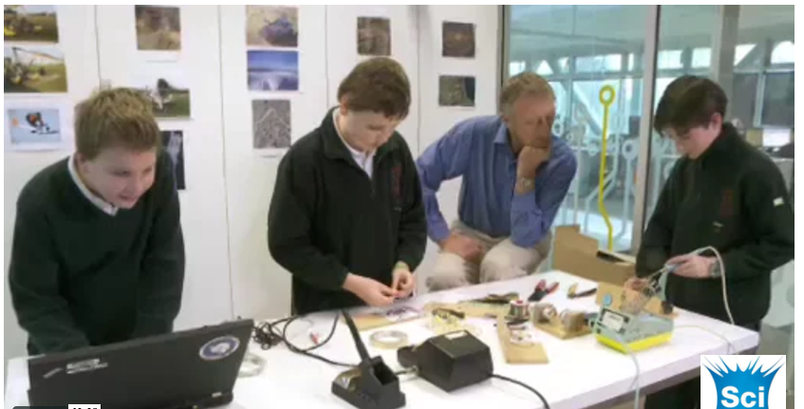
Science learning outcomes
A focus on data allows students to:
learn quantitative skills, technical methods, and scientific concepts
ask scientific questions and state hypotheses
design and conduct scientific investigations
use technology for collecting and manipulating data
integrate prior scientific understanding
critically evaluate the validity/quality of data or evidence and their consequent interpretations or conclusions
build their scientific literacy and science capabilities
draw conclusions from the data that are logically consistent with the data.
Copyright University of Waikato. All rights reserved.
All images are copyrighted. For further information, please refer to enquiries@sciencelearn.org.nz
Notes:
www.sciencelearn.org.nz/videos/120-turning-a-hobby-into-a-career

Slide 18
General learning outcomes
A focus on data can support students to:
address real-world complex problems
increase verbal, written and graphical communication skills
explore the values and ethics of working with data
learn through their own inquiry
enhance analysis, critical thinking and reasoning skills
learn about visual representation and interpretation of data
Copyright University of Waikato. All rights reserved.
All images are copyrighted. For further information, please refer to enquiries@sciencelearn.org.nz
Notes:
Photo url: www.sciencelearn.org.nz/images/2671-teacher-and-students-discuss-ethics

Slide 19
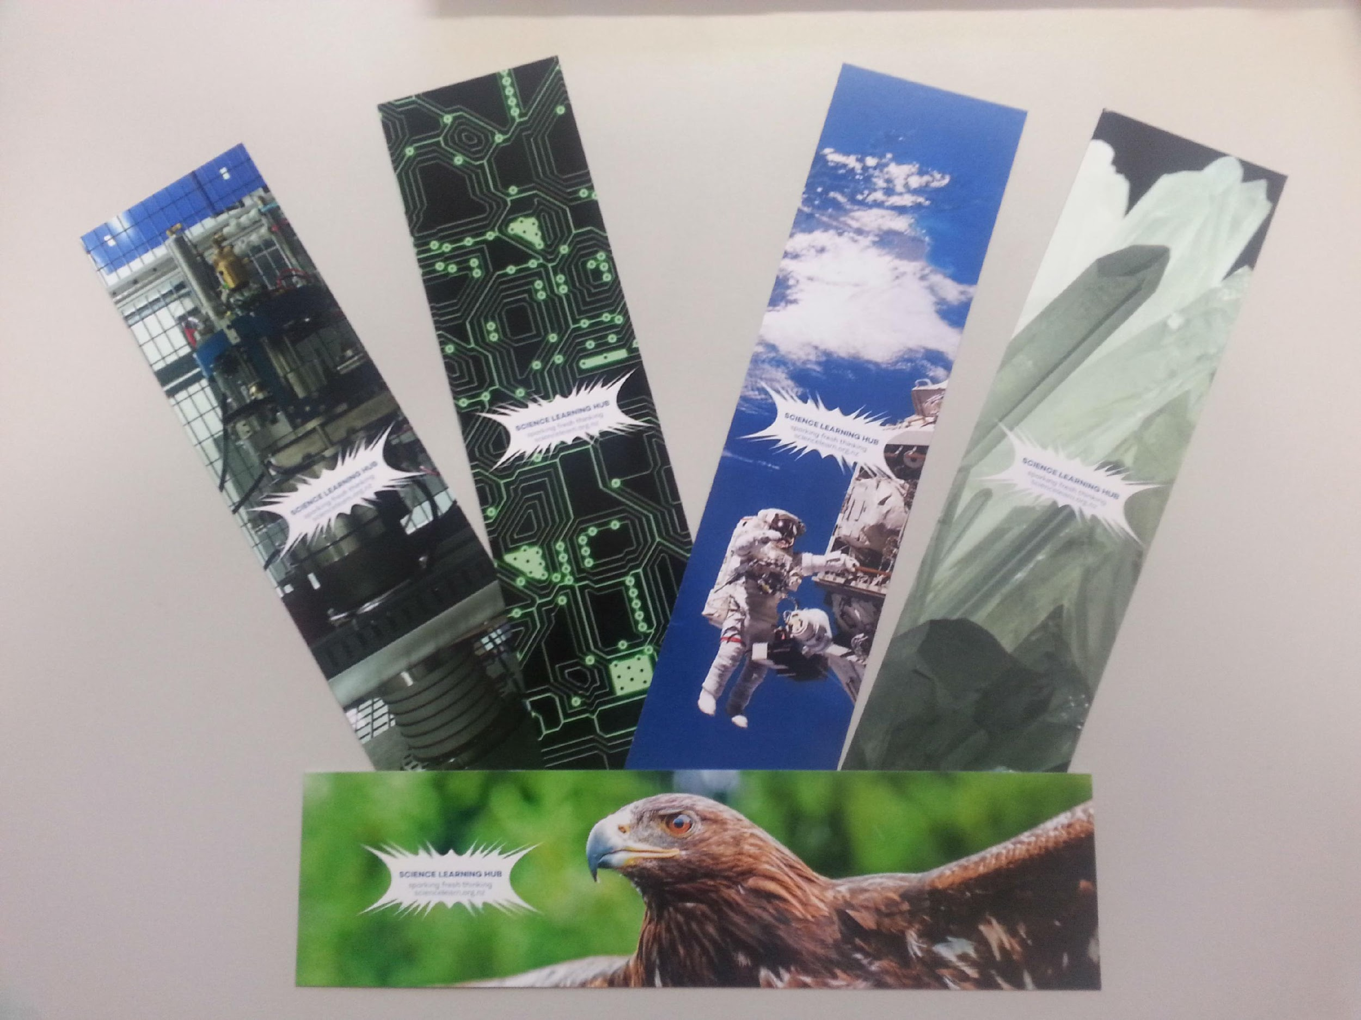
Would you like some bookmarks?
Bookmarks are available – email us enquiries@sciencelearn.org.nz
Follow us on Twitter: https://twitter.com/NZScienceLearn
Like us on Facebook: www.facebook.com/nzsciencelearn
On Pinterest: https://nz.pinterest.com/nzsciencelearn/
Join us in the pond: https://www.pond.co.nz/
Copyright University of Waikato. All rights reserved.
All images are copyrighted. For further information, please refer to enquiries@sciencelearn.org.nz

Slide 20
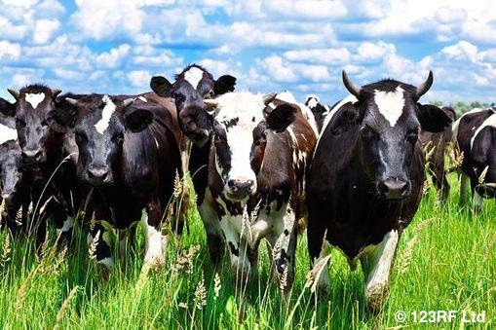
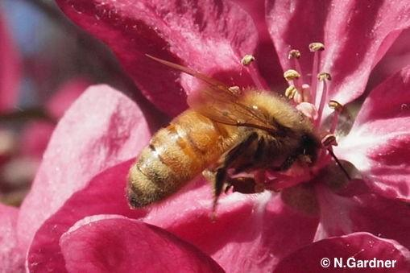
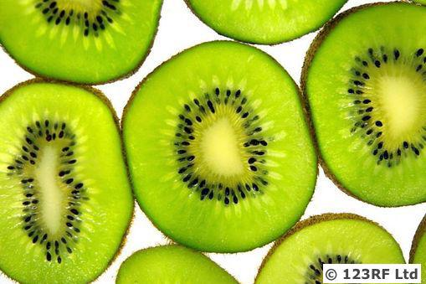
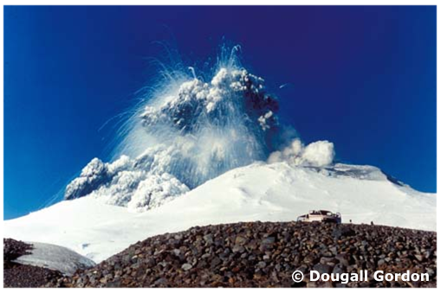
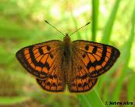
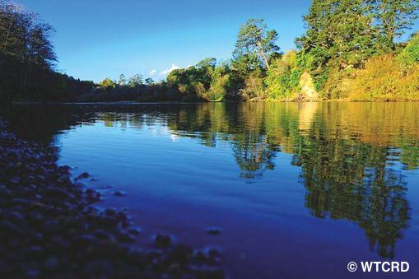
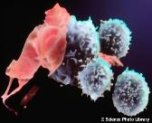
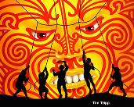
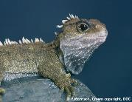
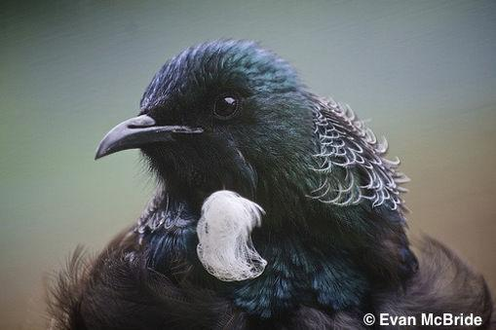
Thanks!
Questions and comments?
The images contained within this PowerPoint presentation are copyrighted to the University of Waikato and other third-party individuals and organisations. Any reuse beyond the classroom as per the intended use of these resources should be cleared with the copyright owner/s.

