Slide 1
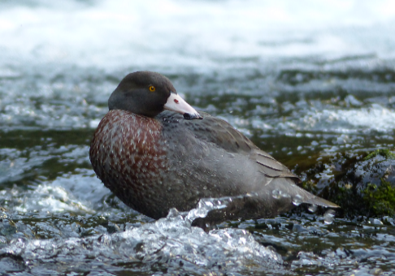
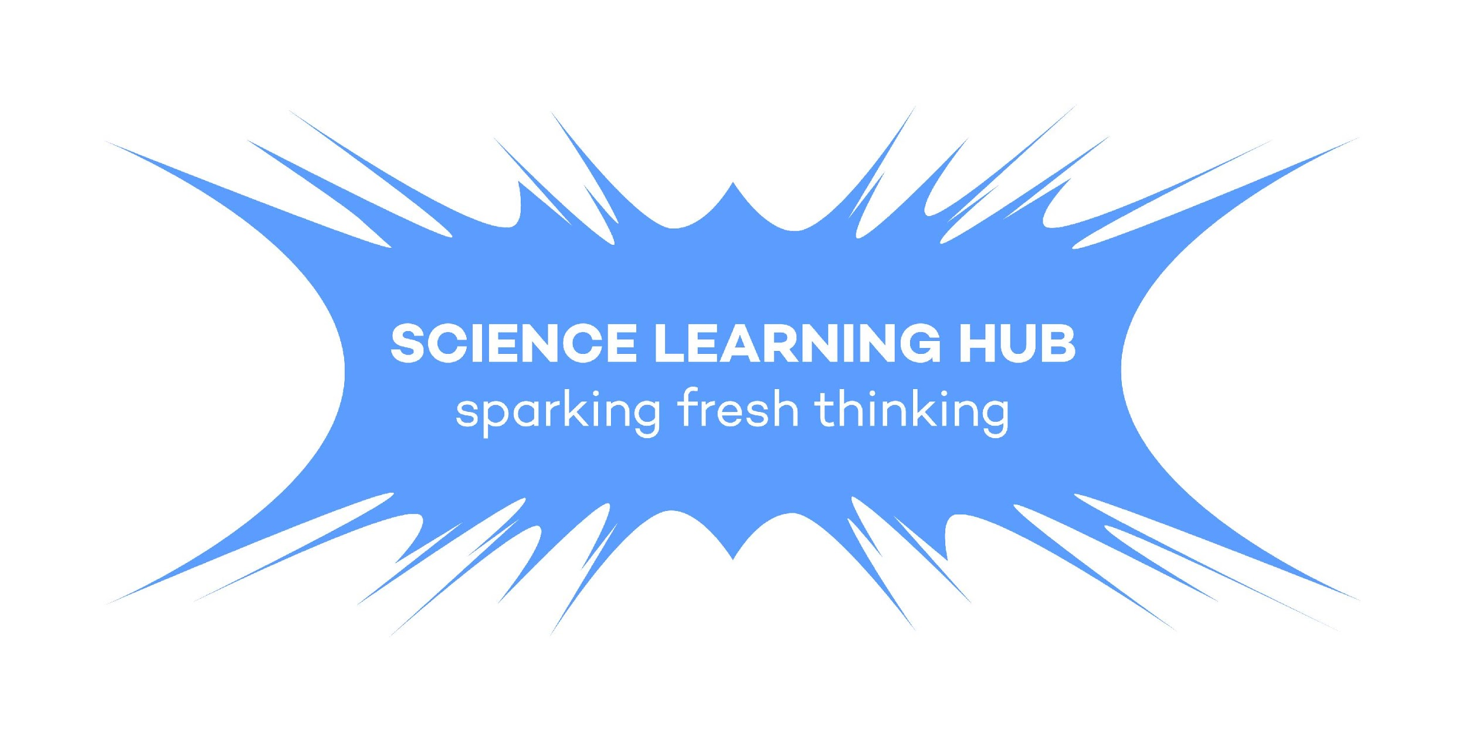
DIVING INTO INQUIRY WITH WHIO
With
Lynnette Rogers
and
Shanthie Walker
6 April 2017
4pm
Photo by Bubs Smith
Notes:
Lyn introduces us, and where we are from.

Slide 2
DIVING INTO INQUIRY WITH WHIO
Topic | Slideshow number(s) | Video timecode
Introducing the Science Learning Hub (SLH) and presenters and Index | 1–2 | 00:12
Webinar purpose | 3–4 | 00:29
DOC education strategy and conservation kids | 5–6 | 01:39
What do we already know about whio? – eliciting prior knowledge | 7–8 | 02:53
Whio – why all the fuss? | 9 | 04:37
Genesis and DOC relationship | 10 | 06:36
Whio bingo – eliciting prior knowledge | 11–12 | 05:20
Exploring the resources and what underpins them – Māori perspectives, conservation and environmental education for sustainability | 13–16 | 18:04
Diving into inquiry | 17–20 | 22:03
What next? – asking questions | 21–21 | 29:42
What next? – Useful links | 23 | 30:44
Thanks | 24 | 32:20
Photo by Bubs Smith
Notes:
We are modelling activities and the process of inquiry.

Slide 3
DIVING INTO INQUIRY WITH WHIO
Purposes of this webinar
To support you to:
enhance your students’ understanding about conservation education
engage your students in inquiry
help develop students’ science capabilities.
Photo by Bubs Smith
Notes:
We are modelling activities and the process of inquiry.

Slide 4
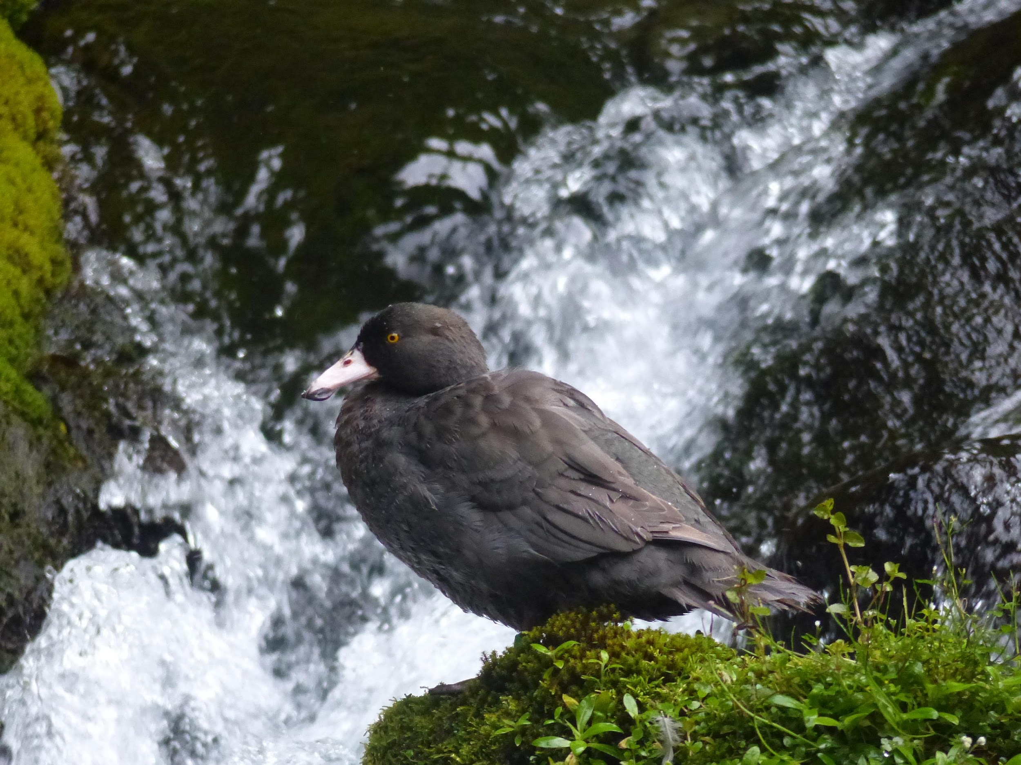
BACKGROUND AND THEMES
We will share ideas about:
DOC’s education strategy and resources
conservation education
environmental education for sustainability
Māori perspectives and values
inquiry learning
the whio.

Slide 5
DOC’s EDUCATION STRATEGY
Notes:
Conservation education is teaching and learning to develop knowledge, values and skills in young New Zealanders so they may be actively engaged learners, who are able to sustain and care for their environment now and in the future.
DOC is supporting teachers with conservation education resources, pedagogy and information to help our young people connect with nature and restore New Zealand's heritage because they understand and value its contribution to their quality of life.

Slide 6
A CONSERVATION KID IS:
A young person who:
is connected with our natural and historic heritage
has conservation capability – knowledge, values and skills
is actively applying these to support, develop and sustain their actions.
Notes:
DOC resources are designed to equip teachers with tools, knowledge, values and skills to empower a new generation of conservation kids. A conservation kid is connected, has capabilities and is actively engaged in their environment. Conservation education is not an extra subject but is a broad context for teaching and learning across the curriculum.

Slide 7
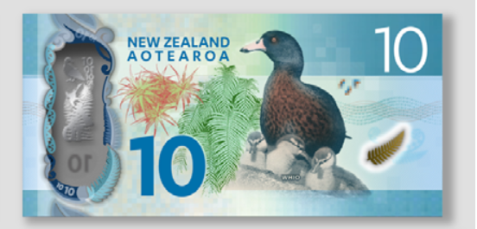
WHIO – A NEW ZEALAND ICON
What do we already know about whio?
Notes:
Asking for questions is a nice way teachers may use with students to elicit interest, prior knowledge/experience and questions from their students.
Why is it an icon? What questions do they have? What do they know already?

Slide 8
WHIO – A NEW ZEALAND ICON
What do we already know about whio?
– some of our participants ideas
native
endangered
webbed feet
unique
adaptations
endemic
soft bill
live in fast flowing water
found in Manawatu and further afield
I've seen some in a National Park
seen some - Whanganui river
Notes:
These responses indicate a good prior knowledge, so the subsequent teaching and learning would be tailored to take this into account.

Slide 9
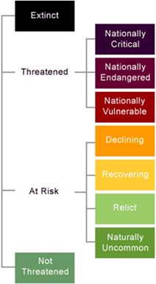
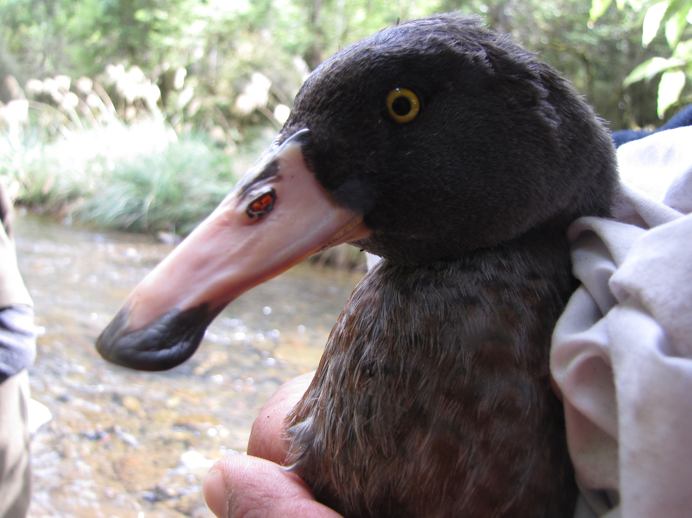
WHIO – WHY ALL THE FUSS?
A threatened species: nationally vulnerable category
Approximately 3,000 mature individuals in the wild
Significant threats: habitat destruction and introduced predators
Indicator species
Photo by Bubs Smith
Notes:
The whio/blue duck is a context for the inquiry, weaving together scientific concepts and capabilities along with their story of survival and how their conservation is bringing people together.

Slide 10
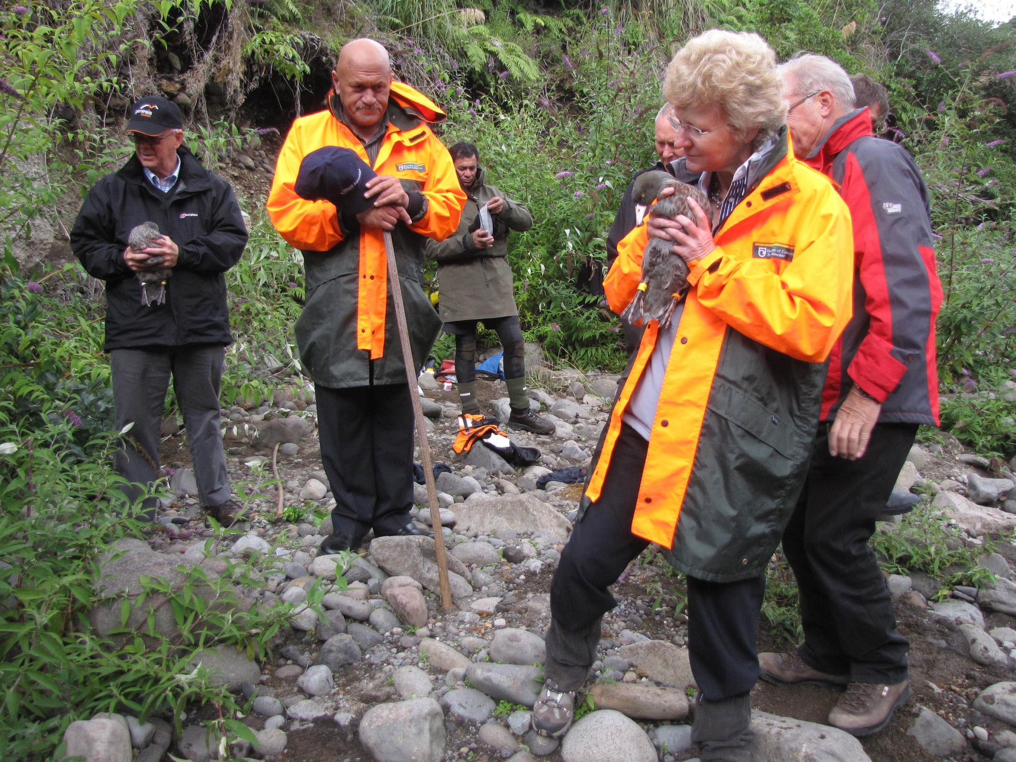
WHIO FOREVER: GENESIS ENERGY & DOC
Photo by Bubs Smith
Notes:
Genesis Energy and DOC staff have worked together since 2011 to protect whio. The partnership began working on the mitigation around whio for the Tongariro Power Scheme, and it occurred to them that, if more could be invested in predator control, significant gains for the whio could be made. Now Genesis Energy are going beyond their mitigation requirements, their staff are more involved with whio – people working at the hydro power stations on the rivers involved in whio conservation. It is now an example for other projects nationwide to replicate and boost whio populations throughout New Zealand.

Slide 11
WHIO BINGO
Who can state something special about whio? | Who knows where whio live? | Who knows another name for whio?
Who has seen a whio in the wild? | Who can name a special feature of whio? | Who knows who looks after whio?
Who knows if whio are native? | Who can name something that negatively impacts on whio? | Who has visited a fast-flowing river?
Notes:
We asked participants to share what they know about whio, using bingo as a tool. After the video clips, they may know more specific information. This is another way in which we can elicit prior knowledge. This activity can be found on the SLH ‘Eliciting prior knowledge’. Questioning can be altered depending on the prior experience of the students.

Slide 12
WHIO BINGO – some participants answers
Who can state something special about whio? Endemic, native, webbed feet | Who knows where whio live? Fast flowing water | Who knows another name for whio? Blue duck
Who has seen a whio in the wild? Several people | Who can name a special feature of whio? Soft bill | Who knows who looks after whio? DOC
Who knows if whio are native? Yes they are | Who can name something that negatively impacts on whio? Pollution, floods, weather, water quality | Who has visited a fast-flowing river? Most people

Slide 13
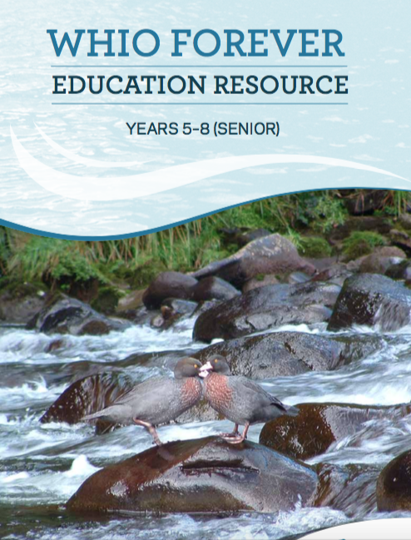
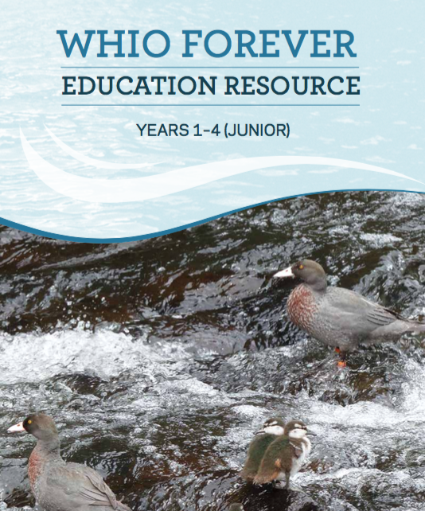
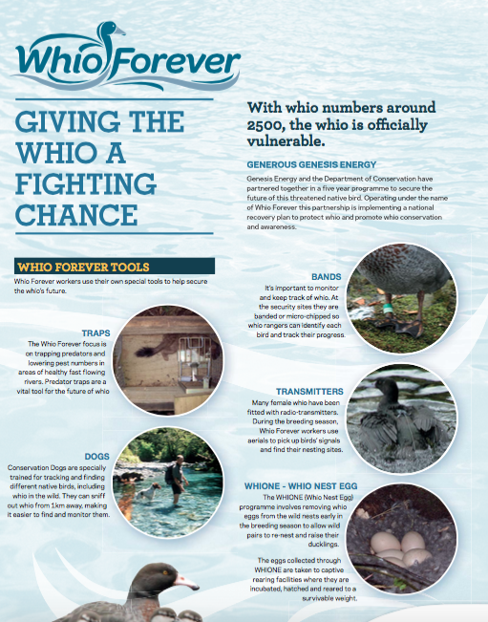
WHIO FOREVER RESOURCES
The resources include:
booklets
posters
videos
PowerPoints
online information
www.doc.govt.nz/education-whio
www.whioforever.co.nz/about-the-whio/educational-resources
Notes:
You can download digital copies of all resources, posters and slideshows. These resources can be used as desired.

Slide 14
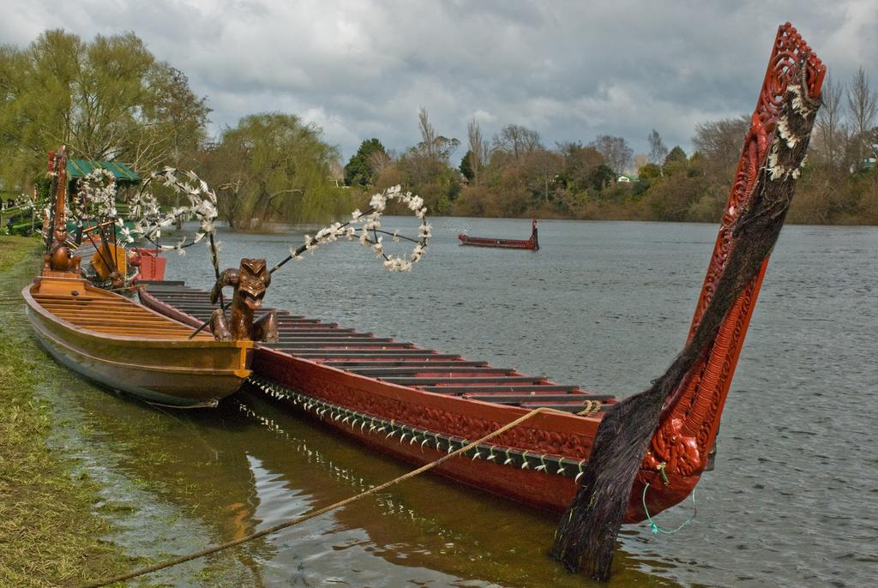
MĀORI PERSPECTIVES
In this resource, we focus on concepts/values of:
whakapapa
mauri
tangata whenua
manaaki
kaitiakitanga.
Photo above by Phillip Capper
https://www.flickr.com/photos/flissphil/2786713672/in/photolist-5ffCTs-5faXJa
Notes:
Tangata whenua have a unique relationship to the land, which brings with it responsibilities such as kaitiakitanga. These values and concepts are woven throughout resource, and links to a Māori world view are included throughout.

Slide 15
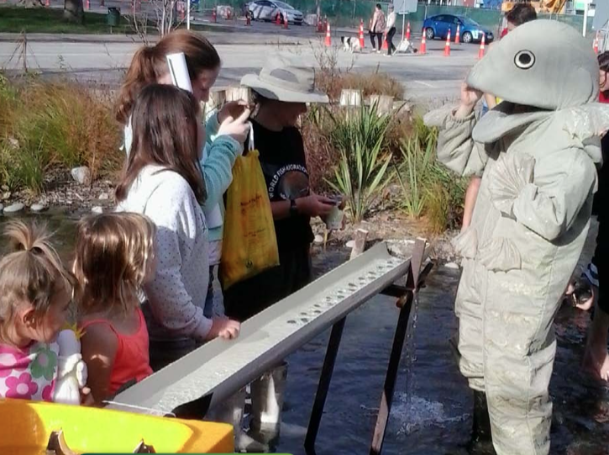
ENVIRONMENTAL EDUCATION FOR SUSTAINABILITY (EEfS)
The major pedagogical approaches to EEfS, which are all student centred and, ideally, student directed, are:
experiential learning
co-operative learning
inquiry learning.
EEfS and conservation education focuses on using these approaches to foster students’ ability and skills to take appropriate action to change their world.
These approaches are particularly relevant to science education through the nature of science and the broader NZC through the future focus principle, values and key competencies.
Notes:
Conservation education is a slice of EEfS – an important slice for New Zealand. These pedagogies can be used to engage students in thinking about conservation or sustainability, building their capacity or interest in inquiry, and are relevant to science education (e.g. NoS, science capabilities, key competencies, values in NZC) the focus on students taking action and building their action competence.
More information can be found on TKI https://nzcurriculum.tki.org.nz/Curriculum-resources/Education-for-sustainability

Slide 16
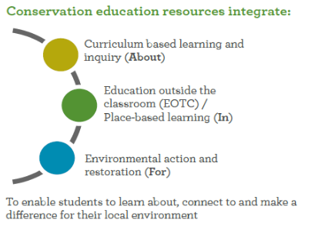
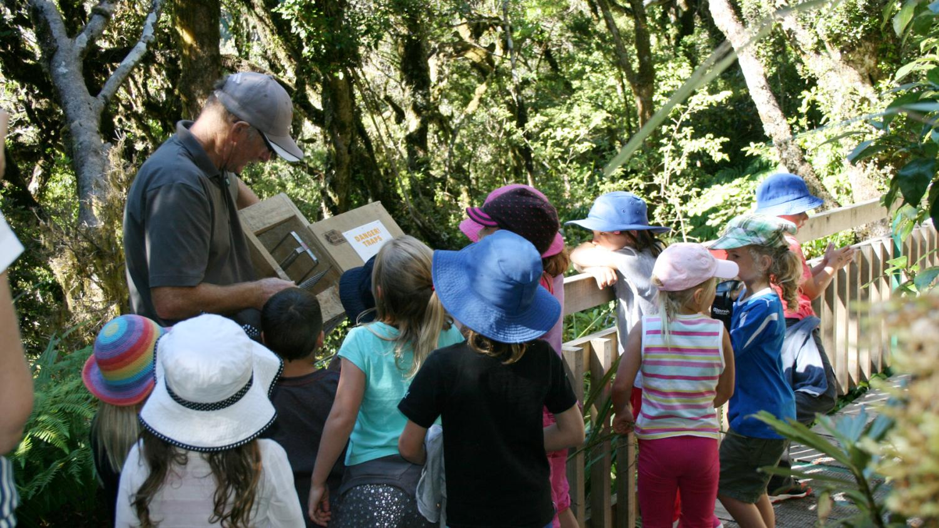
ENVIRONMENTAL EDUCATION FOR SUSTAINABILITY AND CONSERVATION
Notes:
Conservation education is a subset of EEfS. They both involve incorporating the dimensions of about - knowledge and inquiry, in - EOTC and place-based learning and for- informed action and restoration.

Slide 17
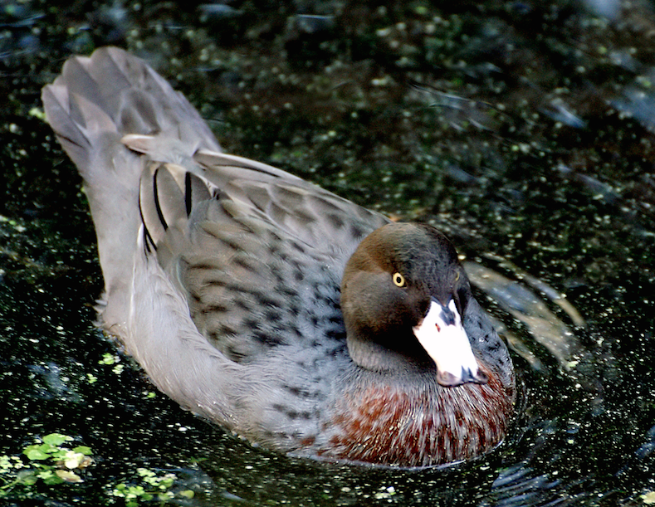
KEY CONCEPTS OF RESOURCE
AN INQUIRY INTO WHIO
Through this inquiry, students will learn
about:
whio ecology
how people are involved with whio
whio challenges/threats
visiting whio
how they can act to solve an issue for whio
other information, depending on where their inquiry leads.
Notes:
The resource is structured as a guided integrated inquiry, but teachers can use the resource in whatever way suits the needs of their learners. It was designed for those new to sustainability education and for experienced educators. The aim is to make it as easy as possible for teachers to pick and run with the material to ensure that they can teach EEfS without huge effort. It includes classroom-ready resources with the LIs/LOs fleshed out for each activity for easy sharing with students.

Slide 18
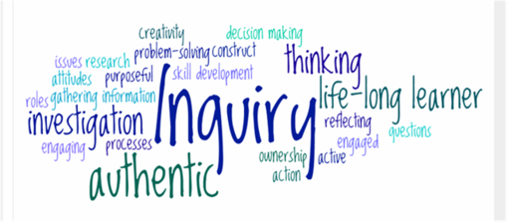
WHY FOCUS ON INQUIRY?
What do we want students to know by the end of their learning inquiry?
They will:
have a multi-faceted, deep understanding of whio, beyond just facts
be able to transfer their inquiry approach to other contexts.
Notes:
Inquiry is a process that has different labels in different settings but is essentially the same. Inquiry learning is an integrated process where the student is in the driver’s seat for their own learning, formulating questions, using thinking skills, finding information and reflecting as they go to reach a deep understanding of a subject.

Slide 19
WHIO INQUIRY PROCESS
Notes:
This webinar focuses on Stages 1–2.

Slide 20
STAGE 1: DIVING IN
Introducing knowledge, providing experiences and stimulating material.
Establishing prior knowledge and experience.

Slide 21
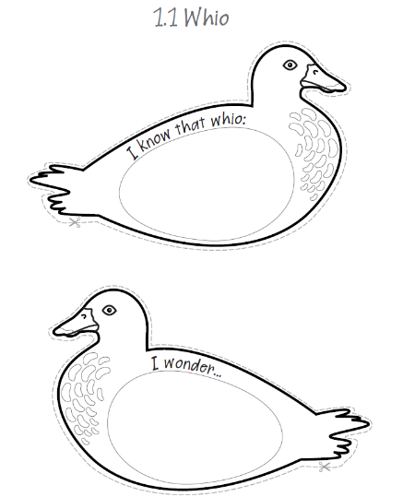
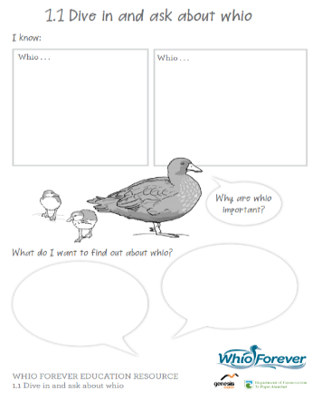
STAGE 2: ASK
Notes:
The purpose of whio slideshow and videos is to have that initial immersion in the subject, building curiosity, which is easily taught with notes in slides to talk through, then students can complete these.
Stage 2 – ask. This activity is used to elicit questions, once students have had an idea of what they want to know. Planning the rest of the unit will depend on findings here – teaching as inquiry. This activity can be found on the SLH ‘Eliciting prior knowledge’ https://www.sciencelearn.org.nz/resources/2250-eliciting-prior-knowledge.

Slide 22
STAGE 2: ASK – some of our participants questions
Do whio have different adaptations since they live in fast flowing streams? Looks tough on the ducklings.
What are the optimum conditions for whio?
Are there any ducks with similar beaks?
What is whio’s habitat?
Are there any other endangered native ducks?
Did they used to live in other rivers?
Can I find out more about the food chain e.g. what nymphs do they eat?
Why are they endangered?

Slide 23
WHAT NEXT? Useful websites and links
Twitter: https://twitter.com/NZScienceLearn
https://twitter.com/docgovtnz
Facebook: www.facebook.com/nzsciencelearn
www.facebook.com/wildsidenz
Pinterest: https://nz.pinterest.com/nzsciencelearn/
https://nz.pinterest.com/docgovtnz/conservation-activities-for-kids/
Whio Forever
www.whioforever.co.nz/
DOC
www.doc.govt.nz/education
Enquiries
conserved@doc.govt.nz
DOC Conservation Education e-newsletter http://createsend.com/t/i-4B26445CA4C4D7BD
Science Learning Hub
www.sciencelearn.org.nz
Enquiries
enquiries@nzsciencelearn.org.nz
Notes:
Ask for addresses to post resources to. What next? Webinars, stages in inquiry, resources etc. Registering with pond, inviting into discussion forum
Pond bucket, YouTube videos.

Slide 24
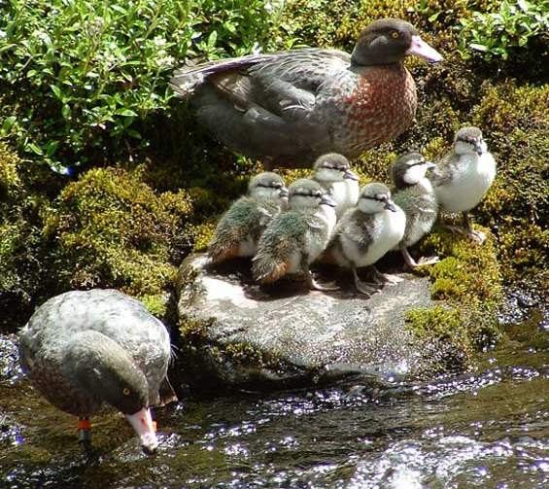
Thanks!
Questions and comments?
The images contained within this PowerPoint presentation are copyrighted to the University of Waikato and other third-party individuals and organisations. Any reuse beyond the classroom as per the intended use of these resources should be cleared with the copyright owner/s.

