Slide 1
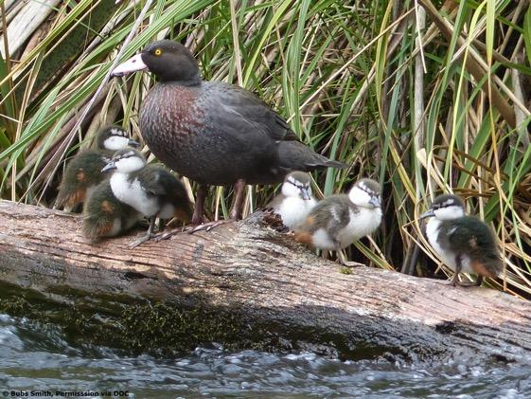

WHY LEARN ABOUT WHIO?
With
Lynnette Rogers
and
Shanthie Walker
11 May 2017
4pm
Photo by Bubs Smith
Notes:
Introduction and welcome.

Slide 2


WHY LEARN ABOUT WHIO?
Purposes of this webinar
To support you to:
enhance your students’ understanding about conservation education
engage your students in inquiry
help develop students’ science capabilities
build on your knowledge of the whio.
Photo by Bubs Smith
Notes:
We are modelling activities and the process of inquiry. Asking for questions is a nice way to elicit interest, prior knowledge/experience and questions from students.

Slide 3
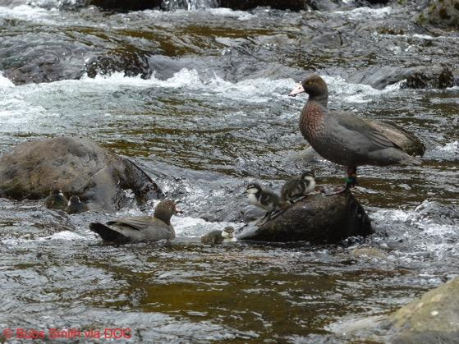

BACKGROUND AND THEMES
We will share information and ideas about:
whio – habitat and adaptations
inquiry learning.

Slide 4
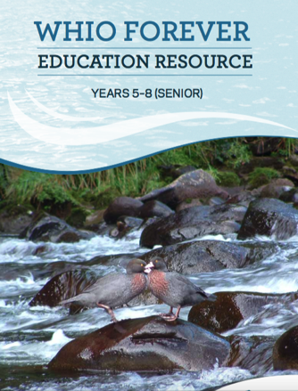
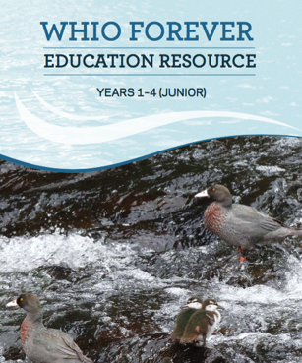
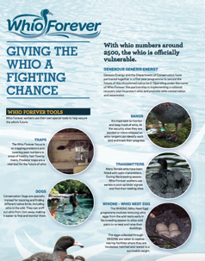

WHIO FOREVER RESOURCES
The resources include:
booklets
posters
videos
PowerPoints
online information www.doc.govt.nz/education-whio
Notes:
Although the whio is the context here, the Whio Forever resources and ideas for activities can be easily altered or transferred to other conservation projects/topics/species.

Slide 5
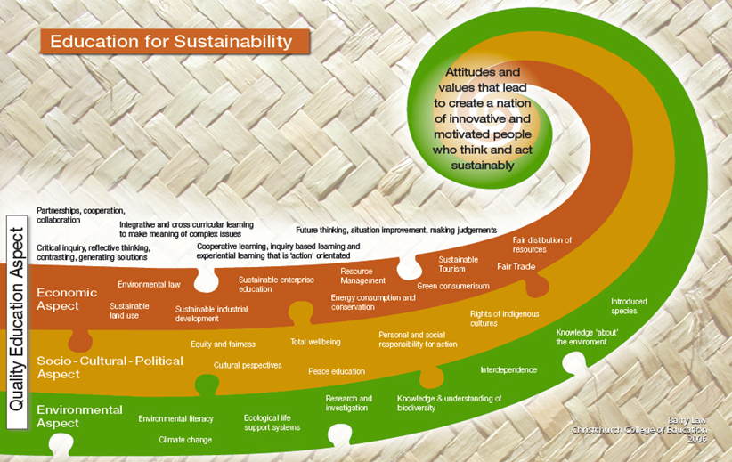


ENVIRONMENTAL EDUCATION FOR SUSTAINABILITY AND CONSERVATION
Notes:
Conservation education is a subset of EEfS. They both involve incorporating the dimensions of about (knowledge and inquiry), in (EOTC and place-based learning) and for (informed action and restoration).
To find out more - http://nzcurriculum.tki.org.nz/Curriculum-resources/Education-for-sustainability

Slide 6
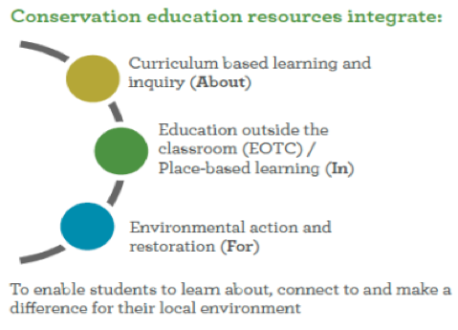

ENVIRONMENTAL EDUCATION FOR SUSTAINABILITY AND CONSERVATION
Both EEfS and
conservation
education focus on
fostering students’
ability and skills to
take appropriate
action to improve
their world.
Notes:
Conservation education is a subset of EEfS. They both involve incorporating the dimensions of about, in and for.
To find out more – http://nzcurriculum.tki.org.nz/Curriculum-resources/Education-for-sustainability

Slide 7
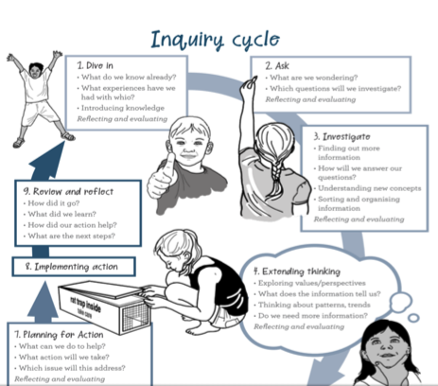
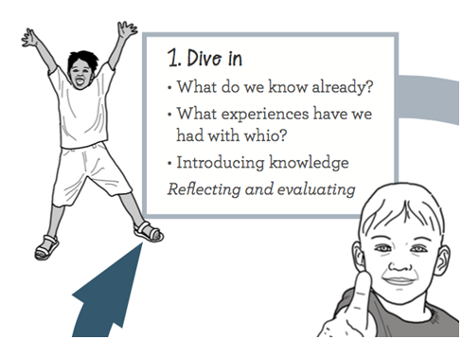
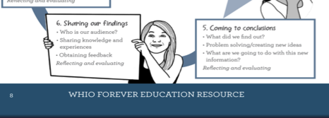

WHIO INQUIRY PROCESS
Notes:
This is a screenshot of the the inquiry process from the Whio Forever resource. Last time (Diving into inquiry with whio) we focused on Stage 1 and moved into Stage 2. We are now moving into Stage 3 and, depending on where the discussions/learning may go, into Stage 4.

Slide 8
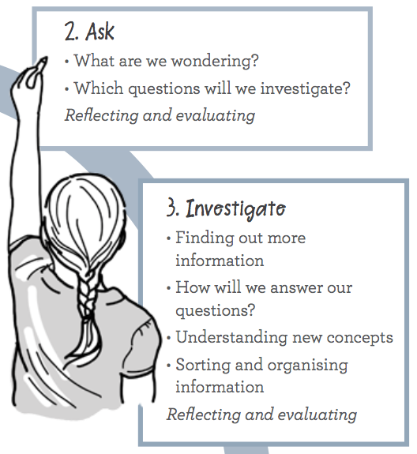
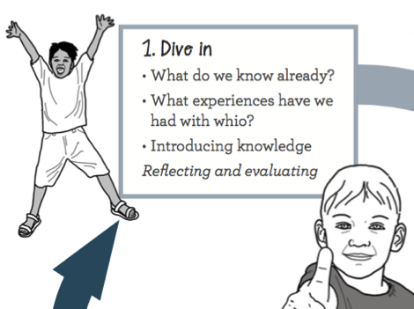

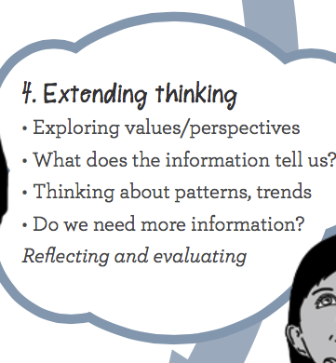


WHIO INQUIRY PROCESS
Notes:
Depending on the questions, different tacks may be taken to approach an inquiry. To cater for different student interests, you will provide different resources. How you approach it will also depend on how able or experienced your students (and you) are with inquiry learning. So the resources may be explored by the students (with an appropriate level of guidance, as you know your students’ capabilities and interests) or the lesson sequence may be more structured and led by you. Often a class inquiry can be the model that is then followed up with individual or group inquiries, once students are familiar with and aware of the process.

Slide 9
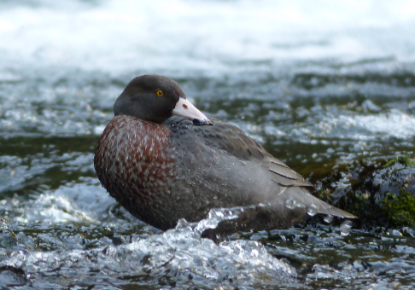


STAGE 2: ASK – some of our participants’ questions
Do whio have different adaptations since they live in fast-flowing streams? Looks tough on the ducklings.
What are the optimum conditions for whio?
Are there any ducks with similar beaks?
What is the whio’s habitat?
Are there any other endangered native ducks?
Did they used to live in other rivers?
© Bubs Smith permission via DOC
Can I find out more about the food chain, e.g. what nymphs do they eat?
Why are they endangered?
Notes:
The questions on this slide are examples of what may be generated in Stage 2 – Ask. These questions were from the participants in the webinar “Diving into inquiry with whio”.
Critique these questions i.e. Some are easy to answer, yes or no – closed questions, and for a good inquiry good open questions are required.
So… some of these questions may have to be elaborated upon, or simply answered, in order to generate useful inquiry questions.

Slide 10
A possible grouping of questions for investigation
What are the optimum conditions for whio?
Do whio have different adaptations since they live in fast-flowing streams?
What is the whio’s habitat?
Can I find out more about the food chain, e.g. what nymphs do they eat?
Why are they endangered?
Did they used to live in other rivers?
© Bubs Smith permission via DOC
Are there any other endangered native ducks?
Are there any ducks with similar beaks?
Notes:
You may ask the students to group the questions. Maybe group questions and designate teams to answer questions, provide resources. This slide shows a possible grouping of questions.

Slide 11
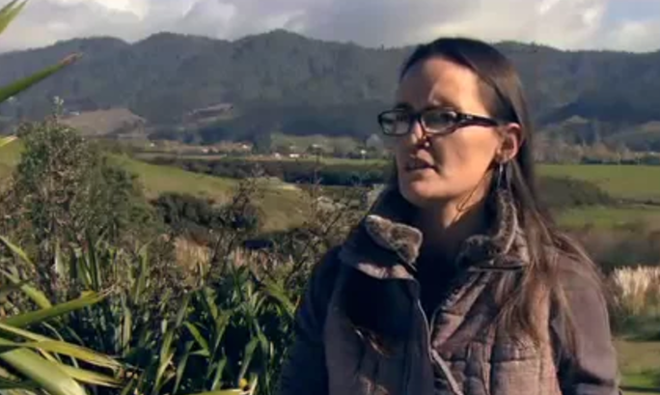

WHAKAPAPA AND BIODIVERSITY
Photo by Bubs Smith
Notes:
Whakapapa and biodiversity video clip https://www.sciencelearn.org.nz/videos/258-whakapapa-and-biodiversity

Slide 12
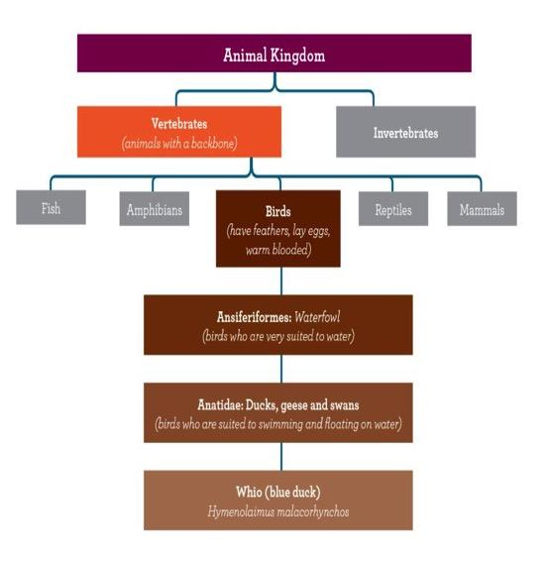

CLASSIFYING WHIO
Whio are also known as blue ducks.
They belong to the family of birds called Anatidae and are one of only three torrent duck species left in the world.
They are endemic, which means that they only live in New Zealand.
Notes:
How do the two lenses of standard scientific classification and whakapapa compare? What added value does each view offer? These questions allow for some rich and deep discussion.
It also relies upon students being able to interpret diagrams like this. The science capabiliites and the key competency ‘Using language, symbols and text’ are fostered when interpreting graphics like this.

Slide 13
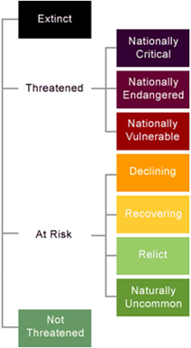
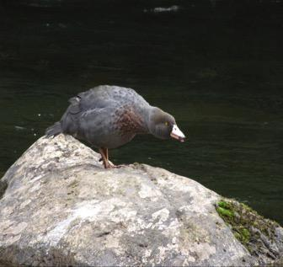
CONSERVATION STATUS
There are at least nine species of native ducks in New Zealand.
Of these, seven are on the endangered list at some level and four are on the ICUN red list for endangered species.
Photo by Bubs Smith
© Bubs Smith permission via DOC
Notes:
Interpreting a graphic and categorising as skills to be taught.

Slide 14
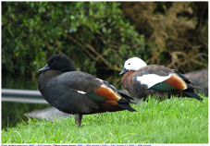
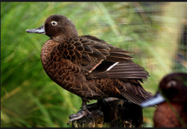
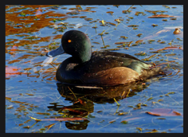
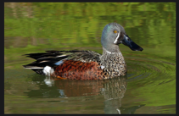
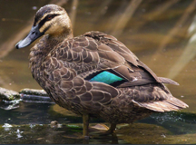
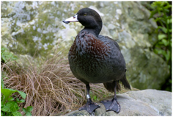
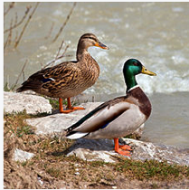
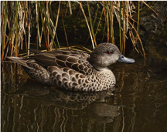

SPOT THE DIFFERENCE
Look at these pictures of ducks found in New Zealand.
What do they have in common? How do they differ? What other information might we need in order to identify them? What distinguishes whio from the rest?
Notes:
Modelling an activity asking students to identify similarities and differences between these ducks. This activity can be found here: Which duck is which?
Top left, clockwise
https://www.flickr.com/photos/volvob12b/29490011292
https://commons.wikimedia.org/wiki/File:Paradise-Shelduck-pair.jpg
https://www.flickr.com/photos/volvob12b/10377584085
https://www.flickr.com/photos/volvob12b/18888143941
https://commons.wikimedia.org/wiki/File:Whio_(Blue_Duck)_at_Staglands,_Akatarawa,_New_Zealand.jpg
https://en.wikipedia.org/wiki/Mallard
https://commons.wikimedia.org/wiki/File:Anas_gracilis_-Nga_Manu_Nature_Reserve,_Waikanae,_New_Zealand_-swimming-8.jpg
http://www.curiousnaturalist.com/blog/going-down-under-nz-3/

Slide 15
SPOT THE DIFFERENCE – some answers and ideas
SIMILARITIES
Feathers, bills, eyes on the side of their head, webbed feet, beak shape that works well in water, live in an aquatic environment, the way they move (paddling), amphibian, all look to have fat breasts.
DIFFERENCES
Colouring, shape of bill, size of duck, location, habitat, size, shape and colour of feathers, plumage, whether males and females are the same.
What makes whio different from the other ducks?
Soft bill, colour.
What else might you need to know to tell different ducks apart?
Where it lives, what it eats, how (well) it flies, mating habits etc.
Notes:
You can use these ideas for a discussion to follow up on the idea of classification. This is a good activity for fostering observation skills, sorting/fostering prior knowledge and for discussing the difference between observation and inference (some of these answers demonstrate this, e.g. webbed feet). It can also be used to introduce the concept of adaptations.
Top left, clockwise
https://www.flickr.com/photos/volvob12b/29490011292
https://commons.wikimedia.org/wiki/File:Paradise-Shelduck-pair.jpg
https://www.flickr.com/photos/volvob12b/10377584085
https://www.flickr.com/photos/volvob12b/18888143941
https://commons.wikimedia.org/wiki/File:Whio_(Blue_Duck)_at_Staglands,_Akatarawa,_New_Zealand.jpg
https://en.wikipedia.org/wiki/Mallard
https://commons.wikimedia.org/wiki/File:Anas_gracilis_-Nga_Manu_Nature_Reserve,_Waikanae,_New_Zealand_-swimming-8.jpg
http://www.curiousnaturalist.com/blog/going-down-under-nz-3/

Slide 16
SPOT THE DIFFERENCE
NZ shoveler/
kuruwhengi
Paradise shelduck/
pūtangitangi
Brown teal/
pāteke
Scaup/pāpango
Grey duck/pārera
Blue duck/whio
Grey teal/tētē
Mallard – introduced
Notes:
To find out how endangered these ducks are, look at the article Who’s who in the duck world?
Top left, clockwise
https://www.flickr.com/photos/volvob12b/29490011292
https://commons.wikimedia.org/wiki/File:Paradise-Shelduck-pair.jpg
https://www.flickr.com/photos/volvob12b/10377584085
https://www.flickr.com/photos/volvob12b/18888143941
https://commons.wikimedia.org/wiki/File:Whio_(Blue_Duck)_at_Staglands,_Akatarawa,_New_Zealand.jpg
https://en.wikipedia.org/wiki/Mallard
https://commons.wikimedia.org/wiki/File:Anas_gracilis_-Nga_Manu_Nature_Reserve,_Waikanae,_New_Zealand_-swimming-8.jpg
http://www.curiousnaturalist.com/blog/going-down-under-nz-3/

Slide 17
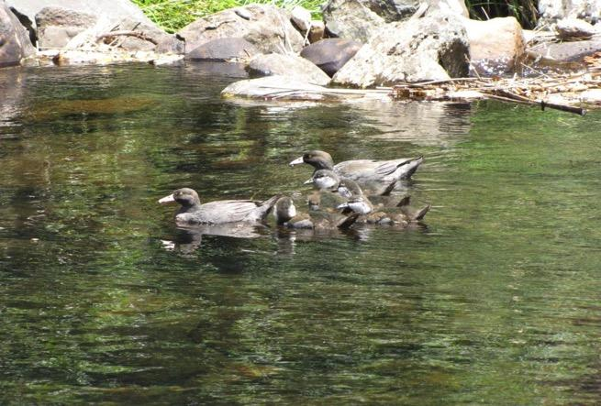
HABITAT ACTIVITY
© Bubs Smith permission via DOC
Notes:
Environmental connections: habitat – where do whio live?
Show a series of six photos, asking each time if it represents a good whio habitat.

Slide 18
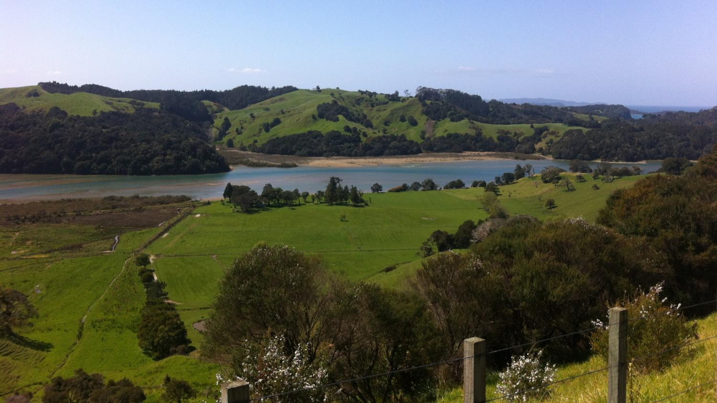
Notes:
No.

Slide 19
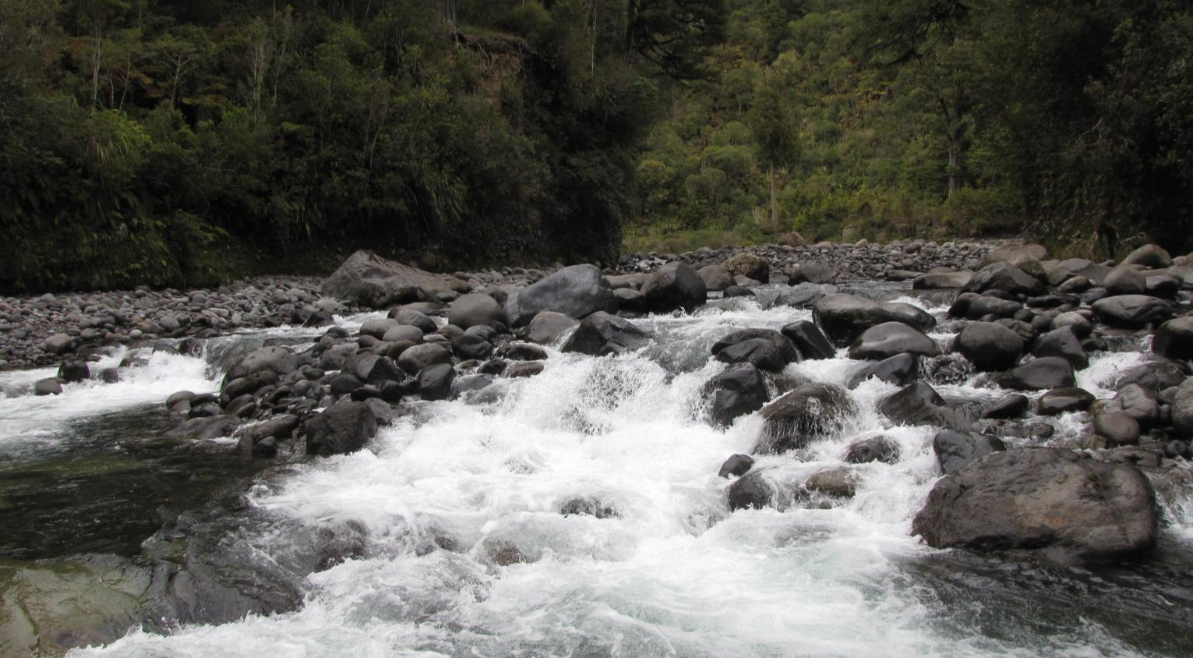
Notes:
Yes.

Slide 20
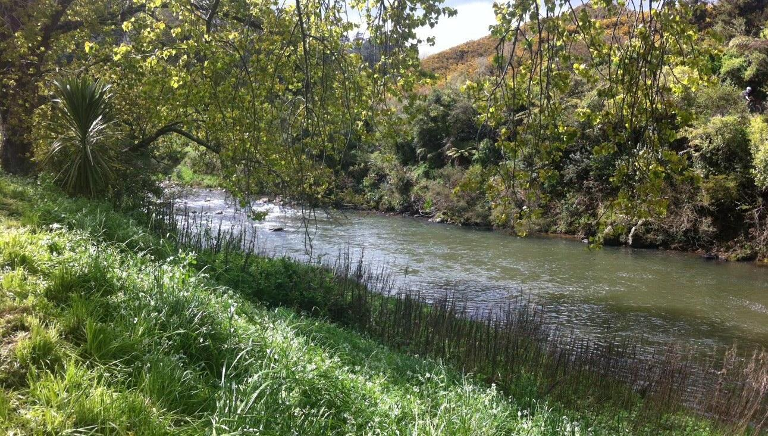
Notes:
No.

Slide 21
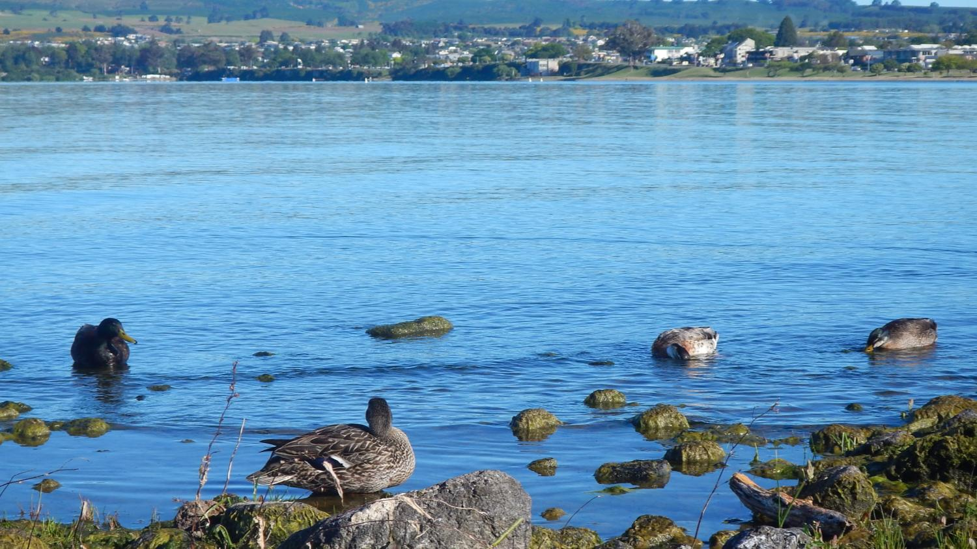
Notes:
No.

Slide 22
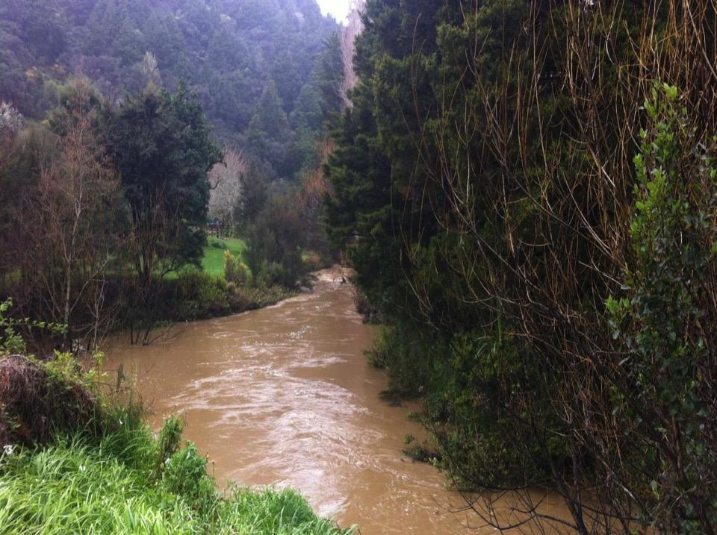
Notes:
No.

Slide 23
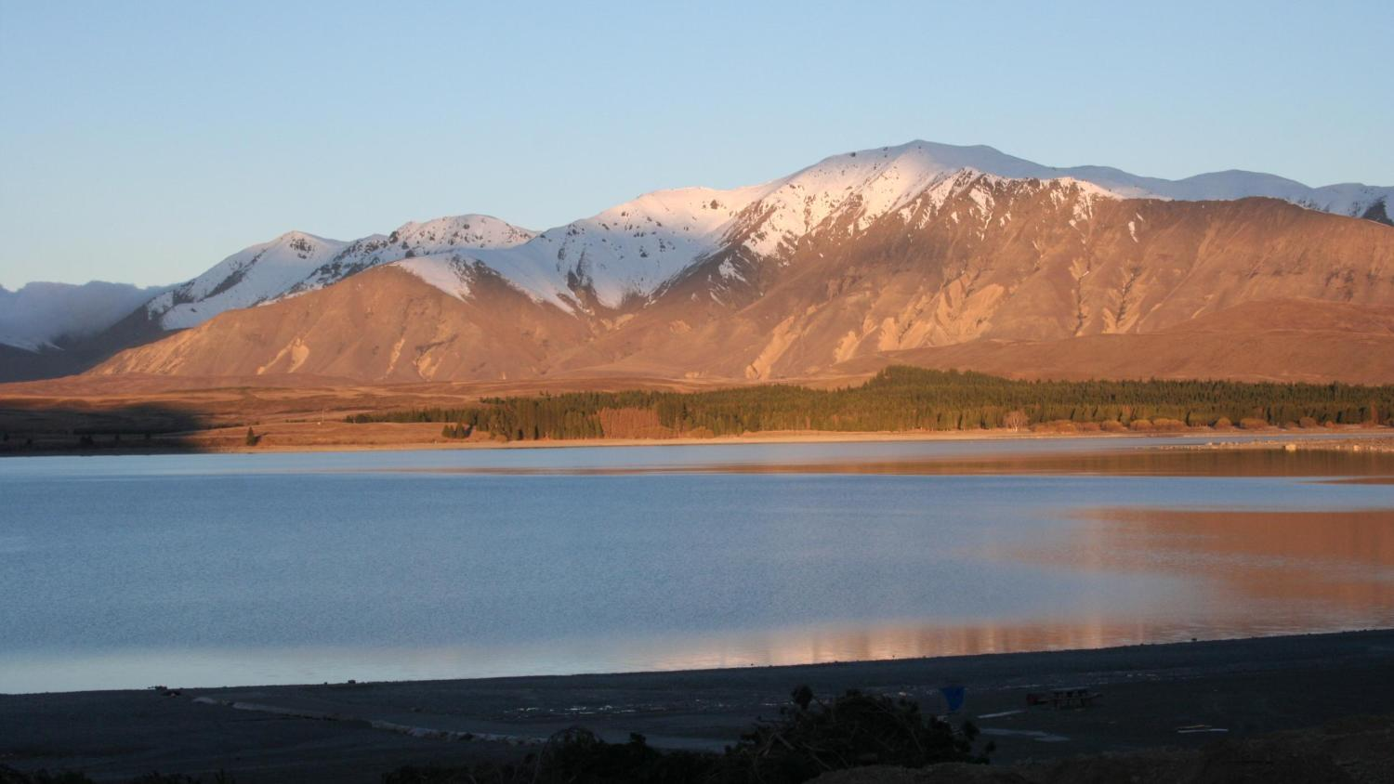
Notes:
No.

Slide 24
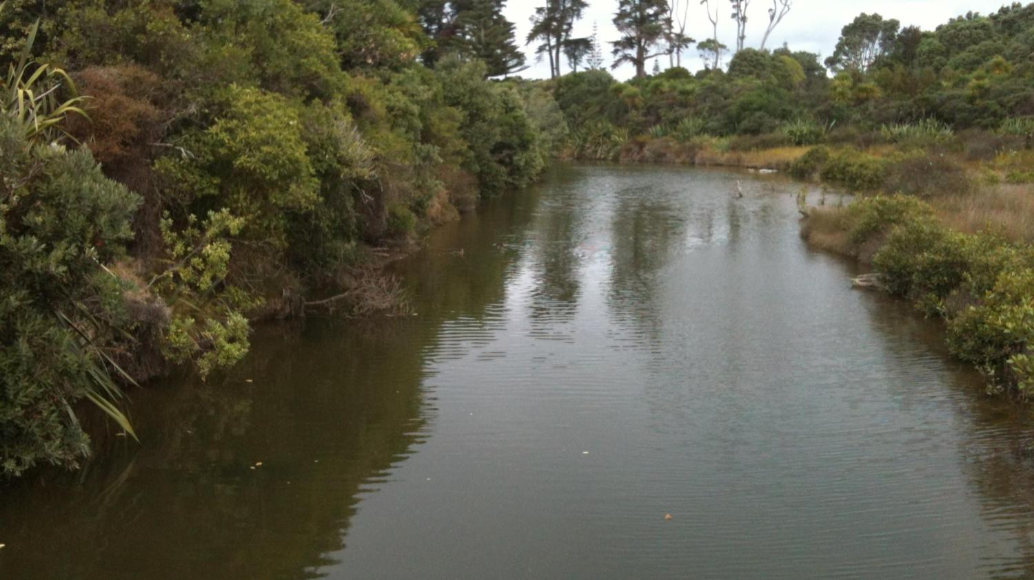
Notes:
No.

Slide 25
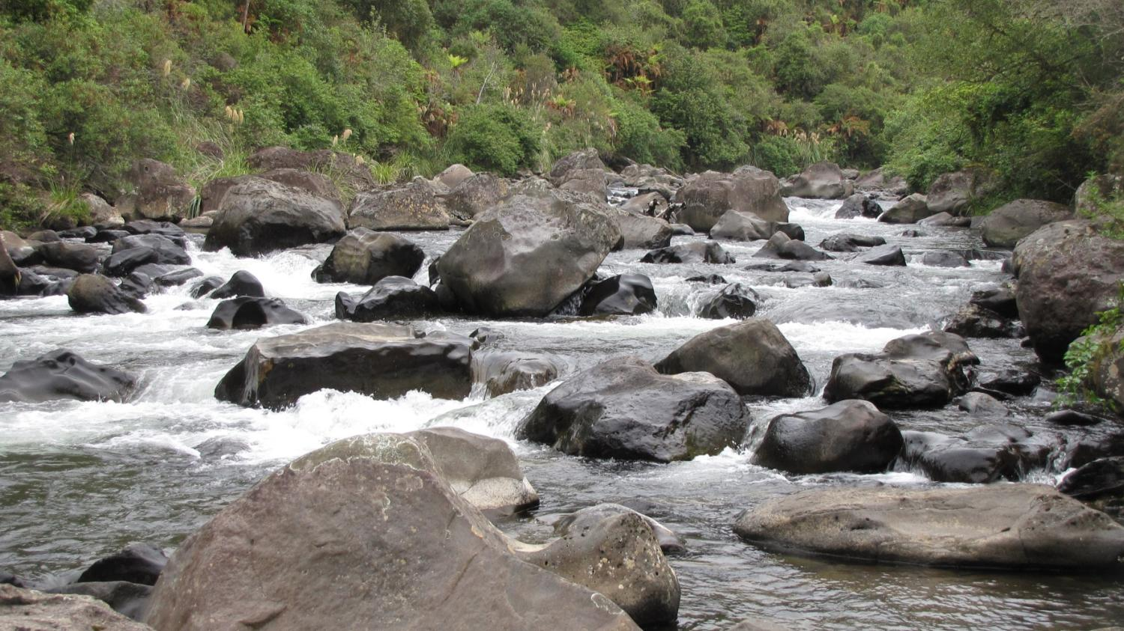
Notes:
The ideal habitat.

Slide 26
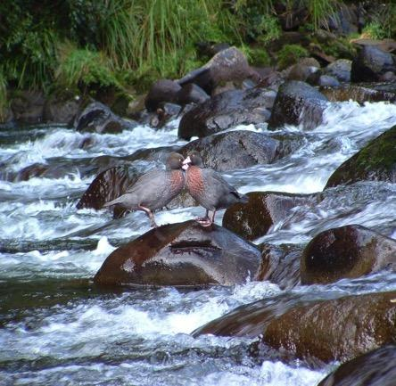
WHIO HABITAT
Whio need rivers or streams that are:
fast-flowing
surrounded by trees
rocky-bottomed, clean and clear
(not polluted!!)
These streams provide an abundant food source: mayfly, stonefly and caddisfly larvae. These larvae feed on biofilm/algae off the rocks.
© Bubs Smith permission via DOC

Slide 27
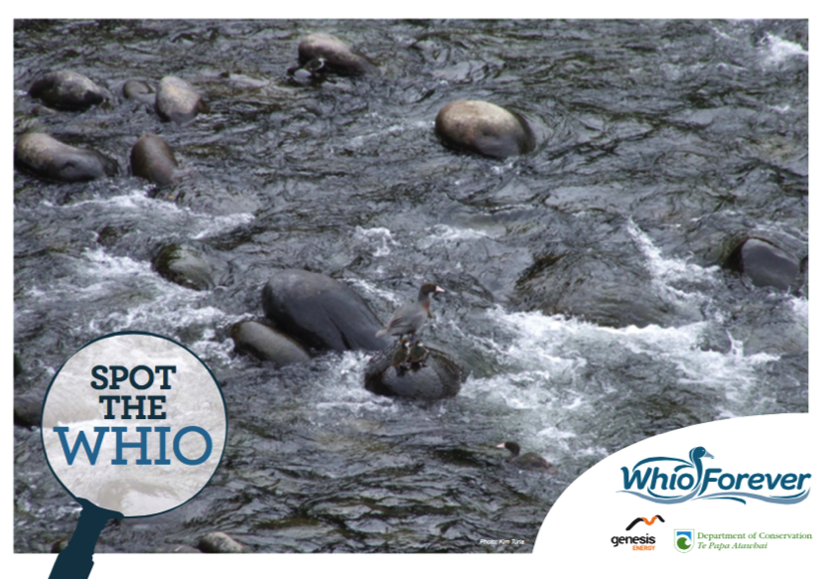

SPOT THE WHIO
Notes:
Using the photo, ask how many whio are visible. This activity can be found in the poster set from the Whio Forever resource.

Slide 28
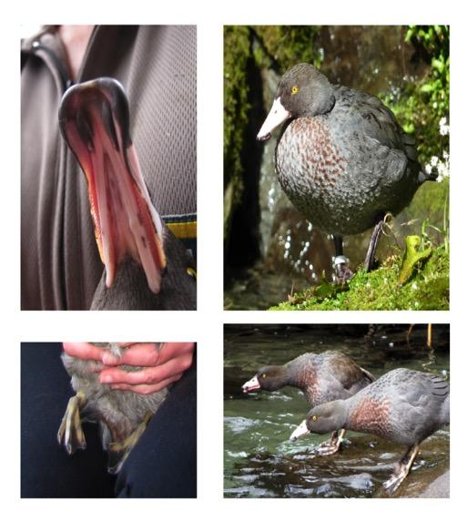

ADAPTATIONS
Waterproof
feathers
Soft bill
with rubbery
lips to scrape larvae off the rocks
Streamlined body
designed to glide
through the water
Webbed feet
that open
and close like an umbrella
Notes:
Adaptations are what make an organism well suited to their habitat. They are survival features. This is elaborated on in the resource.
The first video is found at https://www.sciencelearn.org.nz/videos/258-whakapapa-and-biodiversity
The second video is from the activity Whio feathers – what are they for?

Slide 29
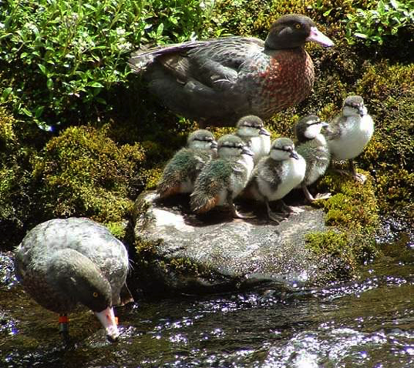

WHAT NEXT?
Notes:
What other ideas, experiences, activities etc. might you offer your students as part of this stage in the inquiry process.
Some other activities/ideas that might be useful for progressing the inquiry include the kahoots game, posters and PPT's related to habitat and adaptations . YouTube has also got some good DOC stories of Whio recovery.
Crown copyright – Te Papa: DOC https://drive.google.com/drive/folders/0B41YSBTx_bjaMHNlOE1BR0pITU0

Slide 30
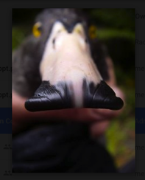
WHIO INQUIRY PROCESS
Notes:
Recapping the inquiry cycle. The next stages are where students consolidate their learning and begin to plan action.

Slide 31

WHAT NEXT? Useful websites and links
Twitter https://twitter.com/NZScienceLearn
https://twitter.com/
Facebook www.facebook.com/nzsciencelearn
https://www.facebook.com/wildsidenz
Pinterest https://nz.pinterest.com/nzsciencelearn/
https://nz.pinterest.com/docgovtnz/conservation-activities-for-kids/
Whio Forever
http://www.whioforever.co.nz/
DOC
http://www.doc.govt.nz/education
Enquiries
conserved@doc.govt.nz
DOC Conservation Education
e-newsletter http://createsend.com/t/i-4B26445CA4C4D7BD
Science Learning Hub
https://www.sciencelearn.org.nz
Enquiries
enquiries@nzsciencelearn.org.nz

Slide 32

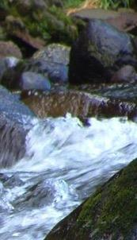
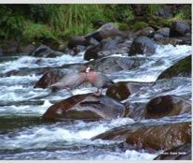
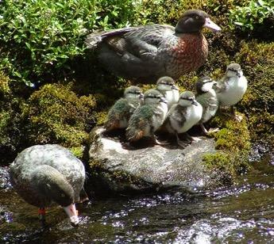
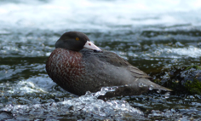
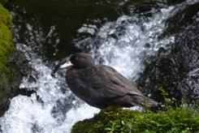
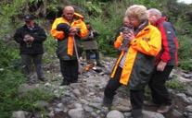
Thanks!
Questions and comments?
The images contained within this PowerPoint presentation are copyrighted to the University of Waikato and other third-party individuals and organisations. Any reuse beyond the classroom as per the intended use of these resources should be cleared with the copyright owner/s.
Notes:
Lyn: Are there any more questions to follow up on in the next two sessions?’ Brief outline of the focus of the next two sessions. Thanks, and please can we have your feedback?

