Slide 1
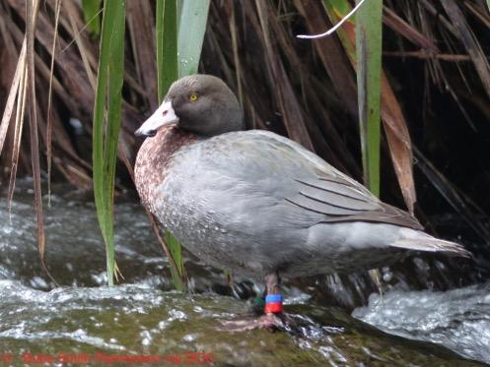
INQUIRY OUTSIDE THE CLASSROOM
With
Lynnette Rogers
and
Shanthie Walker
1 June 2017
4pm
Photo by Bubs Smith
Notes:
Introduction and welcome.

Slide 2
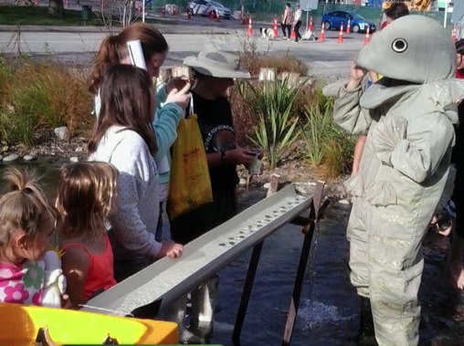
WHY LEARN ABOUT WHIO?
Purposes of this webinar
To support you to:
enhance your students’ understanding about conservation education
engage your students in inquiry outside the classroom
build on your understandings about the value and practicality of EOTC.
DOC
Photo by Bubs Smith
Notes:
In this professional learning session, Shanthie and Lyn use the Whio Forever and other resources to model part of a process of student inquiry into conservation. We (where possible) used the whio/blue duck as a context to build teachers confidence in supporting students to explore their environment.
Photo from habitat heroes DOC resource. Downloadable at www.doc.govt.nz/get-involved/conservation-education/resources/habitat-heroes-streams

Slide 3
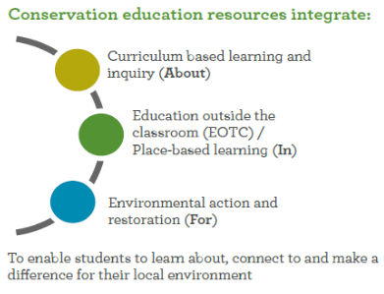
ENVIRONMENTAL EDUCATION FOR SUSTAINABILITY AND CONSERVATION
Getting in to the environment allows learning to be:
more engaging
relevant – in context
nurturing of creativity and imagination
experimental, investigative and inquiry based.
Notes:
Conservation education is a subset of EEfS. They both involve incorporating the dimensions of about, in, and for.
‘In’ is just that - giving students time outdoors exploring, investigating, building curiosity, finding things out.

Slide 4
LEARNING OUTSIDE THE CLASSROOM – UNESCO
“Providing students with high quality learning activities in relevant situations beyond the walls of the classroom is vital for helping students appreciate their first hand experiences from a variety of different perspectives. Experiences outside the classroom also enhances learning by providing students with opportunities to practice skills of enquiry, values analysis and clarification and problem solving in everyday situations.”
Notes:
Quote from: Teaching and learning for a sustainable future: Learning outside the classroom UNESCO www.unesco.org/education/tlsf/mods/theme_d/mod26.html
Photo from DOC resources

Slide 5
GETTING OUTDOORS – SOME PARTICIPANTS IDEAS
What experiences do we already offer our students in the outdoors?
heading down to the back field where the stream is
camping out
visiting Ulva Island
recycling centre
walking down to the local gully for observations
visit a lake
go to a waterfall to study trees
butterfly
tagging
planting
to a quarry to study butterflies
a shore visit
going to the zoo
the stream to do water studies
the outdoor ED class kayaked and passed whio last week
visit local wetland
school camp
fishing
the beach for rock pooling
Notes:
Photo from DOC resources

Slide 6
WHY GO OUTSIDE THE CLASSROOM? – SOME PARTICIPANTS IDEAS
Why it is important to take students outside?
It builds an understanding of the world around them
They can witness interactions within the environment
They experience interactions between themselves and the environment
To be engaged with their surroundings
To breathe it, feel it, touch it
Learn to value it
Can see a purpose to the 'inside' learning
It's their world out there and they need to be a part of it
Life happens out there, not always inside
“COS IT’S FUN!”
DOC
Notes:
Photo from habitat heroes DOC resource. Downloadable at www.doc.govt.nz/get-involved/conservation-education/resources/habitat-heroes-streams

Slide 7
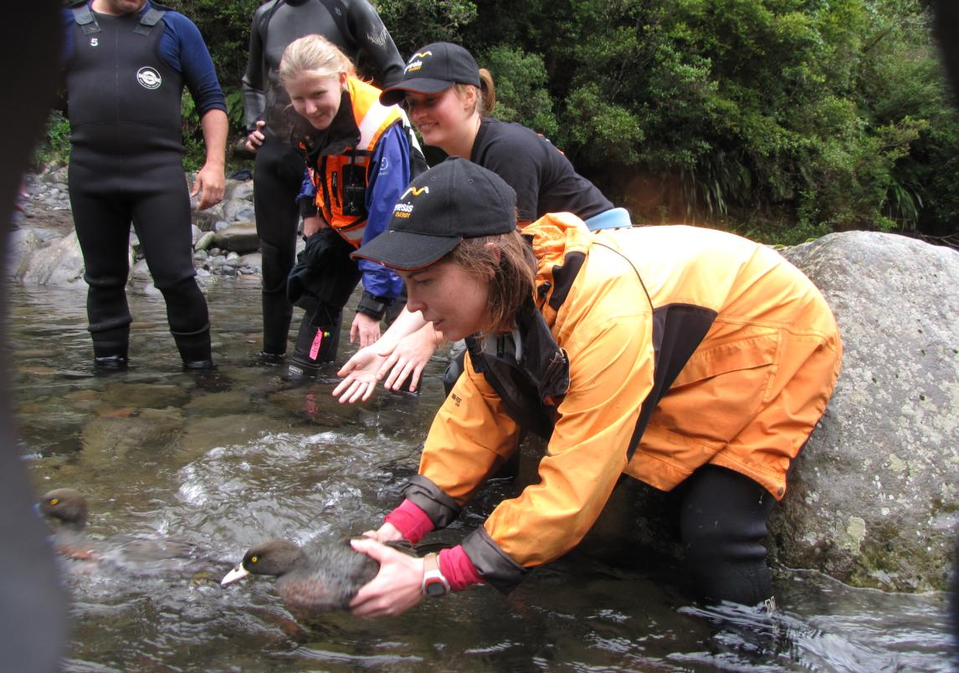
KEY APPROACHES TO LEARNING IN THE OUTDOORS 1
EXPERIENTIAL LEARNING
“At the heart of all learning is the way we process our experiences.”
“Experiential learning engages students in critical thinking, problem solving and decision making in contexts that are personally relevant to them.”
It involves:
debriefing and reflection
consolidation of new ideas and skills
application of new ideas and skills.
Notes:
One major pedagogical approach to EEFS and conservation education is experiential learning.
Quote from www.unesco.org/education/tlsf/mods/theme_d/mod20.html
Photo from DOC resources

Slide 8
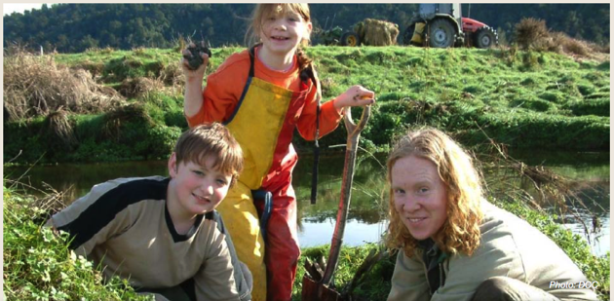
KEY APPROACHES TO LEARNING IN THE OUTDOORS 2
INQUIRY LEARNING
“Inquiry learning is a learner-centred approach that emphasises higher order thinking skills.”
Inquiry learning involves the development of thinking and problem-solving skills.
Students are responsible for processing the data they are working with in order to reach their own conclusions.
Notes:
Another pedagogical approach to EEFS and conservation education is experiential learning. Both are student centred approaches. Quote from www.unesco.org/education/tlsf/mods/theme_d/mod20.html
Photo from habitat heroes DOC resource. Downloadable at www.doc.govt.nz/get-involved/conservation-education/resources/habitat-heroes-streams

Slide 9
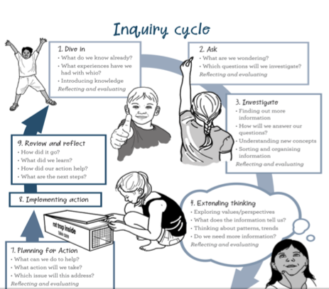
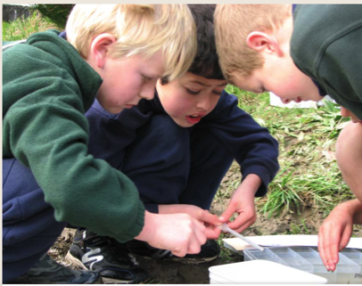
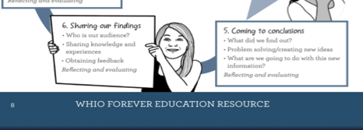
CONSERVATION INQUIRY PROCESS
Notes:
Whio Forever and other DOC resources have been developed using an inquiry process. A lot of SLH activities and articles are based on science investigation and inquiry.
Photo from habitat heroes DOC resource. Downloadable at www.doc.govt.nz/get-involved/conservation-education/resources/habitat-heroes-streams

Slide 10
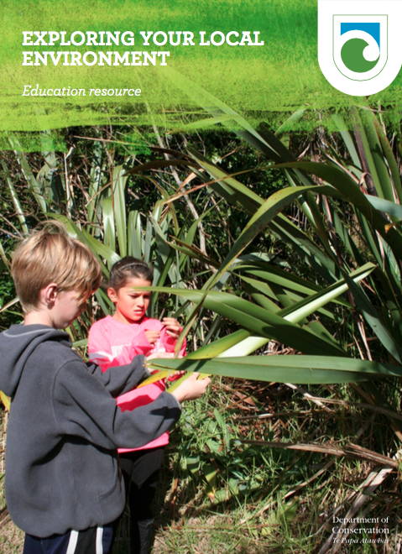
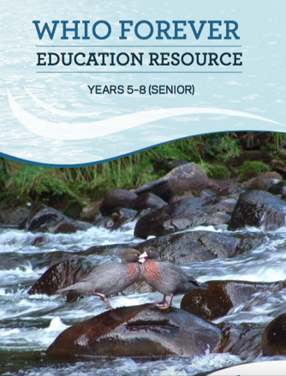
WHIO FOREVER AND OTHER USEFUL DOC RESOURCES
Notes:
www.doc.govt.nz/get-involved/conservation-education/resources/exploring-your-local-environment and http://www.whioforever.co.nz

Slide 11
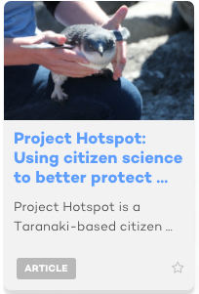
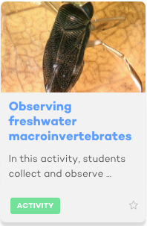
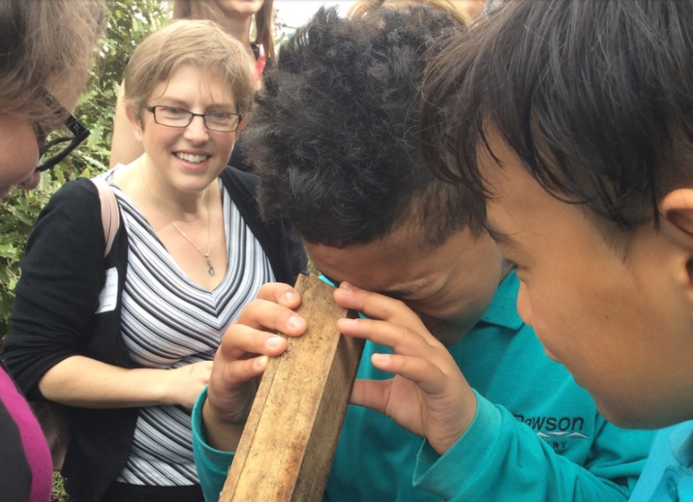
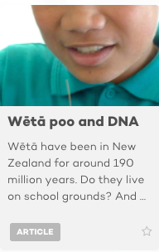
USEFUL RESOURCES ON THE SCIENCE LEARNING HUB
Dawson Primary
Notes:
Photos from
www.sciencelearn.org.nz/resources/1595-project-hotspot-using-citizen-science-to-better-protect-coastal-threatened-species
www.sciencelearn.org.nz/resources/1821-observing-freshwater-macroinvertebrates
www.sciencelearn.org.nz/resources/1963-weta-poo-and-dna
Other resources include
using local experts and people with passion like volunteers
local and regional council resources e.g. The Hamilton City Council Gully Restoration guide
LEARNZ www.learnz.org.nz

Slide 12
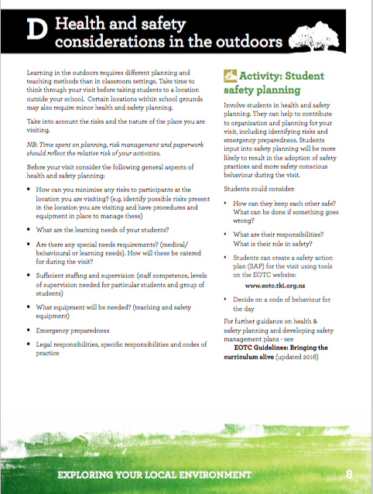
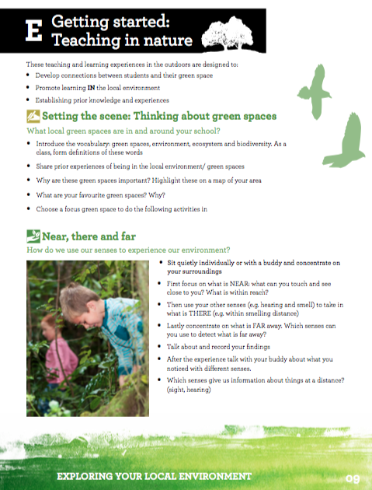
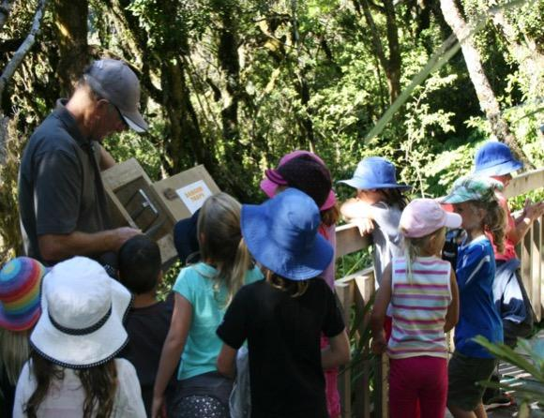
EOTC CONSIDERATIONS
Notes:
There are pages in the DOC resources that outline what to consider regarding
Photo from PPT “Whio and people” part of the Whio Forever by DOC

Slide 13
PREPARING FOR EOTC – SOME PARTICIPANTS IDEAS
Ask kids what they might want to do
Fulfill all school requirements such as RAMS etc.
Visit the site in advance, check out the hazards, toilets etc.
Check the tides for beach trips
Sometimes it takes days for high water levels to reach down stream - talk with regional council or locals
It is important to check stream levels - if there has been rain recently
Check the weather
Have you got enough HELP!!! around water? Make sure you have enough eyes on the kids
Notes:
www.eotc.tki.org.nz
Photo from PPT “Whio and people” part of the Whio Forever by DoC

Slide 14
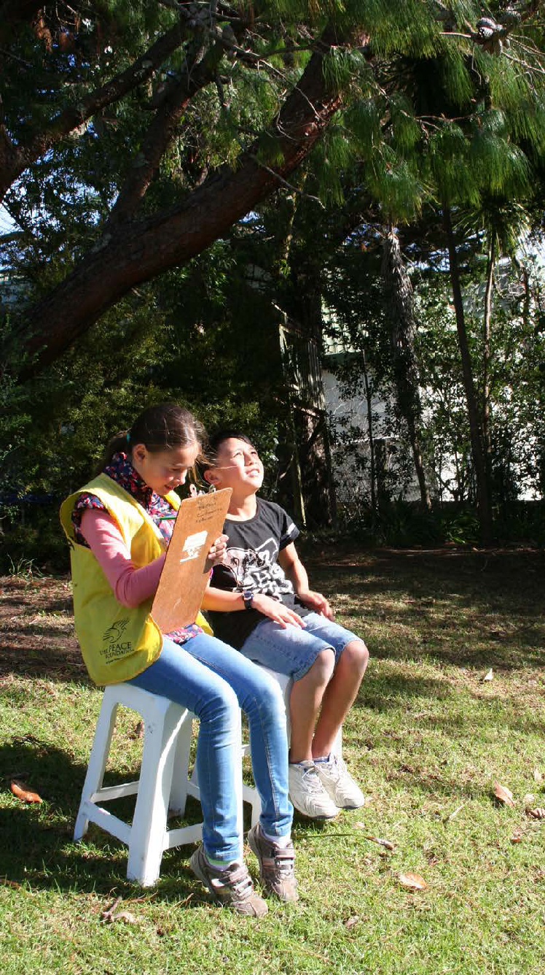
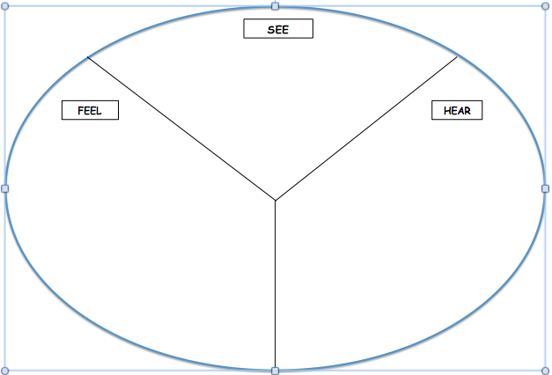
EXPERIENCING THE ENVIRONMENT – ACTIVITY – some participants responses
grass needs cutting,
trees, water; insects, sky, greenery,
birds
wind, pleasantness,
excitement, sunshine,
warmth
fire crackling,
trucks, birds,
trees rustling,
insects
Notes:
Activity using a graphic organiser to record what students experienced using their senses. In the webinar we pretended we were these students.
Photo from ‘Experiencing birds in your green space’ DOC resource.
This could be followed comparing how much bird song is in an urban area vs. the bush.
This is a good graphic organiser for stimulating environmental writing. Maybe use a Venn diagram to explore similar ideas.
Photo from DOC resources

Slide 15
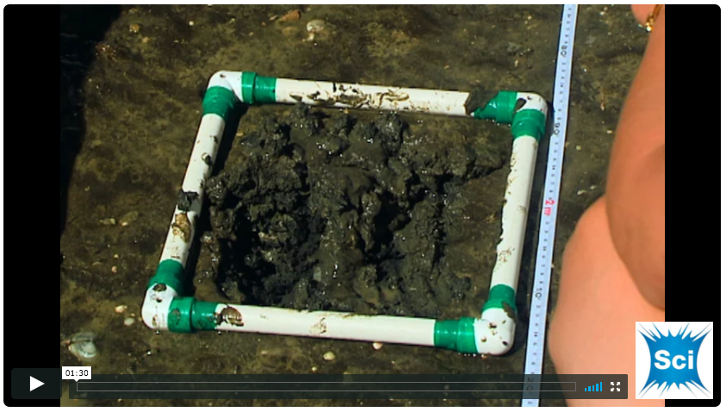
INSPIRED TO DISCOVER
Notes:
Video from www.sciencelearn.org.nz/videos/655-using-a-quadrat. This connects to the Citizen Science resource Marine Metre Squared www.mm2.net.nz and to the Science Learning Hub activity Making and using a quadrat www.sciencelearn.org.nz/resources/2318-making-and-using-a-quadrat
See also this useful video from Te Papa: Inspired to discover www.youtube.com/watch?v=bq4M2YRDe9c&t=4s, featuring New Zealand scientists talking about their work.

Slide 16
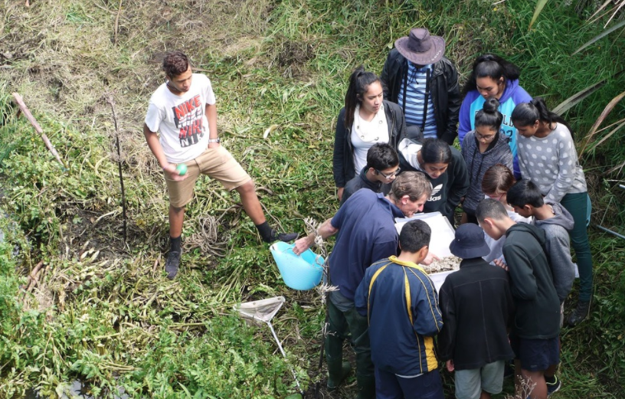
CURRICULUM CONNECTIONS
Offer students opportunity to:
critically reflect on their experiences
develop new ideas
explore values, their own and others
collect and analyse information.
Sarah Morgan, Comet Auckland
Photo by Bubs Smith
Notes:
Photo from www.sciencelearn.org.nz/images/2099-species-count
Teachers use taskbooks, notebooks, logbooks, worksheets/workbooks to keep students focused and engaged. Some ask/support students to become experts in a particular aspect of the experience and jig-saw their ideas.

Slide 17
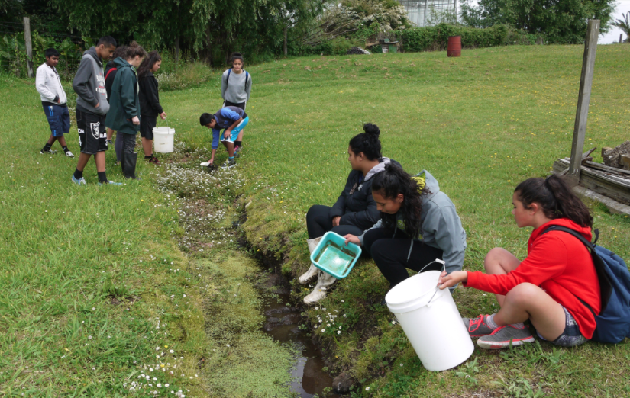
WORKING LIKE SCIENTISTS
Offer students opportunity to:
experience and build connections to their environment and wider surroundings
get excited and build their curiosity about the world.
Sarah Morgan, Comet Auckland
Photo by Bubs Smith
Notes:
Photo from www.sciencelearn.org.nz/images/2095-muddy-bottom

Slide 18
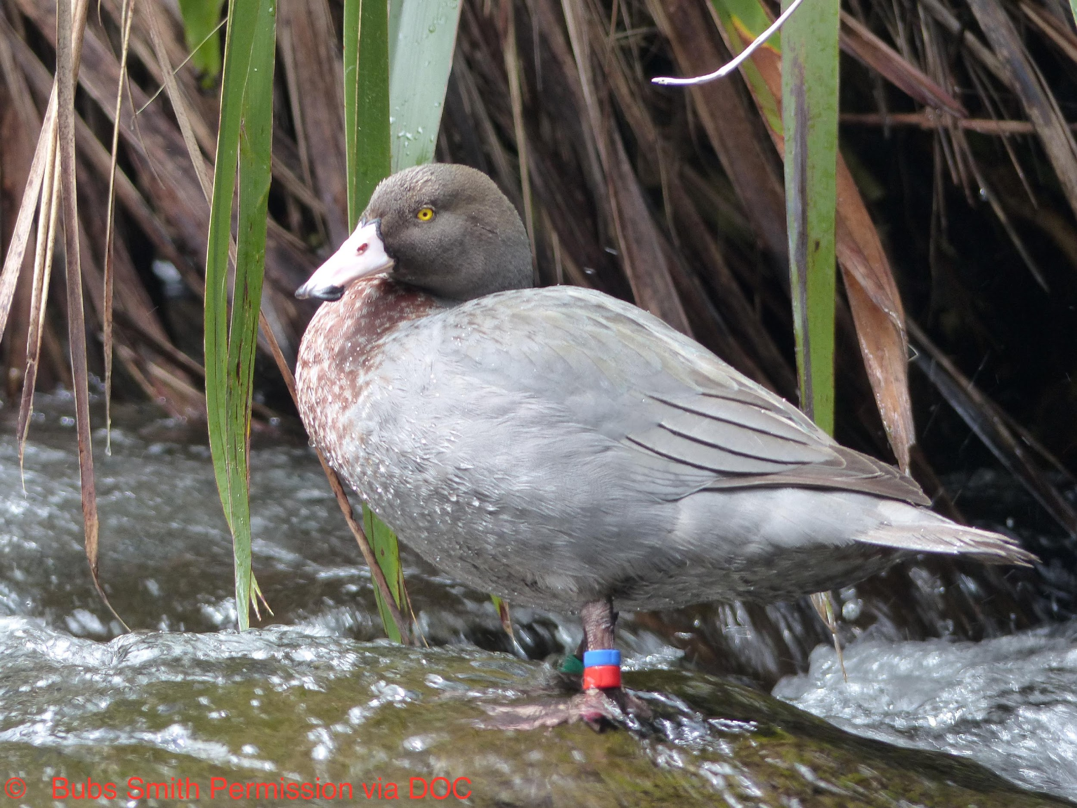
EXPERIENCING THE WHIO?
Photo by Bubs Smith
Notes:
Photo from www.sciencelearn.org.nz/images/2846-whio-the-blue-duck. Bubs Smith DOC permission.

Slide 19
WHAT NEXT? Useful websites and links
Twitter https://twitter.com/NZScienceLearn
https://twitter.com/
Facebook www.facebook.com/nzsciencelearn
https://www.facebook.com/wildsidenz
Pinterest https://nz.pinterest.com/nzsciencelearn/
https://nz.pinterest.com/docgovtnz/conservation-activities-for-kids/
Whio Forever
http://www.whioforever.co.nz/about-the-whio/find-a-whio
DOC
http://www.doc.govt.nz/education
Enquiries
conserved@doc.govt.nz
DOC Conservation Education e-newsletter http://createsend.com/t/i-4B26445CA4C4D7BD
Science Learning Hub
https://www.sciencelearn.org.nz
Enquiries
enquiries@nzsciencelearn.org.nz

Slide 20
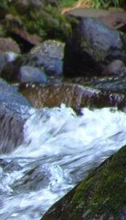
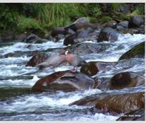
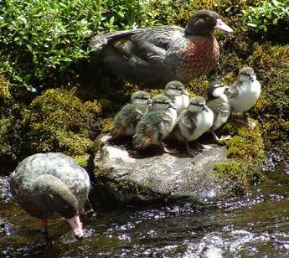
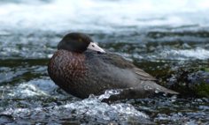
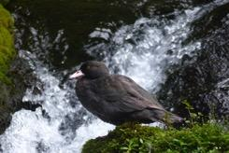
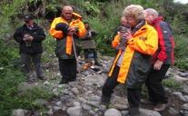
Thanks!
Questions and comments?
The images contained within this PowerPoint presentation are copyrighted to the University of Waikato and other third-party individuals and organisations. Any reuse beyond the classroom as per the intended use of these resources should be cleared with the copyright owner/s.

