Slide 1
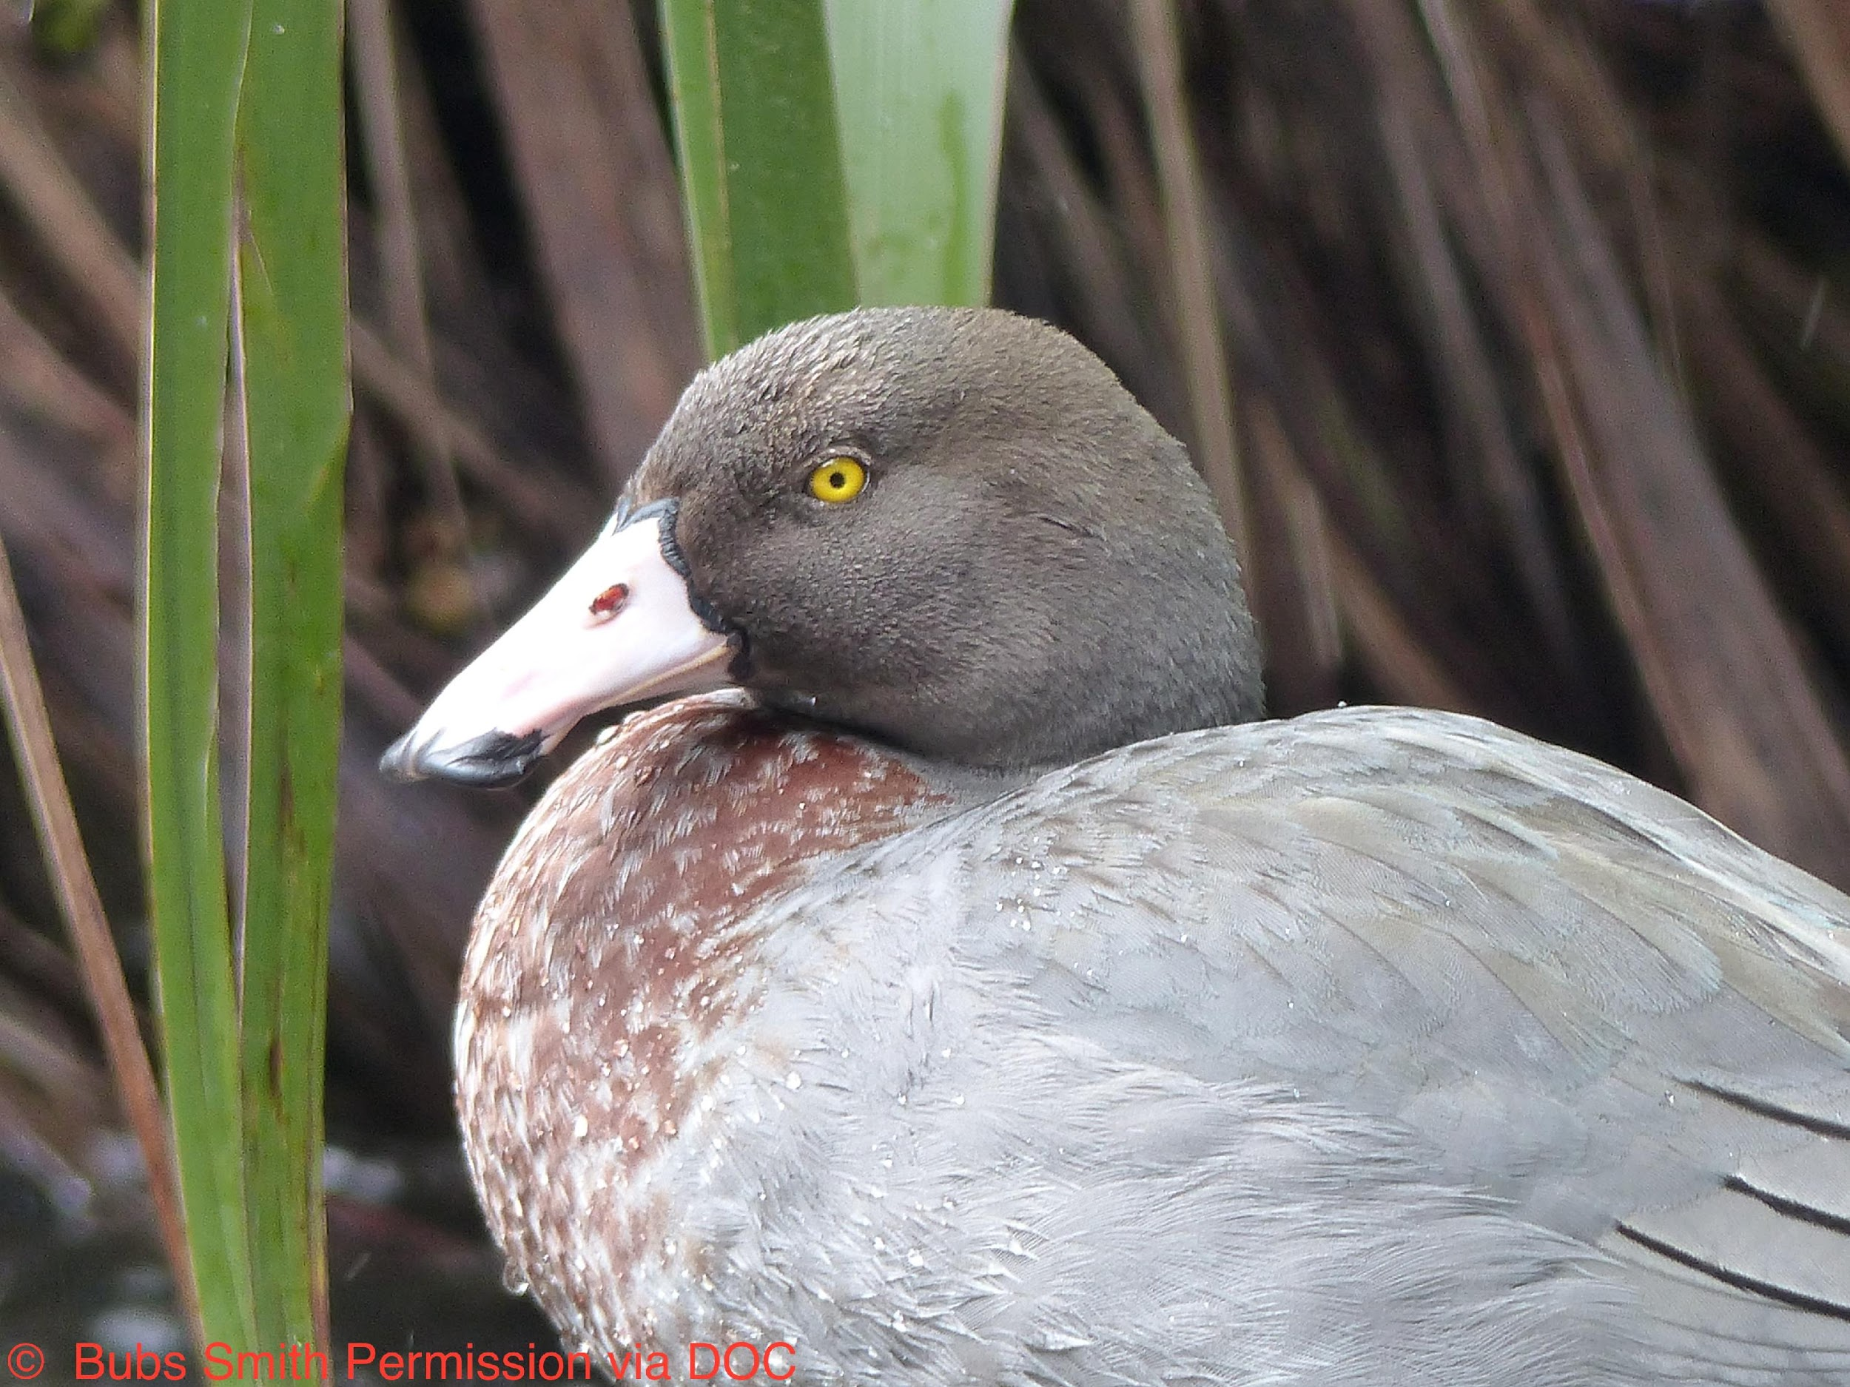
TAKING ACTION FOR CONSERVATION
With
Lynnette Rogers
and
Andrea Soanes
22 June 2017
4pm
Photo by Bubs Smith
Notes:
Introduction and welcome.

Slide 2
TAKING ACTION FOR CONSERVATION
Purposes of this webinar
To support you to:
enhance your students’ understanding about whio
engage your students in conservation inquiry
build your students’ action competence – planning and taking appropriate conservation action
DOC
Photo by Bubs Smith
Notes:
Shanthie Walker was unable to join us for this session and Andrea Soanes has joined instead.

Slide 3
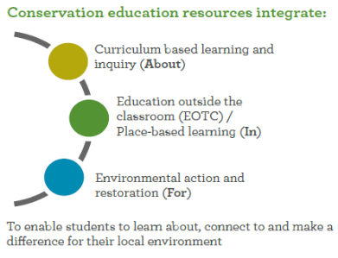
ENVIRONMENTAL EDUCATION FOR SUSTAINABILITY AND CONSERVATION
Having experiences that lead to taking action for the environment allows:
learning to be relevant and meaningful – in context
students to build the confidence to make a difference in their world
students to explore values, perspectives and connections within their community.

Slide 4
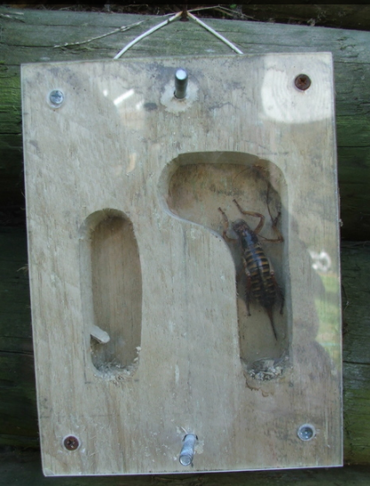
SOME EXAMPLES OF STUDENT ACTION
MAKING A GARDEN
MAKING A MURAL
PLANTING TREES
RECOMMENDING OR SUBMITTING IDEAS
BUILDING A WĒTĀ HOUSE
CREATING AWARENESS
BUILDING A PROPAGATION HOUSE
GETTING INVOLVED IN DECISION MAKING
COLLECTING SEEDS
GETTING INVOLVED IN CONSULTATION
MAKING A BIRD FEEDER
CREATING OR JOINING AN ACTION GROUP
PRESENTING TO THE BOT
TRAPPING PESTS
PUBLICISING IDEAS
RESTORING
HABITATS
WRITING SCHOOL POLICY
DOING RIPARIAN PLANTING
dubh/C.C 2.0
Notes:
Looking at some ideas for action.
Photo from www.sciencelearn.org.nz/images/2439-weta-motel

Slide 5
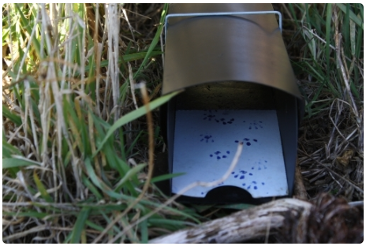
MORE EXAMPLES OF ACTION
Create or use tracking tunnels
Share knowledge with family, community or school
make a film
write and/or perform a play for other levels in the school
put ideas or information on a social networking platform
design and post a brochure/flier for the local notice board
Assist with raising whio
Do some fundraising
Plant native species to encourage native birds and invertebrates into school grounds
Let others know what is happening
Monitor the local stream - to provide information and evidence for action
Work in the field helping with other groups and actions that are happening
Notes:
Photo from www.sciencelearn.org.nz/images/1315-tracking-tunnel

Slide 6
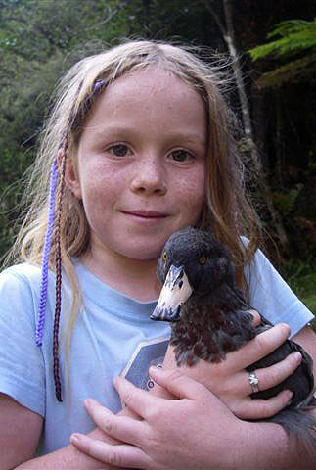
CURRICULUM CONNECTIONS
Nature of Science: Participating and contributing
Science capability: engage with science “It involves students taking an interest in science issues, participating in discussions about science and at times taking action”
Key competencies, values and principles of the NZC, e.g. Future focus
Action competence
Notes:
More information about action competence can be found http://nzcurriculum.tki.org.nz/Curriculum-resources/Education-for-sustainability#collapsible4
http://nzcurriculum.tki.org.nz/Principles/Future-focus
http://scienceonline.tki.org.nz/Science-capabilities-for-citizenship/Introducing-five-science-capabilities/Engage-with-science

Slide 7
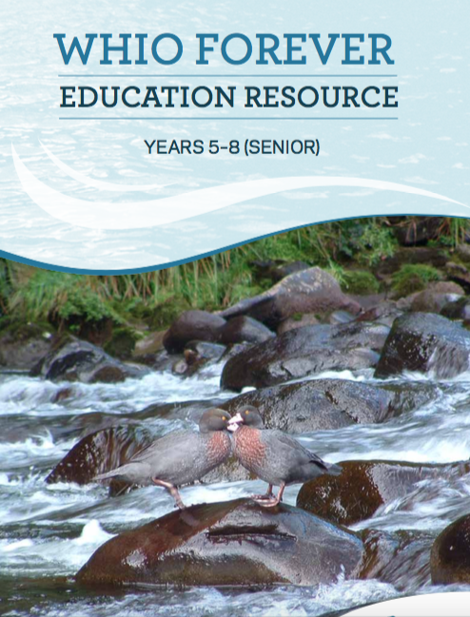
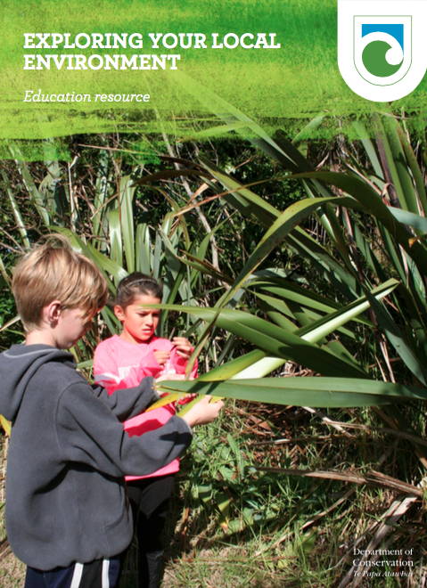
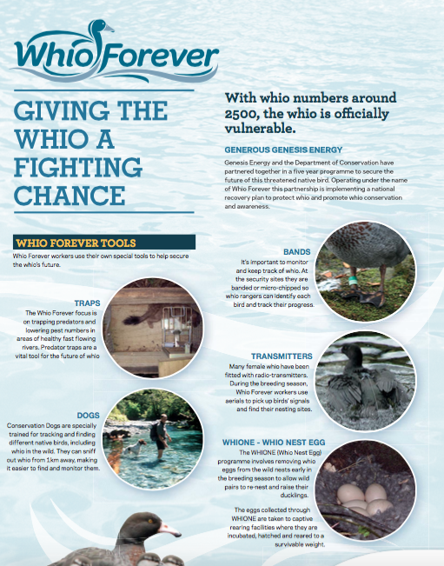
DEPARTMENT OF CONSERVATION RESOURCES SUPPORTING CONSERVATION ACTION
The resources include:
booklets
posters
videos
PowerPoints
online information.
Notes:
Resources downloadable at www.whioforever.co.nz/about-the-whio/educational-resources and www.doc.govt.nz/education-whio

Slide 8
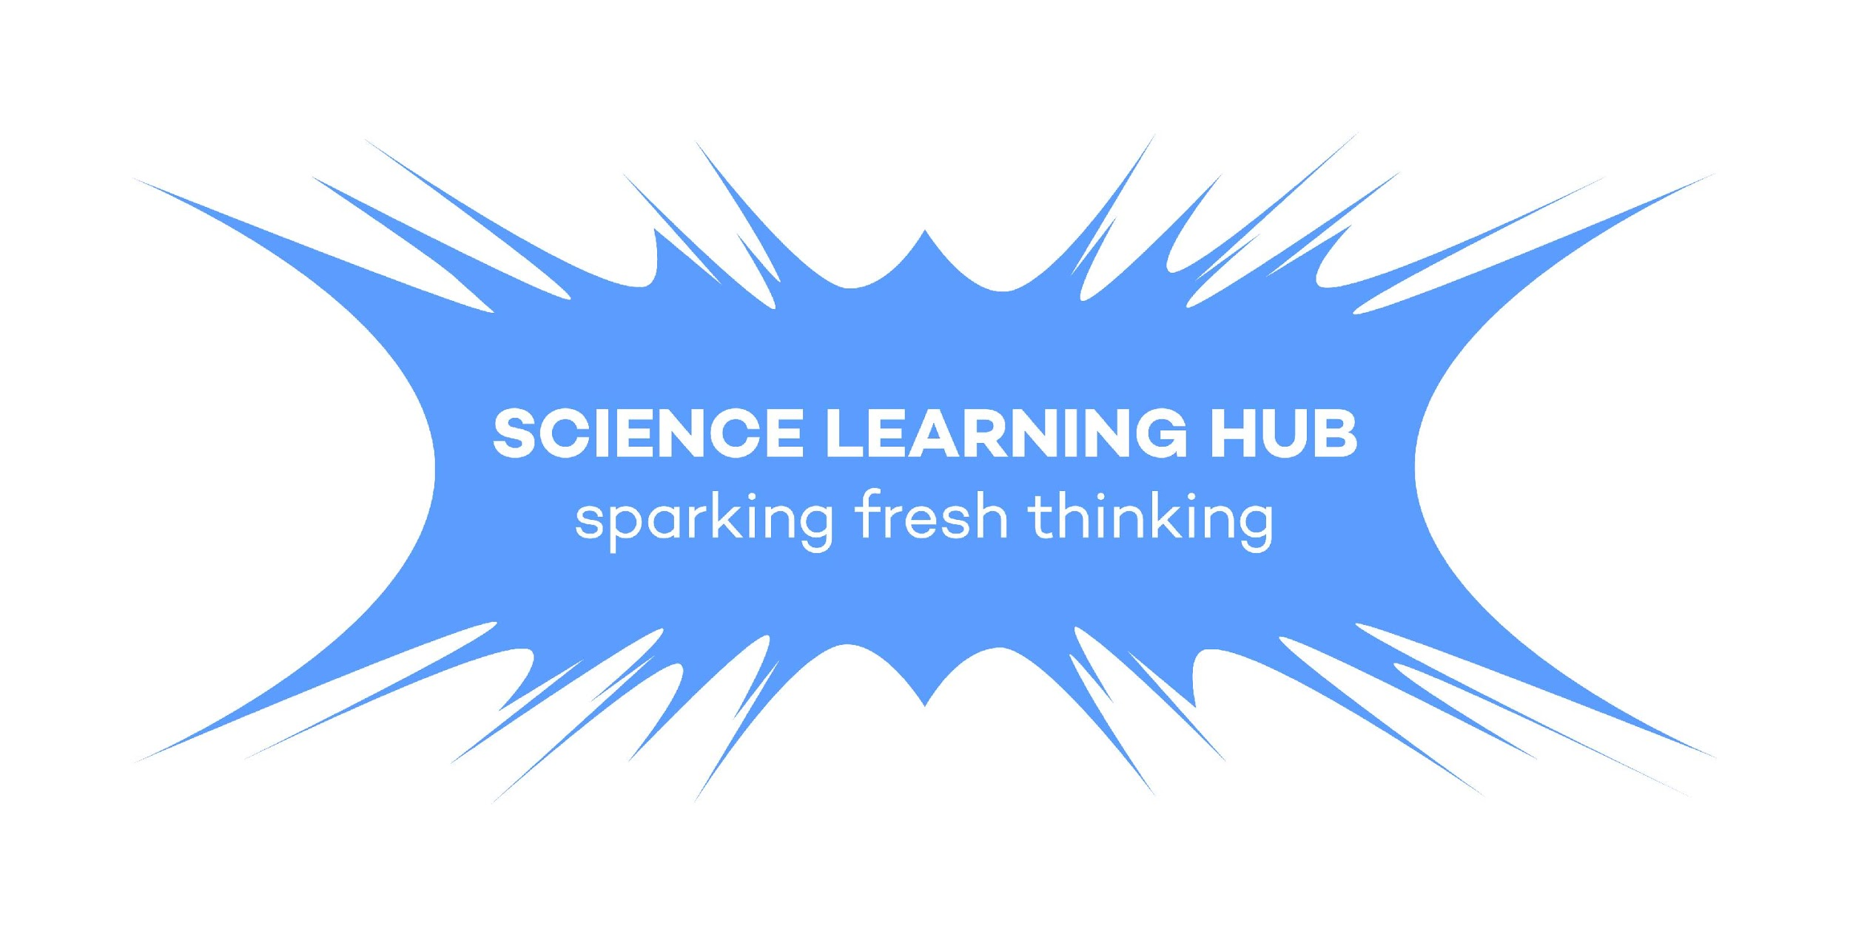
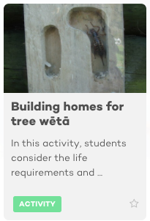
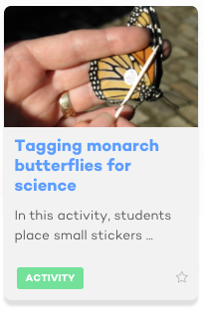
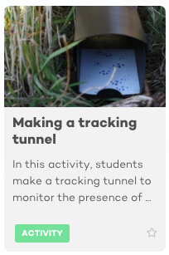
SCIENCE LEARNING HUB RESOURCES SUPPORTING CONSERVATION ACTION
Notes:
www.sciencelearn.org.nz/resources/1964-building-homes-for-tree-weta
www.sciencelearn.org.nz/resources/700-tagging-monarch-butterflies-for-science
www.sciencelearn.org.nz/resources/1171-making-a-tracking-tunnel

Slide 9
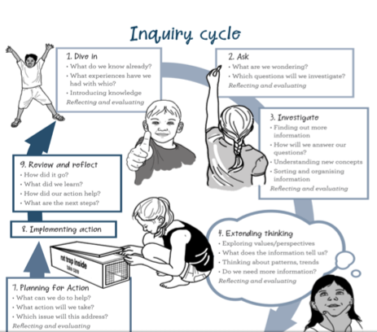
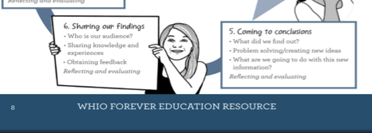
CONSERVATION INQUIRY PROCESS
Notes:
Inquiry process is extracted from the Whio Forever resource www.whioforever.co.nz/about-the-whio/educational-resources

Slide 10
INQUIRY PROCESS: STAGES 1–2
Notes:
That in EEfS and conservation we want the inquiry to result in students taking action to improve the world.

Slide 11
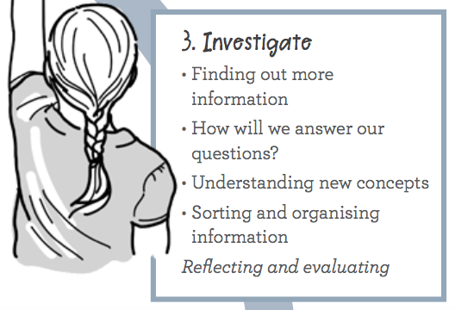
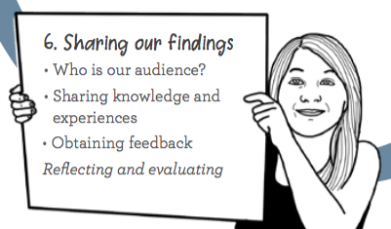
INQUIRY PROCESS: STAGES 3–6

Slide 12
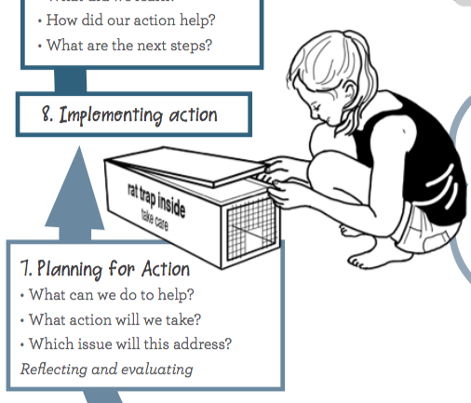
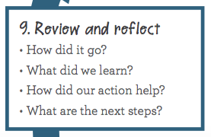
INQUIRY PROCESS: STAGES 7–9

Slide 13
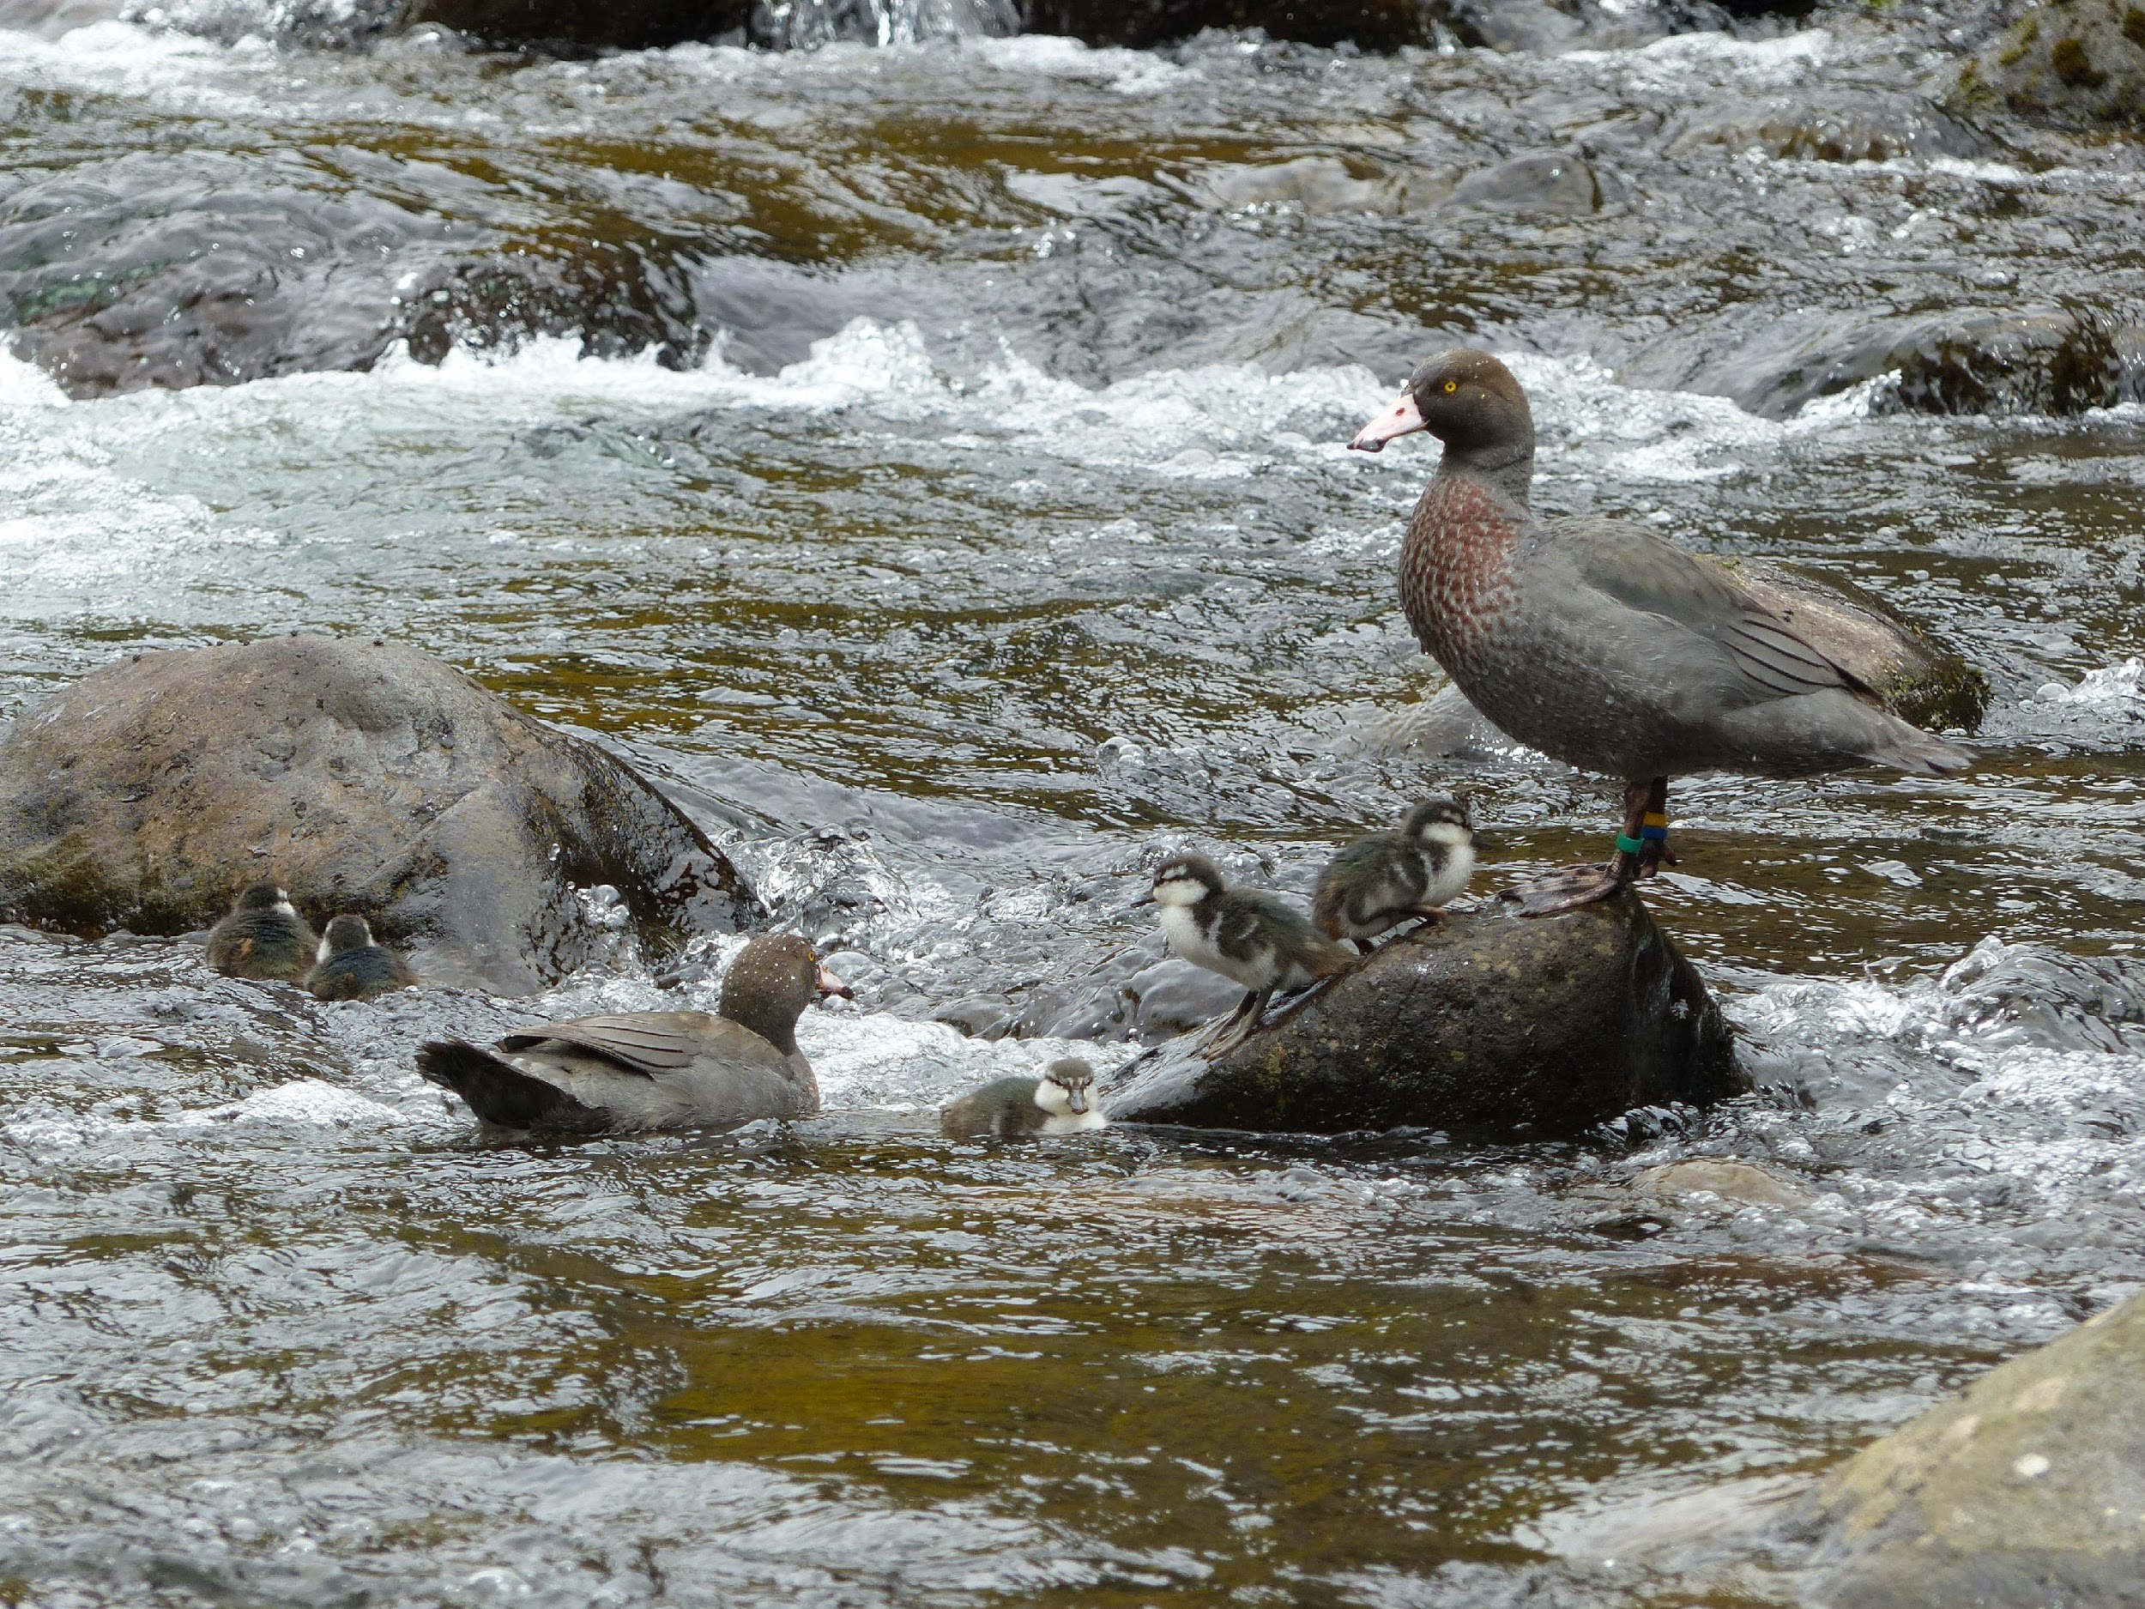
WHAT HAVE WE LEARNED ABOUT WHIO?
The current situation for whio:
They are nationally vulnerable.
They live in fast-flowing, clean, rocky-bottomed streams and rivers.
They eat macroinvertebrates.
They are specially adapted to their habitat, including their soft bill, streamlined body and camouflage.
The main threats to whio are habitat destruction and predators.
Notes:
People can have positive or negative effects on other organisms.

Slide 14
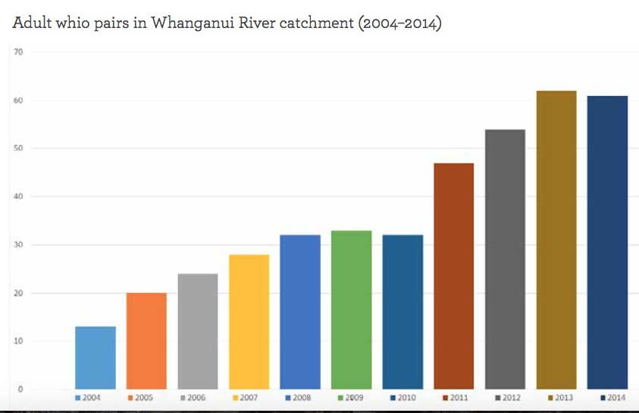
WHAT ACTIONS ARE BEING TAKEN TO SAVE THE WHIO?
Successful strategies include:
predator control
captive breeding and release
education
partnership projects
habitat monitoring and restoration.
Notes:
Graph from page 43 of the junior version of the Whio Forever resource. www.whioforever.co.nz/about-the-whio/educational-resources

Slide 15
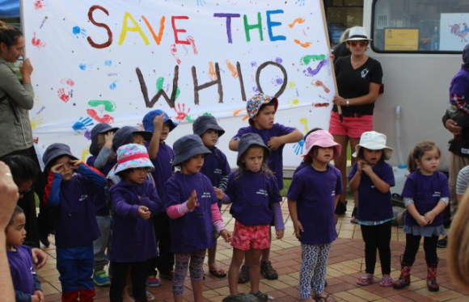
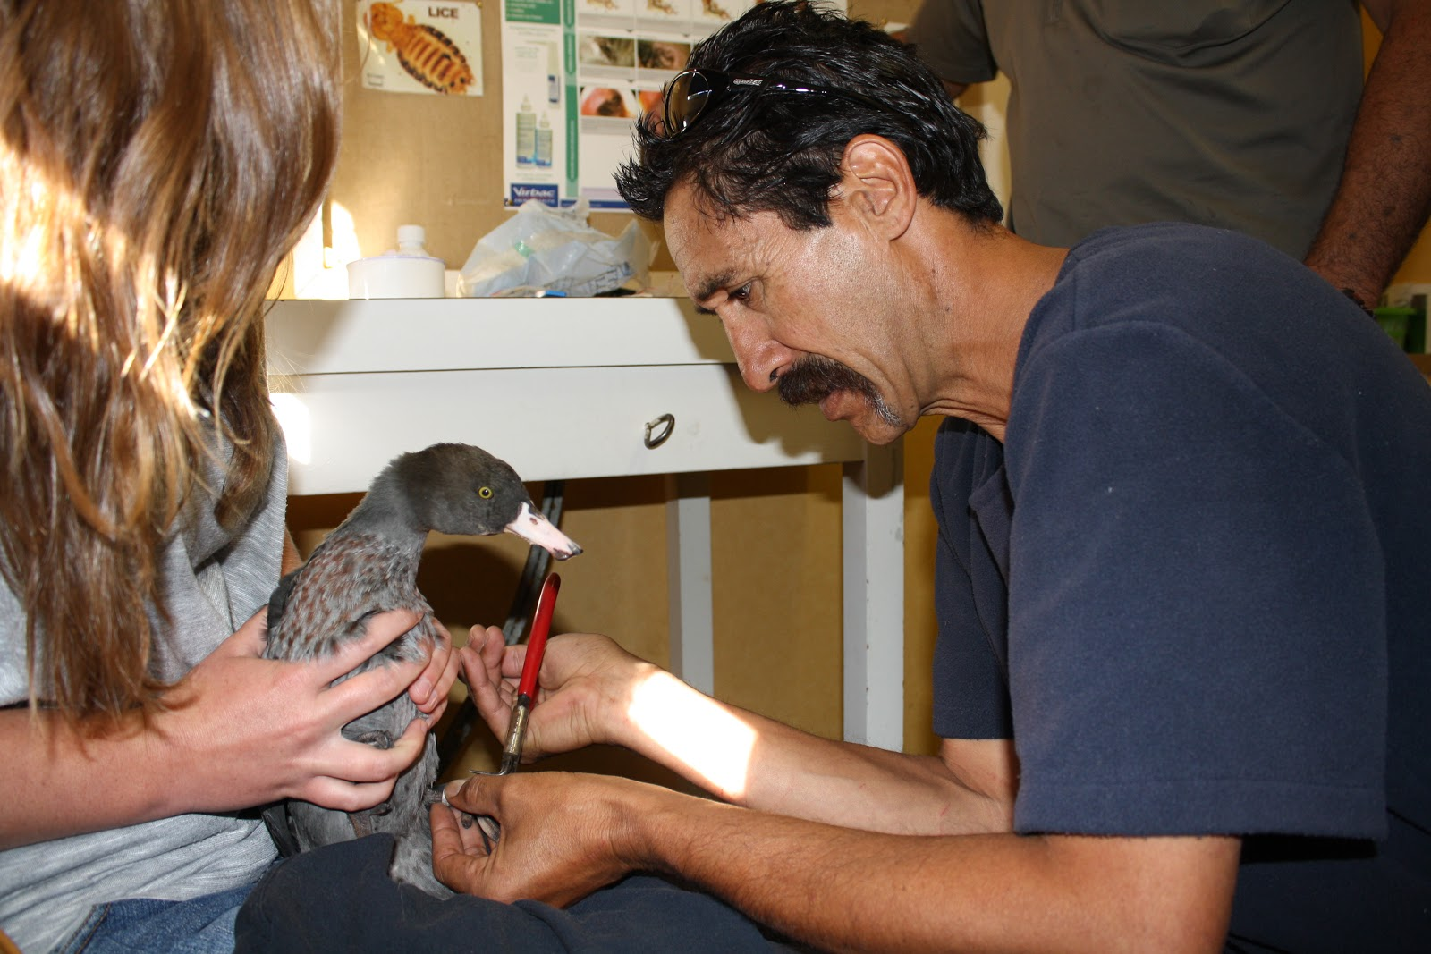
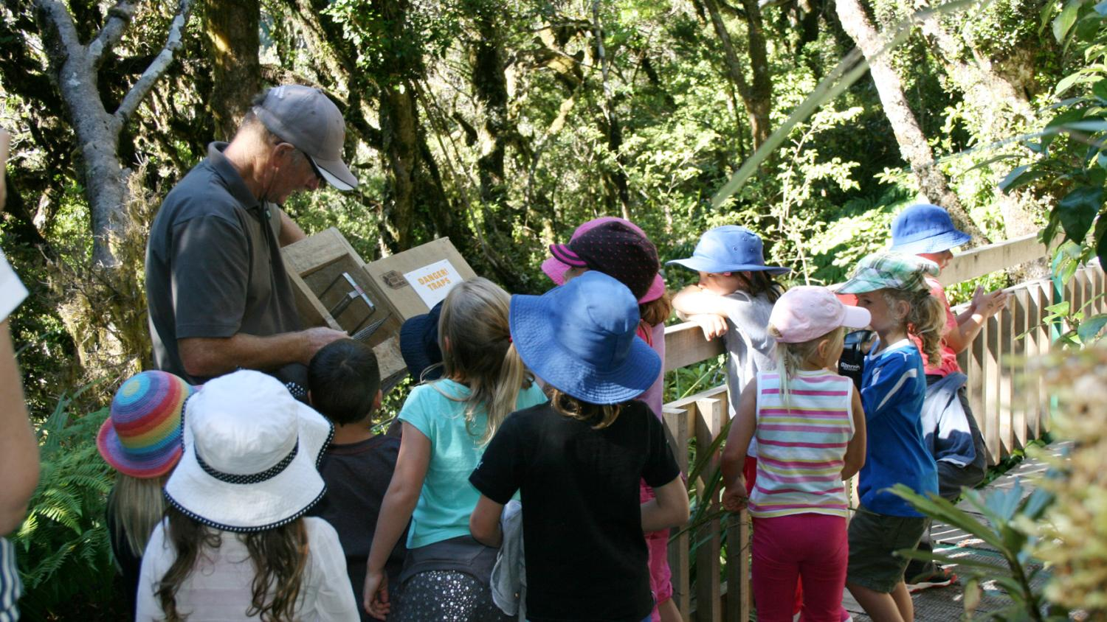
WHAT ACTIONS COULD WE DO TO HELP THE WHIO?
Notes:
Refer back to slides 4 and 5, and look at these pictures to get ideas about possible actions your students might come up with.

Slide 16
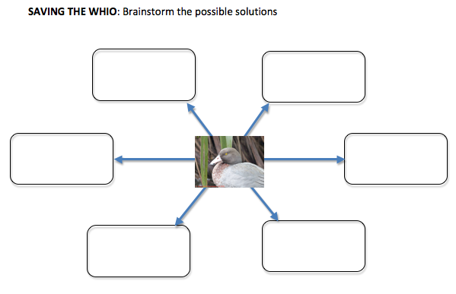
IDENTIFYING ACTIONS
Notes:
Using simple graphic organisers to support students to sort their ideas.

Slide 17
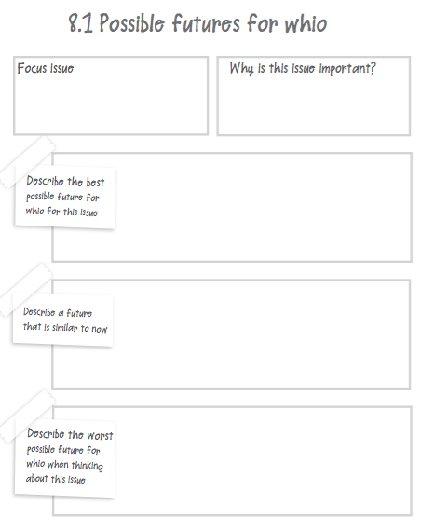
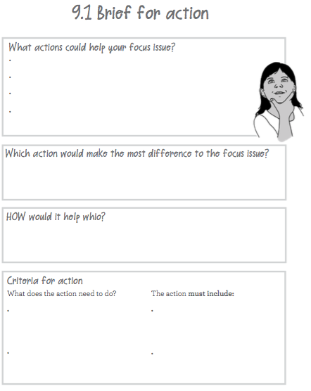
WHICH ACTION WILL BE BEST?
Notes:
Thinking of future focus, what are we wanting to achieve? What actions might achieve that?

Slide 18
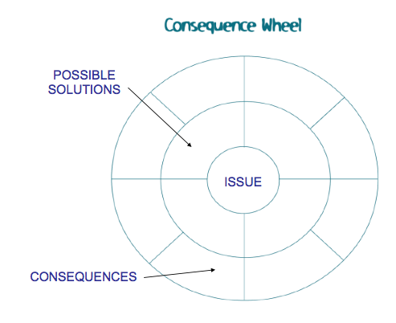
WHICH ACTION WILL BE BEST?
THE CONSEQUENCE WHEEL
Possible solutions
Issue
Consequences –
pros and cons

Slide 19
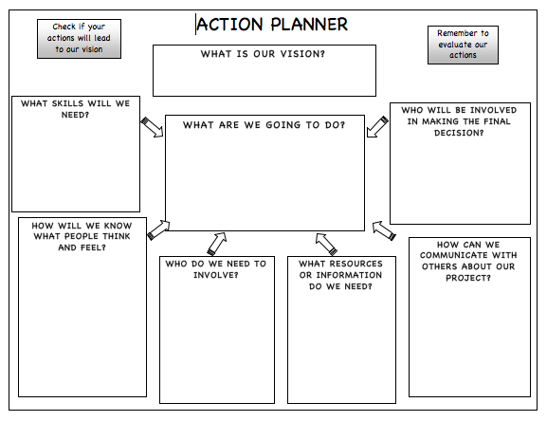
PLANNING ACTION

Slide 20
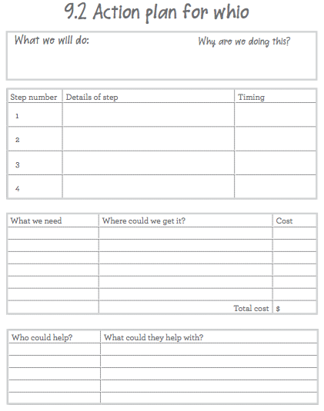
DETAILS OF PLANNING

Slide 21
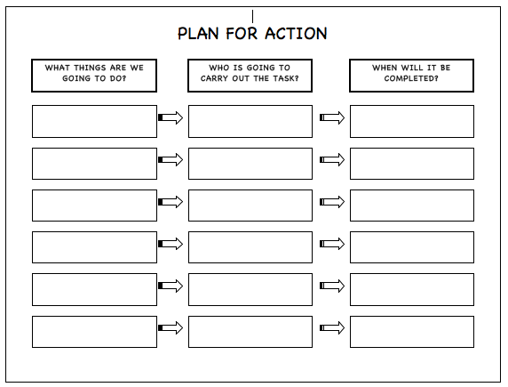
WHO DOES WHAT AND WHEN?

Slide 22
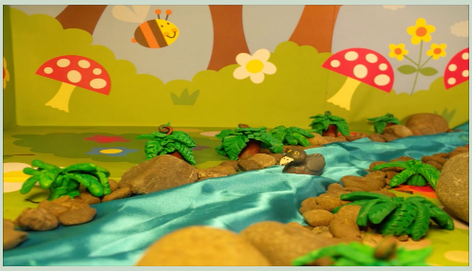
OFFERING INSPIRATION FOR ACTION
Whenua finds a future http://www.theoutlookforsomeday.net/films/2015/014
Notes:
Video is here www.theoutlookforsomeday.net/films/2015/014.

Slide 23
WHAT NEXT? Useful websites and links
Twitter https://twitter.com/NZScienceLearn
https://twitter.com/
Facebook www.facebook.com/nzsciencelearn
https://www.facebook.com/wildsidenz
Pinterest https://nz.pinterest.com/nzsciencelearn/
https://nz.pinterest.com/docgovtnz/conservation-activities-for-kids/
Whio Forever
http://www.whioforever.co.nz/about-the-whio/find-a-whio
http://www.whioforever.co.nz/about-the-whio/find-a-whio
DOC
http://www.doc.govt.nz/education
Enquiries
conserved@doc.govt.nz
DOC Conservation Education e-newsletter http://createsend.com/t/i-4B26445CA4C4D7BD
Science Learning Hub
https://www.sciencelearn.org.nz
Enquiries
enquiries@nzsciencelearn.org.nz

Slide 24
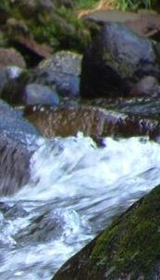
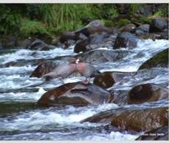
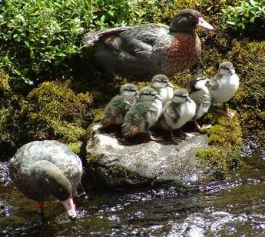
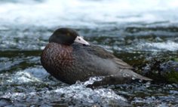
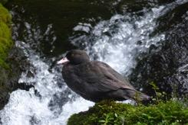
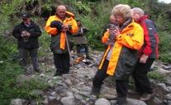
THANKS AND … CHALLENGE YOURSELVES
What have you learned in this/these webinar(s)?
What are you going to put into practice as a result of this/these webinar(s)?
The images contained within this PowerPoint presentation are copyrighted to the University of Waikato and other third-party individuals and organisations. Any reuse beyond the classroom as per the intended use of these resources should be cleared with the copyright owner/s.

