Slide 1
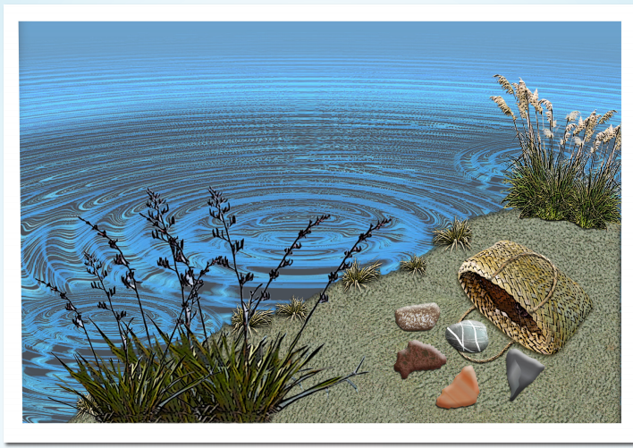
Ethical thinking in science
Lyn Rogers
and
Andrea Soanes
3 August
2017
4–4:45 pm
© Copyright. University of Waikato. All Rights Reserved | www.sciencelearn.org.nz
All images are copyrighted. For further information, please refer to enquiries@sciencelearn.org.nz

Slide 2
Welcome to ethical thinking in science Introducing the Science Learning Hub Ethics thinking toolkit
We aim to:
support you to extend your students’ critical thinking
use the toolkit to explore ethical issues in various science contexts
model strategies to support your students’ thinking in science.
© Copyright. University of Waikato. All Rights Reserved | www.sciencelearn.org.nz
All images are copyrighted. For further information, please refer to enquiries@sciencelearn.org.nz

Slide 3
What is ethics?
Participants’ ideas
Why do we teach it?
Principles that govern people’s
behaviour and actions
As we learn more, we can change our opinion
Because our students are making future decisions based on their past experiences and values
It is about how science is applied
and how research is carried out
A principle that
guides our
decisions
To encourage a deeper level of
enquiry and critiquing
Our values
It encourages students to think a little bit deeper and on individual levels
Ethics is thinking about the moral
issues that face our society
To understand that science/technology
decisions have consequences
Rights/responsibilities/
values/thinking
Students need to consider the outcomes of science
© Copyright. University of Waikato. All Rights Reserved | www.sciencelearn.org.nz
All images are copyrighted. For further information, please refer to enquiries@sciencelearn.org.nz
Notes:
All these ideas are correct

Slide 4
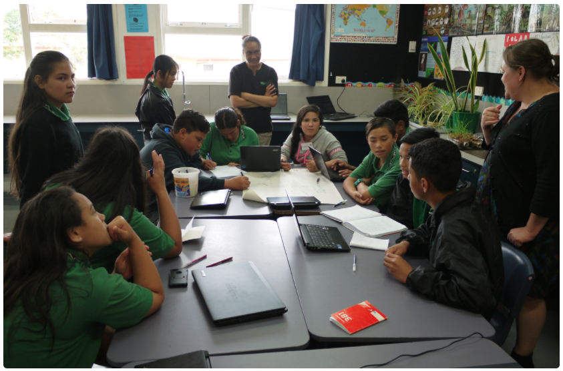
What is ethics?
“Ethics is the study of why certain decisions are understood to be morally right or morally wrong and the reasoned views behind making these judgements.”
Sarah Morgan/Comet Auckland
© Copyright. University of Waikato. All Rights Reserved | www.sciencelearn.org.nz
All images are copyrighted. For further information, please refer to enquiries@sciencelearn.org.nz
Notes:
Quote from www.sciencelearn.org.nz/resources/2146-frameworks-for-ethical-analysis

Slide 5
Curriculum connections
The NZC ‘front end’
Vision – lifelong learners are literate and numerate; critical and creative thinkers; active seekers, creators and users of knowledge and are informed decision makers.
Principles – all, depending on the context.
Key competencies – thinking; participating and contributing.
Values – all.
© Copyright. University of Waikato. All Rights Reserved | www.sciencelearn.org.nz
All images are copyrighted. For further information, please refer to enquiries@sciencelearn.org.nz
Notes:
Ref. NZC pages 7-13

Slide 6
Curriculum connections – values
The NZC requires that students develop their ability to:
express their own values
explore, with empathy, the values of others
critically analyse values and actions based on them
discuss disagreements that arise from differences in values and negotiate solutions
make ethical decisions and act on them.
© Copyright. University of Waikato. All Rights Reserved | www.sciencelearn.org.nz
All images are copyrighted. For further information, please refer to enquiries@sciencelearn.org.nz
Notes:
Ref. NZC page 10

Slide 7
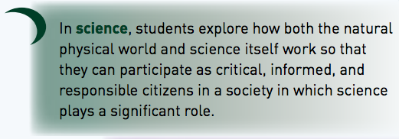
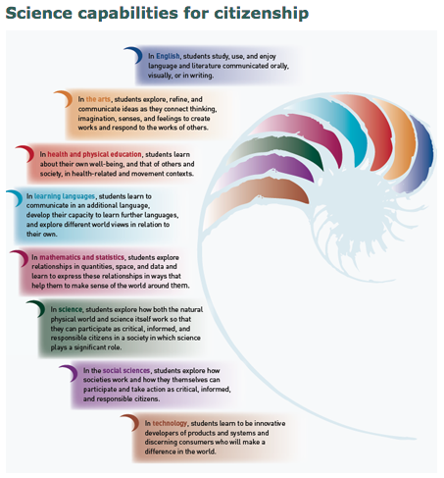
Specifically science – curriculum connections
Nature of science
“They learn how science ideas are communicated and to make links between scientific knowledge and everyday decisions and actions.”
Participating and contributing – bring a scientific perspective to decisions and actions as appropriate.
© Copyright. University of Waikato. All Rights Reserved | www.sciencelearn.org.nz
All images are copyrighted. For further information, please refer to enquiries@sciencelearn.org.nz
Notes:
The Nature of science NZC page 28. By Level 3 (Science) students are asked to explore various aspects of an issue and make decisions about possible actions. This is the socio-scientific issues aspect in the senior science curriculum.

Slide 8
Science connections (continued)
Science capabilities
Engage with science – “This capability requires students to use the other capabilities to engage with science in real-life contexts. It involves students taking an interest in science issues, participating in discussions about science and at times taking action.”
Critique evidence – “… scientifically literate citizens need to think about who benefits from any particular findings …”
123RF Ltd
© Copyright. University of Waikato. All Rights Reserved | www.sciencelearn.org.nz
All images are copyrighted. For further information, please refer to enquiries@sciencelearn.org.nz
Notes:
http://scienceonline.tki.org.nz/Science-capabilities-for-citizenship

Slide 9
What is the difference between morals and ethics? Some participants’ ideas – food for thought
Ethics is making a decision based on your knowledge of right and wrong
Moral is what you know is
right and wrong
Morals are where you sit on ethics
Ethics tend to be about the external –
an external shared conduct.
Morals are more individual.
Morals are personal, whereas ethics are
more of a social/group thing
© Copyright. University of Waikato. All Rights Reserved | www.sciencelearn.org.nz
All images are copyrighted. For further information, please refer to enquiries@sciencelearn.org.nz
Notes:
Ask participants what their ideas are, and why they think it is important. Brainstorm ideas into chat if this hasn’t been already established.

Slide 10
Morals versus ethics
To have an ethical viewpoint, you have to be able to give some reason for it.
An ethical conclusion is more likely to be valid if:
the arguments that lead to the particular conclusion are convincingly supported by sound reasoning
the arguments are conducted within a well established ethical framework
a reasonable degree of consensus exists about the validity of the conclusion, as confirmed by a process of genuine debate.
© Copyright. University of Waikato. All Rights Reserved | www.sciencelearn.org.nz
All images are copyrighted. For further information, please refer to enquiries@sciencelearn.org.nz
Notes:
Quote from Dr Michael Reiss www.sciencelearn.org.nz/videos/1358-ethics-vs-morals

Slide 11
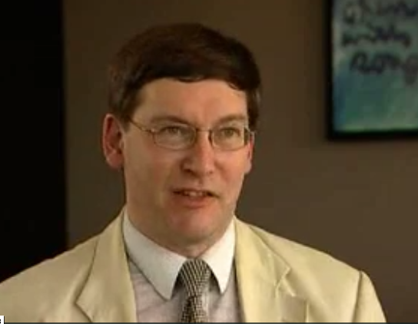
Dr Michael Reiss – why discuss ethics?
“Real world ethical discussions often
don’t reach any consensus
for a very long time.”
“In many ways, the discussion is the best part because it brings out the complexity of the issue and makes people aware of viewpoints they may not have otherwise considered. In the classroom it works best when students draw on what they already know, and then develop their thinking to find themselves reasoning in ways that they hadn’t previously appreciated.”
© Copyright. University of Waikato. All Rights Reserved | www.sciencelearn.org.nz
All images are copyrighted. For further information, please refer to enquiries@sciencelearn.org.nz
Notes:
Video ‘Introducing ethics in teaching’ www.sciencelearn.org.nz/videos/1362-introducing-ethics-in-teaching
“… for a society that is going to cohere and work together, you don’t of course need everyone to have the same ethical viewpoints … but you [probably] need people to be able to respect one another, [even] if they have very different ethical viewpoints.”

Slide 12
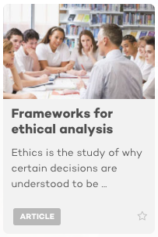
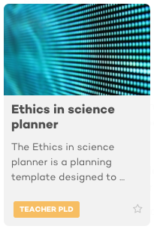
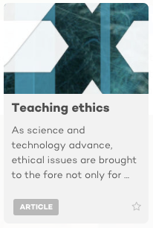
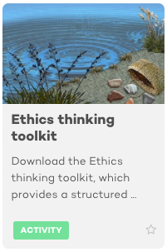
Science Learning Hub connections
123RF Ltd
123RF Ltd
Check out the ethics and science topic for a range of ethics resources
© Copyright. University of Waikato. All Rights Reserved | www.sciencelearn.org.nz
All images are copyrighted. For further information, please refer to enquiries@sciencelearn.org.nz
Notes:
www.sciencelearn.org.nz/resources/2146-frameworks-for-ethical-analysis
www.sciencelearn.org.nz/resources/2150-teaching-ethics
www.sciencelearn.org.nz/resources/2148-ethics-in-science-planner
www.sciencelearn.org.nz/resources/2363-ethics-thinking-toolkit

Slide 13
Some contexts we could use to foster ethical thinking
Kaimanawa horses – what are the rights of introduced species?
Conservation - Why save some animals (or plants) and not others?
Water quality and use
HPV immunisation
How do we decide what to spend our money, energy and resources on? E.g. research, conservation
123RF Ltd
Almost any topic can offer some chance to discuss ethics or to do some ethical thinking
Fossils – is it ethical to remove them and take/sell/display them away from the country that the discovery was made in?
Cloning
Embryology
Climate change
Māori kites – there are 7 ancient kites in the whole world but only 2 in Te Papa. Why? Where are the rest?
Plastic in the ocean
Should Māori taonga be in overseas museums?
Can anyone own the DNA of a plant?
Palm oil
© Copyright. University of Waikato. All Rights Reserved | www.sciencelearn.org.nz
All images are copyrighted. For further information, please refer to enquiries@sciencelearn.org.nz

Slide 14
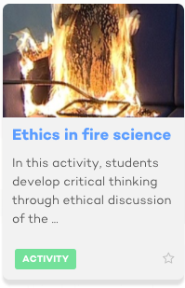
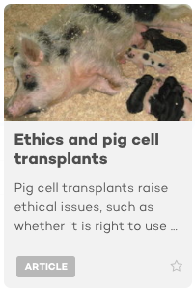
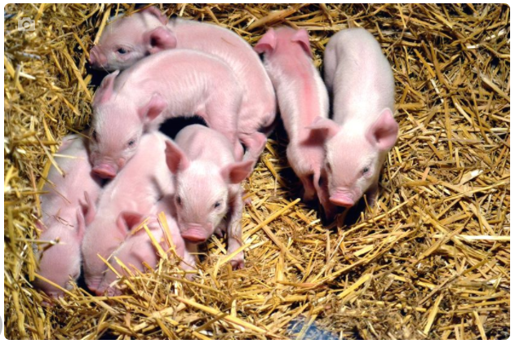
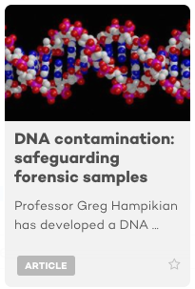
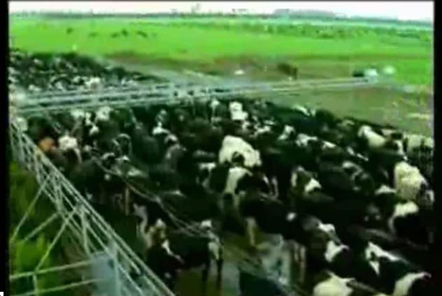
Using the Hub to explore ethical issues
LCT
Glyn Lewis, licensed through 123RF Ltd
Wellcome Creative CC 2.0
© Copyright. University of Waikato. All Rights Reserved | www.sciencelearn.org.nz
All images are copyrighted. For further information, please refer to enquiries@sciencelearn.org.nz
Notes:
You can use our resources, activities, articles, photos or videos as a basis for ethical discussions or for information to explore an issue.
www.sciencelearn.org.nz/resources/795-ethics-in-fire-science
www.sciencelearn.org.nz/resources/911-ethics-and-pig-cell-transplants
www.sciencelearn.org.nz/resources/2242-dna-contamination-safeguarding-forensic-samples
Photos from www.sciencelearn.org.nz/resources/1215-ethics-and-xenotransplantation and
www.sciencelearn.org.nz/videos/639-bioethics-and-biotechnology-research-in-new-zealand
Ask participants what their ideas are, and why they think it is important.
14

Slide 15
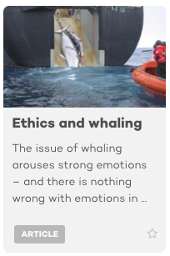
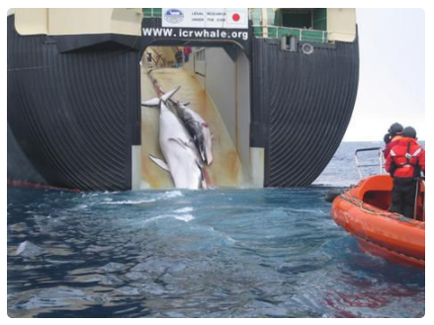
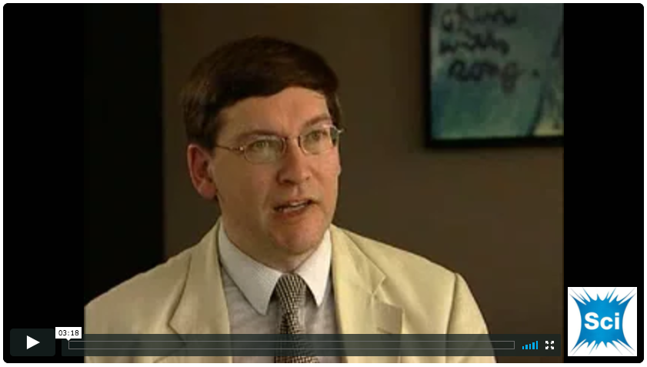
Exploring an issue – whaling
© Australian Customs and Border Protection Service
© Copyright. University of Waikato. All Rights Reserved | www.sciencelearn.org.nz
All images are copyrighted. For further information, please refer to enquiries@sciencelearn.org.nz
Notes:
Lets’ look at one context in a little more detail. Eg. whaling
Show video ‘The ethics of whaling’ www.sciencelearn.org.nz/videos/1365-the-ethics-of-whaling
www.sciencelearn.org.nz/resources/2147-ethics-and-whaling
Discuss that he only looked at a small number of aspects to do with the ethics of whaling, and that to make any decisions regarding this

Slide 16
Using the toolkit to explore ethical issues
© Copyright. University of Waikato. All Rights Reserved | www.sciencelearn.org.nz
All images are copyrighted. For further information, please refer to enquiries@sciencelearn.org.nz

Slide 17
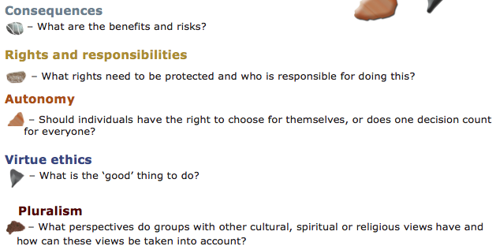
Using ethical frameworks
© Copyright. University of Waikato. All Rights Reserved | www.sciencelearn.org.nz
All images are copyrighted. For further information, please refer to enquiries@sciencelearn.org.nz

Slide 18
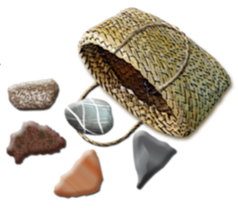
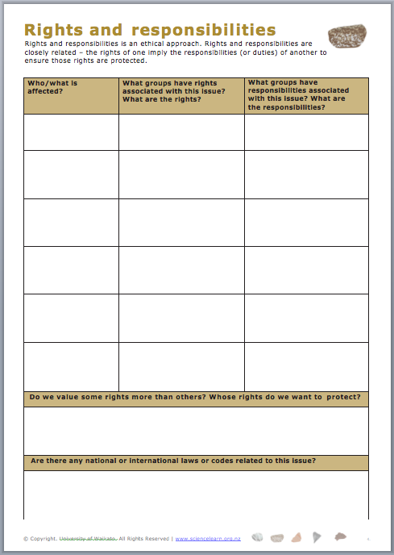
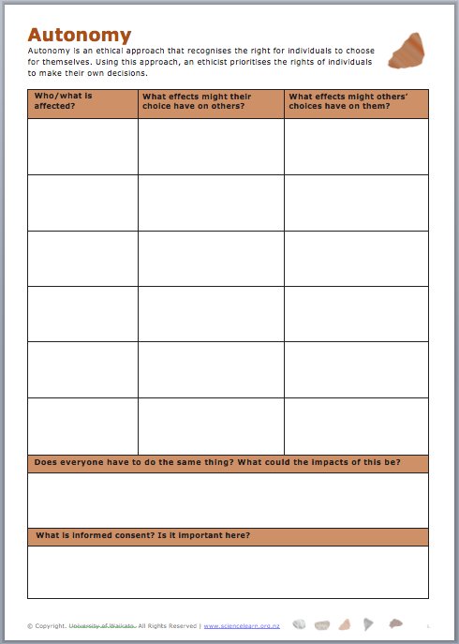
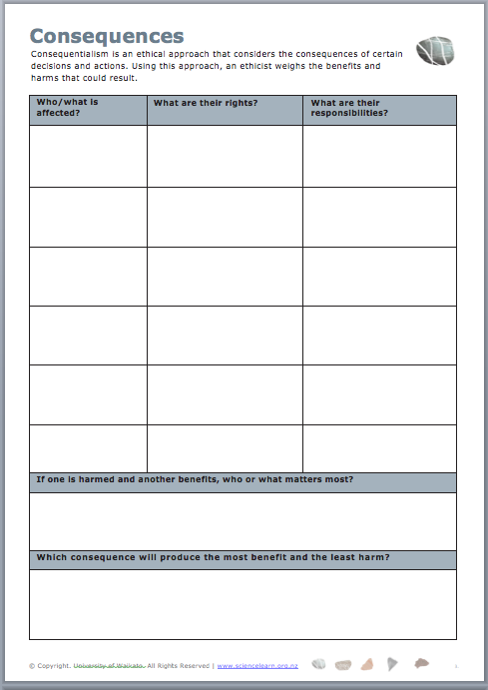
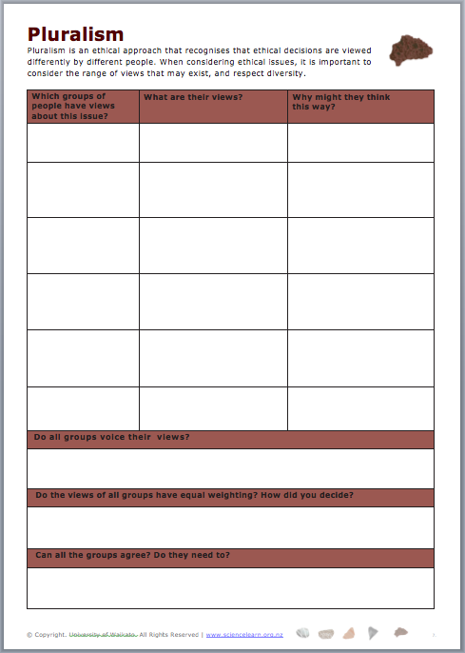
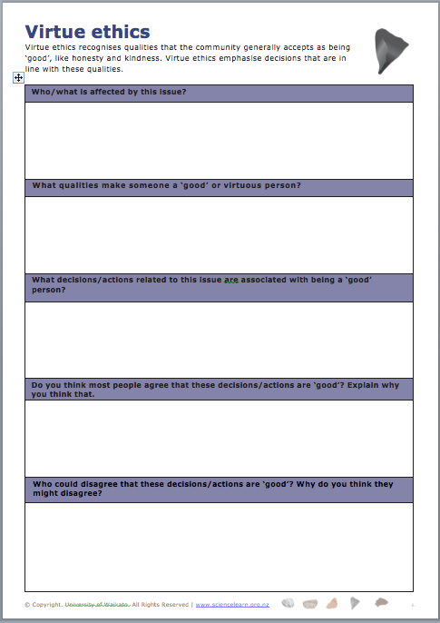
Using ethical frameworks – the toolkit
© Copyright. University of Waikato. All Rights Reserved | www.sciencelearn.org.nz
All images are copyrighted. For further information, please refer to enquiries@sciencelearn.org.nz

Slide 19
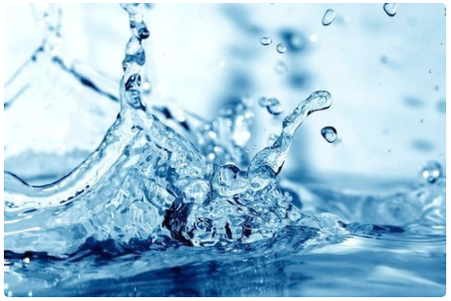
Using the toolkit first step – identify the issue
123RF Ltd
© Copyright. University of Waikato. All Rights Reserved | www.sciencelearn.org.nz
All images are copyrighted. For further information, please refer to enquiries@sciencelearn.org.nz
Notes:
Using headlines to identify an issue.
19

Slide 20
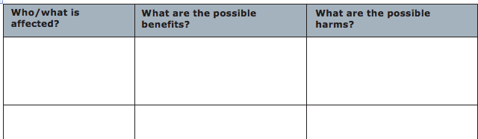
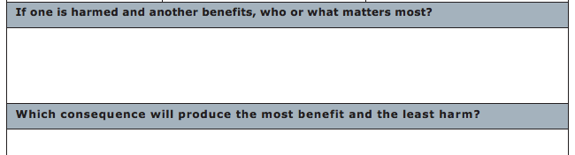
© Copyright. University of Waikato. All Rights Reserved | www.sciencelearn.org.nz
All images are copyrighted. For further information, please refer to enquiries@sciencelearn.org.nz

Slide 21
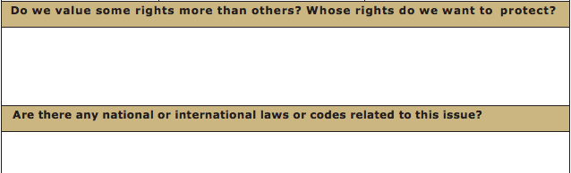
© Copyright. University of Waikato. All Rights Reserved | www.sciencelearn.org.nz
All images are copyrighted. For further information, please refer to enquiries@sciencelearn.org.nz

Slide 22
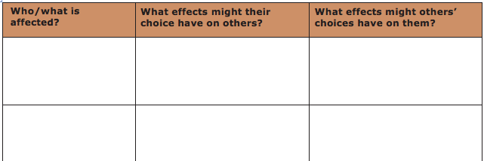
© Copyright. University of Waikato. All Rights Reserved | www.sciencelearn.org.nz
All images are copyrighted. For further information, please refer to enquiries@sciencelearn.org.nz

Slide 23
© Copyright. University of Waikato. All Rights Reserved | www.sciencelearn.org.nz
All images are copyrighted. For further information, please refer to enquiries@sciencelearn.org.nz

Slide 24
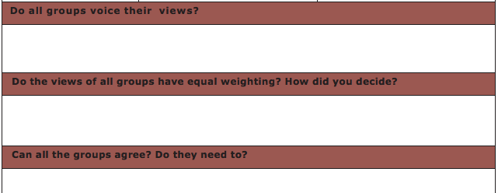
© Copyright. University of Waikato. All Rights Reserved | www.sciencelearn.org.nz
All images are copyrighted. For further information, please refer to enquiries@sciencelearn.org.nz
Notes:
24

Slide 25
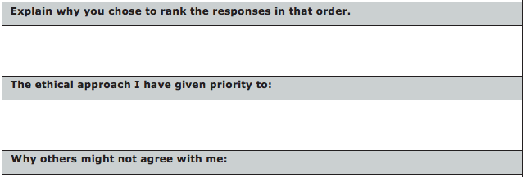
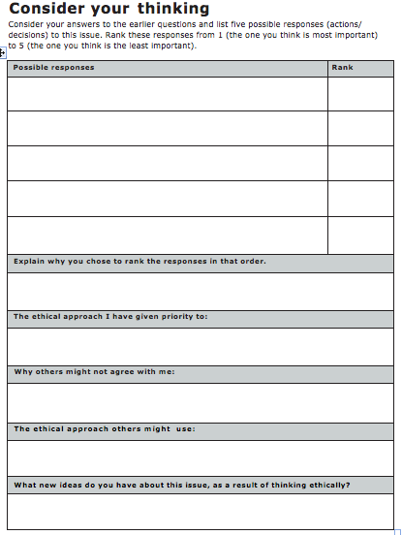
Thinking about it all
© Copyright. University of Waikato. All Rights Reserved | www.sciencelearn.org.nz
All images are copyrighted. For further information, please refer to enquiries@sciencelearn.org.nz
Notes:
That there may not be any ‘right’ answer. These questions are to reflect on any learning, etc. Go through the questions one at a time, discussing that even now there may be no resolution or consensus. What is the role of scientific evidence in all this?

Slide 26
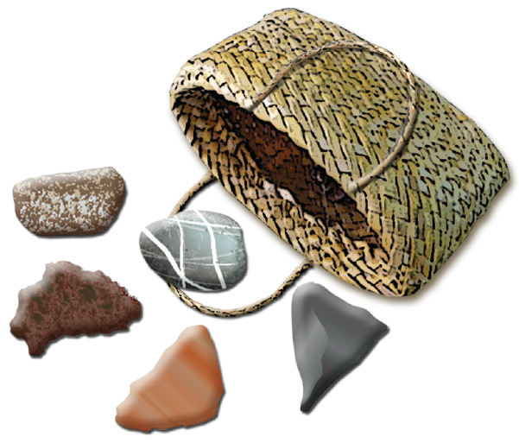
Pedagogy – some strategies and activities
Case studies; ‘What if…’ scenarios; debates; class discussions; concept cartoons; guest speakers; mantle of the expert; media analysis; PMI; noisy round robin; presentations to an audience; reciprocal reading; role-play; silent/noisy card shuffle; small group discussions; values continuum; view a painting or photo and discuss the issues behind the painting; using graphic organisers and other strategies to scaffold students’ writing; think, pair, share.
© Copyright. University of Waikato. All Rights Reserved | www.sciencelearn.org.nz
All images are copyrighted. For further information, please refer to enquiries@sciencelearn.org.nz

Slide 27
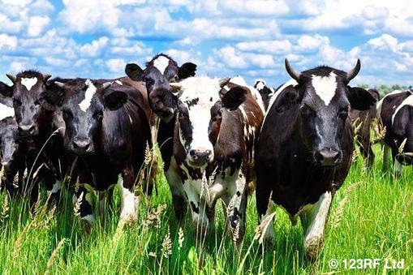
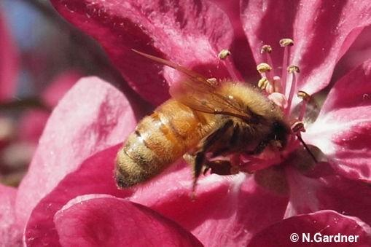
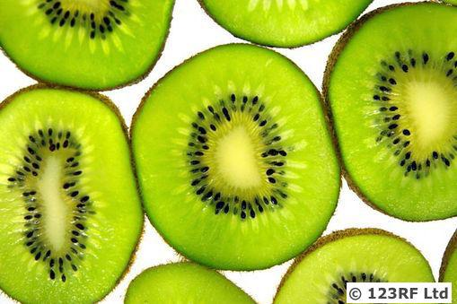
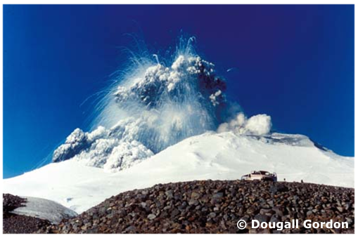
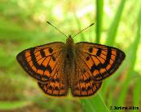
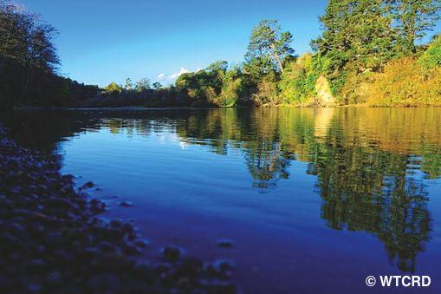
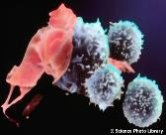
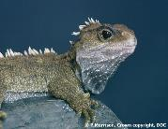
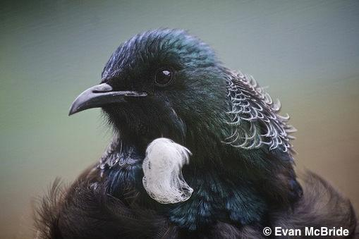
What ethical thinking opportunities do I already offer my students?
What have I learned?
What new ideas will I put into practice?
Thanks!
The images contained within this PowerPoint presentation are copyrighted to the University of Waikato and other third-party individuals and organisations. Any reuse beyond the classroom as per the intended use of these resources should be cleared with the copyright owner/s.

Slide 28
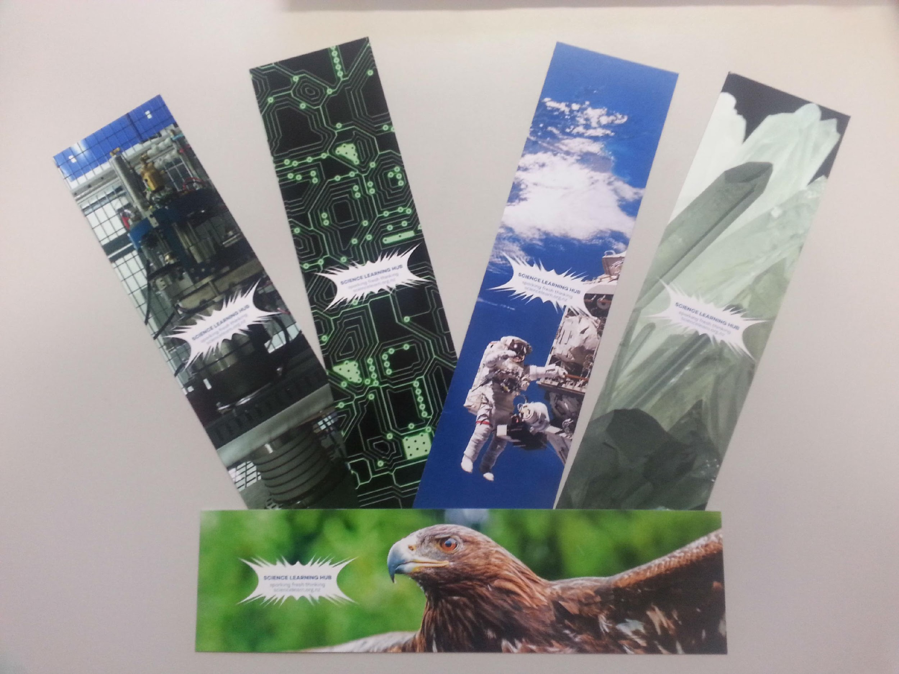
What next? Stay in touch
Email us on enquiries@sciencelearn.org.nz
https://twitter.com/NZScienceLearn
www.facebook.com/nzsciencelearn
https://nz.pinterest.com/nzsciencelearn
www.instagram.com/sciencelearninghubnz
Any questions or ideas, or if you would like some bookmarks
email us enquiries@sciencelearn.org.nz
© Copyright. University of Waikato. All Rights Reserved | www.sciencelearn.org.nz
All images are copyrighted. For further information, please refer to enquiries@sciencelearn.org.nz
Notes:
28

