Slide 1
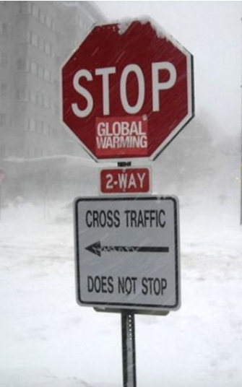
Science and literacy – making connections
Lyn Rogers
and
Angela Schipper
Thursday 31 August
2017
4–4.45 pm
AgnosticPreachersKid
CC 3.0
© Copyright. University of Waikato. All Rights Reserved | www.sciencelearn.org.nz

Slide 2
Index
Topic PowerPoint slide number(s)
Introduction, welcome and purpose 1–3
Exploring how learning literacy through science differs from developing scientific literacy 4–8
Nature of science connections 9
Some basic assumptions 10
Literacy in science – planning 11–14
Vocabulary building 15–19
Comprehension and text structures 20–22
Combining literacy and science 23–24
Using the Hub to immerse in context 25–27
Relevant practice 28
Useful resources 29–30
Reflection questions and thanks 31
Want to keep connected? SLH links 32

Slide 3
Welcome to Science and literacy – making connections
In this webinar we will:
discuss how learning literacy through science learning differs from developing scientific literacy
explore the connections between science and literacy learning and how the two can be complementary
identify a range of strategies designed to deliberately incorporate literacy learning opportunities into science contexts.
AgnosticPreachersKid
CC 3.0
© Copyright. University of Waikato. All Rights Reserved | www.sciencelearn.org.nz

Slide 4
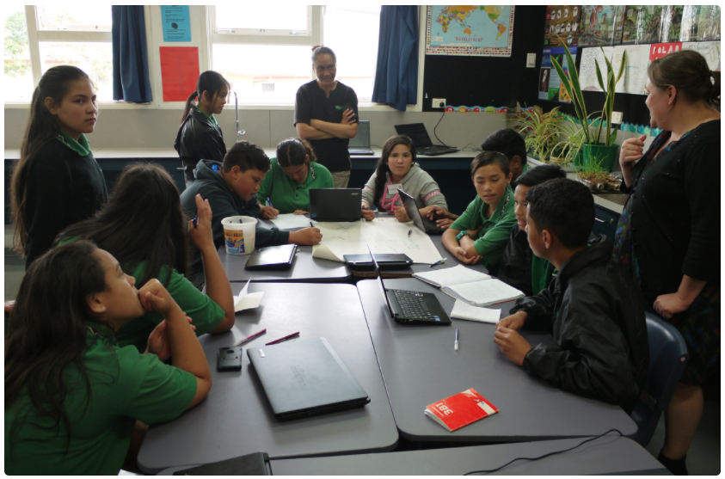
How does learning literacy through science differ from developing scientific literacy?
What is science literacy?
What is scientific literacy?
What is the difference between these and literacy in science?
Sarah Morgan/Comet Auckland
© Copyright. University of Waikato. All Rights Reserved | www.sciencelearn.org.nz
Notes:
What do these terms mean, how are they similar, how are they different?

Slide 5
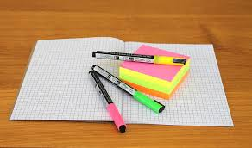
Science literacy is …
… the content knowledge and vocabulary of science
(NZ Science Teacher, Journal Number 129, 2012)
Some participants’ responses:
… the language that is specific to science
… being able to understand the language of science
… using scientific vocabulary and ideas
… understanding science concepts
… the discourse and language associated with science
… being critical consumers of scientific information
… understanding and being able to communicate scientific ideas
... the ability to explain scientific concepts
© Copyright. University of Waikato. All Rights Reserved | www.sciencelearn.org.nz

Slide 6
Scientific literacy is…
… the understanding of scientific concepts and processes required for personal decision making, participation in civic and cultural affairs, and economic productivity
US National Center for Education Statistics
…the ability to engage with science-related issues, and with the ideas of science, as a reflective citizen OECD PISA framework 2015
Some participants’ responses:
… becoming familiar with not only scientific terms and language but understanding how science works within the world
… understanding the nature of science
… using a scientific lens when looking at problems and questions
… using science methods and key science theories to help you understand science ideas that you may face in your everyday life
… to think like a scientist
… about understanding and using science ideas in the wider world
© Copyright. University of Waikato. All Rights Reserved | www.sciencelearn.org.nz

Slide 7
Literacy is…
… the ability to understand, respond to and use those forms of written language that are required by society and valued by individuals and communities (MoE) – literacy in science is simply applying these skills in a science context
Some participants’ responses:
… using science as a context to develop reading and writing
… using science ideas and vocabulary in reading and writing
… being able to understand science through reading and writing
… using literacy skills to help organise thinking that science has encouraged, e.g. students having the opportunity to use graphic organisers to record data and using this to provide a base for literacy
… as teachers, being able to understand key concepts and integration of both science and literacy learning areas
© Copyright. University of Waikato. All Rights Reserved | www.sciencelearn.org.nz
Notes:
Looking at the curriculum and linking science and literacy, we are also looking at building visual and oral literacy skills. These can lend themselves to support development of written literacy. Science uses these skills also, e.g. reading some scientific material will require visual interpretation, and some science concepts are better expressed in a visual way.

Slide 8
Comparing definitions
Science literacy: the content and vocabulary of science
Scientific literacy: the understanding of scientific concepts and processes required for personal decision making, participation in civic and cultural affairs, and economic productivity or the ability to engage with science-related issues, and with the ideas of science, as a reflective citizen
Literacy: the ability to understand, respond to and use those forms of written language that are required by society and valued by individuals and communities
Literacy in science: literacy skills are needed for science communication and to access science understandings
© Copyright. University of Waikato. All Rights Reserved | www.sciencelearn.org.nz

Slide 9
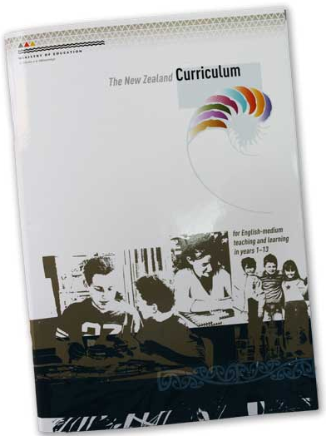
Nature of science
Understanding about science
Learn about science as a knowledge system – the features of scientific knowledge and the processes by which it is developed – and learn about the ways in which the work of scientists interacts with society.
Investigating in science
Carry out science investigations using a variety of approaches: classifying and identifying, pattern seeking, exploring, investigating models, fair testing, making things or developing systems.
Communicating in science
Develop knowledge of the vocabulary, numeric and symbol systems, and conventions of science and use this knowledge to communicate about their own and others’ ideas.
Participating and contributing
Bring a scientific perspective to decisions and actions as appropriate.
© Copyright. University of Waikato. All Rights Reserved | www.sciencelearn.org.nz
Notes:
Connecting science and literacy is important because language is the key to expressing understandings, communicating and problem solving in all subjects.
Language helps a learner reflect upon and describe observed relationships, ask salient questions of peers or teachers and understand instructions and explanations given by others.

Slide 10
Some basic assumptions
Year 1–5 students are learning to read.
Year 6–13 students are reading to learn.
To write well, students must be able to read well.
All students come into this class or context with some knowledge, experience, skills and/or preconceptions, and our job as teachers is to find out what these are.
Through relevant practice, we can deliberately plan to offer students multiple and varied opportunities to build on what they know; ways of practising new ideas, skills and understandings.
“The greatest obstacle to enjoying and learning science for many students is the language barrier.”
© Copyright. University of Waikato. All Rights Reserved | www.sciencelearn.org.nz
Notes:
Quote from Henderson and Wellington (1998)

Slide 11
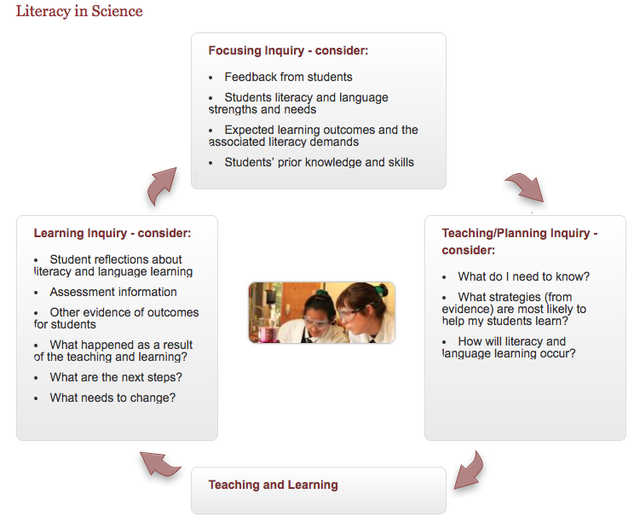
Literacy in science – planning
What next?
Knowing your students
Putting it into practice
Planning for their needs
How did it go?
Infographic from Literacy Online/TKI
© Copyright. University of Waikato. All Rights Reserved | www.sciencelearn.org.nz
Notes:
How are you going to take the information you have about your students into account when you are planning? Think of strategies, topics etc. that might meet the needs and interests of your students. If your students are struggling with reading, what might be the cause? Are they having difficulty with decoding or comprehension or both? This is the first question to ask yourself. 10% of your struggling students will be having difficulty with each of these and 20% with both.

Slide 12
Knowing your students – what do they know?
Formal assessment
NZCER has a nature of science formative assessment that asks questions about what vocab/equipment they have used in the past.
Thinking with evidence test.
English as a second language resources are great.
Co-operative learning resources.
Formative assessments.
:
Prior learning
Look at previous grades.
Observe them during learning tasks and in social contexts.
Talk to colleagues, e.g. former teachers and via discussions at syndicate and science department meetings.
Use parental voice.
Have conversations with the students themselves.
Use introductory and fun questionnaires, Google surveys, e.g. to start a topic or a year.
:
© Copyright. University of Waikato. All Rights Reserved | www.sciencelearn.org.nz
Notes:
These were some ideas the participants shared in the live webinar. Think of your classes. How do you find out about your students? Focus on knowing your students’ learning needs in literacy and science to plan for their learning. Check out our discussion forum for more specific references.

Slide 13
Knowing your students – what interests them?
Get to know students’ families, e.g. what their parents do for a job, what they do in the weekends.
Talk to the parents about their children.
Spend time talking to the students themselves, individually and regularly, finding out what interests them, e.g. before school.
By just listening to them, children will share their interests and what they think about.
Provide plenty of opportunities for communication.
Ask them explicitly about their experiences, e.g. ask what science things they did before school, today, in the weekend?:
© Copyright. University of Waikato. All Rights Reserved | www.sciencelearn.org.nz
Notes:
These were some ideas the participants shared in the live webinar. Think of your classes. How do you find out about your students?

Slide 14
Knowing your students – planning opportunities to share
Provide plenty of opportunities for communication, e.g. using talk partners, discussions, sharing ideas, working in groups, co-operative learning strategies.
Talk about what they already know – let them know you value their ideas and what they can do, e.g. via brainstorms and class discussions, prompting questions, conversations.
Buddy science – seniors with juniors.
Use the teachable moment – students are good at noticing new things, especially bugs and bringing them in to share. Encourage this.
Include lots of picture book discussions on science topics.
Start from what interests them, then you can draw on their prior knowledge and use their experiences.
Provide plenty of hands-on exploration and experiences to talk about, feel, describe.
Be explicit about ‘doing’ science.
© Copyright. University of Waikato. All Rights Reserved | www.sciencelearn.org.nz
Notes:
These were some ideas the participants shared in the live webinar. What opportunities do you offer?

Slide 15
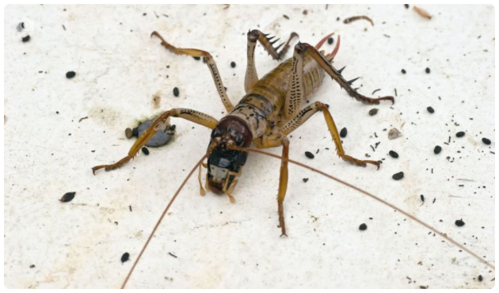
Vocabulary building – wētā as a context
What words do your students already know?
Are there any new words here?
Give students time/opportunities to identify these, guess, predict, check and share their meanings.
Andy Heyward/licensed through 123RF Ltd
© Copyright. University of Waikato. All Rights Reserved | www.sciencelearn.org.nz
Notes:
Do all our students know the essential words, what they mean, how they might be used? Make no assumptions. We have chosen this text (from the SLH), as our texts are designed for teachers and this was chosen to suit our audience.
When teaching science, we can’t assume that only the science words are the new ones.
15

Slide 16
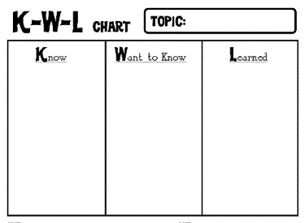
Vocabulary building – wētā as a context
Tree wētā are the most common of New Zealand’s wētā species. They live in native bush and backyard gardens throughout most of the country except for parts of Otago and Southland. There are seven species of tree wētā, and many are associated with specific geographic locations. The wētā species have scientific names, common names and Māori names.
Andy Heyward/licensed through 123RF Ltd
Wētā
© Copyright. University of Waikato. All Rights Reserved | www.sciencelearn.org.nz
Notes:
Really important to look at your students when choosing appropriate strategies. It is important also to anticipate which words may be tricky. Take the opportunities as they arise to connect the known to the new (e.g. new words ‘species’ and ‘specific’ are similar to ‘special’.)

Slide 17
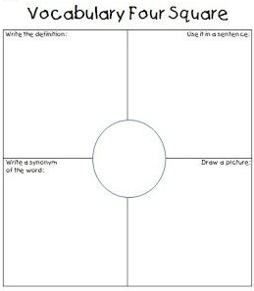
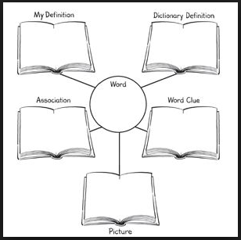
Vocabulary strategies
© Copyright. University of Waikato. All Rights Reserved | www.sciencelearn.org.nz

Slide 18
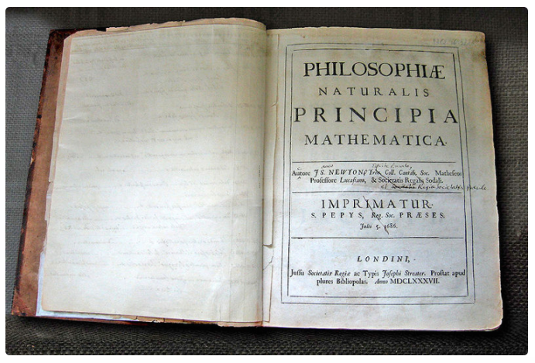
Vocabulary building
In summary, here are some useful strategies you can use to help students build their vocabulary:
Decide which words may need explicit instruction.
Discuss the words – what do they look like, sound like, mean?
Explore connections to other words – link to words they know, look for clues as to what it could mean or how to remember it, e.g. look at roots, prefixes, suffixes.
Explore any alternative meanings.
Look at synonyms.
Use scaffolding materials such as graphic organisers.
Look for clues in the text or pictures.
Andrew Dunn/CC 2.0
© Copyright. University of Waikato. All Rights Reserved | www.sciencelearn.org.nz
Notes:
Research suggests students need to add between 2,000 and 3,000 words a year to their vocabulary to keep their reading progress on track. Knowing your students, their interests, their community etc. will help explore the connections between what they know and new words. Choose the most important words to focus on – the most common or crucial to understanding the context/topic.

Slide 19
Vocabulary building
Andrew Dunn/CC 2.0
© Copyright. University of Waikato. All Rights Reserved | www.sciencelearn.org.nz
Notes:
What connections could we make with the words in the title of the book in the picture on screen?

Slide 20
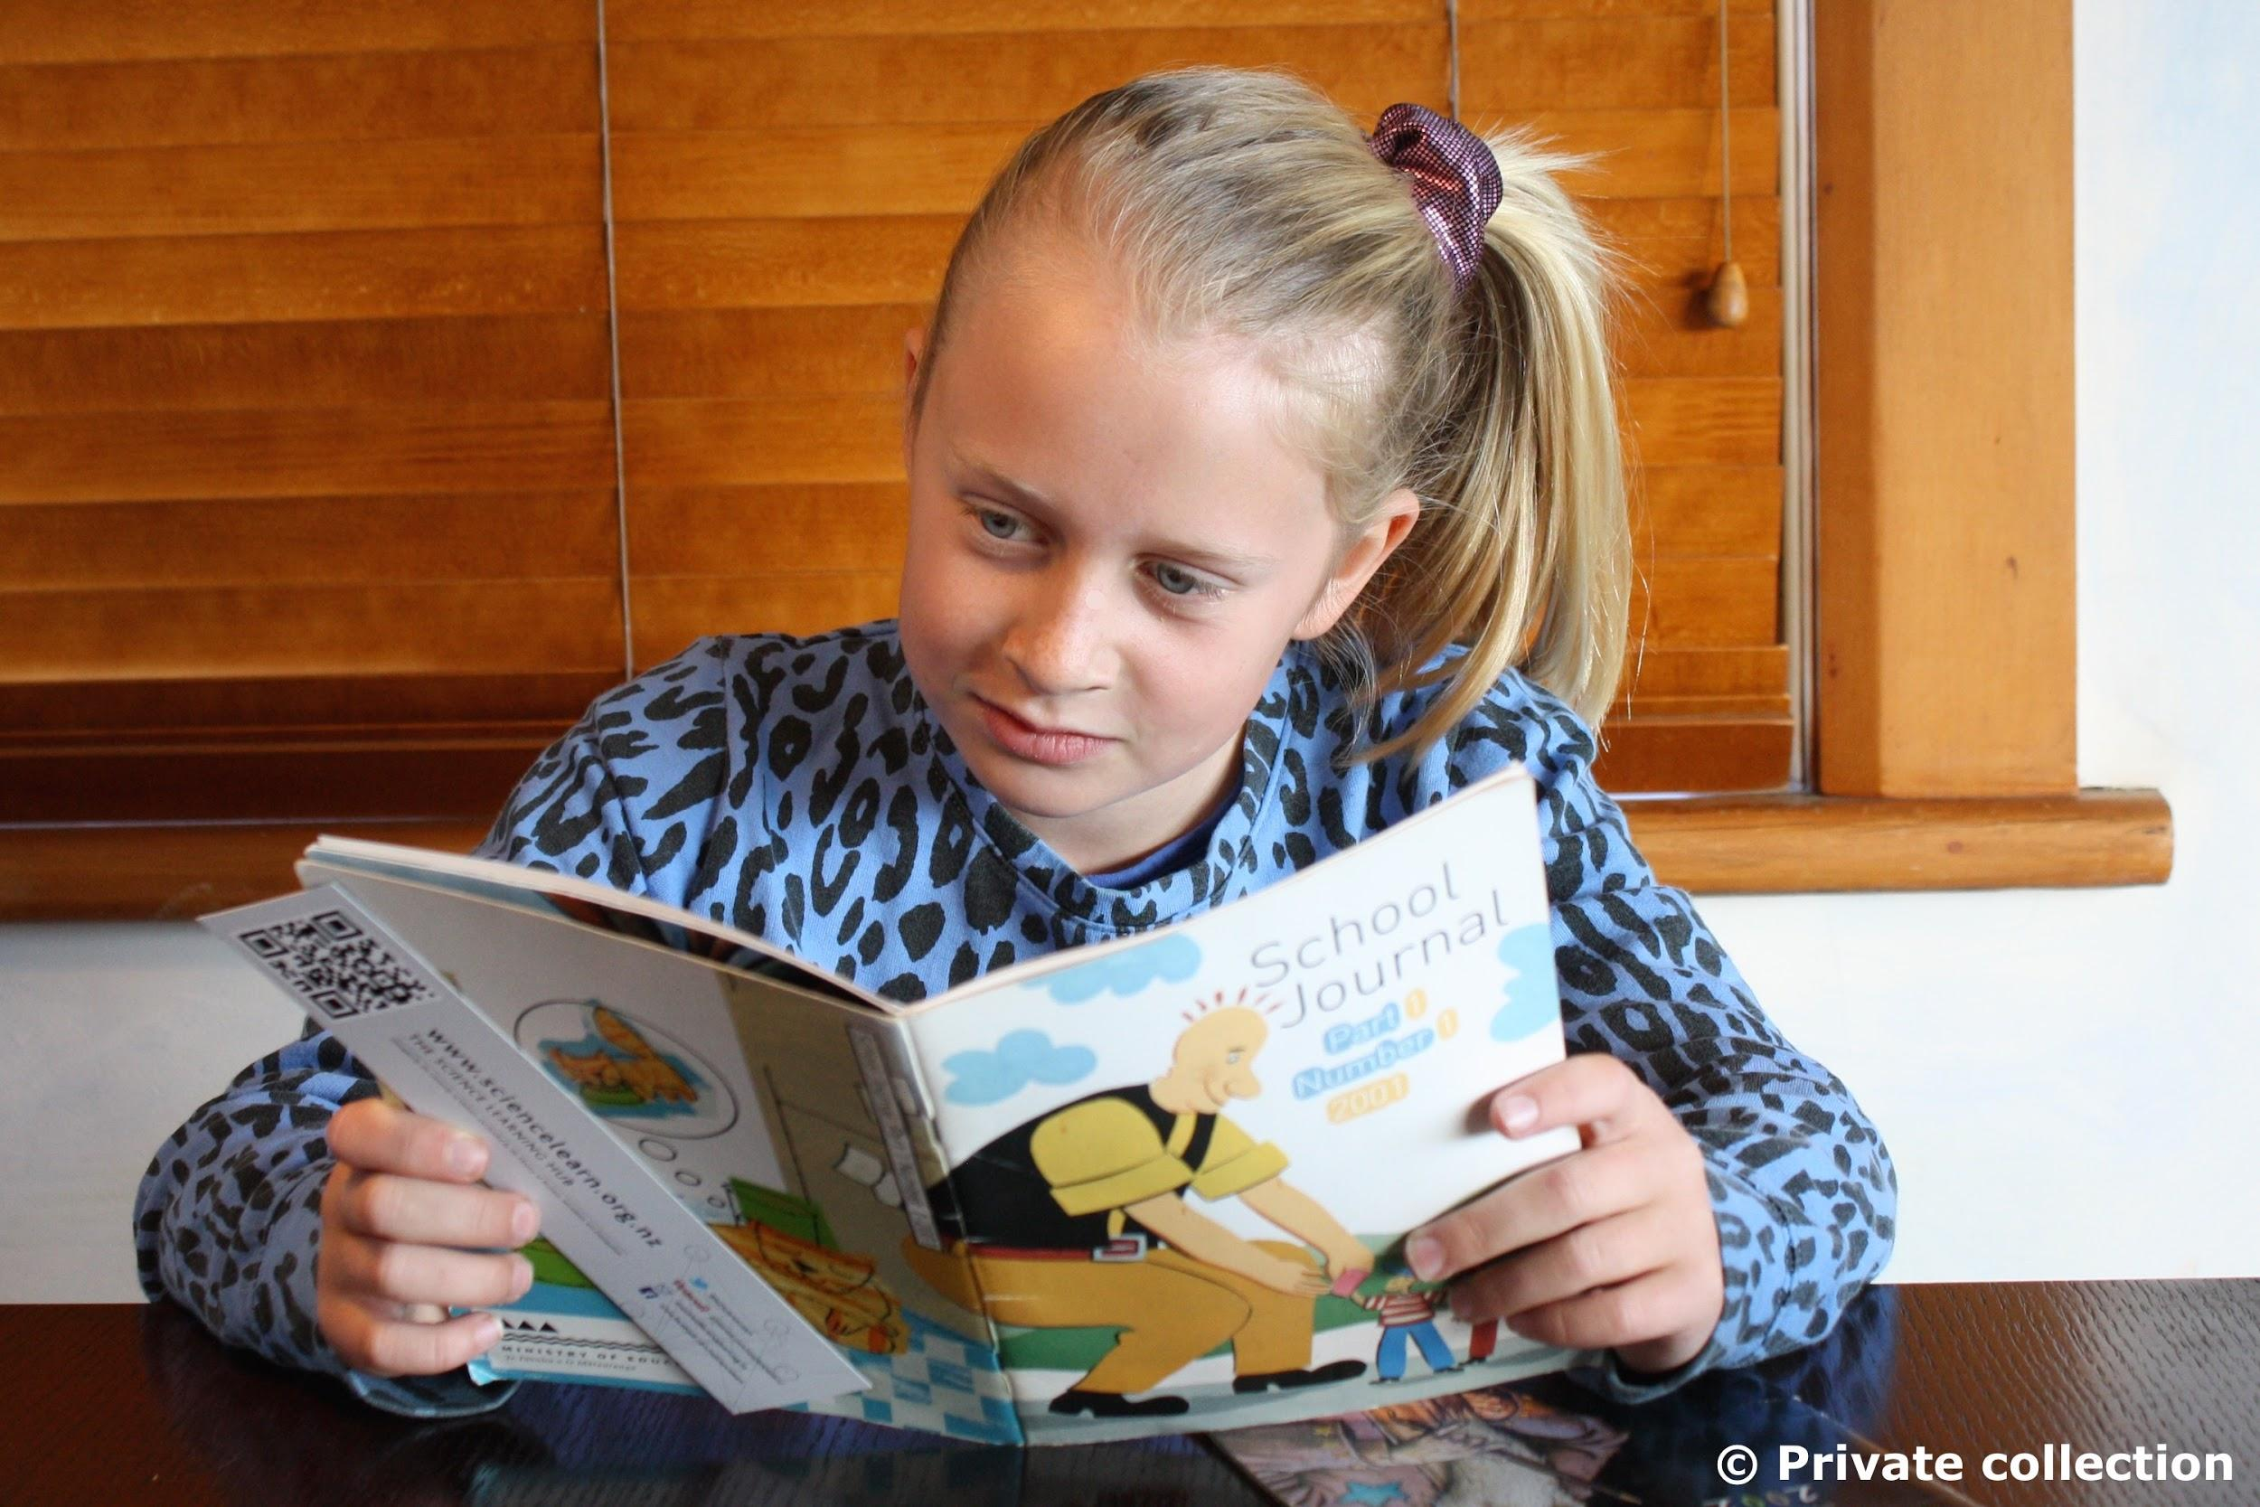
Comprehension
Good readers:
use their background knowledge to make meaning
ask themselves questions while reading at three levels, related to what is stated in the text, what they think the author means and beyond what the text says (3-level guides)
analyse the text – what is the structure, and how does that help make meaning?
make mental images
summarise what they have read – can identify and pull together the important ideas and discard redundant information.
© Copyright. University of Waikato. All Rights Reserved | www.sciencelearn.org.nz
Notes:
Immerse students in the context. Stimulate their curiosity, generate a willingness to build their own skills and understandings, get students to become involved in their own inquiry and asking their own questions. Anticipate the comprehension problems students may have with a new topic.

Slide 21
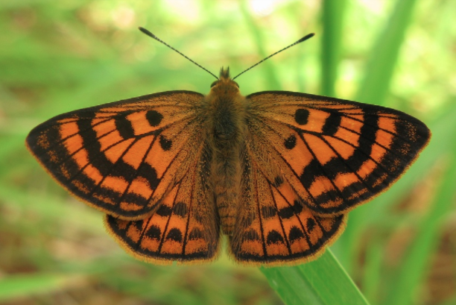
Looking at text types/structures
Sequential
Recount (diary, biography, timeline, journal)
Explanation
Procedure (method, instructions, recipe)
Cause and effect
Problem/solution
Continuum
Descriptive
Report (essay, paragraph, ‘research project’)
Web/map
Matrix (comparison, compare and contrast, Venn diagram)
List
Argument and persuasion
Debate, formal argument, advertisement etc.
Expressive writing
Jérôme Albre
© Copyright. University of Waikato. All Rights Reserved | www.sciencelearn.org.nz
Notes:
What types of text do you think are used in science? Give examples.
Ref. Sue Dymock, University of Waikato.

Slide 22
Thinking about text types/structures
Science uses all of them, depending on the context.
Reading: What type of text is it? Why was it written this way? Who might have been the audience? Is there another way the ideas could have been communicated?
Writing: What do I want to achieve? Who is my audience?
In a given scenario, which texts might be appropriate to use? Why? Which type of text could be used for which purpose?
123RF Ltd
© Copyright. University of Waikato. All Rights Reserved | www.sciencelearn.org.nz

Slide 23
Thinking about science learning while ‘doing’ literacy and thinking about literacy while ‘doing’ science
Immerse students in a science context and actively look for opportunities to foster literacy by:
providing a range of experiences, resources and practical activities using multi-sensory methods to explore science topics, making it engaging, stimulating and vivid – use props, displays, models, experiments, investigations
using a range of texts for reading and include pictures, maps, stories, posters, poems, sketches, newspaper articles, graphs, diagrams etc.
providing opportunities for students to record their ideas in a range of different ways – encourage students to describe and discuss their thoughts and observations.
© Copyright. University of Waikato. All Rights Reserved | www.sciencelearn.org.nz
Notes:
These can support students to start scientific thinking, to challenge their own thinking, to find information in a variety of ways.
Connect new learning with students’ own experience – real-life examples and everyday applications of science to their lives – and be clear about the science involved and make the connections to other curriculum areas.

Slide 24
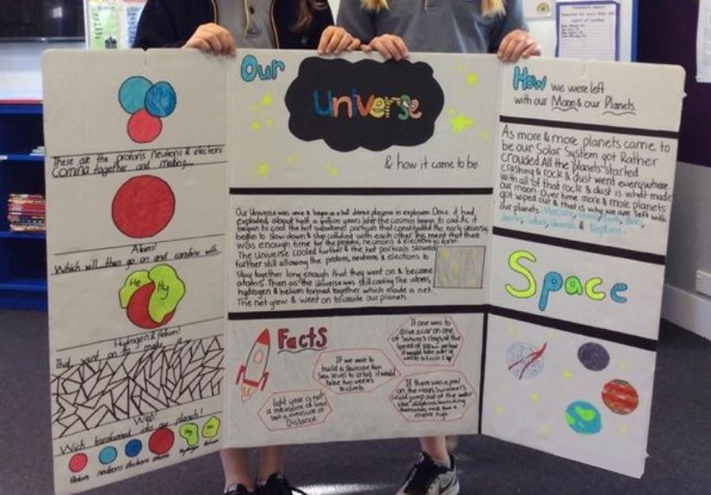
Why combine literacy and science?
Research statistics suggest that students retain:
10% of what they read
26% of what they hear
30% of what they see
50% of what they see and hear
70% of what they say
90% of what they say as they do something.
So … ‘doing’ science offers a great context for supporting students to develop their language.
Private collection, all rights reserved
© Copyright. University of Waikato. All Rights Reserved | www.sciencelearn.org.nz

Slide 25
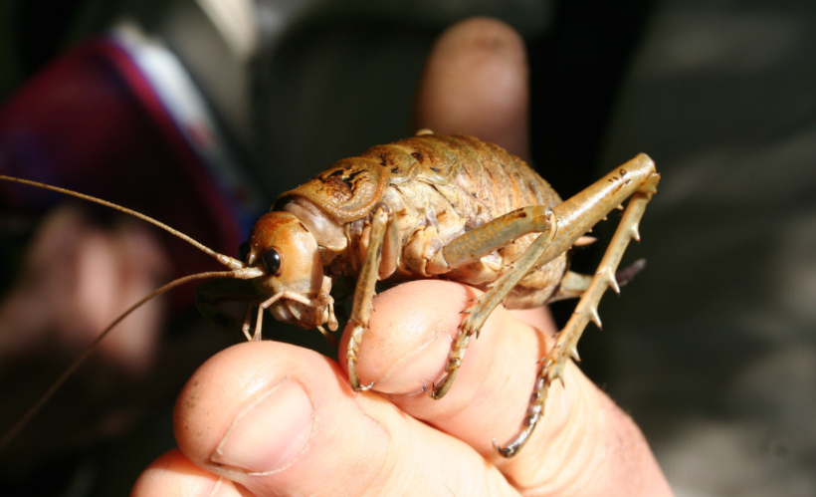
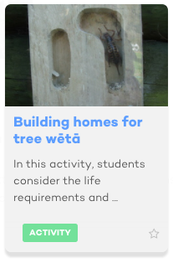
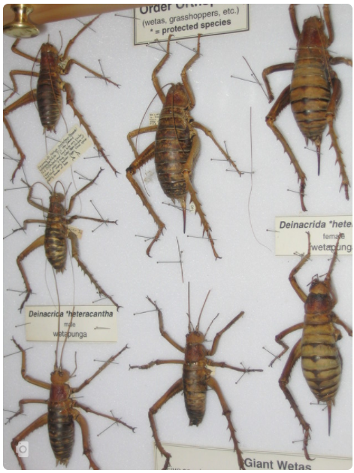
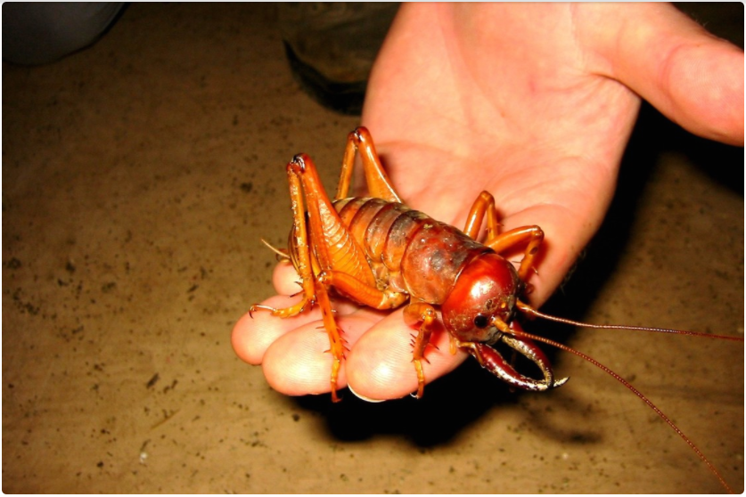
Immersion in context – wētā
Tom Lynch
dubh, CC2.0
Andy Heyward/licensed through 123RF Ltd
Chris Winks/LCR
© Copyright. University of Waikato. All Rights Reserved | www.sciencelearn.org.nz
Notes:
A variety of resources from the SLH to do with wētā.

Slide 26
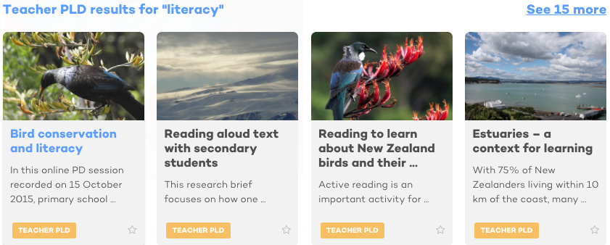
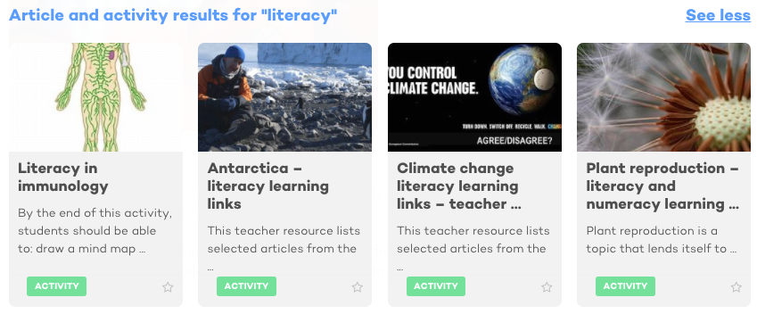
Literacy resources
© Copyright. University of Waikato. All Rights Reserved | www.sciencelearn.org.nz
All images are copyrighted. For further information, please refer to enquiries@sciencelearn.org.nz
Notes:
A variety of resources from the SLH.
26

Slide 27
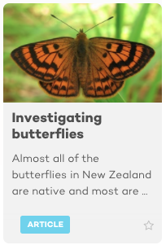
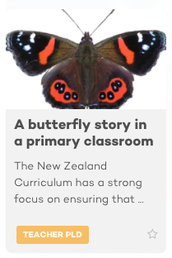
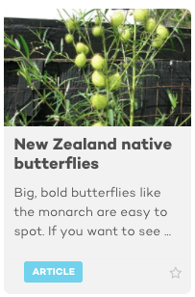
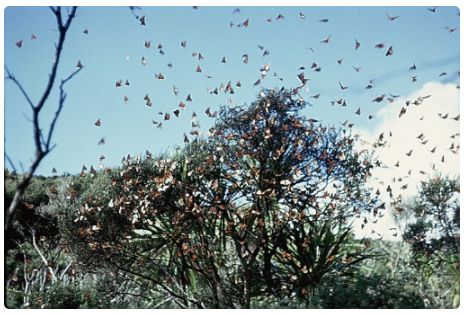
Literacy resources
T.Wills/CC 3.0
Angela Schipper
Jérôme Albre
Jacqui Knight
© Copyright. University of Waikato. All Rights Reserved | www.sciencelearn.org.nz
Notes:
A variety of resources from the SLH to do with butterflies.

Slide 28
Relevant practice for fostering literacy in science
Provide multiple opportunities to maintain and generalise skills
Utilise a variety of material, e.g. different text types, different representations of information/ideas, different experiences.
Provide scaffolding/differentiation by offering choices.
Vary the number of people involved in activities – use co-operative learning strategies.
Vary the content – use different contexts/topics to foster the same literacy skills.
Use graphic organisers, cause and effect charts, Bloom’s hierarchy, 6 thinking hats etc. for processing and communicating science ideas.
Provide regular and specific feedback/feedforward.
Explicitly teach about and model use of text structures, decoding strategies, effective reading behaviours – sharing the purposes with students so they know what they are learning and why.
© Copyright. University of Waikato. All Rights Reserved | www.sciencelearn.org.nz
Notes:
Provide 4–6 opportunities for each key piece of learning – the more practice, the more embedded the skills become.

Slide 29
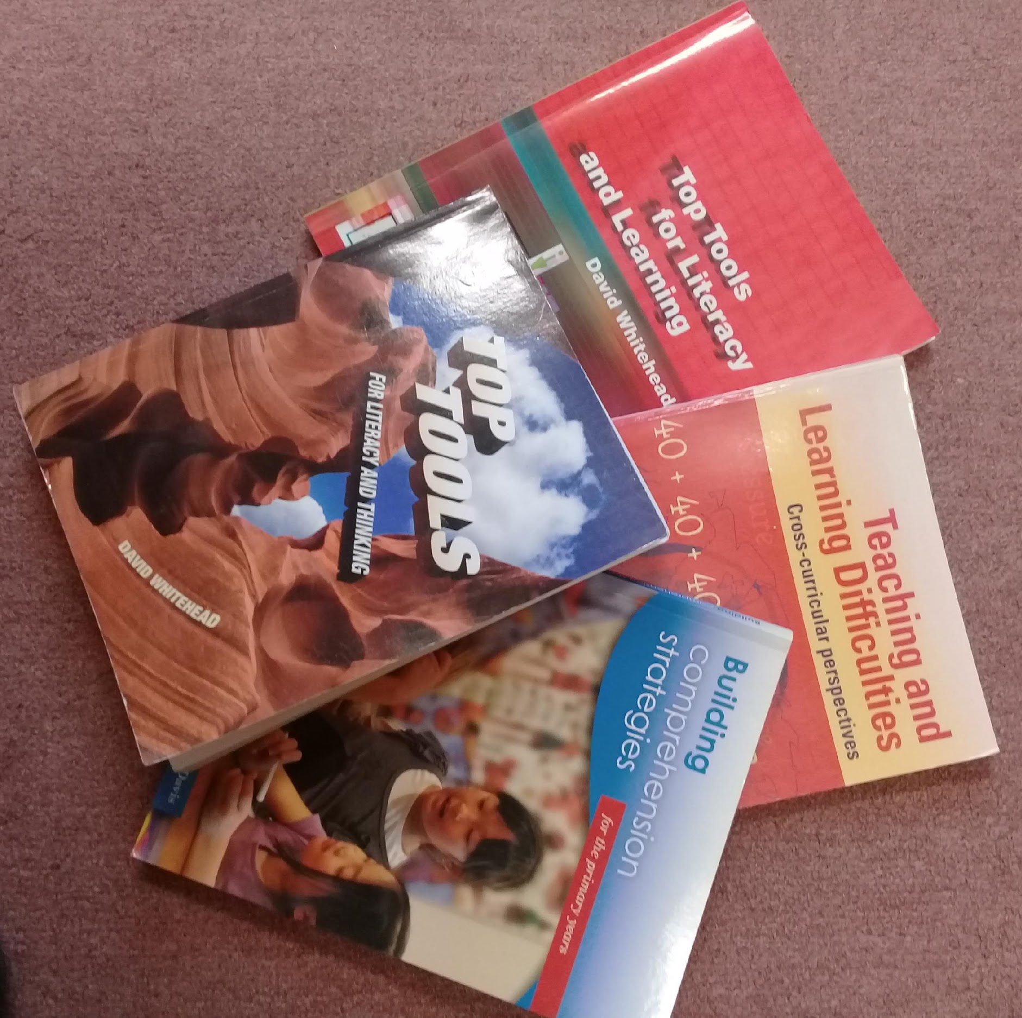
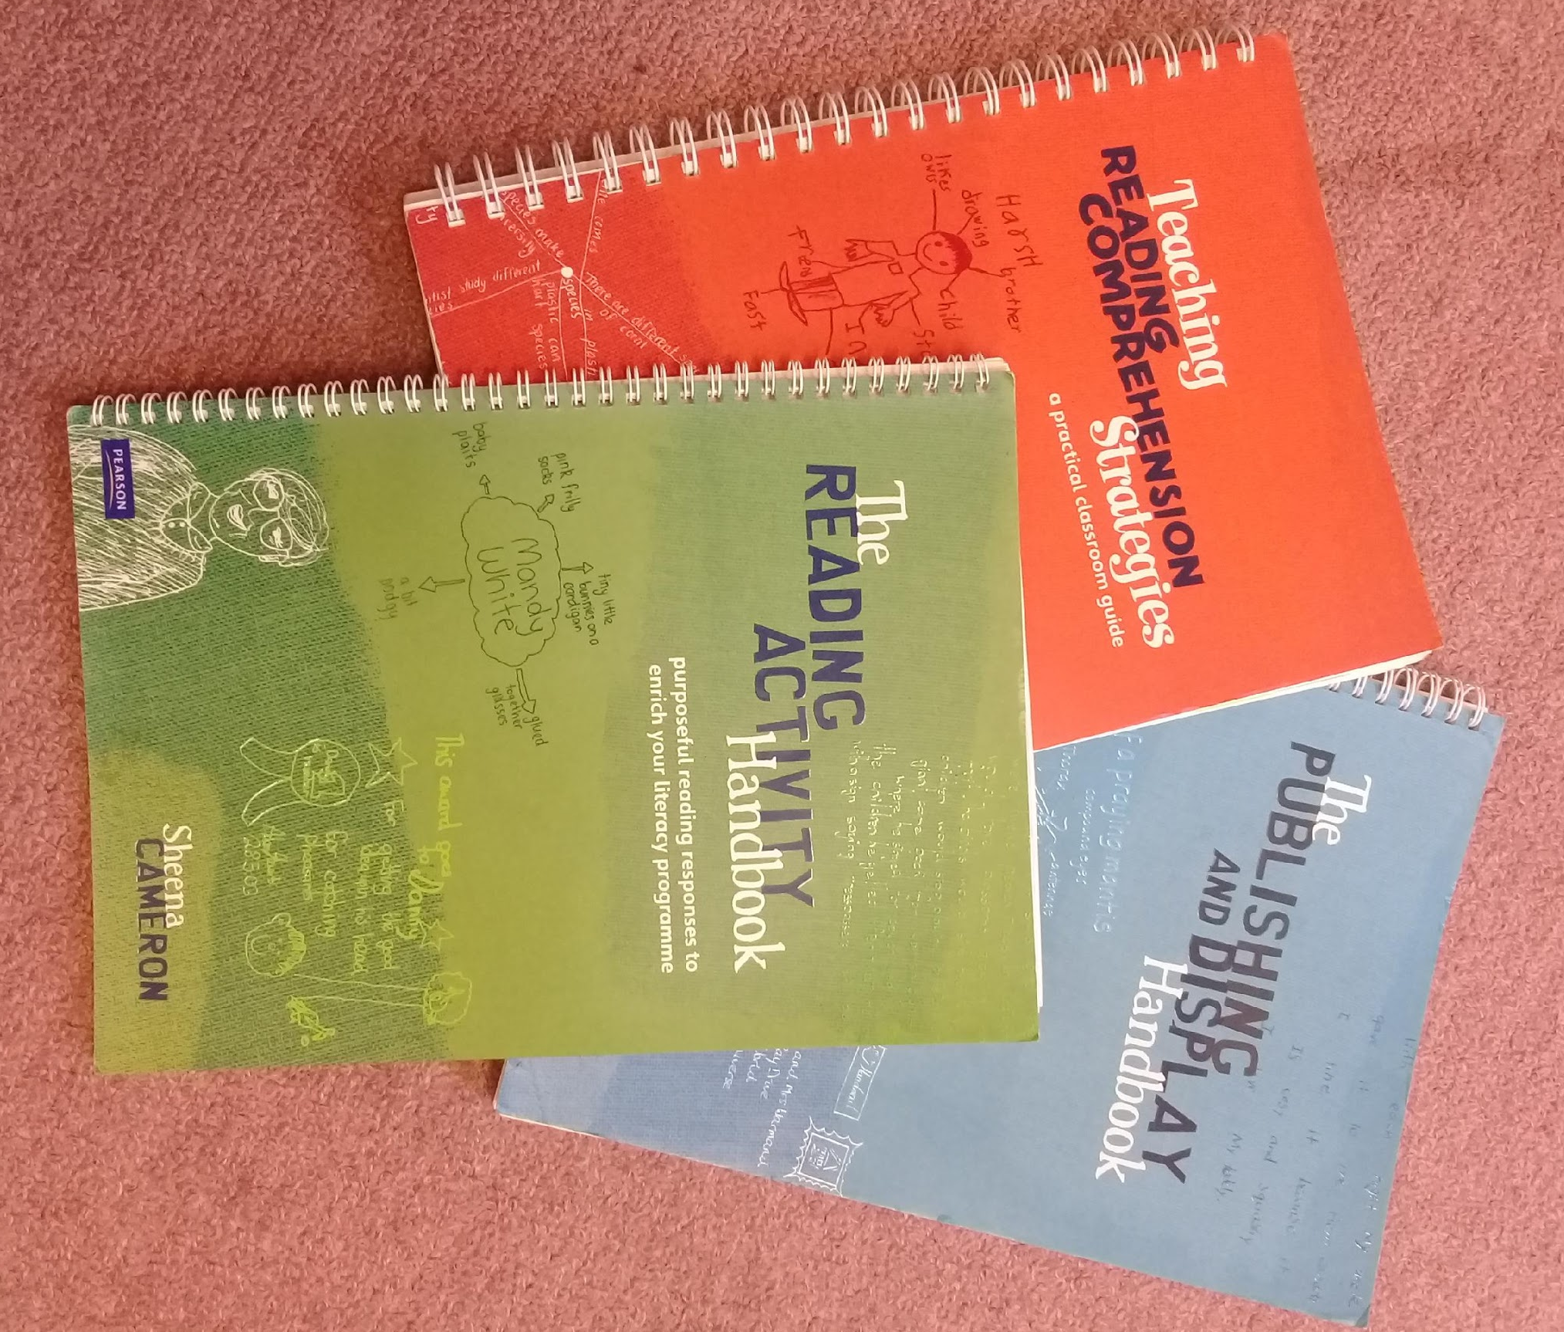
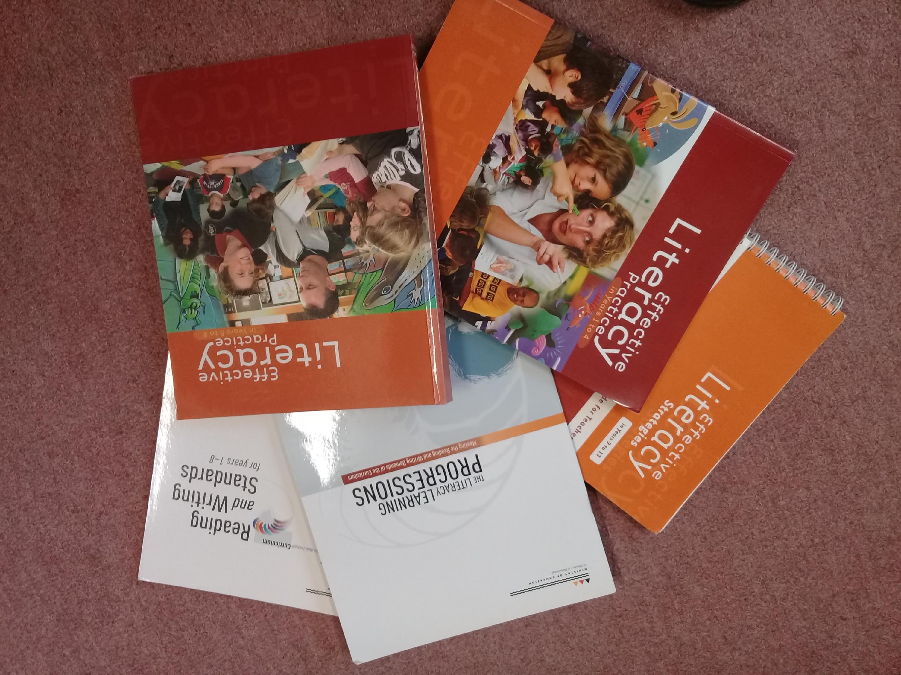
Resources
© Copyright. University of Waikato. All Rights Reserved | www.sciencelearn.org.nz
Notes:
A variety of resources: Sheena Cameron, David Whitehead, MoE.
29

Slide 30
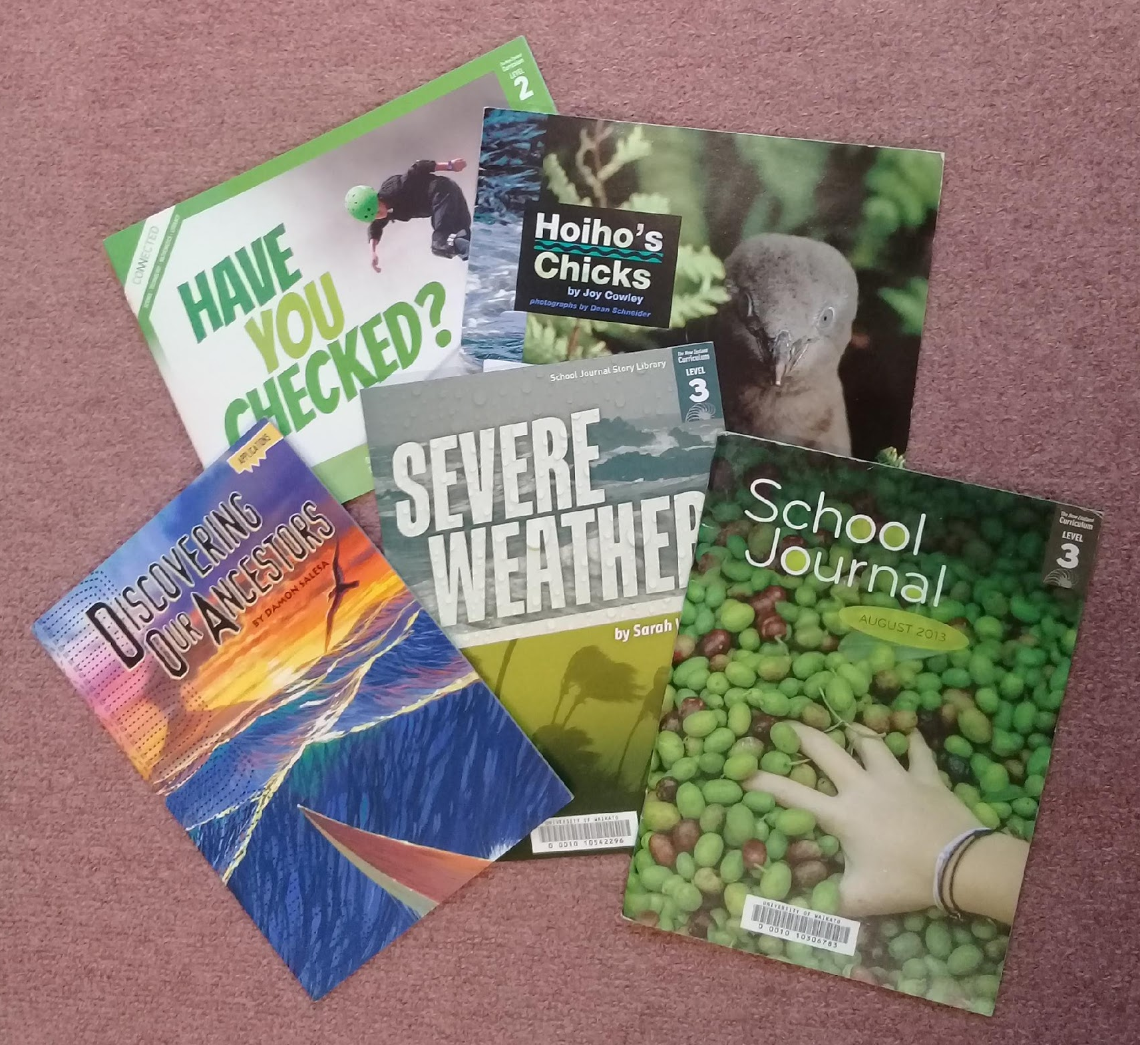
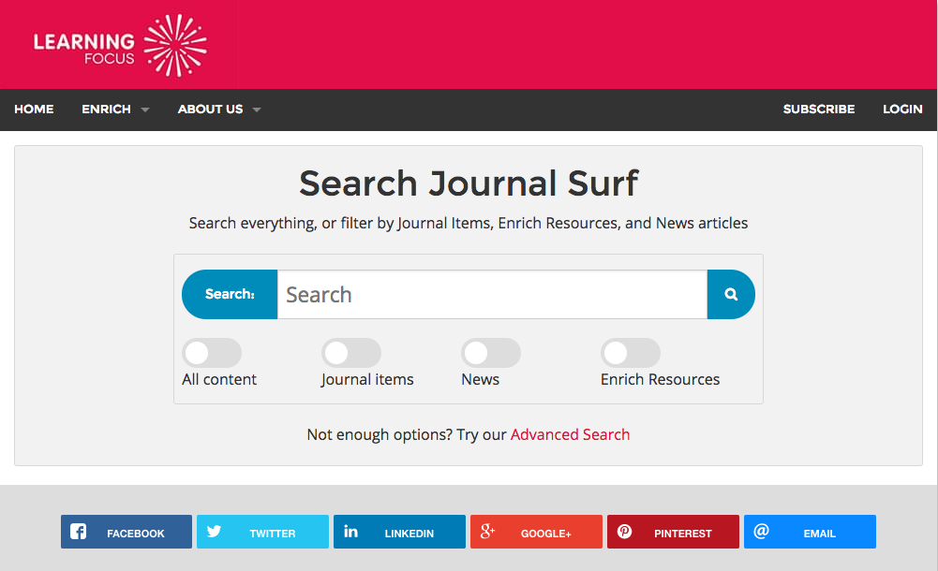
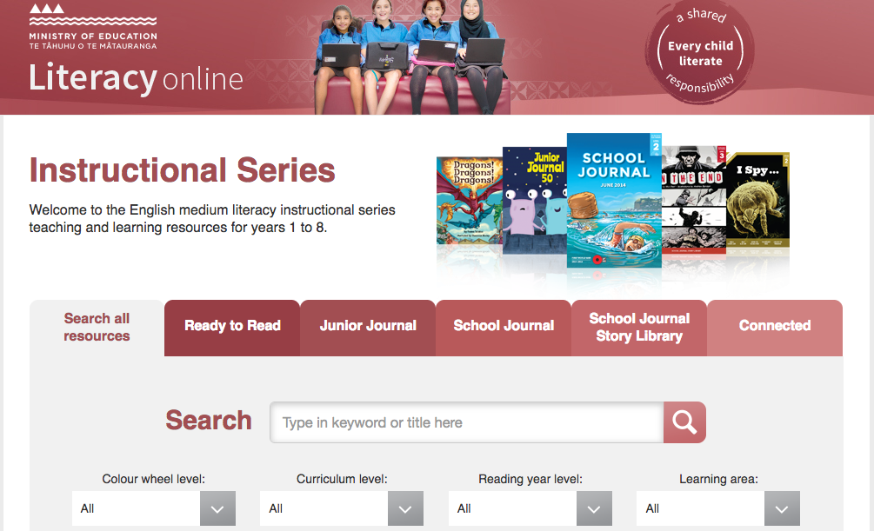
Literacy resources
© Copyright. University of Waikato. All Rights Reserved | www.sciencelearn.org.nz
Notes:
Down the Back of the Chair http://www.thechair.co.nz
Journal Surf https://journalsurf.co.nz/
Literacy Online instructional series http://instructionalseries.tki.org.nz/

Slide 31
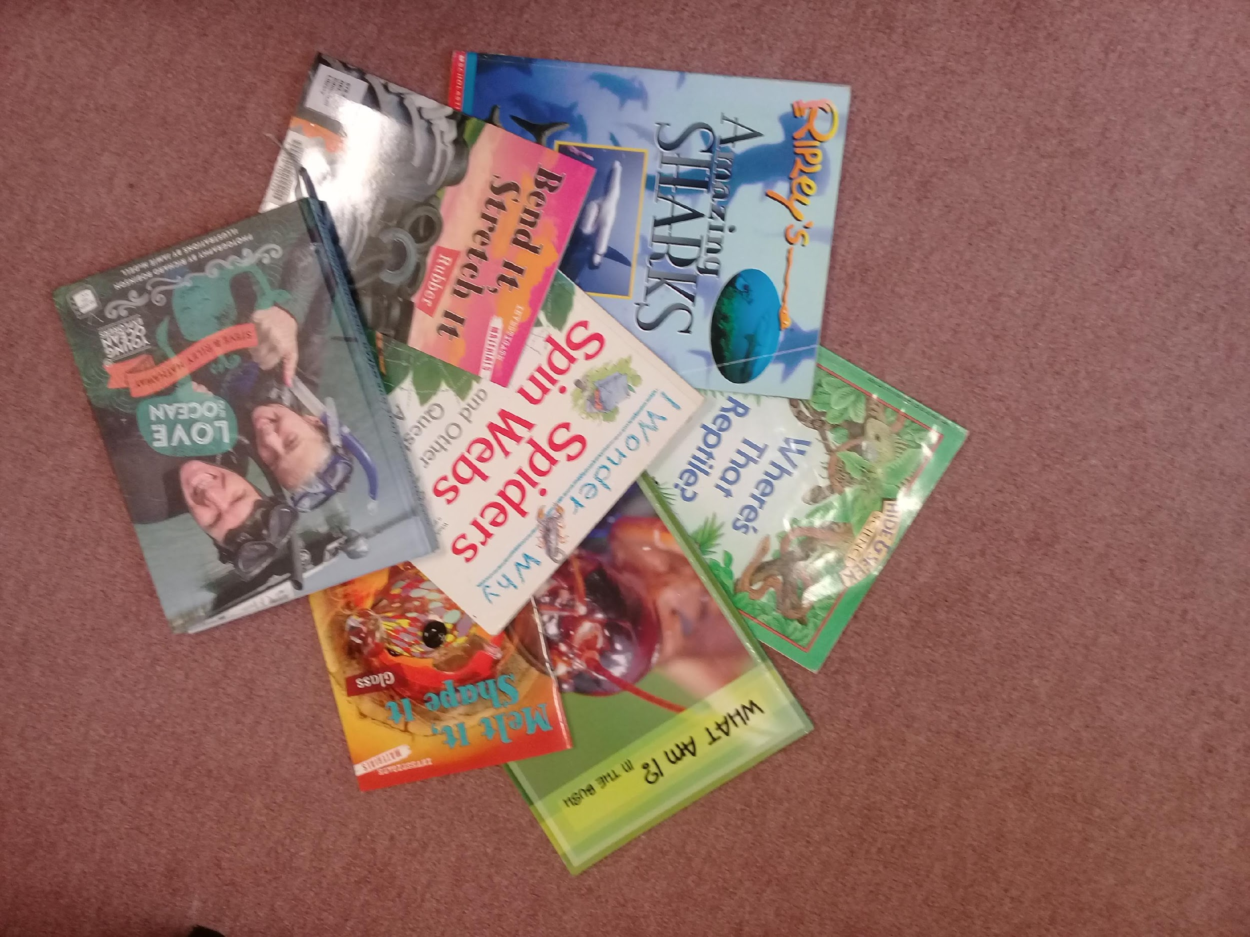
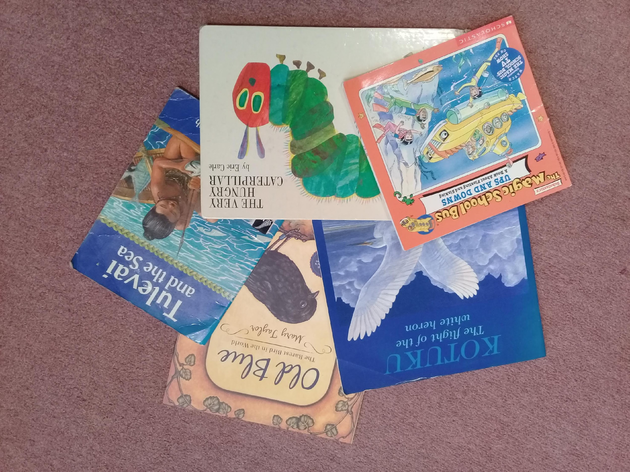
What next?
Self-reflection
Are there any science contexts/topics into which you could integrate a greater focus on literacy?
Has your thinking changed about connecting science and literacy? If so, how?
How might your practice change?
Join us in our literacy in science discussion forum on
www.pond.co.nz/discussion/4160312/science-and-literacy-pld
Thank-you
© Copyright. University of Waikato. All Rights Reserved | www.sciencelearn.org.nz

Slide 32
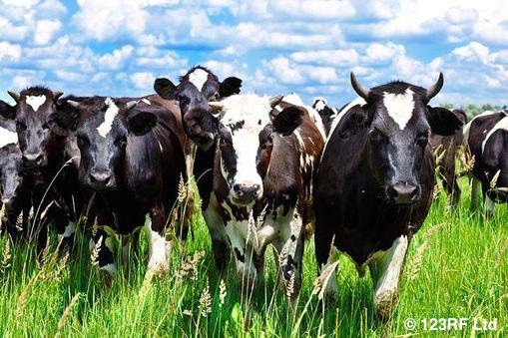
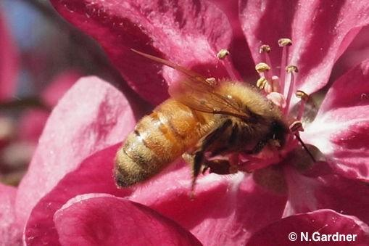
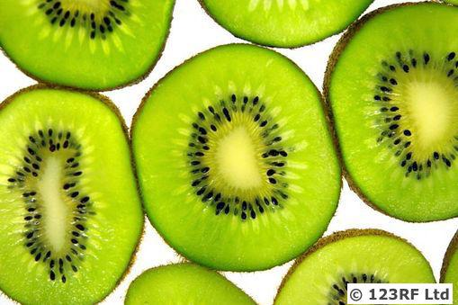
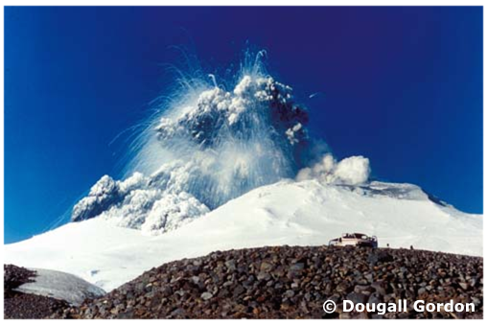
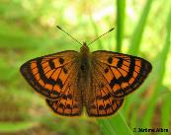
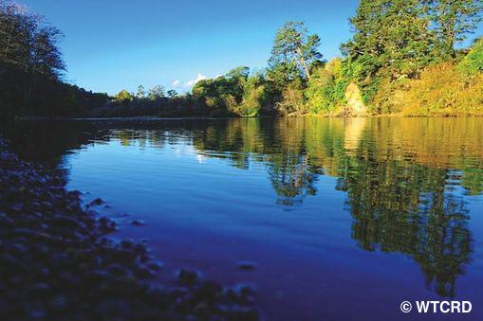
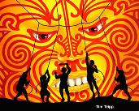
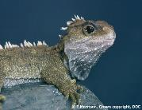
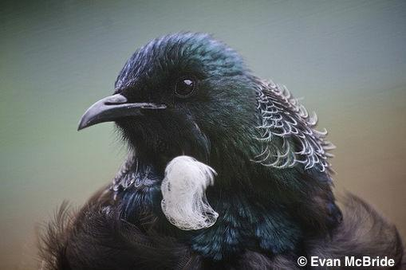
Want to keep connected?
Email us on enquiries@sciencelearn.org.nz
Follow us on Twitter: https://twitter.com/NZScienceLearn
Like us on Facebook: www.facebook.com/nzsciencelearn
On Pinterest: https://nz.pinterest.com/nzsciencelearn/
Join us in the pond: www.pond.co.nz/discussion/4160312/science-and-literacy-pld
© Copyright. University of Waikato. All Rights Reserved | www.sciencelearn.org.nz

