Slide 1
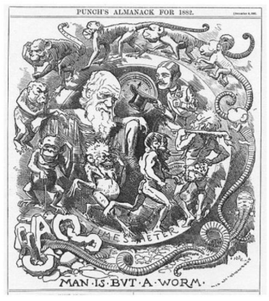
Literacy in the secondary science classroom
Lyn Rogers
and
Andrea Soanes
Thursday
21 September
2017
4:00–4:45pm
© Copyright. University of Waikato. All Rights Reserved | www.sciencelearn.org.nz
All images are copyrighted. For further information, please refer to enquiries@sciencelearn.org.nz

Slide 2
Index
Topic Slide #(s) Timecode
Introduction, welcome and purpose 1–3 00:00
What is literacy in science? 4 02:39
Offering literacy opportunities in science – what we already do 5–6 02:54
Thinking about literacy while ‘doing’ science 7 04:09
Literacy in science – planning 8 06:07
Comprehension – what good readers do 9 09:13
Exploring the strategies good readers use –
1 - activate background knowledge 10–12 11:18
Exploring the strategies good readers use –
2 - ask questions 13 17:35
Exploring the strategies good readers use –
3 - analyse text structures 14–19 19:17
Exploring the strategies good readers use –
4 - make a mental image 20 26:29
Exploring the strategies good readers use –
5 - summarise 21 27:57
Applying skills to writing 22–23 28:44
Catering for a range of literacy levels 24 30:59
Planning to incorporate literacy – how? 25 31:38
Useful resources 26–28 33:10
Reflecting 29 34:49
Want to keep connected? SLH links 30 34:59

Slide 3
Literacy in the secondary science classroom
In this webinar, we will
explore how science and literacy can be integrated by:
discussing how literacy practice can be deliberately incorporated into your science programme
discussing how improving literacy skills can enhance science learning
sharing some simple strategies to support literacy skill building.
© Copyright. University of Waikato. All Rights Reserved | www.sciencelearn.org.nz
All images are copyrighted. For further information, please refer to enquiries@sciencelearn.org.nz

Slide 4
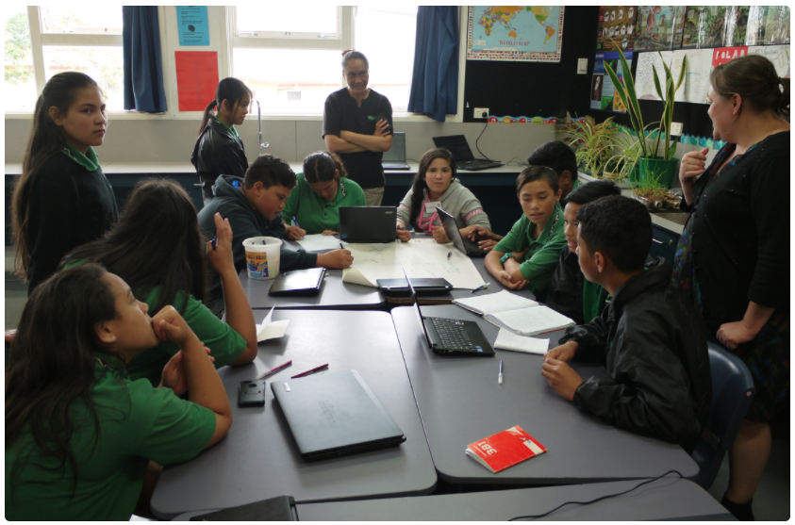
What is literacy in science?
Science literacy: the content and vocabulary of science.
Scientific literacy: the understanding of scientific concepts and processes required for personal decision making, participation in civic and cultural affairs and economic productivity or the ability to engage with science-related issues and with the ideas of science as a reflective citizen.
Literacy: the ability to understand, respond to and use those forms of written language that are required by society and valued by individuals and communities.
Literacy in science: literacy skills are needed for science communication and to access science understandings.
Sarah Morgan/Comet Auckland
© Copyright. University of Waikato. All Rights Reserved | www.sciencelearn.org.nz
All images are copyrighted. For further information, please refer to enquiries@sciencelearn.org.nz

Slide 5
Offering literacy opportunities in science
What do we already do?
© Copyright. University of Waikato. All Rights Reserved | www.sciencelearn.org.nz
All images are copyrighted. For further information, please refer to enquiries@sciencelearn.org.nz
Notes:
An opportunity for thinking.

Slide 6
Opportunities we already offer
– some participants’ ideas
Using frameworks for planning and
carrying out investigations
Do lots of oral sharing – with reading
Practice exam questions –
with feedback/feedforward
We give the students
linking words
Consistent language is so important!
Do lots of oral sharing – experiment with
hands-on, leading into writing
Use three-level reading guides
Create or supply vocab. lists for definitions
Use writing frames
Explore and discuss
science in the
news/current affairs
Use Connected journals
Vocab. matching activities
Pictures help too
Cooperative activities - jigsaws, students can verbally explain concepts to peers
Talk with the English teacher about the students - have a look at common skills and strategies so students have a common and consistent language when talking about literacy skills
CLOZE activities
Graphic organisers
Use a rubric for each NoS
area being assessed
Text reconstruction activities
Use and discuss student exemplars
Spelling words as a starter –
words that are either used or
going to be used
Include strategies to increase
scientific key-word familiarity
and use in context
Assessment
For Learning
Frameworks for writing
conclusions
Don’t make assumptions about background knowledge -
some of our children have limited experiences outside of school. Our immigrants (and even some local students) may not have experienced an earthquake or even been to the beach....
Writing sentences and encourage
them to link two sentences
together with linking words.
© Copyright. University of Waikato. All Rights Reserved | www.sciencelearn.org.nz
All images are copyrighted. For further information, please refer to enquiries@sciencelearn.org.nz

Slide 7
Think about literacy while ‘doing’ science
Actively look for opportunities to foster literacy and plan to provide:
a range of experiences, resources and practical activities using multisensory methods to explore topics, making them engaging, stimulating and vivid
immersion in the context/topic
opportunities that encourage students to describe and discuss their thoughts and observations and to record their ideas in a range of different ways
effective questioning that focuses on stimulating thought, thinking creatively and using data and information that is relevant
instructions that are very clear and represent these in a variety of ways.
© Copyright. University of Waikato. All Rights Reserved | www.sciencelearn.org.nz
All images are copyrighted. For further information, please refer to enquiries@sciencelearn.org.nz

Slide 8
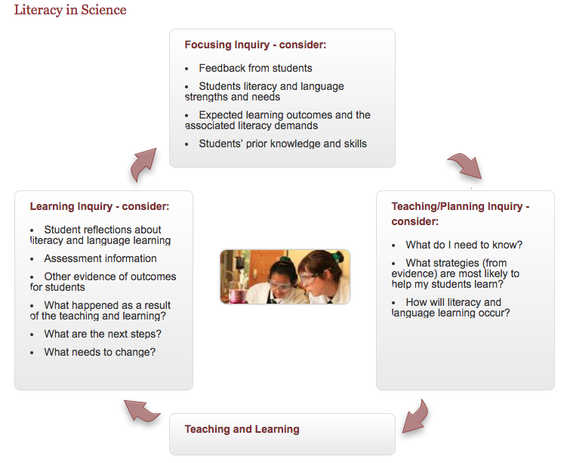
Literacy in science – planning
What next?
Knowing your students
How did it go?
Putting it into practice
Planning for their needs
Infographic from Literacy Online/TKI
© Copyright. University of Waikato. All Rights Reserved | www.sciencelearn.org.nz
All images are copyrighted. For further information, please refer to enquiries@sciencelearn.org.nz

Slide 9
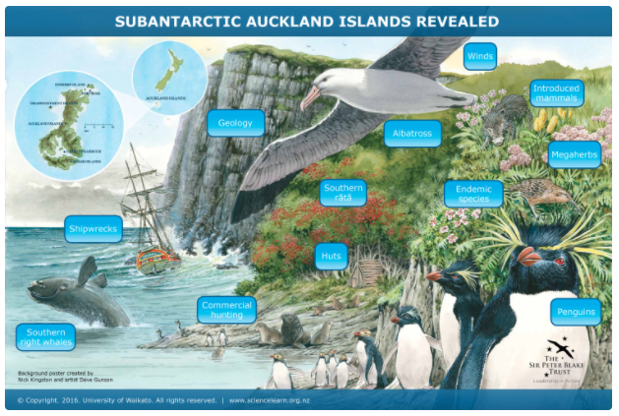
Comprehension
What good readers do:
Activate background knowledge to make meaning.
Ask questions while reading.
Analyse the text.
Make mental images.
Summarise what they have read.
“Many students experience problems comprehending expository texts …
Some get lost in the words and can’t see the picture. Content area
reading is often technical, the topic is unfamiliar, vocabulary is new, and
text materials differ from the narrative form with which they are familiar.”
© Copyright. University of Waikato. All Rights Reserved | www.sciencelearn.org.nz
All images are copyrighted. For further information, please refer to enquiries@sciencelearn.org.nz
Notes:
Quote: Sue Dymock Teaching Text Structures

Slide 10
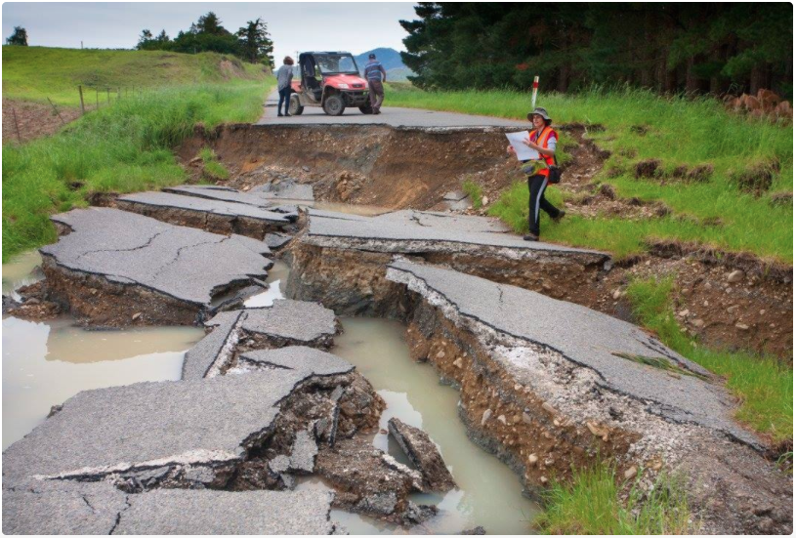
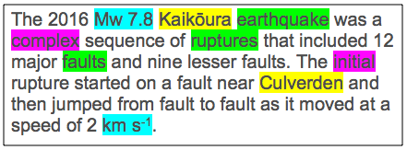
Activate background knowledge
The 2016 Mw 7.8 Kaikōura earthquake was a complex sequence of ruptures that included 12 major faults and nine lesser faults. The initial rupture started on a fault near Culverden and then jumped from fault to fault as it moved at a speed of 2 km s⁻¹.
Katherine Pedley
Vocabulary building
Identifying key words
© Copyright. University of Waikato. All Rights Reserved | www.sciencelearn.org.nz
All images are copyrighted. For further information, please refer to enquiries@sciencelearn.org.nz

Slide 11
Activate background knowledge
Katherine Pedley
© Copyright. University of Waikato. All Rights Reserved | www.sciencelearn.org.nz
All images are copyrighted. For further information, please refer to enquiries@sciencelearn.org.nz

Slide 12
Activate background knowledge
The 2016 Mw 7.8 Kaikōura earthquake was a complex sequence of ruptures that included 12 major faults and nine lesser faults. The initial rupture started on a fault near Culverden and then jumped from fault to fault as it moved at a speed of 2 km s⁻¹.
Katherine Pedley
Discuss what is in the text:
What are the key words?
What do/might they mean?
What are the key ideas?
What is it saying?
Exploring meanings
© Copyright. University of Waikato. All Rights Reserved | www.sciencelearn.org.nz
All images are copyrighted. For further information, please refer to enquiries@sciencelearn.org.nz

Slide 13
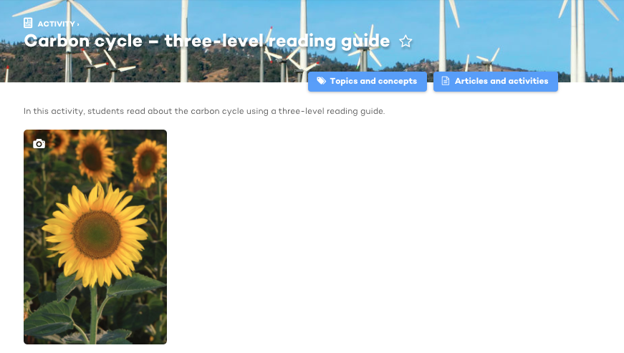
Ask questions
Three-level reading guides support students to ask questions on three levels:
What does the text say?
Question starters include: identify; name; describe; draw; what …
What is inferred? (reading between the lines)
Question starters include: explain; how; why; what evidence is there?
What implications are there?
Questions prompt students to elaborate; apply; justify; evaluate; compare and contrast; link ideas in the text to other ideas.
123RF Ltd
© Copyright. University of Waikato. All Rights Reserved | www.sciencelearn.org.nz
All images are copyrighted. For further information, please refer to enquiries@sciencelearn.org.nz

Slide 14
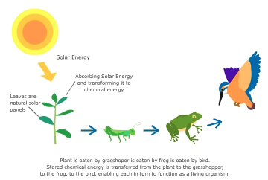
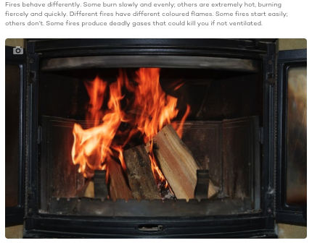
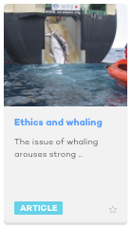
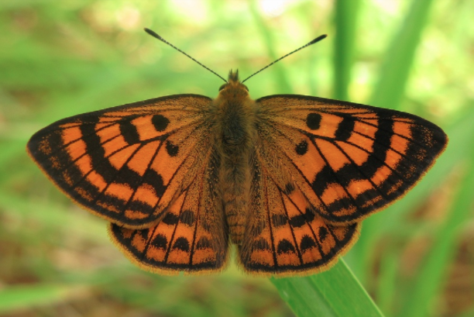
Analyse text structures
Sequential – there is a
sequence
of events or
ideas
Descriptive – there is no required order to the ideas
Argument and
persuasion –
is discursive
123RF Ltd
Australian Customs and Border Protection Service
Expressive – is (at least in part) fictional
Jérôme Albre
© Copyright. University of Waikato. All Rights Reserved | www.sciencelearn.org.nz
All images are copyrighted. For further information, please refer to enquiries@sciencelearn.org.nz
Notes:
Ref. Sue Dymock

Slide 15
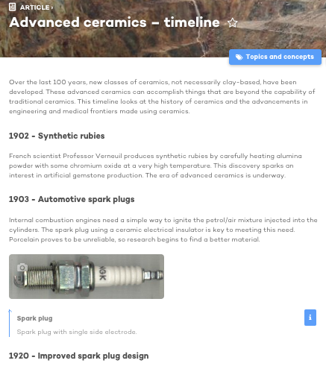
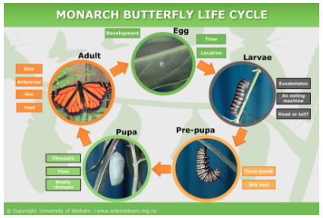
Analyse text structures
Sequential texts
Recount, e.g. biography, log
Explanation
Procedure, e.g. steps in an experimental method
Cause and effect
Problem and solution
Continuum/timeline
Flow charts
© Copyright. University of Waikato. All Rights Reserved | www.sciencelearn.org.nz
All images are copyrighted. For further information, please refer to enquiries@sciencelearn.org.nz
Notes:
Ref. Sue Dymock

Slide 16
Using sequential texts in science
- some participants’ examples
Sequential text examples include:
Recount: blogging about their investigation results, biography of a historic scientist, keep a log of research progress, have a scientist of the week – use a picture book to look at a scientist's life, then use particular vocabulary or examples for the rest of the week
Explanation: linking science ideas with results from investigations, explaining hands-on experiments
Procedure: steps in an experimental method, instructions
Cause and effect: water quality issues, earthquakes, volcanoes, cause and effect during formation of rock types
Problem and solution: developing an inquiry; solving socio-scientific issues – applying science understandings to provide solutions
Continuum/timeline: timelines in reproduction, geology
Flow charts: cycles e.g. water, rock, life, nutrients, sun life cycle, energy transformations, photosynthesis, ions for L2 Chemistry
© Copyright. University of Waikato. All Rights Reserved | www.sciencelearn.org.nz
All images are copyrighted. For further information, please refer to enquiries@sciencelearn.org.nz
Notes:
Ref. Sue Dymock

Slide 17
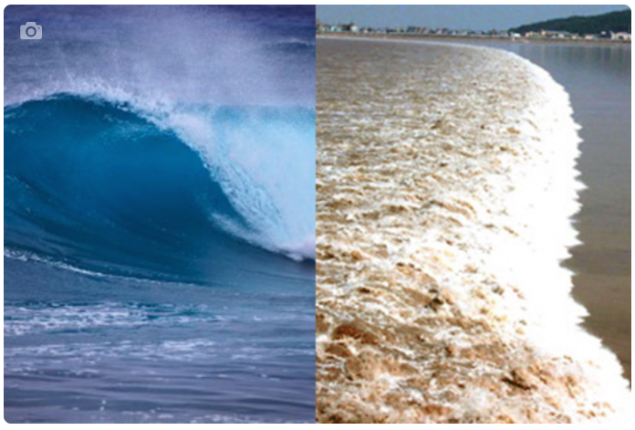
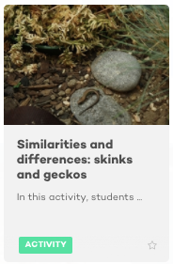
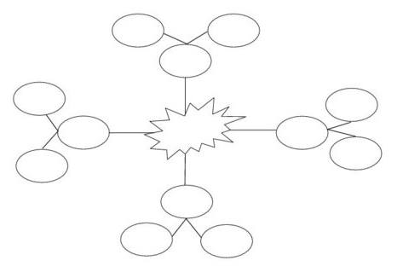
Analyse text structures
Descriptive texts
Report
Web/map
Matrix, e.g. compare and contrast
Chart, Venn diagram
List
Tomas Del Amo, 123RF
© Copyright. University of Waikato. All Rights Reserved | www.sciencelearn.org.nz
All images are copyrighted. For further information, please refer to enquiries@sciencelearn.org.nz
Notes:
Ask participants for examples of each of these being used in science.
Ref. Sue Dymock

Slide 18
Using descriptive texts in science - some participants’ examples
Descriptive text examples include:
Report: research project on a native animal, biotic/abiotic factors in a field report
Web/map: adaptations of an organism, helping students identify all important aspects of a concept e.g. molecular polarity
Matrix/chart: compare and contrast plant vs animal cells, point vs block mutations
Venn diagram: comparing sedimentary, metamorphic and igneous rocks, comparing animal families i.e. mammals and birds, differences between mechanical waves and electromagnetic waves
List: features of each class of organism, properties of metals
© Copyright. University of Waikato. All Rights Reserved | www.sciencelearn.org.nz
All images are copyrighted. For further information, please refer to enquiries@sciencelearn.org.nz

Slide 19
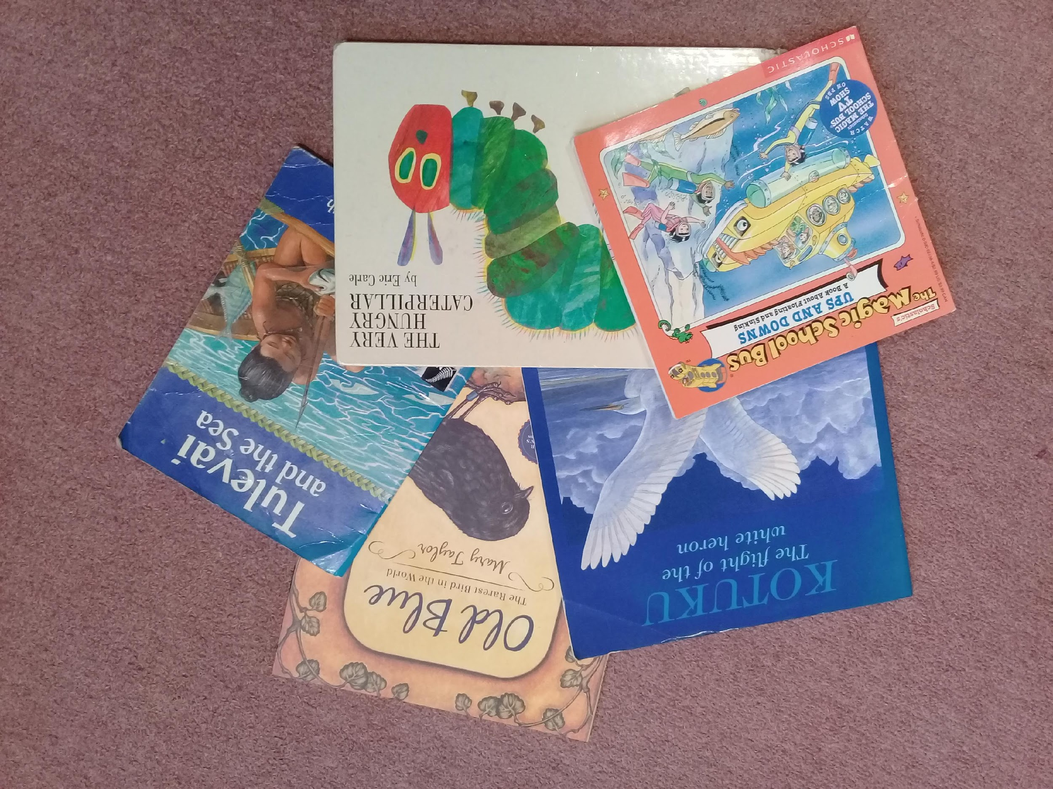
Analyse text structures
Argument and persuasion
Debate, formal argument, advertisement, discursive
Examples include: deciding whether to take action regarding climate change; critiquing evidence as to whether it supports a conclusion or supports an hypothesis.
123RF Ltd
Expressive writing is fiction
Poetry, storytelling, drama
Examples include: “Writing fun acrostic poetry with science has been a big hit; students have loved to make up a rap also...”; making their own story about how the Earth was made; personifying something as a character in a story e.g. a water drop
© Copyright. University of Waikato. All Rights Reserved | www.sciencelearn.org.nz
All images are copyrighted. For further information, please refer to enquiries@sciencelearn.org.nz

Slide 20
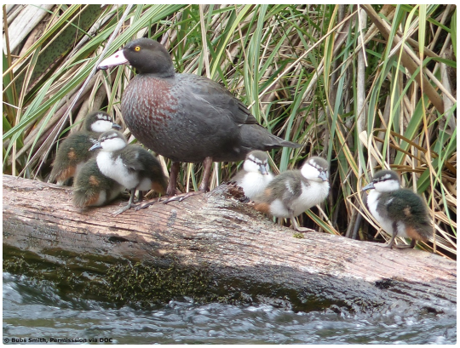
Make a mental image
Biology of the whio
The whio is a blue-grey duck with a speckled chestnut breast. It has a white/pale grey bill with soft black flaps at the tip. Its legs and feet are dark grey. It has distinctive yellow eyes that face forward. The main way to distinguish the sexes is by their voices. Male whio have a high-pitched whistle – ‘whi-o’ – and the females call with a low rattly growl. The whio feeds almost entirely on the aquatic invertebrates found on rocks in clean rivers. It has a bill uniquely designed for feeding in rocky waterways. The bill has a pair of soft black flaps on each side that assist in scraping the invertebrates off the rocks and protect the bony bill from damage. Most foraging is in shallow rapids, but whio also dive for their food and sometimes eat drifting larvae and the adult invertebrates from the water surface.
Bubs Smith
© Copyright. University of Waikato. All Rights Reserved | www.sciencelearn.org.nz
All images are copyrighted. For further information, please refer to enquiries@sciencelearn.org.nz
Notes:
What type of text is this? How does this structure help make meaning? Do the facts need to be in that order to make sense? No. Texts like this are difficult for students. They have no sub-headings etc. but could have, to make it more readable. The facts fall into certain categories such as feeding, breeding, appearance, adaptations. It is a report that could be represented as a web structure. It also could be presented as a list, but the visual construct of the web caters for visual learners and allows us to sort the facts and ideas.

Slide 21
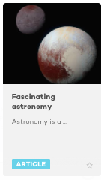
Summarise
To effectively summarise, students can use all the previous strategies:
Read the text.
Identify the text structure.
Make a diagram of the text structure.
Discard redundant information.
Circle the critical ideas.
Create concise statements from those ideas.
NASA/JHUAPL/SwRI
© Copyright. University of Waikato. All Rights Reserved | www.sciencelearn.org.nz
All images are copyrighted. For further information, please refer to enquiries@sciencelearn.org.nz

Slide 22
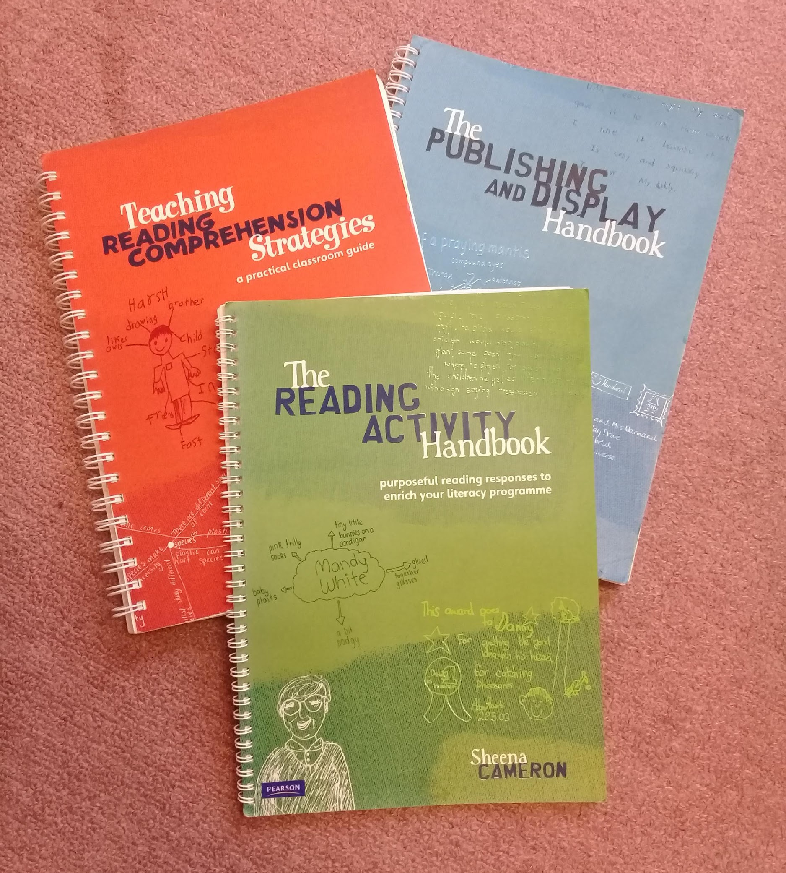
Comprehension – applying skills for writing
To be good writers, students need to be good readers.
What good readers do:
Activate background knowledge to make meaning.
Ask questions while reading.
Analyse the text.
Make mental images.
Summarise what they have read.
Good writers employ the same strategies.
© Copyright. University of Waikato. All Rights Reserved | www.sciencelearn.org.nz
All images are copyrighted. For further information, please refer to enquiries@sciencelearn.org.nz
Notes:
Quote Sue Dymock Teaching Text Structures

Slide 23
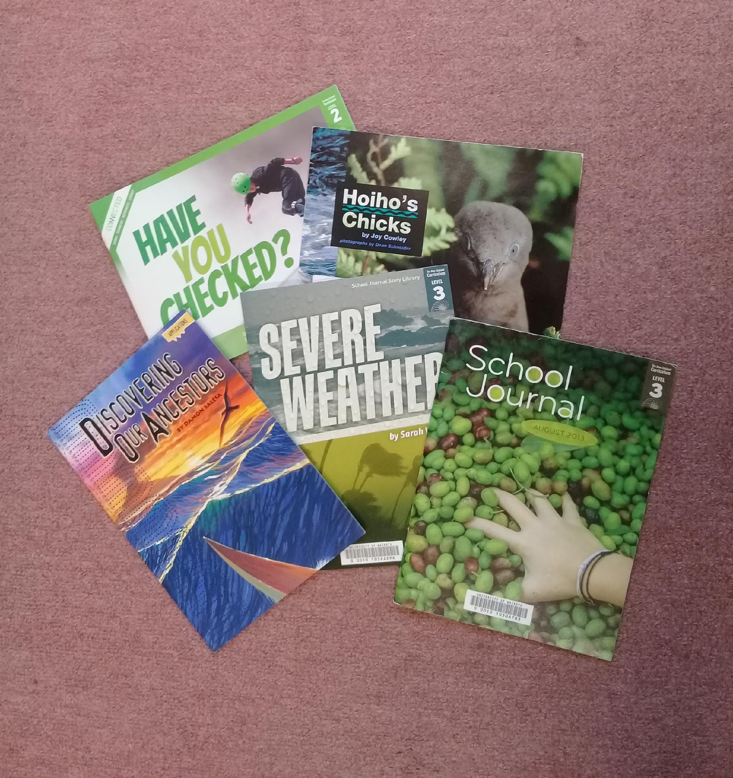
Writing
Writing skills are effectively reading skills turned around.
Students need to decide these things:
Who is my audience?
What ideas or information am I trying to convey?
What text structure would be most appropriate for this?
They then need to:
make a diagram of the text structure
put their information into the diagram
discard redundant information
circle the critical ideas
create sentences from the notes.
To help, we can:
use sentence starters to support students writing for different purposes
use charts
create key word lists or displays.
© Copyright. University of Waikato. All Rights Reserved | www.sciencelearn.org.nz
All images are copyrighted. For further information, please refer to enquiries@sciencelearn.org.nz

Slide 24
Catering for a range of literacy levels
Provide between 4 and 6 opportunities for each key piece of learning – the more practice, the more embedded the skills/ideas become.
Provide scaffolding/differentiation by offering choices:
Vary the number of people involved in activities content and material – use different contexts/topics to foster the same literacy skills and different literacy choices focusing on the same science concepts.
Vary the level and style of activities: simple versus hard; vocab versus comprehension; open tasks allowing varied responses and allowing for processing in various ways.
Provide regular and specific feedback/feed-forward.
Use co-operative learning strategies – this fosters discussion and helps clarify ideas through sharing and learning together.
© Copyright. University of Waikato. All Rights Reserved | www.sciencelearn.org.nz
All images are copyrighted. For further information, please refer to enquiries@sciencelearn.org.nz

Slide 25
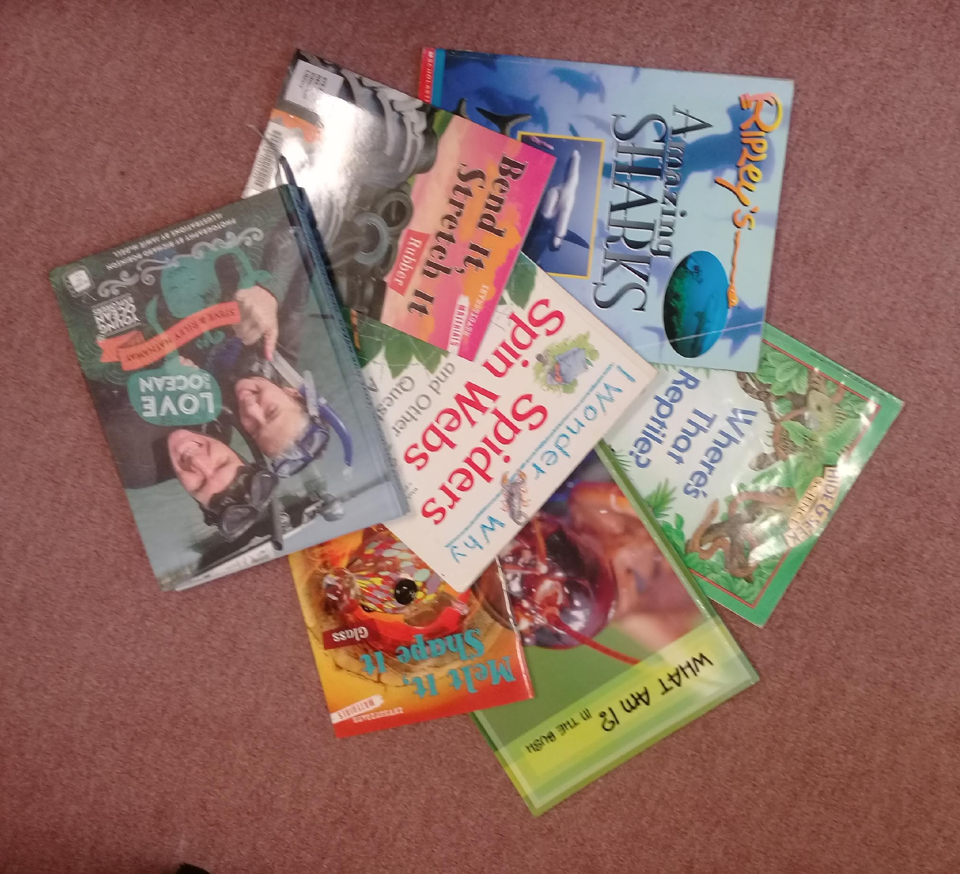
Planning to incorporate literacy – how?
Take advantage of the teachable moment.
Plan for relevance – connecting new learning with students’ own experience using real-life examples and everyday applications of science to their lives.
Make classroom displays relevant and language rich, e.g. posters, key words, student work, question boards.
Provide selections of reading materials, e.g. magazines, books at various reading levels.
Make the connections to other curriculum areas.
© Copyright. University of Waikato. All Rights Reserved | www.sciencelearn.org.nz
All images are copyrighted. For further information, please refer to enquiries@sciencelearn.org.nz

Slide 26
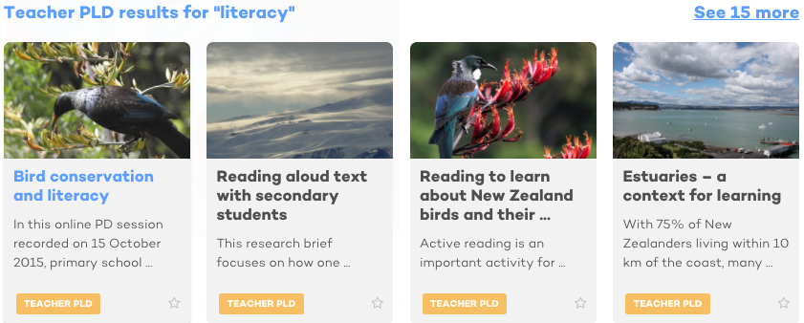
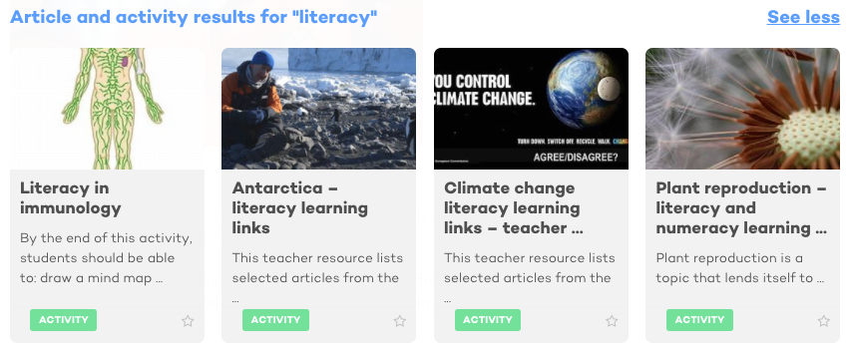
Some literacy resources from the Science Learning Hub
© Copyright. University of Waikato. All Rights Reserved | www.sciencelearn.org.nz
All images are copyrighted. For further information, please refer to enquiries@sciencelearn.org.nz

Slide 27
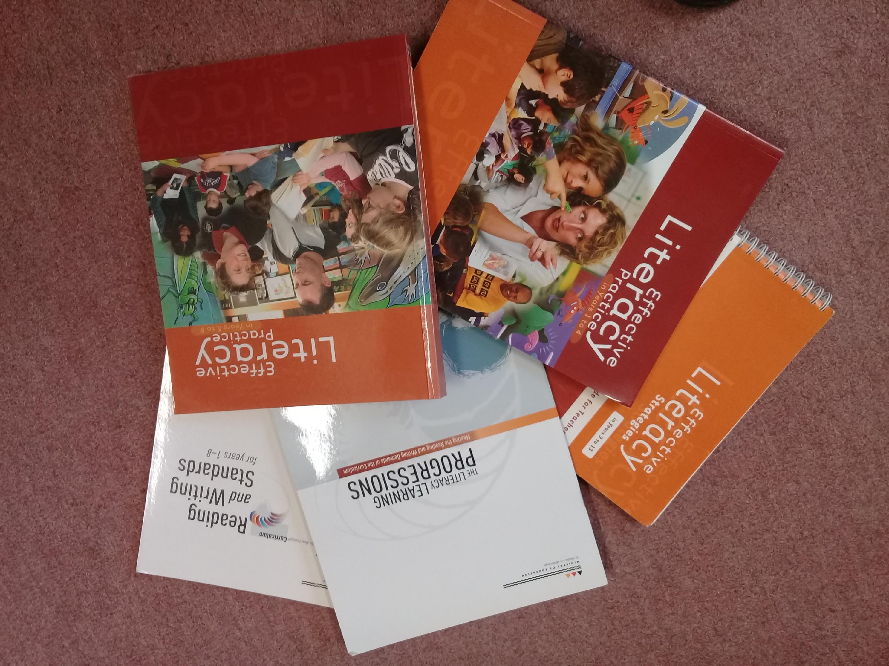
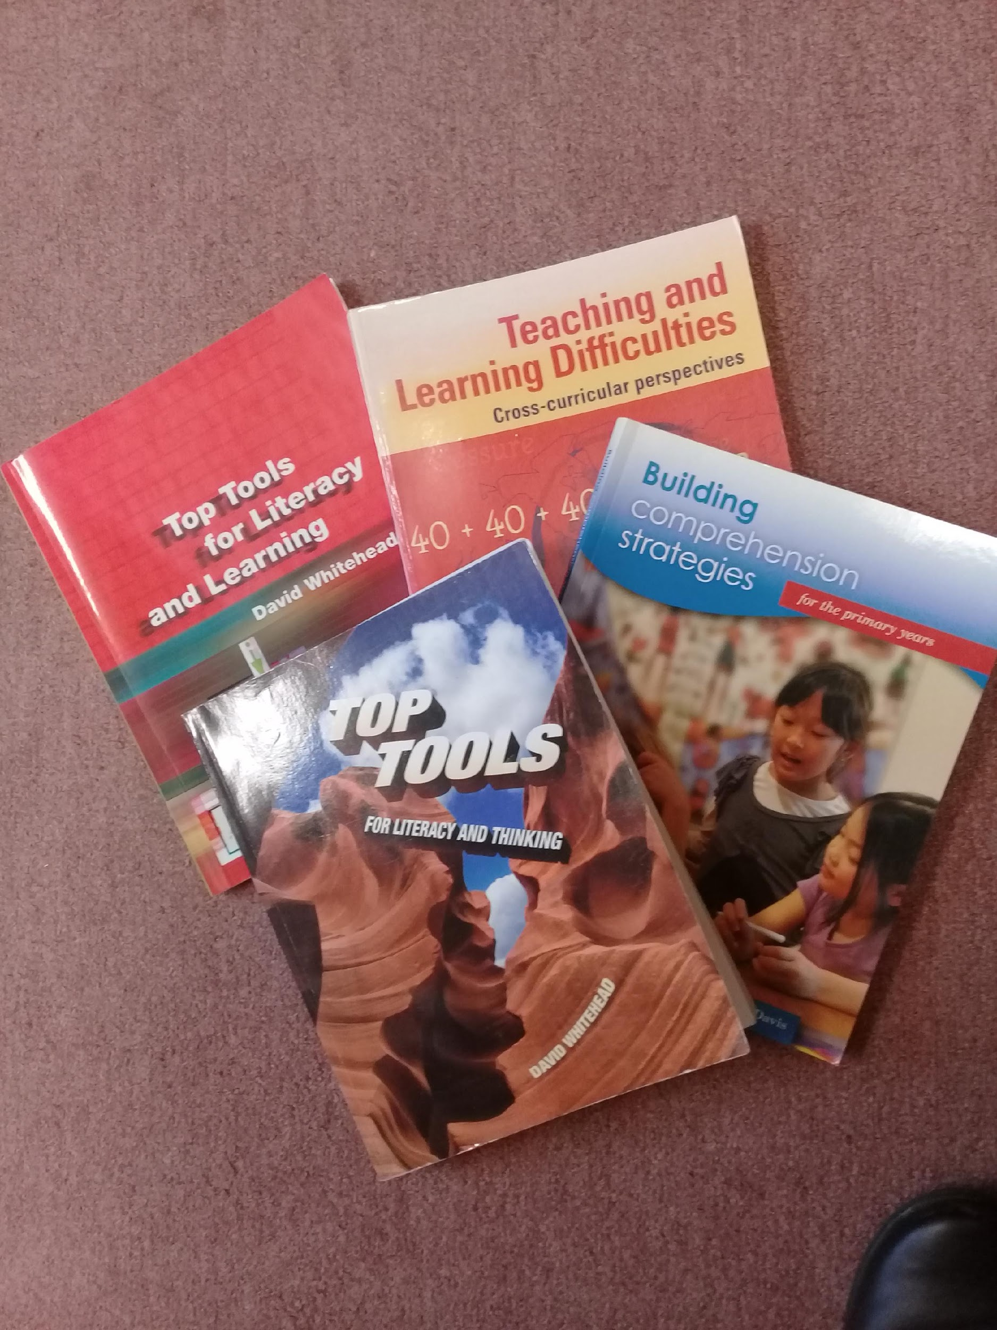
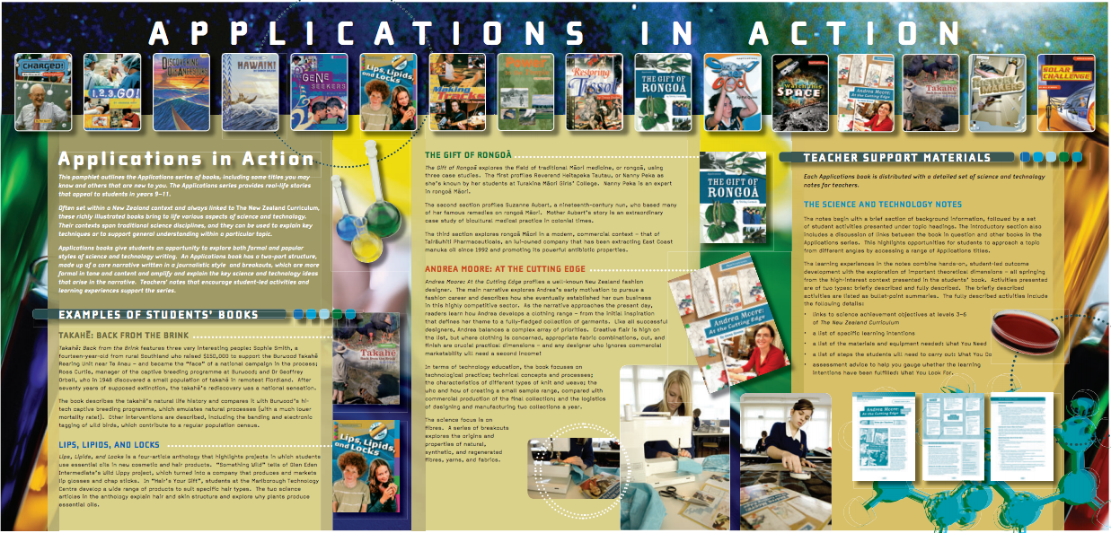
Literacy resources
© Copyright. University of Waikato. All Rights Reserved | www.sciencelearn.org.nz
All images are copyrighted. For further information, please refer to enquiries@sciencelearn.org.nz

Slide 28
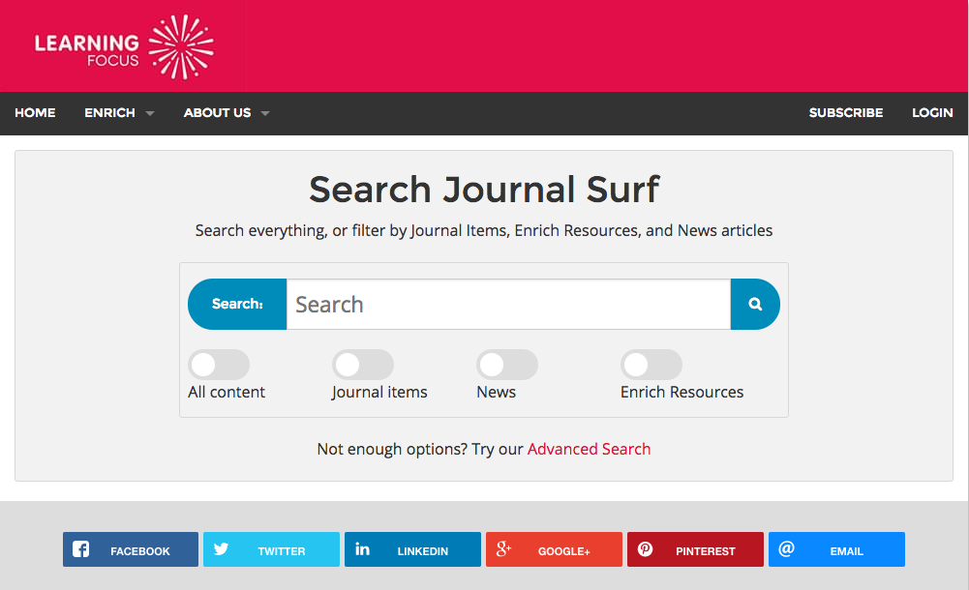
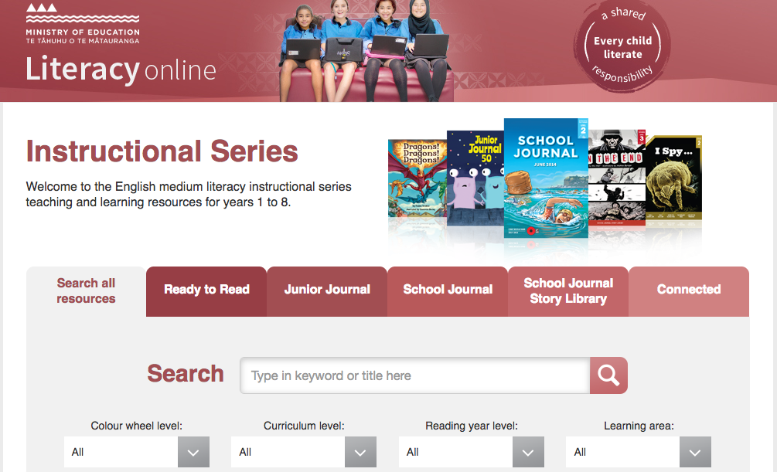
More literacy resources
© Copyright. University of Waikato. All Rights Reserved | www.sciencelearn.org.nz
All images are copyrighted. For further information, please refer to enquiries@sciencelearn.org.nz
Notes:
https://journalsurf.co.nz http://www.thechair.co.nz http://literacyonline.tki.org.nz https://natlib.govt.nz/schools

Slide 29
Just reflecting
Are there any science contexts/topics that appear to lend themselves better to include a greater focus on literacy?
Has your thinking changed about connecting science and literacy? If so, how?
How might your practice change?
123RF Ltd
© Copyright. University of Waikato. All Rights Reserved | www.sciencelearn.org.nz
All images are copyrighted. For further information, please refer to enquiries@sciencelearn.org.nz

Slide 30
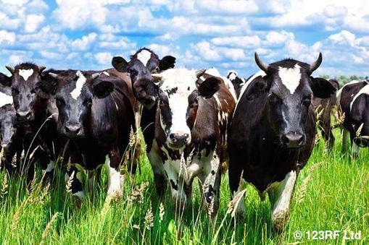
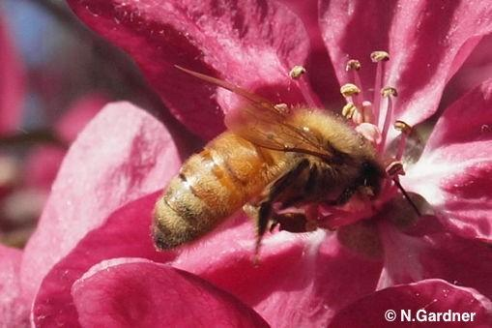
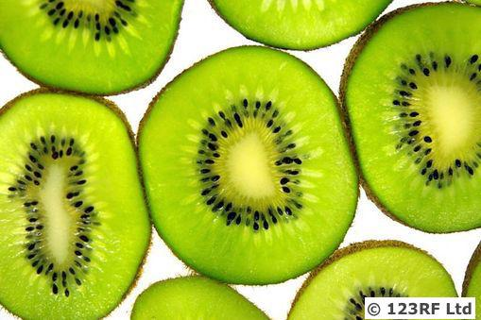
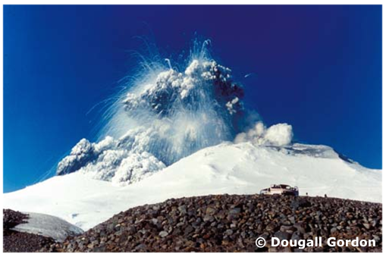
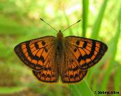
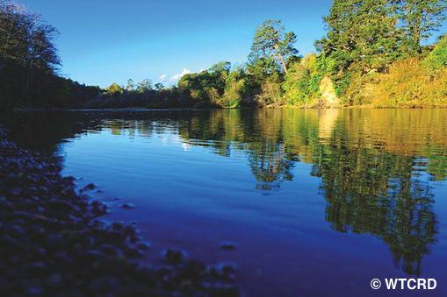
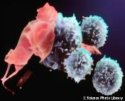
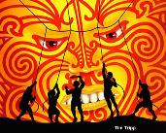
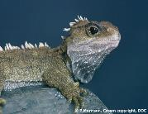
Thanks - want to keep connected?
Email us on enquiries@sciencelearn.org.nz
Follow us on Twitter: https://twitter.com/NZScienceLearn
Like us on Facebook: www.facebook.com/nzsciencelearn
On Pinterest: https://nz.pinterest.com/nzsciencelearn/
Join us in the pond: www.pond.co.nz/community/214015/science-learning-hub/
Join us in our science and literacy discussion channel on Slack.
(This link may expire: if it does, contact us via our enquiries email and
we will send you a new one.)

