Slide 1
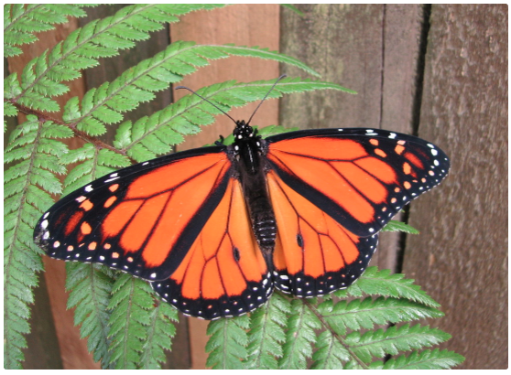

Welcome to
‘Fostering literacy through primary science’
Anne Barker
and
Lyn Rogers
Thursday
26 October
2017
4–4.45pm
Kath Widdowson
© Copyright. University of Waikato. All Rights Reserved | www.sciencelearn.org.nz
All images are copyrighted. For further information, please refer to enquiries@sciencelearn.org.nz
Notes:
www.sciencelearn.org.nz/images/3139-adult-size

Slide 2
Index
Topic | Slide number(s) | Video timecode
Introduction, welcome and purpose of the webinar | 1–3 | 00:00
Discussing the links between literacy and science | 4–5 | 01:48
The importance of talk | 6 | 03:31
Science texts | 7 | 04:31
Newsboard – a process for connecting science and literacy | 8–19 | 06:04
Following newsboard with inquiry | 20–21 | 21:22
Curriculum connections | 22–23 | 25:25
Generating ‘meaty’ talk | 24 | 28:40
Texts for reading – resources | 25–2 | 29:39
Comprehension and inquiry | 29–30 | 33:17
More resources | 31–33 | 34:36
Reflection | 34 | 37:08
Contact details and thanks | 35 | 37:34

Slide 3
Fostering literacy through primary science
– our purpose
In this webinar we will explore how science and literacy can be integrated by:
discussing how science topics and activities can be used as contexts to deliberately foster students’ literacy skills
exploring some simple strategies to support vocabulary development, comprehension, oral language and writing in science.
Kath Widdowson
© Copyright. University of Waikato. All Rights Reserved | www.sciencelearn.org.nz
All images are copyrighted. For further information, please refer to enquiries@sciencelearn.org.nz
Notes:
www.sciencelearn.org.nz/resources/511-monarch-butterflies

Slide 4
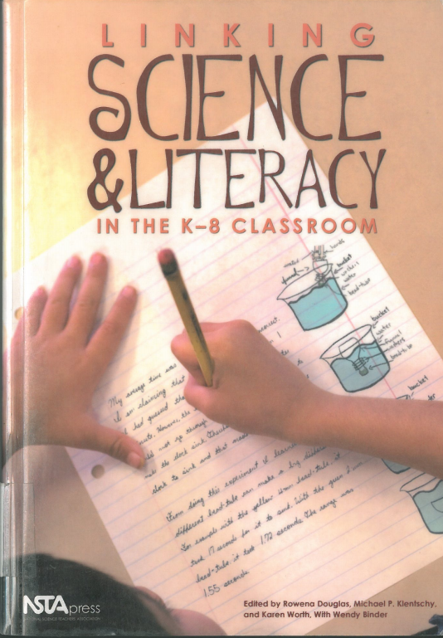
Science and literacy
“Not everything we want students to learn about science can be observed or manipulated in the classroom (and some not in the natural world).”
“[Scientists] learn about and come to understand the natural world through text as well as first-hand experience. So too can students, or at least that is our claim and our goal”
Cervetti, Pearson, Bravo, Barber (2006)
© Copyright. University of Waikato. All Rights Reserved | www.sciencelearn.org.nz
All images are copyrighted. For further information, please refer to enquiries@sciencelearn.org.nz
Notes:
Our aim is to support you to see specific and clear links to literacy through science to enable some cribbing of time for science.

Slide 5
Science and literacy
Using literacy to engage with science
Literacy as a tool that enables science thinking and learning
e.g. reading to find science information
Using science to engage with literacy
Science as a context to teach literacy
e.g. newsboard is using a science-based text to teach literacy
Listen/talk
Read/write
View/present
© Copyright. University of Waikato. All Rights Reserved | www.sciencelearn.org.nz
All images are copyrighted. For further information, please refer to enquiries@sciencelearn.org.nz
Notes:
Two different perspectives to view and engage with the three modalities of literacy.

Slide 6
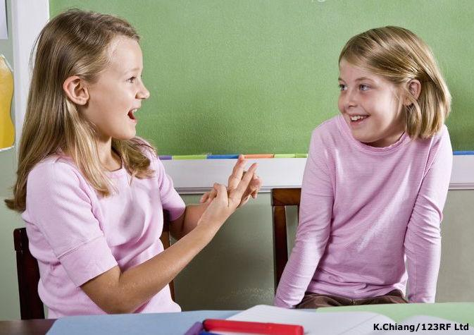
The person who’s talking is doing the learning
“In schools, talk is sometimes valued and sometimes avoided, but – and this is surprising – talk is rarely taught. It is rare to hear teachers discuss their efforts to teach students to talk well. Yet talk, like reading and writing, is a major motor – I could even say the major motor – of intellectual development.”
Calkins (2000) p.226
© Copyright. University of Waikato. All Rights Reserved | www.sciencelearn.org.nz
All images are copyrighted. For further information, please refer to enquiries@sciencelearn.org.nz
Notes:
Talk involving discussion, sharing ideas etc. Developing the skill of making observations whilst developing oral language.

Slide 7
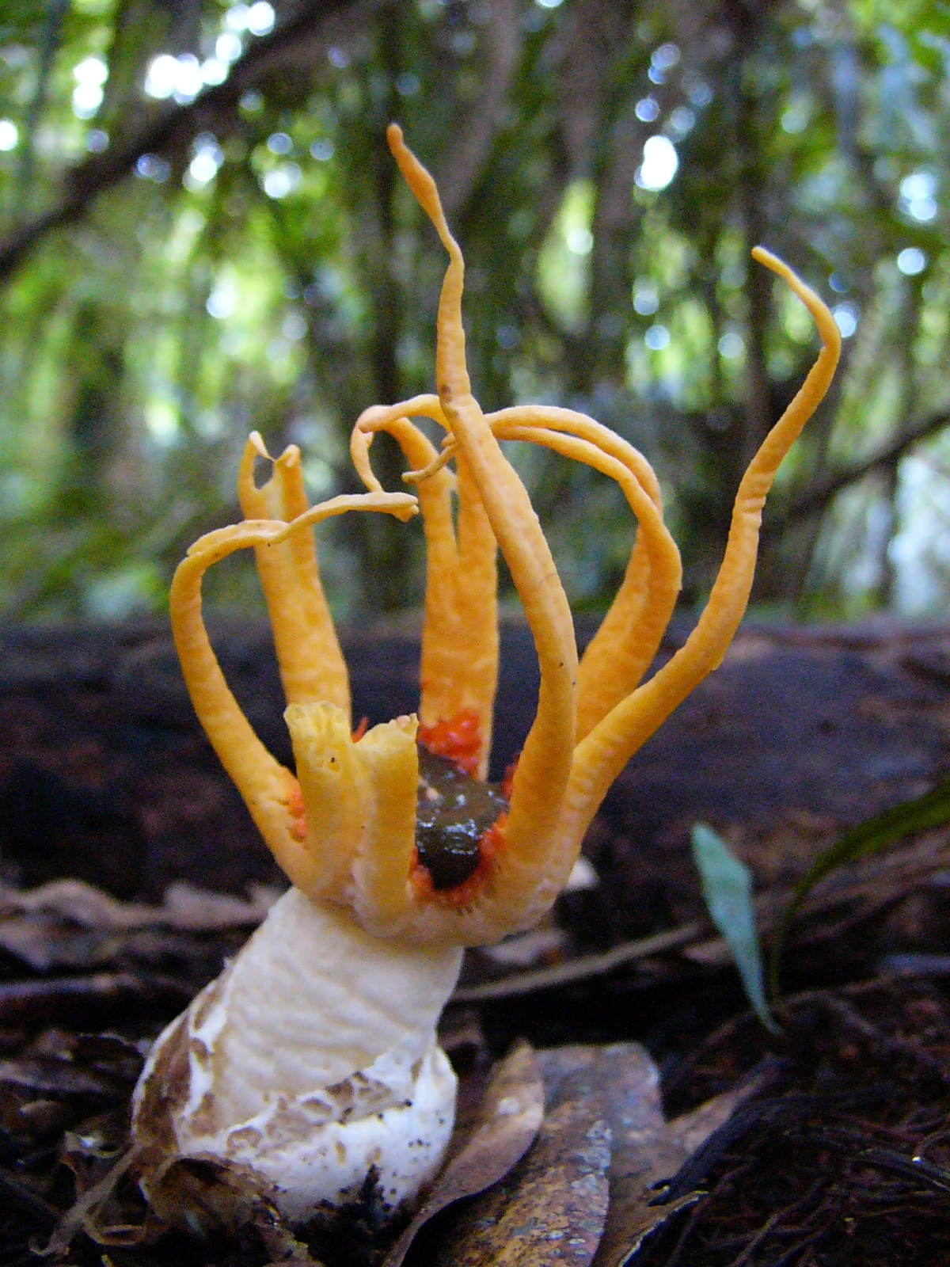
Science texts
Texts can provide context.
Texts can deliver content.
Texts can model:
      inquiry processes
      literary processes
      nature of science.
Texts can support second-hand inquiry.
Texts support first-hand inquiry.
Steve Reekie
© Copyright. University of Waikato. All Rights Reserved | www.sciencelearn.org.nz
All images are copyrighted. For further information, please refer to enquiries@sciencelearn.org.nz

Slide 8

Newsboard
– a tool for cross-curricular integration
© Copyright. University of Waikato. All Rights Reserved | www.sciencelearn.org.nz
All images are copyrighted. For further information, please refer to enquiries@sciencelearn.org.nz
Notes:
Newsboards offer:
a shared reading opportunity
a connection with family and whānau
opportunities to engage with text beyond reading level
opportunities to interact with text from a scientific perspective – notice, think, wonder – predict, observe, explain
opportunities to use specific literacy techniques – cloze, prediction, reading for meaning, hypothesising unknown words.

Slide 9
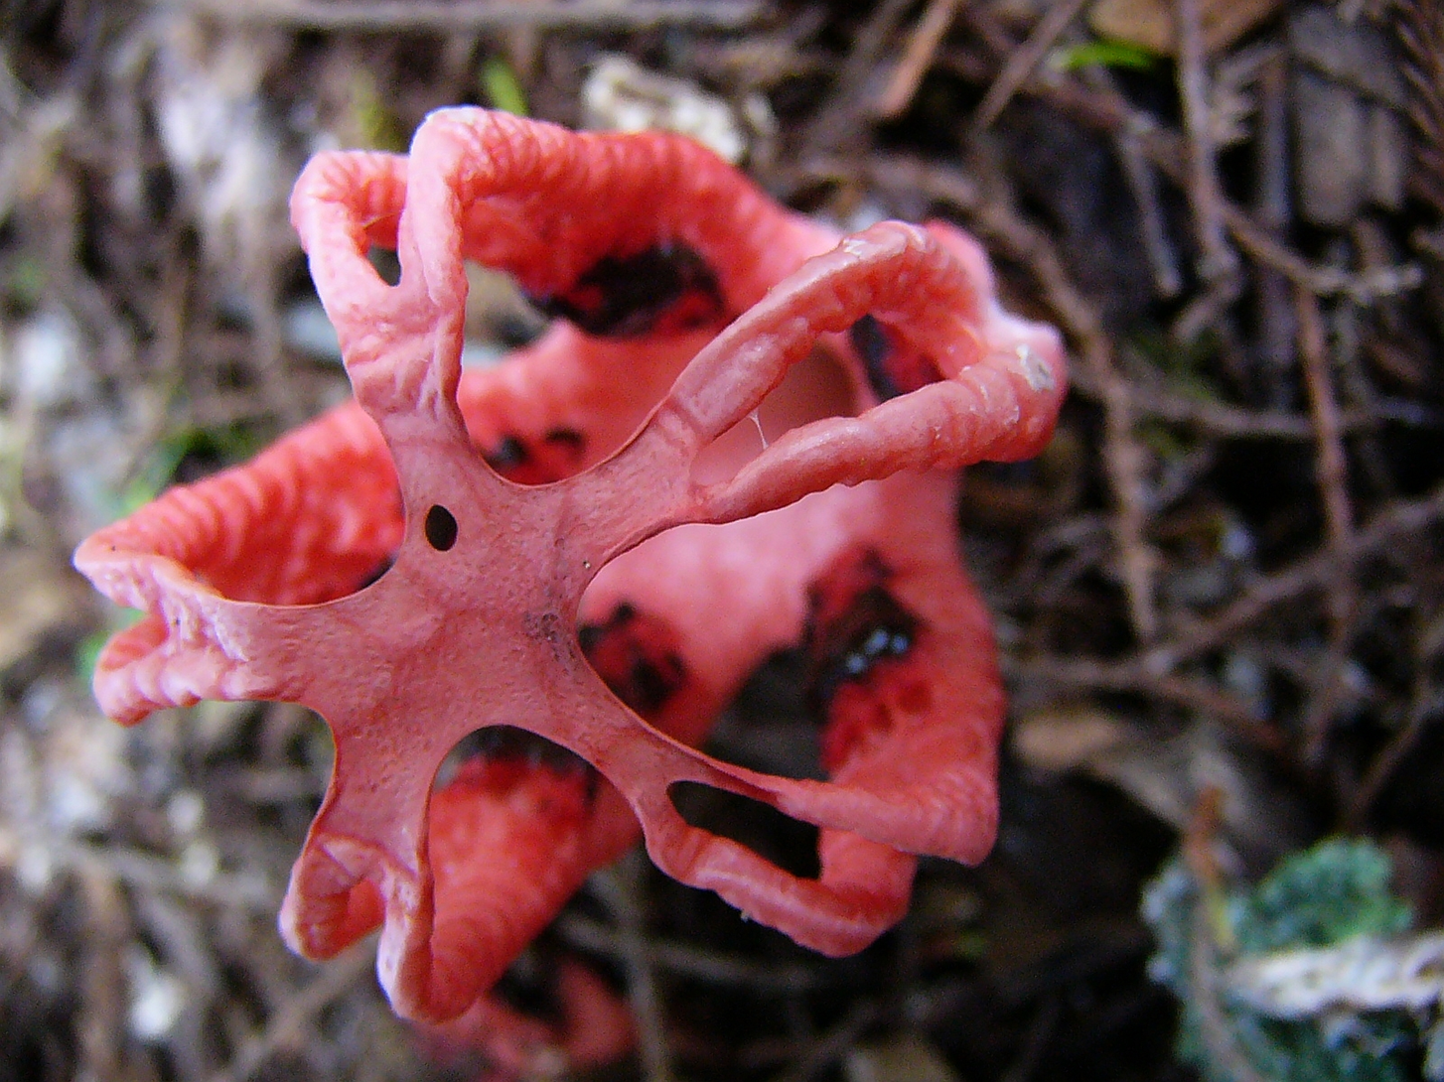
Steve Reekie
© Copyright. University of Waikato. All Rights Reserved | www.sciencelearn.org.nz
All images are copyrighted. For further information, please refer to enquiries@sciencelearn.org.nz
Notes:
Image from www.stuff.co.nz/national/blogs/in-our-nature/8618612/Autumn-aliens
Step 1 – A very quick look. This image is only shown for a short time.

Slide 10
The picture
What did you observe?
What prediction/s can you make about the article that the picture came from?
© Copyright. University of Waikato. All Rights Reserved | www.sciencelearn.org.nz
All images are copyrighted. For further information, please refer to enquiries@sciencelearn.org.nz
Notes:
Step 2 – Discuss what you saw. In science, we don’t always get the chance to have a prolonged look. List your observations, make predictions

Slide 11
The picture – some participants’ observations
Some kind of sea animal
Like an upside down snail
A fungus
A pink sea creature
Weird
Symmetry
Red octopus
Red flower
Squid-like creature
‘Arms’
Orange red colour of a creature
Arms that were connected in the centre
Have a close look. Are all these observations, or are there some inferences here too?
Natural
© Copyright. University of Waikato. All Rights Reserved | www.sciencelearn.org.nz
All images are copyrighted. For further information, please refer to enquiries@sciencelearn.org.nz
Notes:
Step 2 – Discuss what you saw. In science, we don’t always get the chance to have a prolonged look.

Slide 12
The picture
– some participants’ predictions about what the article might be about
Adaptations
Biodiversity
The article will be about living creatures
It will be about a pink plant
A pink fungus
Something might have been discovered
A new discovery of animal life
Some new mushroom to put on toast
A new medical discovery
© Copyright. University of Waikato. All Rights Reserved | www.sciencelearn.org.nz
All images are copyrighted. For further information, please refer to enquiries@sciencelearn.org.nz
Notes:
Step 2 – Discuss what you saw. Making predictions about what the article may be about based only on their glimpse of the picture.

Slide 13
Using observation to make predictions
Steve Reekie
© Copyright. University of Waikato. All Rights Reserved | www.sciencelearn.org.nz
All images are copyrighted. For further information, please refer to enquiries@sciencelearn.org.nz
Notes:
Step 3 – Taking another look, making more predictions, beginning to ask questions and to discuss ideas.

Slide 14
More participants’ observations and predictions about the picture and article
Microscopic particle/biological 'thing' blown up so the naked eye can see it
Looks like twigs at the back
Inside of the flower
I've changed my mind - did initially think that was a fishing net behind but now think it is a member of the tamarilo family
A seeding plant
A pink fungus
I agree it is something microscopic
Seed pod
A virus
I'm wondering if it is on a tree?
Natural phenomena found in the sea
Fungus
Are those twigs in the background?
Tiny squid cleans the sea of plastic
Still think it is a flower
Steve Reekie
© Copyright. University of Waikato. All Rights Reserved | www.sciencelearn.org.nz
All images are copyrighted. For further information, please refer to enquiries@sciencelearn.org.nz
Notes:
After a better look the responses are richer now; students begin discussing their ideas and this offers more opportunity for teachers to use critical and prompting questions such as ‘Why do you think that?’

Slide 15
The title
Autumn Aliens
What new information does this title offer?
Steve Reekie
© Copyright. University of Waikato. All Rights Reserved | www.sciencelearn.org.nz
All images are copyrighted. For further information, please refer to enquiries@sciencelearn.org.nz
Notes:
Step 4 – Looking at the title
This process is adapted from http://www.stuff.co.nz/national/blogs/in-our-nature/8618612/Autumn-aliens by Anne Barker Te Toi Tupu 2013

Slide 16
New ideas – participants using the title
Autumn Aliens
We don’t usually associate water and sea with seasons very often…
Autumn is when a lot of fungi appear.....
Seasonal fungus.
Alien means that it is foreign or imported.
Still think something biological but the season is adding a different twist to the picture.
Mushrooms often grow in autumn so I am still thinking it may be a fungus or type of mould.
Steve Reekie
Autumn makes me think we only see this on occasion.
© Copyright. University of Waikato. All Rights Reserved | www.sciencelearn.org.nz
All images are copyrighted. For further information, please refer to enquiries@sciencelearn.org.nz
Notes:
Step 4 – Looking at the title, people beginning to challenge their previous ideas as new information comes in. This is the nature of science in action.
This process is adapted from www.stuff.co.nz/national/blogs/in-our-nature/8618612/Autumn-aliens by Anne Barker Te Toi Tupu 2013

Slide 17
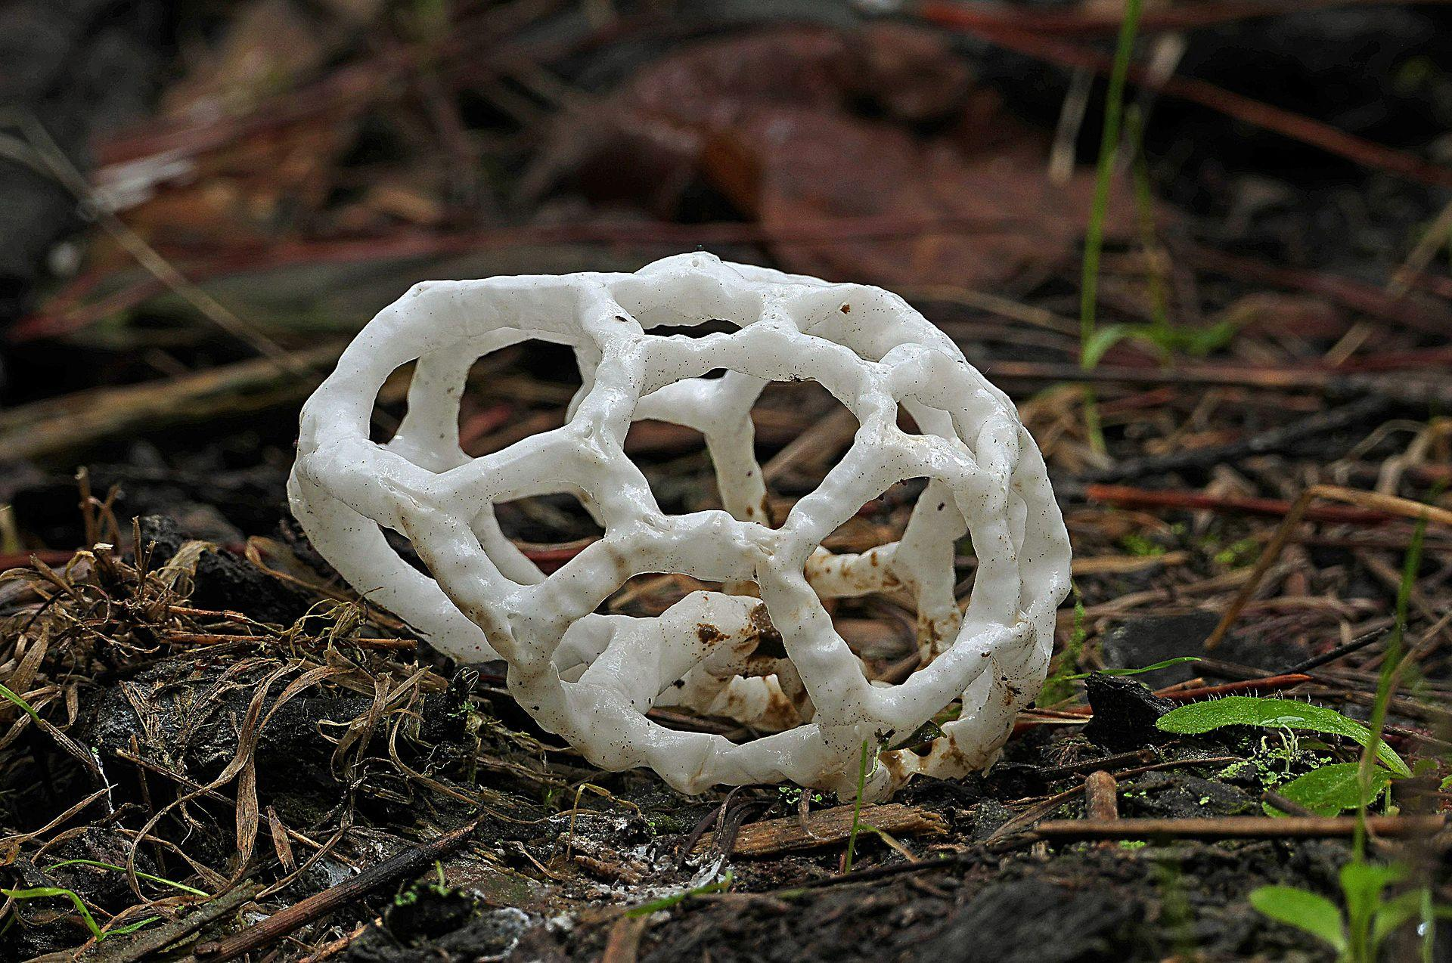
The text
A few years ago my Mum phoned me to say that she had this ‘alien’ thing in her backyard…
it had burst out of a kind of puffball, and was a white tough but slimy latticework-looking ball thing
© Copyright. University of Waikato. All Rights Reserved | www.sciencelearn.org.nz
All images are copyrighted. For further information, please refer to enquiries@sciencelearn.org.nz
Notes:
Step 5 – begin to look at the text – read it aloud, chorally, stopping to model reading strategies as you go.

Slide 18
The text (cont.)
After some research we found out it was a basket fungus. These quirky looking fungi are endemic to New Zealand. Autumn is the best time of year for discovering mushrooms and toadstools.
This year has had an explosion of mushrooms and toadstools probably because of the perfect recipe of warm, dry…
© Copyright. University of Waikato. All Rights Reserved | www.sciencelearn.org.nz
All images are copyrighted. For further information, please refer to enquiries@sciencelearn.org.nz

Slide 19
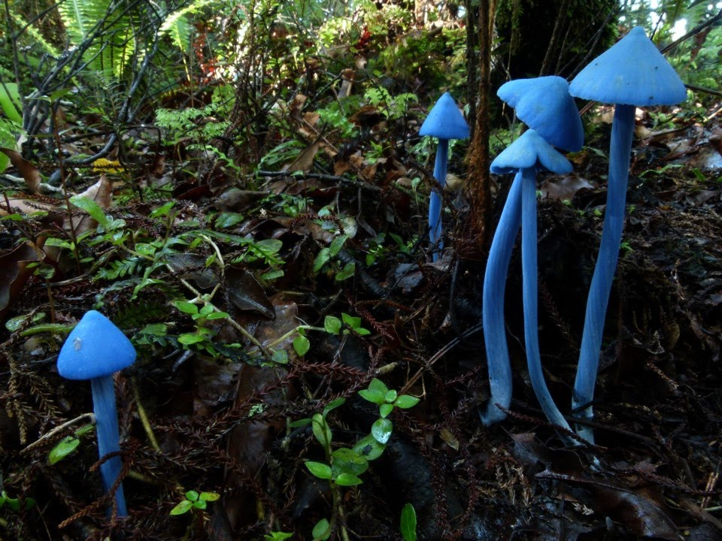
The text (cont.)
…weather followed by a week of rain – just add spores and hey presto, a smattering of toadstools, mushrooms and other fungi popping up in all kinds of places.
Fungi are often thought of as ‘gross’ when you remember that they include mould on your bread and the itchy sensation of athlete’s foot between your toes. However fungi play an important role in our lives. Without fungi we wouldn’t have wine, cheese, bread and penicillin.
There are thought to be up to 20,000 species of fungi in New Zealand, but only a fraction of these have been described.
© Copyright. University of Waikato. All Rights Reserved | www.sciencelearn.org.nz
Images 1, 2 and 4 are courtesy of Steve Reekie - all rights reserved. Basket fungi - public domain.

Slide 20
Inquiry?
Steve Reekie
© Copyright. University of Waikato. All Rights Reserved | www.sciencelearn.org.nz
All images are copyrighted. For further information, please refer to enquiries@sciencelearn.org.nz
Notes:
The reading and photos can be used as a launching point for future reading, investigation, art with fungi.

Slide 21
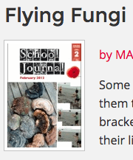
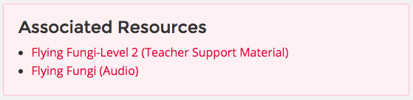
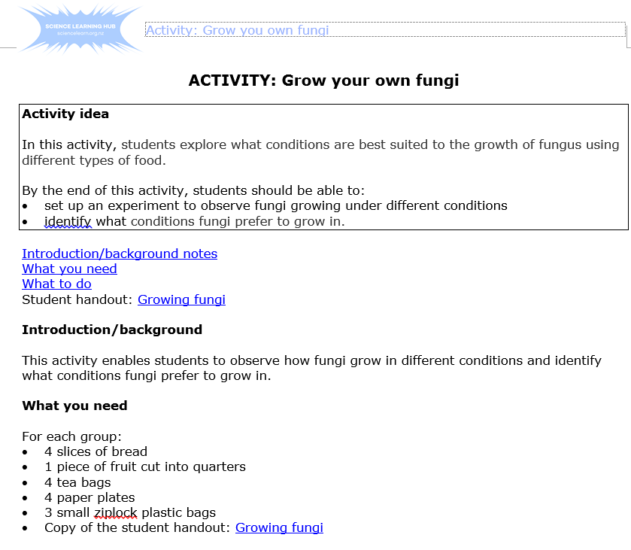
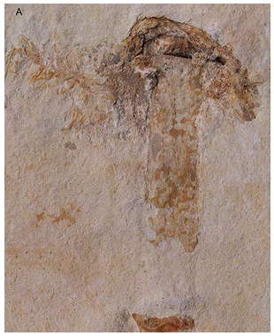
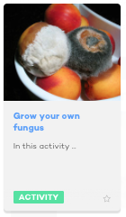
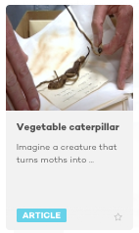

Texts can provide context
Invite students to engage with scientific contexts and content, explore further resources and opportunities for investigation.
Audio-visual
Investigations and activities
Articles, stories, headlines and pictures
© Copyright. University of Waikato. All Rights Reserved | www.sciencelearn.org.nz
All images are copyrighted. For further information, please refer to enquiries@sciencelearn.org.nz
Notes:
Some resources to use – providing opportunities for students to discover more about fungi, grow fungi, fungal spore prints. Link to prior knowledge, Māori knowledge.

Slide 22
Connecting to the nature of science
Big science idea: ?? Nature of science – achievement aims
Understanding about science Learn about science as a knowledge system: the features of scientific knowledge and the processes by which it is developed; and learn about the ways in which the work of scientists interacts with society. | Investigating in science Carry out science investigations using a variety of approaches: classifying and identifying, pattern seeking, exploring, investigating models, fair testing, making things, or developing systems. | Communicating in science Develop knowledge of the vocabulary, numeric and symbol systems, and conventions of science and use this knowledge to communicate about their own and others’ ideas. | Participating and contributing Bring a scientific perspective to decisions and actions as appropriate.
© Copyright. University of Waikato. All Rights Reserved | www.sciencelearn.org.nz
All images are copyrighted. For further information, please refer to enquiries@sciencelearn.org.nz
Notes:
Need to make clear and explicit links to the curriculum. That we are ‘doing science’.
These overview statements aren’t written into the published NZC book but are available as the fold-outs that came originally with the NZC into schools and online at http://nzcurriculum.tki.org.nz/The-New-Zealand-Curriculum/Science/Achievement-objectives#collapsible1.

Slide 23
Science capabilities for citizenship
Gather and interpret data | Use evidence
Interpreting data involves making meaning from observations. A conclusion you draw from observations is called an inference. To help students differentiate between observation and inference, ask: Is it something we can see, hear, smell, touch or taste? Is it measurable? What did you see? (observation) What might that mean? (inference) They ask questions like: “Could there be another explanation for this data?” They might collect more data, perhaps using a different method. They might also test alternative explanations. They communicate and debate their ideas with other scientists | Students should be encouraged to ask and answer questions such as: How do you know that? What makes you think so? How could you check that? So an example of that would be… Can you think of an example when this wouldn’t work?
Critique evidence | Interpret representations
In order to evaluate the trustworthiness of data, students need to know quite a lot about the qualities of scientific tests. They need both methodological knowledge and statistical knowledge to know what sorts of questions to ask. Students should be encouraged to ask and answer questions such as: How sure are you of your results? How did you get the data? What were the possible shortcomings of this method? How could you check your findings? How were the measurements taken and recorded? How confident are you that the measurements are accurate? Did these results surprise you? What were you expecting to find out? Would these results always be true? | Scientists represent their ideas in a variety of ways, including models graphs, charts, diagrams and written texts. A model is a representation of an idea, an object, a process or a system. What does this representation tell us? What is left out? How does this representation get the message across? Why is it presented in this particular way?
Engage with science
This capability requires students to use the other capabilities to engage with science in real-life contexts. It involves students taking an interest in science issues, participating in discussions about science and at times taking action.
© Copyright. University of Waikato. All Rights Reserved | www.sciencelearn.org.nz
All images are copyrighted. For further information, please refer to enquiries@sciencelearn.org.nz
Notes:
http://scienceonline.tki.org.nz/Introducing-five-science-capabilities

Slide 24
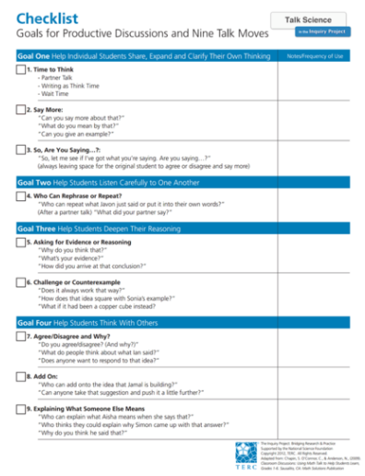
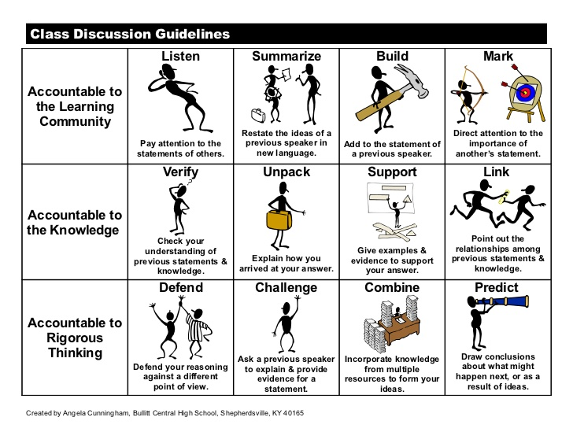
Ways we can generate some meaty talk
Accountable talk
Science talk moves
© Copyright. University of Waikato. All Rights Reserved | www.sciencelearn.org.nz
All images are copyrighted. For further information, please refer to enquiries@sciencelearn.org.nz
Notes:
Talk is important because it is through talk that we make meaning. If we can’t talk about it, we can’t write or read it.

Slide 25
Texts can model inquiry processes,
literary processes and the nature of science
Newsboard (shared reading, guided)
An approach that enables students to participate at their intellectual level even though it may be beyond their reading level.
Reading about science and scientists (shared, reading to, guided or independent reading)
Developing engagement in science through sharing interesting, curious, amazing stories.
Exploring the idea of science as part of their future identity.
Developing understanding of what it is to be a scientist.
Reading to do science (shared, reading to, guided or independent reading)
Functional reading that enables students to investigate in science.
© Copyright. University of Waikato. All Rights Reserved | www.sciencelearn.org.nz
All images are copyrighted. For further information, please refer to enquiries@sciencelearn.org.nz

Slide 26
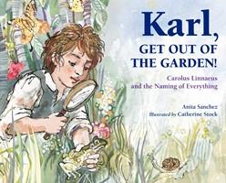
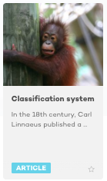
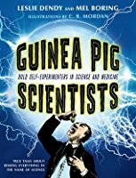
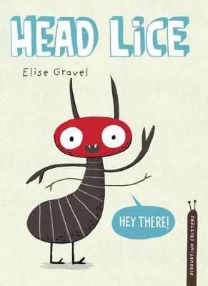
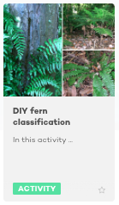
Reading about science and scientists
Less than 5% of the texts read to students are non-fiction – why?
  Reflection of the demographics of teachers?
  Who are the less-engaged students during ‘reading to’ lessons?
© Copyright. University of Waikato. All Rights Reserved | www.sciencelearn.org.nz
All images are copyrighted. For further information, please refer to enquiries@sciencelearn.org.nz
Notes:
Science as a context to do literacy – these could be used as reading material. https://www.sciencelearn.org.nz/resources/1438-classification-system and https://www.sciencelearn.org.nz/resources/1411-diy-fern-classification – opportunities to go further with finding out what Karl did for science.

Slide 27
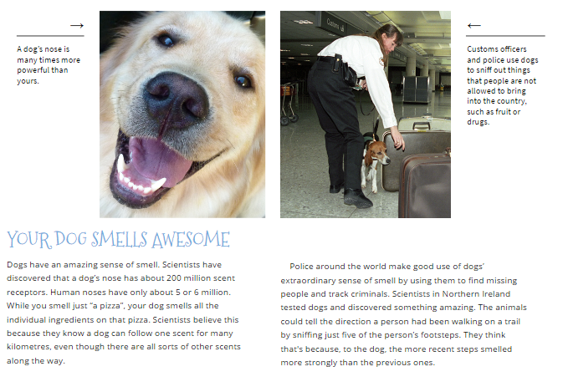
Reading in science
This might lead to investigation
Resources include:
Connected online
– levelled
science-based reading material.
© Copyright. University of Waikato. All Rights Reserved | www.sciencelearn.org.nz
All images are copyrighted. For further information, please refer to enquiries@sciencelearn.org.nz
Notes:
Independent reading activity might form a part of your literacy rotation – so choosing interesting science-based reading AND providing the gear to enable investigation scientifically can really encourage and enable students.
Connected series is at Literacy online: http://literacyonline.tki.org.nz

Slide 28
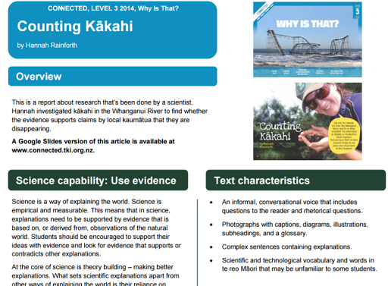
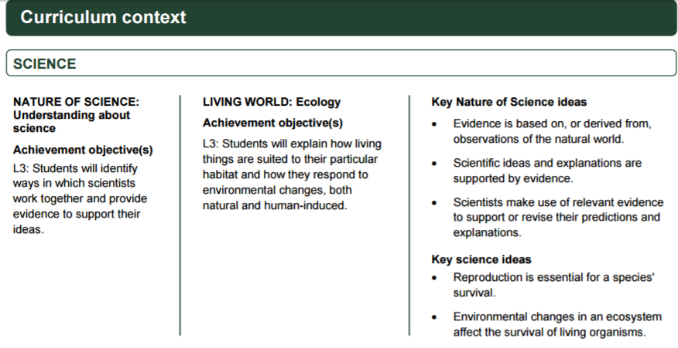
Teacher resources available
© Copyright. University of Waikato. All Rights Reserved | www.sciencelearn.org.nz
All images are copyrighted. For further information, please refer to enquiries@sciencelearn.org.nz
Notes:
This information – supporting the connected series is accessible through a couple of entry points, English online, Science online or via the science capabilities resources on TKI.

Slide 29
Comprehension – applying skills for writing
To be good writers, students need to be good readers.
Good readers:
activate background knowledge to make meaning
ask questions while reading
analyse the text (author’s choice)
make mental images
summarise what they have read.
Good writers employ the same strategies.
© Copyright. University of Waikato. All Rights Reserved | www.sciencelearn.org.nz
All images are copyrighted. For further information, please refer to enquiries@sciencelearn.org.nz
Notes:
Reading for meaning – making scientific texts manageable for students. We can support students to do all the things above in science. MoQuote Sue Dymock “Teaching Text Structures”.

Slide 30
Comprehension strategies are inquiry strategies
Science and literacy share a set of core meaning-making strategies.
The shared strategies include:
  activating prior knowledge
  establishing purposes/goals
  making and reviewing predictions
  drawing inferences and conclusions
  making connections
  acquiring information
  solving problems
  recognising relationships.
© Copyright. University of Waikato. All Rights Reserved | www.sciencelearn.org.nz
All images are copyrighted. For further information, please refer to enquiries@sciencelearn.org.nz
Notes:
We need to discuss the link between science and inquiry. There is still a misconception that science is all about the scientific method in its most restricted form and that it is largely about accumulation of factual information.

Slide 31

Resources
© Copyright. University of Waikato. All Rights Reserved | www.sciencelearn.org.nz
All images are copyrighted. For further information, please refer to enquiries@sciencelearn.org.nz
Notes:
This is a website that offers ways of using New Zealand picture books to engage with learning across the curriculum – always a win-win situation.

Slide 32
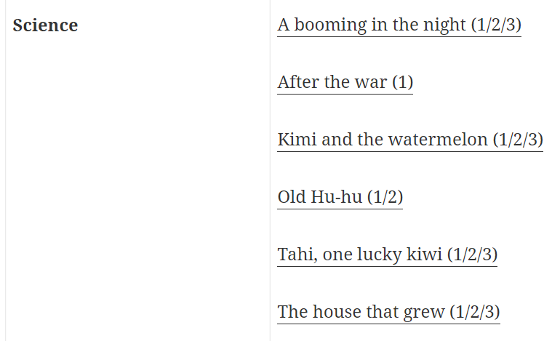
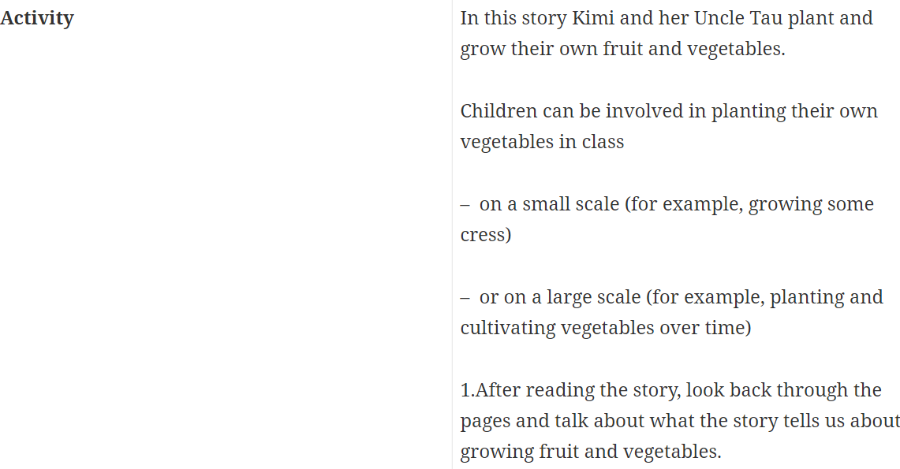
What does the resource offer me?
© Copyright. University of Waikato. All Rights Reserved | www.sciencelearn.org.nz
All images are copyrighted. For further information, please refer to enquiries@sciencelearn.org.nz
Notes:
Information including science links in the picture books is accessible on the site at www.picturebooks.co.nz/

Slide 33
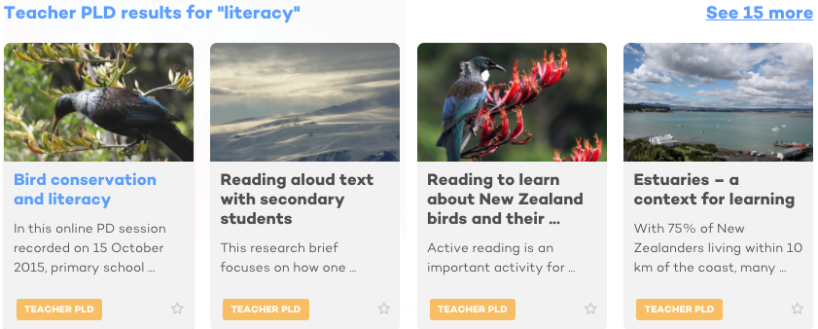
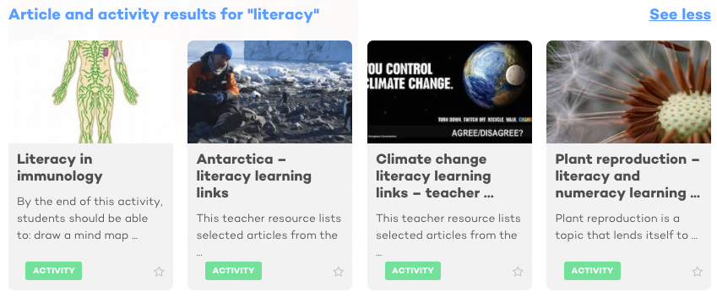
Some literacy resources from the
Science Learning Hub
© Copyright. University of Waikato. All Rights Reserved | www.sciencelearn.org.nz
All images are copyrighted. For further information, please refer to enquiries@sciencelearn.org.nz

Slide 34
Just reflecting
Are there any science contexts/topics that appear to lend themselves better to include a greater focus on literacy?
Has your thinking changed about connecting science and literacy? If so, how?
How might your practice change?
Kath Widdowson
© Copyright. University of Waikato. All Rights Reserved | www.sciencelearn.org.nz
All images are copyrighted. For further information, please refer to enquiries@sciencelearn.org.nz

Slide 35






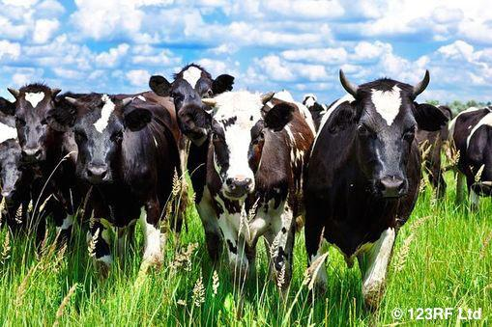
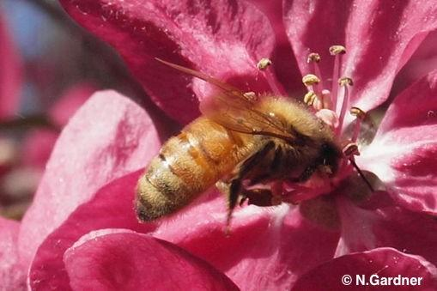
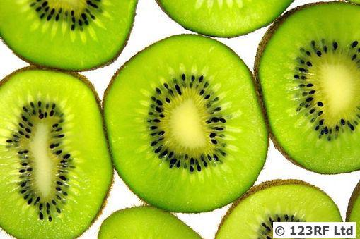
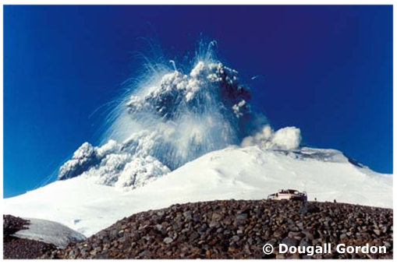
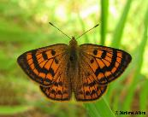
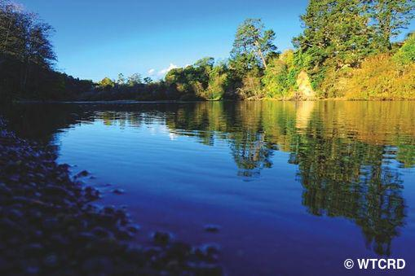
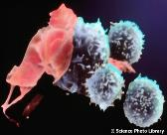
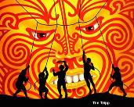
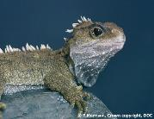
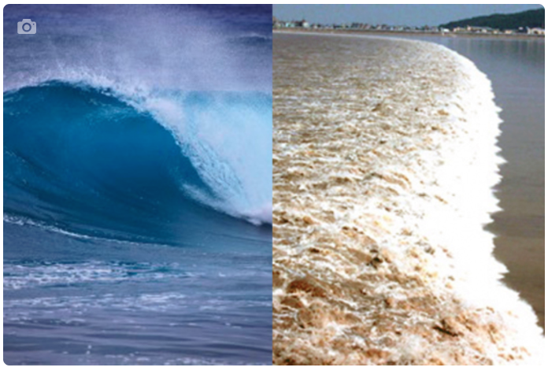
Thanks – want to keep connected?
Science Learning Hub
Email us on
enquiries@sciencelearn.org.nz
Follow us on Twitter: https://twitter.com/NZScienceLearn
Like us on Facebook: www.facebook.com/nzsciencelearn
On Pinterest: https://nz.pinterest.com/nzsciencelearn/
Join us in the pond: https://www.pond.co.nz/community/
214015/science-learning-hub/
Anne Barker Accredited PLD Facilitator anne.barker@waikato.ac.nz 07 838 4466 Ext 8230 027 353 9688 Private Bag 3105, Hamilton 3240 www.waikato.ac.nz/professionallearning
Join us in our science and literacy discussion channel on Slack.
This link may expire: if it does, contact us via our enquiries email, and we will send you a new one.

