Slide 1
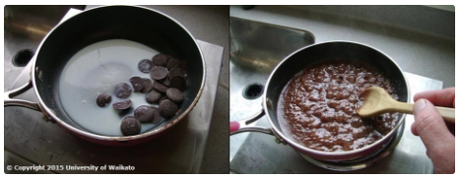
Kitchen science
Angela Schipper and Lyn Rogers
Thursday 16 November
2017
© Copyright. University of Waikato. All Rights Reserved | www.sciencelearn.org.nz
All images are copyrighted. For further information, please refer to enquiries@sciencelearn.org.nz

Slide 2
Index
Topic | Slide | Video timecode
Introduction, welcome and purpose of the webinar | 1–2 | 00:00
Simple science activities | 3–4 | 00:53
Fostering students’ thinking | 5 | 07:47
Making ice cream | 6–9 | 09:43
Making a solar oven | 10–14 | 30:57
Carbon dioxide | 15–18 | 37:31
Curriculum connections | 19–20 | 44:05
Supporting resources | 21 | 45:00
Reflection | 22 | 46:35
Contact details and thanks | 23 | 46:47

Slide 3
Kitchen science
In this webinar, we explore how kitchen science can be used to deepen your students’ understanding of science in everyday contexts. We will demonstrate how simple household ingredients and equipment can be utilised to excite and engage students in science learning.
© Copyright. University of Waikato. All Rights Reserved | www.sciencelearn.org.nz
All images are copyrighted. For further information, please refer to enquiries@sciencelearn.org.nz

Slide 4
Simple science activities
Bubbles
Slime
Hokey pokey
Baking soda rockets
Fudge
Volcano
© Copyright. University of Waikato. All Rights Reserved | www.sciencelearn.org.nz
All images are copyrighted. For further information, please refer to enquiries@sciencelearn.org.nz
Notes:
There is no shortage of ideas about, and access to, simple science activities using everyday ingredients and equipment. These are fun, engaging and easy to carry out. However, the challenge is to explain the science behind them.
Images are from
https://www.sciencelearn.org.nz/images/721-magma-under-andesite-volcanoes
https://www.sciencelearn.org.nz/videos/1577-developing-primary-secondary-links
https://www.sciencelearn.org.nz/resources/405-effervescent-canister-rockets
https://www.sciencelearn.org.nz/images/665-investigating-bubbles
https://www.sciencelearn.org.nz/resources/1503-oobleck-versus-flubber
https://www.sciencelearn.org.nz/images/747-making-lava-fudge

Slide 5
More common, simple science activities
Making bread
Making cheese or yoghurt
Making ginger beer
Bath bombs and bath salts
MORE IDEAS
Making lip balm
Using pepper, sugar and detergent or food dye and detergent to show surface tension
Colouring chocolate using oil based colours verses water based ones
© Copyright. University of Waikato. All Rights Reserved | www.sciencelearn.org.nz
All images are copyrighted. For further information, please refer to enquiries@sciencelearn.org.nz

Slide 6
Fostering students’ thinking – curriculum connections
As a teacher, what we are thinking about when planning:
What science thinking processes and ideas can we foster?
How to help our students to engage with science – students engage in discussions about science issues.
What are the big concepts and science ideas?
What about links to literacy and numeracy?
“We learn more through fascination
than information.”
© Copyright. University of Waikato. All Rights Reserved | www.sciencelearn.org.nz
All images are copyrighted. For further information, please refer to enquiries@sciencelearn.org.nz
Notes:
Quote: Rob McGowan

Slide 7
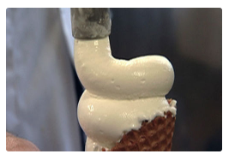
Thinking about making ice cream
Preliminary prompting questions:
What is ice cream made of?
How is it made? What happens through the process?
Why does that happen?
What could affect the process?
What are the key words we have used?
Is there anything we need to know before we begin?
© Copyright. University of Waikato. All Rights Reserved | www.sciencelearn.org.nz
All images are copyrighted. For further information, please refer to enquiries@sciencelearn.org.nz
Notes:
Image from https://www.sciencelearn.org.nz/images/1193-omega-3-enriched-ice-cream

Slide 8
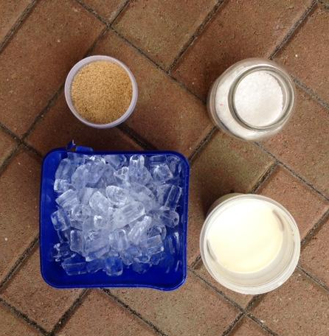
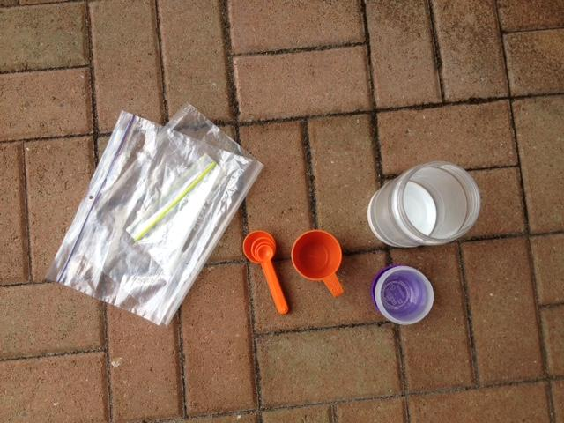
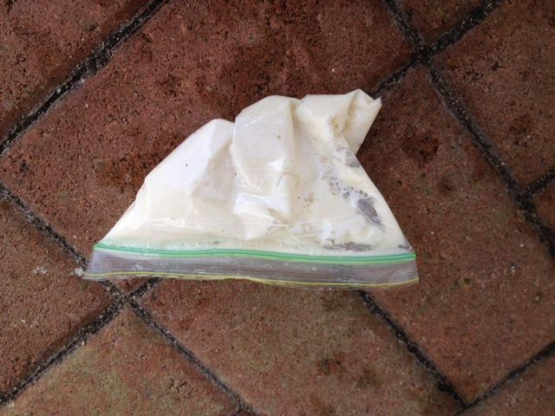
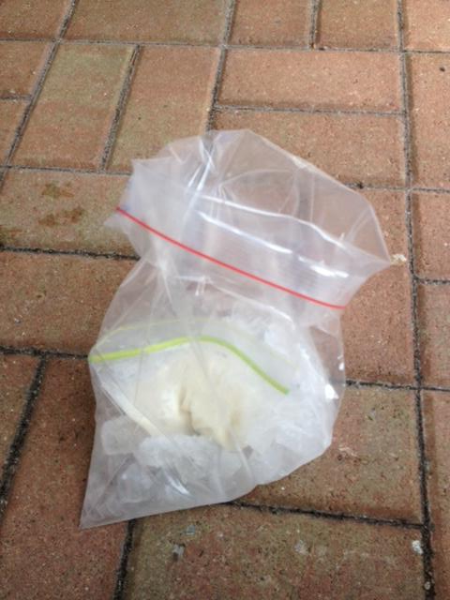
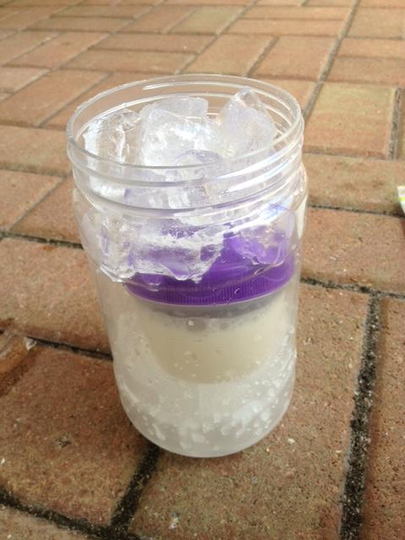
Making ice cream
1. Mix milk/cream and sugar in the small container.
Ingredients and equipment: ice; salt; sugar; milk/cream; 2 plastic containers or bags; measuring spoons and cup.
2. Mix ice and salt in the large container.
3. Put the small container into the large one, seal and shake.
4. Rinse and eat.
© Copyright. University of Waikato. All Rights Reserved | www.sciencelearn.org.nz
All images are copyrighted. For further information, please refer to enquiries@sciencelearn.org.nz
Notes:
Images of the processof making ice cream. Details can be found in the SLH activity - Making ice cream.

Slide 9
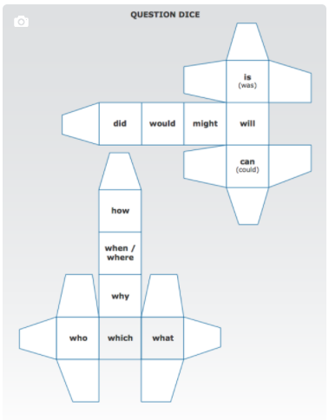
Making ice cream
Preliminary prompting questions:
What observations did we make? What did we notice?
What questions did we come up with? e.g.
Why does that happen?
How does it happen?
What does the salt do?
What if we didn’t add salt?
What does the ice do?
What is actually happening scientifically?
© Copyright. University of Waikato. All Rights Reserved | www.sciencelearn.org.nz
All images are copyrighted. For further information, please refer to enquiries@sciencelearn.org.nz
Notes:
Image from https://www.sciencelearn.org.nz/resources/61-question-dice-game

Slide 10
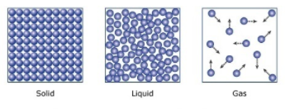
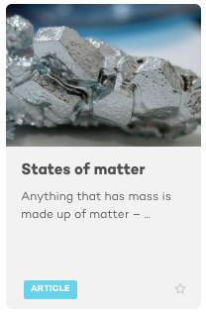
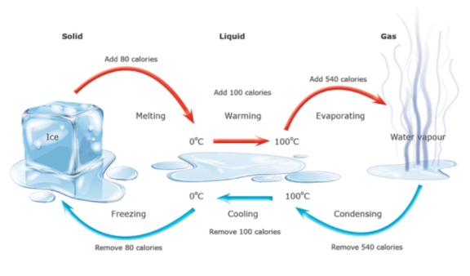
Making ice cream
The science behind it
Foobar, Creative Commons 3.0
© Copyright. University of Waikato. All Rights Reserved | www.sciencelearn.org.nz
All images are copyrighted. For further information, please refer to enquiries@sciencelearn.org.nz
Notes:
Images from
https://www.sciencelearn.org.nz/resources/1499-states-of-matter
https://www.sciencelearn.org.nz/resources/258-using-evidence-heat-and-change-of-state

Slide 11
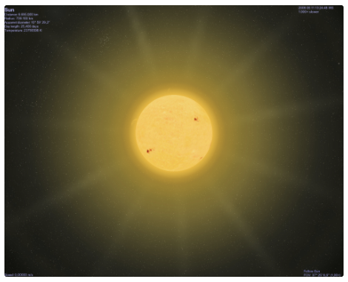
Making a solar oven – using the Sun’s energy for cooking
https://www.sciencelearn.org.nz/images/2142-the-sun
© Copyright. University of Waikato. All Rights Reserved | www.sciencelearn.org.nz
All images are copyrighted. For further information, please refer to enquiries@sciencelearn.org.nz
Notes:
Image from https://www.sciencelearn.org.nz/images/2142-the-sun

Slide 12
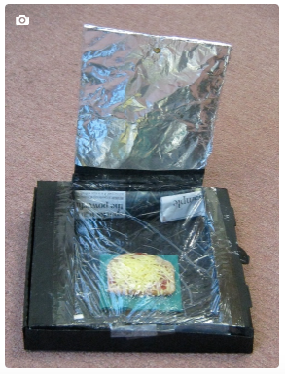
To use the Sun’s energy for cooking, what else do we need to know?
What things do we need or want to know? What questions do we have?
Do we need to do some research? If so, what are some of the key words we might need to use?
What investigations might we carry out?
© Copyright. University of Waikato. All Rights Reserved | www.sciencelearn.org.nz
All images are copyrighted. For further information, please refer to enquiries@sciencelearn.org.nz
Notes:
For ideas about possible investigations, look at https://www.sciencelearn.org.nz/resources/1751-using-heat-energy
Image from https://www.sciencelearn.org.nz/resources/1754-making-a-solar-oven

Slide 13
Making a solar oven Preliminary investigations – using heat energy
Designing and carrying out simple experiments and investigations can
lead to new ideas – and in this case,
provide a better basis for building a
successful solar oven.
So, how might we approach the task of building a solar oven?
© Copyright. University of Waikato. All Rights Reserved | www.sciencelearn.org.nz
All images are copyrighted. For further information, please refer to enquiries@sciencelearn.org.nz
Notes:
For background information about the science behind things, look at:
https://www.sciencelearn.org.nz/resources/1747-using-solar-energy
https://www.sciencelearn.org.nz/resources/750-heat-energy
https://www.sciencelearn.org.nz/resources/1756-alternative-conceptions-about-energy

Slide 14
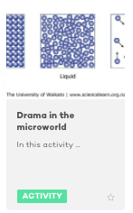
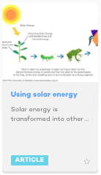
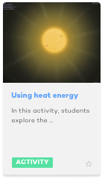
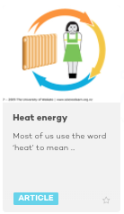
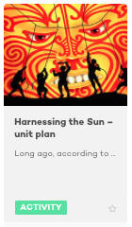
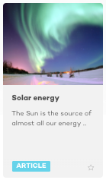
Making a solar oven – research
© Tim Tripp
© Copyright. University of Waikato. All Rights Reserved | www.sciencelearn.org.nz
All images are copyrighted. For further information, please refer to enquiries@sciencelearn.org.nz

Slide 15
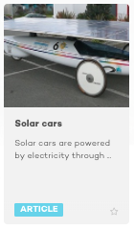
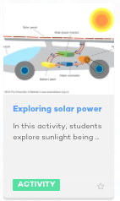
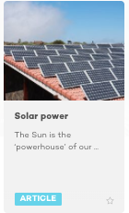
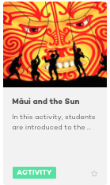
What next?
© Tim Tripp
© Copyright. University of Waikato. All Rights Reserved | www.sciencelearn.org.nz
All images are copyrighted. For further information, please refer to enquiries@sciencelearn.org.nz
Notes:
The solar oven may lead to questions or extension into other areas – what else is solar energy used for etc.

Slide 16
Carbon dioxide – knowing the science 1
The chemical reaction between baking soda and vinegar produces carbon dioxide gas.
Gases take up more room than liquids and solids:
In a volcano model, the CO₂ gas creates foam and makes the mixture expand and overflow down the sides of the volcano.
In a pop-rocket, the CO₂ causes pressure to build up – if the lid pops off the container, the rocket is launched upwards.
© Copyright. University of Waikato. All Rights Reserved | www.sciencelearn.org.nz
All images are copyrighted. For further information, please refer to enquiries@sciencelearn.org.nz

Slide 17
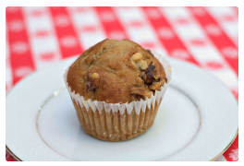
Carbon dioxide – knowing the science 2
Heating baking soda produces carbon dioxide gas.
Gases take up more room than liquids and solids.
In baking, the CO₂ gas makes the mixture expand and rise.
D. Kappa, 123RF Ltd
© Copyright. University of Waikato. All Rights Reserved | www.sciencelearn.org.nz
All images are copyrighted. For further information, please refer to enquiries@sciencelearn.org.nz
Notes:
Image from https://www.sciencelearn.org.nz/images/1206-omega-3-enriched-muffin

Slide 18
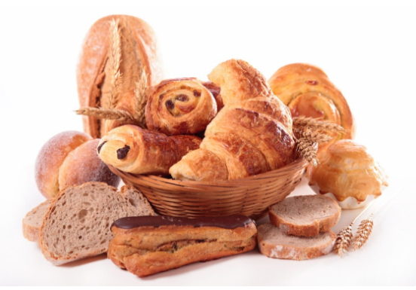
Carbon dioxide – knowing the science 3
The processes of making ginger beer and baking bread use yeast. These yeasts produce carbon dioxide gas when they grow.
Gases take up more room than liquids and solids:
By giving bread time to rise, the yeast has time to grow and reproduce. Then in baking, the CO₂ produced makes the mixture expand and rise.
In (home-made) ginger beer, yeasts grow and make CO₂, which makes the drink fizzy.
SodaStreams and commercial fizzy drinks add ready-made CO₂.
Margouillat/123RF Ltd
© Copyright. University of Waikato. All Rights Reserved | www.sciencelearn.org.nz
All images are copyrighted. For further information, please refer to enquiries@sciencelearn.org.nz

Slide 19
Making observations and using clues – beginning to think chemically
Carbon dioxide is also called CO₂ – this formula shows
what particles are in carbon dioxide. There are also clues in the name. It contains carbon and oxygen.
Baking soda is also called NaHCO₃ – there are no clues in the name, but there are clues in the formulae about why it gives off CO₂ – it contains carbon and oxygen particles!
Adding vinegar or heat to baking soda and fermentation by yeast are all examples of chemical change – where something new is made.
© Copyright. University of Waikato. All Rights Reserved | www.sciencelearn.org.nz
All images are copyrighted. For further information, please refer to enquiries@sciencelearn.org.nz
Notes:
Baking soda is actually also called sodium bicarbonate – and there are clues in that name. The chemical name also gives us a clue about why scientists use symbols.

Slide 20
Back to the curriculum – connecting to the nature of science
Understanding about science
Appreciate that scientists ask questions about our world that lead to investigations and that open-mindedness is important because there may be more than one explanation.
Investigating in science
Extend their experiences and personal explanations of the natural world through exploration, play, asking questions and discussing simple models.
Communicating in science
Build their language and develop their understandings
of the many ways the natural world can be represented.
Participating and contributing
Explore and act on issues and questions that link
their science learning to their daily living.
© Copyright. University of Waikato. All Rights Reserved | www.sciencelearn.org.nz
All images are copyrighted. For further information, please refer to enquiries@sciencelearn.org.nz

Slide 21
Back to the curriculum 2
Physical world: Using physics
Apply their understanding of physics to various
applications.
Material world: Properties and changes of matter
Observe, describe and compare physical and chemical properties of common materials and changes
that occur when materials are mixed, heated
or cooled.
D.Kappa, 123RF Ltd
© Copyright. University of Waikato. All Rights Reserved | www.sciencelearn.org.nz
All images are copyrighted. For further information, please refer to enquiries@sciencelearn.org.nz

Slide 22
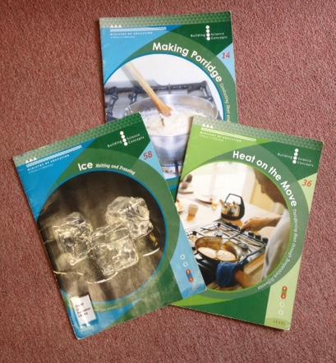
Supporting resources
Building Science Concepts booklets
58 – Ice
14 – Making porridge
36 – Heat on the move
29 – Solar energy
46 – Keeping warm
47 – Insulation
© Copyright. University of Waikato. All Rights Reserved | www.sciencelearn.org.nz
All images are copyrighted. For further information, please refer to enquiries@sciencelearn.org.nz
Notes:
http://scienceonline.tki.org.nz/What-do-my-students-need-to-learn/Building-Science-Concepts
http://www.thechair.co.nz/

Slide 23
Just reflecting
What other science activities do you do that lend themselves to delving deeper?
Has your thinking changed about deepening the science?
If so, how?
How might your practice change now?
© Copyright. University of Waikato. All Rights Reserved | www.sciencelearn.org.nz
All images are copyrighted. For further information, please refer to enquiries@sciencelearn.org.nz

Slide 24
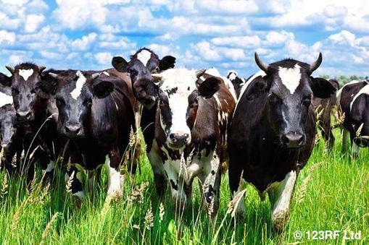
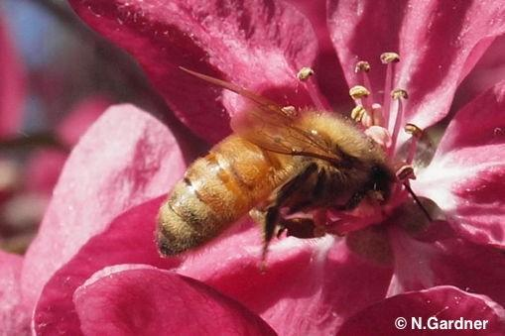
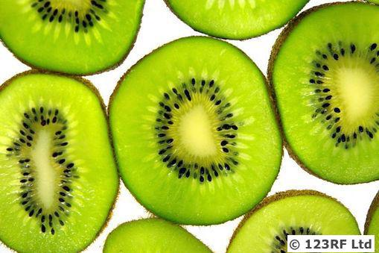
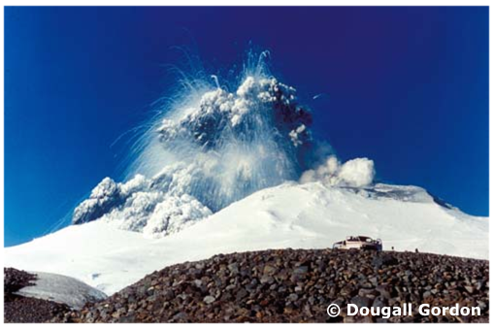
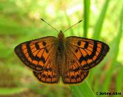
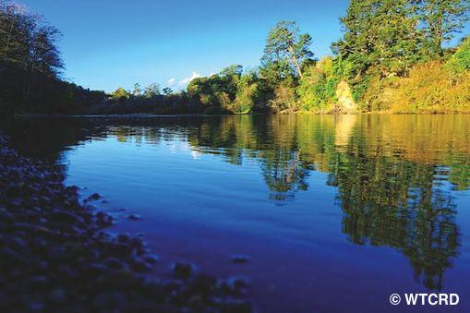
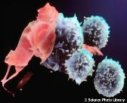
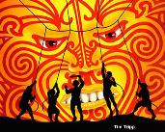
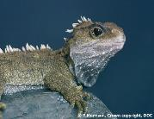
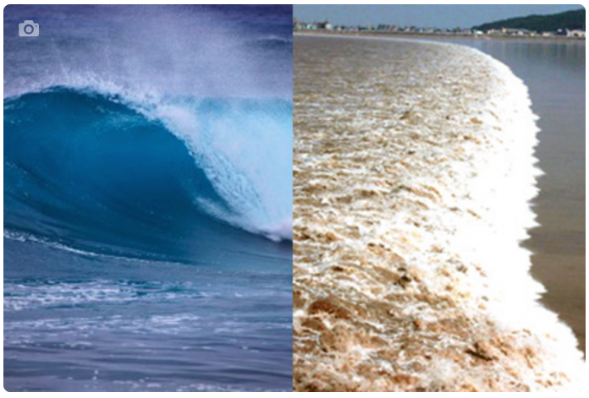
Thanks – want to keep connected?
Science Learning Hub
Email us on enquiries@sciencelearn.org.nz
Follow us on Twitter: https://twitter.com/NZScienceLearn
Like us on Facebook: www.facebook.com/nzsciencelearn
On Pinterest: https://nz.pinterest.com/nzsciencelearn/
Join us in the pond: https://www.pond.co.nz/community/
214015/science-learning-hub/
Join us in our kitchen science discussion channel on Slack.
(This link may expire: if it does, contact us via our enquiries email, and we will send you a new link.)

