Slide 1
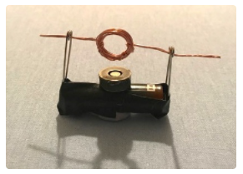
Exploring magnetism
Lyn Rogers and Dr Simon Taylor
4–4.45pm Thursday 7 December
© Copyright. University of Waikato. All Rights Reserved | www.sciencelearn.org.nz
All images are copyrighted. For further information, please refer to enquiries@sciencelearn.org.nz
Notes:
Image from www.sciencelearn.org.nz/images/2724-model-of-a-simple-electric-motor

Slide 2
Index – Part 1
Topic | Slide | Video timecode
Introduction, welcome and purpose of the webinar | 4 | 01:04
Curriculum connections | 5 | 02:53
Gathering prior knowledge | 7 | 04:20
What is a magnet? | 6 | 06:45
From play to investigation | 8–9 | 08:38
What is magnetism? | 10 | 17:56
Investigating invisible forces | 11 | 19:31
Representing a concept | 12 | 21:13
The Earth – a massive magnet | 13 | 21:15
Making your own compass | 14 | 30:06

Slide 3
Index – Part 2
Topic | Slide | Video timecode
The Earth’s magnetic field | 15 | 34:06
The big ideas so far | 16 | 35:19
Why is magnetism important? | 17 | 37:02
Using magnetism | 18 | 37:23
The electric motor | 19–20 | 37:44
The generator | 21 | 43:44
The electromagnet | 22 | 45:09
Superconductors | 23 | 47:56
Reflection | 24 | --
Contact details and thanks | 25 | 50:00

Slide 4
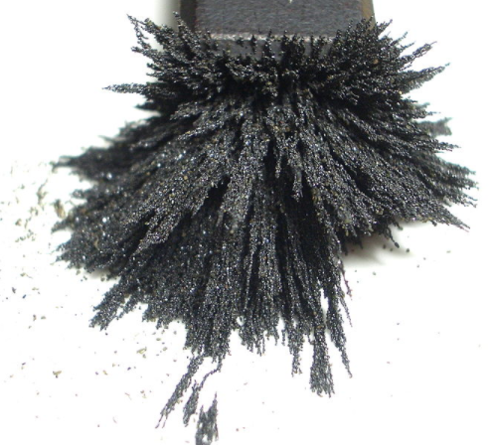
Exploring magnetism
Today we will:
explore how magnetism can be used as a context to engage our students in scientific thinking
demonstrate some simple activities
discuss how we can use these activities to build understandings about the physical world.
Aney CC3.0
© Copyright. University of Waikato. All Rights Reserved | www.sciencelearn.org.nz
All images are copyrighted. For further information, please refer to enquiries@sciencelearn.org.nz
Notes:
Image from https://commons.wikimedia.org/wiki/File:Powder_steel_on_magnet.jpg

Slide 5
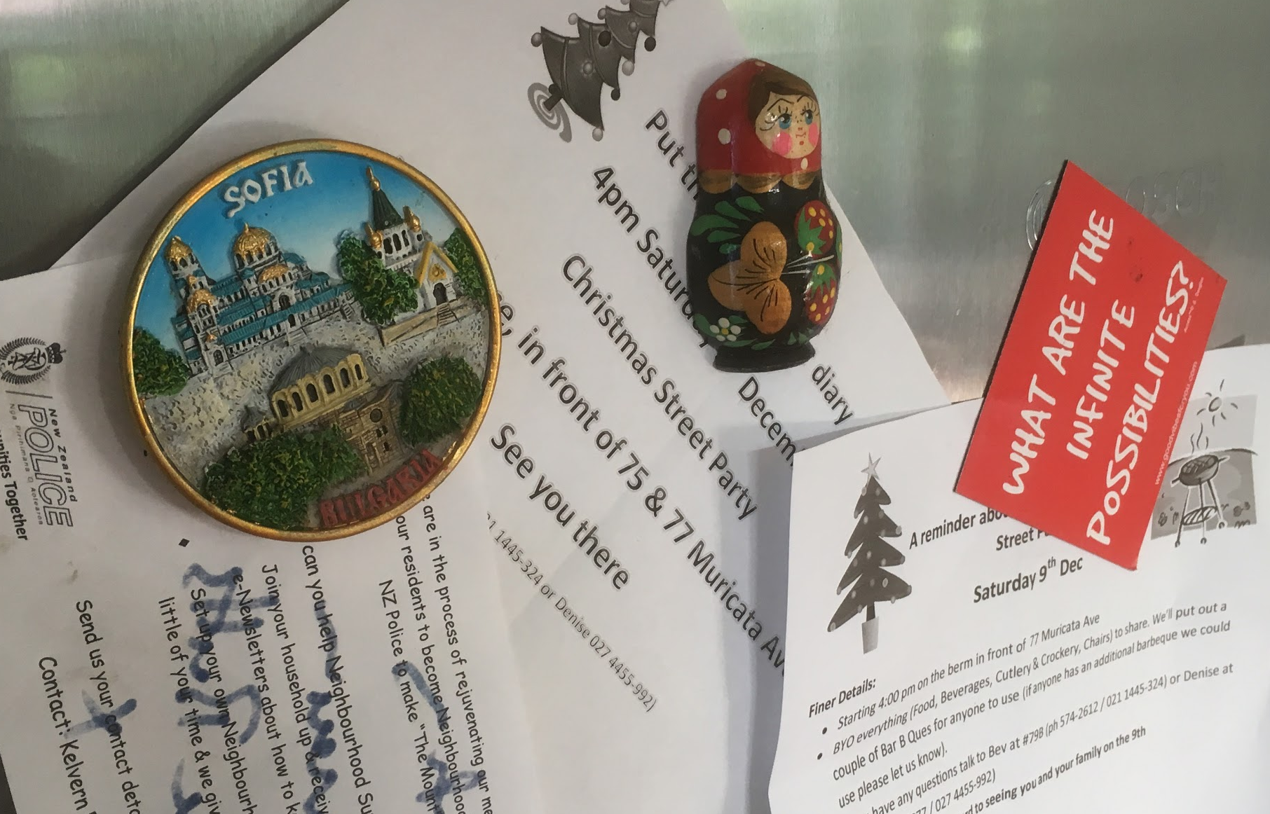
Curriculum connections – the nature of science
Understanding about science
Appreciate that scientists ask questions about our world that lead to investigations and that open-mindedness is important because there may be more than one explanation.
Investigating in science
Extend their experiences and personal explanations of the natural world through exploration, play, asking questions and discussing simple models.
Simon Taylor
© Copyright. University of Waikato. All Rights Reserved | www.sciencelearn.org.nz
All images are copyrighted. For further information, please refer to enquiries@sciencelearn.org.nz
Notes:
Image from Simon Taylor

Slide 6
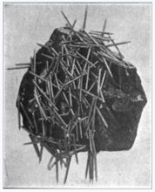
What is a magnet?
What do we know about magnetism?
- gathering prior knowledge
Magnets are fun to use
A magnet attracts some metals
Magnetism is a bigger mass attracting a smaller mass
A solid object that pulls things to it or pushes things
The Earth is a magnet
A force
© Copyright. University of Waikato. All Rights Reserved | www.sciencelearn.org.nz
All images are copyrighted. For further information, please refer to enquiries@sciencelearn.org.nz
Notes:
Image from https://en.wikipedia.org/wiki/Magnetism public domain

Slide 7
What is a magnet?
A magnet is a material or object (usually containing iron) that pulls substances (usually also containing iron) towards it.
A substance can be magnetised if the particles within it are able to stay aligned in a particular way – that creates poles of the magnet and creates an attractive force field.
© Copyright. University of Waikato. All Rights Reserved | www.sciencelearn.org.nz
All images are copyrighted. For further information, please refer to enquiries@sciencelearn.org.nz
Notes:
Image from https://en.wikipedia.org/wiki/Magnetism public domain

Slide 8
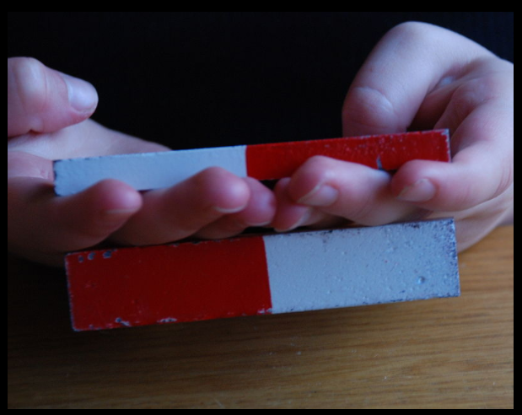
From play to investigation
What do magnets do?
What things are magnetic? What things aren’t?
How can we tell?
What do we notice?
What is going on?
What happens when we…?
Science capability – gather and interpret data
Learners make careful observations and differentiate between observation and inference.
They might ask questions such as: What did we see? (observation); What might that mean? (inference); How could we explain what we see?
© Copyright. University of Waikato. All Rights Reserved | www.sciencelearn.org.nz
All images are copyrighted. For further information, please refer to enquiries@sciencelearn.org.nz
Notes:
Image from https://commons.wikimedia.org/wiki/File:Ceramic_magnets.jpg - public domain

Slide 9
Magnetic investigations – what do we already do?
Look at different magnets and predict which one is stronger
Devise investigations, e.g. to see if a bigger magnet means it's stronger, or does joining magnets together make them stronger? How far does the force go?
Try to 'attract' different materials
Make games that use magnets, e.g. ‘fishing’ a paperclip on a string with a magnet or racing magnet cars by using repulsion.
See how strong the force is – e.g. how many paperclips will the magnet pick up?
Create ‘magic tricks’ to stimulate curiosity
See if you can 'block' the force
© Copyright. University of Waikato. All Rights Reserved | www.sciencelearn.org.nz
All images are copyrighted. For further information, please refer to enquiries@sciencelearn.org.nz
Notes:
Image from https://commons.wikimedia.org/wiki/File:Ceramic_magnets.jpg public domain

Slide 10
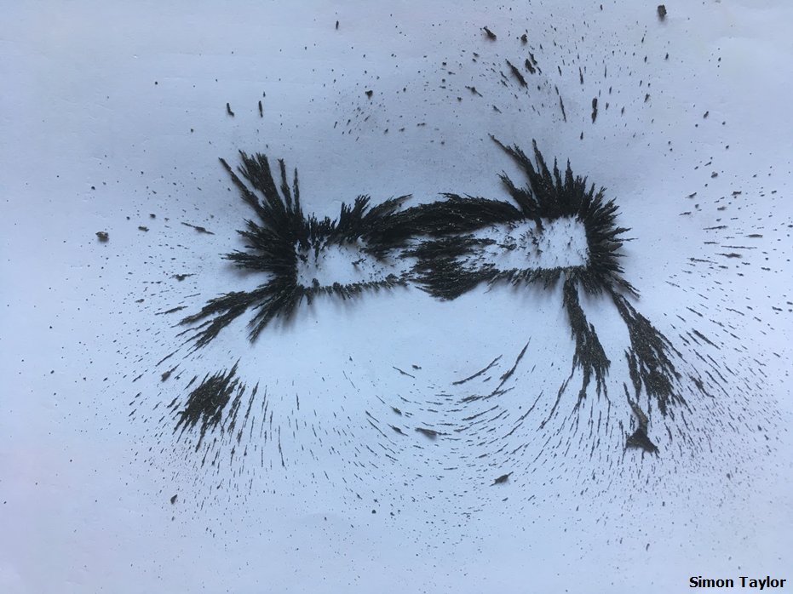
What is magnetism?
Magnetism is a force – it influences the environment around it. The space in which magnetic force operates is the magnetic field.
The magnetic field of invisible force flows from the north to the south pole of a magnet.
© Copyright. University of Waikato. All Rights Reserved | www.sciencelearn.org.nz
All images are copyrighted. For further information, please refer to enquiries@sciencelearn.org.nz
Notes:
Image from Dr Simon Taylor
Simon to explain polarity (simply). Do all magnets have poles? Why are there arrows?

Slide 11
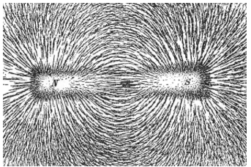
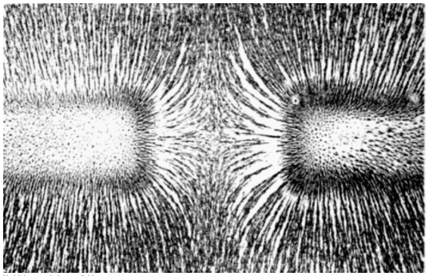
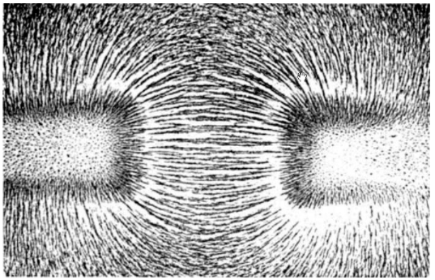
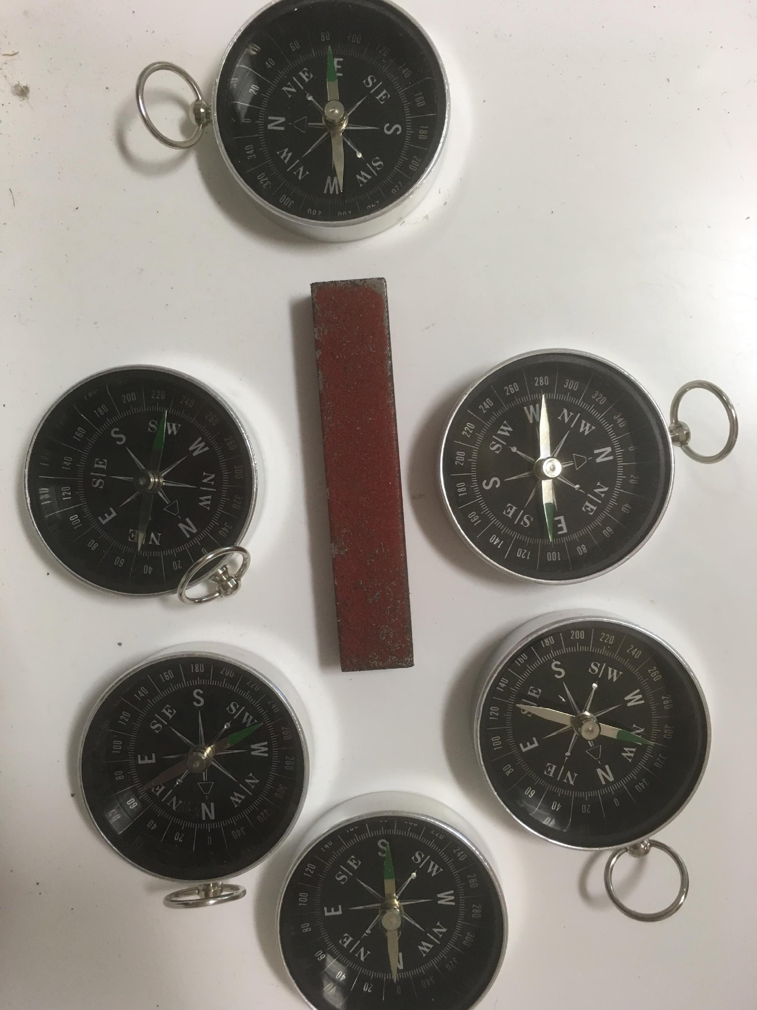
Investigating invisible forces
Explore the patterns around magnets; make
predictions; create theories. Magnetism is
invisible but can be detected indirectly –
using evidence.
Science capability – use evidence
Learners support their ideas with evidence and look
for evidence supporting others’ explanations.
They might ask questions such as: How do you know
that? What makes you think so? How could you
check that?
© Copyright. University of Waikato. All Rights Reserved | www.sciencelearn.org.nz
All images are copyrighted. For further information, please refer to enquiries@sciencelearn.org.nz
Notes:
Images from https://commons.wikimedia.org/wiki/File:Magnetic_field_of_bar_magnets_attracting.png all public domain
https://commons.wikimedia.org/wiki/File:Magnetic_field_of_bar_magnets_repelling.png
https://commons.wikimedia.org/wiki/File:Magnet0873.png
and an image from Simon Taylor

Slide 12
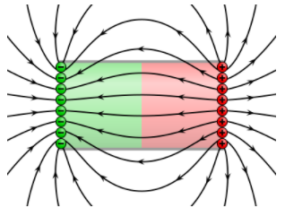
Representing a concept
Science capability – interpret representations
Scientists represent their ideas in a variety of ways, including models graphs, charts, diagrams and written texts.
What does this representation tell us?
What is left out or added?
How does this representation get the message across?
Geek3 CC4.0
© Copyright. University of Waikato. All Rights Reserved | www.sciencelearn.org.nz
All images are copyrighted. For further information, please refer to enquiries@sciencelearn.org.nz
Notes:
Image from https://commons.wikimedia.org/wiki/File:VFPt_magnet_H_charges.svg LHS image is public domain

Slide 13
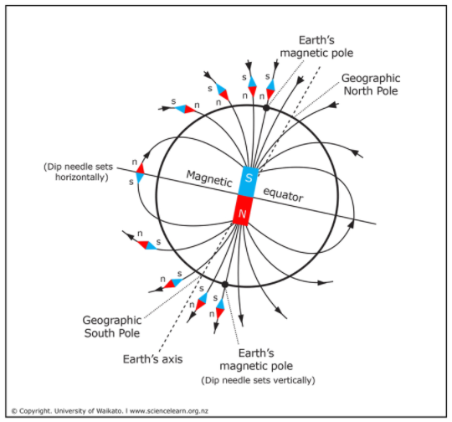
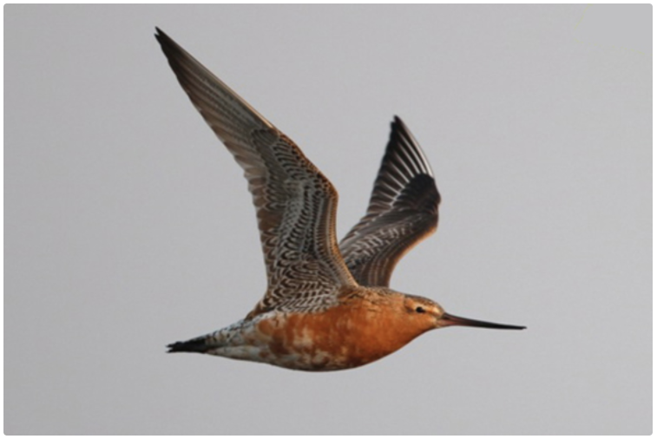
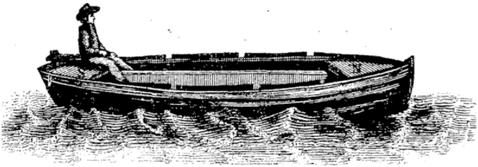
The Earth – a massive magnet
Dr Phil Battley
© Copyright. University of Waikato. All Rights Reserved | www.sciencelearn.org.nz
All images are copyrighted. For further information, please refer to enquiries@sciencelearn.org.nz
Notes:
Images from www.sciencelearn.org.nz/images/1820-earth-s-magnetic-field
www.sciencelearn.org.nz/images/281-godwit-in-flight
Boat image is public domain
Image from https://commons.wikimedia.org/wiki/File:A_concise_essay_on_magnetism;_with_an_account_of_the_declination_and_inclination_of_the_magnetic_needle;_and_an_attempt_to_ascertain_the_cause_of_the_Fleuron_T119950-2.png
At the centre of the Earth spins the Earth’s core. The core is made up of mostly iron. The outer portion of the core is liquid iron that spins and makes the Earth into a giant magnet. This is where we get the names for the north and south poles. These poles are actually the positive and negative poles of the Earth’s giant magnet.
Connects to work on structure of the Earth and rocks. Reversing poles every 750,000 years ago give us ideas of the history of the Earth – the rock particles have been aligned differently as the poles reverse. True north and magnetic north – they aren’t the same – this has implications for people using maps and compasses for navigation.
Knowledge of the existence of magnetic forces isn’t new. Some rocks were magnetic. Compasses have been around since 200BC, invented in China when it was found that a magnet will (if free to do so) align with the poles of the Earth. By the 12th century, Western navigators were using compasses.. This is very useful to us here on Earth as it lets us use magnets in compasses to find our way and make sure we are heading in the right direction. It’s also useful to animals such as birds and whales who use the Earth’s magnetic field to find the right direction when migrating.

Slide 14
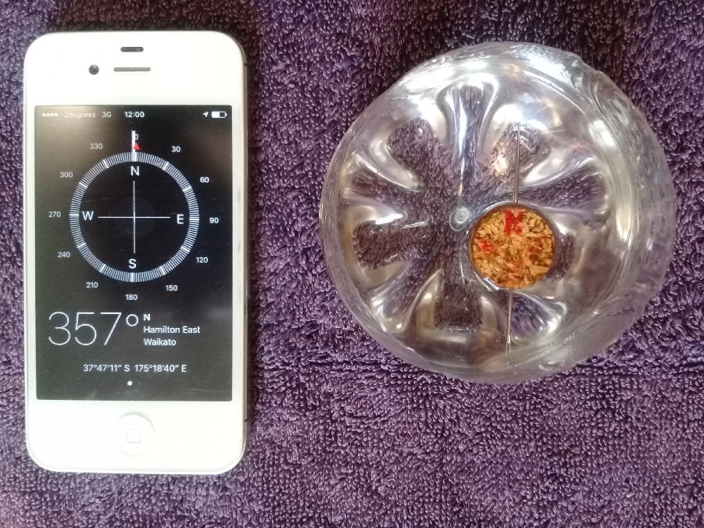
Making your own compass
© Copyright. University of Waikato. All Rights Reserved | www.sciencelearn.org.nz
All images are copyrighted. For further information, please refer to enquiries@sciencelearn.org.nz
Notes:
Image from www.sciencelearn.org.nz/resources/2203-making-a-weather-vane-and-compass

Slide 15
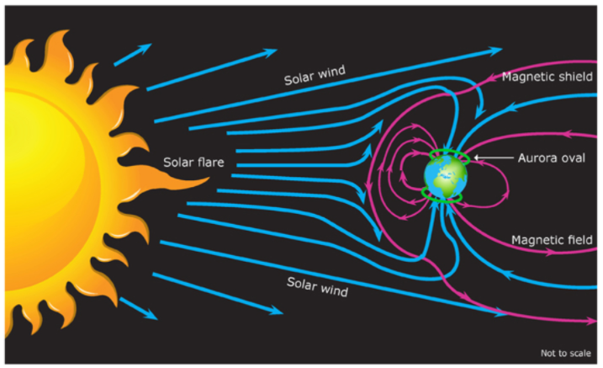
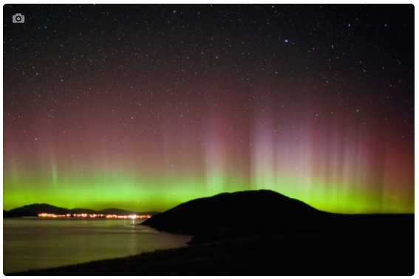
The Earth’s magnetic field
Fraser Gunn
© Copyright. University of Waikato. All Rights Reserved | www.sciencelearn.org.nz
All images are copyrighted. For further information, please refer to enquiries@sciencelearn.org.nz
Notes:
Images from www.sciencelearn.org.nz/images/247-solar-wind-plasma-and-the-magnetosphere
www.sciencelearn.org.nz/resources/240-gaseous-atmosphere

Slide 16
Developing magnetic thinking
– the big ideas so far
Magnets can be used to make some things move without being touched – magnetism does not need contact to apply a force.
A magnet pulls on all things made of iron and either pushes or pulls on other magnets, and we can feel the effect of these forces – materials vary in how they respond to magnetism.
The space where magnetic force can be felt is called a magnetic field.
The Earth has a magnetic field that can be detected by using a compass.
© Copyright. University of Waikato. All Rights Reserved | www.sciencelearn.org.nz
All images are copyrighted. For further information, please refer to enquiries@sciencelearn.org.nz
Notes:
In order not to build misconceptions, it is important to explore magnetism by allowing students to work through the concepts form one to the next. This is easiest achieved through investigations – with prompting questions used to help students explain their ideas.

Slide 17
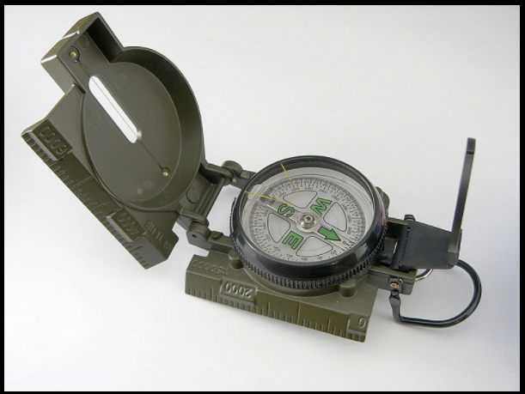
Why is magnetism important?
Complex modern machinery such as magnetic trains and MRI are possible.
Magnets are part of electric motors – so everything with a motor relies on magnets.
Magnetism is used for navigation, e.g. compasses, bird migration.
Everyday functions such as cupboard latches, fridge magnets, electronic card reading etc. use magnetism.
Magnets are used in electricity generation.
Adamantios CC3.0
© Copyright. University of Waikato. All Rights Reserved | www.sciencelearn.org.nz
All images are copyrighted. For further information, please refer to enquiries@sciencelearn.org.nz
Notes:
Image from https://commons.wikimedia.org/wiki/Compass#/media/File:Liquid-filled-lensatic-compass-hdr-0a.jpg

Slide 18
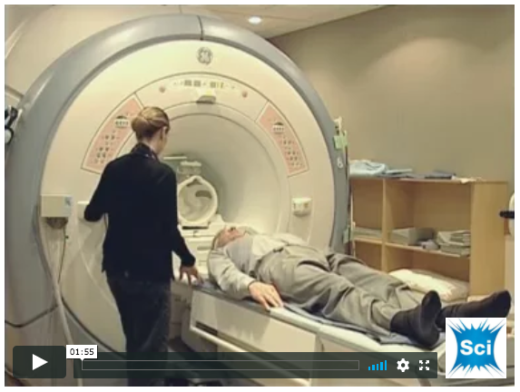
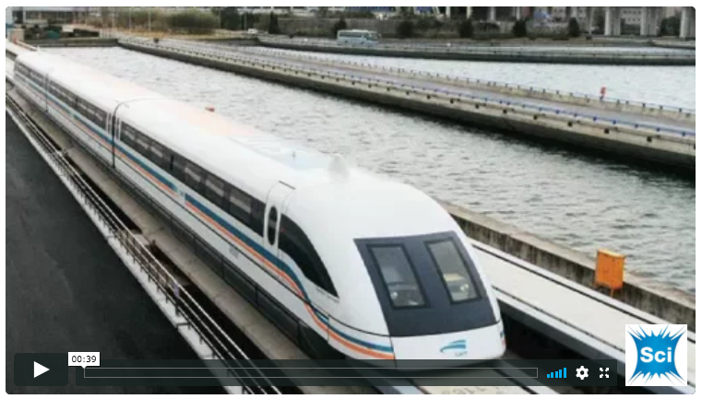
Using magnetism
– more advanced big ideas
Magnetism is related to electricity.
They are both different aspects of electromagnetic force – moving electrically charged particles produce magnetic forces, and moving magnets produce electric forces.
The interplay of these two forces is the basis for many modern technologies.
© Copyright. University of Waikato. All Rights Reserved | www.sciencelearn.org.nz
All images are copyrighted. For further information, please refer to enquiries@sciencelearn.org.nz
Notes:
Images from www.sciencelearn.org.nz/resources/997-magnetic-resonance-imaging-mri
www.sciencelearn.org.nz/resources/1789-meissner-effect-nick-strickland-video-clips

Slide 19
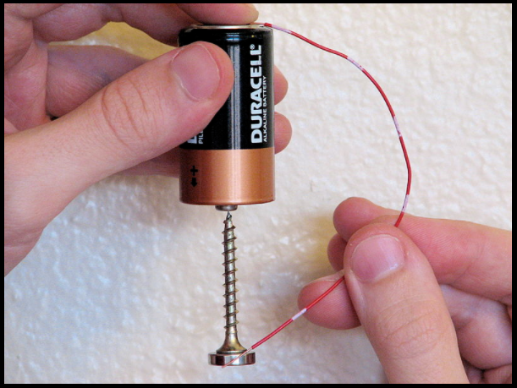
The electric motor
The current travelling through a coil of wire creates an electric field that can be influenced by a magnetic field. The interplay of the two fields causes movement. This movement, if channelled in the right direction and attached to other moving parts, can be used as a motor.
Windell H. Oskay CC3.0
© Copyright. University of Waikato. All Rights Reserved | www.sciencelearn.org.nz
All images are copyrighted. For further information, please refer to enquiries@sciencelearn.org.nz
Notes:
Images from https://www.sciencelearn.org.nz/images/2724-model-of-a-simple-electric-motor
https://commons.wikimedia.org/w/index.php?search=homopolar+motor&title=Special:Search&go=Go&searchToken=5gpfpoictt9z1u2yn6wgcyqoe#/media/File:Homopolar_Motor_Large.jpg

Slide 20
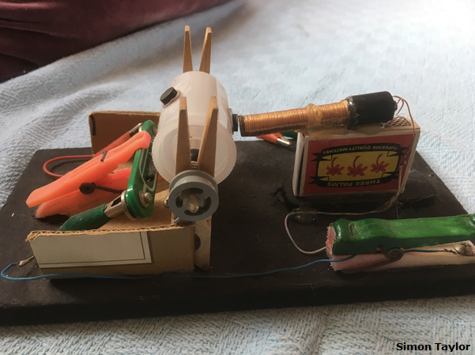
The electric motor
© Copyright. University of Waikato. All Rights Reserved | www.sciencelearn.org.nz
All images are copyrighted. For further information, please refer to enquiries@sciencelearn.org.nz
Notes:
Image from Dr Simon Taylor

Slide 21
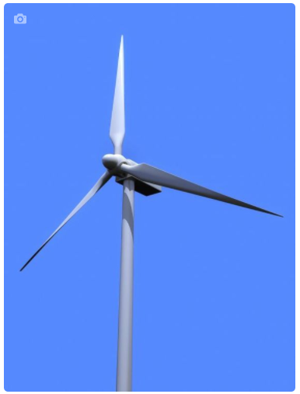
The generator
Electricity can be generated in a wire by reversing the process – movement of the magnet or the wire (when they are close enough for their fields to interplay) causes the electrons in the wire to move.
Sebastian Kaulitzki/123RF Ltd
© Copyright. University of Waikato. All Rights Reserved | www.sciencelearn.org.nz
All images are copyrighted. For further information, please refer to enquiries@sciencelearn.org.nz
Notes:
Image from www.sciencelearn.org.nz/resources/1565-wind-power

Slide 22
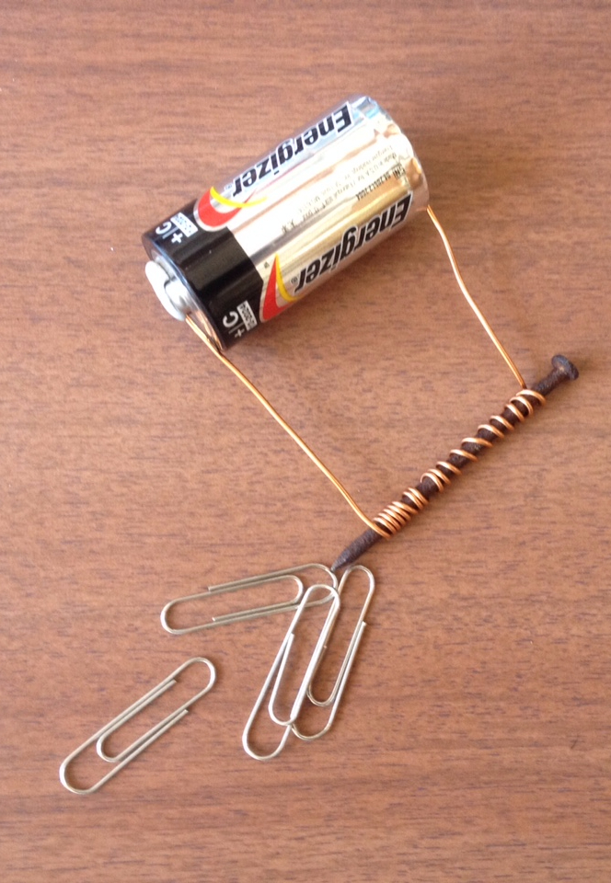
The electromagnet
By wrapping a wire around an iron nail and running current through the wire, magnets can be created.
The electric field in the wire coil creates a magnetic field around the nail.
This is called electromagnetism.
© Copyright. University of Waikato. All Rights Reserved | www.sciencelearn.org.nz
All images are copyrighted. For further information, please refer to enquiries@sciencelearn.org.nz
Notes:
Image from Lyn - University of Waikato

Slide 23
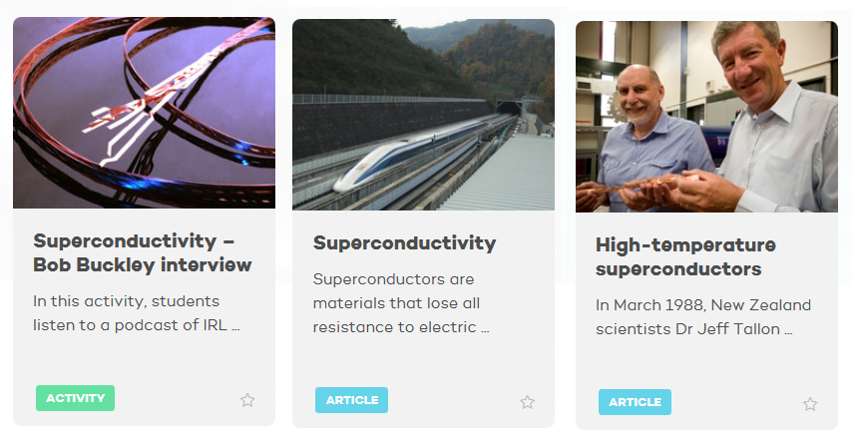
Superconductors
IRL
IRL Research
Yosemite/CC3.0
IRL Research
© Copyright. University of Waikato. All Rights Reserved | www.sciencelearn.org.nz
All images are copyrighted. For further information, please refer to enquiries@sciencelearn.org.nz
Notes:
www.sciencelearn.org.nz/resources/1777-superconductivity
www.sciencelearn.org.nz/resources/1765-high-temperature-superconductors
www.sciencelearn.org.nz/resources/1788-superconductivity-bob-buckley-interview
Extension ideas

Slide 24
Just reflecting
What other science activities do you do that lend themselves to delving deeper?
Has your thinking changed about deepening the science?
If so, how?
How might your practice change now?
© Copyright. University of Waikato. All Rights Reserved | www.sciencelearn.org.nz
All images are copyrighted. For further information, please refer to enquiries@sciencelearn.org.nz
Notes:
image is public domain

Slide 25





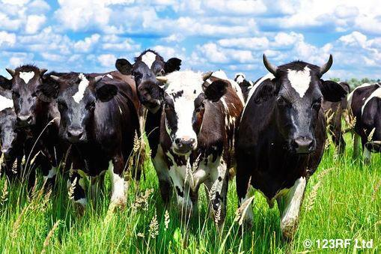
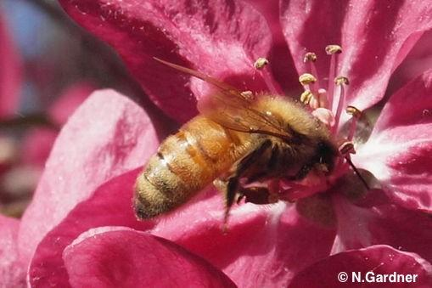
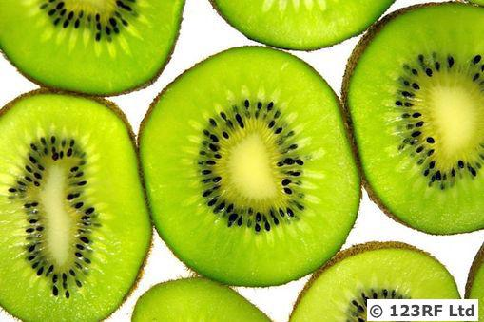
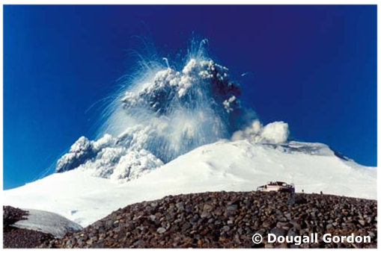
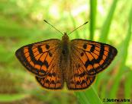
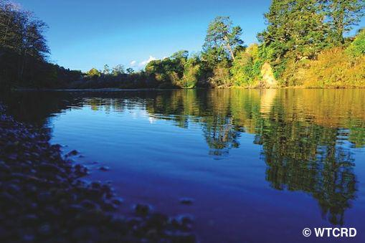
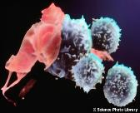
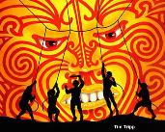
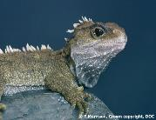
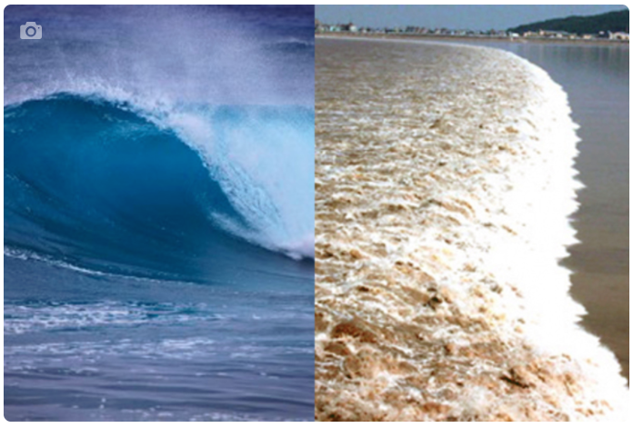
Thanks – want to keep connected?
Science Learning Hub
Email us on enquiries@sciencelearn.org.nz
Follow us on Twitter: https://twitter.com/NZScienceLearn
Like us on Facebook: www.facebook.com/nzsciencelearn
On Pinterest: https://nz.pinterest.com/nzsciencelearn/
Join us in the pond: https://www.pond.co.nz/community/
214015/science-learning-hub/
Join us in our magnetism discussion channel on Slack.
(This link may expire: if it does, contact us via our enquiries email, and we will send you a new link.)

