Slide 1
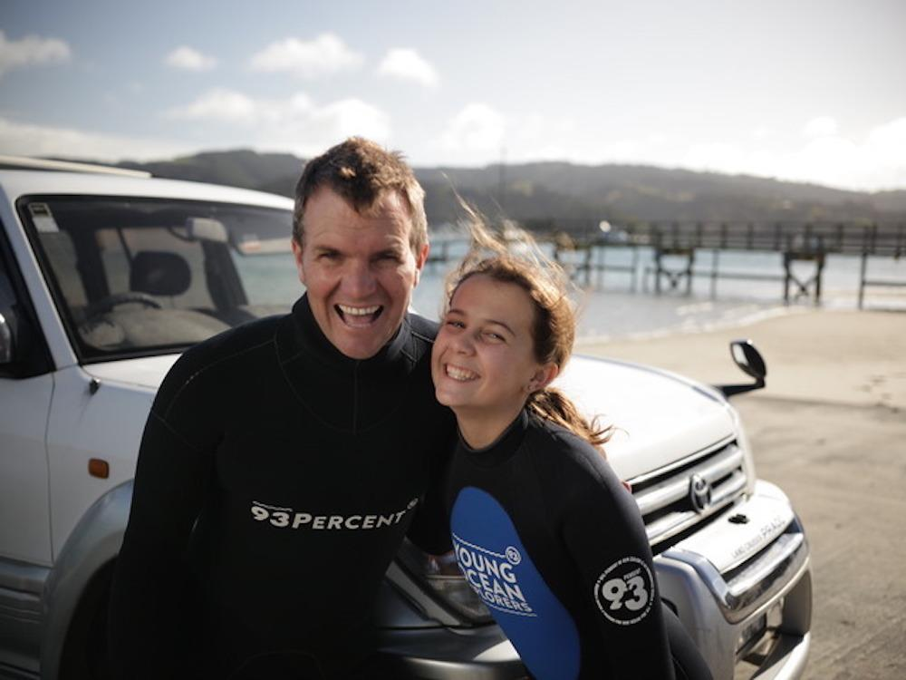
Diving into marine resources
© Steve Hathaway
Lyn Rogers and
Steve Hathaway (Young Ocean Explorers)
4–4.45pm Thursday 22 February
© Copyright. University of Waikato. All Rights Reserved | www.sciencelearn.org.nz
All images are copyrighted. For further information, please refer to enquiries@sciencelearn.org.nz

Slide 2
Index
Topic | Slide number(s) | Video timecode
Introduction, welcome and purpose of the webinar | 1–3 | 00:9
Steve Hathaway – an introduction | 4 | 02:05
Why study the ocean? | 5–6 | 06:11
Young Ocean Explorers | 7–10 | 10:41
Who else is involved? | 11 | 19:39
Investigating marine reserves | 12–15 | 23:39
Being there – in the environment | 16 | 31:15
Stimulating discussion and curiosity | 17 | 34:23
Exploring values and perspectives | 18–19 | 43:27
Some more SLH marine resources | 20 | n/a
Thanks and contact details | 21 | 45:35
© Copyright. University of Waikato. All Rights Reserved | www.sciencelearn.org.nz
All images are copyrighted. For further information, please refer to enquiries@sciencelearn.org.nz

Slide 3
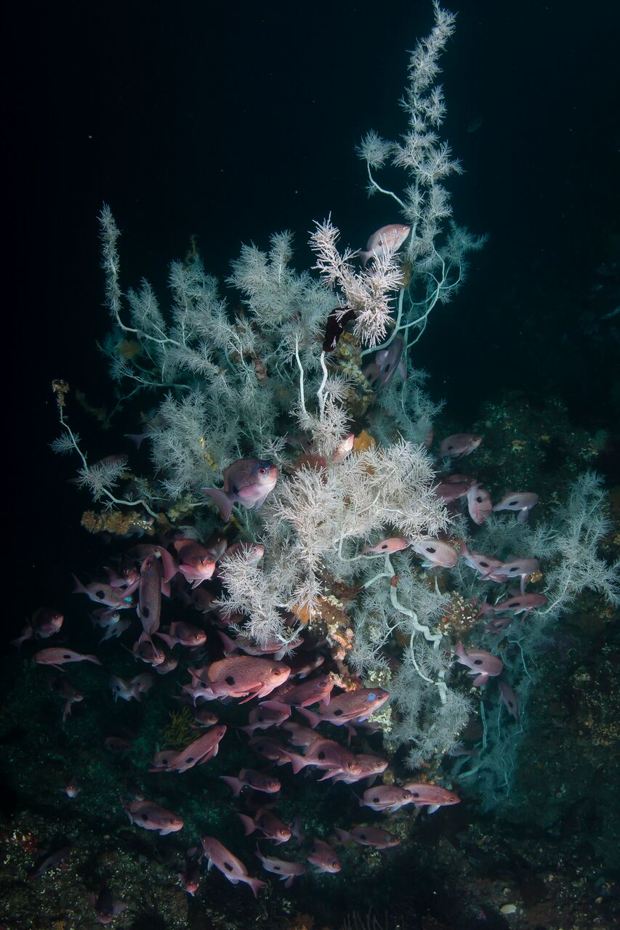

Diving into marine resources
In this webinar we will:
    Chat with Steve Hathaway from Young Ocean Explorers about his work as an underwater cameraman and his passion for the ocean.
    Explore some resources available to teach aspects of marine science – specifically from Young Ocean Explorers, SLH and DOC.
    Discuss how we can use these resources to engage our students in learning about the marine environment.
© DOC
© Copyright. University of Waikato. All Rights Reserved | www.sciencelearn.org.nz
All images are copyrighted. For further information, please refer to enquiries@sciencelearn.org.nz

Slide 4
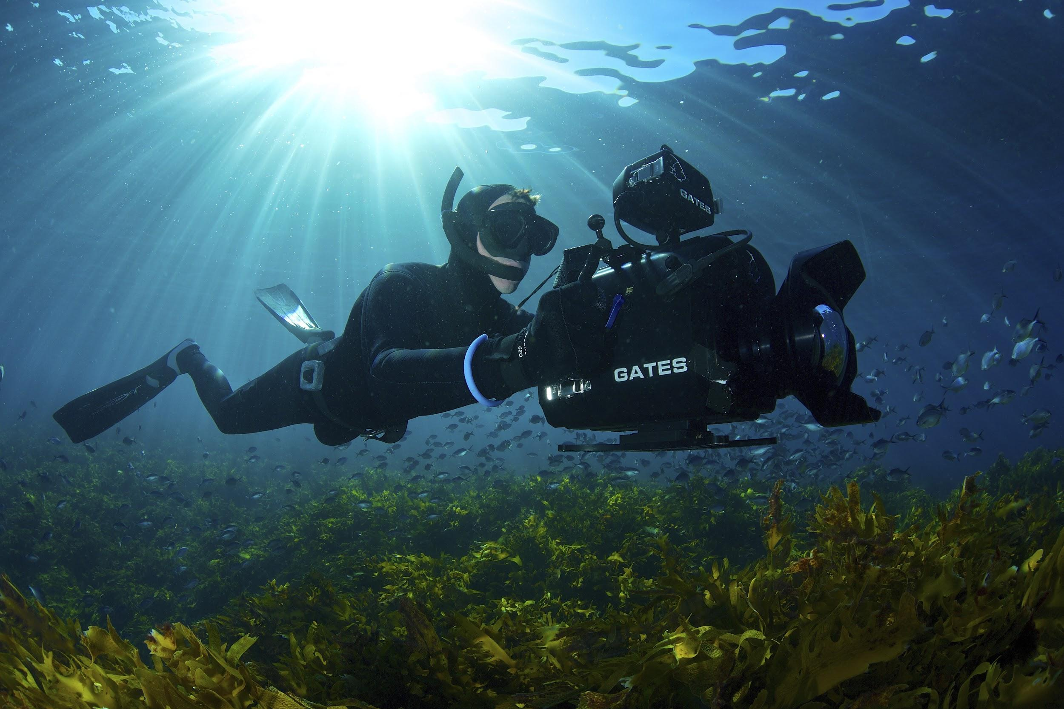

Steve Hathaway – an introduction
© Robert Marc Lehmann
© Copyright. University of Waikato. All Rights Reserved | www.sciencelearn.org.nz
All images are copyrighted. For further information, please refer to enquiries@sciencelearn.org.nz

Slide 5
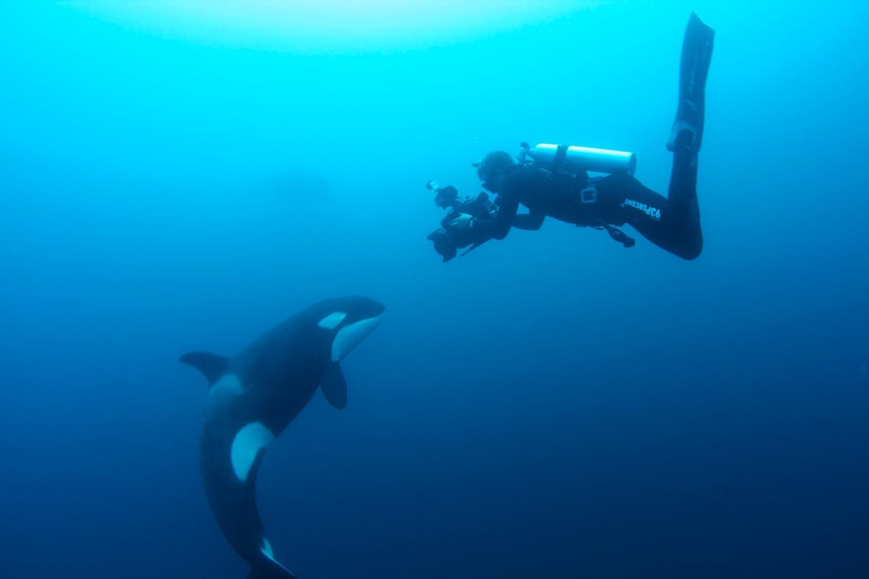
Why study the ocean?
New Zealand has between 15,000 and 18,000 kilometre of coastline.
Nowhere is further from the coast than 130 km.
80% of the coastline is directly exposed to the sea.
Summer water temperatures range from 21°C in the north to 14°C degrees in the south, (or more if you include the more northern and southern islands).
© Eli Martinez
© Copyright. University of Waikato. All Rights Reserved | www.sciencelearn.org.nz
All images are copyrighted. For further information, please refer to enquiries@sciencelearn.org.nz

Slide 6
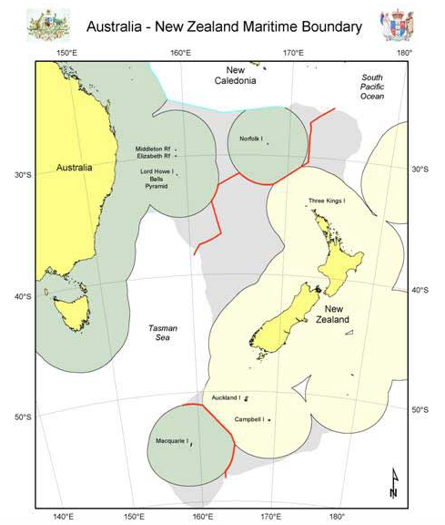
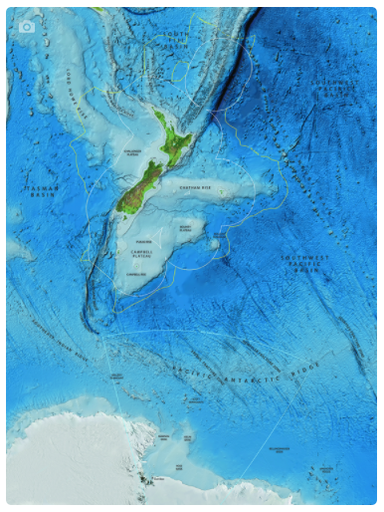
What is the 93%?
The EEZ – New Zealand’s exclusive economic zone – covers 4,083,744 km² – approximately 15 times the land area of the country. 93% of New Zealand is underwater.
© LINZ/Creative Commons 4.0
© NIWA
© Copyright. University of Waikato. All Rights Reserved | www.sciencelearn.org.nz
All images are copyrighted. For further information, please refer to enquiries@sciencelearn.org.nz

Slide 7
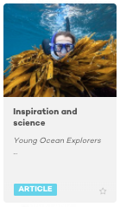
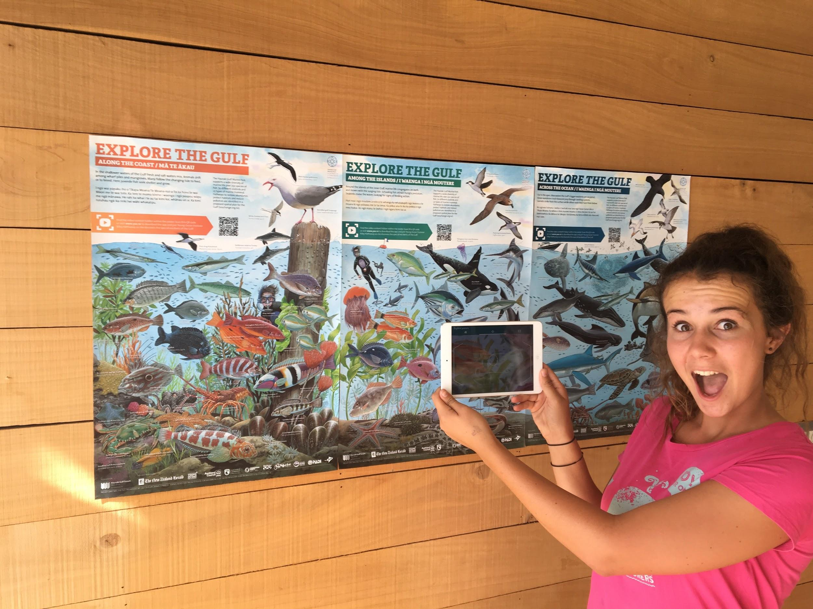
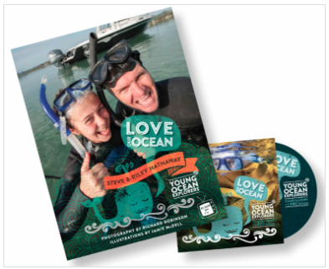
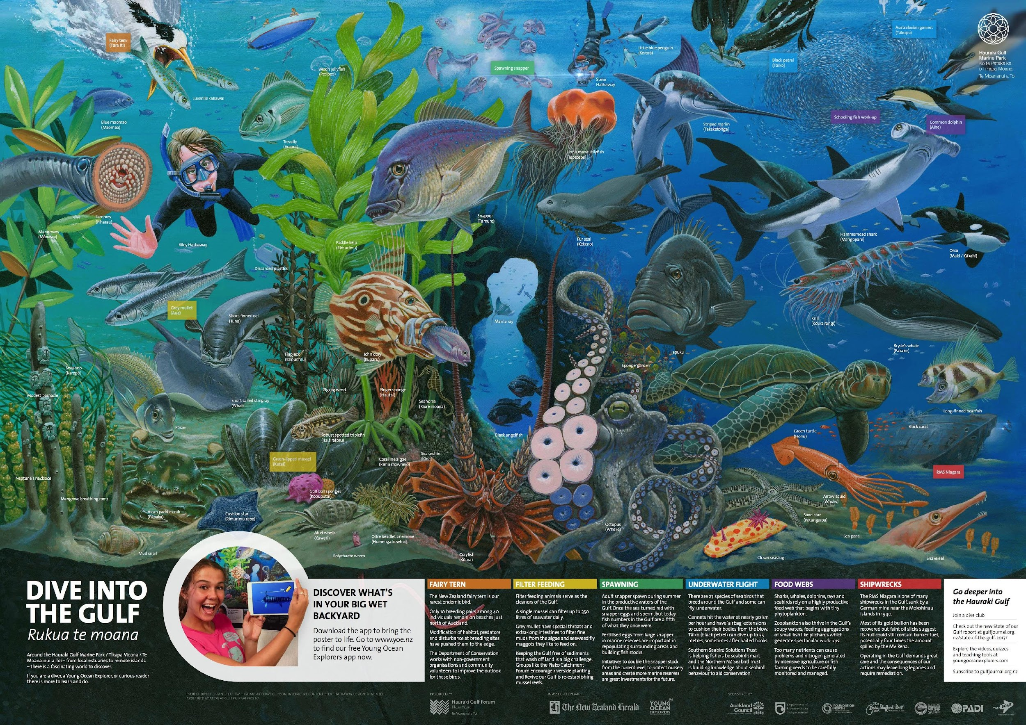
Young Ocean Explorers – resources
© Copyright. University of Waikato. All Rights Reserved | www.sciencelearn.org.nz
All images on this slide are © Steve Hathaway

Slide 8
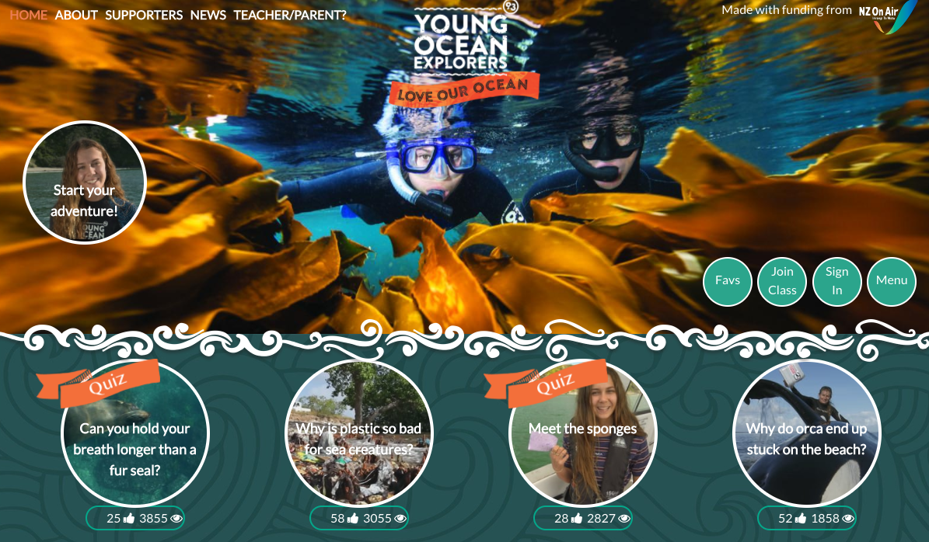
Young Ocean Explorers
© Steve Hathaway
© Copyright. University of Waikato. All Rights Reserved | www.sciencelearn.org.nz
All images are copyrighted. For further information, please refer to enquiries@sciencelearn.org.nz
Notes:
The front page of Young Ocean Explorers website – full of engaging videos, quizzes, assignments etc. www.youngoceanexplorers.com

Slide 9
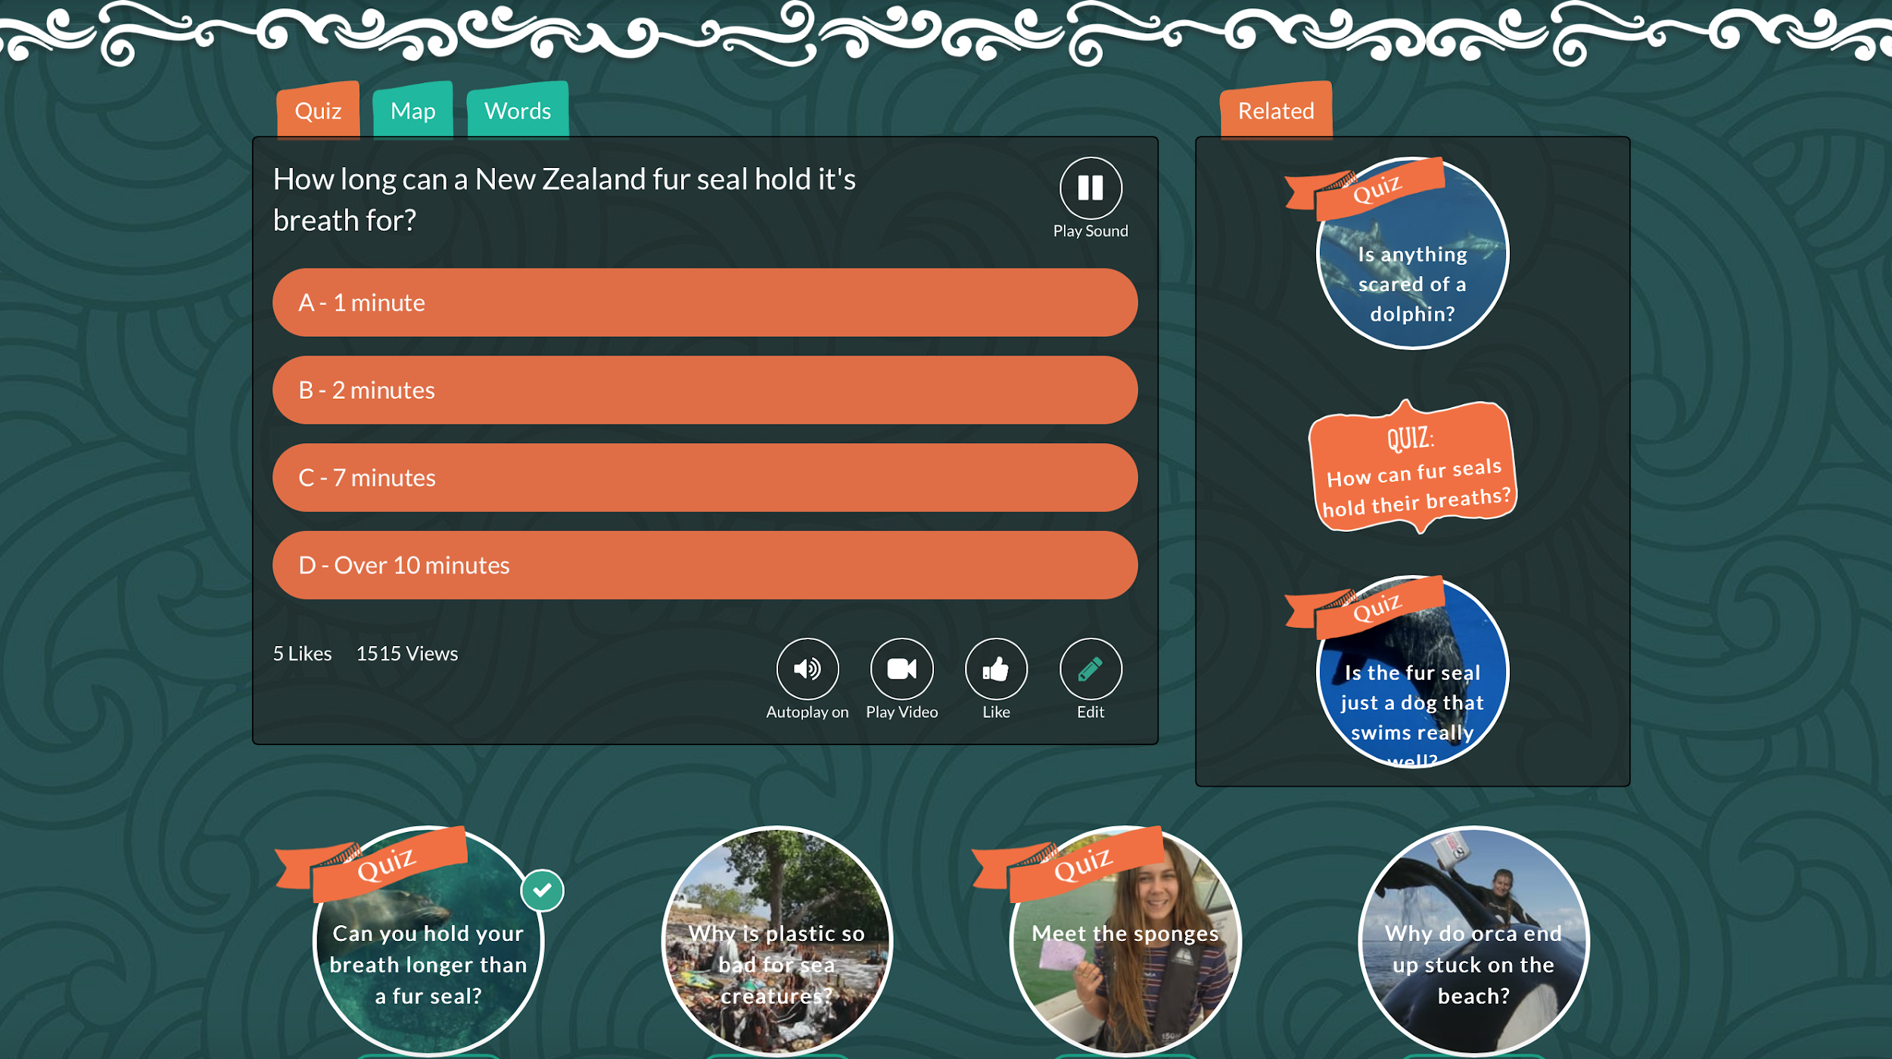
Young Ocean Explorers – a quiz
© Steve Hathaway
© Copyright. University of Waikato. All Rights Reserved | www.sciencelearn.org.nz
All images are copyrighted. For further information, please refer to enquiries@sciencelearn.org.nz
Notes:
Try this on the YOE live website – first a short video plays that asks the question – then this frame pops up with a choice of answers, followed by another video with Riley giving the answer.

Slide 10
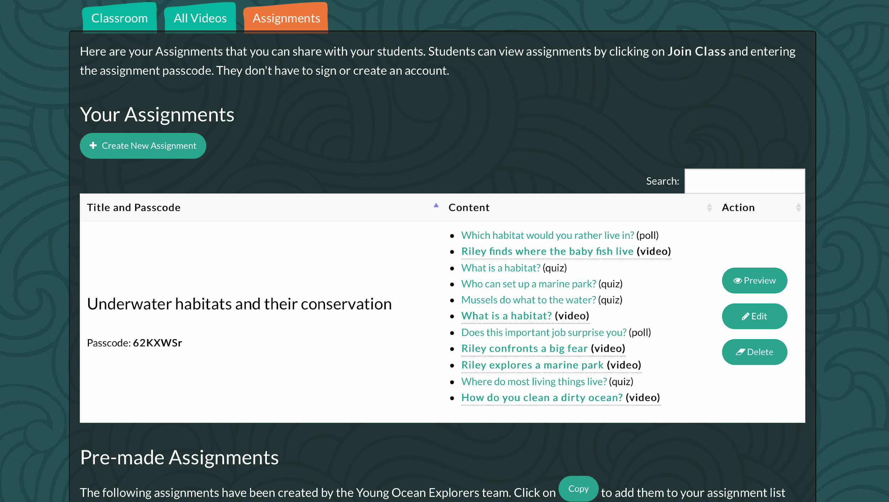
Young Ocean Explorers – an assignment
© Steve Hathaway
© Copyright. University of Waikato. All Rights Reserved | www.sciencelearn.org.nz
All images are copyrighted. For further information, please refer to enquiries@sciencelearn.org.nz
Notes:
Assignments can be used pre-prepared or you can make your own.

Slide 11
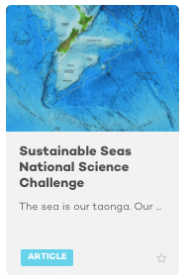
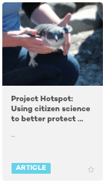
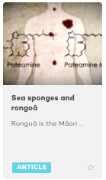
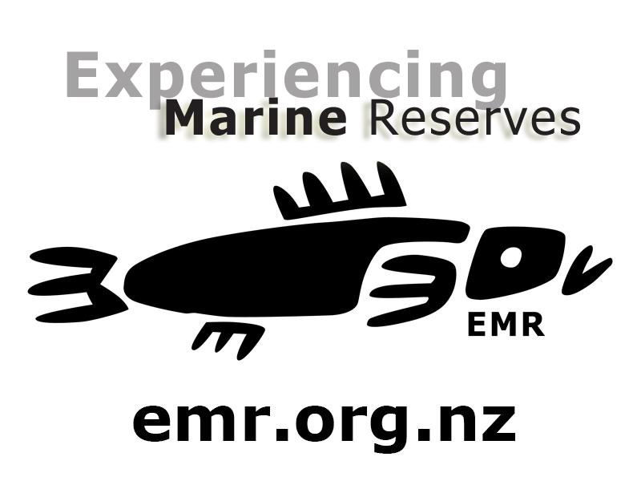


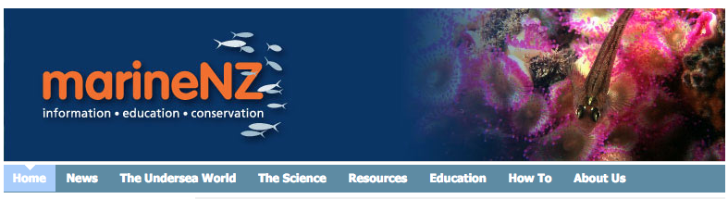
Who else is involved? – a sampling
© NIWA
© Sharyn Smart
©Scottie Productions
“New Zealand’s coastal ecosystems are the most multi-valued, multi-used and contested ecosystems in the country.”
(Professor Simon Thrush)
© Copyright. University of Waikato. All Rights Reserved | www.sciencelearn.org.nz
All images are copyrighted. For further information, please refer to enquiries@sciencelearn.org.nz
Notes:
There is a huge variety of people, groups and organisations working in some way in marine science (both formal and citizen science), education, conservation, exploration, Participatory Science Projects, National Science Challenges, Mātauranga Māori etc. This slide shows a sample of these groups/organisations.

Slide 12
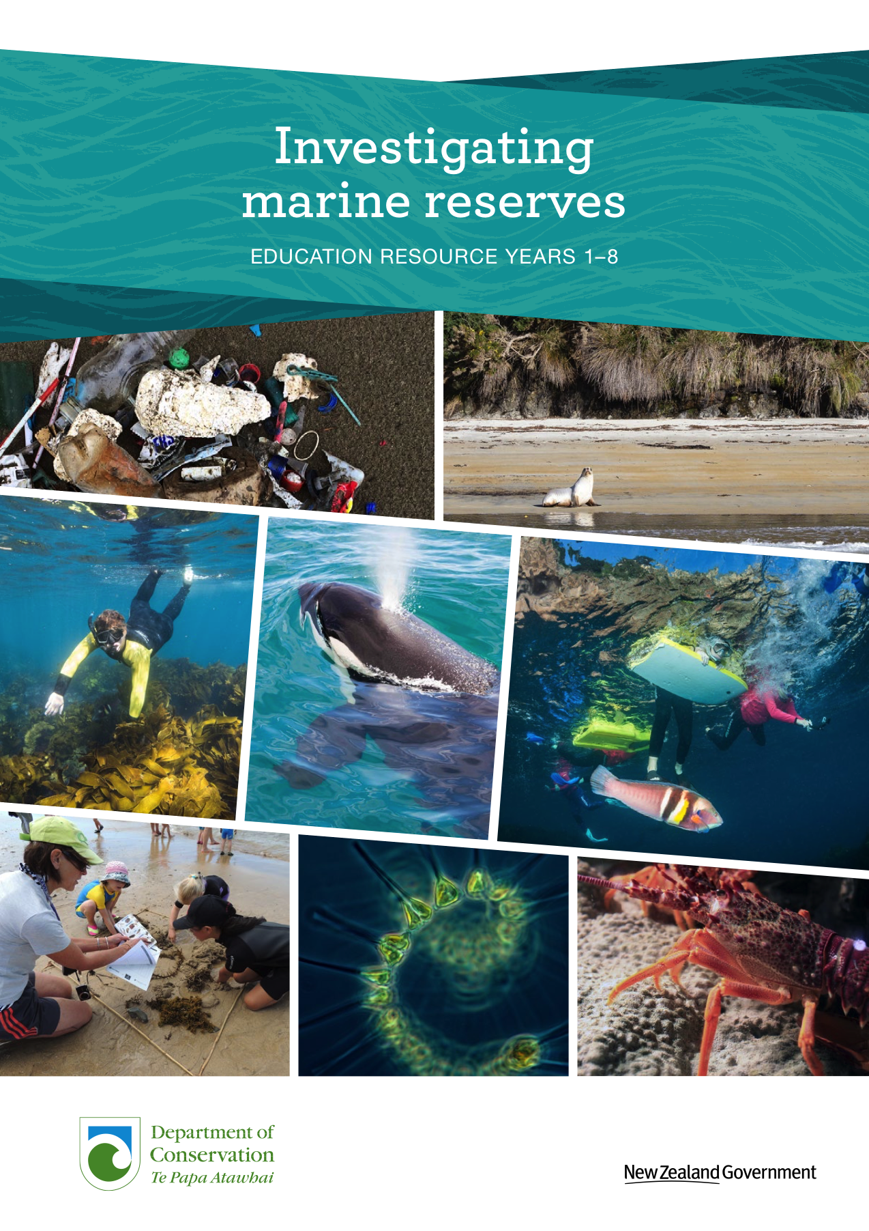
Investigating Marine Reserves
This is:
an integrated curriculum teaching resource that explores New Zealand’s marine reserves as a real-life context for learning
developed for primary school students and teachers, linking to the New Zealand Curriculum at levels 1–4
able to be adapted for use at various levels
available at www.doc.govt.nz/education-marine-reserves
© DOC
© Copyright. University of Waikato. All Rights Reserved | www.sciencelearn.org.nz
All images are copyrighted. For further information, please refer to enquiries@sciencelearn.org.nz

Slide 13
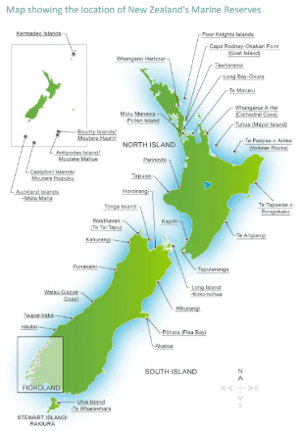
Investigating Marine Reserves
What are marine reserves?
Why are they important?
© DOC
© Copyright. University of Waikato. All Rights Reserved | www.sciencelearn.org.nz
All images are copyrighted. For further information, please refer to enquiries@sciencelearn.org.nz
Notes:
Use these questions to prompt discussion – begin an inquiry – the answers are in the resource.

Slide 14
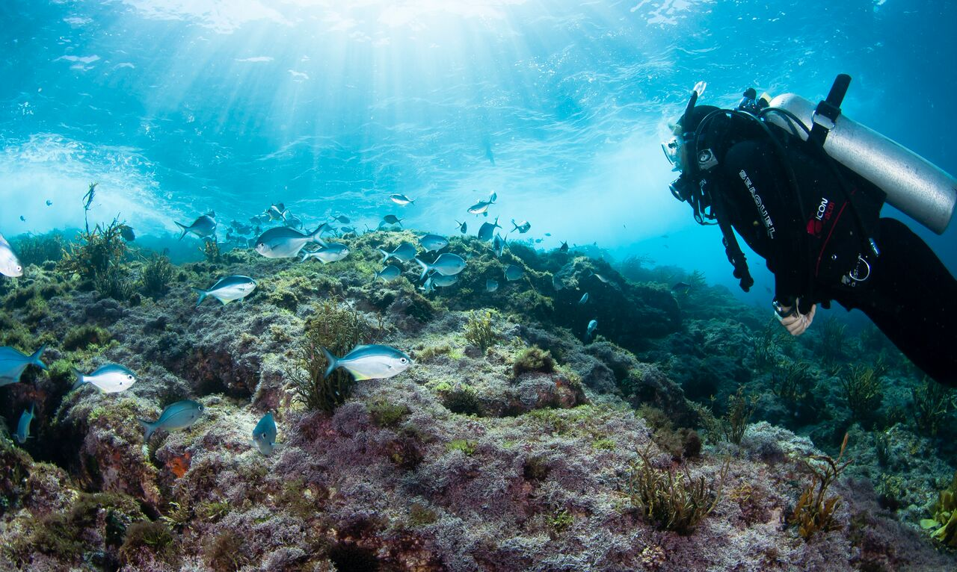
Investigating Marine Reserves
© DOC
Objectives of the resource: To provide students, teachers and their communities with opportunities to grow their knowledge, skills and understandings about marine conservation, so that they can help resolve environmental challenges for the marine environment in their local area and beyond.
© Copyright. University of Waikato. All Rights Reserved | www.sciencelearn.org.nz
All images are copyrighted. For further information, please refer to enquiries@sciencelearn.org.nz
Notes:
The resource’s objectives have been split up within it to be more explicit – outlining specific learning outcomes, curriculum connections etc. and the resource is set out into useful chapters.

Slide 15
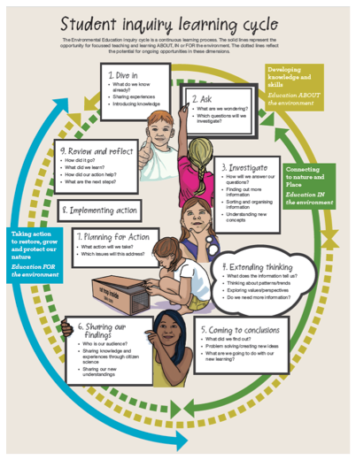
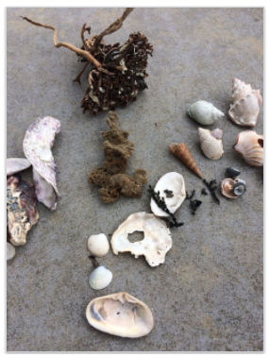
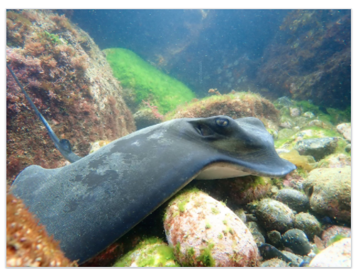
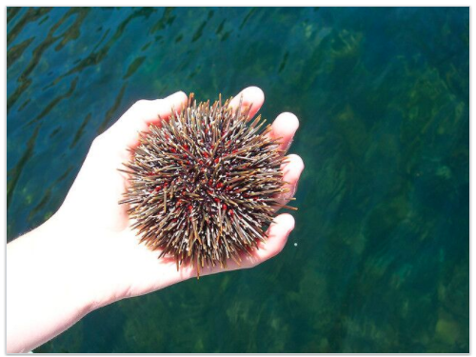
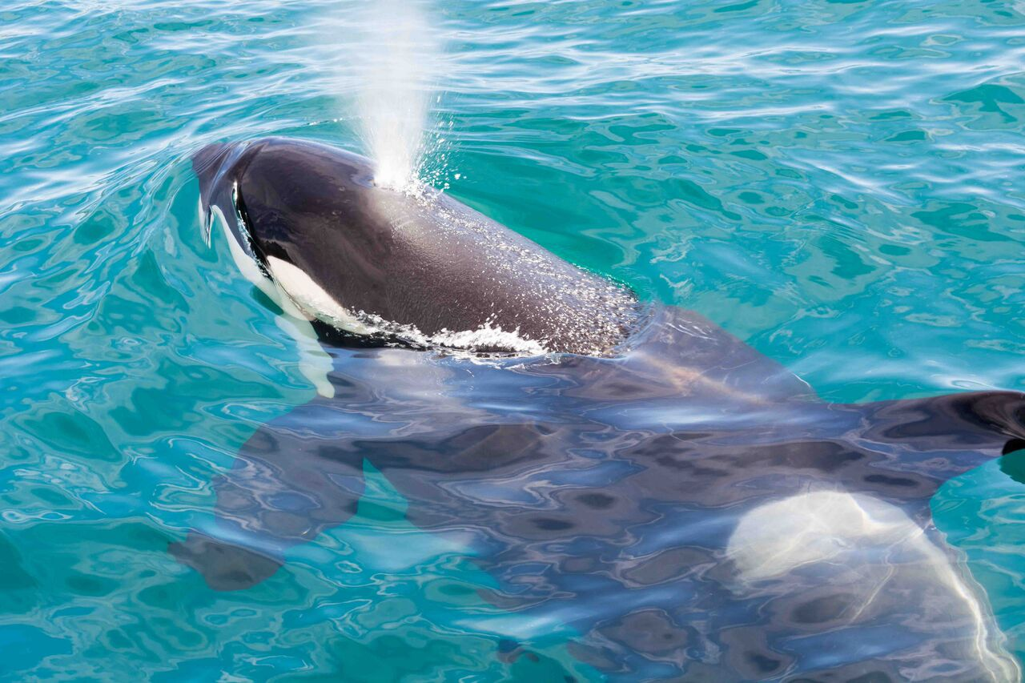
Fostering inquiry
© Copyright. University of Waikato. All Rights Reserved | www.sciencelearn.org.nz
All images on this slide are © DOC
Notes:
Looking at the inquiry cycle that the resource is based on – the first phase in any inquiry being the immersion stage – using videos like those we have seen, experiences/experiential learning, getting students out into the environment and curious about it – stimulating interest, excitement, curiosity and questions that can then be investigated. This links to EEFS and conservation education and to other inquiry models teachers are already using.
https://www.sciencelearn.org.nz/images/4452-student-inquiry-learning-cycle

Slide 16
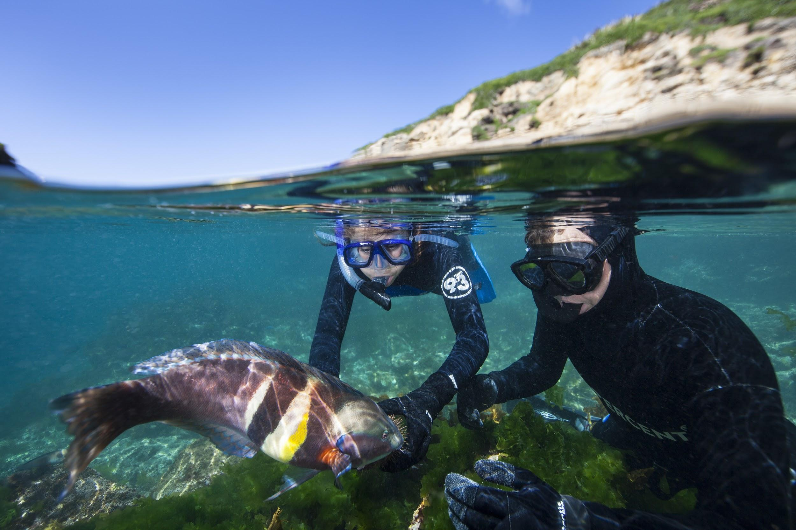
Being there – in the environment
© Steve Hathaway
© Copyright. University of Waikato. All Rights Reserved | www.sciencelearn.org.nz
All images are copyrighted. For further information, please refer to enquiries@sciencelearn.org.nz
Notes:
There is no real substitute to getting students in the environment, to build connections and curiosity.

Slide 17
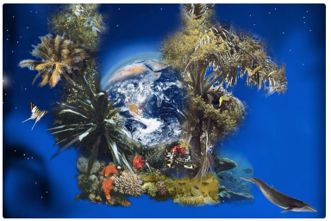
Stimulating discussion and curiosity
© Zeit News
© Copyright. University of Waikato. All Rights Reserved | www.sciencelearn.org.nz
All images are copyrighted. For further information, please refer to enquiries@sciencelearn.org.nz
Notes:
Discuss how we can use different resources (videos, images, etc.) to stimulate curiosity in the first stages of an inquiry. Using a picture like this, (https://www.sciencelearn.org.nz/images/1266-biodiversity) asking questions about it – Steve pointed out that it brings up a feeling that the organisms on the land are more important, whereas most of the life on Earth is actually under the sea.

Slide 18
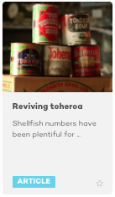
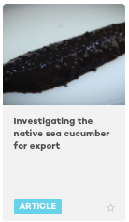
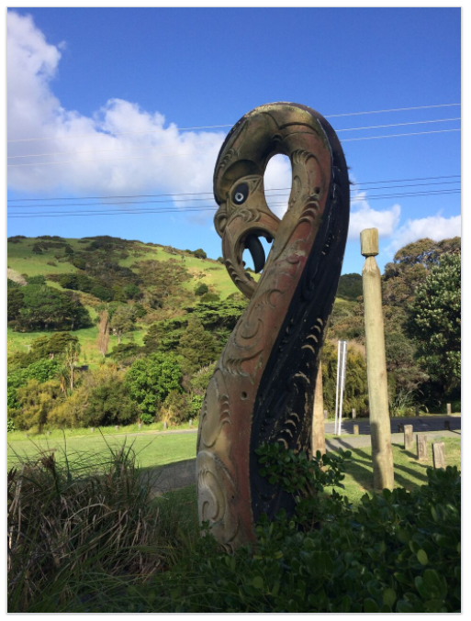
Te Ao Māori – values and perspectives
© Scottie Productions
© Scottie Productions
The sea for Māori is not only a resource but also a source of identity and whakapapa. Māori resource management strategies are based on the relationships between people and the environment.
© DOC
© Copyright. University of Waikato. All Rights Reserved | www.sciencelearn.org.nz
All images are copyrighted. For further information, please refer to enquiries@sciencelearn.org.nz
Notes:
Exploring and applying science in the modern world requires us to explore values and perspectives – as does the NZC. Obviously in New Zealand, this means building understandings and relationships with tangata whenua. TKI has tips about how you might do this if you aren’t easily able to. The DOC resource outlines some key ideas underpinning Māori relationships and interactions with the moana.

Slide 19

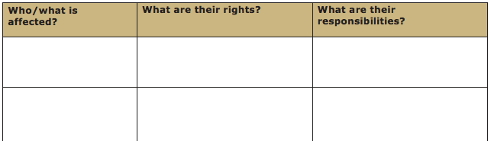
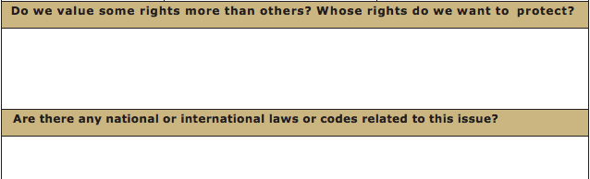
Ethics thinking toolkit – planning for action
© Copyright. University of Waikato. All Rights Reserved | www.sciencelearn.org.nz
All images are copyrighted. For further information, please refer to enquiries@sciencelearn.org.nz
Notes:
An example of a framework to use to explore values and perspectives, as well as the complexities of decision-making - part of the SLH Ethics thinking toolkit relevant to the marine environment, rights and responsibilities. This links to the participating and contributing aspect of the nature of science in the NZC – taking action – exploring socio-scientific issues.

Slide 20
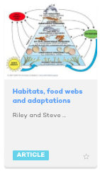
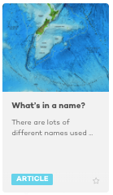
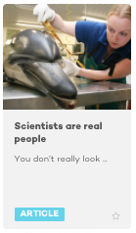
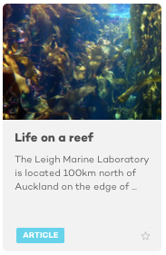
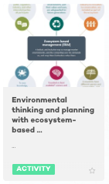
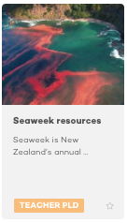
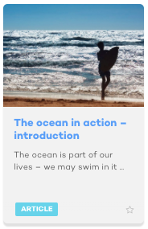
Some more SLH marine resources
© Fastily/Creative Commons 3.0
© NIWA
© Massey University
© NIWA, Chang et al. (2005) and Miriam Godfrey
© 123RF Ltd
© Sustainable Seas NSC
© Copyright. University of Waikato. All Rights Reserved | www.sciencelearn.org.nz
All images are copyrighted. For further information, please refer to enquiries@sciencelearn.org.nz

Slide 21


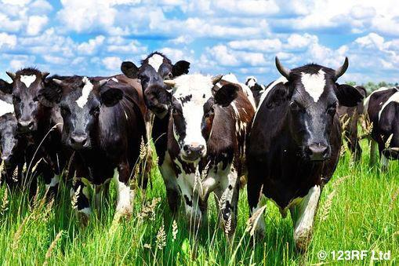
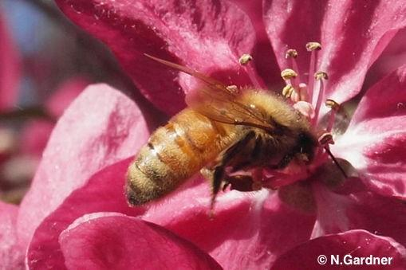
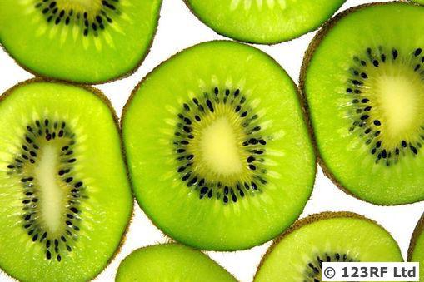
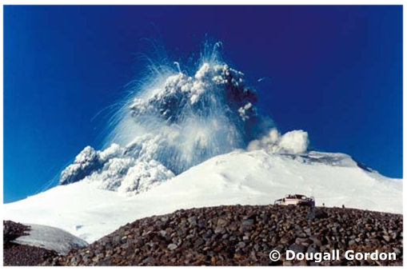
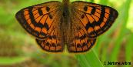
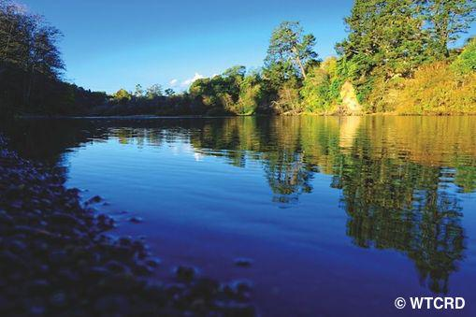
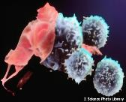

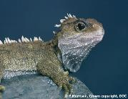
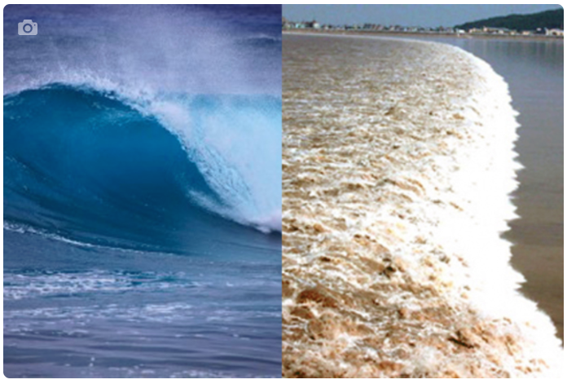
Thanks – want to keep in touch?
Department of Conservation
www.doc.govt.nz/education
www.doc.govt.nz/get-involved/conservation-education/resources/protecting-our-marine-world/
Email us on enquiries@sciencelearn.org.nz
https://twitter.com/NZScienceLearn
www.facebook.com/nzsciencelearn
https://nz.pinterest.com/nzsciencelearn
www.instagram.com/sciencelearninghubnz
Young Ocean Explorers
www.youngoceanexplorers.com

