Slide 1
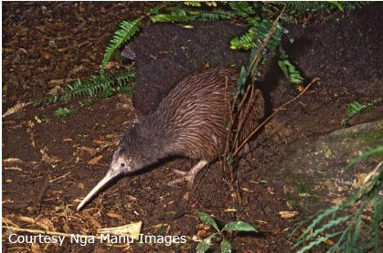
Endemic, native or introduced?
New Zealand’s
native birds – endemic, native or introduced?
© The University of Waikato | www.sciencelearn.org.nz

Slide 2
Endemic, native or introduced?
Endemic birds
Birds that have evolved and occur and breed naturally only in New Zealand.
© The University of Waikato | www.sciencelearn.org.nz

Slide 3
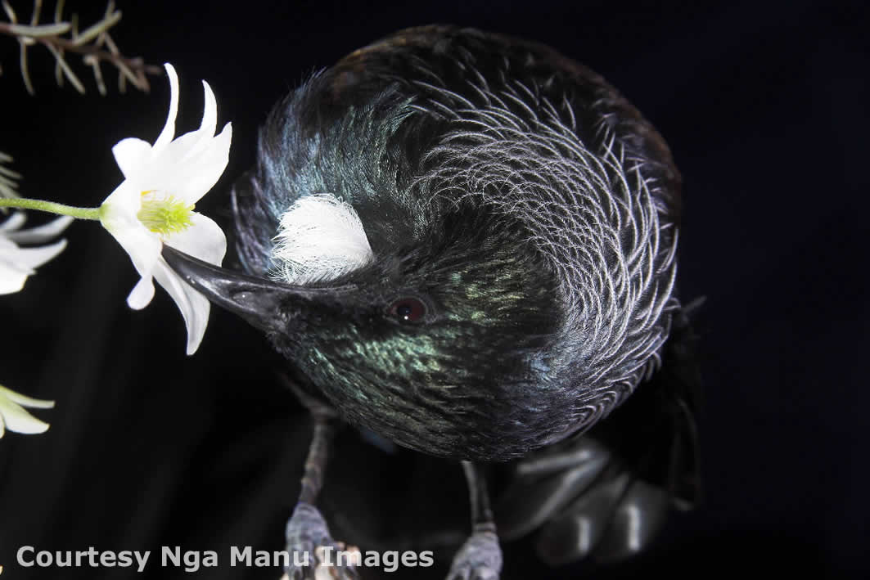
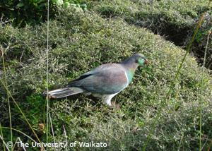
Endemic, native or introduced?
Endemic birds
Common name:
tūī
Scientific name:
Prosthemadera novaeseelandiae
Māori name:
tūī
Common name:
New Zealand wood pigeon
Scientific name:
Hemiphaga novaeseelandiae
Māori name:
kererū
© The University of Waikato | www.sciencelearn.org.nz

Slide 4
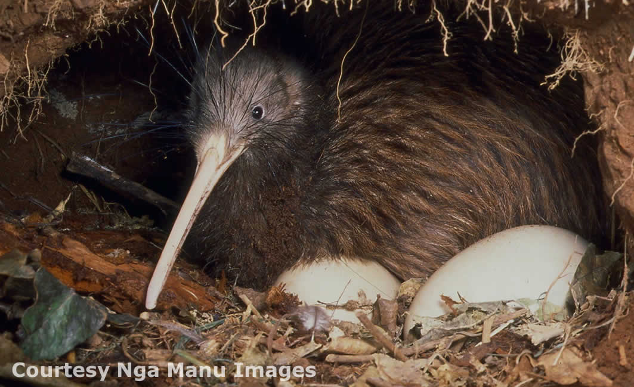
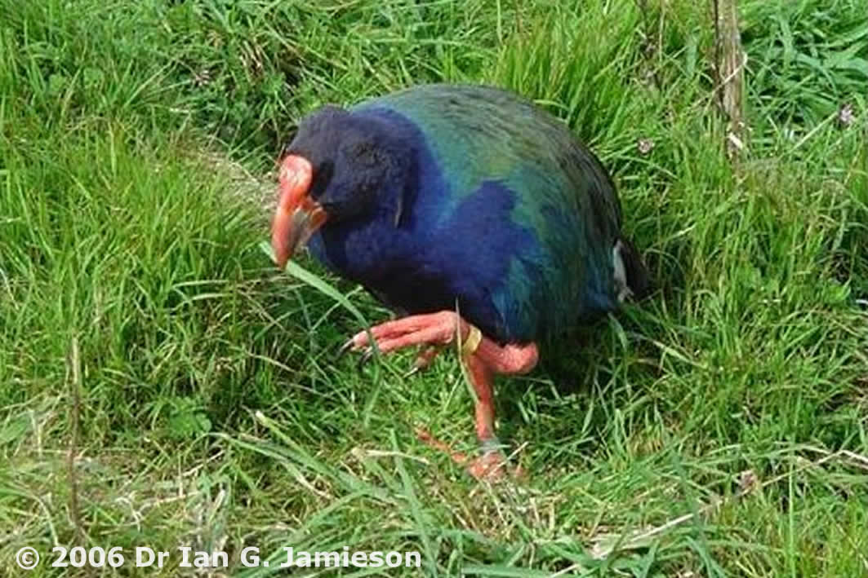
Endemic, native or introduced?
Endemic birds
Common name:
kiwi
Scientific name:
Apteryx spp
Māori name:
kiwi
Common name:
takahē
Scientific name:
Porphyrio mantelli
Māori name:
takahē
© The University of Waikato | www.sciencelearn.org.nz

Slide 5
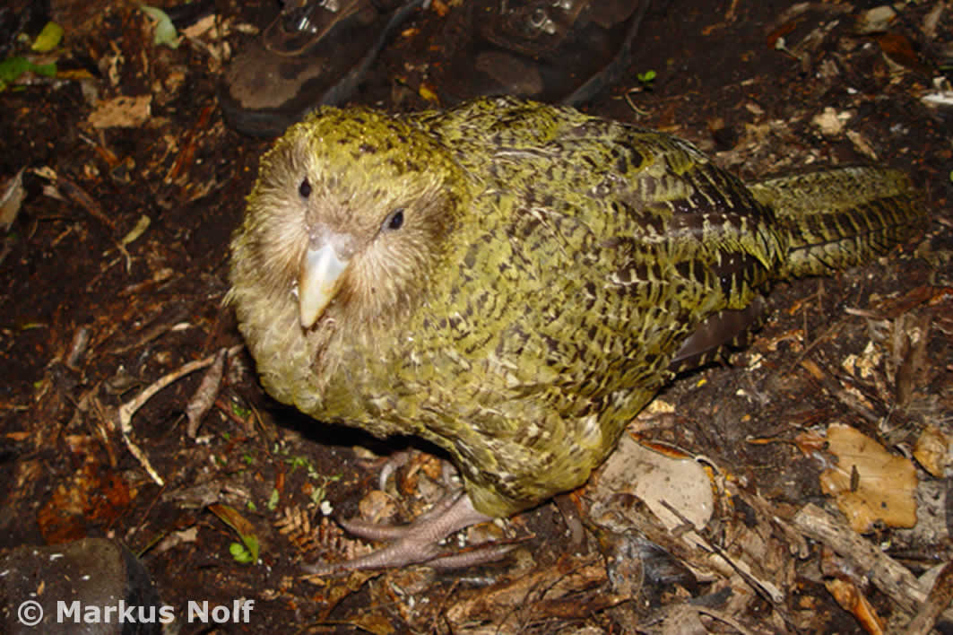
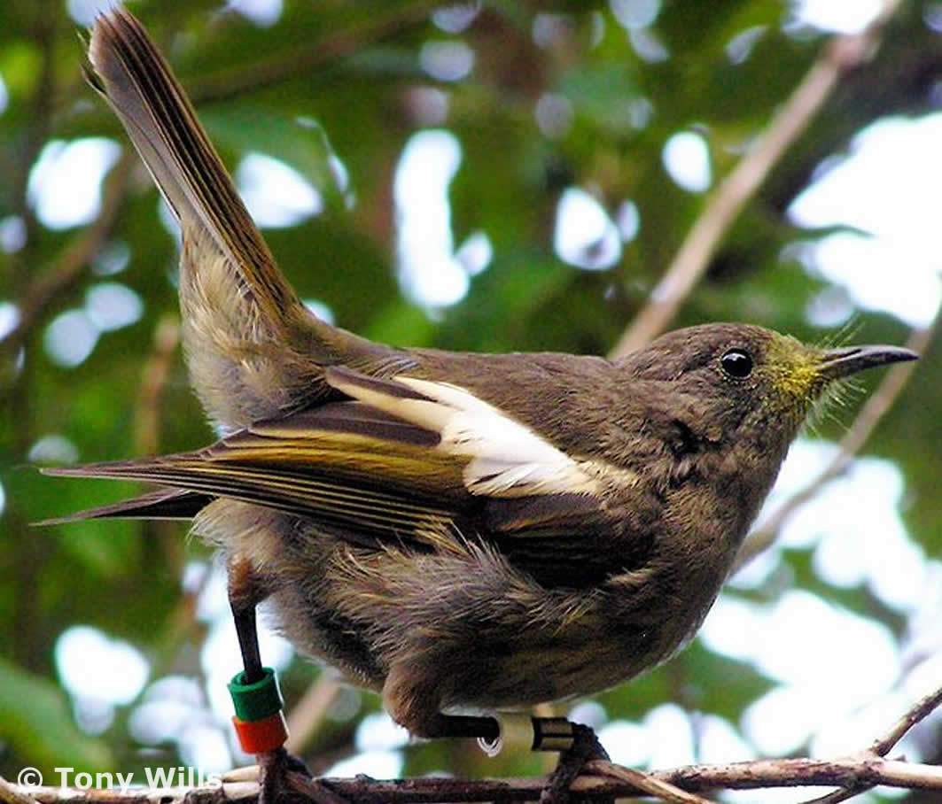
Endemic, native or introduced?
Endemic birds
Common name:
kākāpō
Scientific name:
Strigops habroptilus
Māori name:
kākāpō
Common name:
stitchbird
Scientific name:
Notiomystis cincta
Māori name:
hihi
© The University of Waikato | www.sciencelearn.org.nz

Slide 6
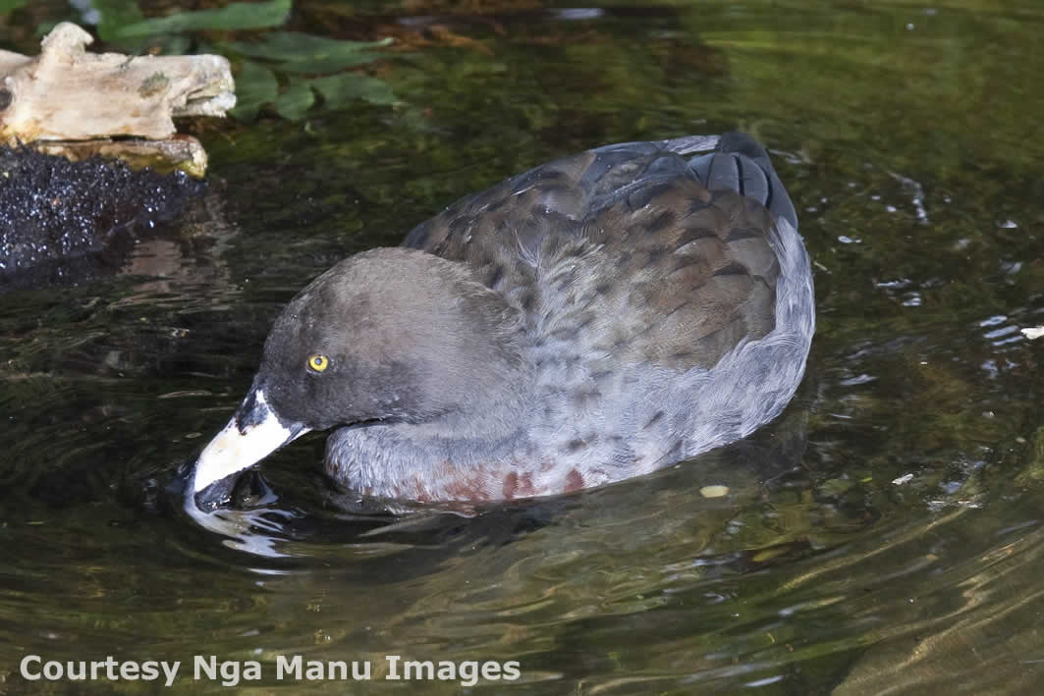
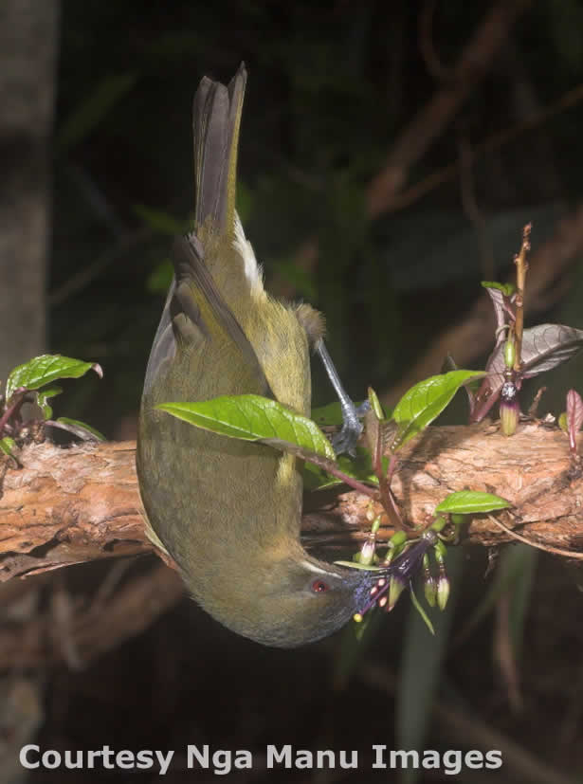
Endemic, native or introduced?
Endemic birds
Common name:
blue duck
Scientific name:
Hymenolanimus malacorhynchos
Māori name:
whio
Common name:
bellbird
Scientific name:
Anthornis melanura
Māori name:
korimako
© The University of Waikato | www.sciencelearn.org.nz

Slide 7
Endemic, native or introduced?
Native birds
Birds that have arrived in New Zealand by themselves and established themselves here. They are also found in other countries.
© The University of Waikato | www.sciencelearn.org.nz

Slide 8
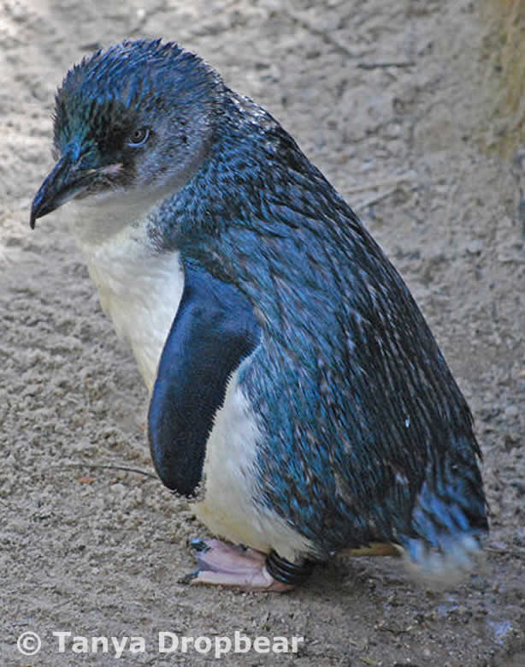
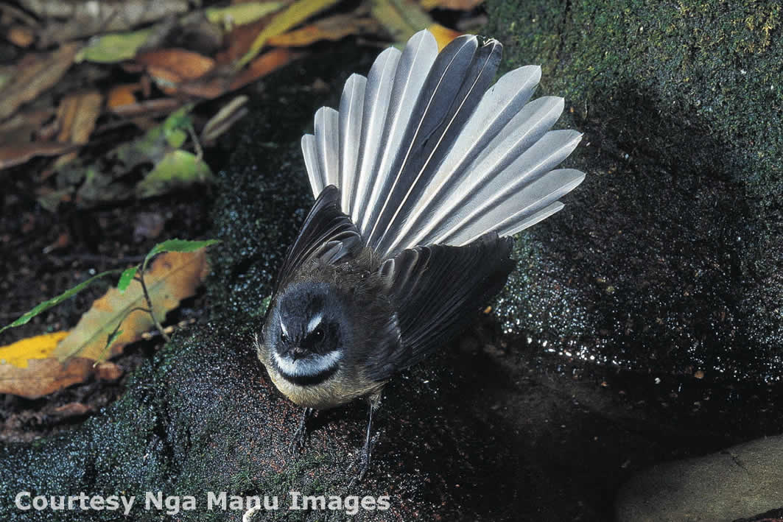
Endemic, native or introduced?
Native birds
Common name:
little blue penguin
Scientific name:
Eudyptula minor
Māori name:
kororā
Common name:
fantail
Scientific name:
Rhipidura fuliginosa
Māori name:
pīwakawaka
© The University of Waikato | www.sciencelearn.org.nz

Slide 9
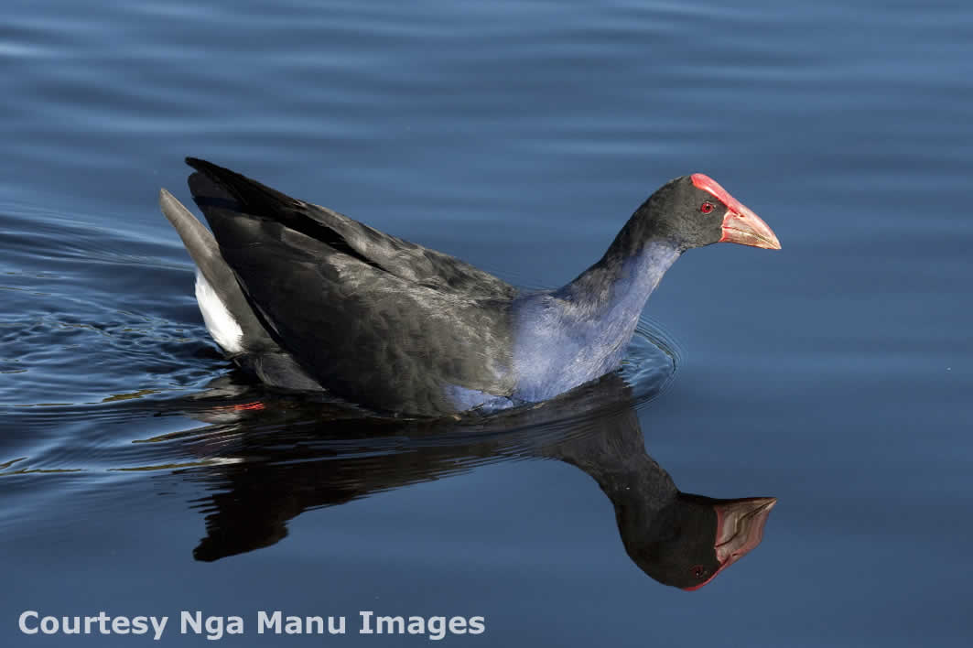
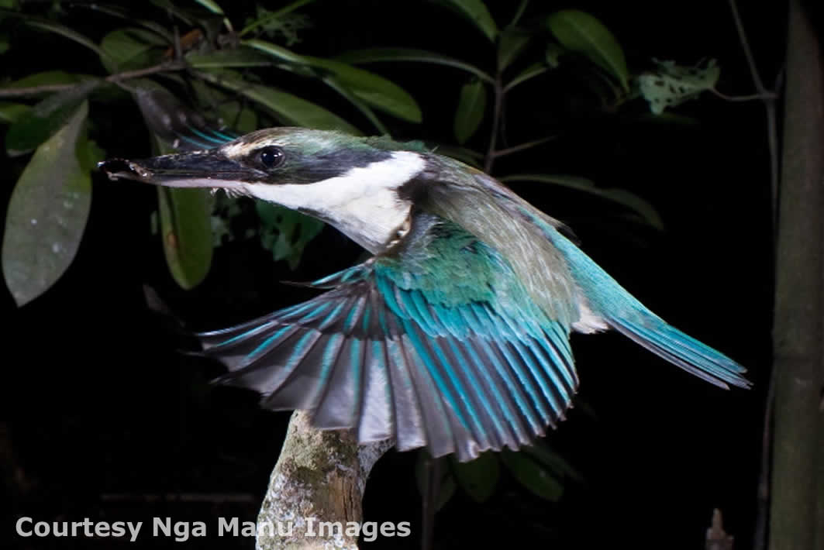
Endemic, native or introduced?
Native birds
Common name:
swamp hen
Scientific name:
Porphyrio porphyrio
Māori name:
pūkeko
Common name:
kingfisher
Scientific name:
Halcyon sancta
Māori name:
kōtare
© The University of Waikato | www.sciencelearn.org.nz

Slide 10
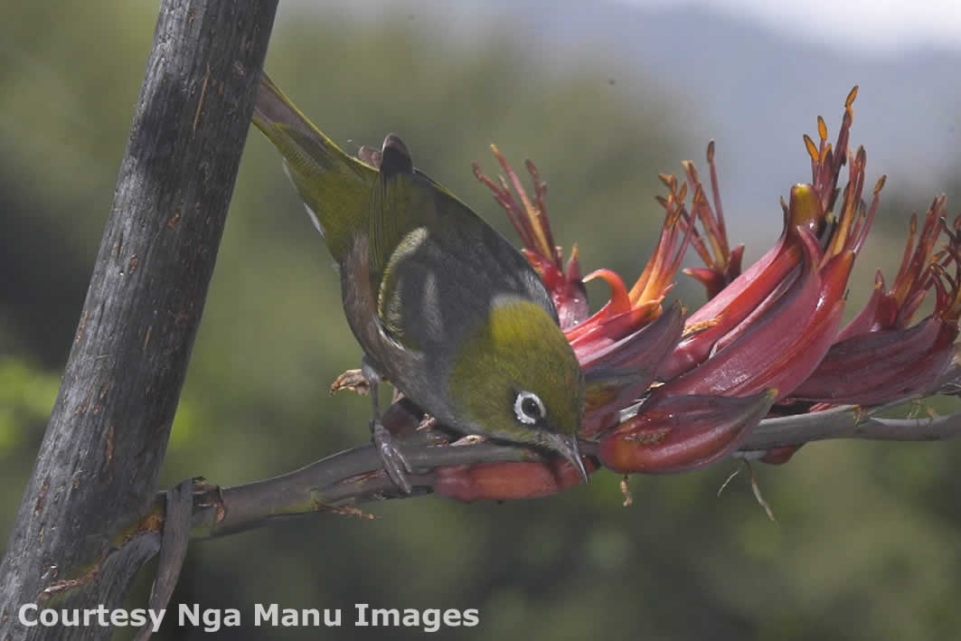
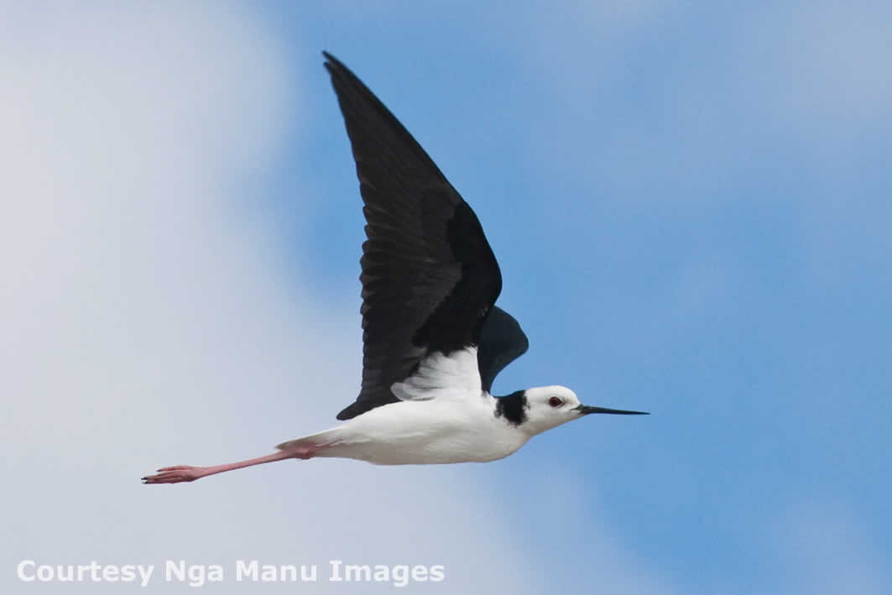
Endemic, native or introduced?
Native birds
Common name:
silvereye
Scientific name:
Zosterops lateralis
Māori name:
tauhou
Common name:
pied stilt
Scientific name:
Himantopus himantopus
Māori name:
poaka
© The University of Waikato | www.sciencelearn.org.nz

Slide 11
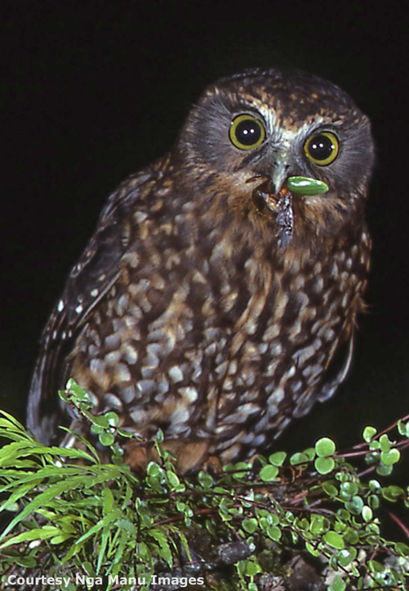
Endemic, native or introduced?
Native birds
Common name:
morepork
Scientific name:
Ninox novaeseelandiae
Māori name:
ruru
© The University of Waikato | www.sciencelearn.org.nz

Slide 12
Endemic, native or introduced?
Introduced birds
Birds that humans have
brought to New Zealand.
© The University of Waikato | www.sciencelearn.org.nz

Slide 13
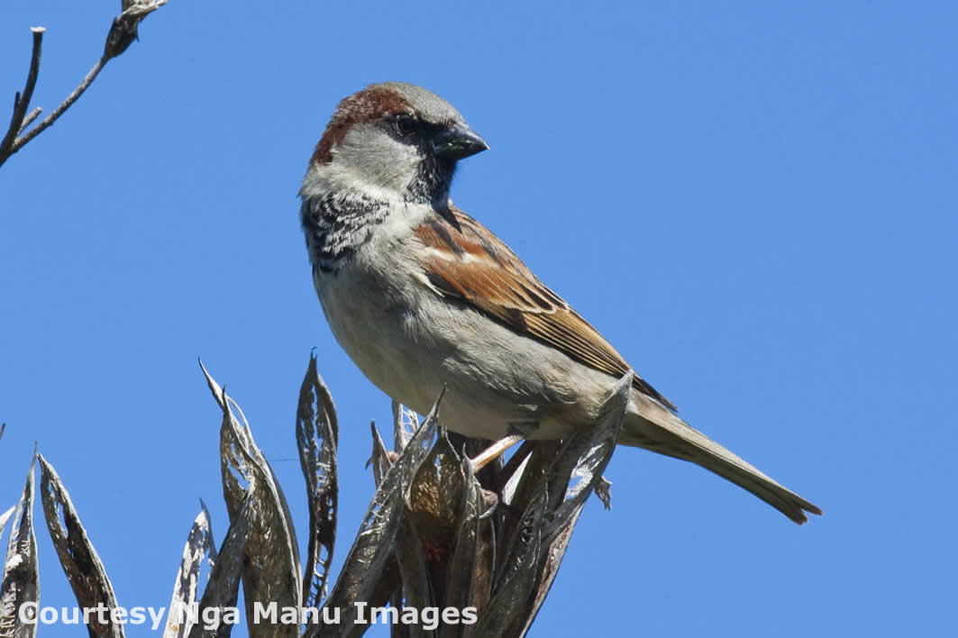
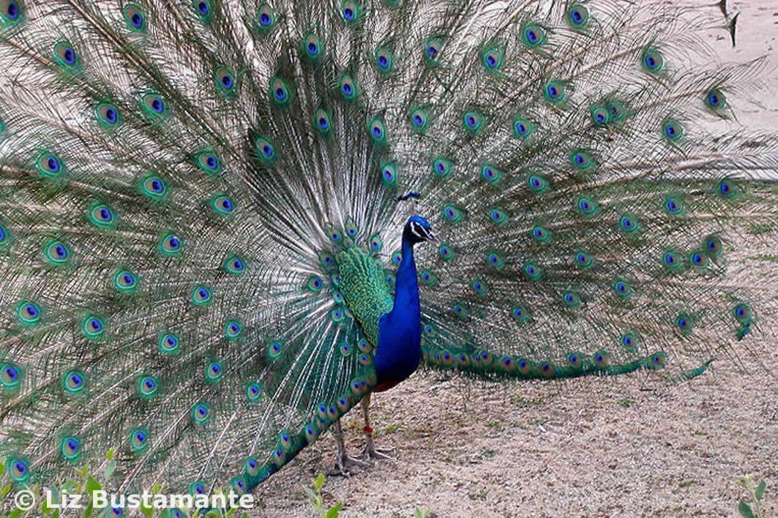
Endemic, native or introduced?
Introduced birds
Common name:
house sparrow
Scientific name:
Passer domesticus
Common name:
peacock
Scientific name:
Pavo cristatus
© The University of Waikato | www.sciencelearn.org.nz

Slide 14
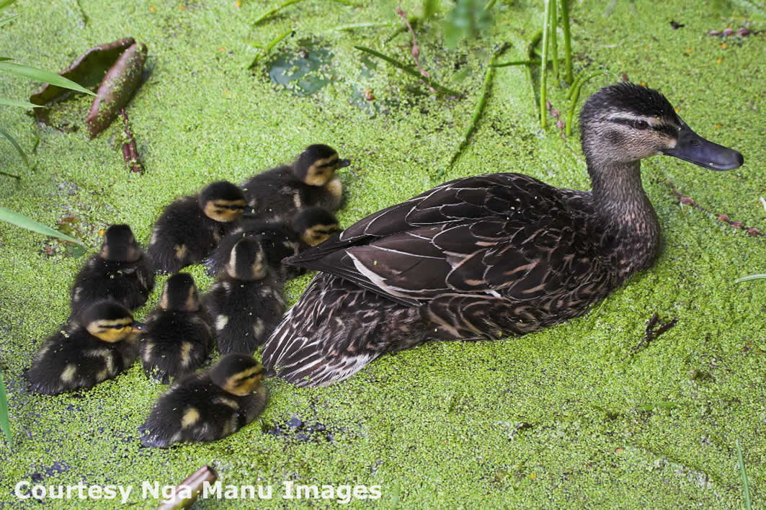
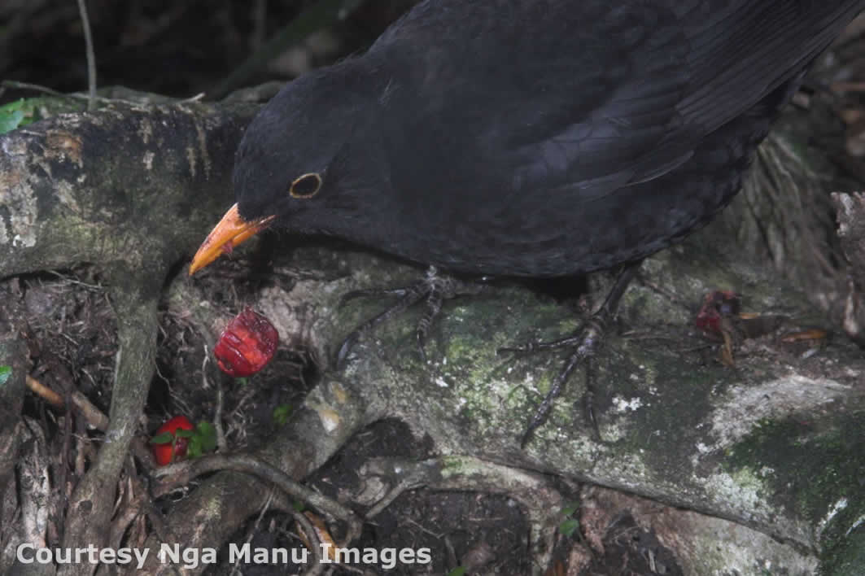
Endemic, native or introduced?
Introduced birds
Common name:
mallard
Scientific name:
Anas platyrhynchos
Common name:
blackbird
Scientific name:
Turdus merula
© The University of Waikato | www.sciencelearn.org.nz

Slide 15
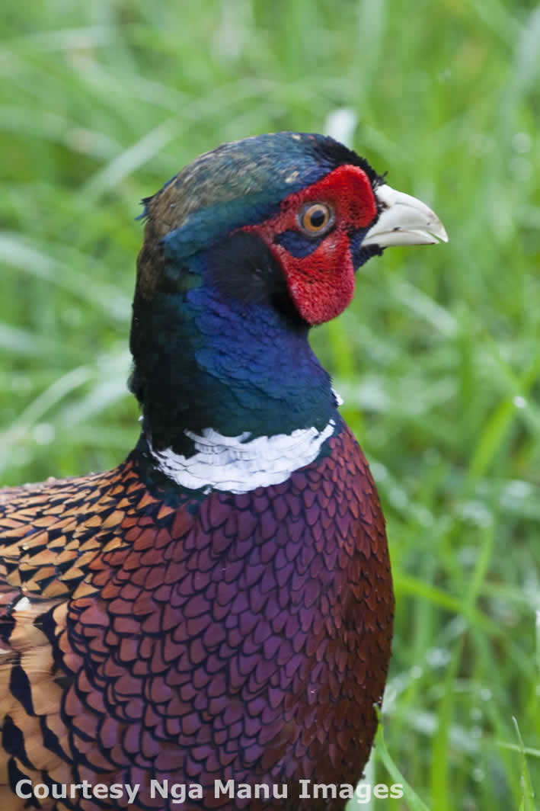
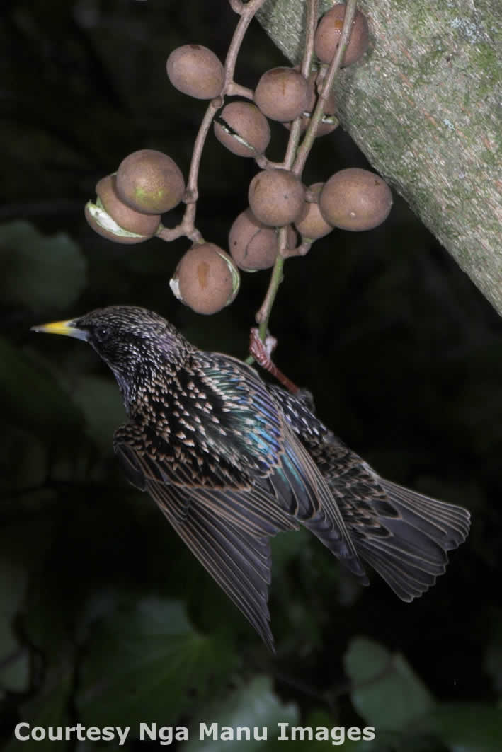
Endemic, native or introduced?
Introduced birds
Common name:
pheasant
Scientific name:
Phasianus colchicus
Common name:
starling
Scientific name:
Sturnus vulgaris
© The University of Waikato | www.sciencelearn.org.nz

Slide 16
Endemic, native or introduced?
The Science Learning Hub would like to thank the following for the use of their images for this PowerPoint
Ngā Manu images
bellbird
blackbird
blue duck
fantail
house sparrow
kingfisher
kiwi
mallard
morepork
pheasant
pied stilt
pūkeko
silvereye
starling
tūī
The University of Waikato kererū
Creative Commons little blue penguin
peacock
http://creativecommons.org/licenses/by/2.0/deed.en
Creative Commons and hihi
GNU Free Documentation kākāpō
Licence, version 1.2
Dr Ian Jamieson takahē
© The University of Waikato | www.sciencelearn.org.nz

