Slide 1
Tackling planning in science
© Steve Hathaway
Lyn Rogers and Angela Schipper
4–4:45pm Thursday 22 March 2018
© Copyright. University of Waikato. All Rights Reserved | www.sciencelearn.org.nz
All images are copyrighted. For further information, please refer to enquiries@sciencelearn.org.nz

Slide 2
Index
Topic | PowerPoint slide number(s) | Video timecode
Introducing the Science Learning Hub and presenters | 1 | 00:00
Index | 2–3 | 00:10
Introducing the learning outcomes | 4 | 00:20
Why might we choose a context or topic? | 5–9 | 01:08
Climate change – how or where do we start? | 10–13 | 05:58
Deciding on the curriculum angle to take | 14–19 | 12:55
How confident are we? | 20 | 22:05
What approach will we take? | 21 | 24:56
© Steve Hathaway
© Copyright. University of Waikato. All Rights Reserved | www.sciencelearn.org.nz
All images are copyrighted. For further information, please refer to enquiries@sciencelearn.org.nz

Slide 3
Index
Topic | PowerPoint slide number(s) | Video timecode
What activities will we choose? | 22 | 25:53
Engagement through inquiry | 23 | 27:21
What is climate change? What are the consequences? | 24–25 | 29:56
Using thinking hats to generate questions | 26 | 32:36
Exploring the science of sea-level rise | 27–28 | 36:23
How do we know our students have learned? | 29–30 | 40:63
Some more SLH resources | 31 | -
Thanks – links to keep in touch | 32 | 45:31
© Steve Hathaway
© Copyright. University of Waikato. All Rights Reserved | www.sciencelearn.org.nz
All images are copyrighted. For further information, please refer to enquiries@sciencelearn.org.nz

Slide 4
Tackling planning in science
Today we will explore how we can plan to engage students in science and model easily transferable planning skills and pedagogies, using climate change as a context.
© Copyright. University of Waikato. All Rights Reserved | www.sciencelearn.org.nz
All images are copyrighted. For further information, please refer to enquiries@sciencelearn.org.nz

Slide 5
Why might we choose a context or topic?
We have to do it.
It is in the curriculum, the syndicate plan, faculty scheme or the year/term plan.
© Ministry of Education, NZ
© Copyright. University of Waikato. All Rights Reserved | www.sciencelearn.org.nz
All images are copyrighted. For further information, please refer to enquiries@sciencelearn.org.nz
Notes:
Be explicit when students are ‘doing science’ and that it isn’t just a ‘topic’ but that there are ways of being scientists – thinking and investigating, being curious, asking questions that are easy to foster but good for students to know they are being scientific when they are doing these things.

Slide 6
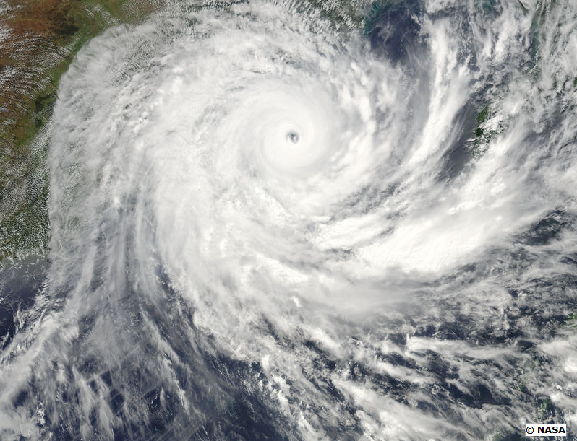
Why might we choose a context or topic?
2. We are responding to current events.
© Copyright. University of Waikato. All Rights Reserved | www.sciencelearn.org.nz
All images are copyrighted. For further information, please refer to enquiries@sciencelearn.org.nz
Notes:
Taking the teachable moment is a valuable way of introducing science into your programmes – what is going on in the lives of our students or the news that surrounds them? www.sciencelearn.org.nz/images/1059-tropical-cyclone-yasi

Slide 7
Why might we choose a topic?
3. We are responding to student interest – artefacts or questions.
Licenced from 123RF Ltd
© Copyright. University of Waikato. All Rights Reserved | www.sciencelearn.org.nz
All images are copyrighted. For further information, please refer to enquiries@sciencelearn.org.nz
Notes:
Often students will bring in materials to you, see a photo or ask questions that can be responded to, or their interest may become evident during discussions.

Slide 8
Why might we choose a topic?
4. We are making real-world connections – making use of available expertise, your own interest/experience or exploring local contexts.
Wendy St George/NIWA
© Copyright. University of Waikato. All Rights Reserved | www.sciencelearn.org.nz
All images are copyrighted. For further information, please refer to enquiries@sciencelearn.org.nz
Notes:
www.sciencelearn.org.nz/admin/images/1414-weno-working-with-a-student

Slide 9
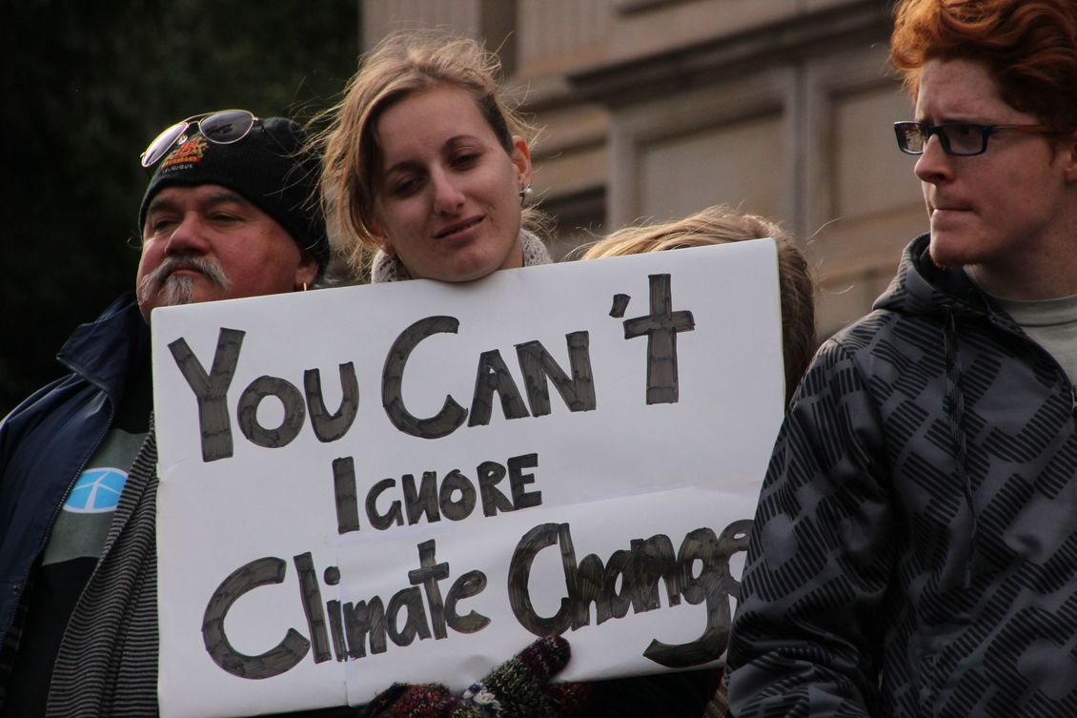
Why might we choose a topic?
5. We are deliberately making connections to other learning.
Takvar/Creative Commons 2.0
© Copyright. University of Waikato. All Rights Reserved | www.sciencelearn.org.nz
All images are copyrighted. For further information, please refer to enquiries@sciencelearn.org.nz
Notes:
www.sciencelearn.org.nz/admin/images/2821-you-can-t-ignore-climate-change

Slide 10
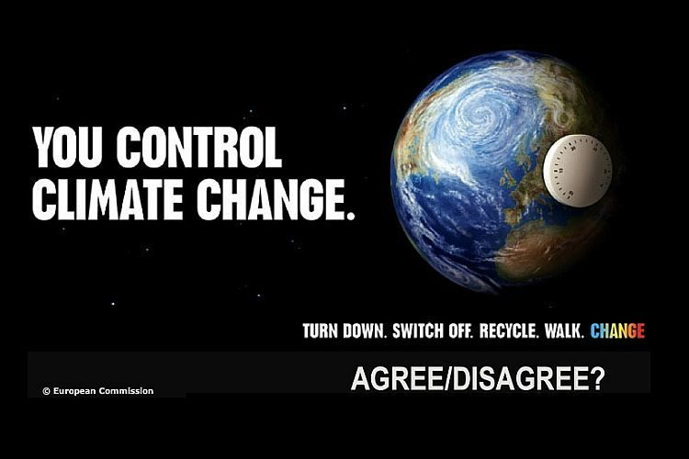
Climate change
How or where do we start?
© Copyright. University of Waikato. All Rights Reserved | www.sciencelearn.org.nz
All images are copyrighted. For further information, please refer to enquiries@sciencelearn.org.nz
Notes:
Assume we have chosen to tackle climate change as a topic. www.sciencelearn.org.nz/images/451-climate-change-poster

Slide 11
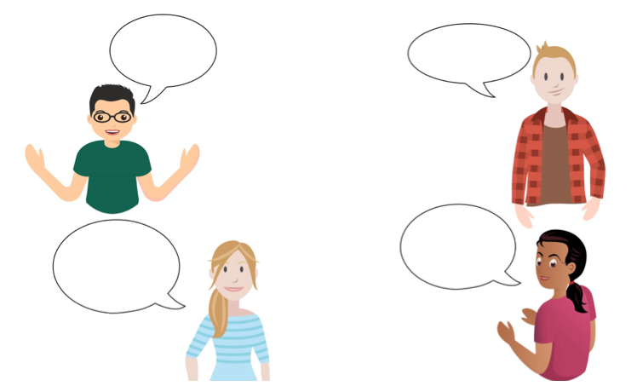
What do we already know about climate change? – some participants’ ideas
Most of these gases are attributed to human behaviour
Rising CO₂
Sea levels
are changing
Many causes
How the world's temperature has warmed
Weather patterns
changing
A whole range of issues related to our weather
Increasing temperatures on a long term average
Involves extreme weather patterns
Changing currents with warming seas
Due to increasing greenhouse gases
© Copyright. University of Waikato. All Rights Reserved | www.sciencelearn.org.nz
All images are copyrighted. For further information, please refer to enquiries@sciencelearn.org.nz

Slide 12
What do we already know about climate change?
© Copyright. University of Waikato. All Rights Reserved | www.sciencelearn.org.nz
All images are copyrighted. For further information, please refer to enquiries@sciencelearn.org.nz
Notes:
Ask for prior knowledge – modelling how you might find this out, using concept cartoons. What other questions may arise from this? Is everyone right? How will we check whether what we know is correct?

Slide 13
Narrow it down!
© Copyright. University of Waikato. All Rights Reserved | www.sciencelearn.org.nz
All images are copyrighted. For further information, please refer to enquiries@sciencelearn.org.nz
Notes:
We suggest the ‘less is more’ approach. It will be better to choose some aspect of a topic like this rather than tackle the whole lot – it will depend on why you chose this topic/context and how long you want to spend – you can ‘do’ some science in a short time – not always taking weeks for a full inquiry or unit of work. www.sciencelearn.org.nz/images/2819-the-causes-and-impacts-of-climate-change

Slide 14
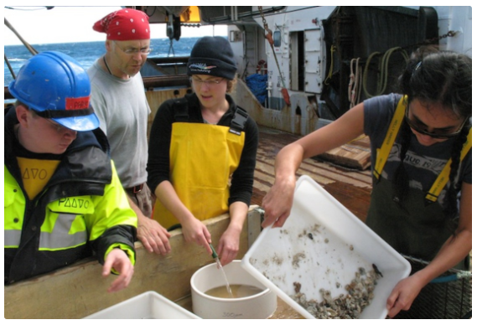
Decide what curriculum angle to take – nature of science?
Understanding science
Investigating in science
Communicating
in science
Participating and
contributing
© NIWA
© Copyright. University of Waikato. All Rights Reserved | www.sciencelearn.org.nz
All images are copyrighted. For further information, please refer to enquiries@sciencelearn.org.nz
Notes:
You may be guided by student interest, or you may want to look at curriculum connections to decide on how to proceed.

Slide 15
Science capabilities?
Engage with Science
Critique evidence
Interpret representations
Use evidence
Gather and interpret data
© Copyright. University of Waikato. All Rights Reserved | www.sciencelearn.org.nz
All images are copyrighted. For further information, please refer to enquiries@sciencelearn.org.nz
Notes:
The science capabilities help ‘unpack’ the nature of science.

Slide 16
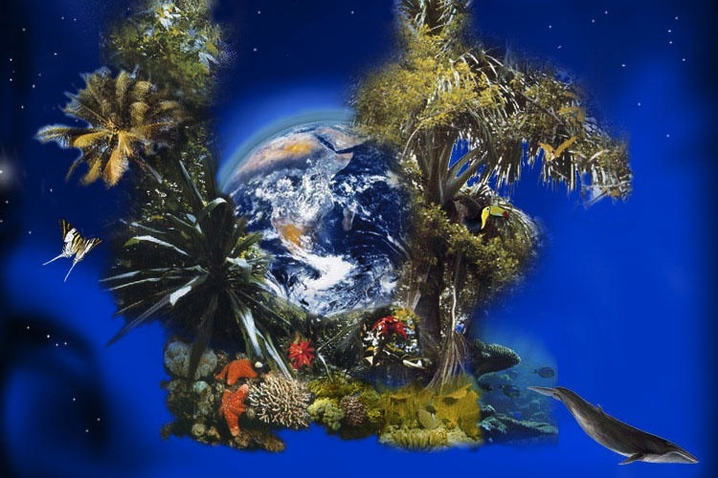
Achievement objectives – Living World
Ecology
Understand how living things interact with each other and with the non-living environment.
© ZeitNews
© Copyright. University of Waikato. All Rights Reserved | www.sciencelearn.org.nz
All images are copyrighted. For further information, please refer to enquiries@sciencelearn.org.nz
Notes:
www.sciencelearn.org.nz/images/1266-biodiversity

Slide 17
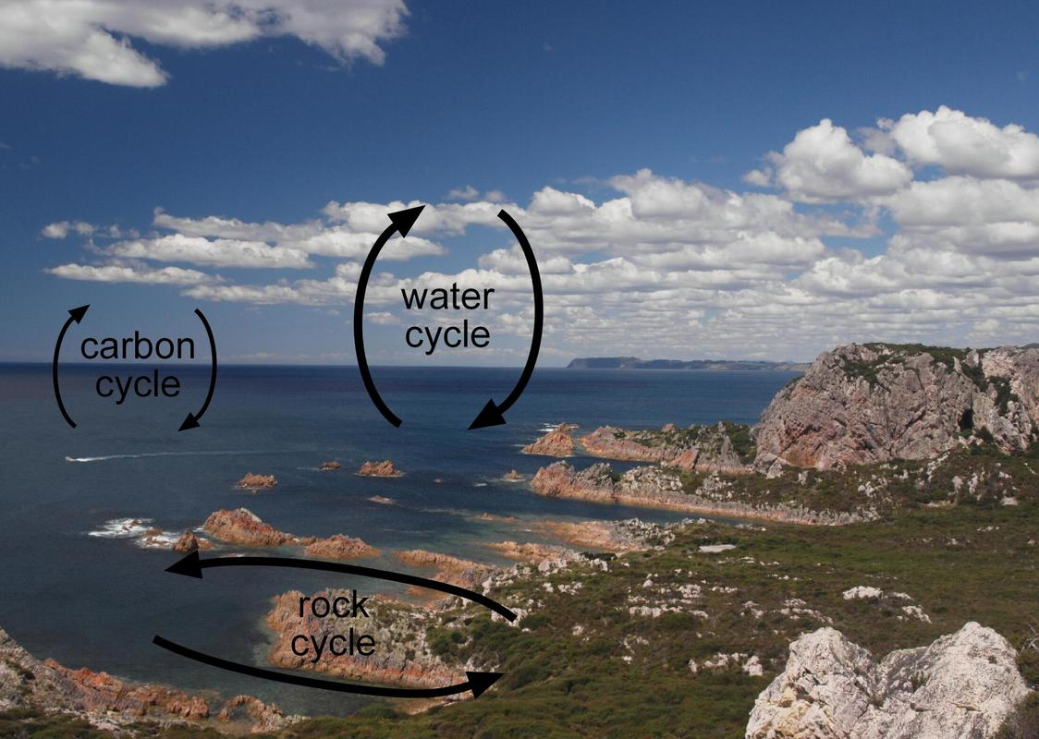
Achievement objectives – Planet Earth and Beyond
Earth systems
Investigate and understand the spheres of the Earth system: geosphere (land), hydrosphere (water), atmosphere (air), and biosphere (life).
Interacting systems
Investigate and understand that the geosphere, hydrosphere, atmosphere, and biosphere are connected via a complex web of processes.
© Copyright. University of Waikato. All Rights Reserved | www.sciencelearn.org.nz
All images are copyrighted. For further information, please refer to enquiries@sciencelearn.org.nz
Notes:
www.sciencelearn.org.nz/images/772-ocean-and-earth-cycles

Slide 18
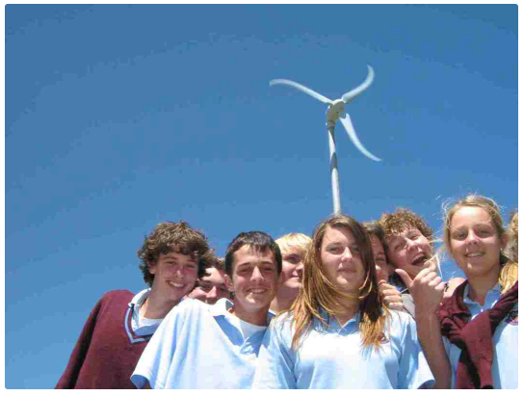
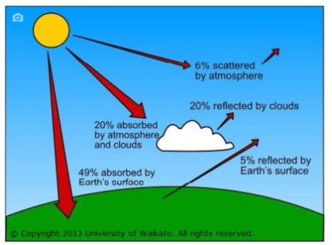
Achievement objectives – Physical World
Physical inquiry and physics concepts
Explore and investigate physical phenomena in everyday situations.
Using physics
Apply their understanding of physics to various applications.
W.Foy/Inglewood High School
© Copyright. University of Waikato. All Rights Reserved | www.sciencelearn.org.nz
All images are copyrighted. For further information, please refer to enquiries@sciencelearn.org.nz

Slide 19
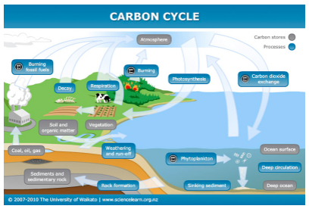
Achievement objectives – Material World
Properties and changes of matter
Investigate the properties of materials.
Chemistry and society
Make connections between the concepts of chemistry and their applications and show an understanding of the role chemistry plays in the world around them.
© Copyright. University of Waikato. All Rights Reserved | www.sciencelearn.org.nz
All images are copyrighted. For further information, please refer to enquiries@sciencelearn.org.nz
Notes:
Summarise how easy it is to connect to the curriculum – and therefore how easy it is to be ‘doing science’. That you don’t need to do the whole lot – just be reassured that you are covering relevant curriculum connections and can do little bits that can be built on later.
www.sciencelearn.org.nz/image_maps/3-carbon-cycle

Slide 20
How confident are we?
What questions do we have – about the content, about science learning? How much do we need to know?
Where do we go to answer our questions?
What key words/ideas/strategies
might we need to learn?
What connections can we make to
other learning? – in science,
in other curriculum areas,
in everyday life?
© Copyright. University of Waikato. All Rights Reserved | www.sciencelearn.org.nz
All images are copyrighted. For further information, please refer to enquiries@sciencelearn.org.nz
Notes:
We don’t have to be the expert.

Slide 21
What approach will we take?
How much do our students already know about the topic?
What science skills do they already have?
How much of a role will we take?
How will we organise the learning?
© Copyright. University of Waikato. All Rights Reserved | www.sciencelearn.org.nz
All images are copyrighted. For further information, please refer to enquiries@sciencelearn.org.nz
Notes:
Now we know what aspect of the curriculum we will focus on, and have prepared our own background knowledge, and found out what our students already know, we can ask ourselves these questions.

Slide 22
What activities will we choose?
What activities will foster the desired learning?
What resources do we need?
© Copyright. University of Waikato. All Rights Reserved | www.sciencelearn.org.nz
All images are copyrighted. For further information, please refer to enquiries@sciencelearn.org.nz
Notes:
It may take several different activities to stimulate good student questions that may lead to inquiry or investigation. Pick something that is relevant to the students’ questions and to your decision about what learning you want to achieve.

Slide 23
Engagement through inquiry
Fostering engagement in science is easy, even for the ‘difficult’ concepts, by:
providing food for thought
offering experiences
using visuals
designing experiments
testing ideas
encouraging discussion
using relevant examples
stimulating curiosity and prompting questioning and thinking.
Don’t try to tackle it all – do less, but do it well.
© Copyright. University of Waikato. All Rights Reserved | www.sciencelearn.org.nz
All images are copyrighted. For further information, please refer to enquiries@sciencelearn.org.nz

Slide 24
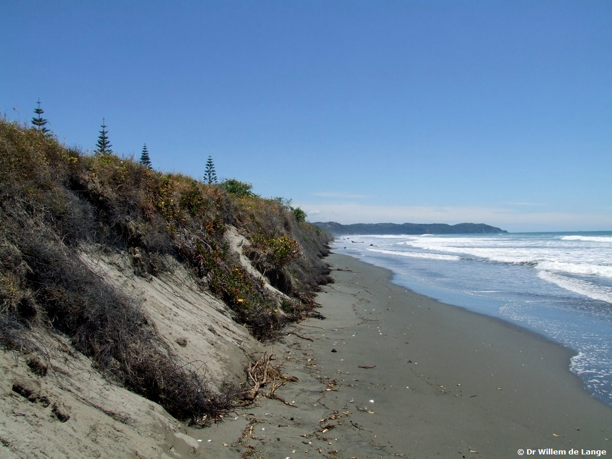
What is climate change?
What are the consequences?
© Dr William De Lange
© Copyright. University of Waikato. All Rights Reserved | www.sciencelearn.org.nz
All images are copyrighted. For further information, please refer to enquiries@sciencelearn.org.nz
Notes:
A good idea is to choose something that will connect to curiosity, starting with what the students know. For example, a relevant photo that will extend student thinking in the desired direction. Ask - What can you observe? www.sciencelearn.org.nz/images/105-erosion-of-sand-dunes

Slide 25
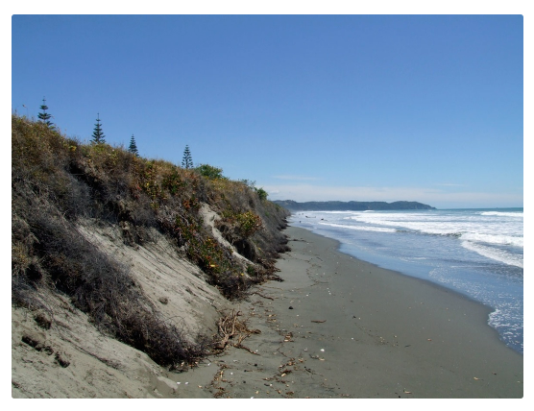
What can you observe? – some participants’ responses
A few trees
Tidal movements
No beach – sea level rising?
Motion of waves
Erosion
Sea level rising
Sand is moving
Steep sand dunes
Dune planting
Not a lot of space for the tide to come in
© Dr William De Lange
© Copyright. University of Waikato. All Rights Reserved | www.sciencelearn.org.nz
All images are copyrighted. For further information, please refer to enquiries@sciencelearn.org.nz
Notes:
www.sciencelearn.org.nz/images/105-erosion-of-sand-dunes

Slide 26
Using thinking hats to generate questions
How do you feel about this photo?
What are some solutions, possibilities or alternatives?
What could be the issues?
What has it made you think about?
What are some of the positive aspects?
What might be some of the dangers, threats or problems?
What are some of the facts and details?
What questions do you need answers to?
© Copyright. University of Waikato. All Rights Reserved | www.sciencelearn.org.nz
All images are copyrighted. For further information, please refer to enquiries@sciencelearn.org.nz
Notes:
Thinking hats are one of a wide variety of thinking tools that can support students to ‘interrogate’ what they observe and extend their thinking about the topic – what can they infer about what may have happened or what may soon happen? For example, effects of cyclones can be exacerbated – sea-level rise, cyclones and king tides already having an effect – many places in New Zealand already experiencing coastal erosion – if we can expect more of that, what future do we want to create?/ideas – technology and science developing solutions and alternatives, delayed effect. Focus on the importance of capacity building – hope and possibility, not all doom and gloom.

Slide 27
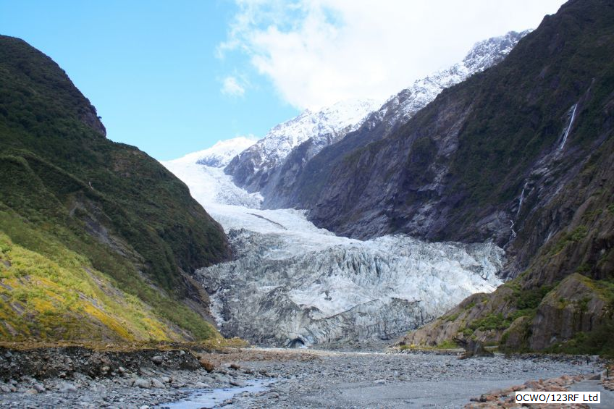
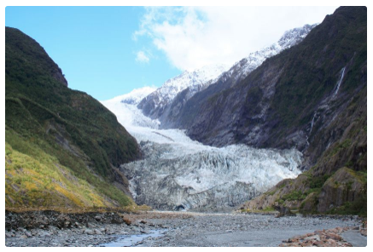
Exploring the science of sea-level rise
OCWO/123RF Ltd
© Copyright. University of Waikato. All Rights Reserved | www.sciencelearn.org.nz
All images are copyrighted. For further information, please refer to enquiries@sciencelearn.org.nz
Notes:
Another photo – what has it got to so with sea level rise or erosion – stimulating curiosity. www.sciencelearn.org.nz/images/801-franz-josef-glacier

Slide 28
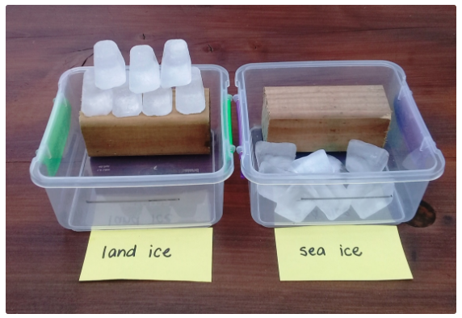
Exploring the science of sea-level rise
© Copyright. University of Waikato. All Rights Reserved | www.sciencelearn.org.nz
All images are copyrighted. For further information, please refer to enquiries@sciencelearn.org.nz
Notes:
Discuss the importance of data, critique, experience, misuse of data. www.sciencelearn.org.nz/images/2889-modelling-the-link-between-ice-melt-and-sea-level-rise

Slide 29
How do we know our students have learned?
Decide what we want to assess –
Specific science content knowledge?
Conceptual understanding?
Nature of science?
School-wide
focus and reporting
Engage with Science
Critique evidence
Interpret representations
Use evidence
Gather and interpret data
© Copyright. University of Waikato. All Rights Reserved | www.sciencelearn.org.nz
All images are copyrighted. For further information, please refer to enquiries@sciencelearn.org.nz

Slide 30
How do we know our students have learned?
Choose assessment method/s –
Allow for differentiation
Know your students needs and abilities
Use a variety of tasks eg. oral tasks
Open ended tasks
© Copyright. University of Waikato. All Rights Reserved | www.sciencelearn.org.nz
All images are copyrighted. For further information, please refer to enquiries@sciencelearn.org.nz

Slide 31
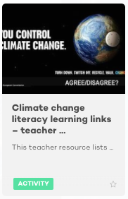
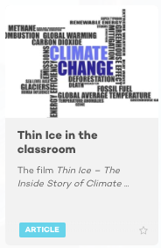
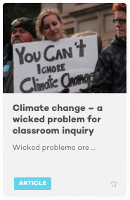
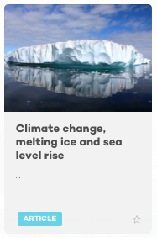
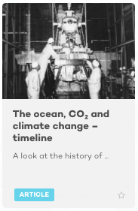
Some more SLH resources
© Massey University
© Copyright. University of Waikato. All Rights Reserved | www.sciencelearn.org.nz
All images are copyrighted. For further information, please refer to enquiries@sciencelearn.org.nz
Notes:
www.sciencelearn.org.nz/resources/2276-climate-change-literacy-learning-links-teacher-resource
www.sciencelearn.org.nz/resources/2233-thin-ice-in-the-classroom
www.sciencelearn.org.nz/resources/2229-climate-change-a-wicked-problem-for-classroom-inquiry
www.sciencelearn.org.nz/resources/2277-climate-change-melting-ice-and-sea-level-rise
www.sciencelearn.org.nz/resources/1862-the-ocean-co-and-climate-change-timeline

Slide 32
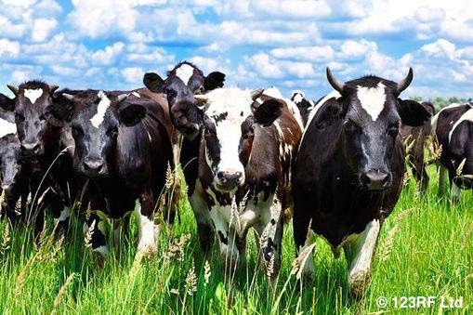
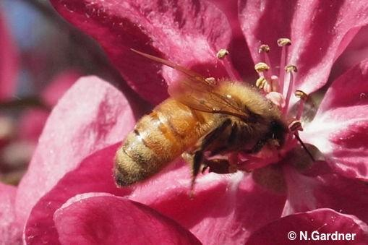
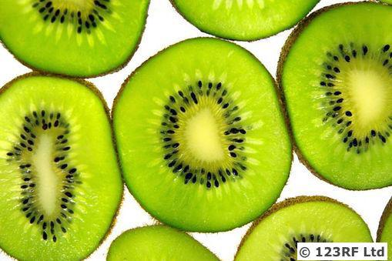
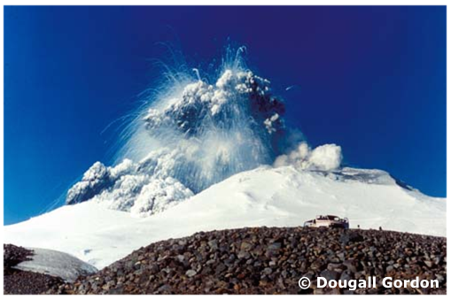
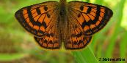
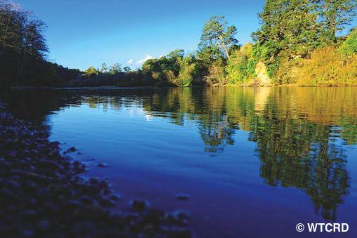
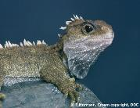
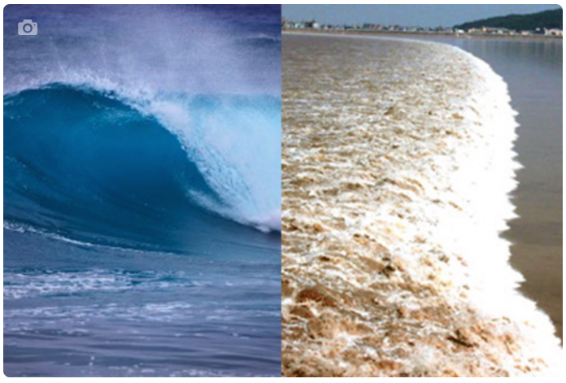
Thanks – want to keep in touch?
Email us on enquiries@sciencelearn.org.nz
https://twitter.com/NZScienceLearn
www.facebook.com/nzsciencelearn
https://nz.pinterest.com/nzsciencelearn
www.instagram.com/sciencelearninghubnz

