Slide 1

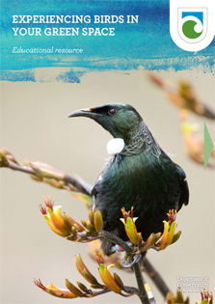
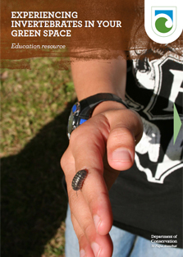
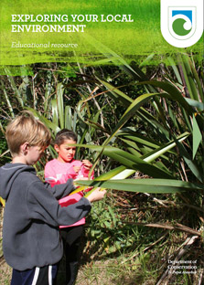
Eco-explorers
with
Greta Dromgool
and
Ben Moorhouse
3 May 2018
© Steve Hathaway
© Copyright. University of Waikato. All Rights Reserved | www.sciencelearn.org.nz
All images are copyrighted. For further information, please refer to enquiries@sciencelearn.org.nz
Notes:
Images: www.doc.govt.nz/pagefiles/163549/exploring-local-resources-223.jpg
www.doc.govt.nz/pagefiles/163237/experiencing-birds-223.jpg
www.doc.govt.nz/pagefiles/166044/experiencing-invertebrates-223.jpg

Slide 2
Index
Topic | PowerPoint slide number(s ) | Video timecode
Introducing the Science Learning Hub and presenters | 1 | 00:00
Index | 2–3 | 00:10
Purpose | 4 | 00:27
What is conservation education? | 5 | 01:06
Why conservation education? | 6-7 | 03:09
Curriculum links | 8 | 06:40
Connected topics and concepts | 9 | 08:42
Introducing DOC resources | 10–18 | 09:08
© Copyright. University of Waikato. All Rights Reserved | www.sciencelearn.org.nz
All images are copyrighted. For further information, please refer to enquiries@sciencelearn.org.nz

Slide 3
Index
Topic | PowerPoint slide number(s ) | Video timecode
Inquiry | 19–20 | 14:20
Health and safety | 21 | 17:01
Exploring your environment activities | 22–24 | 18:57
Experiencing birds and invertebrates activities | 25–30 | 24:50
Citizen science links | 31 | 33:32
DOC and SLH links, thanks | 32-33 | 36:13
© Copyright. University of Waikato. All Rights Reserved | www.sciencelearn.org.nz
All images are copyrighted. For further information, please refer to enquiries@sciencelearn.org.nz

Slide 4
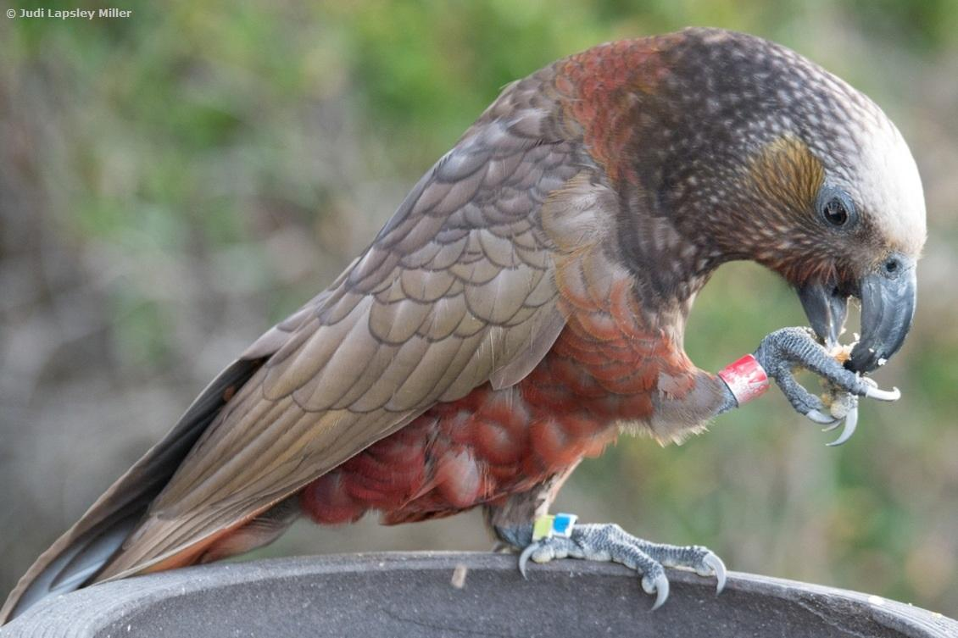
Purpose
To support you to enhance your students’ understanding about conservation education
We will:
introduce DOC resources
share engaging activities
model an inquiry approach
facilitate discussion about the opportunities and challenges of working in the environment.
© Copyright. University of Waikato. All Rights Reserved | www.sciencelearn.org.nz
All images are copyrighted. For further information, please refer to enquiries@sciencelearn.org.nz
Notes:
Image: www.sciencelearn.org.nz/images/1313-a-banded-kaka

Slide 5
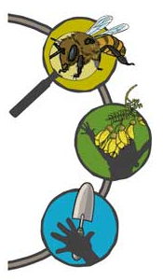
What is conservation education?
Education ABOUT the environment – developing knowledge and skills
Education IN the environment – connecting to nature and place
Education FOR the environment –
taking action to restore, grow and protect
© Copyright. University of Waikato. All Rights Reserved | www.sciencelearn.org.nz
All images are copyrighted. For further information, please refer to enquiries@sciencelearn.org.nz
Notes:
Conservation education provides authentic opportunities for learning and gives schools an opportunity to connect with their local community in a meaningful way. It’s about providing your students with a real-life context on which to base their learning and an opportunity to apply their learning to authentic local community opportunities. DOC sees conservation education as a component of the larger umbrella that is environmental education or education for sustainability. It integrates three dimensions of learning.
Postcast on Conservation education: www.sciencelearn.org.nz/videos/1812-snippets-about-conservation-education
Image: www.doc.govt.nz/pagefiles/58827/about-in-for-icon-2.jpg

Slide 6
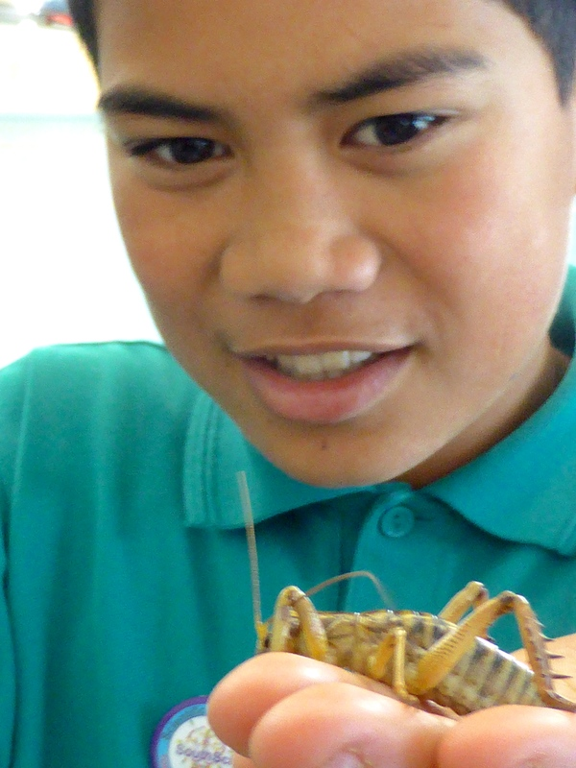
He nohonga ngātahitanga ahau me te taiāo.
We live as one with our natural world.
Why conservation education?
Dawson Primary School
© Copyright. University of Waikato. All Rights Reserved | www.sciencelearn.org.nz
All images are copyrighted. For further information, please refer to enquiries@sciencelearn.org.nz
Notes:
DOC to touch on DOC perspective of importance of conservation education – big picture ideas
For life to survive and thrive on Earth, we need to understand that we are all part of one natural world.
Without fresh air, water, seas, fertile soils, forests, animals and plants, we humans couldn’t survive.
Everything, even the tiniest of bugs, has a role to play, and that includes us.
You are part of your local environment. You, your school and your neighbourhood are all part of a bigger ecosystem. Everything is connected – from the deepest ocean to outer space – and what we do does make a difference.
5 big picture values, and 4 big picture ideas are integrated into conservation education. These are drawn from the Māori perspective of the natural world. These could be used as a starting point to explore your own ideas and values about the natural world.
www.doc.govt.nz/get-involved/conservation-education/what-is-conservation-education/#big-picture
Timing: 2 min
Image: www.sciencelearn.org.nz/images/2436-up-close-with-a-weta

Slide 7
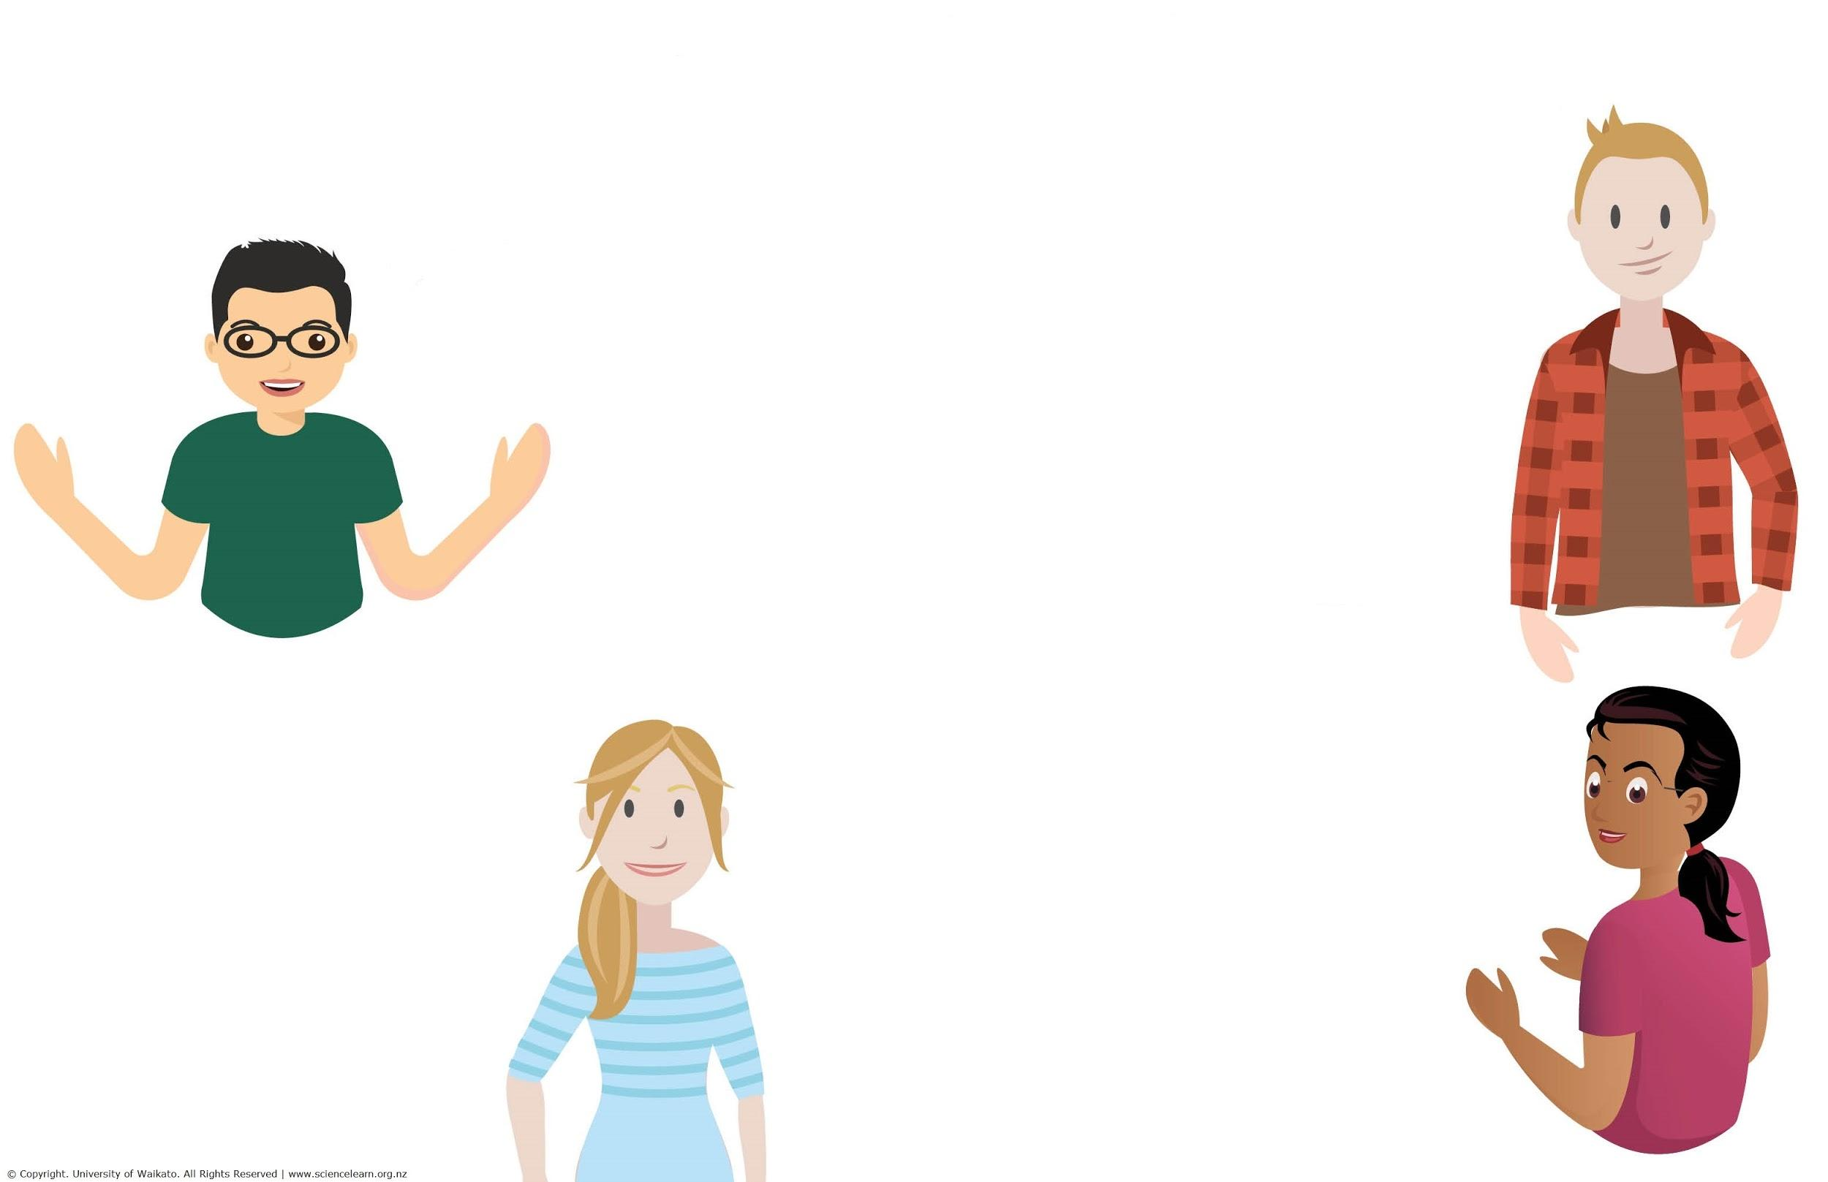
Why conservation education?
Some participants ideas:
Making connections and being connected
Contextual learning
Kaitiakitanga, taking care
of the environment
Getting outside and getting dirty
Being aware about what’s outside
Ko au ko te taiao, ko te taiao ko au, I am the environment, the environment is me
Perspectives
Authentic, thinking about our roles and responsibilities
© Copyright. University of Waikato. All Rights Reserved | www.sciencelearn.org.nz
All images are copyrighted. For further information, please refer to enquiries@sciencelearn.org.nz
Notes:
Thank you to everyone who contributed their ideas.

Slide 8

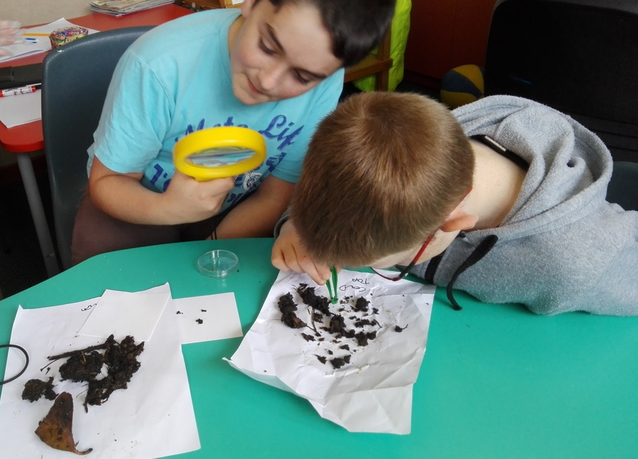
Curriculum
Connections
Whole-school inquiries, LEOTC experiences, science fairs
Values and key competencies
Science:
Nature of Science
Science Capabilities
Living World Strand
Literacy and numeracy, technology, social sciences ...
Stratford Primary School
© Copyright. University of Waikato. All Rights Reserved | www.sciencelearn.org.nz
All images are copyrighted. For further information, please refer to enquiries@sciencelearn.org.nz
Notes:
Conservation education connects to and supports learning in many other areas. Look for cross-curricular synergies.
Whole-school inquiries focused on overarching concepts such as connectedness work really well with conservation education
Image: www.sciencelearn.org.nz/images/3023-capow-students-investigating-what-is-in-soil

Slide 9
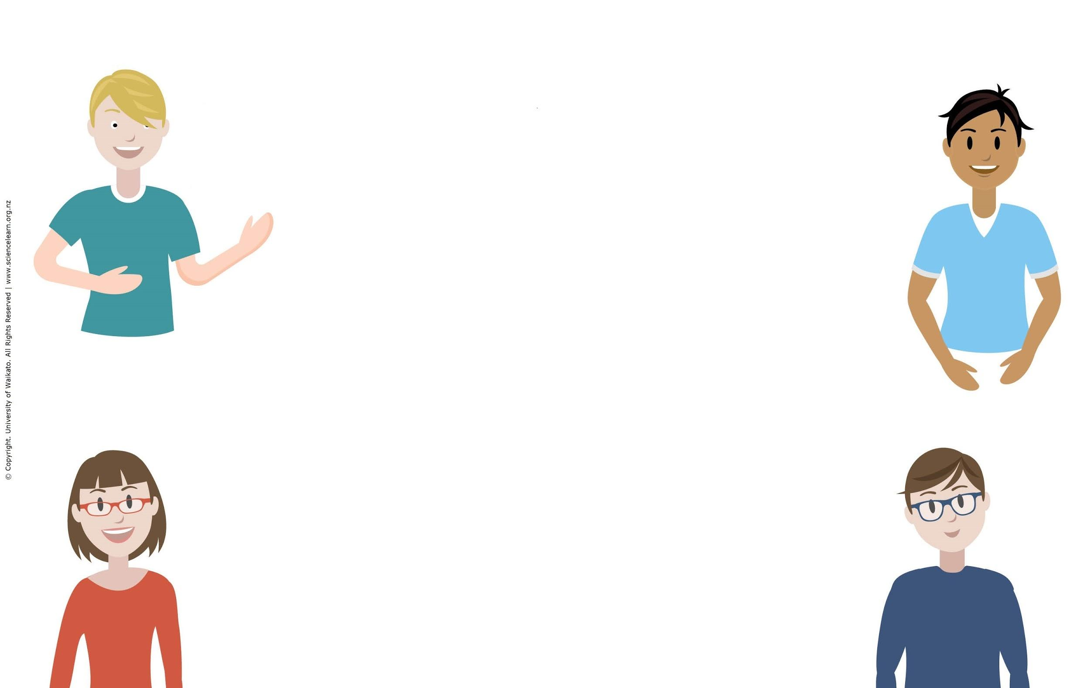
Connected science topics and concepts
Some participants ideas:
Ecology, ecosystems, biodiversity, adaptations and evolution
Sustainable energy, farming, pest control, using quadrats and data collection
Water quality, the water cycle and water care
Mātauranga Māori, native birds and plants and stream health
© Copyright. University of Waikato. All Rights Reserved | www.sciencelearn.org.nz
All images are copyrighted. For further information, please refer to enquiries@sciencelearn.org.nz
Notes:
Thank you to everyone who contributed their ideas.

Slide 10
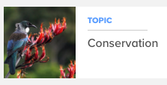
DOC resources
To enable students to learn about, connect to and make a difference in their local environment.
Science Learning Hub resources
Concepts and topics: biodiversity, ecosystems, native species
PLD: webinars,
planning,
pedagogy
Add Links
© Copyright. University of Waikato. All Rights Reserved | www.sciencelearn.org.nz
All images are copyrighted. For further information, please refer to enquiries@sciencelearn.org.nz
Notes:
This resource introduces key concepts and includes activities to help identify a local green space and begin to explore and connect to it.
Using this resource, students will:
appreciate that people are part of the natural world
build knowledge and understanding of ecosystems
begin to investigate what is living in a green space
begin to understand how birds, invertebrates and other native and endemic animals are part of a healthy ecosystem.
www.doc.govt.nz/get-involved/conservation-education/resources/exploring-your-local-environment
Using this resource, students can start to form an inquiry plan for your green space. We will look at this in depth a bit later in the webinar.
Image: Tui on flax, www.sciencelearn.org.nz/images/203-tui

Slide 11
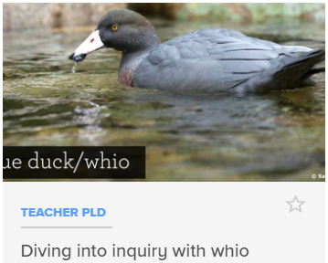
DOC resources
To enable students to learn about, connect to and make a difference in their local environment.
Science Learning Hub resources
Concepts and topics: biodiversity, ecosystems, native species
PLD: webinars,
planning,
pedagogy
Add Links
© Copyright. University of Waikato. All Rights Reserved | www.sciencelearn.org.nz
All images are copyrighted. For further information, please refer to enquiries@sciencelearn.org.nz
Notes:
Image: Whio, www.sciencelearn.org.nz/images/2744-whio-forever-education-resource

Slide 12
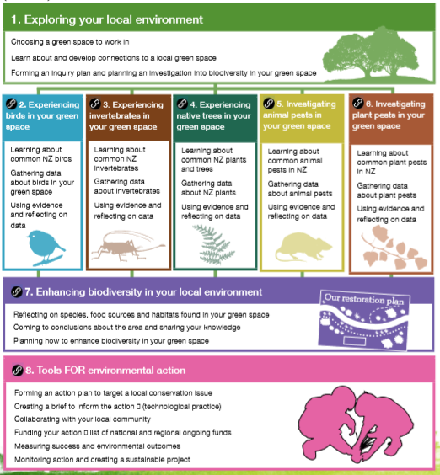
© Copyright. University of Waikato. All Rights Reserved | www.sciencelearn.org.nz
All images are copyrighted. For further information, please refer to enquiries@sciencelearn.org.nz
Notes:
The resource series encourages students throughout New Zealand to go outdoors, explore and connect to a local environment.
The resources can be used for stand-alone authentic learning experiences to a comprehensive integrated inquiry unit. We’ve designed the series so that each resource can be used by itself or joined together to create a unit of work.
Resources 1–6 are focussed on curriculum-based learning and inquiry as well as EOTC and participating in citizen science projects (e.g. the Garden Bird Survey). Resource 7 supports understanding connections within your green space and developing a restoration plan. This leads on to taking action for the environment (resource 8).
We encourage teachers to adapt and use ideas from these resources to suit students’ needs, inquiries and interests.

Slide 13
DOC resources
© Copyright. University of Waikato. All Rights Reserved | www.sciencelearn.org.nz
All images are copyrighted. For further information, please refer to enquiries@sciencelearn.org.nz
Notes:
Introduce Experiencing Birds in Your Green Space and Experiencing Invertebrates in Your Green Space
Web links to resources
www.doc.govt.nz/education-experiencingbirds
www.doc.govt.nz/education-experiencinginvertebrates

Slide 14
© Copyright. University of Waikato. All Rights Reserved | www.sciencelearn.org.nz
All images are copyrighted. For further information, please refer to enquiries@sciencelearn.org.nz

Slide 15
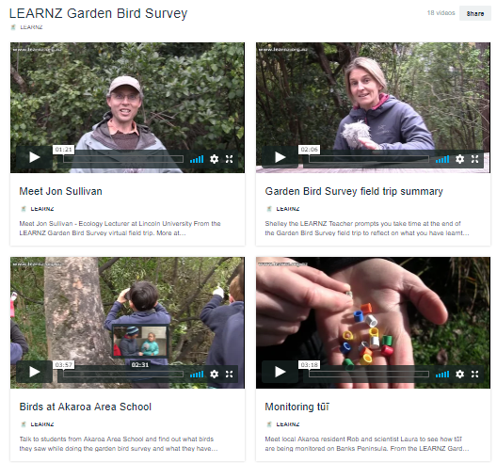
DOC resources
www.landcareresearch.co.nz/science/plants-animals-fungi/animals/birds/garden-bird-surveys
© Copyright. University of Waikato. All Rights Reserved | www.sciencelearn.org.nz
All images are copyrighted. For further information, please refer to enquiries@sciencelearn.org.nz
Notes:
Bird resource created with Landcare Research.
Garden Bird Survey: www.landcareresearch.co.nz/science/plants-animals-fungi/animals/birds/garden-bird-surveys

Slide 16
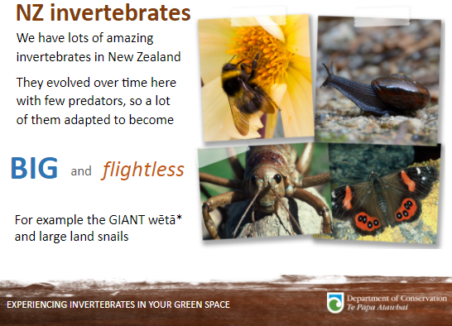
DOC resources
© Copyright. University of Waikato. All Rights Reserved | www.sciencelearn.org.nz
All images are copyrighted. For further information, please refer to enquiries@sciencelearn.org.nz
Notes:
PowerPoints available for NZ invertebrates- scroll down to find downloadable presentation: www.doc.govt.nz/get-involved/conservation-education/resources/experiencing-invertebrates-in-your-green-space/

Slide 17
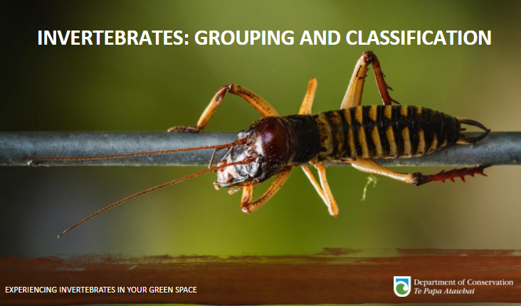
DOC resources
© Copyright. University of Waikato. All Rights Reserved | www.sciencelearn.org.nz
All images are copyrighted. For further information, please refer to enquiries@sciencelearn.org.nz
Notes:
PowerPoints available for invertebrate classification- scroll down to find downloadable presentation: www.doc.govt.nz/get-involved/conservation-education/resources/experiencing-invertebrates-in-your-green-space

Slide 18
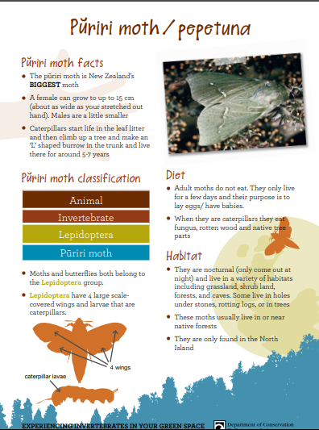
DOC resources
© Copyright. University of Waikato. All Rights Reserved | www.sciencelearn.org.nz
All images are copyrighted. For further information, please refer to enquiries@sciencelearn.org.nz
Notes:
Factsheets available for invertebrates
Teacher question: Basic learning about flora and fauna (see next webinar for flora)
Timing: 30 secs

Slide 19
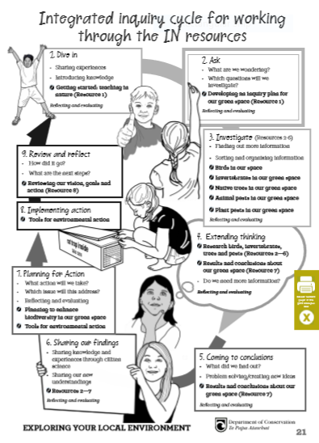
© Copyright. University of Waikato. All Rights Reserved | www.sciencelearn.org.nz
All images are copyrighted. For further information, please refer to enquiries@sciencelearn.org.nz
Notes:
Factsheets available for invertebrates- scroll down to find downloadable presentation: www.doc.govt.nz/get-involved/conservation-education/resources/experiencing-invertebrates-in-your-green-space

Slide 20
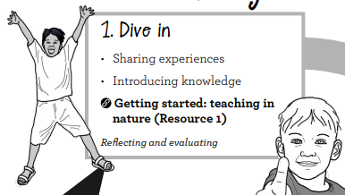
© Copyright. University of Waikato. All Rights Reserved | www.sciencelearn.org.nz
All images are copyrighted. For further information, please refer to enquiries@sciencelearn.org.nz

Slide 21
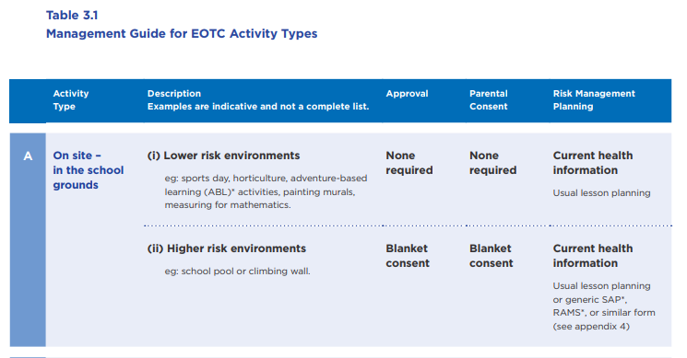

Getting started: health and safety
Involve students
EOTC Guidelines: Bringing the curriculum alive (2016)
© Copyright. University of Waikato. All Rights Reserved | www.sciencelearn.org.nz
All images are copyrighted. For further information, please refer to enquiries@sciencelearn.org.nz
Notes:
Before we dive in, let’s check the depth!
Support on page 8 of Exploring your local environment, includes how you might involve students: www.doc.govt.nz/get-involved/conservation-education/what-is-conservation-education/integrated-inquiry-learning-cycle/
EOTC Guidelines: http://eotc.tki.org.nz/EOTC-home/EOTC-Guidelines

Slide 22
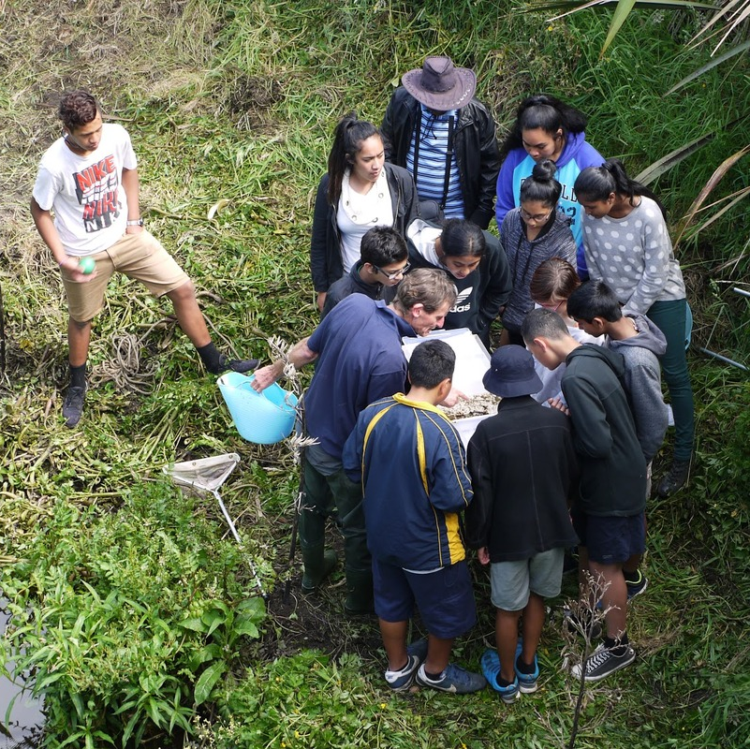
Getting started: teaching in nature
Identifying a green space
Connecting to a green space
Near, there and far
Museum of nature
Photo story
Sarah Morgan, Comet Auckland
© Copyright. University of Waikato. All Rights Reserved | www.sciencelearn.org.nz
All images are copyrighted. For further information, please refer to enquiries@sciencelearn.org.nz
Notes:
What is a green space, what might this look like in schools?
An open space containing grass, plants, animals, trees and/or forest. They are great potential habitats for endemic and native animals. Examples include school grounds, gardens, local parks or reserves.
Exploring your local environment: www.doc.govt.nz/get-involved/conservation-education/resources/exploring-your-local-environment/
Image: Students at stream: www.sciencelearn.org.nz/images/2099-species-count-at-city-stream

Slide 23
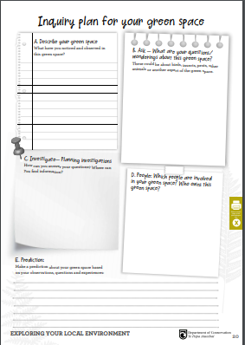
Getting started
An inquiry plan for your green space
© Copyright. University of Waikato. All Rights Reserved | www.sciencelearn.org.nz
All images are copyrighted. For further information, please refer to enquiries@sciencelearn.org.nz
Notes:
After completing the introductory learning experiences in the Exploring Your Local Environment resource, students could draw and/or write about their initial observations/findings in A) Describe your green space.
Then record questions that have come to mind in B) Ask – use these questions to form the inquiry plan. Ensure these questions are open and require thought and research to answer.
Groups of students or individuals could investigate a question, or a whole class could work towards answering a question.
In C) Investigate, record how it might be possible to find answers to inquiry questions.
Look into which groups of people might use or have a say in the green space you have identified. Record this in D) People. Ensure you have the support of everyone involved before you start your investigations.
Students could make a prediction about your green space based on initial observations, experiences and questions.
Keep referring to and adding to this plan as learning progresses.
Exploring your local environment: www.doc.govt.nz/get-involved/conservation-education/resources/exploring-your-local-environment/

Slide 24
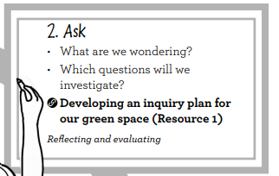
© Copyright. University of Waikato. All Rights Reserved | www.sciencelearn.org.nz
All images are copyrighted. For further information, please refer to enquiries@sciencelearn.org.nz

Slide 25
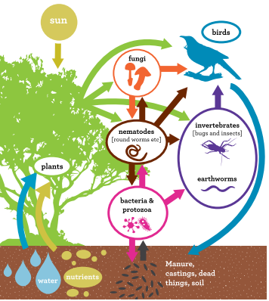
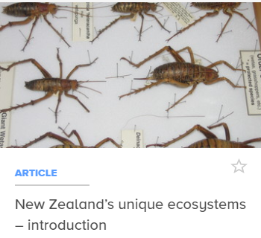
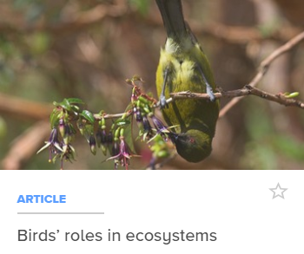
Experiencing birds and invertebrates
Why are they important?
Supporting SLH resources:
© Copyright. University of Waikato. All Rights Reserved | www.sciencelearn.org.nz
All images are copyrighted. For further information, please refer to enquiries@sciencelearn.org.nz
Notes:
Lots of supporting Science Learning Hub resources.
For example:
www.sciencelearn.org.nz/topics/conservation, www.sciencelearn.org.nz/resources/1163-birds-roles-in-ecosystems, www.sciencelearn.org.nz/resources/1762-new-zealand-s-unique-ecosystems-introduction
Images:
Wētā: www.sciencelearn.org.nz/images/1732-weta
Bellbird: www.sciencelearn.org.nz/images/1328-male-bellbird-feeding

Slide 26
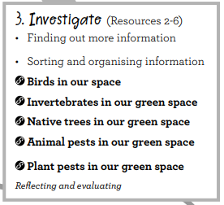
© Copyright. University of Waikato. All Rights Reserved | www.sciencelearn.org.nz
All images are copyrighted. For further information, please refer to enquiries@sciencelearn.org.nz

Slide 27
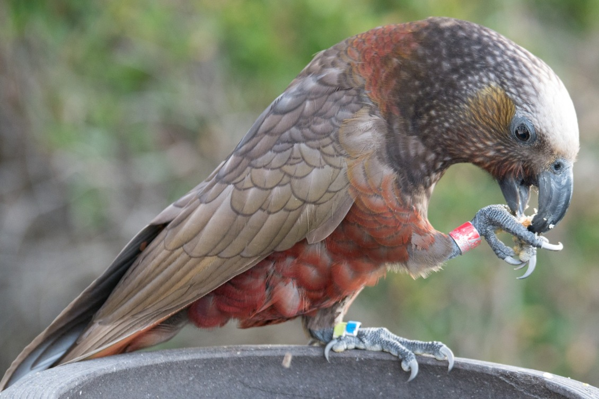
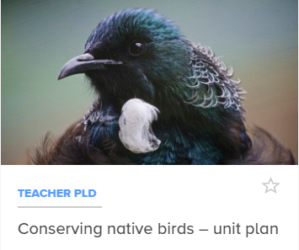
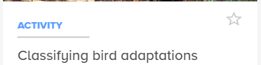
Experiencing birds
My experiences of birds
Bird brained
Bird watching
Which birds have been here?
Sensing birds
Review green space inquiry
Thinking about birds
Supporting SLH resources:
PLD: Unit plan and literacy
© Copyright. University of Waikato. All Rights Reserved | www.sciencelearn.org.nz
All images are copyrighted. For further information, please refer to enquiries@sciencelearn.org.nz
Notes:
Experiencing birds in your green space: www.doc.govt.nz/get-involved/conservation-education/resources/experiencing-birds-in-your-green-space/
Science Learning Hub resources: www.sciencelearn.org.nz/resources/1174-conserving-native-birds-unit-plan
www.sciencelearn.org.nz/resources/1169-classifying-bird-adaptations
Images:
Tui: www.sciencelearn.org.nz/images/1316-the-tui
Kiwi: www.sciencelearn.org.nz/images/1313-a-banded-kaka

Slide 28
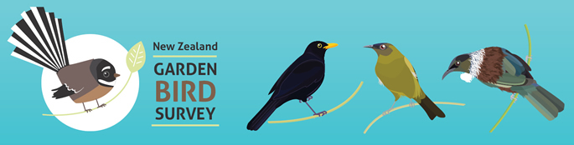
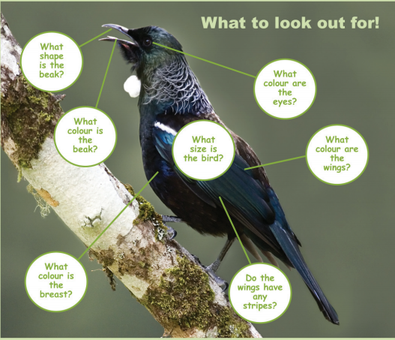
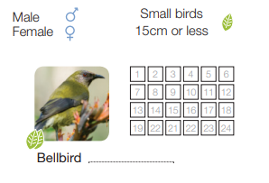
This year’s survey: 30 June to 8 July 2018
Guide and tally sheet available: Garden Bird Survey
© Copyright. University of Waikato. All Rights Reserved | www.sciencelearn.org.nz
All images are copyrighted. For further information, please refer to enquiries@sciencelearn.org.nz
Notes:
The survey can be done by anyone, individually or in small groups. In 2018, the official survey is from 30 June to 8 July. If you are planning on doing the survey during this week, you can upload your findings to the Landcare Research website.
However, the survey can be done at any time – there is a data collection sheet in the Experiencing Birds resource.
The official survey requires you to observe birds for 1 hour and record the highest number of each species seen at any one time.
For younger students, this could be broken up into four observation sessions of 15 minutes or six sessions of 10 minutes.
Another option is to break the hour session into six parts and have six pairs of students each do 10 minutes of the hour, one after the other, all recording on the same sheet.
See the Experiencing Birds resource for more guidance, and there are some great ‘how to’ videos on the Landcare Research website too.
www.landcareresearch.co.nz/__data/assets/image/0005/99806/GBS-homepage-685.jpg

Slide 29
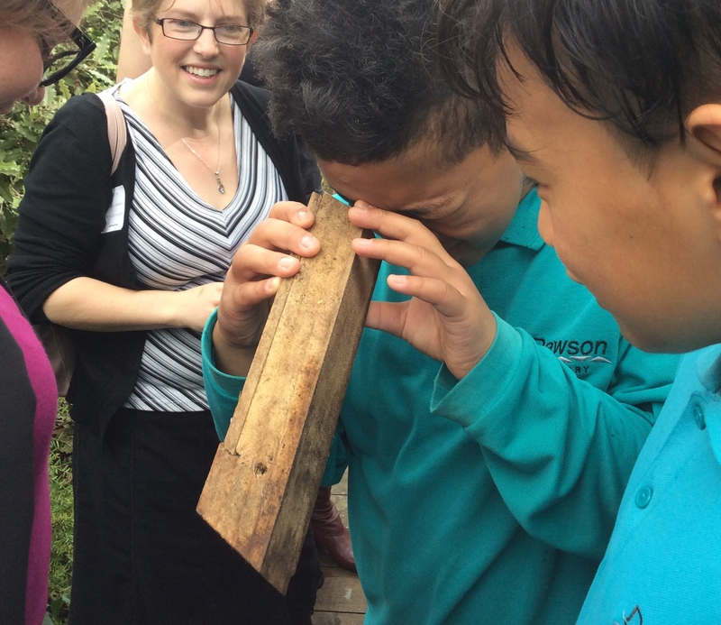
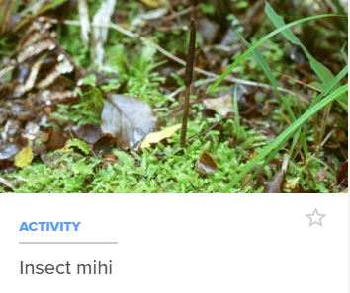
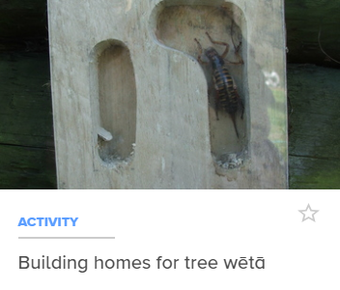
Experiencing invertebrates
Invertebrate scavenger hunt
Inside a compost bin
Insect senses
Grouping invertebrates
Gathering data
Supporting SLH resources:
Insect activities
Dawson Primary School
© Copyright. University of Waikato. All Rights Reserved | www.sciencelearn.org.nz
All images are copyrighted. For further information, please refer to enquiries@sciencelearn.org.nz
Notes:
Experiencing invertebrates in your green space: www.doc.govt.nz/get-involved/conservation-education/resources/experiencing-invertebrates-in-your-green-space
Science Learning Hub resources: www.sciencelearn.org.nz/resources/1447-insect-mihi, https://www.sciencelearn.org.nz/resources/1964-building-homes-for-tree-weta
Images
Looking in a Weta motel: www.sciencelearn.org.nz/images/2437-what-s-living-in-the-weta-motel
Fungi: www.sciencelearn.org.nz/images/1736-vegetable-caterpillar-fungus-growing
Weta motel: www.sciencelearn.org.nz/images/2439-weta-motel

Slide 30
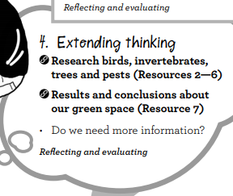
© Copyright. University of Waikato. All Rights Reserved | www.sciencelearn.org.nz
All images are copyrighted. For further information, please refer to enquiries@sciencelearn.org.nz
Notes:
Going further, an opportunity to evaluate learning (student driven).

Slide 31
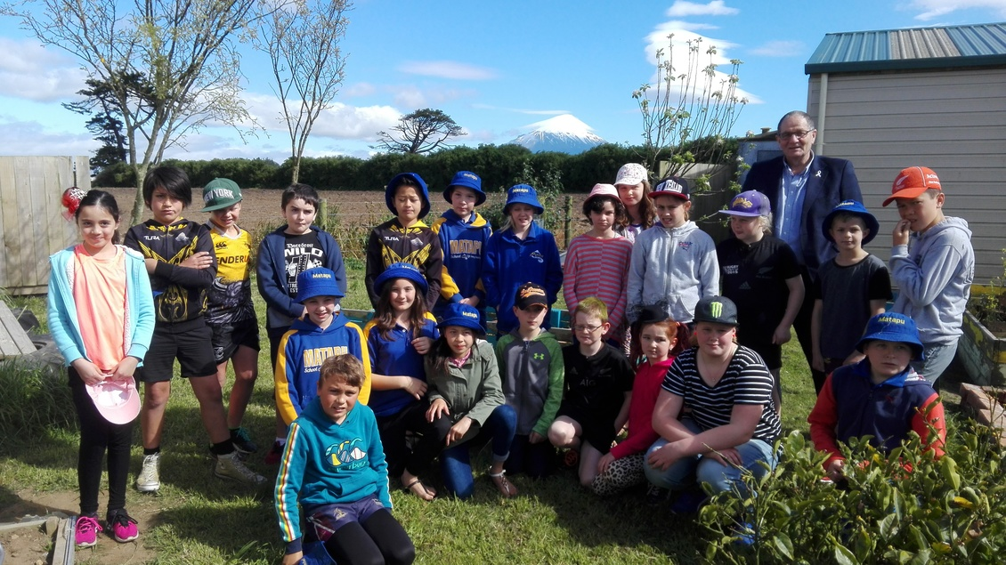
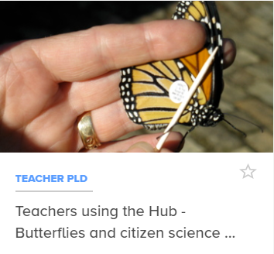
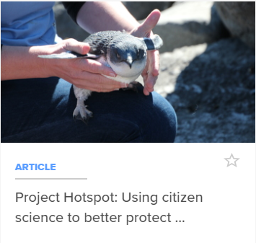
Citizen science
Opportunities to share knowledge and data
S.Smart
Stratford Primary School
© Copyright. University of Waikato. All Rights Reserved | www.sciencelearn.org.nz
All images are copyrighted. For further information, please refer to enquiries@sciencelearn.org.nz
Notes:
Science Learning Hub resources: www.sciencelearn.org.nz/concepts/citizen-science
Useful links:
www.doc.govt.nz/get-involved/
www.landcare.org.nz/files/file/2023/Inventory%20of%20Citizen%20Science.pdf
http://naturewatch.org.nz/
Images
Butterfly: www.sciencelearn.org.nz/images/549-tagged-butterfly
Penguin: www.sciencelearn.org.nz/images/1945-blue-penguin
Students: www.sciencelearn.org.nz/images/3025-capow-students-from-matapu-school

Slide 32
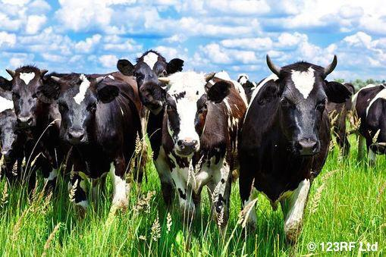
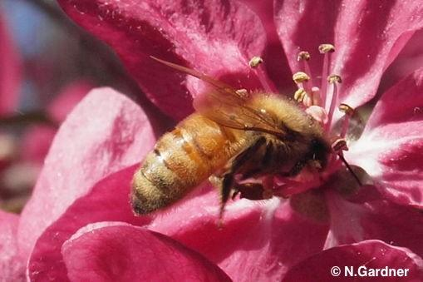
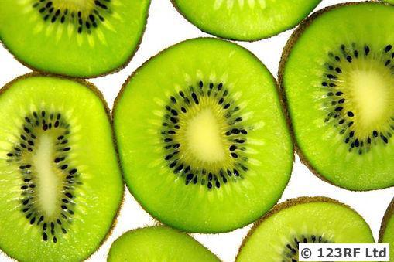
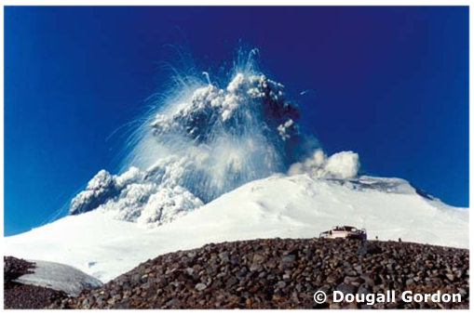
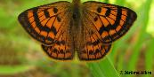
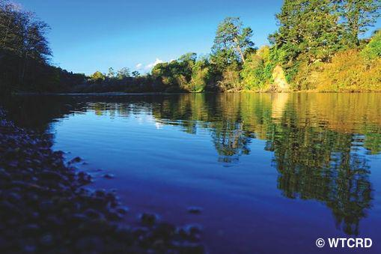
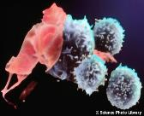
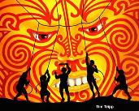
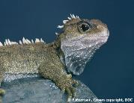
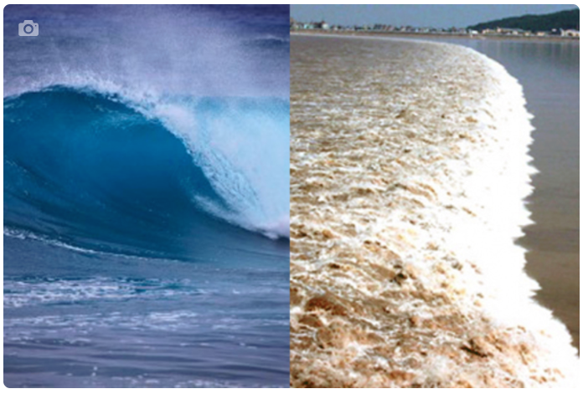
Thanks – keep in touch
Department of Conservation
www.doc.govt.nz/education
Contact us on conserved@doc.govt.nz
e-newsletter www.doc.govt.nz/news/newsletters/conservation-education/
POND page www.pond.co.nz/community/721642/department-of-conservation/1
Notes:
Want to continue the conversation? Lots of opportunities to keep in touch.

Slide 33

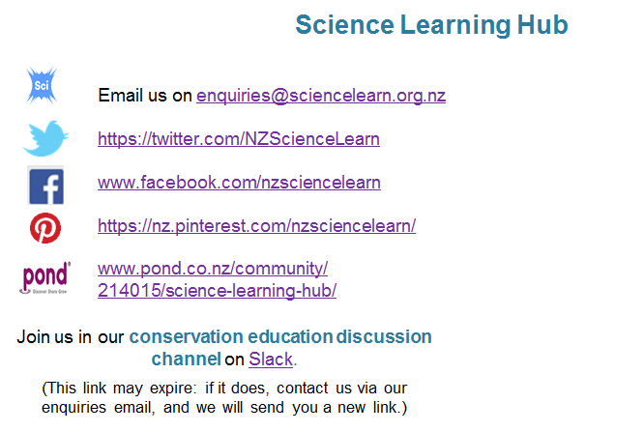


Thanks – keep in touch
Science Learning Hub
Contact us if you would like bookmarks, a collection curated or to connect to a scientist.
Notes:
Want to continue the conversation? Lots of opportunities to keep in touch.

