Slide 1

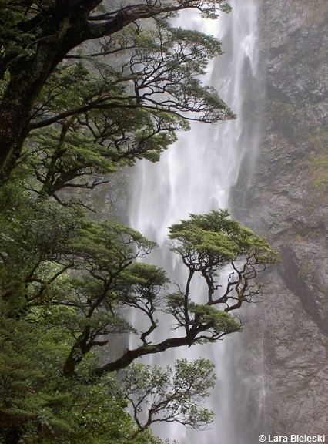
Our native trees
Lyn Rogers (SLH)
and
Ben Moorhouse (DOC)
Thursday 17 May 2018
© Copyright. University of Waikato. All Rights Reserved | www.sciencelearn.org.nz
All images are copyrighted. For further information, please refer to enquiries@sciencelearn.org.nz
Notes:
Image from www.sciencelearn.org.nz/images/1765-beech-trees

Slide 2
Index
Topic | PowerPoint slide number(s) | Video timecode
Introducing the Science Learning Hub and presenters, index | 1–3 | 00:00
Purpose | 4 | 00:39
What is a tree? | 5–7 | 01:03
Identifying native trees – classification | 8–9 | 02:57
Identifying native trees – observation | 10–12 | 06:43
Why are native trees important? | 13–15 | 13:50
Department of Conservation resources | 16–18 | 15:33
What is special about New Zealand trees? | 19 | 22:00
© Copyright. University of Waikato. All Rights Reserved | www.sciencelearn.org.nz
All images are copyrighted. For further information, please refer to enquiries@sciencelearn.org.nz

Slide 3
Index
Topic | PowerPoint slide number(s) | Video timecode
Podocarp forests | 20 | 24:18
Co-evolution, whakapapa and interdependence | 21 | 27:27
Local speciation | 22 | 28:45
Special adaptations | 23 | 30:38
Opportunities for connecting with native trees | 24 | 31:55
What next? | 25 | 35:18
DOC and SLH links, thanks | 26–27 | 37:25
© Copyright. University of Waikato. All Rights Reserved | www.sciencelearn.org.nz
All images are copyrighted. For further information, please refer to enquiries@sciencelearn.org.nz

Slide 4
Our native trees
In this webinar, we will
explore some readily available resources and simple science activities that will inspire you to incorporate native trees into your Living World contexts
discuss how engaging in science inquiries can support learning across the curriculum and can be easily adapted to any level.
© Steve Hathaway
© Copyright. University of Waikato. All Rights Reserved | www.sciencelearn.org.nz
All images are copyrighted. For further information, please refer to enquiries@sciencelearn.org.nz
Notes:
Image from www.sciencelearn.org.nz/images/1765-beech-trees

Slide 5
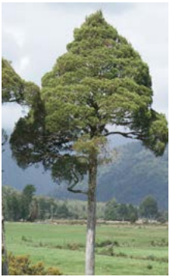
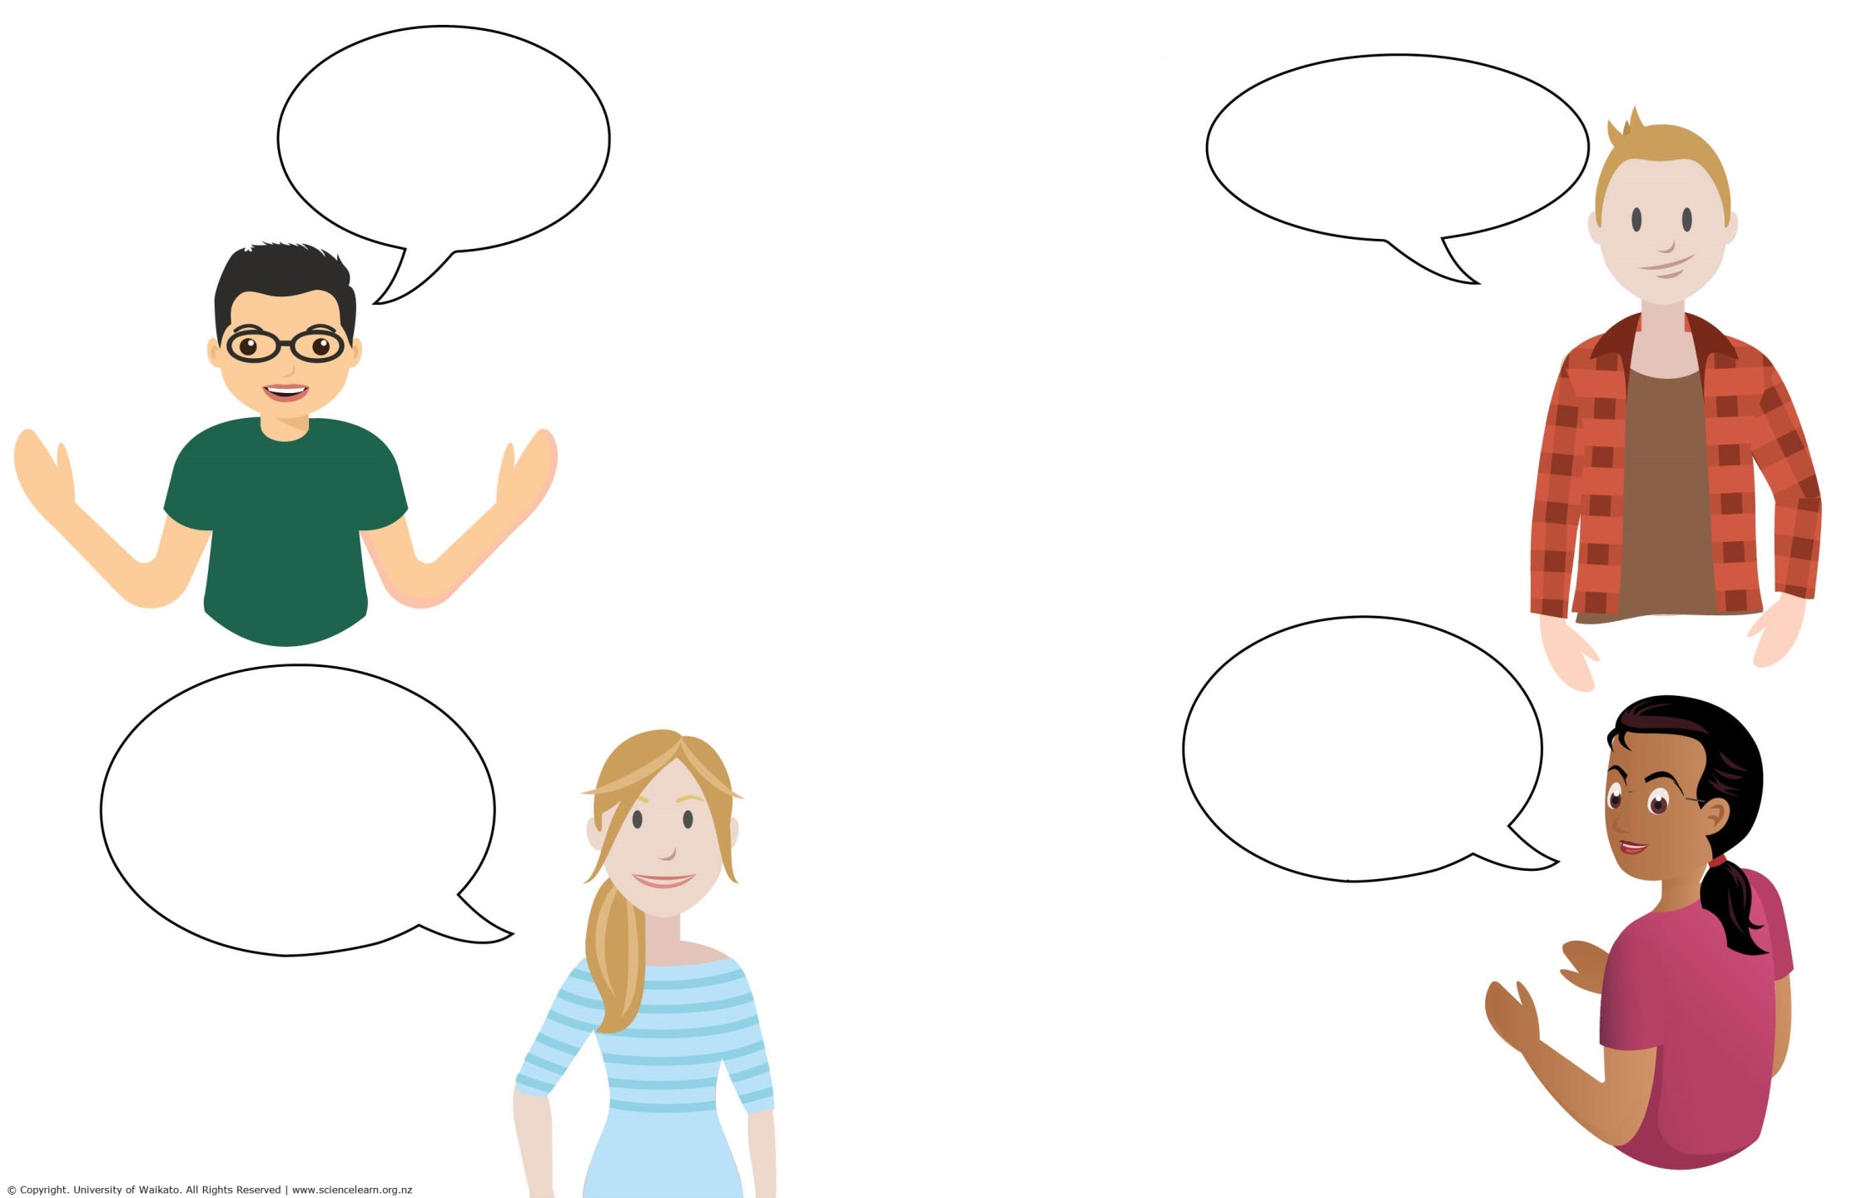
What is a tree?
© Copyright. University of Waikato. All Rights Reserved | www.sciencelearn.org.nz
All images are copyrighted. For further information, please refer to enquiries@sciencelearn.org.nz
Notes:
Images - www.doc.govt.nz/Documents/getting-involved/students-and-teachers/experiencing-native-trees-in-your-green-space.pdf pg 10 and www.sciencelearn.org.nz/resources/2567-using-concept-cartoons-to-explore-students-scientific-thinking

Slide 6
What is a tree? –
webinar participant’s prior knowledge
A tree makes
their own food
They are larger
than a bush
Trees provide
habitats
Oxygen-producing
plants
A woody plant
Trees have bark
Has a trunk
Trees are big
A large plant with a trunk and branches
© Copyright. University of Waikato. All Rights Reserved | www.sciencelearn.org.nz
All images are copyrighted. For further information, please refer to enquiries@sciencelearn.org.nz
Notes:
Images - www.doc.govt.nz/Documents/getting-involved/students-and-teachers/experiencing-native-trees-in-your-green-space.pdf pg 10

Slide 7
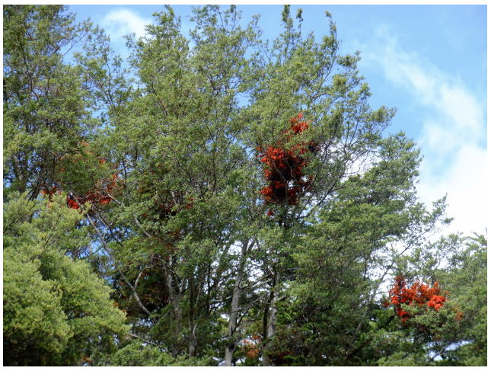
What is a tree?
A tree is a perennial plant, typically having a permanently woody stem or trunk, usually growing to a considerable height and usually bearing lateral branches at some distance from the ground, with a crowned form of foliage.
A shrub is a woody plant with several perennial stems, usually shorter than 4 m.
©Thefunkysockgirl
So … when we talk New Zealand trees, we are including shrubs too!
© Copyright. University of Waikato. All Rights Reserved | www.sciencelearn.org.nz
All images are copyrighted. For further information, please refer to enquiries@sciencelearn.org.nz
Notes:
Image - www.sciencelearn.org.nz/resources/74-mistletoes-and-mutualism

Slide 8
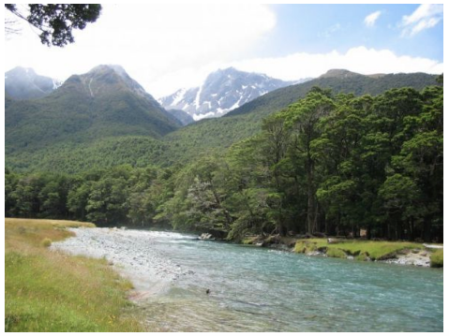
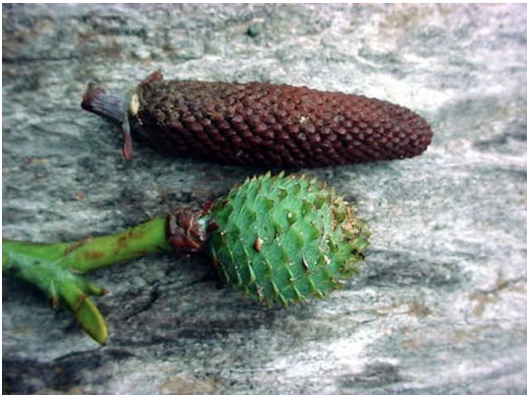
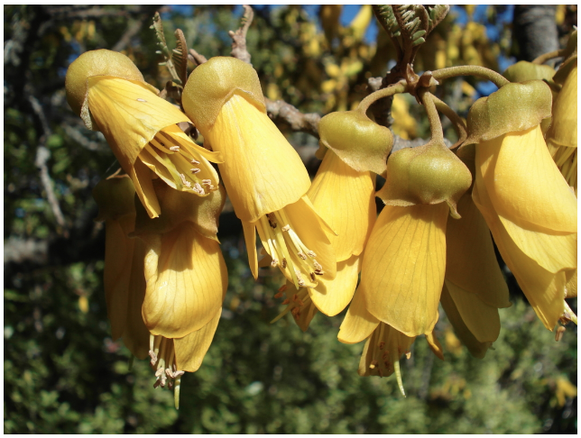
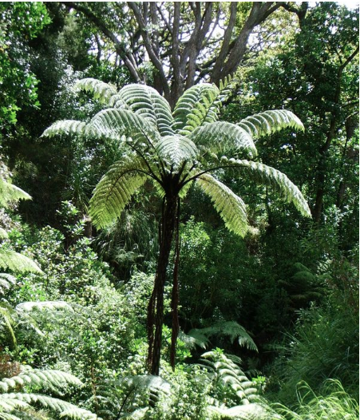
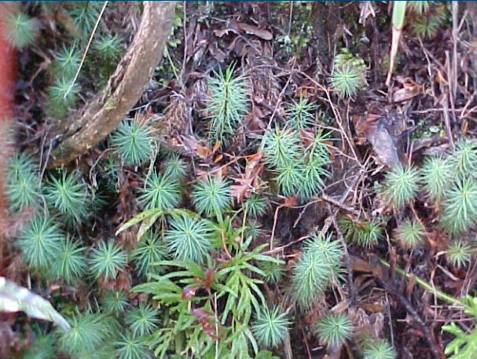
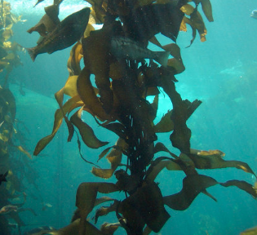
Identifying native trees
Trees are all plants but are not actually a scientific group of their own. Plants come in five different groups, and trees are found in three of them.
Cone-bearing plants
Flowering plants
Spore-bearing plants e.g. ferns
All plants
Non-vascular plants e.g. mosses
Algae
© Copyright. University of Waikato. All Rights Reserved | www.sciencelearn.org.nz
All images are copyrighted. For further information, please refer to enquiries@sciencelearn.org.nz

Slide 9
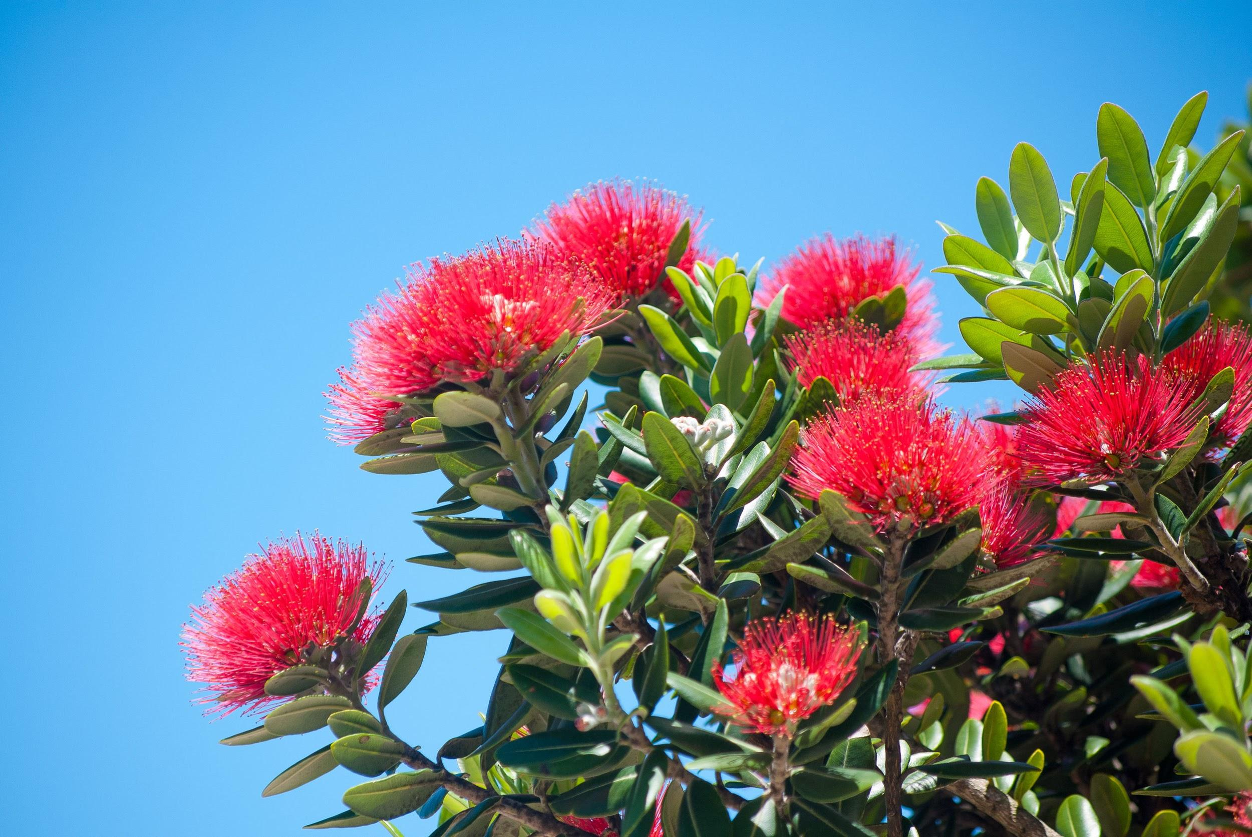
Naming native trees
  Plants
Kingdom
  Flowering plants
  (Angiosperms)
Phylum
  Eudicots and Rosids
Class
  Myrtales
V.Boussenko/123RF Ltd
Order
Common and Māori name: Pōhutukawa -
Metrosideros excelsa.
A close relative is the Northern rātā – Metrosideros robusta.
Examples of more distant relatives are others in the Myrtle family – mānuka, ramarama, etc.
  Myrtaceae (Myrtles)
Family
  Metrosideros
Genus
  excelsa
Species
© Copyright. University of Waikato. All Rights Reserved | www.sciencelearn.org.nz
All images are copyrighted. For further information, please refer to enquiries@sciencelearn.org.nz

Slide 10
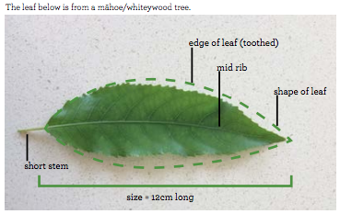
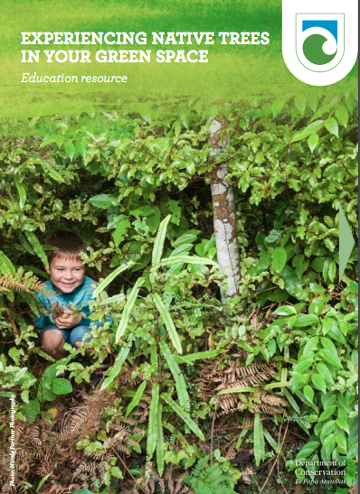
Identifying native trees
– 100 observations
© Copyright. University of Waikato. All Rights Reserved | www.sciencelearn.org.nz
All images are copyrighted. For further information, please refer to enquiries@sciencelearn.org.nz
Notes:
Images screenshots from www.doc.govt.nz/Documents/getting-involved/students-and-teachers/experiencing-native-trees-in-your-green-space.pdf page 10
Close observation is important in deciding which plants are which. By asking for 100 observations we are hoping the observations will be deeper, draw on more prior knowledge and utilise more descriptive language.

Slide 11
Identifying native trees
– some observations
It is green
Oval leaf with pointed end
Small veins coming off a main vein
Shiny
Has a pointed end
It is 12 cm long
The main rib is a different
colour to the rest of the leaf
It has a main spine
called the midrib
Medium green colour
Has small veins between
the bigger veins
Edges are wobbly
Serrated edges
Bright green
Has wavy edges – is not flat
Can see the veins
Stem is a lighter colour
The midrib is firm whereas
the rest of leaf appears thinner
and not so strong
Toothed edges rather
than smooth
Midrib with side veins
nearly opposite each other
It is a thin tear drop shape
Has symmetrical side veins from the main vein
Shiny top of leaf – what
about the underside?
A strong stem outside the leaf
© Copyright. University of Waikato. All Rights Reserved | www.sciencelearn.org.nz
All images are copyrighted. For further information, please refer to enquiries@sciencelearn.org.nz
Notes:
Images - www.doc.govt.nz/Documents/getting-involved/students-and-teachers/experiencing-native-trees-in-your-green-space.pdf pg 10
Beige boxes: simple observations - surface features of the leaf.
Blue boxes: include use of the additional information that was included in the diagram.
Green boxes: demonstrate some prior knowledge - making inferences
Pink box: has gone as far as to show curiosity to know more.
So this simple activity can elicit a range of information for a teacher to use.

Slide 12
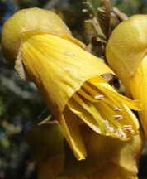
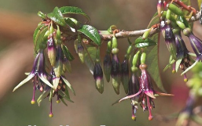
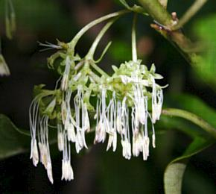
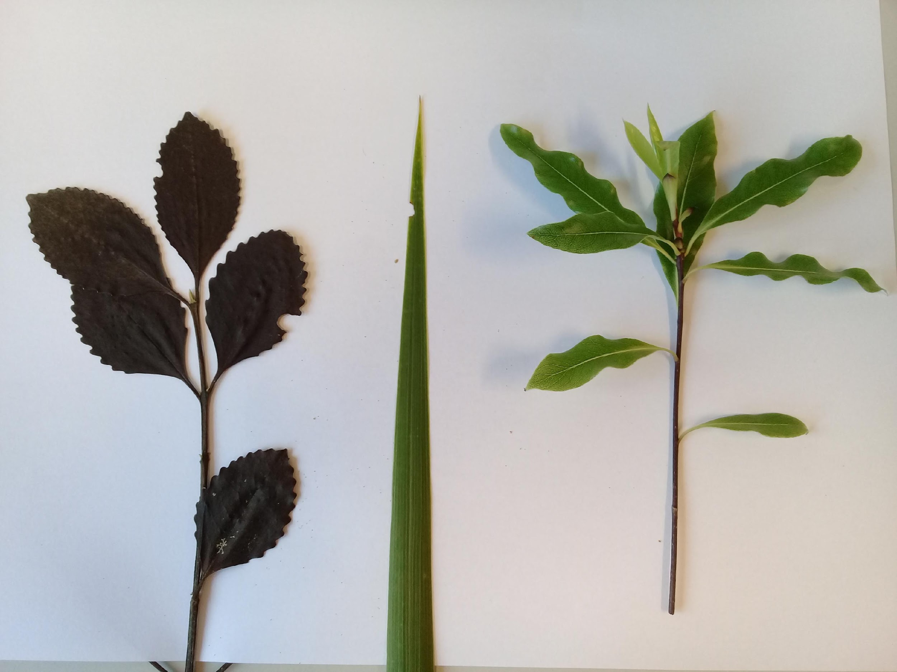
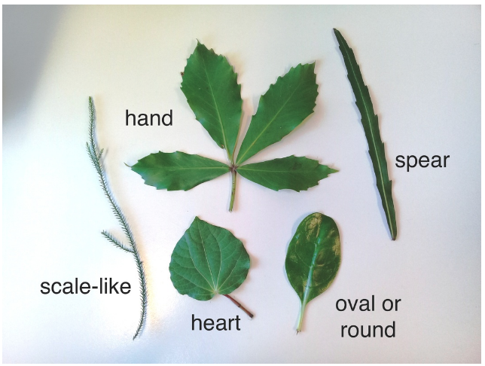
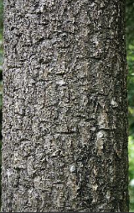
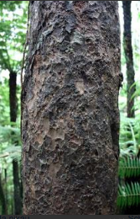
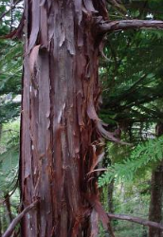
Identifying native trees
– making careful observations
Leaf arrangement
Tony Foster/ bushmansfriend.co.nz
Flowers
Bark
Leaf shape
Tony Foster/ bushmansfriend.co.nz
© Copyright. University of Waikato. All Rights Reserved | www.sciencelearn.org.nz
All images are copyrighted. For further information, please refer to enquiries@sciencelearn.org.nz

Slide 13
Why are native trees important?
© Steve Hathaway
© Copyright. University of Waikato. All Rights Reserved | www.sciencelearn.org.nz
All images are copyrighted. For further information, please refer to enquiries@sciencelearn.org.nz
Notes:
Image from www.sciencelearn.org.nz/images/79-a-favourite-angiosperm

Slide 14
Why are native trees important?
- some participant ideas
We are surrounded by them
They are part of who we are
Because they are indigenous
to Aotearoa
They are important to Māori
They are part of our heritage
and the land
They support our native birds
Trees provide habitats
Walking outside under trees is
such a peaceful thing to do
Many are unique to our country
They help us live
They purify our air and help with global warming
© Copyright. University of Waikato. All Rights Reserved | www.sciencelearn.org.nz
All images are copyrighted. For further information, please refer to enquiries@sciencelearn.org.nz
Notes:
Images - www.doc.govt.nz/Documents/getting-involved/students-and-teachers/experiencing-native-trees-in-your-green-space.pdf pg 10 and www.sciencelearn.org.nz/resources/2567-using-concept-cartoons-to-explore-students-scientific-thinking

Slide 15
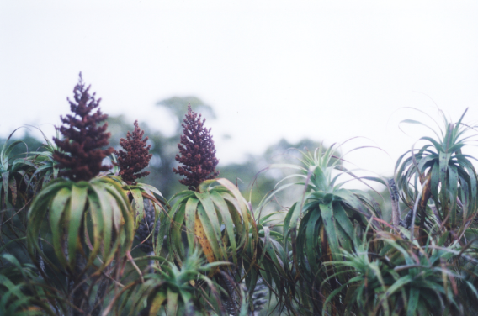

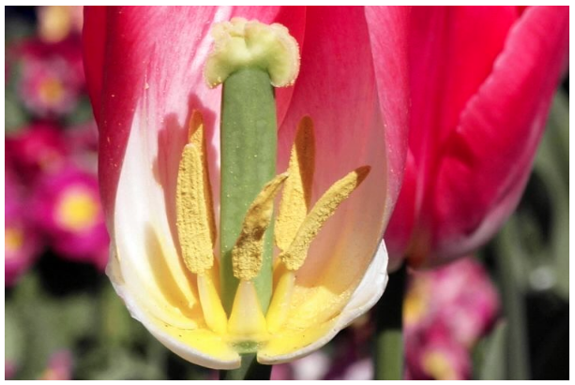
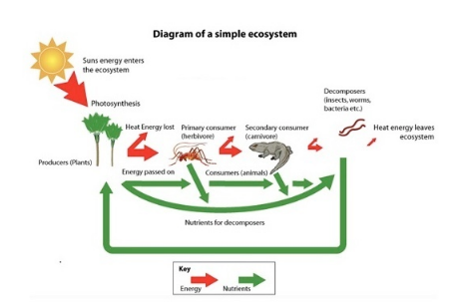
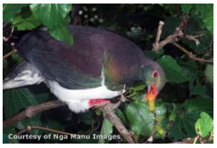
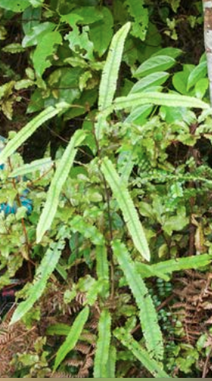
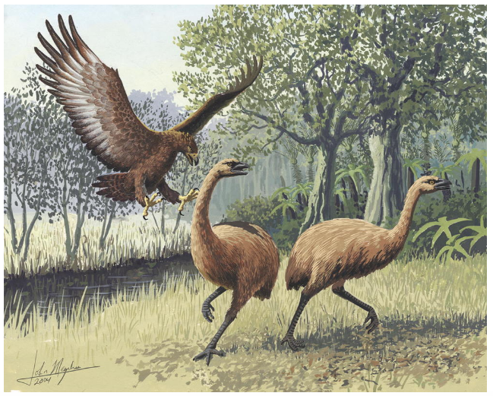
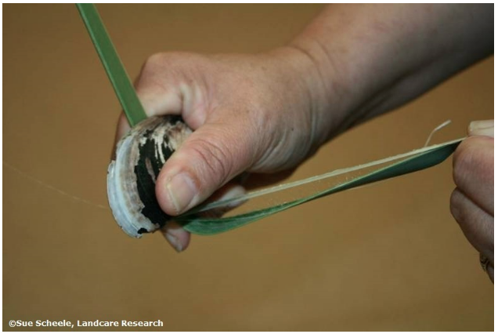
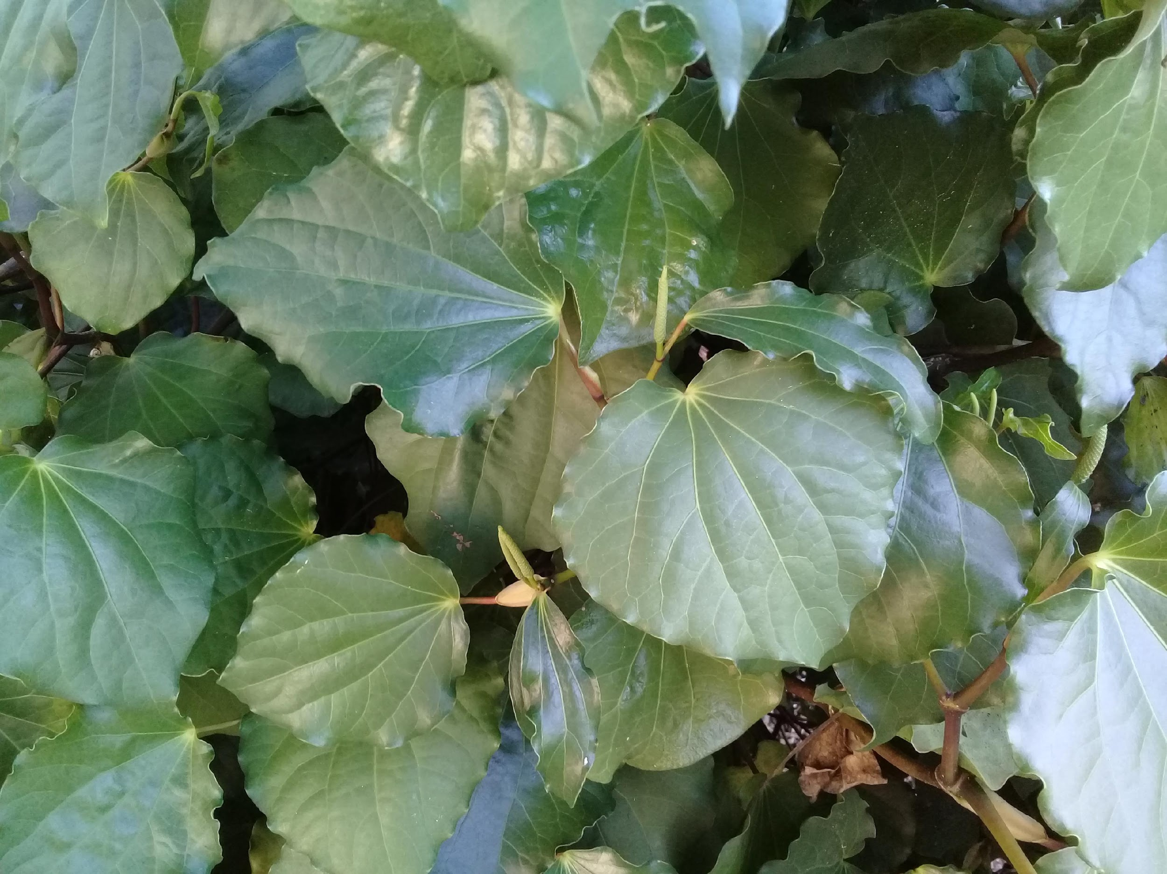
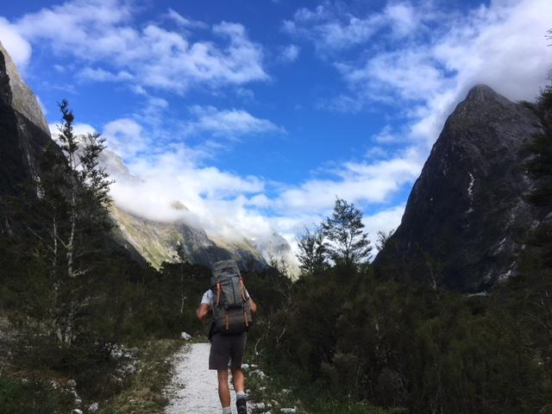
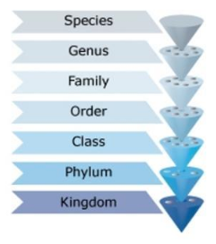
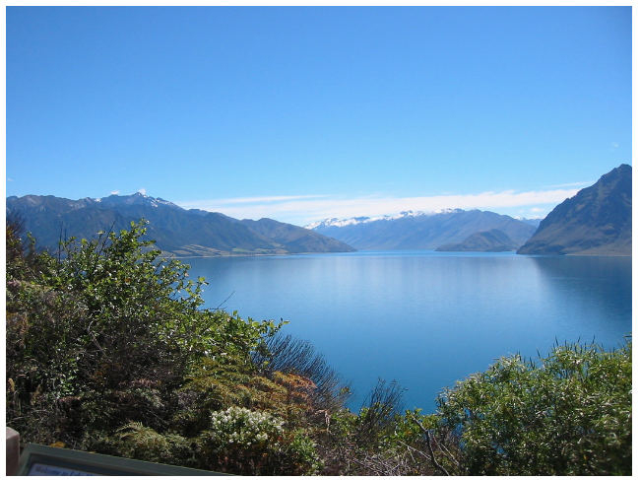
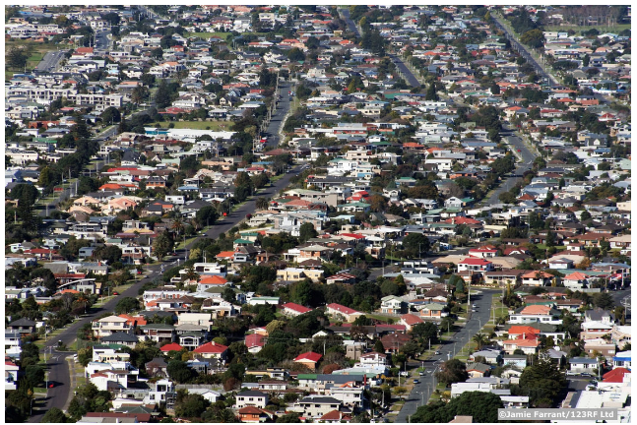
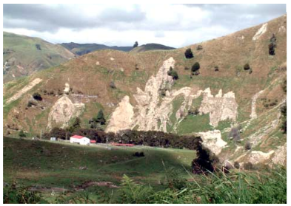
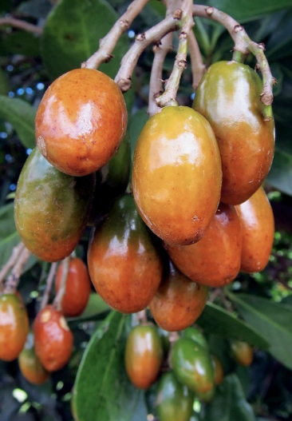
Why study native trees?
ECOSYSTEMS
Seeds
Atmosphere
PLANT LIFE CYCLES
Pollination
Food webs
Fertilisation
Habitats
Growth
Adaptations
Rongoā
Tourism
Classification
© Steve Hathaway
Water quality
Building
Plant parts: structures and functions
HUMAN USES
Erosion control
LIVING THINGS
Food
© Copyright. University of Waikato. All Rights Reserved | www.sciencelearn.org.nz
All images are copyrighted. For further information, please refer to enquiries@sciencelearn.org.nz

Slide 16
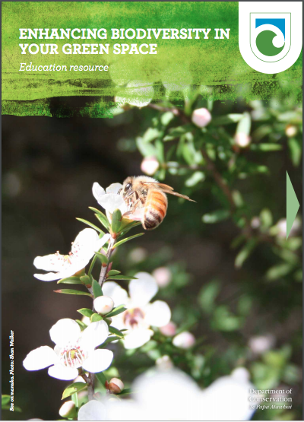
New resources from the
Department of Conservation
© Copyright. University of Waikato. All Rights Reserved | www.sciencelearn.org.nz
All images are copyrighted. For further information, please refer to enquiries@sciencelearn.org.nz

Slide 17
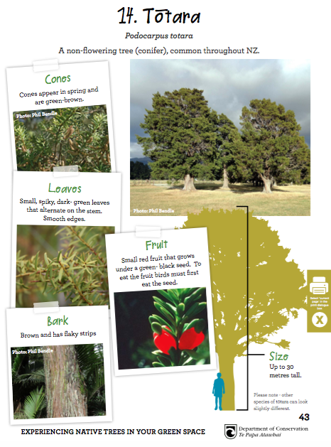
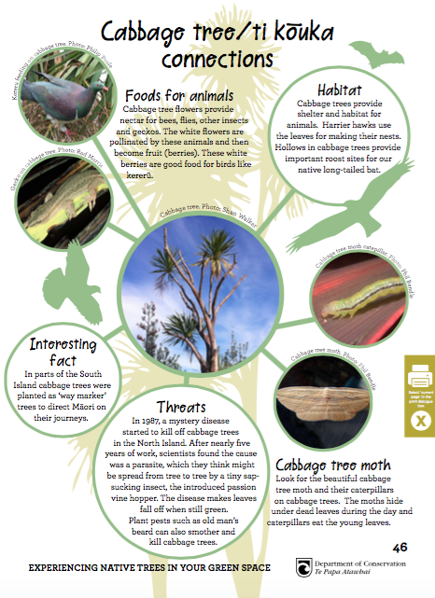
Useful resources
© Copyright. University of Waikato. All Rights Reserved | www.sciencelearn.org.nz
All images are copyrighted. For further information, please refer to enquiries@sciencelearn.org.nz
Notes:
Images from www.doc.govt.nz/Documents/getting-involved/students-and-teachers - from Experiencing native trees in your green space

Slide 18
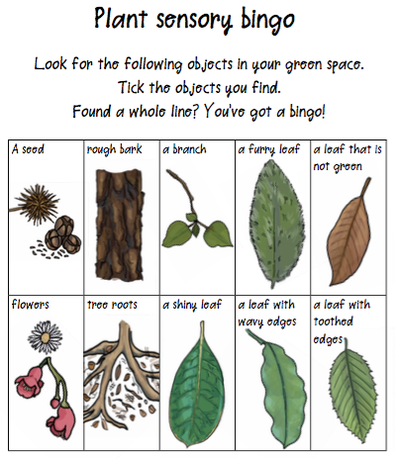
Activities for engagement
© Copyright. University of Waikato. All Rights Reserved | www.sciencelearn.org.nz
All images are copyrighted. For further information, please refer to enquiries@sciencelearn.org.nz
Notes:
Images from www.doc.govt.nz/Documents/getting-involved/students-and-teachers – from Experiencing native trees in your green space

Slide 19
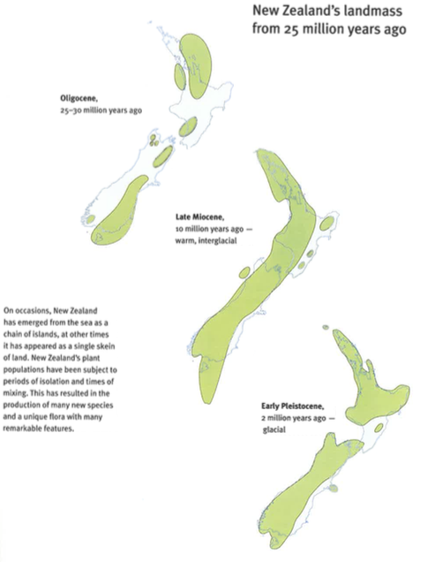
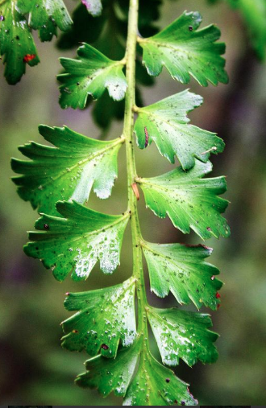
What is special about
New Zealand trees?
We separated from Gondwanaland approximately 85 million years ago.
Our separation from Australia was at least 2,000 km approximately 55 million years ago.
As a result, 82% of New Zealand plants are endemic – not found anywhere else – and many represent a legacy from Gondwanaland.
Plant Heritage New Zealand – Tony Foster – Publ. Raupo 2008
© Copyright. University of Waikato. All Rights Reserved | www.sciencelearn.org.nz
All images are copyrighted. For further information, please refer to enquiries@sciencelearn.org.nz

Slide 20
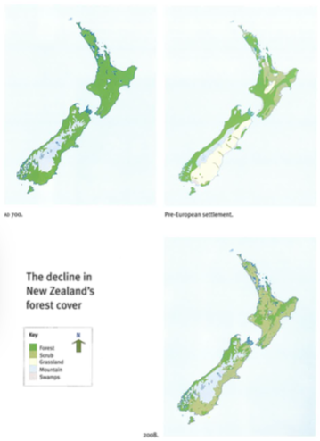
Podocarp forests
New Zealand is famous for its podocarp forests.
They are one of the Gondwanaland legacies.
The 17 species include kahikatea, miro, rimu and tōtara.
The podocarp forests create ecosystems that contain the highest diversity of species in New Zealand.
  Plants
Kingdom
  Cone-bearing plants (Conifers)
Phylum
  Pinophyta
Class
  Pinales
Order
  Podocarpaceae
Family
  Podocarpus
Genus
  totara
Species
Plant Heritage New Zealand – Tony Foster – Publ. Raupo 2008
© Copyright. University of Waikato. All Rights Reserved | www.sciencelearn.org.nz
All images are copyrighted. For further information, please refer to enquiries@sciencelearn.org.nz

Slide 21

Co-evolution, whakapapa and interdependence
John Megahan
© Copyright. University of Waikato. All Rights Reserved | www.sciencelearn.org.nz
All images are copyrighted. For further information, please refer to enquiries@sciencelearn.org.nz
Notes:
Image from www.sciencelearn.org.nz/images/1748-haast-s-eagle - www.sciencelearn.org.nz/resources/1599-our-changing-ecosystems-timeline

Slide 22
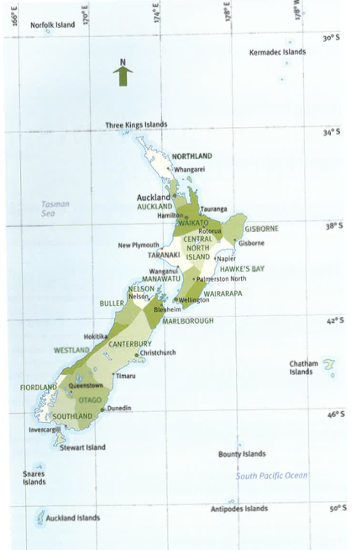
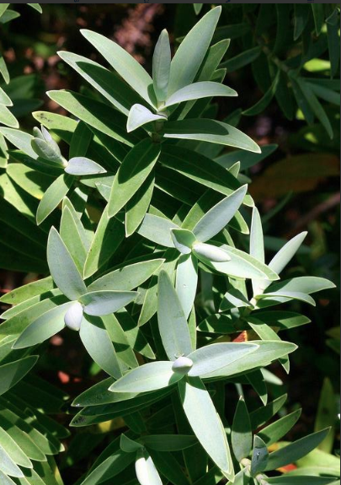
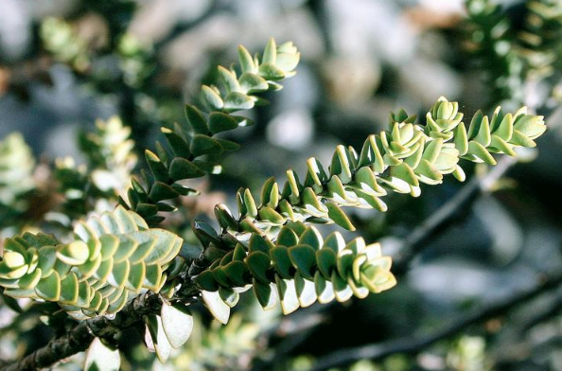
Local specialisations of
New Zealand trees
Geological processes, active erosion, glaciation, climate change and sea level changes over millions of years have forced speciation – the process of creating species that are adapted to particular locations.
© Copyright. University of Waikato. All Rights Reserved | www.sciencelearn.org.nz
All images on this slide are copyrighted. They are from Plant Heritage New Zealand – Tony Foster – Publ. Raupo 2008

Slide 23
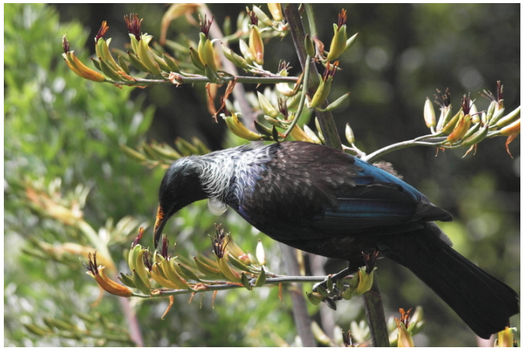
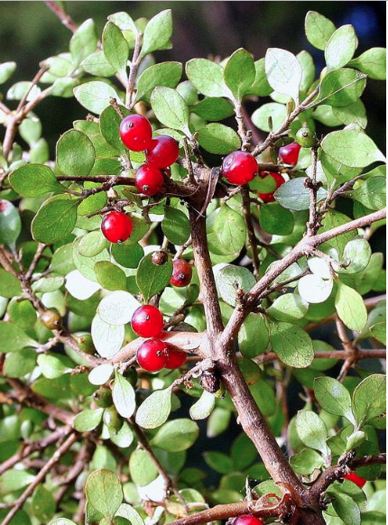
Special adaptations
Divarication in plants – there are several theories about why some native shrubs and low growing trees have small leaves with densely interlaced stems.
Many flowers are small and white – the pollinators in New Zealand are of different species and the flowers are specifically adapted to particular pollinators.
Most trees are evergreen, so not many of our trees are cold-tolerant.
Many have slightly different forms depending on the environment they are growing in, and hybridism is common.
Many plants have different juvenile and adult forms.
Dioecious – 12–13% have separate male and female trees.
© Copyright. University of Waikato. All Rights Reserved | www.sciencelearn.org.nz
All images on this slide are the copyright of Tony Foster/ bushmansfriend.co.nz

Slide 24
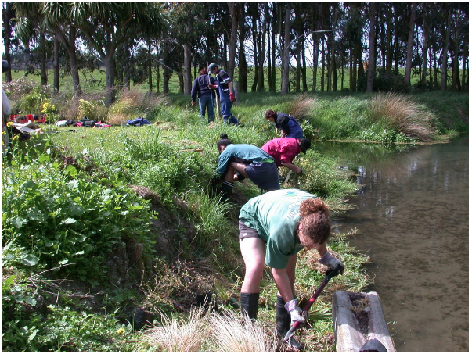

Opportunities
Society links
Getting involved in current initiatives
Arbor Day plantings
One billion trees (central government)
One million trees (Auckland Council)
Related topics or concepts
Climate change
Riparian or erosion plantings
Water quality
Curriculum links
Nature of Science
Participating and contributing
Living World
Life processes
Ecology
Landcare Research Manaaki Whenua
© Ministry of Education, NZ
© Copyright. University of Waikato. All Rights Reserved | www.sciencelearn.org.nz
All images are copyrighted. For further information, please refer to enquiries@sciencelearn.org.nz
Notes:
www.sciencelearn.org.nz/images/1772-replanting-a-riparian-strip – Landcare Research Manaaki Whenua

Slide 25
What action can we take?
MAKING A MURAL
GETTING INVOLVED IN DECISION MAKING
RECOMMENDING OR SUBMITTING IDEAS
CREATING PUBLICITY
PUBLICISING IDEAS
BUILDING A PROPAGATION HOUSE
DOING RIPARIAN PLANTING
COLLECTING NATIVE SEEDS
COLLECTING MORE DATA
PLANTING TO ATTRACT POLLINATORS
MAKING SIGNS
CREATING OR JOINING AN ACTION GROUP
© Steve Hathaway
JOIN ACTIVITIES SUCH AS BE WITH A TREE WEEK, ARBOR DAY OR CONSERVATION WEEK
TRAPPING PESTS
MAKING A BIRD FEEDER
RESTORING
HABITATS
© Copyright. University of Waikato. All Rights Reserved | www.sciencelearn.org.nz
All images are copyrighted. For further information, please refer to enquiries@sciencelearn.org.nz

Slide 26
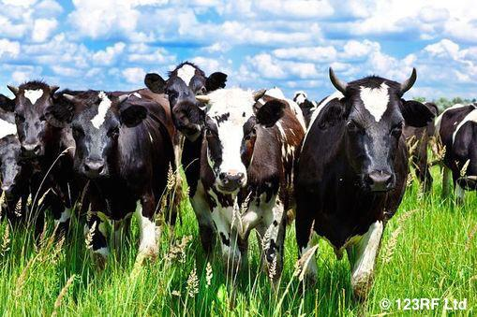
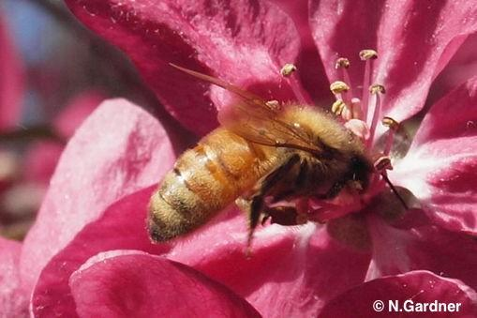








Thanks – keep in touch
Department of Conservation
https://www.doc.govt.nz/education
Contact us on conserved@doc.govt.nz
e-newsletter www.doc.govt.nz/news/newsletters
Notes:
Want to continue the conversation? Lots of opportunities to keep in touch.

Slide 27



Thanks – keep in touch
Email us on enquiries@sciencelearn.org.nz
https://twitter.com/NZScienceLearn
www.facebook.com/nzsciencelearn
https://nz.pinterest.com/nzsciencelearn
www.instagram.com/sciencelearninghubnz
Contact us if you would like bookmarks, a collection curated or to connect to a scientist.

