Slide 1
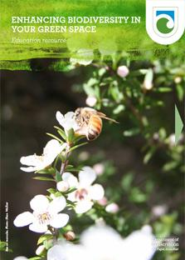
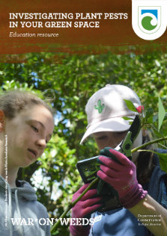
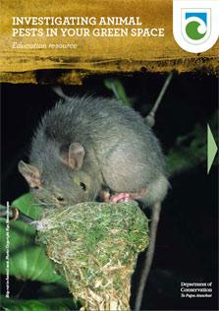
Pest detectives
with
Greta Dromgool,
Adrienne De Melo
and
Ben Moorhouse
24 May 2018
© Steve Hathaway
© Copyright. University of Waikato. All Rights Reserved | www.sciencelearn.org.nz
All images are copyrighted. For further information, please refer to enquiries@sciencelearn.org.nz
Notes:
Images: www.doc.govt.nz/get-involved/conservation-education/search/

Slide 2
Index
Topic | PowerPoint slide number(s) | Video timecode
Introducing the Science Learning Hub and presenters | 1 | 00:00
Index | 2–3 | 00:04
Purpose | 4 | 00:12
Finding DOC resources | 5-7 | 00:57
Investigating pests resources | 8-9 | 02:00
What is a pest? | 10 | 03:17
What is an investigation? | 11-12 | 05:46
Why investigate pests? | 13-14 | 07:57
© Copyright. University of Waikato. All Rights Reserved | www.sciencelearn.org.nz
All images are copyrighted. For further information, please refer to enquiries@sciencelearn.org.nz

Slide 3
Index
Topic | PowerPoint slide number(s) | Video timecode
Planning a pest investigation | 15 | 16:36
Ethics | 16 | 20:22
Language | 17 | 22:19
Planning a pest investigation | 18 | 24:34
Investigating animal pests | 19-25 | 25:19
Investigating plant pests | 26-30 | 31:06
Predator Free 2050 | 31-33 | 32:56
DOC and SLH links, thanks | 32-33 | 33:19
© Copyright. University of Waikato. All Rights Reserved | www.sciencelearn.org.nz
All images are copyrighted. For further information, please refer to enquiries@sciencelearn.org.nz

Slide 4
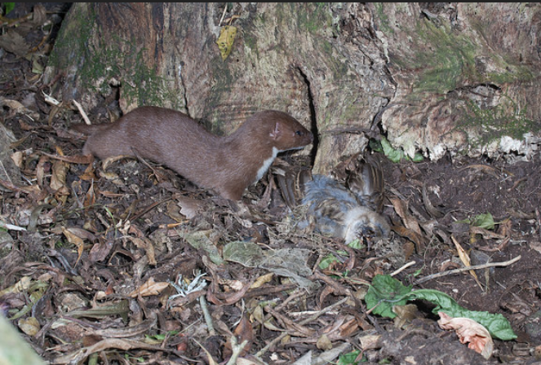
Purpose
To support you to enhance your students’ understanding about conservation education.
We will:
introduce DOC resources
share engaging, hands-on activities
scaffold an investigation into plant and animal pests.
Ngā Manu Nature Images
www.doc.govt.nz/education
© Copyright. University of Waikato. All Rights Reserved | www.sciencelearn.org.nz
All images are copyrighted. For further information, please refer to enquiries@sciencelearn.org.nz
Notes:
Image: www.sciencelearn.org.nz/images/3545-weasel-with-dead-sparrow

Slide 5
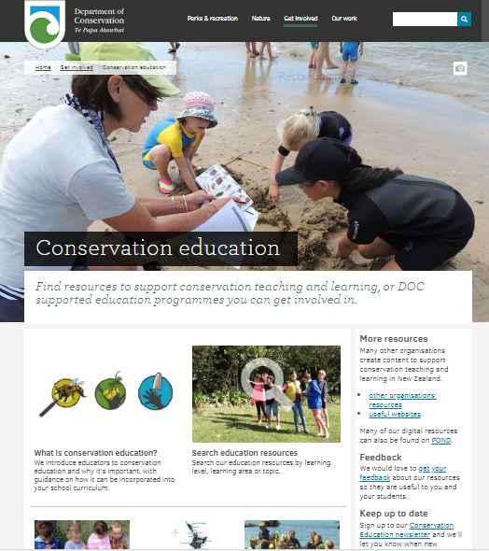
www.doc.govt.nz/education
© Copyright. University of Waikato. All Rights Reserved | www.sciencelearn.org.nz
All images are copyrighted. For further information, please refer to enquiries@sciencelearn.org.nz

Slide 6
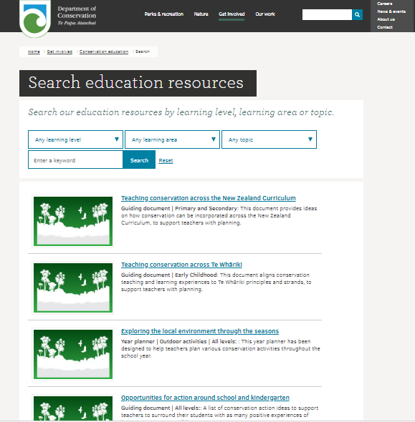
www.doc.govt.nz/education
© Copyright. University of Waikato. All Rights Reserved | www.sciencelearn.org.nz
All images are copyrighted. For further information, please refer to enquiries@sciencelearn.org.nz

Slide 7
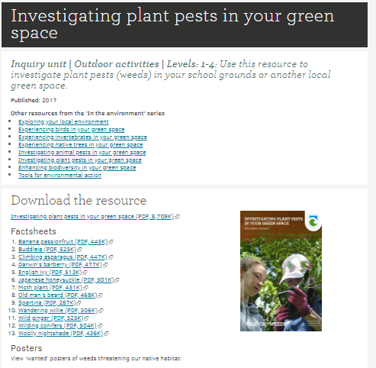
www.doc.govt.nz/education
© Copyright. University of Waikato. All Rights Reserved | www.sciencelearn.org.nz
All images are copyrighted. For further information, please refer to enquiries@sciencelearn.org.nz

Slide 8
DOC resources
www.doc.govt.nz/education
© Copyright. University of Waikato. All Rights Reserved | www.sciencelearn.org.nz
All images are copyrighted. For further information, please refer to enquiries@sciencelearn.org.nz
Notes:
Images: www.doc.govt.nz/get-involved/conservation-education/search

Slide 9
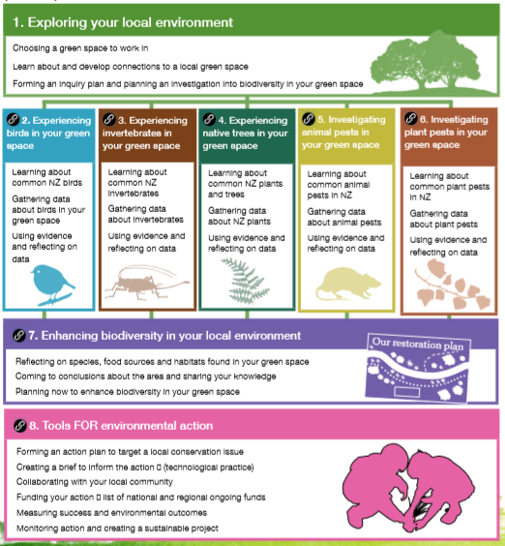
© Copyright. University of Waikato. All Rights Reserved | www.sciencelearn.org.nz
All images are copyrighted. For further information, please refer to enquiries@sciencelearn.org.nz
Notes:
www.doc.govt.nz/get-involved/conservation-education/search

Slide 10
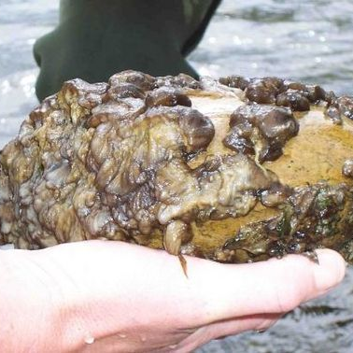
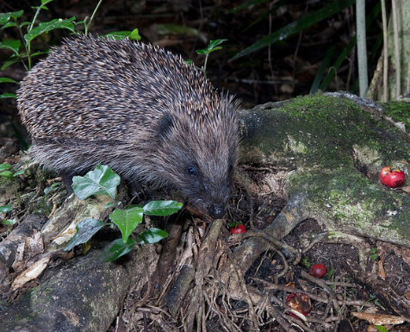
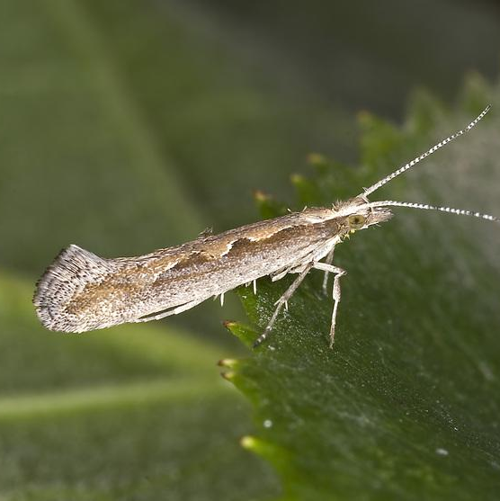
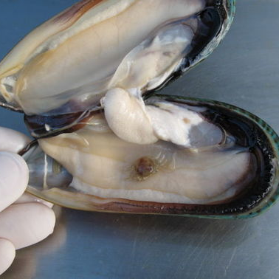
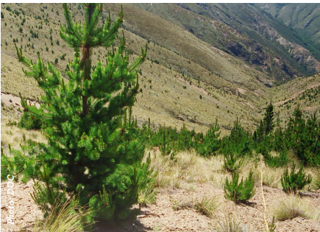
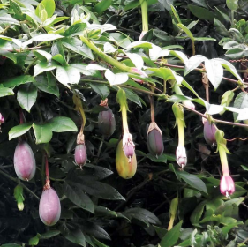
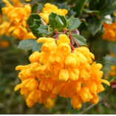
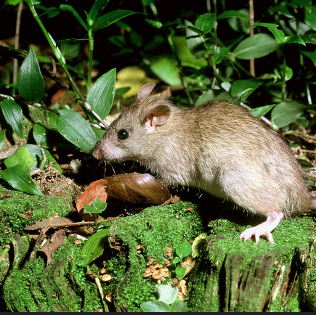
2006 Biosecurity NZ
Ngā Manu Nature Images
What is a pest?
Olaf Leillinger/CC2.5
Ngā Manu Nature Images
© Copyright. University of Waikato. All Rights Reserved | www.sciencelearn.org.nz
All images are copyrighted. For further information, please refer to enquiries@sciencelearn.org.nz
Notes:
Image: Wildling pine: www.doc.govt.nz/Documents/getting-involved/students-and-teachers/investigating-planting-species-2018.pdf
Image: Hedgehog investigating maire berries: www.flickr.com/photos/129662450@N02/30451801023/
Image: Rat: www.flickr.com/photos/129662450@N02/31127408496/in/photostream
Image: Darwin’s barberry and the banana passionfruit: www.doc.govt.nz/Documents/getting-involved/students-and-teachers/investigating-plant-pests-in-your-green-space.pdf
Image: Diamondback moth: www.sciencelearn.org.nz/images/2989-diamondback-moth
Image: Pea crab in mussel: www.sciencelearn.org.nz/images/554-pea-crab-inside-mussel
Image: Didymo on rock: www.sciencelearn.org.nz/images/1762-didymo

Slide 11
What is an investigation?
Participant responses:
a linear set of steps with a known outcome
uncreative
testing
looking closer and deeper with a scientific interest
only one way of doing things
exploring an idea
What it is
boring
research
observing
re-testing
critiquing
active
a
formula
What it is not
passive
© Copyright. University of Waikato. All Rights Reserved | www.sciencelearn.org.nz
All images are copyrighted. For further information, please refer to enquiries@sciencelearn.org.nz

Slide 12
What is an investigation?
Nature of science: Investigating in science
Giving students first-hand experiences
Drawing attention to nature of science aspects in students’ own investigations and in the investigation of scientists.
Zhiyu Li, licensed through 123RF Ltd
© Copyright. University of Waikato. All Rights Reserved | www.sciencelearn.org.nz
All images are copyrighted. For further information, please refer to enquiries@sciencelearn.org.nz
Notes:
Image: www.sciencelearn.org.nz/images/1237-new-zealand-countryside
Useful link: www.sciencelearn.org.nz/resources/5-investigations-in-science

Slide 13
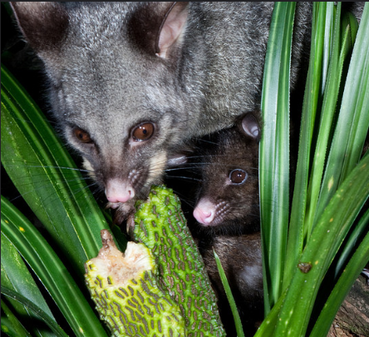
Why investigate pests?
Highly topical
Strong links to science curriculum
Flexible
Contextual
Māori perspectives
Leads to action and community involvement
Ngā Manu Nature Images
© Copyright. University of Waikato. All Rights Reserved | www.sciencelearn.org.nz
All images are copyrighted. For further information, please refer to enquiries@sciencelearn.org.nz
Notes:
Image: possum eating kiekie - www.flickr.com/photos/129662450@N02/30356880493/

Slide 14
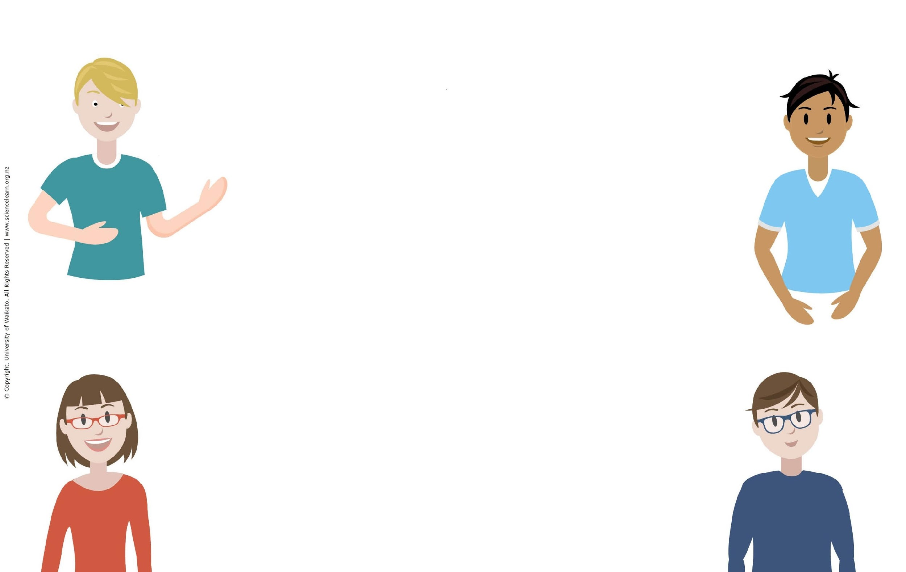
Participant examples of learning about pests
We looked at biological control of possums
We had a small bit of bush at the back of the school. There were mice, rats and hedgehogs. We used tracking tunnels – so often they hide!
Investigating marine and freshwater pests like didymo or carp
We observed the white butterfly lifecycle alongside the monarch butterfly. We had a wee dilemma what to do with the white butterflies we raised!
I am trying to get my school involved in the local backyard trapping project
© Copyright. University of Waikato. All Rights Reserved | www.sciencelearn.org.nz
All images are copyrighted. For further information, please refer to enquiries@sciencelearn.org.nz

Slide 15
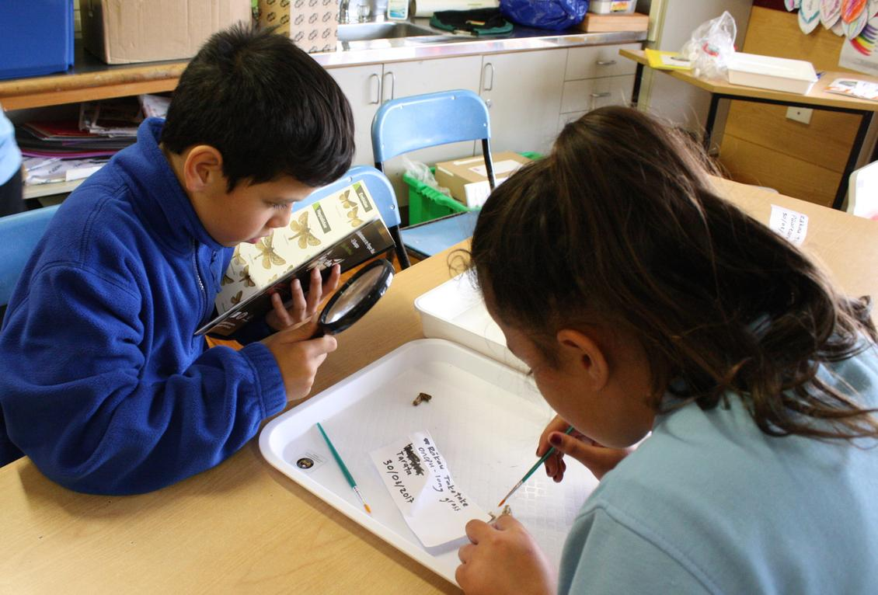
Planning a pest investigation
Considerations
Learning and assessment
Time
People
Support
© Copyright. University of Waikato. All Rights Reserved | www.sciencelearn.org.nz
All images are copyrighted. For further information, please refer to enquiries@sciencelearn.org.nz
Notes:
Useful link: http://scienceonline.tki.org.nz/Nature-of-science/What-is-the-Nature-of-Science/Teacher-suggestions-Investigating-in-science
Image: www.sciencelearn.org.nz/images/3189-observing-moths

Slide 16
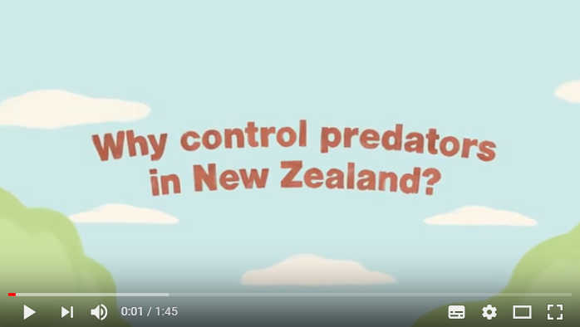
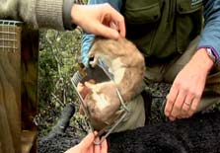
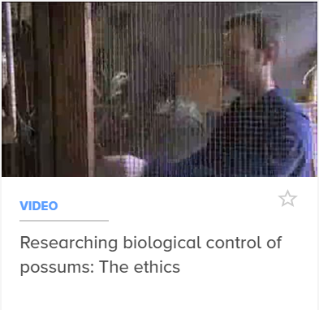
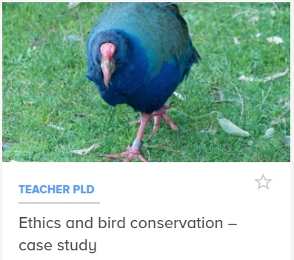
Ethics: Investigating animal pests
Be explicit about the purpose
Decide on your own comfort zone
Be prepared to discuss, debate and make changes
https://www.youtube.com/watch?v=vUhSVViFSEc
© Copyright. University of Waikato. All Rights Reserved | www.sciencelearn.org.nz
All images are copyrighted. For further information, please refer to enquiries@sciencelearn.org.nz
Notes:
Before beginning predator-control activities like tracking or trapping, we must understand why New Zealand needs to control predators, and how to trap pests with respect.
Image: www.doc.govt.nz/get-involved/conservation-activities/meet-the-locals-videos/first-series/trappers/
Image: www.sciencelearn.org.nz/resources/2363-ethics-thinking-toolkit
Takahe: www.sciencelearn.org.nz/resources/2154-ethics-and-bird-conservation-case-study (image: www.sciencelearn.org.nz/resources/2154-ethics-and-bird-conservation-case-study)
Possum Video: www.sciencelearn.org.nz/videos/590-researching-biological-control-of-possums-the-ethics

Slide 17
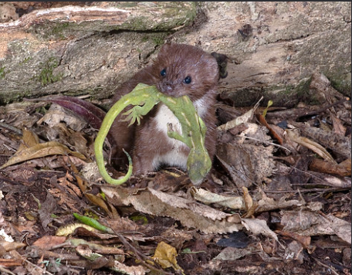
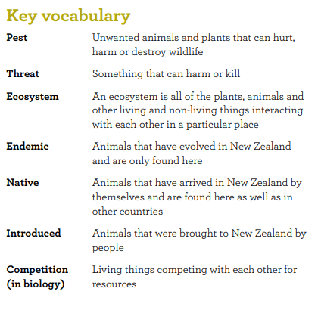
Minding your language
Identify different contexts
Be explicit about what makes certain language scientific
Ask students why this distinction is important
Ngā Manu Nature Images
© Copyright. University of Waikato. All Rights Reserved | www.sciencelearn.org.nz
All images are copyrighted. For further information, please refer to enquiries@sciencelearn.org.nz
Notes:
Image: Dead gecko: www.flickr.com/photos/129662450@N02/30358140153/in/photostream/
Image: www.sciencelearn.org.nz/images/2447-harakeke-at-dunedin-botanical-gardens
Useful link: www.sciencelearn.org.nz/resources/2444-science-and-literacy-making-connections

Slide 18
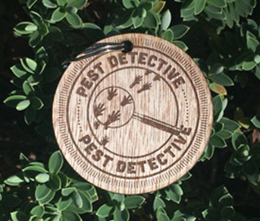
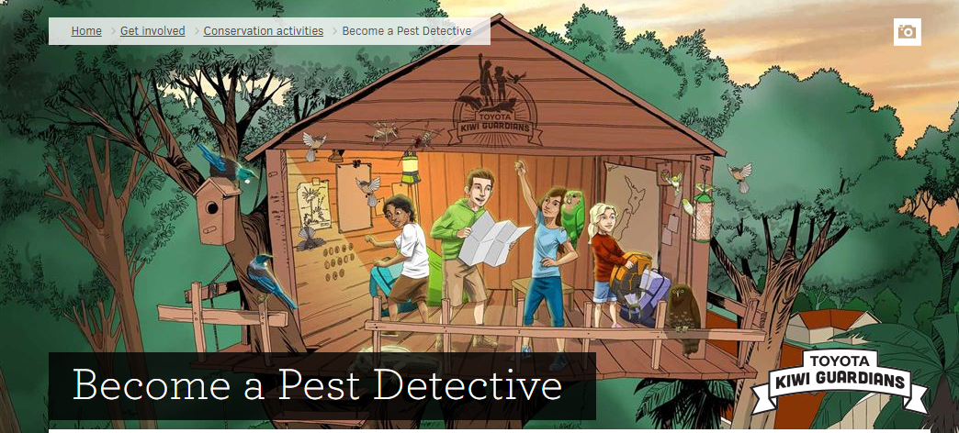
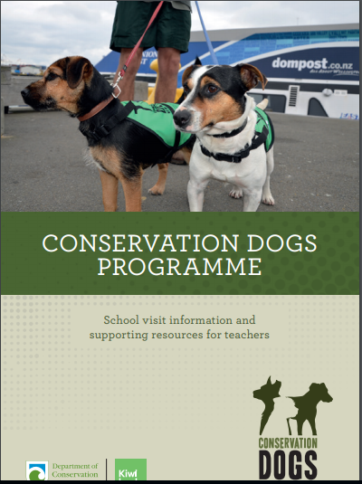
Planning a pest investigation
Getting students’ interest
Eliciting questions and wonderings
© Copyright. University of Waikato. All Rights Reserved | www.sciencelearn.org.nz
All images are copyrighted. For further information, please refer to enquiries@sciencelearn.org.nz
Notes:
Image: www.doc.govt.nz/get-involved/conservation-education/resources/conservation-dogs-programme/
www.doc.govt.nz/get-involved/conservation-activities/become-a-pest-detective/

Slide 19
Investigating animal pests
Students can:
gather and interpret data about animal pests
identify and learn about introduced pests and how they affect endemic and native plants and animals
begin to understand how pests have an impact on the wider ecosystem.
© Copyright. University of Waikato. All Rights Reserved | www.sciencelearn.org.nz
All images are copyrighted. For further information, please refer to enquiries@sciencelearn.org.nz
Notes:
Image: www.doc.govt.nz/get-involved/conservation-education/search/
www.doc.govt.nz/get-involved/conservation-education/resources/investigating-animal-pests-in-your-green-space

Slide 20
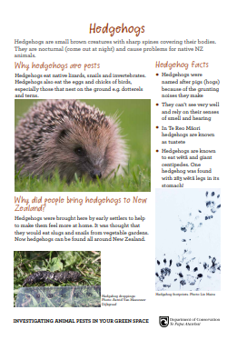
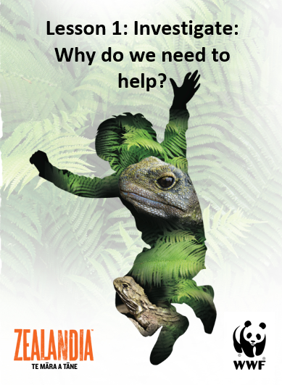
Animal pest introductory activities
Activities: page 7
On the trail of animal pests
People and pests
Science Learning Hub resources
Lesson plans
PLD
© Copyright. University of Waikato. All Rights Reserved | www.sciencelearn.org.nz
All images are copyrighted. For further information, please refer to enquiries@sciencelearn.org.nz
Notes:
Image: www.doc.govt.nz/Documents/getting-involved/students-and-teachers/investigating-animal-pests-in-your-green-space.pdf and www.sciencelearn.org.nz/resources/2077-investigate-why-do-we-need-to-help

Slide 21
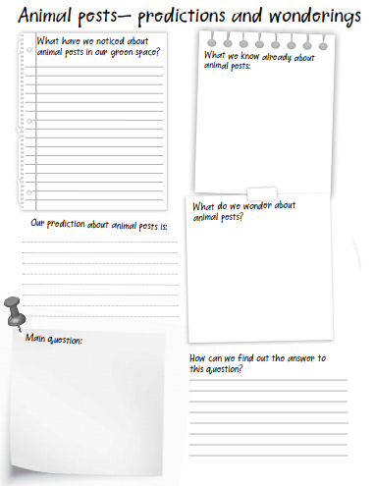
© Copyright. University of Waikato. All Rights Reserved | www.sciencelearn.org.nz
All images are copyrighted. For further information, please refer to enquiries@sciencelearn.org.nz
Notes:
www.doc.govt.nz/get-involved/conservation-education/resources/investigating-animal-pests-in-your-green-space

Slide 22
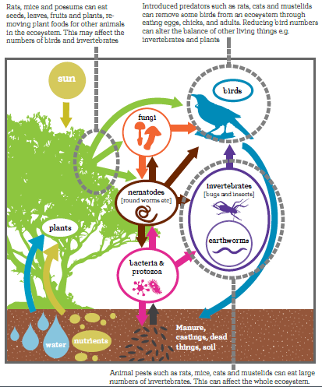
Changing ecosystems
Page:10
© Copyright. University of Waikato. All Rights Reserved | www.sciencelearn.org.nz
All images are copyrighted. For further information, please refer to enquiries@sciencelearn.org.nz
Notes:
www.doc.govt.nz/get-involved/conservation-education/resources/investigating-animal-pests-in-your-green-space

Slide 23
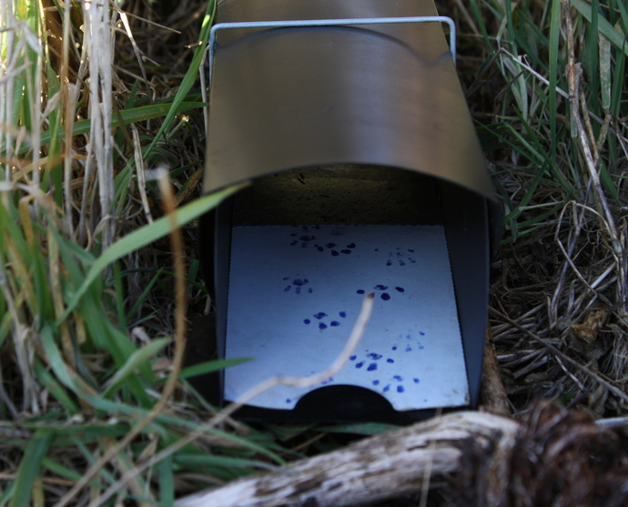
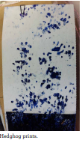
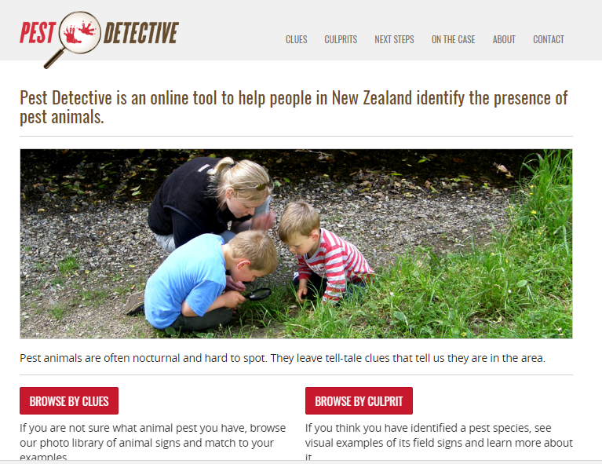
Investigating animal pests
Gathering data
For example:
Tracking tunnels
Wax tags
Page:11-13
© Copyright. University of Waikato. All Rights Reserved | www.sciencelearn.org.nz
All images are copyrighted. For further information, please refer to enquiries@sciencelearn.org.nz
Notes:
www.doc.govt.nz/get-involved/conservation-education/resources/investigating-animal-pests-in-your-green-space
Image: www.sciencelearn.org.nz/images/1315-tracking-tunnel
Useful links:
www.sciencelearn.org.nz/resources/1171-making-a-tracking-tunnel
www.pestdetective.org.nz
www.landcareresearch.co.nz/science/plants-animals-fungi/animals/vertebrate-pests

Slide 24
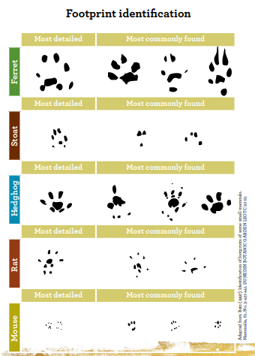
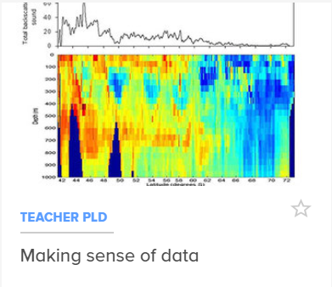
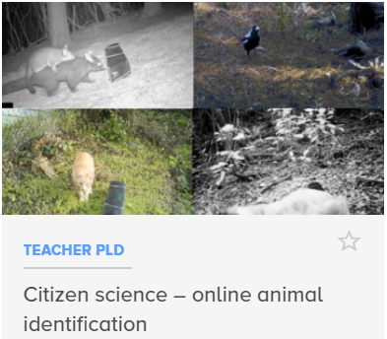
Investigating animal pests
Reflecting on data
Using identification guides
Making statements about data
Victoria University of Wellington
© Copyright. University of Waikato. All Rights Reserved | www.sciencelearn.org.nz
All images are copyrighted. For further information, please refer to enquiries@sciencelearn.org.nz
Notes:
www.doc.govt.nz/get-involved/conservation-education/resources/investigating-animal-pests-in-your-green-space/
www.sciencelearn.org.nz/resources/2607-citizen-science-online-animal-identification
Images: www.sciencelearn.org.nz/images/1464-fisheries-acoustic-data, www.sciencelearn.org.nz/images/3544-animals-recorded-by-cameras
Naturewatch - now inaturalist: http://inaturalist.nz/

Slide 25
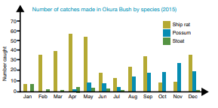
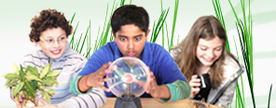
Investigating animal pests
Organising, displaying and making sense of data
Critiquing evidence
page 16
Ministry of Education, Crown Copyright, NZ
© Copyright. University of Waikato. All Rights Reserved | www.sciencelearn.org.nz
All images are copyrighted. For further information, please refer to enquiries@sciencelearn.org.nz
Notes:
Image of Students with science gear: http://scienceonline.tki.org.nz/Science-capabilities-for-citizenship/Introducing-five-science-capabilities/Gather-interpret-data
Image of Graph in: www.doc.govt.nz/get-involved/conservation-education/resources/investigating-animal-pests-in-your-green-space/

Slide 26
Investigating plant pests
Students can:
gather and interpret data about plant pests
identify and learn about introduced weeds and how they affect native plants and animals
begin to understand how weeds have an impact on the wider ecosystem.
© Copyright. University of Waikato. All Rights Reserved | www.sciencelearn.org.nz
All images are copyrighted. For further information, please refer to enquiries@sciencelearn.org.nz
Notes:
www.doc.govt.nz/get-involved/conservation-education/search

Slide 27
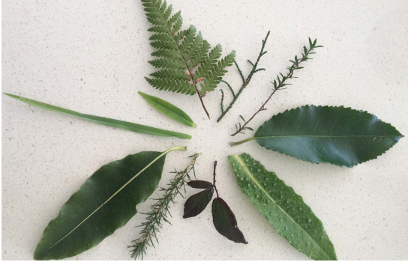
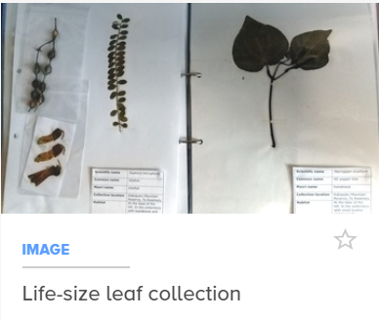
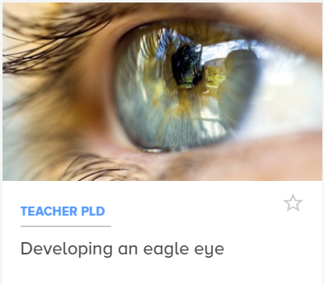
Plant pest introductory activities
Noticing leaves and weeds
Pest plant alert
Science Learning Hub
resources
Pages: 7-8
Erion Cuko
© Copyright. University of Waikato. All Rights Reserved | www.sciencelearn.org.nz
All images are copyrighted. For further information, please refer to enquiries@sciencelearn.org.nz
Notes:
Safety – handling plants – sensitivities and allergies
Image: www.doc.govt.nz/Documents/getting-involved/students-and-teachers/investigating-plant-pests-in-your-green-space.pdf
www.sciencelearn.org.nz/resources/2609-making-a-life-size-leaf-collection (image: www.sciencelearn.org.nz/images/3551-life-size-leaf-collection)
www.sciencelearn.org.nz/resources/2018-developing-an-eagle-eye (image: www.sciencelearn.org.nz/images/36-the-human-eye)

Slide 28
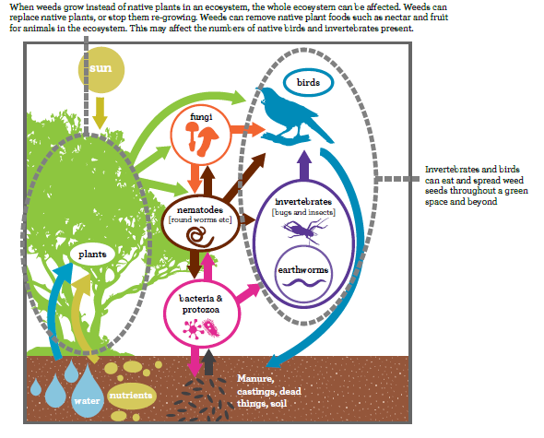
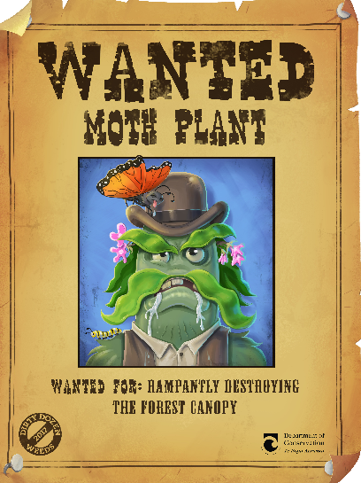
Changing ecosystems
Page:11
© Copyright. University of Waikato. All Rights Reserved | www.sciencelearn.org.nz
All images are copyrighted. For further information, please refer to enquiries@sciencelearn.org.nz
Notes:
Images: www.doc.govt.nz/Documents/getting-involved/students-and-teachers/investigating-plant-pests-in-your-green-space.pdf

Slide 29
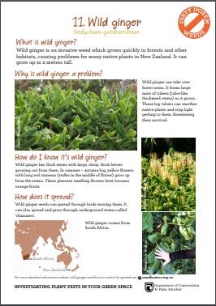
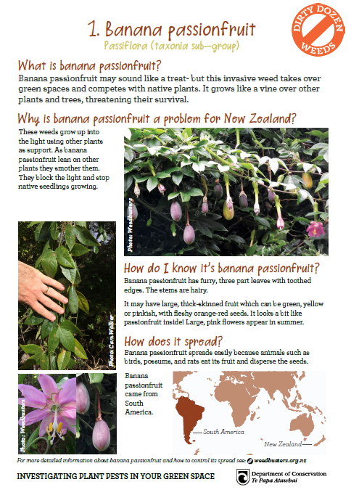
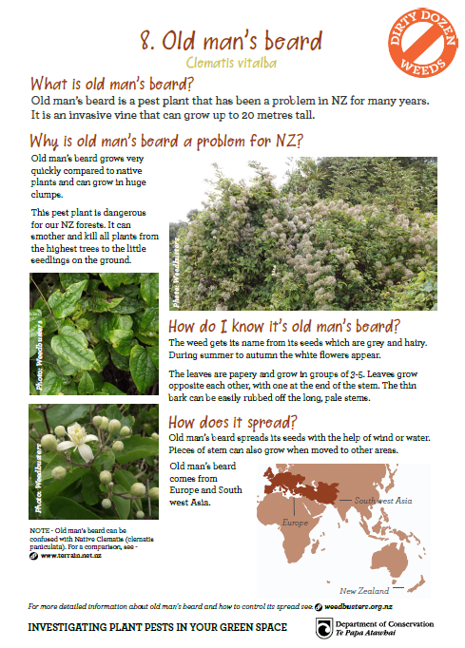
Investigating plant pests
Gathering data
surveys
factsheets
© Copyright. University of Waikato. All Rights Reserved | www.sciencelearn.org.nz
All images are copyrighted. For further information, please refer to enquiries@sciencelearn.org.nz
Notes:
Images: www.doc.govt.nz/Documents/getting-involved/students-and-teachers/investigating-plant-pests-in-your-green-space.pdf

Slide 30
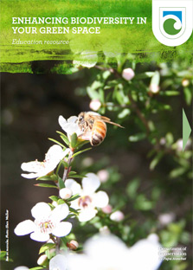
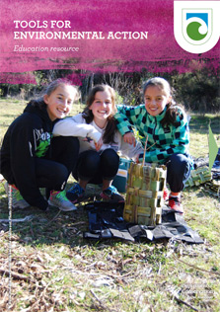
Investigating pests
Extending thinking and sharing knowledge
Linking learning to your green space and community
Citizen science connections
Next steps: Enhancing Biodiversity, Tools for Action
© Copyright. University of Waikato. All Rights Reserved | www.sciencelearn.org.nz
All images are copyrighted. For further information, please refer to enquiries@sciencelearn.org.nz
Notes:
Images: www.doc.govt.nz/get-involved/conservation-education/resources/enhancing-biodiversity-in-your-green-space/
www.doc.govt.nz/get-involved/conservation-education/resources/tools-for-environmental-action/

Slide 31
Predator Free 2050
© Copyright. University of Waikato. All Rights Reserved | www.sciencelearn.org.nz
All images are copyrighted. For further information, please refer to enquiries@sciencelearn.org.nz
Notes:
Image: www.doc.govt.nz/nature/pests-and-threats/predator-free-2050/

Slide 32
Predator Free 2050
Rob Suisted
© Copyright. University of Waikato. All Rights Reserved | www.sciencelearn.org.nz
All images are copyrighted. For further information, please refer to enquiries@sciencelearn.org.nz
Notes:
Article: www.sciencelearn.org.nz/resources/2195-predator-free-2050-vision (image www.sciencelearn.org.nz/images/2504-going-predator-free)

Slide 33
Predator Free 2050
Rob Suisted
© Copyright. University of Waikato. All Rights Reserved | www.sciencelearn.org.nz
All images are copyrighted. For further information, please refer to enquiries@sciencelearn.org.nz
Notes:
Image: https://predatorfreenz.org/tools-resources/online-data-collection/

Slide 34
Thanks – keep in touch
Department of Conservation
www.doc.govt.nz/education
Contact us on conserved@doc.govt.nz
e-newsletter www.doc.govt.nz/news/newsletters/conservation-education/
POND page www.pond.co.nz/community/721642/department-of-conservation/1
Notes:
Want to continue the conversation? Lots of opportunities to keep in touch.

Slide 35
Thanks – keep in touch
Science Learning Hub
Contact us if you would like bookmarks, a collection curated or to connect to a scientist.
Email us on enquiries@sciencelearn.org.nz
https://twitter.com/NZScienceLearn
www.facebook.com/nzsciencelearn
https://nz.pinterest.com/nzsciencelearn/
www.pond.co.nz/community/214015/science-learning-hub
in our conservation education discussion channel on Slack.
(This link may expire: if it does, contact us via our enquiries email, and we will send you a new link.)
Notes:
Want to continue the conversation? Lots of opportunities to keep in touch.

