Slide 1
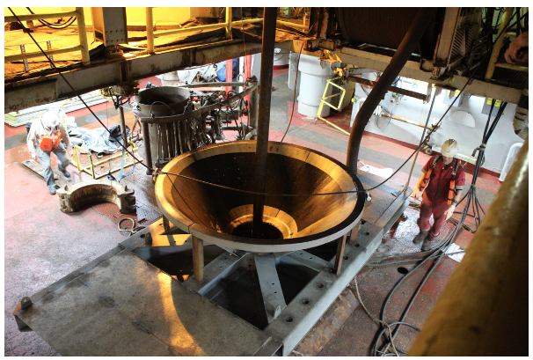
Exploring natural hazards
Lyn Rogers and Aliki Weststrate
21 June 2018
The International Ocean Discovery Program, Aliki Weststrate
© Copyright. University of Waikato. All Rights Reserved | www.sciencelearn.org.nz
All images are copyrighted. For further information, please refer to enquiries@sciencelearn.org.nz
Notes:
Image from www.sciencelearn.org.nz/images/3508-free-fall-tunnel-part-of-the-cork-observatory

Slide 2
Index
Topic | PowerPoint slide number(s) | Video timecode
Introducing the Science Learning Hub and presenters | 1 | 00:00
Index | 2–3 | 00:12
Webinar purpose | 4 | 00:42
Curriculum connections | 5 | 02:05
What are natural hazards? | 6–8 | 04:35
Pacific Rim of Fire | 9 | 05:37
Plate boundaries | 10–13 | 07:09
Planning pathway – earthquakes | 14 | 17:42
Planning pathway – volcanoes | 15 | 18:37
© Copyright. University of Waikato. All Rights Reserved | www.sciencelearn.org.nz
All images are copyrighted. For further information, please refer to enquiries@sciencelearn.org.nz

Slide 3
Index
Topic | PowerPoint slide number(s) | Video timecode
Associated hazards – tsunamis and landslides | 16 | 19:10
JOIDES Resolution – researching natural hazards | 17 | 21:35
Expedition #375 – Hikurangi subduction zone | 18–20 | 22:28
What are slow slips? | 21 | 26:49
What did you find out? | 22 | 30:21
What were the challenges? | 23 | 33:09
What next – for science? | 24 | 39:37
What next – in the classroom? | 25 | 42:09
SLH links, keep in touch and thanks | 26 | 43:58
© Copyright. University of Waikato. All Rights Reserved | www.sciencelearn.org.nz
All images are copyrighted. For further information, please refer to enquiries@sciencelearn.org.nz

Slide 4
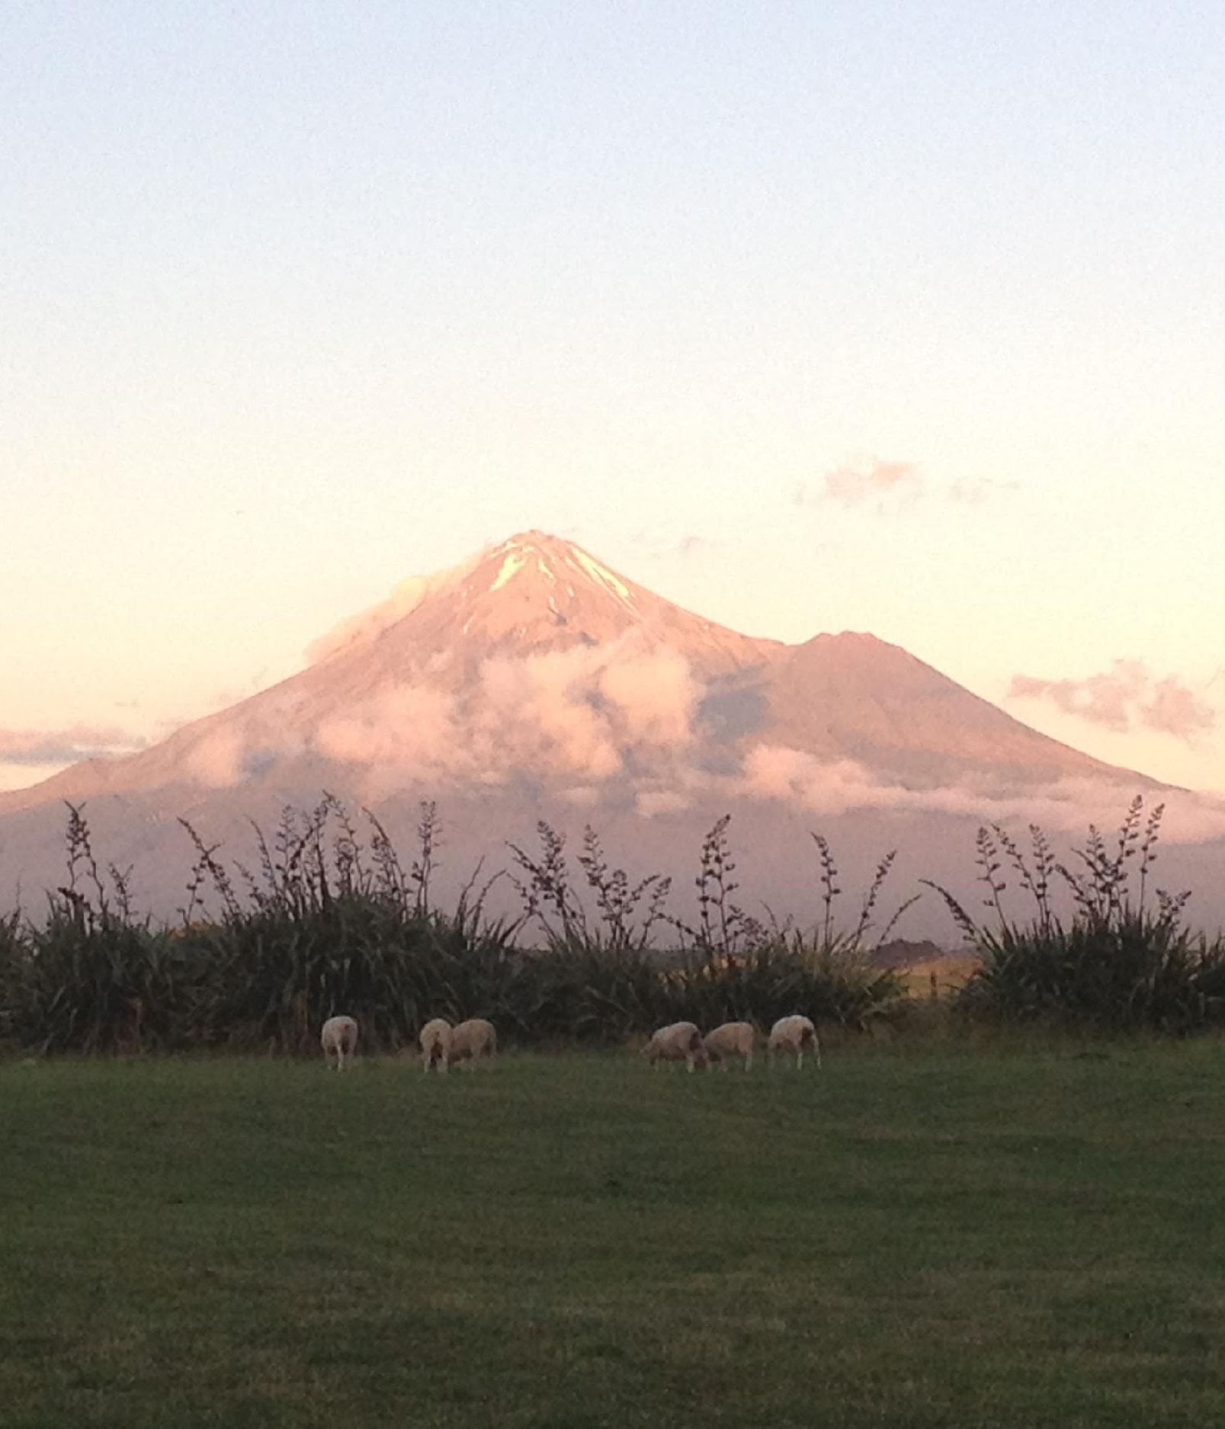
Exploring natural hazards
In this webinar, Lyn Rogers and guest Aliki Weststrate will:
introduce some readily available resources and activities
explore some of the science involved in building our understandings of natural hazards
delve into some of the exciting research happening in this field in New Zealand
discuss how engaging students in ‘real’ science stories can engage them in developing their own skills for science inquiry.
© Copyright. University of Waikato. All Rights Reserved | www.sciencelearn.org.nz
All images are copyrighted. For further information, please refer to enquiries@sciencelearn.org.nz
Notes:
GNS science is a geoscience research organisation funded by the government to explore the earth’s crust - to understand resources, natural hazards and the changing environment.

Slide 5
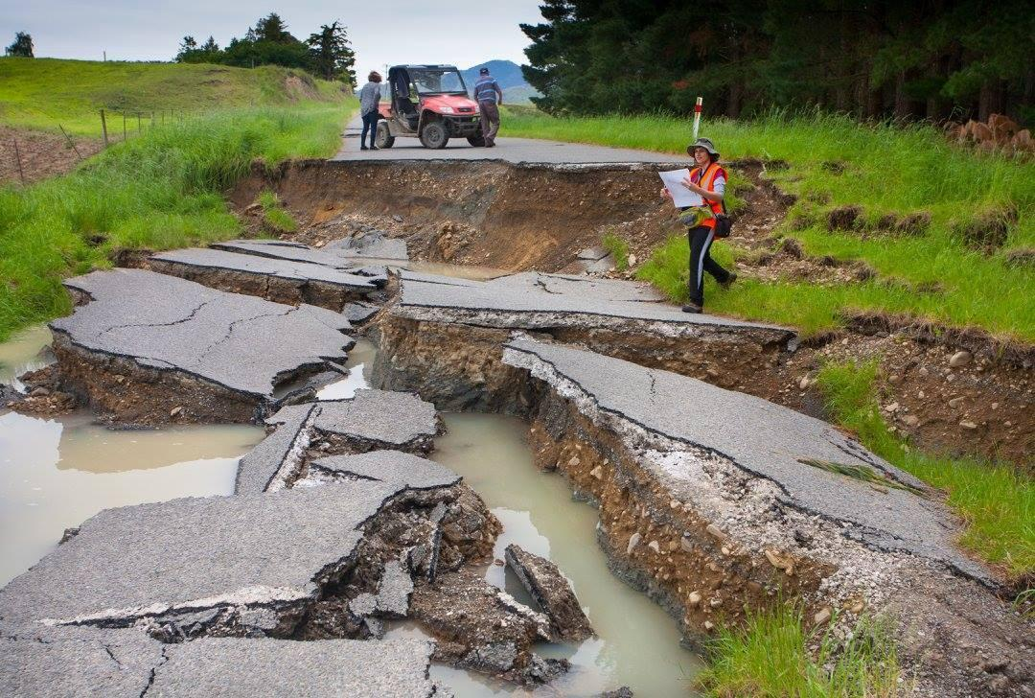
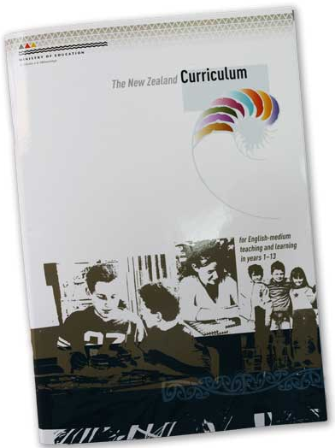
Curriculum connections
– where do natural hazards fit?
Planet Earth and Beyond: Earth systems and also interacting systems in the senior school.
Nature of Science includes the use of models for testing new materials and structures, the need to collect indirect evidence when formulating models of the Earth and the tentative nature
of science as evidenced in tectonic plates theory. It also requires students to look at and understand information presented in non-text formats such as maps and graphs.
Dr Katherine Pedley
© Steve Hathaway
Crown copyright
© Copyright. University of Waikato. All Rights Reserved | www.sciencelearn.org.nz
All images are copyrighted. For further information, please refer to enquiries@sciencelearn.org.nz
Notes:
Images from www.sciencelearn.org.nz/images/3275-new-zealand-earthquakes, www.sciencelearn.org.nz/images/2669-the-new-zealand-curriculum
This content also connects easily to other learning across the curriculum, especially in social studies – also, as natural hazards are almost by definition relatively unexpected, they can provide the ‘teachable moment’.

Slide 6
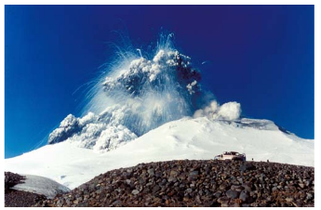
What are natural hazards?
© Steve Hathaway
Dougall Gordon
© Copyright. University of Waikato. All Rights Reserved | www.sciencelearn.org.nz
All images are copyrighted. For further information, please refer to enquiries@sciencelearn.org.nz
Notes:
Image from www.sciencelearn.org.nz/images/714-mt-ruapehu Rights: Dougall Gordon

Slide 7
What are natural hazards?
-some participant’s views
Natural landforms that can pose a risk e.g. geothermal activity etc.
Geological
events
Hazards and risks from natural proceses
Meteorological
events
Volcanoes
Lahars
Anything natural that causes potential problems with infrastructure, or could affect people's lives.
Tsunamis
© Steve Hathaway
Natural phenomena that has a negative impact on human lives due to proximity, scale, population location, etc.
Asteroid strikes
Earthquakes
Dougall Gordon
© Copyright. University of Waikato. All Rights Reserved | www.sciencelearn.org.nz
All images are copyrighted. For further information, please refer to enquiries@sciencelearn.org.nz
Notes:
Image from www.sciencelearn.org.nz/images/714-mt-ruapehu Rights: Dougall Gordon
Common threads – they are natural and can have some negative impact on human lives.

Slide 8
What are natural hazards?
“A natural hazard is a natural phenomenon that might have a negative effect on humans or the environment.”
(Wikipedia)
Geological hazards are linked to New Zealand’s location.
© Steve Hathaway
Dougall Gordon
© Copyright. University of Waikato. All Rights Reserved | www.sciencelearn.org.nz
All images are copyrighted. For further information, please refer to enquiries@sciencelearn.org.nz
Notes:
Image from www.sciencelearn.org.nz/images/714-mt-ruapehu Rights: Dougall Gordon
We are only going to look at geological hazards, not those related to weather and climate.

Slide 9
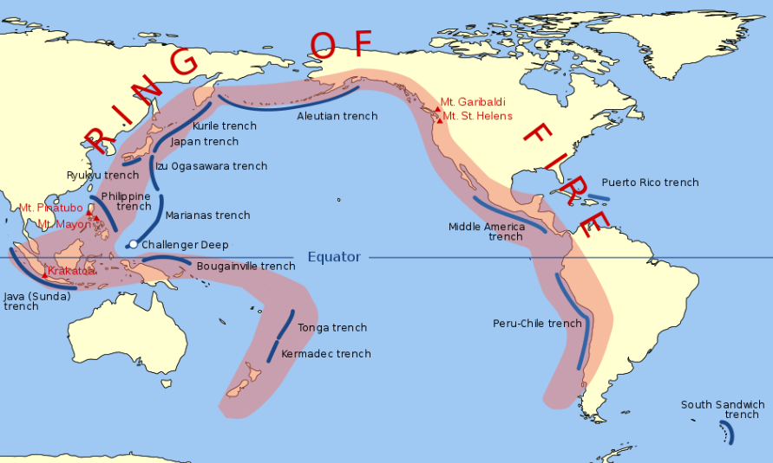
What causes natural hazards?
Pacific Ring of Fire
© Steve Hathaway
© Copyright. University of Waikato. All Rights Reserved | www.sciencelearn.org.nz
All images are copyrighted. For further information, please refer to enquiries@sciencelearn.org.nz
Notes:
Image from https://en.wikipedia.org/wiki/Ring_of_Fire#/media/File:Pacific_Ring_of_Fire.svg
Looking at our area of the world, we are part of the Pacific Ring of Fire – an area that runs right around the perimeter of the Pacific where there is increased risk of earthquakes (90% of all earthquakes in the world happen here), volcanoes (75% of all volcanic eruptions) and tsunamis (80% of all tsunamis also occur along the Ring of Fire).

Slide 10
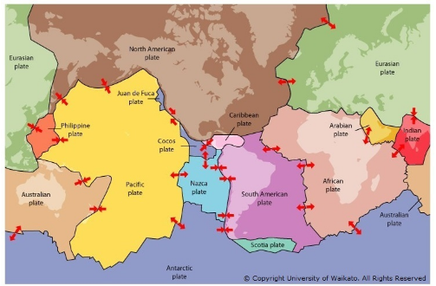
What causes natural hazards?
The Earth’s crust
© Steve Hathaway
© Copyright. University of Waikato. All Rights Reserved | www.sciencelearn.org.nz
All images are copyrighted. For further information, please refer to enquiries@sciencelearn.org.nz
Notes:
Image from www.sciencelearn.org.nz/images/350-tectonic-plate-boundaries - Rights UoW
The Earth’s crust is broken into huge pieces, called plates. These continually move against each other due to the forces underneath them. The forces underneath the top crust (in the mantle) are the movement of hot molten rocks, moving around like hot toffee. As fluid pressures change and morph in this molten layer, it then moves the crust above and causes the tectonic plates on it to shift. These movements cause volcanoes and earthquakes.

Slide 11
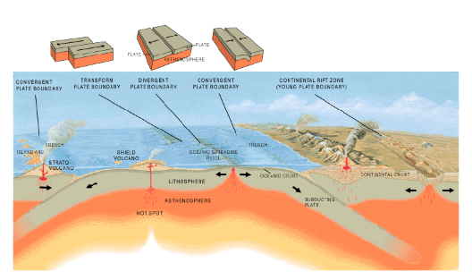
What causes natural hazards?
Plate boundaries
© Steve Hathaway
© Copyright. University of Waikato. All Rights Reserved | www.sciencelearn.org.nz
All images are copyrighted. For further information, please refer to enquiries@sciencelearn.org.nz
Notes:
Image from www.sciencelearn.org.nz/images/1721-three-types-of-plate-boundaries Rights US Geological Survey (USGS)
See also: www.sciencelearn.org.nz/resources/1426-the-moving-earth

Slide 12
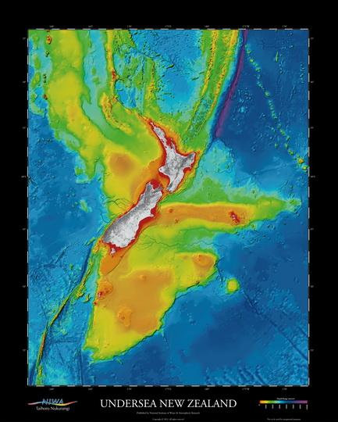
What causes natural hazards?
Plate boundaries
New Zealand lies across a plate boundary – where two sections of the Earth’s crust are moving against each other.
Most possible interactions between plates are happening underneath New Zealand.
- Subduction under the Central Plateau, extending up the coast under the Pacific as far as Tonga.
- Plates sliding past each other.
- Uplift in the South Island.
© Steve Hathaway
NIWA, Creative Commons 4.0
© Copyright. University of Waikato. All Rights Reserved | www.sciencelearn.org.nz
All images are copyrighted. For further information, please refer to enquiries@sciencelearn.org.nz
Notes:
Image from NIWA –poster: www.niwa.co.nz/media-gallery/detail/109673/34202
In New Zealand, the Australian and Pacific plates push against each other along a curving boundary. How they meet each other changes along the boundary. At the southern end of the South Island, the Australian plate dives down (subducts) below the Pacific plate, while in the North Island, the opposite situation occurs – with the Pacific plate being pushed under by the Australian plate. In between, through most of the South Island, the two plates grind past each other along the Alpine Fault as a transform fault, causing uplift and growing the mountain range.
In this image, you can see the continental shelf off the east coast of the North Island in yellow, which then drops down into a very deep Hikurangi trough (deep channel) shown in green and then blue. This runs from Kaikōura in the south all the way thousands of kilometres up to Tonga.

Slide 13
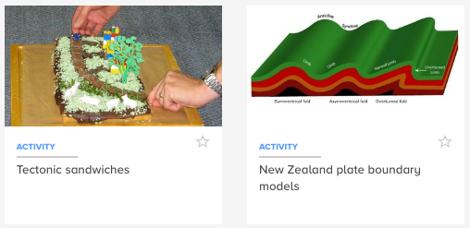
Some activities exploring plate boundaries
© Steve Hathaway
© Copyright. University of Waikato. All Rights Reserved | www.sciencelearn.org.nz
All images are copyrighted. For further information, please refer to enquiries@sciencelearn.org.nz
Notes:
Activities: www.sciencelearn.org.nz/resources/934-tectonic-sandwiches
www.sciencelearn.org.nz/resources/351-new-zealand-plate-boundary-models
There are a huge range of activities relevant to all of this.

Slide 14
Earthquakes
www.sciencelearn.org.nz/resources/2530-earthquakes-resources-planning-pathways
© Copyright. University of Waikato. All Rights Reserved | www.sciencelearn.org.nz
All images are copyrighted. For further information, please refer to enquiries@sciencelearn.org.nz
Notes:
Image from www.sciencelearn.org.nz/images/2951-waiau-fault-scarp
The country is frequently shaken by earthquakes. Most are small, but some have caused major damage. The earthquake resources on the Hub have been curated into a planning pathway www.sciencelearn.org.nz/resources/2530-earthquakes-resources-planning-pathways – an interactive map that can be used to explore different aspects of earthquakes – activities, videos, unit plans etc. under related aspects of the topic. Many of these have been written especially for different levels in the curriculum and focused on the New Zealand curriculum – including for teachers of junior students.

Slide 15
Volcanoes
www.sciencelearn.org.nz/resources/2525-volcanoes-resources-planning-pathways
© Copyright. University of Waikato. All Rights Reserved | www.sciencelearn.org.nz
All images are copyrighted. For further information, please refer to enquiries@sciencelearn.org.nz
Notes:
Image from www.sciencelearn.org.nz/images/837-heat-energy-is-in-volcanoes-and-ice
As with the earthquakes one, we have curated the collection of materials we have into the big science ideas around volcanoes (www.sciencelearn.org.nz/resources/2525-volcanoes-resources-planning-pathways) – each including a range of resources such as activities, videos, beautiful photos and articles explaining the science. We even have a special collection for teachers of senior secondary science at NCEA. We have PLD articles and webinars expanding both of these in more detail – regarding pedagogy and planning to cover these topics.

Slide 16
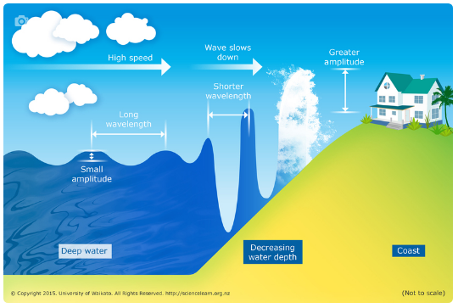
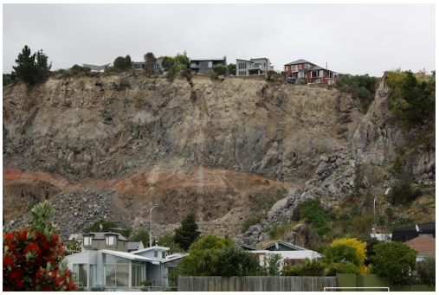
Associated hazards
Tsunamis
Tsunamis happen when the sea floor moves. This can happen due to volcanic eruptions and earthquakes.
Landslides
Many landslides happen because of earthquakes. Land that has been lifted by earthquakes can erode quickly, forming steep hillsides that are prone to landslides.
© Copyright. University of Waikato. All Rights Reserved | www.sciencelearn.org.nz
All images are copyrighted. For further information, please refer to enquiries@sciencelearn.org.nz
Notes:
Images from www.sciencelearn.org.nz/images/627-tsunami-shoaling - Rights: UoW and www.sciencelearn.org.nz/images/358-landslide-caused-by-earthquake Rights: UoW
A good example of these two hazards is the 7.8 Mw Kaikōura earthquake, which created a 7 m tsunami wave at Goose Bay and closed roads and rail into and out of Kaikōura in late 2016.

Slide 17
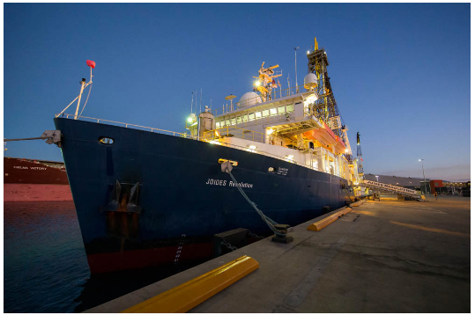
Researching about natural
hazards – JOIDES Resolution
Photo by Tim Fulton, IODP expedition 371
© Copyright. University of Waikato. All Rights Reserved | www.sciencelearn.org.nz
All images are copyrighted. For further information, please refer to enquiries@sciencelearn.org.nz
Notes:
Image from www.sciencelearn.org.nz/images/3347-the-science-vessel-joides-resolution Rights: Photo by Tim Fulton, IODP expedition 371. International Ocean Discovery Program (IODP) and JOIDES Resolution Science Operator (JRSO)
This ship, JOIDES Resolution, travels the world’s ocean doing earthquake, volcano and climate change science by drilling into the crust.

Slide 18
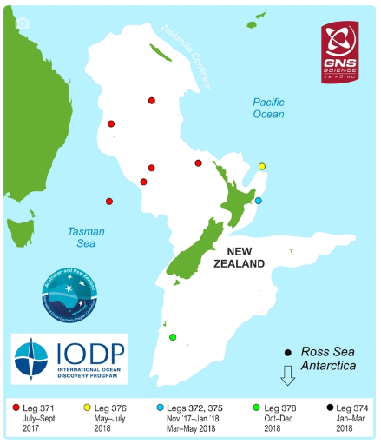
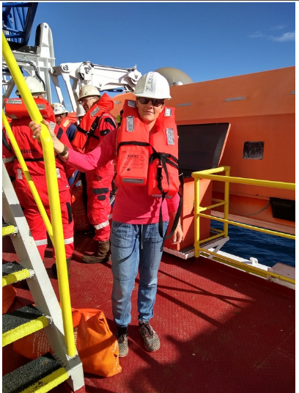
Researching hazards
Hikurangi subduction zone
– expedition #375
ANZIC, International Ocean Discovery Program (IODP) and GNS Science
The International Ocean Discovery Program, Aliki Weststrate
© Copyright. University of Waikato. All Rights Reserved | www.sciencelearn.org.nz
All images are copyrighted. For further information, please refer to enquiries@sciencelearn.org.nz
Notes:
Image from www.sciencelearn.org.nz/images/3349-researching-in-new-zealand-s-waters (GNS)
and www.sciencelearn.org.nz/images/3483-aliki-during-a-lifeboat-drill-on-board-joides-resolution Rights: The International Ocean Discovery Program, Aliki Weststrate.
There aren’t many of these ships in the world that can drill this deep AND have high-tech labs on board for scientists to do instant analysis of the cores. They also do a lot of post-cruise research back home with the samples they take from the cores (which they have posted to their home countries).
The expedition #375 was to better understand the Hikurangi subduction zone because it is potentially the largest source of earthquake and tsunami hazard in New Zealand.

Slide 19
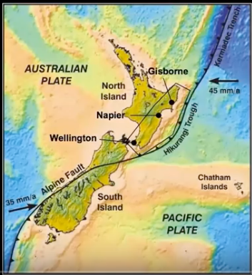
Where were you?
© Copyright. University of Waikato. All Rights Reserved | www.sciencelearn.org.nz
All images are copyrighted. For further information, please refer to enquiries@sciencelearn.org.nz
Notes:
Image screen shot from video
Expedition #375 was just east of Gisborne – at 4 sites ranging 30 km to 100 km from the shore. On the map, the expedition was roughly where the black triangle is east of Gisborne city, right on top of the subducting Pacific plate. This place was chosen because the fault zone is so shallow near Gisborne, it is the best place to study slow slip events (also referred to as slow earthquakes or silent earthquakes).

Slide 20
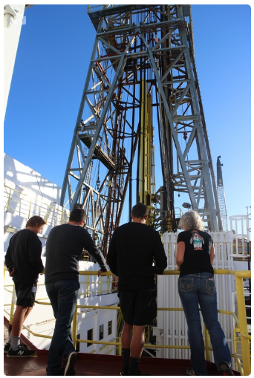
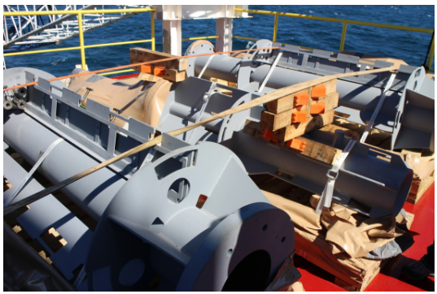
What technology did you use?
© Copyright. University of Waikato. All Rights Reserved | www.sciencelearn.org.nz
All images on this page were taken by Aliki Weststrate and are the property of The International Ocean Discovery Program. For further information, please refer to enquiries@sciencelearn.org.nz
Notes:
Images from www.sciencelearn.org.nz/images/3352-gns-science
and www.sciencelearn.org.nz/images/3484-the-derrick-tower-with-a-yellow-drill-pipe-on-board-joides-resolution
and www.sciencelearn.org.nz/images/3508-free-fall-tunnel-part-of-the-cork-observatory
and www.sciencelearn.org.nz/images/3512-te-matakite-observatory-parts-on-deck Rights: The International Ocean Discovery Program, Aliki Weststrate.
JOIDES Resolution is an amazing science ship – it is quite industrial with a 60 m high drill tower and hundreds of drill pipes that are connected together by a drill team using heavy machinery, but then inside there are high-tech labs that study the core’s physical properties, magnetic properties, fossils, structure and chemistry.

Slide 21
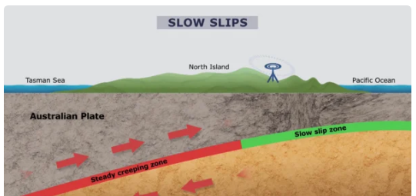
What are slow slips,
and why study them?
Slow slips are movements of the land that are happening so slowly that we can’t feel them.
© Copyright. University of Waikato. All Rights Reserved | www.sciencelearn.org.nz
All images are copyrighted. For further information, please refer to enquiries@sciencelearn.org.nz
Notes:
Images from www.sciencelearn.org.nz/videos/1756-slow-slip-event-an-animation and www.sciencelearn.org.nz/images/355-slip-deficit-in-the-north-island
From article: www.sciencelearn.org.nz/resources/341-what-are-slow-slips

Slide 22
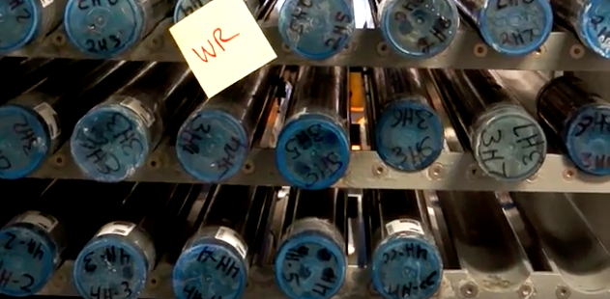
What did you find out?
The International Ocean Discovery Program, Aliki Weststrate
© Copyright. University of Waikato. All Rights Reserved | www.sciencelearn.org.nz
All images are copyrighted. For further information, please refer to enquiries@sciencelearn.org.nz
Notes:
Image from 1m12s in the video
www.youtube.com/watch?v=67i7_g2TPRs&index=20&list=PLroDmZEKRHPNmk3D8dKdZFqUaSxzQ-5ks
All the objectives that they set were achieved.

Slide 23
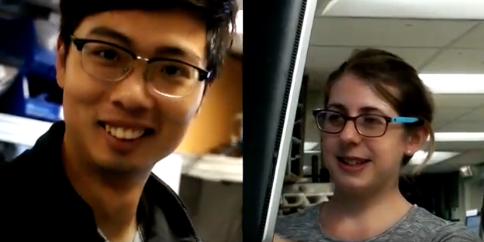
What were the challenges?
© Copyright. University of Waikato. All Rights Reserved | www.sciencelearn.org.nz
All images are copyrighted. For further information, please refer to enquiries@sciencelearn.org.nz
Notes:
Image – screenshot at 1m58s in the same video.
This is Nature of Science in action – collaboration toward a common goal. We had 32 earthquake experts from countries around the world on board, doing their specialist science. They worked together as a team from their different angles, and together, they were putting the pieces together like a puzzle.

Slide 24
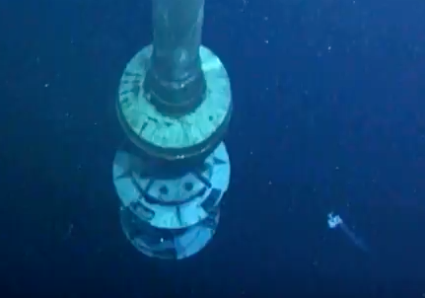
What next – for science?
© Copyright. University of Waikato. All Rights Reserved | www.sciencelearn.org.nz
All images are copyrighted. For further information, please refer to enquiries@sciencelearn.org.nz
Notes:
Image from 3m06s in the same video
The trip gives scientists heaps of new data to work on for the next 5–10 years.

Slide 25
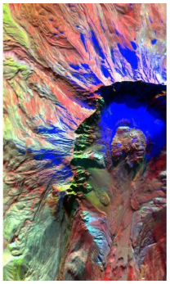
What next – in the classroom?
How could we use all this in our classroom?
How do we use videos, images etc. to stimulate curiosity?
Who noticed the creatures in the sea in the last slide/video? Is there an opportunity here to go off on a tangent – what else might the scientists have found?
How could stories like this be used in the classroom?
What might we do next?
NASA
© Copyright. University of Waikato. All Rights Reserved | www.sciencelearn.org.nz
All images are copyrighted. For further information, please refer to enquiries@sciencelearn.org.nz
Notes:
Image from www.sciencelearn.org.nz/images/1970-nasa-infrared-image-of-mount-st-helens - NASA

Slide 26
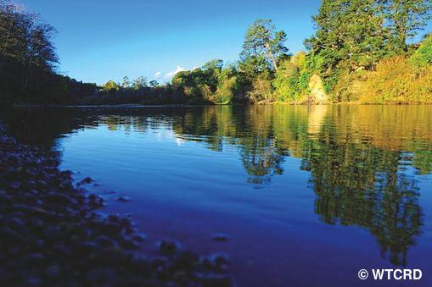
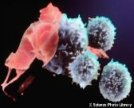
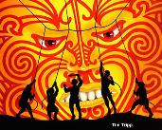
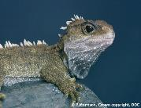
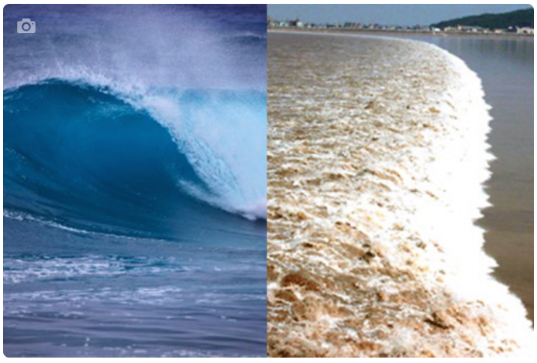
Thanks – keep in touch
Science Learning Hub
Contact Aliki aliki@outerreaches.co.nz
Read more here.
Email us on enquiries@sciencelearn.org.nz
https://twitter.com/NZScienceLearn
www.facebook.com/nzsciencelearn
https://nz.pinterest.com/nzsciencelearn/
www.pond.co.nz/community/214015/science-learning-hub/
Join us in our natural hazards discussion channel on Slack.
(This link may expire: if it does, contact us via our enquiries email, and we will send you a new link.)

