Slide 1
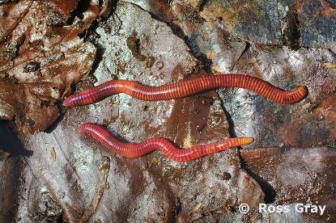
Common New Zealand earthworms
Tiger worm
The tiger worm gets its name from its red and yellow striped body.
It is most commonly found in compost piles, living close to the surface of the soil. Tiger worms will not live for long if transplanted into normal soil.
Tiger worms are cultivated and sold as compost worms. They reproduce easily provided they have plenty of food.
Scientific name: Eisenia fetida
Common name: tiger worm
Status: introduced
Soil niche: epigeic
Length: 30–130 mm

Slide 2
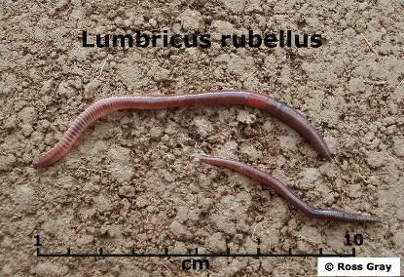
Common New Zealand earthworms
Dung worm
The dung worm is a reddish brown colour with a purple sheen. It is iridescent in bright light and has a red saddle. It is active when disturbed.
The dung worm lives in the upper 5 cm of soil but is also found in cow pats or in horse manure.
Very common in New Zealand.
Scientific name: Lumbricus rubellus
Common name: dung worm
Status: introduced
Soil niche: epigeic
Length: 25–150 mm

Slide 3
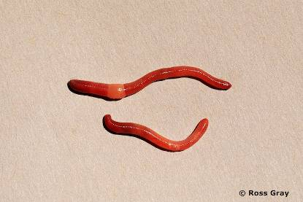
Common New Zealand earthworms
Bark worm
The bark worm is a litter-dwelling earthworm.
It is short, bright red and has faint yellow colouring near the tip of its tail.
The bark worm produces around 40–100 cocoons (egg cases) per year. This is a lot compared to some other earthworms. Bark worms live close to the soil surface so their young have a reduced chance of survival due to predation, temperature changes or drought.
Scientific name: Dendrodrilus rubidus
Common name: bark worm
Status: introduced
Soil niche: epigeic
Length: 20–100 mm

Slide 4
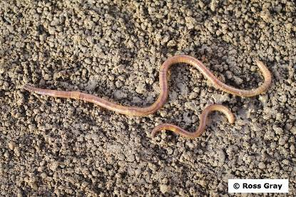
Common New Zealand earthworms
Snake worm
The snake worm gets its name from its long, slender body and its habit of writhing like a snake when it is disturbed.
The snake worm is greenish brown in colour and lives at or near the soil surface.
Scientific name: Amynthas corticus
Common name: snake worm
Status: introduced
Soil niche: epigeic
Length: 70–180 mm

Slide 5
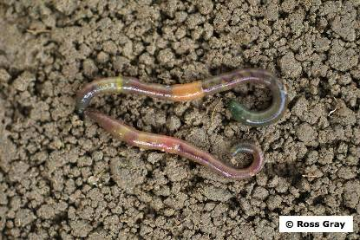
Common New Zealand earthworms
Green worm
The green worm is greenish brown in colour. The colouration works as camouflage, helping to protect the earthworm from predators.
The green worm coils stiffly when disturbed.
Scientific name: Allolobophora chlorotica
Common name: green worm
Status: introduced
Soil niche: endogeic
Length: 40–70 mm

Slide 6
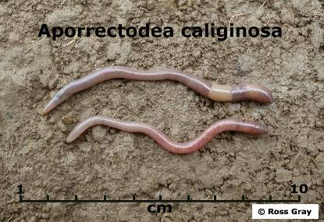
Common New Zealand earthworms
Grey worm
The grey worm is the most common earthworm in New Zealand. It is grey with a dark pink head.
It ingests (eats) large amounts of soil and the organic matter in it.
Grey worms live in the top 20–30 cm of soil. They are common in pastures throughout the country.
Scientific name: Aporrectodea caliginosa
Common name: grey worm
Status: introduced
Soil niche: endogeic
Length: 40–100 mm

Slide 7
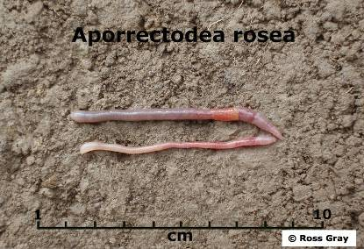
Common New Zealand earthworms
Pink worm
The pink worm is small. It has a pale pink head and tail. Its clitellum – the glandular ring or saddle near the head – is dark, pinkish orange.
The pink worm lives in the top 20–30 cm depth of soil. Like other endogeic species, these earthworms burrow through the soil, creating channels for air, water and plant roots.
It eats plant matter found in the soil.
Scientific name: Aporrectodea rosea
Common name: pink worm
Status: introduced
Soil niche: endogeic
Length: 25–85 mm

Slide 8
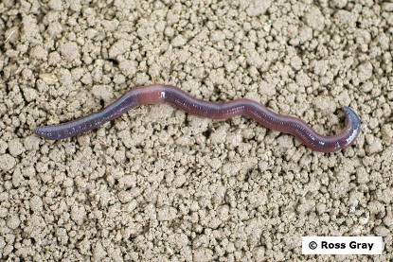
Common New Zealand earthworms
Southern worm
The southern worm is dark greyish brown in colour.
It lives in the top 20–30 cm of soil. It ingests (swallows) soil as it burrows, eating the organic matter. The soil passes through the earthworm’s digestive system. The digestion process can change soil nutrients into a form more accessible to plants.
Scientific name: Aporrectodea trapezoides
Common name: southern worm
Status: introduced
Soil niche: endogeic
Length: 40–90 mm

Slide 9
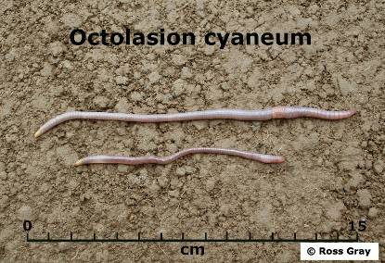
Common New Zealand earthworms
Yellow tail worm
The yellow tail worm is pale grey in colour. It has a distinctive yellow tip at the end of its tail.
The yellow tail earthworm is endogeic, living within the top 20–30 cm of soil. It is widespread throughout New Zealand but less common than the grey worm or dung worm.
Scientific name: Octolasion cyaneum
Common name: yellow tail
Status: introduced
Soil niche: endogeic
Length: 65–180 mm

Slide 10
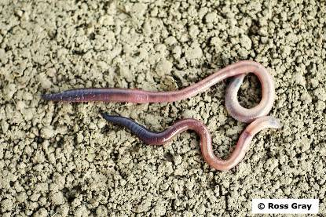
Common New Zealand earthworms
Blackhead worm
The blackhead worm is a large earthworm. It is dark greyish brown in colour with a distinctive black head.
Blackhead earthworms are deep burrowers. Their burrows can extend as deep as 3 metres. They look for food on the soil surface and then drag it down into their burrows. They tend to make permanent or semi-permanent burrows.
Scientific name: Aporrectodea longa
Common name: blackhead worm
Status: introduced
Soil niche: anecic
Length: 90–120 mm

Slide 11
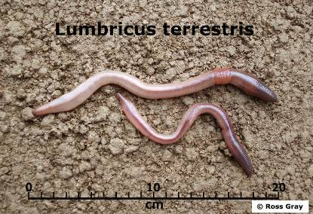
Common New Zealand earthworms
Nightcrawler
The nightcrawler is a very large earthworm. It is reddish brown with a purple sheen and appears iridescent in bright light.
It is a deep-burrowing earthworm. Nightcrawlers feed on the soil surface. They pull leaves and other organic materials down into their burrows. Nightcrawlers are useful in orchards, where they remove leaves that fall to the ground.
Scientific name: Lumbricus terrestris
Common name: nightcrawler
Status: introduced
Soil niche: anecic
Length: 90–300 mm

Slide 12
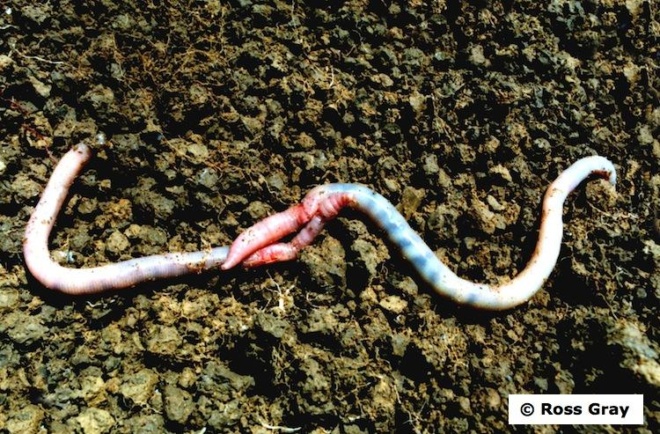
Common New Zealand earthworms
Octochaetus multiporus
O. multiporus is native to New Zealand. It is a large earthworm, growing up to 30 cm in length and 1 cm in diameter. It is pale in colour with a purple streak that runs along the top of its body.
O. multiporus lives in the subsoil at depths of 3–5 metres. It makes extensive, permanent burrows.
O. multiporus is bioluminescent. When disturbed, it squirts out a bright yellow-orange fluid that glows in the dark. Maori traditionally used O. multiporus as baits and fishing lures.
Scientific name: Octochaetus multiporus
Status: native
Soil niche: anecic
Length: up to 300 mm

Slide 13
Common New Zealand earthworms
The Science Learning Hub would like to thank Ross Gray for the use of his images for this activity.

