Slide 1
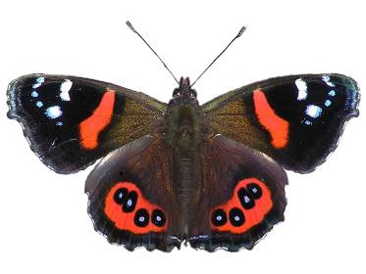
Red admiral
New Zealand native butterflies
The red admiral is a common sight
between September and April. It feeds on
nectar plants and tree sap.
Larvae feed on stinging nettles, pulling the
leaves around themselves with a silk thread
to form tents.
Red admirals are long-lived and overwinter
as adults. Several generations are
produced each year.
Kahukura means ‘red cloak’.
© Tony Wills
Scientific name: Vanessa gonerilla gonerilla Fabricus
Māori name: Kahukura
Distribution: throughout New Zealand
Habitat: gardens, open country forests
Wingspan: 50–60mm

Slide 2
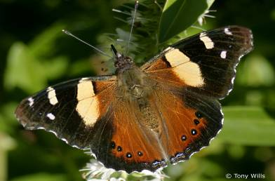
Yellow admiral
New Zealand native butterflies
A migratory native that also occurs in Australia. Local population numbers may be boosted by migrants crossing the Tasman Sea.
Larvae feed on any of the nettle species. They hang down in a ‘J’ position for 2 days before pupating.
Easy to raise if you have their larval food plant.
Kahukōwhai means ‘yellow cloak’.
Scientific name: Vanessa itea Fabricus
Māori name: kahukōwhai
Distribution: throughout New Zealand
Habitat: low altitude open country and gardens
Wingspan: 48–55mm

Slide 3
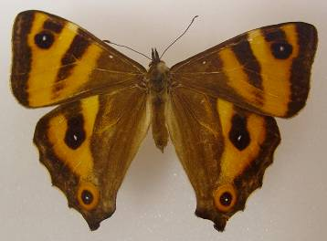
Forest ringlet
New Zealand native butterflies
Once common, the forest ringlet population is decreasing – wasps are the most probable cause.
Larvae feed largely at night on sedges, bush tussock and cutty grass. Larvae hibernate over winter.
They fly on sunny days and sunbathe near
the tree tops. Females move to the forest floor to lay eggs.
Scientific name: Dodonidia helmsii Butler
Distribution: Lewis Pass and a few colonies in the North Island
Habitat: tree tops and edges of beech forest glades
Wingspan: 40–64mm

Slide 4
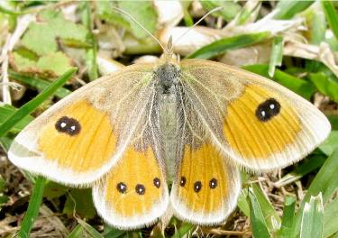
Common tussock
New Zealand native butterflies
The common tussock is a weak flier. It
‘crash lands’ into the grass and has to find
its footing.
The 3 tussock species occupy distinctive
geographical areas in the South Island.
Larvae feed on a number of tussock plants.
They are slow eaters.
The larvae, pupae and adults are well
camouflaged.
Scientific name: Argyropenga antipodum Doubleday
Distribution: Southern Alps on the eastern side of the divide
Habitat: lowland swamps and grasslands, tussocklands to 1,600m
Wingspan: 31–46mm

Slide 5
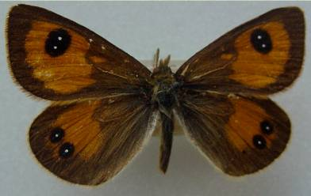
Janita’s tussock
New Zealand native butterflies
The Janita’s tussock is a weak flier. It
‘crash lands’ into the grass and has to find
its footing.
The 3 tussock species occupy distinctive
geographical areas in the South Island.
Janita’s tussock overlaps the territories of
the other 2 tussocks.
Larvae feed on snow tussock. They are slow
eaters.
The larvae, pupae and adults are well
camouflaged.
Scientific name: Argyropenga janitae Craw
Distribution: eastern Southern Alps from Nelson to North Otago
Habitat: tussocklands between 500–2,000m
Wingspan: 31–45mm

Slide 6
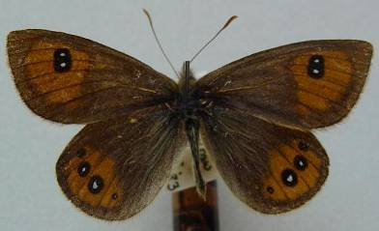
Harris’s tussock
New Zealand native butterflies
This rare butterfly is found in a few South
Island locations. Its distribution overlaps
with Janita’s tussock.
Harris’s tussock prefers wetter areas than
the common tussock.
Larvae feed on snow tussock. They are slow
eaters.
The larvae, pupae and adults are well
camouflaged.
Scientific name: Argyropenga harrisi Craw
Distribution: north-west Nelson, Mt Owen and Lewis Pass
Habitat: tussocklands between 800–2,000m
Wingspan: 33–44mm

Slide 7
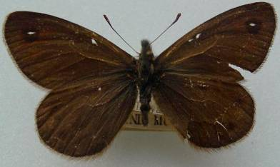
Butler’s ringlet
New Zealand native butterflies
This rare butterfly is difficult to find due to
camouflage and its boggy mountain habitat.
Experts are unsure of its larval food plant.
Final instar larvae eat snow tussock but first instar larvae do not.
The larvae are slow, intermittent feeders who are thought to feed at night.
Females only fly short distances and only fly on sunny days.
Scientific name: Erebiola butleri Fereday
Māori name: pepe pōuri
Distribution: subalpine tussock along the main dividing range of the Southern Alps
Habitat: damp terraces of scrub and tussock from 900–1,300m
Wingspan: 39–54mm

Slide 8
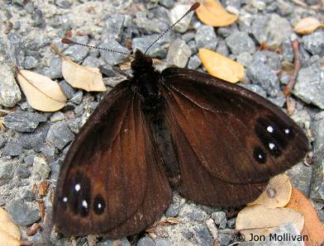
Black mountain ringlet
New Zealand native butterflies
New Zealand’s high-altitude butterfly.
The only New Zealand butterfly to lay its
eggs on rocks to maximise the sun’s warmth
for quicker development.
The larvae feed on blue tussock grass. They
feed at night to avoid predation by birds.
The pupae are suspended beneath rocks for
warmth.
Adults have thick, hairy bodies to act as
insulation.
Scientific name: Percnodaimon merula Hewitson
Māori name: pepe pōuri
Distribution: rocky slopes of South Island mountains 800–2,000m
Habitat: sunny, rocky scree slopes
Wingspan: 39–54mm

Slide 9
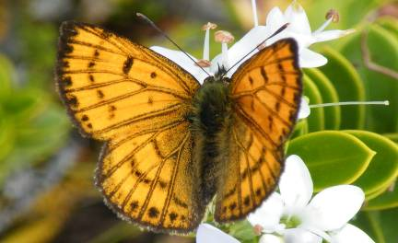
Common copper
New Zealand native butterflies
A common butterfly found throughout the
country within reasonable distance of its
larval food plant pōhuehue, the
Muehlenbeckia species.
Adults are short-lived with 1–2 week life
spans.
Common coppers can have 3 generations
per year in favourable conditions.
They overwinter as pupae.
Scientific name: Lycaena salustius Fabricius
Māori name: pepe para riki
Distribution: throughout New Zealand to 2,000m
Habitat: open country
Wingspan: 24–33mm

Slide 10
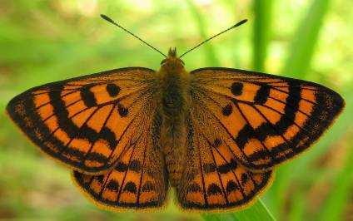
Rauparaha’s copper
New Zealand native butterflies
Named after Te Rauparaha because the
butterfly was initially found along the
coastline associated with his travels.
Larvae feed on pōhuehue (Muehlenbeckia
species), a semi-deciduous plant. Larvae
probably overwinter at the base of the plant
and feed once plant growth begins in spring.
The pupae do not hang. They hide in dry
litter or stones on the ground.
Scientific name: Lycaena rauparaha Fereday
Māori name: mokarakare
Distribution: western and northern coastline in the North Island,
Golden Bay to North Canterbury in the South Island
Habitat: coastal dunes with mixed vegetation
Wingspan: 25–31mm

Slide 11
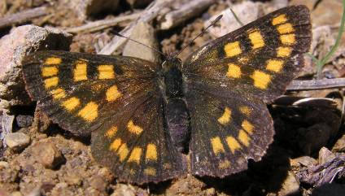
Glade copper
New Zealand native butterflies
The glade copper gets its name from its
habitat – forest glades, gullies and around
streams.
Larvae feed only on the large-leafed
pōhuehue (Muehlenbeckia australis).
The pupae hide in a tent of pōhuehue leaves
bound together by silk.
Adults live for 7 days.
Scientific name: Lycaena feredayi Bates
Māori name: pepe para riki
Distribution: throughout much of New Zealand
Habitat: forest glades, gullies and along water courses
Wingspan: 25–32mm

Slide 12
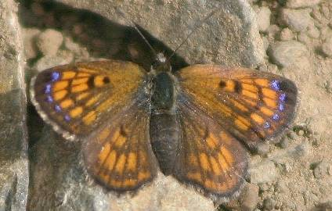
Boulder copper
New Zealand native butterflies
The boulder copper is the smallest of the
coppers. It is a ground dwelling-butterfly
that likes to bask on warm stones. Its
upper wings are purple but the underside
provides good camouflage.
Larvae feed on creeping pōhuehue
(Muehlenbeckia axillaris).
Pupae hide on the ground in dry litter or
stones.
There may be 3 generations in favourable
years.
Scientific name: Boldenaria boldenarum White
Māori name: pepe para riki
Distribution: throughout the South Island and central areas of the North Island
Habitat: tussock and shingle areas, braided rivers and roadsides
Wingspan: 17–27mm

Slide 13
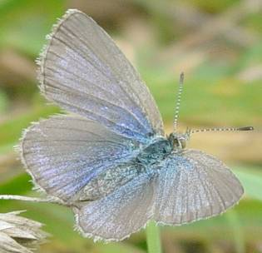
Common blue
New Zealand native butterflies
The common blue is probably our most
common butterfly. The combination of its
small size and its habit of hugging the
ground mean it is often out of our vision.
Larvae eat clovers, trefoils and lucerne.
They can be considered a pest because
they reduce pasture production.
Females are a duller, grey colour.
This blue butterfly is also found in
Australia and the western Pacific.
Scientific name: Zinzina labradus Godart
Māori name: pepe ao uri
Distribution: throughout the North and South Islands, but absent in
inland Canterbury and Central Otago
Habitat: open grassy places, roadside, riverbeds
Wingspan: 17–27mm

Slide 14
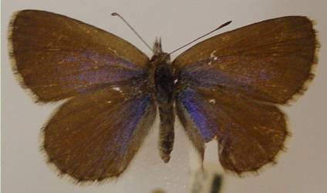
Southern blue
New Zealand native butterflies
The southern blue evolved and adapted to
New Zealand’s indigenous grasslands.
Where land was cleared for farming, the
southern blue has been displaced by the
common blue.
Larvae eat native broom, clovers and trefoils.
If they run out of food, they can pupate
successfully, resulting in a smaller adult.
Scientific name: Zizina oxleyi C&R Felder
Distribution: east of Southern Alps from North Canterbury to northern Southland
Habitat: bare, dry stony places, lowland riverbeds, tussocklands
Wingspan: 17–21mm

Slide 15
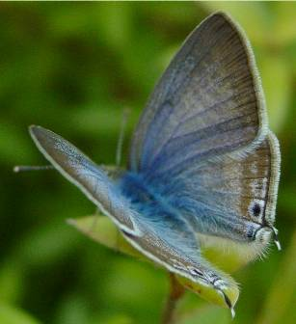
Long-tailed blue
New Zealand native butterflies
The long-tailed blue was first spotted on
Waiheke Island in 1965. It is self-introduced so it’s considered a native.
Eggs are laid on unopened flower buds.
Larvae eat the flower buds and soft, immature seeds of broom, peas, sweet peas, broad beans, gorse, lupins and tree lucernes.
Scientific name: Lampides boeticus Linnaeus
Distribution: throughout the North Island and top of the South Island
Habitat: open country and garden where its food plant grows
Wingspan: 20–36mm

Slide 16
New Zealand native butterflies
The Science Learning Hub would like to thank the following for the use of their images for this activity
Tony Wills Red and yellow admiral
Landcare Research Forest ringlet
Jerome Albre Common tussock
Robert Arter-Williamson Janita’s tussock
Harris’s tussock
Butler’s ringlet
Jon Sullivan Black mountain ringlet
Norm Twigge Common copper
Jerome Albre Rauparaha’s copper
Tony Wills Glade copper
Mike Lusk Boulder copper
Robert Arter-Williamson Common blue
Southern blue
Long tailed blue

