Slide 1
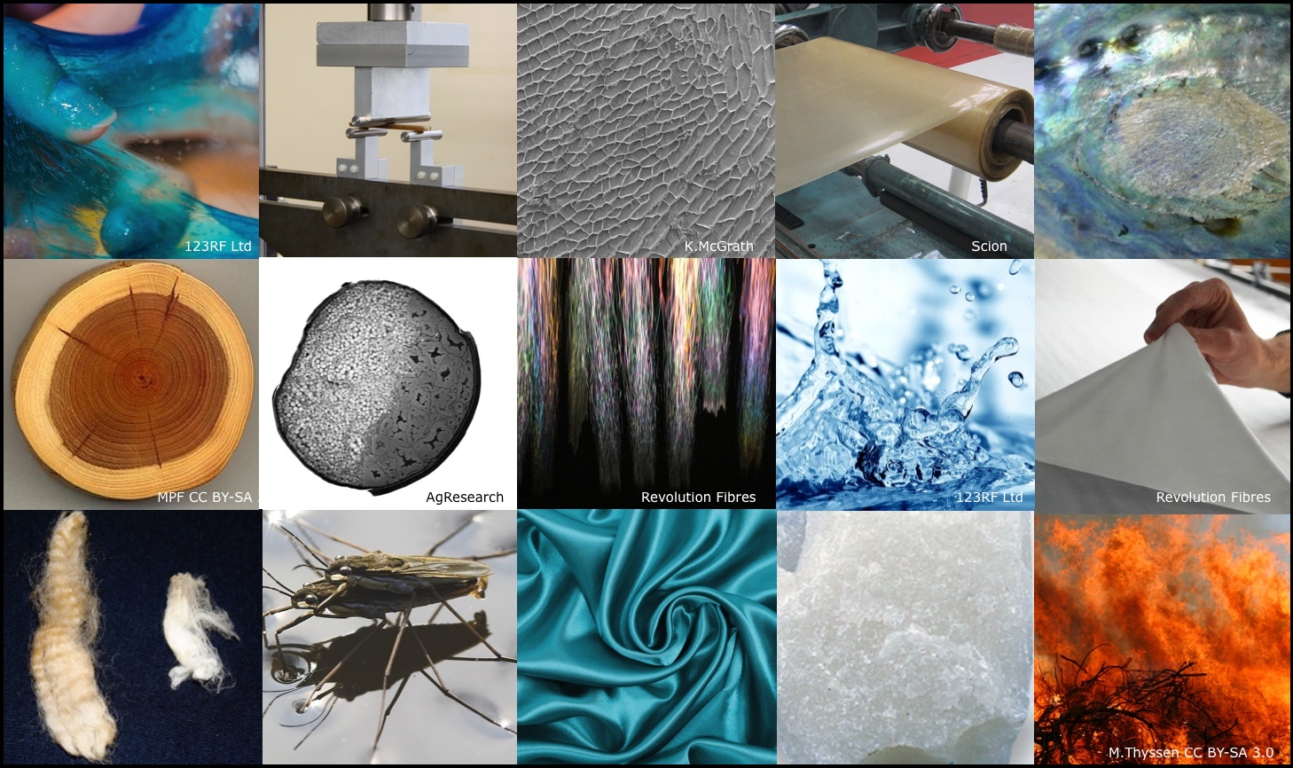
Chemistry made simple – properties of matter
© Steve Hathaway
Greta Dromgool
4–4.45pm Thursday 23 August
© Copyright. University of Waikato. All Rights Reserved | www.sciencelearn.org.nz
All images are copyrighted. For further information, please refer to enquiries@sciencelearn.org.nz

Slide 2
Index
Topic | PowerPoint slide number(s ) | Video timecode
Introducing the Science Learning Hub and presenters | 1 | 00:00
Index | 2 | 00:06
Purpose | 3 | 00:30
Teacher experiences of teaching and learning chemistry | 4–5 | 01:31
NZ curriculum levels 1 and 2 – exploring common materials | 6–9 | 03:20
Properties of materials | 10–14 | 06:16
Changing materials | 15–17 | 13:34
NZ curriculum levels 3 and 4 – measuring and grouping | 18–21 | 16:54
NZ curriculum level 5 – investigating groups of materials | 22–31 | 25:00
SLH links, keep in touch and thanks | 32–33 | 31:11
© Copyright. University of Waikato. All Rights Reserved | www.sciencelearn.org.nz
All images are copyrighted. For further information, please refer to enquiries@sciencelearn.org.nz

Slide 3
Purpose
In this webinar, we will support you to build your knowledge and confidence by:
identifying properties of a range of different materials
grouping materials based on observed or measured properties.
We will also:
provide opportunities for questions and checking your understanding
explore additional resources available to support you.
© Copyright. University of Waikato. All Rights Reserved | www.sciencelearn.org.nz
All images are copyrighted. For further information, please refer to enquiries@sciencelearn.org.nz

Slide 4
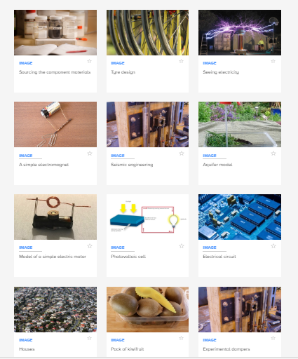
Science can be overwhelming
© Copyright. University of Waikato. All Rights Reserved | www.sciencelearn.org.nz
All images are copyrighted. For further information, please refer to enquiries@sciencelearn.org.nz

Slide 5
Teachers’ experiences of learning chemistry.
I learnt some chemistry at teachers college
I got help from other expert teachers and from PLD
I have done reading around the topics as I have to teach them
High school and I never understood it!
© Copyright. University of Waikato. All Rights Reserved | www.sciencelearn.org.nz
All images are copyrighted. For further information, please refer to enquiries@sciencelearn.org.nz

Slide 6
What does the curriculum say?
Level | Achievement objectives
1&2 | Observe, describe, and compare physical and chemical properties of common materials and changes that occur when materials are mixed, heated, or cooled.
3&4 | Group materials in different ways, based on the observations and measurements of the characteristic chemical and physical properties of a range of different materials.
5 | Investigate the chemical and physical properties of different groups of substances, for example, acids and bases, fuels, and metals. Distinguish between pure substances and mixtures and between elements and compounds.
© Copyright. University of Waikato. All Rights Reserved | www.sciencelearn.org.nz
All images are copyrighted. For further information, please refer to enquiries@sciencelearn.org.nz

Slide 7
What are some common materials?
© Copyright. University of Waikato. All Rights Reserved | www.sciencelearn.org.nz
All images are copyrighted. For further information, please refer to enquiries@sciencelearn.org.nz
Notes:
Air, water, metals, plastics, glass, ceramics, rocks, petroleum, organic (page 348, Skamp and Preston, 2014).

Slide 8
Teacher ideas of common materials
Air and other gases?
Fabrics like wool
Rocks and minerals
Organic materials, like ones from plants
Metals, plastics and glass
Water?
© Copyright. University of Waikato. All Rights Reserved | www.sciencelearn.org.nz
All images are copyrighted. For further information, please refer to enquiries@sciencelearn.org.nz
Notes:
Air, water, metals, plastics, glass, ceramics, rocks, petroleum, organic (page 348, Skamp and Preston, 2014).

Slide 9
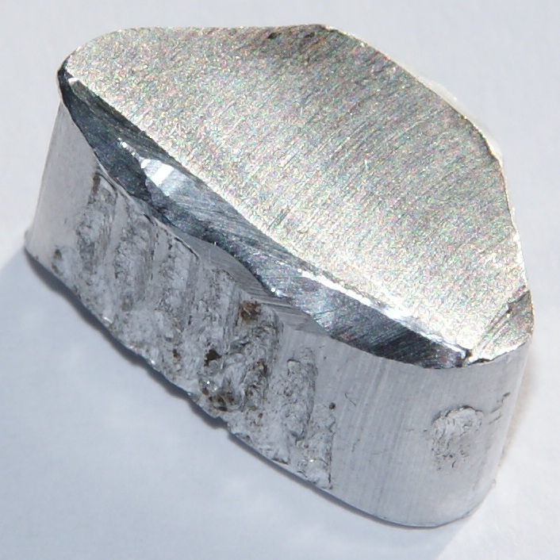
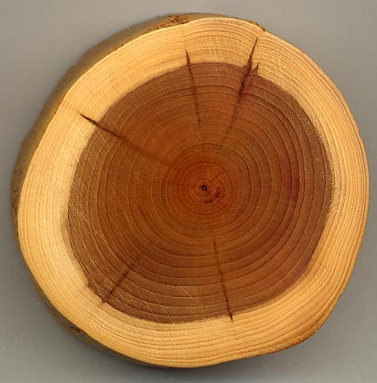
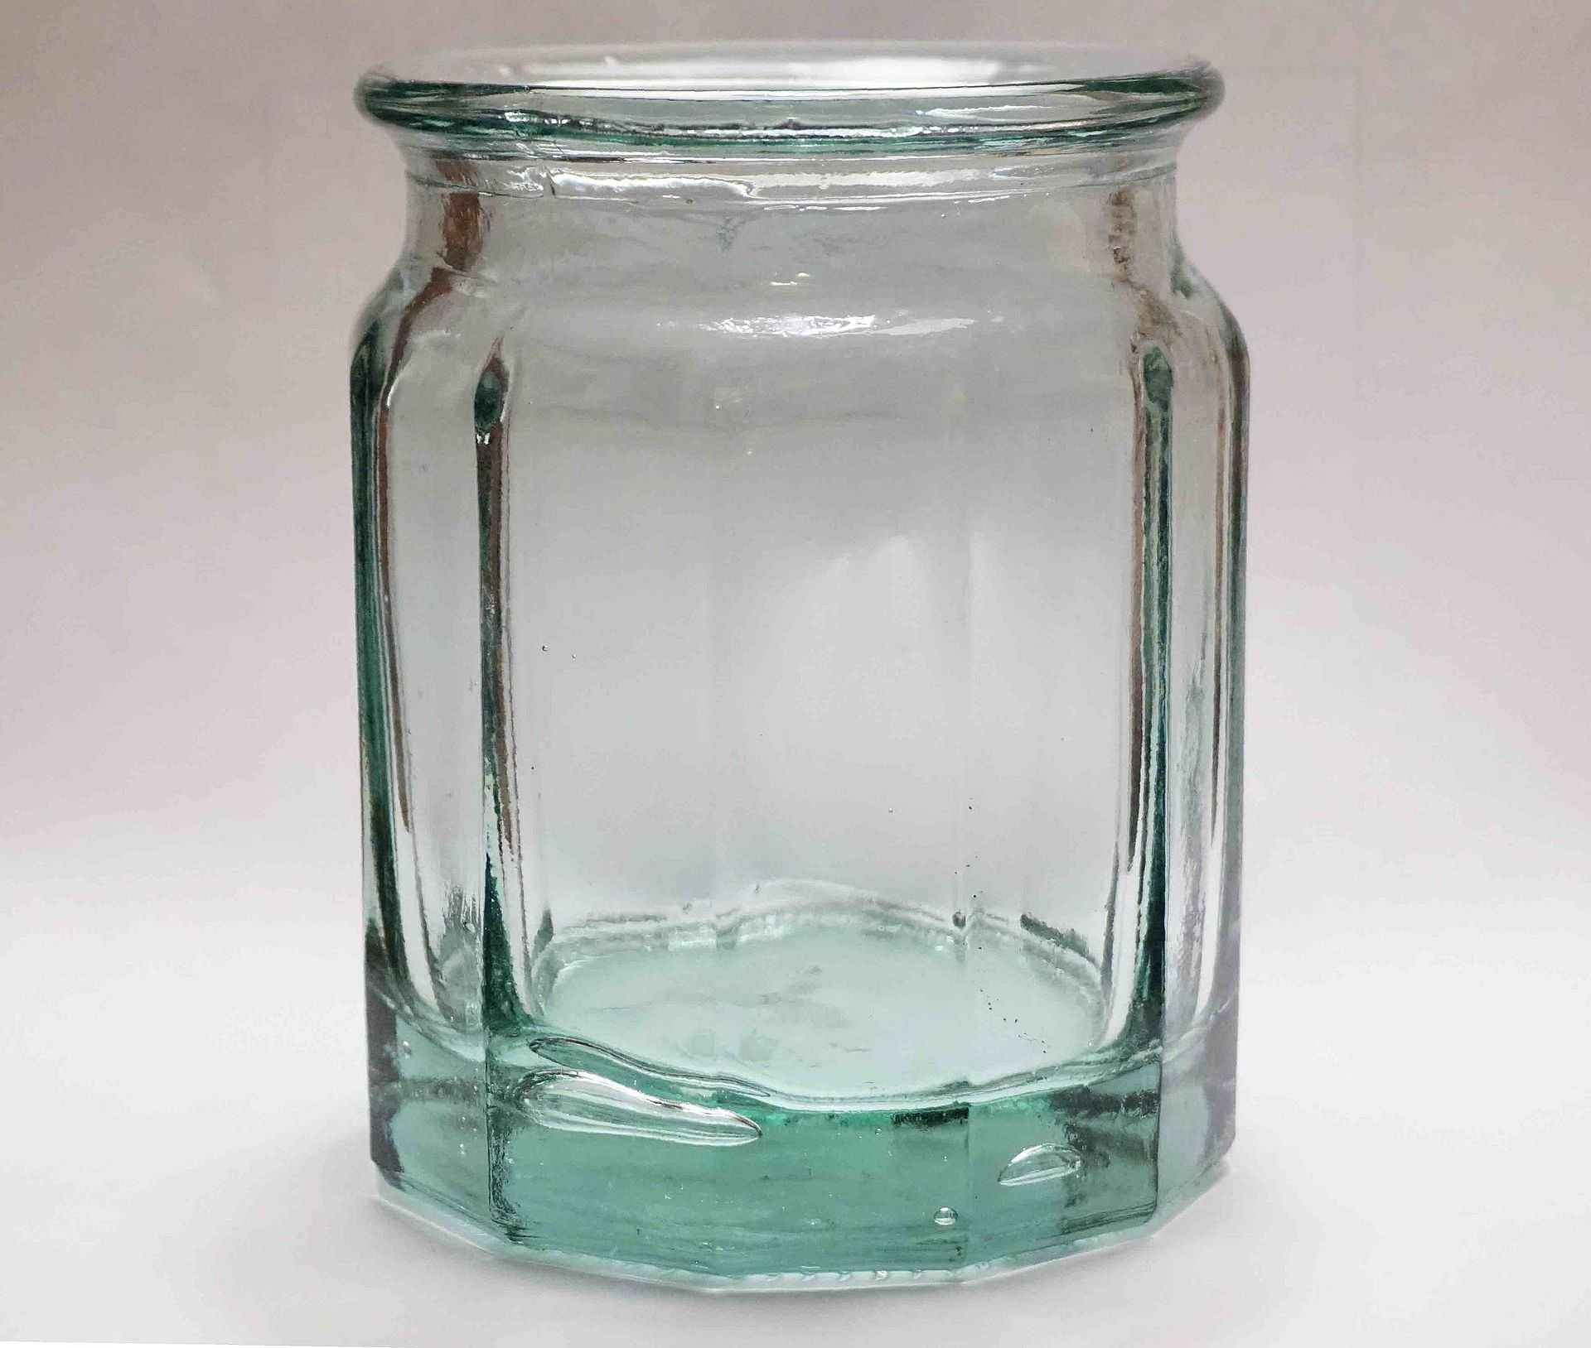
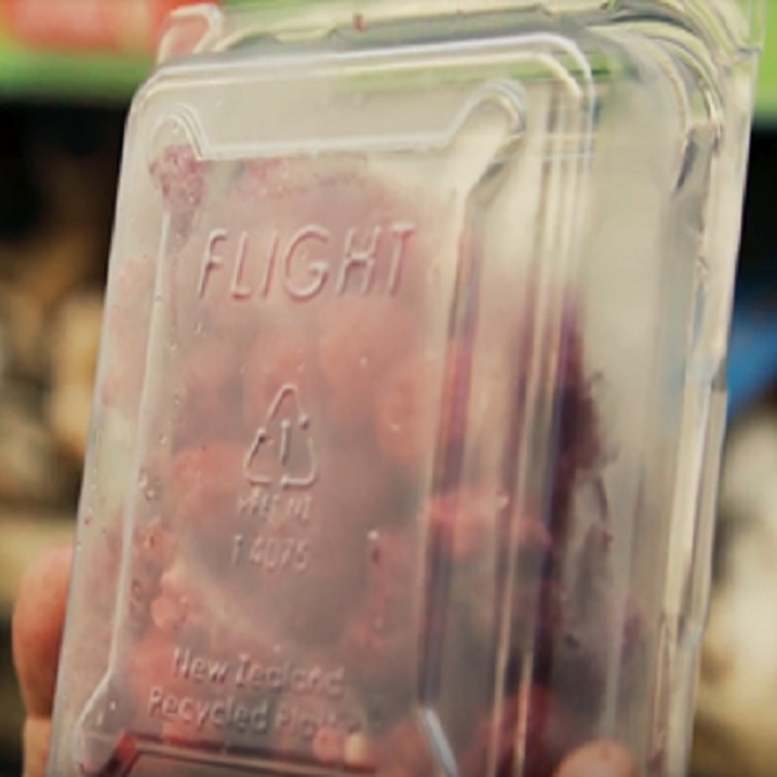
Examples of common materials
CC BY 3.0
MPF, CC BY-SA 3.0
Zaereth, CC BY-SA 4.0
Flight Packaging
© Copyright. University of Waikato. All Rights Reserved | www.sciencelearn.org.nz
All images are copyrighted. For further information, please refer to enquiries@sciencelearn.org.nz
Notes:
Wood: https://upload.wikimedia.org/wikipedia/commons/0/0b/Taxus_wood.jpg
Fabric: https://en.wikipedia.org/wiki/Textile#/media/File:Tartan_Clan_Campbell.png Public Domain, https://commons.wikimedia.org/w/index.php?curid=1329188
Metal: https://en.wikipedia.org/wiki/Metal#/media/File:Aluminium-4.jpg
Glass: https://en.wikipedia.org/wiki/Glass#/media/File:Soda-lime_glass_jar_showing_bubbles_trapped_within.jpg
Plastic: www.sciencelearn.org.nz/images/3243-flight-stamp-on-packaging

Slide 10
What are some properties of materials?
Give examples.
Be aware of the difference between an object and the material it is made of.
Hint: properties are the characteristics of a material that you can sense (see, hear, feel, smell) or measure.
© Copyright. University of Waikato. All Rights Reserved | www.sciencelearn.org.nz
All images are copyrighted. For further information, please refer to enquiries@sciencelearn.org.nz
Notes:
Object vs material demo.

Slide 11
Properties of materials
Weight and density. Whether it is a solid, liquid or gas.
Whether the material conducts heat or electricity or if it is magnetic.
Is it flexible?. Smooth or rough? What about the colour and shininess?
Is it waterproof or absorbent? Does it make a sound when hit?
© Copyright. University of Waikato. All Rights Reserved | www.sciencelearn.org.nz
All images are copyrighted. For further information, please refer to enquiries@sciencelearn.org.nz

Slide 12
Observe, describe, compare
Properties of metals
?
?
?
?
CC BY 3.0
?
© Copyright. University of Waikato. All Rights Reserved | www.sciencelearn.org.nz
All images are copyrighted. For further information, please refer to enquiries@sciencelearn.org.nz
Notes:
Metal: https://en.wikipedia.org/wiki/Metal#/media/File:Aluminium-4.jpg

Slide 13
Observe, describe, compare
Properties of metals
Solid
Shiny
Silver colour
Conduct heat
CC BY 3.0
Conduct electricity
© Copyright. University of Waikato. All Rights Reserved | www.sciencelearn.org.nz
All images are copyrighted. For further information, please refer to enquiries@sciencelearn.org.nz
Notes:
Metal: https://en.wikipedia.org/wiki/Metal#/media/File:Aluminium-4.jpg

Slide 14
Observe, describe, compare
CC BY 3.0
MPF, CC BY-SA 3.0
© Copyright. University of Waikato. All Rights Reserved | www.sciencelearn.org.nz
All images are copyrighted. For further information, please refer to enquiries@sciencelearn.org.nz
Notes:
Metal: https://en.wikipedia.org/wiki/Metal#/media/File:Aluminium-4.jpg
Wood: https://upload.wikimedia.org/wikipedia/commons/0/0b/Taxus_wood.jpg

Slide 15
How might materials change?
© Copyright. University of Waikato. All Rights Reserved | www.sciencelearn.org.nz
All images are copyrighted. For further information, please refer to enquiries@sciencelearn.org.nz

Slide 16
If heated or cooled, materials might change state.
Sometimes I notice the colour changes when I cook something!
When I leave my bike outside, it goes rusty.
In hard materials technology, I can change the shape of metal by hitting it.
© Copyright. University of Waikato. All Rights Reserved | www.sciencelearn.org.nz
All images are copyrighted. For further information, please refer to enquiries@sciencelearn.org.nz

Slide 17
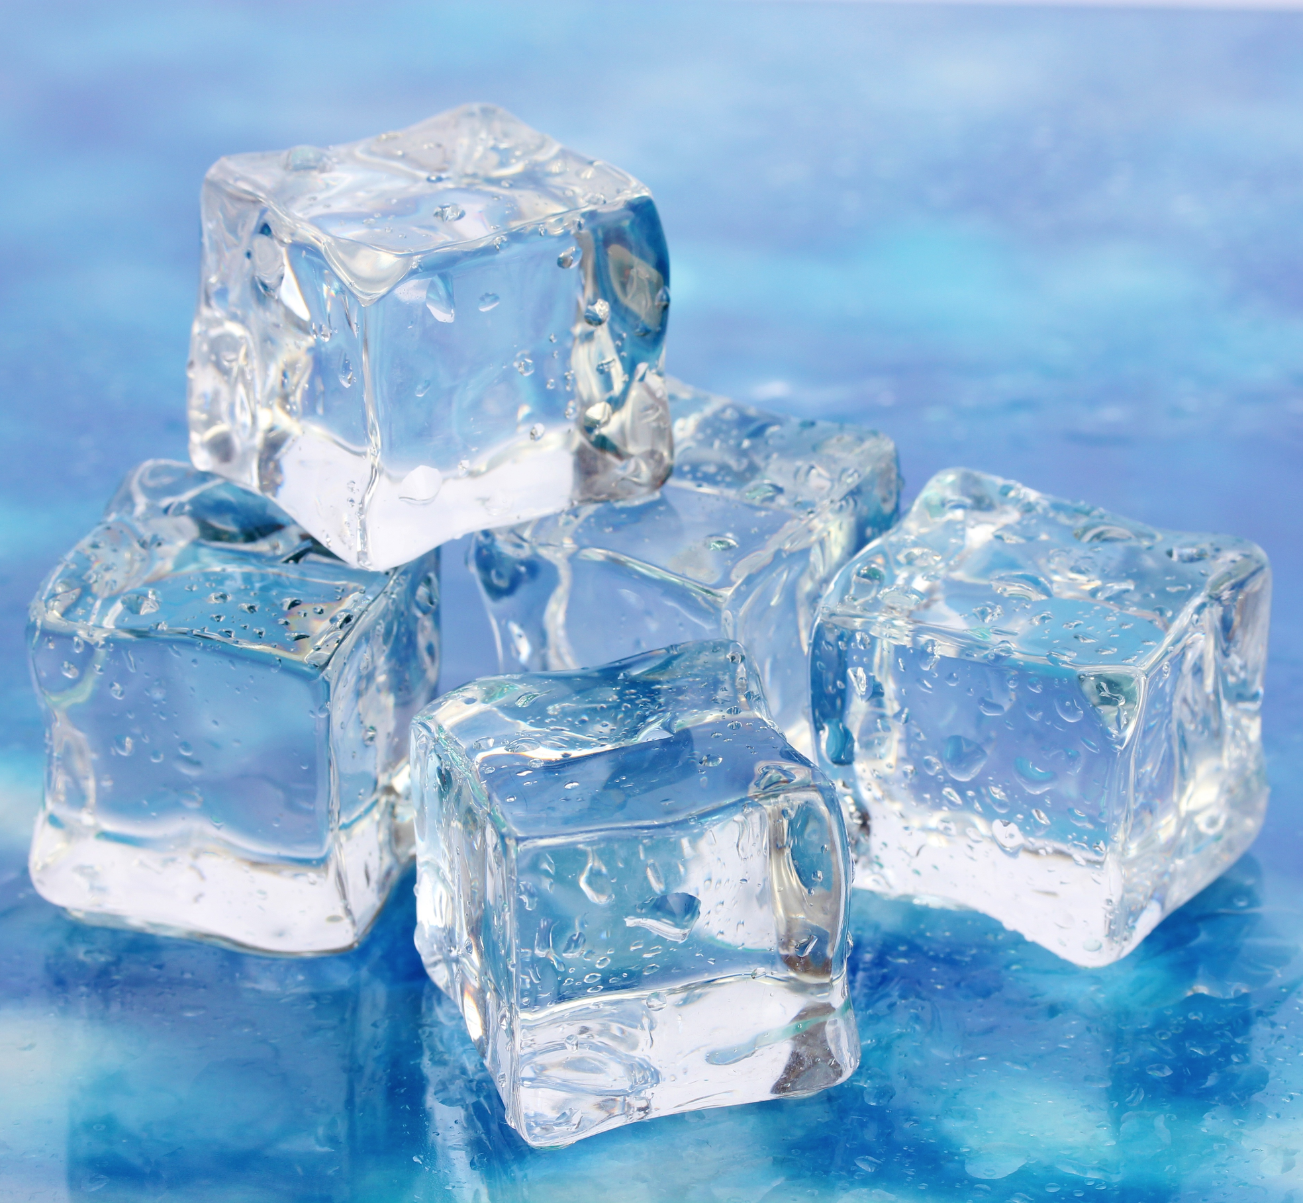
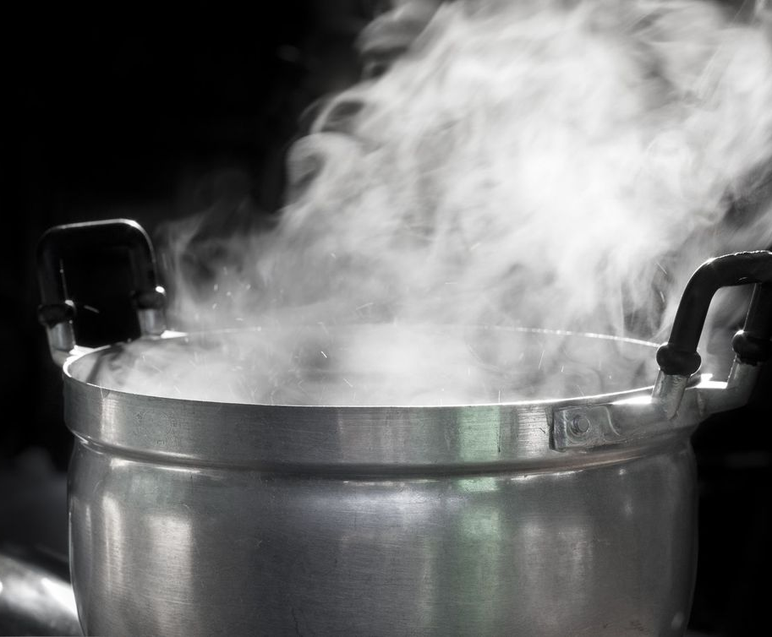
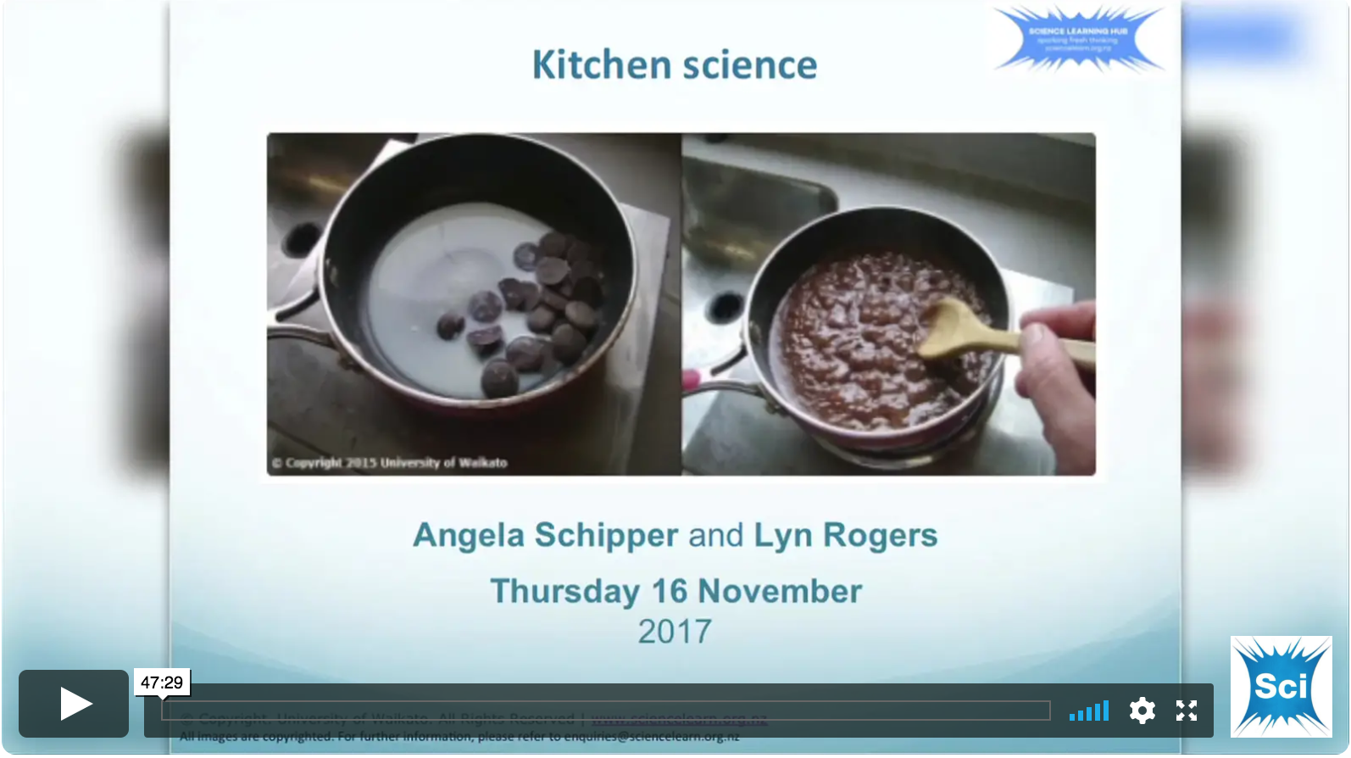
Changes to matter
Mixing, heating and cooling
Examples using common materials:
Water being cooled and heated.
Mixing salt and water.
Melting and mixing butter.
Mixing cornflour and water.
See the Kitchen science webinar for more hands-on examples.
belchonock, 123RF Ltd
A.Wathanasing, 123RF Ltd
Ivan Mikhaylov, 123RF Ltd
© Copyright. University of Waikato. All Rights Reserved | www.sciencelearn.org.nz
All images are copyrighted. For further information, please refer to enquiries@sciencelearn.org.nz
Notes:
A pot of boiling water: www.sciencelearn.org.nz/images/664-a-pot-of-boiling-water
Water in liquid state: www.sciencelearn.org.nz/images/2343-water
Ice cubes: Copyright: belchonock / 123RF Stock Photo
www.123rf.com/photo_17768872_ice-on-brightblue-background.html?term=ice%2Bcube&vti=objiclnjr1iva875zo-1-3&

Slide 18
What does the curriculum say?
Level | Achievement objectives
1&2 | Observe, describe, and compare physical and chemical properties of common materials and changes that occur when materials are mixed, heated, or cooled.
3&4 | Group materials in different ways, based on the observations and measurements of the characteristic chemical and physical properties of a range of different materials.
5 | Investigate the chemical and physical properties of different groups of substances, for example, acids and bases, fuels, and metals. Distinguish between pure substances and mixtures and between elements and compounds.
© Copyright. University of Waikato. All Rights Reserved | www.sciencelearn.org.nz
All images are copyrighted. For further information, please refer to enquiries@sciencelearn.org.nz

Slide 19
How might we measure material properties?
© Copyright. University of Waikato. All Rights Reserved | www.sciencelearn.org.nz
All images are copyrighted. For further information, please refer to enquiries@sciencelearn.org.nz

Slide 20
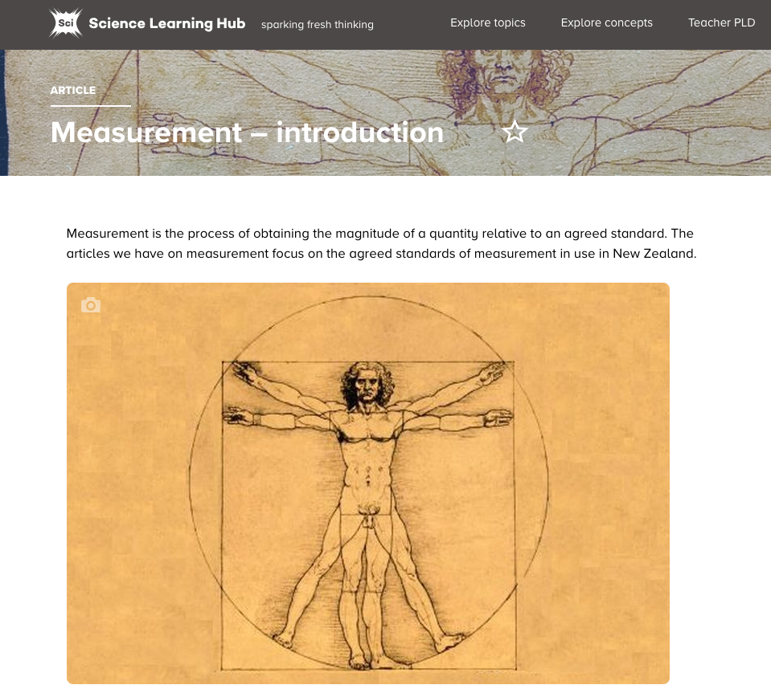
Measuring properties of materials
Don’t forget the difference between objects and the materials they are made of.
Examples:
Measuring the hardness of different plastics or rocks using sandpaper.
Measuring the compressive strength of pasta versus an eraser.
Measuring the tensile strength of threads of wool, dental floss and copper wire.
© Copyright. University of Waikato. All Rights Reserved | www.sciencelearn.org.nz
All images are copyrighted. For further information, please refer to enquiries@sciencelearn.org.nz

Slide 21
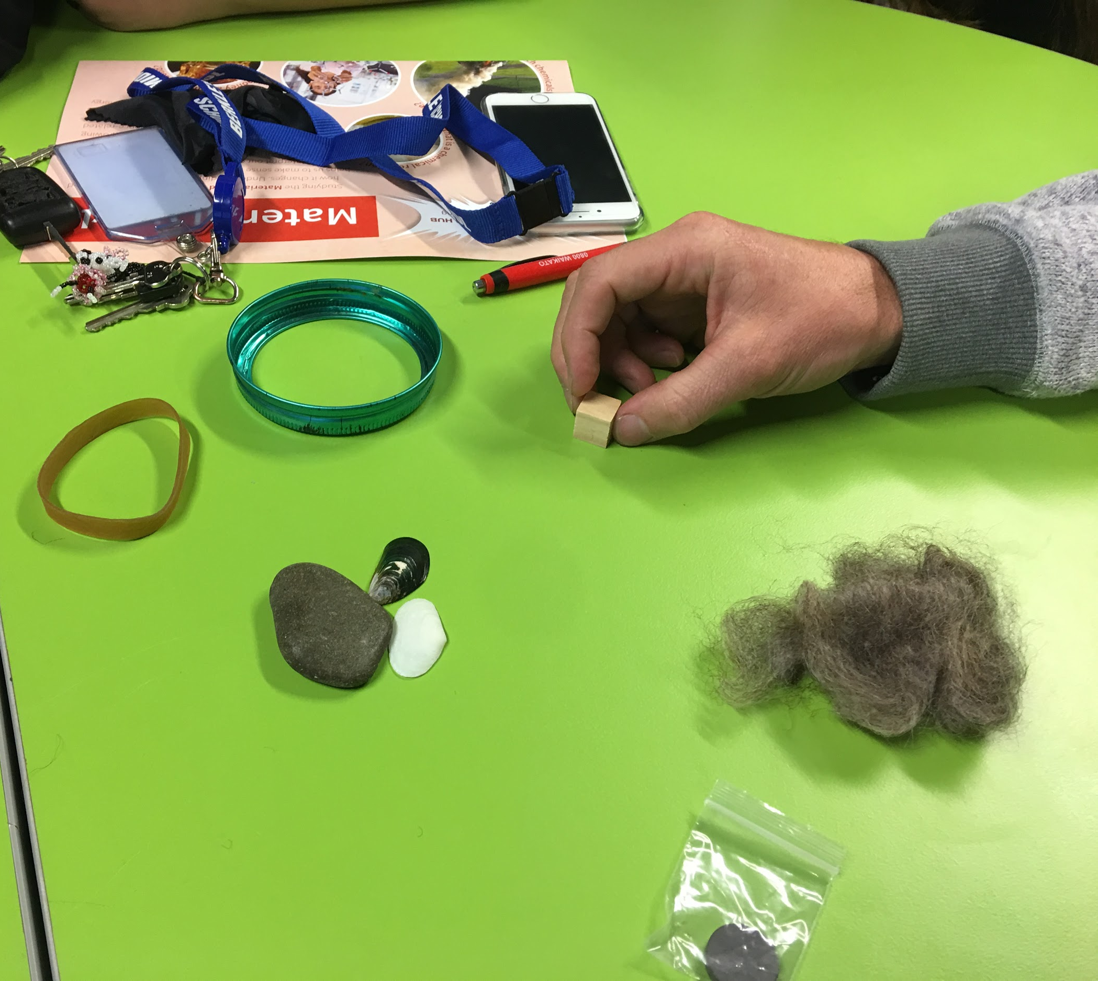
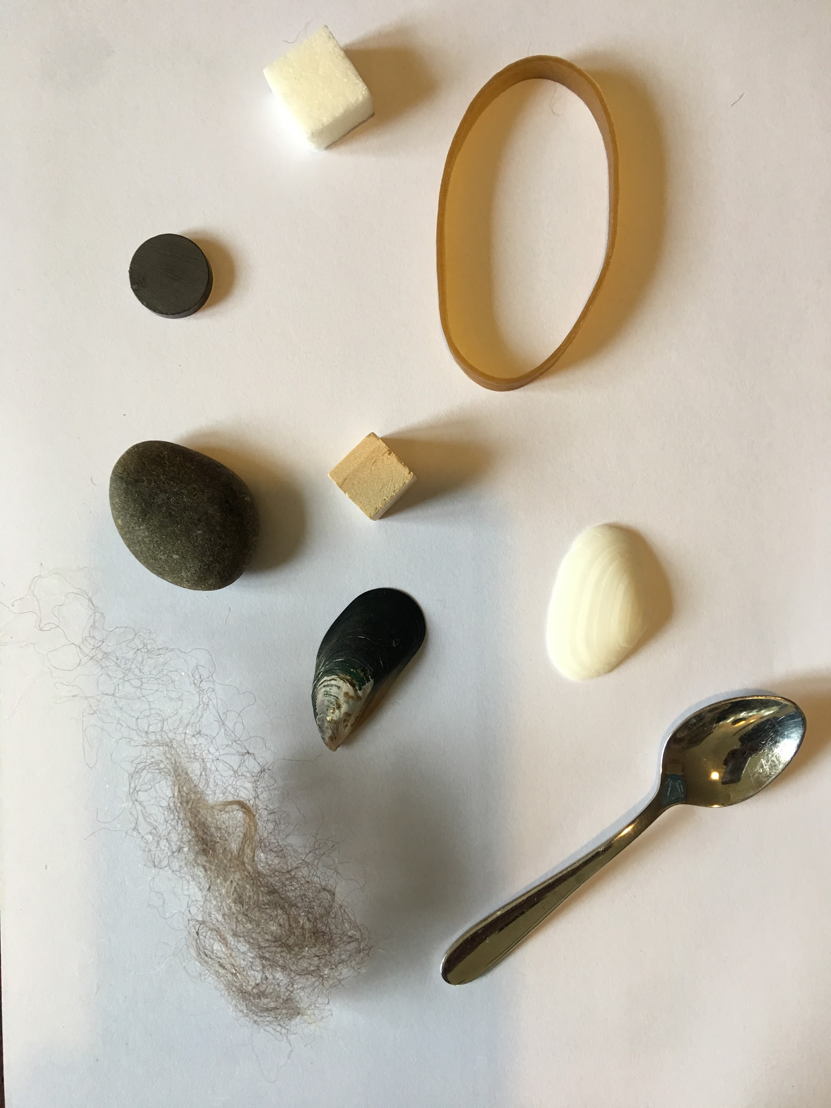
Grouping materials
Have a go …
How could you group these objects based on their properties?
© Copyright. University of Waikato. All Rights Reserved | www.sciencelearn.org.nz
All images are copyrighted. For further information, please refer to enquiries@sciencelearn.org.nz

Slide 22
What does the curriculum say?
Level | Achievement objectives
1&2 | Observe, describe, and compare physical and chemical properties of common materials and changes that occur when materials are mixed, heated, or cooled.
3&4 | Group materials in different ways, based on the observations and measurements of the characteristic chemical and physical properties of a range of different materials.
5 | Investigate the chemical and physical properties of different groups of substances, for example, acids and bases, fuels, and metals. Distinguish between pure substances and mixtures and between elements and compounds.
© Copyright. University of Waikato. All Rights Reserved | www.sciencelearn.org.nz
All images are copyrighted. For further information, please refer to enquiries@sciencelearn.org.nz

Slide 23
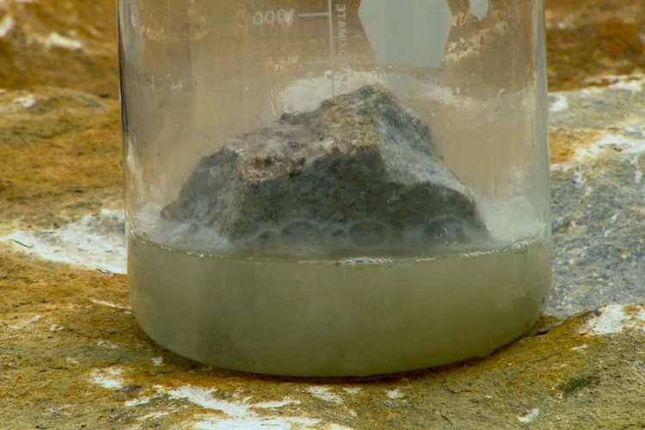
Acids and bases
Investigating properties
Corrosive
Feel slippery
Sour to taste
Bitter
React with metals
React with oils
© Copyright. University of Waikato. All Rights Reserved | www.sciencelearn.org.nz
All images are copyrighted. For further information, please refer to enquiries@sciencelearn.org.nz
Notes:
Limestone in acid: www.sciencelearn.org.nz/images/478-limestone-the-fizzy-rock

Slide 24
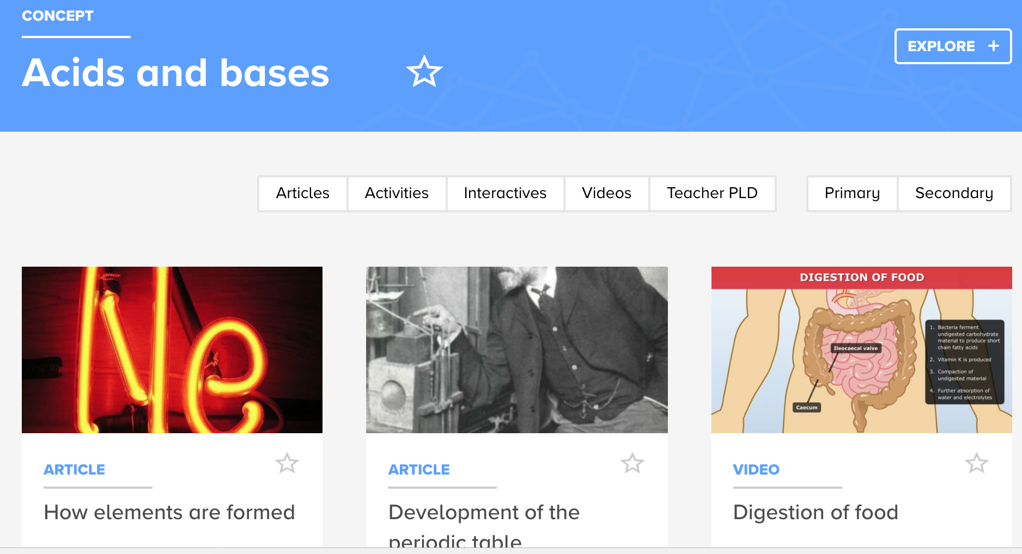
Acids and bases
Investigating properties
Pslawinski, CC BY-SA 2.5
© Copyright. University of Waikato. All Rights Reserved | www.sciencelearn.org.nz
All images are copyrighted. For further information, please refer to enquiries@sciencelearn.org.nz

Slide 25
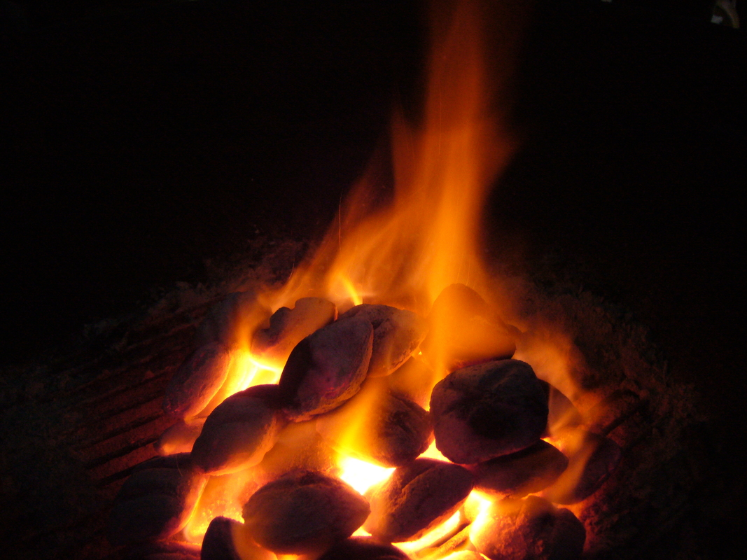
Fuels
Investigating properties
React to release energy
Can be natural or artificial
Can be solid, liquid or gas
Combustible*
snyt-tact (Talk), CC BY-SA 2.5
© Copyright. University of Waikato. All Rights Reserved | www.sciencelearn.org.nz
All images are copyrighted. For further information, please refer to enquiries@sciencelearn.org.nz

Slide 26
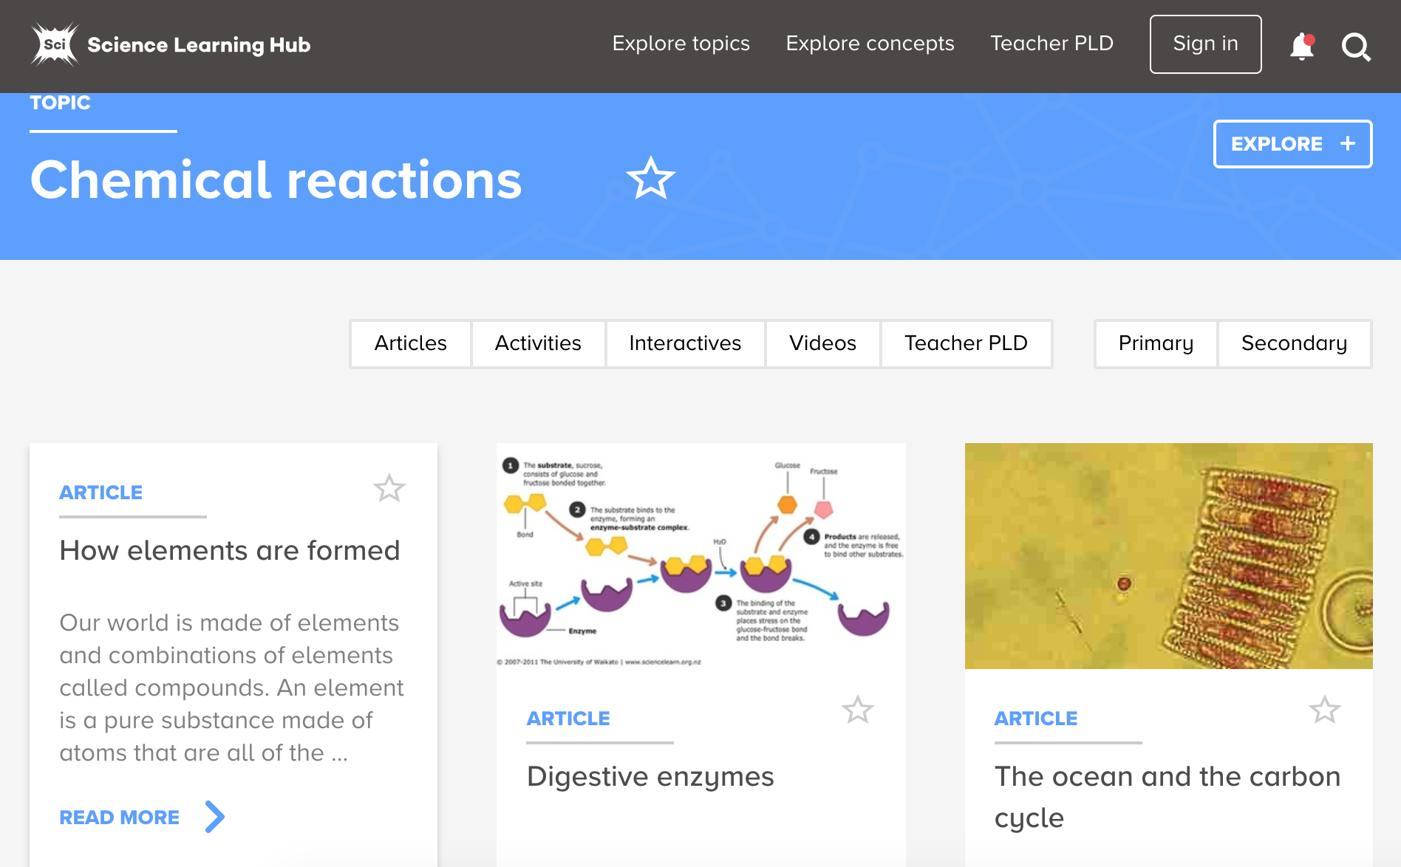
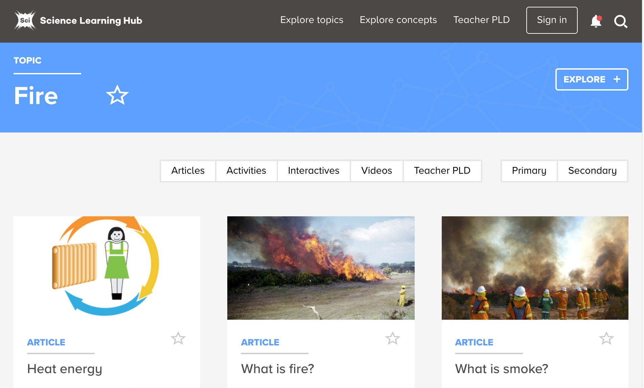
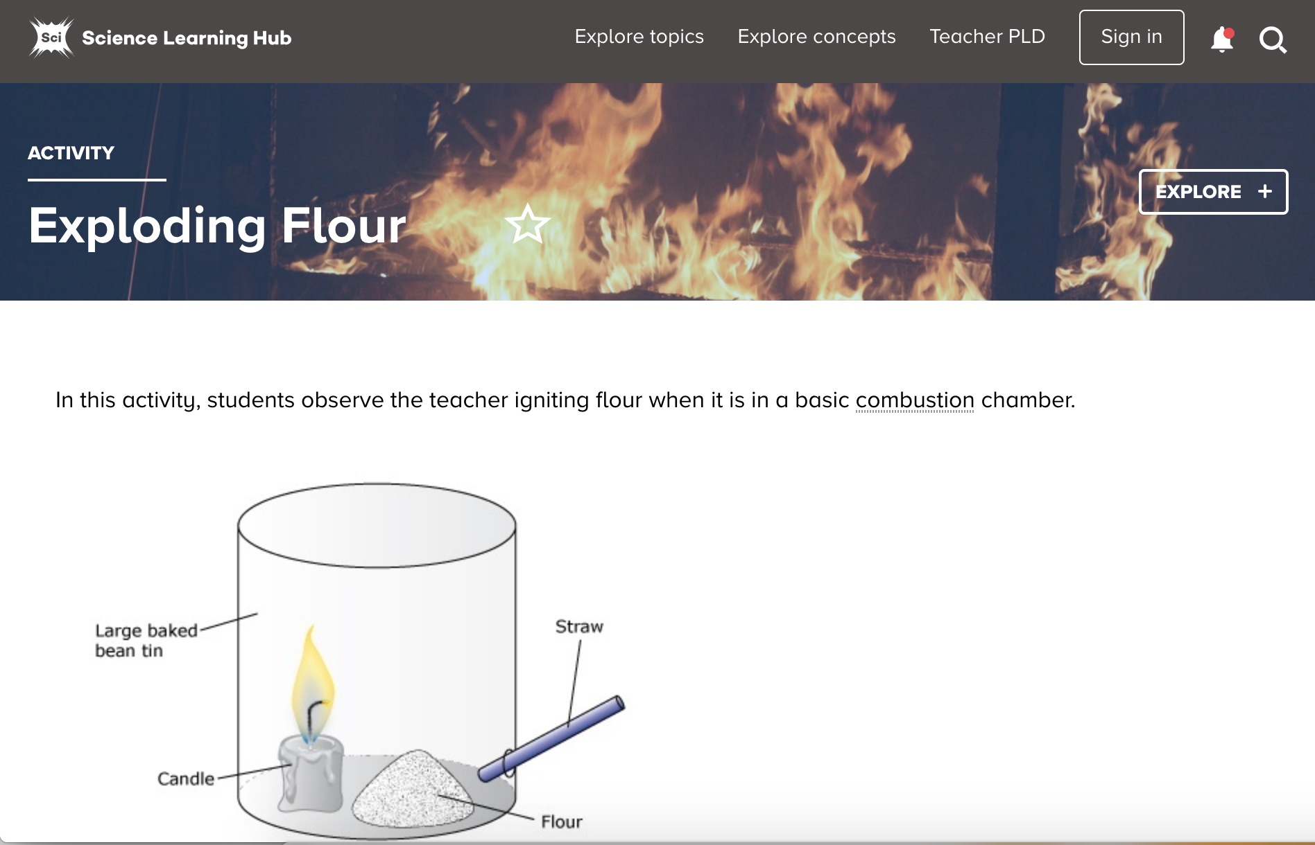
Fuels
Investigating properties
Scion
Scion
© Copyright. University of Waikato. All Rights Reserved | www.sciencelearn.org.nz
All images are copyrighted. For further information, please refer to enquiries@sciencelearn.org.nz

Slide 27
Metals
Investigating properties
Sonorous
Conductive
Lustrous
High density
Malleable
Ductile
CC BY 3.0
© Copyright. University of Waikato. All Rights Reserved | www.sciencelearn.org.nz
All images are copyrighted. For further information, please refer to enquiries@sciencelearn.org.nz

Slide 28
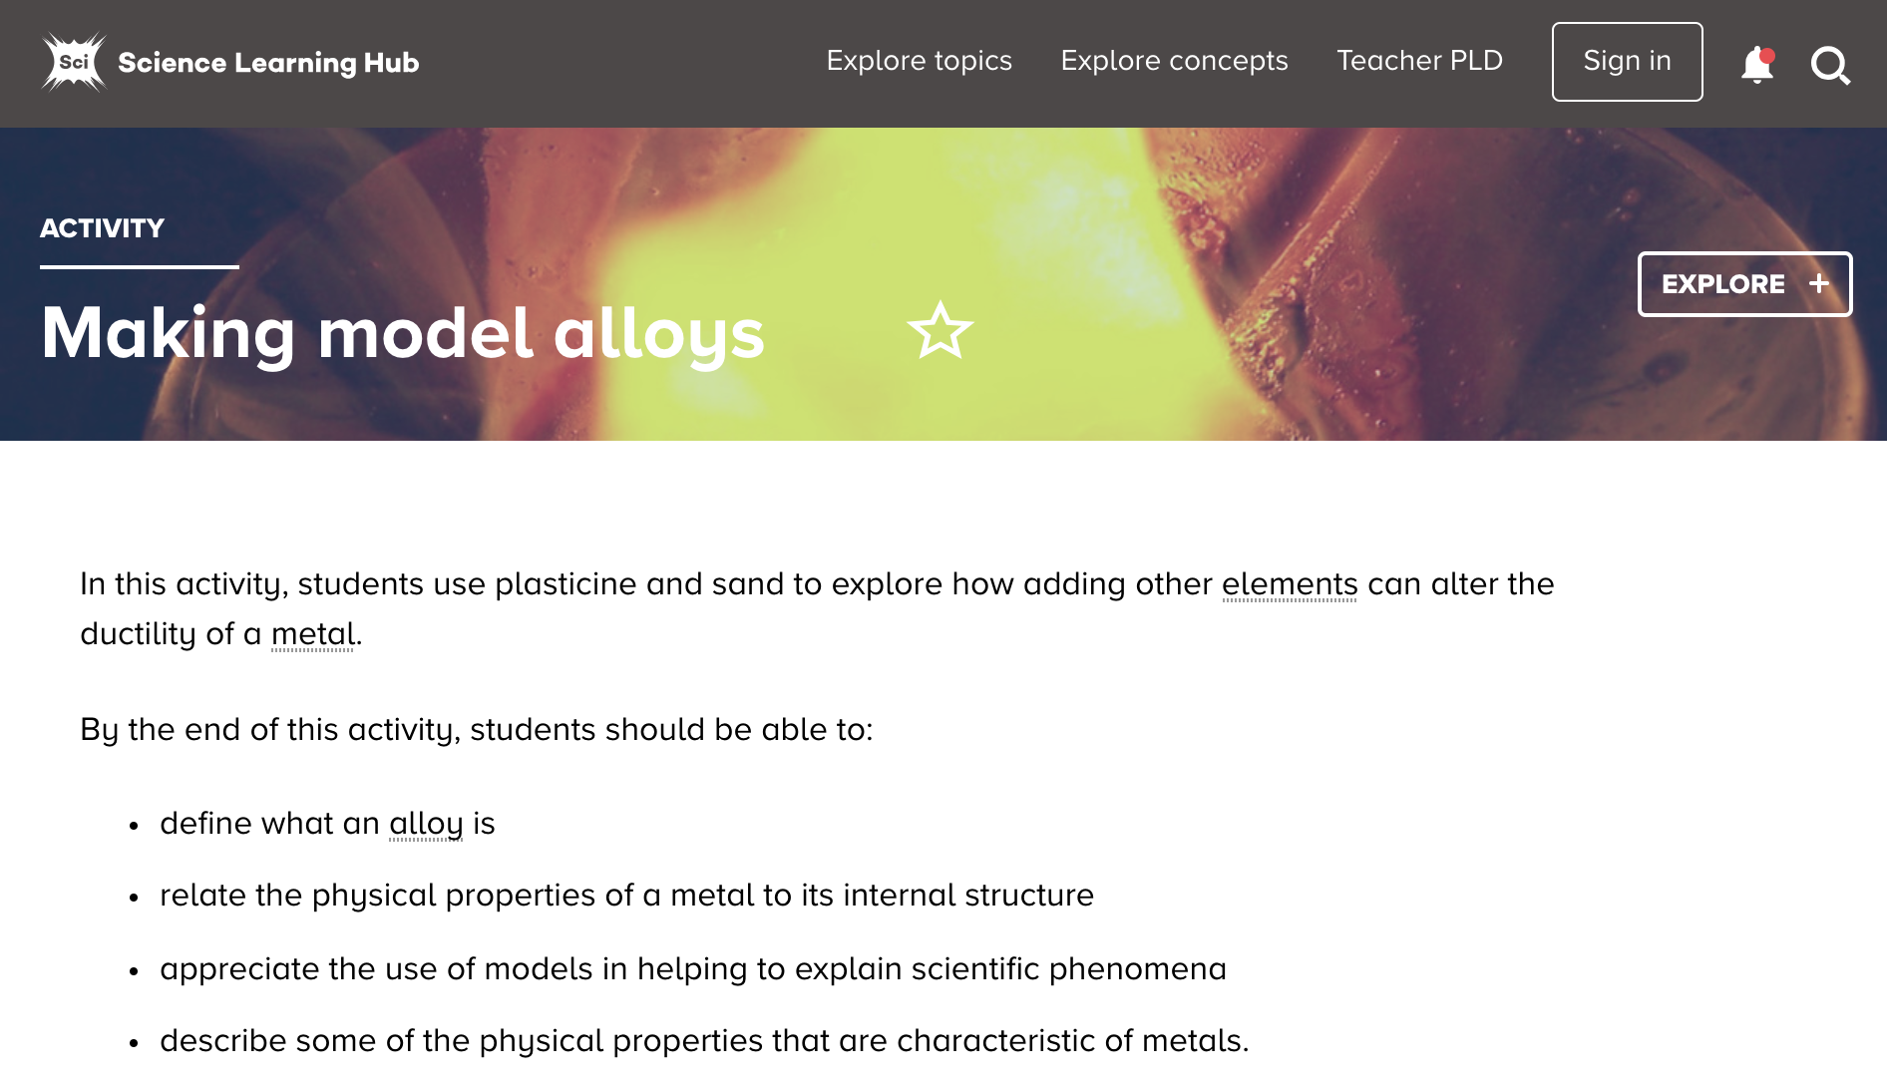
Metals
Investigating properties
Kevin Boudreaux
© Copyright. University of Waikato. All Rights Reserved | www.sciencelearn.org.nz
All images are copyrighted. For further information, please refer to enquiries@sciencelearn.org.nz

Slide 29
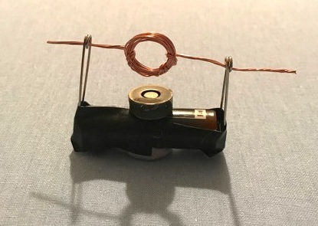
Metals
Investigating properties
© Copyright. University of Waikato. All Rights Reserved | www.sciencelearn.org.nz
All images are copyrighted. For further information, please refer to enquiries@sciencelearn.org.nz
Notes:
Motor: www.sciencelearn.org.nz/images/2724-model-of-a-simple-electric-motor

Slide 30
What does the curriculum say?
Level | Achievement objectives
1&2 | Observe, describe, and compare physical and chemical properties of common materials and changes that occur when materials are mixed, heated, or cooled.
3&4 | Group materials in different ways, based on the observations and measurements of the characteristic chemical and physical properties of a range of different materials.
5 | Investigate the chemical and physical properties of different groups of substances, for example, acids and bases, fuels, and metals. Distinguish between pure substances and mixtures and between elements and compounds.
© Copyright. University of Waikato. All Rights Reserved | www.sciencelearn.org.nz
All images are copyrighted. For further information, please refer to enquiries@sciencelearn.org.nz

Slide 31
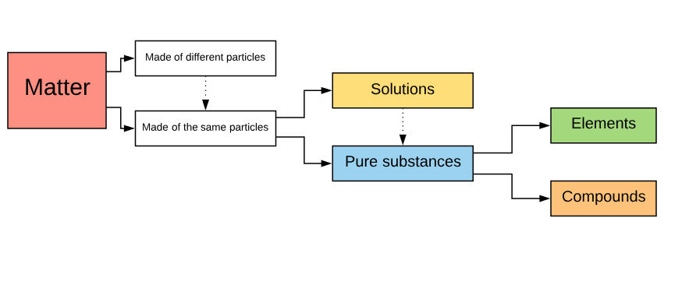
Pure substance, mixtures,
elements and compounds
© Copyright. University of Waikato. All Rights Reserved | www.sciencelearn.org.nz
All images are copyrighted. For further information, please refer to enquiries@sciencelearn.org.nz

Slide 32
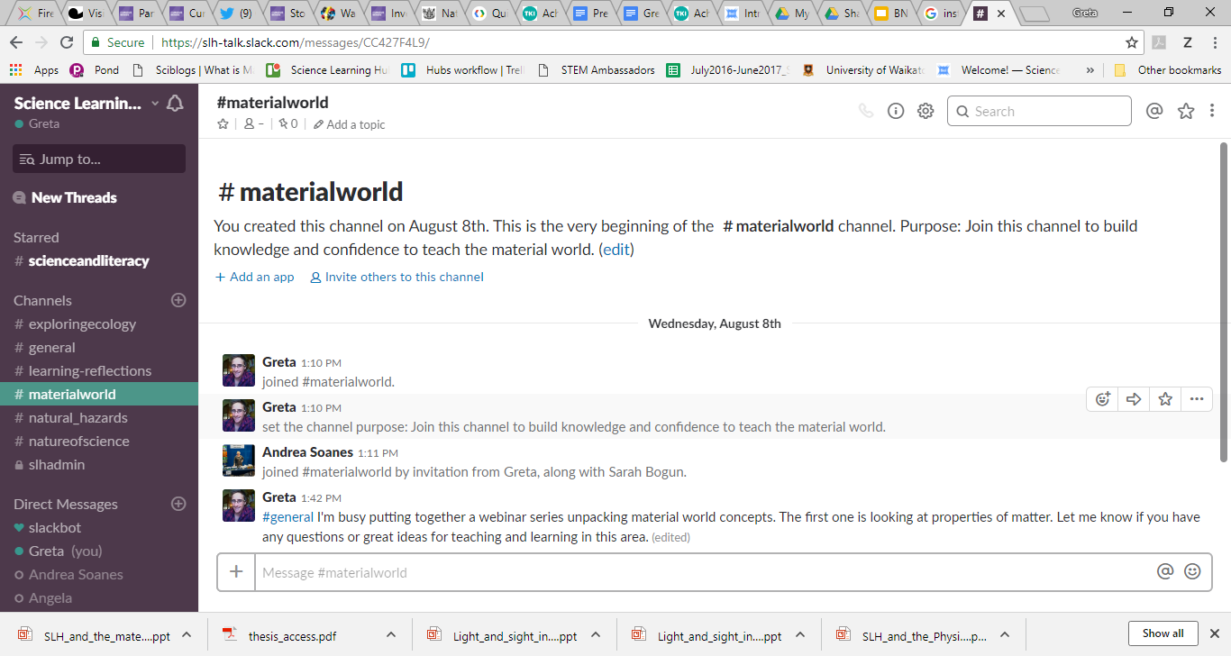
Support
slh-talk.slack.com
© Copyright. University of Waikato. All Rights Reserved | www.sciencelearn.org.nz
All images are copyrighted. For further information, please refer to enquiries@sciencelearn.org.nz
Notes:
https://slh-talk.slack.com

Slide 33
Thanks – want to keep in touch?
Science Learning Hub
Email us on enquiries@sciencelearn.org.nz
https://twitter.com/NZScienceLearn
www.facebook.com/nzsciencelearn
https://nz.pinterest.com/nzsciencelearn/
https://www.pond.co.nz/community/
214015/science-learning-hub/
www.instagram.com/sciencelearninghubnz
Join us in our discussion channel on Slack.
(Any problems accessing Slack, please contact us via our enquiries email, enquiries@sciencelearn.org.nz.)

