Slide 1
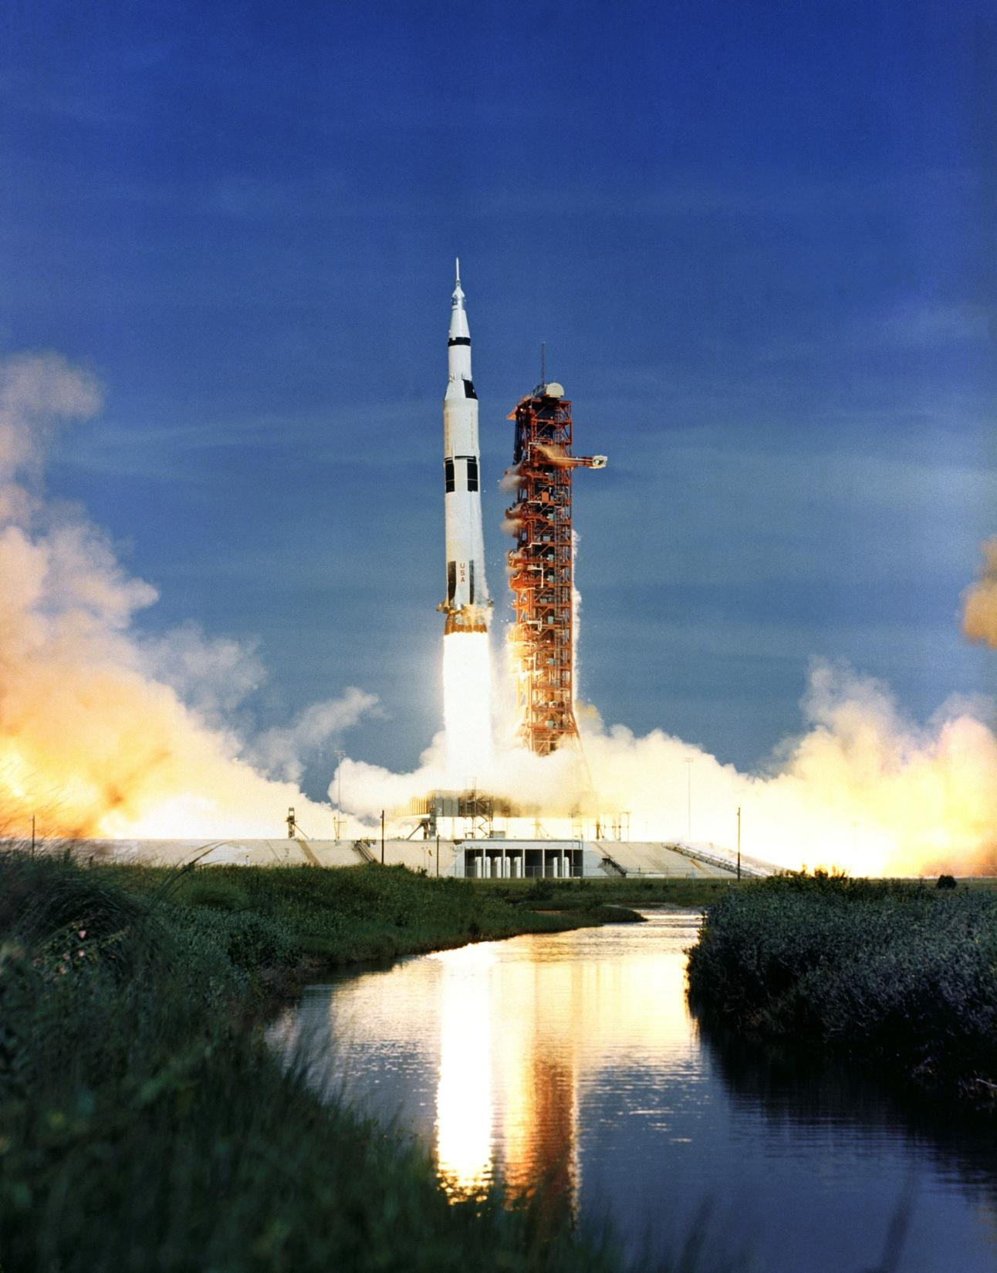
Saturn V
Pronounced ‘Saturn five’.
NASA, USA.
Saturn rockets launched Apollo missions to Moon, 1968 to 1972.
Apollo 11 mission launched on 16 July 1969.
Height = 110 m (longer than a rugby field, nearly as tall as the Auckland Sky Tower).
This image is the Apollo 15 launch on 26 July 1971.
_{NASA}

Slide 2
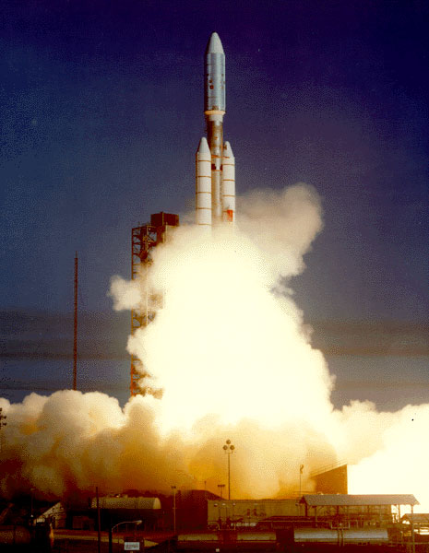
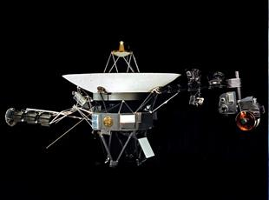
Titan Centaur
NASA, USA.
Titan Centaur rockets were used to launch the two Voyager probes in 1977.
Height 48 m.
Voyager probes 1 and 2
Mass 721.9 kg.
Flyby of Jupiter in 1979.
Flyby of Saturn in 1980.
Voyager 1 most distant human-made object in space (17,734,600,000 km or 118 AU as at 23 September 2011).
Both continue to send/receive signals as they travel into interstellar space.
_{NASA-MSFC}
_{NASA}

Slide 3
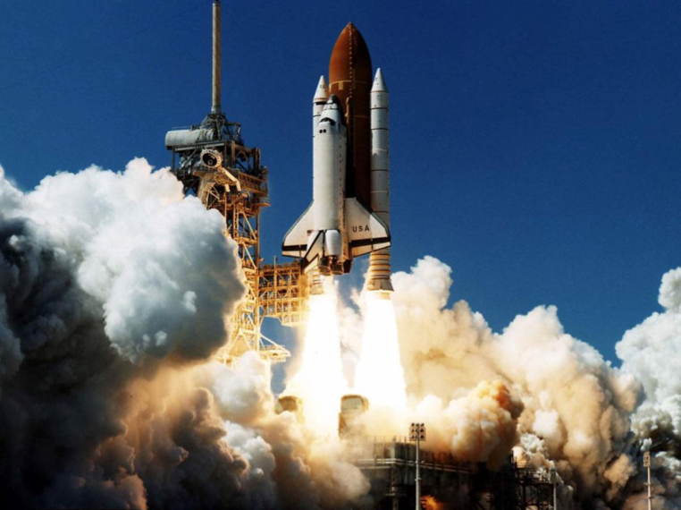
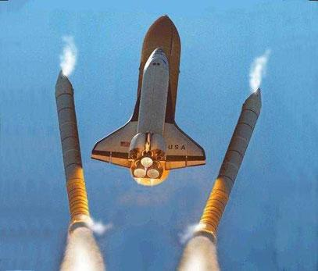
Space Shuttle
NASA, USA.
135 flights, 1981 to 2011.
Height = 56 m at launch.
Carries people and objects such as satellites into Earth orbit.
Used to build and transport to the International Space Station.
Has two solid rocket boosters that separate after 2 minutes.
The big external tank continues to supply propellant to the three main engines on the Space Shuttle orbiter for another 6 minutes.
_{NASA}
_{ePower-Propulsion}

Slide 4
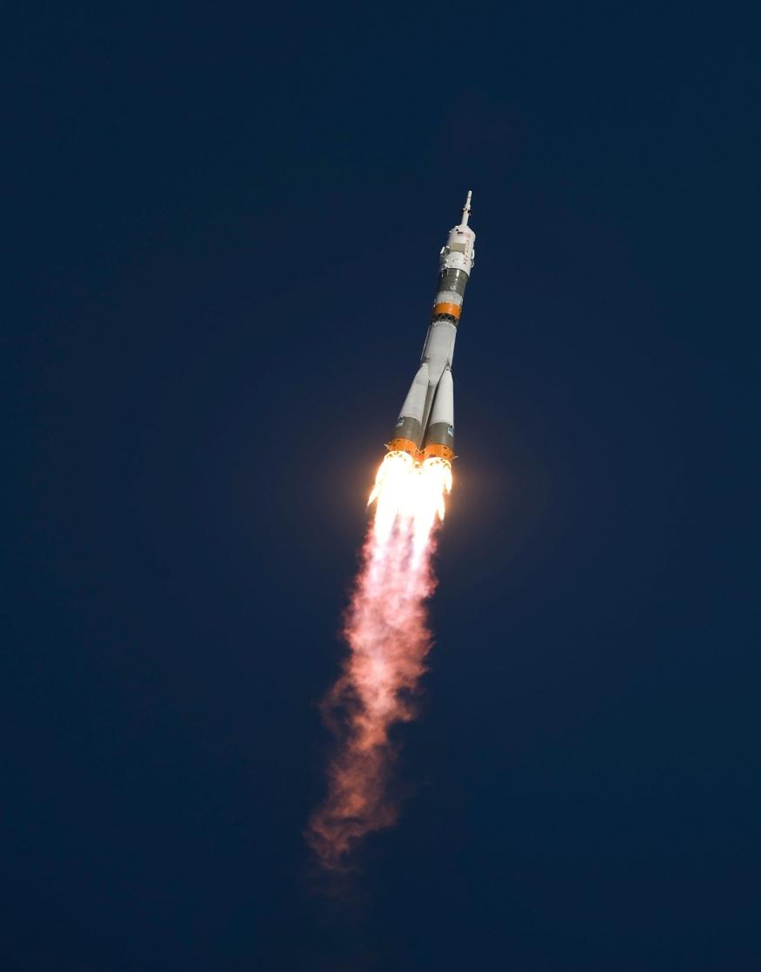
Soyuz-FG
Russia.
Launches satellites into orbit.
Missions to the International Space Station.
Height = 49.5 m.
This image is of the TMA-13 mission carrying supplies and three crew to the International Space Station in 2008.
_{NASA/Bill Ingalls}

Slide 5
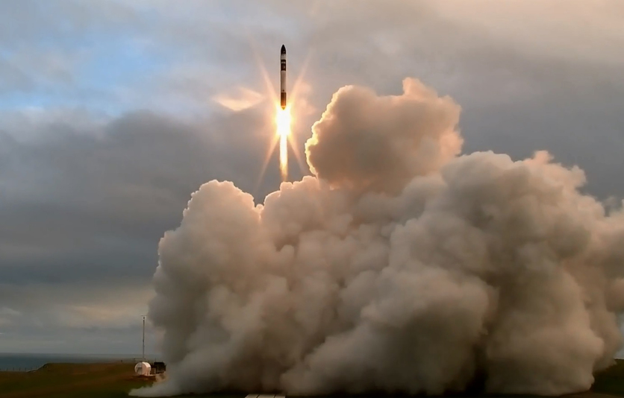
Electron
Rocket Lab, New Zealand.
Height = 17 m.
Diameter = 1.2 m.
Peak thrust of 192 kN.
First Electron rocket launch test was on 25 May 2017, which made New Zealand the 11th nation to launch a satellite.
Focus is on launch services for the growing small-satellite industry.
The primary components of the engine are 3D printed.
Battery-driven fuel pumps.
_{Rocket Lab}

Slide 6
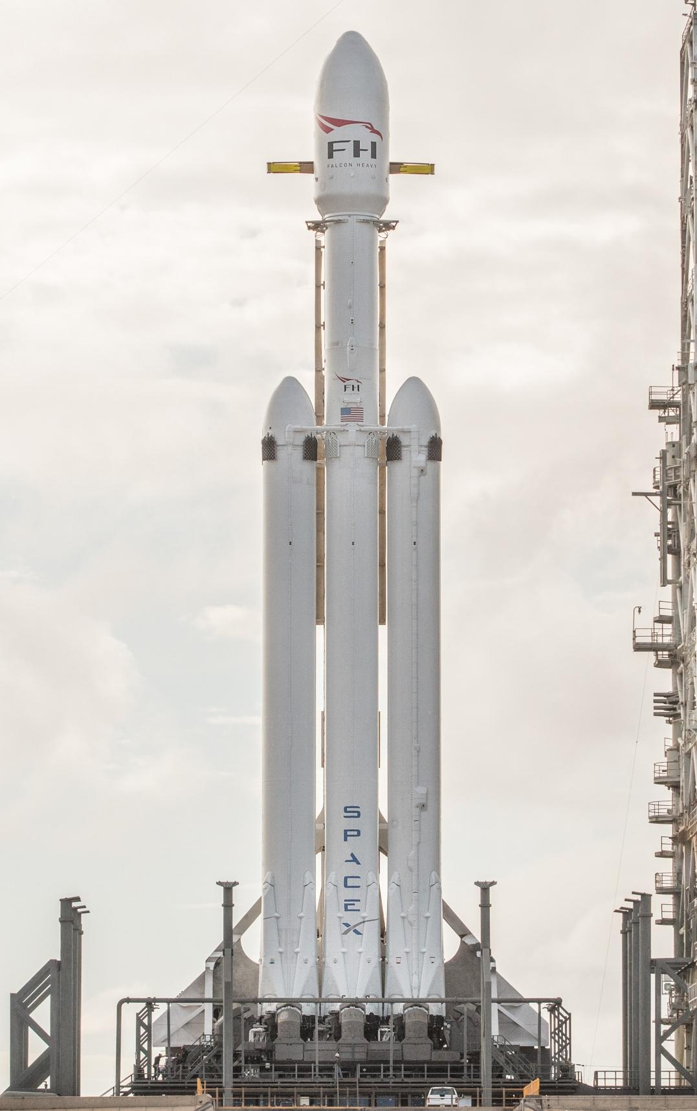
Falcon rocket vehicles
Space Exploration Technologies (SpaceX), USA.
Multi-use rocket launch vehicles.
Falcon 1– first successful flight was on 28 September 2008. Further development is currently on hold as the development focus is on the larger Falcon 9.
Falcon 9 is designed for vertical landing.
Falcon Heavy, a three-core variant, was launched on 6 February 2018. Its three boosters are designed to be recovered and reused.
_{SpaceX}

Slide 7
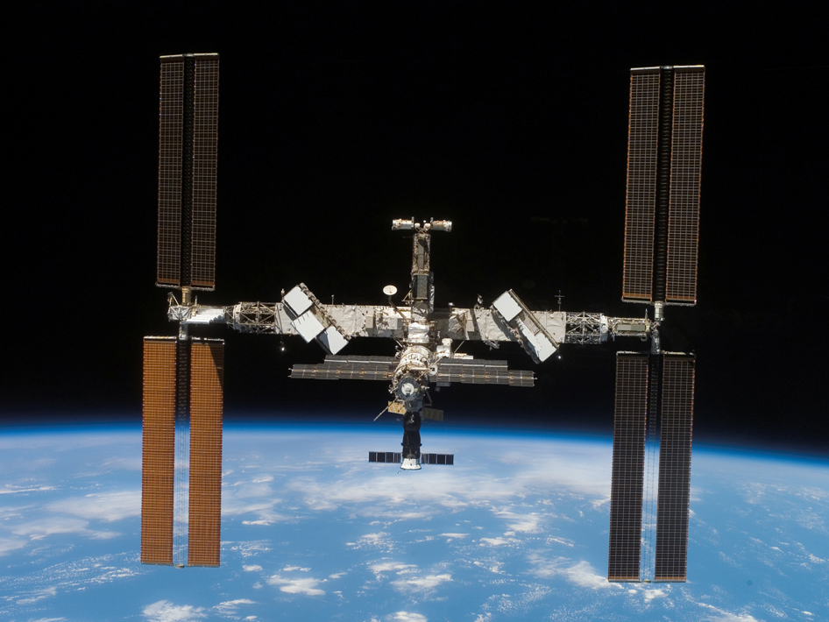
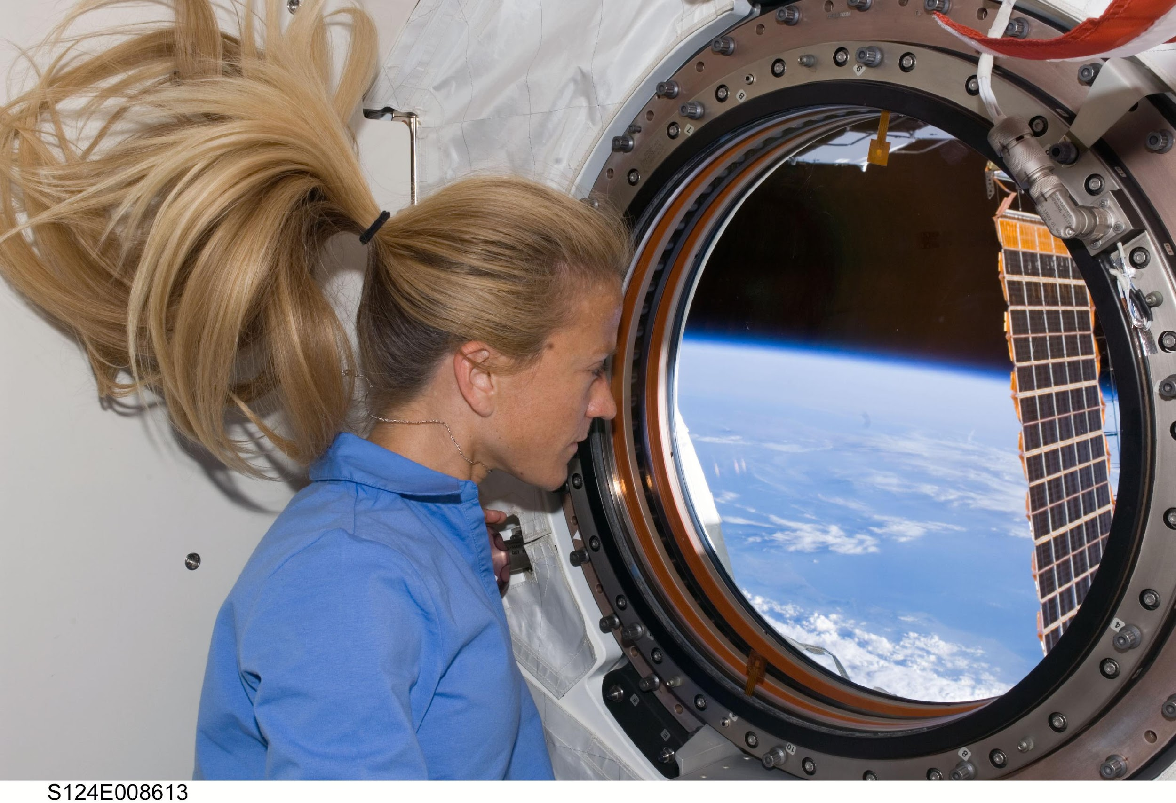
International Space Station
The International Space Station (ISS) is the size of a rugby field.
Astronauts live on board for up to 6 months at a time.
Huge solar panels generate energy from the Sun.
Altitude is 360 kilometres above the Earth’s surface.
Orbital speed of 28,000 kilometres per hour.
It takes 90 minutes to go around the Earth once. Astronauts experience 16 day/night cycles every 24 hours!
_{NASA}
_{NASA}

Slide 8
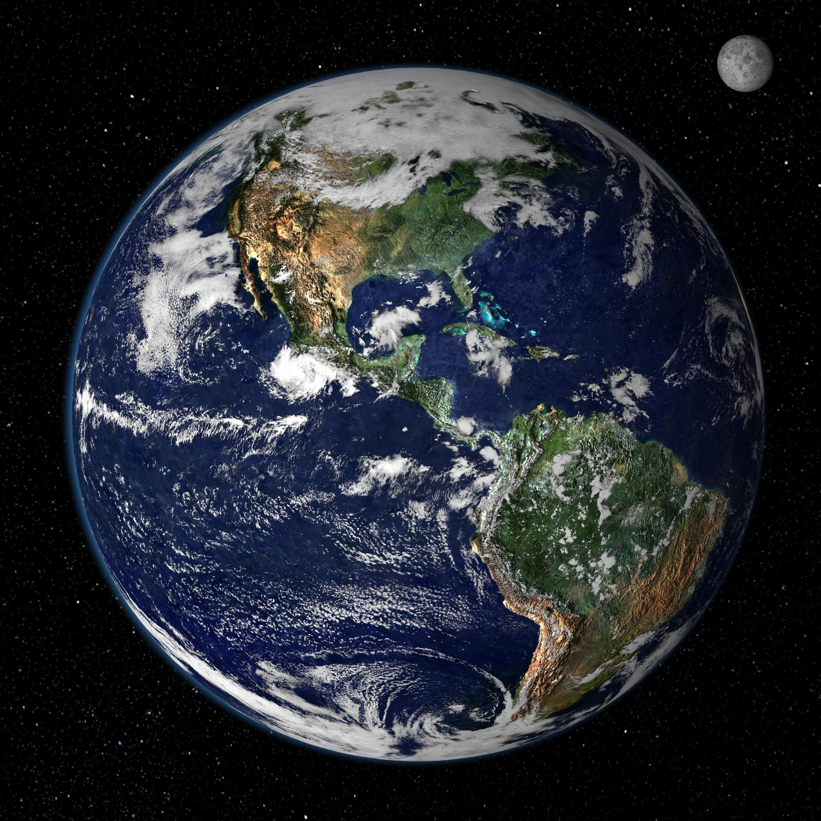
Scale model distances
If the Earth was just 10 cm diameter, what would be:
the thickness of the atmosphere?
the distance to the International Space Station?
the diameter of the Moon?
the distance to the Moon?
the diameter of the Sun?
the distance to the Sun?
_{NASA}

Slide 9
Scale model distances
Object | Real distance (km) | Scale model
Diameter of Earth | 12 ,756 | 10 cm
Thickness of 99% of Earth’s atmosphere | 31 | 0.2 mm
Official start of space | 100 | 0.8 mm
Altitude of the International Space Station | 360 | 2.8 mm
Diameter of the Moon | 3 ,475 | 2.7 cm
Distance to the Moon | 385, 000 | 3.0 m
Diameter of the Sun | 1,392,000 | 10.9 m
Distance to the Sun from Earth | 150,000,000 | 1.2 km

Slide 10
Questions to consider
What makes a rocket start moving?
What keeps a rocket moving once the rocket engines have finished?
Why do some rockets stay in space and some fall back to the Earth?
What challenges does the New Zealand space industry face?
What countries have launched rockets into space?
What are some of your favourite images from space (e.g. Hubble Space Telescope images)?
What are some of NASA’s current and future missions?

Slide 11
The Science Learning Hub would like to thank NASA, ePower-Propulsion, Rocket Lab and SpaceX for the use of their images for this activity.

