Slide 1
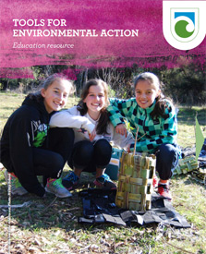
Eco-champions
With
Greta Dromgool
and
Ben Moorhouse
20 September 2018
© Steve Hathaway
© DOC
© Copyright. University of Waikato. All Rights Reserved | www.sciencelearn.org.nz
All images are copyrighted. For further information, please refer to enquiries@sciencelearn.org.nz

Slide 2
Index
Topic | Slide show number(s) | Video timecode
Introducing the Science Learning Hub and presenters | 1 | 00:00
Index | 2 | 00:10
Purpose | 3 | 00:23
DOC resources | 4–6 | 01:02
Biodiversity | 7–10 | 04:00
Reconnecting with your green space | 11 | 06:19
Reflecting on findings | 12 | 11:20
Connections in your green space | 13 | 13:37
What is environmental action? | 14–18 | 16:08
Goals and vision | 19–21 | 26:51
Decision- making tools, planning and examples | 22–29 | 34:09
Working alongside your community | 30–33 | 41:57
Implementing, monitoring and sharing | 34–36 | 44:16
Funding and supporting action | 37–38 | 46:47
DOC and SLH links, keep in touch and thanks | 39–40 | 47:10
© Copyright. University of Waikato. All Rights Reserved | www.sciencelearn.org.nz
All images are copyrighted. For further information, please refer to enquiries@sciencelearn.org.nz

Slide 3
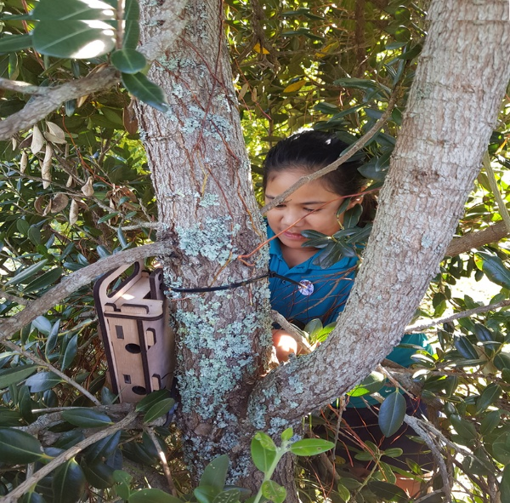
Purpose
To support you to enhance your students’ understanding about conservation education.
We will:
support you with planning and carrying out environmental action with your students
share ideas, resources and examples
Dawson Primary School
© Copyright. University of Waikato. All Rights Reserved | www.sciencelearn.org.nz
All images are copyrighted. For further information, please refer to enquiries@sciencelearn.org.nz

Slide 4
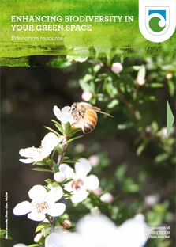
© DOC
© DOC
© Copyright. University of Waikato. All Rights Reserved | www.sciencelearn.org.nz
All images are copyrighted. For further information, please refer to enquiries@sciencelearn.org.nz

Slide 5
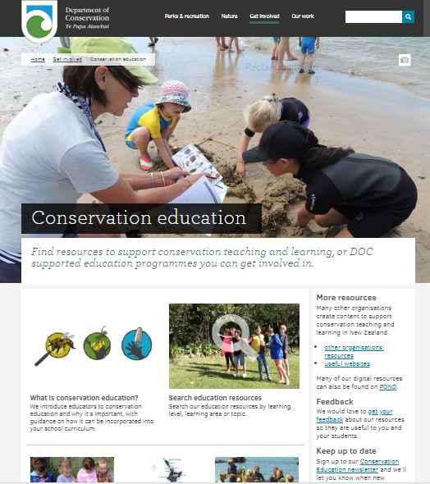
How to find the resources
www.doc.govt.nz/education
© DOC
© Copyright. University of Waikato. All Rights Reserved | www.sciencelearn.org.nz
All images are copyrighted. For further information, please refer to enquiries@sciencelearn.org.nz

Slide 6
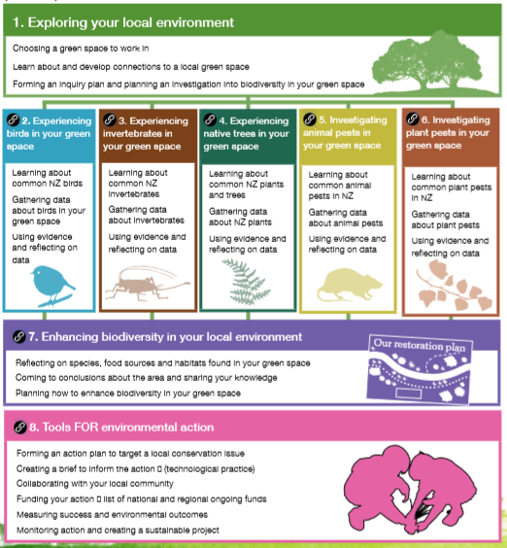
© DOC
© Copyright. University of Waikato. All Rights Reserved | www.sciencelearn.org.nz
All images are copyrighted. For further information, please refer to enquiries@sciencelearn.org.nz

Slide 7
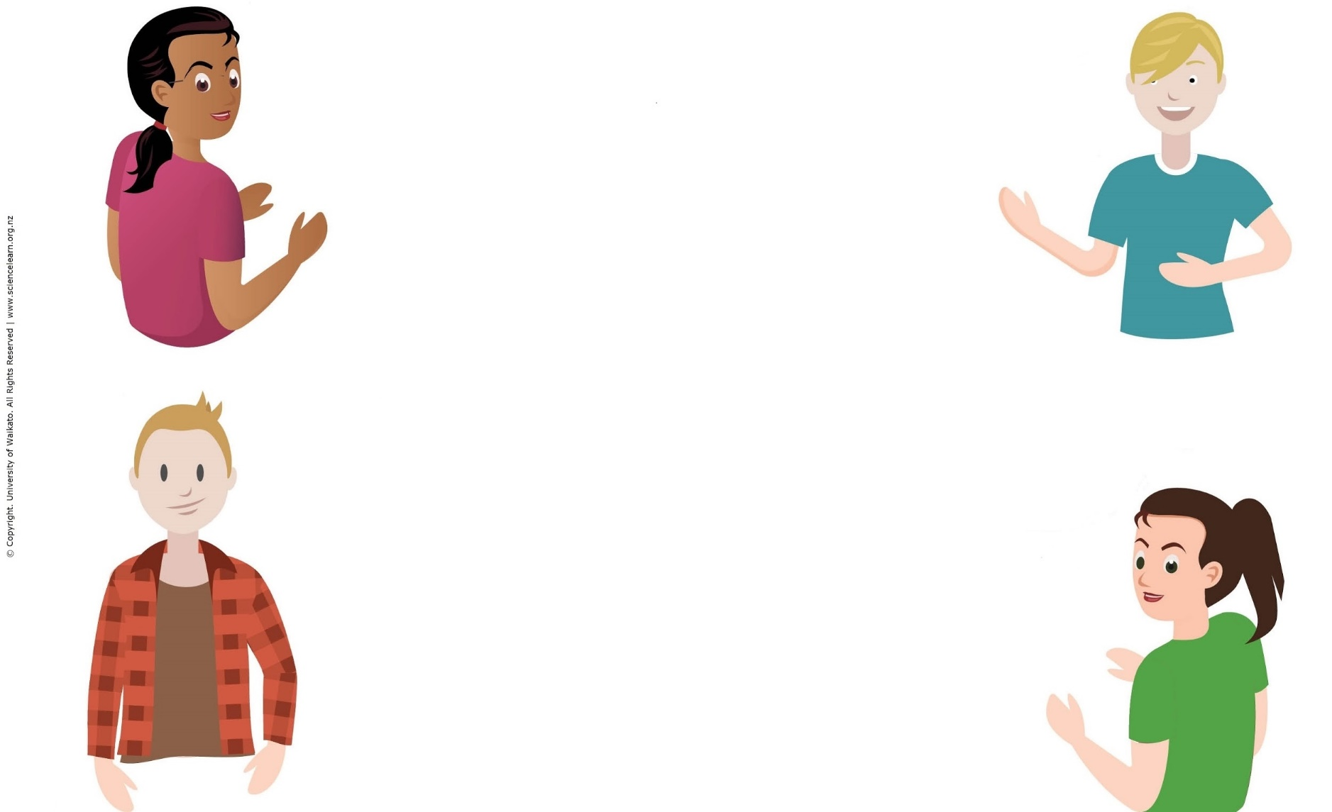
What is biodiversity?
Why enhance biodiversity?
© Copyright. University of Waikato. All Rights Reserved | www.sciencelearn.org.nz
All images are copyrighted. For further information, please refer to enquiries@sciencelearn.org.nz

Slide 8
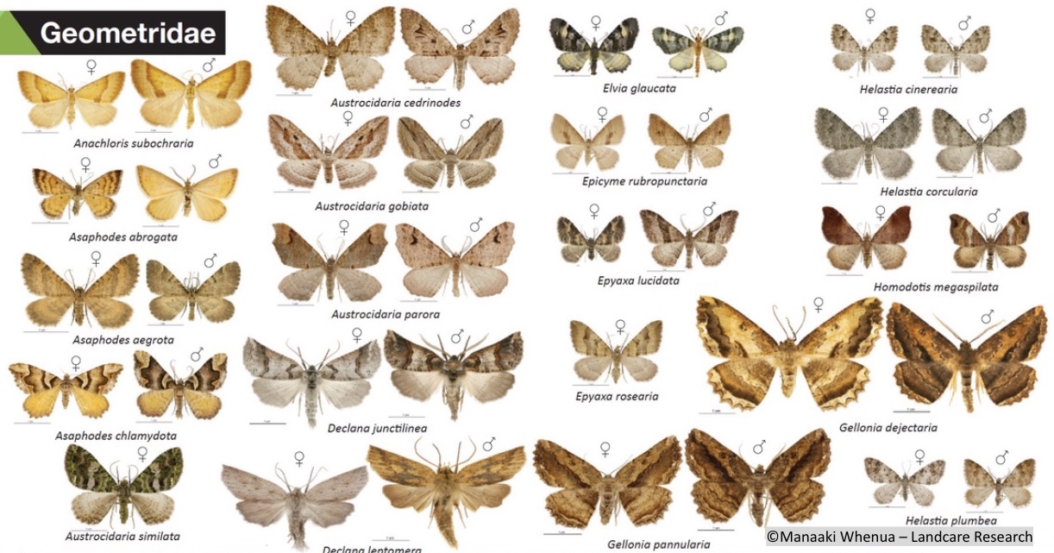
What is biodiversity?
Why enhance biodiversity?
© Copyright. University of Waikato. All Rights Reserved | www.sciencelearn.org.nz
All images are copyrighted. For further information, please refer to enquiries@sciencelearn.org.nz

Slide 9
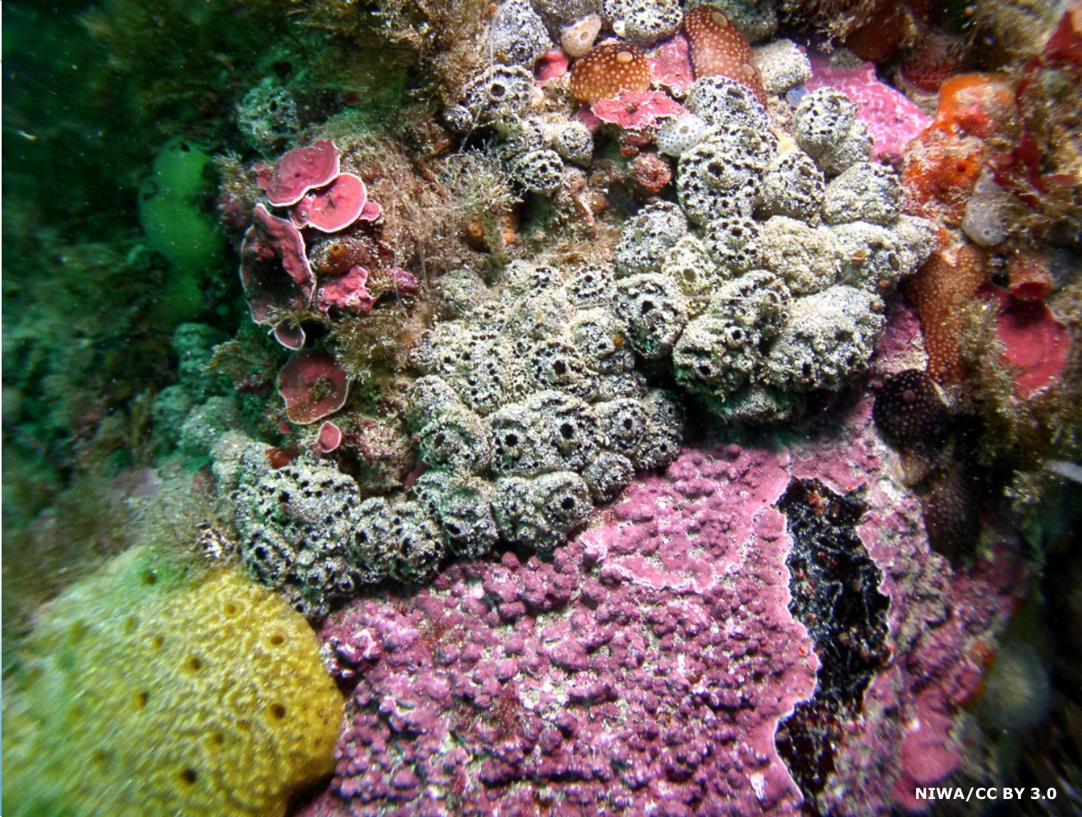
What is biodiversity?
Why enhance biodiversity?
© Copyright. University of Waikato. All Rights Reserved | www.sciencelearn.org.nz
All images are copyrighted. For further information, please refer to enquiries@sciencelearn.org.nz

Slide 10
What is biodiversity?
Why enhance biodiversity?
The uniqueness of places, what lives there and how we affect them. We can be inspired by the beauty and technology of organisms.
The range of flora and fauna, in different environments. A higher biodiversity of species is generally a good indication of a healthy ecosystem.
Enhancing biodiversity is important so we know what we have and we can keep what we have.
Everything is connected so when we lose a species it affects something that will affect something else, and it will eventually affect us.
© Copyright. University of Waikato. All Rights Reserved | www.sciencelearn.org.nz
All images are copyrighted. For further information, please refer to enquiries@sciencelearn.org.nz

Slide 11
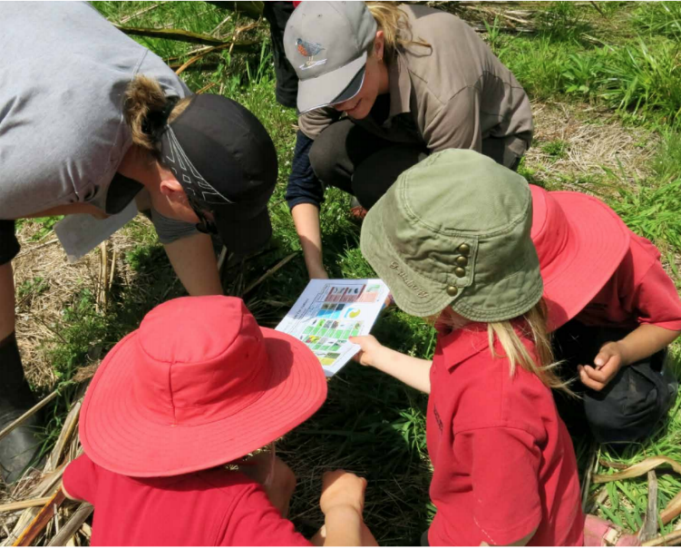
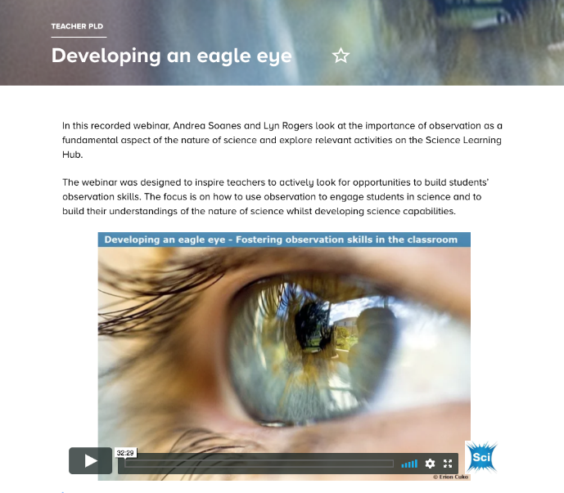
Reconnecting with your green space
Making observations
Making sense of observations
Photo: Marie McDonald
© Copyright. University of Waikato. All Rights Reserved | www.sciencelearn.org.nz
All images are copyrighted. For further information, please refer to enquiries@sciencelearn.org.nz
Notes:
Image: Kaitieke School students identifying insects in their green space using DOC’s Invertebrates ID guide ( doc.govt.nz). Photo: Marie McDonald. From: www.doc.govt.nz/globalassets/documents/getting-involved/students-and-teachers/in-the-environment-series/tools-for-environmental-action.pdf

Slide 12
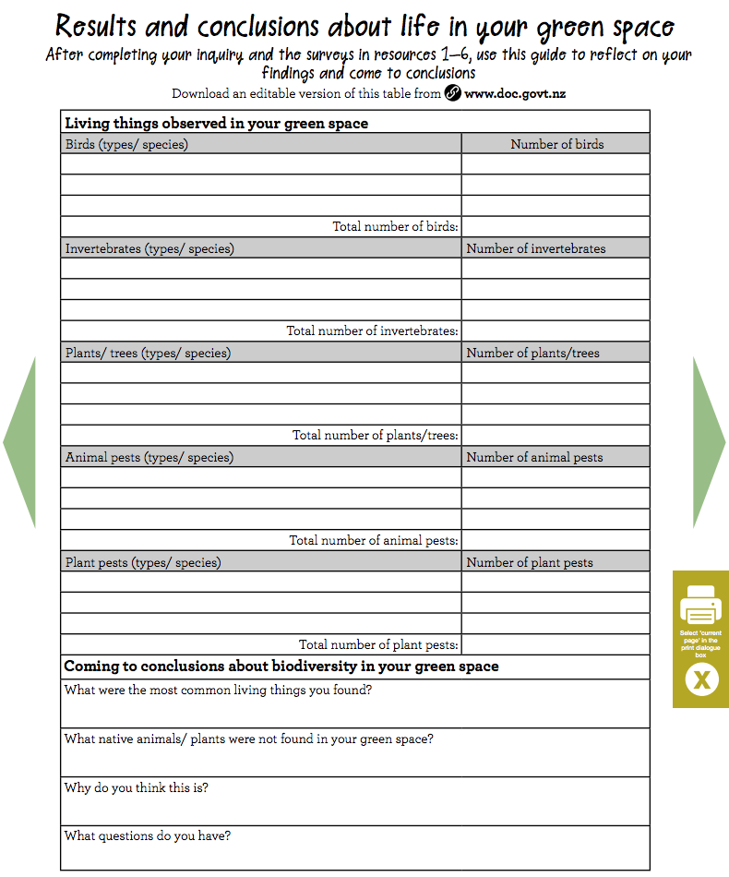
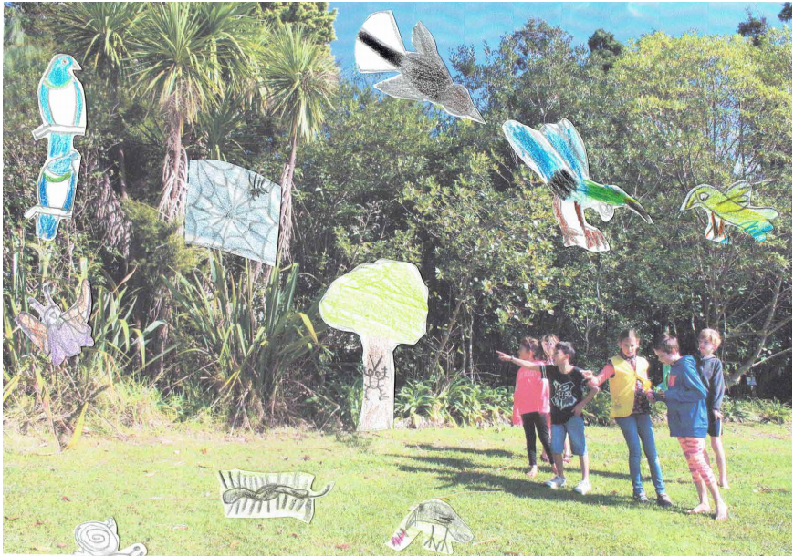
Reflecting on findings
Verran Primary School, © DOC
© DOC
© Copyright. University of Waikato. All Rights Reserved | www.sciencelearn.org.nz
All images are copyrighted. For further information, please refer to enquiries@sciencelearn.org.nz

Slide 13
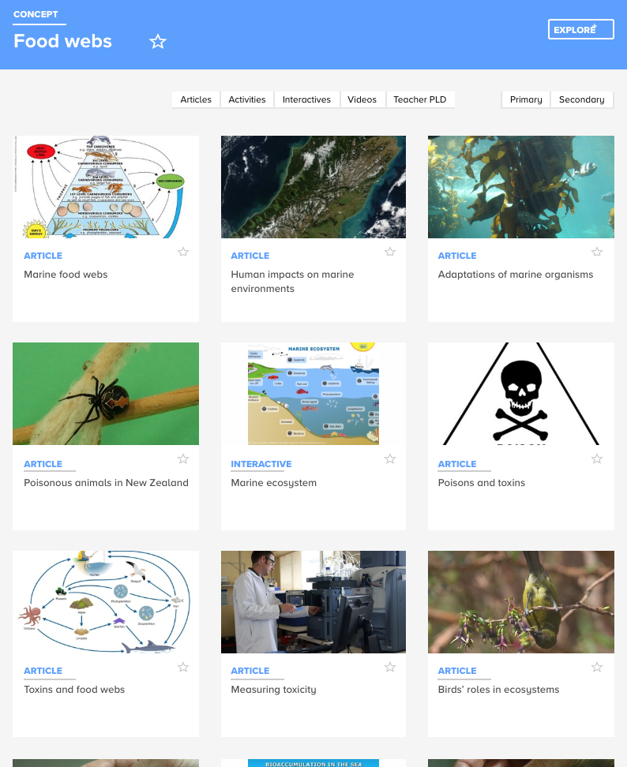
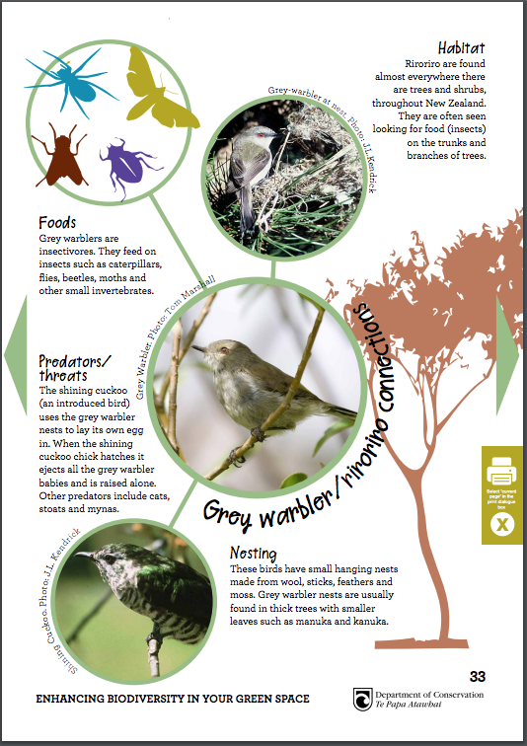
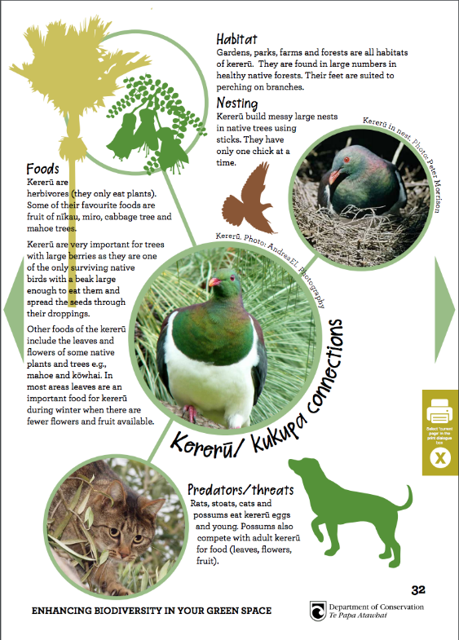
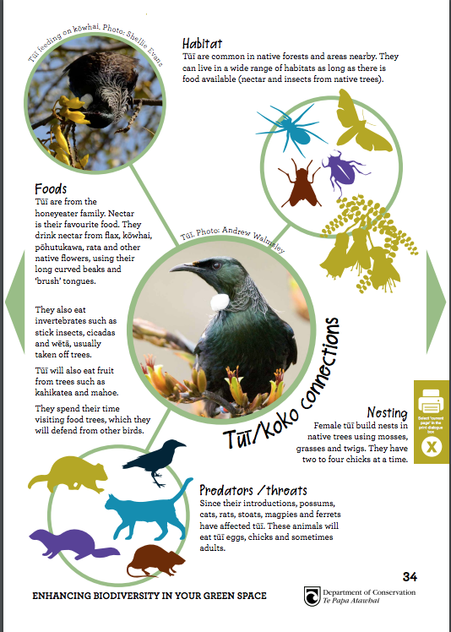
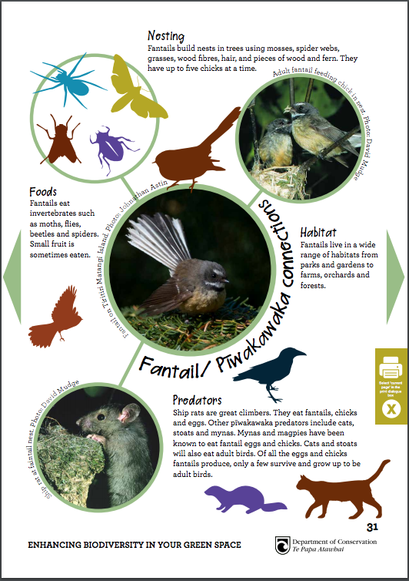
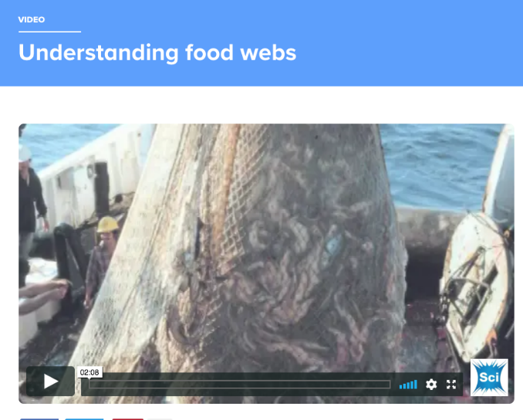
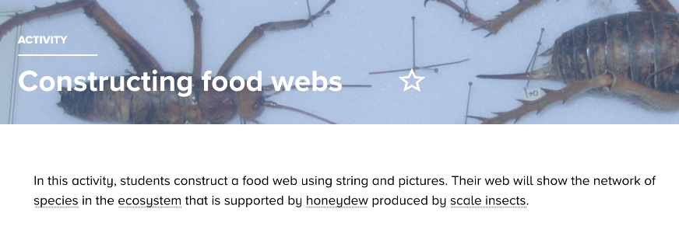
Connections in your green space
© DOC
© Copyright. University of Waikato. All Rights Reserved | www.sciencelearn.org.nz
All images are copyrighted. For further information, please refer to enquiries@sciencelearn.org.nz

Slide 14
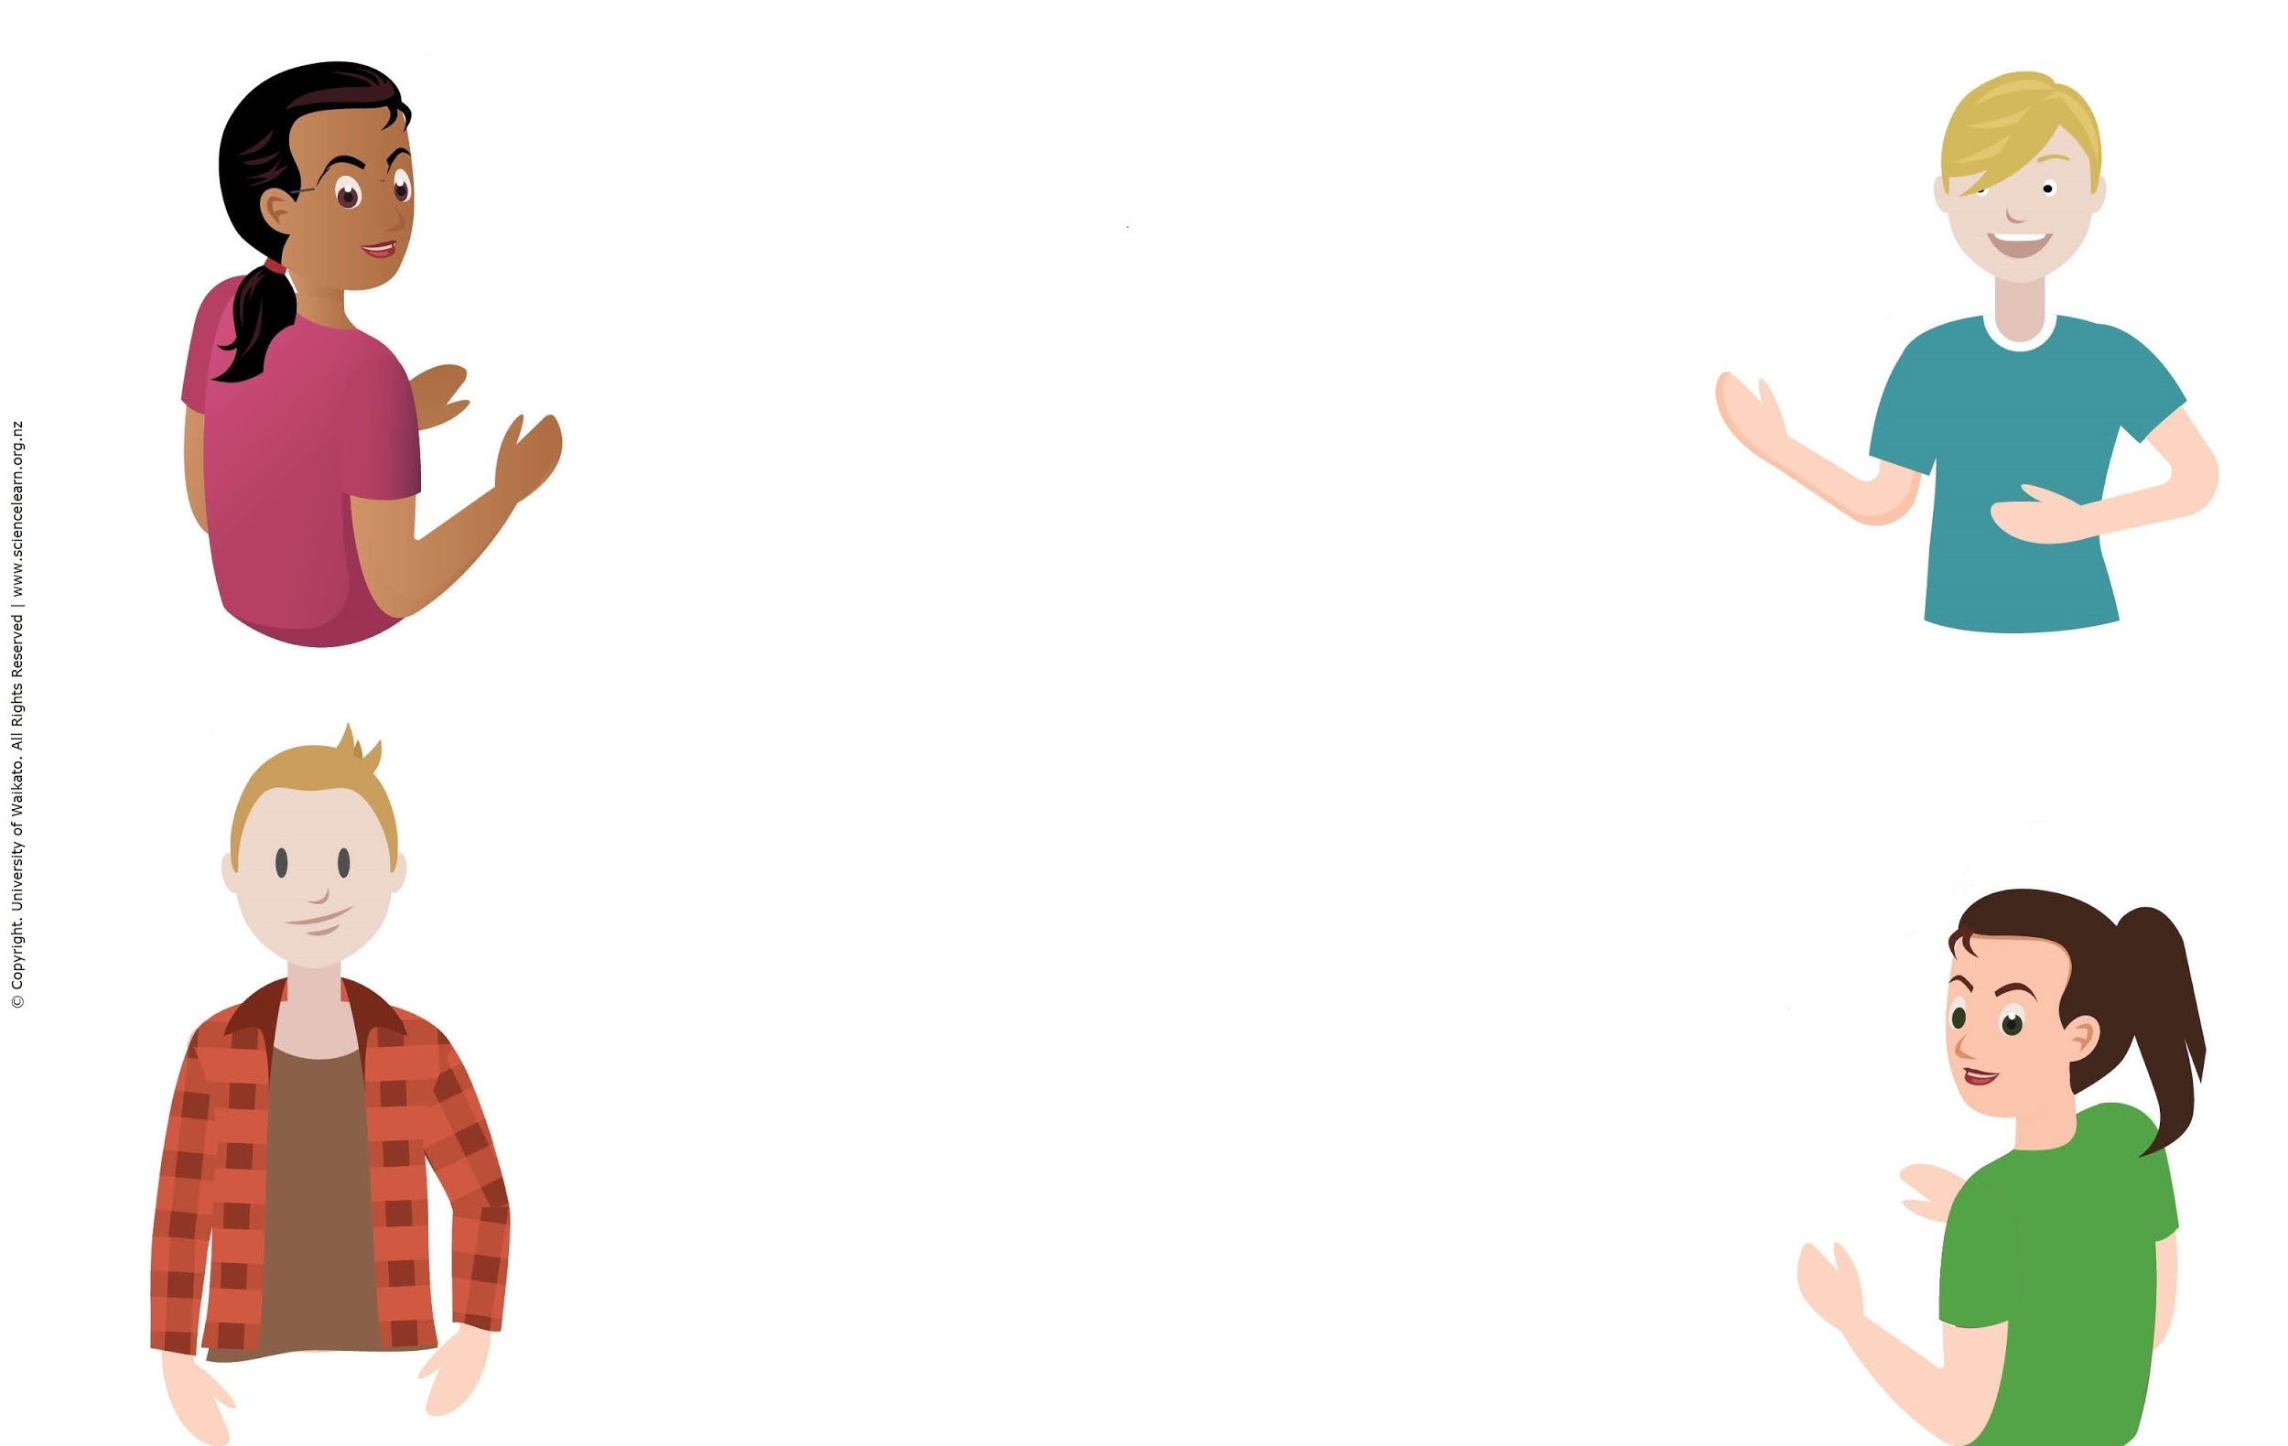
What is environmental action?
What environmental action have you been involved in or are you
thinking about?
© Copyright. University of Waikato. All Rights Reserved | www.sciencelearn.org.nz
All images are copyrighted. For further information, please refer to enquiries@sciencelearn.org.nz

Slide 15
What is environmental action?
Environmental action could be cleaning up an area, including waterways and parks.
Making changes to help a local ecosystem to improve its health. Making society aware of pollution, garden creation, organising recycling, encouraging food without plastic packaging, bird counts, butterfly tagging and riparian planting.
For students to learn about pest management and pest free New Zealand 2050, and encourage their families and friends to participate in pest management.
Removing weeds that are preventing growth of the native plants that our native birds need.
© Copyright. University of Waikato. All Rights Reserved | www.sciencelearn.org.nz
All images are copyrighted. For further information, please refer to enquiries@sciencelearn.org.nz

Slide 16
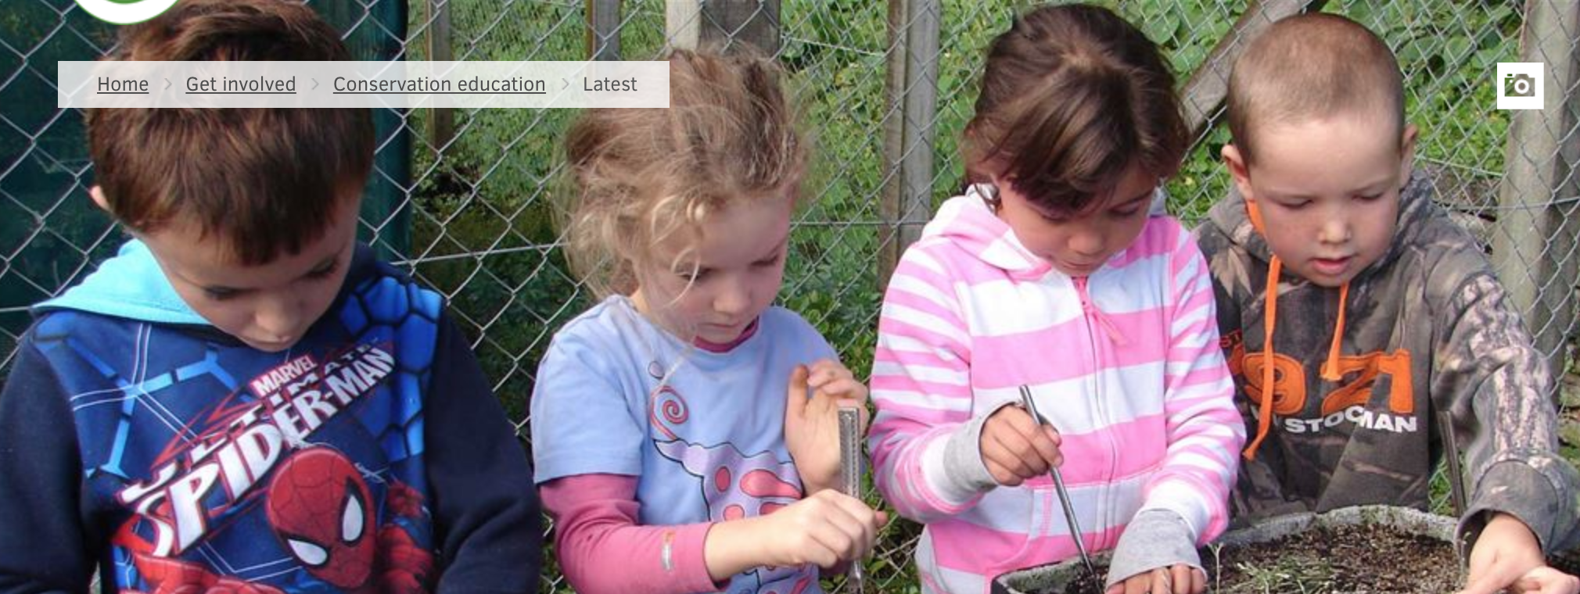
What is environmental action?
Michael Tapp/DOC
© Copyright. University of Waikato. All Rights Reserved | www.sciencelearn.org.nz
All images are copyrighted. For further information, please refer to enquiries@sciencelearn.org.nz

Slide 17
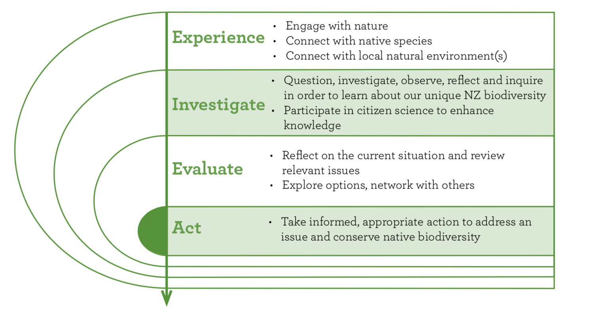
When to take action
© DOC
© Copyright. University of Waikato. All Rights Reserved | www.sciencelearn.org.nz
All images are copyrighted. For further information, please refer to enquiries@sciencelearn.org.nz

Slide 18
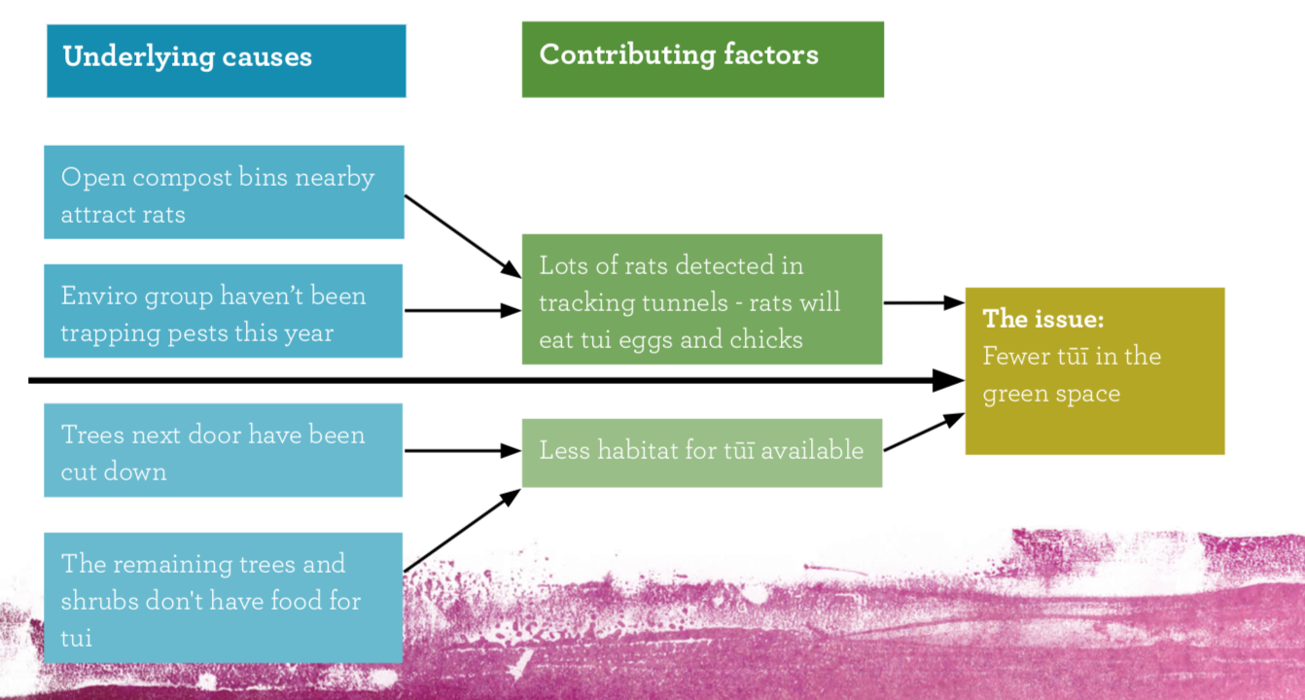
What’s the issue?
© DOC
© Copyright. University of Waikato. All Rights Reserved | www.sciencelearn.org.nz
All images are copyrighted. For further information, please refer to enquiries@sciencelearn.org.nz

Slide 19
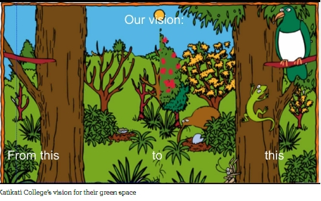
Goals and vision
Katikati College
© Copyright. University of Waikato. All Rights Reserved | www.sciencelearn.org.nz
All images are copyrighted. For further information, please refer to enquiries@sciencelearn.org.nz

Slide 20
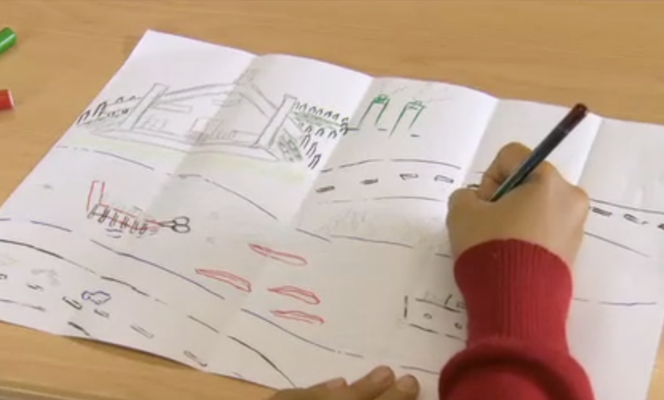
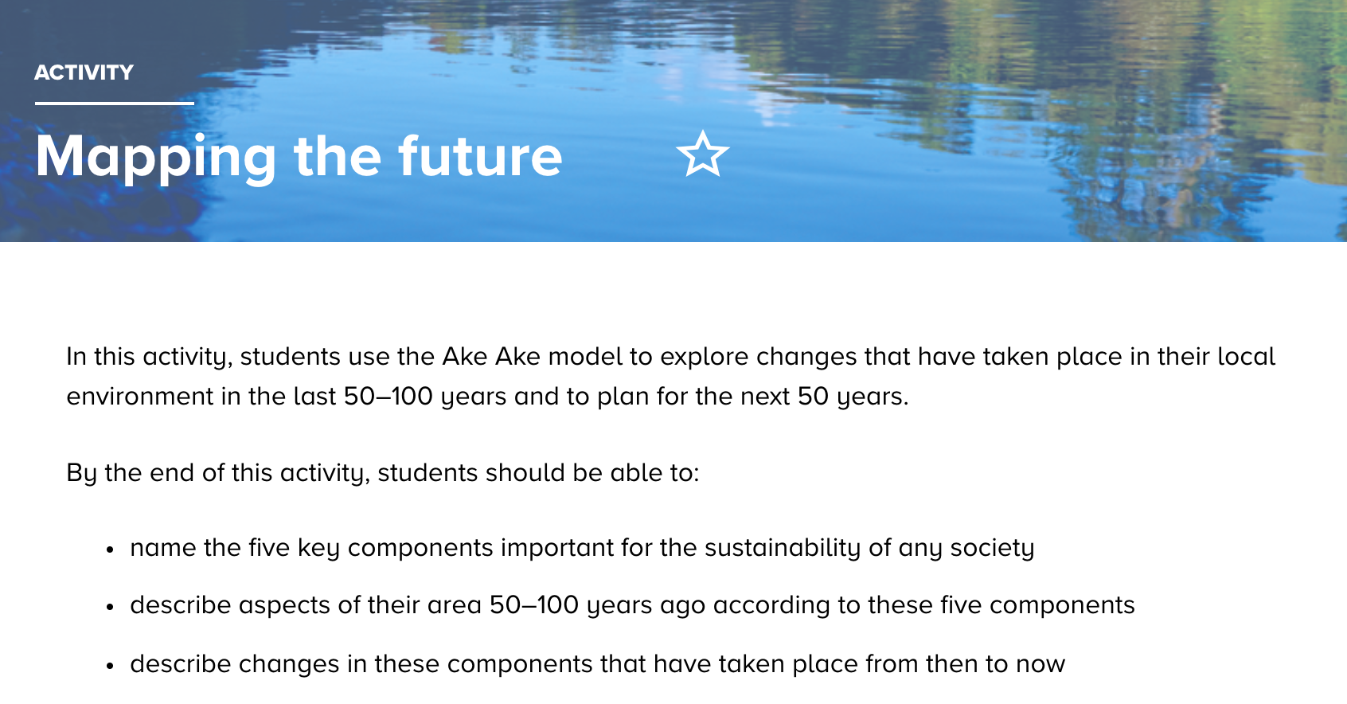
Goals and vision
© Copyright. University of Waikato. All Rights Reserved | www.sciencelearn.org.nz
All images are copyrighted. For further information, please refer to enquiries@sciencelearn.org.nz

Slide 21
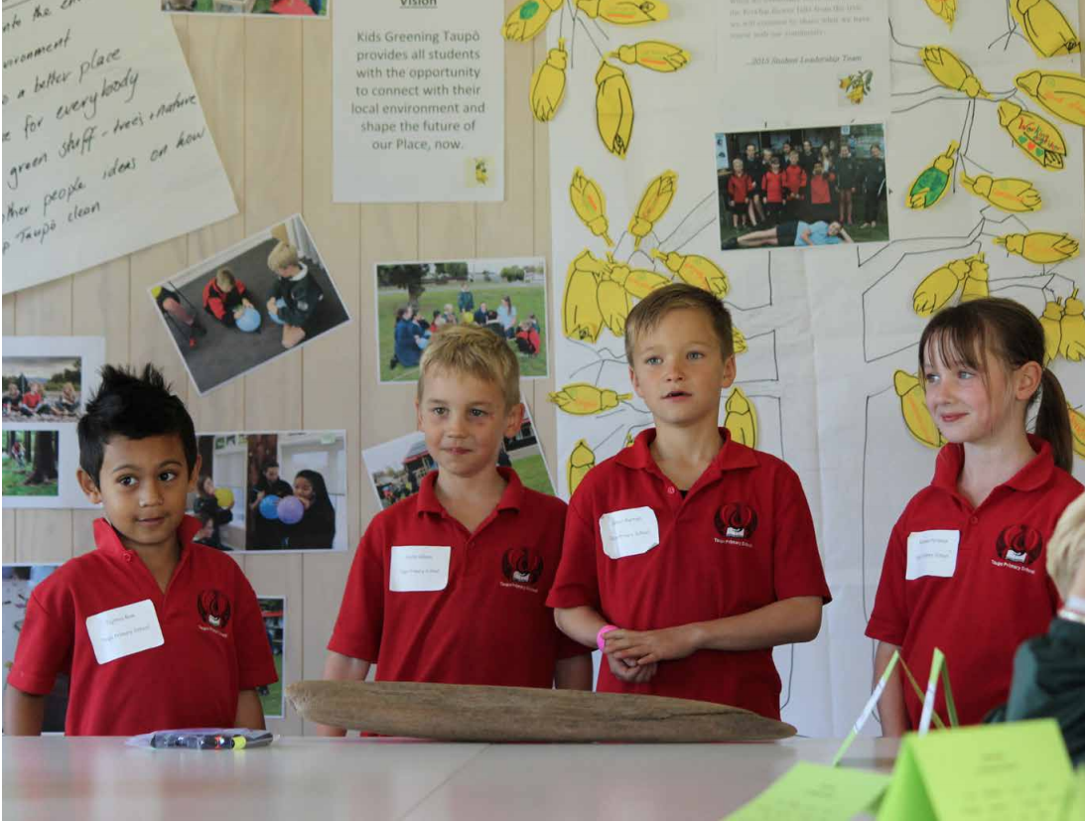
Student-led action
Photo: Kids Greening Taupō programme
© Copyright. University of Waikato. All Rights Reserved | www.sciencelearn.org.nz
All images are copyrighted. For further information, please refer to enquiries@sciencelearn.org.nz

Slide 22
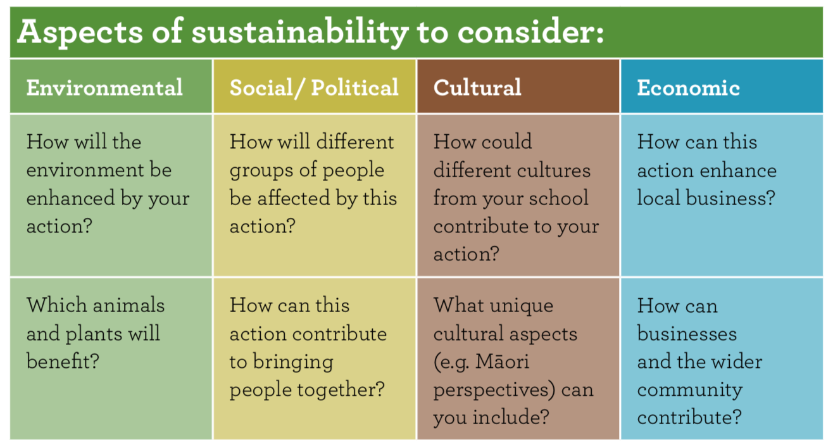
Decision-making tools
© DOC
© Copyright. University of Waikato. All Rights Reserved | www.sciencelearn.org.nz
All images are copyrighted. For further information, please refer to enquiries@sciencelearn.org.nz

Slide 23
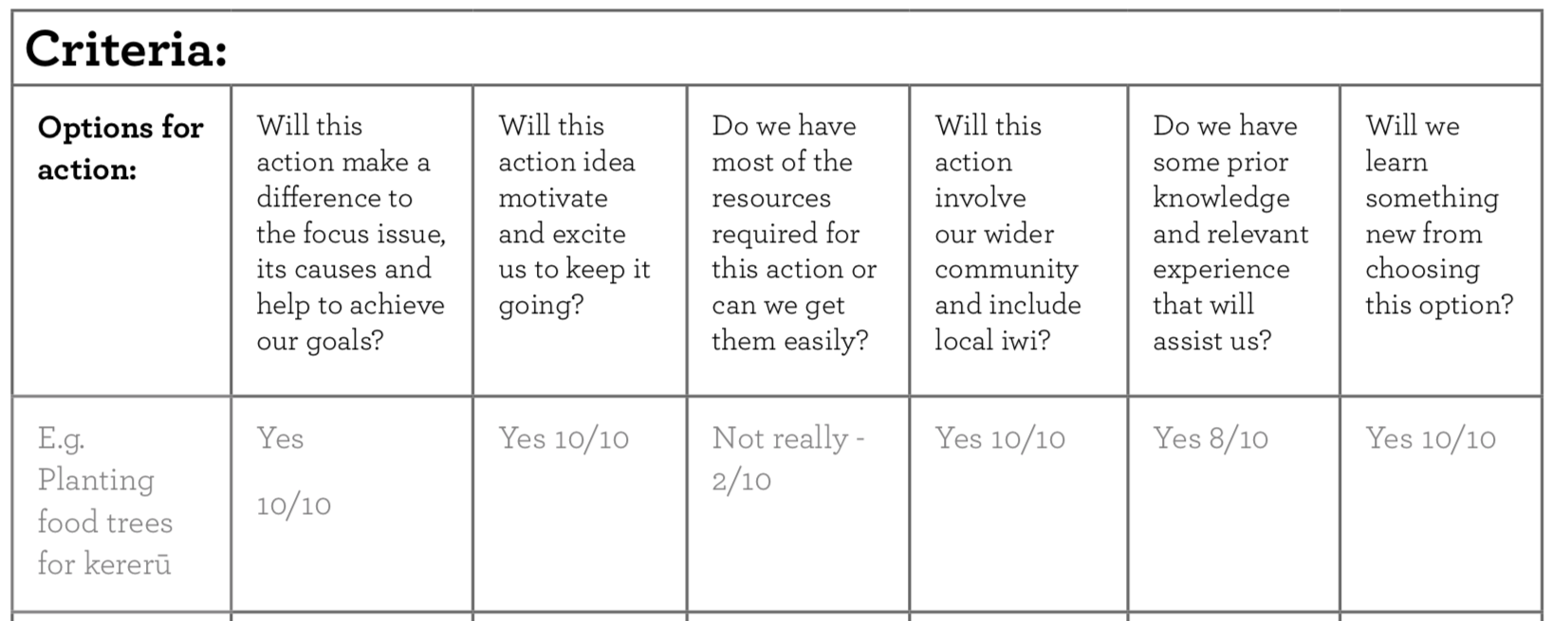
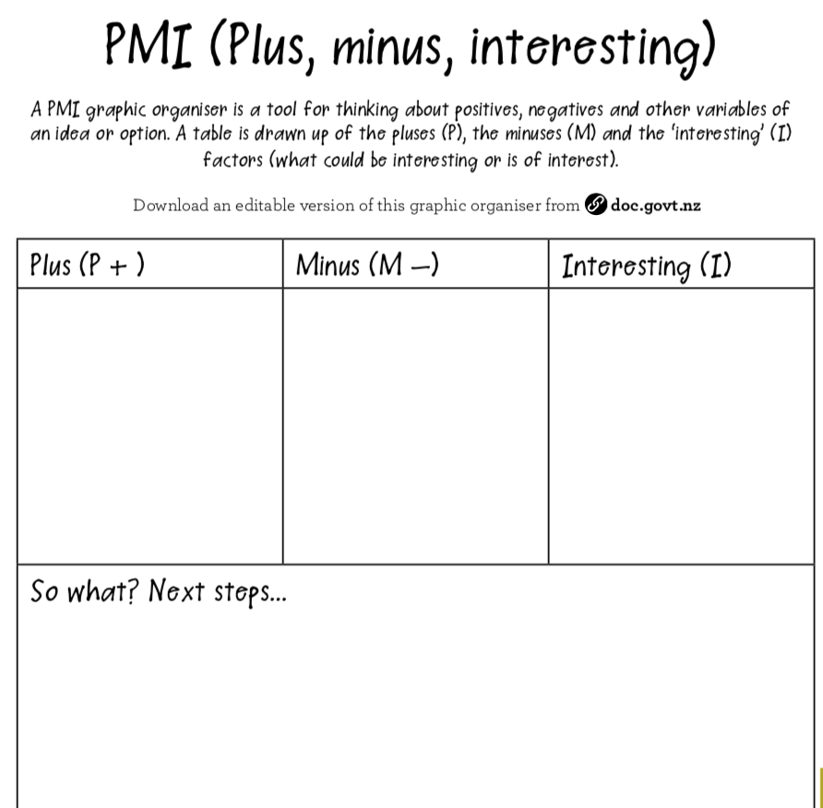
Decision-making tools
© Copyright. University of Waikato. All Rights Reserved | www.sciencelearn.org.nz
All images are copyrighted. For further information, please refer to enquiries@sciencelearn.org.nz
© DOC

Slide 24
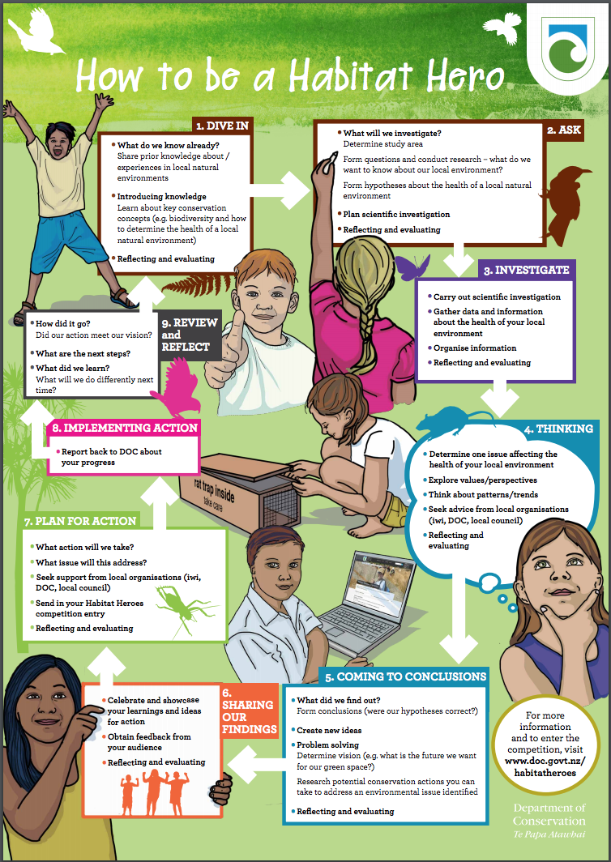
© DOC
© Copyright. University of Waikato. All Rights Reserved | www.sciencelearn.org.nz
All images are copyrighted. For further information, please refer to enquiries@sciencelearn.org.nz

Slide 25
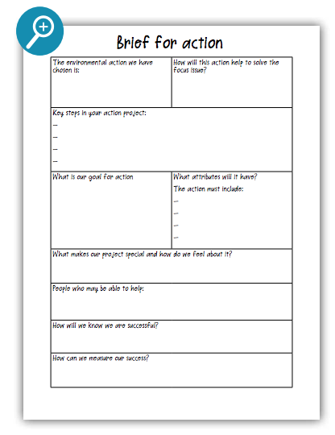
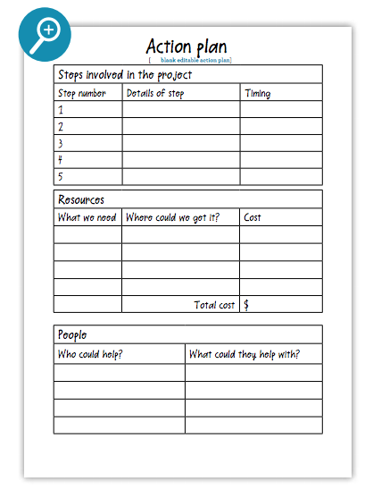
Action planning
© DOC
© DOC
© Copyright. University of Waikato. All Rights Reserved | www.sciencelearn.org.nz
All images are copyrighted. For further information, please refer to enquiries@sciencelearn.org.nz

Slide 26
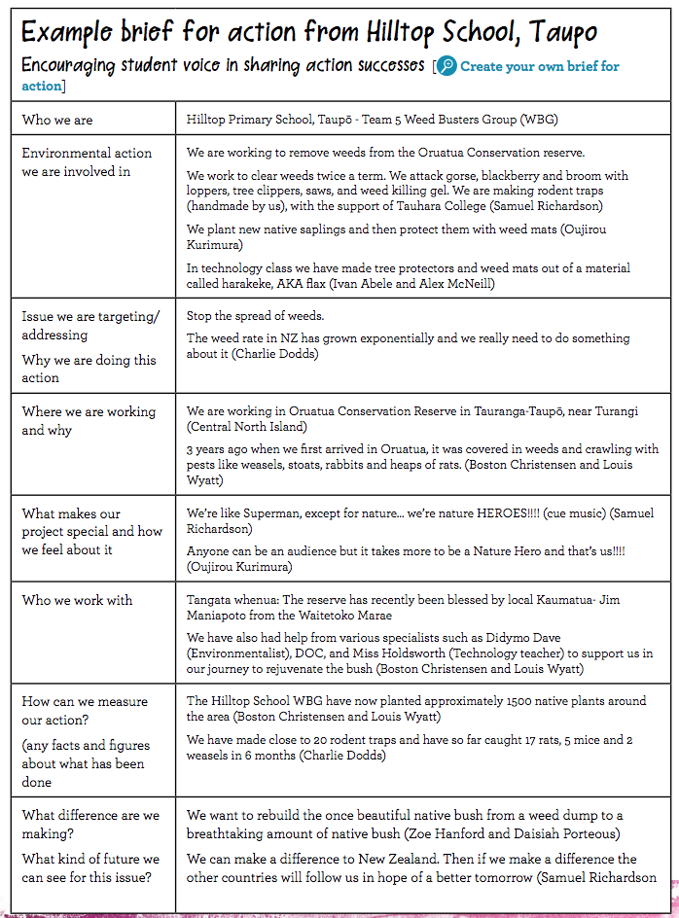
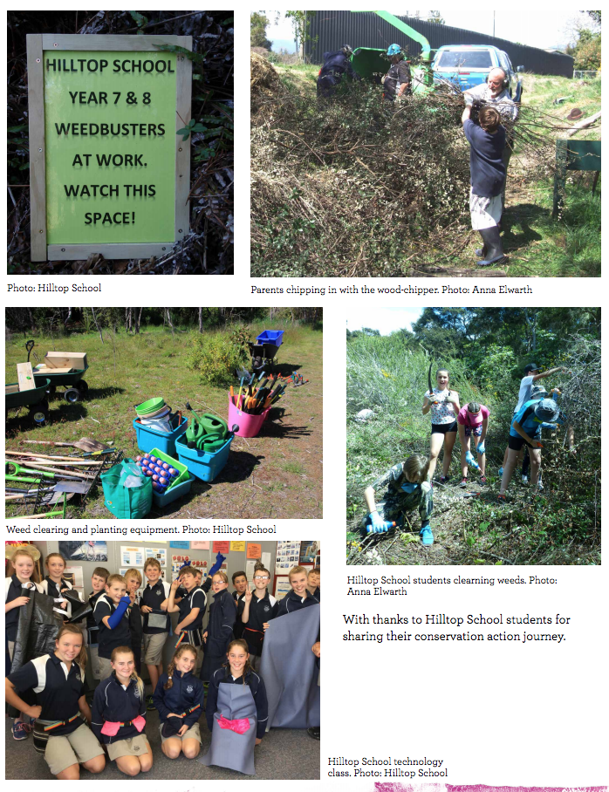
Example brief
© DOC
© Copyright. University of Waikato. All Rights Reserved | www.sciencelearn.org.nz
All images are copyrighted. For further information, please refer to enquiries@sciencelearn.org.nz

Slide 27
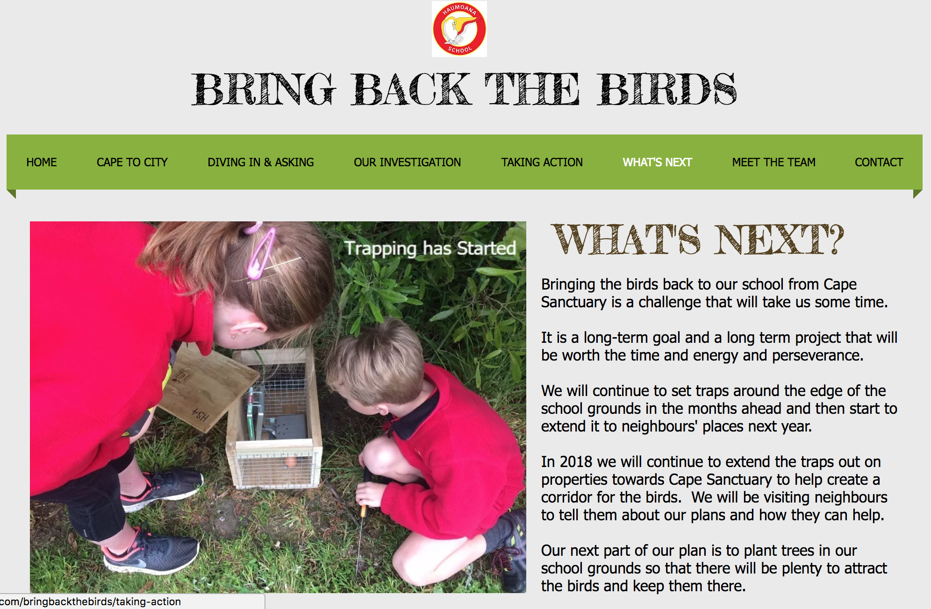
Examples of action
© 2017 by Haumoana School
© Copyright. University of Waikato. All Rights Reserved | www.sciencelearn.org.nz
All images are copyrighted. For further information, please refer to enquiries@sciencelearn.org.nz

Slide 28
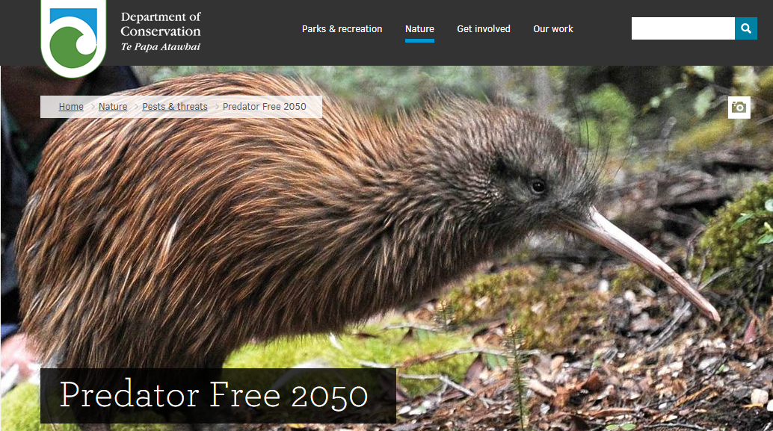
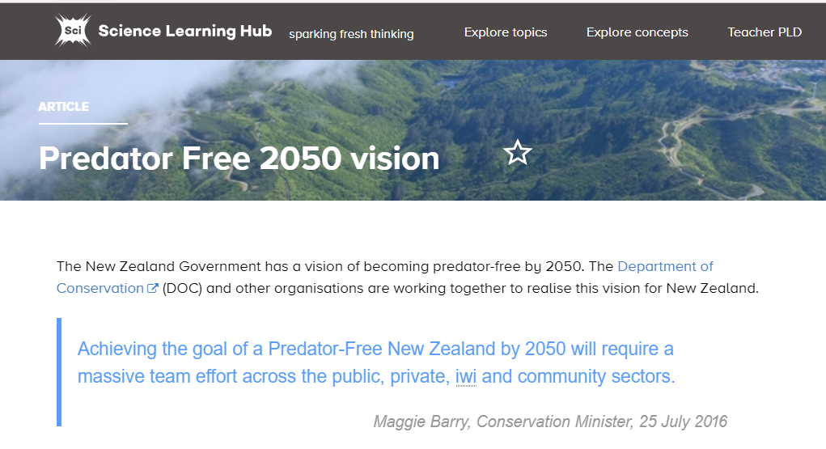
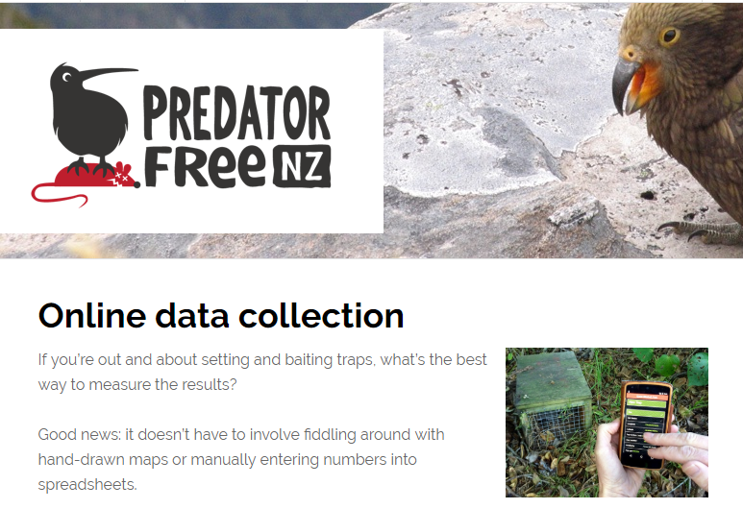
Predator Free 2050
© DOC
Rob Suisted/Zealandia
© Predator Free NZ
© Copyright. University of Waikato. All Rights Reserved | www.sciencelearn.org.nz
All images are copyrighted. For further information, please refer to enquiries@sciencelearn.org.nz

Slide 29
Examples of action
© Bay Bush Action Trust
© Copyright. University of Waikato. All Rights Reserved | www.sciencelearn.org.nz
All images are copyrighted. For further information, please refer to enquiries@sciencelearn.org.nz

Slide 30
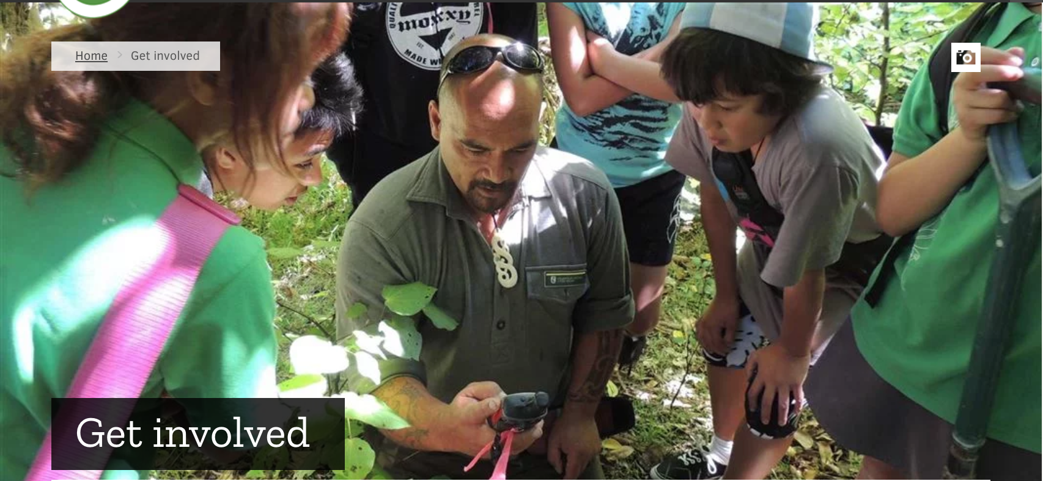
Working alongside your community
Who are your local community?
Trudi Ngawhare/DOC
© Copyright. University of Waikato. All Rights Reserved | www.sciencelearn.org.nz
All images are copyrighted. For further information, please refer to enquiries@sciencelearn.org.nz

Slide 31
Working alongside your community
© 2011 Te Potiki National Trust Limited
© Copyright. University of Waikato. All Rights Reserved | www.sciencelearn.org.nz
All images are copyrighted. For further information, please refer to enquiries@sciencelearn.org.nz

Slide 32
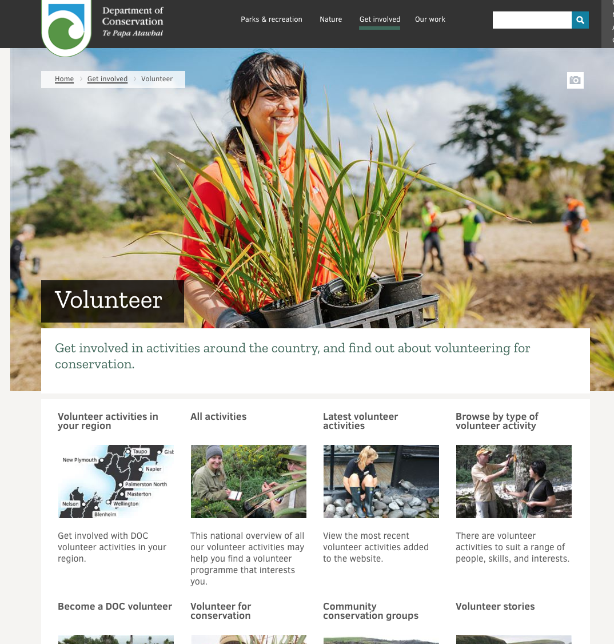
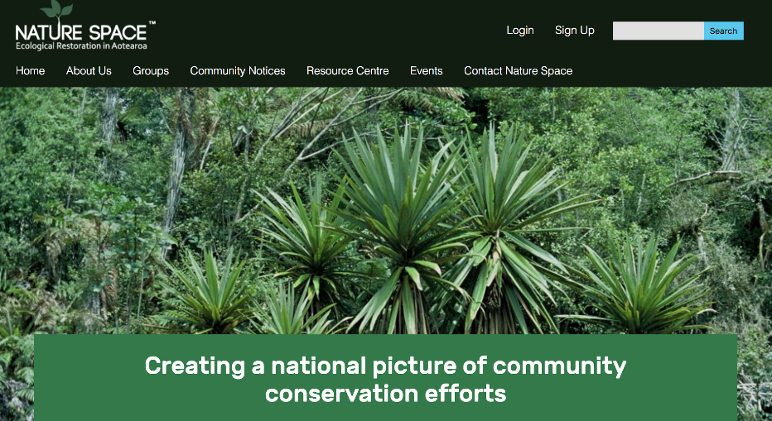
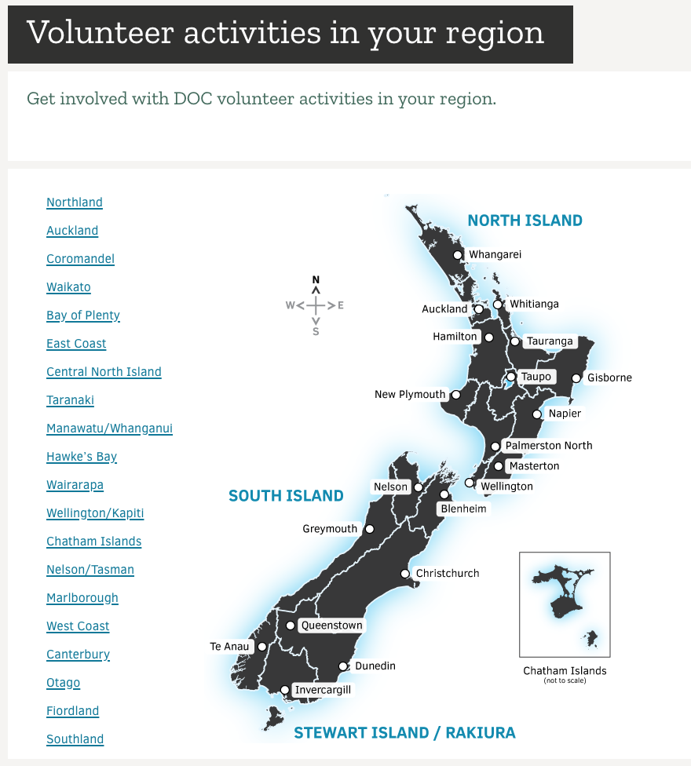
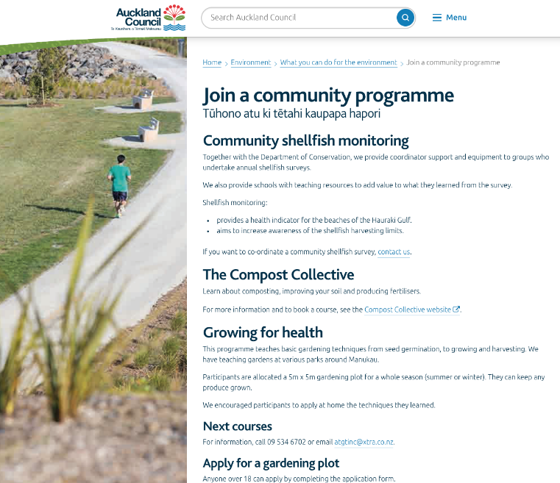
Working alongside your community
© DOC
© Copyright. University of Waikato. All Rights Reserved | www.sciencelearn.org.nz
All images are copyrighted. For further information, please refer to enquiries@sciencelearn.org.nz

Slide 33
Working alongside your community
Who could support you with environmental action in your community?
© Copyright. University of Waikato. All Rights Reserved | www.sciencelearn.org.nz
All images are copyrighted. For further information, please refer to enquiries@sciencelearn.org.nz

Slide 34
© DOC
© Copyright. University of Waikato. All Rights Reserved | www.sciencelearn.org.nz
All images are copyrighted. For further information, please refer to enquiries@sciencelearn.org.nz

Slide 35
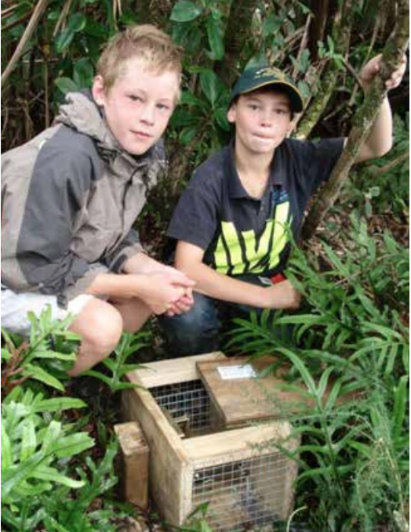
Implementing action
Health and safety
Safety action plans
Discuss behaviour
ETOC guidelines
Ethics
© DOC
© Copyright. University of Waikato. All Rights Reserved | www.sciencelearn.org.nz
All images are copyrighted. For further information, please refer to enquiries@sciencelearn.org.nz

Slide 36
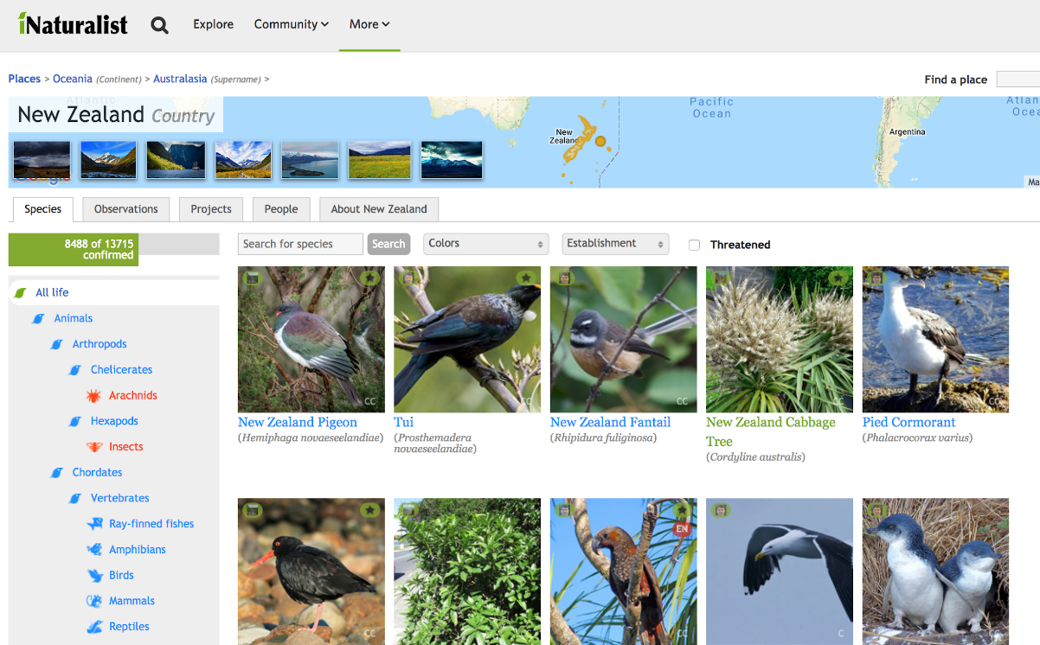
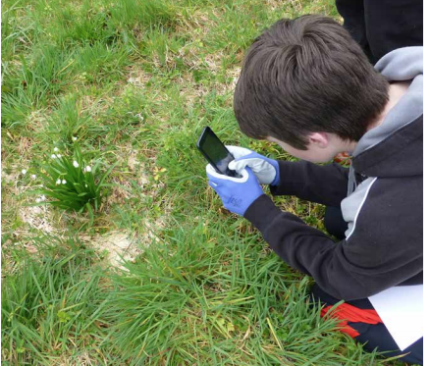
Monitoring and sharing action
Why document?
Show progress
Share findings
Funding
Review
Future action
Benefits of photos
iNaturalist
https://inaturalist.nz/
Murray Dawson/Whataroa School
© Copyright. University of Waikato. All Rights Reserved | www.sciencelearn.org.nz
All images are copyrighted. For further information, please refer to enquiries@sciencelearn.org.nz

Slide 37
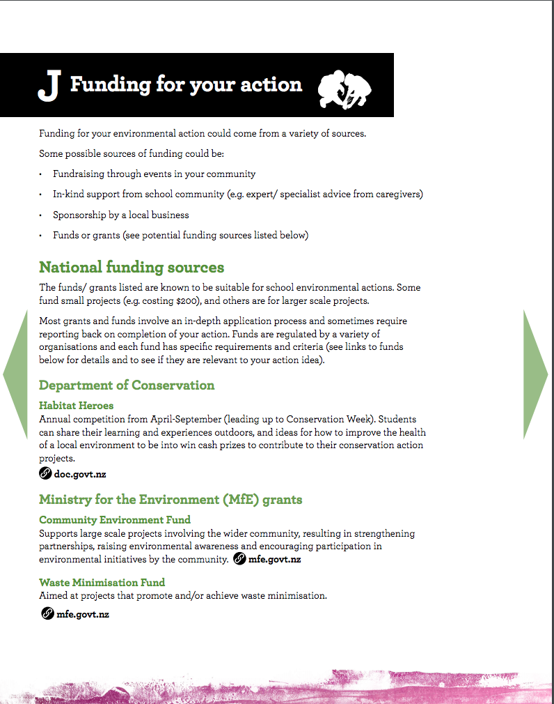
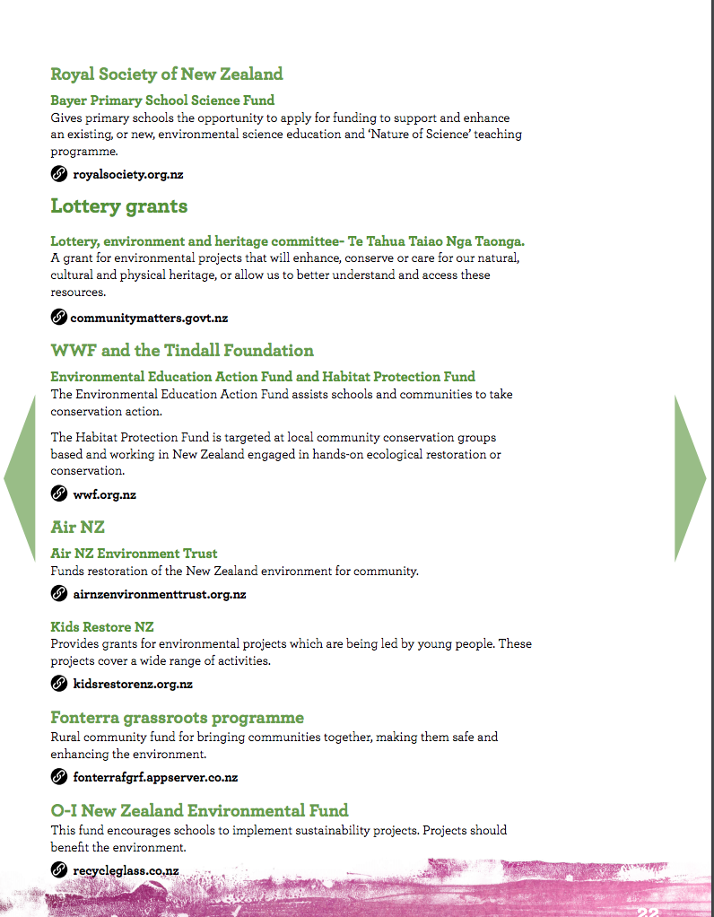
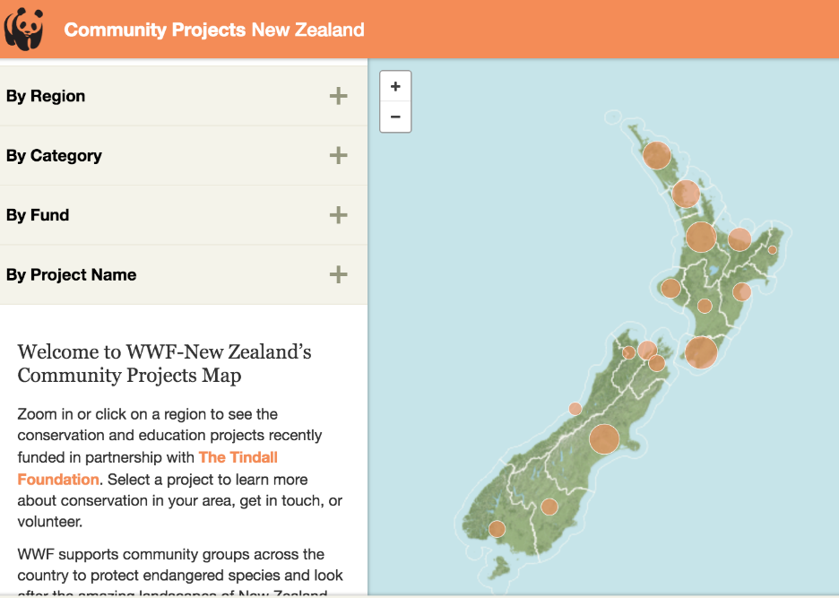
Funding action
Tools for Environmental Action pages 21–24
© DOC
© World Wildlife Fund NZ (WWF)
© Copyright. University of Waikato. All Rights Reserved | www.sciencelearn.org.nz
All images are copyrighted. For further information, please refer to enquiries@sciencelearn.org.nz

Slide 38
Supporting action
© DOC
© Copyright. University of Waikato. All Rights Reserved | www.sciencelearn.org.nz
All images are copyrighted. For further information, please refer to enquiries@sciencelearn.org.nz

Slide 39
Thanks – keep in touch
Department of Conservation
www.doc.govt.nz/education
Contact us on conserved@doc.govt.nz
e-newsletter www.doc.govt.nz/news/newsletters/conservation-education/
POND page www.pond.co.nz/community/721642/department-of-conservation/1

Slide 40
Thanks – keep in touch
Science Learning Hub
Email us on enquiries@sciencelearn.org.nz
https://twitter.com/NZScienceLearn
www.facebook.com/nzsciencelearn
https://nz.pinterest.com/nzsciencelearn/
www.pond.co.nz/community/214015/science-learning-hub/1
www.instagram.com/sciencelearninghubnz
Join us in our discussion channel on Slack.
(Any problems accessing Slack, please contact us via our enquiries email, enquiries@sciencelearn.org.nz.)

