Slide 1
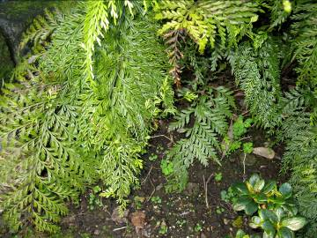
Hen and chickens fern
New Zealand native ferns
Rhizomes are short, erect and dark brown. The stipe and rachis are green.
Fronds are tufted, arching and feathery. The fronds are often covered in bulbils –hence its common name. The bulbils take root once the frond drops to the ground.
Sori are oblong and arranged on the pinnae margin.
Scientific name: Asplenium bulbiferum
Māori name: mouku
Distribution: throughout New Zealand
Habitat: lowland and low montane forests
Frond size: 200–1550 mm
© Copyright. University of Waikato. All Rights Reserved | www.sciencelearn.org.nz

Slide 2
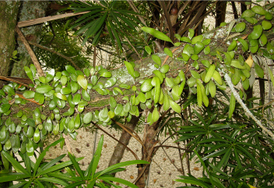
Leather-leaf fern
New Zealand native ferns
Endemic to New Zealand.
Creeping rhizome grows up surfaces ranging from tree trunks to garden walls.
Fronds are thick and leathery, glossy on the top with white hairs on the underside. Sterile fronds are rounded, short and broad in shape. Fertile fronds are long and narrow.
Sori are oblong and arranged on the pinnae margin.
Scientific name: Pyrrosia eleagnifolia
Māori name: ngārara wehi
Distribution: throughout New Zealand to 1,000 m
Habitat: common on trees, rocks in native forests and exposed coastal areas
Frond size: 30–200 mm
© Copyright. University of Waikato. All Rights Reserved | www.sciencelearn.org.nz

Slide 3
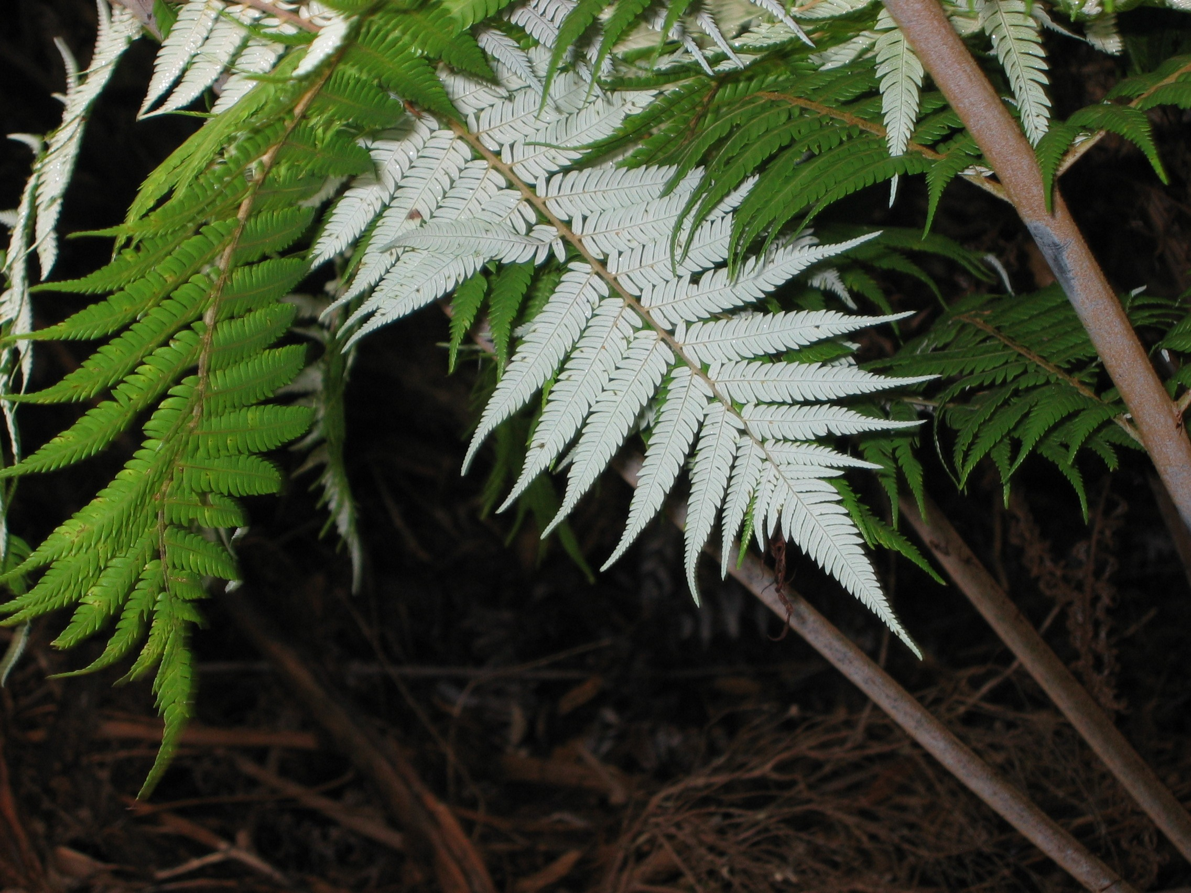
Silver fern
New Zealand native ferns
Endemic to New Zealand.
Rhizome is vertical, forming a trunk up to 10 m tall.
Fronds are long with a distinctive white underside. This silver colour appears when the fern is 3 or 4 years old.
Sori are round and arranged along the vein of the pinnae.
Scientific name: Cyathea dealbata
Māori name: ponga
Distribution: throughout North Island, most of the South Island north of Dunedin but rare on the West Coast
Habitat: common in native forest and open scrub
Frond size: 1.5–3 m
© Copyright. University of Waikato. All Rights Reserved | www.sciencelearn.org.nz

Slide 4
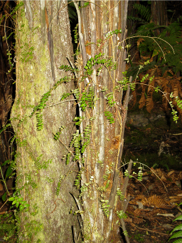
Thread fern
New Zealand native ferns
Endemic to New Zealand.
Rhizome is long and creeping.
Fronds differ considerably according to their location on the rhizome.
Fronds creeping along at ground level are sterile, rounded and very small. As the rhizome climbs upwards, the fronds are progressively larger with elongated, tapering pinnae. Several metres above the ground, the pinnae are long, narrow and pointed, hence the common name.
Scientific name: Blechnum filiforme
Māori name: pānako
Distribution: throughout North Island, confined to the Nelson area in the South Island
Habitat: common in lowland native forest
Frond size: creeping fronds are 60–300 mm, climbing fronds are up to 700 mm
© Copyright. University of Waikato. All Rights Reserved | www.sciencelearn.org.nz

Slide 5
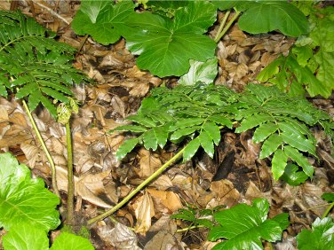
King fern
New Zealand native ferns
Rhizomes are erect and compact.
The king fern is New Zealand’s largest ground fern, hence its common name. Fronds are tufted and huge – up to 4 m long.
Pinnae are long, strap-like, dark green and glossy. Emergent growth is yellowish-green and darkens as the fronds grow.
Sori are oblong and arranged on the pinnae margin.
Scientific name: Marattia salicina
Māori name: para
Distribution: from Taranaki northwards
Habitat: lowland, heavily forested areas
Frond size: up to 4 m
© Copyright. University of Waikato. All Rights Reserved | www.sciencelearn.org.nz

Slide 6
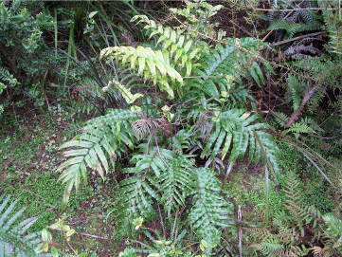
Palm-leaf fern/cape fern
New Zealand native ferns
Endemic to New Zealand.
Rhizomes are ground creeping.
Fronds can grow very large. Sterile fronds are green with finely serrated, strap-like pinnae.
Fertile fronds are thin and spindly in appearance. Young fronds are red before reaching maturity.
Sori are oval.
Scientific name: Blechnum novae-zelandiae
Māori name: kiokio
Distribution: very common throughout the country to 1,000 m
Habitat: common in road cuttings, bush, scrub and swamps
Frond size: 300–3,200 mm long
© Copyright. University of Waikato. All Rights Reserved | www.sciencelearn.org.nz

Slide 7
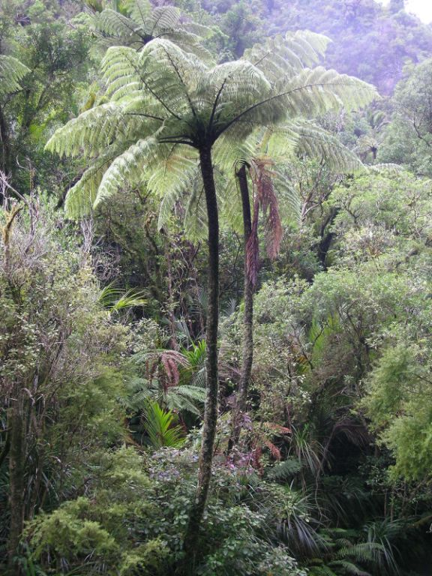
Black tree fern
New Zealand native ferns
A large tree that grows up to 20 m tall.
Rhizomes are vertical, black and covered with hexagonal stipe bases.
Fronds are large and drop from the plant when they die.
The pinnae are 400–1,000 m long.
Sori are round.
Museum of New Zealand Te Papa Tongarewa
Scientific name: Cyathea medullaris
Māori name: mamaku
Distribution: common throughout the North Island, parts of the South Island, Stewart Island and the Chatham Islands
Habitat: lowland forests in the north and wetter areas in the south
Frond size: up to 5 m long
© Copyright. University of Waikato. All Rights Reserved | www.sciencelearn.org.nz

Slide 8
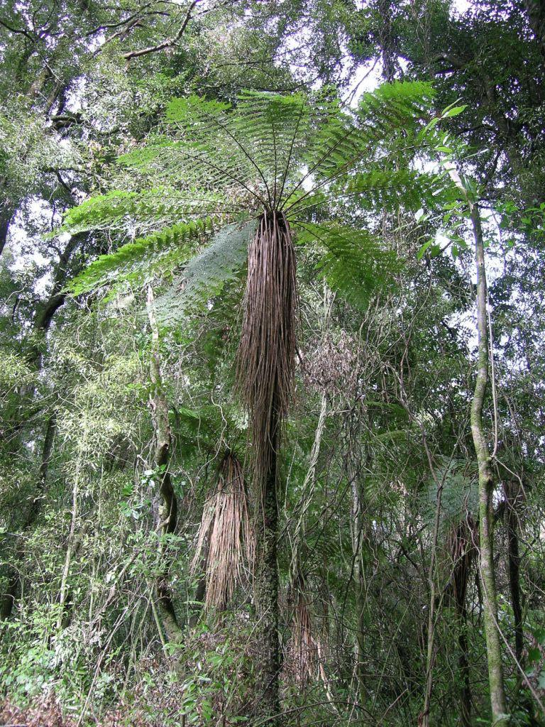
Soft tree fern
New Zealand native ferns
Endemic to New Zealand.
Rhizomes are vertical and grow up to 5 m tall.
Fronds appear soft and delicate. Dead fronds do not drop from the tree but form a distinctive skirt.
The primary pinnae are up to 500 mm long.
The indusia are saucer-shaped.
Museum of New Zealand Te Papa Tongarewa
Scientific name: Cyathea smithii
Māori name: kātote
Distribution: common throughout all of New Zealand
Habitat: lowland to montane, an understorey plant, common in pine plantations
Frond size: up to 2.5 m long
© Copyright. University of Waikato. All Rights Reserved | www.sciencelearn.org.nz

Slide 9
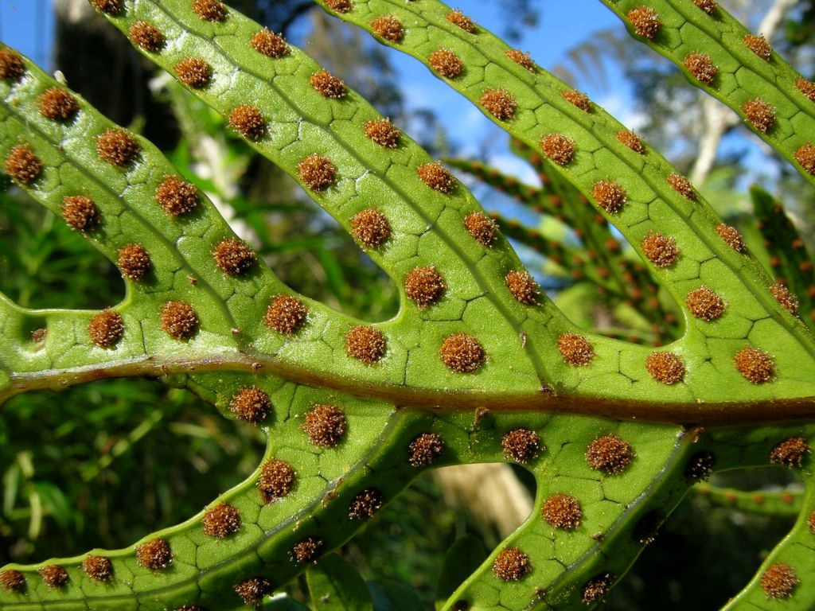
Hound’s tongue
New Zealand native ferns
Native to New Zealand and Australia.
Rhizomes creep along the ground or up tree trunks. They are epiphytes.
Fronds are green, leathery and glossy. Fertile fronds have smaller lobes than sterile fronds.
Sori are round and visibly bulge.
Museum of New Zealand Te Papa Tongarewa
Scientific name: Microsorum pustulatum
Māori name: kōwaowao or pāraharaha
Distribution: coastal to montane areas
Habitat: forest and open habitats throughout New Zealand, often in drier places
Frond size: 220–375 mm long
© Copyright. University of Waikato. All Rights Reserved | www.sciencelearn.org.nz

Slide 10
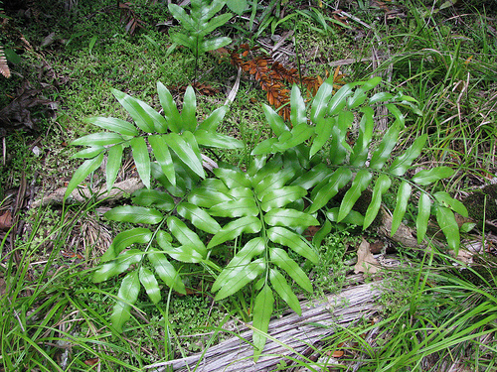
Shining spleenwort
New Zealand native ferns
Endemic to New Zealand and the Kermadec Islands.
Rhizomes are erect.
The fronds are dark and glossy green, and the pinnae are in a herringbone pattern.
Sori are up to 20 mm long.
© Gary Higgins, CC BY-NC-SA 4.0
Scientific name: Asplenium oblongifolium
Māori name: huruhuru whenua
Distribution: very common throughout the country to 1000 m
Habitat: mostly coastal and lowland areas, but diverse habitats up to montane areas
Frond size: up to 1 m long
© Copyright. University of Waikato. All Rights Reserved | www.sciencelearn.org.nz

