Slide 1
PRECIPITATION AND CLOUDS
What is precipitation?
Phases of water in the air
Cloud formation
© Copyright 2012. University of Waikato. All rights reserved. | www.sciencelearn.org.nz

Slide 2
What is precipitation?
Precipitation is part of the water cycle, where water vapour in the atmosphere returns to a solid or liquid state and falls to the Earth.
Precipitation includes things like rain, snow and hail.

Slide 3
Precipitation processes
condensation
convection
precipitation
water
vapour
evaporation

Slide 4
Phases of water in the air
Vapour
Invisible but detectable Water in a gaseous state Vapour/steam
Droplets
Visible as rain Form when air becomes saturated via the process of condensation
Ice particles
At temperatures below 0°C Hail often found at warmer ground surface temperatures

Slide 5
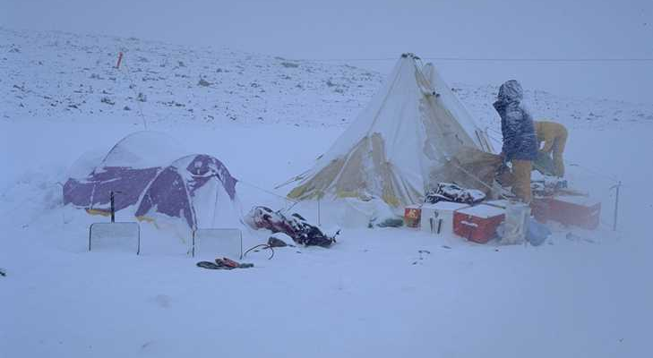
Most temperate-zone precipitation starts off as snow!

Slide 6
Water vapour transport
Where does our rain originate?
Water vapour is transported and concentrated in the atmosphere by vertical and horizontal motion
advection
convection
precipitation
evaporation

Slide 7
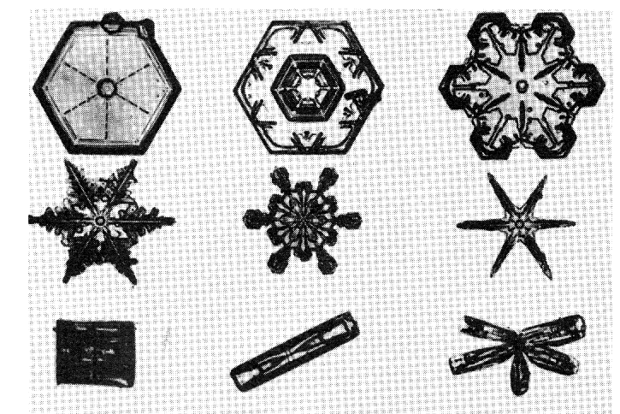
Ice particles

Slide 8
Wellington fog

Slide 9
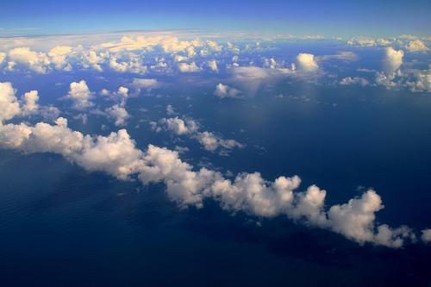
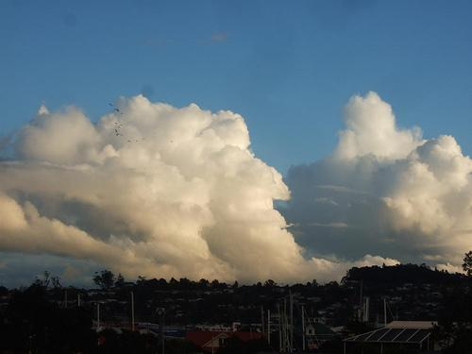
Cumulus clouds
Edward Hyde

Slide 10
Clouds at Cape Hallett, Antarctica

Slide 11
Clouds
Clouds are mixtures of droplets and ice particles
ice
0°C isotherm
ice droplets
glaciated clouds
temp. < –40°C
droplets
cold clouds
part/all above 0°C isotherm
mixed clouds
warm clouds
temp. > 0°C

Slide 12
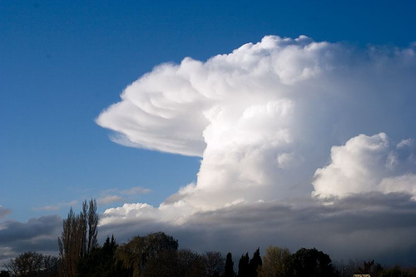
Cumulonimbus – a mixed cloud
Philip Norton

Slide 13
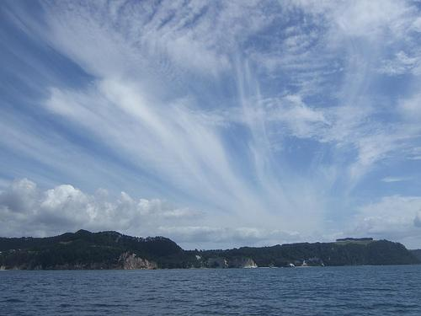
Cirrus – glaciated clouds
Edward Hyde

