Slide 1
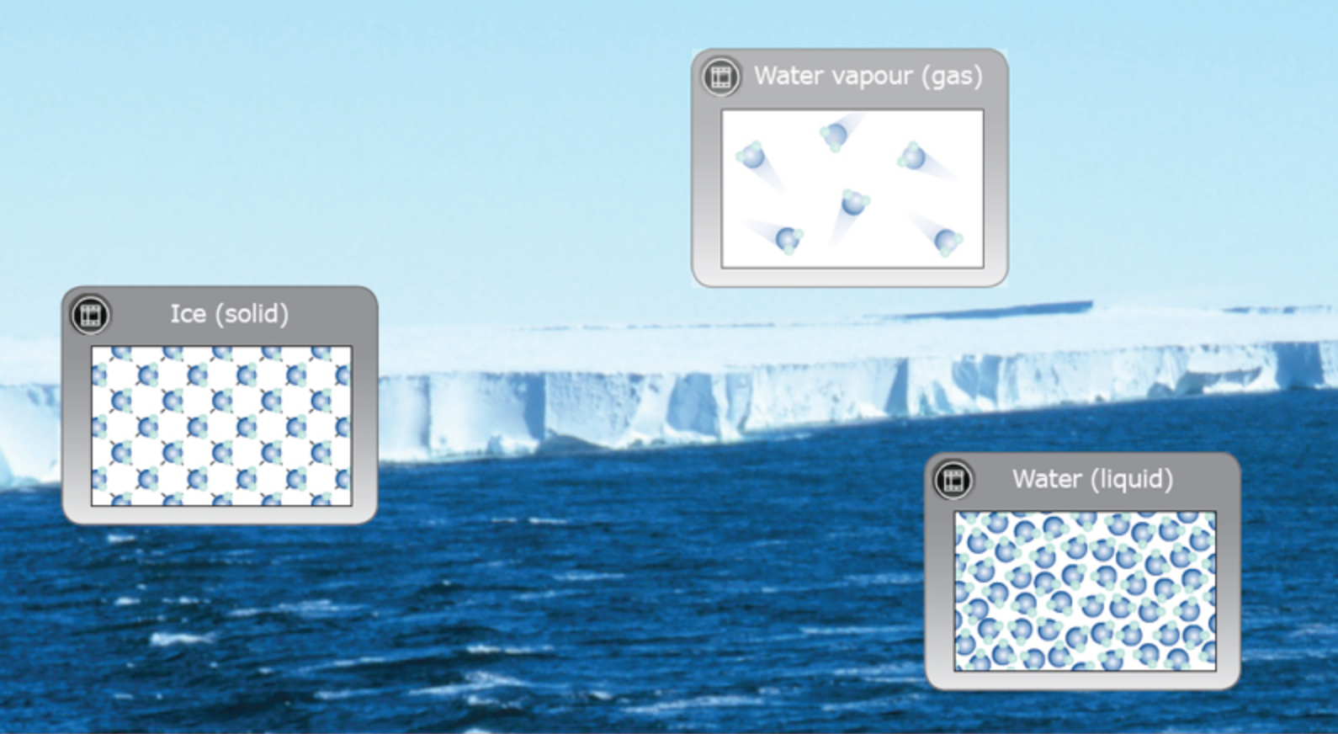
Chemistry made simple – atoms
© Steve Hathaway
Greta Dromgool
4–4.45pm Thursday 25 October
© Copyright. University of Waikato. All Rights Reserved | www.sciencelearn.org.nz
All images are copyrighted. For further information, please refer to enquiries@sciencelearn.org.nz

Slide 2


The Science Learning Hub
Pokapū Akoranga Pūtaiao
A trustworthy online resource – produced by educators and scientists
Based on world-class New Zealand science research
Supported by learning activities, information about the key science ideas and concepts, multimedia tools and other resources
Written for New Zealand teachers and students
Notes:
The SLH is funded by the New Zealand government – MBIE Ministry of Business, Innovation and Employment – under the Curious Minds fund

Slide 3
Index
Topic | Slide number(s ) | Video timecode
Introducing the Science Learning Hub and presenters | 1–2 | 00:00
Index, purpose and support | 3–6 | 00:34
What does the curriculum say? | 7–10 | 01:47
Big science ideas | 11 | 04:25
Using models | 12–13 | 05:17
What is matter? | 14–21 | 08:20
Particles in motion | 22 | 23:11
Empty spaces | 23 | 26:51
States of matter | 24–28 | 29:35
The structure of atoms | 28–34 | 35:11
Chemical reactions and contexts | 35–38 | 40:00
SLH links, keep in touch and thanks | 39 | 40:47
© Copyright. University of Waikato. All Rights Reserved | www.sciencelearn.org.nz
All images are copyrighted. For further information, please refer to enquiries@sciencelearn.org.nz

Slide 4

Purpose
We will support you to
build your knowledge and confidence to teach science by:
unpacking the concept of the particle nature of matter
sharing activities that will support your understanding
providing opportunities for questions and checking your understanding.
© Copyright. University of Waikato. All Rights Reserved | www.sciencelearn.org.nz
All images are copyrighted. For further information, please refer to enquiries@sciencelearn.org.nz

Slide 5

Science can be overwhelming
Questions are good!
What concepts are the most important ?
How do you get around the lack of science resources?
How do you avoid confusion for young children when talking about particles?
Is there a conceptual tool to make it clear?
How do you make it exciting for young children?
© Copyright. University of Waikato. All Rights Reserved | www.sciencelearn.org.nz
All images are copyrighted. For further information, please refer to enquiries@sciencelearn.org.nz

Slide 6
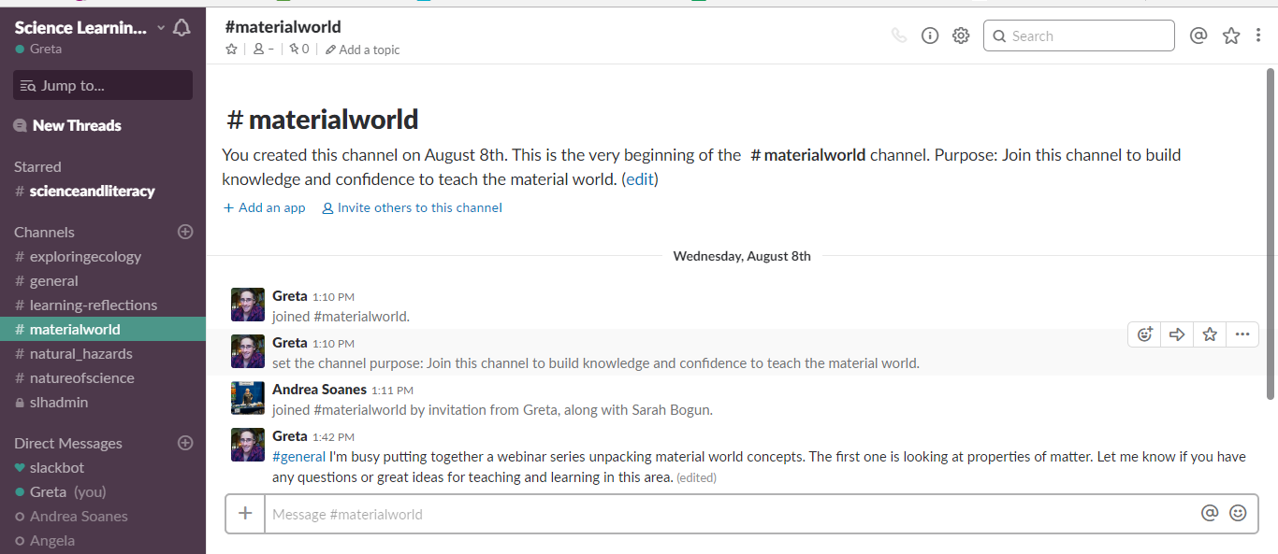
Support
slh-talk.slack.com
© Copyright. University of Waikato. All Rights Reserved | www.sciencelearn.org.nz
All images are copyrighted. For further information, please refer to enquiries@sciencelearn.org.nz

Slide 7

What does the curriculum say?
Level 4
Begin to develop an understanding of the particle nature of matter and use this to explain observed changes.
© Copyright. University of Waikato. All Rights Reserved | www.sciencelearn.org.nz
All images are copyrighted. For further information, please refer to enquiries@sciencelearn.org.nz

Slide 8
What does the curriculum say?
Level 4
Begin to develop an understanding of the particle nature of matter and use this to explain observed changes.
© Copyright. University of Waikato. All Rights Reserved | www.sciencelearn.org.nz
All images are copyrighted. For further information, please refer to enquiries@sciencelearn.org.nz

Slide 9
What does the curriculum say?
Level 4
Begin to develop an understanding of the particle nature of matter and use this to explain observed changes.
© Copyright. University of Waikato. All Rights Reserved | www.sciencelearn.org.nz
All images are copyrighted. For further information, please refer to enquiries@sciencelearn.org.nz

Slide 10
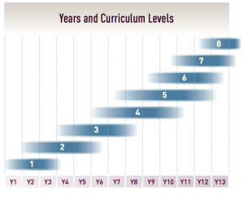
What does the curriculum say?
© Copyright. University of Waikato. All Rights Reserved | www.sciencelearn.org.nz
All images are copyrighted. For further information, please refer to enquiries@sciencelearn.org.nz
Notes:
http://nzcurriculum.tki.org.nz/The-New-Zealand-Curriculum/Science/Achievement-objectives#collapsible4

Slide 11
Big science ideas
All matter is made of very small particles.
These particles are in constant motion.
Space between particles is empty.
Bonds exist between particles.
Chemical reactions involve rearrangement of particles.
(adapted from Wynne Harlen, 2010)
© Copyright. University of Waikato. All Rights Reserved | www.sciencelearn.org.nz
All images are copyrighted. For further information, please refer to enquiries@sciencelearn.org.nz

Slide 12
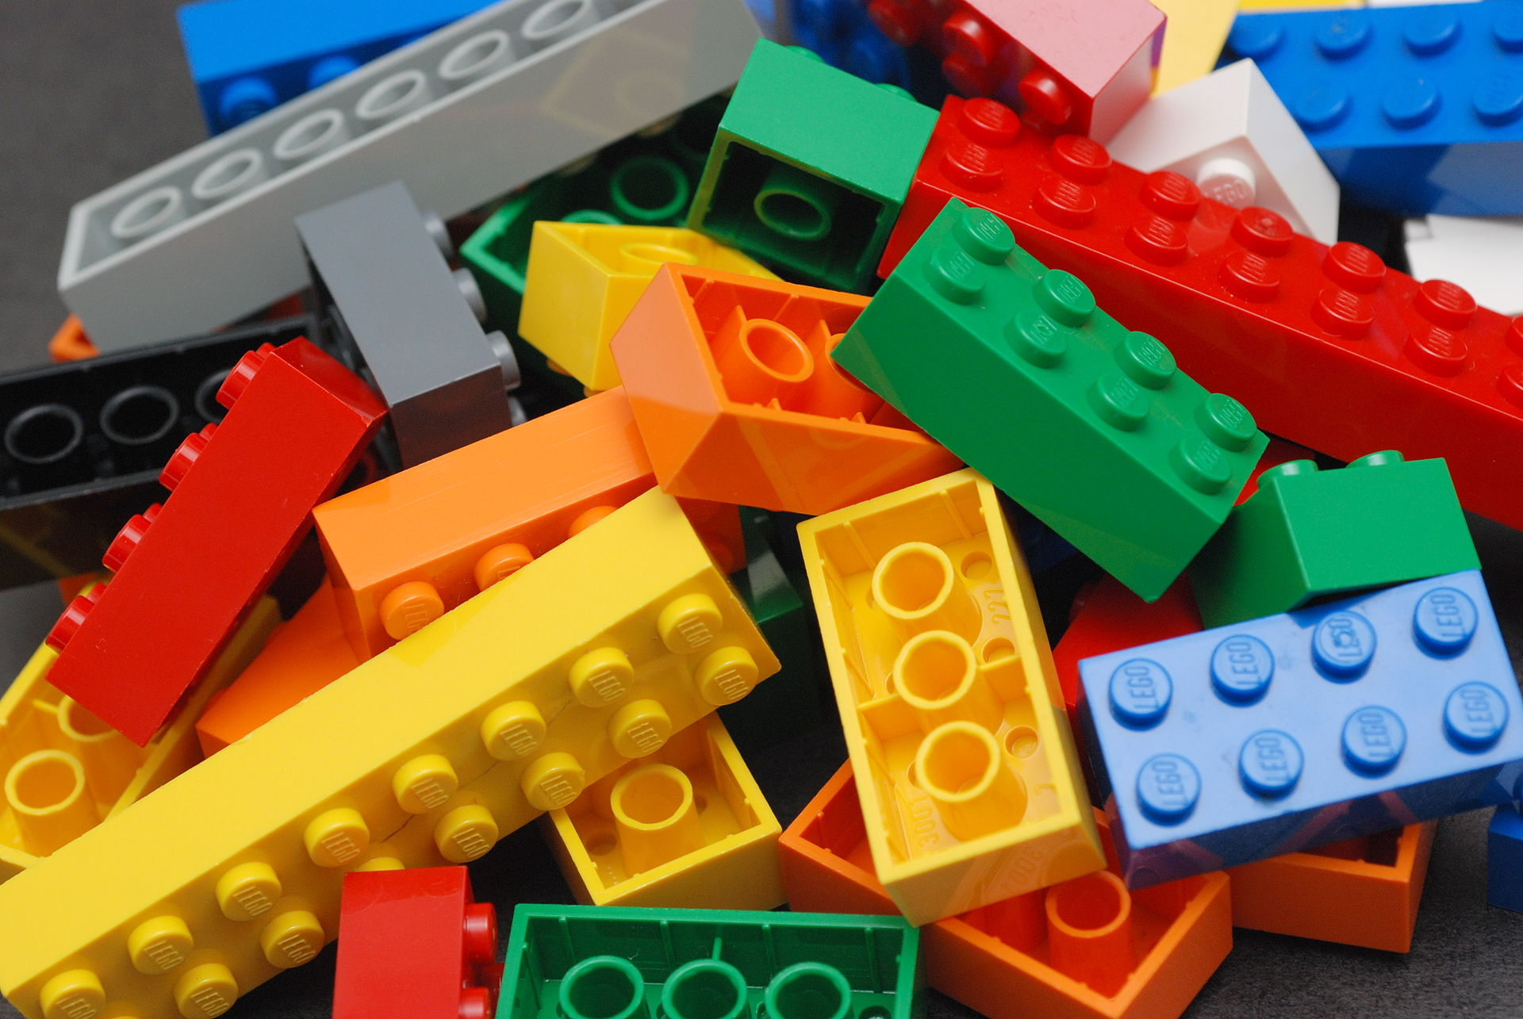
Using models
Be explicit about when we are using models.
Models are representations.
Think about the advantages and disadvantages of different models.
Alan Chia, CC BY-SA 2.0
© Copyright. University of Waikato. All Rights Reserved | www.sciencelearn.org.nz
All images are copyrighted. For further information, please refer to enquiries@sciencelearn.org.nz
Notes:
By Alan Chia - Lego Color Bricks, CC BY-SA 2.0, https://commons.wikimedia.org/w/index.php?curid=6068229

Slide 13
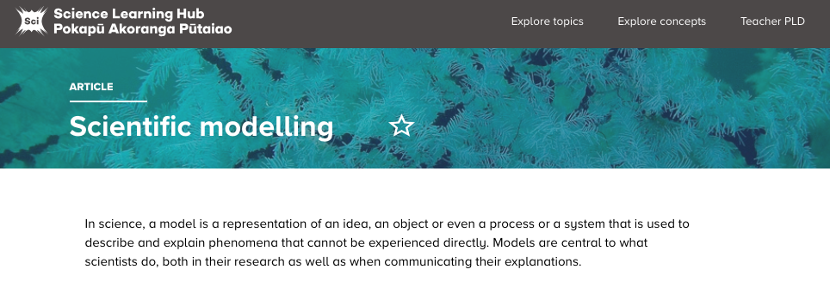
Using models
NZ Curriculum level 4
Nature of science: Investigating in science
Ask questions, find evidence, explore simple models, and carry out appropriate investigations to develop simple explanations.
©S.Wing, UoO
© Copyright. University of Waikato. All Rights Reserved | www.sciencelearn.org.nz
All images are copyrighted. For further information, please refer to enquiries@sciencelearn.org.nz
Notes:
Image: https://www.sciencelearn.org.nz/resources/575-scientific-modelling

Slide 14

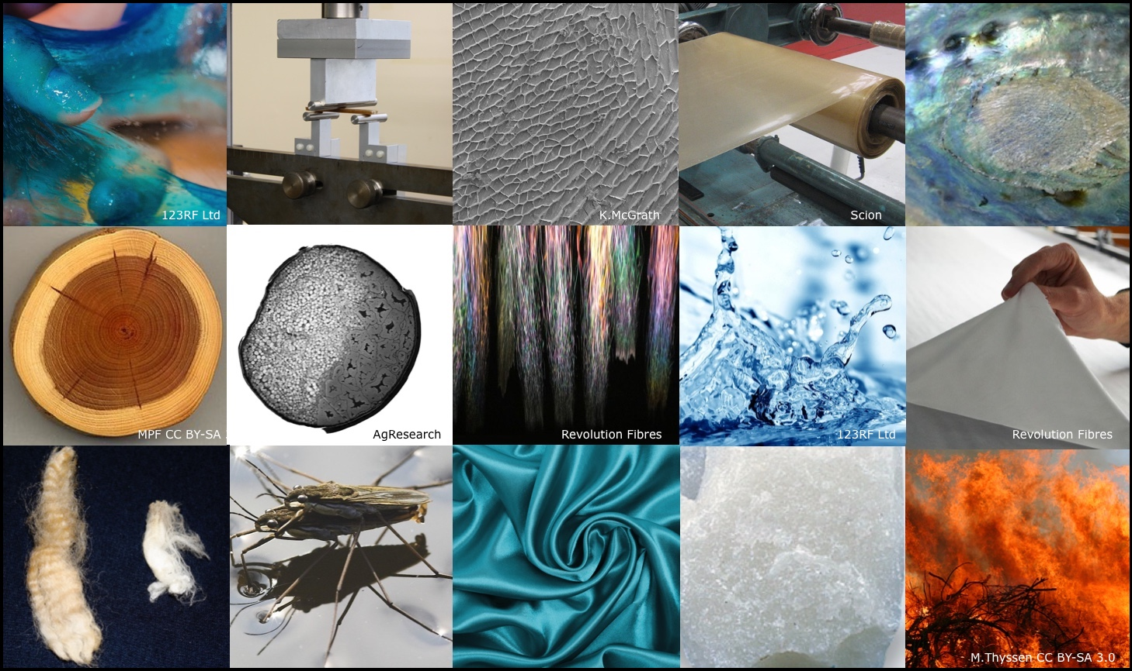
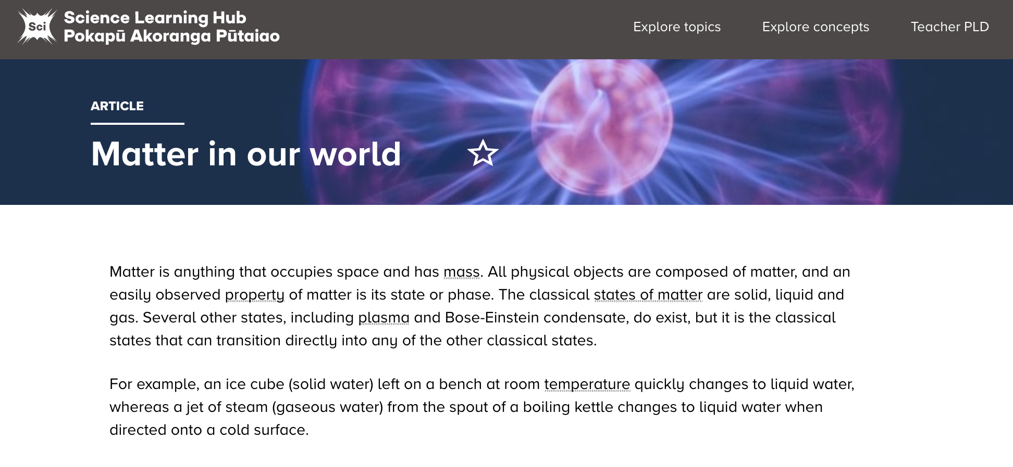
Matter is made of small bits
What is matter?
©123RF Ltd
© Copyright. University of Waikato. All Rights Reserved | www.sciencelearn.org.nz
All images are copyrighted. For further information, please refer to enquiries@sciencelearn.org.nz
Notes:
Image: https://www.sciencelearn.org.nz/resources/236-matter-in-our-world

Slide 15
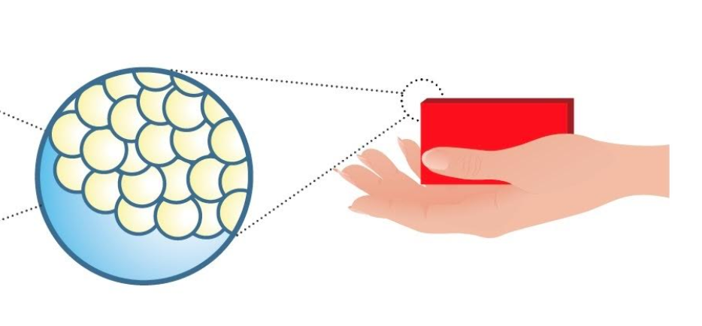
Matter is made of small bits
© Copyright. University of Waikato. All Rights Reserved | www.sciencelearn.org.nz
All images are copyrighted. For further information, please refer to enquiries@sciencelearn.org.nz
Notes:
Image: https://www.sciencelearn.org.nz/images/2151-structure-of-matter-flow-diagram
Video to watch: Voyage into the world of atoms https://www.youtube.com/watch?v=7WhRJV_bAiE
Or Zoom into aluminium: https://www.dailymotion.com/video/x4mv3m

Slide 16

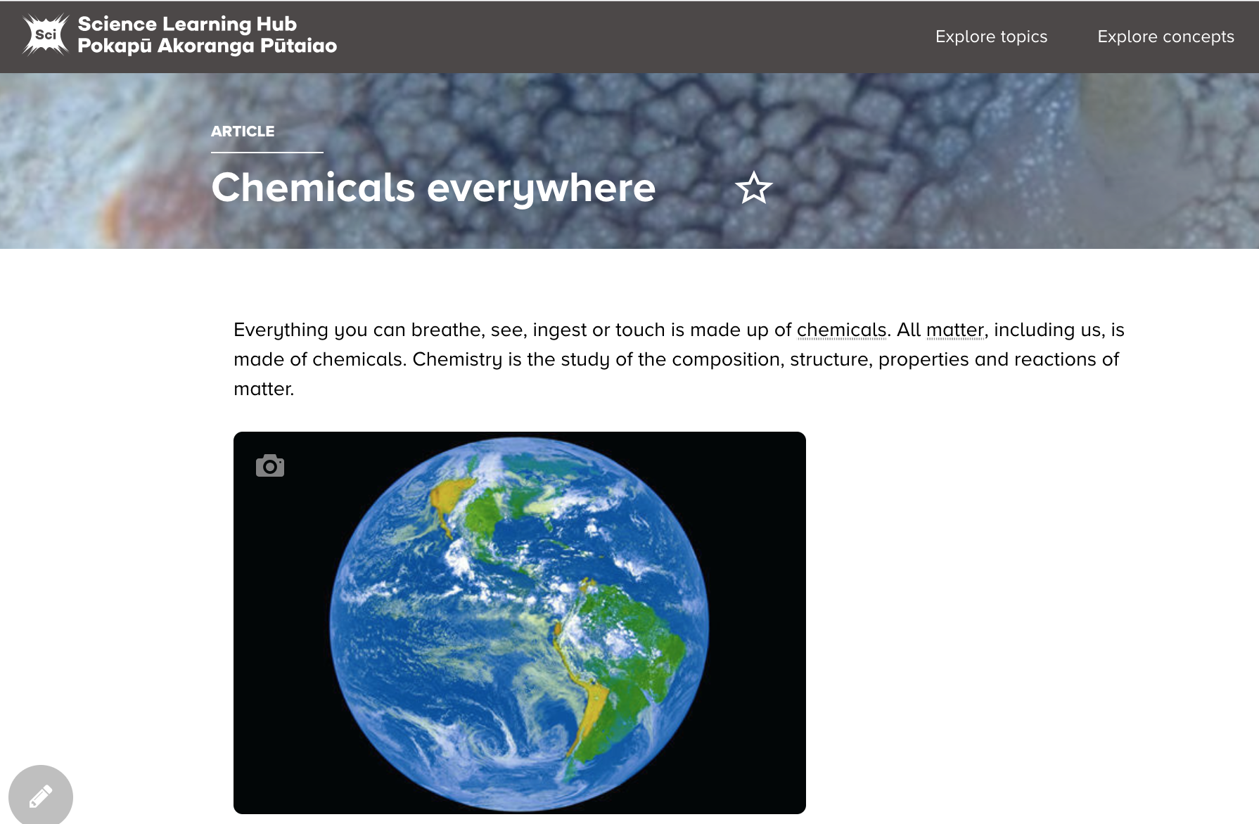
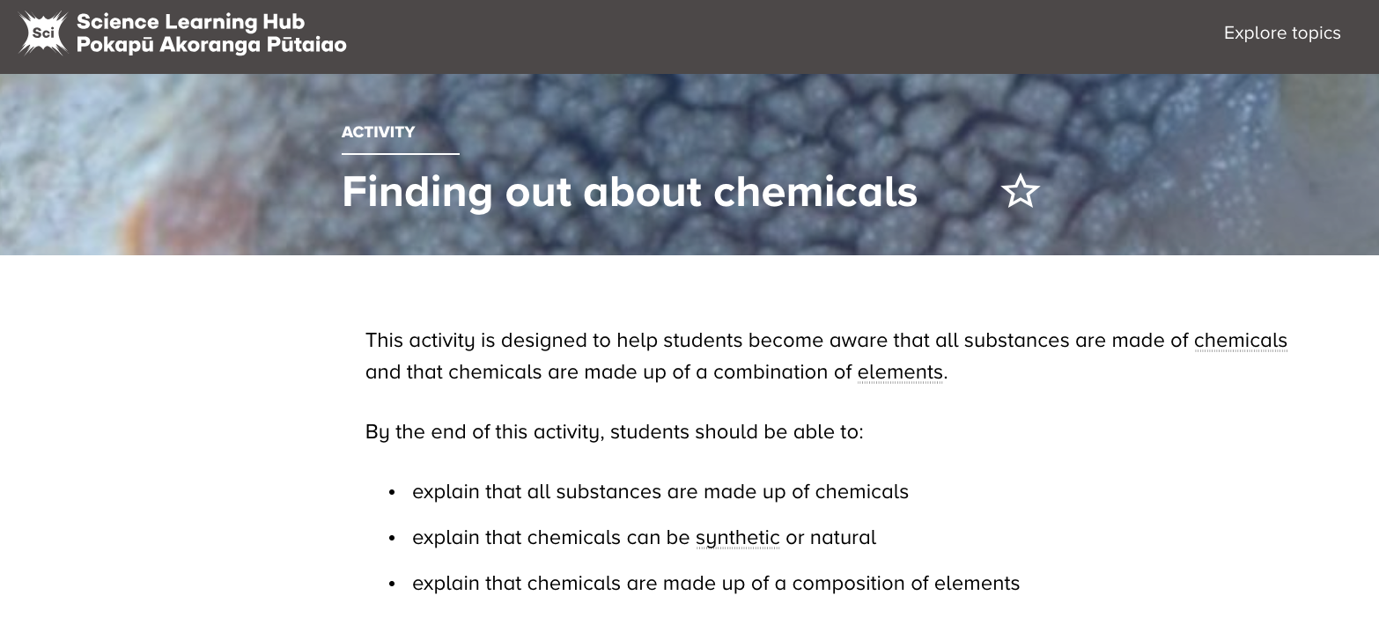
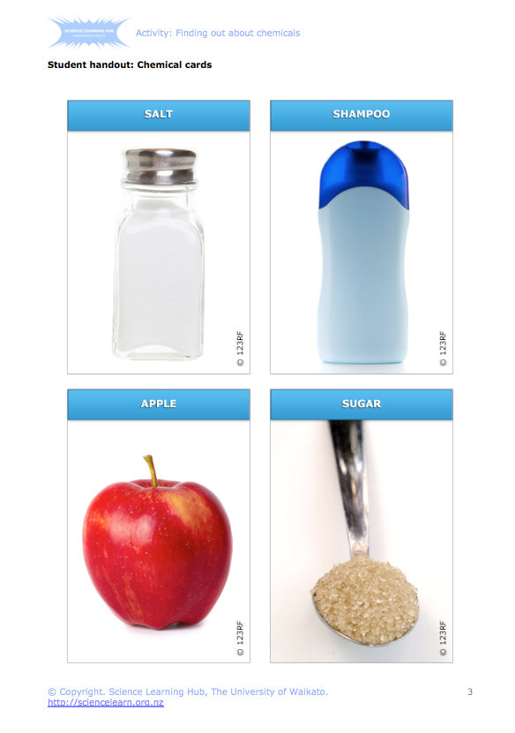
Matter is made of small bits
What do we call these bits?
Particles
Chemicals
Atoms
Elements
© Copyright. University of Waikato. All Rights Reserved | www.sciencelearn.org.nz
All images are copyrighted. For further information, please refer to enquiries@sciencelearn.org.nz
Notes:
Chemicals everywhere: www.sciencelearn.org.nz/resources/363-chemicals-everywhere
Finding out about chemicals: www.sciencelearn.org.nz/resources/378-finding-out-about-chemicals

Slide 17

Matter is made of small bits
How small?
Very.
Ted Talk: Just how small is an atom?
SLH: Measure a molecule
© Copyright. University of Waikato. All Rights Reserved | www.sciencelearn.org.nz
All images are copyrighted. For further information, please refer to enquiries@sciencelearn.org.nz
Notes:
Video: https://www.ted.com/talks/just_how_small_is_an_atom
Off the scale video: https://www.dailymotion.com/video/x3m2bb0
Boy and his atom video: https://www.youtube.com/watch?v=oSCX78-8-q0

Slide 18
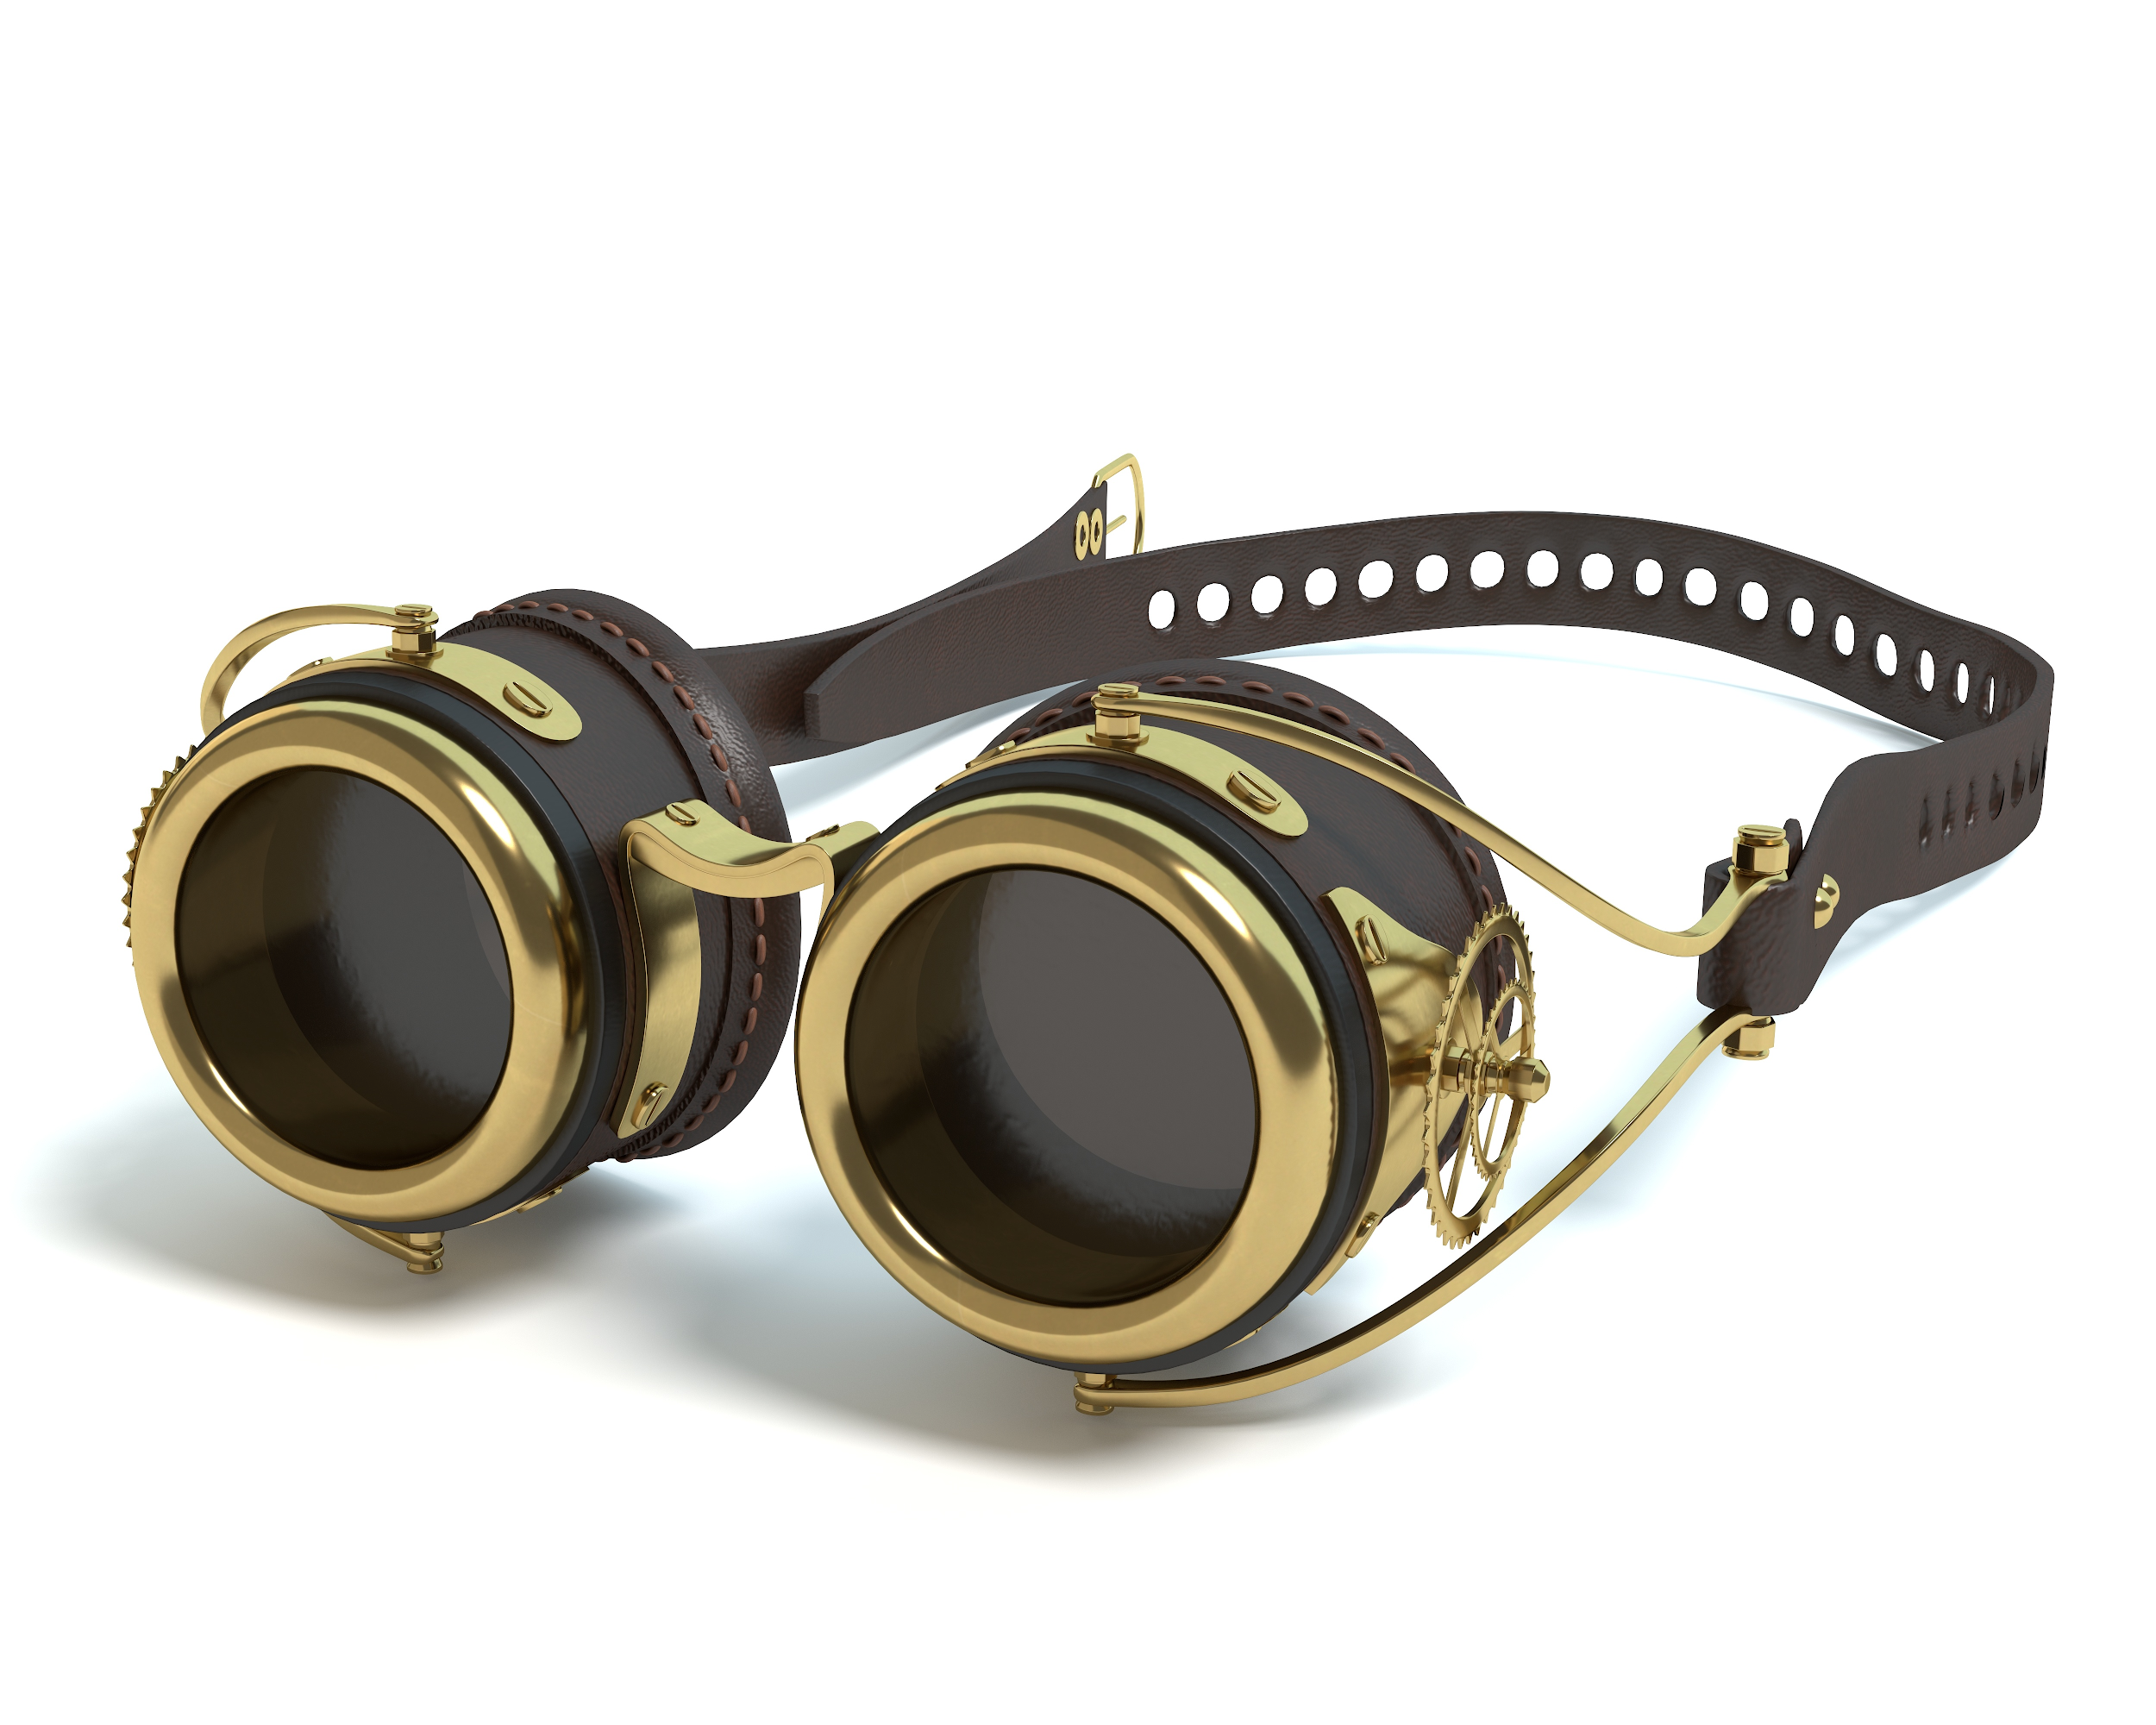
Matter is made of small bits
Wesley Abrams, 123RF Ltd
© Copyright. University of Waikato. All Rights Reserved | www.sciencelearn.org.nz
All images are copyrighted. For further information, please refer to enquiries@sciencelearn.org.nz
Notes:
Image ID : 57873100 Media Type : Photography
Copyright : Wesley Abrams
Video to watch: https://www.youtube.com/watch?v=7WhRJV_bAiE

Slide 19

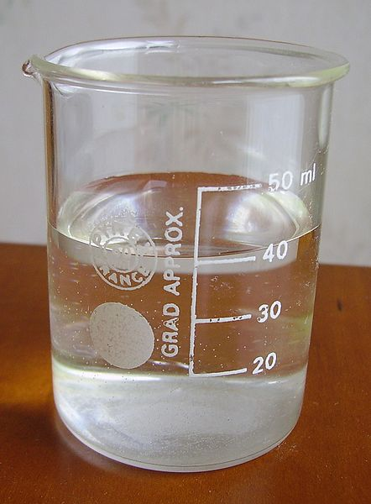
Concept cartoons
Ideas from participants
Its’ water.
The water could have something else in it.
It’s a liquid.
We don’t know if it is water, we will need to test it.
SLH resources about concept cartoons
© Copyright. University of Waikato. All Rights Reserved | www.sciencelearn.org.nz
All images are copyrighted. For further information, please refer to enquiries@sciencelearn.org.nz
Notes:
https://www.sciencelearn.org.nz/resources/2566-using-concept-cartoons

Slide 20
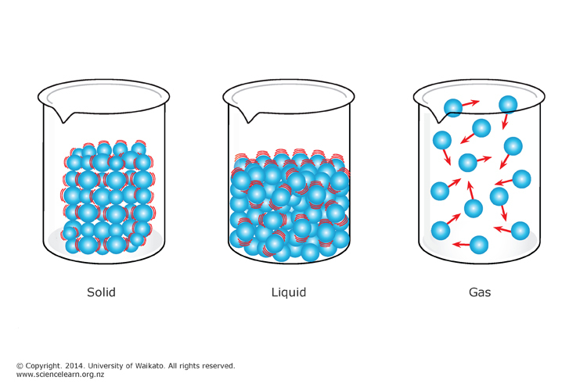
Matter is made of small bits
© Copyright. University of Waikato. All Rights Reserved | www.sciencelearn.org.nz
All images are copyrighted. For further information, please refer to enquiries@sciencelearn.org.nz
Notes:
Image: https://commons.wikimedia.org/wiki/File:Water_in_a_beaker.JPG
https://www.sciencelearn.org.nz/images/228-kinetic-model-of-matter

Slide 21
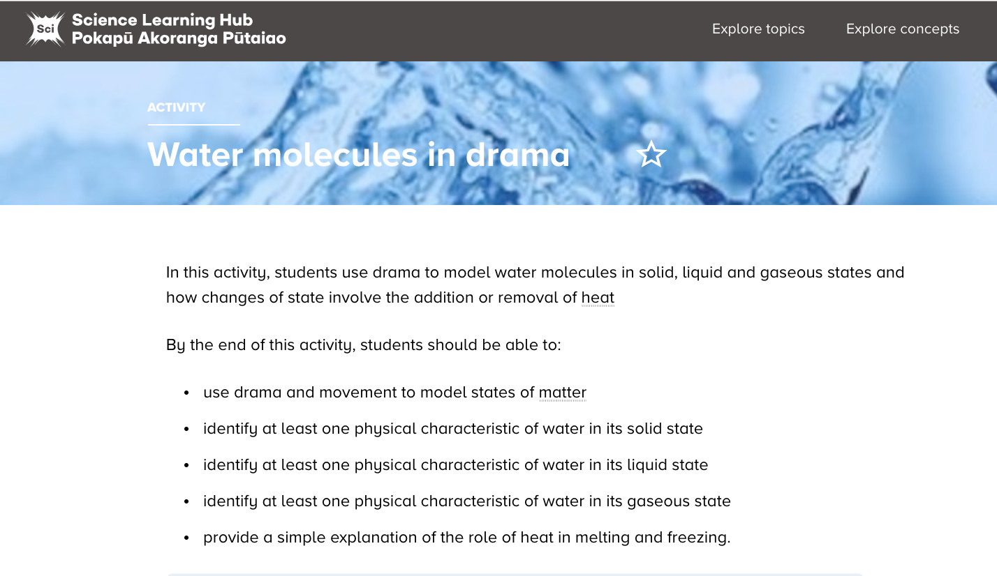
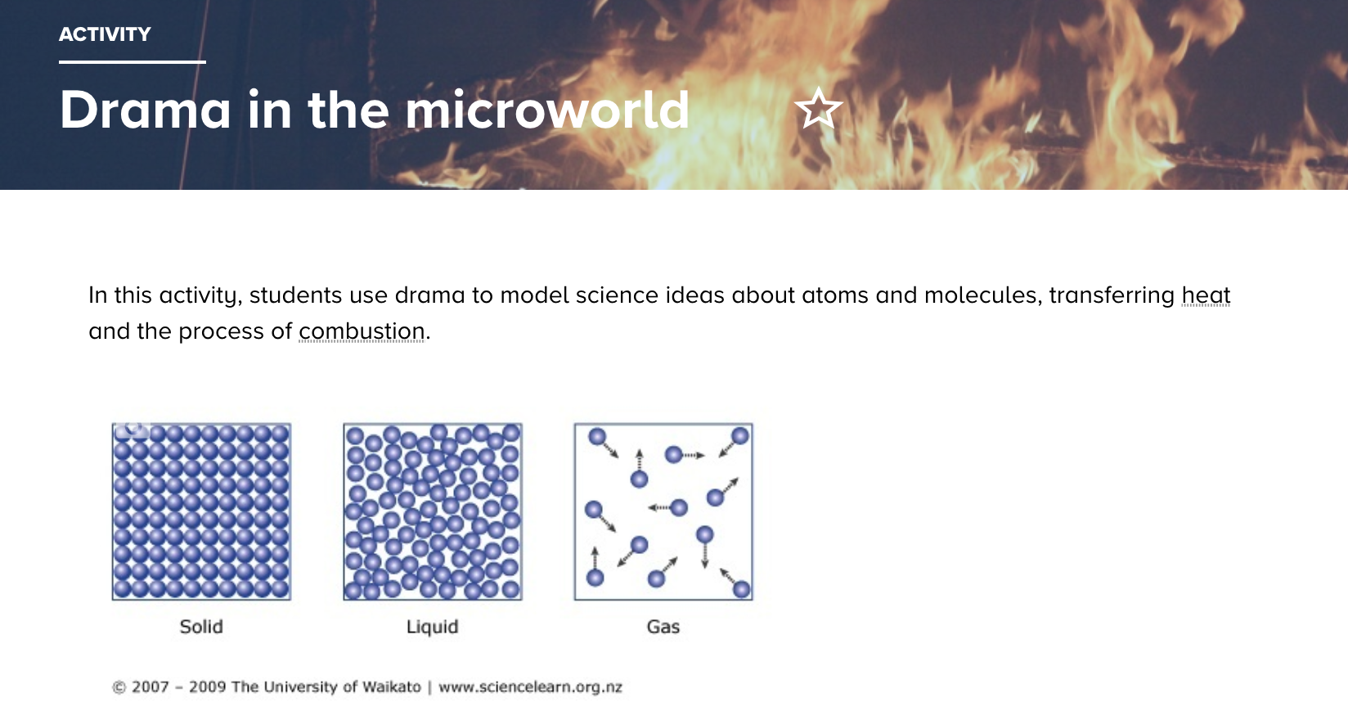
Using drama
©123RF Ltd
©123RF Ltd
© Copyright. University of Waikato. All Rights Reserved | www.sciencelearn.org.nz
All images are copyrighted. For further information, please refer to enquiries@sciencelearn.org.nz
Notes:
https://www.sciencelearn.org.nz/resources/774-drama-in-the-microworld
https://www.sciencelearn.org.nz/resources/612-water-molecules-in-drama
PLD Performing in science: https://www.sciencelearn.org.nz/images/3015-drama-and-science

Slide 22
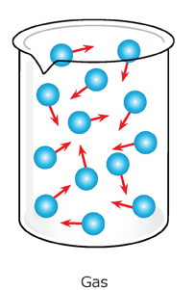
Particles are in motion
Tightly packed together, usually in a regular array, and vibrate back and forth.
Still tightly packed, but as well as vibrating, they can move over and in between one another.
Spaced out relative to one another and are moving around with rapid, random motion.
© Copyright. University of Waikato. All Rights Reserved | www.sciencelearn.org.nz
All images are copyrighted. For further information, please refer to enquiries@sciencelearn.org.nz
Notes:
Image: https://www.sciencelearn.org.nz/images/228-kinetic-model-of-matter

Slide 23
Empty spaces
© Copyright. University of Waikato. All Rights Reserved | www.sciencelearn.org.nz
All images are copyrighted. For further information, please refer to enquiries@sciencelearn.org.nz
Notes:
Air around us BSC: http://scienceonline.tki.org.nz/What-do-my-students-need-to-learn/Building-Science-Concepts/Titles-and-concept-overviews/The-Air-around-Us-Exploring-the-Substance-we-Live-in
Truly Chaotic- gases article (advanced) : https://www.sciencelearn.org.nz/resources/1253-truly-chaotic-the-gaseous-state

Slide 24
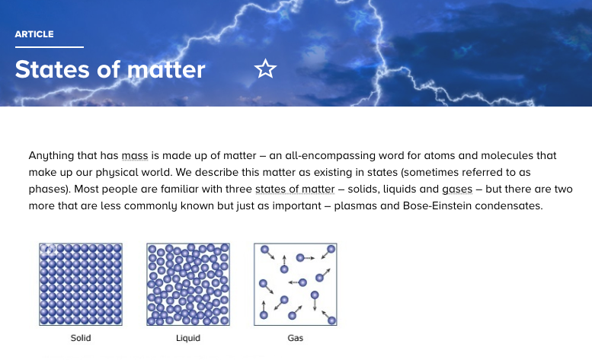
States of matter
©123RF Ltd
© Copyright. University of Waikato. All Rights Reserved | www.sciencelearn.org.nz
All images are copyrighted. For further information, please refer to enquiries@sciencelearn.org.nz

Slide 25
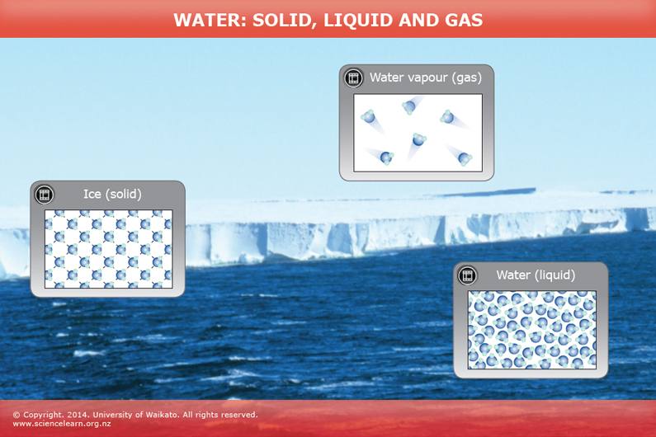
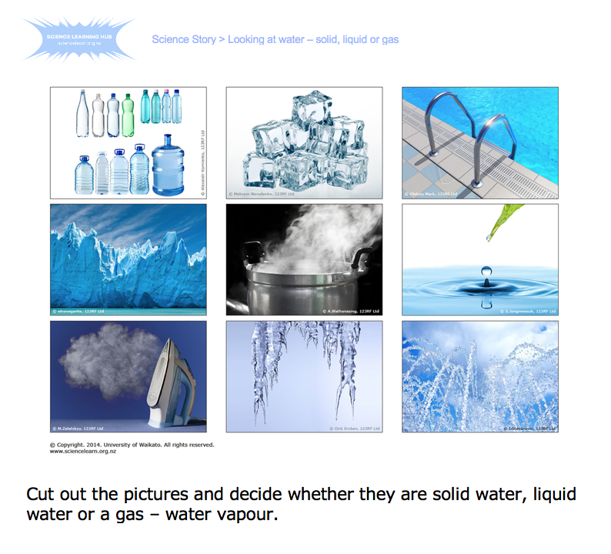
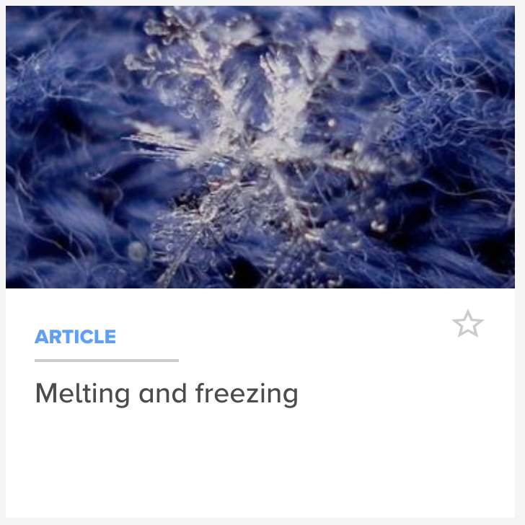
States of matter
© Copyright. University of Waikato. All Rights Reserved | www.sciencelearn.org.nz
All images are copyrighted. For further information, please refer to enquiries@sciencelearn.org.nz
Notes:
Article Solids, Liquids and Gases: https://www.sciencelearn.org.nz/resources/607-solids-liquids-and-gases
Looking at Water states Activity: https://www.sciencelearn.org.nz/resources/611-looking-at-water-solid-liquid-or-gas
Snowflake card image: https://www.sciencelearn.org.nz/images/660-a-snowflake

Slide 26
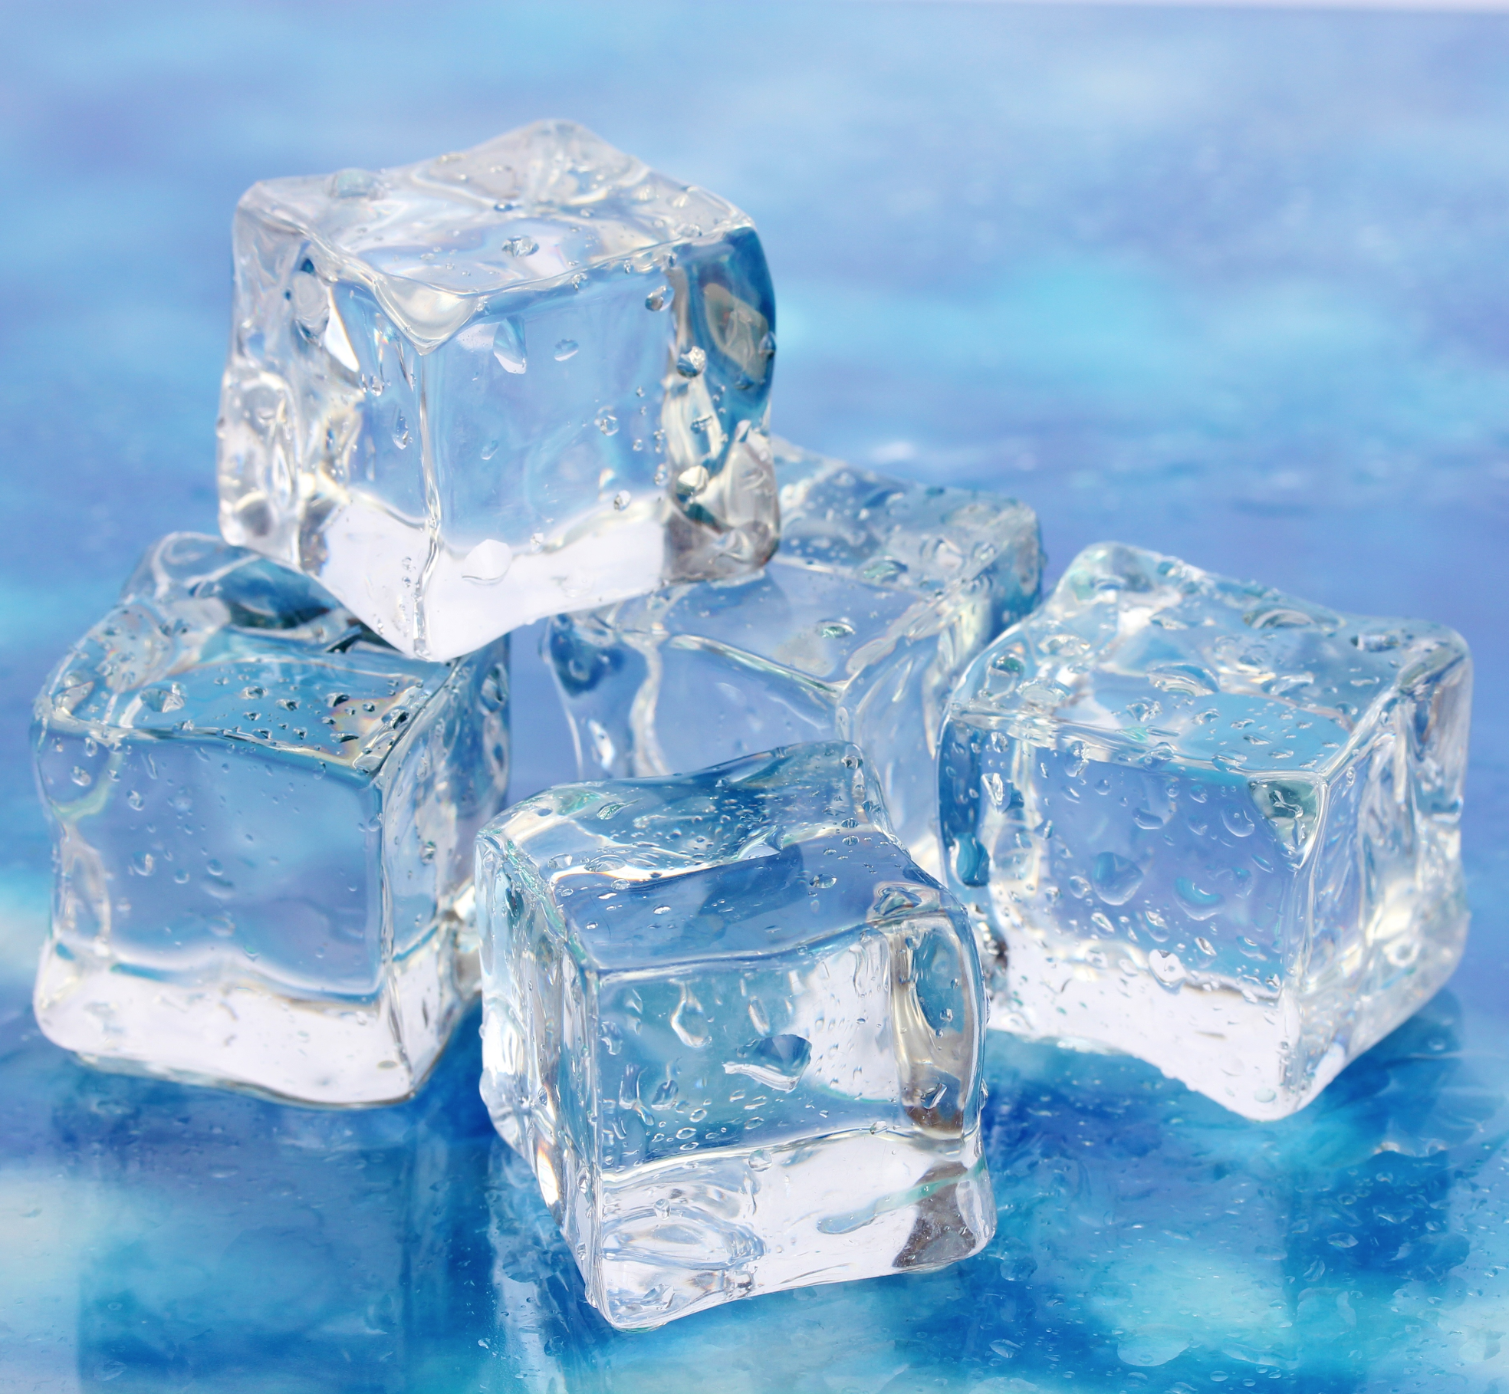
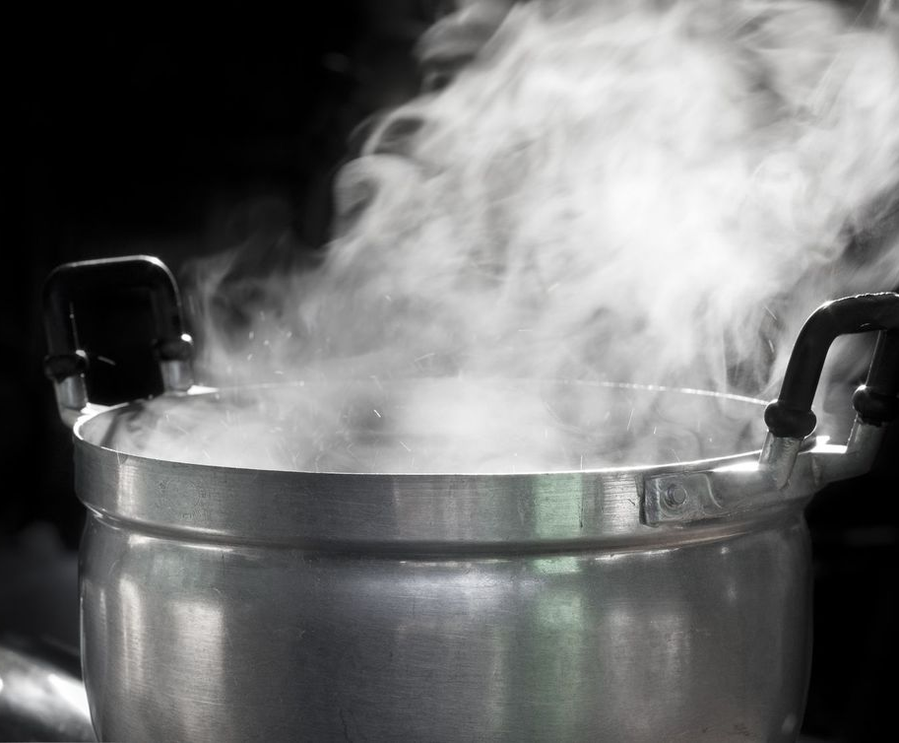


States of matter
Beware of water!
Particles in a solid state are arranged further apart. This makes ice float.
belchonock, 123RF Ltd
A.Wathanasing, 123RF Ltd
Ivan Mikhaylov, 123RF Ltd
©123RF Ltd
© Copyright. University of Waikato. All Rights Reserved | www.sciencelearn.org.nz
All images are copyrighted. For further information, please refer to enquiries@sciencelearn.org.nz
Notes:
A pot of boiling water: https://www.sciencelearn.org.nz/images/664-a-pot-of-boiling-water
Water in liquid state: https://www.sciencelearn.org.nz/images/2343-water
Ice cubes: Copyright: belchonock / 123RF Stock Photo
https://www.123rf.com/photo_17768872_ice-on-brightblue-background.html?term=ice%2Bcube&vti=objiclnjr1iva875zo-1-3&

Slide 27
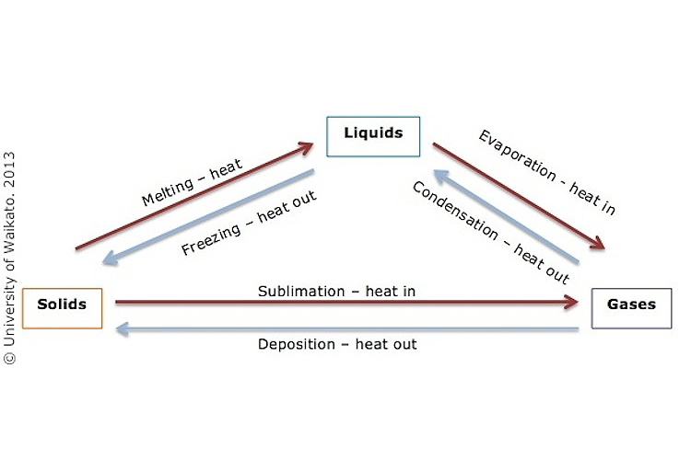
States of matter
Solids, liquids and gases
© Copyright. University of Waikato. All Rights Reserved | www.sciencelearn.org.nz
All images are copyrighted. For further information, please refer to enquiries@sciencelearn.org.nz

Slide 28
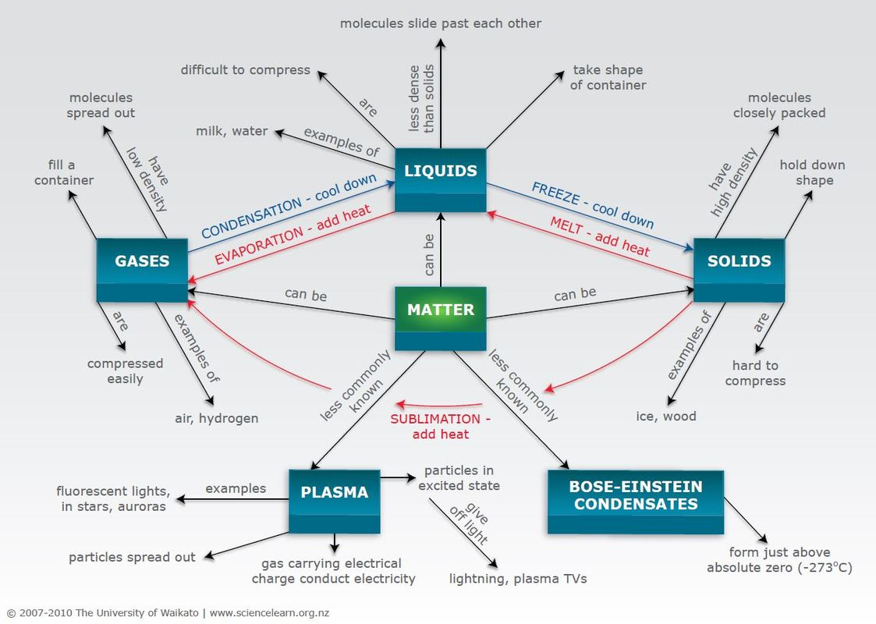
States of matter
© Copyright. University of Waikato. All Rights Reserved | www.sciencelearn.org.nz
All images are copyrighted. For further information, please refer to enquiries@sciencelearn.org.nz
Notes:
https://www.sciencelearn.org.nz/images/220-states-of-matter-concept-map

Slide 29
What does the curriculum say?
Level 5
Describe the structure of the atoms of different elements.
Distinguish between an element and a compound, a pure substance and a mixture at particle level.
© Copyright. University of Waikato. All Rights Reserved | www.sciencelearn.org.nz
All images are copyrighted. For further information, please refer to enquiries@sciencelearn.org.nz
© Copyright. University of Waikato. All Rights Reserved | www.sciencelearn.org.nz
All images are copyrighted. For further information, please refer to enquiries@sciencelearn.org.nz

Slide 30
What does the curriculum say?
© Copyright. University of Waikato. All Rights Reserved | www.sciencelearn.org.nz
All images are copyrighted. For further information, please refer to enquiries@sciencelearn.org.nz
Notes:
http://nzcurriculum.tki.org.nz/The-New-Zealand-Curriculum/Science/Achievement-objectives#collapsible4

Slide 31
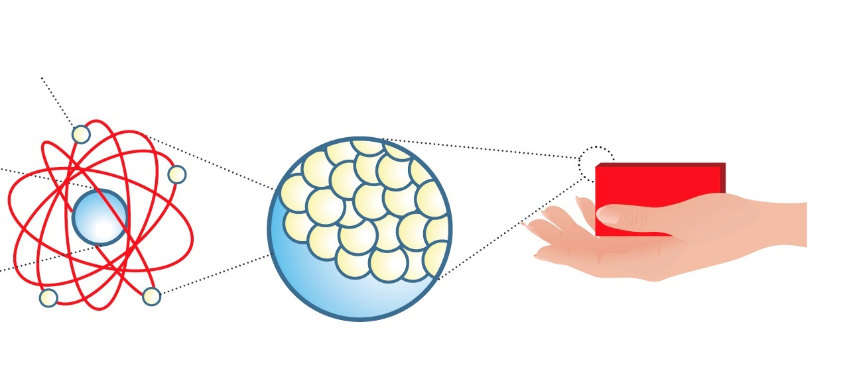
The structure of atoms
© Copyright. University of Waikato. All Rights Reserved | www.sciencelearn.org.nz
All images are copyrighted. For further information, please refer to enquiries@sciencelearn.org.nz
Notes:
Image: https://www.sciencelearn.org.nz/images/2151-structure-of-matter-flow-diagram
Video to watch: Voyage into the world of atoms https://www.youtube.com/watch?v=7WhRJV_bAiE
Or Zoom into aluminium: https://www.dailymotion.com/video/x4mv3m

Slide 32
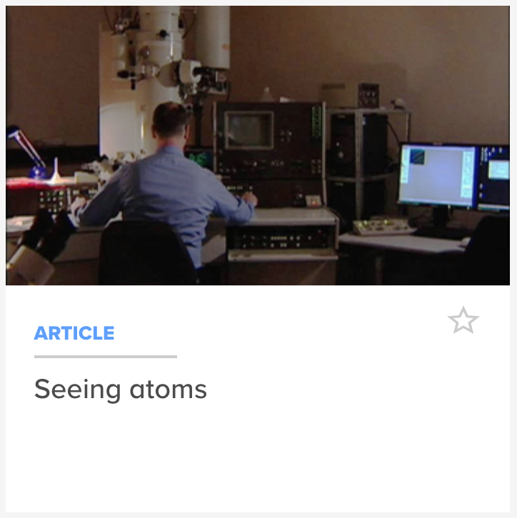
The structure of atoms
Models of atoms
TKI Selecting models of atoms
History and nature of science
© Copyright. University of Waikato. All Rights Reserved | www.sciencelearn.org.nz
All images are copyrighted. For further information, please refer to enquiries@sciencelearn.org.nz
Notes:
http://scienceonline.tki.org.nz/Nature-of-science/Nature-of-Science-Teaching-Activities/Selecting-models-of-atoms
Image: Seeing atoms /Transmission electron microscope image: https://www.sciencelearn.org.nz/images/2036-transmission-electron-microscope

Slide 33
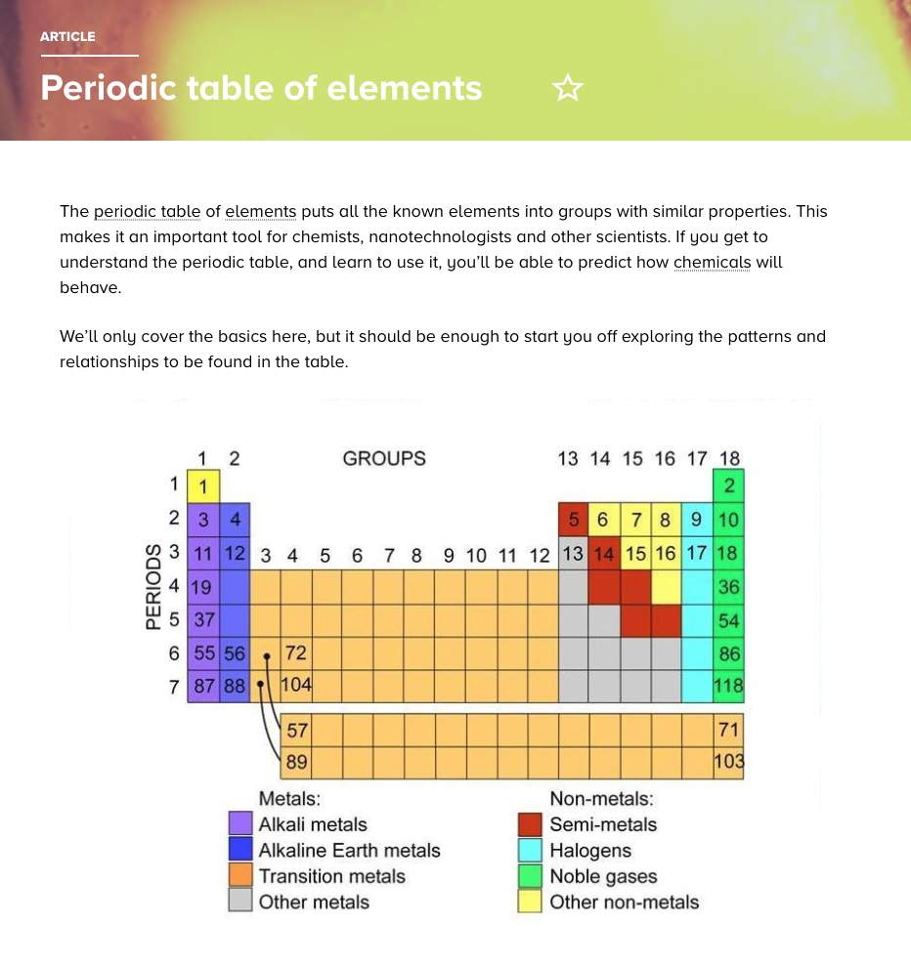
The structure of atoms
Elements
Periodic tables
2019 International Year of the Periodic Table
© Copyright. University of Waikato. All Rights Reserved | www.sciencelearn.org.nz
All images are copyrighted. For further information, please refer to enquiries@sciencelearn.org.nz
Notes:
https://www.sciencelearn.org.nz/resources/1726-periodic-table-of-elements

Slide 34
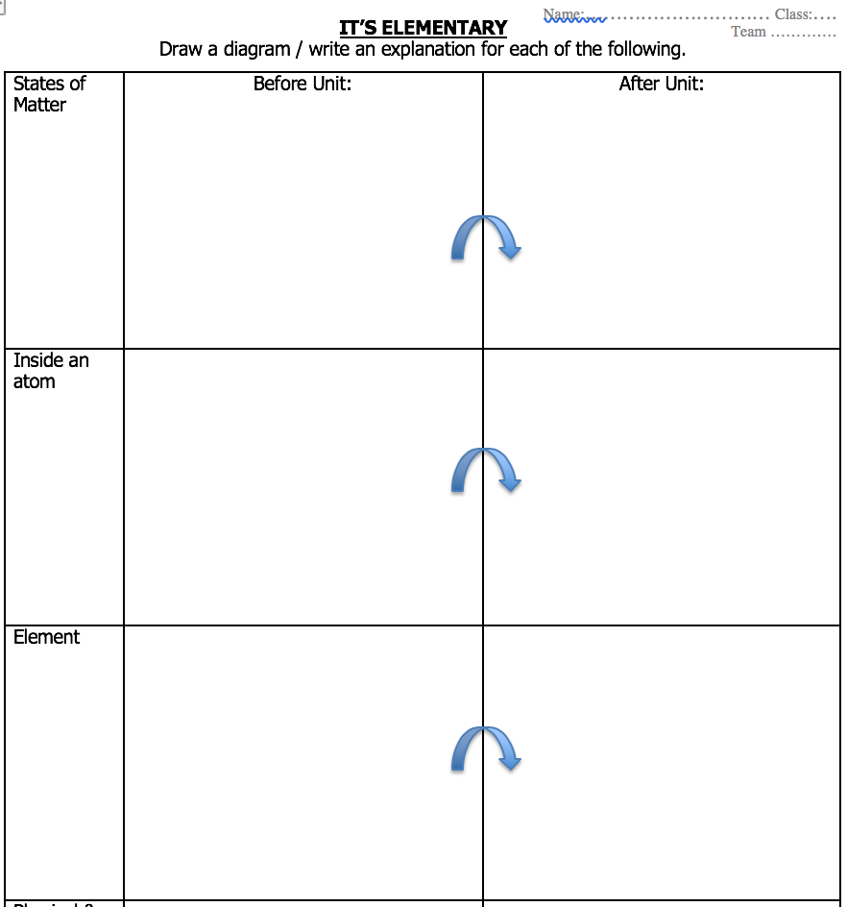
Showing thinking
Science exemplars
Assessment Resource Bank
Flow charts and concept maps
Multiple opportunities
Adapted from: http://www.tki.org.nz/r/assessment/exemplars/sci/material/mw_5a_original_e.html
© Copyright. University of Waikato. All Rights Reserved | www.sciencelearn.org.nz
All images are copyrighted. For further information, please refer to enquiries@sciencelearn.org.nz
Notes:
http://www.tki.org.nz/r/assessment/exemplars/sci/material/mw_5a_original_e.html

Slide 35

Chemical reactions
© Copyright. University of Waikato. All Rights Reserved | www.sciencelearn.org.nz
All images are copyrighted. For further information, please refer to enquiries@sciencelearn.org.nz
Notes:
Image: Fast Rust: http://instructionalseries.tki.org.nz/var/tki-eesoll/storage/images/instructional-series/connected/connected-2013-level-3-food-for-thought/fast-rust/425899-1-eng-NZ/Fast-Rust_resource_image.jpg
https://www.sciencelearn.org.nz/concepts/chemical-reactions

Slide 36
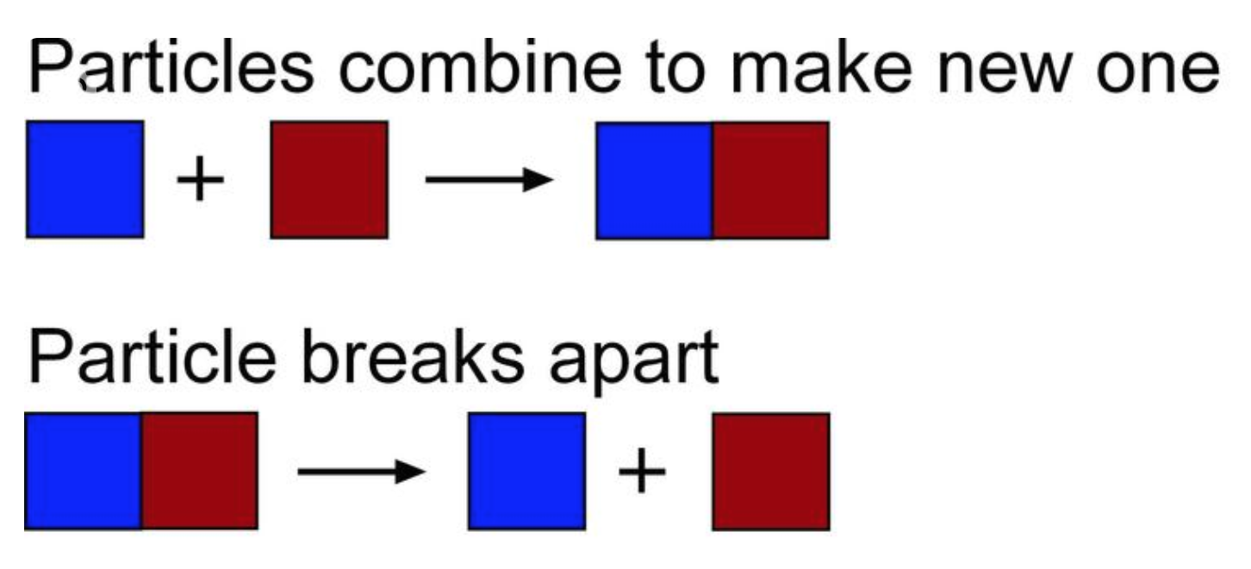
Chemical reactions
© Copyright. University of Waikato. All Rights Reserved | www.sciencelearn.org.nz
All images are copyrighted. For further information, please refer to enquiries@sciencelearn.org.nz
Notes:
Image:https://www.sciencelearn.org.nz/concepts/chemical-reactions

Slide 37
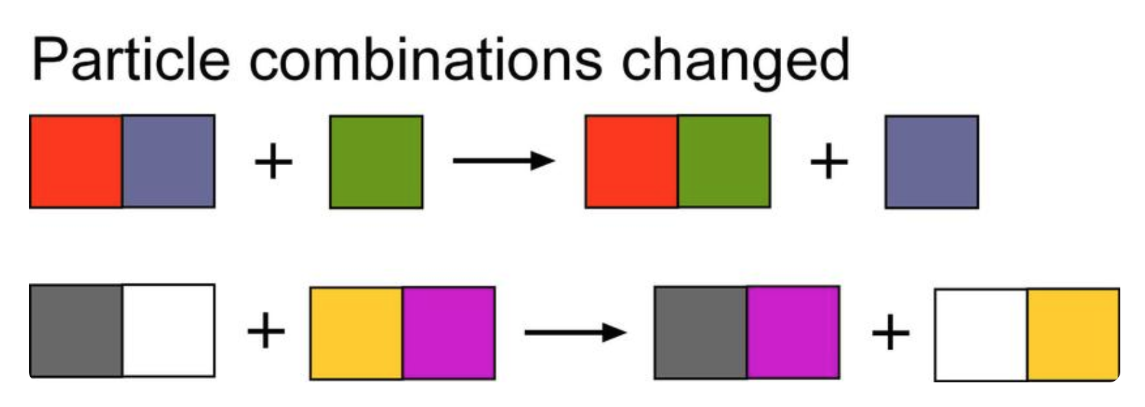
Chemical reactions
© Copyright. University of Waikato. All Rights Reserved | www.sciencelearn.org.nz
All images are copyrighted. For further information, please refer to enquiries@sciencelearn.org.nz
Notes:
Image: https://www.sciencelearn.org.nz/concepts/chemical-reactions

Slide 38
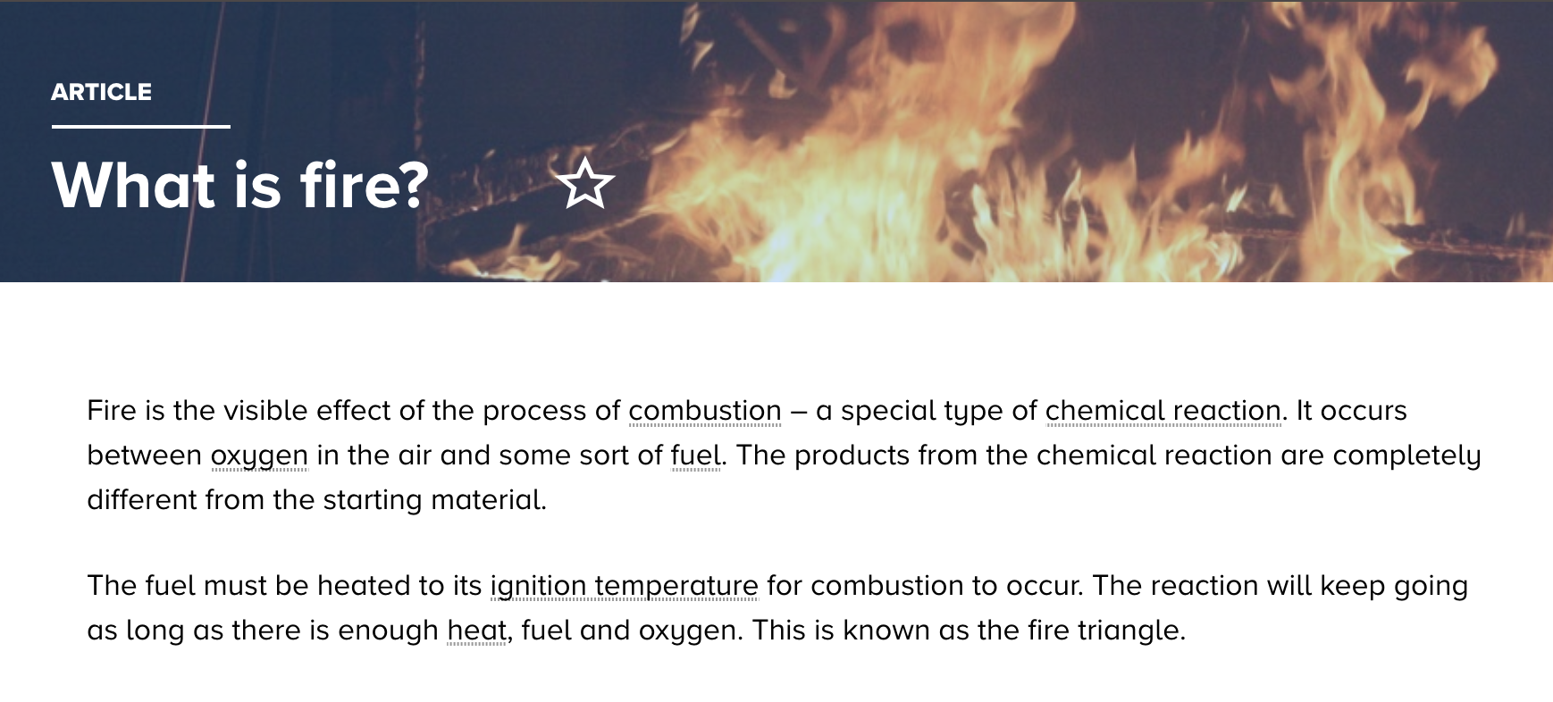
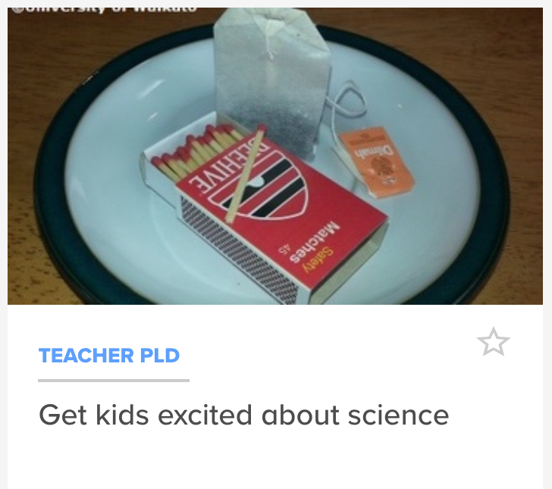
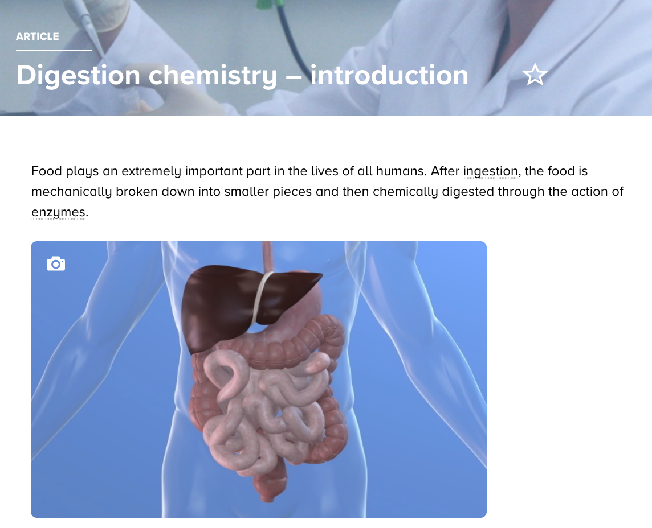

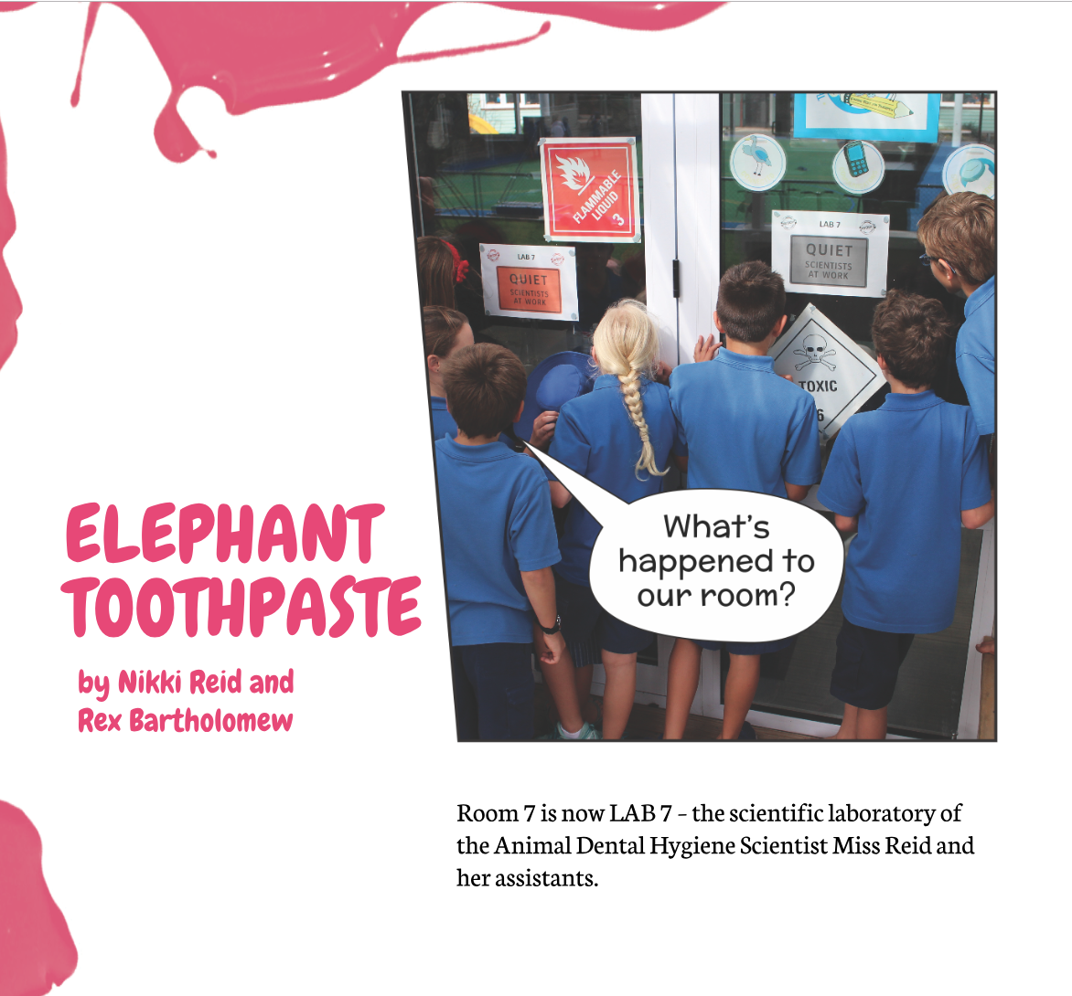
Exciting contexts
©123RF
©123RF
© Copyright. University of Waikato. All Rights Reserved | www.sciencelearn.org.nz
All images are copyrighted. For further information, please refer to enquiries@sciencelearn.org.nz
Notes:
Image: Fast Rust: http://instructionalseries.tki.org.nz/var/tki-eesoll/storage/images/instructional-series/connected/connected-2013-level-3-food-for-thought/fast-rust/425899-1-eng-NZ/Fast-Rust_resource_image.jpg
Elephants toothpaste: https://docs.google.com/presentation/d/1Mrz10FbOZZMU1z9wve4rVUcSzQrWZK_3JSCL8VWclqg/present?slide=id.p
Digestive chemistry: https://www.sciencelearn.org.nz/concepts/chemical-reactions

Slide 39






Thanks – want to keep in touch?
Science Learning Hub
Email us on enquiries@sciencelearn.org.nz
https://twitter.com/NZScienceLearn
www.facebook.com/nzsciencelearn
https://nz.pinterest.com/nzsciencelearn
www.pond.co.nz/community/214015/science-learning-hub/1
www.instagram.com/sciencelearninghubnz
Join us in our discussion channel on Slack.
(Any problems accessing Slack, please contact us via our enquiries email, enquiries@sciencelearn.org.nz.)

