Slide 1
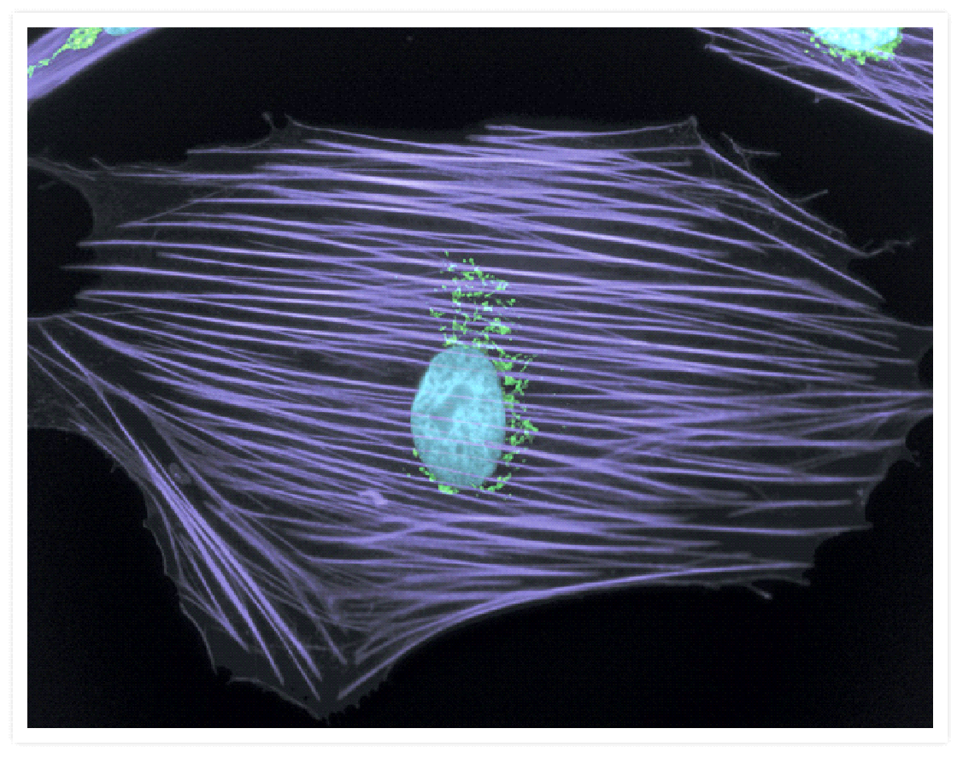
Skin cell
Nucleus = blue Golgi apparatus = green
© Copyright. University of Waikato. All Rights Reserved | www.sciencelearn.org.nz
Images from Invitrogen

Slide 2
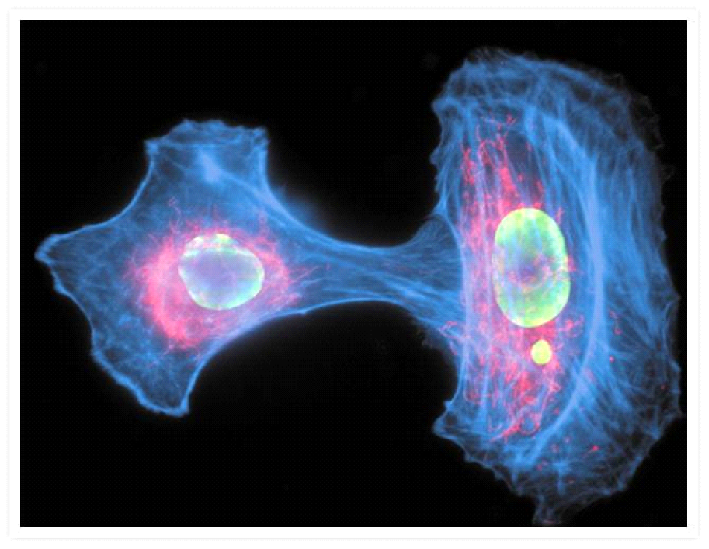
Skin cells
Nucleus = green Mitochondria = red
© Copyright. University of Waikato. All Rights Reserved | www.sciencelearn.org.nz
Images from Invitrogen

Slide 3
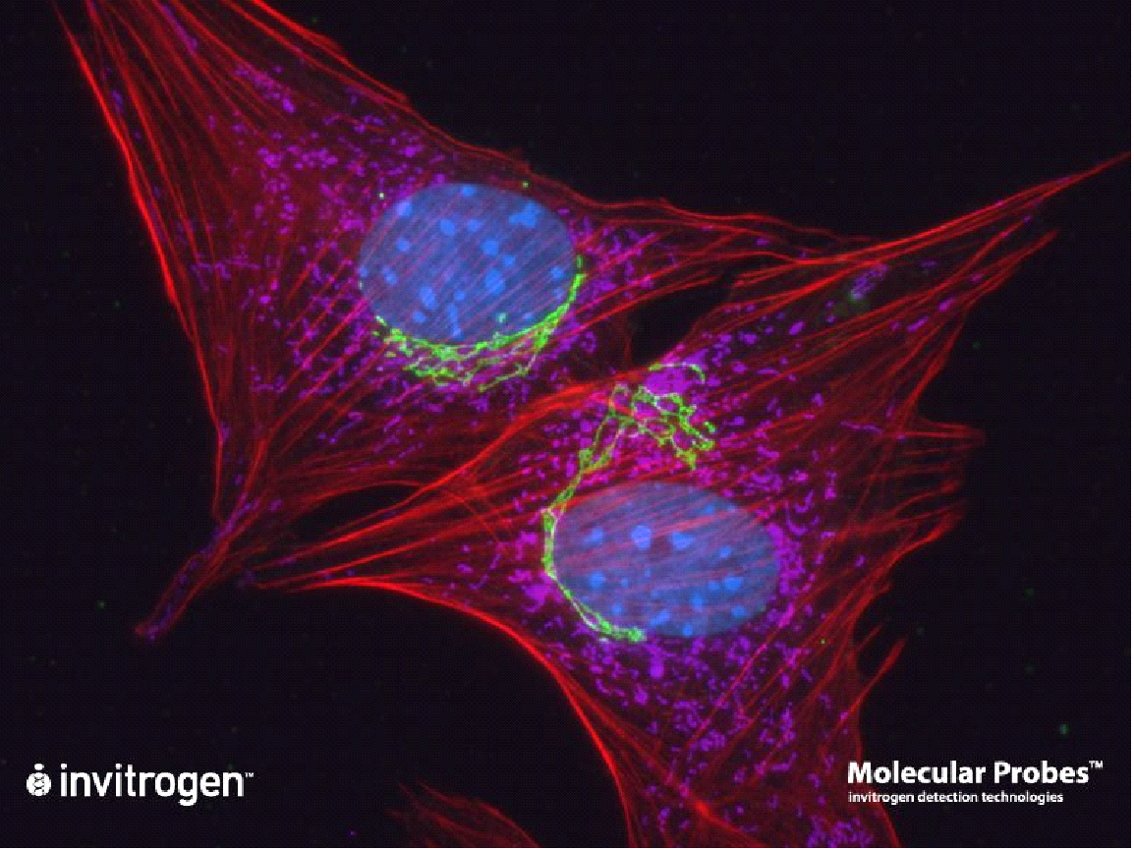
Fibroblast cells
Nucleus = blue Golgi apparatus = green Mitochondria = purple
© Copyright. University of Waikato. All Rights Reserved | www.sciencelearn.org.nz
Images from Invitrogen
Notes:
‹#›

Slide 4
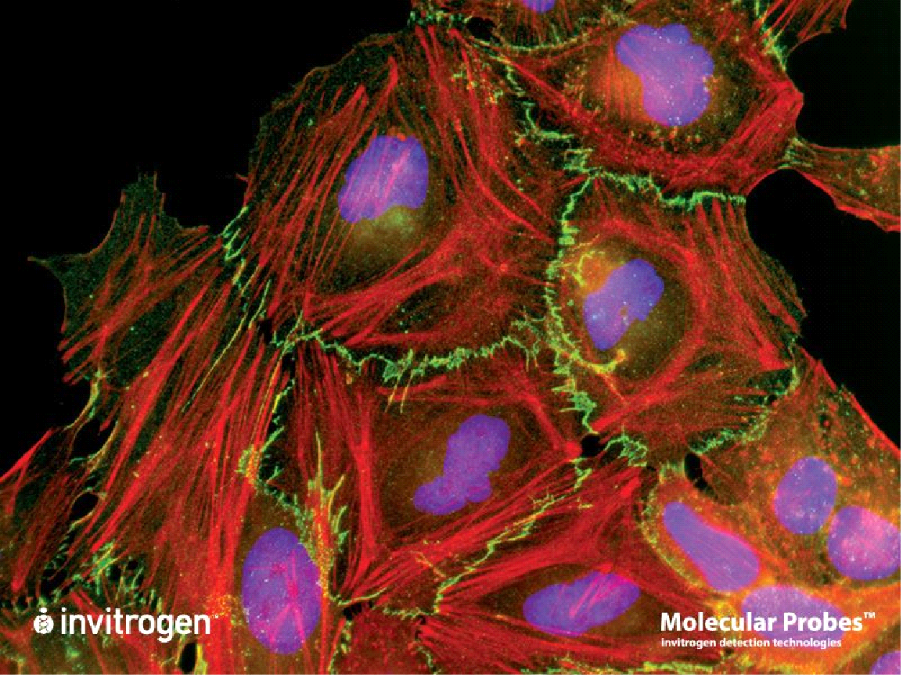
Cancer cells
Nucleus = purple Cell membrane = green
© Copyright. University of Waikato. All Rights Reserved | www.sciencelearn.org.nz
Images from Invitrogen

Slide 5
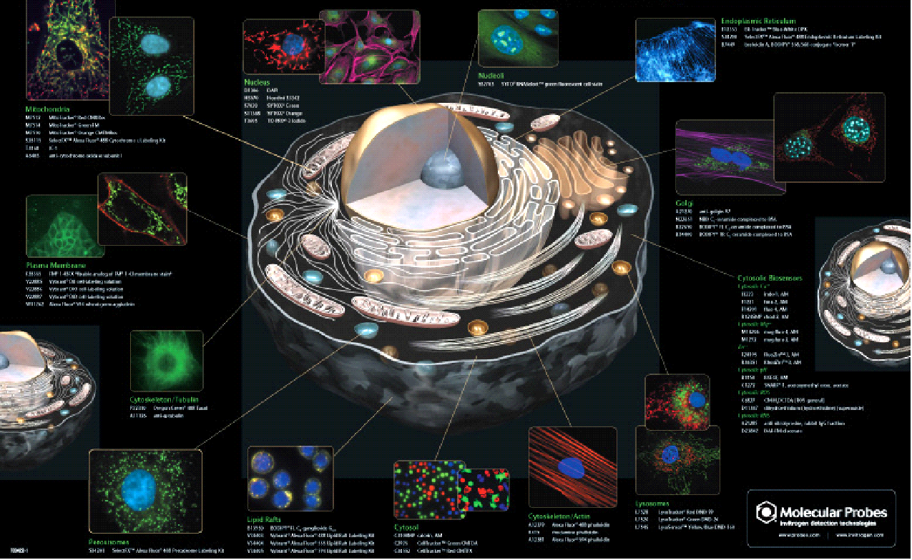
The illuminated cell
© Copyright. University of Waikato. All Rights Reserved | www.sciencelearn.org.nz
Images from Invitrogen

Slide 6
The Science Learning Hub would like to thank the following for the use of their images for this activity
www.thermofisher.com/nz/en/home/brands/invitrogen.html

