Slide 1
How much life is there in a bottle of seawater?
How many organisms are there in a litre of seawater from the Southern Ocean?
How can we find out?
Come take a journey with us through the lab and see what we find when we look at a bottle of water collected from the Southern Ocean.
© Copyright. University of Waikato. All rights reserved. | www.sciencelearn.org.nz

Slide 2
First, we collect the water from a pre-chosen depth using a water sampling bottle that is closed at the depth the sample is required.
© Copyright. University of Waikato. All rights reserved. | www.sciencelearn.org.nz

Slide 3
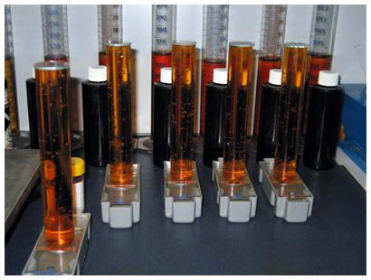
We then preserve the water collected so that we can look at and count the small zooplankton (tiny animals) and phytoplankton (tiny plants) using Lugol’s Iodine. This kills and preserves the plankton and turns the samples a brown colour.
© Copyright. University of Waikato. All rights reserved. | www.sciencelearn.org.nz

Slide 4
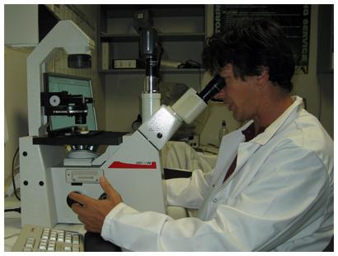
After we have preserved them, we settle the whole sample into a much smaller volume to concentrate the sample and make it much easier to count using the microscope.
© Copyright. University of Waikato. All rights reserved. | www.sciencelearn.org.nz
Notes:
‹#›

Slide 5
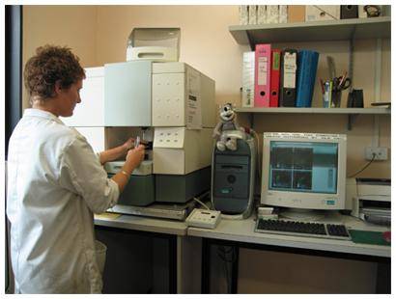
For the bacteria, we preserve the samples by freezing them in liquid nitrogen. When we are ready to count the sample, we thaw it and then stain the sample so that the bacteria can be identified with a flow cytometer.
A flow cytometer is often used in medical laboratories for counting blood cells, which is similar to counting bacteria in seawater.
© Copyright. University of Waikato. All rights reserved. | www.sciencelearn.org.nz

Slide 6
How many organisms do you think there might be in a litre of seawater?
Remember that the number of organisms is likely to increase in number as the size decreases and as we go down the food web.
© Copyright. University of Waikato. All rights reserved. | www.sciencelearn.org.nz
Notes:
‹#›

Slide 7
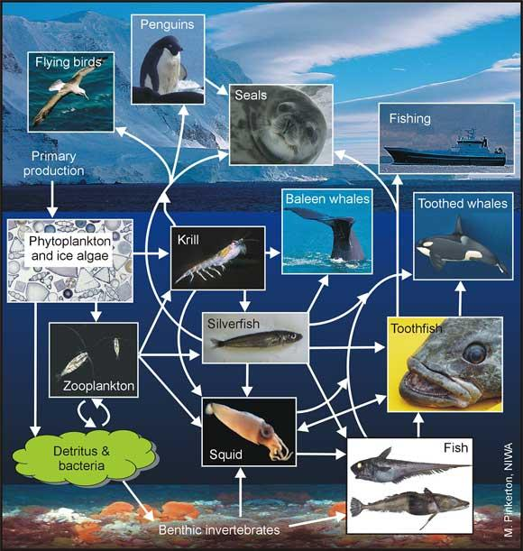
Food web of the Ross Sea, Antarctica.
© Copyright. University of Waikato. All rights reserved. | www.sciencelearn.org.nz
Notes:
‹#›

Slide 8
Bacteria - hundreds of thousands to millions per mL Phytoplankton - thousands to tens of thousands per mL Microzooplankton - hundreds to thousands per L
Now guess the number of organisms
© Copyright. University of Waikato. All rights reserved. | www.sciencelearn.org.nz

Slide 9
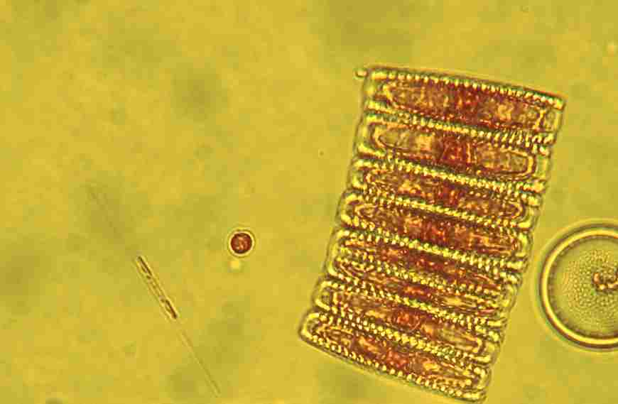
An example of some Antarctic phytoplankton, Fragilaria kerguelensis (large group in the middle), Nitzschia species (single small cell left) and partial cell of Thalassiosira species.
© Copyright. University of Waikato. All rights reserved. | www.sciencelearn.org.nz

Slide 10
The Science Learning Hub acknowledges the assistance of NIWA and the IPY Voyage scientists who supplied images for this resource. All rights remain with the NIWA and IPY CAML.
© Copyright. University of Waikato. All rights reserved. | www.sciencelearn.org.nz

