Slide 1
Welcome to the benthic zone
The benthic zone is the bottom of the water. Benthos refers to animals living in this zone (both on and near the sea floor).
Come with us now and let’s explore the Antarctic benthos…
© Copyright. University of Waikato. All rights reserved. | www.sciencelearn.org.nz

Slide 2
This scary looking guy is a stone crab (Neolithodes) found for the first time in the Antarctic on a seamount near the Balleny Islands in 2004.
© Copyright. University of Waikato. All rights reserved. | www.sciencelearn.org.nz

Slide 3
A new species of amphipod (tiny shrimp-like animals) found in the Ross Sea in 2004.
© Copyright. University of Waikato. All rights reserved. | www.sciencelearn.org.nz

Slide 4
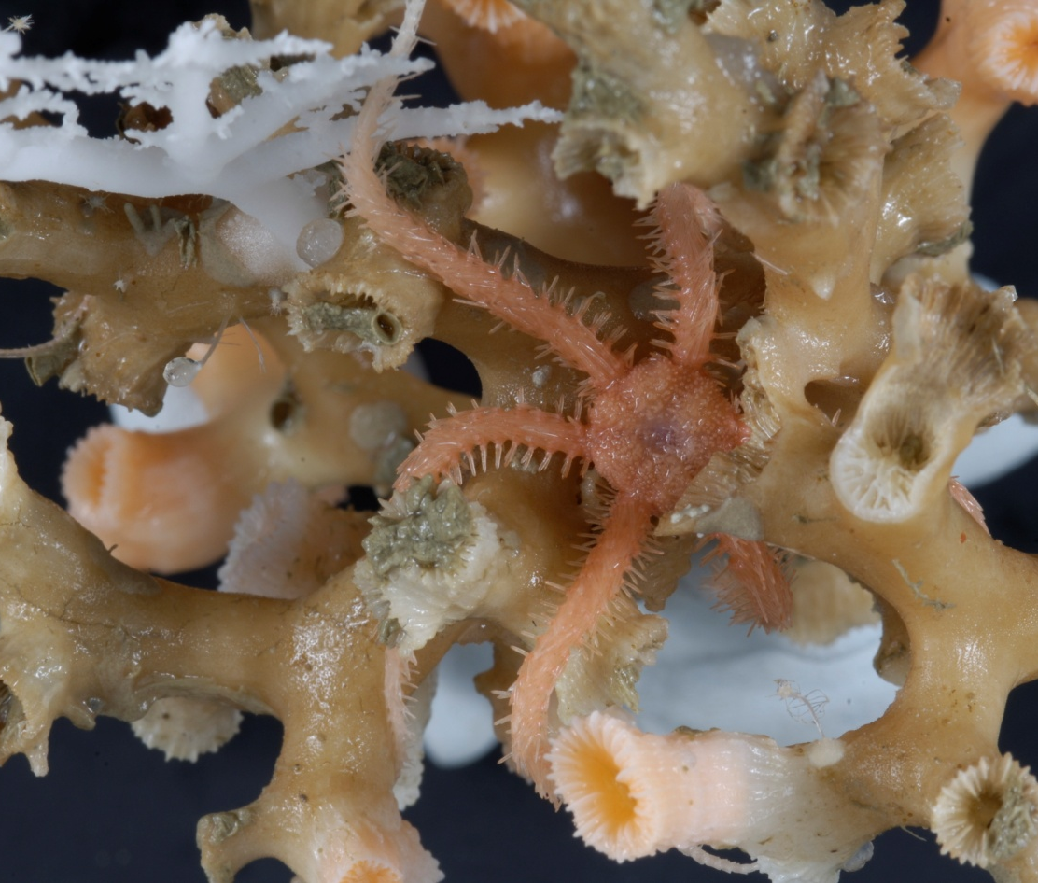
How many different animals can you count on this piece of coral?
Answer – At least 8 including the coral itself!
© Copyright. University of Waikato. All rights reserved. | www.sciencelearn.org.nz
© 2007 - 2009 Science Learning Hub www.sciencelearn.org.nz

Slide 5
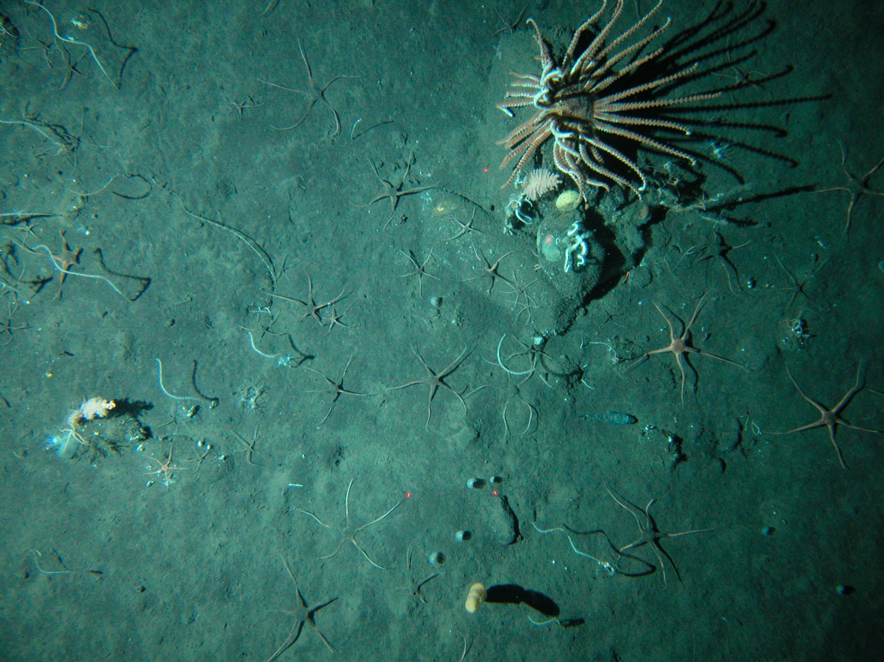
A large brisingid starfish and the smaller brittle stars on a seamount near the Balleny Islands.
© Copyright. University of Waikato. All rights reserved. | www.sciencelearn.org.nz

Slide 6
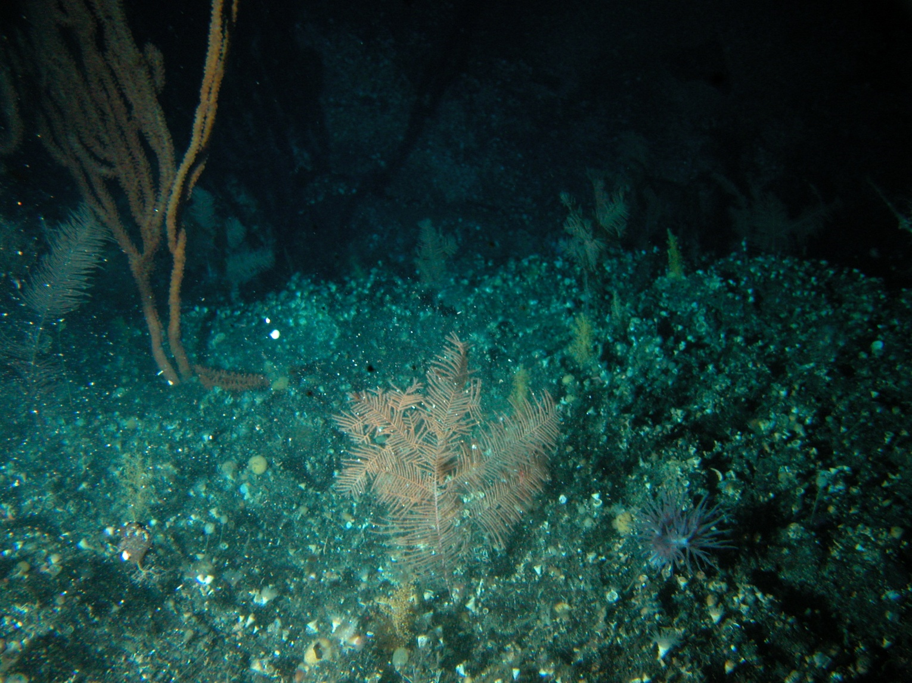
A ‘garden-like’ patch of corals on the seafloor near Scott Seamount.
© Copyright. University of Waikato. All rights reserved. | www.sciencelearn.org.nz

Slide 7
The Science Learning Hub acknowledges the assistance of NIWA and the IPY Voyage scientists who supplied images for this resource. All rights remain with the NIWA and IPY CAML.
© Copyright. University of Waikato. All rights reserved. | www.sciencelearn.org.nz

